Slide 1
Kern County Animal Services
Director’s Report
May 2023

Slide 2
Program Highlights
Foster
21 dogs, 37 puppies, 1 cat and 181 kittens entered the Department’s Foster Care Program for a total of 240 animals in the months of May 2023.
TNR
212 cats were spayed or neutered and released in May 2023. Since 2013, 17,886 cats have been spayed or neutered, and returned to field.
Adoption
157 dogs, 100 puppies, 15 cats, and 68 kittens under 5 months of age were adopted for a total of 340 animals adopted from Kern County Animal Shelters in May 2023.

Slide 3
Vaccination Clinics
May 2023
295 rabies
365 DHPP
63 FVRCP
107 Microchips

Slide 4
Spay/Neuter Program
Bakersfield Clinic May 2nd:
56 Spay/Neuter Surgeries
Bakersfield Clinic May 15th:
53 Spay/Neuter Surgeries
Bakersfield Clinic May 23rd:
43 Spay/Neuter Surgeries
Bakersfield Clinic May 25th:
48 Spay/Neuter Surgeries

Slide 5
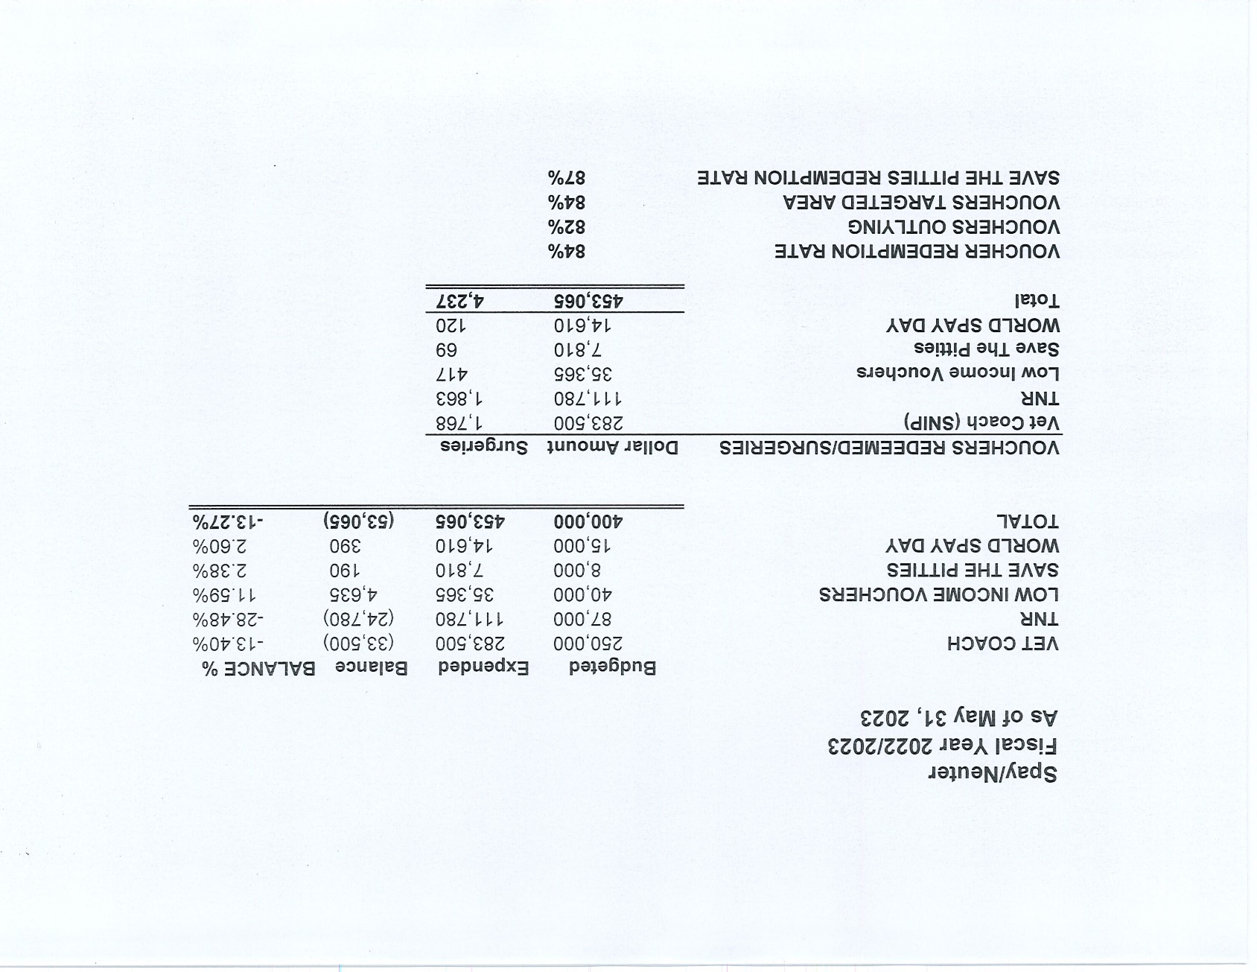

Slide 7
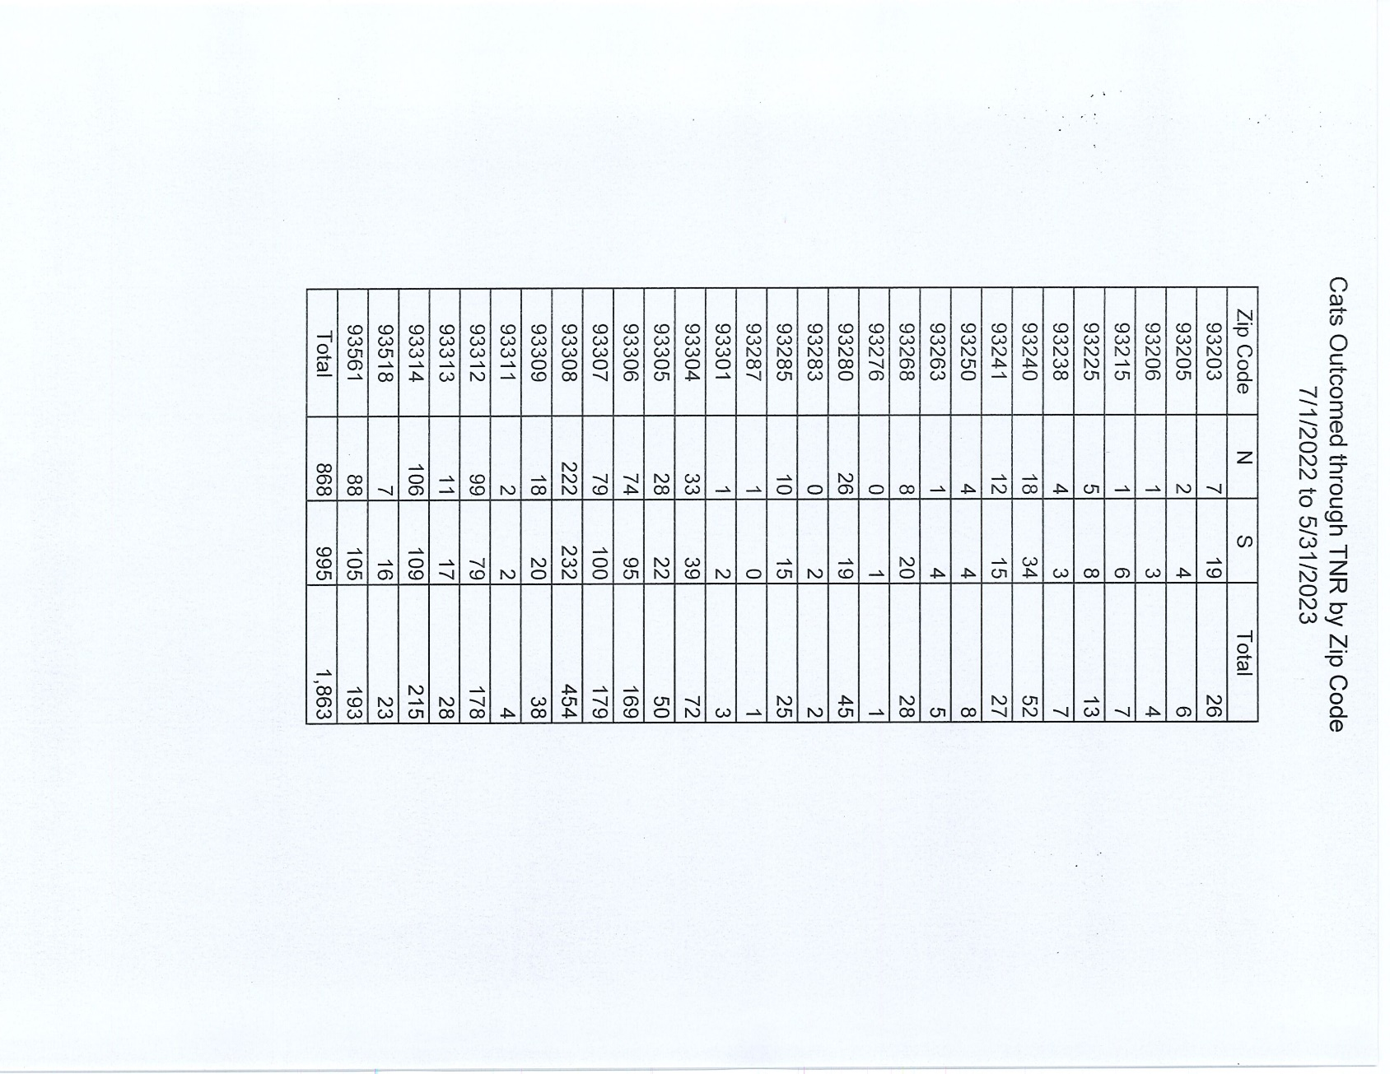

Slide 8
Adoptions Year To Date
911 dogs, 551 puppies under 5 months, 117 cats and 169 kittens under 5 months have been adopted.
Rescue Year To Date
544 dogs, 488 puppies under 5 months, 42 cats and 19 kittens under 5 months have been saved by Rescue partners.
Owner Reclaims
324 dogs (8%) and 9 cats have been reclaimed by owners.
Notes:
71

Slide 9
Streets of Bakersfield

Slide 10
Adoption Promotions

Slide 11
Adoption Promotions

Slide 12
Out In The Community…

Slide 13
Out In The Community…

Slide 14
Out In The Community…

Slide 15
Field Services
May 2023 | Calls Per Area
Lake Isabella | 89
Mojave | 146
North County | 55
Northeast | 284
Northwest | 279
Ridgecrest | 11
Southeast | 235
Southwest | 133
Taft | 105
Tehachapi | 73
Total | 1,410
33 dogs were returned to their owners in the field in May 2023.
85 dogs were secured on property by Animal Control Officers in May 2023.

Slide 16
Field Services-CAF
MAY 2023 | Calls
CAF-Breeder | 18
CAF-Rescue | 1
CAF-Kennel | 1
CAF-Boarding | 0
Total | 21
2 Permits Issued/Inspections Passed
2 Inspection Failed
2 Citations Issued
54 Active CAF Permits

Slide 17
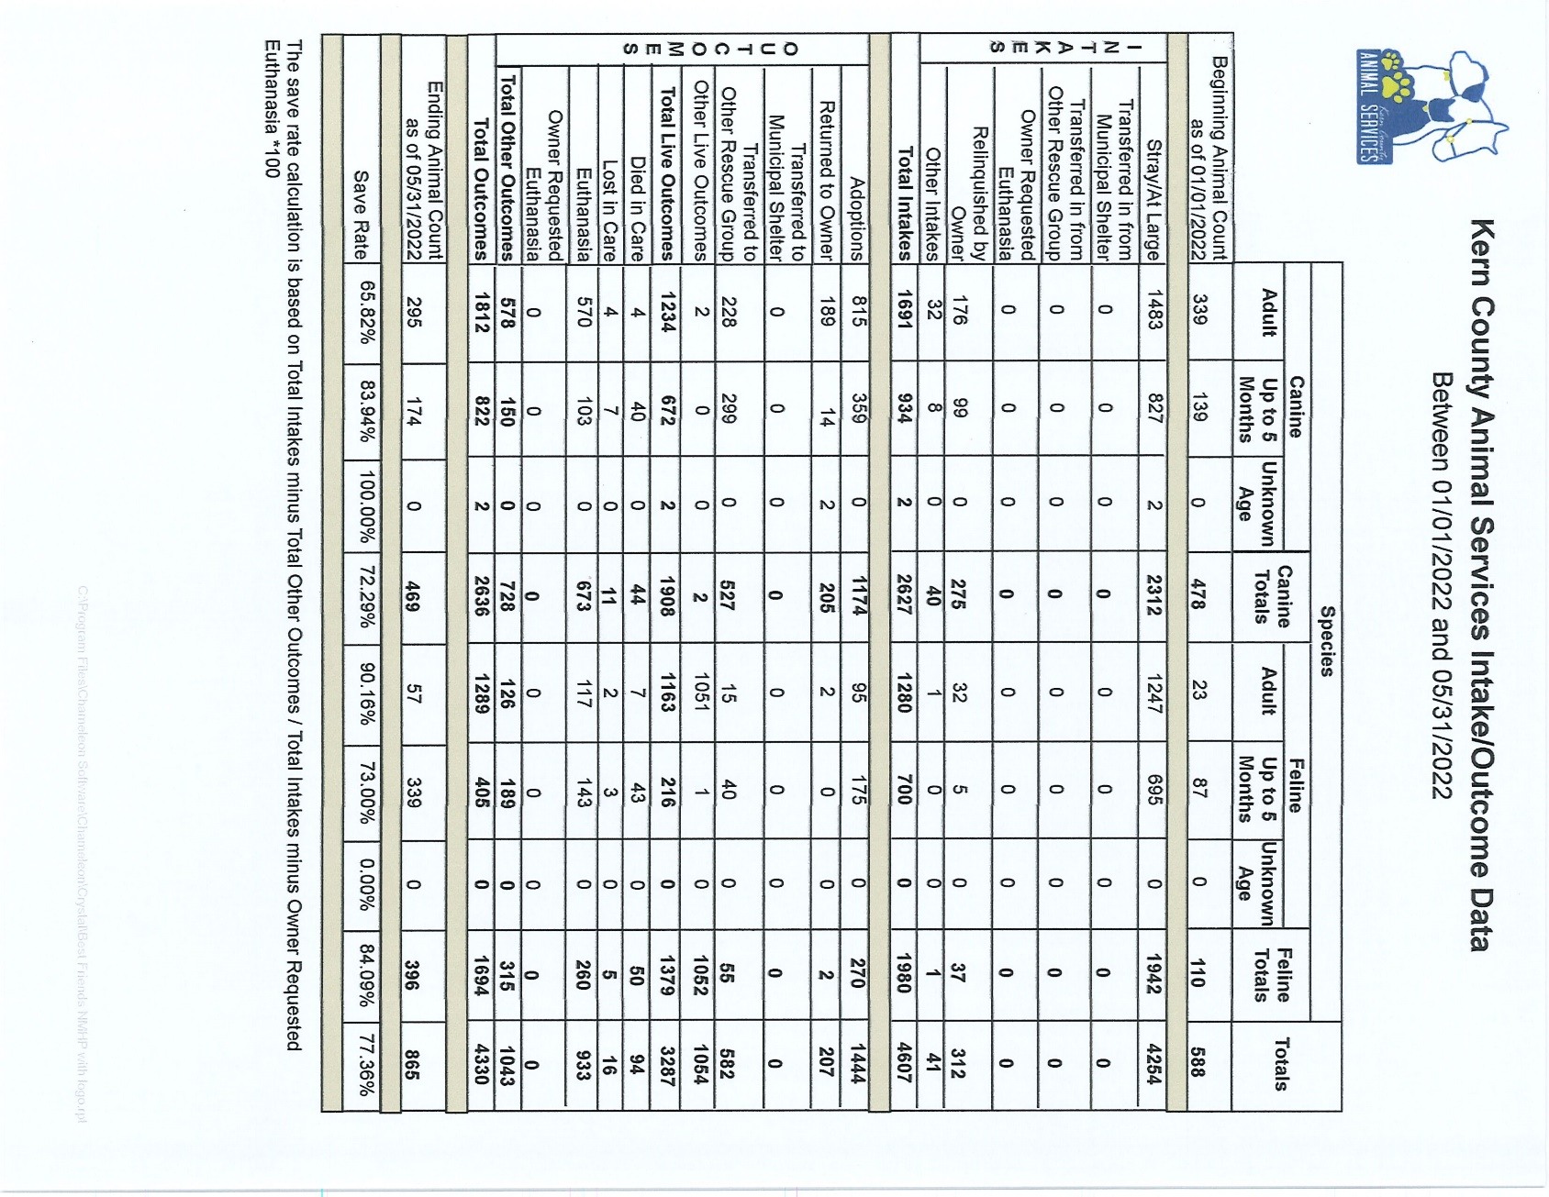

Slide 18
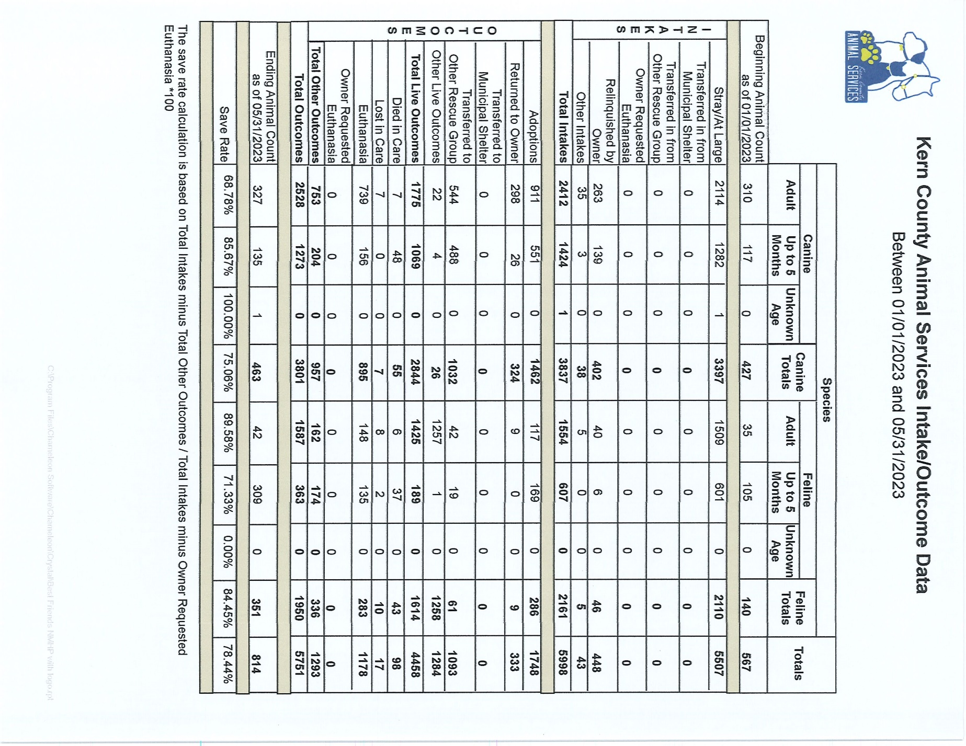

Slide 19
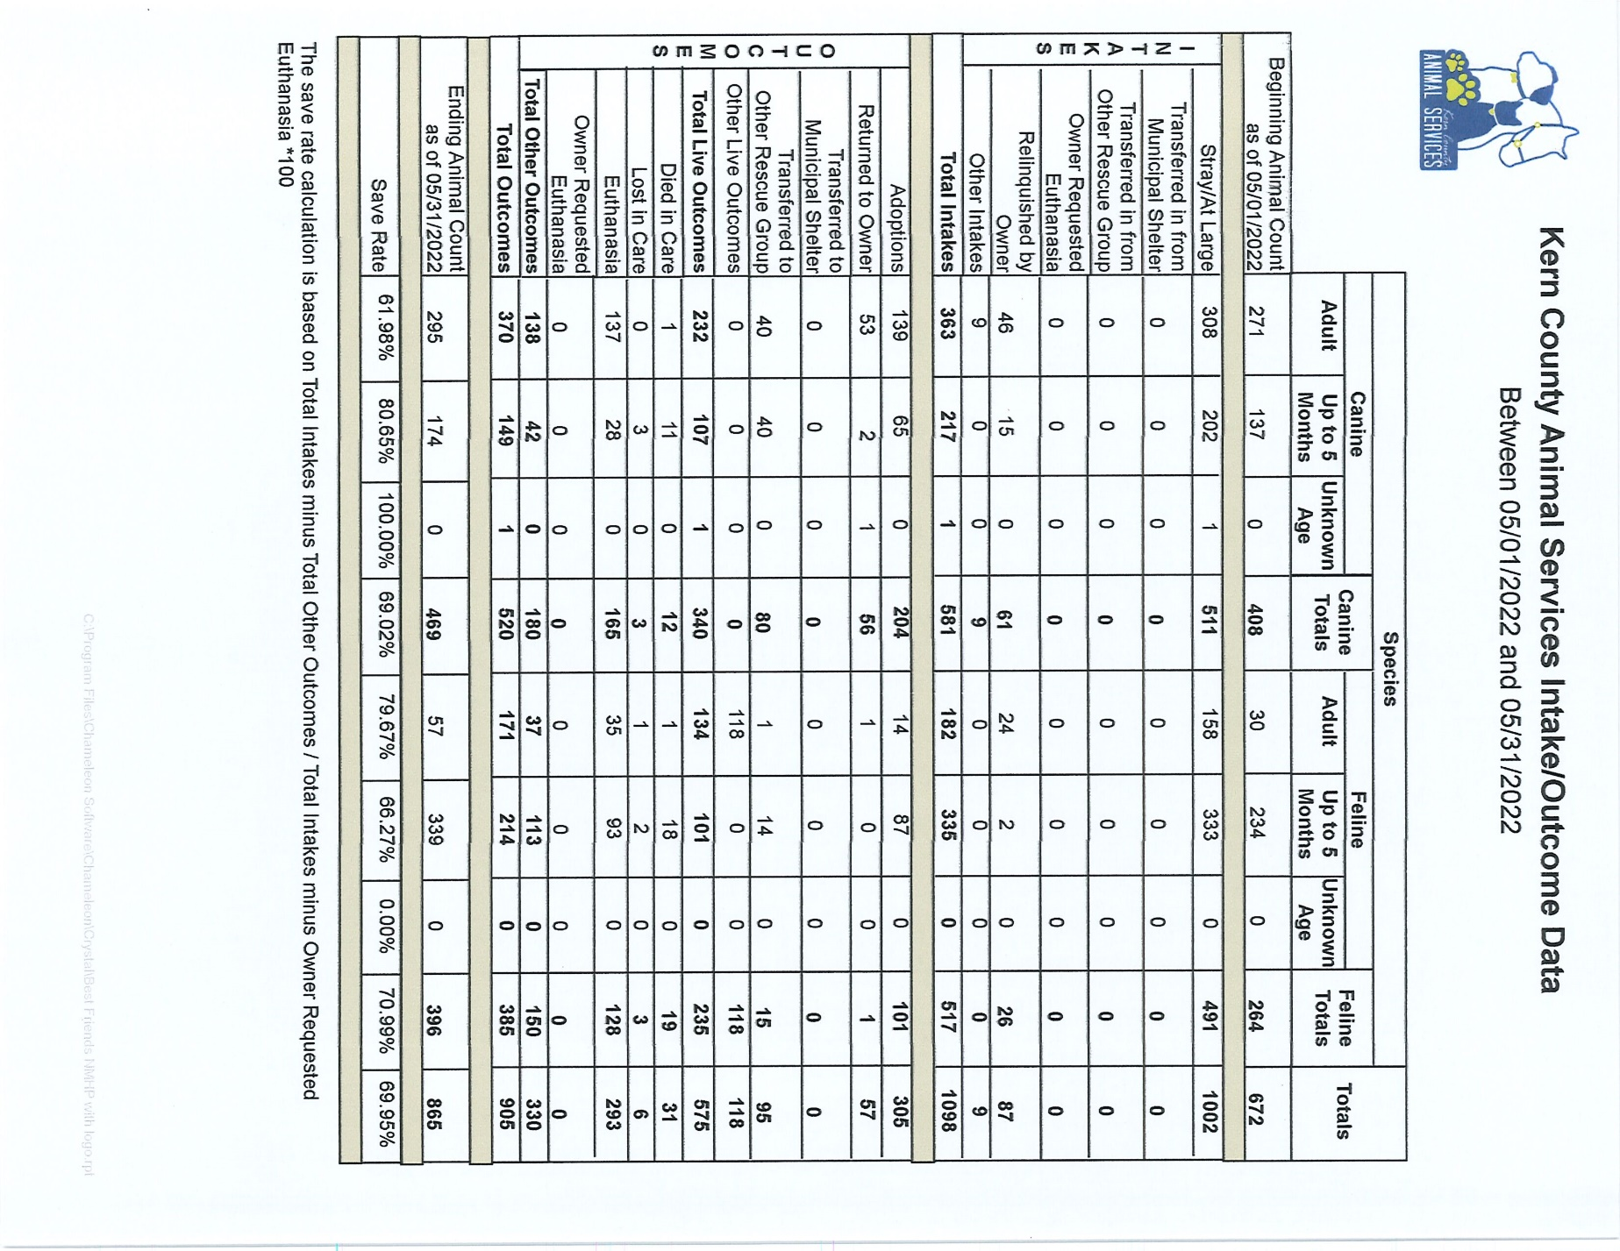

Slide 20
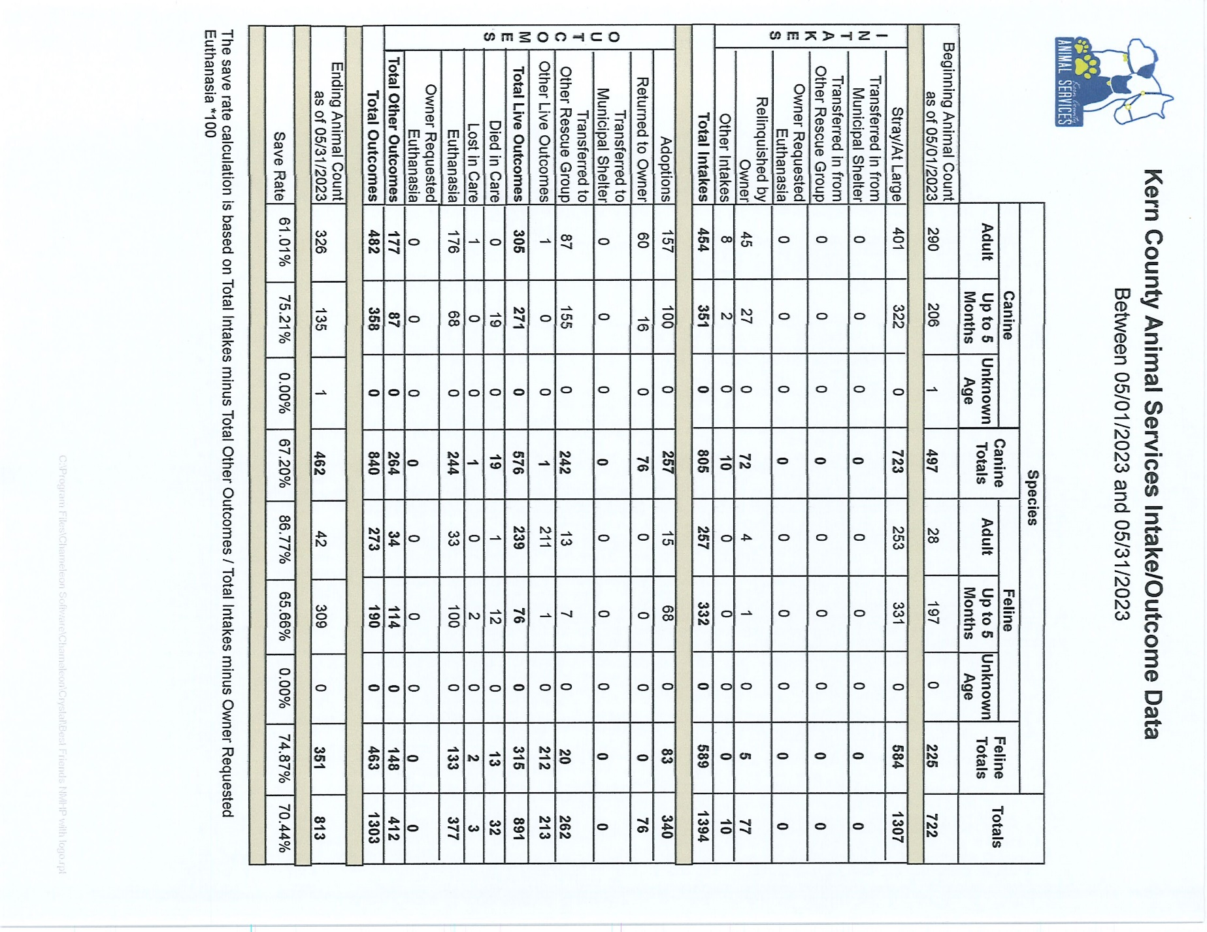

Slide 21
January 1 through June 21
22% more dogs received in 2023 compared to 2019
46% more dogs received in 2023 compared to 2022
50% more young dogs received in 2023 compared to 2022
87% more young dogs received in 2023 compared to 2019
More dogs have been adopted than at any point
More dogs have been saved by Rescue partners than at any point

Slide 22
Volunteer Program
May 2023:
475.01 hours of service were donated
40 new volunteers
69 active volunteers
To date, 2,569.5 hours of service have been donated

