Slide 1
Kern County Animal Services
Director’s Report
June 2023

Slide 2
Program Highlights
Foster
20 dogs, 29 puppies, 1 cat and 168 kittens entered the Department’s Foster Care Program for a total of 218 animals in the month of June 2023.
TNR
243 cats were spayed or neutered and released in June 2023. Since 2013, 18,129 cats have been spayed or neutered, and returned to field.
Adoption
175 dogs, 116 puppies, 15 cats, and 146 kittens under 5 months of age were adopted for a total of 452 animals adopted from Kern County Animal Shelters in June 2023.

Slide 3
Vaccination Clinics
June 2023
329 rabies
258 DHPP
48 FVRCP
83 Microchips

Slide 4
Spay/Neuter Program
East Bakersfield Clinic June 1st:
57 Spay/Neuter Surgeries
Bakersfield Clinic June 8th:
40 Spay/Neuter Surgeries
Bakersfield Clinic June 19th:
45 Spay/Neuter Surgeries

Slide 5
The Children Will Save Us…

Slide 6
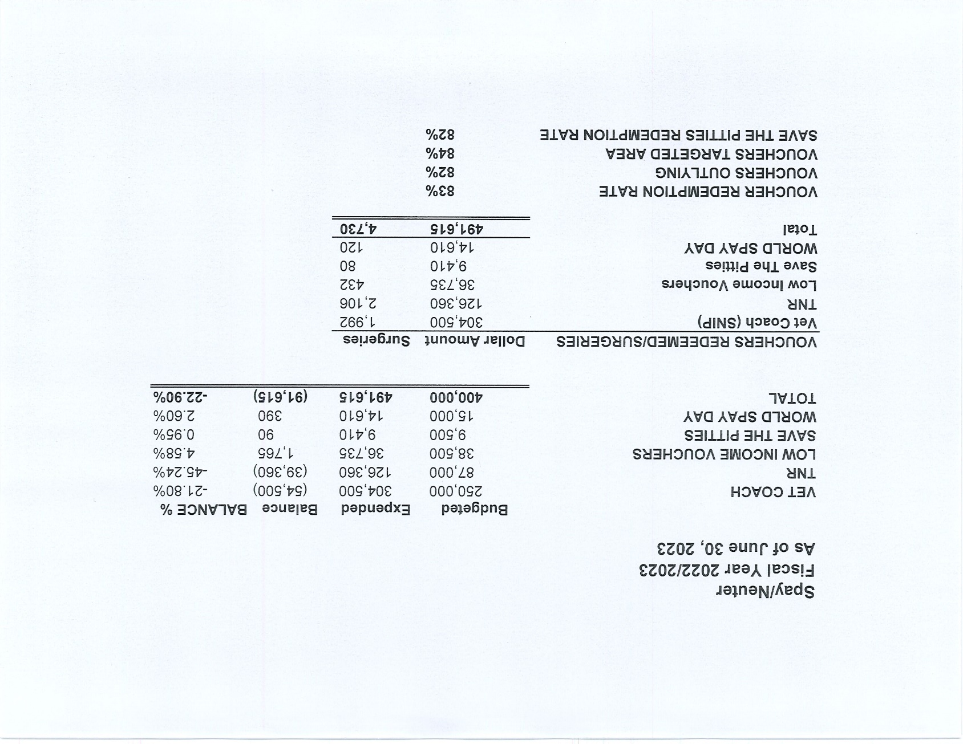

Slide 7
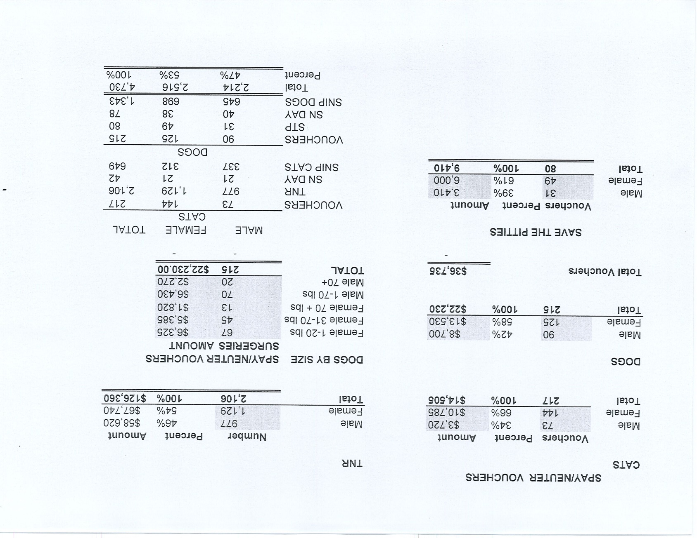

Slide 8
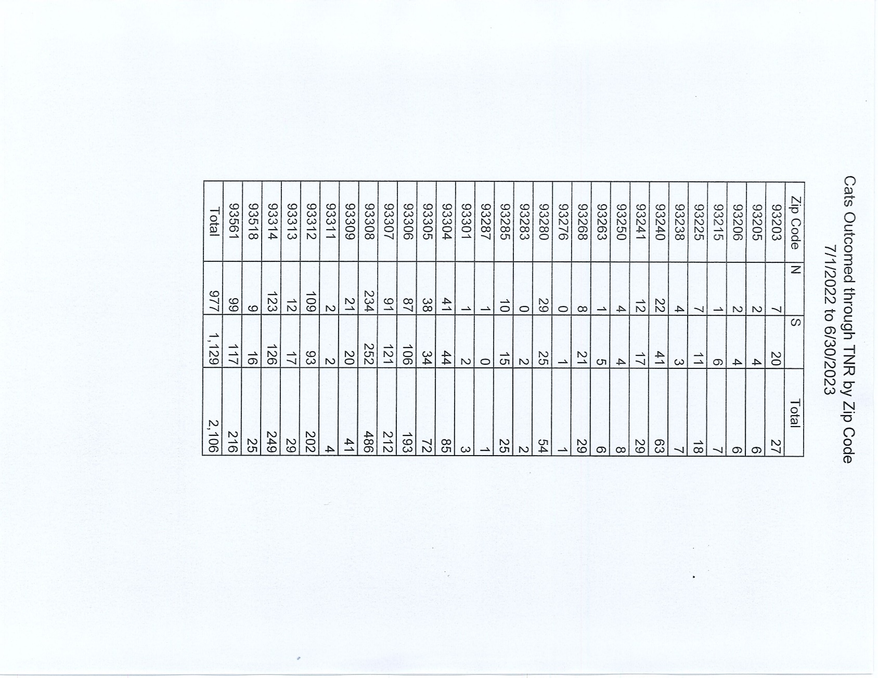

Slide 9
Adoptions Year To Date
1087 dogs, 667 puppies under 5 months, 132 cats and 315 kittens under 5 months have been adopted.
Rescue Year To Date
631 dogs, 597 puppies under 5 months, 132 cats and 315 kittens under 5 months have been saved by Rescue partners.
Owner Reclaims
381 dogs (8%) and 10 cats have been reclaimed by owners.
Notes:
71

Slide 10
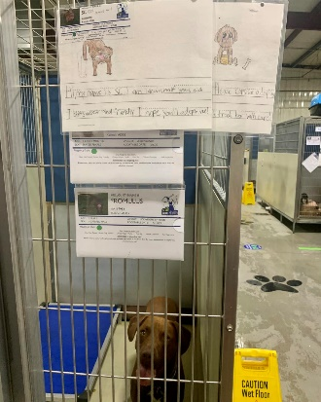
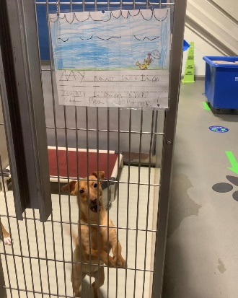
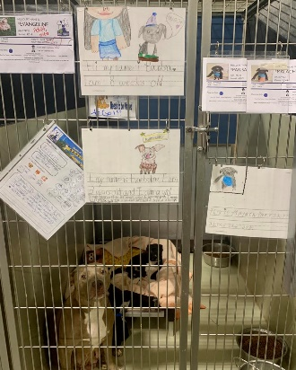
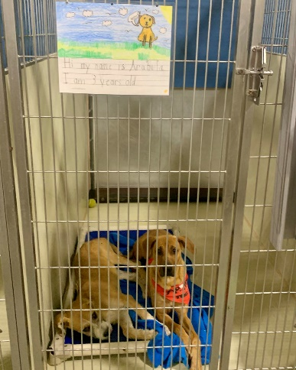
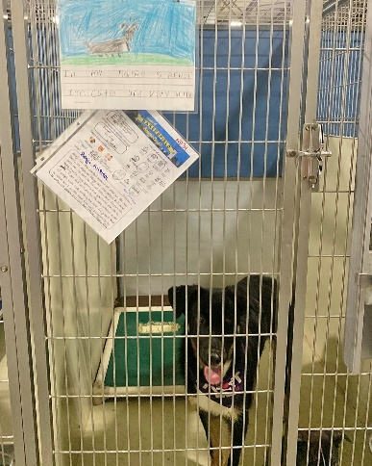
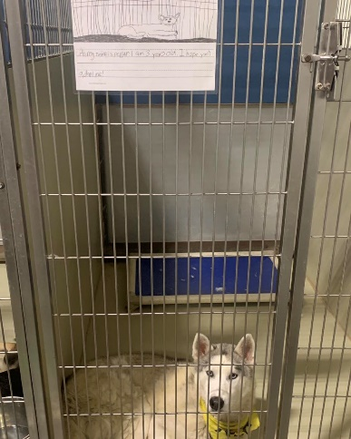
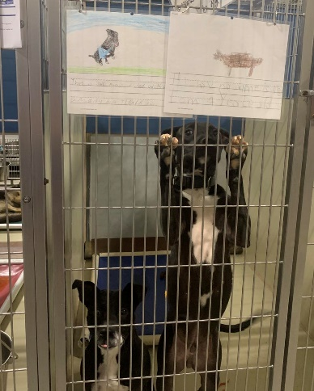
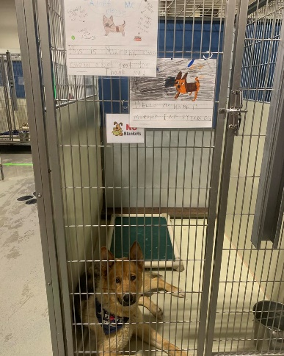
Thank You to Norris Elementary School

Slide 11
Streets of Bakersfield

Slide 12
Streets of Bakersfield

Slide 13
Streets of Bakersfield

Slide 14
Adoption Promotions

Slide 15
Adoption Promotions

Slide 16
Out In The Community…

Slide 17
Out In The Community…

Slide 18
Change to the Safety Net Program

Slide 19
Field Services
June 2023 | Calls Per Area
Lake Isabella | 89
Mojave | 154
North County | 44
Northeast | 310
Northwest | 330
Ridgecrest | 31
Southeast | 163
Southwest | 146
Taft | 114
Tehachapi | 79
Total | 1,460
46 dogs were returned to their owners in the field in June 2023.
34 dogs were secured on property by Animal Control Officers in June 2023.
1,277 more calls for service have been received in ‘23 than ’22
213 more calls per month/53 more calls per week

Slide 20
Field Services-CAF
MAY 2023 | Calls
CAF-Breeder | 11
CAF-Rescue | 0
CAF-Kennel | 1
CAF-Boarding | 0
Total | 12
0 Permits Issued/Inspections Passed
2 Inspection Failed
4 Citations Issued
54 Active CAF Permits

Slide 21
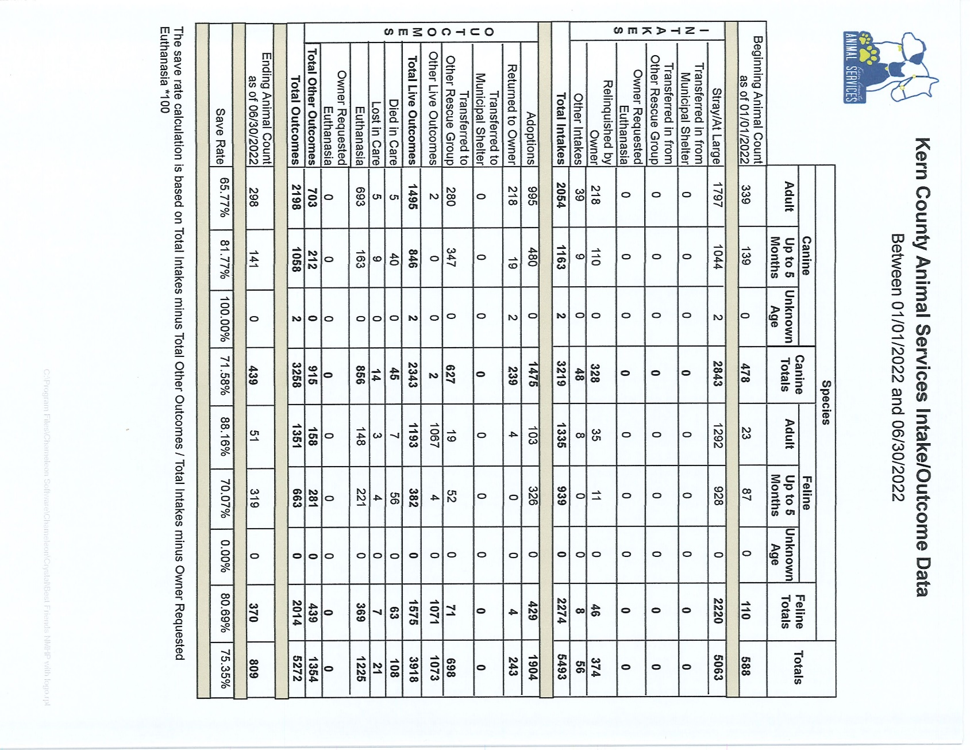

Slide 22
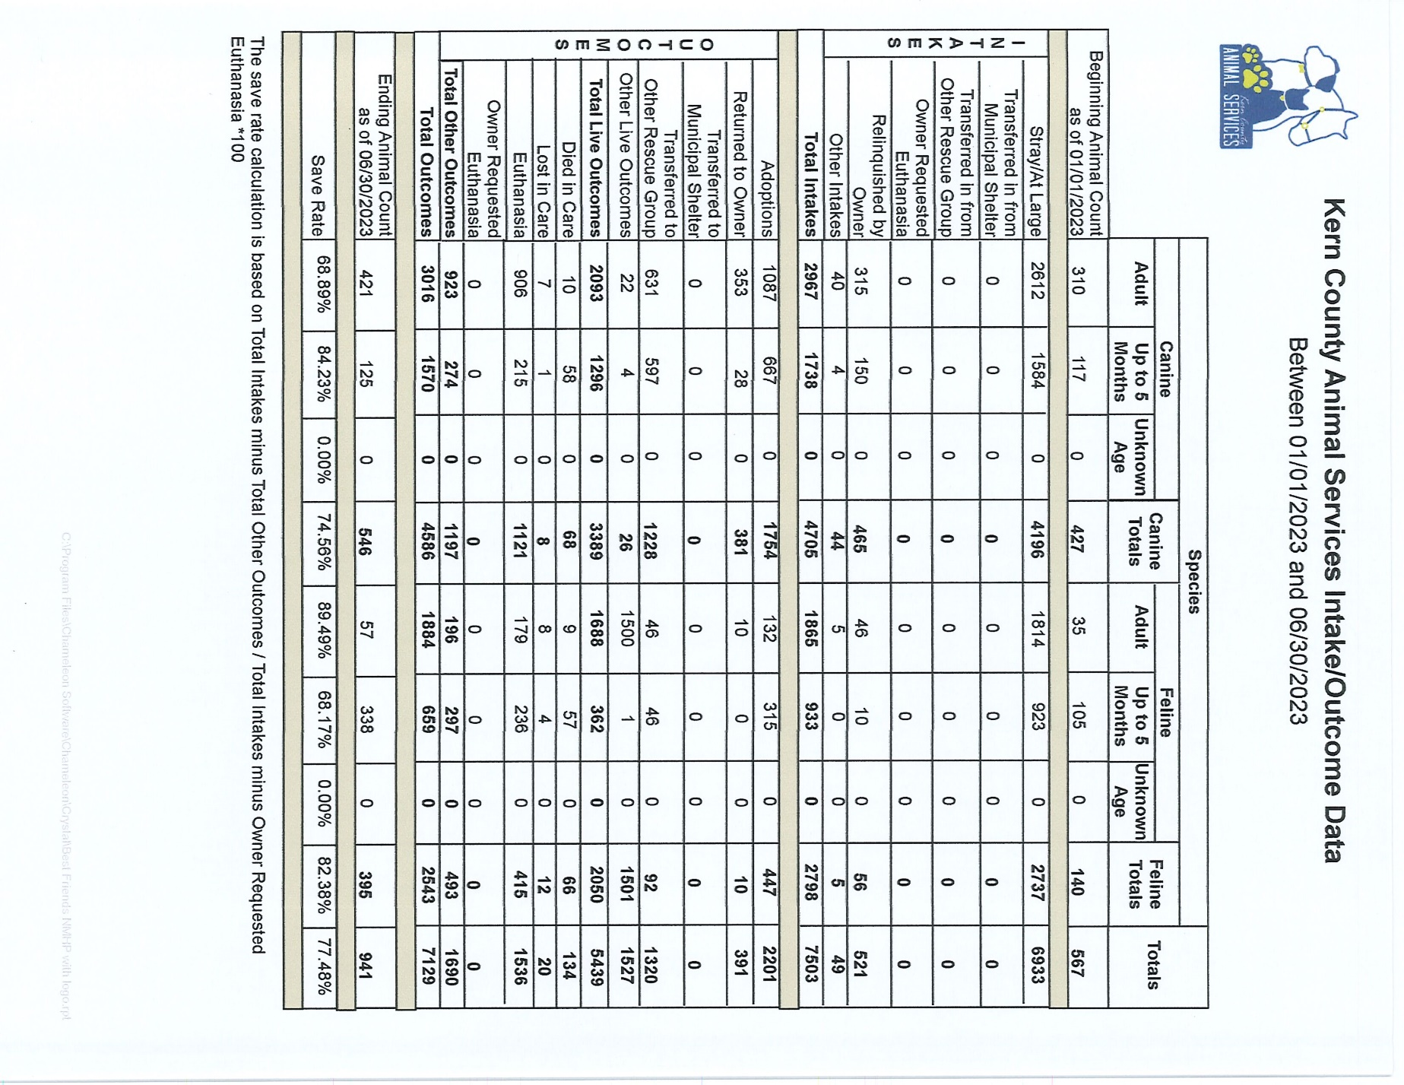

Slide 23
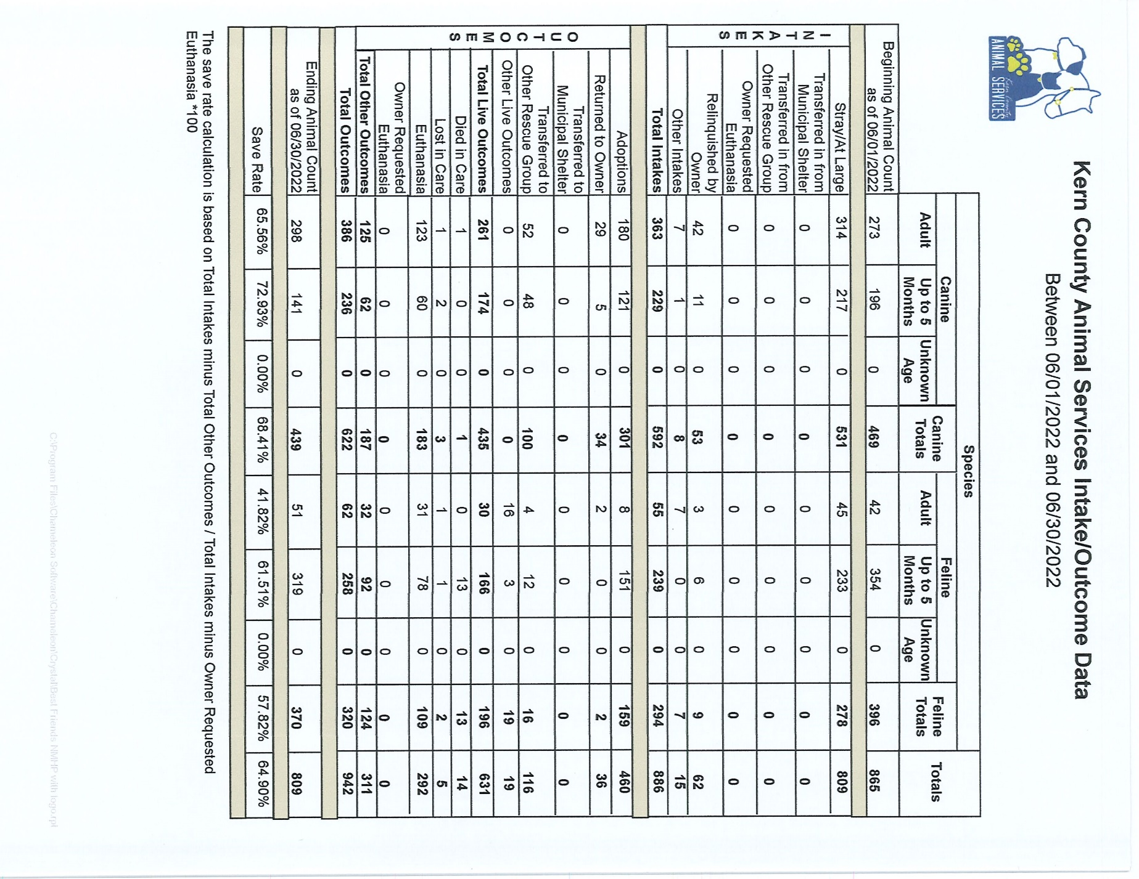

Slide 24
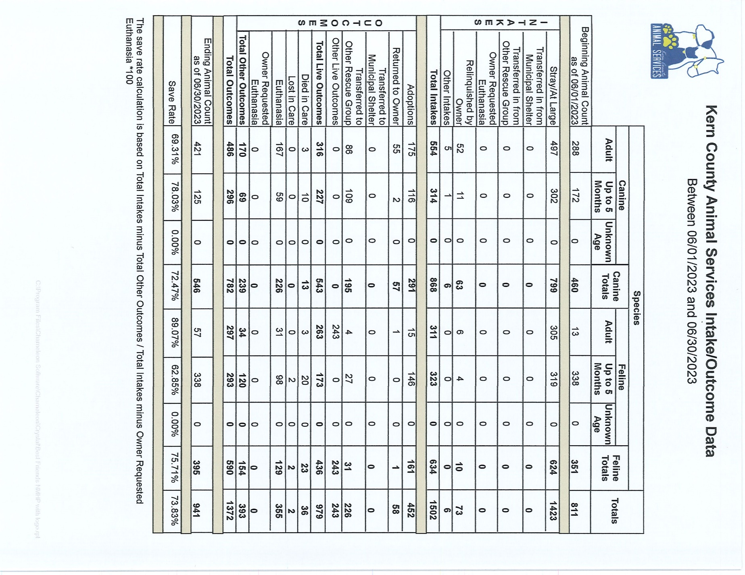

Slide 25
Volunteer Program
June 2023:
845.15 hours of service were donated
40 new volunteers
75 active volunteers
To date, 3,414.65 hours of service have been donated

