Slide 1
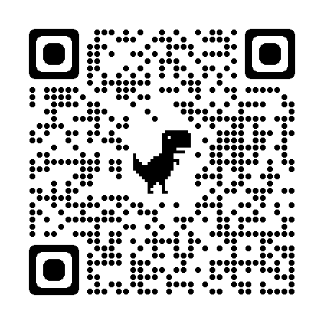
Kern County Animal Services
Director’s Report
January 2024

Slide 2
Program Highlights
Foster
48 dogs, 58 puppies, 2 cats and 21 kittens entered the Department’s Foster Care Program for a total of 129 animals in the month of January.
TNR
208 cats were spayed or neutered and released in January 2024. Year-to-date, 208 cats have gone through the program, and since 2013 19,808 cats have been spayed or neutered, and returned to field.
Adoption
169 dogs, 94 puppies, 47 cats, and 59 kittens under 5 months of age were adopted for a total of 369 animals adopted from Kern County Animal Shelters in January 2024.
2

Slide 3
Vaccination Clinics
January 2024
171 rabies
162 DHPP
0 FVRCP
0 Microchips

Slide 4
Spay/Neuter Program
2 Jan.
Taft Clinic January 2nd:
57 Spay/Neuter Surgeries
8 Jan.
Oildale Clinic January 8th:
53 Spay/Neuter Surgeries
16 Jan.
Bakersfield Clinic January 16th:
43 Spay/Neuter Surgeries
17 Jan.
East Bakersfield Clinic January 17th:
41 Spay/Neuter Surgeries
18 Jan.
Bakersfield Clinic January 18th:
41 Spay/Neuter Surgeries
29 Jan.
East Bakersfield Clinic January 29th:
43 Spay/Neuter Surgeries

Slide 5
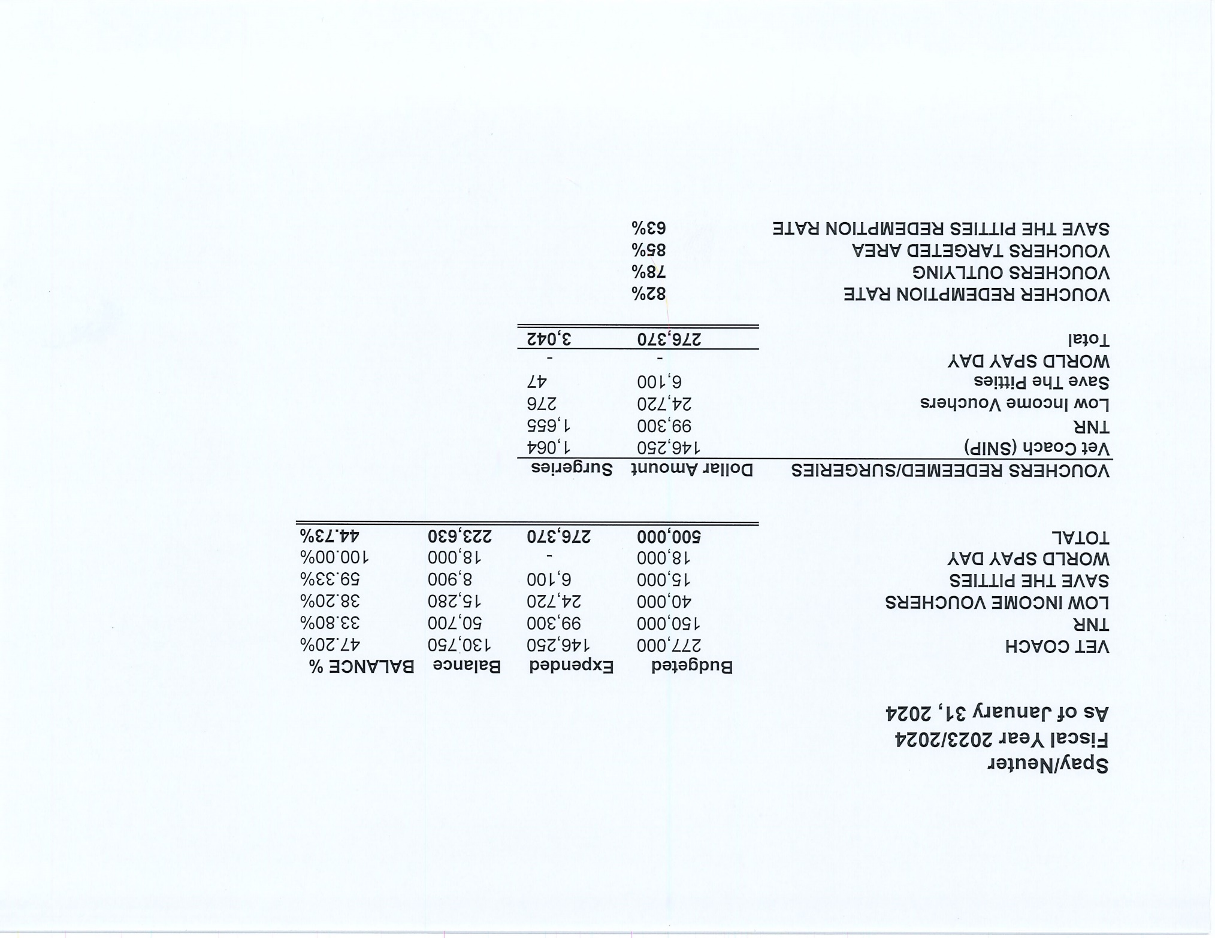

Slide 6
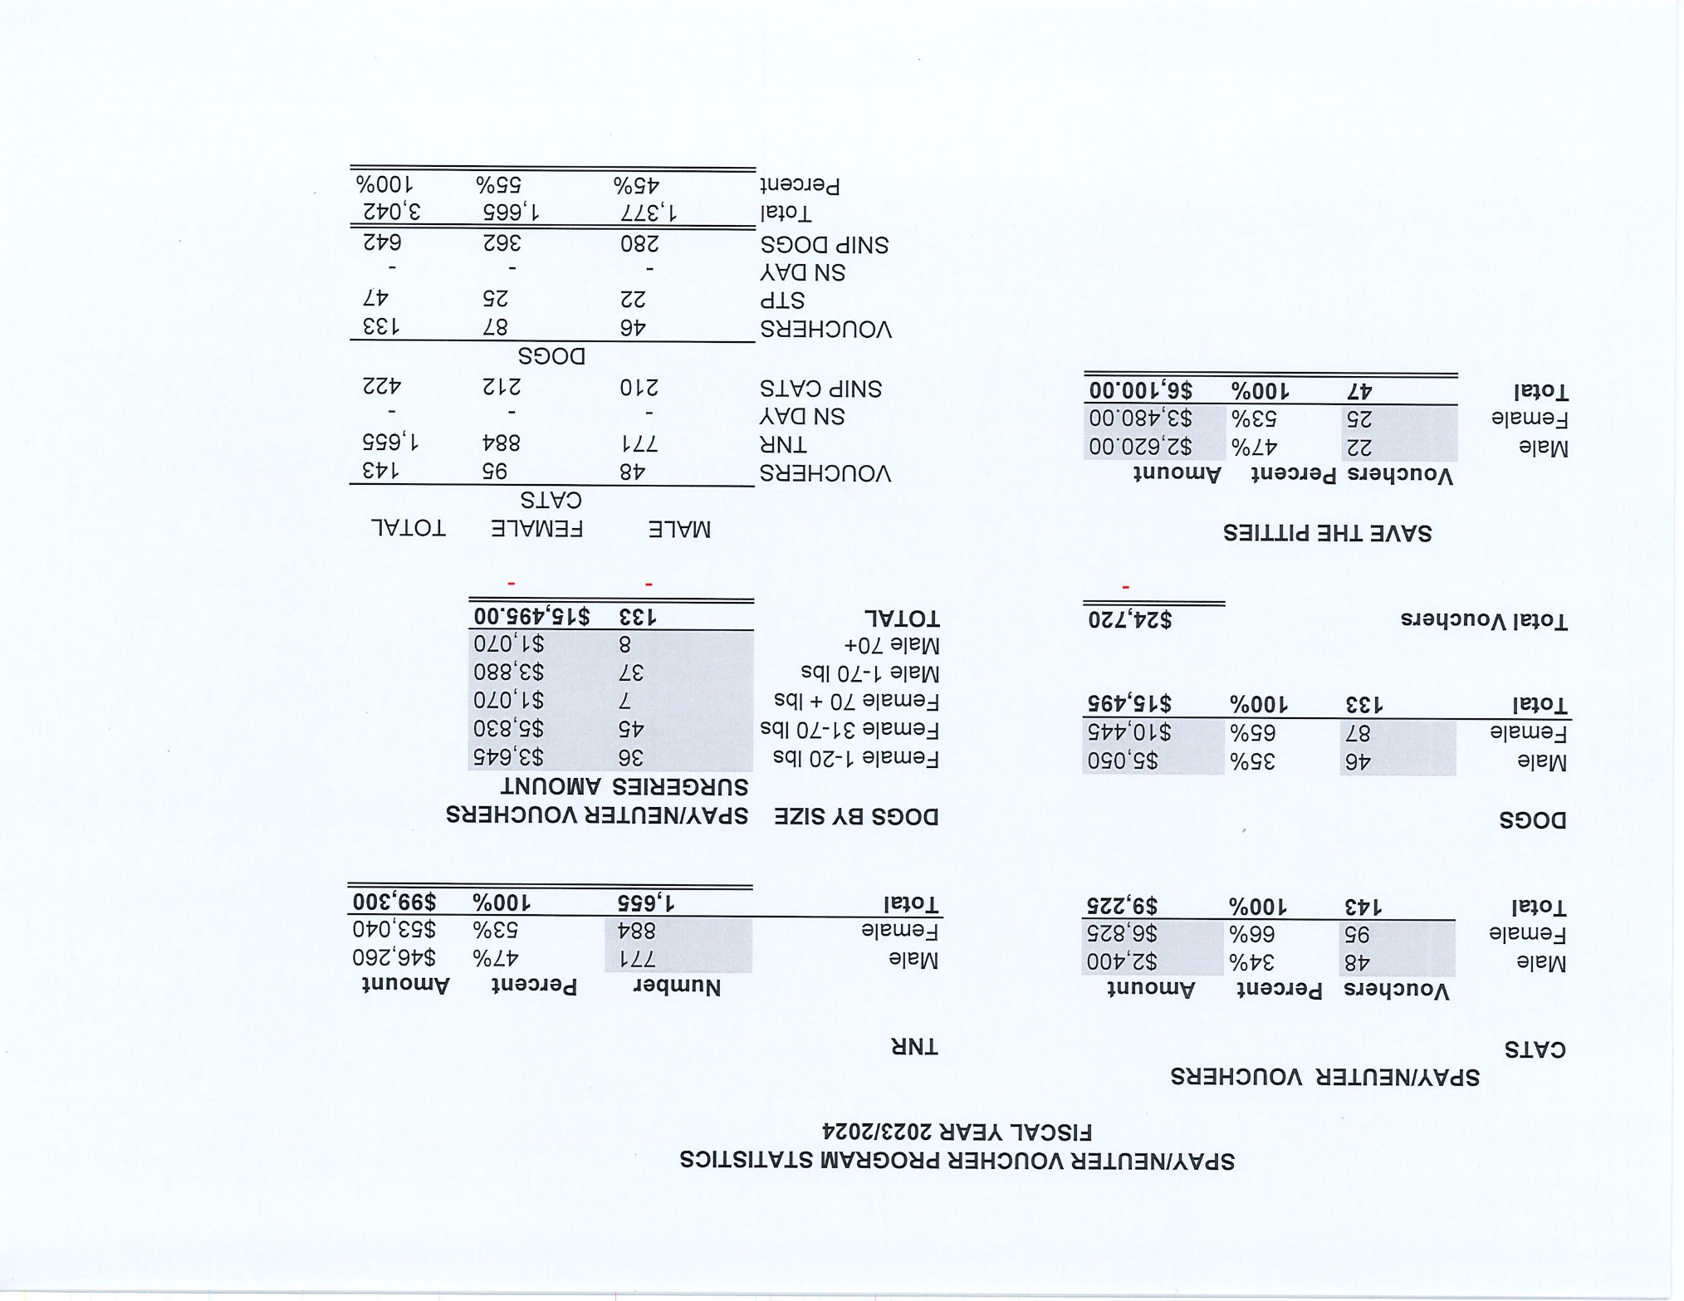

Slide 7
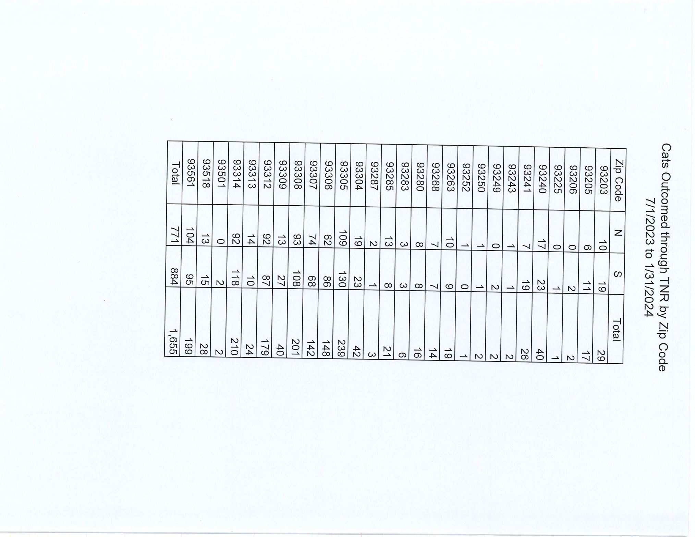

Slide 8
Adoption
369
Rescue
252
RTO
100
Year To Date
Notes:
71

Slide 9
Offsite Adoptions

Slide 10
Offsite Adoptions

Slide 11
Offsite Adoptions

Slide 12
Offsite Adoptions

Slide 13
Streets of Bakersfield

Slide 14
Field Services
January 2024 | Calls Per Area
Lake Isabella | 107
Mojave | 146
North County | 69
Northeast | 357
Northwest | 388
Ridgecrest | 28
Southeast | 239
Southwest | 182
Taft | 137
Tehachapi | 104
Total | 1,757
36 dogs were returned to their owners in the field in January 2024.
108 dogs were secured on property by Animal Control Officers in January 2024.

Slide 15
Field Services-CAF
January 2024 | Calls
CAF-Breeder | 27
CAF-Rescue | 0
CAF-Kennel | 3
CAF-Boarding | 4
Total | 34
5 Permits Issued/Inspections Passed
3 Inspection Failed
0 Citations Issued
65 Active CAF Permits

Slide 16
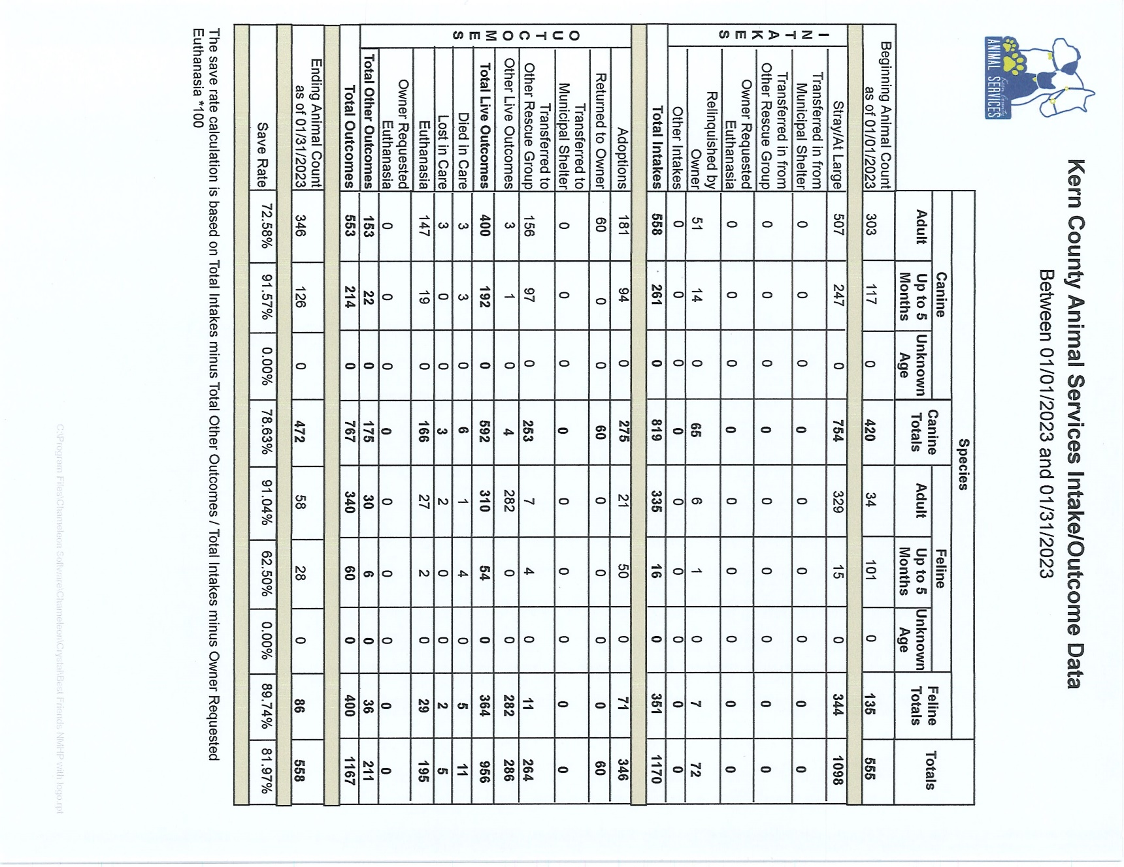

Slide 17
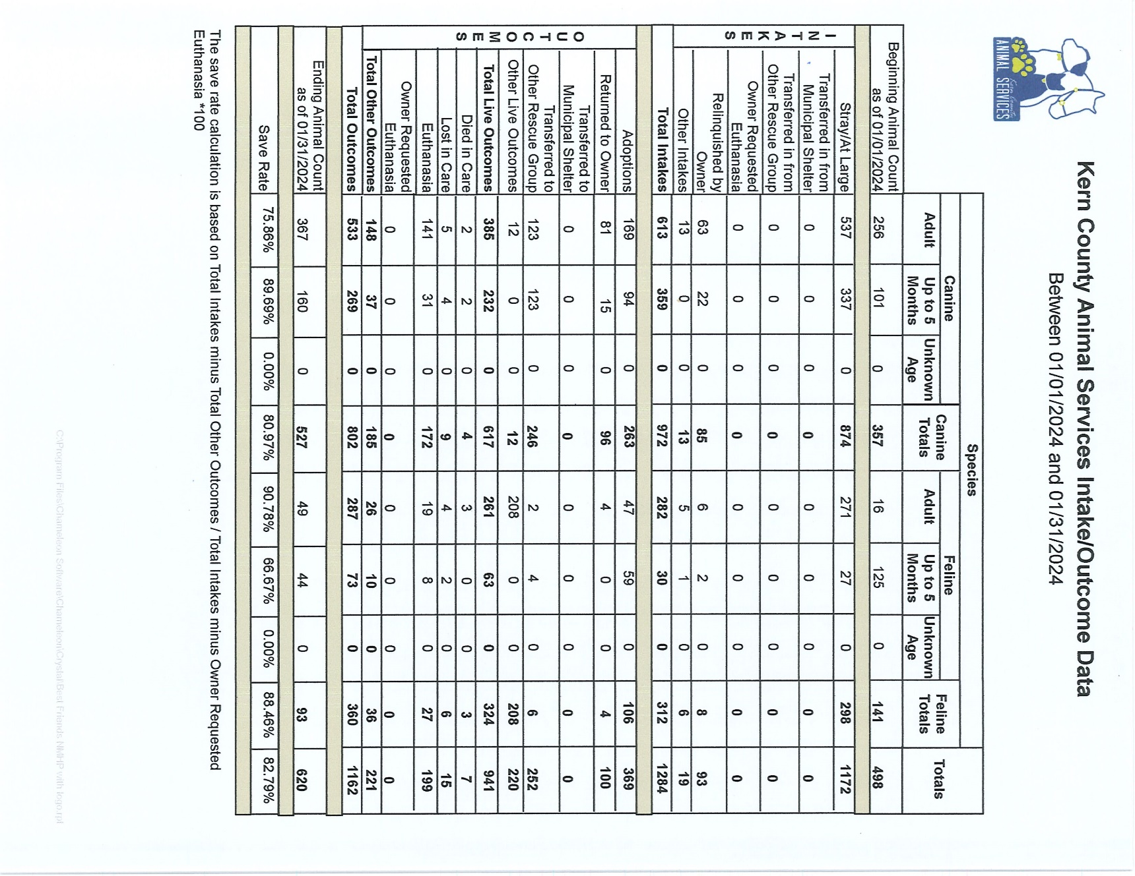

Slide 18
Volunteer Program
January 2024:
342.95 hours of service were donated
51 new volunteers
73 active volunteers
To date, 342.95 hours of service have been donated

