Slide 1

Kern County Animal Services
Director’s Report
March 2022

Slide 2
Program Highlights
Foster
23 dogs, 21 puppies, 6 cat and 55 kittens and 1 rabbit entered the Department’s Foster Care Program for a total of 106 animals in the month of March 2022.
TNR
261 cats were spayed or neutered and released in March 2022. Since 2013, 15,654 cats have been spayed or neutered, and returned to field.
Adoption
194 dogs, 75 puppies, 16 cats, and 18 kittens under 5 months of age were adopted for a total of 303 animals adopted from Kern County Animal Shelters in March of 2022.

Slide 3
Vaccination Clinics
MARCH 2022
  199 rabies
  364 DHPP
  27 FVRCP

Slide 4
Adoptions Year To Date
485 dogs, 181 puppies under 5 months, 64 cats and 73 kittens under 5 months have been adopted.
Rescue Year To Date
124 dogs, 211 puppies under 5 months, 11 cats and 23 kittens under 5 months have been saved by Rescue partners.
Notes:
71

Slide 5


Adoption Promotions

Slide 6
Field Services
MARCH 2022 | Calls Per Area
Lake Isabella | 70
Mojave | 91
North County | 50
Northeast | 302
Northwest | 293
Ridgecrest | 27
Southeast | 222
Southwest | 123
Taft | 120
Tehachapi | 60
Total | 1,358
47 dogs were returned to their owners in the field in March 2022.
96 dogs were secured on property by Animal Control Officers in March 2022.

Slide 7

PET LICENSING WITH DOCUPET

Slide 8
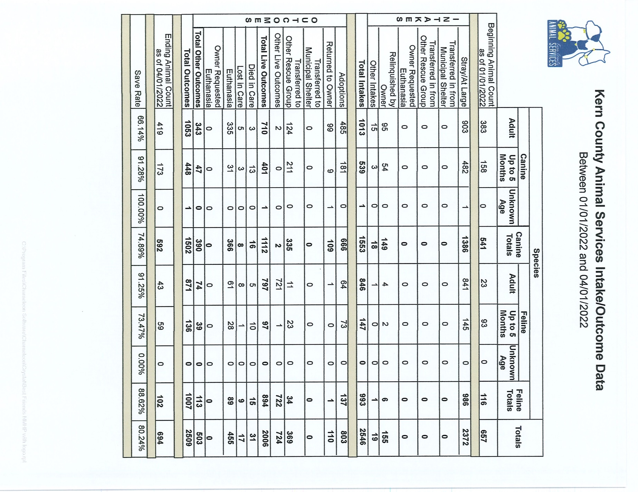

Slide 9
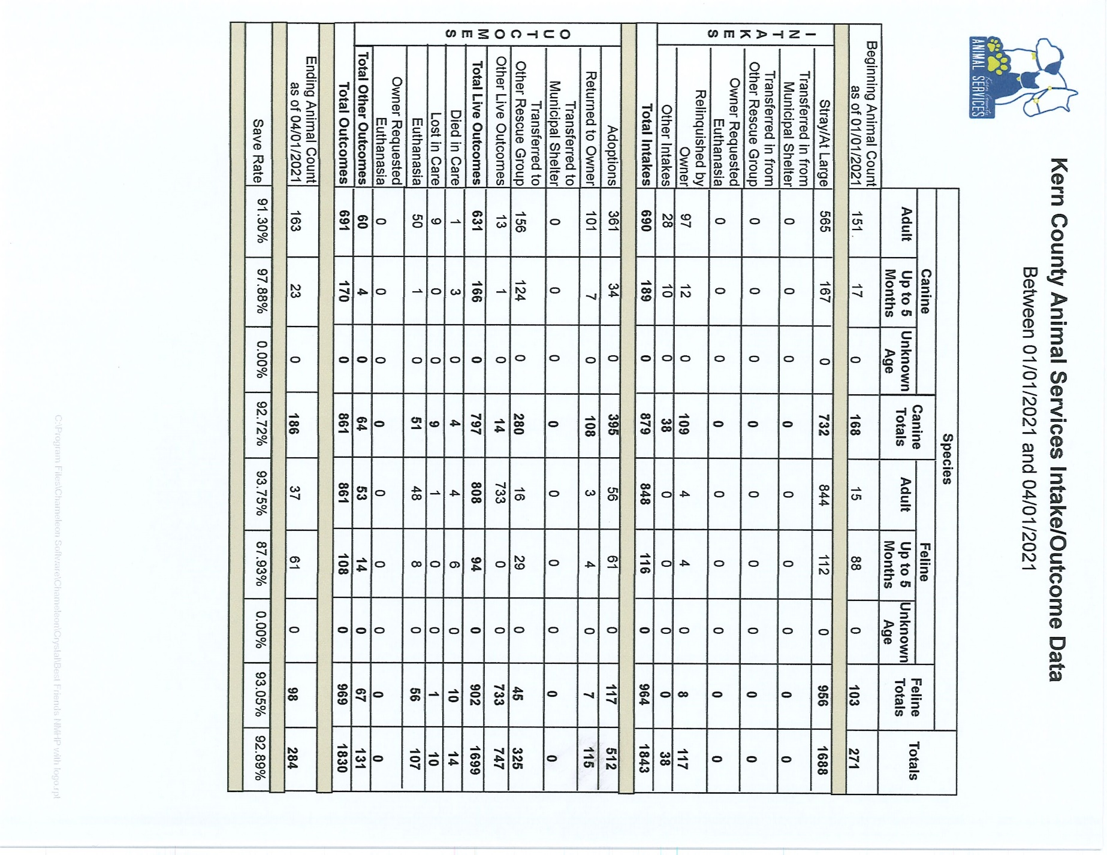

Slide 10
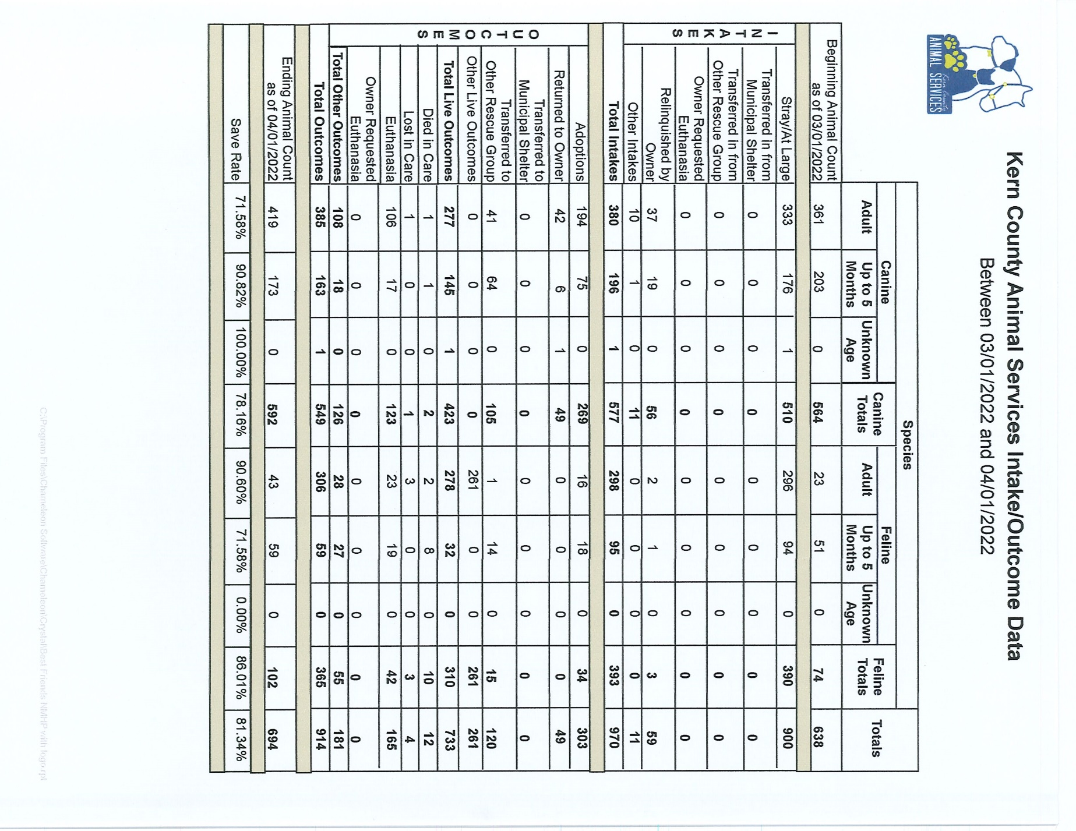

Slide 11
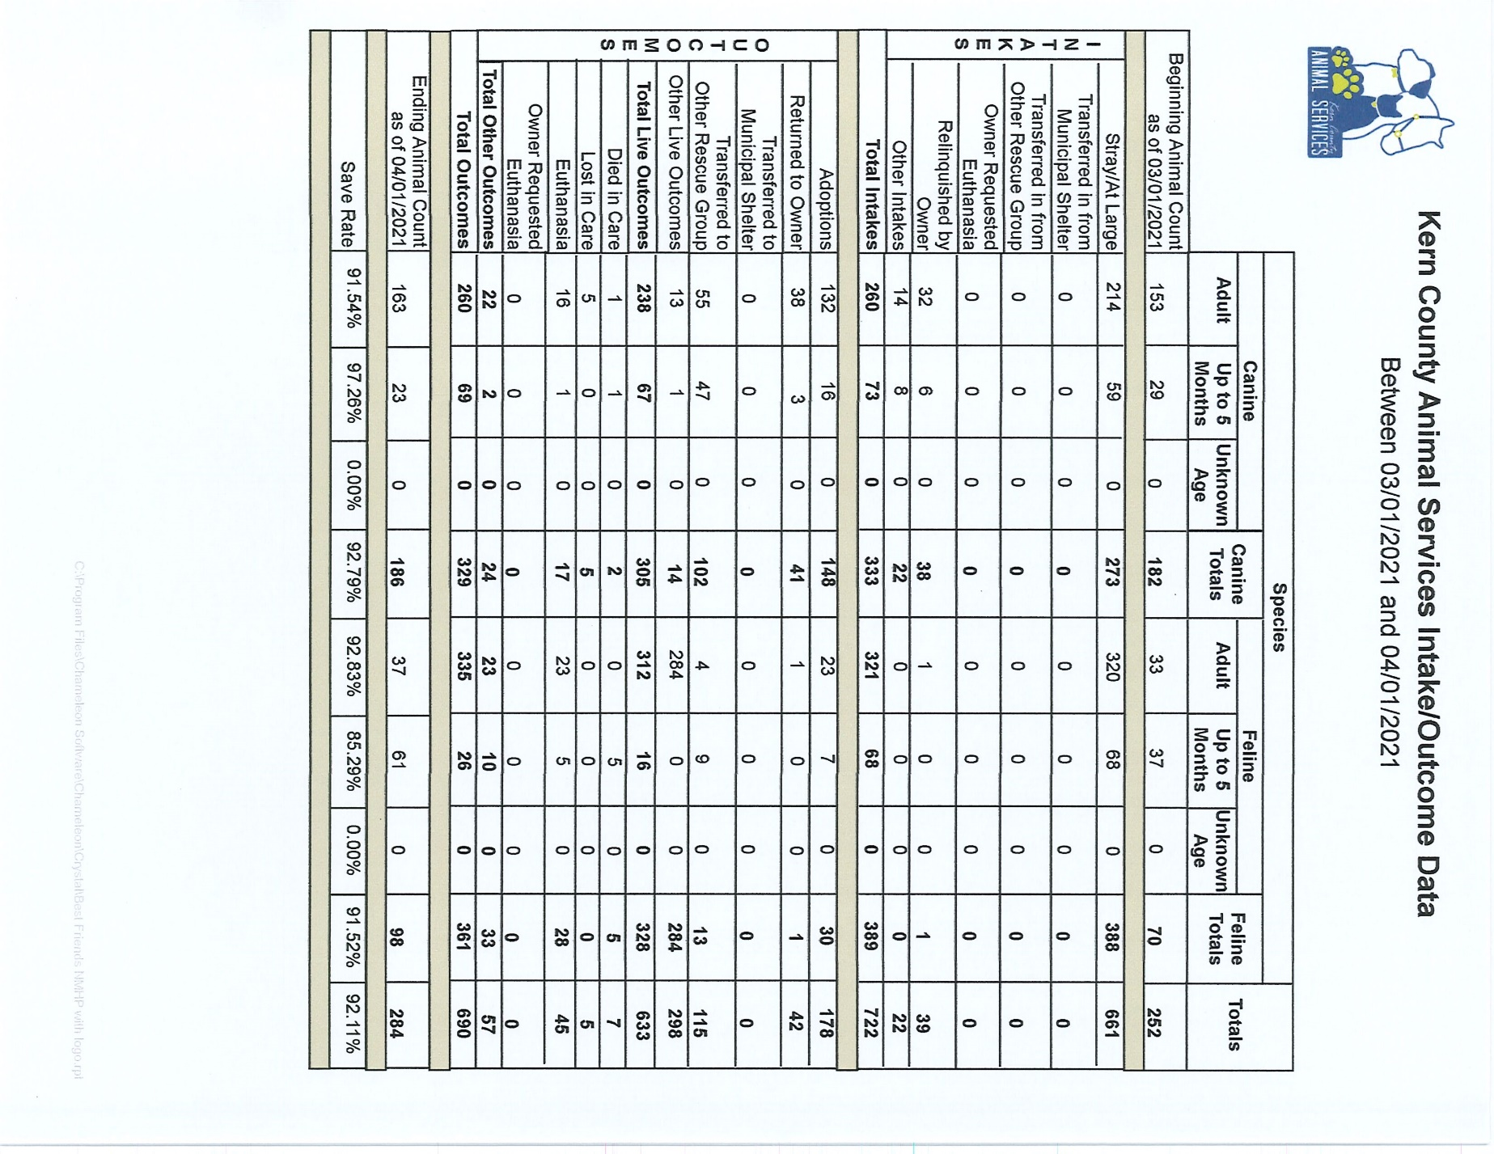

Slide 12
Volunteer Program
March 2022:
        453.15 hours of service were donated
        30 new volunteers
        60 active volunteers

Slide 13
Spay/Neuter Program
Mobile Clinic March 10th & 11th:
        99 Spay/Neuter Surgeries - East Bakersfield
Mobile Clinic March 17th & 18th:
        91 Spay/Neuter Surgeries - Lamont
Mobile Clinic March 26th:
        67 Spay/Neuter Surgeries - Boron
Mobile Clinics Beyond March:
        April 7th and 8th in Buttonwillow/Lost Hills
        Taft and Lake Isabella in May
        Tehachapi in June 2nd and 3rd

Slide 14


Upcoming Spay and Neuter

Slide 15
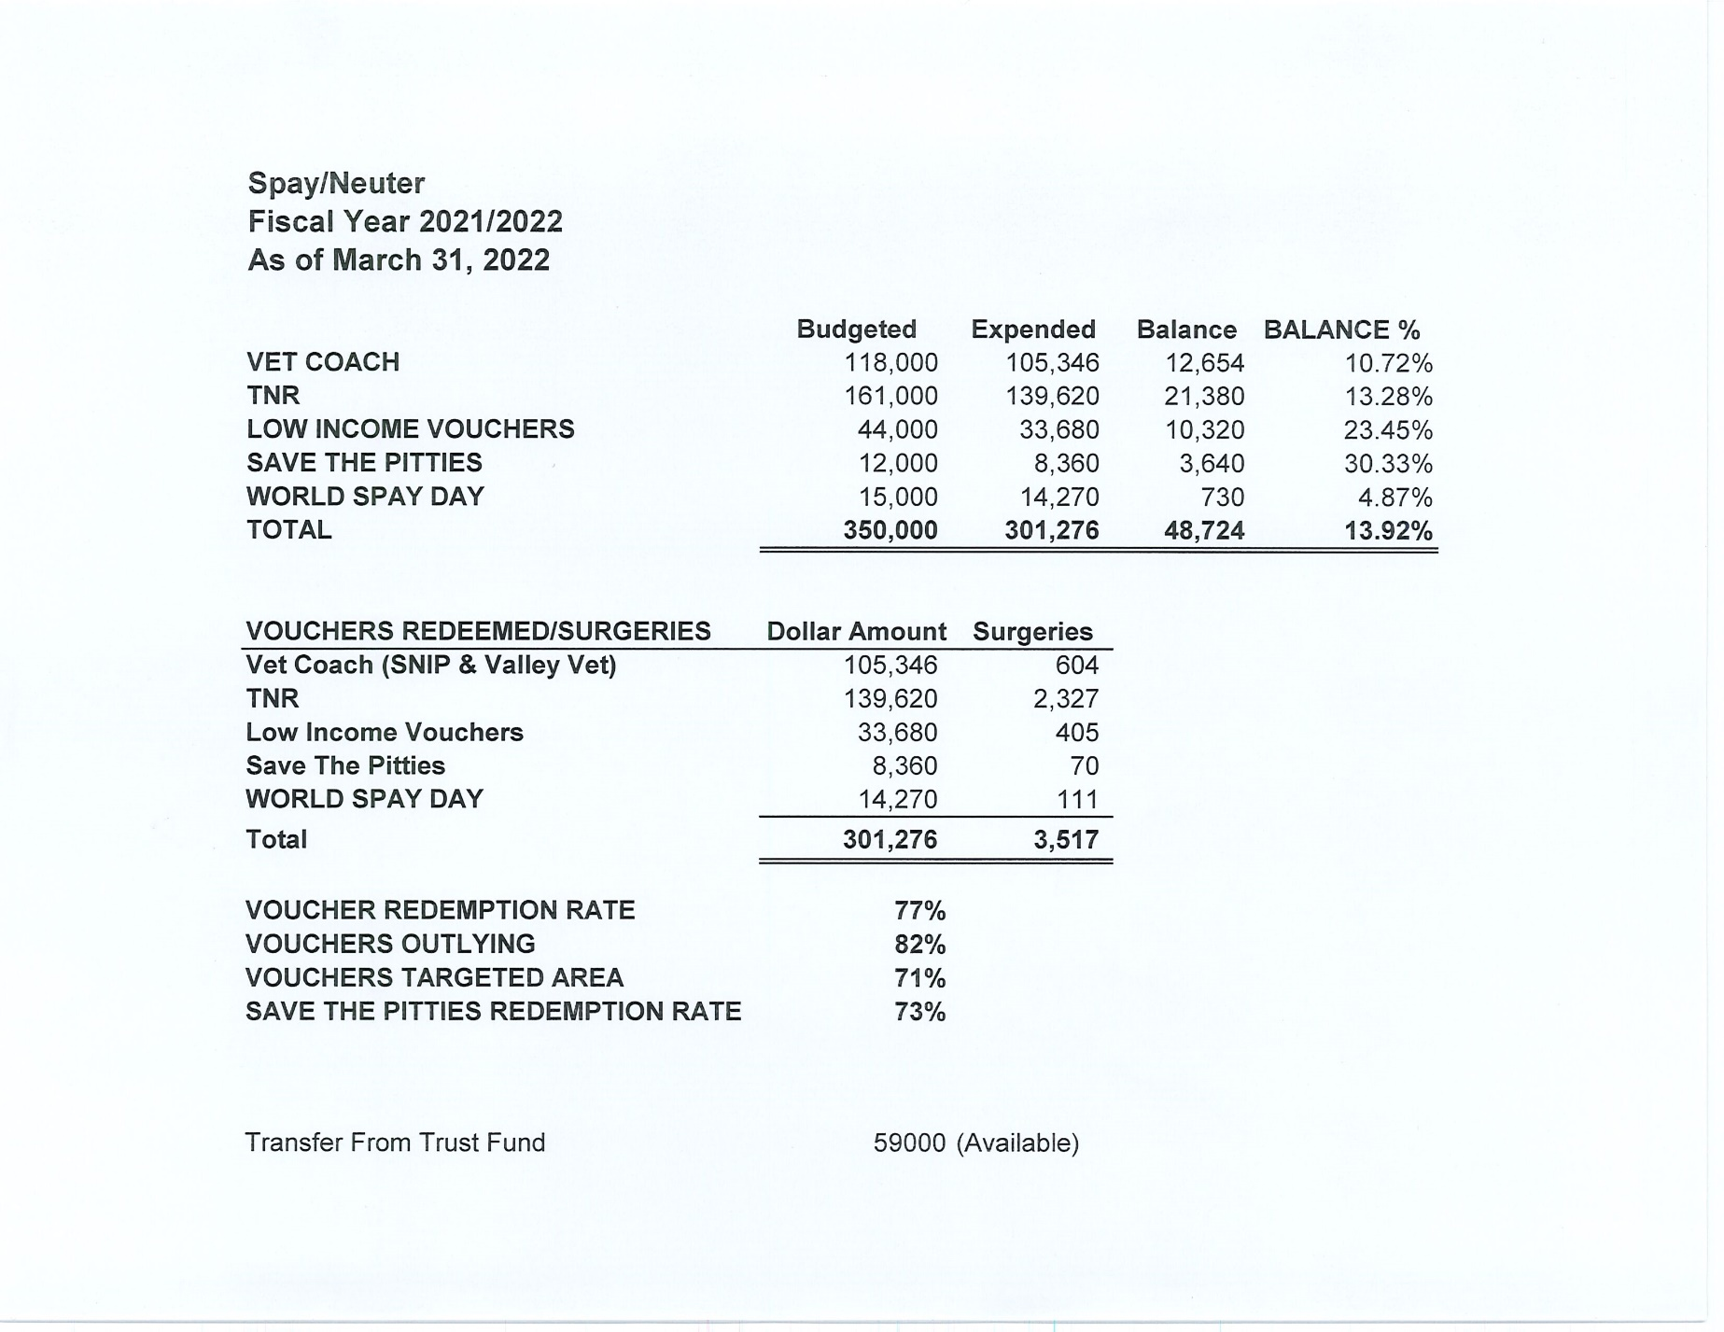

Slide 16
