Slide 1
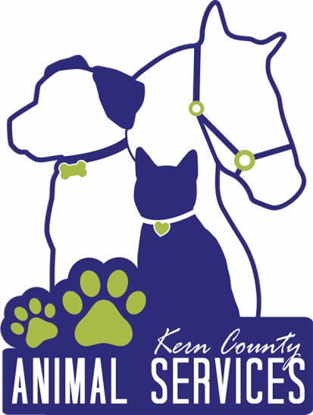
Kern County Animal Services
Director’s Report
April 2022

Slide 2
Program Highlights
Foster
14 dogs, 43 puppies, 4 cat and 182 kittens and 1 rabbit entered the Department’s Foster Care Program for a total of 244 animals in the month of April 2022.
TNR
212 cats were spayed or neutered and released in April 2022. Since 2013, 15,866 cats have been spayed or neutered, and returned to field.
Adoption
145 dogs, 71 puppies, 16 cats, and 14 kittens under 5 months of age were adopted for a total of 246 animals adopted from Kern County Animal Shelters in April of 2022.

Slide 3
Vaccination Clinics
APRIL 2022
  186 rabies
  338 DHPP
  37 FVRCP

Slide 4
Adoptions Year To Date
657 dogs, 285 puppies under 5 months, 81 cats and 88 kittens under 5 months have been adopted.
Rescue Year To Date
187 dogs, 259 puppies under 5 months, 14 cats and 26 kittens under 5 months have been saved by Rescue partners.
Notes:
71

Slide 5

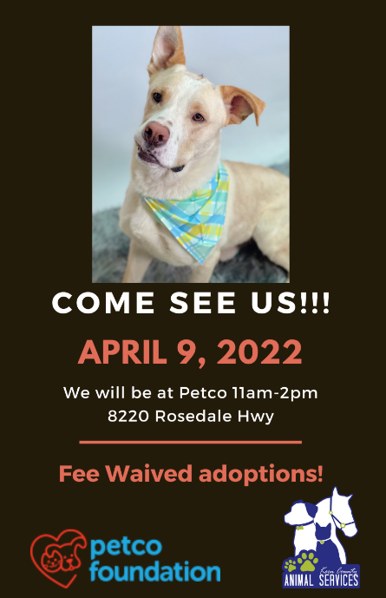
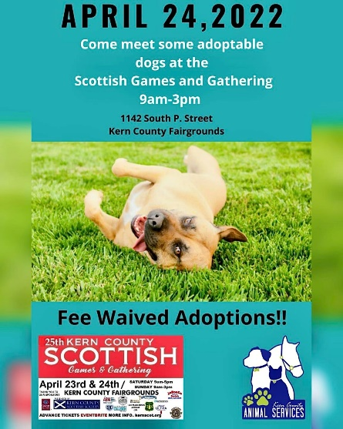
Adoption Promotions

Slide 6
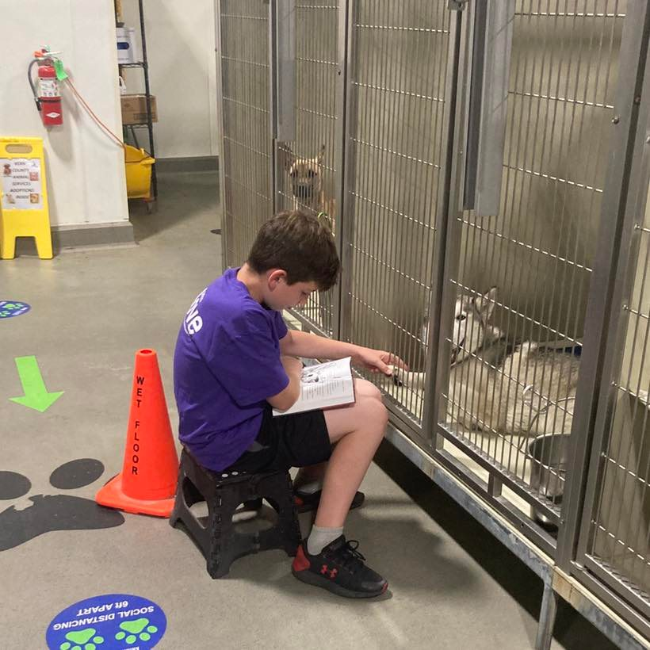
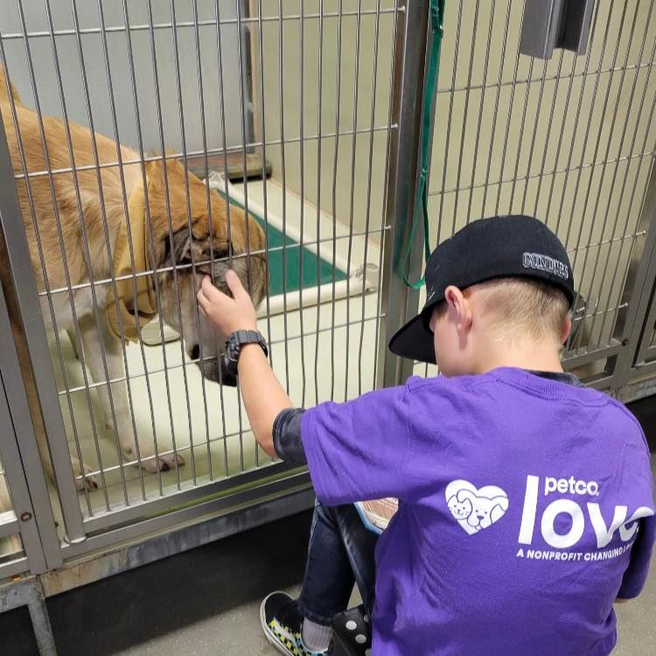
Petco Love Reading Event

Slide 7
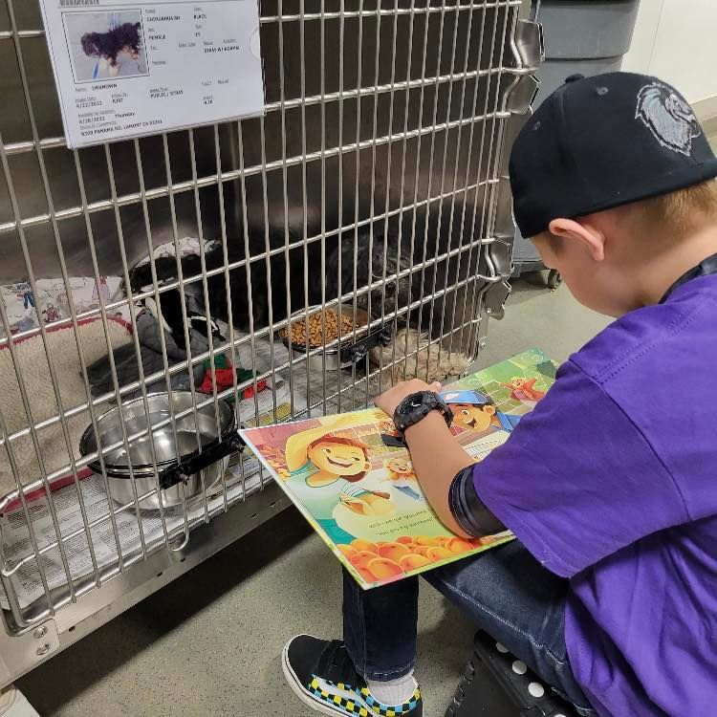
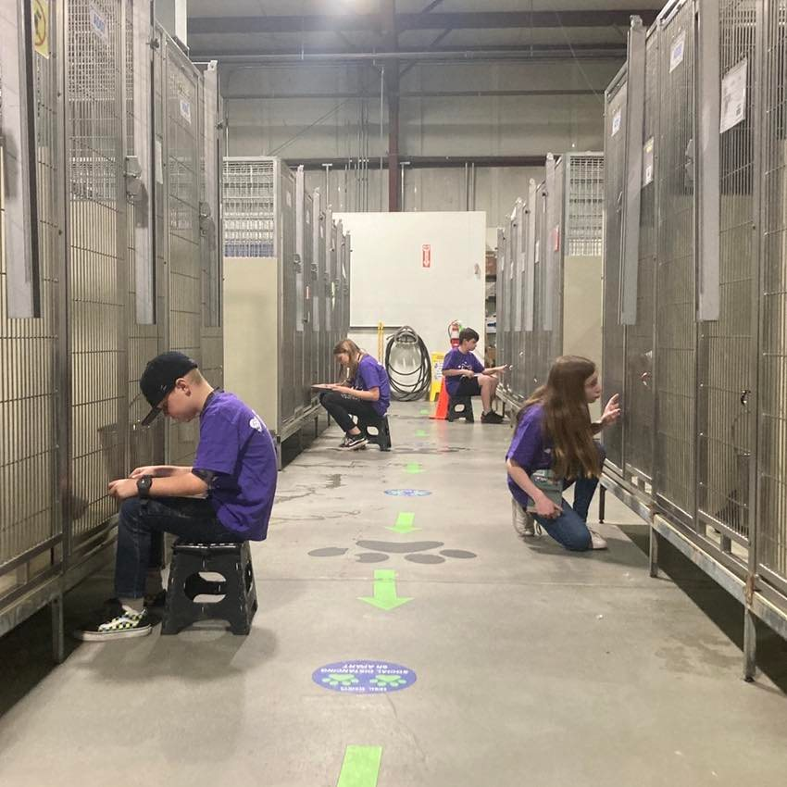
Petco Love Reading Event

Slide 8
Field Services
APRIL 2022 | Calls Per Area
Lake Isabella | 77
Mojave | 133
North County | 38
Northeast | 311
Northwest | 253
Ridgecrest | 18
Southeast | 192
Southwest | 163
Taft | 106
Tehachapi | 72
Total | 1,363
17 dogs were returned to their owners in the field in April 2022.
65 dogs were secured on property by Animal Control Officers in April 2022.

Slide 9
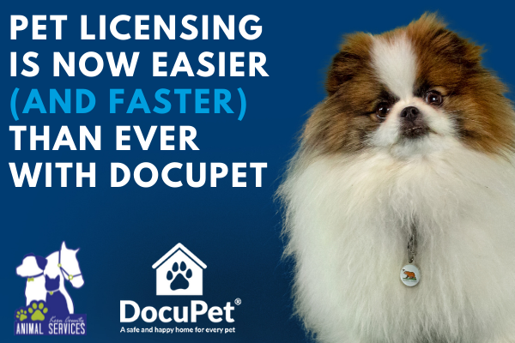
PET LICENSING WITH DOCUPET

Slide 10
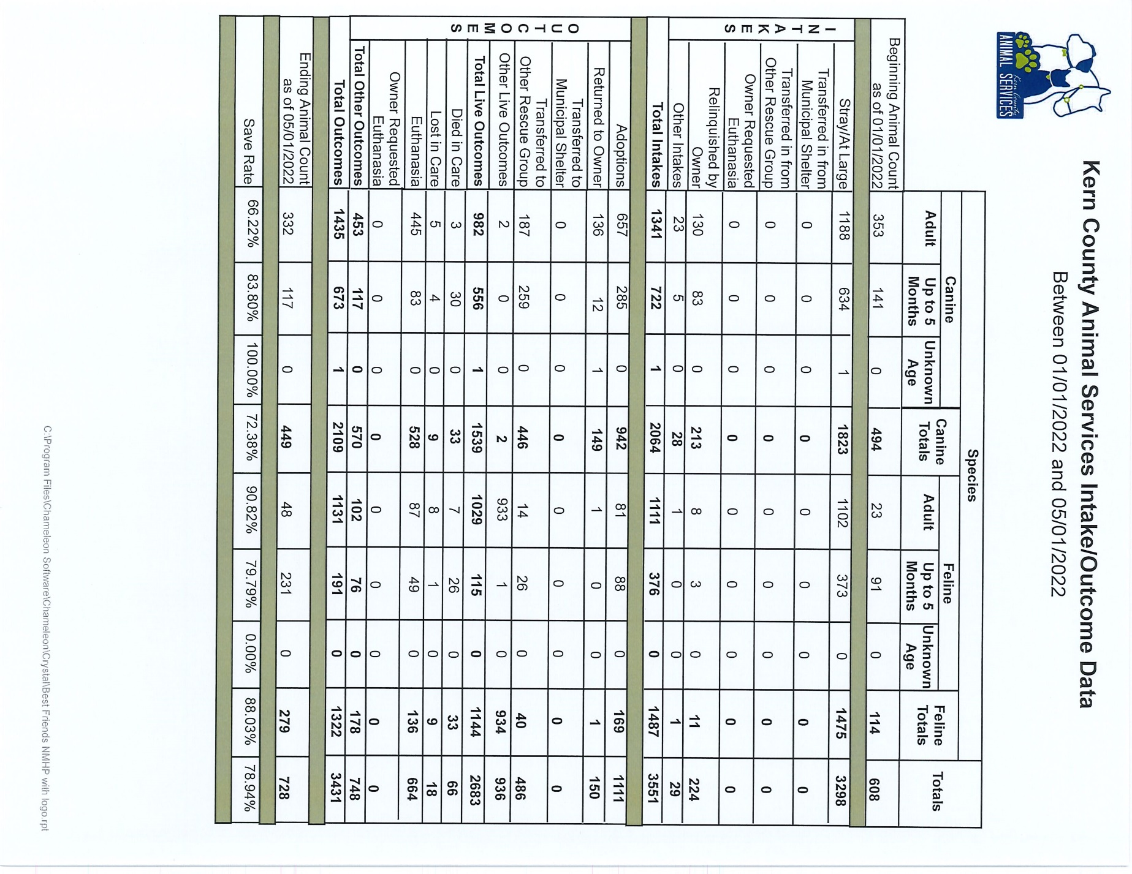

Slide 11
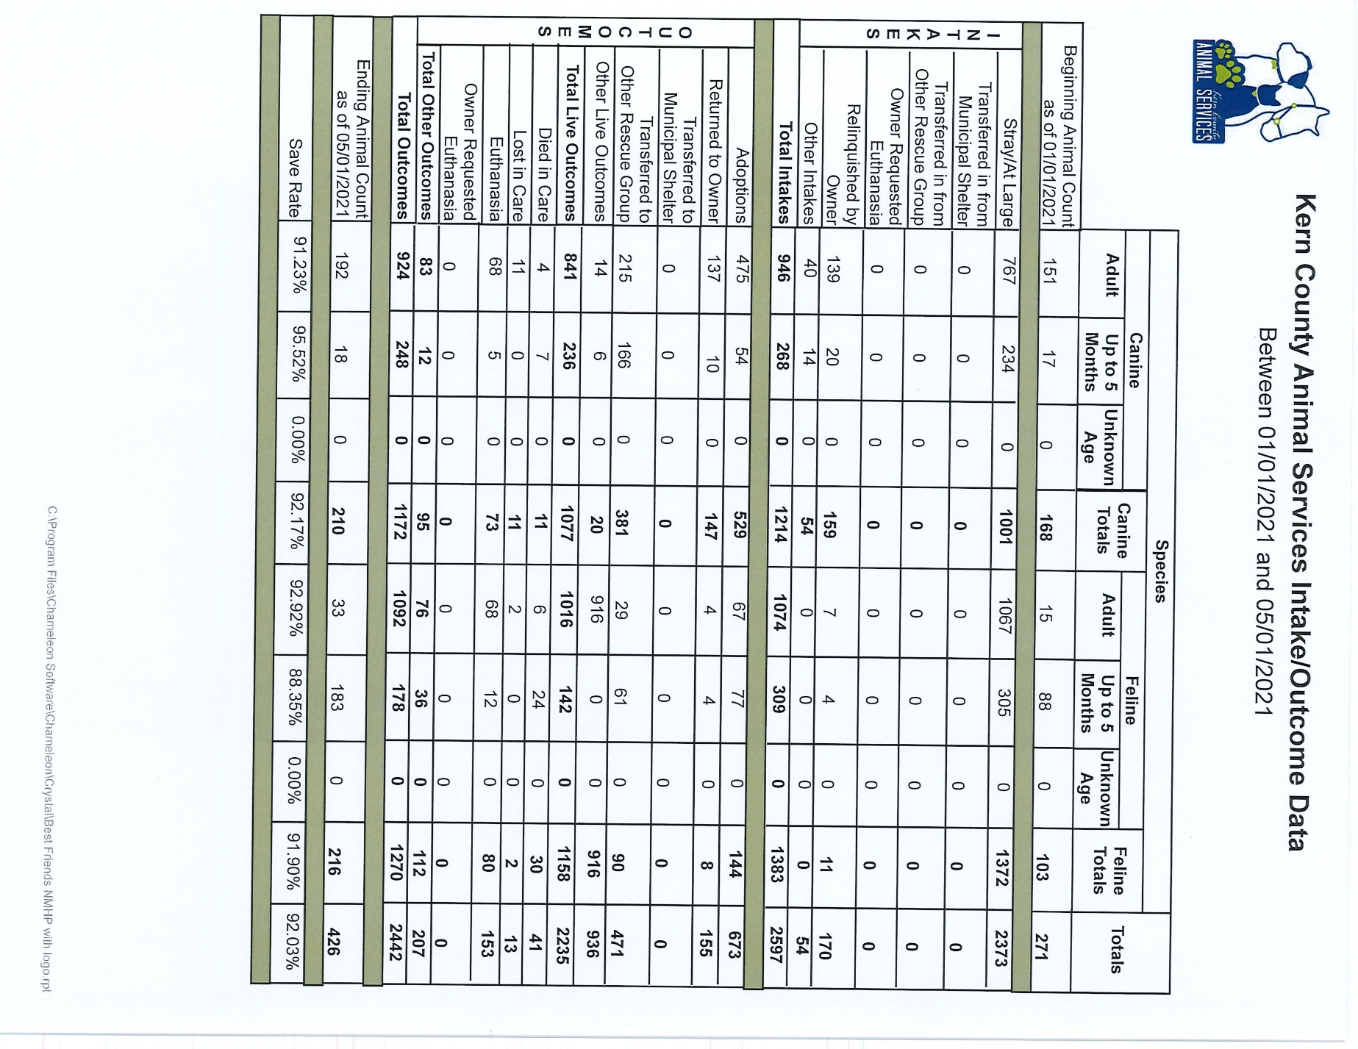

Slide 12
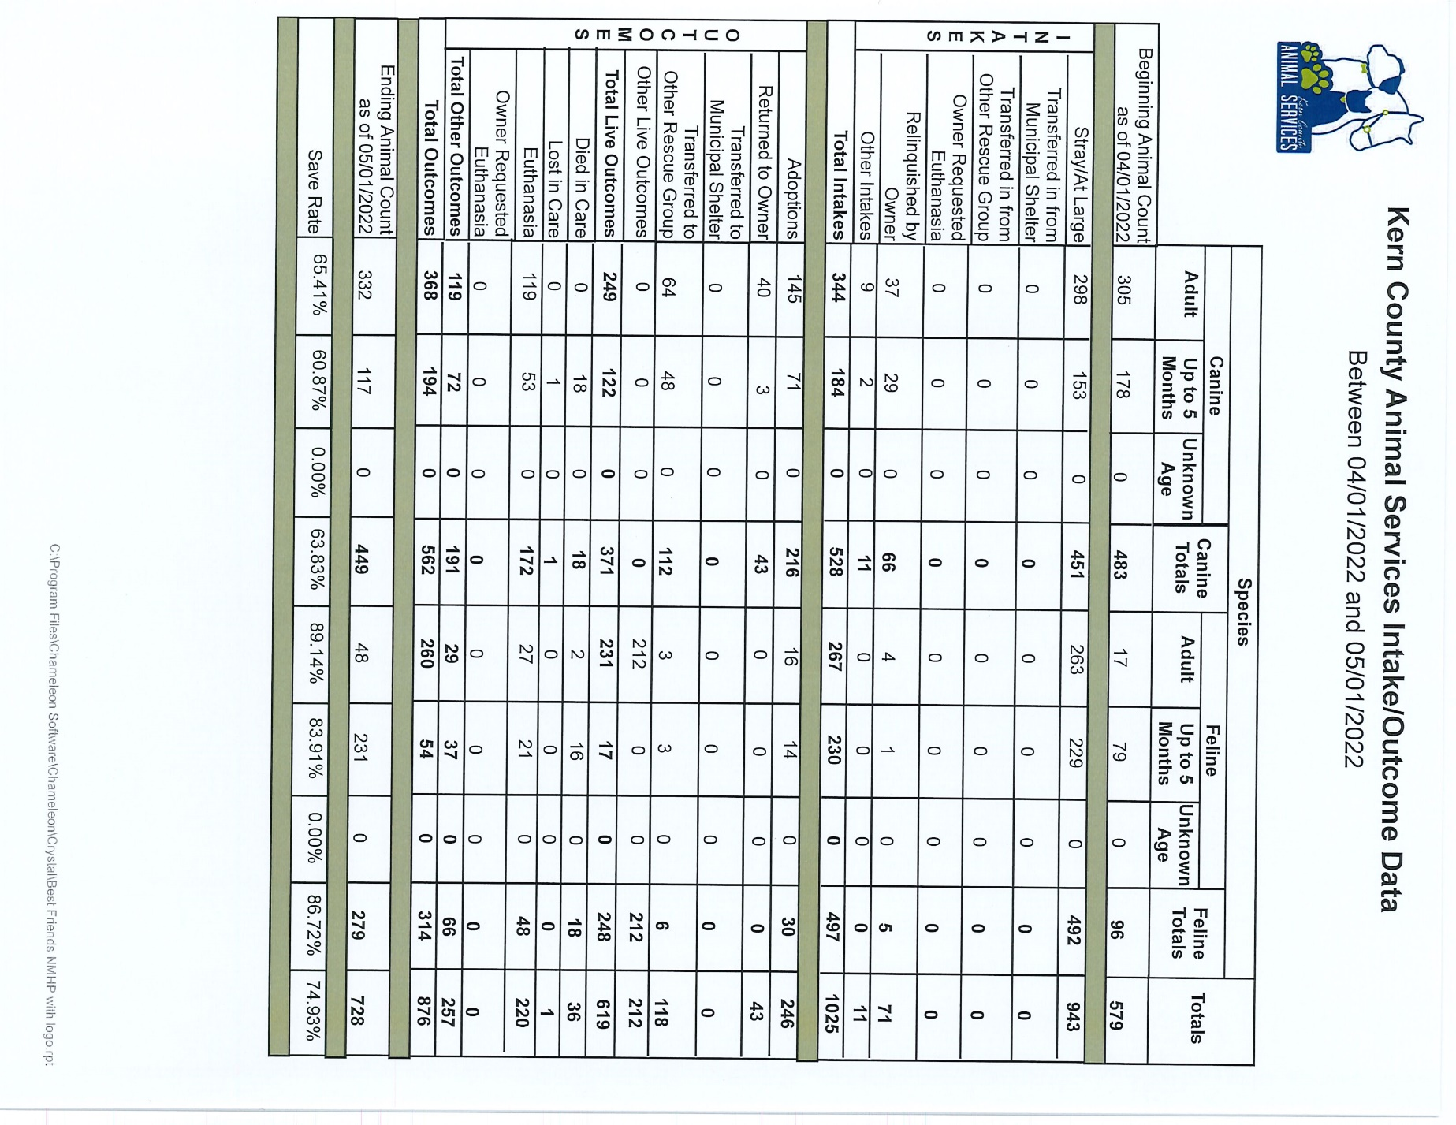

Slide 13
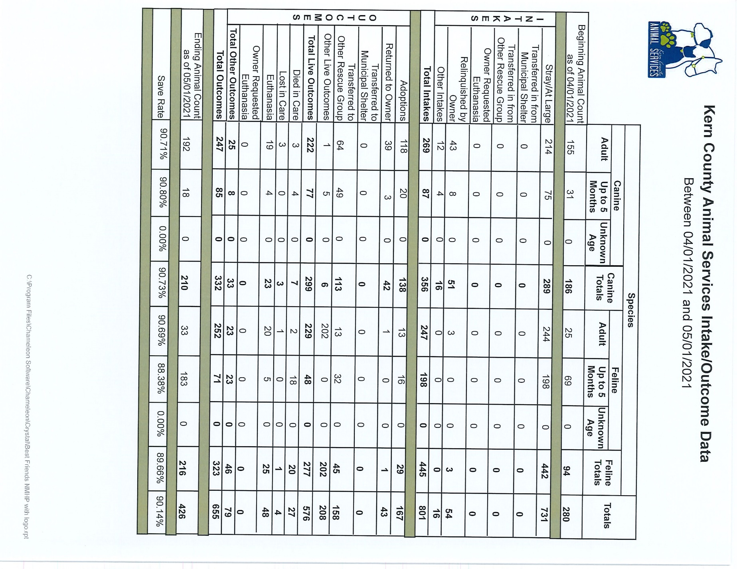

Slide 14
Volunteer Program
April 2022:
        511.83 hours of service were donated
        52 new volunteers
        91 active volunteers

Slide 15
Spay/Neuter Program
Mobile Clinic April 7th & 8th:
        83 Spay/Neuter Surgeries – Buttonwillow
          18 Male Dogs
          42 Female Dogs
          9 Male Cats
          14 Female Cats
Mobile Clinics Beyond April:
        May 24th in Taft
        May 27th in Lake Isabella
        Tehachapi June 2nd and 3rd

Slide 16


Upcoming Spay and Neuter

Slide 17
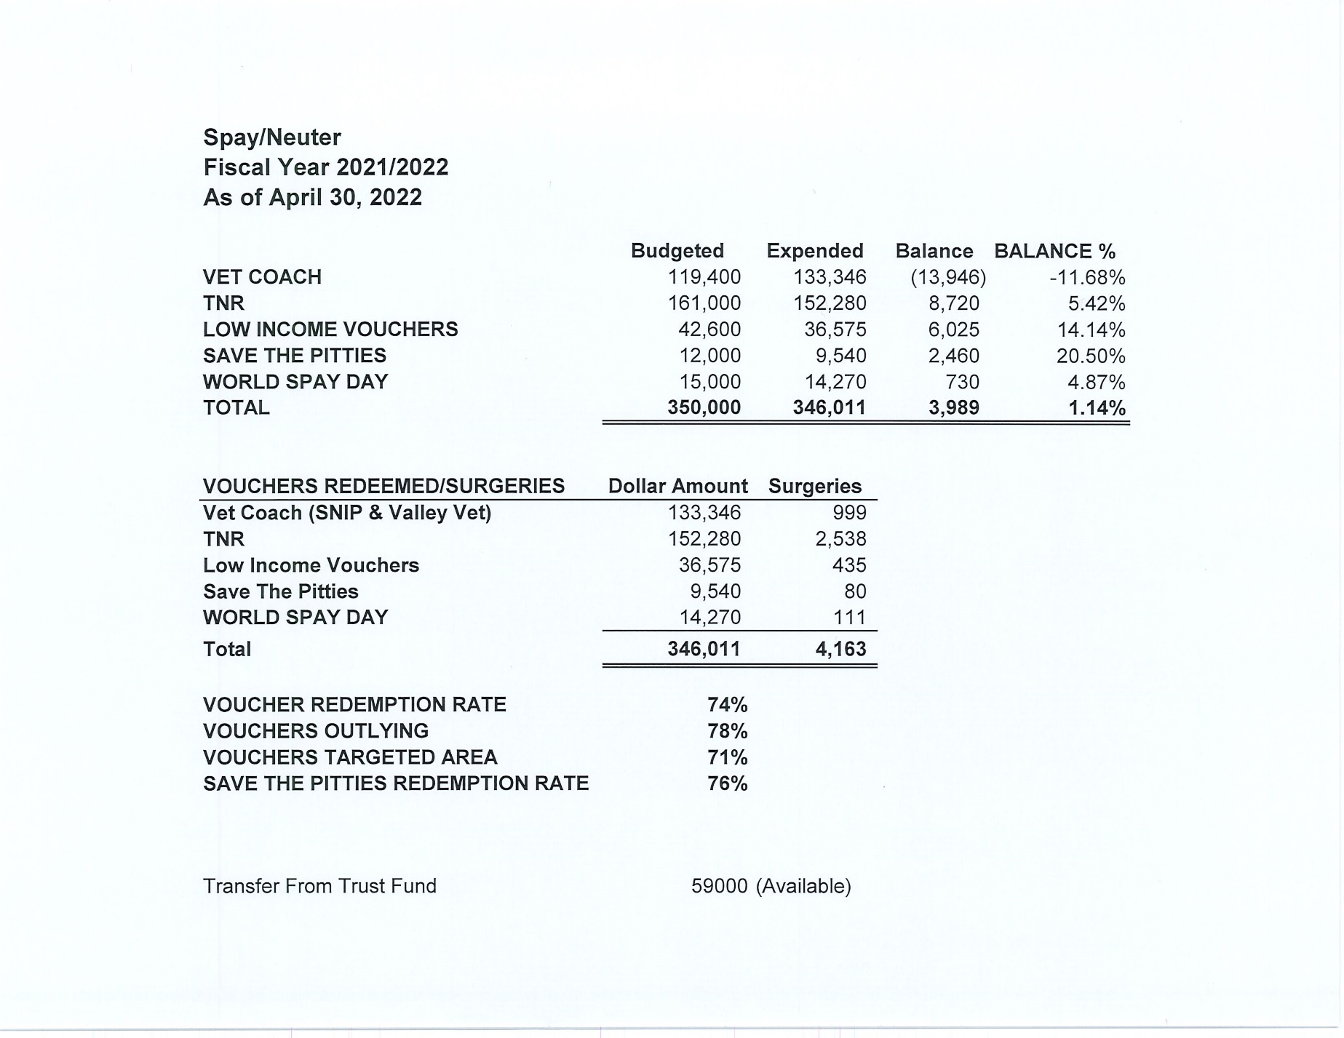

Slide 18
