Slide 1
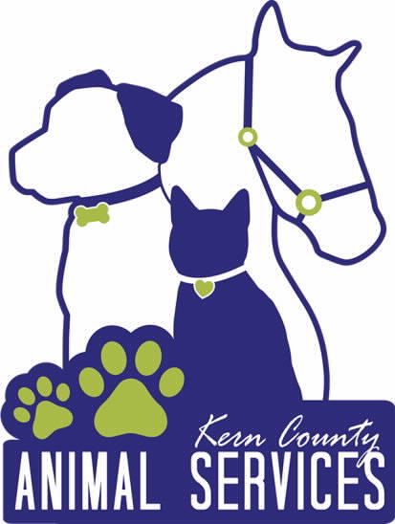
Kern County Animal Services
Director’s Report
May 2022

Slide 2
Program Highlights
Foster
35 dogs, 96 puppies, 4 cat and 197 kittens and 1 rabbit entered the Department’s Foster Care Program for a total of 333 animals in the month of May 2022.
TNR
118 cats were spayed or neutered and released in May 2022. Since 2013, 15,984 cats have been spayed or neutered, and returned to field.
Adoption
142 dogs, 68 puppies, 13 cats, and 93 kittens under 5 months of age were adopted for a total of 316 animals adopted from Kern County Animal Shelters in May of 2022.

Slide 3
Vaccination Clinics
MAY 2022
280 rabies
358 DHPP
48 FVRCP

Slide 4
Adoptions Year To Date
802 dogs, 356 puppies under 5 months, 94 cats and 181 kittens under 5 months have been adopted.
Rescue Year To Date
230 dogs, 299 puppies under 5 months, 15 cats and 40 kittens under 5 months have been saved by Rescue partners.
Notes:
71

Slide 5
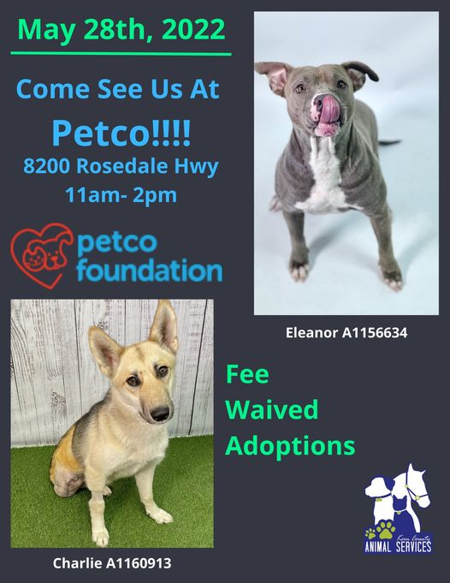
Adoption Promotions

Slide 6
Out in the Community…

Slide 7
Out in the Community…

Slide 8
Field Services
MAY 2022 | Calls Per Area
Lake Isabella | 65
Mojave | 86
North County | 45
Northeast | 331
Northwest | 282
Ridgecrest | 29
Southeast | 157
Southwest | 118
Taft | 97
Tehachapi | 63
Total | 1,273
11 dogs were returned to their owners in the field in May 2022.
108 dogs were secured on property by Animal Control Officers in May 2022.

Slide 9
PET LICENSING WITH DOCUPET

Slide 10
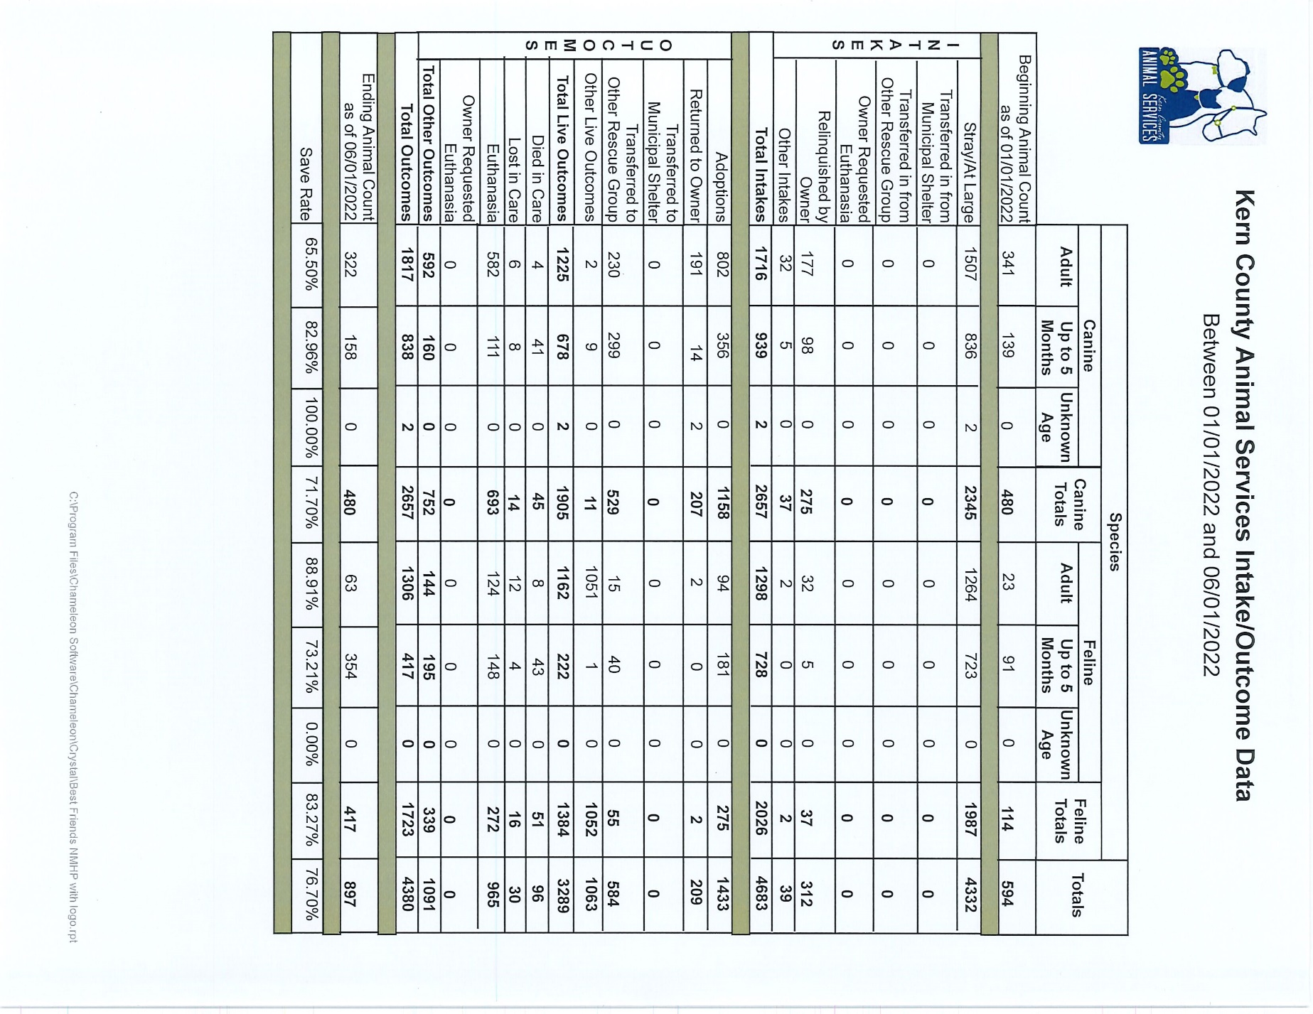

Slide 11
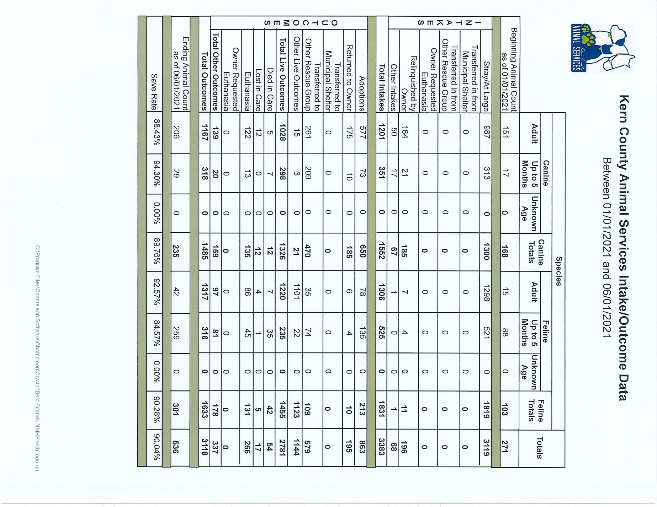

Slide 13
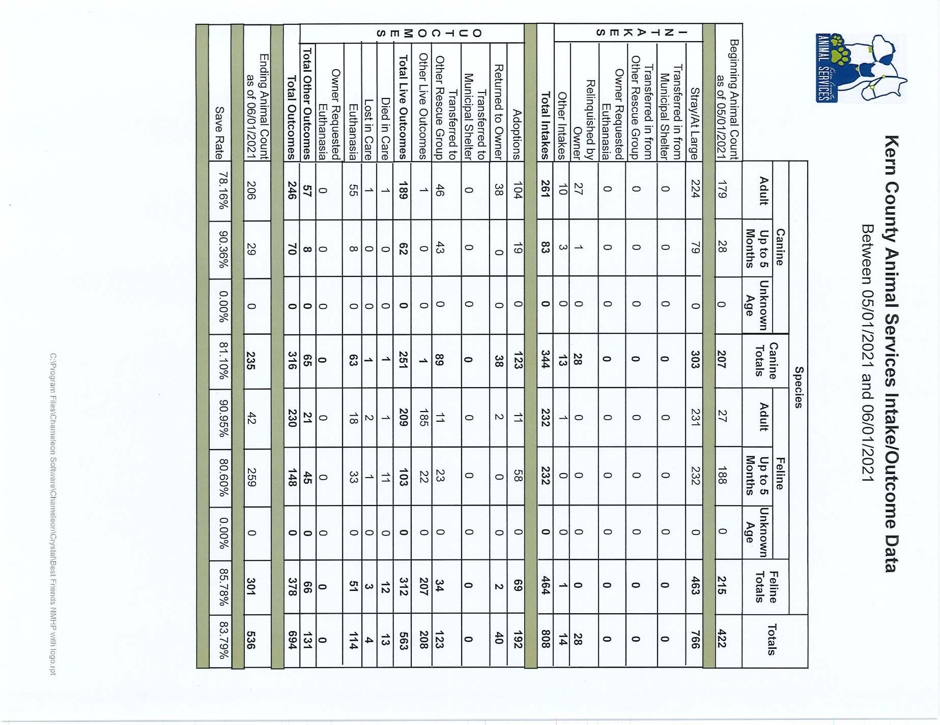

Slide 14
Volunteer Program
May 2022:
555.24 hours of service were donated
30 new volunteers
56 active volunteers

Slide 15
Spay/Neuter Program
Mobile Clinic May 24th:
48 Spay/Neuter Surgeries – Buttonwillow
14 Male Dogs
23 Female Dogs
5 Male Cats
6 Female Cats
Mobile Clinic May 27th:
43 Spay/Neuter Surgeries – Lake Isabella
15 Male Dogs
13 Female Dogs
6 Male Cats
9 Female Cats

Slide 16
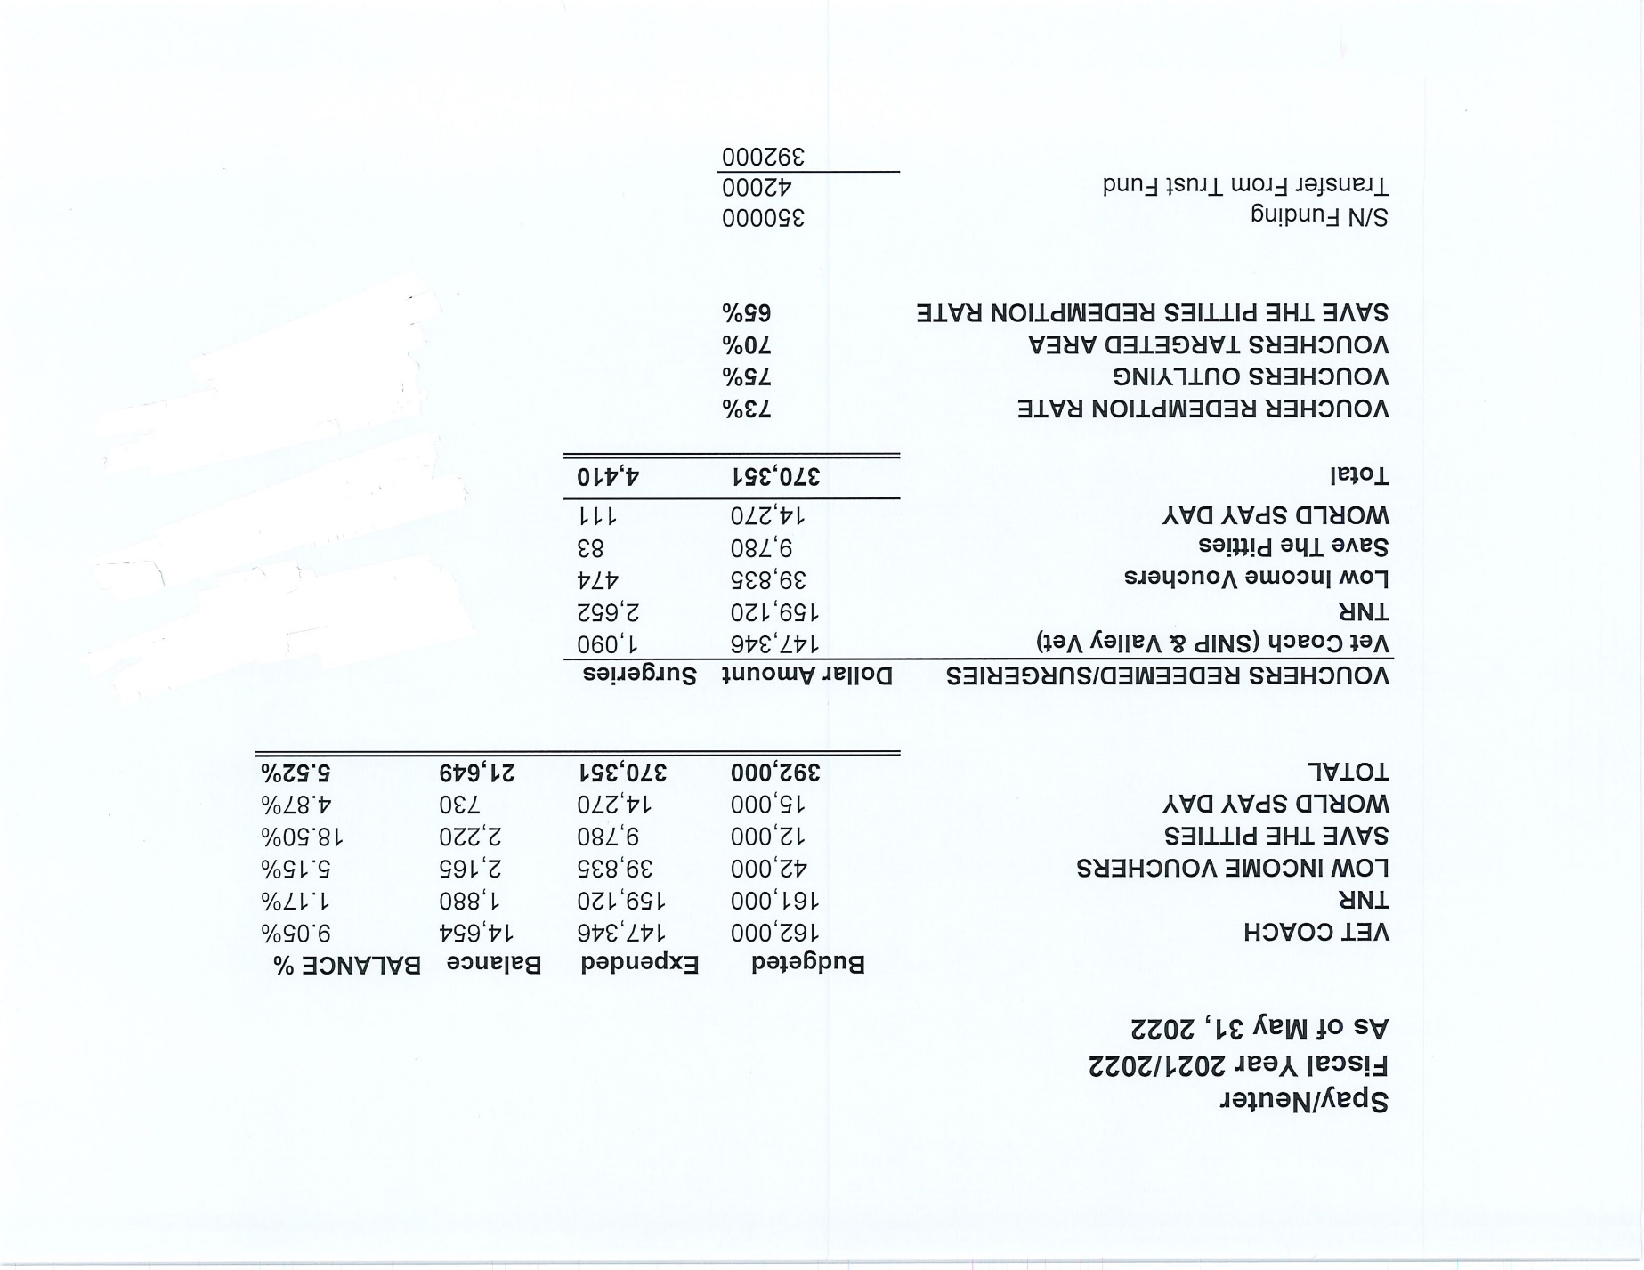

Slide 17
