Slide 1
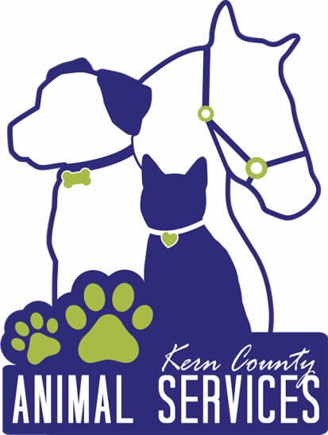
Kern County Animal Services
Director’s Report
July 2022

Slide 2
Program Highlights
Foster
31 dogs, 61 puppies, 5 cats and 133 kittens entered the Department’s Foster Care Program for a total of 230 animals in the month of July 2022.
TNR
10 cats were spayed or neutered and released in July 2022. Since 2013, 16,010 cats have been spayed or neutered, and returned to field.
Adoption
211 dogs, 165 puppies, 19 cats, and 222 kittens under 5 months of age were adopted for a total of 617 animals adopted from Kern County Animal Shelters in July of 2022.

Slide 3
Vaccination Clinics
JULY 2022
  53 rabies
  60 DHPP
  18 FVRCP

Slide 4
Adoptions Year To Date
1206 dogs, 643 puppies under 5 months, 122 cats and 553 kittens under 5 months have been adopted.
Rescue Year To Date
341 dogs, 431 puppies under 5 months, 19 cats and 54 kittens under 5 months have been saved by Rescue partners.
Notes:
71

Slide 5

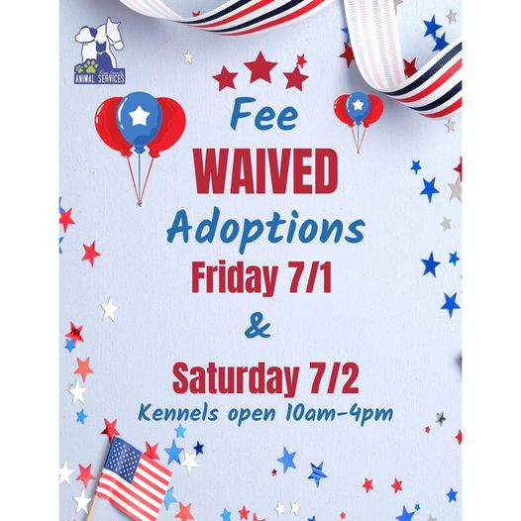
Adoption Promotions

Slide 6
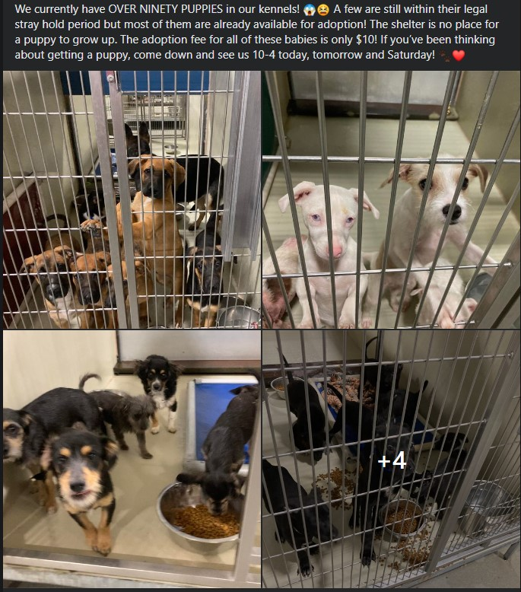
Adoption Promotions

Slide 7
Field Services
JULY 2022 | Calls Per Area
Lake Isabella | 77
Mojave | 83
North County | 45
Northeast | 289
Northwest | 278
Ridgecrest | 10
Southeast | 187
Southwest | 123
Taft | 122
Tehachapi | 65
Total | 1,279
8 dogs were returned to their owners in the field in July 2022.
34 dogs were secured on property by Animal Control Officers in July 2022.

Slide 8
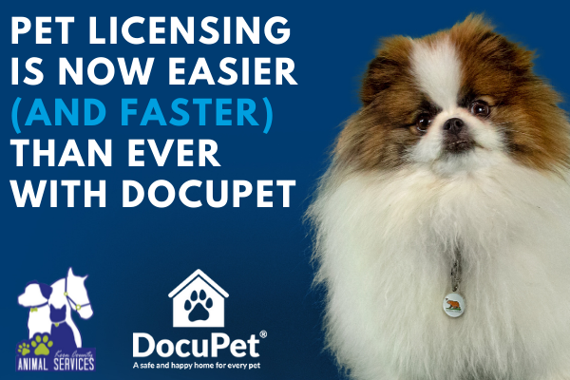
PET LICENSING WITH DOCUPET

Slide 9
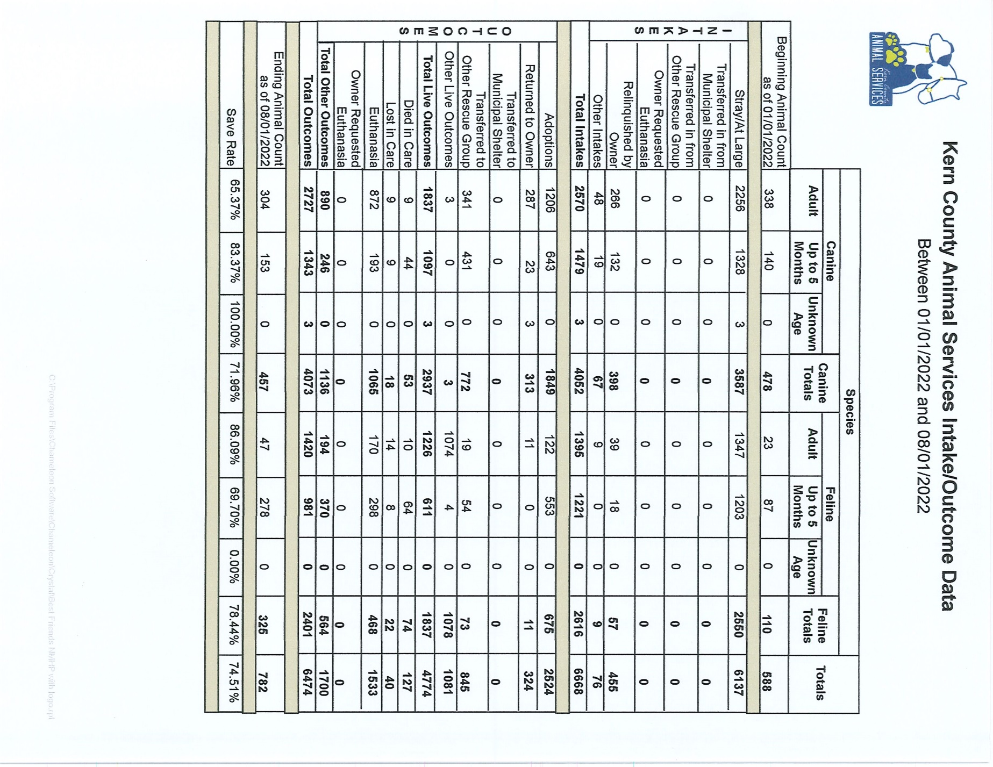

Slide 10
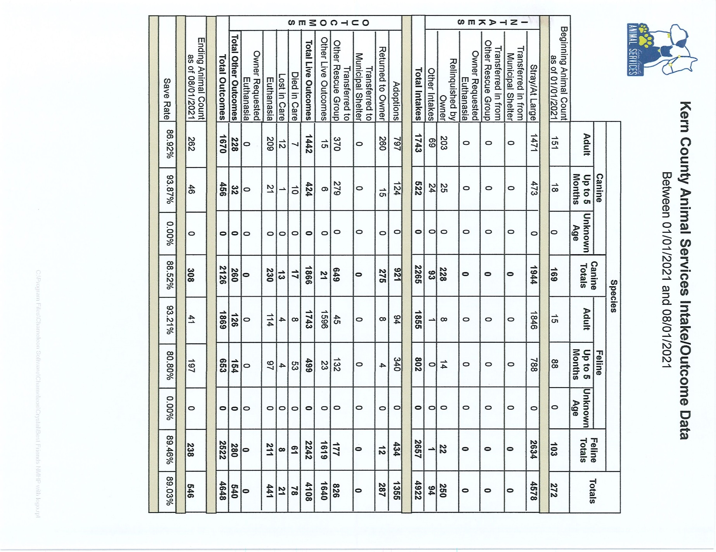

Slide 11
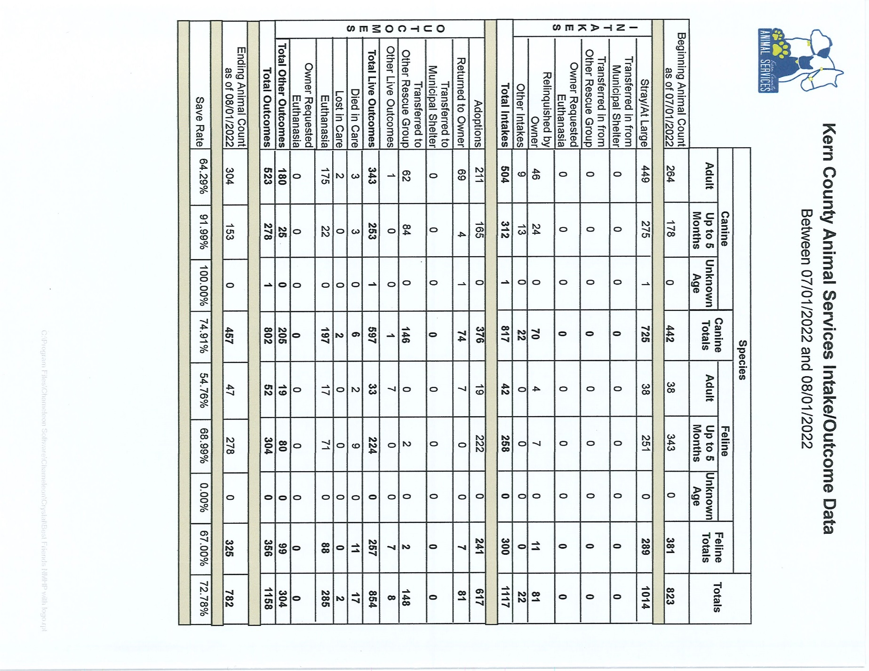

Slide 12
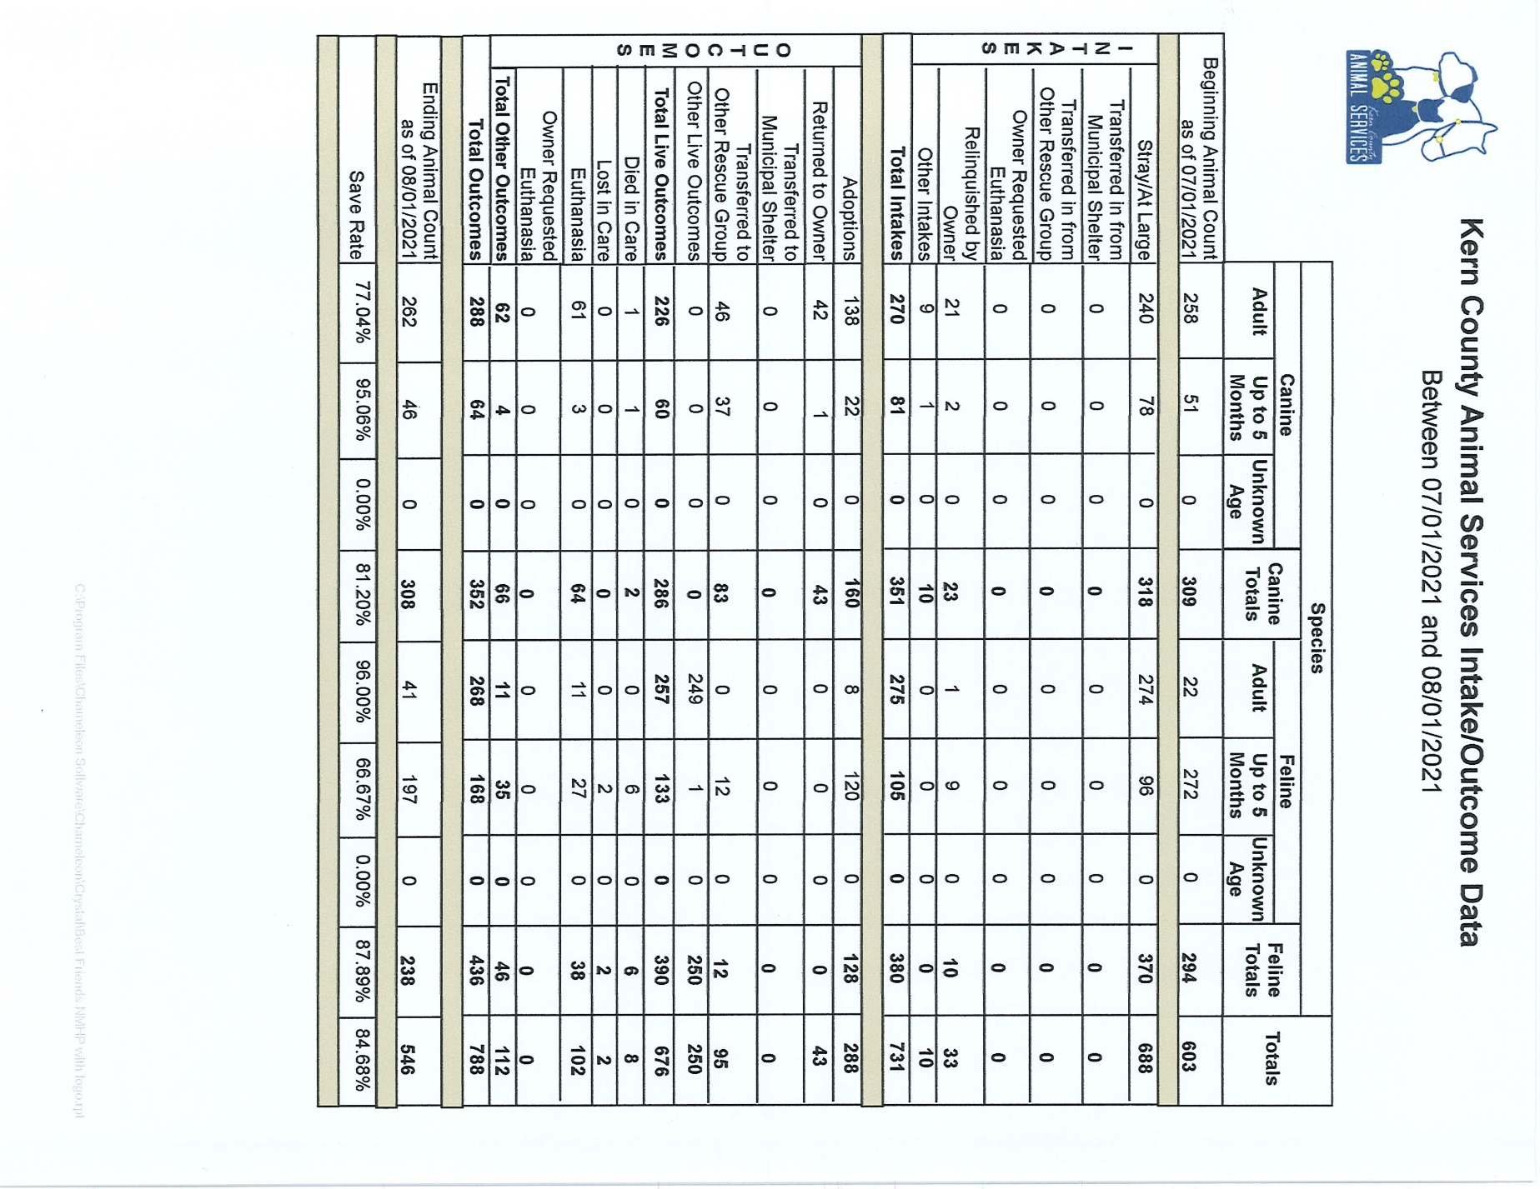

Slide 13
Volunteer Program
July 2022:
        590.95 hours of service were donated
        73 new volunteers
        98 active volunteers

