Slide 1

Kern County Animal Services
Director’s Report
November/December 2022

Slide 2
Program Highlights
Foster
76 dogs, 81 puppies, 2 cats and 103 kittens entered the Department’s Foster Care Program for a total of 262 animals in the months of November and December 2022.
TNR
385 cats were spayed or neutered and released in November and December 2022. Since 2013, 16,628 cats have been spayed or neutered, and returned to field.
Adoption
366 dogs, 145 puppies, 47 cats, and 228 kittens under 5 months of age were adopted for a total of 786 animals adopted from Kern County Animal Shelters in November and December of 2022.

Slide 3
Vaccination Clinics
October 2022
  162 rabies
  205 DHPP
  33 FVRCP
  43 Microchips

Slide 4
Spay/Neuter Program
Bakersfield Clinic November 15th:
        48 Spay/Neuter Surgeries
Shafter/Delano Clinic November 17th:
        42 Spay/Neuter Surgeries
Taft Clinic November 21st:
        46 Spay/Neuter Surgeries
East Bakersfield Clinic November 29th:
        40 Spay/Neuter Surgeries
Bakersfield Clinic December 2nd:
        47 Spay/Neuter Surgeries
East Bakersfield Clinic December 12th:
        39 Spay/Neuter Surgeries
Bakersfield Clinic December 16th:
        34 Spay/Neuter Surgeries
Bakersfield Clinic December 22nd:
        43 Spay/Neuter Surgeries

Slide 5
Adoptions Year To Date
2,158 dogs, 1,136 puppies under 5 months, 233 cats and 1,143 kittens under 5 months have been adopted.
Rescue Year To Date
749 dogs, 782 puppies under 5 months, 35 cats and 120 kittens under 5 months have been saved by Rescue partners.
Notes:
71

Slide 6

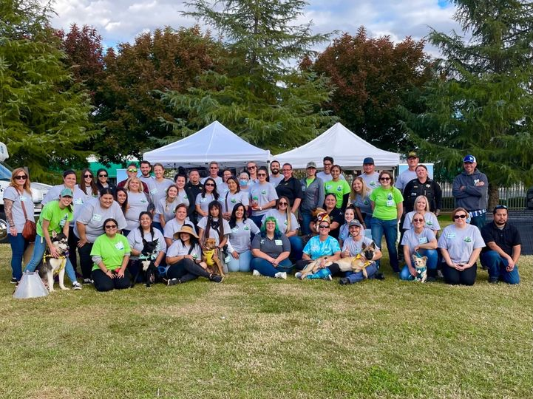
Mega Adoption 2022

Slide 7

Streets of Bakersfield

Slide 8

Congratulations!
To Critters Without Litter
For accomplishing their 100,000th spay or neuter surgery!!

Slide 9
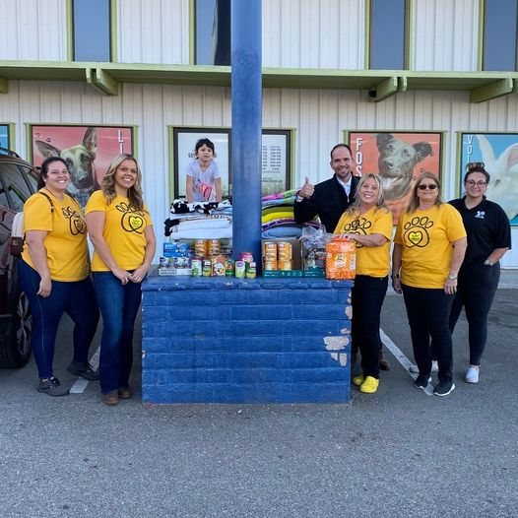
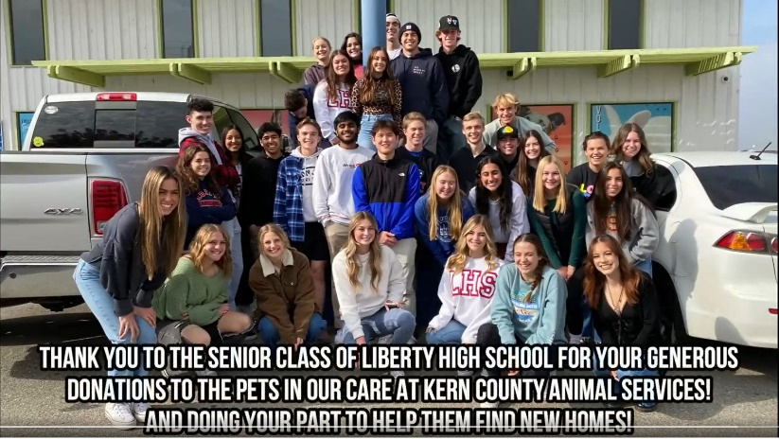
Donations
Together Spay It Forward
Liberty High School

Slide 10
Field Services
NOVEMBER/DECEMBER 2022 | Calls Per Area
Lake Isabella | 153
Mojave | 214
North County | 84
Northeast | 574
Northwest | 513
Ridgecrest | 54
Southeast | 353
Southwest | 339
Taft | 218
Tehachapi | 113
Total | 2,615
146 dogs were returned to their owners in the field in November/December 2022.
443 dogs were secured on property by Animal Control Officers in November/December 2022.

Slide 11
Field Services-CAF
NOVEMBER/DECEMBER 2022 | Calls
CAF-Breeder | 30
CAF-Rescue | 1
CAF-Kennel | 0
CAF-Grooming | 8
Total | 39
2 Permits Issued/Inspections Passed
1 Inspection Failed
0 Citations Issued

Slide 12
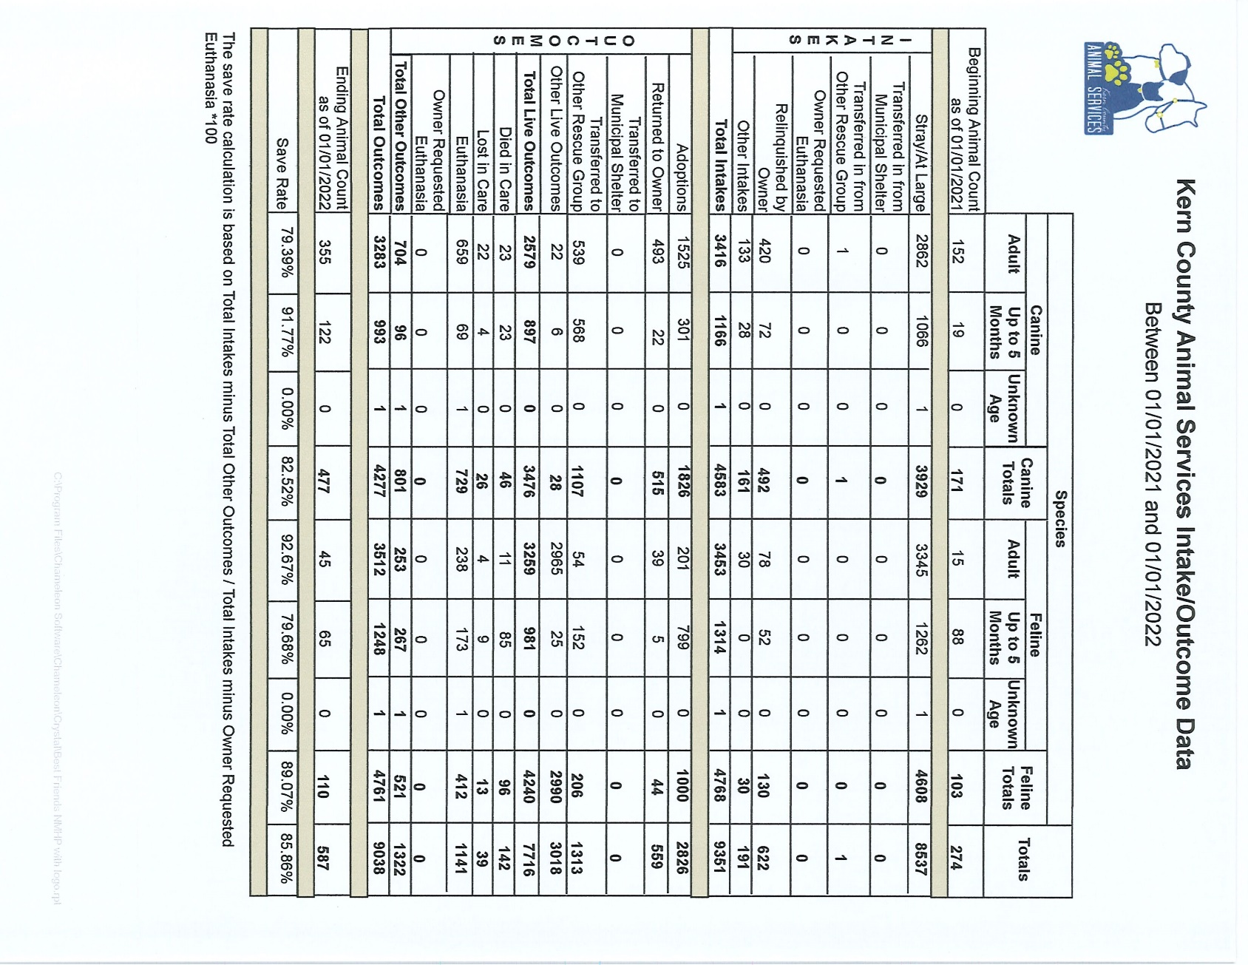

Slide 13
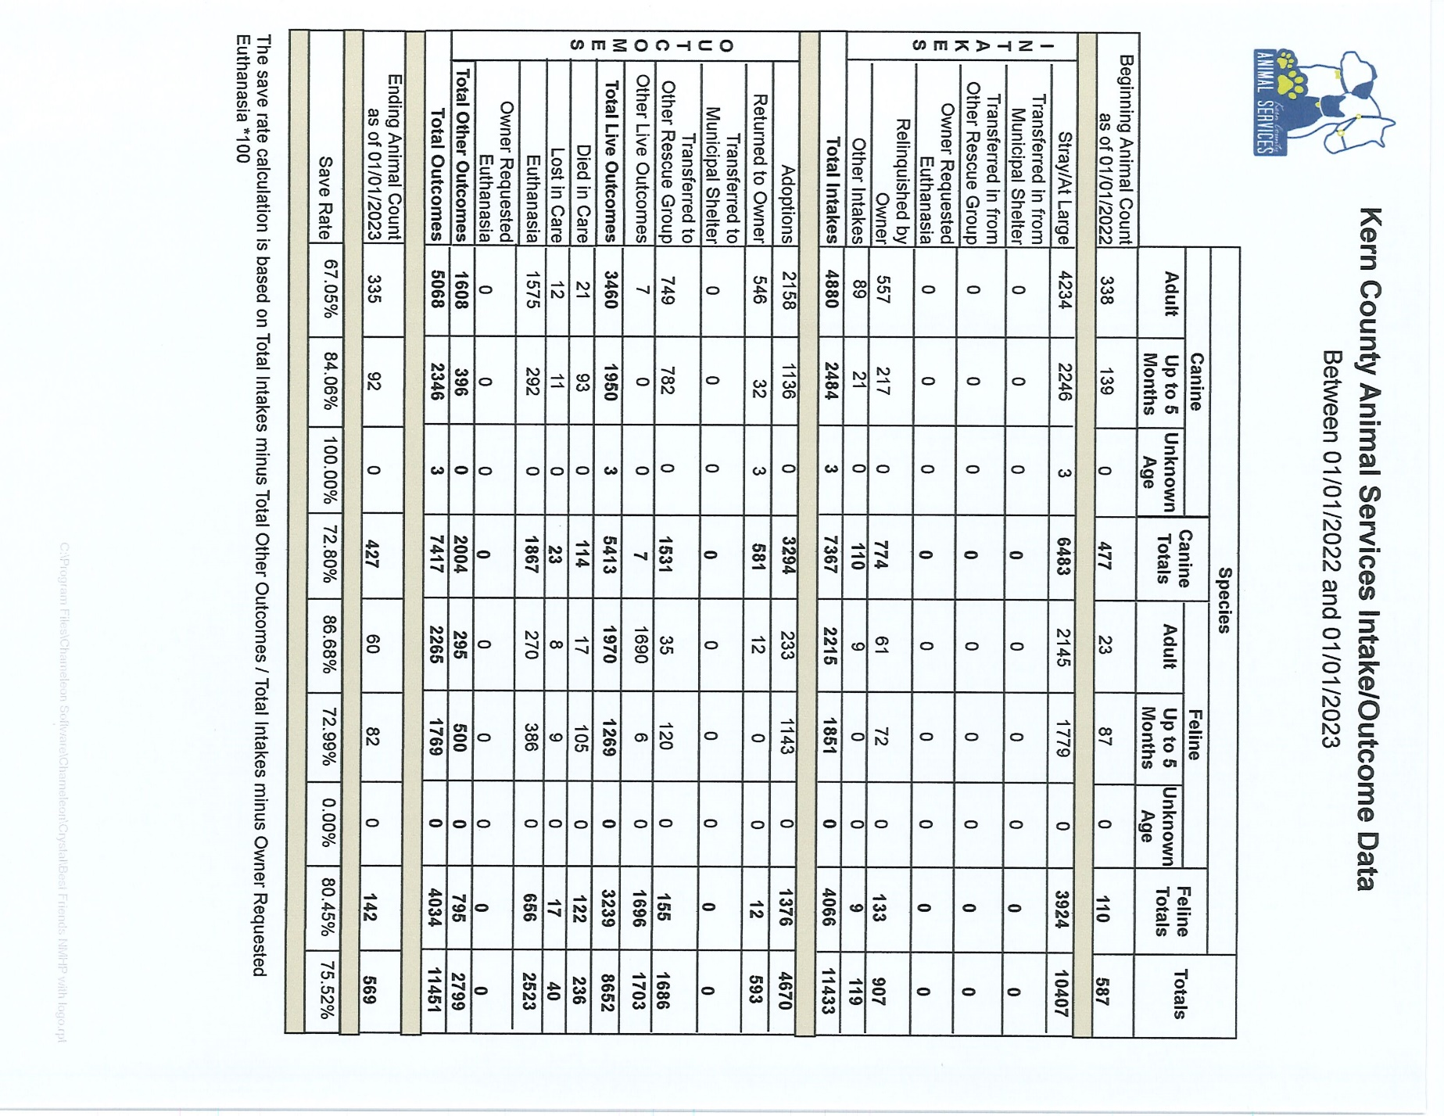

Slide 14
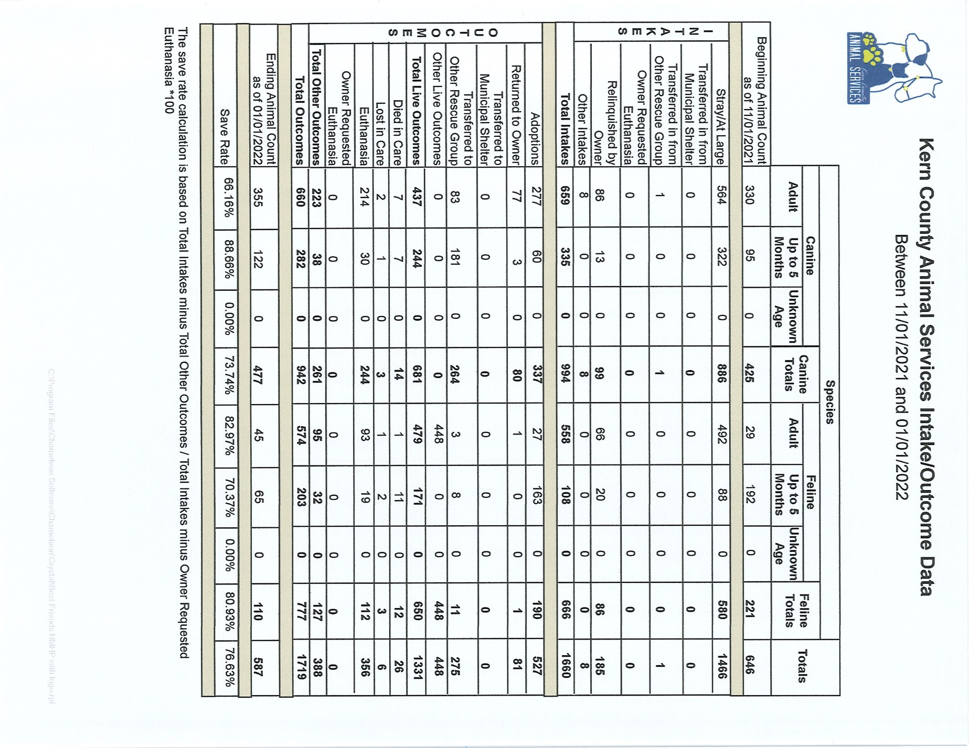

Slide 15
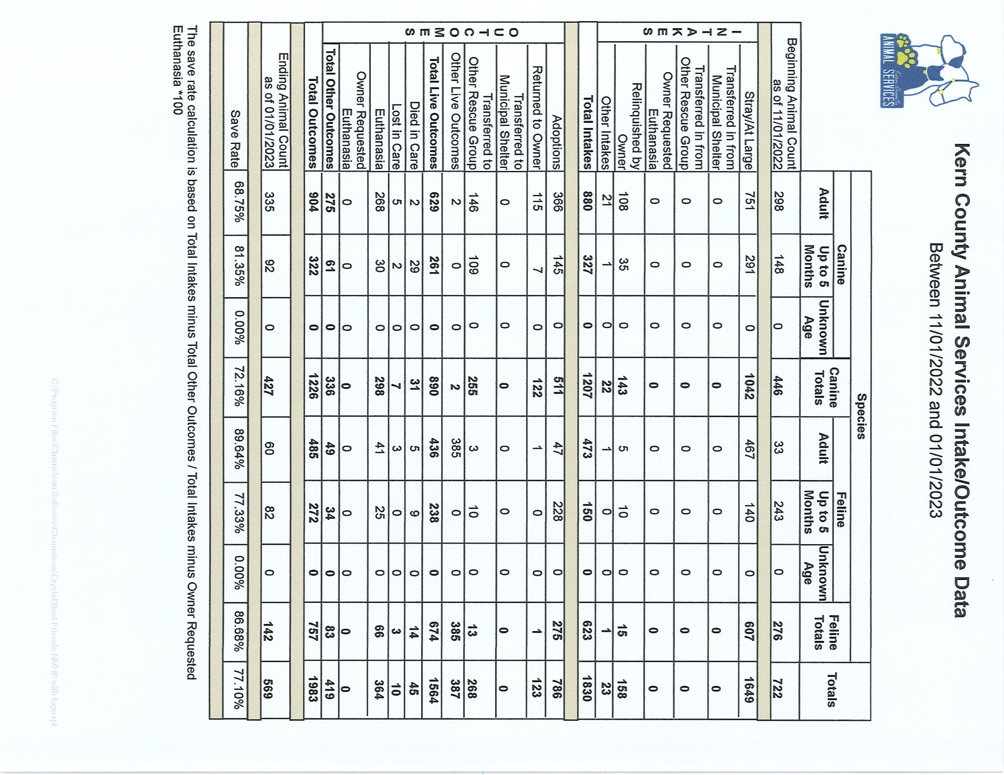

Slide 16
Volunteer Program
November/December 2022:
        1166.47 hours of service were donated
        87 new volunteers
        165 active volunteers
        To date, 6,309.16 hours of service have been donated

