Slide 1

Kern County Animal Services
Director’s Report
January 2023

Slide 2
Program Highlights
Foster
27 dogs, 40 puppies, 2 cats and 10 kittens entered the Department’s Foster Care Program for a total of 79 animals in the months of January 2023.
TNR
282 cats were spayed or neutered and released in January 2023. Since 2013, 16,910 cats have been spayed or neutered, and returned to field.
Adoption
179 dogs, 94 puppies, 20 cats, and 50 kittens under 5 months of age were adopted for a total of 343 animals adopted from Kern County Animal Shelters in January 2023.

Slide 3
Vaccination Clinics
January 2023
(no clinics)
  115 rabies
  39 DHPP
  0 FVRCP
  0 Microchips

Slide 4
Spay/Neuter Program
Bakersfield Clinic January 9th:
        47 Spay/Neuter Surgeries
East Bakersfield Clinic January 12th:
        44 Spay/Neuter Surgeries
Lake Isabella Clinic January 20th:
        Cancelled/Rescheduled
Bakersfield Clinic January 30th:
        42 Spay/Neuter Surgeries
Bakersfield Clinic January 31st:
        33 Spay/Neuter Surgeries

Slide 5
Adoptions Year To Date
179 dogs, 94 puppies under 5 months, 20 cats and 50 kittens under 5 months have been adopted.
Rescue Year To Date
154 dogs, 94 puppies under 5 months, 7 cats and 4 kittens under 5 months have been saved by Rescue partners.
Notes:
71

Slide 6

Streets of Bakersfield

Slide 7


Out In The Community…

Slide 8


Out In The Community…

Slide 9


Out In The Community…

Slide 10

Out In The Community…
32 Dogs have been adopted at off-site adoption events since January.

Slide 11
Field Services
JANUARY 2023 | Calls Per Area
Lake Isabella | 111
Mojave | 143
North County | 66
Northeast | 408
Northwest | 358
Ridgecrest | 9
Southeast | 223
Southwest | 173
Taft | 127
Tehachapi | 91
Total | 1,709
63 dogs were returned to their owners in the field in January 2023.
221 dogs were secured on property by Animal Control Officers in January 2023.

Slide 12
Field Services-CAF
NOVEMBER/DECEMBER 2022 | Calls
CAF-Breeder | 52
CAF-Rescue | 3
CAF-Kennel | 5
CAF-Boarding | 7
Total | 39
3 Permits Issued/Inspections Passed
3 Inspection Failed
21 Citations Issued
47 Active CAF Permits

Slide 13
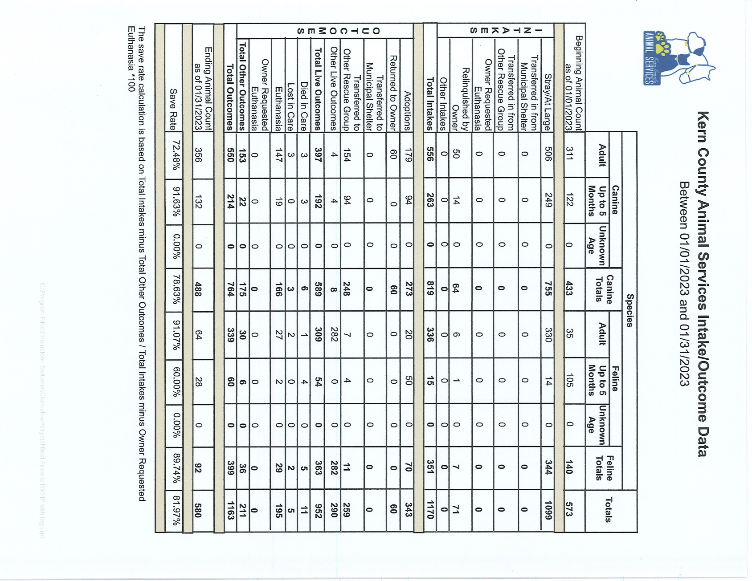

Slide 14
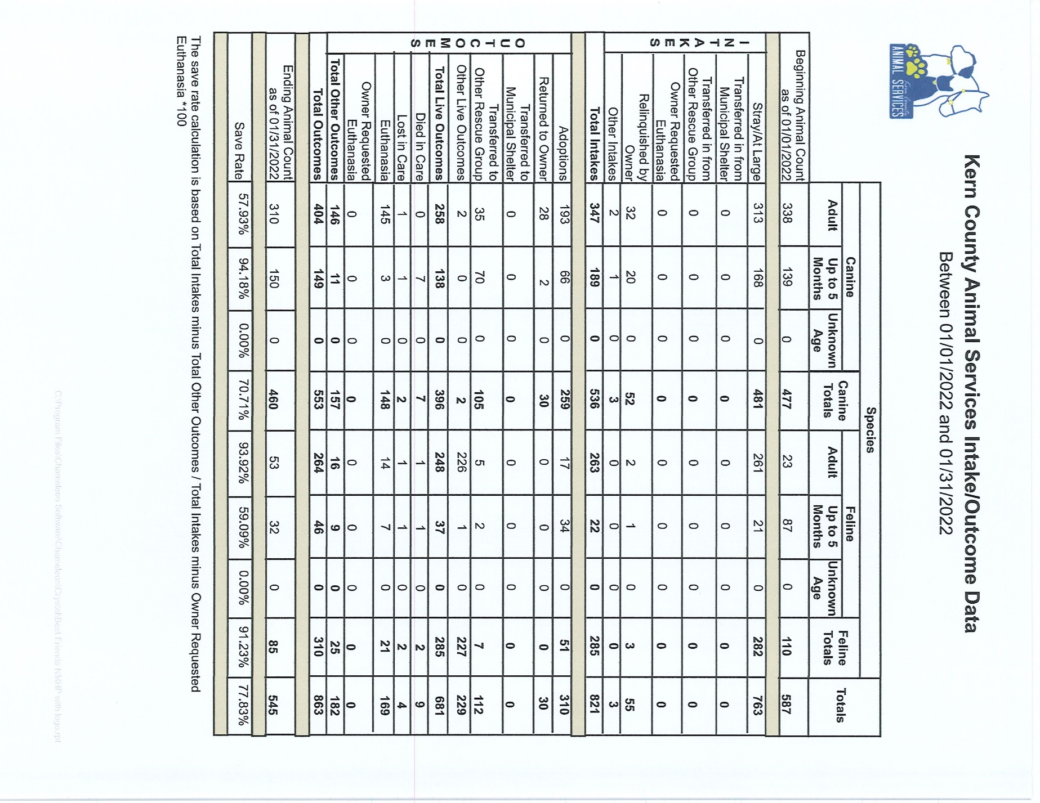

Slide 15
Volunteer Program
January 2023:
        480.58 hours of service were donated
        82 new volunteers
        95 active volunteers
        To date, 480.58 hours of service have been donated

