Slide 1
Kern County Animal Services
Director’s Report
February 2023

Slide 2
Program Highlights
Foster
20 dogs, 50 puppies, 6 cats and 16 kittens entered the Department’s Foster Care Program for a total of 92 animals in the months of February 2023.
TNR
278 cats were spayed or neutered and released in February 2023. Since 2013, 17,188 cats have been spayed or neutered, and returned to field.
Adoption
204 dogs, 135 puppies, 27 cats, and 25 kittens under 5 months of age were adopted for a total of 391 animals adopted from Kern County Animal Shelters in February 2023.

Slide 3
Vaccination Clinics
February 2023
233 rabies
313 DHPP
41 FVRCP
106 Microchips

Slide 4
Spay/Neuter Program
Bakersfield Clinic February 6th:
37 Spay/Neuter Surgeries
East Bakersfield Clinic February 7th:
40 Spay/Neuter Surgeries
Bakersfield Clinic February 17th:
46 Spay/Neuter Surgeries
Bakersfield Clinic February 18th:
46 Spay/Neuter Surgeries
Lamont Clinic February 21st:
45 Spay/Neuter Surgeries
World Spay Day 1 February 28th:
61 Spay/Neuter Surgeries
World Spay Day 2 February 28th:
23 Spay/Neuter Surgeries
298 Spay/Neuter Surgeries Completed Total

Slide 5
World Spay Day

Slide 6
Adoptions Year To Date
611 dogs, 376 puppies under 5 months, 86 cats and 86 kittens under 5 months have been adopted.
Rescue Year To Date
391 dogs, 229 puppies under 5 months, 15 cats and 10 kittens under 5 months have been saved by Rescue partners.
Notes:
71

Slide 7
Streets of Bakersfield

Slide 8
Out In The Community…

Slide 9
Out In The Community…

Slide 10
Out In The Community…

Slide 11
Field Services
FEBRUARY 2023 | Calls Per Area
Lake Isabella | 91
Mojave | 117
North County | 39
Northeast | 337
Northwest | 277
Ridgecrest | 19
Southeast | 186
Southwest | 135
Taft | 87
Tehachapi | 48
Total | 1,336
44 dogs were returned to their owners in the field in February 2023.
149 dogs were secured on property by Animal Control Officers in February 2023.

Slide 12
Field Services-CAF
FEBRUARY 2023 | Calls
CAF-Breeder | 21
CAF-Rescue | 3
CAF-Kennel | 2
CAF-Boarding | 3
Total | 29
2 Permits Issued/Inspections Passed
4 Inspection Failed
16 Citations Issued
49 Active CAF Permits

Slide 13
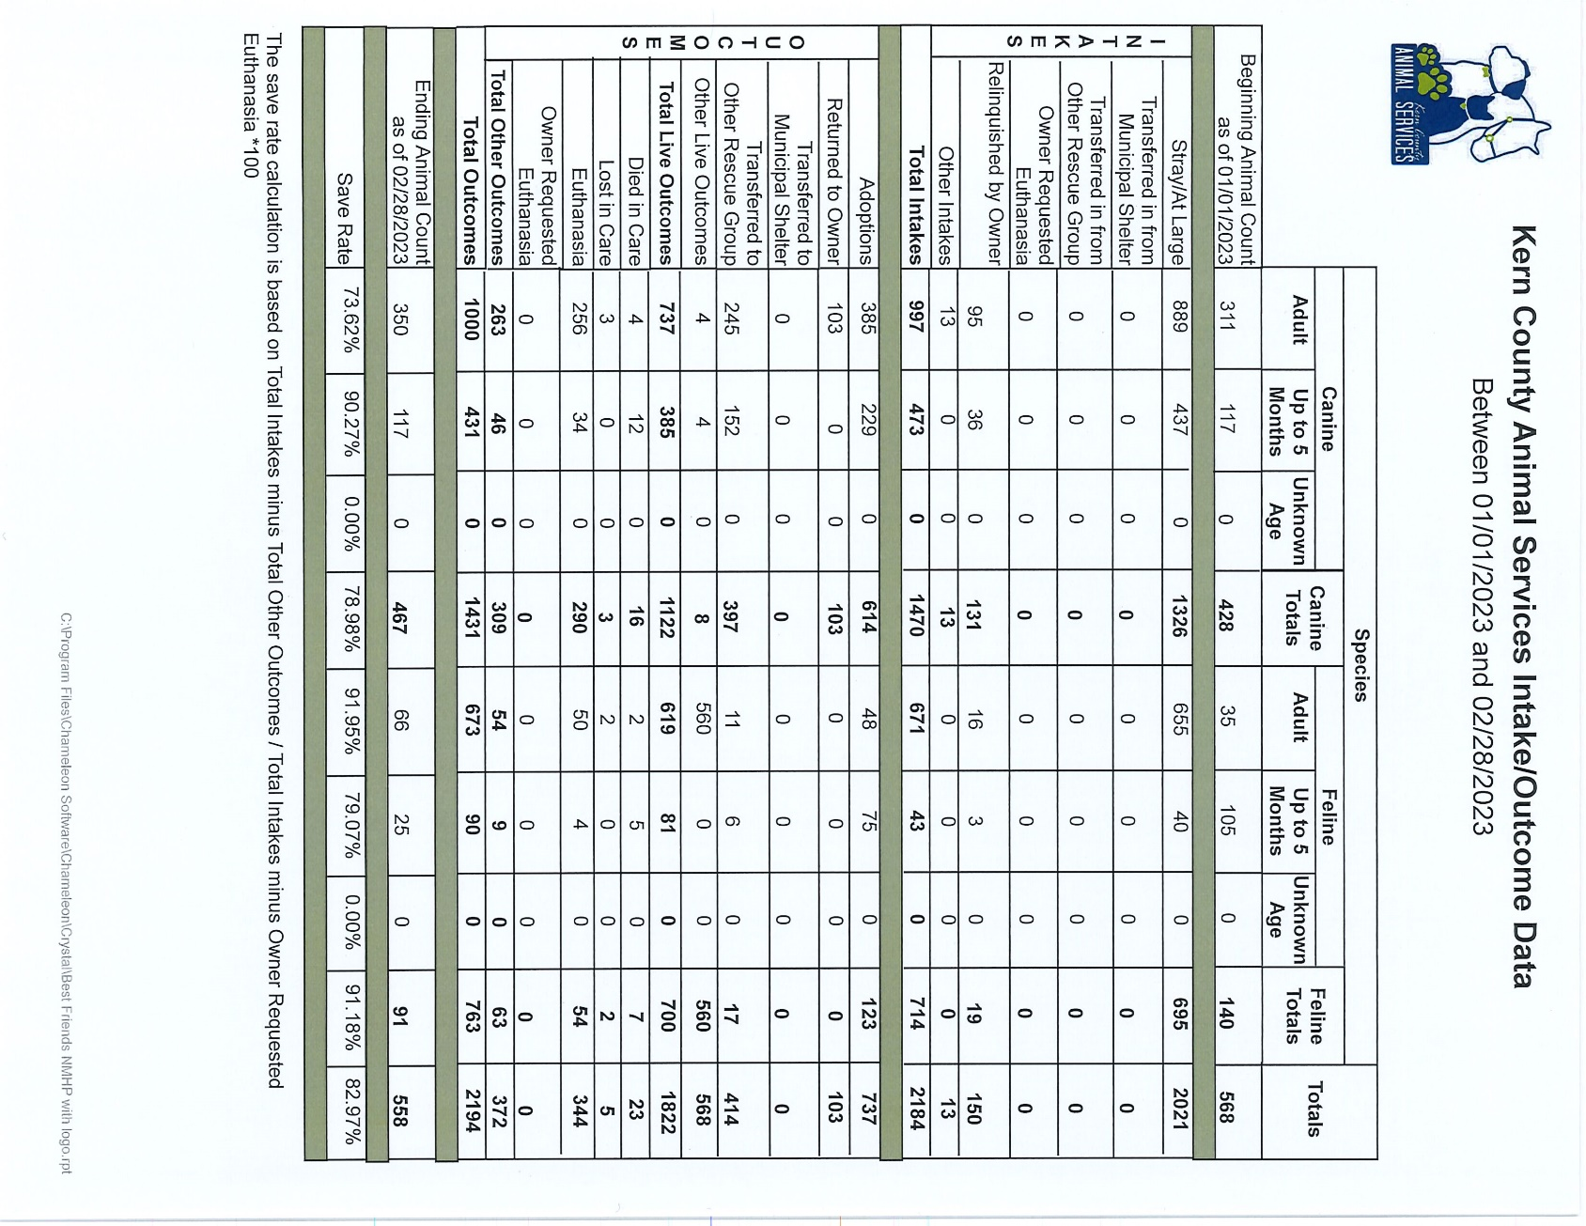

Slide 14
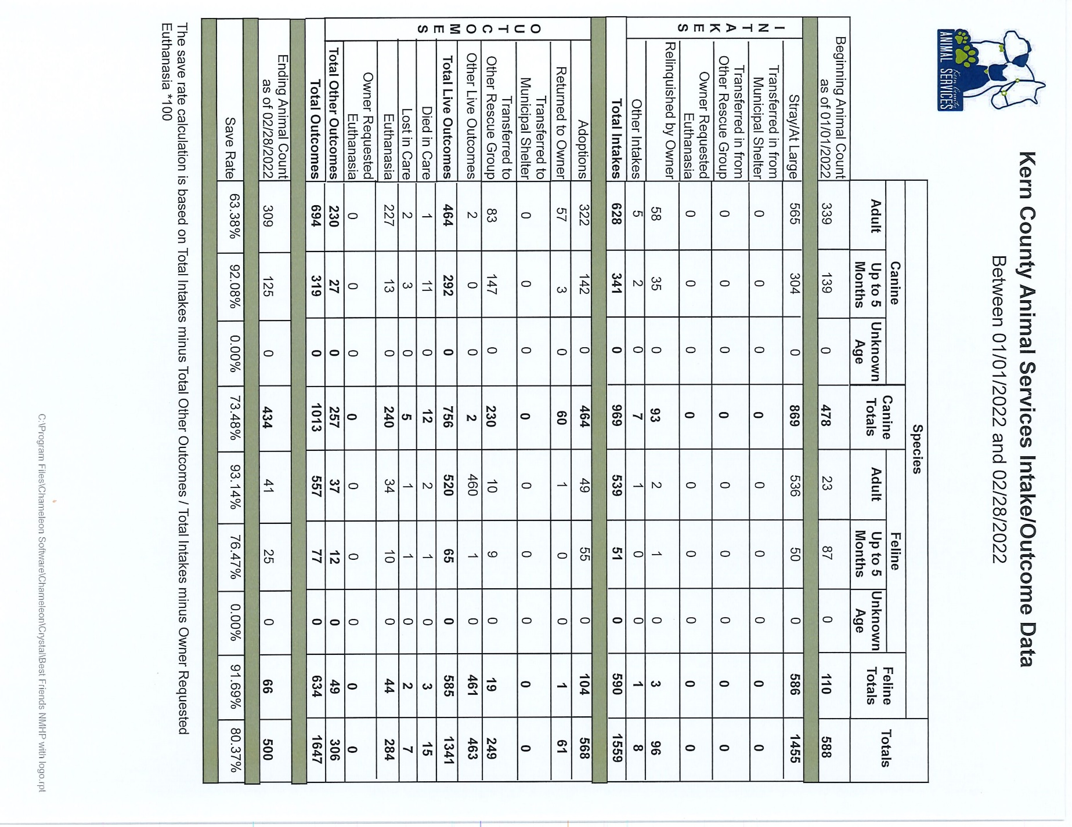

Slide 15
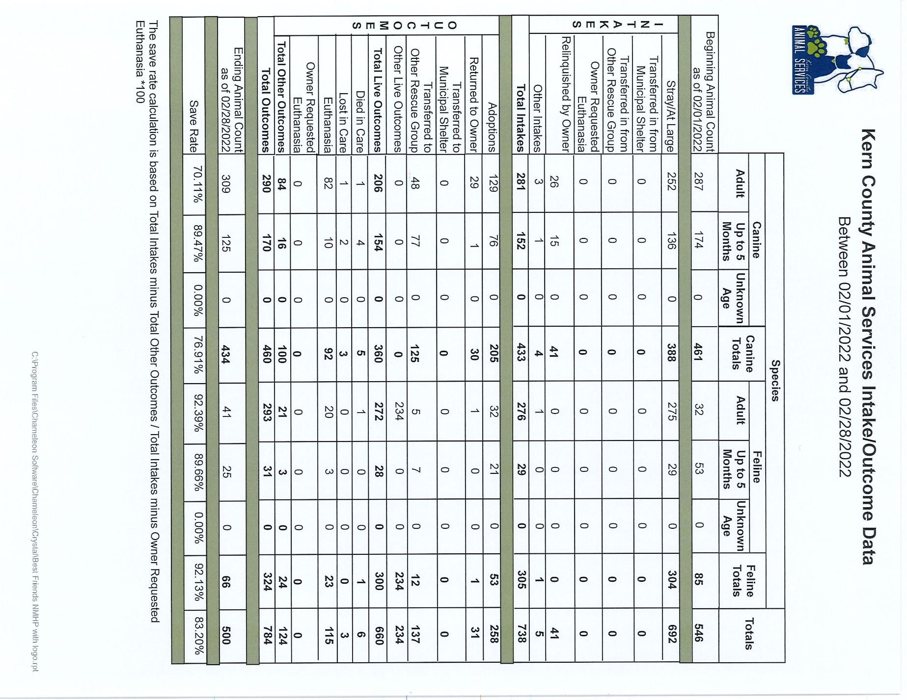

Slide 16
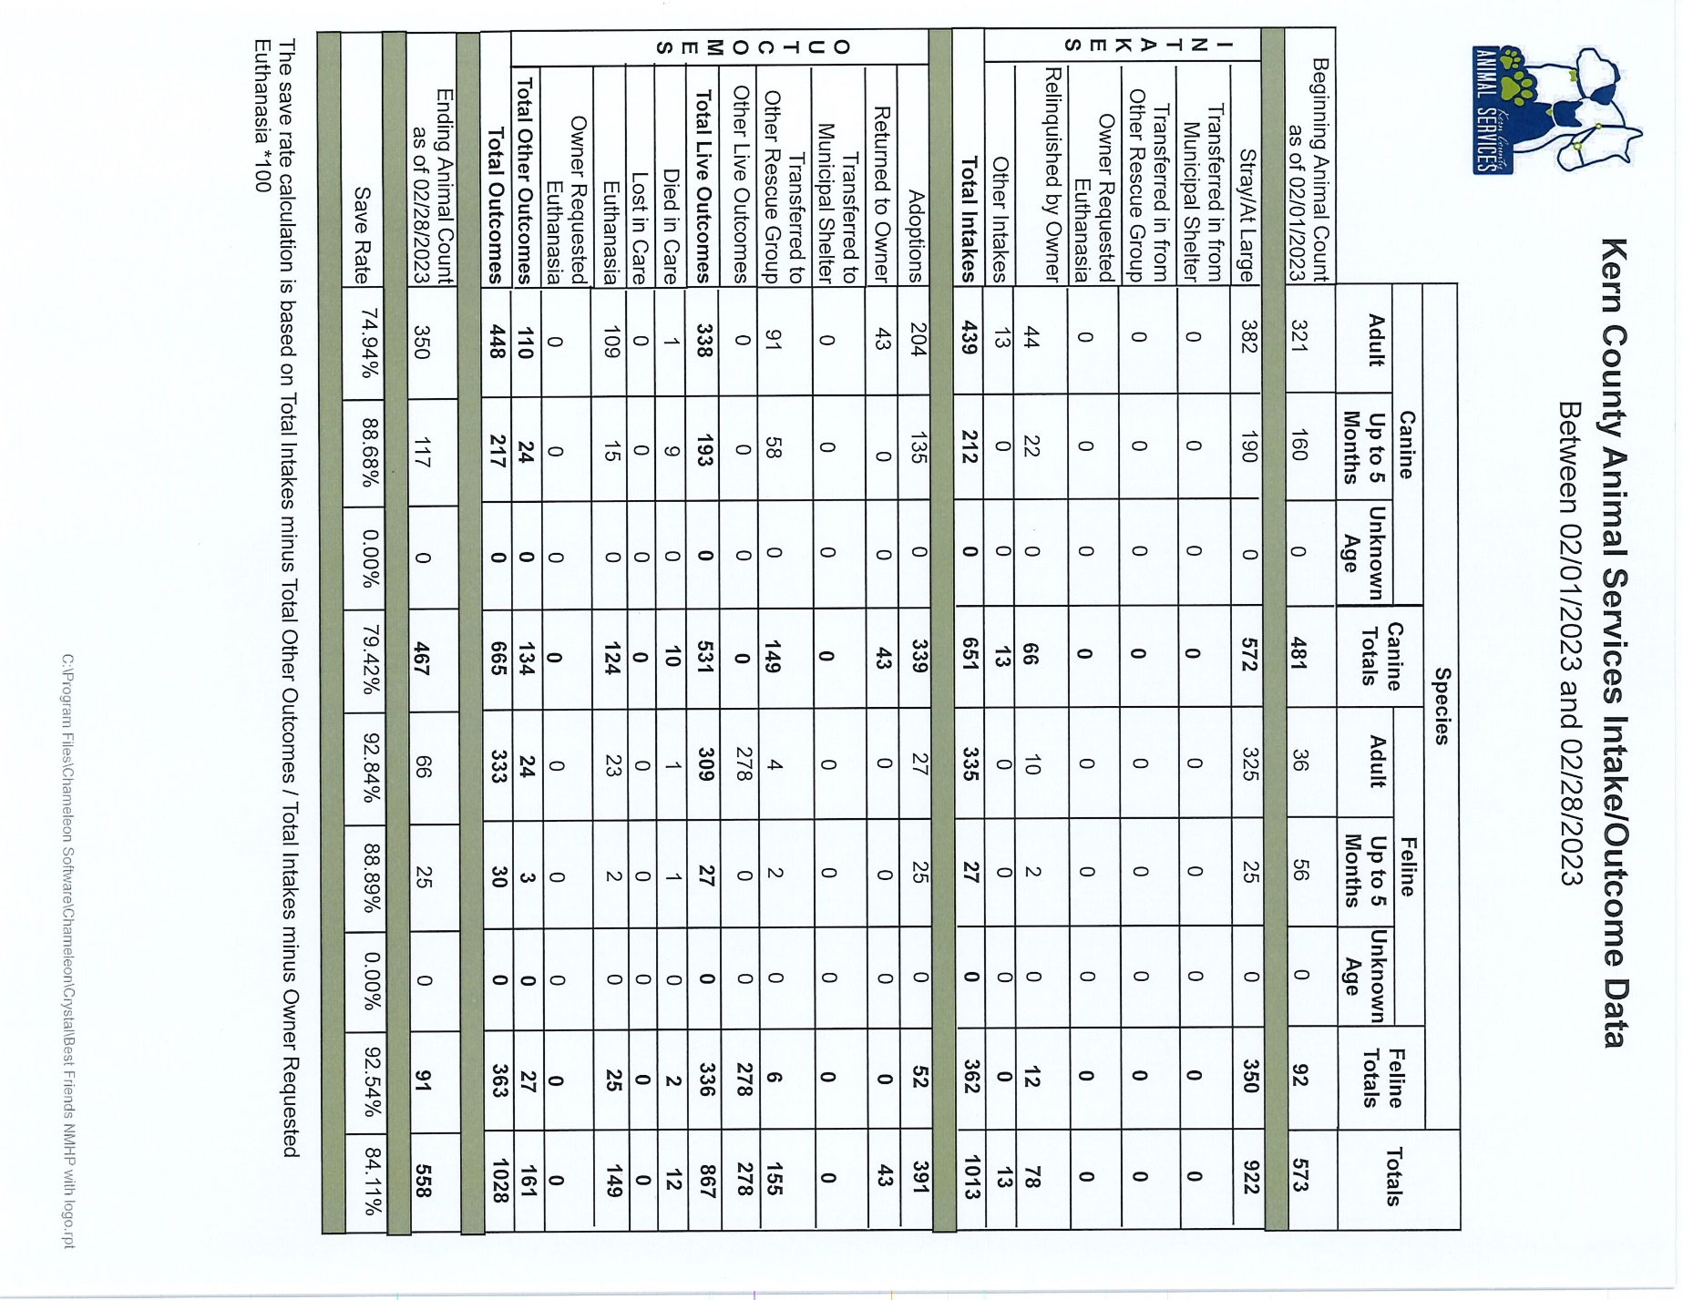

Slide 17
Volunteer Program
February 2023:
486.61 hours of service were donated
38 new volunteers
93 active volunteers
To date, 960.64 hours of service have been donated

