Slide 1
Kern County Animal Services
Director’s Report
July 2023

Slide 2
Program Highlights
Foster
33 dogs, 49 puppies, 2 cats and 121 kittens entered the Department’s Foster Care Program for a total of 205 animals in the month of July 2023.
TNR
233 cats were spayed or neutered and released in July 2023. Since 2013, 18,362 cats have been spayed or neutered, and returned to field.
Adoption
199 dogs, 133 puppies, 11 cats, and 212 kittens under 5 months of age were adopted for a total of 555 animals adopted from Kern County Animal Shelters in July 2023.

Slide 3
Vaccination Clinics
July 2023
275 rabies
265 DHPP
76 FVRCP
204 Microchips

Slide 4
Spay/Neuter Program
Bakersfield Clinic July 7th:
29 Spay/Neuter Surgeries
Bakersfield Clinic July 31st:
54 Spay/Neuter Surgeries

Slide 5
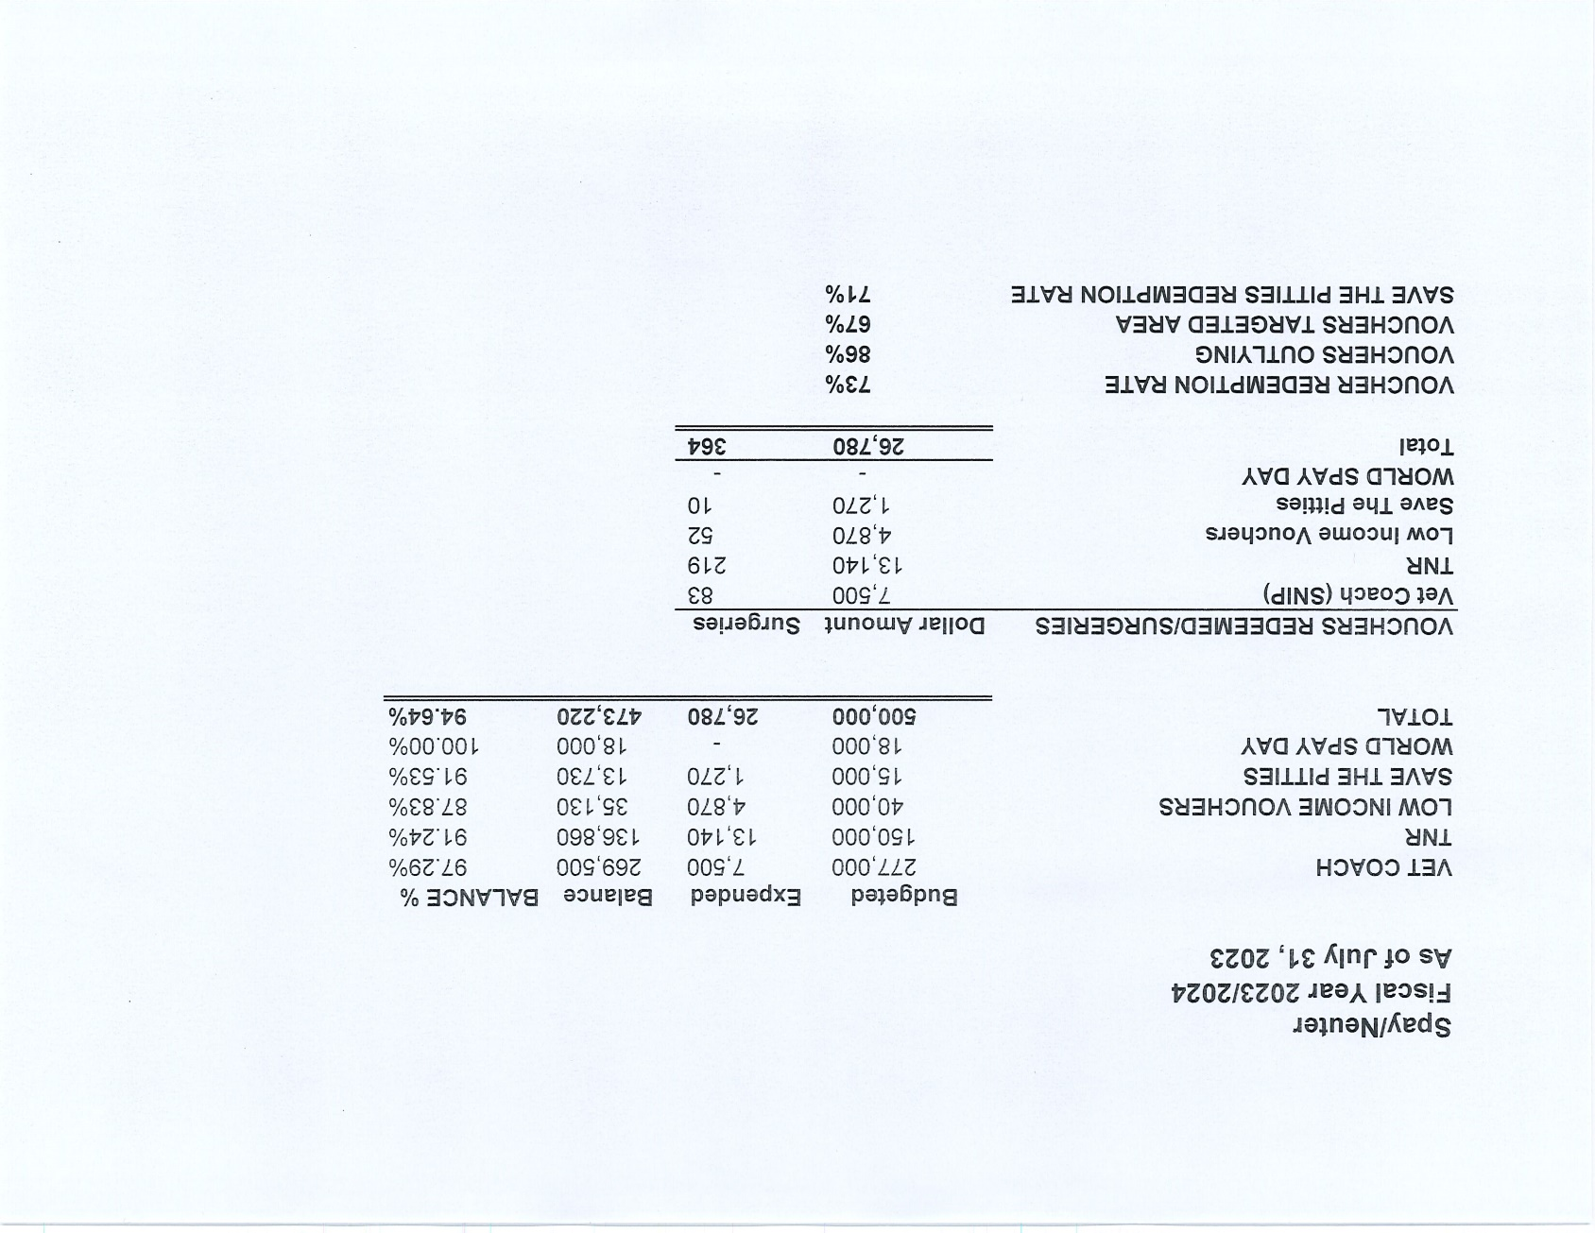

Slide 6
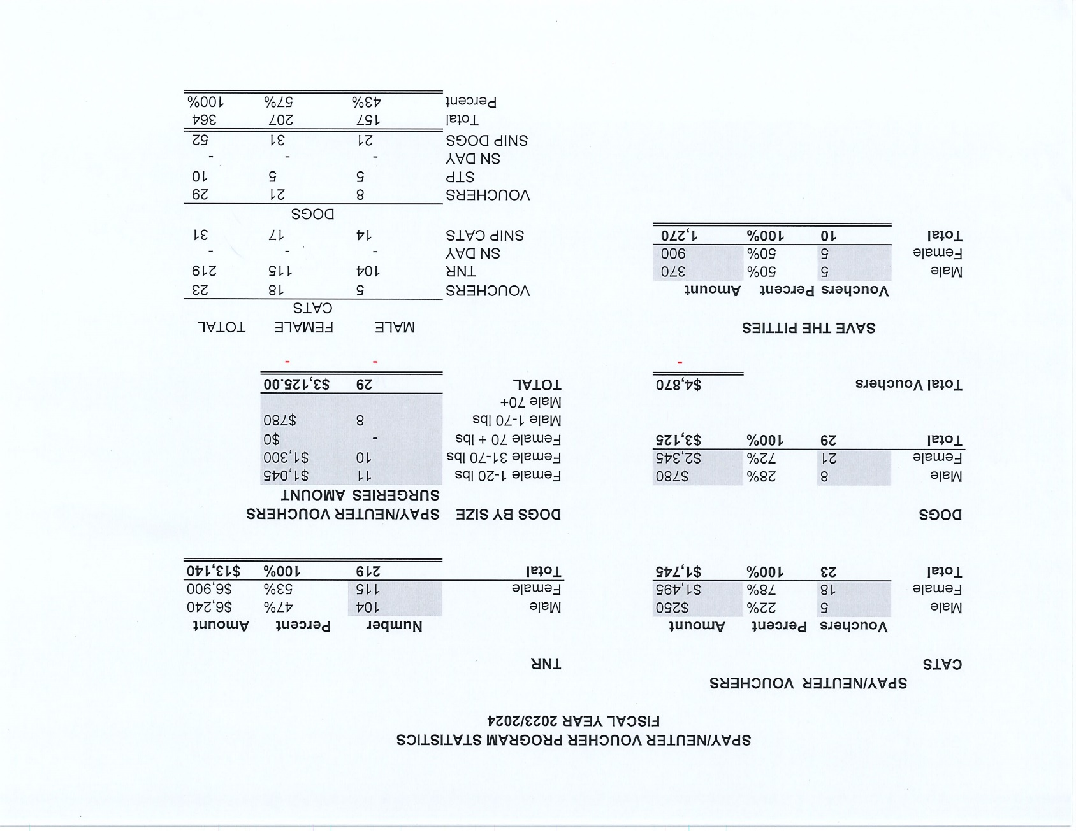

Slide 8
Adoptions Year To Date
1286 dogs, 800 puppies under 5 months, 145 cats and 529 kittens under 5 months have been adopted.
Rescue Year To Date
759 dogs, 678 puppies under 5 months, 52 cats and 61 kittens under 5 months have been saved by Rescue partners.
Owner Reclaims
459 dogs (8%) and 11 cats have been reclaimed by owners.
Notes:
71

Slide 9
Streets of Bakersfield

Slide 10
Streets of Bakersfield

Slide 11
Adoption Promotions

Slide 12
Adoption Promotions

Slide 13
Adoption Promotions

Slide 14
Adoption Promotions

Slide 15
Adoption Promotions

Slide 16
Adoption Promotions

Slide 17
Out In The Community…

Slide 18
Out In The Community…

Slide 19
Field Services
July 2023 | Calls Per Area
Lake Isabella | 106
Mojave | 107
North County | 49
Northeast | 322
Northwest | 292
Ridgecrest | 30
Southeast | 209
Southwest | 127
Taft | 85
Tehachapi | 75
Total | 1,402
60 dogs were returned to their owners in the field in July 2023.
51 dogs were secured on property by Animal Control Officers in July 2023.

Slide 20
Field Services-CAF
JULY 2023 | Calls
CAF-Breeder | 18
CAF-Rescue | 0
CAF-Kennel | 2
CAF-Boarding | 2
Total | 22
3 Permits Issued/Inspections Passed
4 Inspection Failed
22 Citations Issued
57 Active CAF Permits

Slide 21
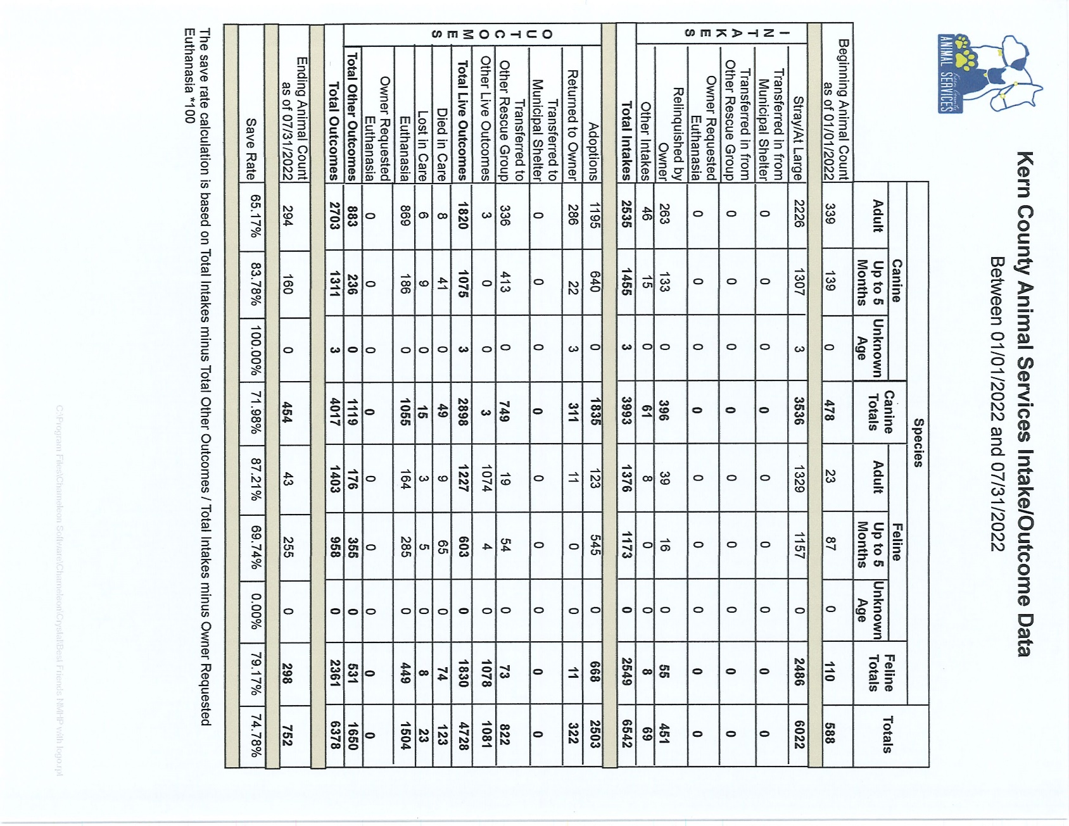

Slide 22
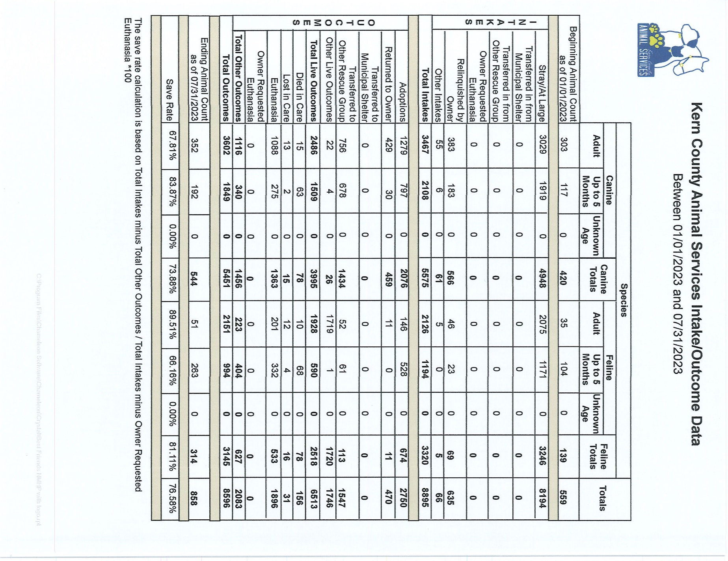

Slide 23
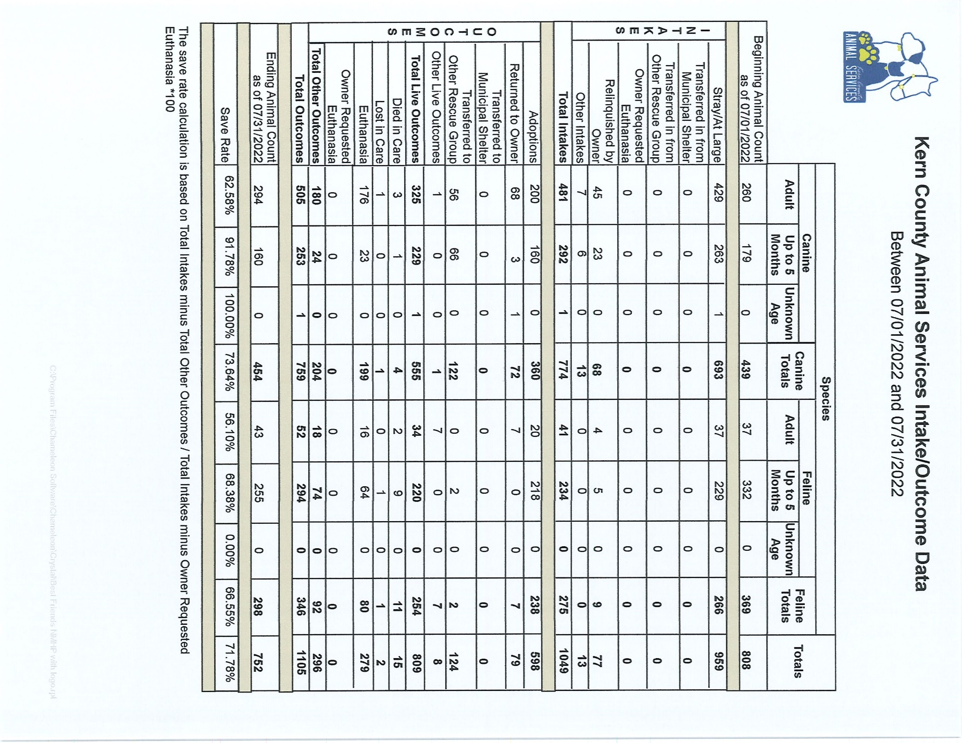

Slide 24
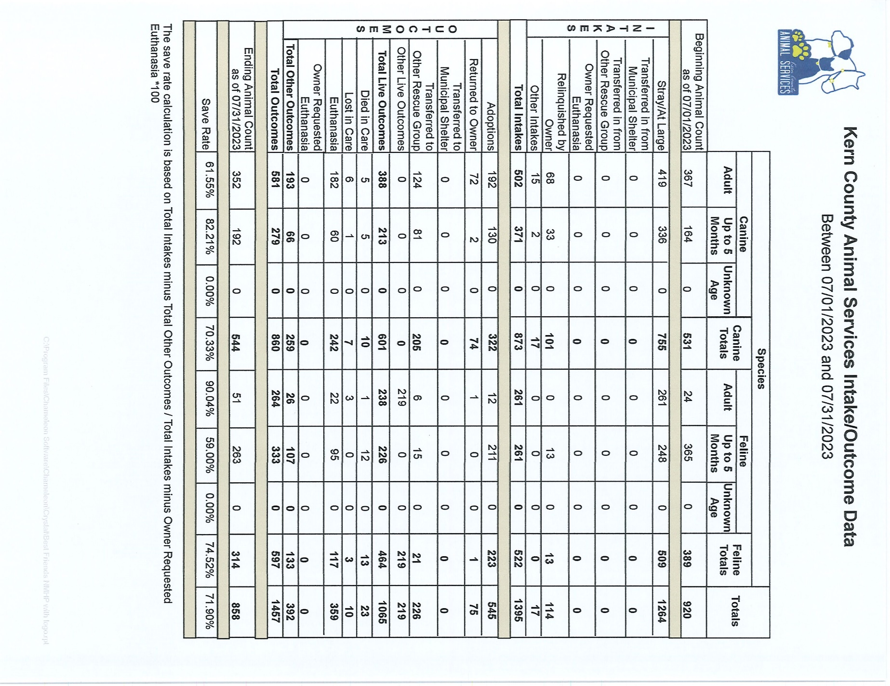

Slide 25
Volunteer Program
July 2023:
609.58 hours of service were donated
44 new volunteers
90 active volunteers
To date, 4,024.23 hours of service have been donated

