Slide 1

Kern County Animal Services
Director’s Report
October 2023

Slide 2
Program Highlights
Foster
36 dogs, 45 puppies, 1 cat and 127 kittens entered the Department’s Foster Care Program for a total of 209 animals in the month of October 2023.
TNR
306 cats were spayed or neutered and released in October 2023. Year-to-date, 2,563 cats have gone through the program, and since 2013 19,191 cats have been spayed or neutered, and returned to field.
Adoption
194 dogs, 68 puppies, 20 cats, and 99 kittens under 5 months of age were adopted for a total of 381 animals adopted from Kern County Animal Shelters in October 2023.

Slide 3
Vaccination Clinics
October 2023
  170 rabies
  169 DHPP
  53 FVRCP
  69 Microchips

Slide 4
Spay/Neuter Program
Bakersfield Clinic October 11th:
        47 Spay/Neuter Surgeries
East Bakersfield Clinic October 12th:
        41 Spay/Neuter Surgeries
East Bakersfield Clinic October 23rd:
        49 Spay/Neuter Surgeries

Slide 5
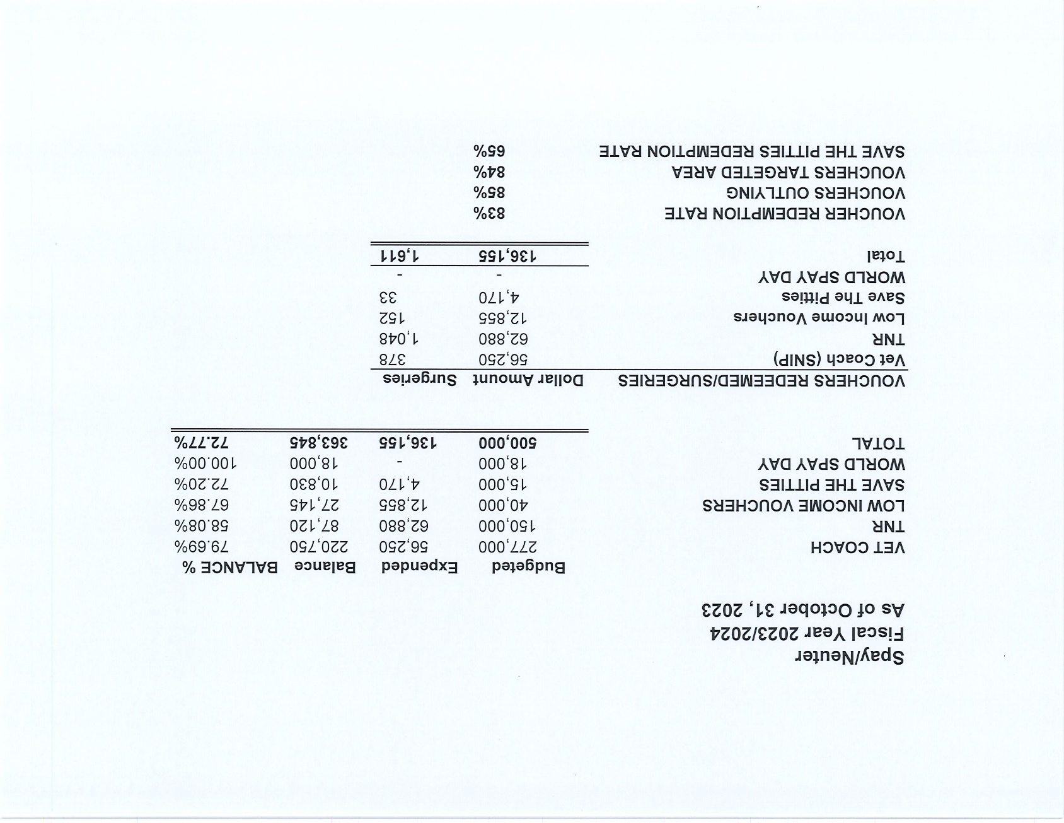

Slide 6
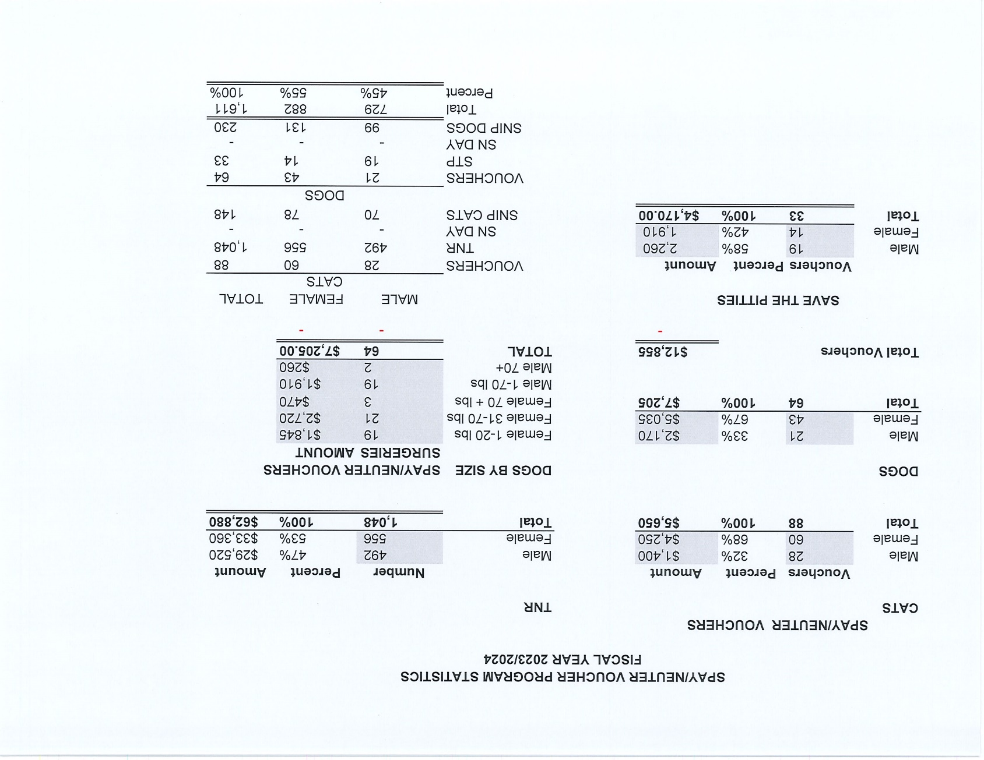

Slide 7
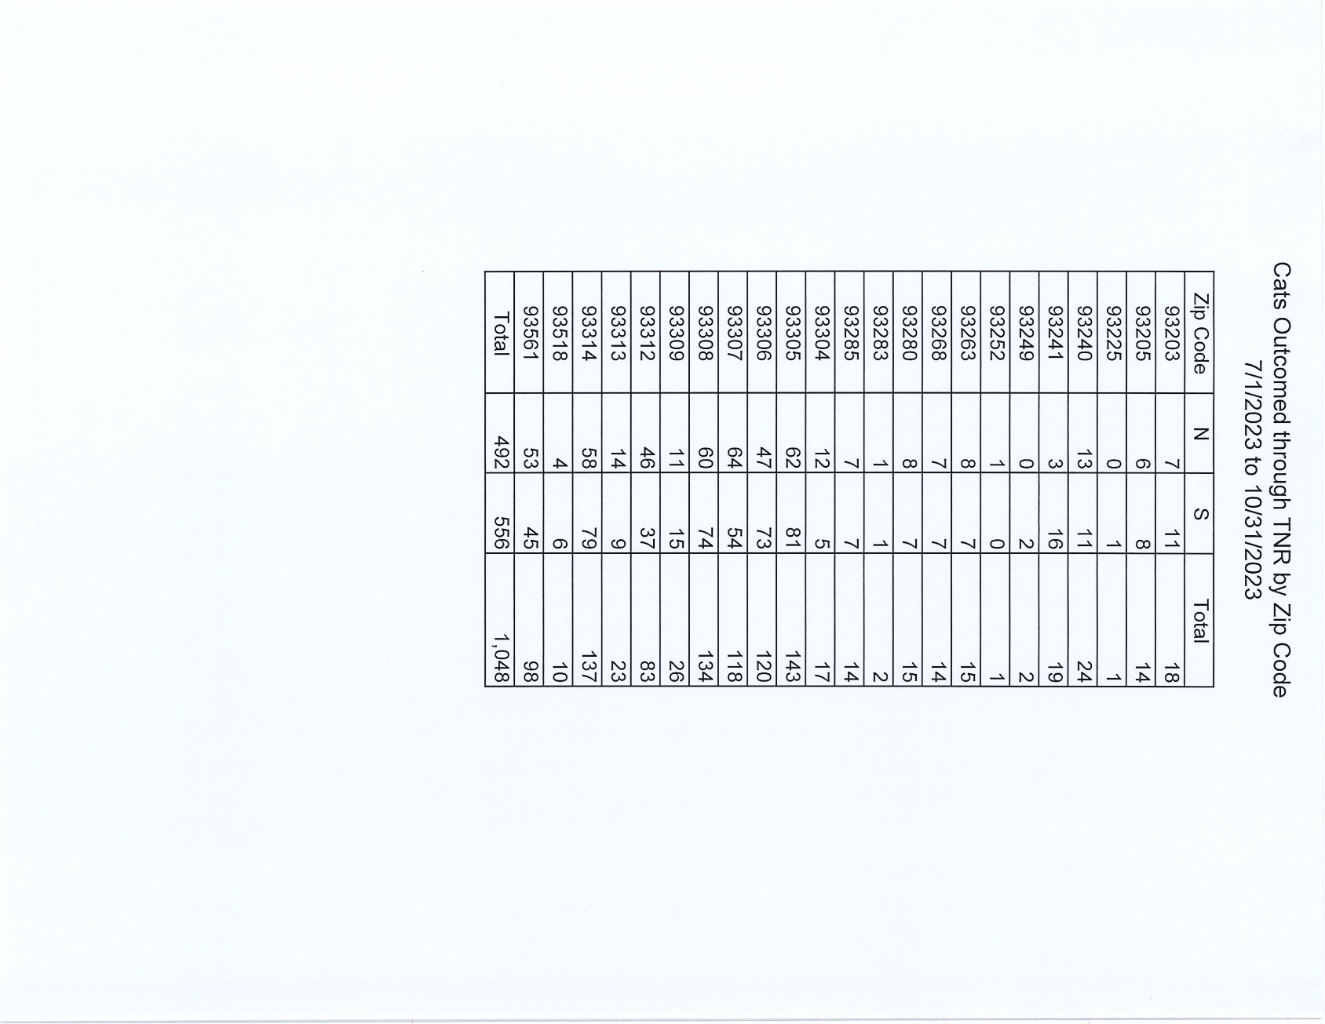

Slide 8
Adoptions Year To Date
1907 dogs, 1088 puppies under 5 months, 189 cats and 936 kittens under 5 months have been adopted.
Rescue Year To Date
1083 dogs, 956 puppies under 5 months, 69 cats and 94 kittens under 5 months have been saved by Rescue partners.
Owner Reclaims
652 dogs (8%) and 12 cats have been reclaimed by owners.
Notes:
71

Slide 9

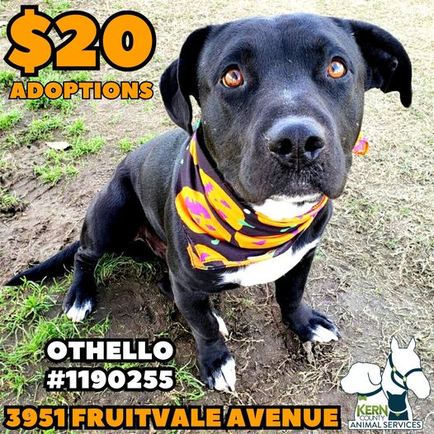
Adoption Promotions

Slide 10


Adoption Promotions

Slide 11


Offsite Adoptions

Slide 12

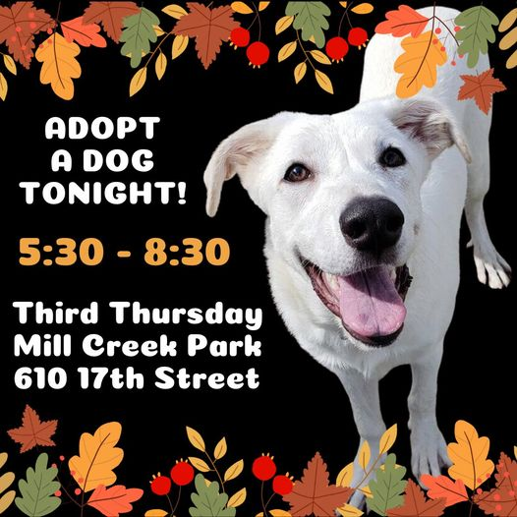
Offsite Adoptions

Slide 13


Offsite Adoptions

Slide 14
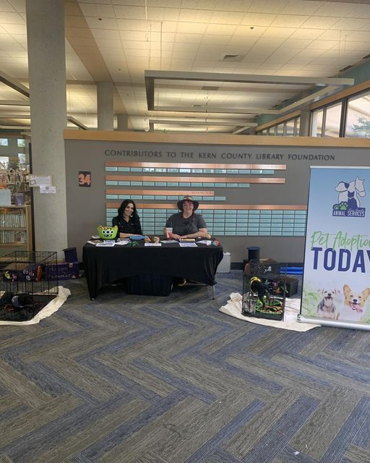

Out and about…

Slide 15
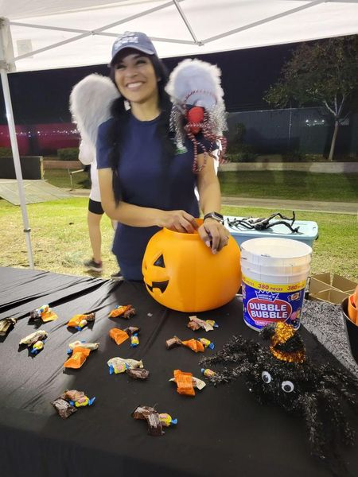
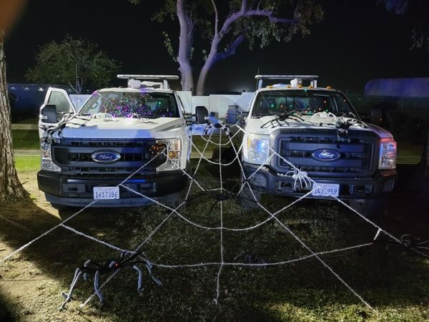
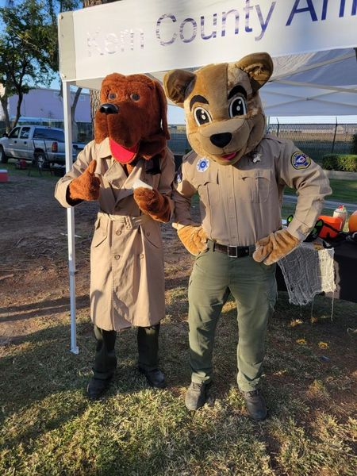
Out and about…

Slide 16

Registered Veterinary Technician Appreciation Week

Slide 17

833-978-3916 “LOST”

Slide 18

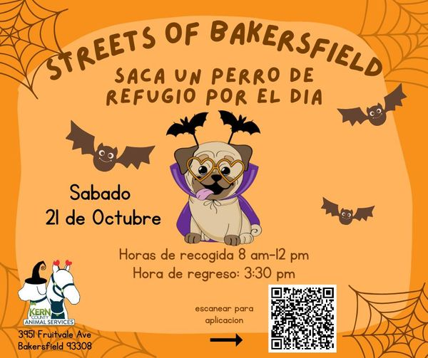
Streets Of Bakersfield

Slide 19
Field Services
October 2023 | Calls Per Area
Lake Isabella | 109
Mojave | 155
North County | 78
Northeast | 383
Northwest | 285
Ridgecrest | 29
Southeast | 205
Southwest | 143
Taft | 101
Tehachapi | 63
Total | 1,551
61 dogs were returned to their owners in the field in October 2023.
87 dogs were secured on property by Animal Control Officers in October 2023.

Slide 20
Field Services-CAF
OCTOBER 2023 | Calls
CAF-Breeder | 39
CAF-Rescue | 5
CAF-Kennel | 0
CAF-Boarding | 1
Total | 45
3 Permits Issued/Inspections Passed
6 Inspection Failed
10 Citations Issued
64 Active CAF Permits

Slide 21
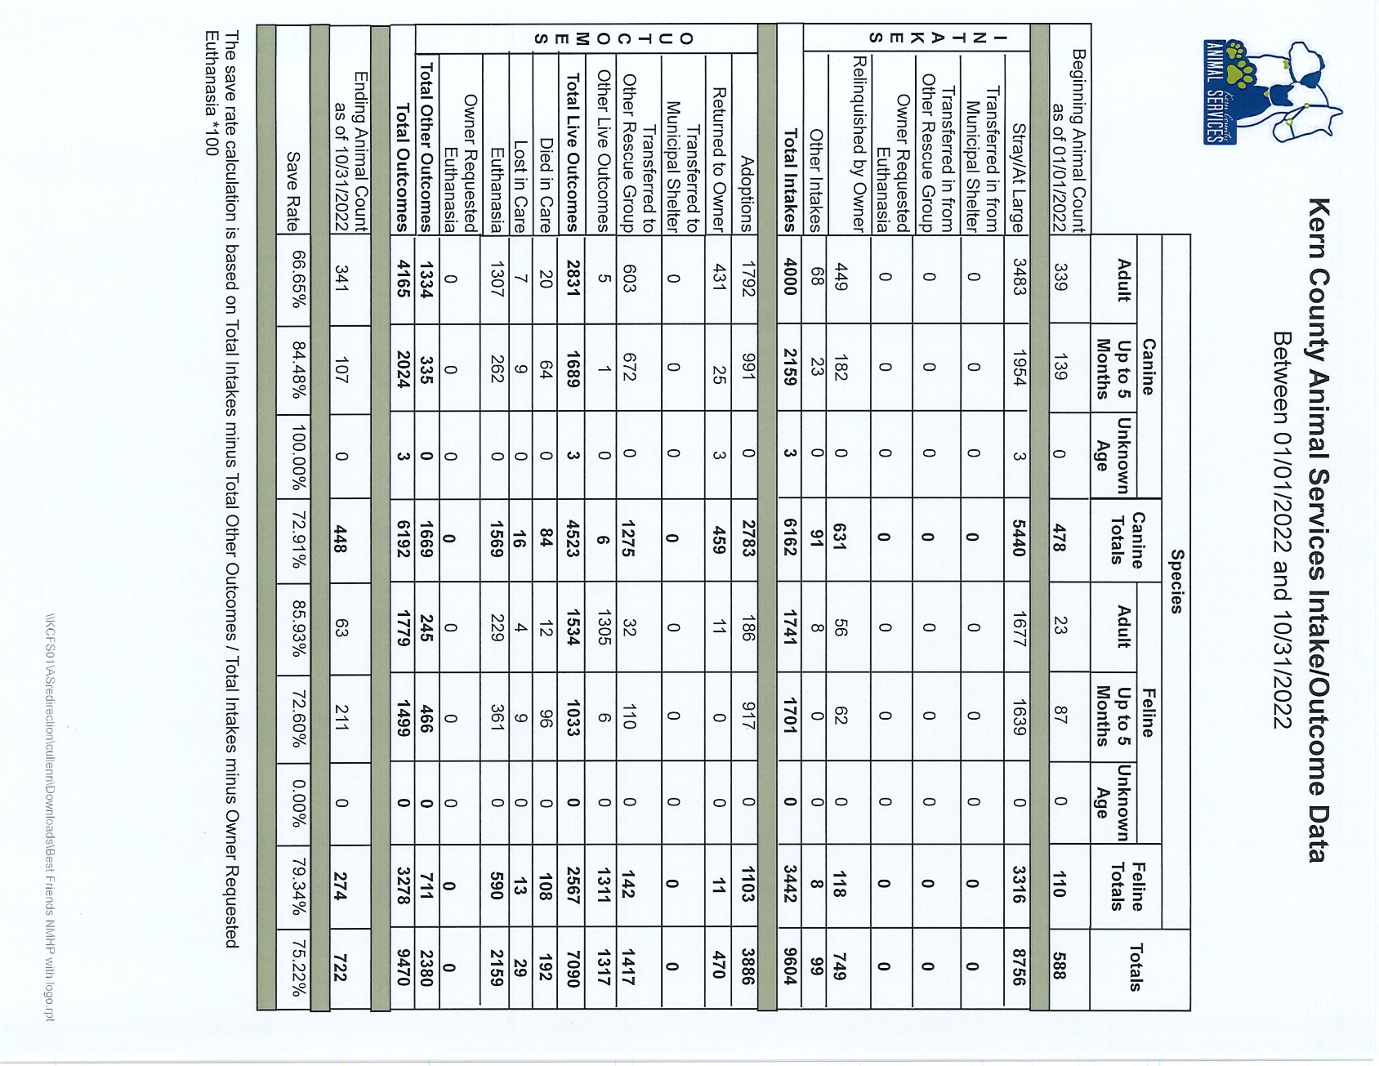

Slide 22
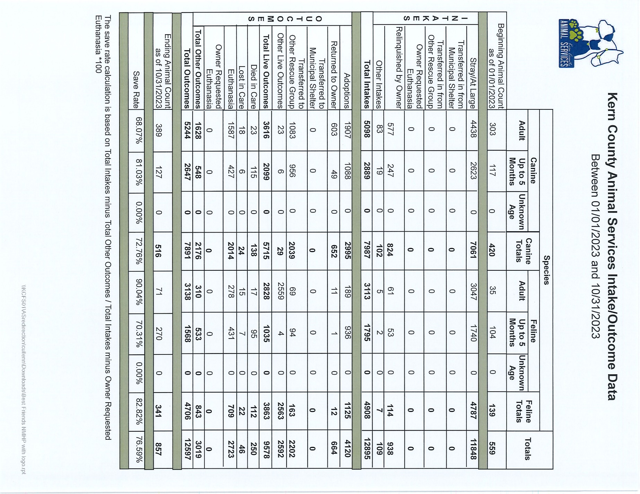

Slide 23
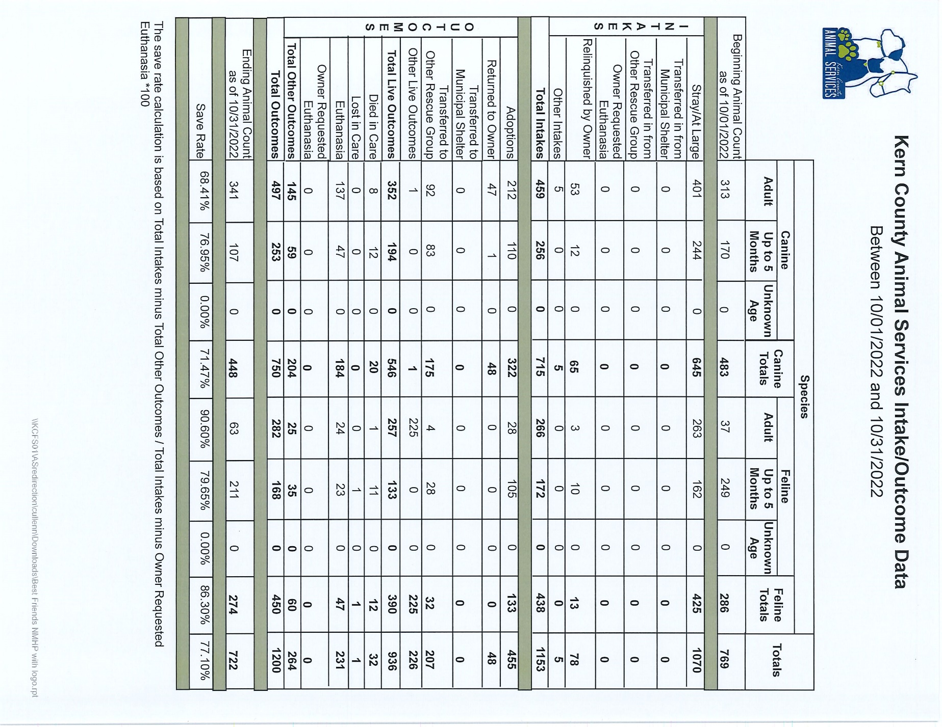

Slide 24
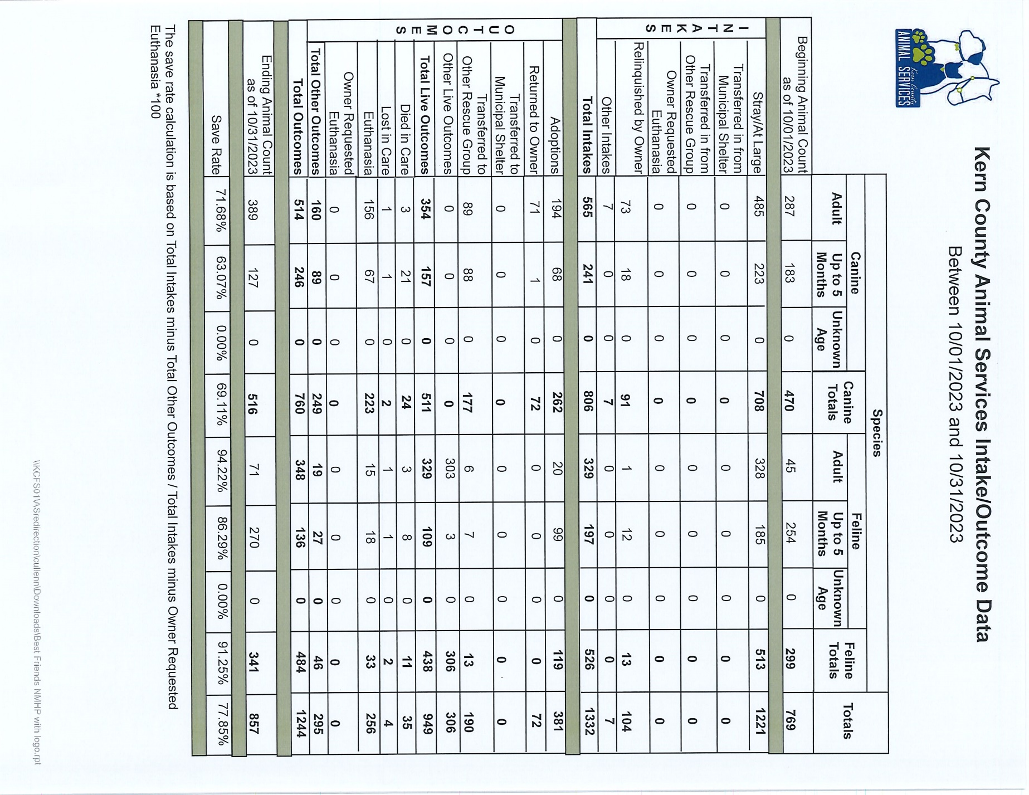

Slide 25
Volunteer Program
October 2023:
        445.08 hours of service were donated
        34 new volunteers
        80 active volunteers
        To date, 5,789.78 hours of service have been donated

