Slide 1
Kern County Animal Services
Director’s Report
September 2023

Slide 2
Program Highlights
Foster
35 dogs, 24 puppies, 2 cats and 100 kittens entered the Department’s Foster Care Program for a total of 161 animals in the month of September 2023.
TNR
221 cats were spayed or neutered and released in September 2023. Year-to-date, 2,255 cats have gone through the program, and since 2013 18,664 cats have been spayed or neutered, and returned to field.
Adoption
213 dogs, 105 puppies, 15 cats, and 133 kittens under 5 months of age were adopted for a total of 466 animals adopted from Kern County Animal Shelters in September 2023.

Slide 3
Vaccination Clinics
September 2023
156 rabies
140 DHPP
47 FVRCP
39 Microchips

Slide 4
Spay/Neuter Program
Mojave Clinic September 6th:
44 Spay/Neuter Surgeries
East Bakersfield Clinic September 27th:
47 Spay/Neuter Surgeries

Slide 5
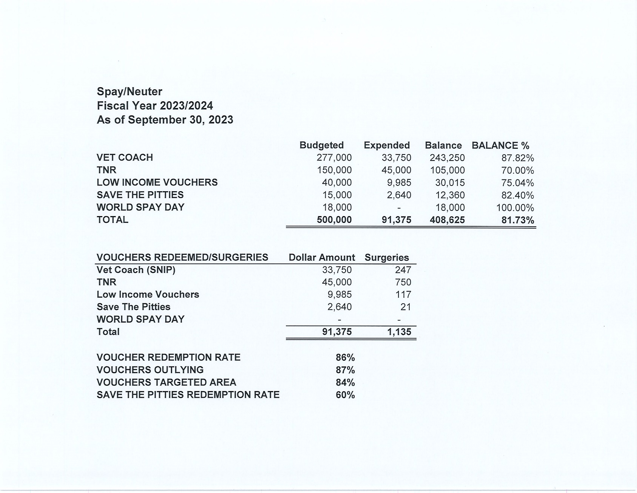

Slide 6
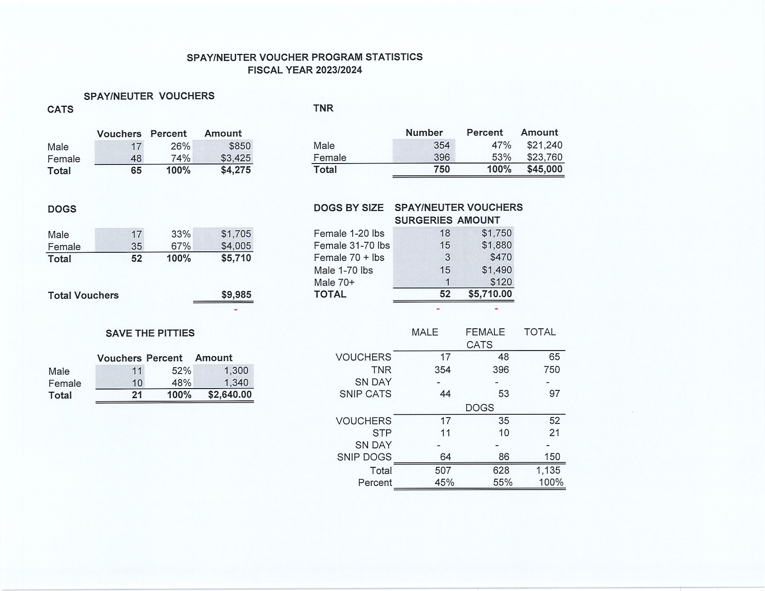

Slide 7
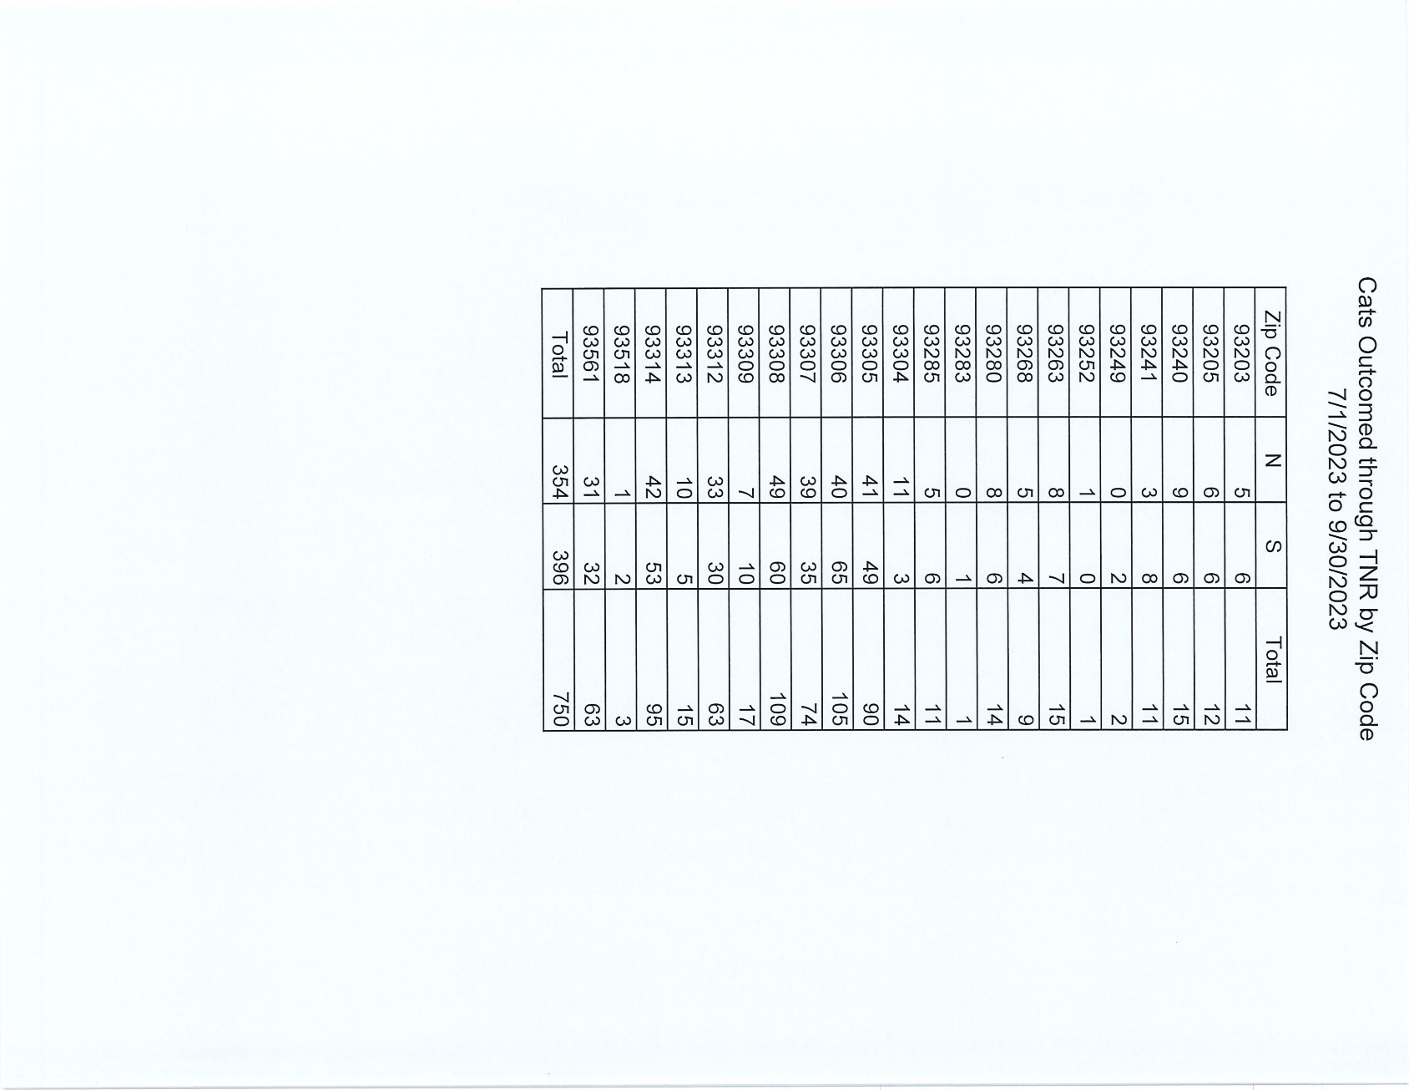

Slide 8
Adoptions Year To Date
1712 dogs, 1020 puppies under 5 months, 169 cats and 837 kittens under 5 months have been adopted.
Rescue Year To Date
994 dogs, 868 puppies under 5 months, 63 cats and 87 kittens under 5 months have been saved by Rescue partners.
Owner Reclaims
580 dogs (8%) and 12 cats have been reclaimed by owners.
Notes:
71

Slide 9
Adoption Promotions

Slide 10
Adoption Promotions

Slide 11
Return to Owner

Slide 12
Field Services
September 2023 | Calls Per Area
Lake Isabella | 102
Mojave | 136
North County | 46
Northeast | 385
Northwest | 316
Ridgecrest | 27
Southeast | 199
Southwest | 144
Taft | 92
Tehachapi | 86
Total | 1,533
67 dogs were returned to their owners in the field in September 2023.
76 dogs were secured on property by Animal Control Officers in September 2023.

Slide 13
Field Services-CAF
SEPTEMBER 2023 | Calls
CAF-Breeder | 32
CAF-Rescue | 1
CAF-Kennel | 4
CAF-Boarding | 1
Total | 38
7 Permits Issued/Inspections Passed
4 Inspection Failed
19 Citations Issued
58 Active CAF Permits

Slide 14
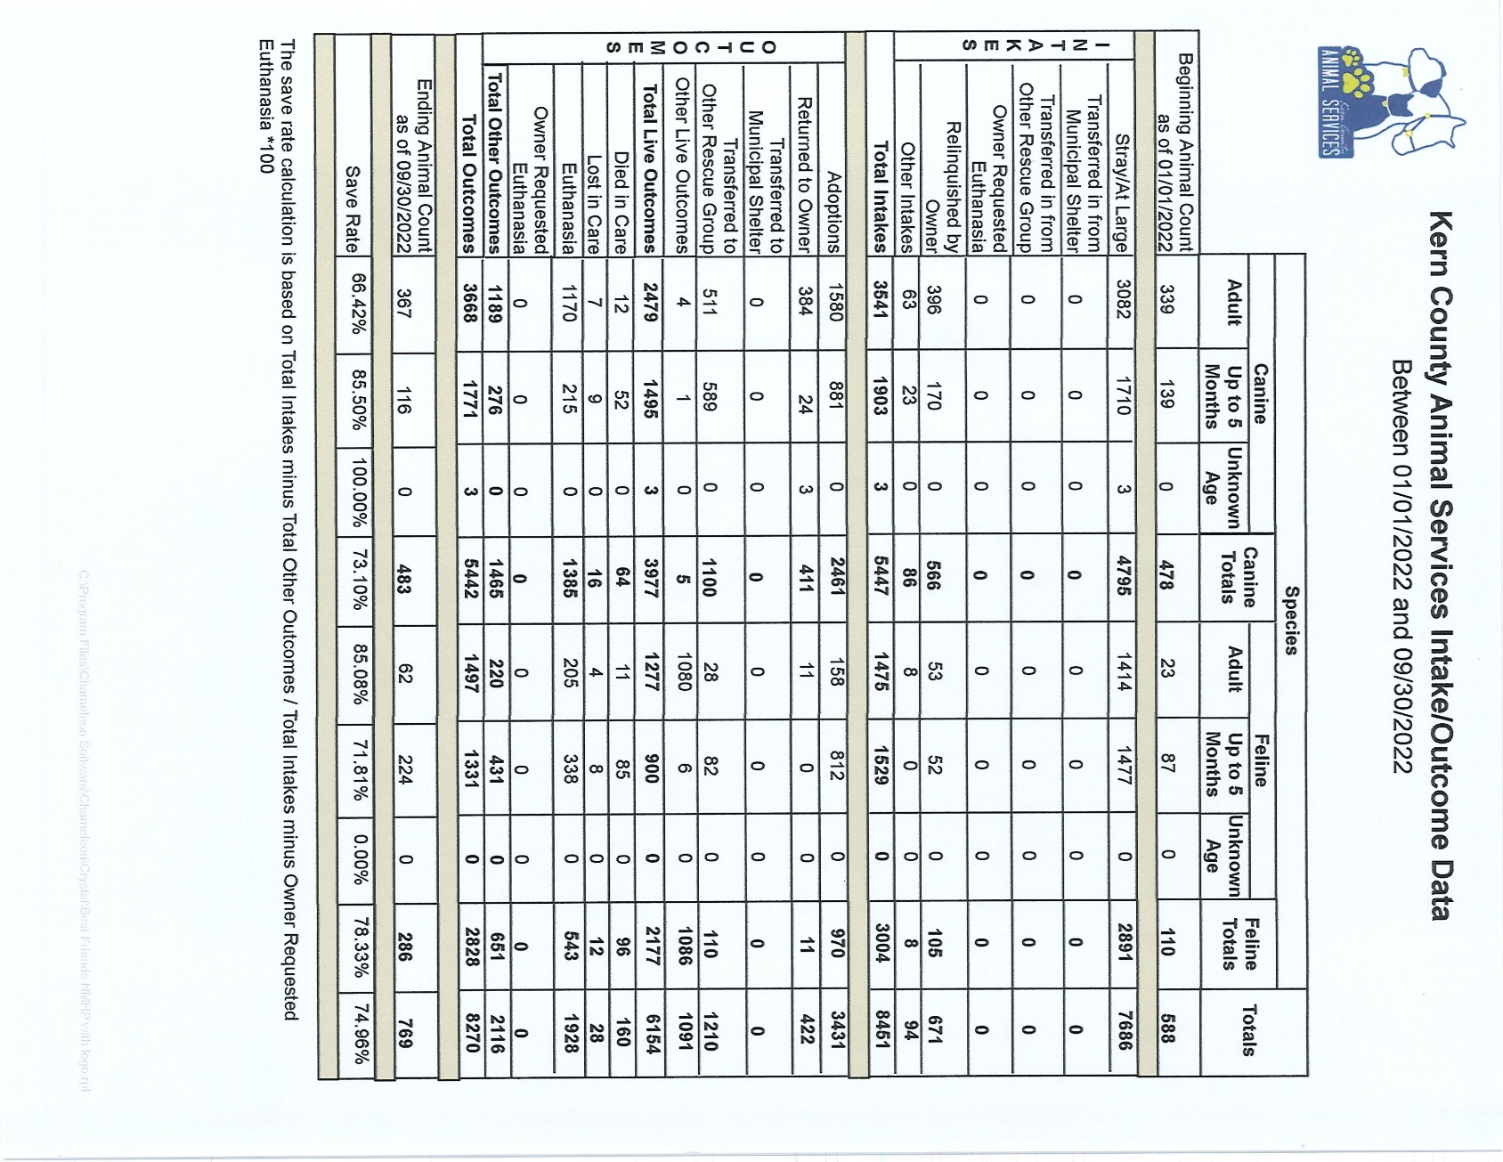

Slide 15
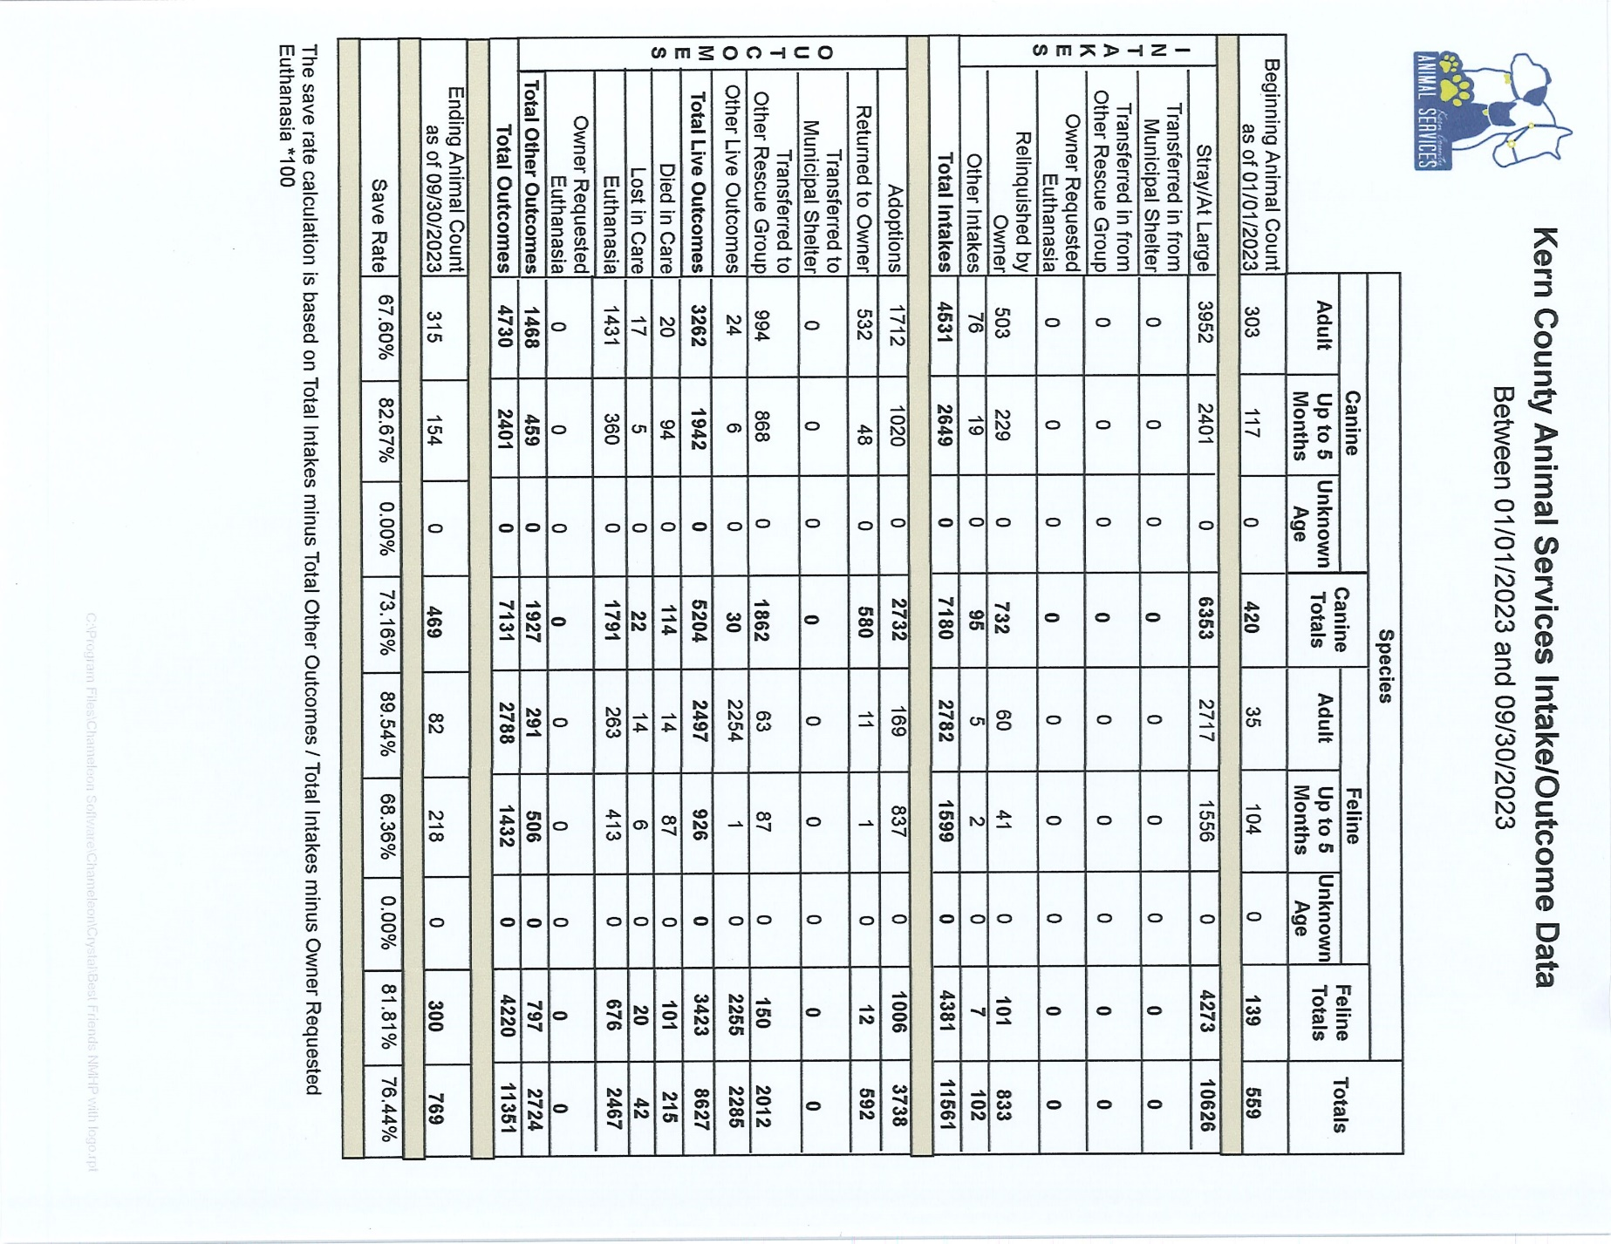

Slide 16
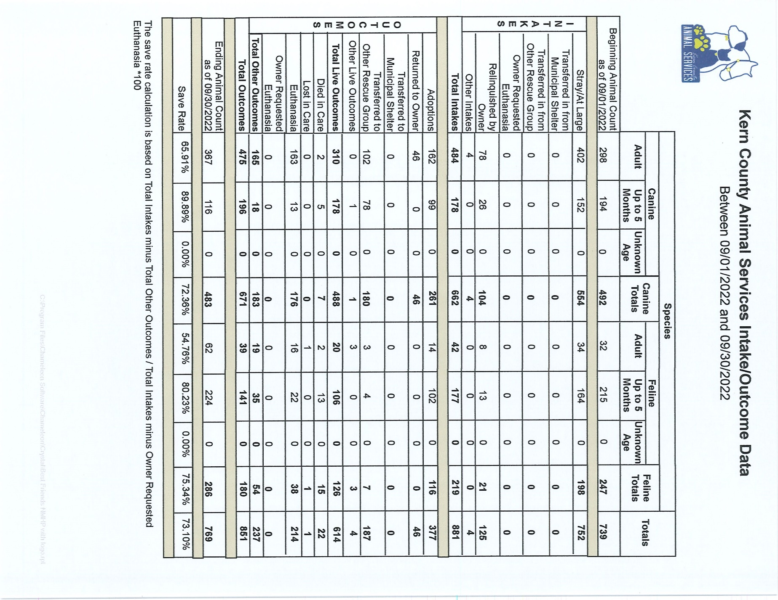

Slide 17
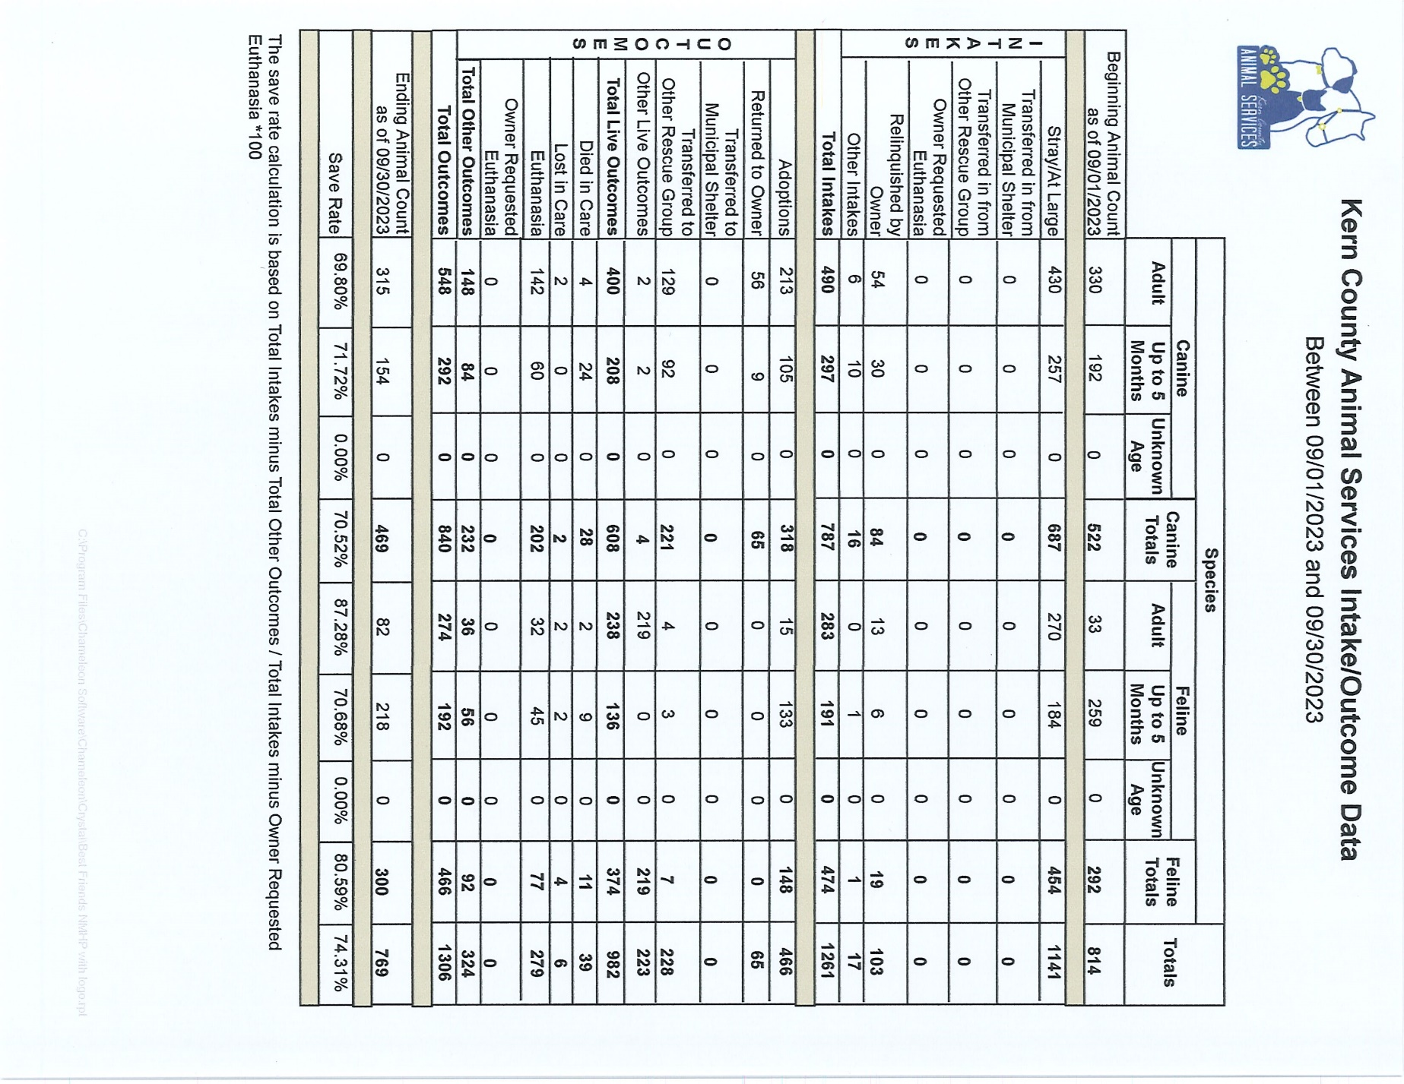

Slide 18
Volunteer Program
September 2023:
685.35 hours of service were donated
40 new volunteers
104 active volunteers
To date, 5,344.70 hours of service have been donated

