Slide 1

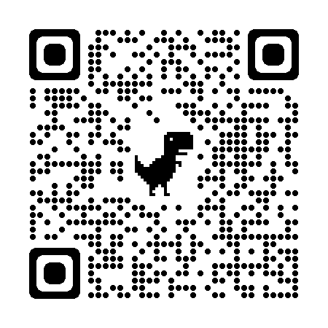
Kern County Animal Services
Director’s Report
February 2024

Slide 2

Program Highlights
Foster
41 dogs, 31 puppies, 5 cats and 28 kittens entered the Department’s Foster Care Program for a total of 105 animals in the month of February.
TNR
203 cats were spayed or neutered and released in February 2024. Year-to-date, 411 cats have gone through the program, and since 2013 20,011 cats have been spayed or neutered, and returned to field.
Adoption
195 dogs, 125 puppies, 16 cats, and 28 kittens under 5 months of age were adopted for a total of 369 animals adopted from Kern County Animal Shelters in February 2024.
2

Slide 3

Vaccination Clinics
February 2024
  257 rabies
  339 DHPP
  30 FVRCP
  43 Microchips

Slide 4
Spay/Neuter Program
7 Feb.
Bakersfield Clinic:
42 Spay/Neuter Surgeries
12 Feb.
East Bakersfield Clinic:
40 Spay/Neuter Surgeries
15 Feb.
Oildale Clinic:
53 Spay/Neuter Surgeries
27 Feb.
World Spay Day:
114 Spay/Neuter Surgeries
28 Feb.
East Bakersfield Clinic:
36 Spay/Neuter Surgeries

Slide 5
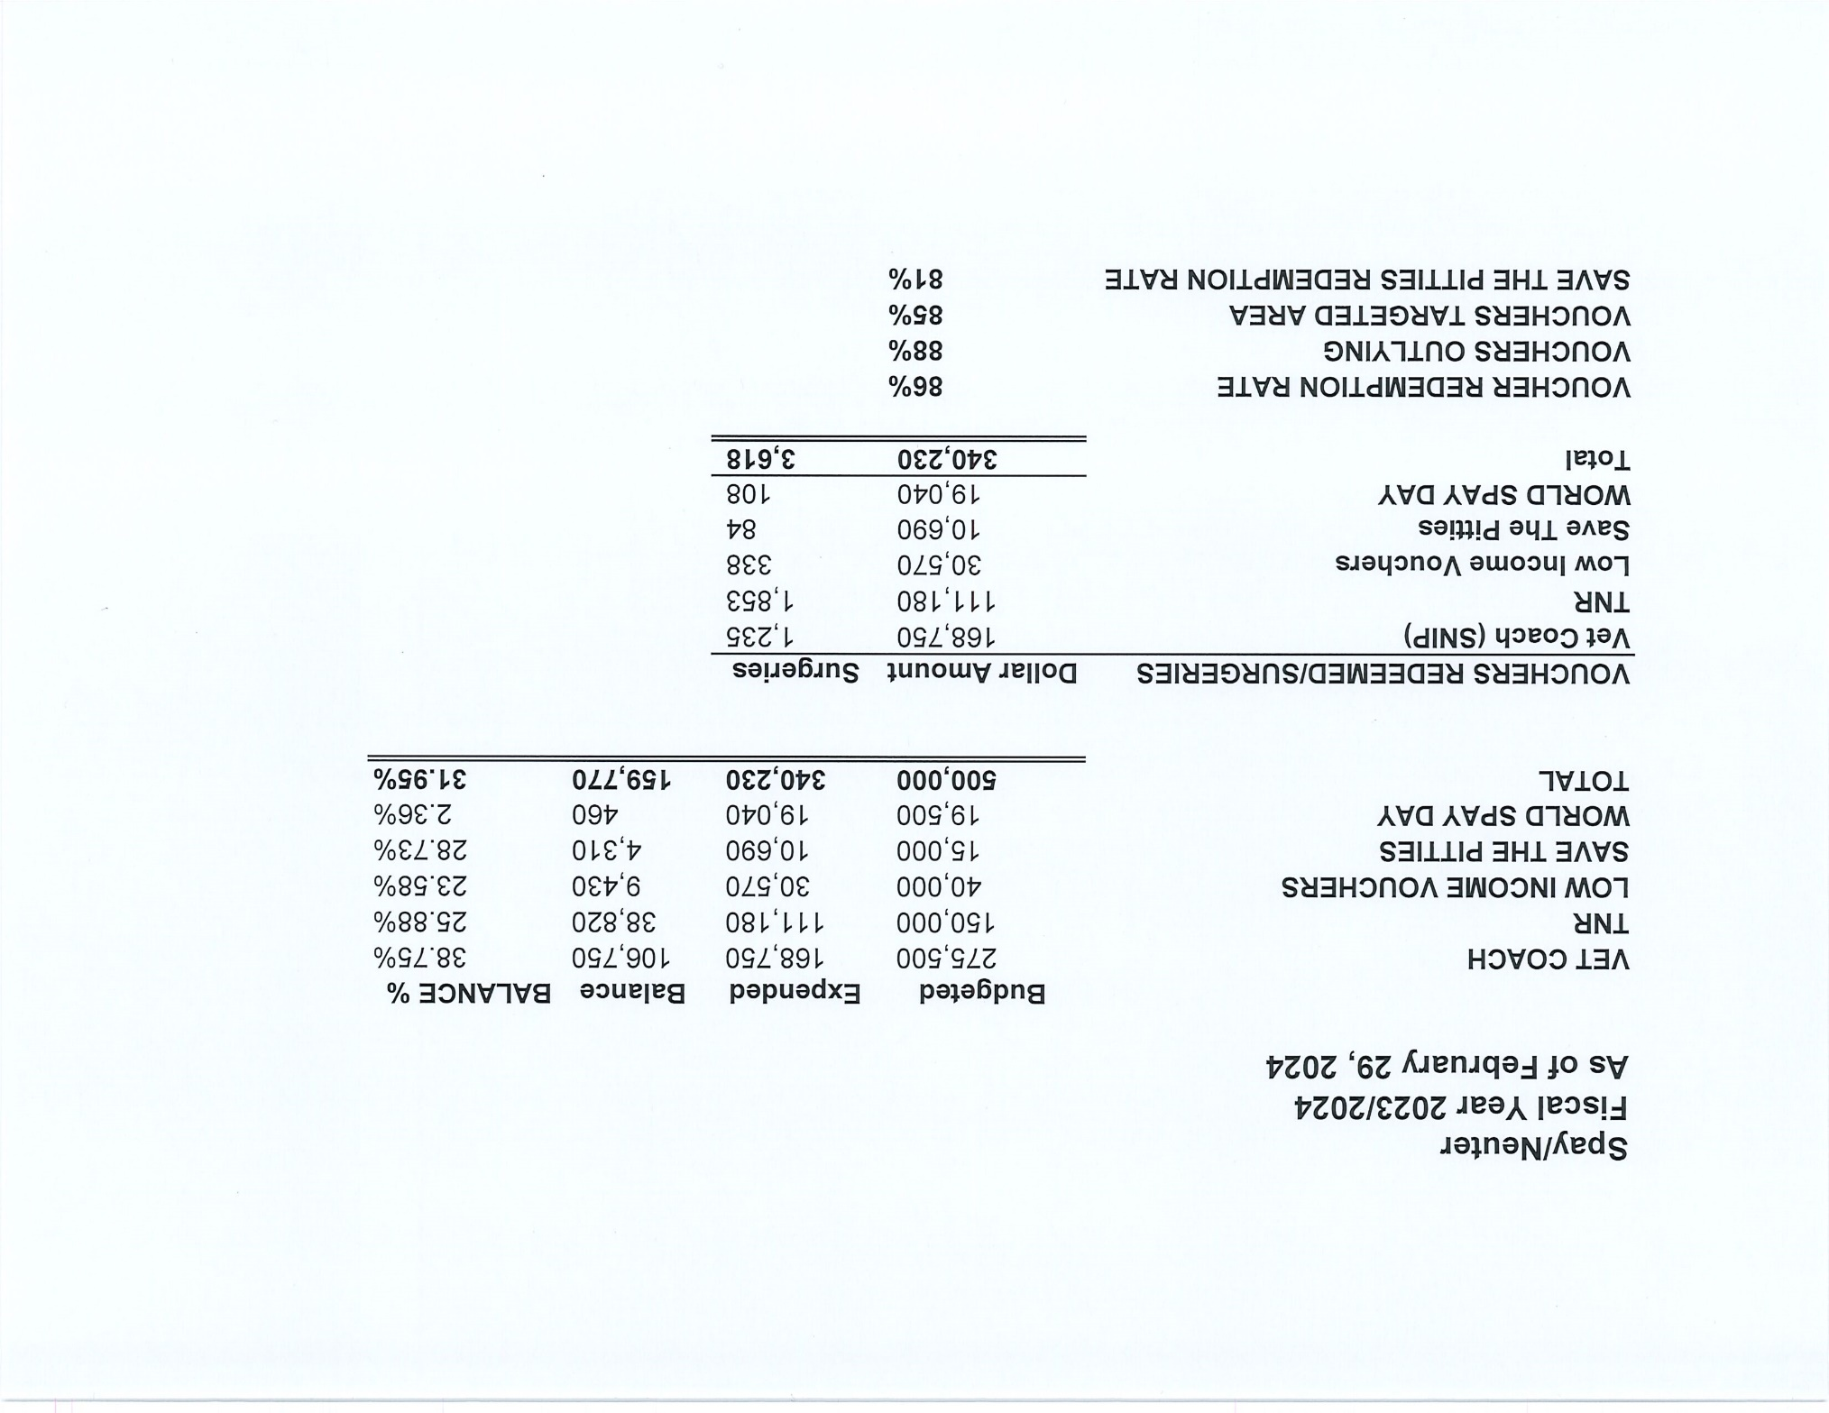


Slide 6
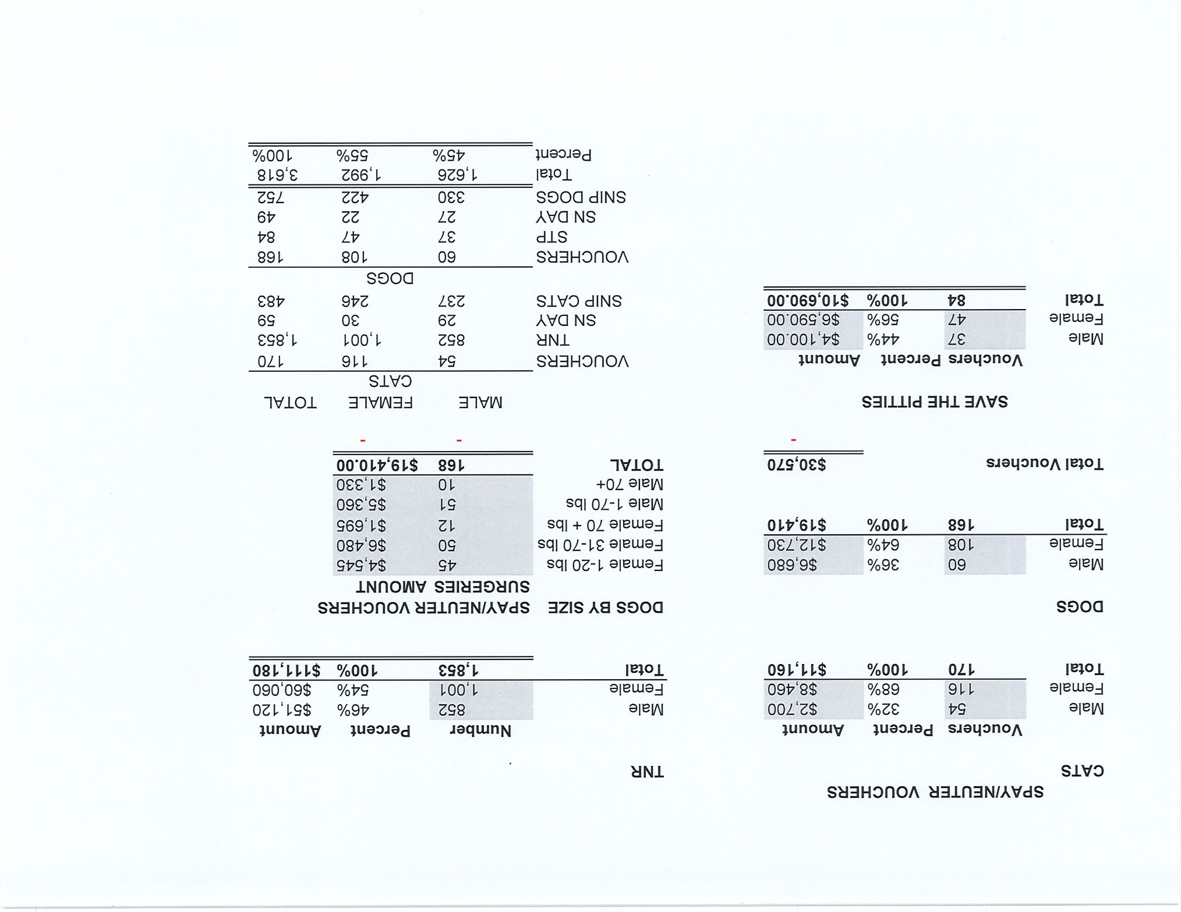

Slide 7
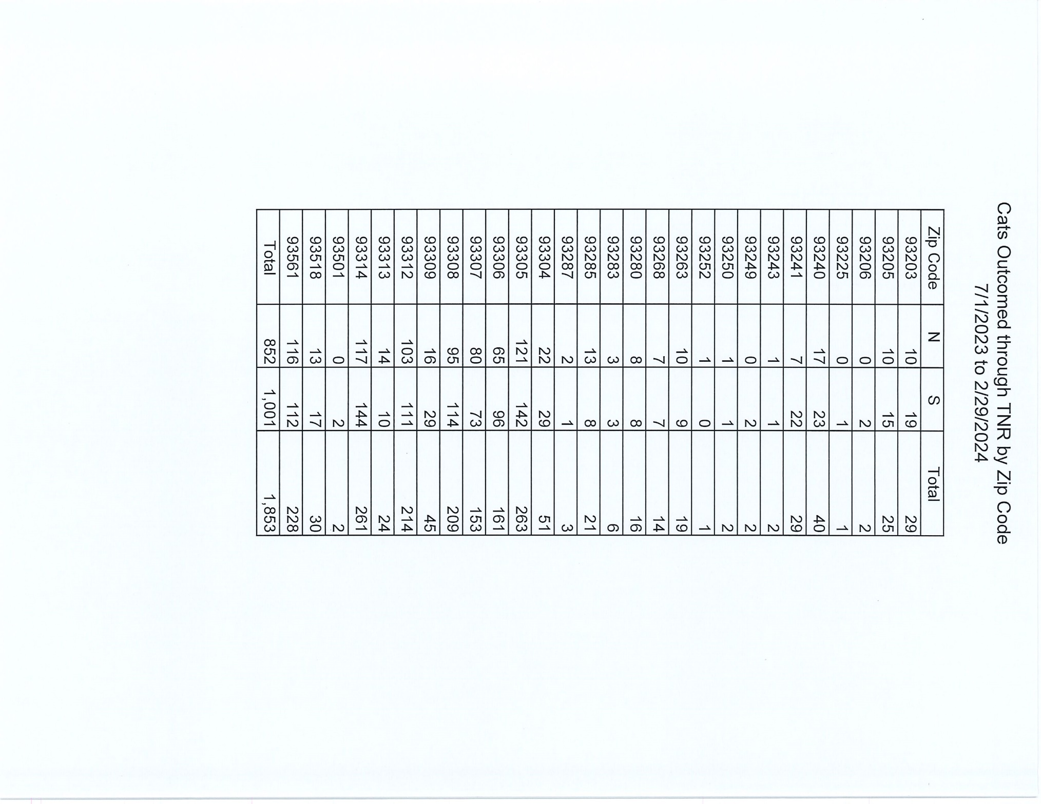

Slide 8
Adoption
  734
Rescue
  563
RTO
  170
Year To Date
Notes:
71

Slide 9


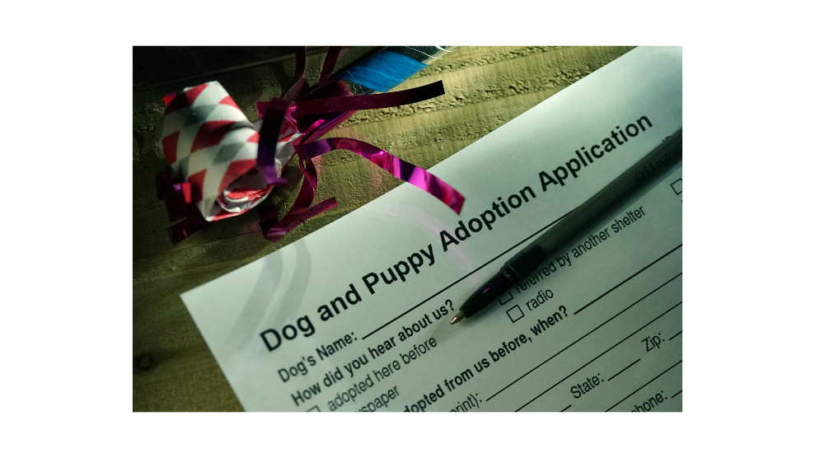

Offsite Adoptions

Slide 10
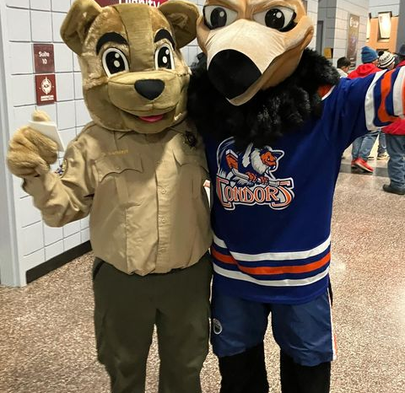
Pet Appreciation Night

Slide 11


Offsite Adoptions

Slide 12


Offsite Adoptions

Slide 13
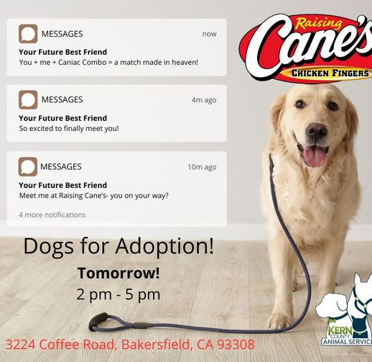

Offsite Adoptions

Slide 14
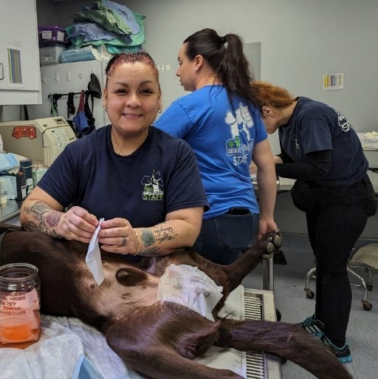
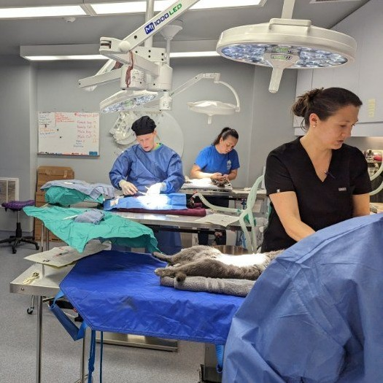
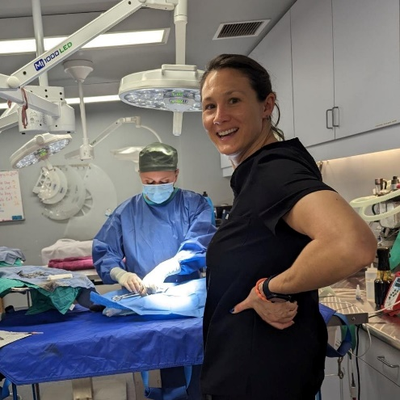
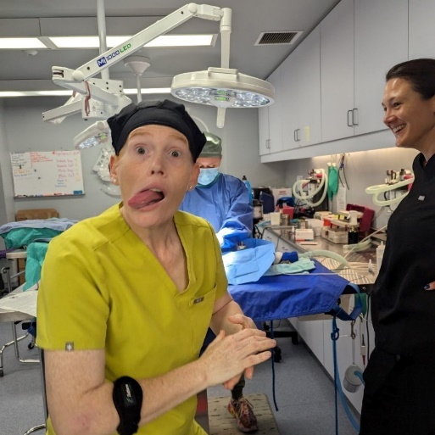
World Spay Day

Slide 15

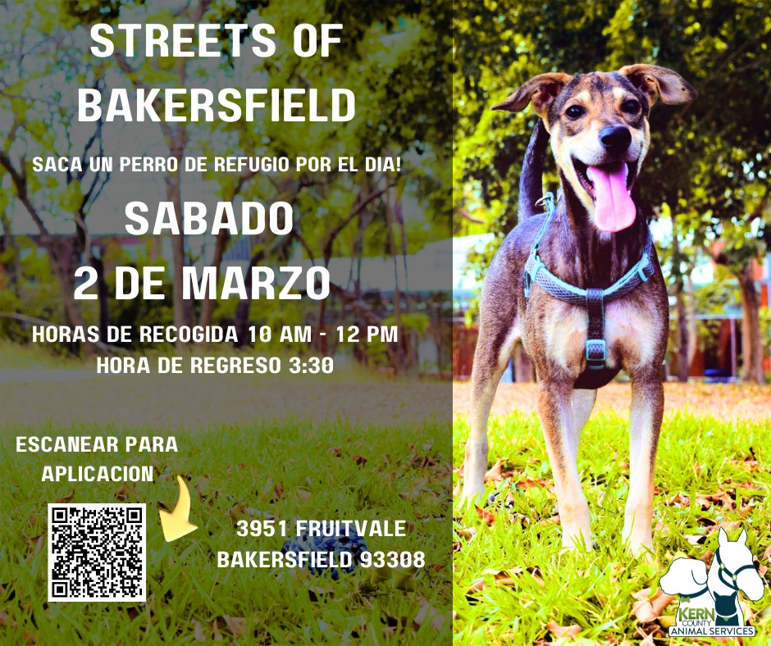

Streets of Bakersfield

Slide 16
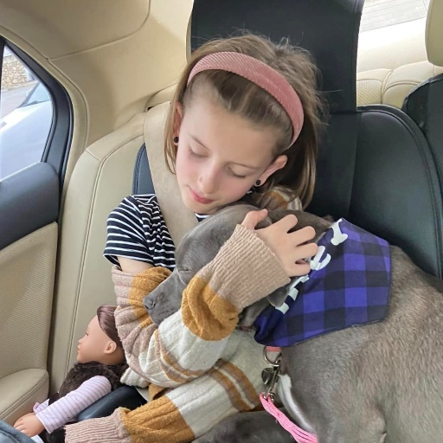
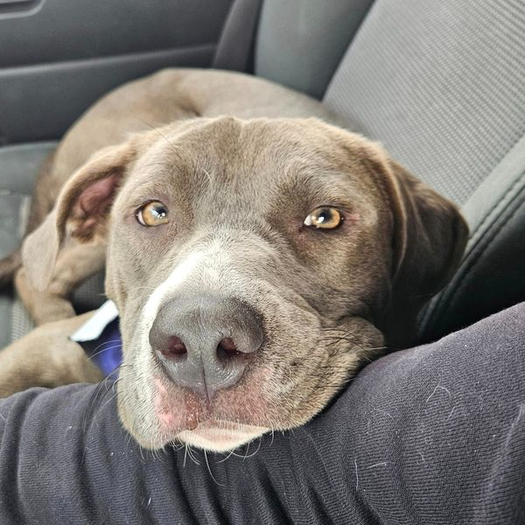
Streets of Bakersfield

Slide 17
Field Services
February 2024 | Calls Per Area
Lake Isabella | 113
Mojave | 122
North County | 47
Northeast | 351
Northwest | 296
Ridgecrest | 33
Southeast | 185
Southwest | 144
Taft | 100
Tehachapi | 83
Total | 1,474
28 dogs were returned to their owners in the field in February 2024.
113 dogs were secured on property by Animal Control Officers in February 2024.

Slide 18
Field Services-CAF
February 2024 | Calls
CAF-Breeder | 25
CAF-Rescue | 1
CAF-Kennel | 0
CAF-Boarding | 5
Total | 31
11 Permits Issued/Inspections Passed
5 Inspection Failed
6 Citations Issued
65 Active CAF Permits

Slide 19
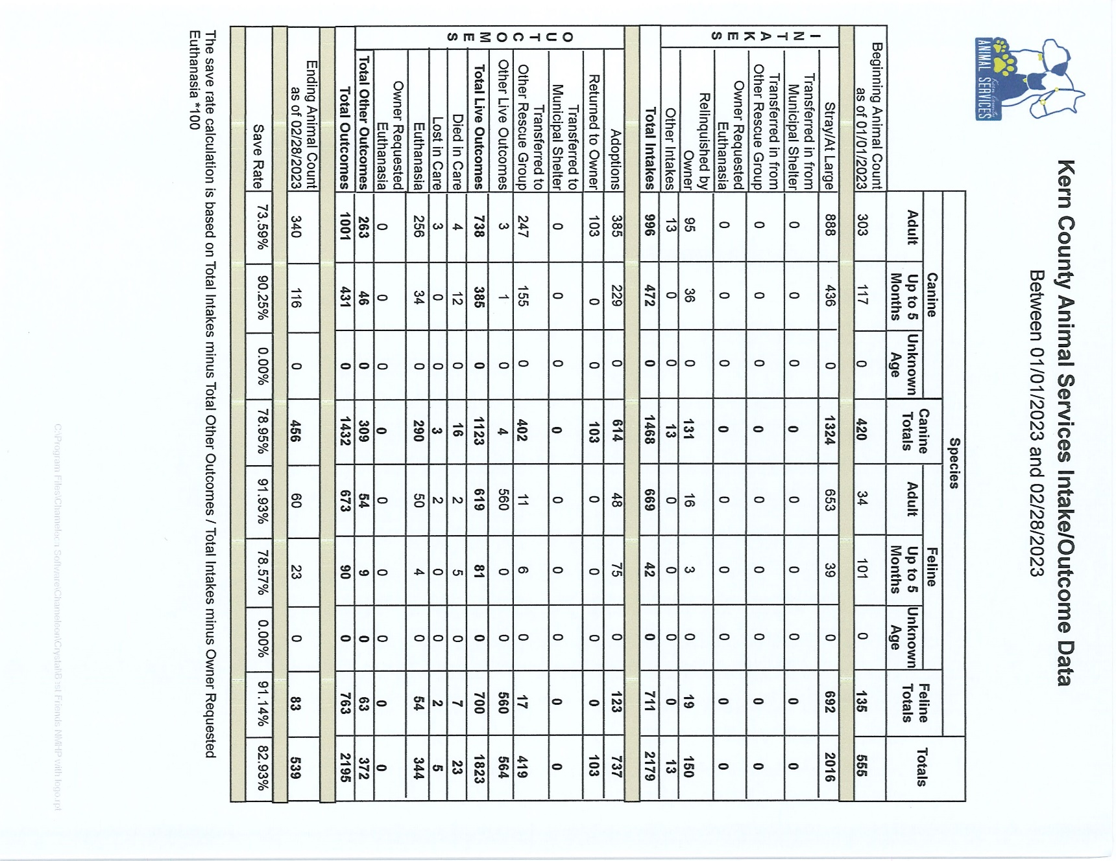

Slide 20
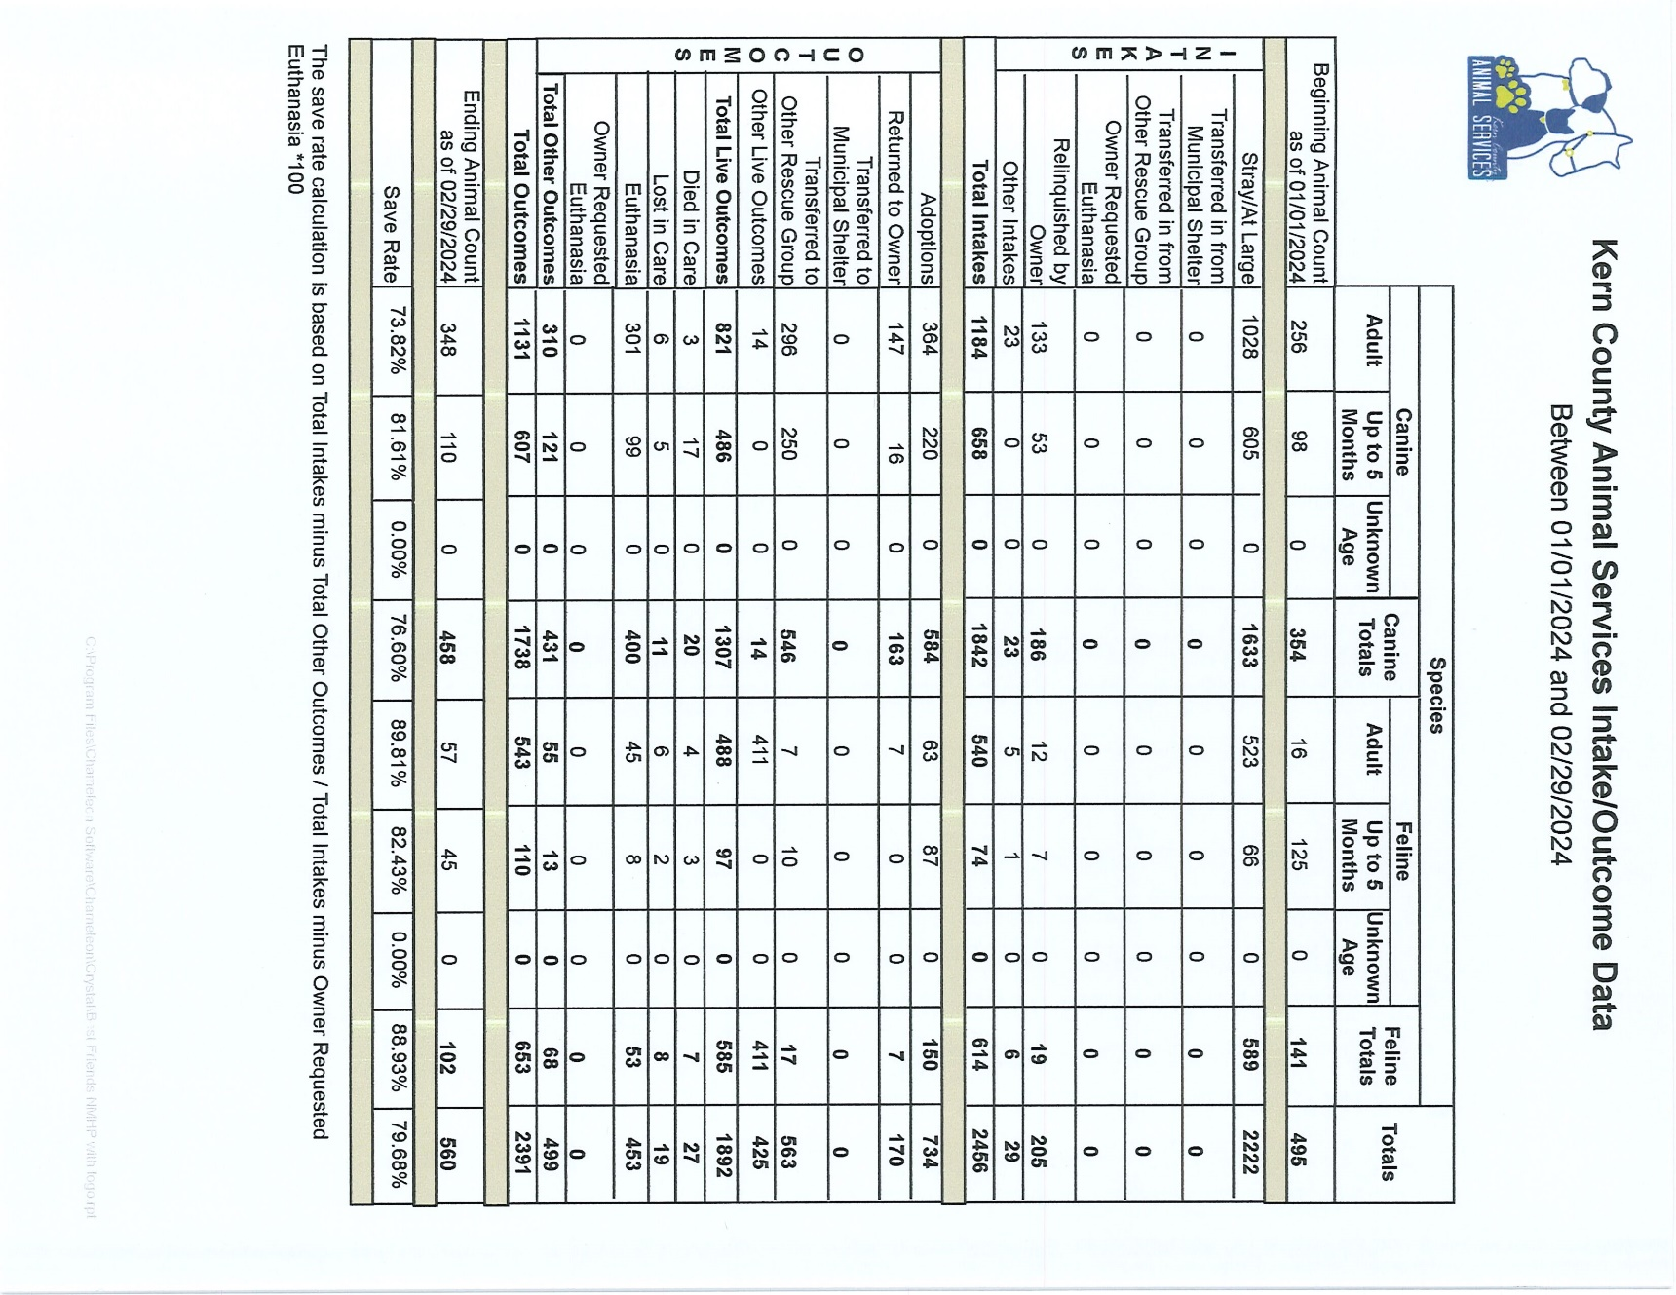

Slide 21
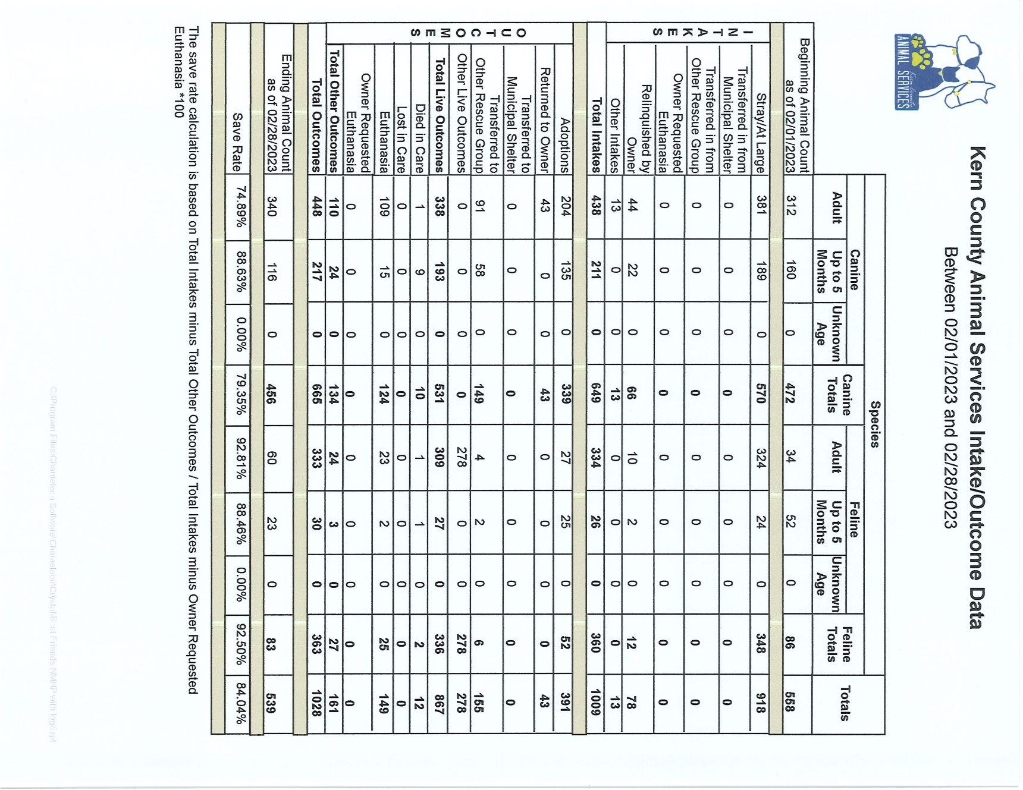

Slide 22
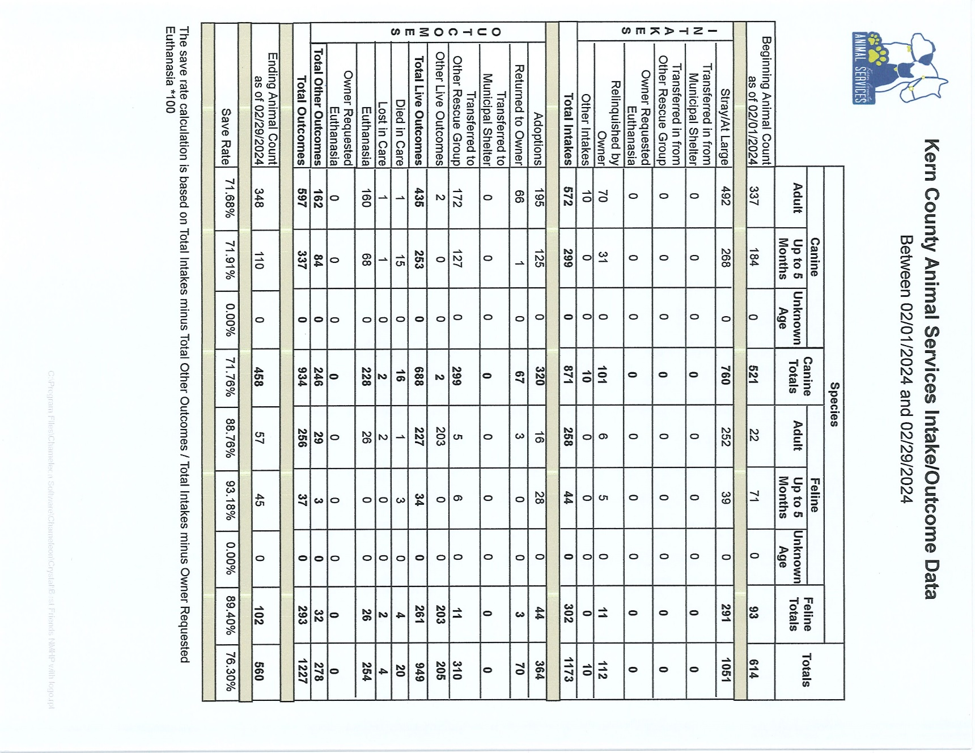

Slide 23
Volunteer Program
February 2024:
        571.97 hours of service were donated
        32 new volunteers
        106 active volunteers
        To date, 914.92 hours of service have been donated

