Slide 1

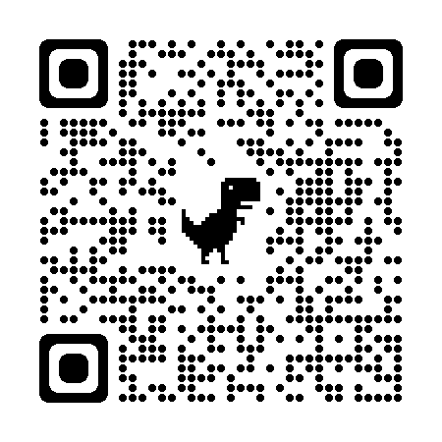
Kern County Animal Services
Director’s Report
August 2024

Slide 2

Program Highlights
Foster
33 dogs, 53 puppies, 1 cat and 123 kittens entered the Department’s Foster Care Program for a total of 211 animals in the month of August.
TNR
124 cats were spayed or neutered and released in August 2024. Year-to-date, 1,283 cats have gone through the program, and since 2013 20,883 cats have been spayed or neutered, and returned to field.
Adoption
163 dogs, 125 puppies, 16 cats, and 181 kittens under 5 months of age were adopted for a total of 485 animals adopted from Kern County Animal Shelters in August 2024.
2

Slide 3

Vaccination Clinics
August 2024
  470 Rabies
  457 DHPP
  181 FVRCP
  107 Microchips
No-Cost Feline and Canine Vaccines Provided by Petco Love

Slide 4
Spay/Neuter Program
429 Animals
8 August
Bakersfield Clinic-Sears Park:
70 Spay/Neuter Surgeries
9 August
Bakersfield Clinic:
43 Spay/Neuter Surgeries
12 August
Bakersfield Clinic:-Pioneer Park
71 Spay/Neuter Surgeries
20 August
Lamont Clinic:
86 Spay/Neuter Surgeries
21 August
Bakersfield Clinic-Heritage Park
45 Spay/Neuter Surgeries
29 August
Bakersfield Clinic-North Meadows Park
51 Spay/Neuter Surgeries
30 August
Bakersfield Clinic
33 Spay/Neuter Surgeries
31 August
Bakersfield Clinic
30 Spay/Neuter Surgeries

Slide 5
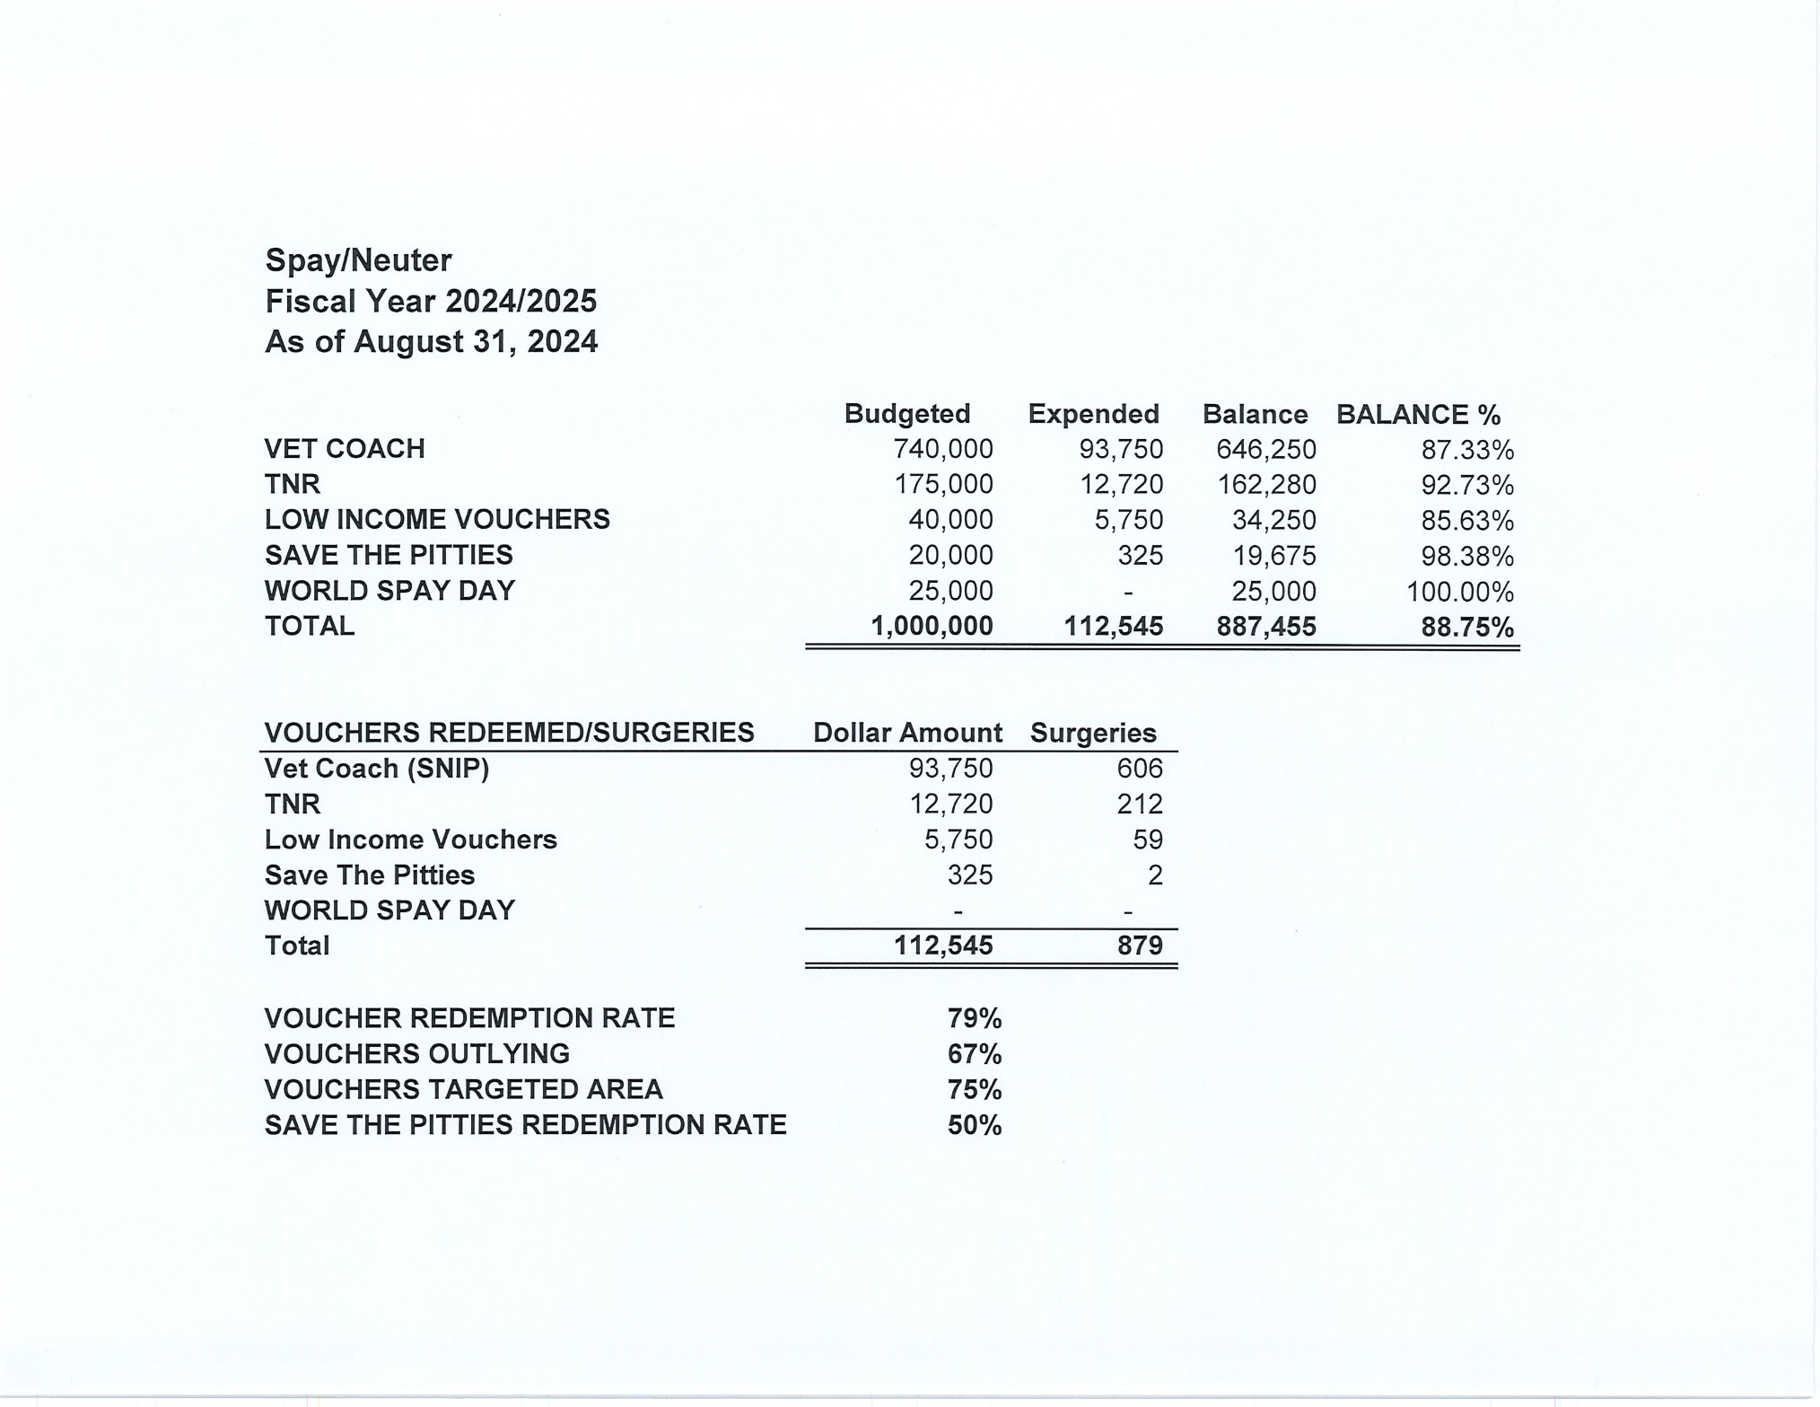


Slide 6
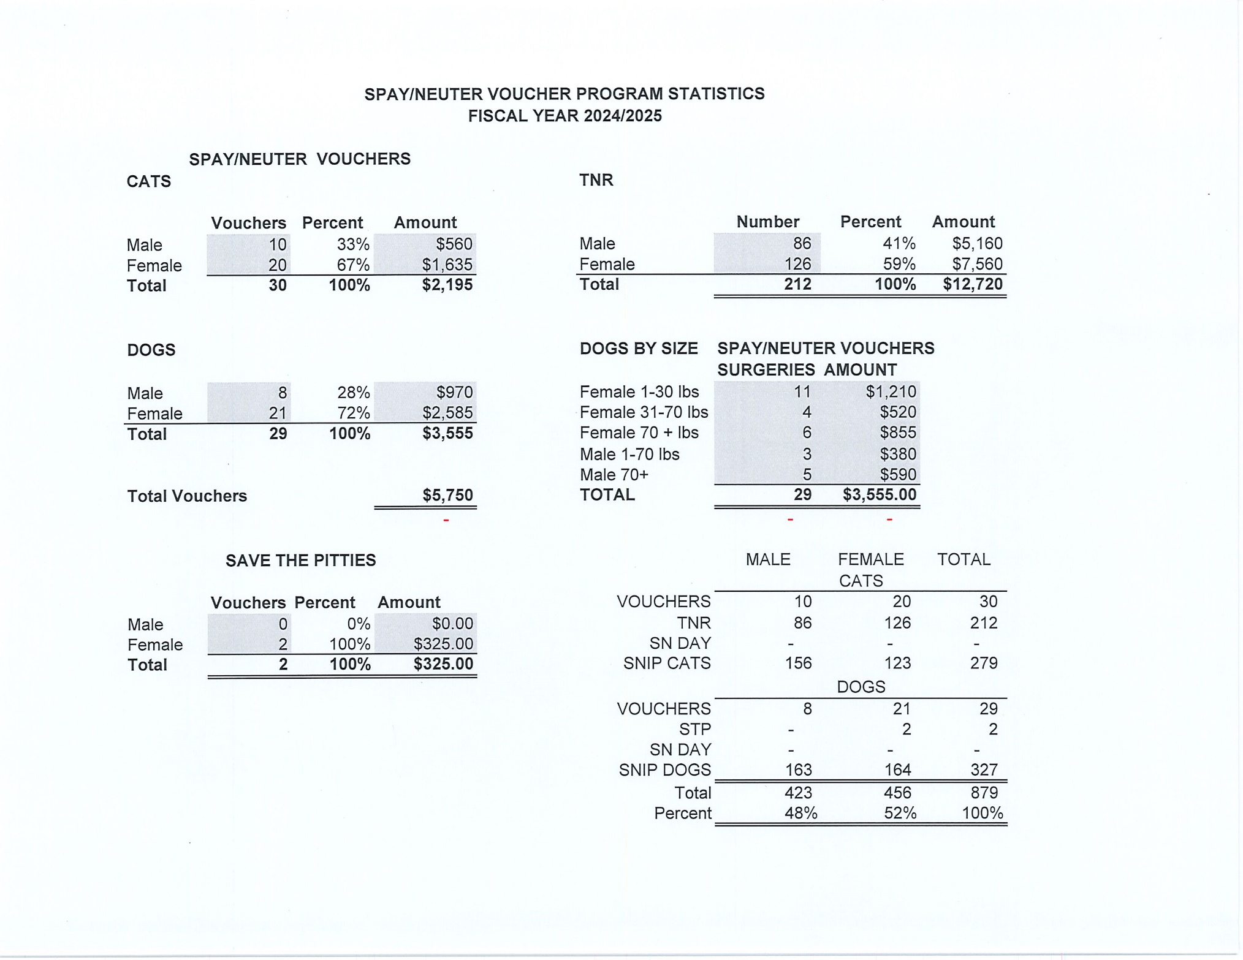

Slide 7
Adoption
  3279
Rescue
  2305
RTO
  601
Year To Date
Notes:
71

Slide 8



Adoptions Promos

Slide 9


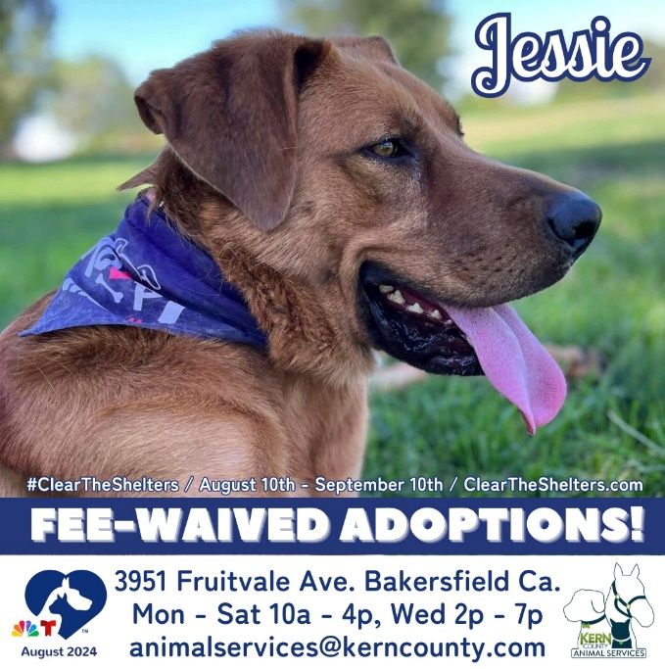
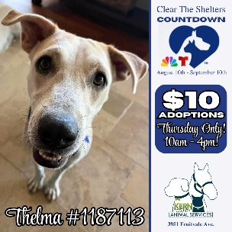
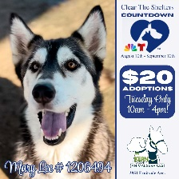
Clear The Shelters
2024

Slide 10
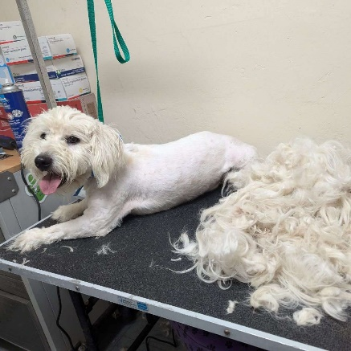
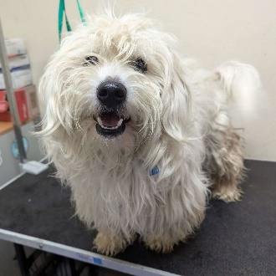
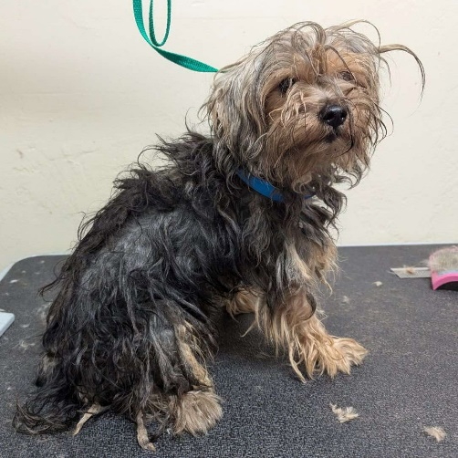
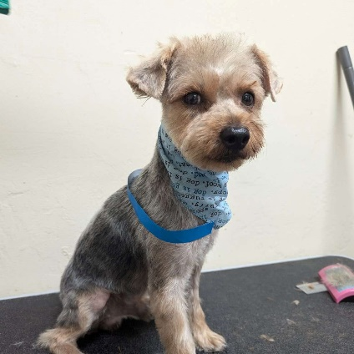
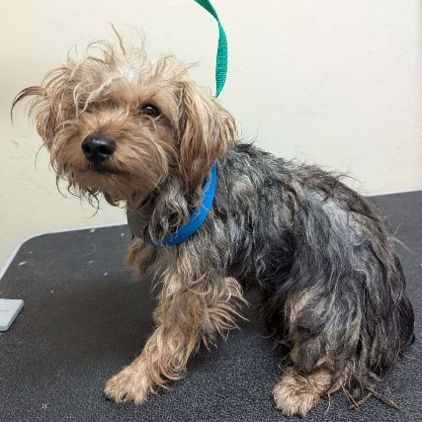
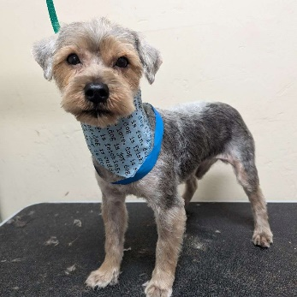
Joan Payton

Slide 11
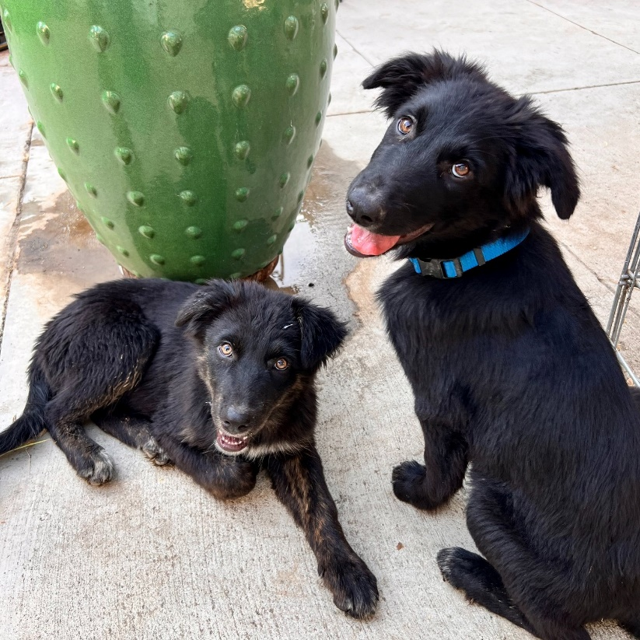
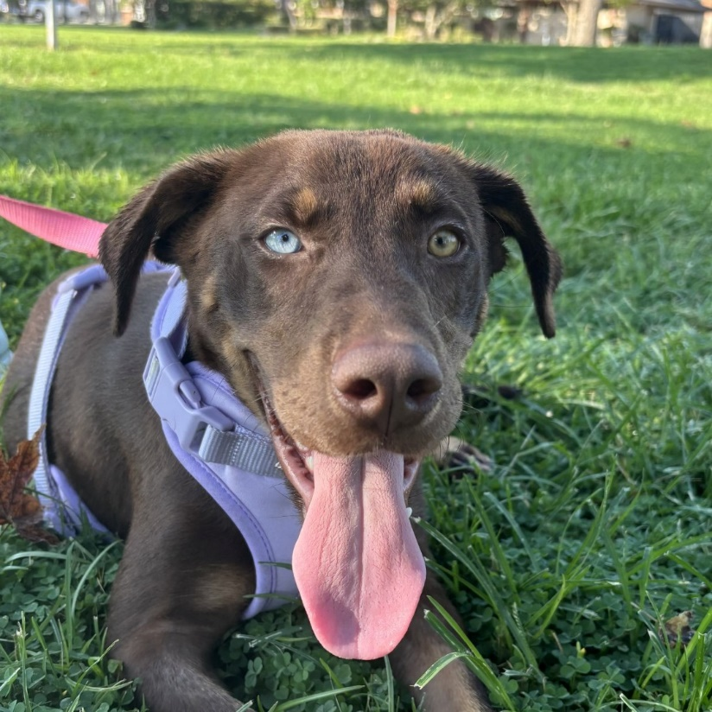
Foster Dog Fridays

Slide 12
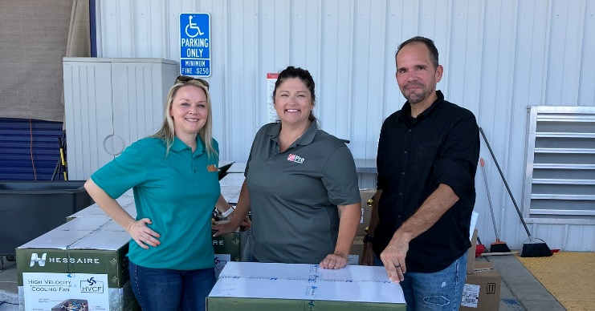
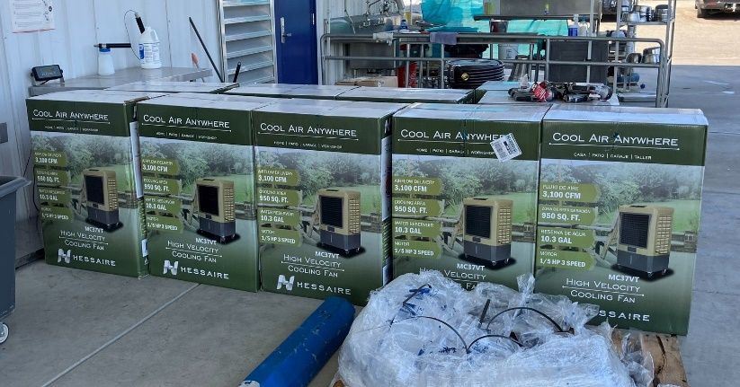
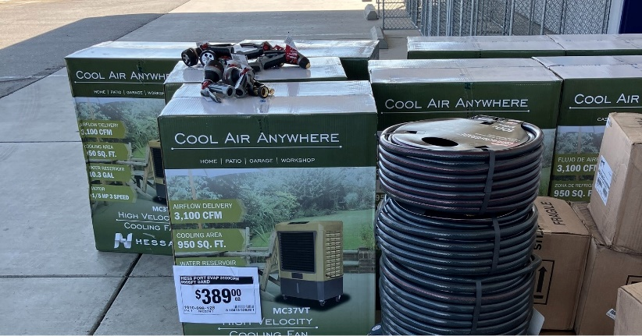
The Home Depot Foundation

Slide 13
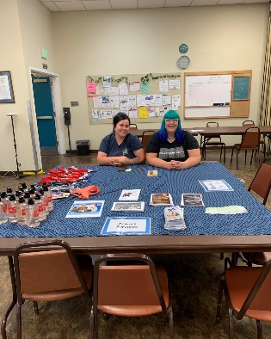
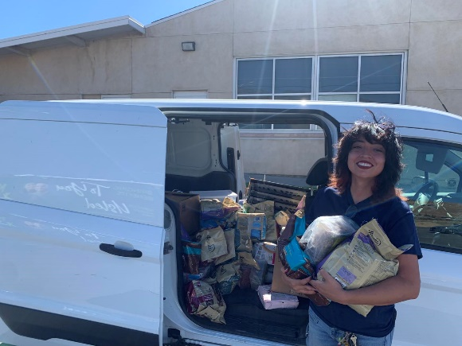
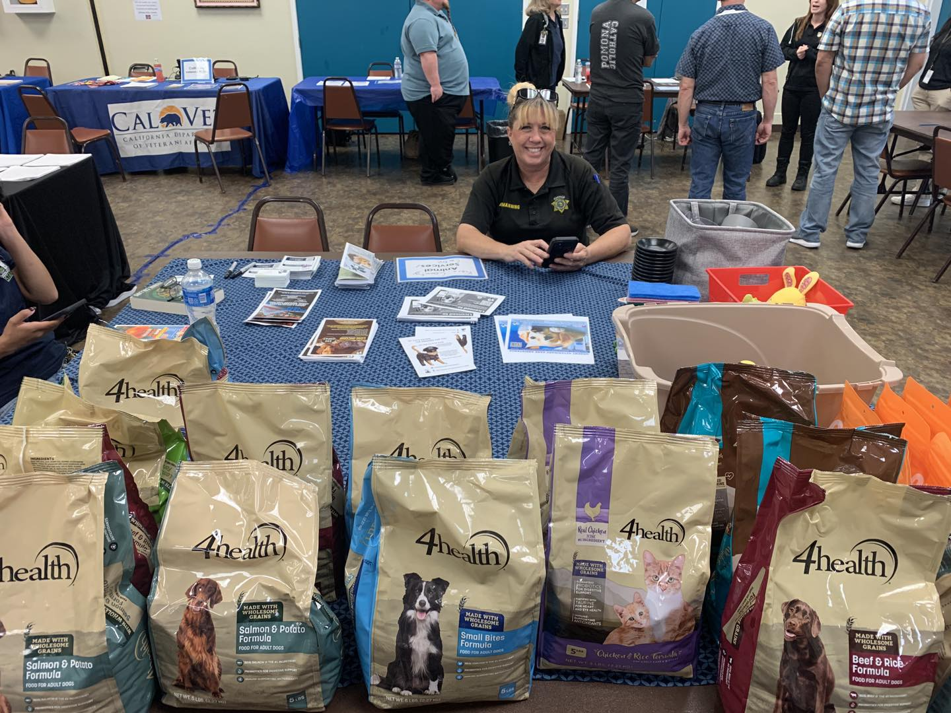
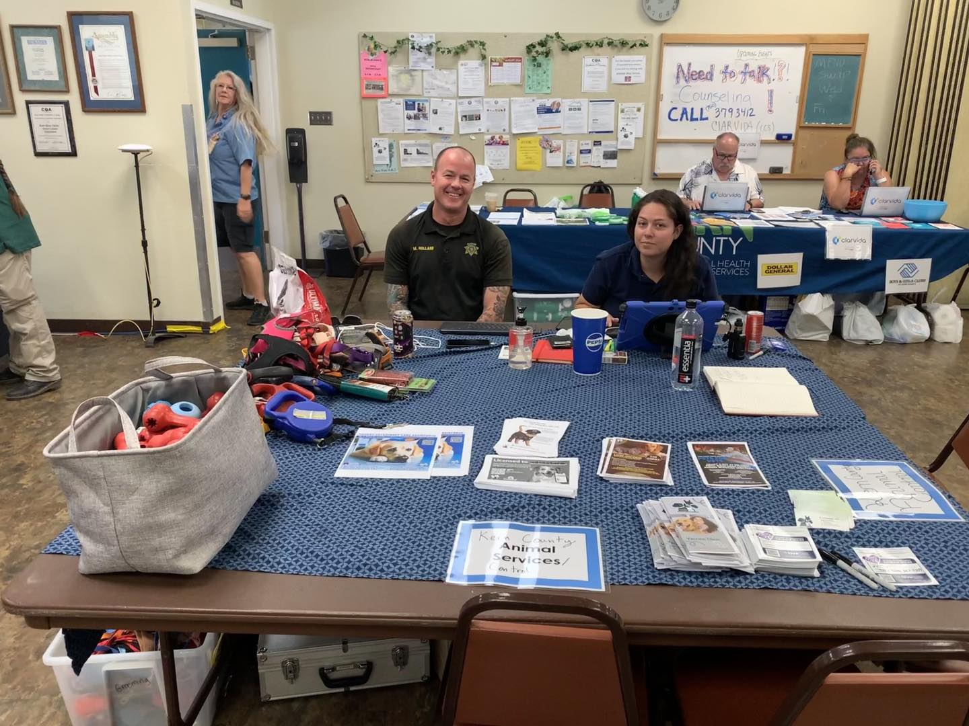
Borel Fire

Slide 14

National Check The Chip Day

Slide 15


Streets of Bakersfield

Slide 16







Adoption events in the community…

Slide 17





Adoption events in the community…

Slide 18
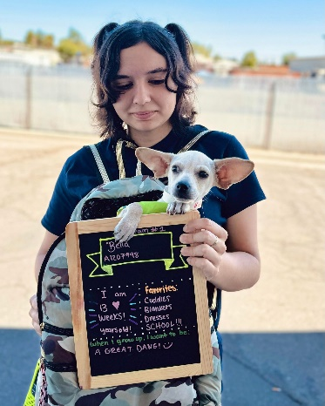
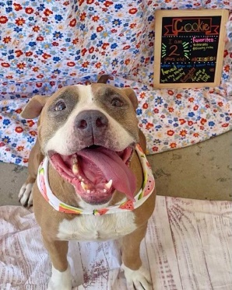
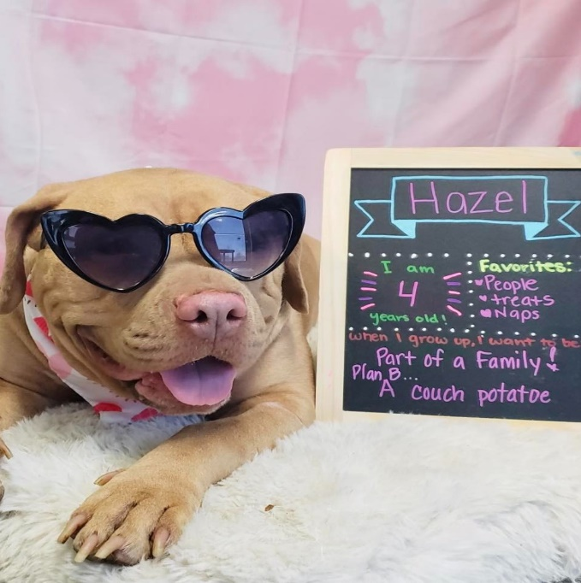
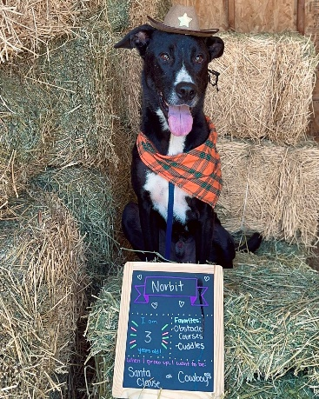
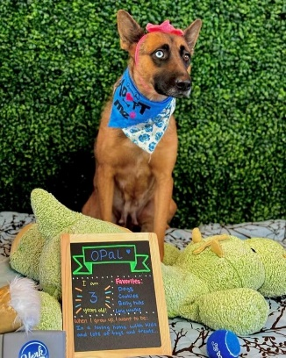
Back To School…but for the doggies

Slide 19
Field Services
August 2024 | Calls Per Area
Lake Isabella | 116
Mojave | 85
North County | 45
Northeast | 304
Northwest | 325
Ridgecrest | 19
Southeast | 140
Southwest | 175
Taft | 111
Tehachapi | 83
Total | 1403
58 dogs were returned to their owners in the field in August 2024.
101 dogs were secured on property by Animal Control Officers in August 2024.

Slide 20
Field Services-CAF
August 2024 | Calls
CAF-Breeder | 38
CAF-Rescue | 5
CAF-Kennel | 5
CAF-Boarding | 3
Total | 51
13 Permits Issued/Inspections Passed
0 Inspection Failed
0 Citations Issued
52 Active CAF Permits

Slide 21
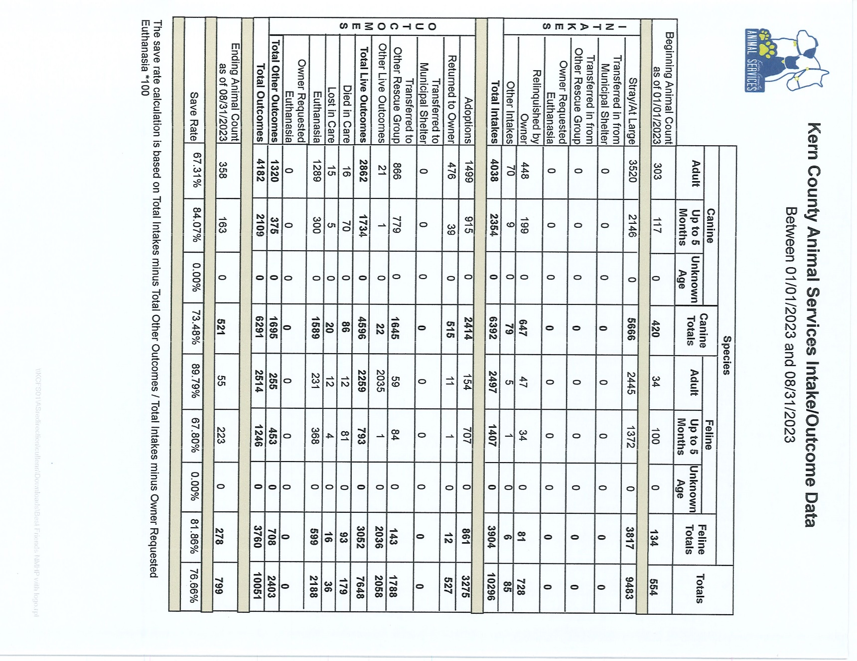

Slide 22
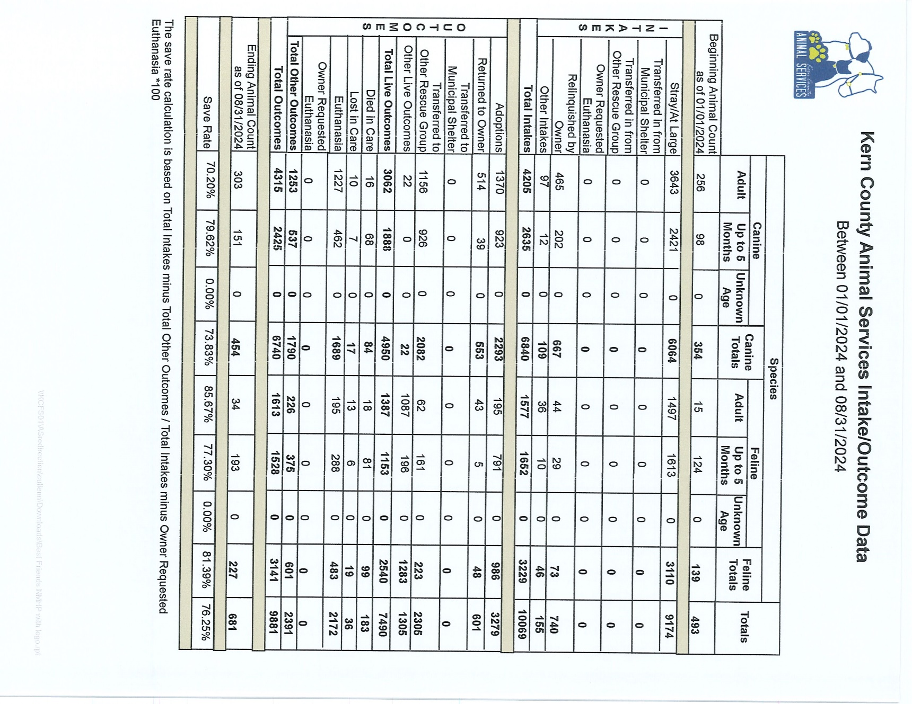

Slide 23
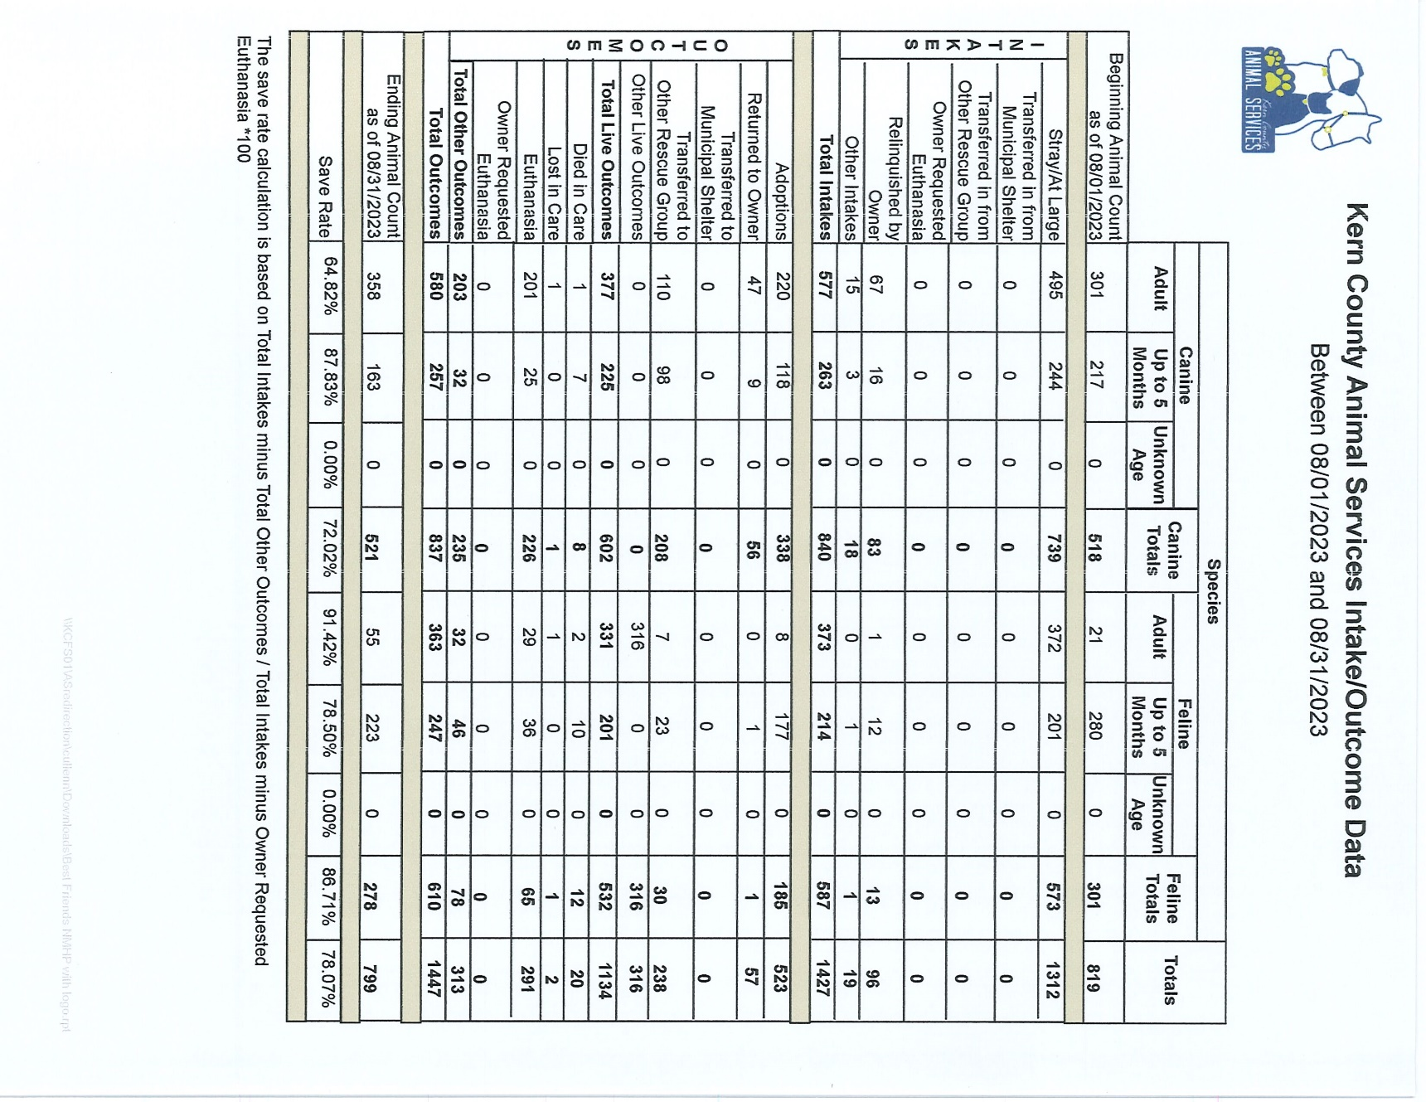

Slide 24
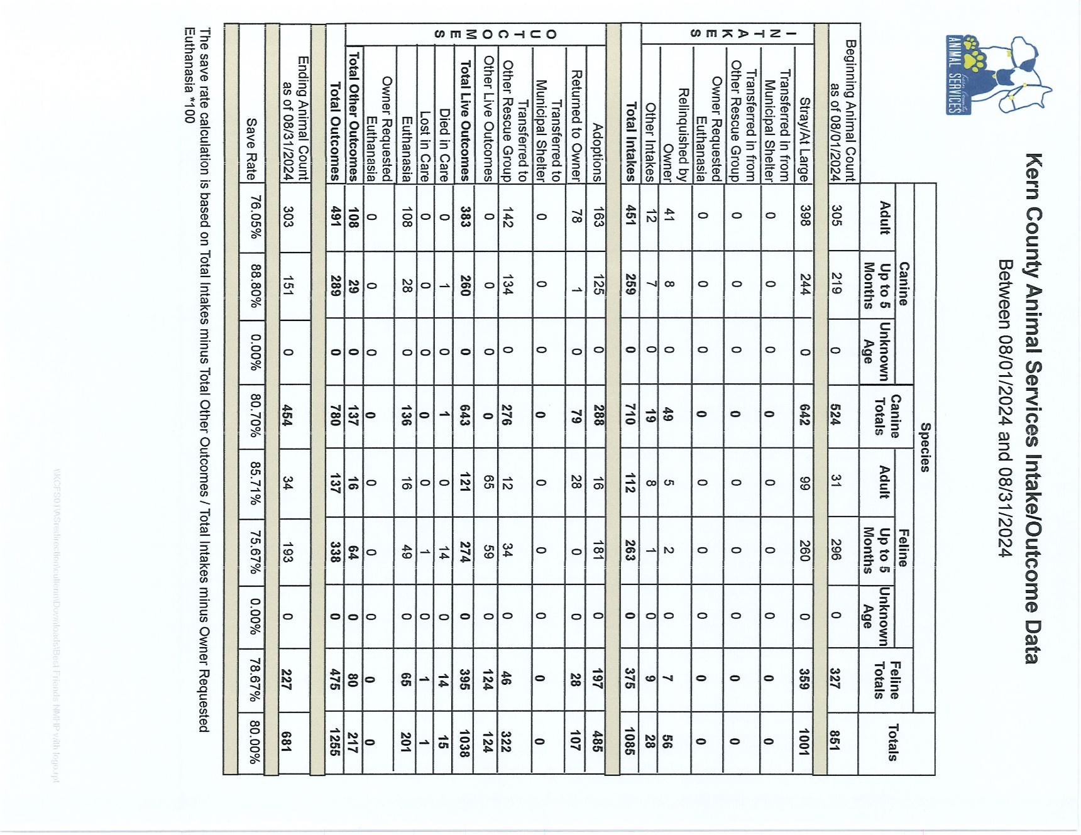

Slide 25
Volunteer Program
August 2024:
        600.29 hours of service were donated
        41 new volunteers
        86 active volunteers
        To date, 4,756.25 hours of service have been donated

