Slide 1

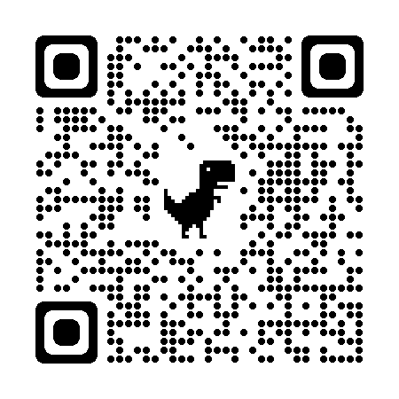
Kern County Animal Services
Director’s Report
January 2025

Slide 2

Program Highlights:
January 2025
Foster
24 dogs, 74 puppies, 1 cats and 17 kittens entered the Department’s Foster Care Program for a total of 116 animals in the months January 2025.
TNR
183 cats were spayed or neutered and released in January 2025. Year-to-date, 183 cats have gone through the program, and since 2013 23,411 cats have been spayed or neutered, and returned to field.
Adoption
176 dogs, 93 puppies, 20 cats, and 68 kittens under 5 months of age were adopted for a total of 357 animals adopted from Kern County Animal Shelters in January 2025.
2

Slide 3

January 2025 Vaccinations
All vaccines administered at low-cost spay/neuter clinics.
  383 Rabies
  182 DHPP
  214 FVRCP

Slide 4
JANUARY 2025
Spay/Neuter Program
734 Animals Altered
January 2
Fruitvale Shelter Clinic:
132 Spay/Neuter Surgeries
January 8
Fruitvale Shelter Clinic:
108 Spay/Neuter Surgeries
January 11
Fruitvale Shelter Clinic:
25 Spay/Neuter Surgeries
January 12
Fruitvale Shelter Clinic:
36 Spay/Neuter Surgeries
January 13
Fruitvale Shelter Clinic:
29 Spay/Neuter Surgeries
January 15
East Bakersfield, Heritage Park Clinic:
84 Spay/Neuter Surgeries
January 16
Oildale, North Meadows Park Clinic:
42 Spay/Neuter Surgeries
January 20
Fruitvale Shelter Clinic:
117 Spay/Neuter Surgeries
January 21
Oildale, North Meadows Park Clinic:
94 Spay/Neuter Surgeries
January 28
East Bakersfield, Pioneer Park Clinic:
67 Spay/Neuter Surgeries

Slide 5
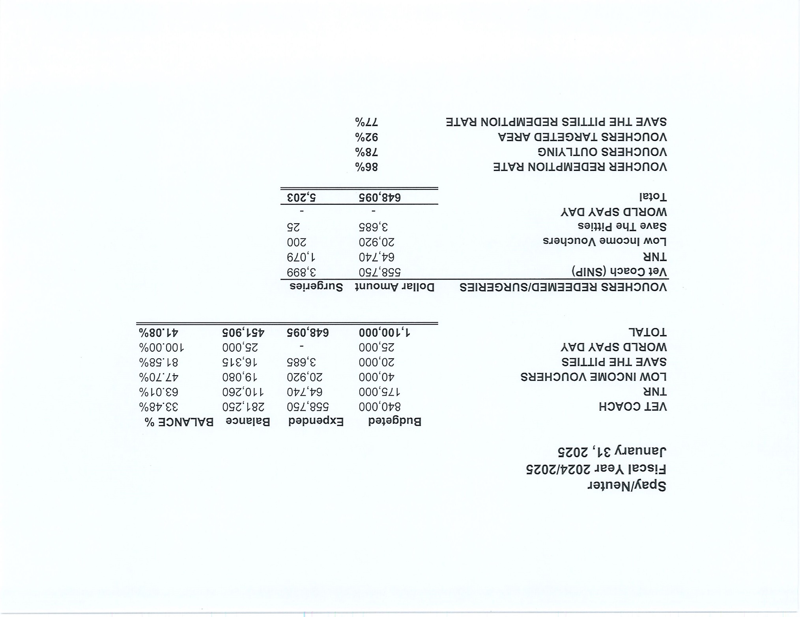


Slide 6
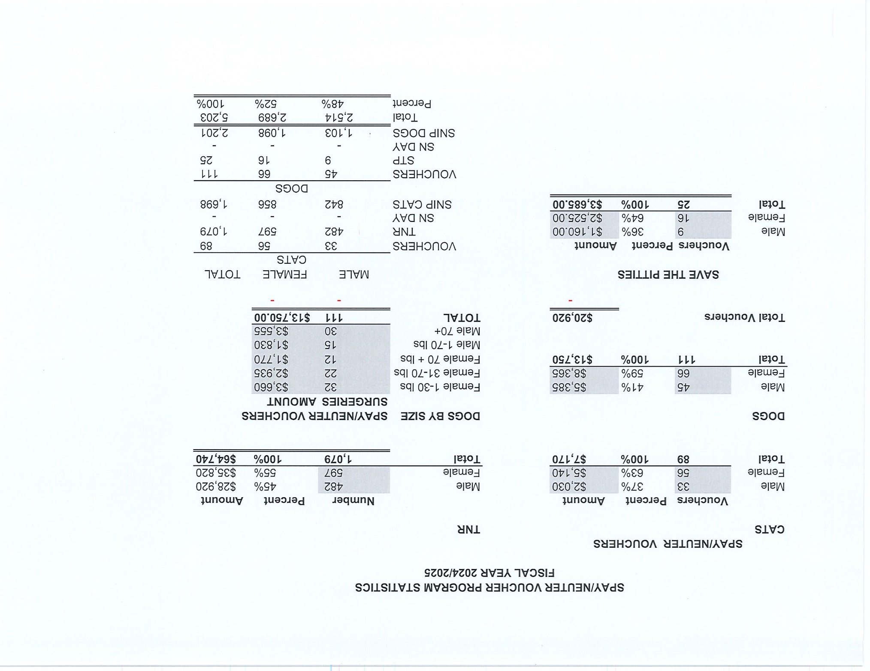

Slide 7


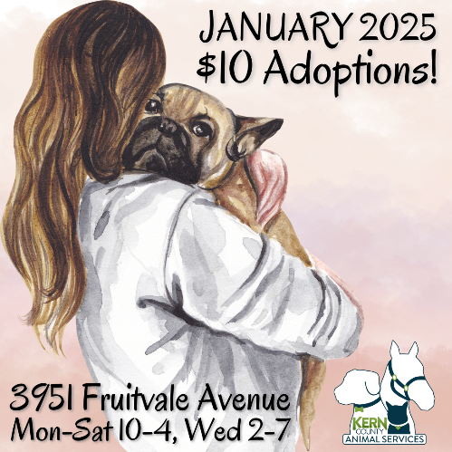
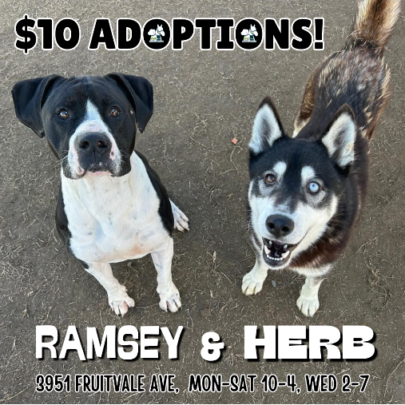
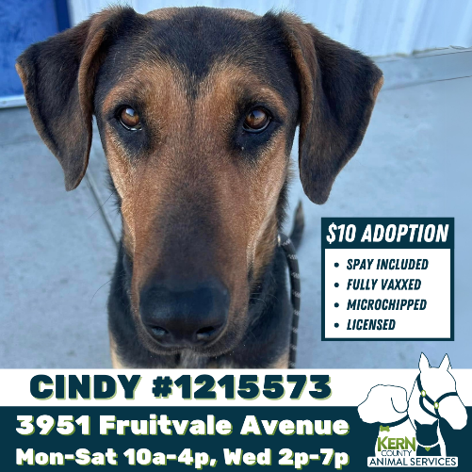

January Promotion:
$10 Adoptions

Slide 8



Streets of Bakersfield:
Doggy Day Out and Sleepovers

Slide 9




Adoption events in the community…

Slide 10


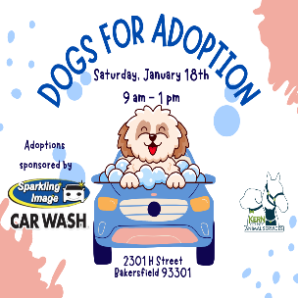

Adoption events in the community…

Slide 11
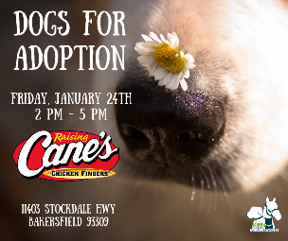



Adoption events in the community…

Slide 12
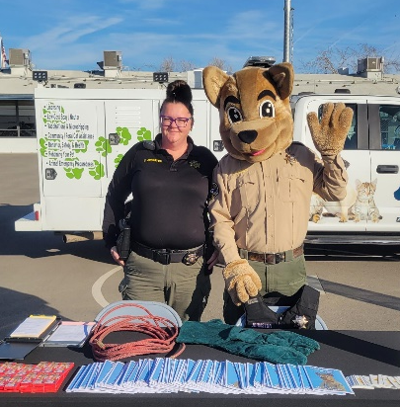
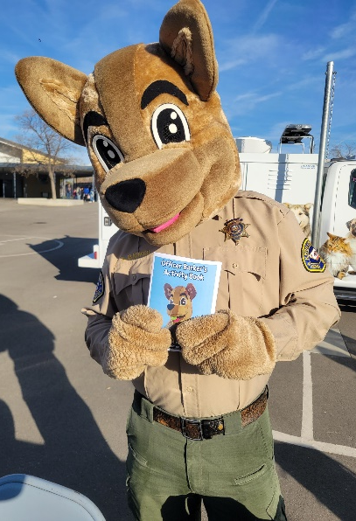
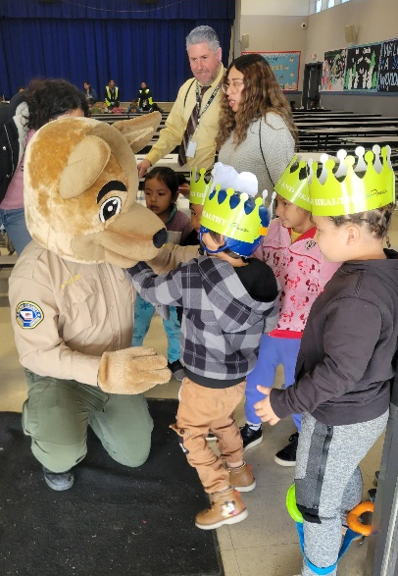
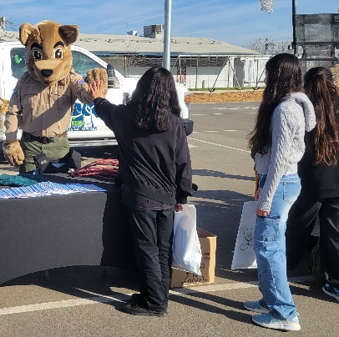
Career Day at
Freemont Elementary!

Slide 13
Field Services
January 2025 | Calls Per Area
Lake Isabella | 115
Mojave | 160
North County | 73
Northeast | 397
Northwest | 291
Ridgecrest | 15
Southeast | 208
Southwest | 170
Taft | 94
Tehachapi | 34
Total | 1,557
35 dogs were returned to their owners in the field in January 2025.
134 dogs were secured on property by Animal Control Officers in January 2025.

Slide 14
Field Services-CAF
January 2025 | Calls
CAF-Breeder | 4
CAF-Rescue | 0
CAF-Kennel | 0
CAF-Boarding | 0
Total | 4
2 Permits Issued/Inspections Passed
0 Inspection Failed
0 Citations Issued
52 Active CAF Permits

Slide 15

Volunteer Program
JANUARY 2025
875.33 hours of service donated
in January 2025.
45 new volunteers
107 active volunteers
875.33 hours of service donated
to date.

Slide 16
Adoption
357
Rescue
371
RTO
95
TNR
183
Total Lives Saved
1012
2025
Year To Date
Notes:
71

Slide 17
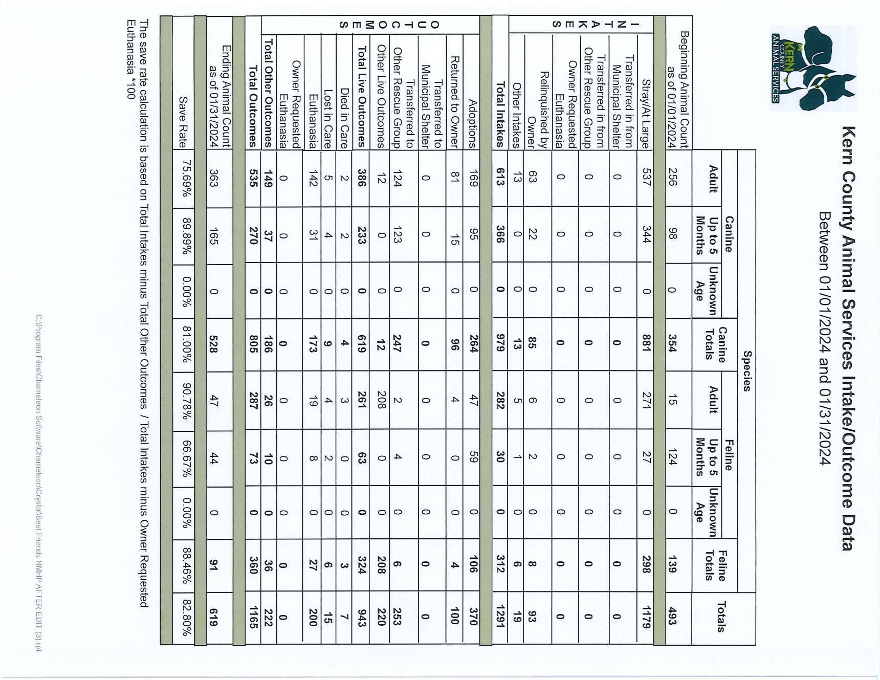

Slide 18
