Slide 1
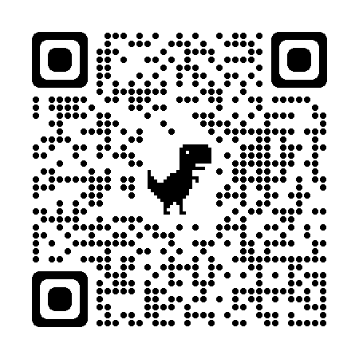
Kern County Animal Services
Director’s Report
April 2025

Slide 2
Program Highlights: April 2025
FOSTER:
37 dogs, 66 puppies, 7 cats and 197 kittens entered the Department’s Foster Care Program for a total of 310 animals in April of 2025.
TNR:
174 cats were spayed or neutered and released in April of 2025. Year-to-date, 485 cats have gone through the program, and since 2013 24,465 cats have been spayed or neutered, and returned to field.
ADOPTIONS:
166 dogs, 146 puppies, 30 cats, and 25 kittens under 5 months of age were adopted for a total of 367 animals adopted from Kern County Animal Shelters in April of 2025.

Slide 3
491 Rabies
426 DHPP
170 FVRCP
57 Bordetella
91 Microchips
Vaccinations:
April 2025

Slide 4
April 2025 Spay/Neuter Program: 401 Animals Altered
April 8th
Lake Isabella, California
37 Spay/Neuter Surgeries
April 10th
Heritage Park, East Bakersfield
110 Spay/Neuter Surgeries
April 22nd
Rosamond, California
51 Spay/Neuter Surgeries
April 23rd
North Meadows Park, Oildale
106 Spay/Neuter Surgeries
April 28th
Heritage Park, East Bakersfield
47 Spay/Neuter Surgeries
April 30th
Heritage Park, East Bakersfield
50 Spay/Neuter Surgeries
Collaboration with S.O.S. Rescue
Collaboration with S.O.S. Rescue

Slide 5
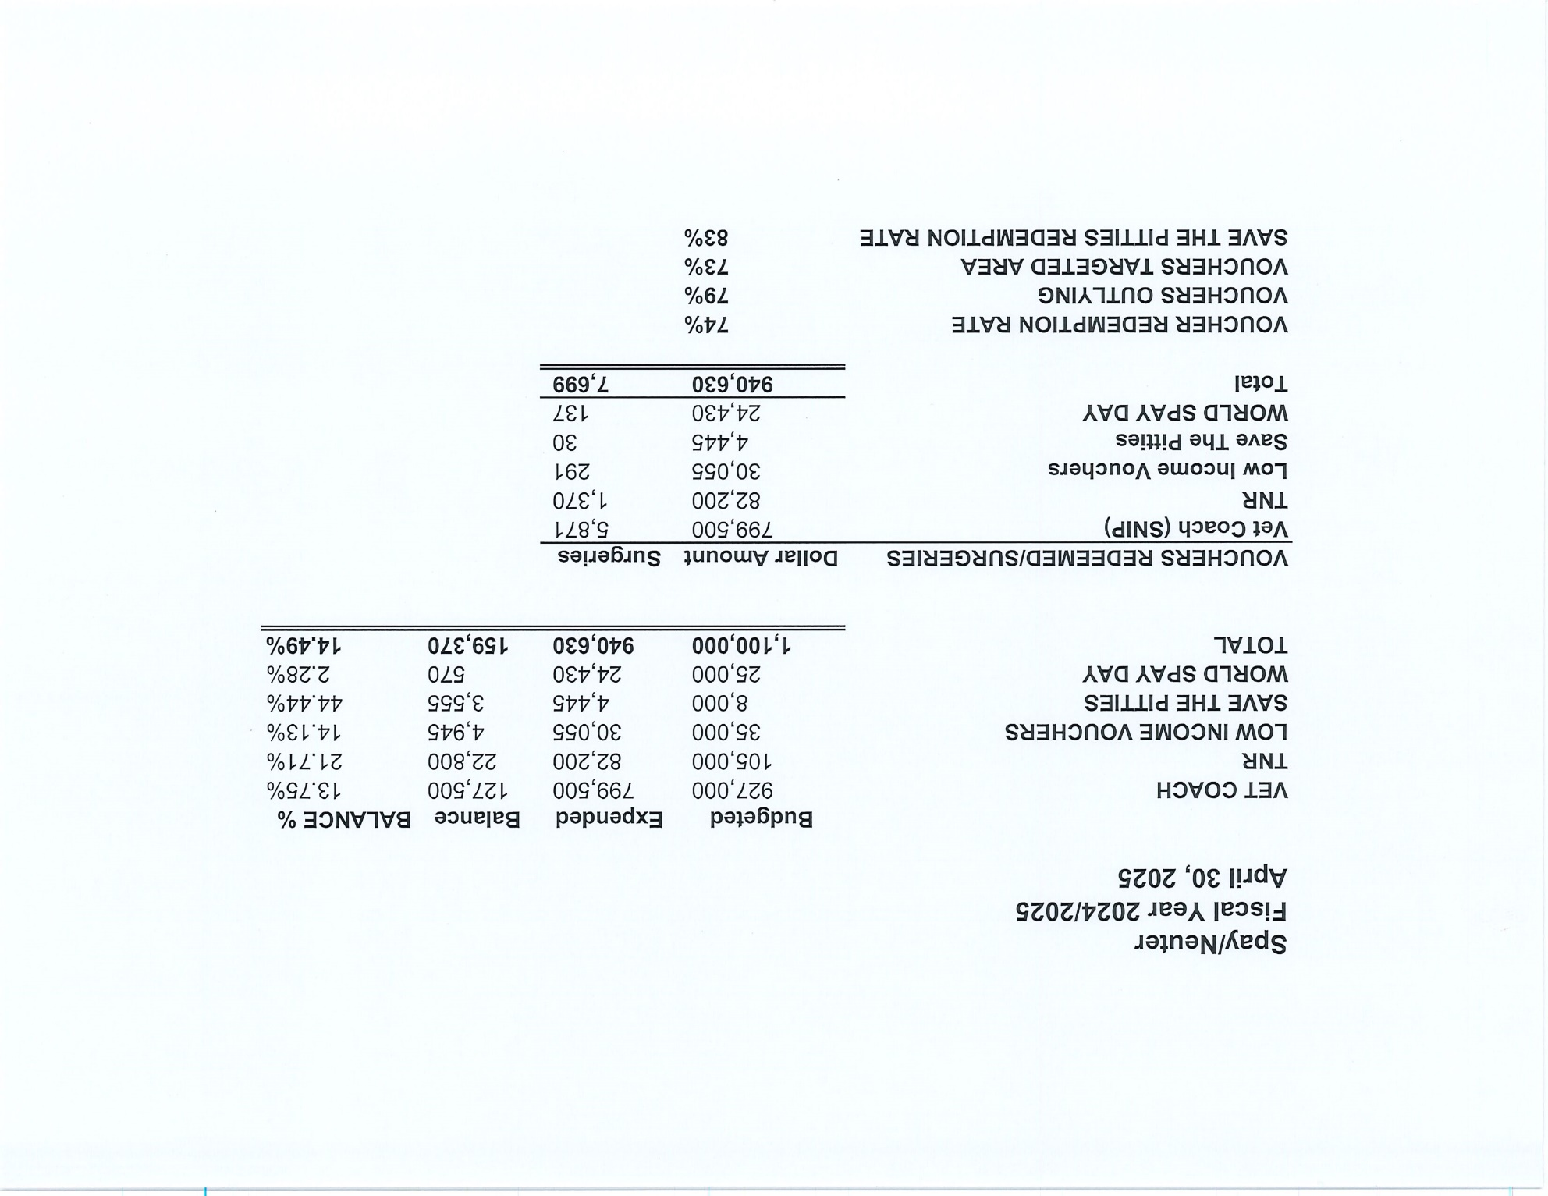

Slide 6
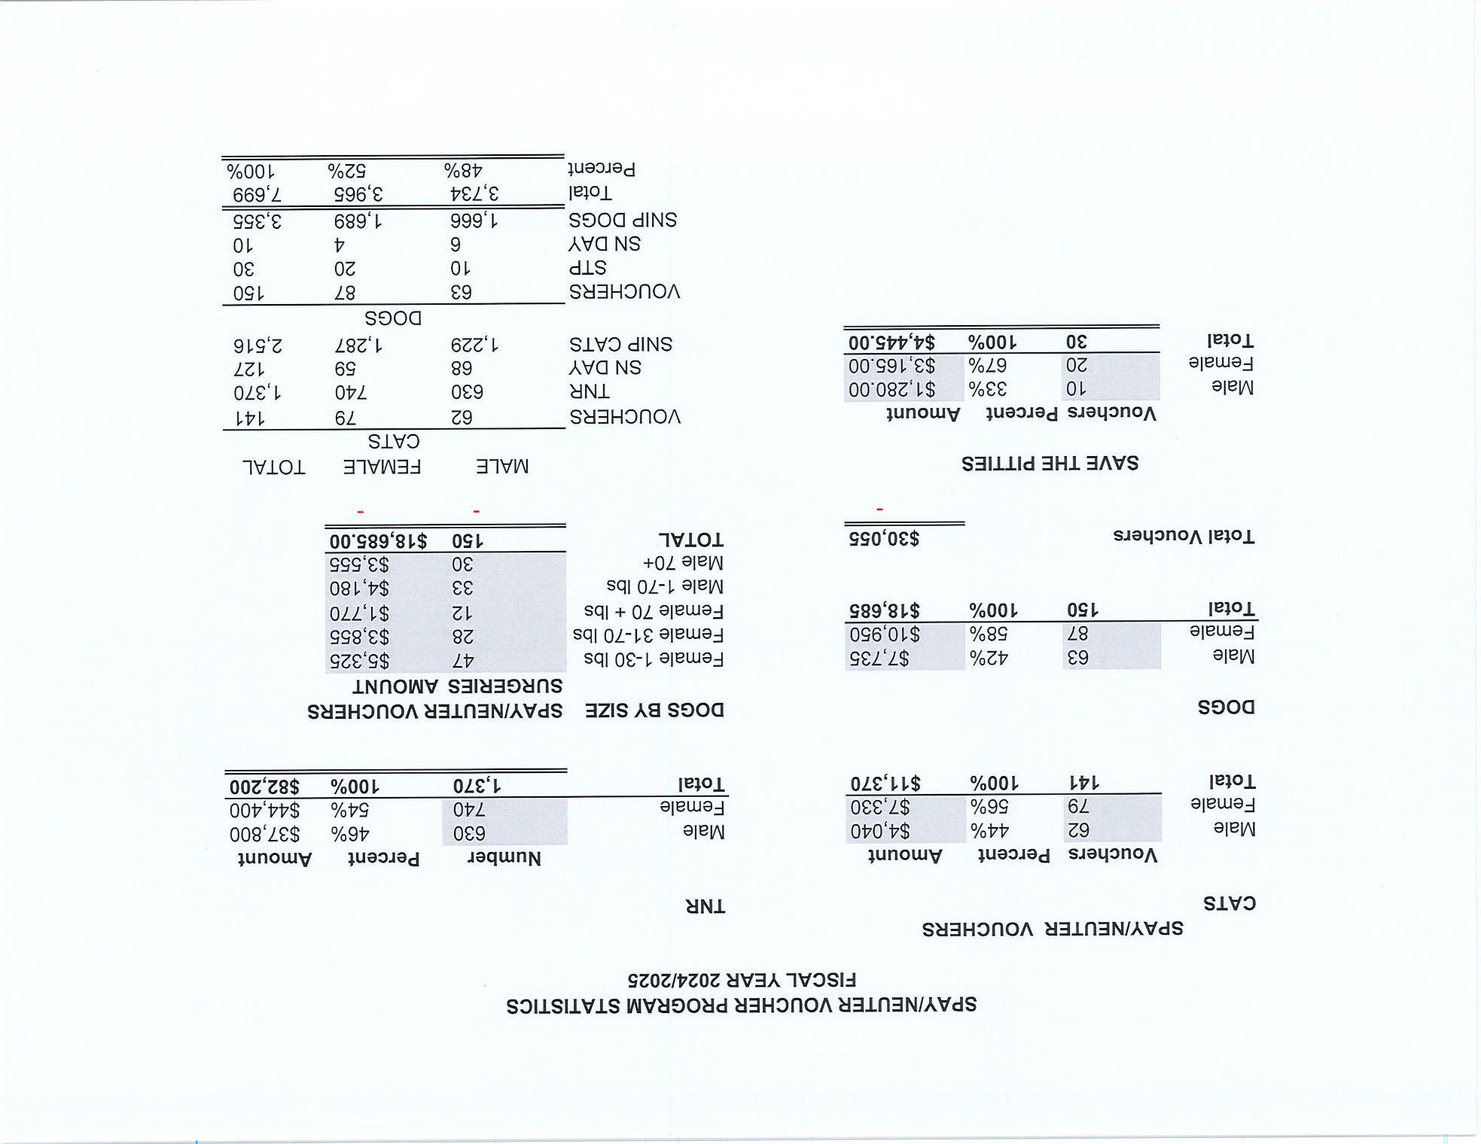

Slide 7
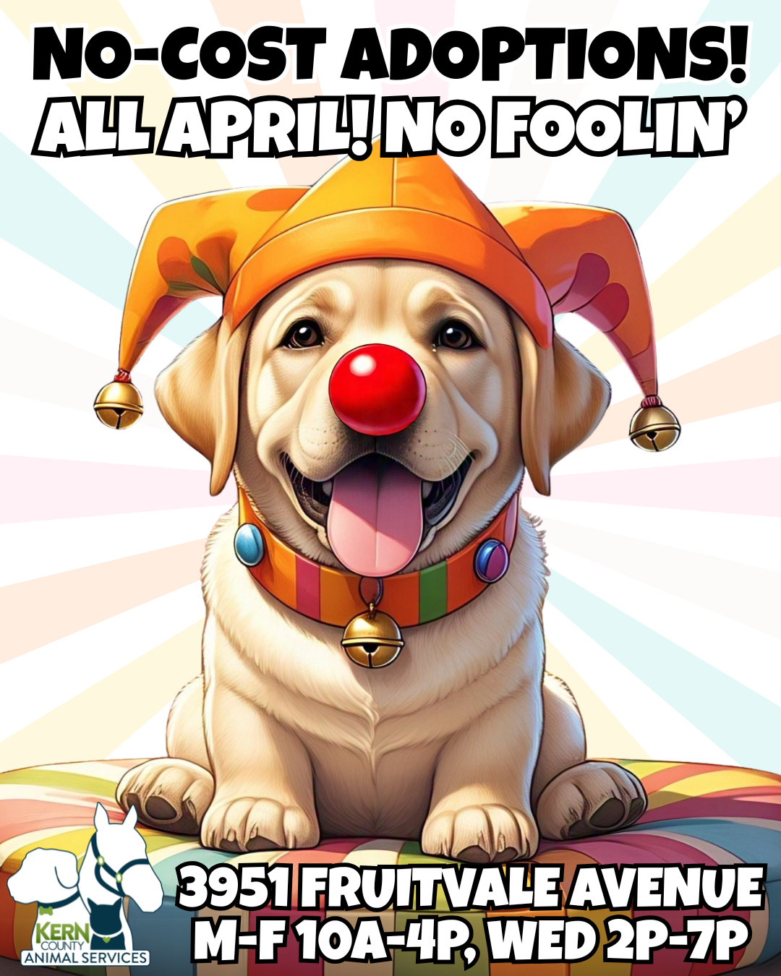

Slide 8
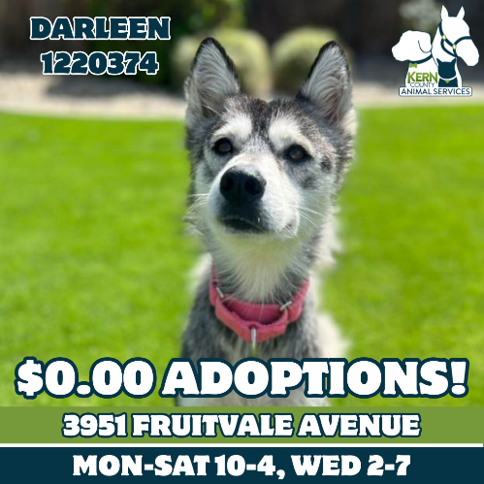
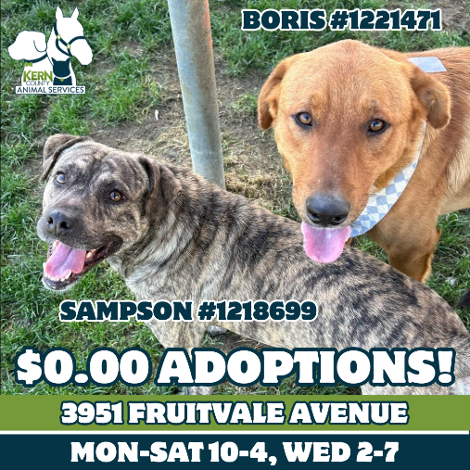
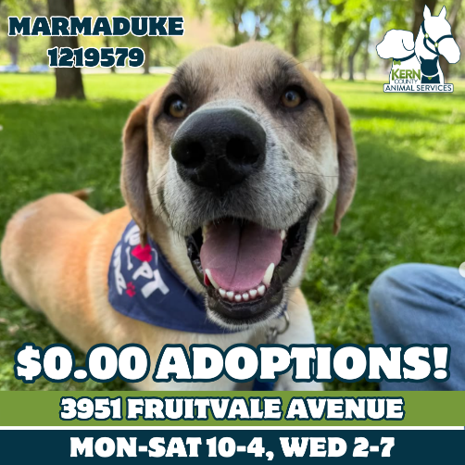
April Adoption Promotion: Adoption Fees Waived!

Slide 9
Streets of Bakersfield: Saturday, April 12th and April 26th

Slide 10
Streets Of Bakersfield: Weekend Sleepovers

Slide 11
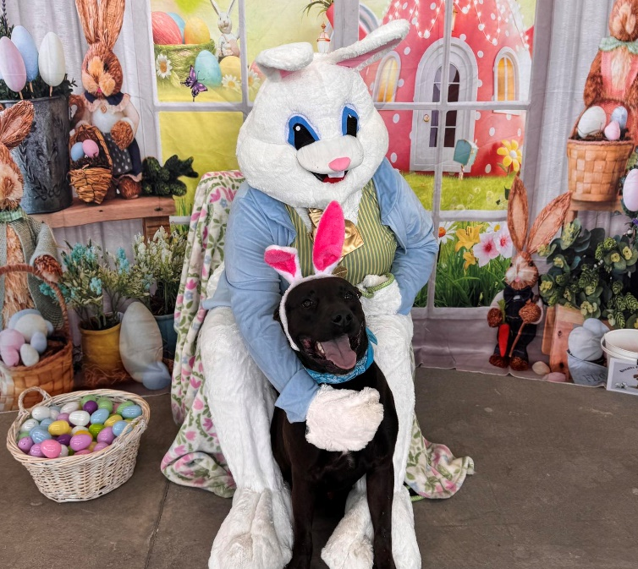
Photos with the Easter Bunny! April 12th & April 18th

Slide 12
Offsite Adoption Events
^{April 4th, 5th, 6th}

Slide 13
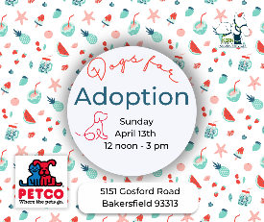
Offsite Adoption Events
April 11th, 12th, 13th

Slide 14
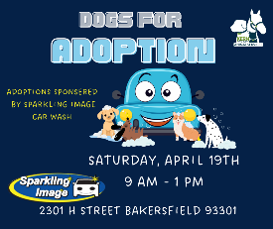
Offsite Adoption Events
April 18th, 19th, 20th

Slide 15
Offsite Adoption Events
April 25th, 26th, 27th

Slide 16
Field Services
April 2025 | Calls Per Area
Lake Isabella | 118
Mojave | 112
North County | 47
Northeast | 263
Northwest | 271
Ridgecrest | 27
Southeast | 167
Southwest | 140
Taft | 113
Tehachapi | 43
Total | 1,301
37 dogs were returned to their owners in the field in April 2025.
130 dogs were secured on property by Animal Control Officers in April 2025.

Slide 17
Field Services-CAF
April 2025 | Calls
CAF-Breeder | 7
CAF-Rescue | 1
CAF-Kennel | 1
CAF-Boarding | 1
Total | 10
8 Permits Issued / Inspections Passed
0 Inspection Failed
0 Citations Issued
52 Active CAF Permits

Slide 18
Volunteer Program APRIL 2025
833.37 hours of service donated
in April 2025.
39 new volunteers
90 active volunteers
3,481.82 hours of service
donated to date.

Slide 19
2025
Year To Date
Adoption
1,432
Rescue
1,154
RTO
299
Spay/Neuter Surgeries
3,330
Total Lives Saved
3,601
Notes:
71

Slide 20
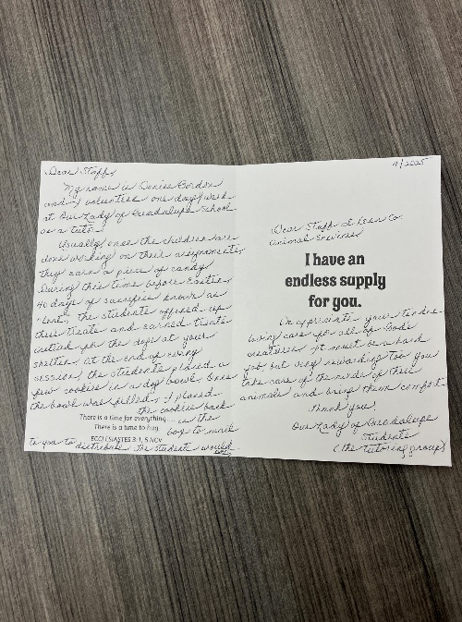
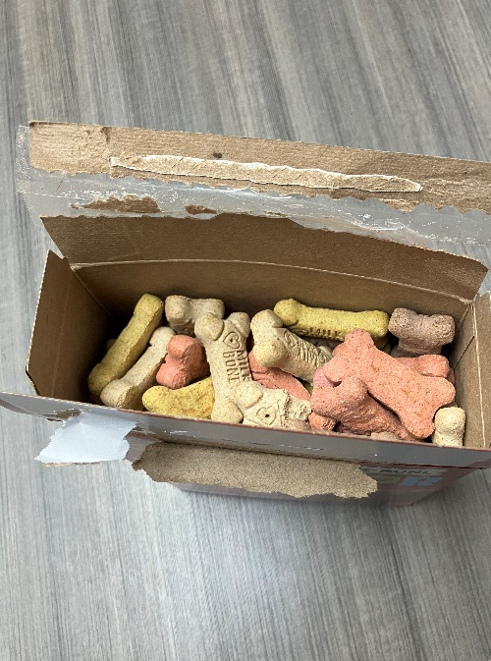
Tutoring Club from Our Lady of Guadalupe School

Slide 21
Dear Staff,
My name is Denise Gordon and I volunteer one day a week at Our Lady
of Guadalupe School as a tutor.
Usually once the children are done working on their assignments, they earn
a piece of candy. During this time before Easter, 40 days of sacrifice known as "Lent," the students offered up their treats and earned treats instead for the dogs at your shelter! At the end of every session, the students placed a few cookies in a dog bowl. Once the bowl was filled, I placed the cookies back in the bag to mail to you to distribute. The students would love to hear if the dogs liked them!
We appreciate your tireless, loving care for all of God's creatures. It must
be a hard job, but very rewarding too. You take care of the needs of the animals and bring them comfort.
Thank you!
Our Lady of Guadalupe Students (the tutoring group)

Slide 22
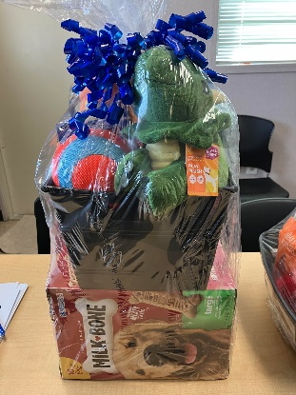
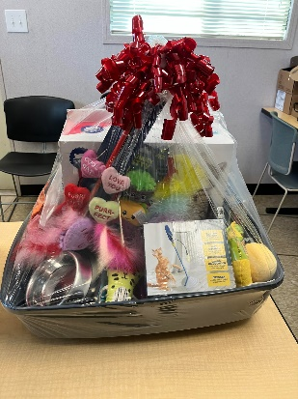
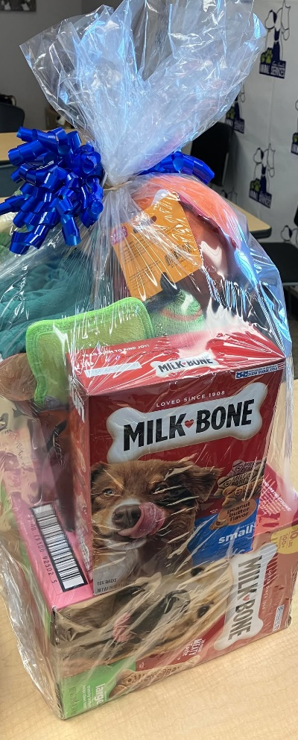
Foster & Volunteer Open House April 5th

Slide 23
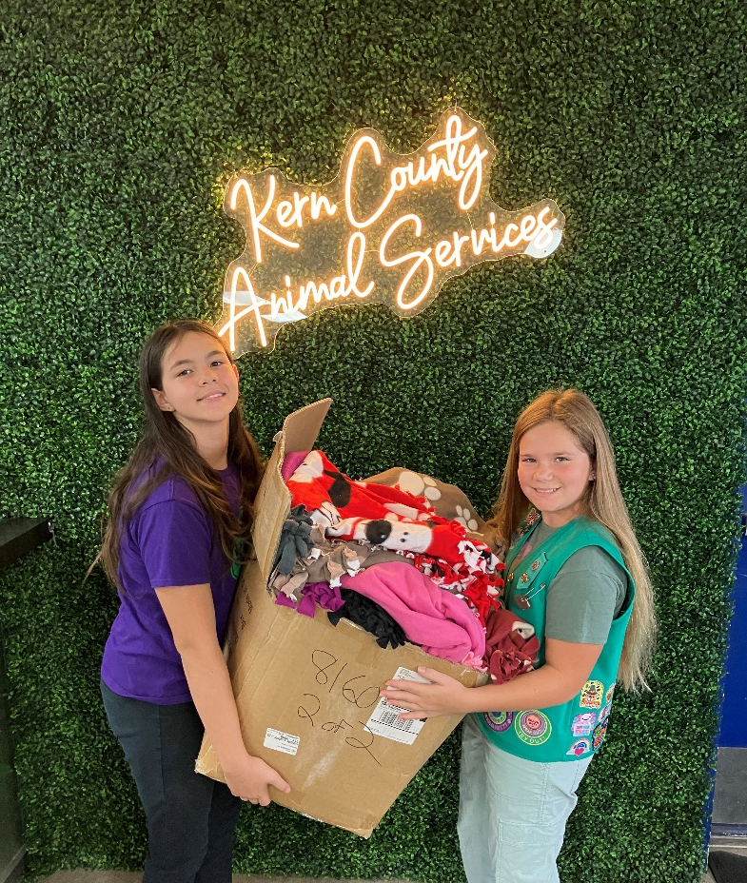
Girl Scout Troop #8160 Blanket Donation Thursday, April 17th

Slide 24
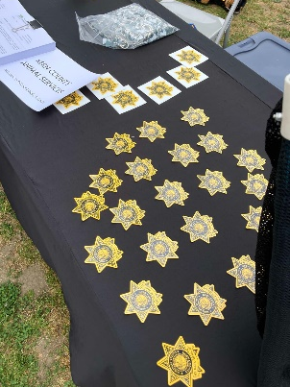
Ollivier Middle School Career Day & Resource Fair! Friday, April 25th

Slide 25
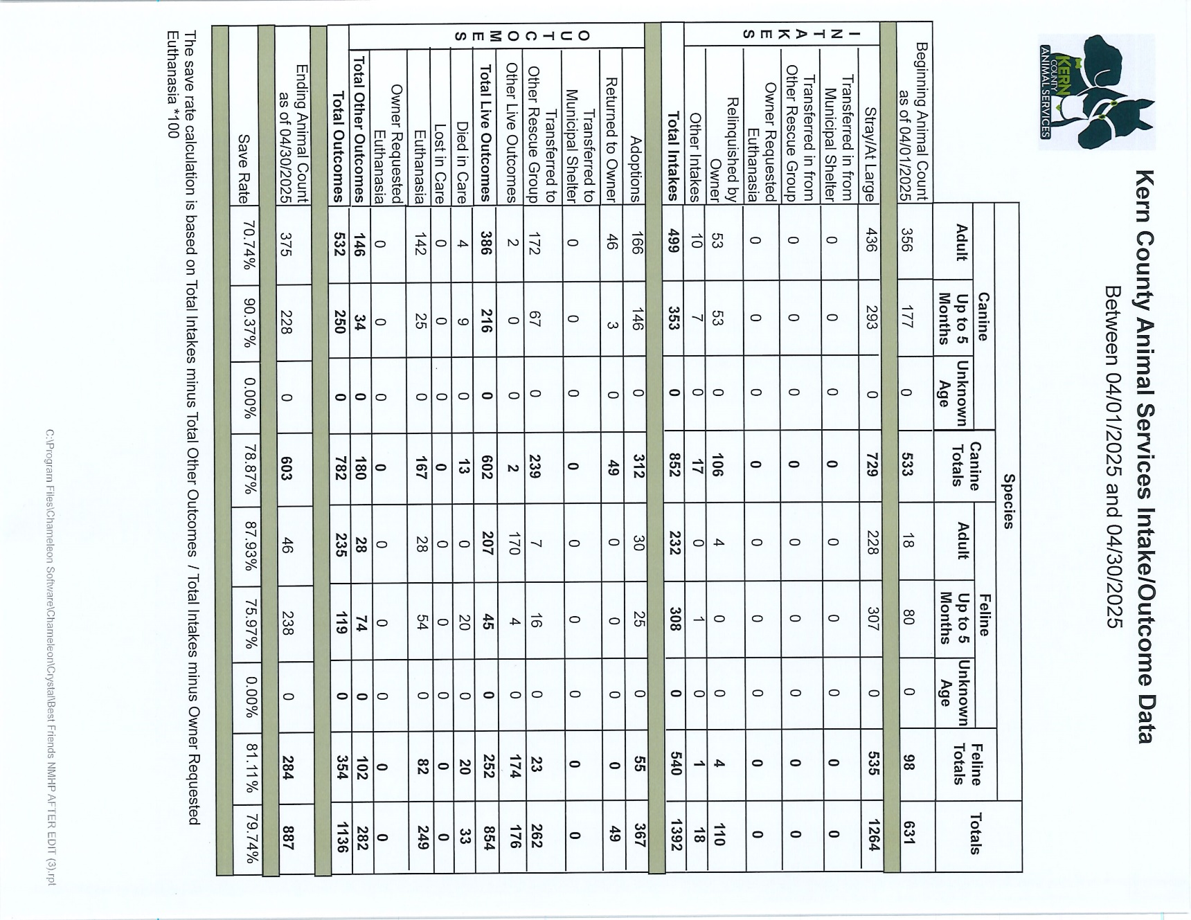

Slide 26
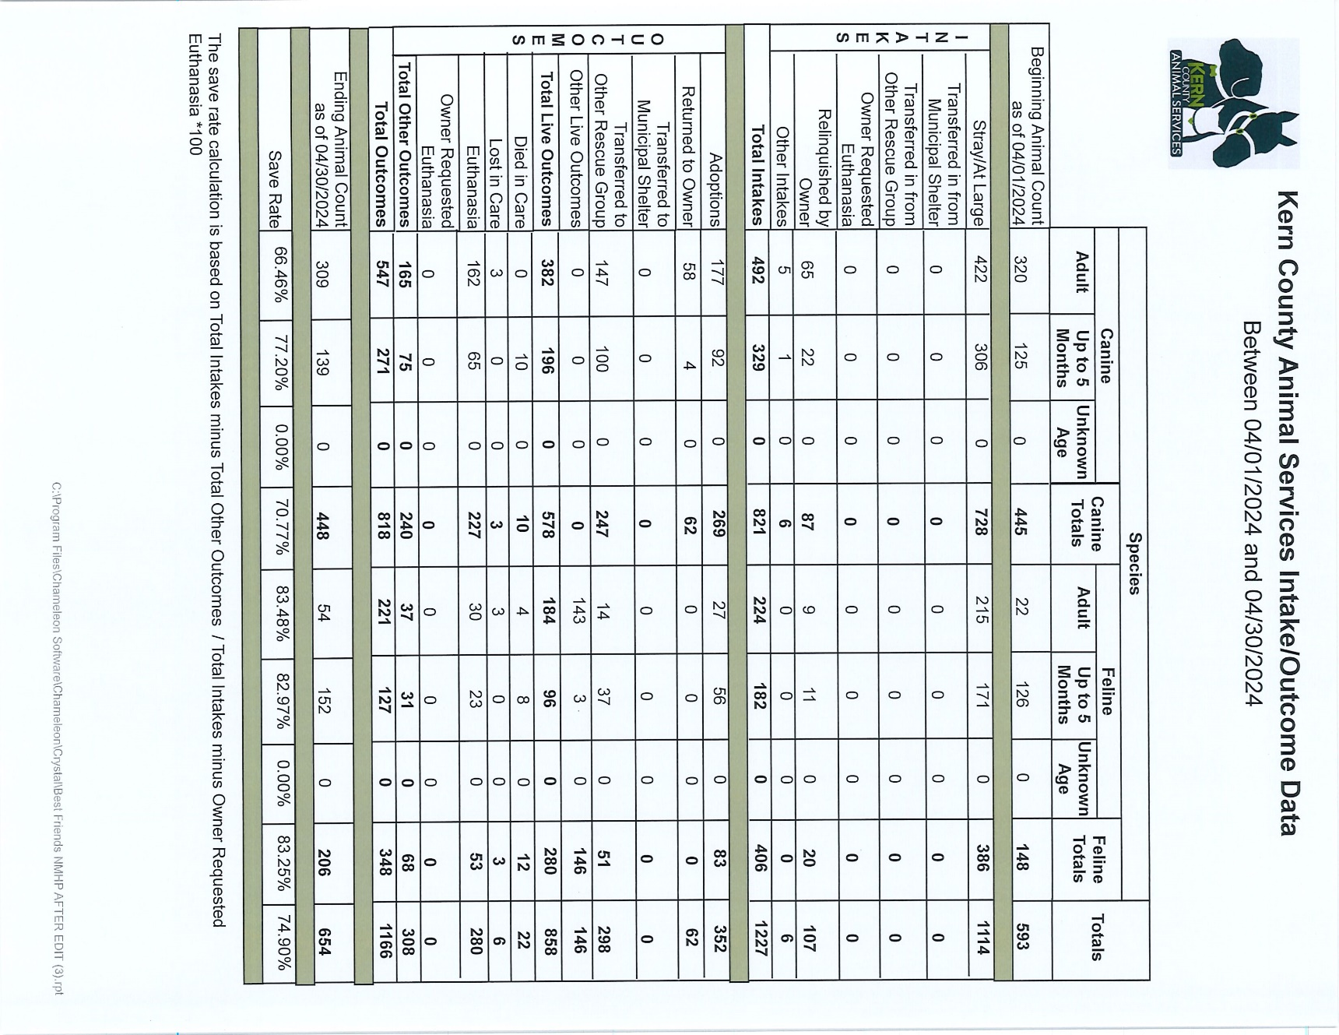

Slide 27
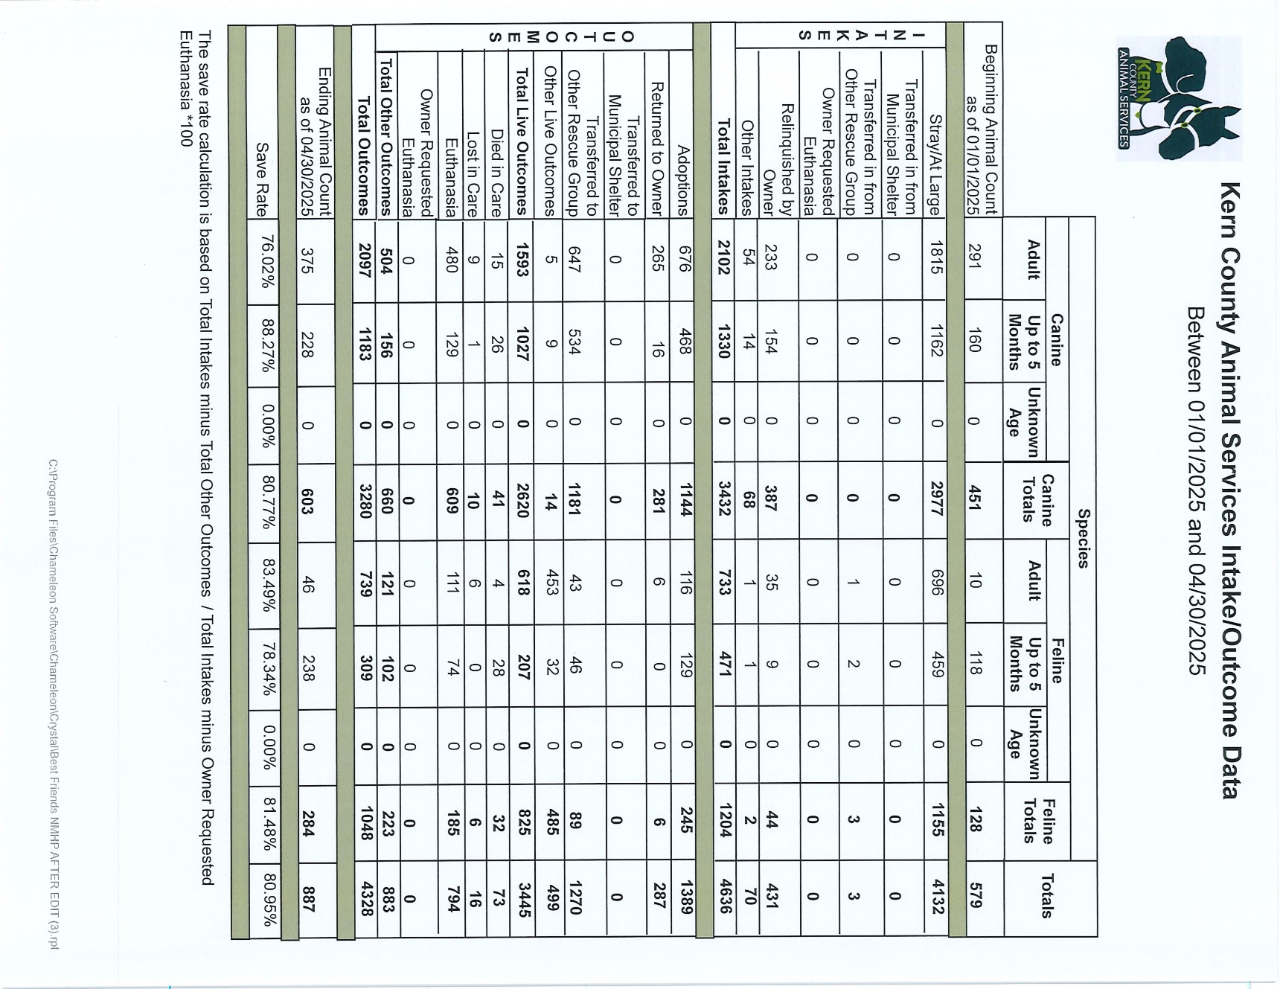

Slide 28
