Slide 1

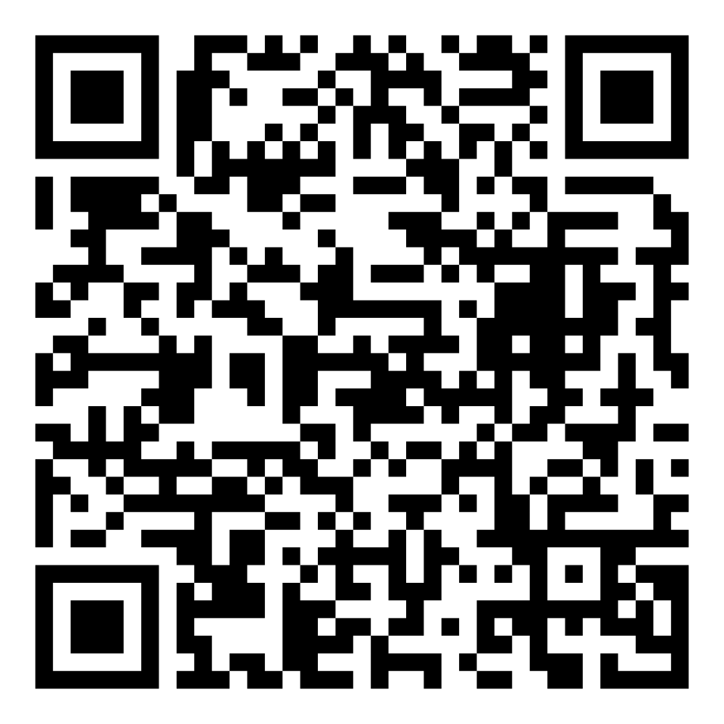
June 2025
Director’s Report

Slide 2
Program Highlights
June 2025
Adoption: 149 dogs, 109 puppies, 23 cats, and 278 kittens under 5 months of age were adopted for a total of 559 animals adopted from Kern County Animal Shelters in the month of June.
Foster: 29 dogs, 47 puppies, 4 cats, and 183 kittens entered the Department’s Foster Care Program in June, for a total of 263 animals.
Rescue: 152 dogs, 146 puppies, 5 cats, and 40 kittens were transferred to other animal rescue organizations in June, for a total of 343 animals.
Spay/Neuter: A total of 424 animals were altered at low-cost KCAS spay/neuter clinics in the month of June.
TNR: 301 cats were spayed or neutered and released in June of 2025. Year-to-date, 987 cats have gone through the program, and since 2013 26,138 cats have been spayed or neutered, and returned to field.

Slide 3
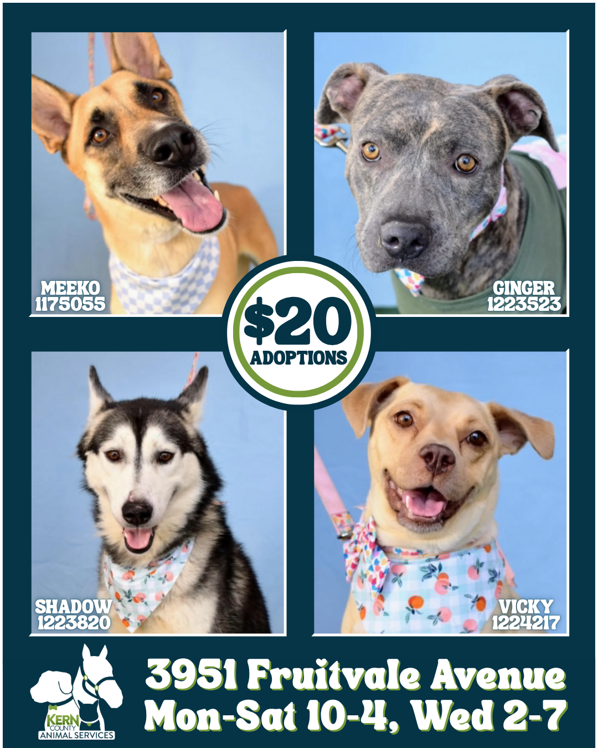
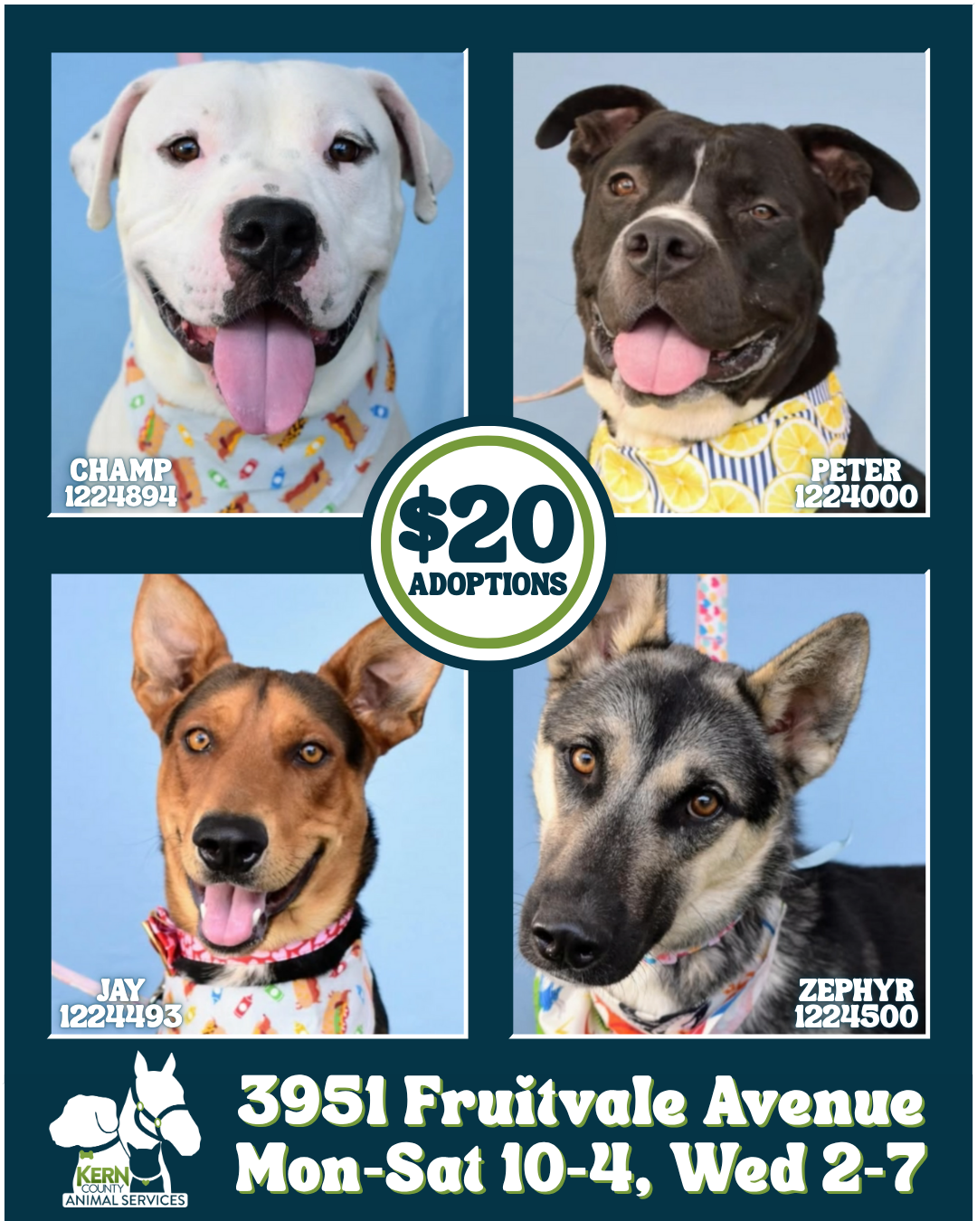
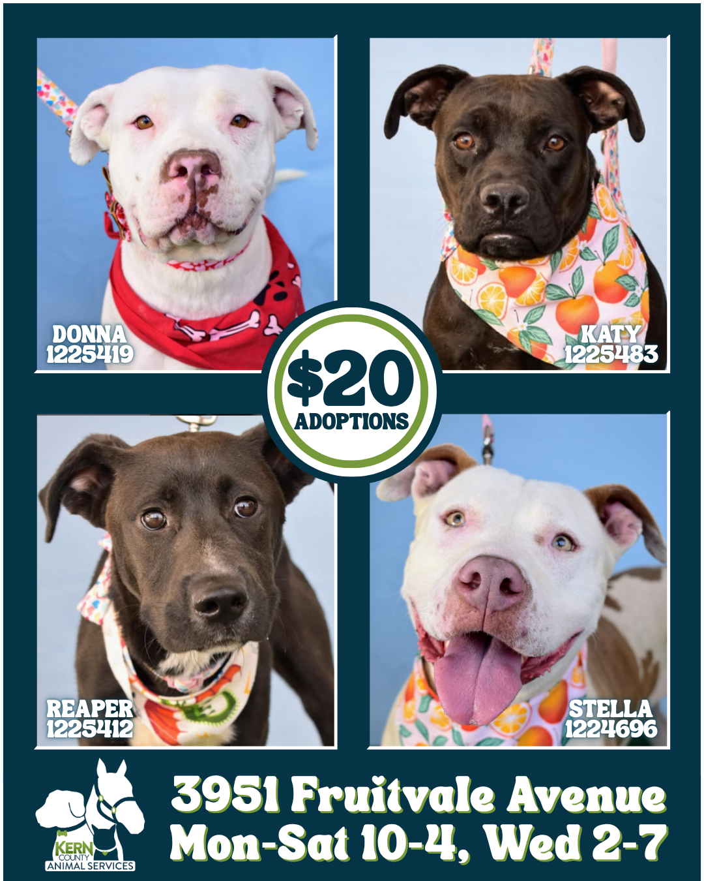
Monthly Adoption Promotions
June 2025
$20 Adoptions
June 2nd – June 28th

Slide 4
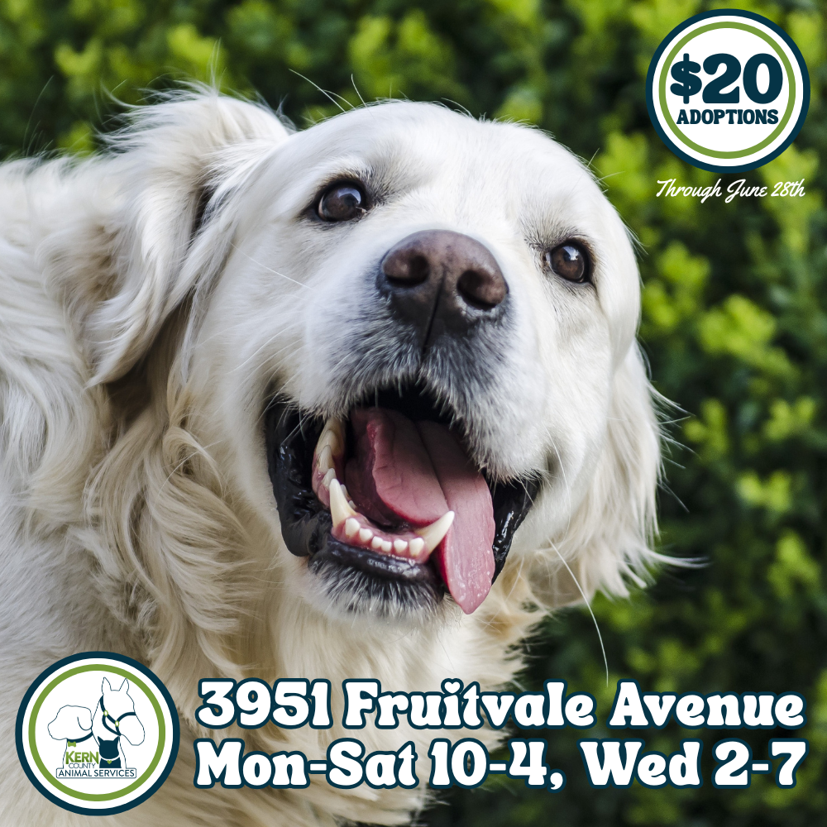
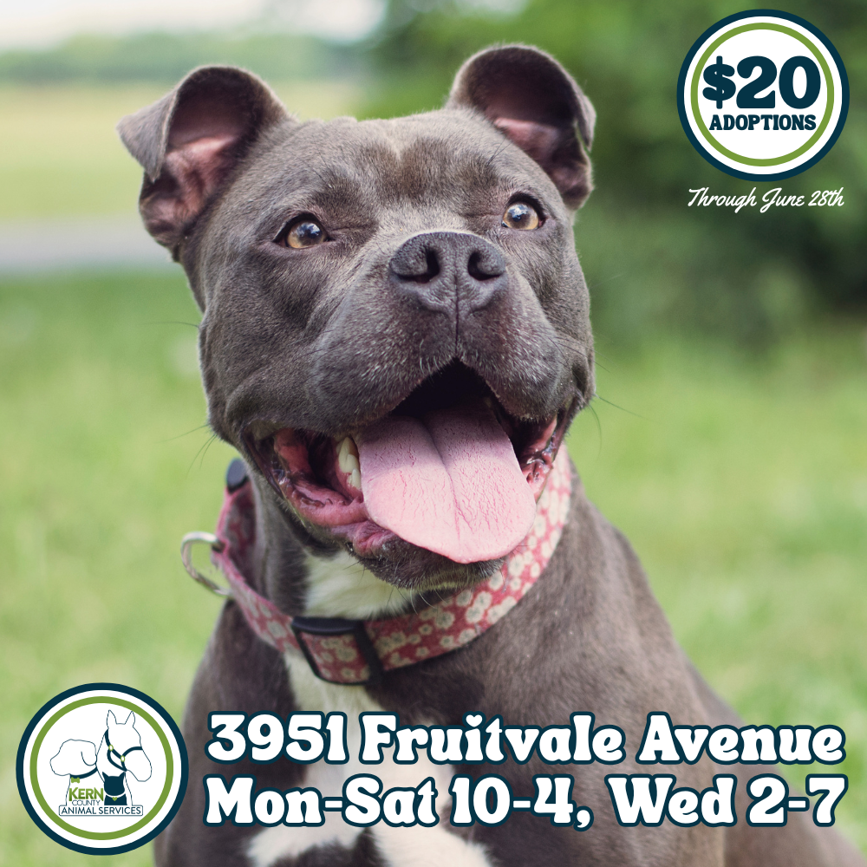
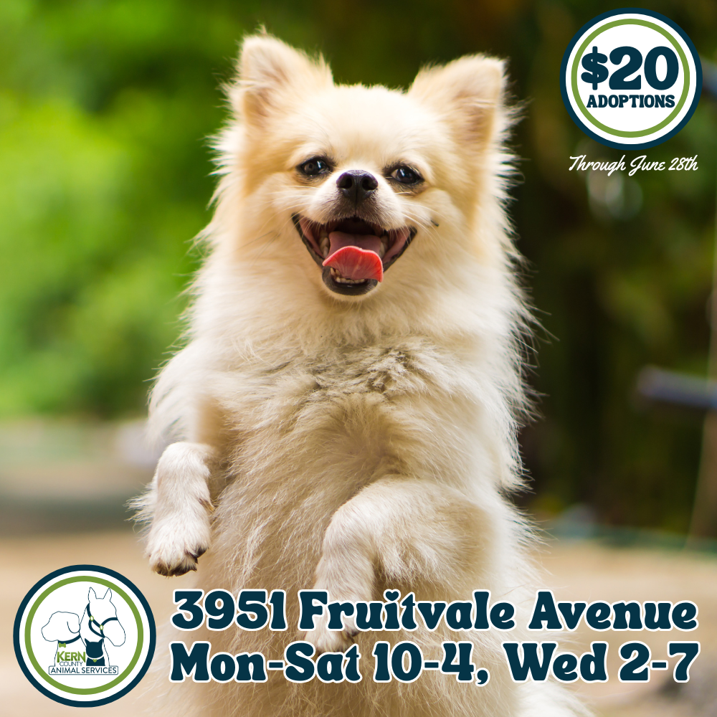
Monthly Adoption Promotions
June 2025
$20 Adoptions
June 2nd – June 28th

Slide 5
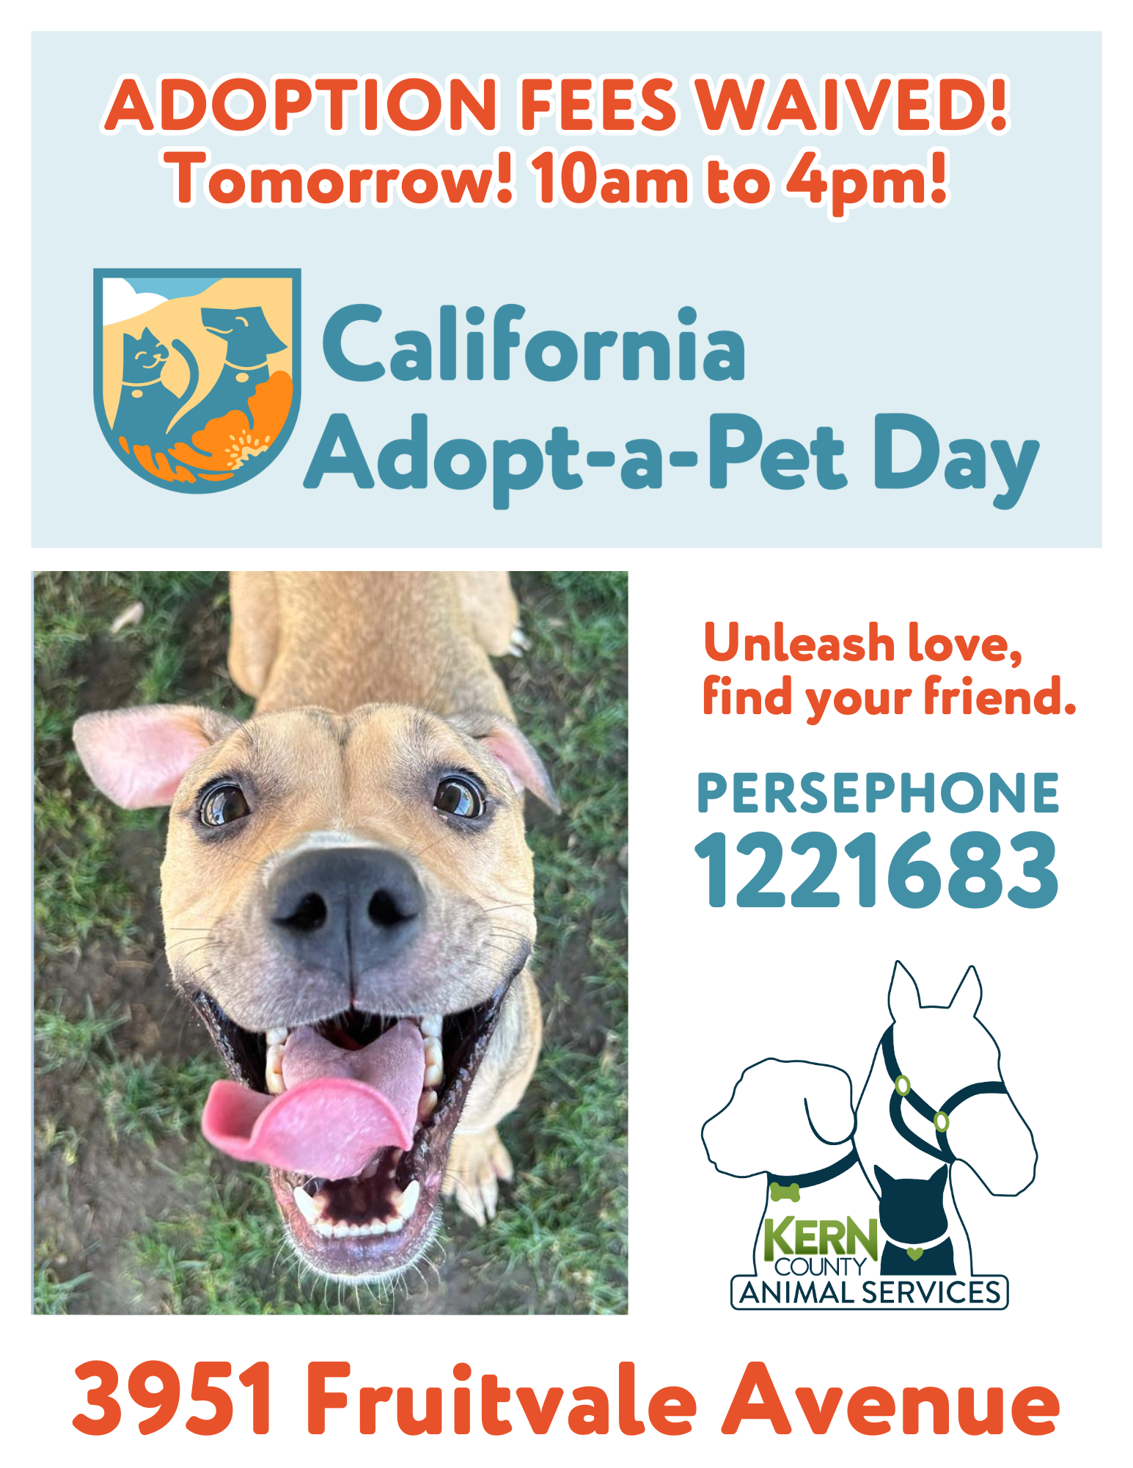
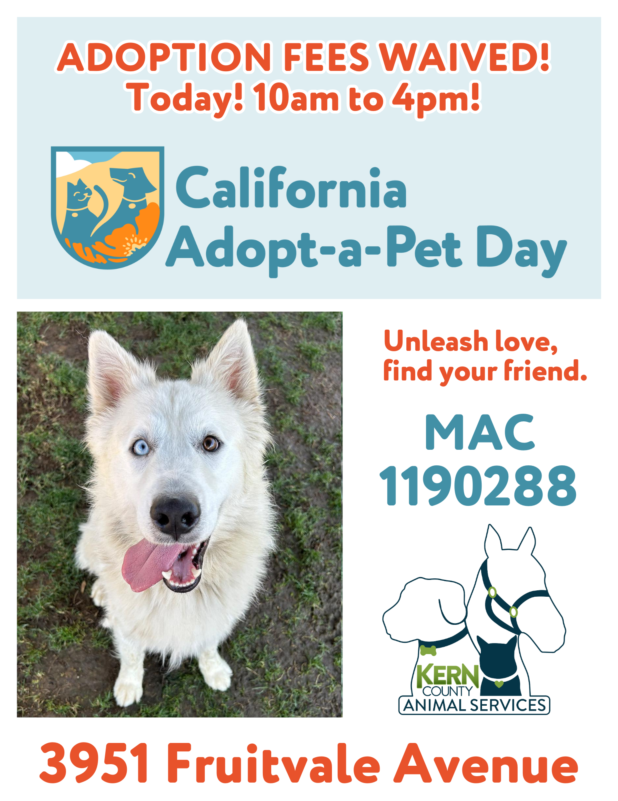

Monthly Adoption Promotions
June 2025
Fee-Waived Adoptions
California Adopt-A-Pet Day
Saturday, June 7th

Slide 6
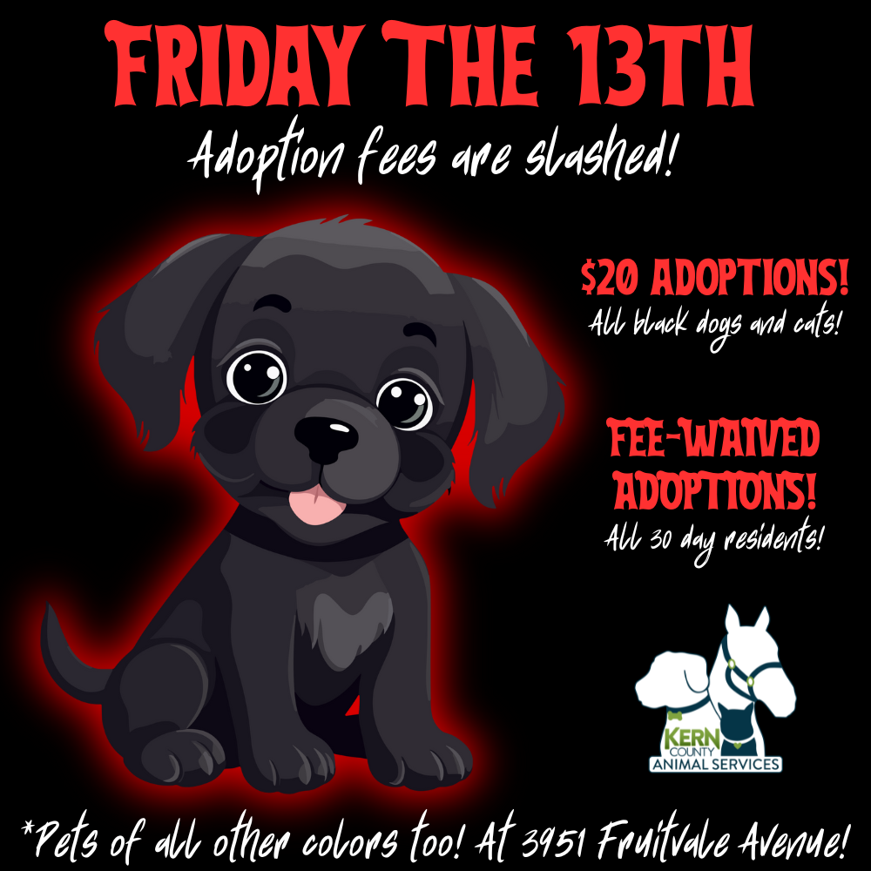

Monthly Adoption Promotions
June 2025
Friday The 13th (June 13th)
Father’s Day (June 15th)

Slide 7




Offsite Adoption Events
June 6th – 8th

Slide 8
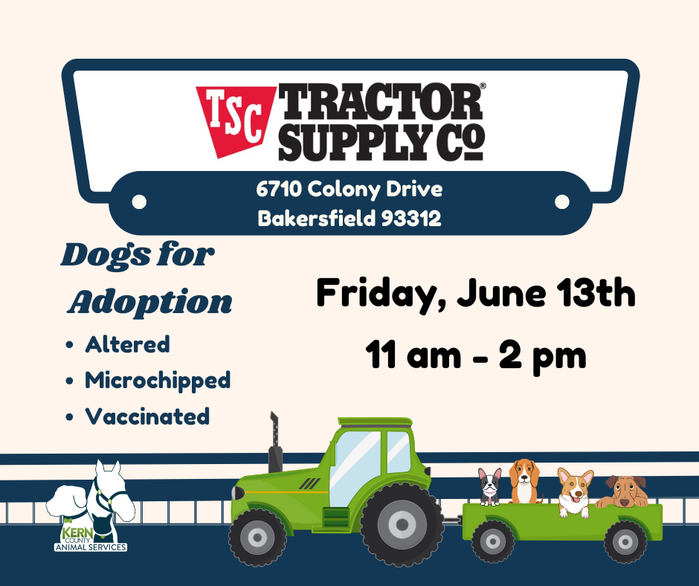


Offsite Adoption Events
June 13th - 15th

Slide 9
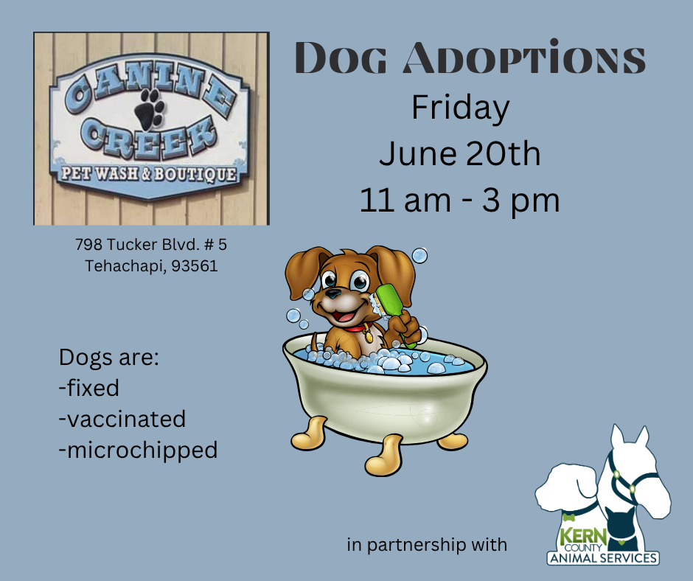
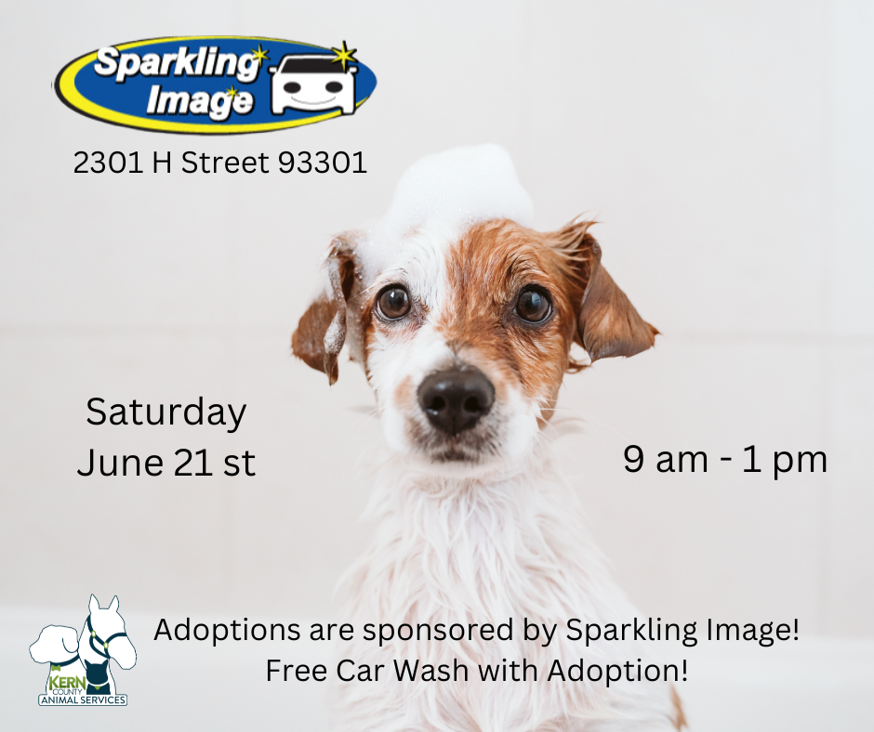

Offsite Adoption Events
June 20th – 22nd

Slide 10



Offsite Adoption Events
June 27th – 29th

Slide 11
Spay/Neuter Program
June 2025
June 2nd
North Meadows Park
46
June 3rd
Heritage Park
84
June 4th
Heritage Park
42
June 5th
Heritage Park (Collaboration with S.O.S. Rescue)
81
June 11th
Taft, California
39
June 12th
Heritage Park (Collaboration with S.O.S. Rescue)
92
June 18th
Tehachapi, California
40
Total Surgeries
424

Slide 12
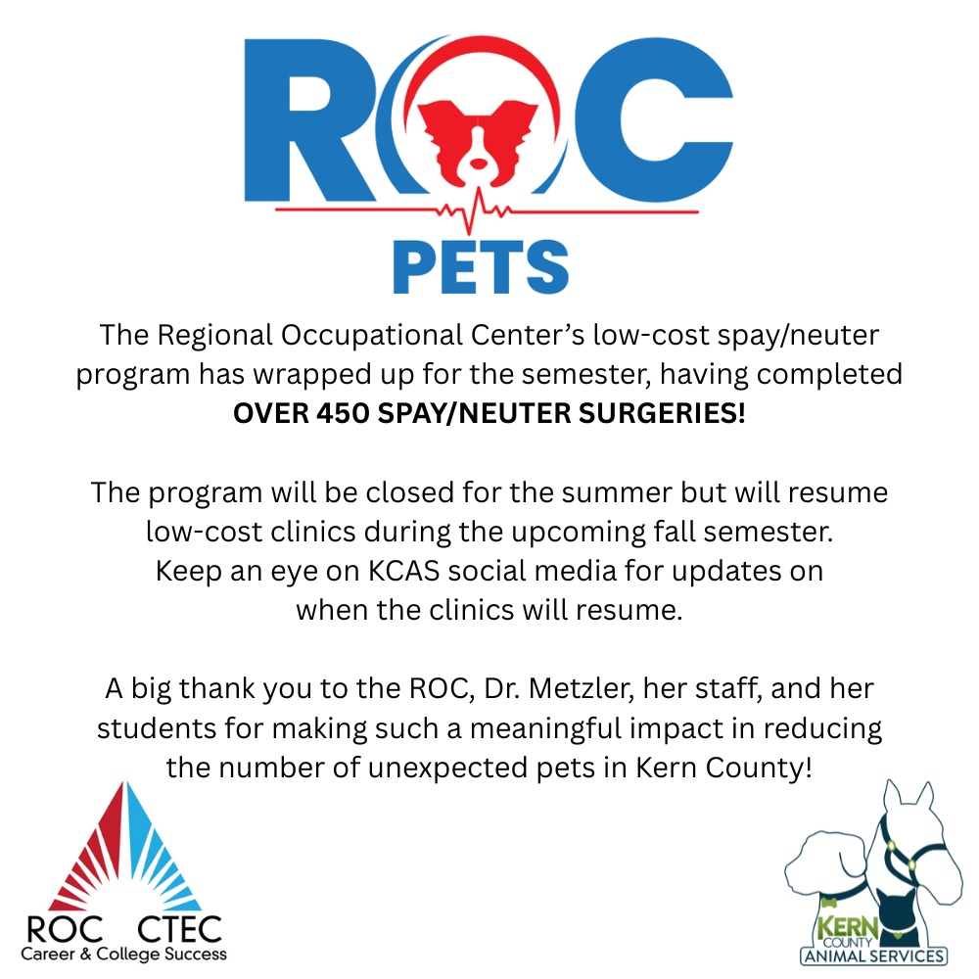

Slide 13
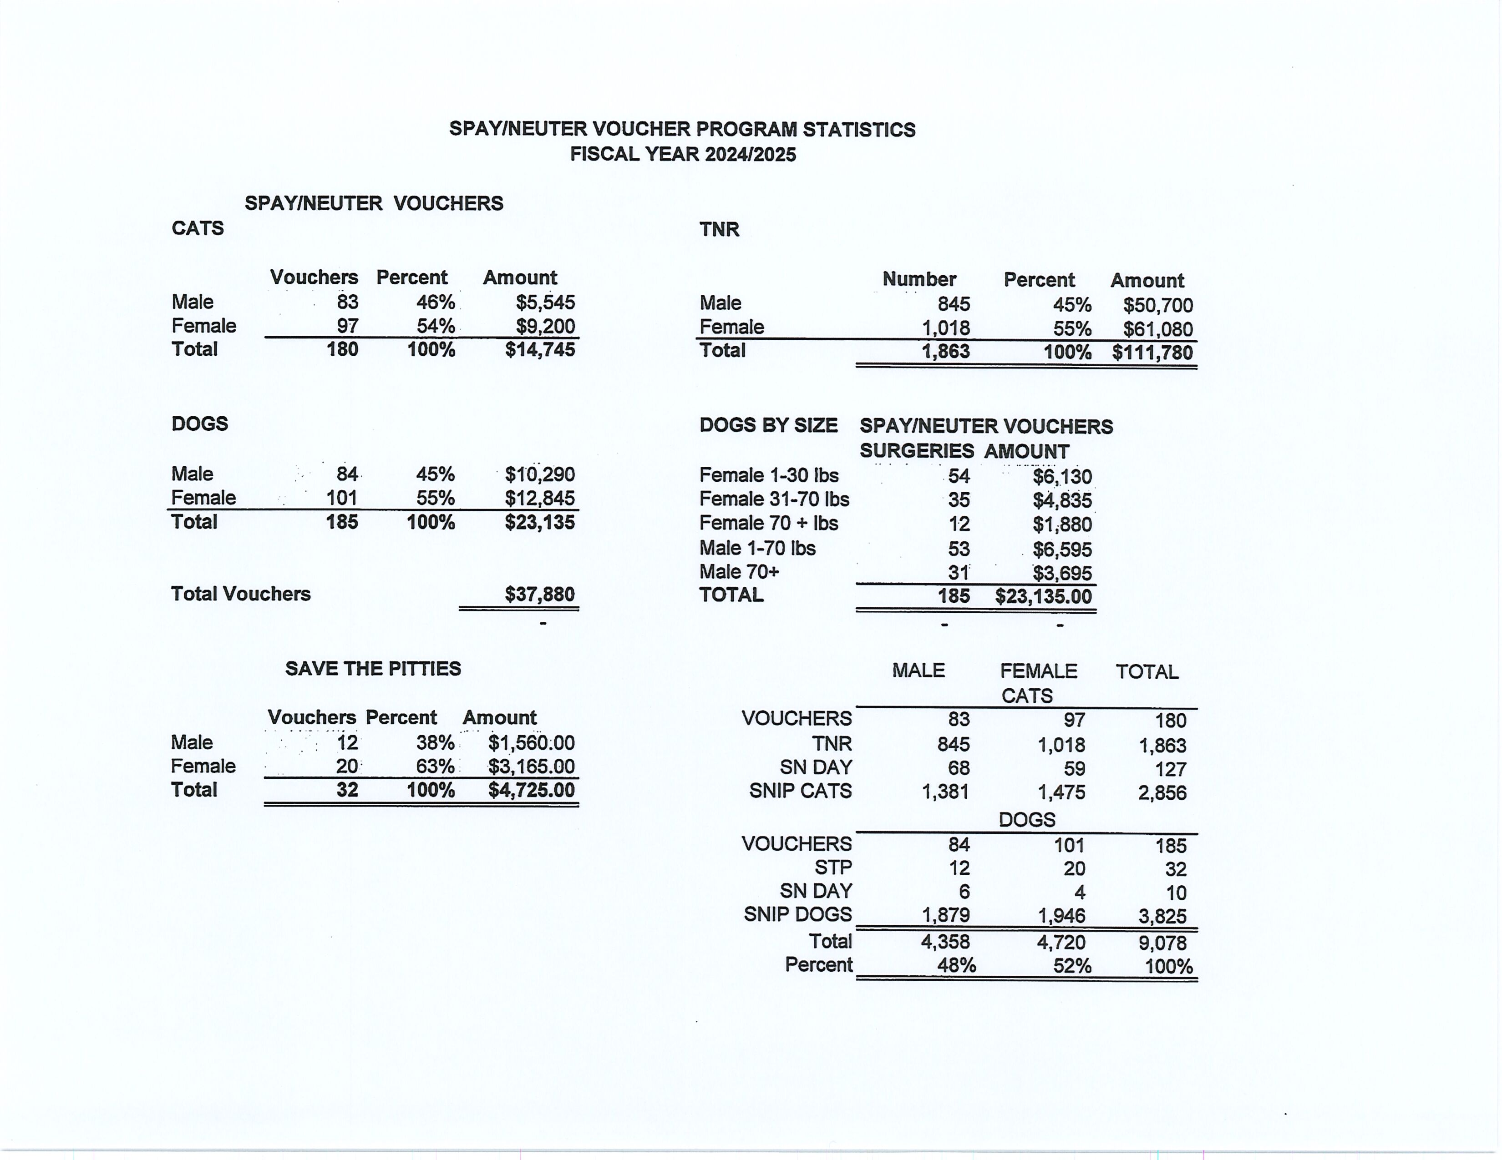

Slide 14
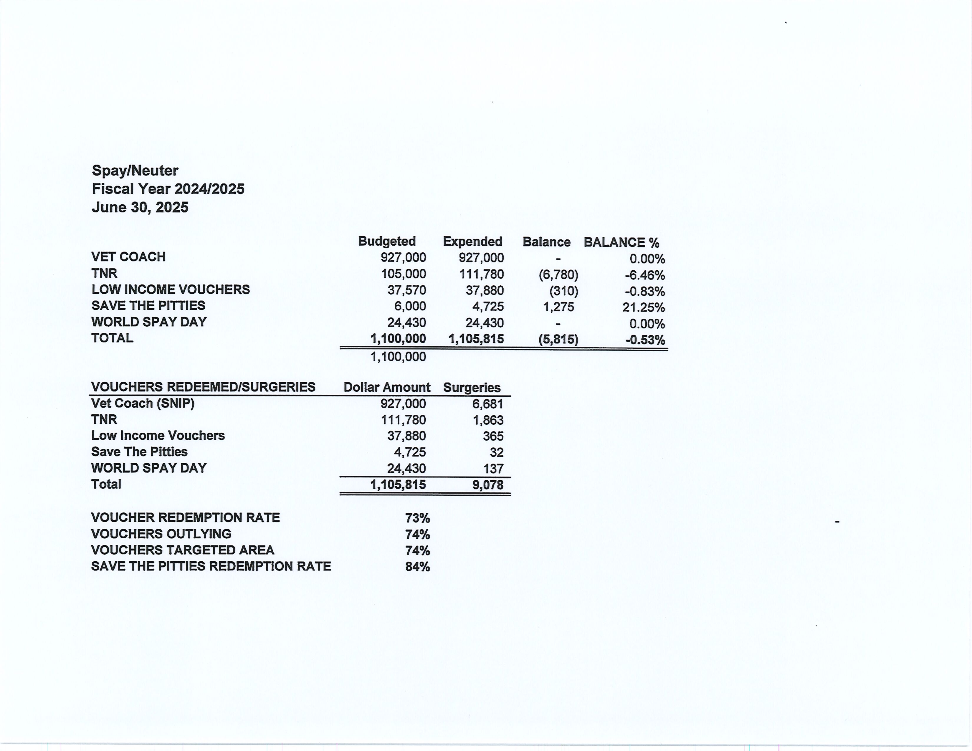

Slide 15
Vaccination Clinics
June 2025
Rabies
450
DHPP*
376
FVRCP*
Microchips
Bordetella
210
75
*DHPP and FVRCP vaccinations provided at no-cost by Petco Love.
66

Slide 16
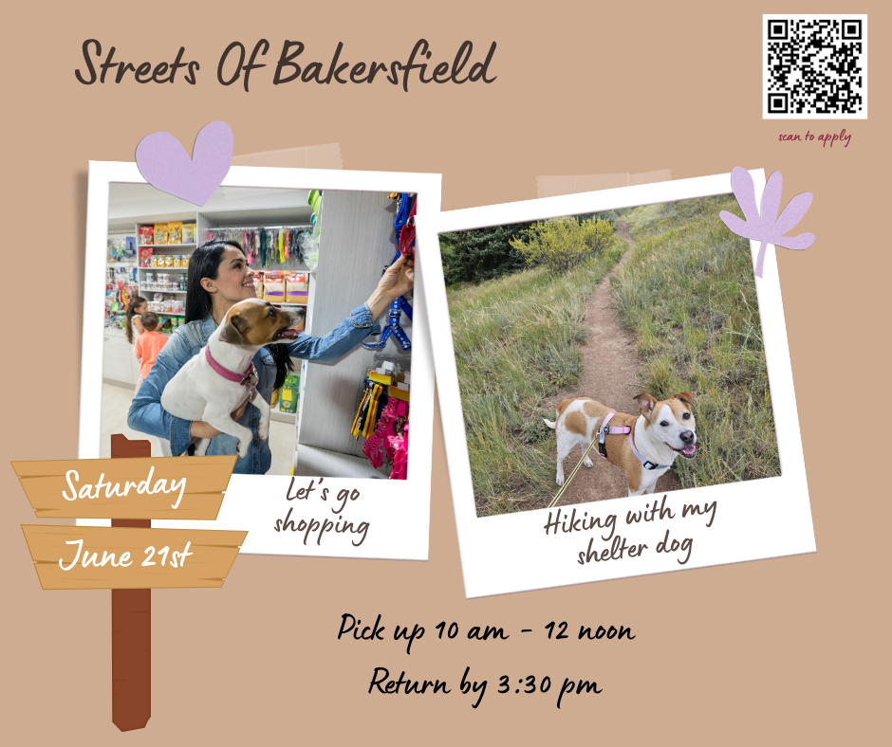

Streets Of Bakersfield
June 7th & June 21st

Slide 17

Weekend Sleepovers
June 7th – June 9th
June 21st – June 23rd

Slide 18
Volunteer Program
June 2025
Active Volunteers
123
New Volunteers
48
Volunteer hours donated in June
Volunteer hours donated in 2025
1,130
5,531

Slide 19
Field Service Calls
June 2025
AREA | CALLS PER AREA
Lake Isabella | 116
Mojave | 98
North County | 58
Northeast | 293
Northwest | 246
Ridgecrest | 22
Southeast | 173
Southwest | 161
Taft | 91
Tehachapi | 57
TOTAL | 1,315
12 dogs were returned to their owners in the field in June 2025.
91 dogs were secured on property by Animal Control Officers in June 2025.

Slide 20
Commercial Animal Facility Calls
June 2025
TYPE | CALLS PER TYPE
CAF – Breeder | 8
CAF – Rescue | 2
CAF – Kennel | 1
CAF – Boarding | 0
TOTAL | 11
5 Inspections Passed
0 Inspections Failed
0 Citations Issued
0 Permits Issued
52 Active CAF Permits

Slide 21

Our Tales For Tails Summer Reading Program
resumed on June 25th and it was a big success!
The kids, their parents, and our shelter pets
all had a great time!
There's plenty of room for many more
to participate! If you missed it in June,
we’re doing it again on July 23rd and
August 27th! For more info hit us up at
animalservicesvolunteer@kerncounty.com!

Slide 22
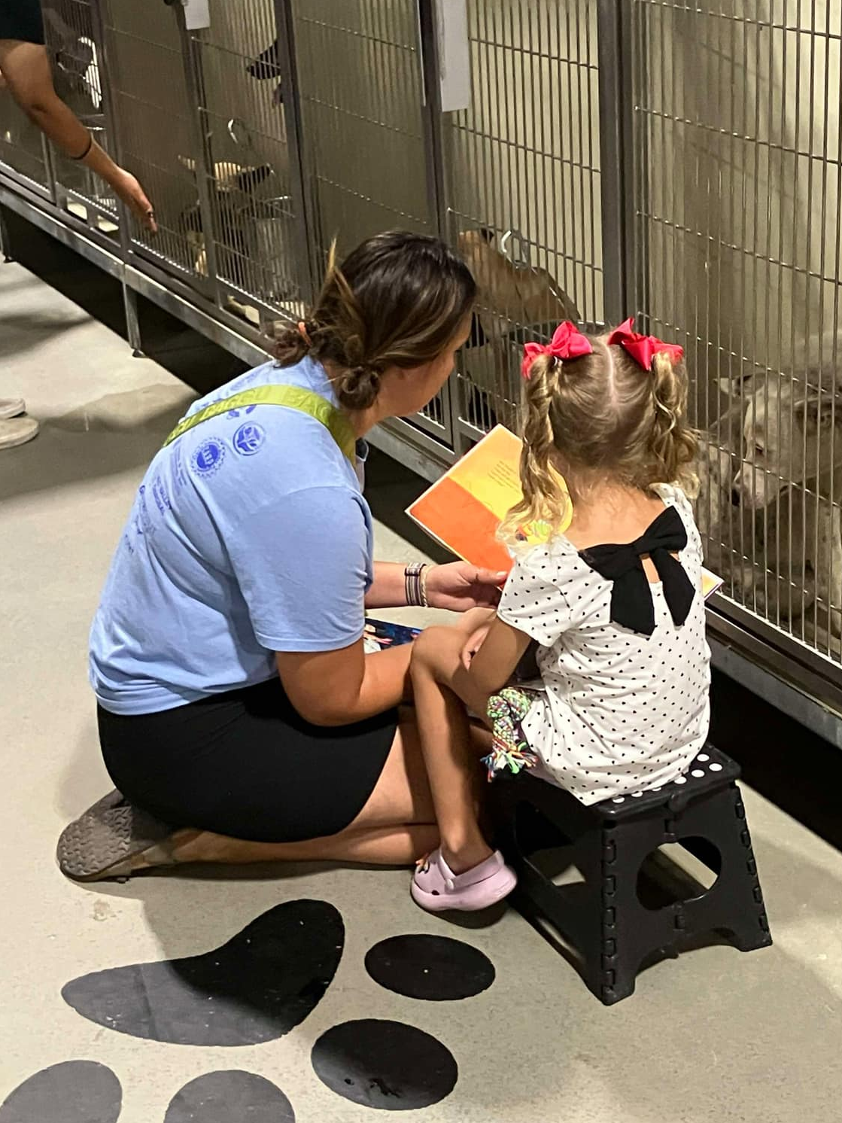
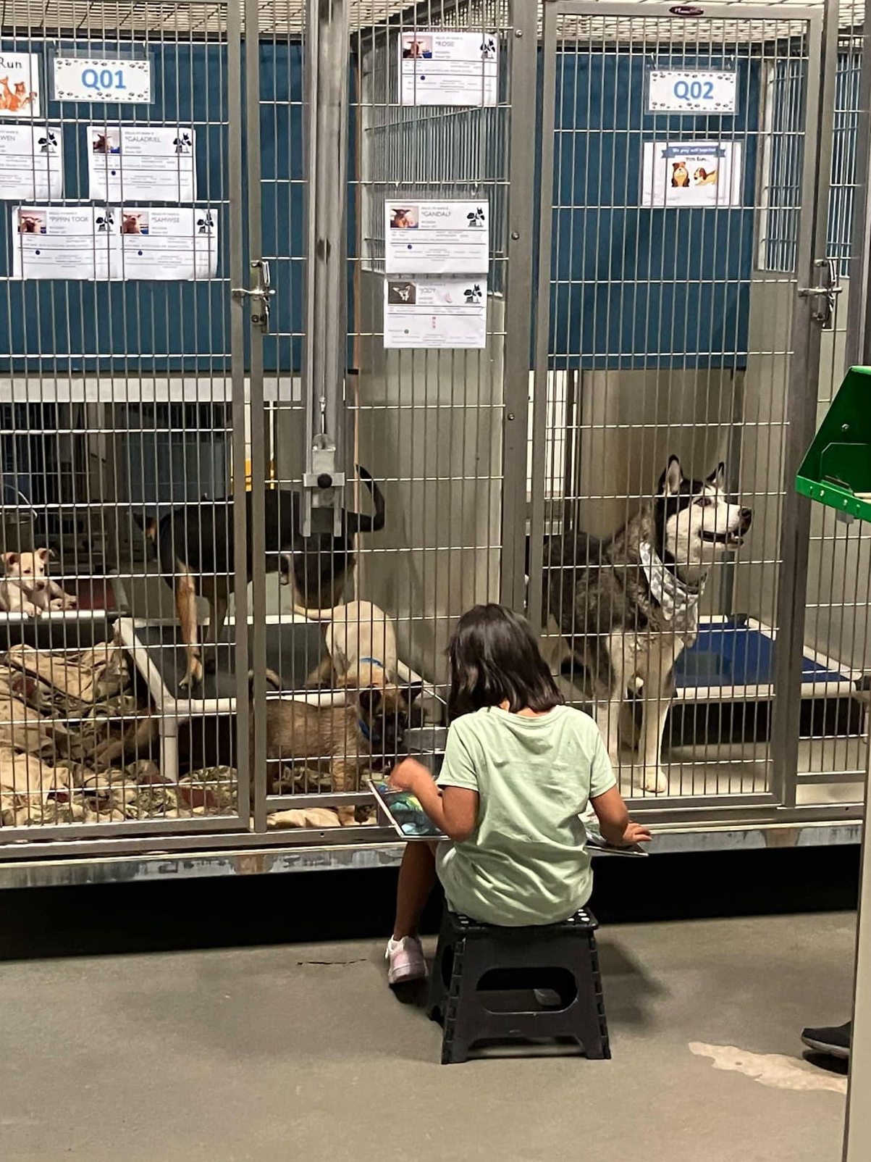
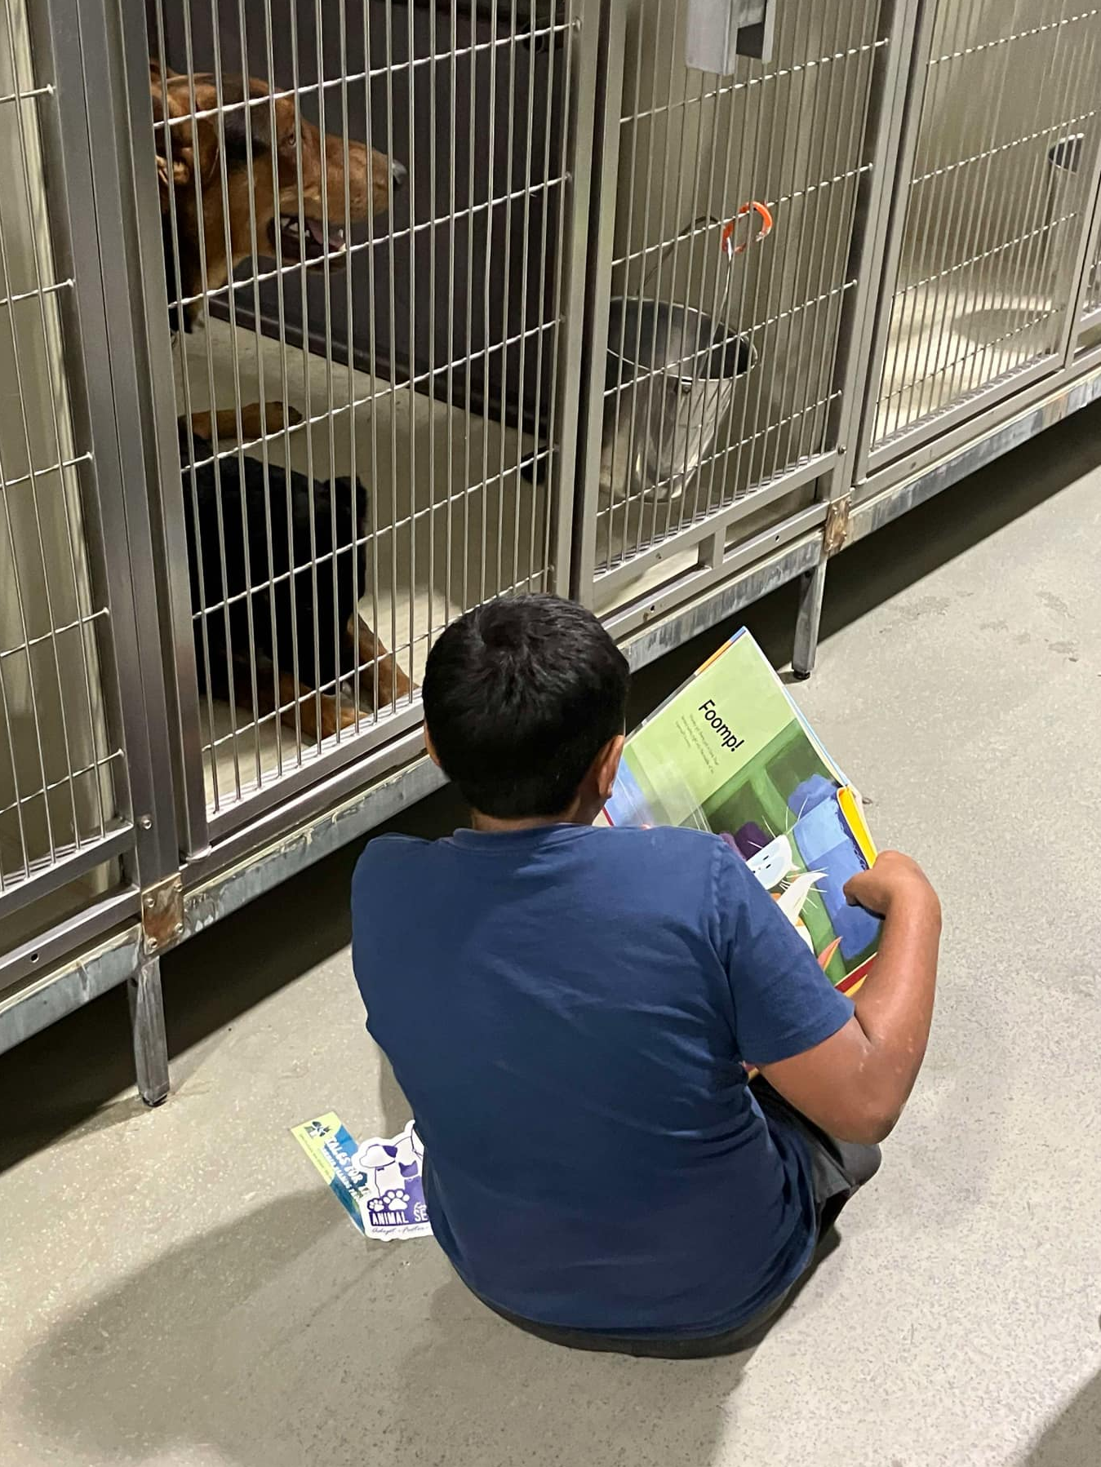
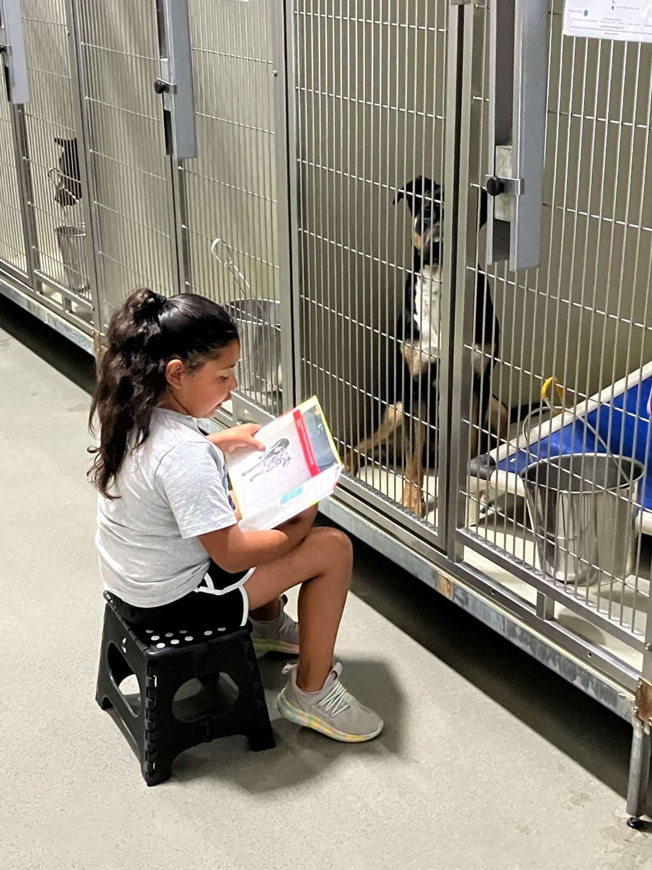
Tales For Tails!

Slide 23
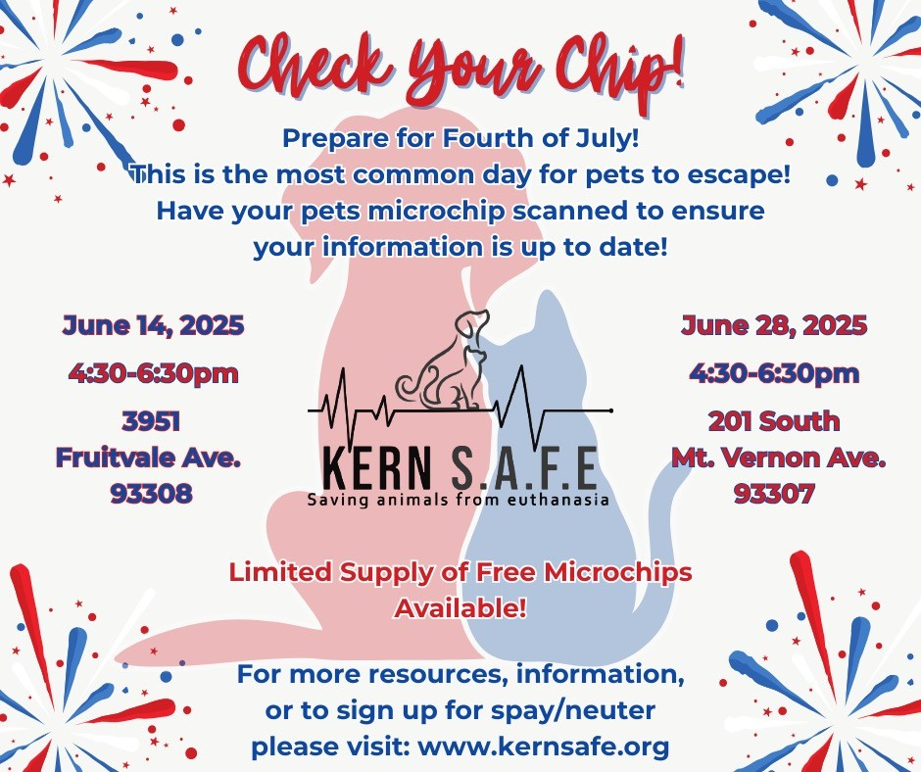
4th Of July Preparation
In the days leading up to the 4th Of July, KCAS teamed-up with Kern S.A.F.E. for a “Check Your Chip” event.
Too many microchips have old or outdated contact information, which prevents pets from being reunited with their owners when they get lost. Events like Check The Chip raises awareness of this problem and helps to fix it!
Free microchips were also available!

Slide 24
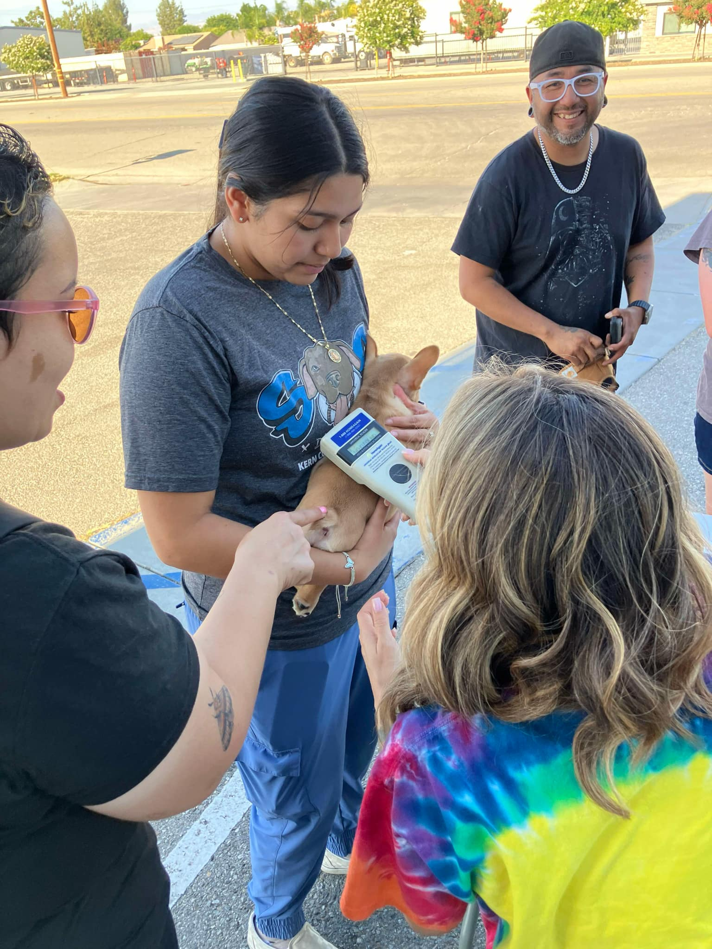
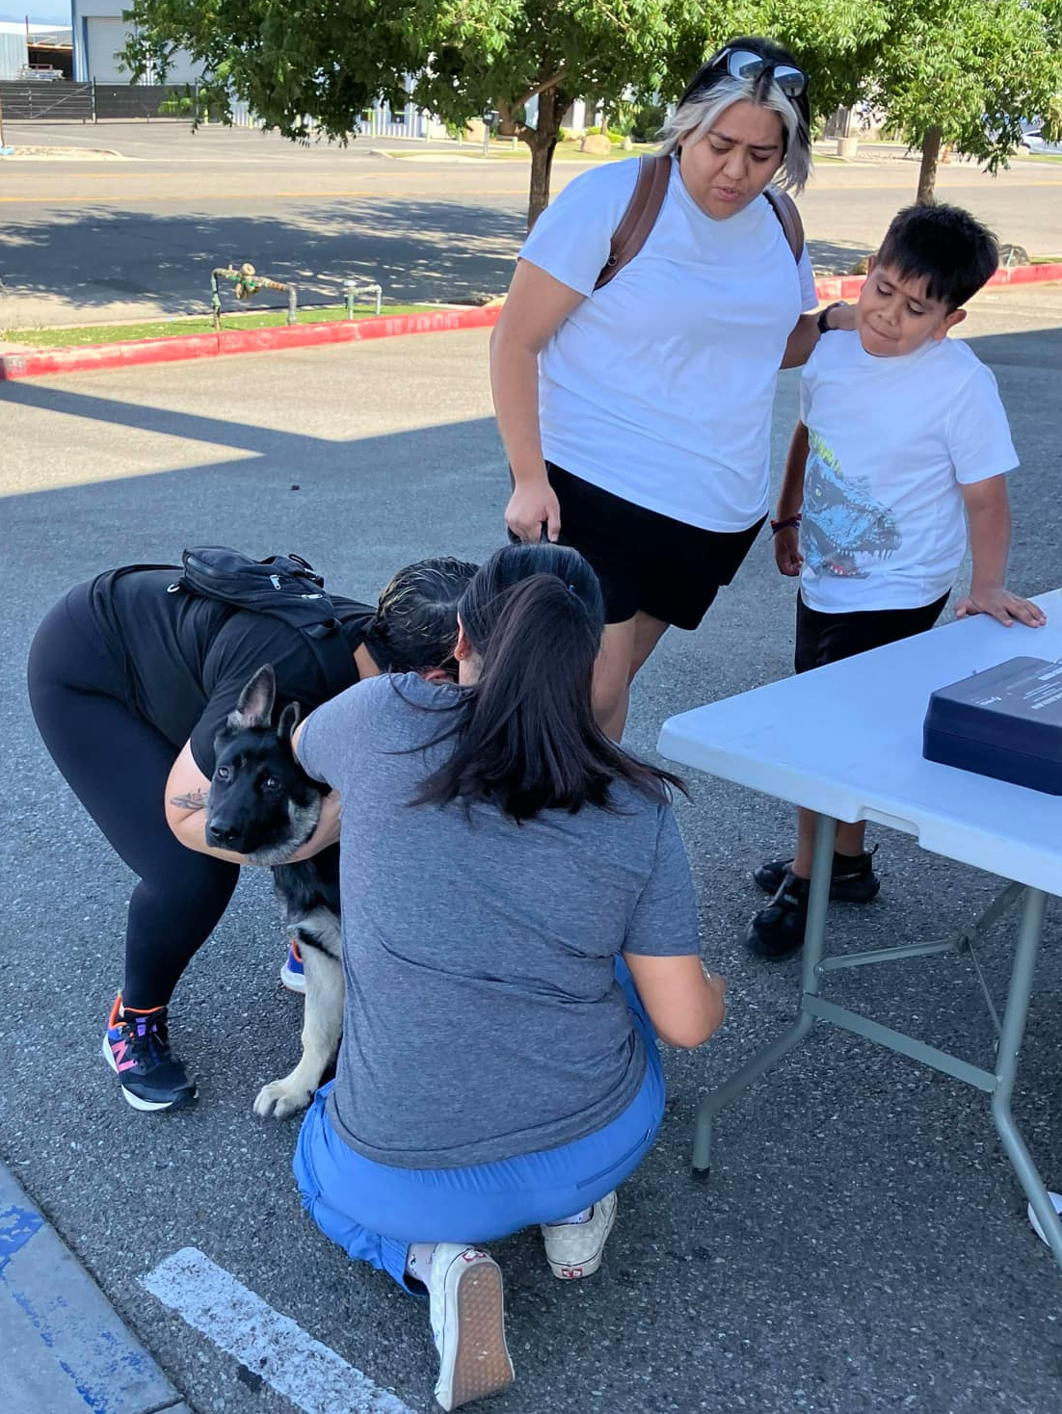
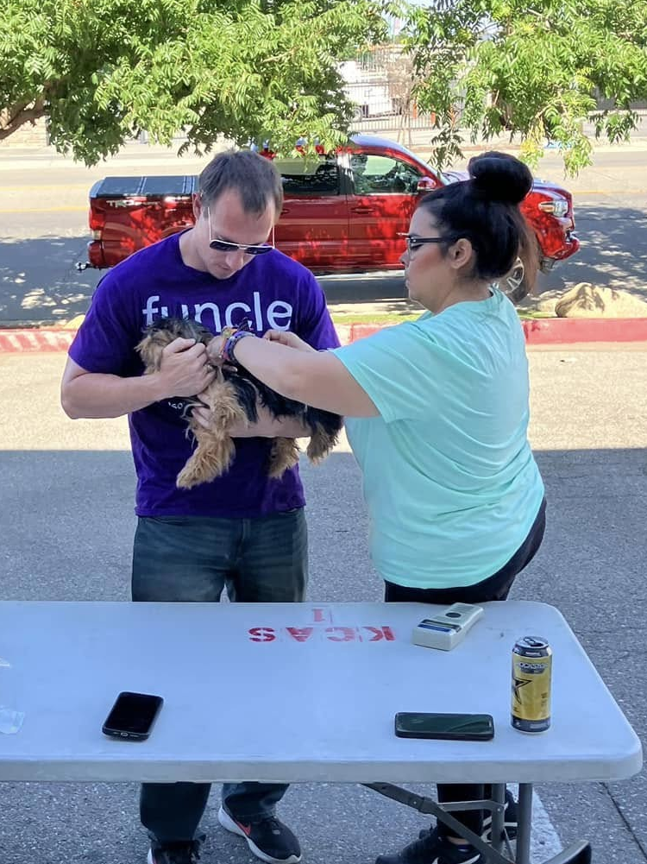
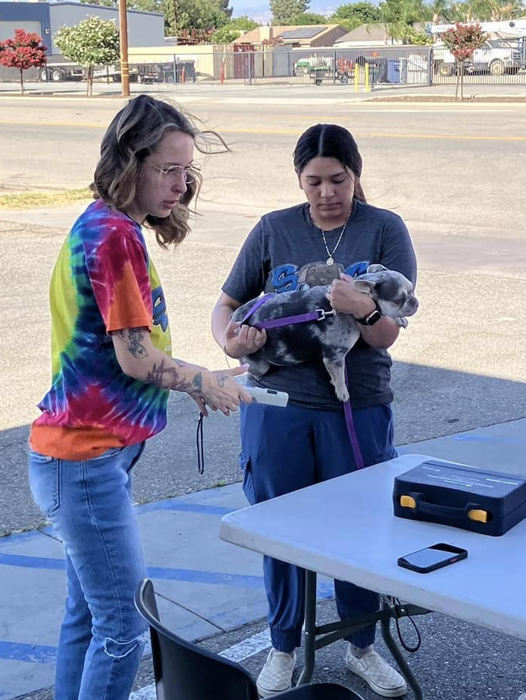
Check The Chip!

Slide 25
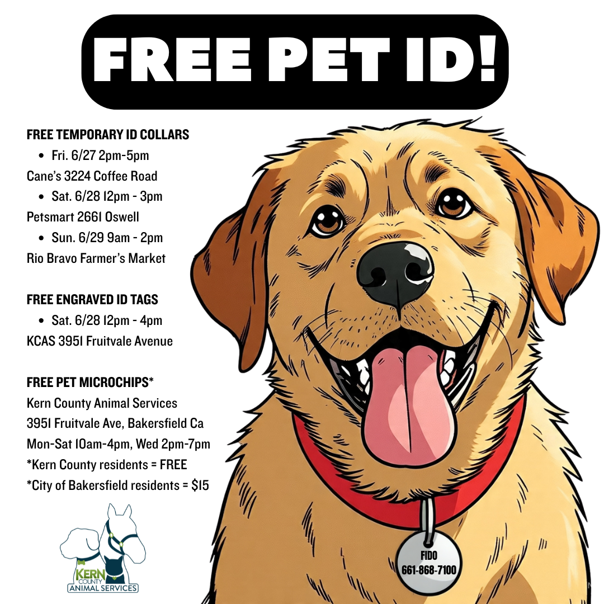
4th Of July Preparation
KCAS offered a variety of pet identification options in advance of the 4th Of July.
Temporary ID collars, engraved ID tags, and microchips!
No matter where in the Bakersfield area you were, KCAS had some form of free pet ID available to you!

Slide 26
2025
Year To Date
January 1st – June 30th
Adoptions: 2,359
Rescued: 1,992
Returned To Owner: 388
Spay/Neuter Surgeries: 4,808
Total Lives Saved: 5,740
Save Rate: 78.24%

Slide 27
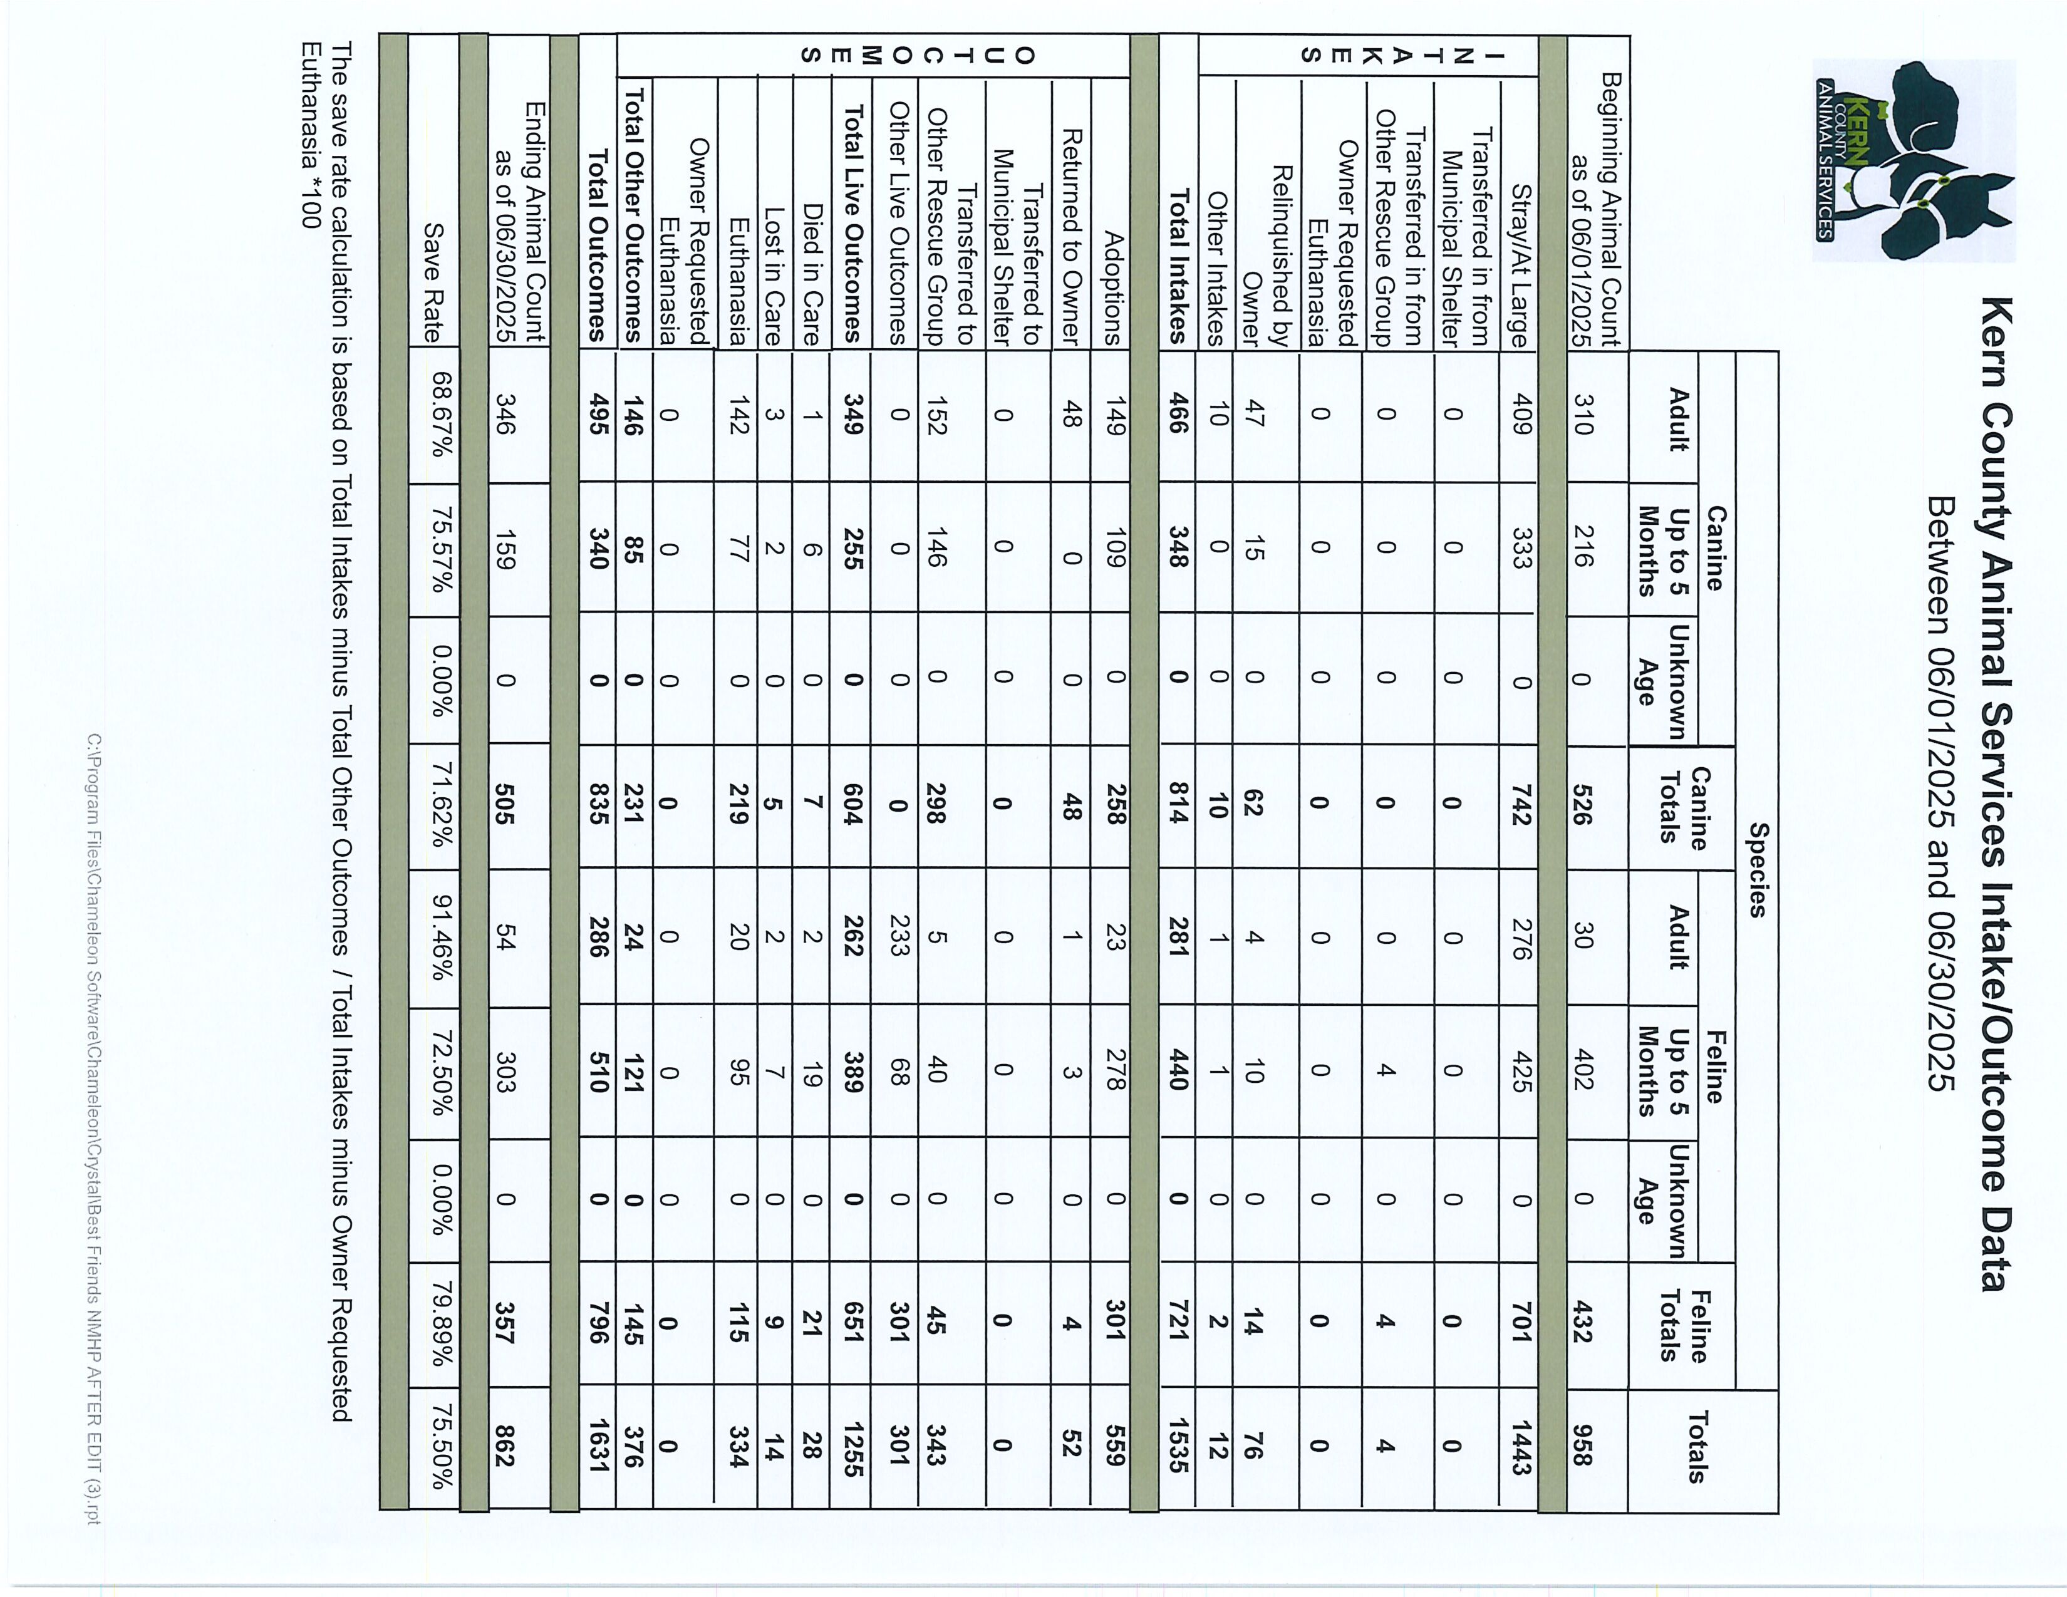

Slide 28
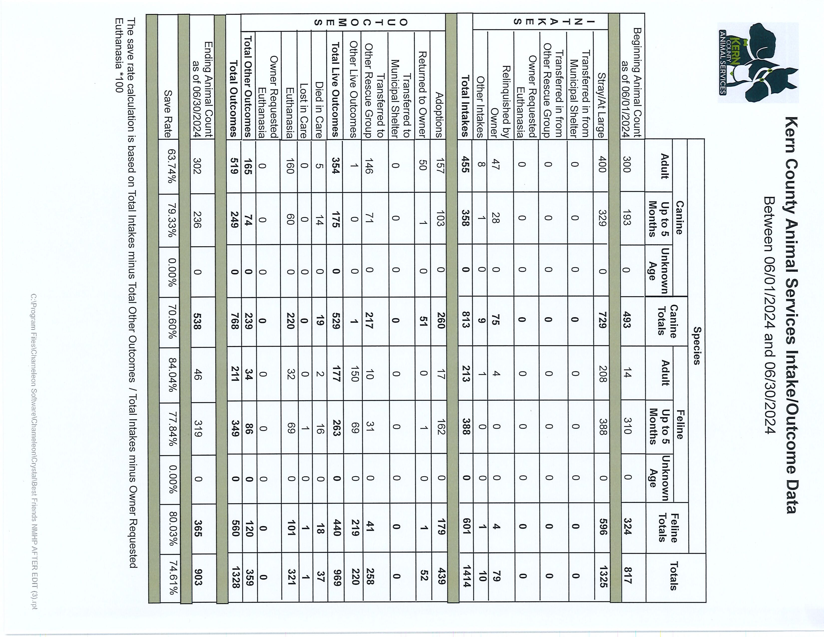

Slide 29
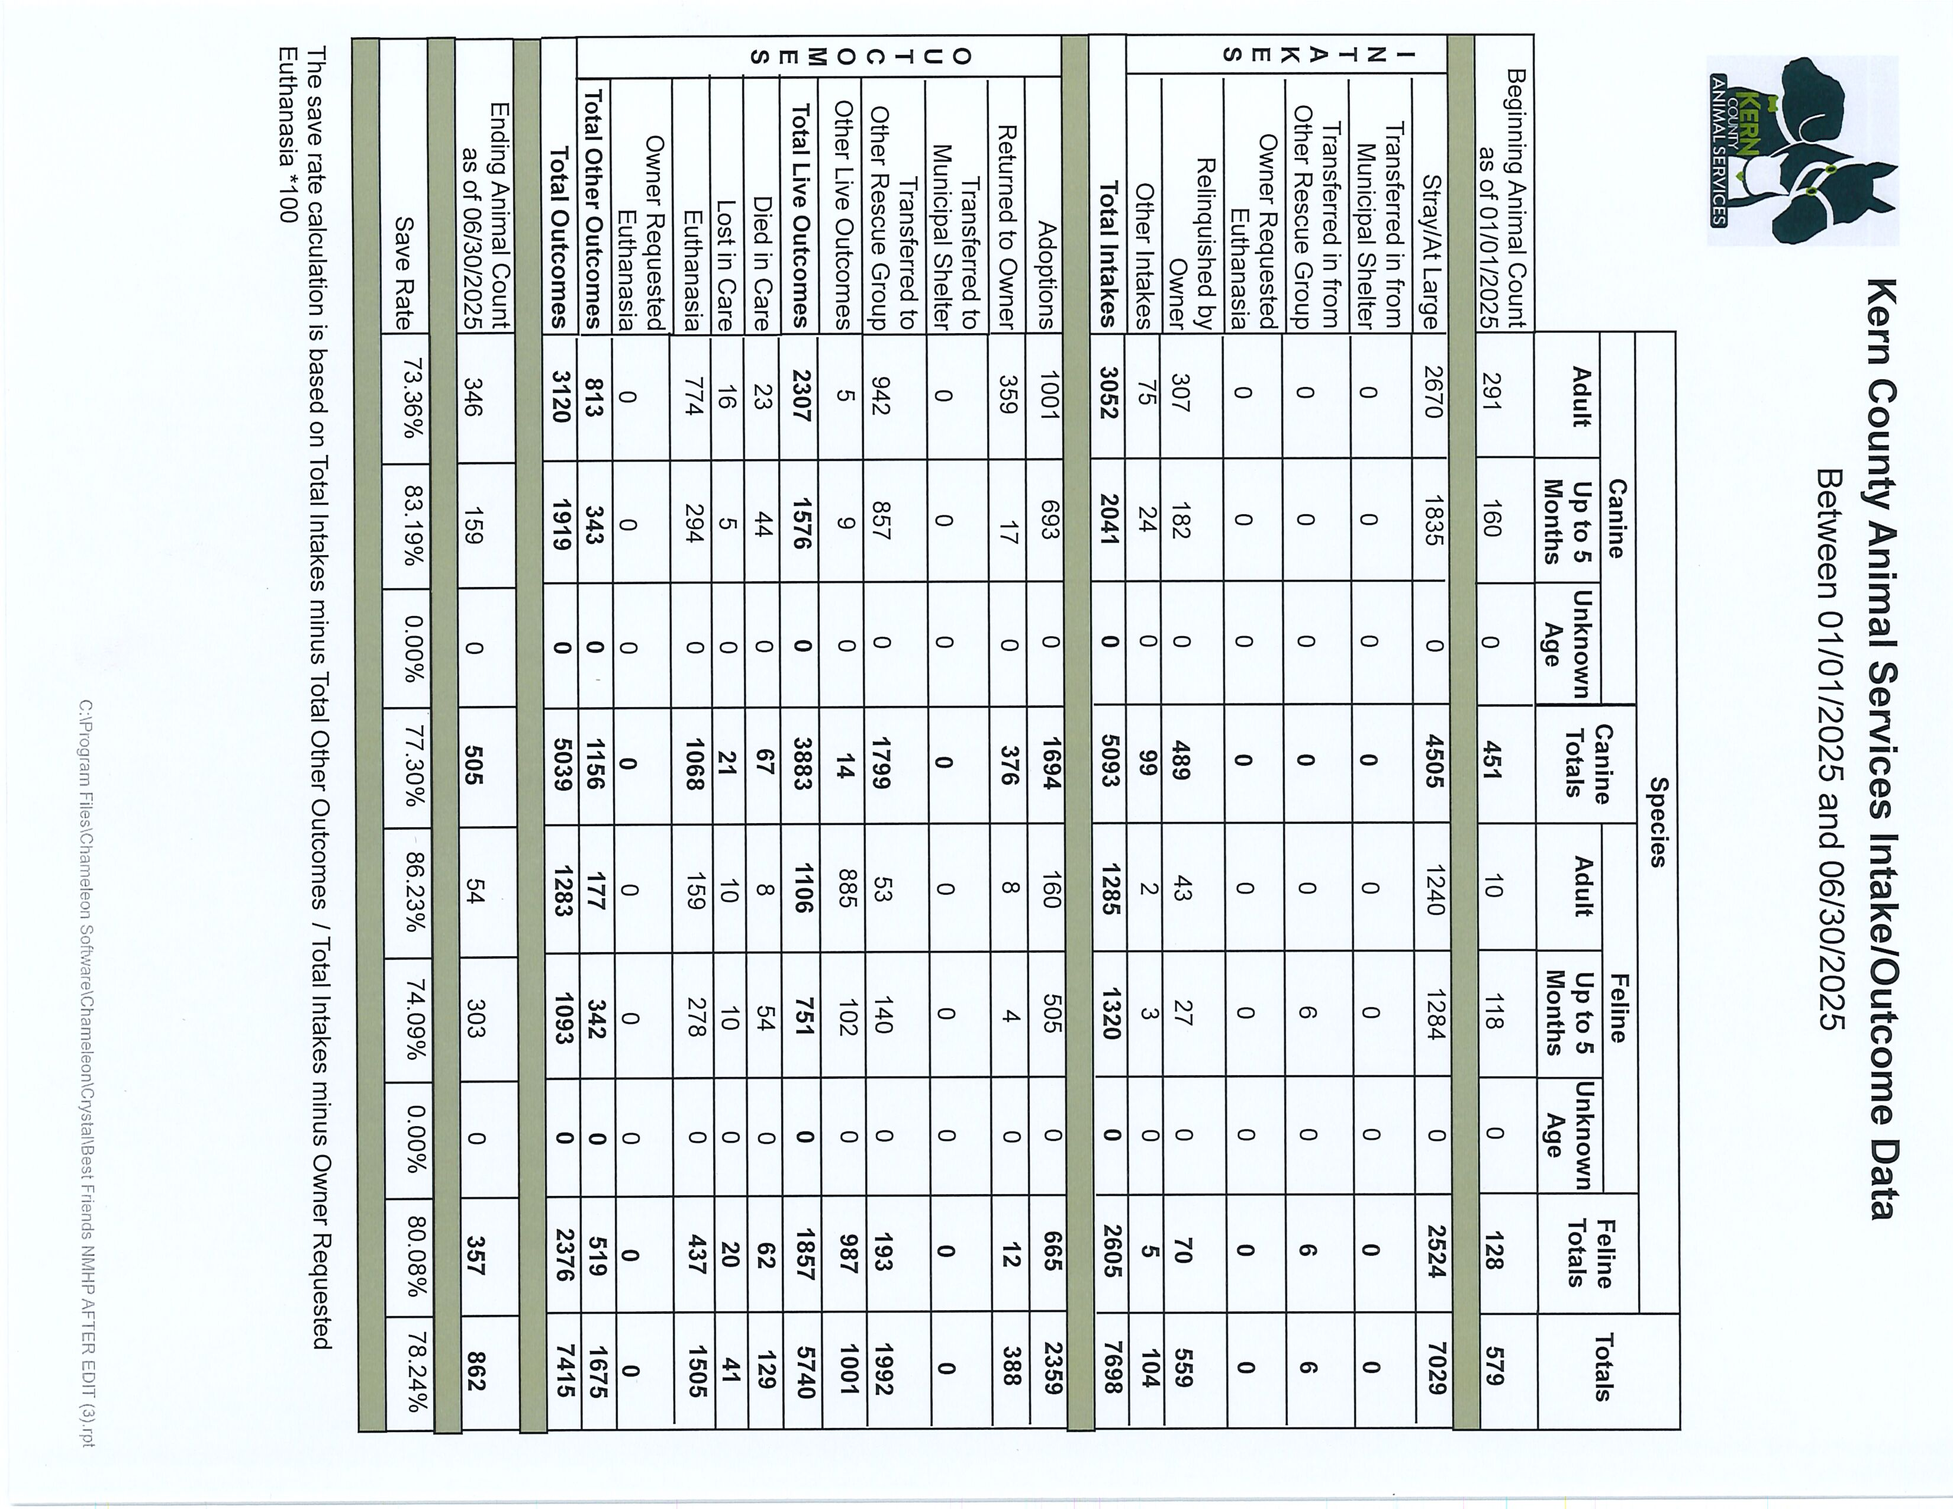

Slide 30
