Slide 1

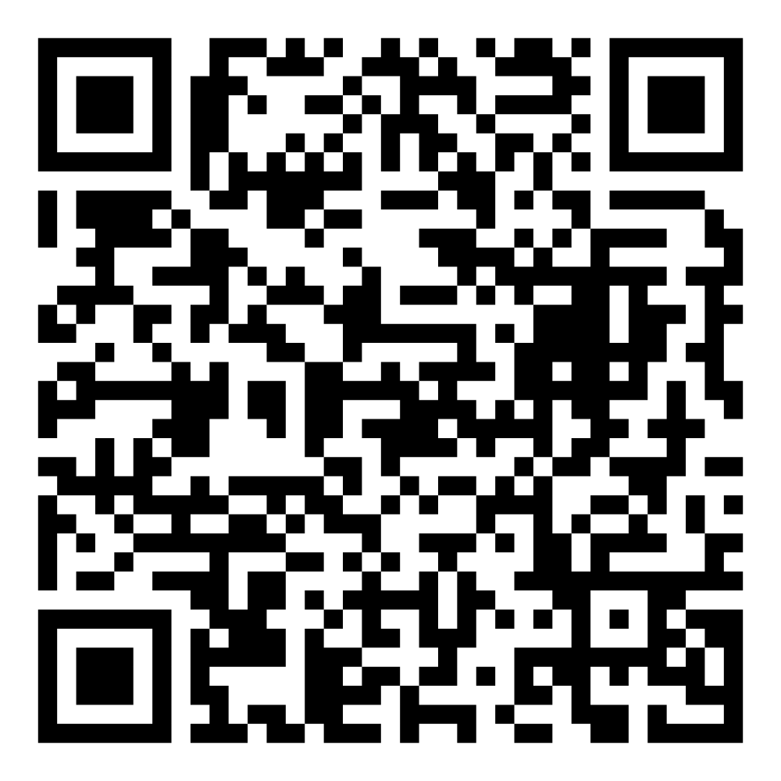
Director’s Report
July 2025

Slide 2
Program Highlights
July 2025
Adoption: 177 dogs, 150 puppies, 21 cats, and 238 kittens under 5 months of age were adopted for a total of 586 animals adopted from Kern County Animal Shelters in the month of July.
Foster: 32 dogs, 34 puppies, 4 cats, and 142 kittens entered the Department’s Foster Care Program in July, for a total of 212 animals.
Rescue: 197 dogs, 117 puppies, 6 cats, and 30 kittens were transferred to other animal rescue organizations in July, for a total of 350 animals.
Spay/Neuter: A total of 236 animals were altered at low-cost KCAS spay/neuter clinics in the month of July.
TNR: 284 cats were spayed or neutered and released in July of 2025. Year-to-date, 1274 cats have gone through the program, and since 2013 26,422 cats have been spayed or neutered and returned to field.

Slide 3
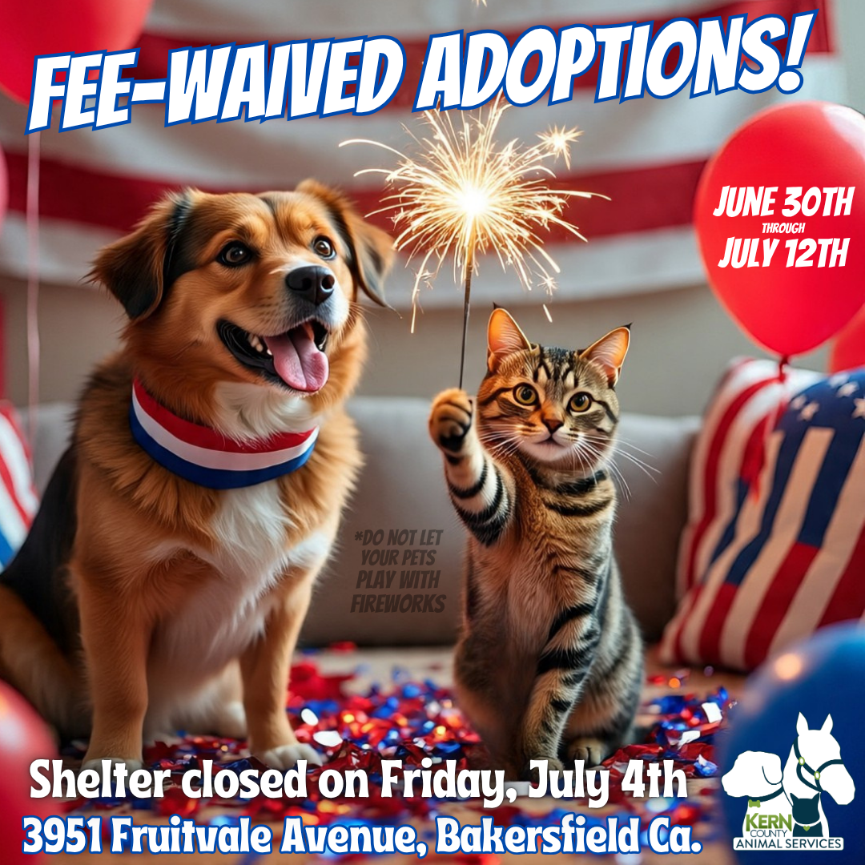
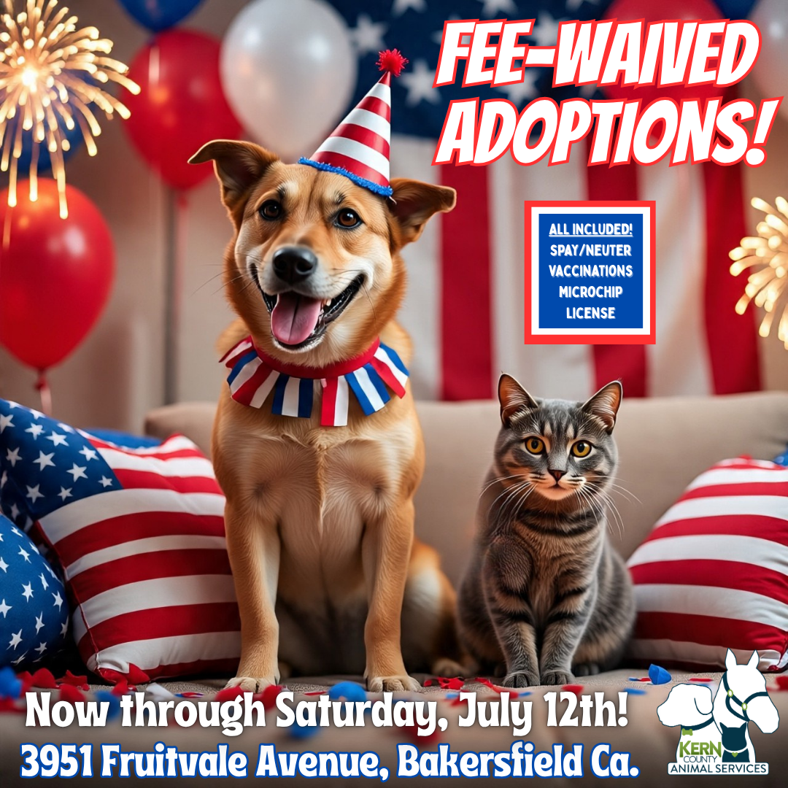
Monthly Adoption Promotions
July 2025
Fee-Waived Adoptions
June 30th - July 12th

Slide 4
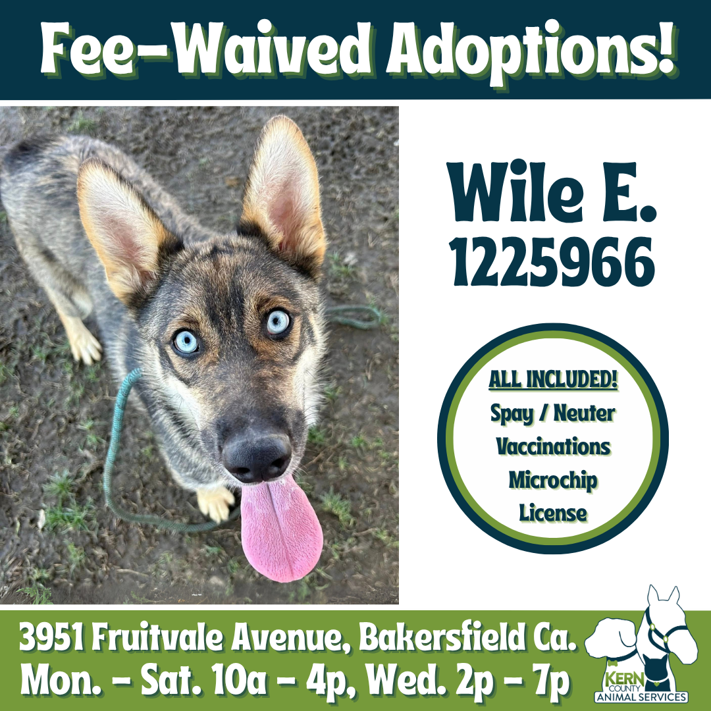
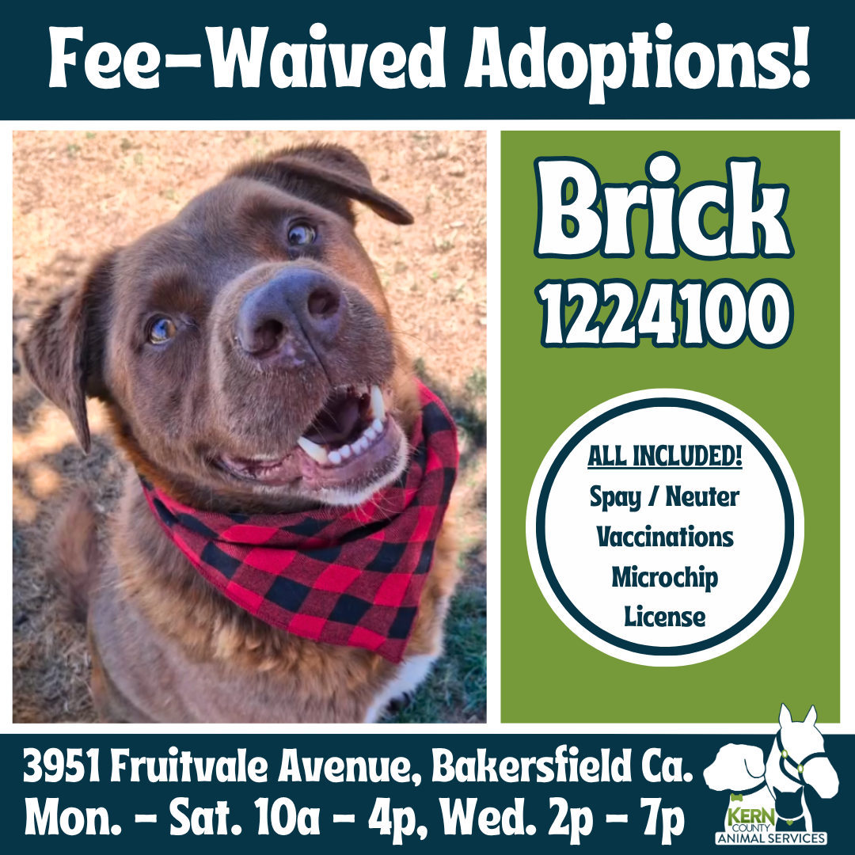
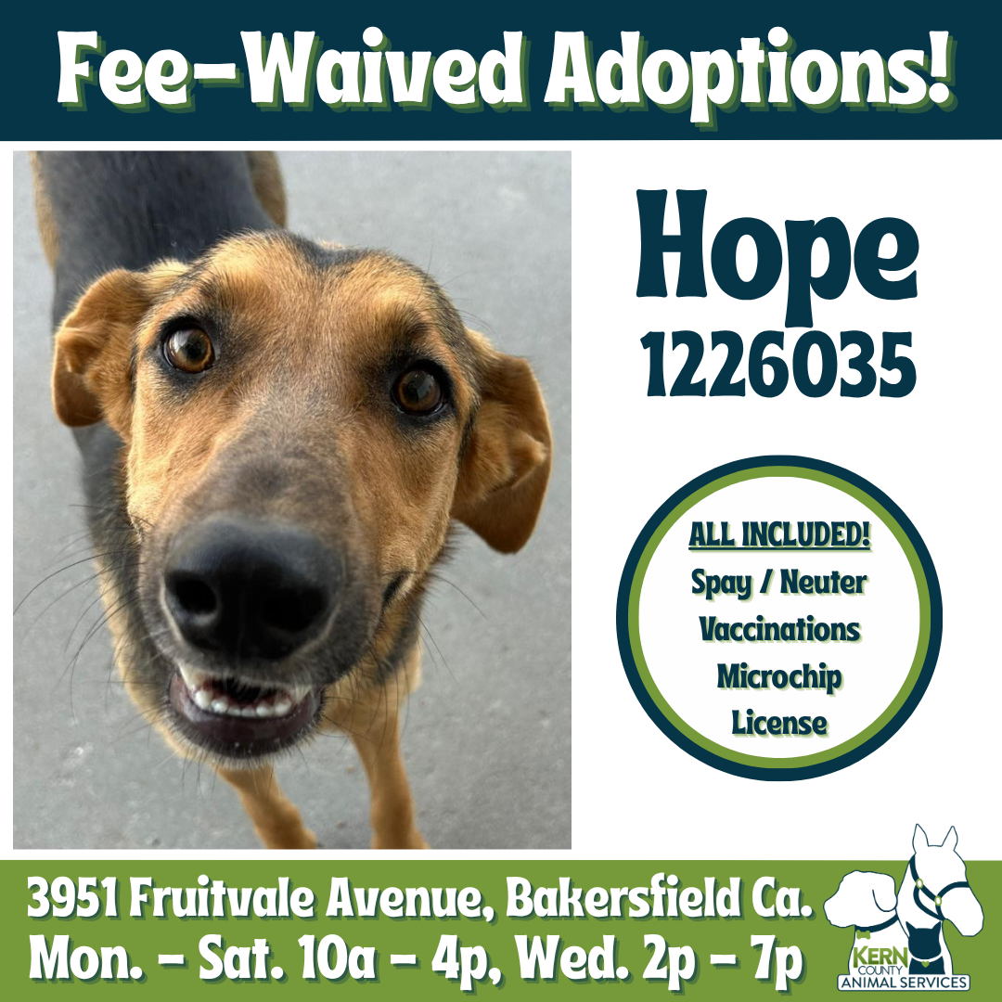
Monthly Adoption Promotions
July 2025
Fee-Waived Adoptions
Extended July 14th - July 19th

Slide 5
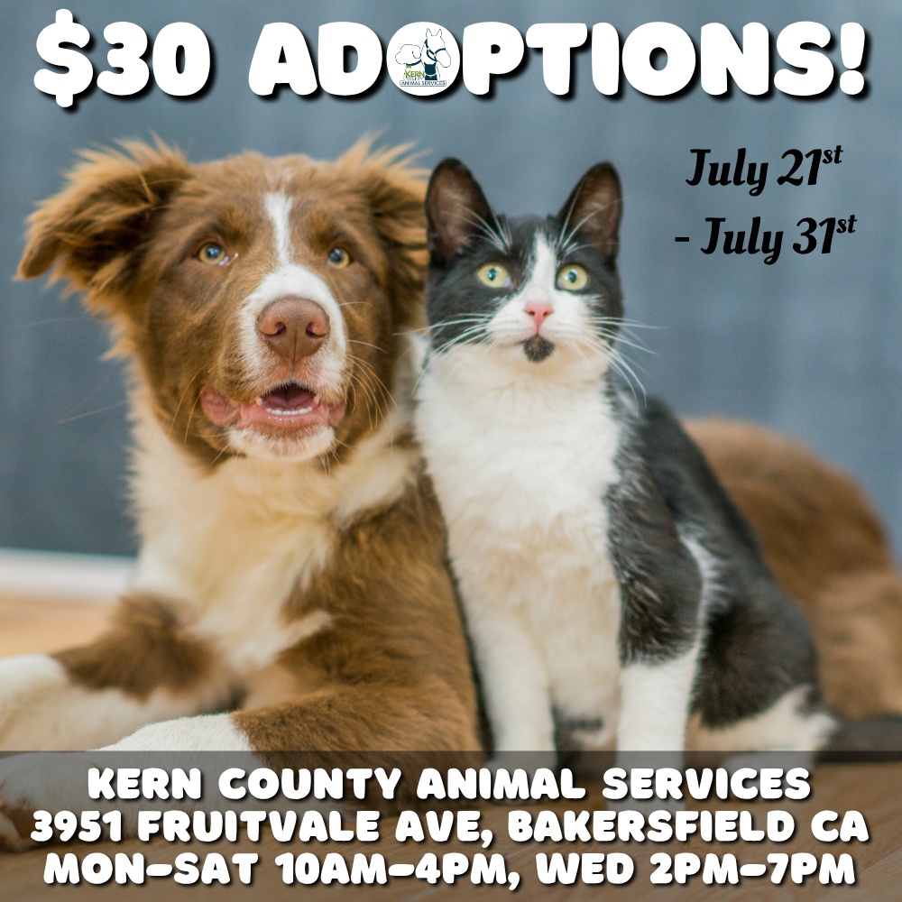
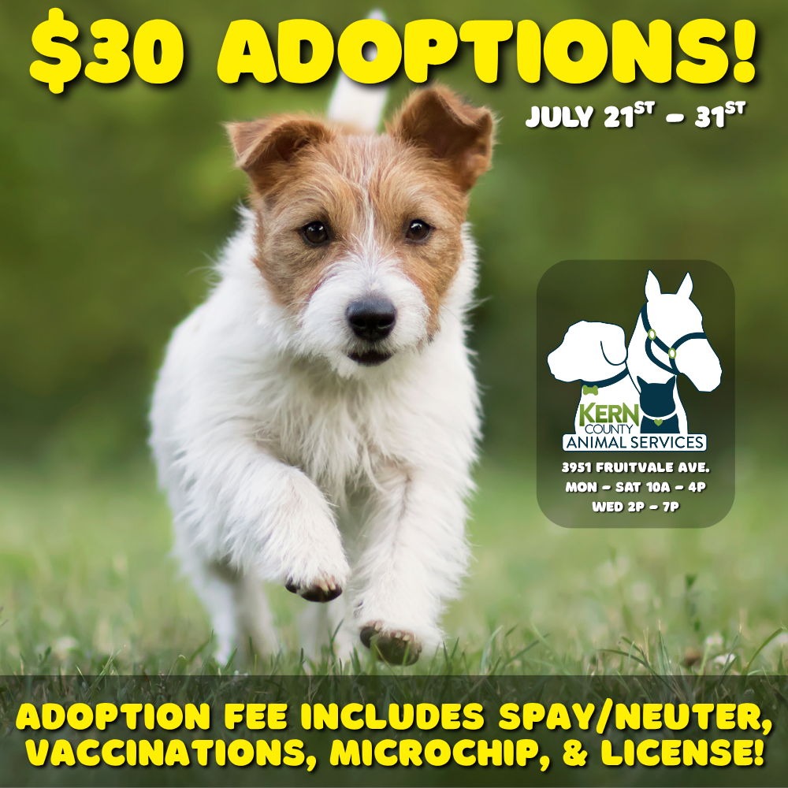
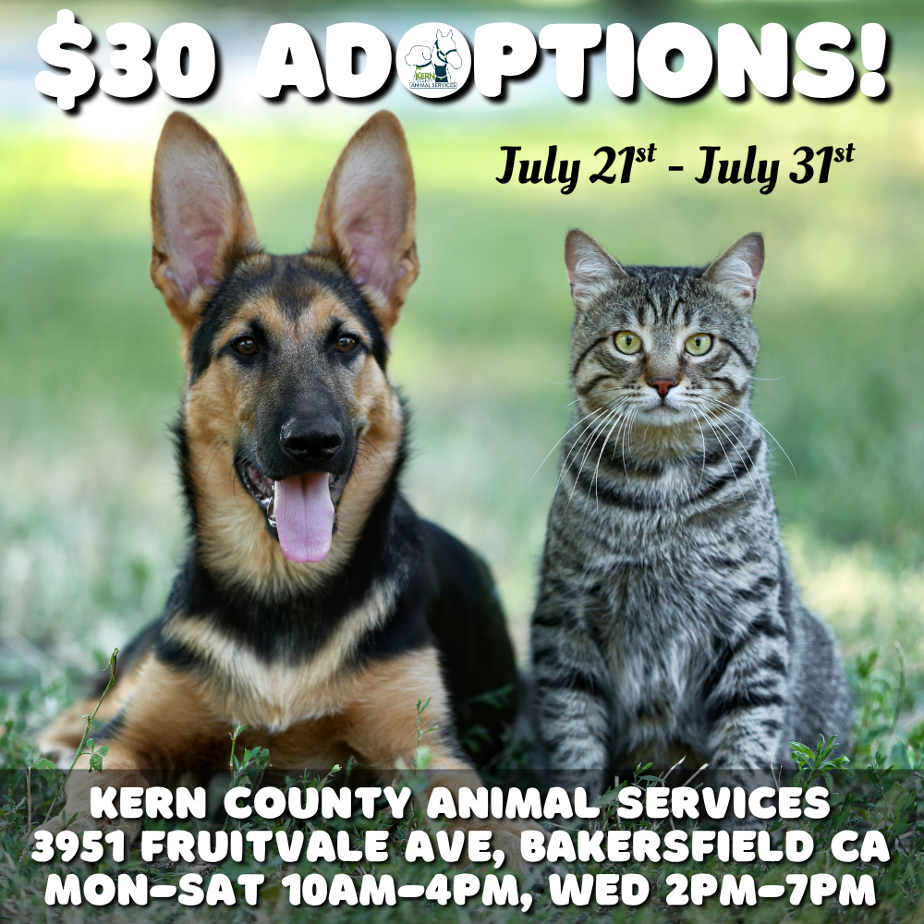
Monthly Adoption Promotions
July 2025
$30 Adoptions
July 21st – July 31st

Slide 6


Offsite Adoption Events
July 5th – 6th

Slide 7
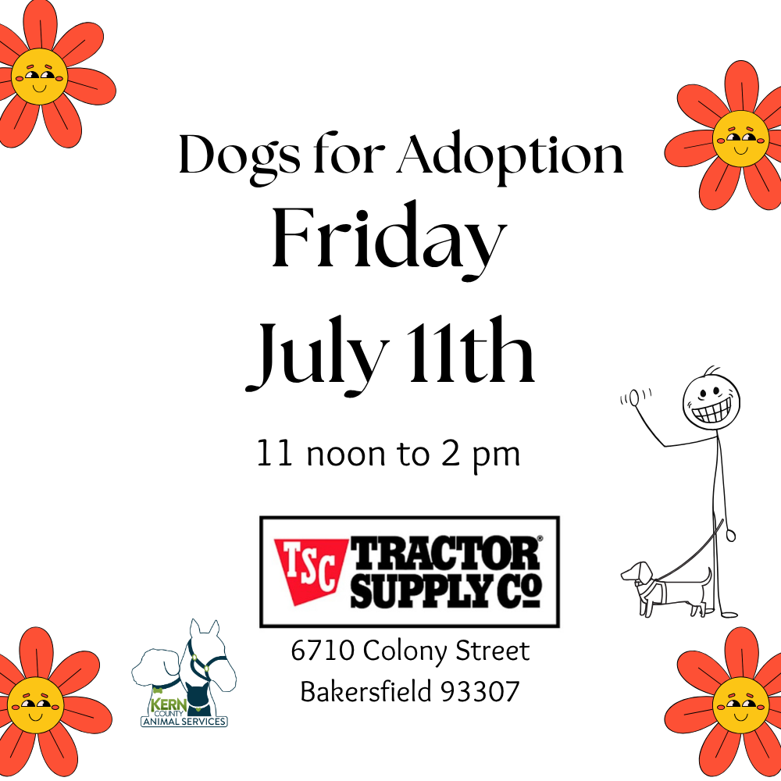

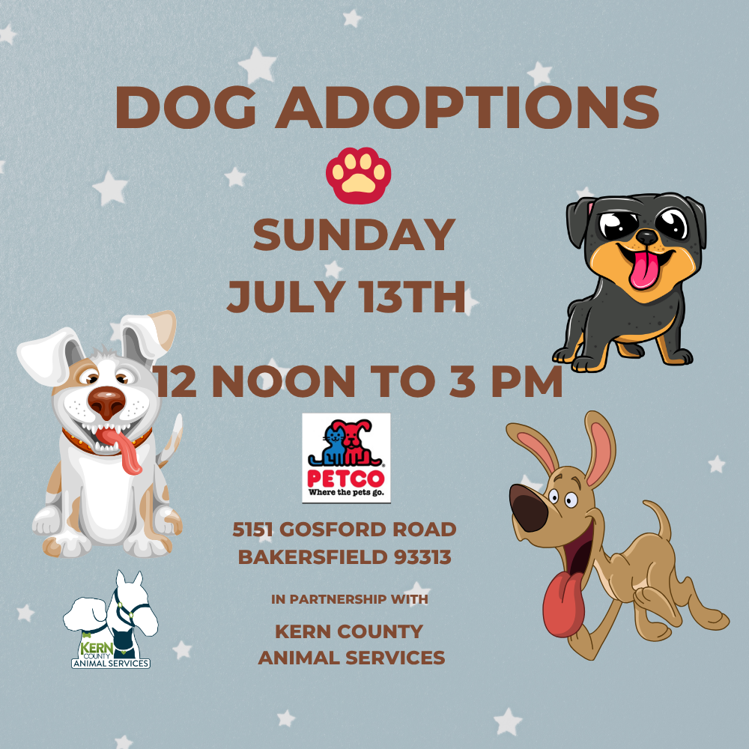
Offsite Adoption Events
July 11th – 13th

Slide 8
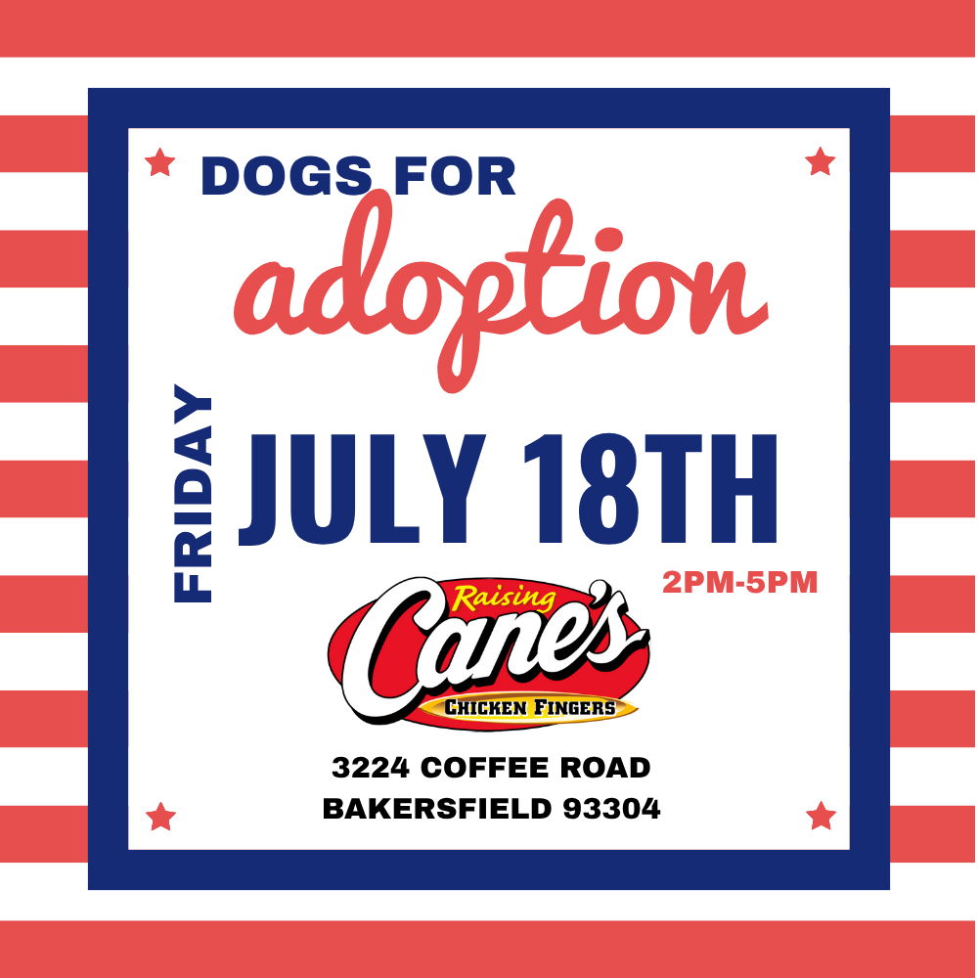


Offsite Adoption Events
July 18th – 20th

Slide 9
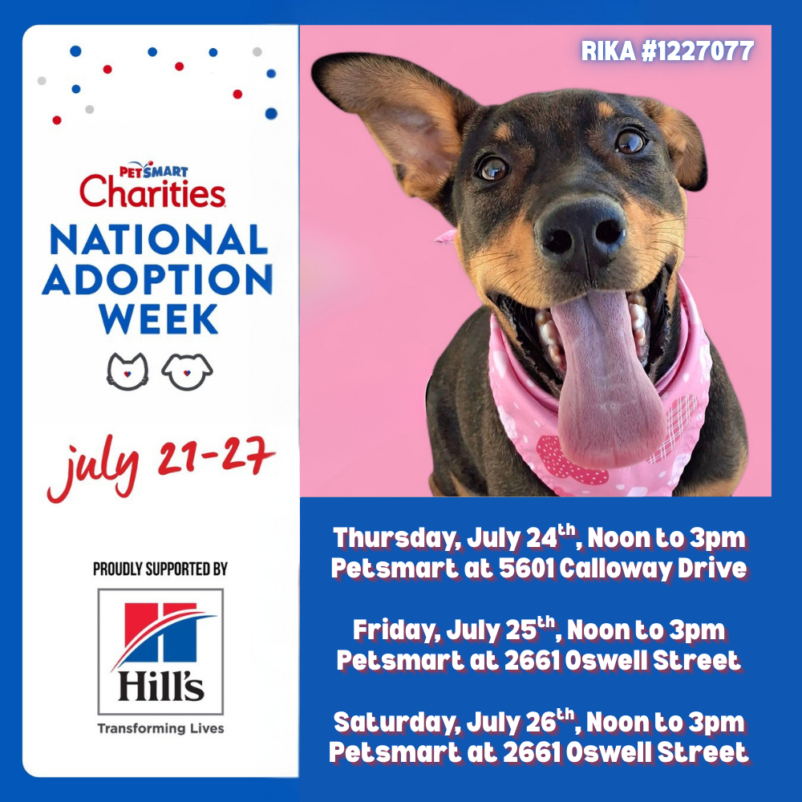
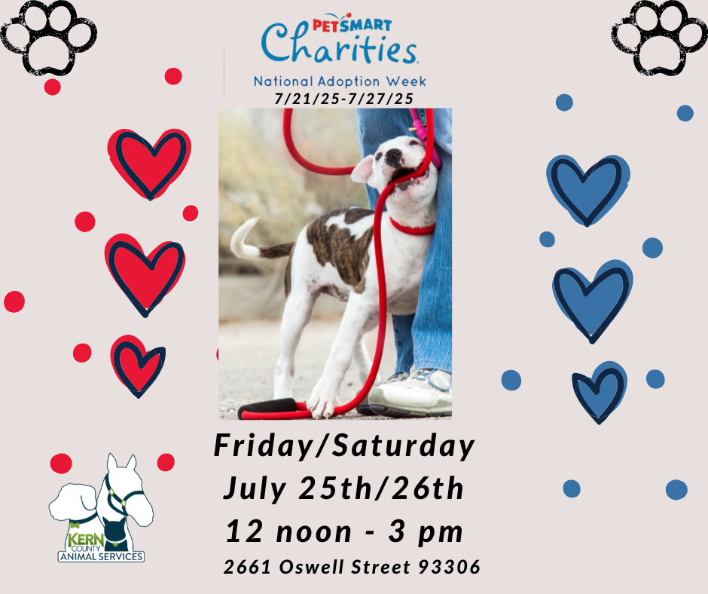

Offsite Adoption Events
July 24th – 27th

Slide 10
Low-Cost Spay/Neuter Clinics
July 2025
Date | Location | Surgeries
July 17th | Heritage Park | 52
July 22nd | Heritage Park | 46
July 23rd | Heritage Park | 58
July 25th | Heritage Park | 51
July 28th | Marley’s Mutts / Tehachapi | 29
 | Total Surgeries | 236

Slide 11
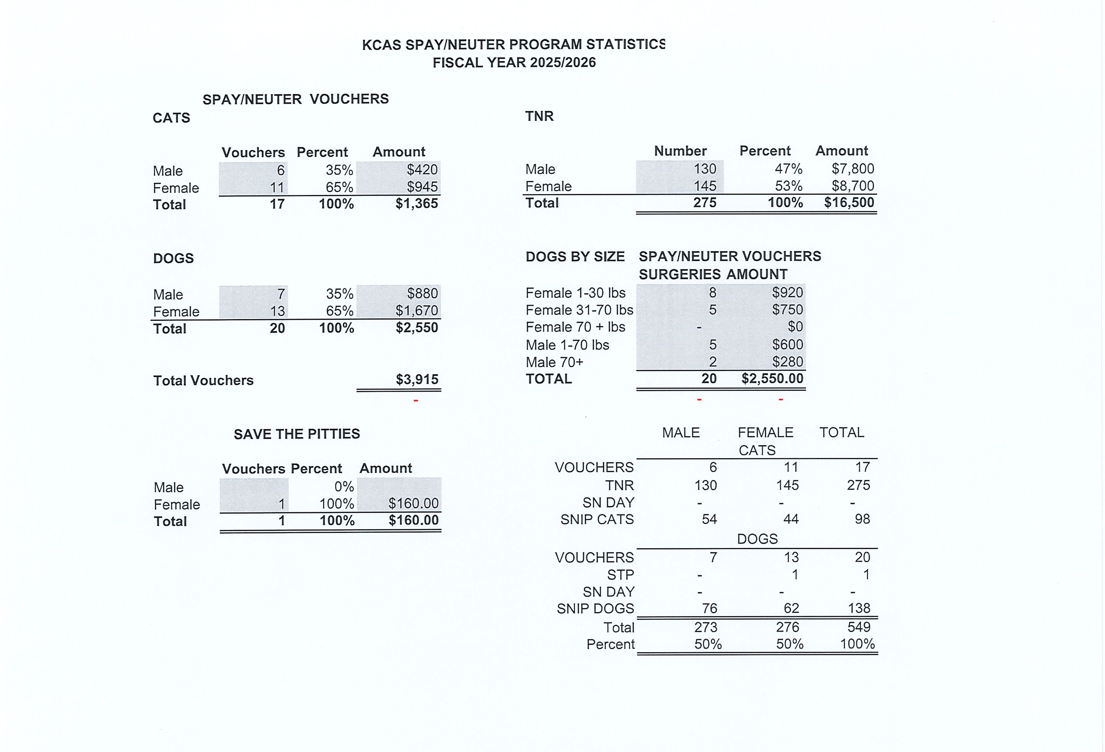

Slide 12
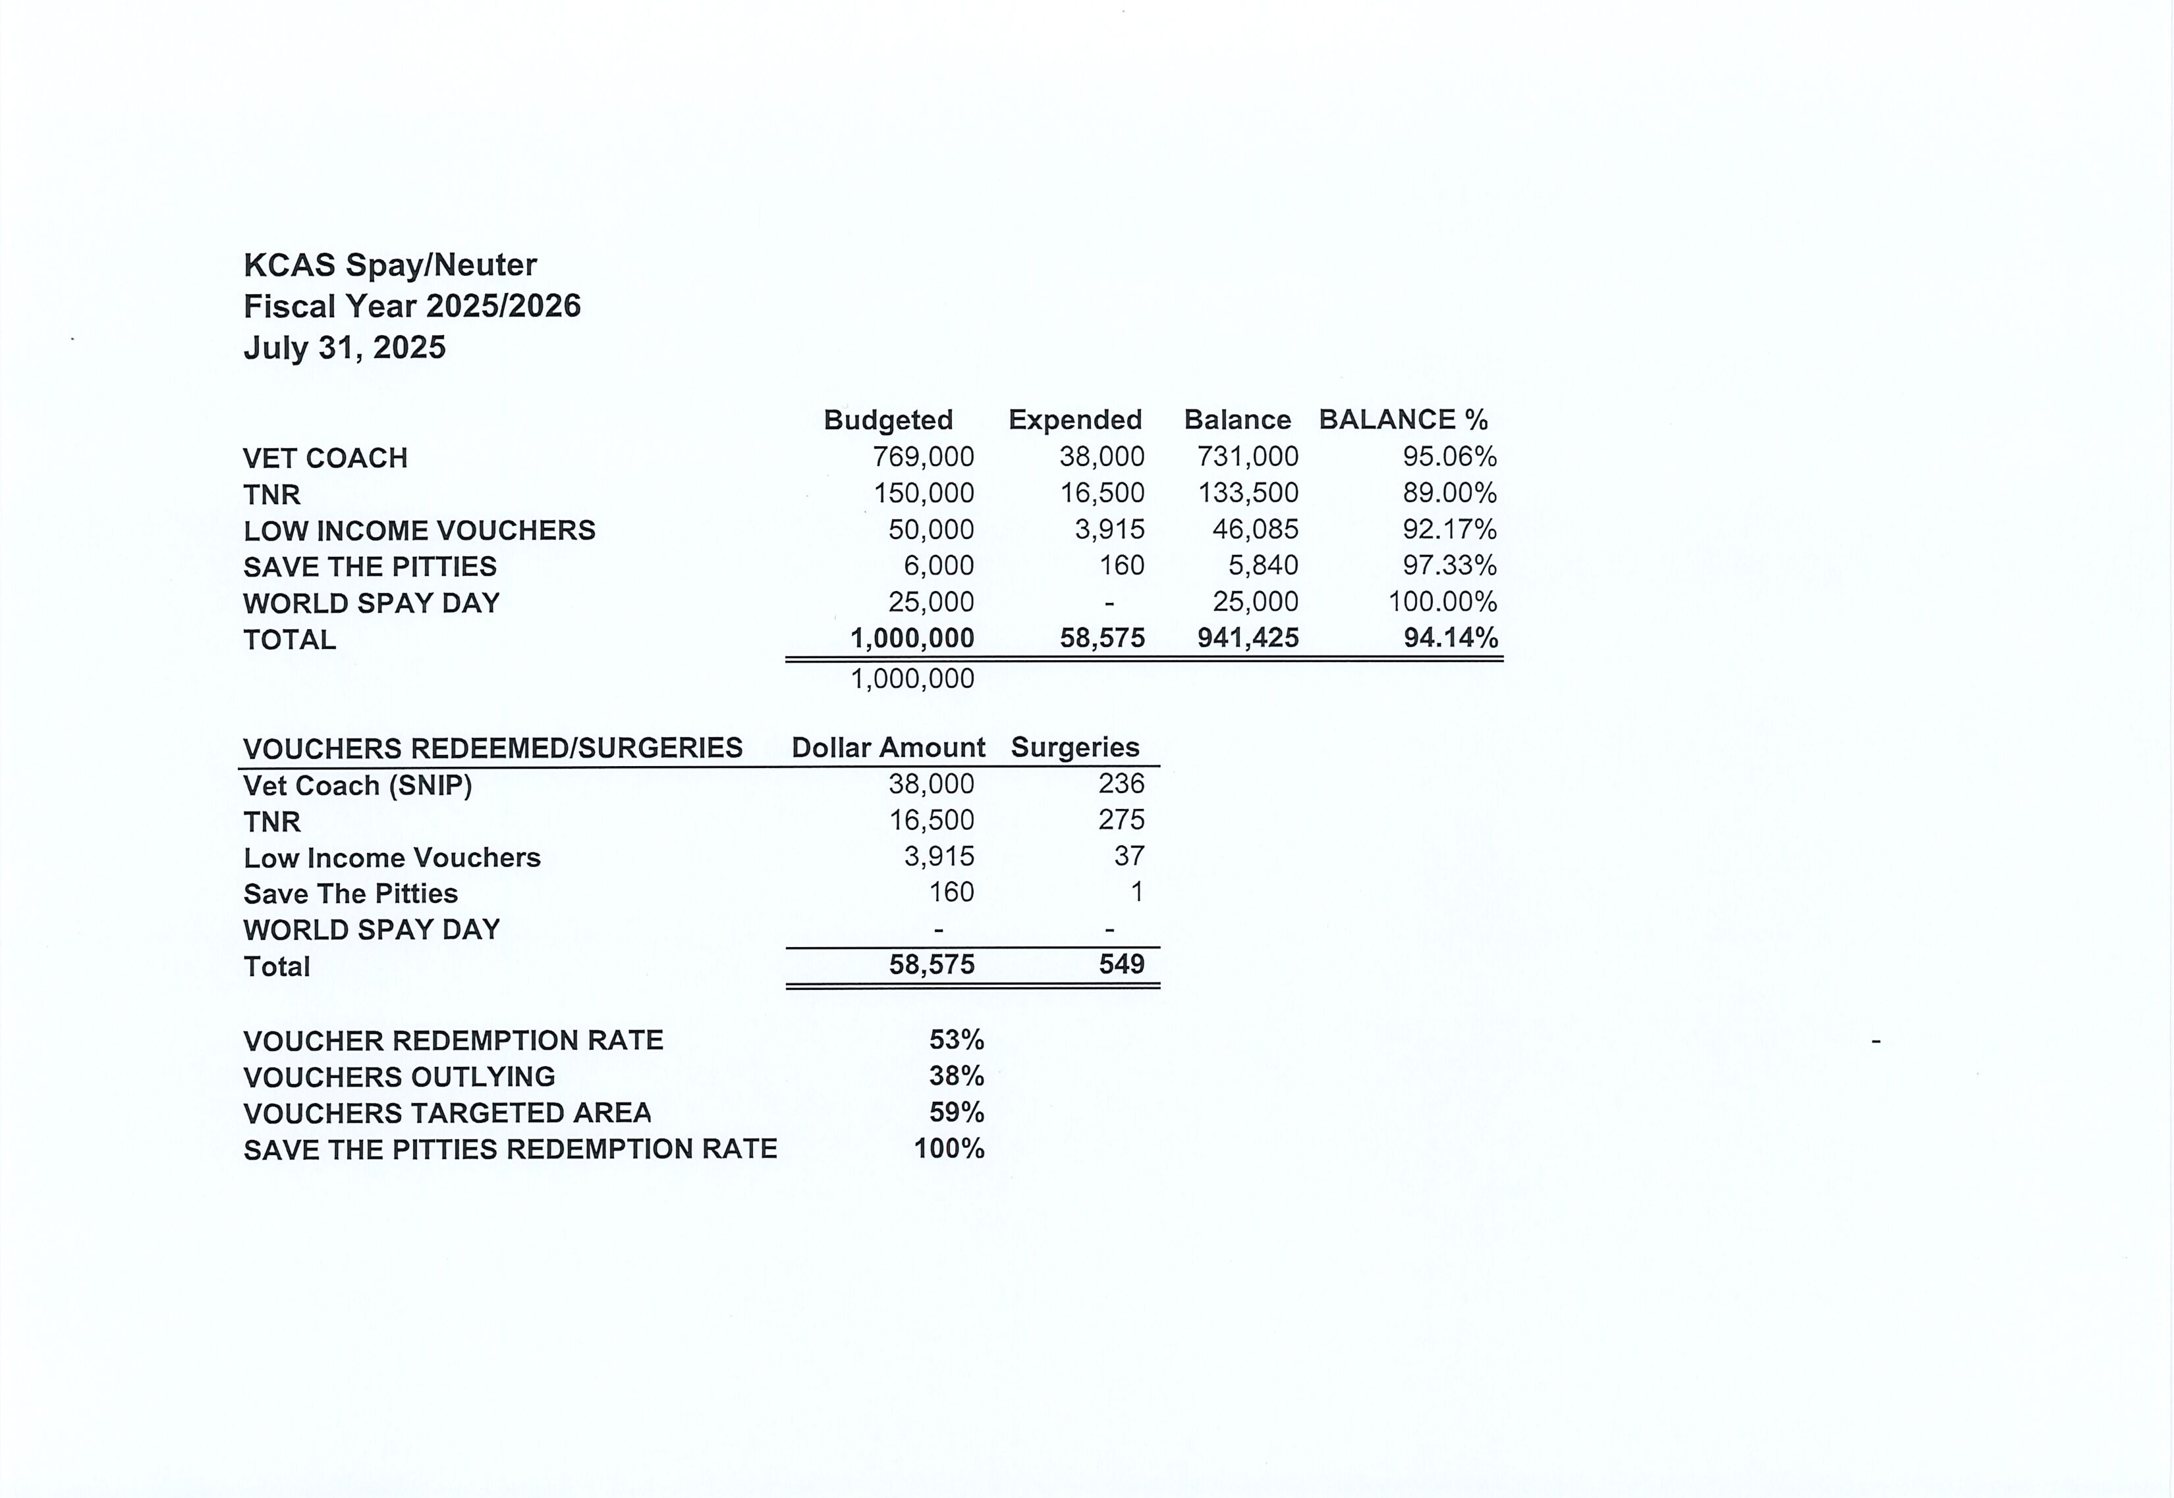

Slide 13
Low-Cost Vaccination Clinics
July 2025
Rabies
260
Microchips
Bordetella
57
56
DHPP* 188
FVRPC* 123
*DHPP and FVRCP vaccinations provided at no-cost by Petco Love.

Slide 14


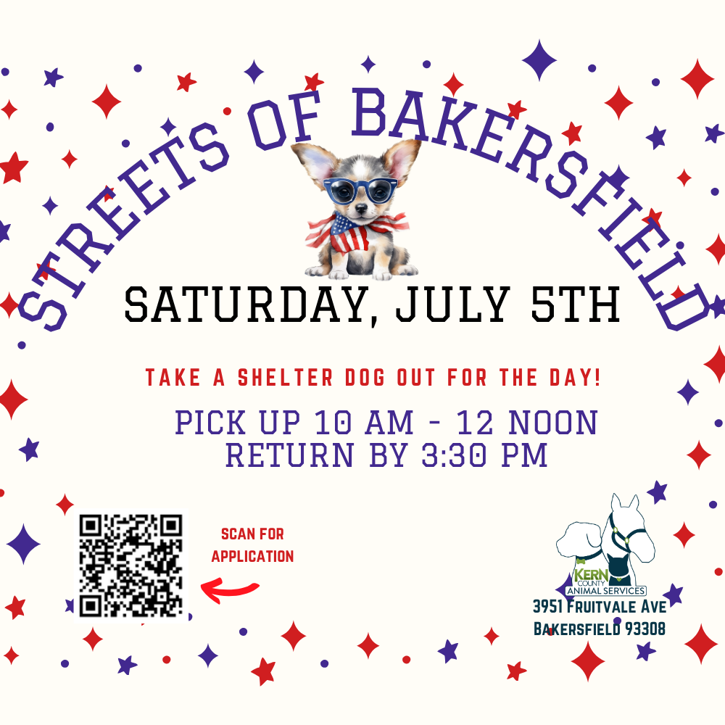
Streets Of Bakersfield
& Weekend Sleepovers
July 5th – July 7th / July 19th - July 21st

Slide 15
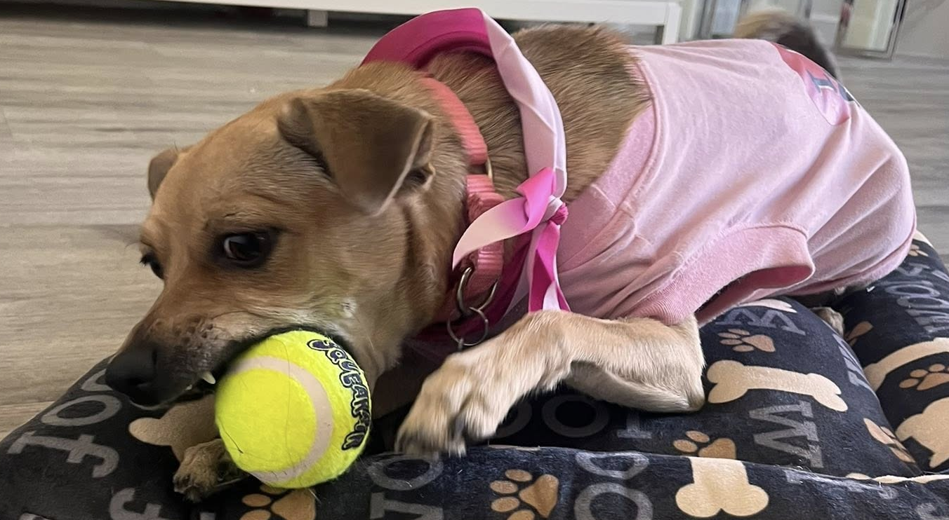
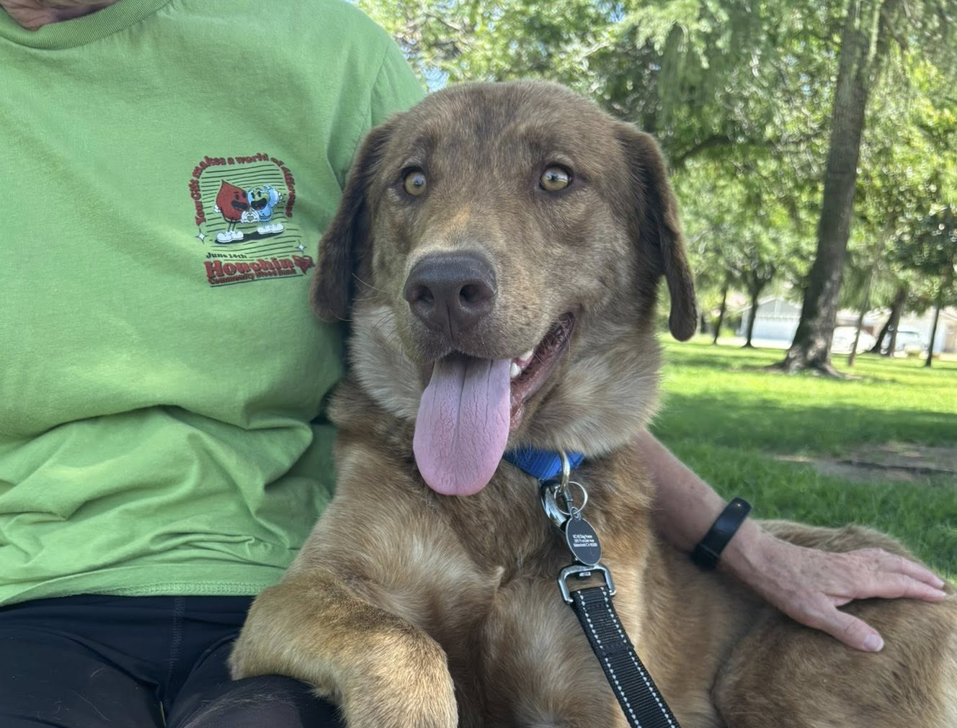
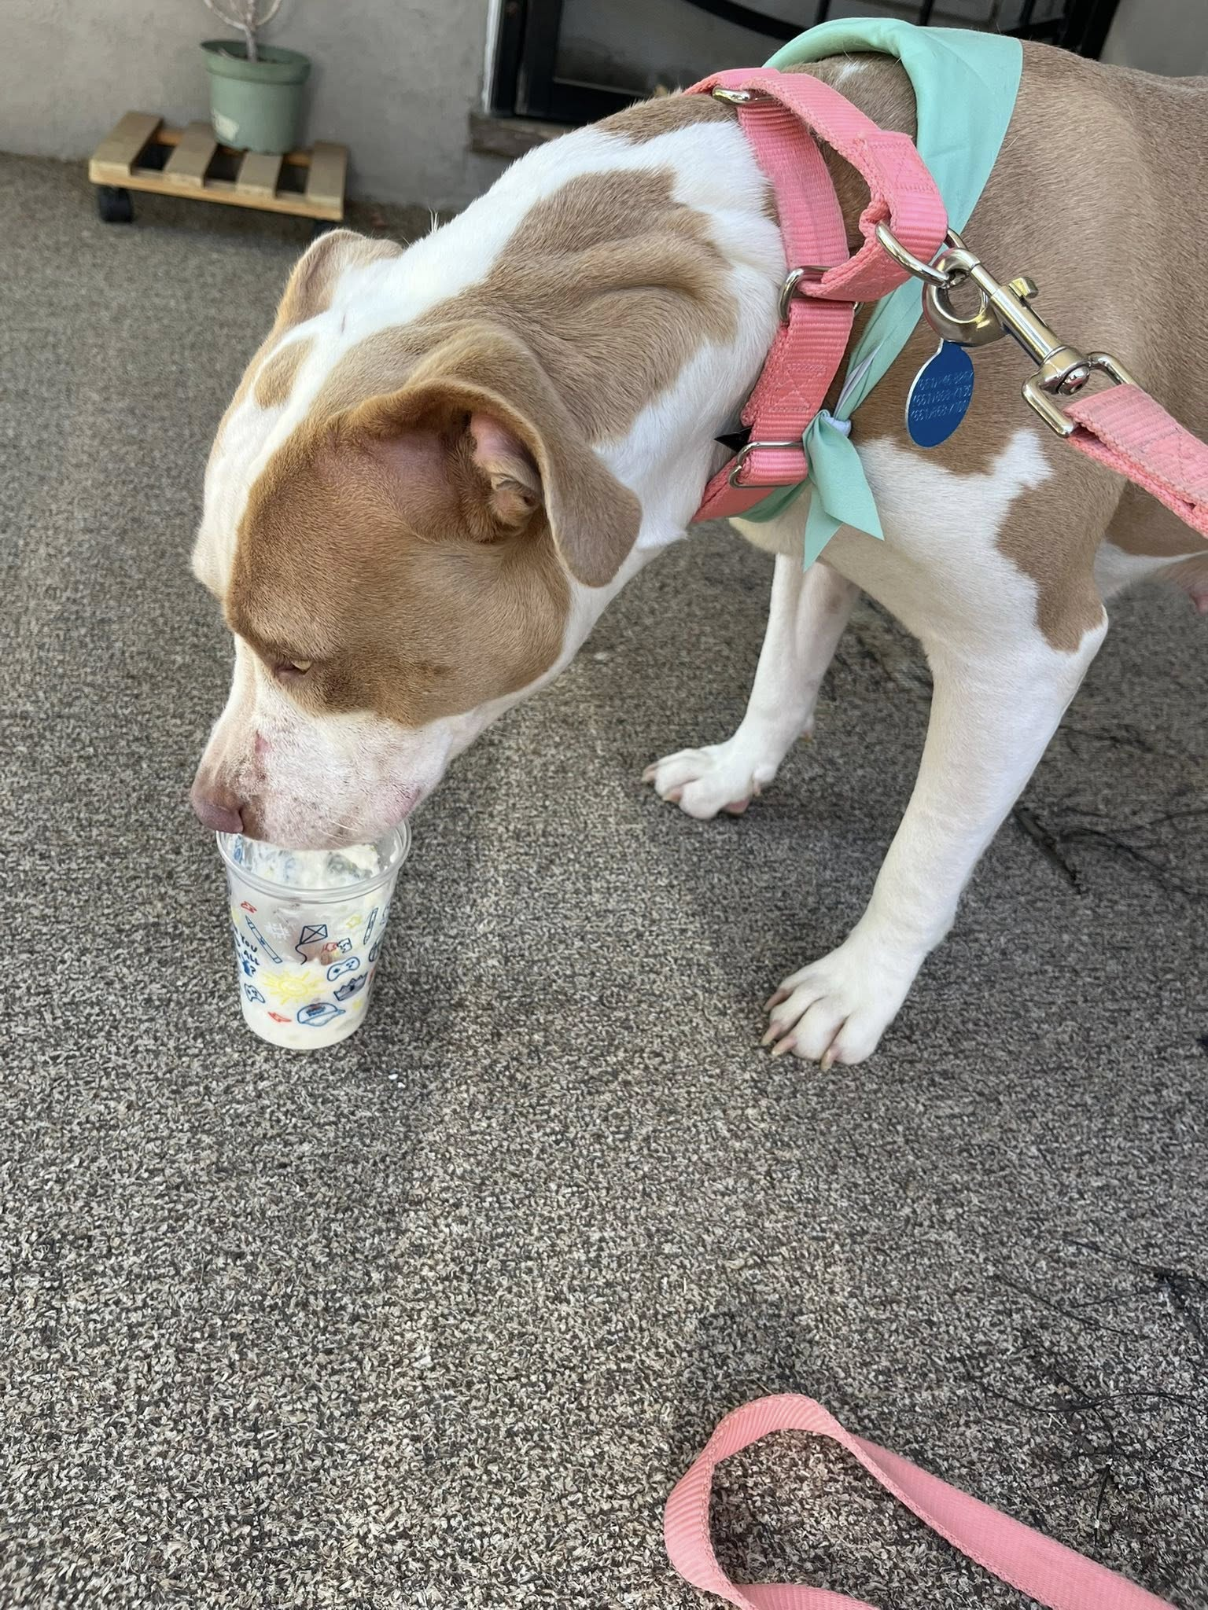
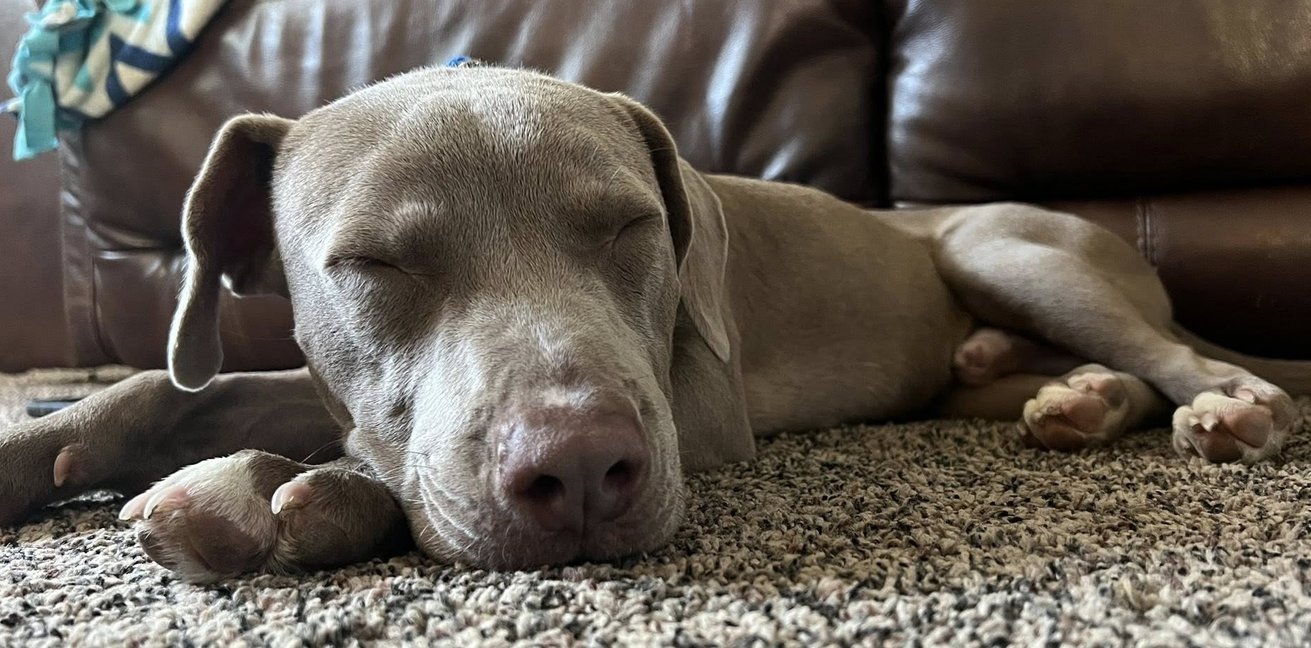

Slide 16
Volunteer Program
July 2025
Active Volunteers
79
New Volunteers
21
Volunteer hours donated in July
Volunteer hours donated in 2025
743.78
6,274.78

Slide 17
Field Service Calls
July 2025
AREA | CALLS PER AREA
Lake Isabella | 139
Mojave | 132
North County | 131
Northeast | 326
Northwest | 274
Ridgecrest | 45
Southeast | 160
Southwest | 150
Taft | 106
Tehachapi | 72
TOTAL | 1535
34 dogs were returned to their owners in the field in July 2025.
102 dogs were secured on property by Animal Control Officers in July 2025

Slide 18
Commercial Animal Facility Calls
June 2025
Commercial Animal Facility Calls
July 2025
TYPE | CALLS PER TYPE
CAF – Breeder | 8
CAF – Rescue | 5
CAF – Kennel | 5
CAF – Boarding | 1
TOTAL | 19
7 Inspections Passed
0 Inspections Failed
0 Citations Issued
7 Permits Issued
52 Active CAF Permits

Slide 19
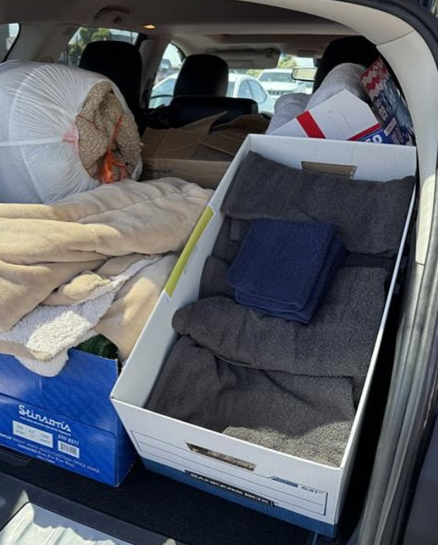
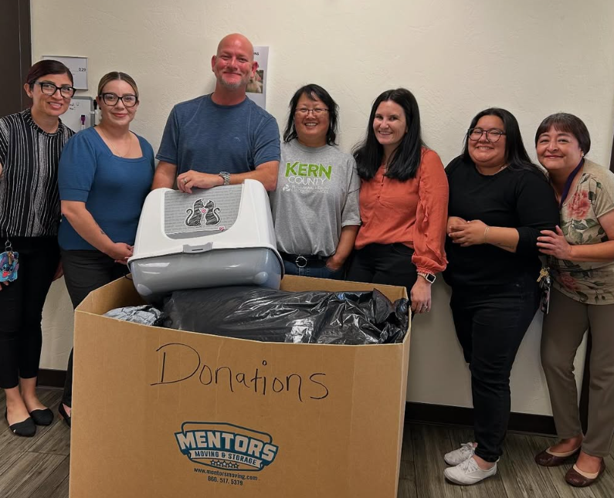
Donations from Kern Behavioral Health & Recovery Services
Kern Behavioral Health & Recovery Services stepped up
again to help our animals at Kern County Animal Services!
They held an pet adoption event in May, In June they
collected boxes of towels, newspapers, and other items
for the shelter, then dropped off those donations in July!
Thank you, KCBHRS!

Slide 20
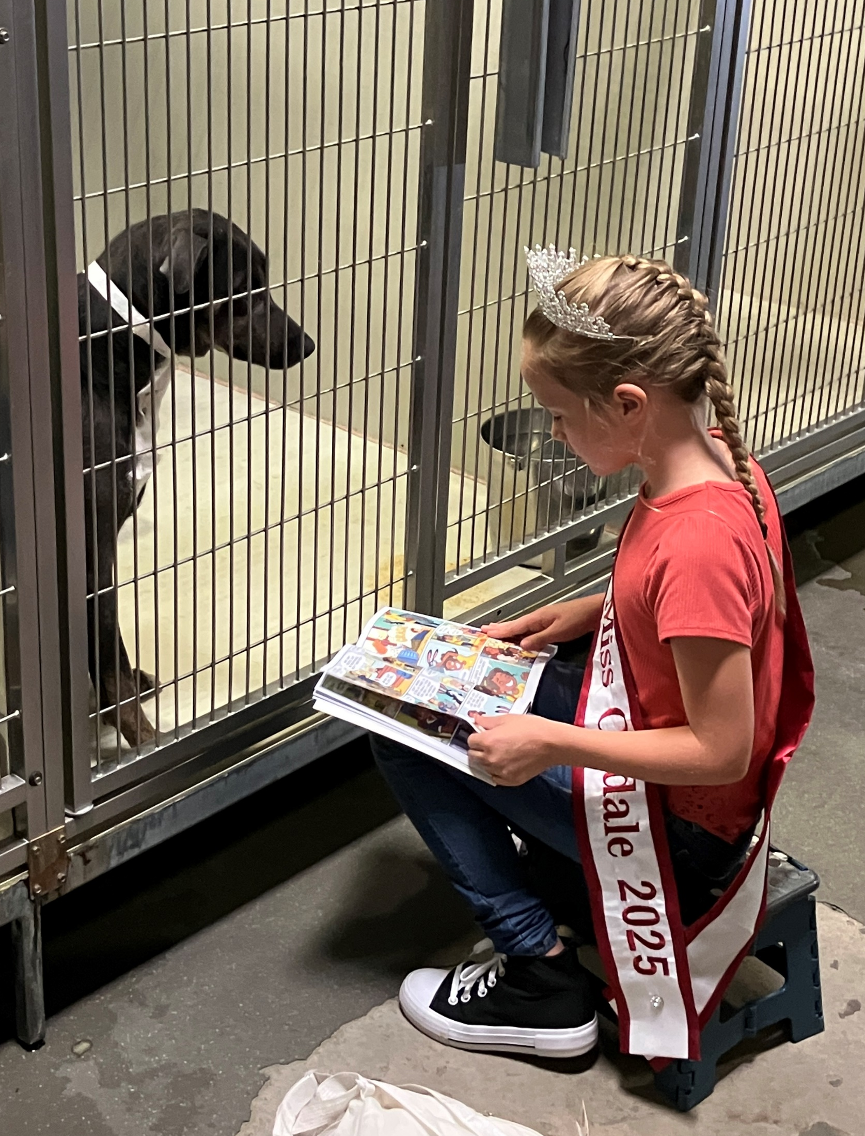
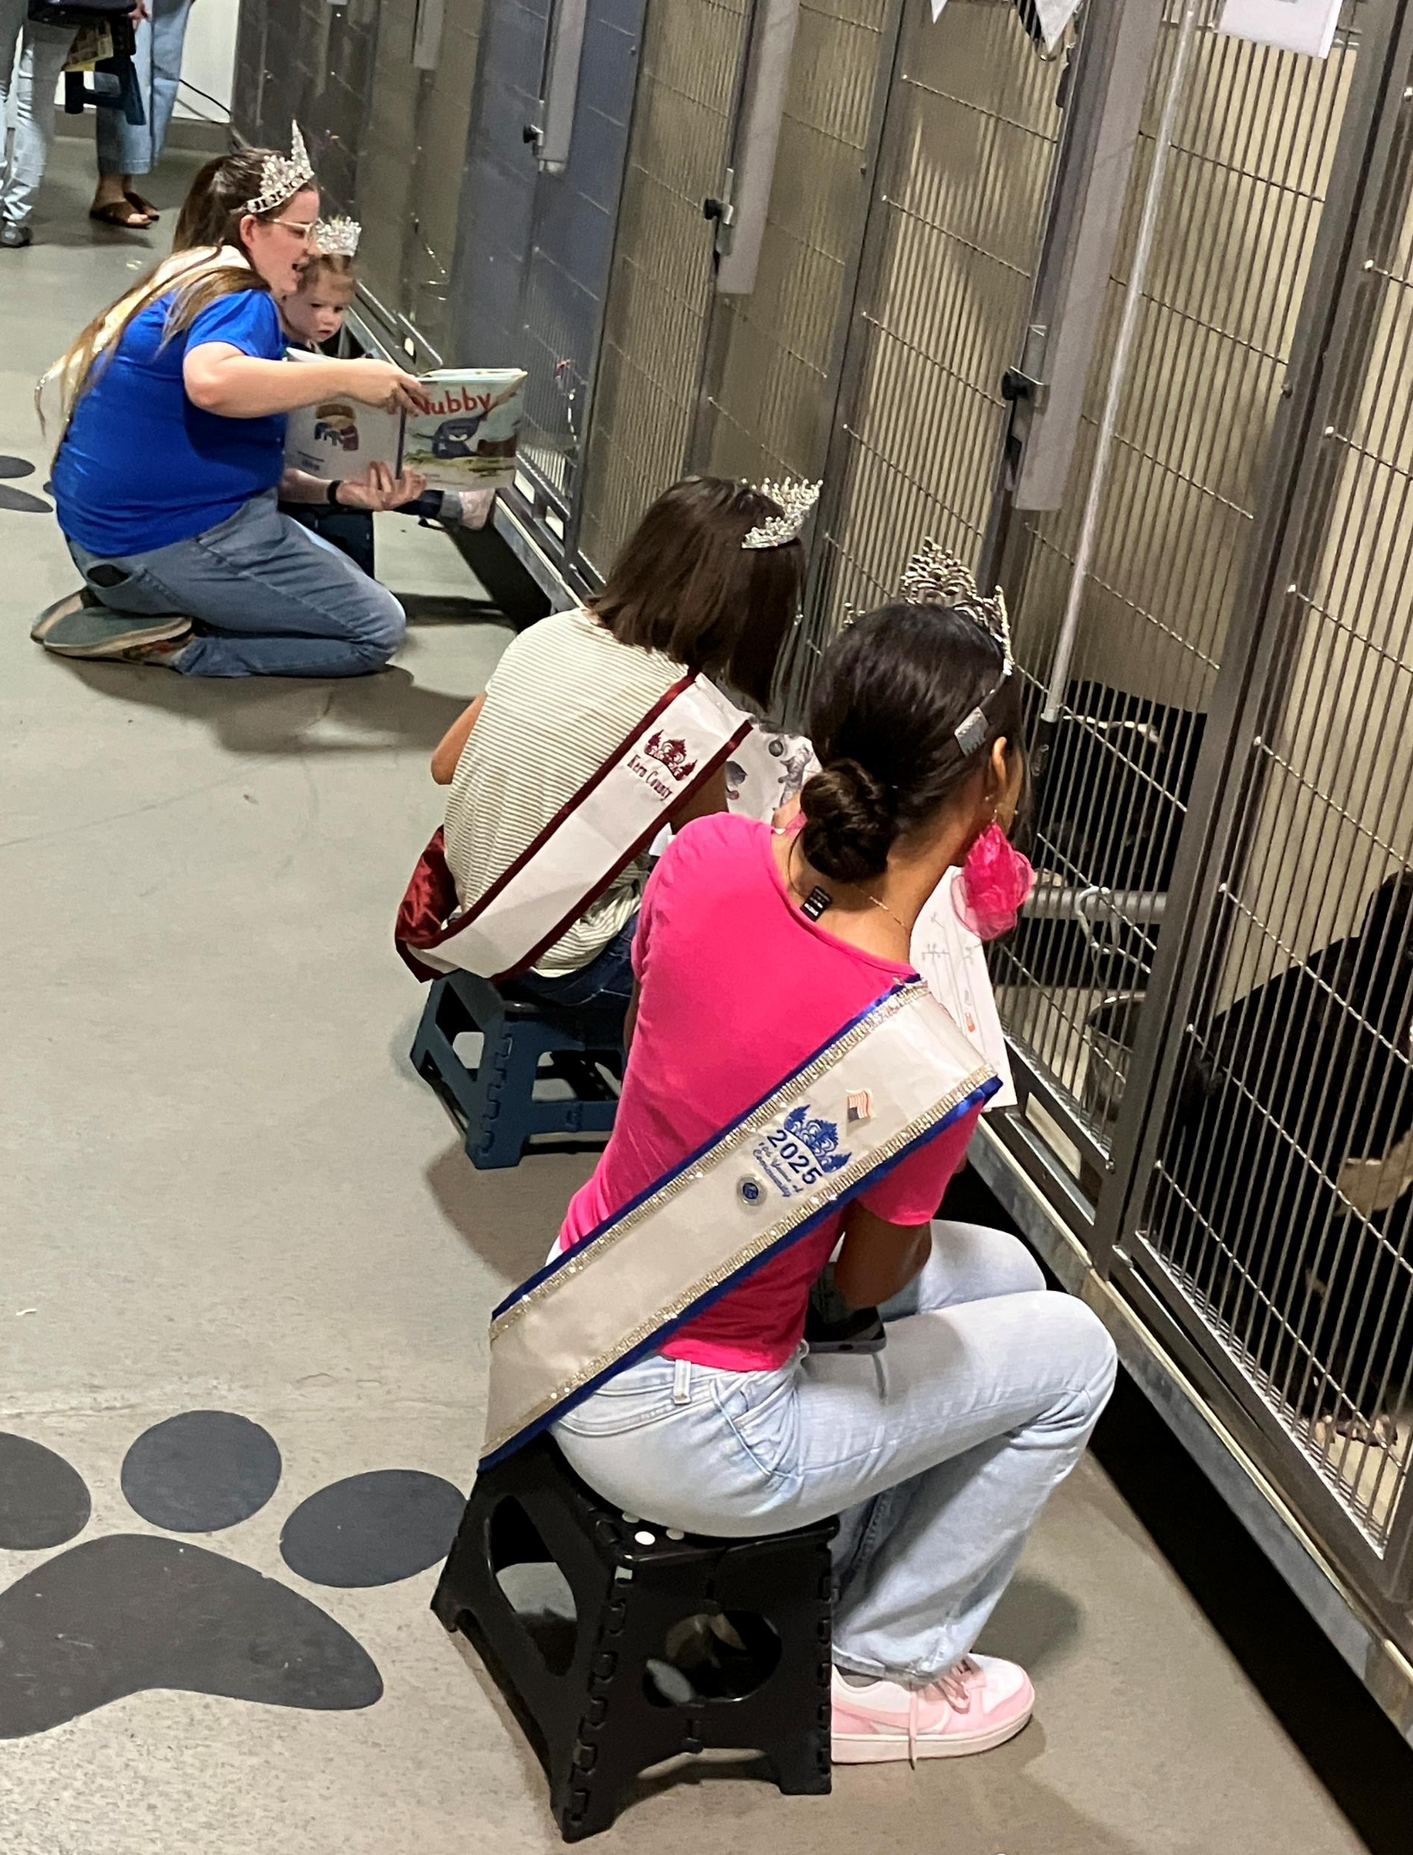
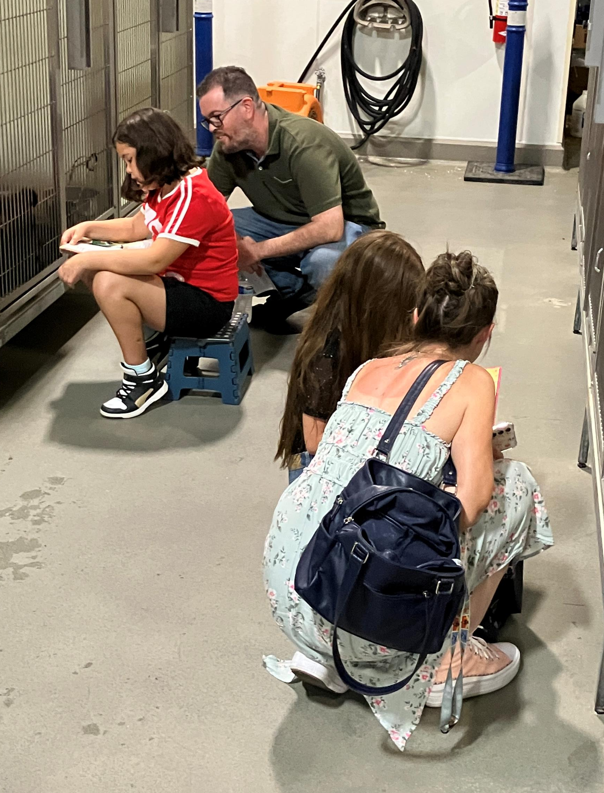
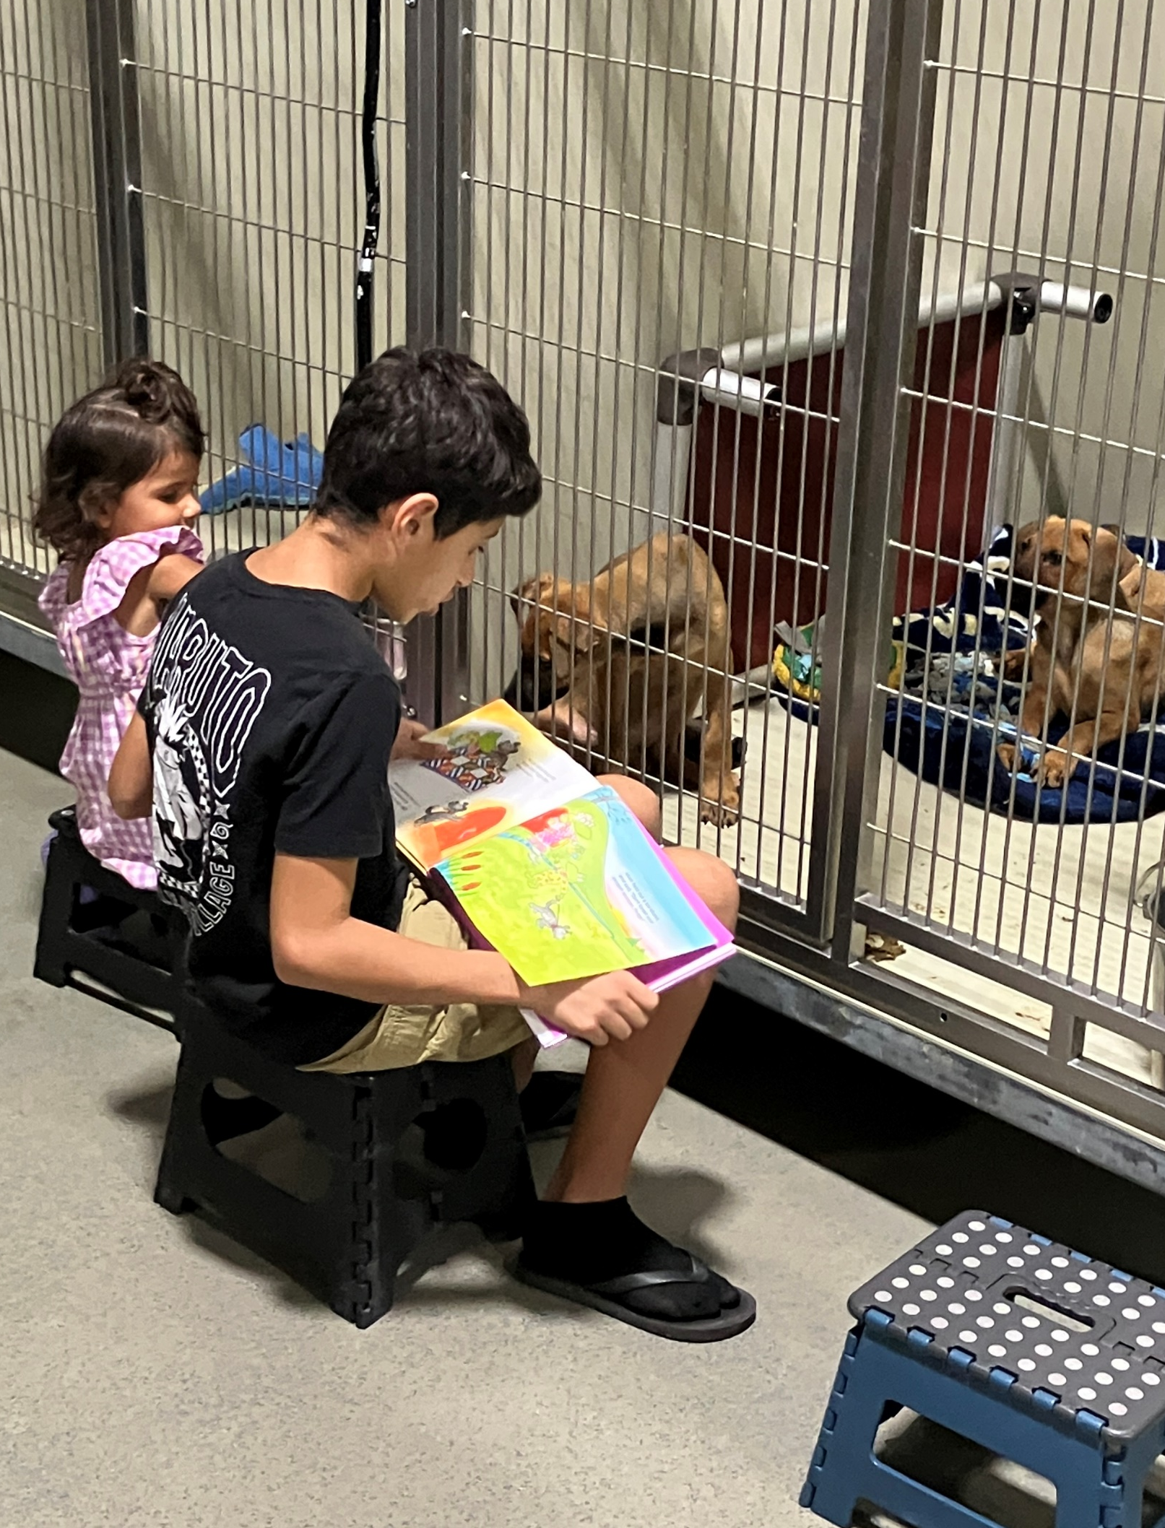
Tales for Tails
July 23rd
Our Tales for Tails Summer Reading Program continued on July 23rd and was another big success! Kids, their parents, and our shelter pets all had a wonderful time.
The next Tales for Tails night is on Wednesday, August 27th. For more information, email us at Animal Services Volunteer @kerncounty.com.

Slide 21
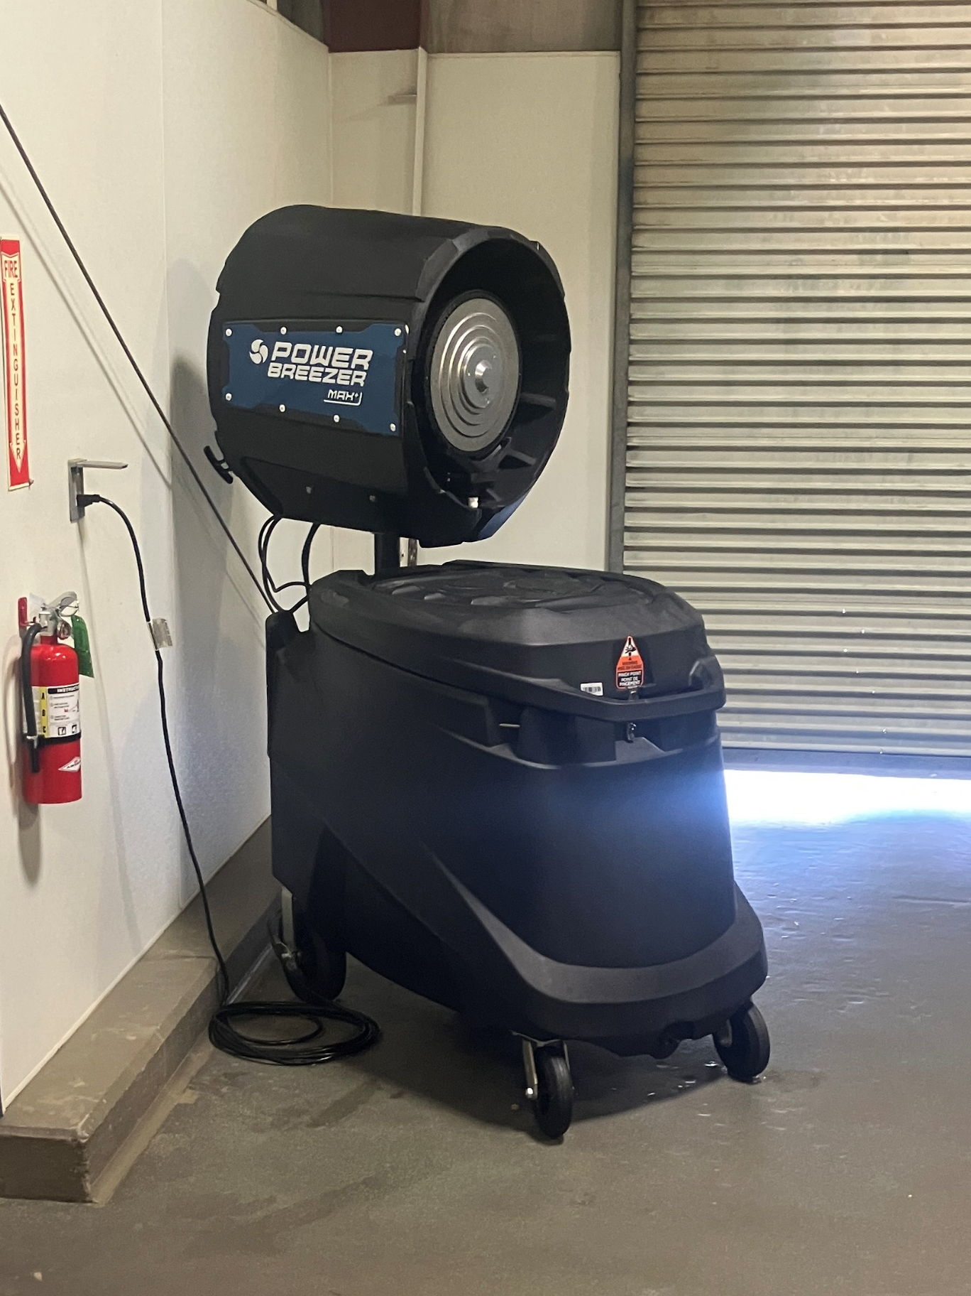
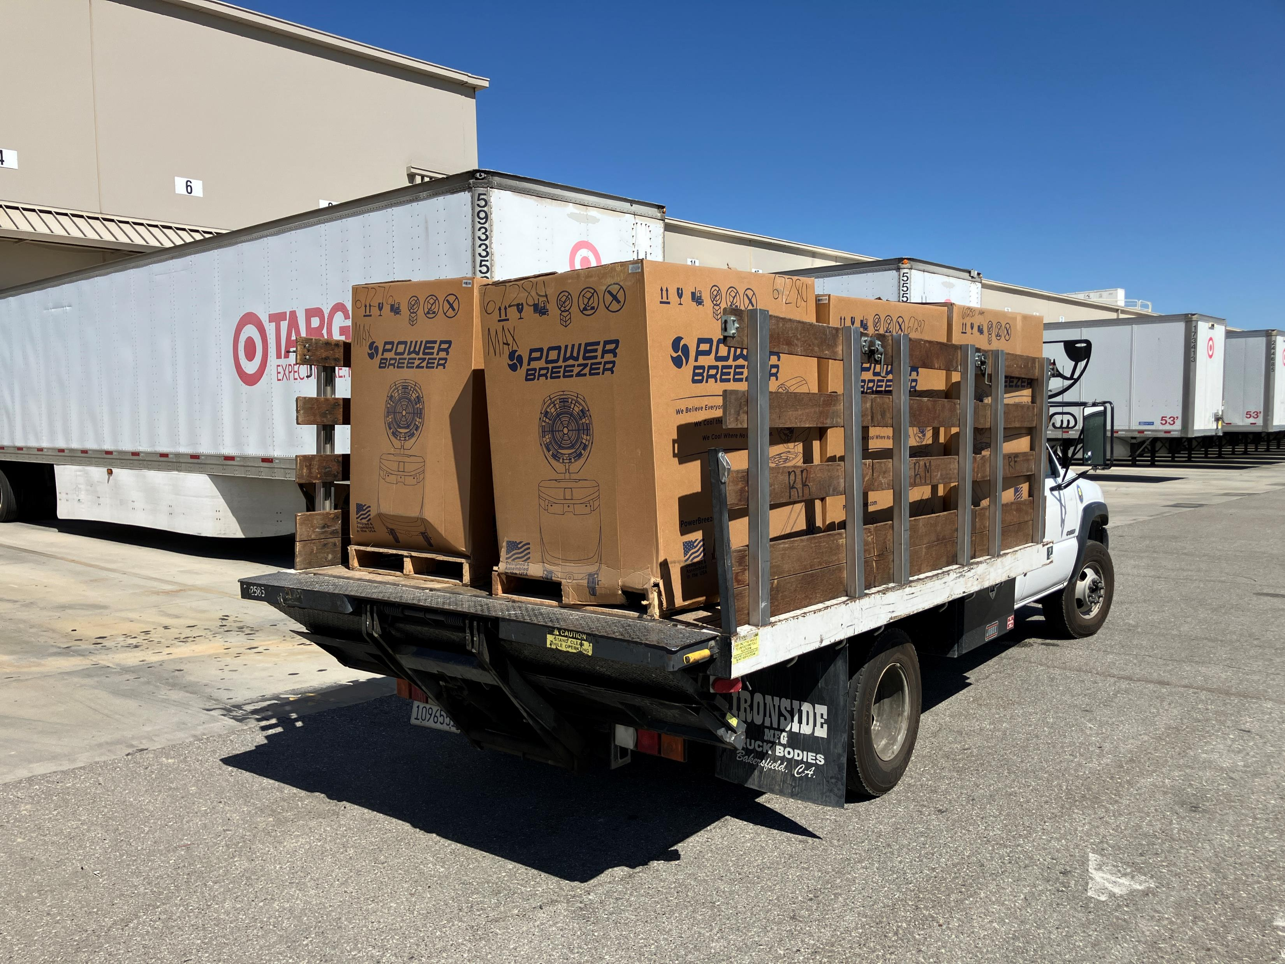
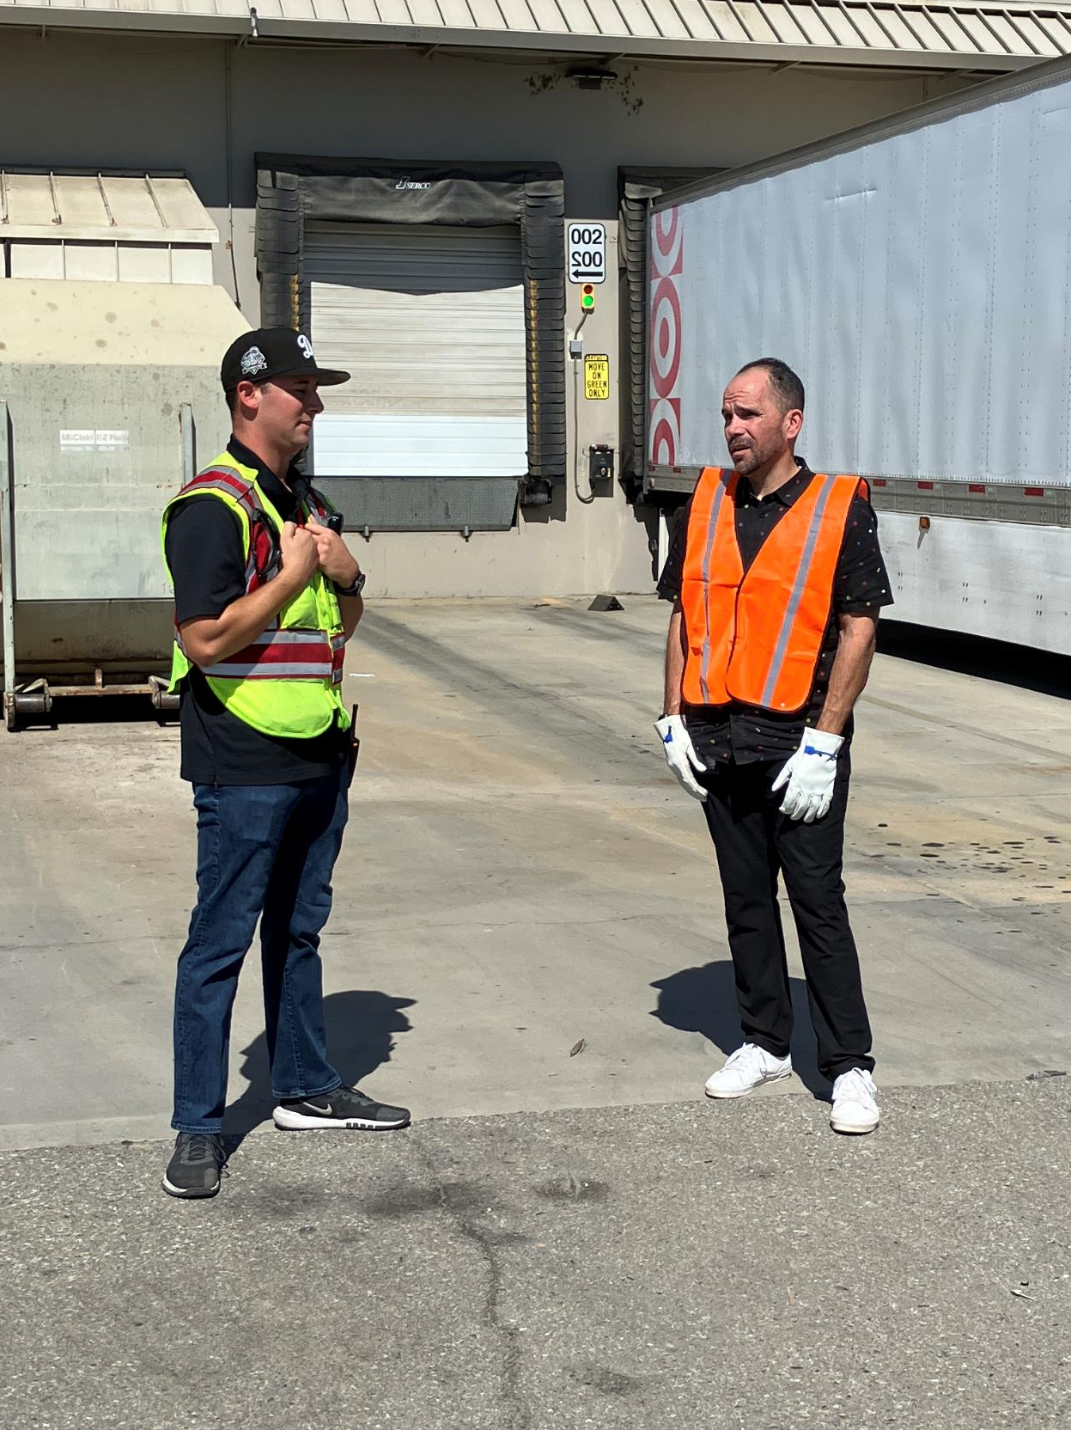
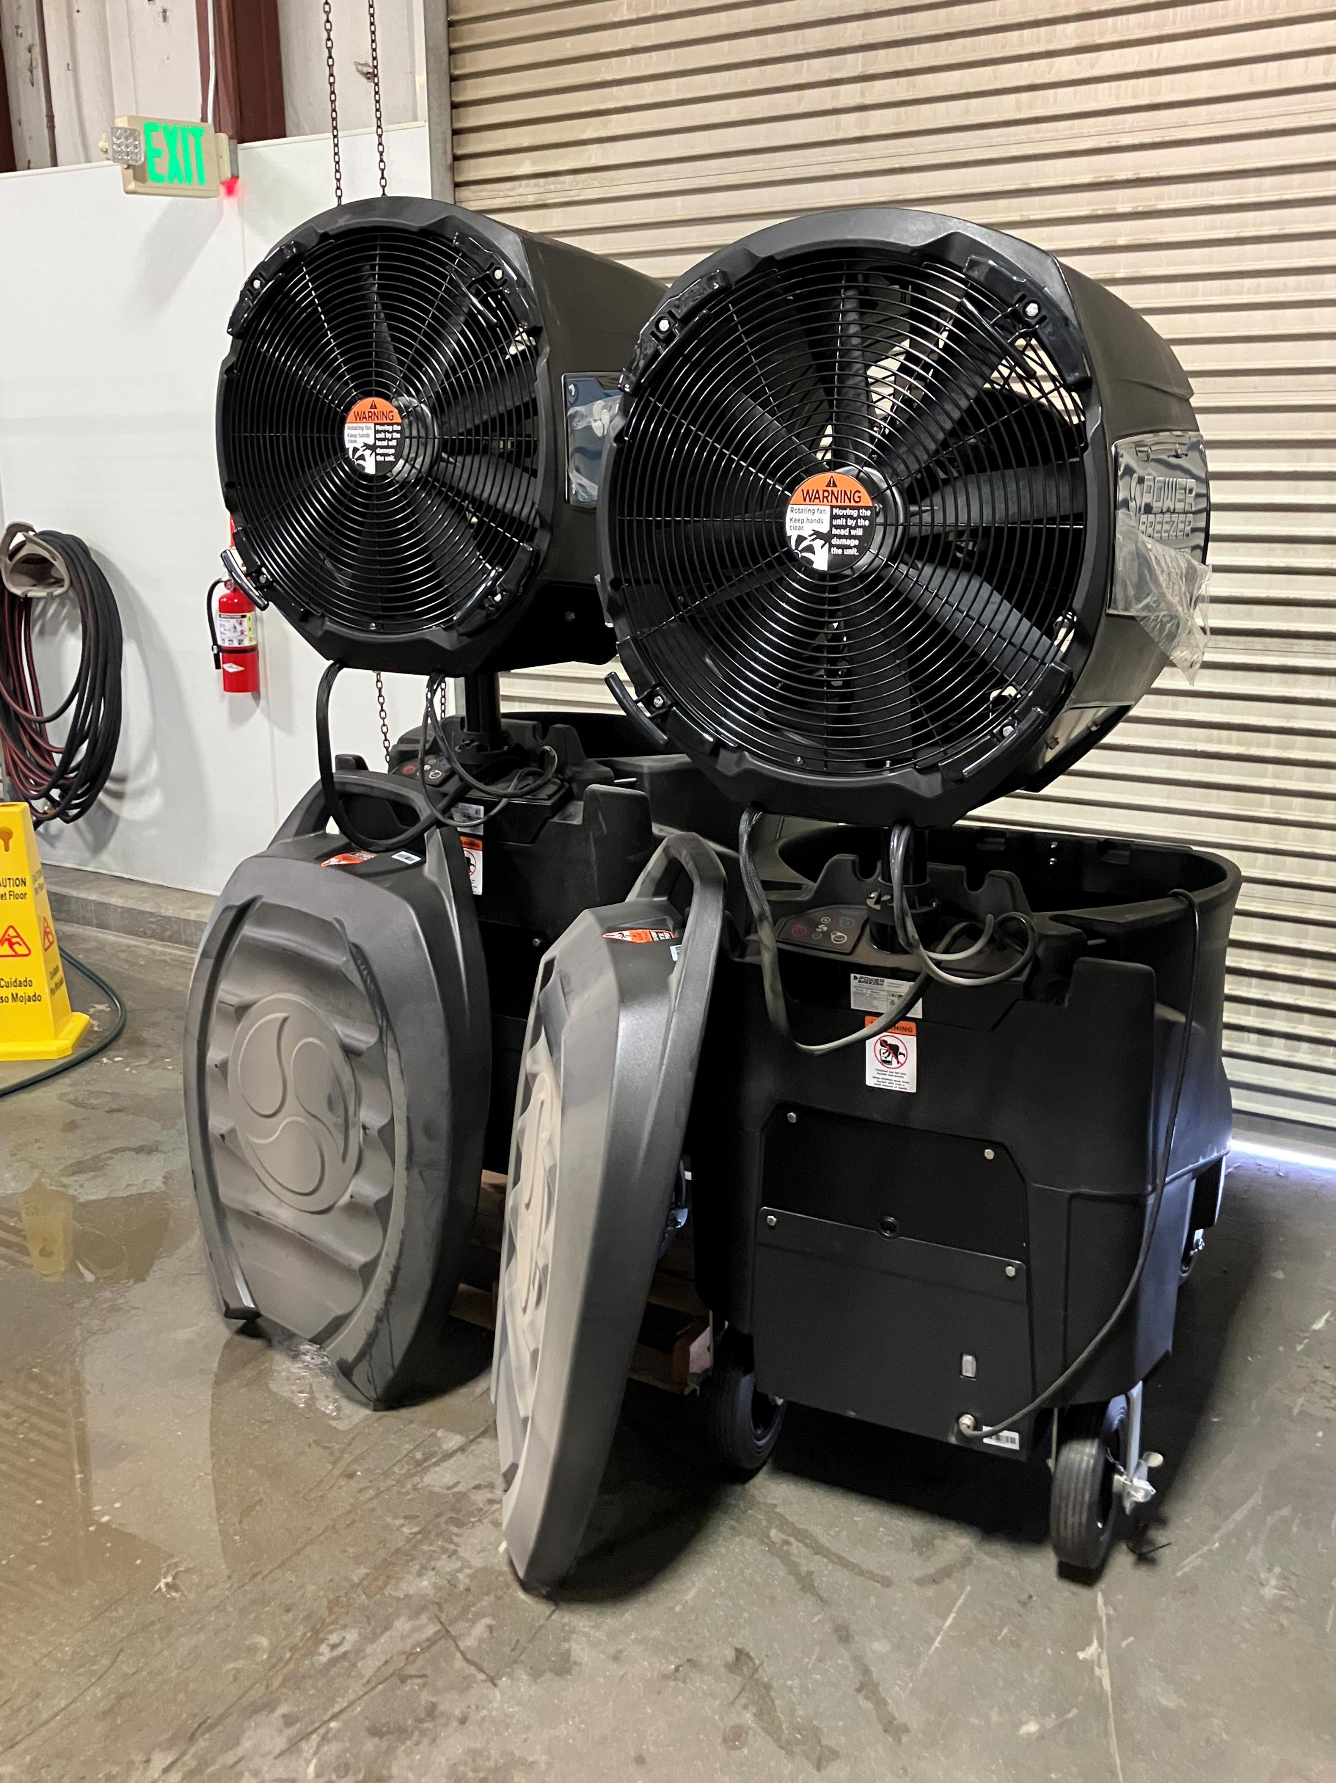
$36,000
Donation from Target
On July 31st,Target donated six brand-new $6,000 industrial misting fans to the shelter. That’s a $36,000 gift of COOL comfort for our pets!
We’re incredibly grateful for this massive donation, which will help keep our animals comfortable during the hot Bakersfield summer!

Slide 22
2025 Year To Date
January 1st – July 31st
2,945
Adoptions
2,341
Rescued
463
Returned To Owner
5,357
Spay/Neuter Surgeries
7,040
Total Lives Saved
78.85%
Save Rate

Slide 23
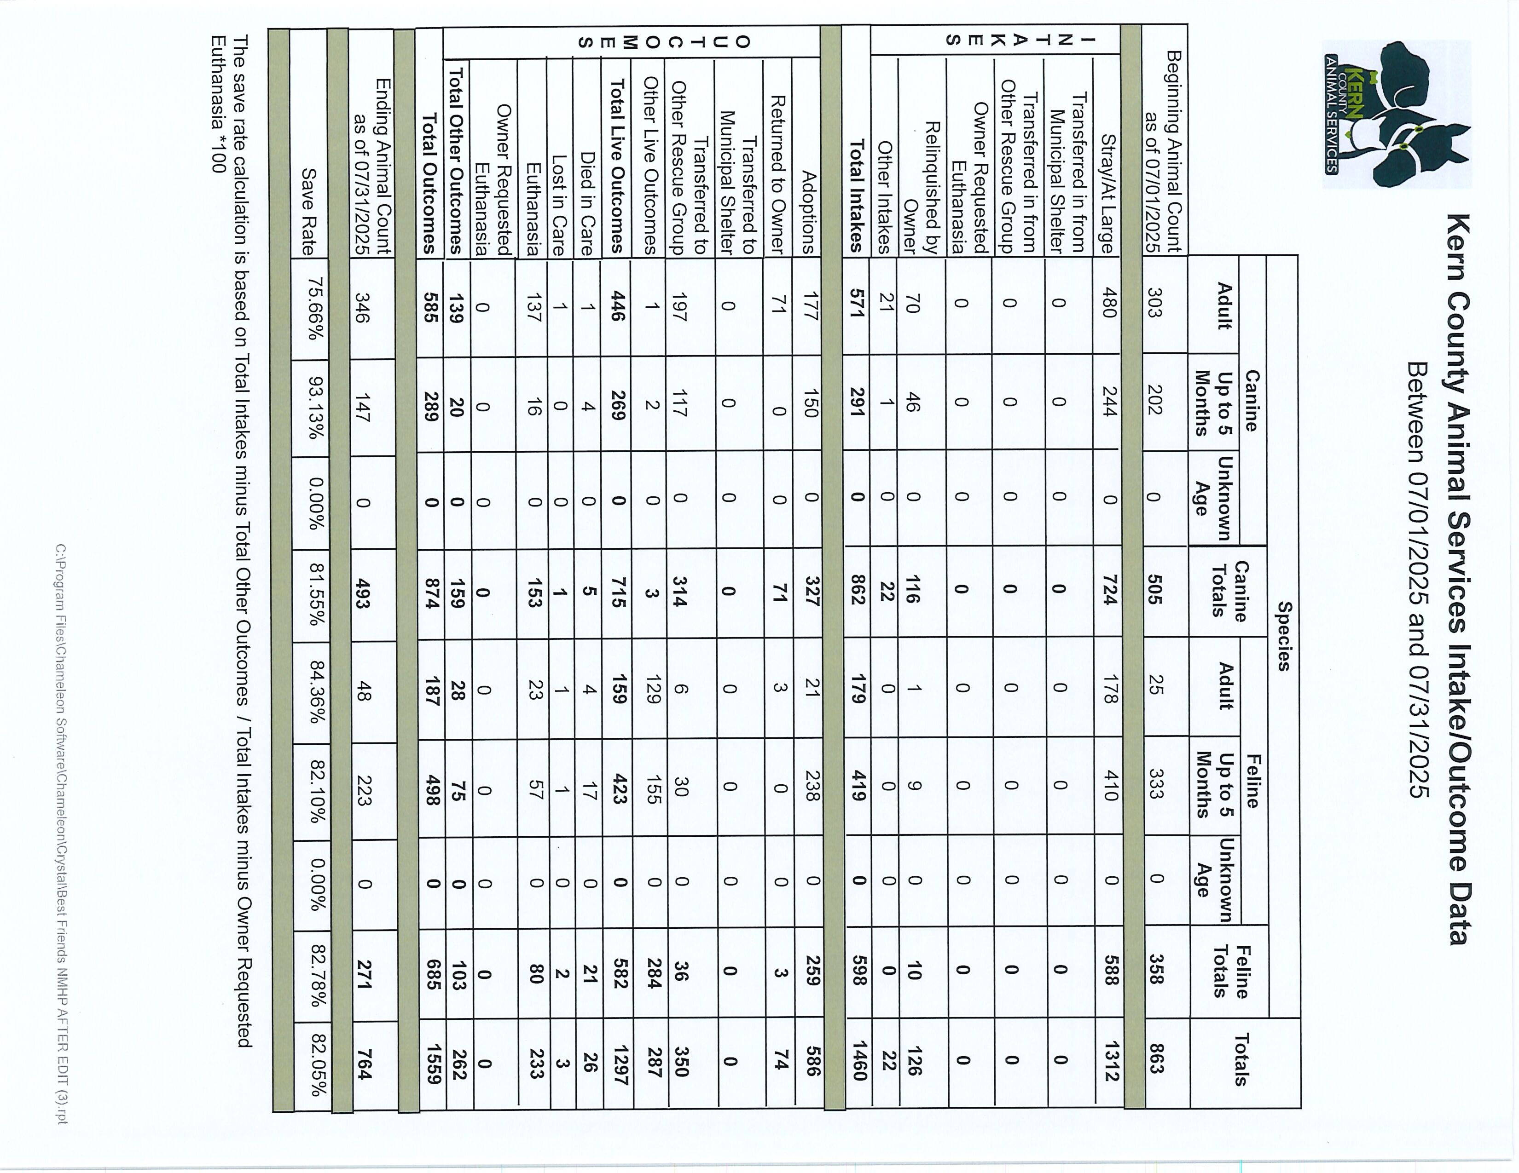

Slide 24
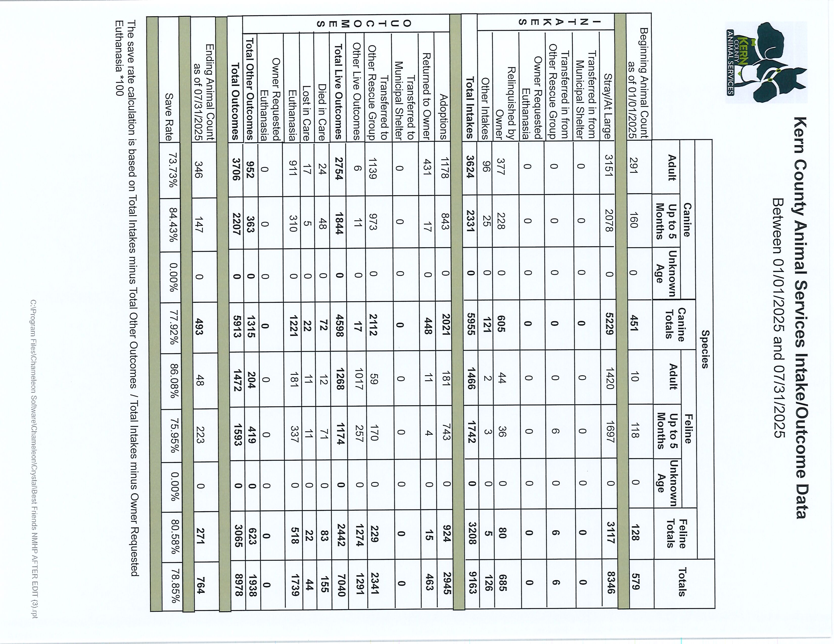

Slide 25
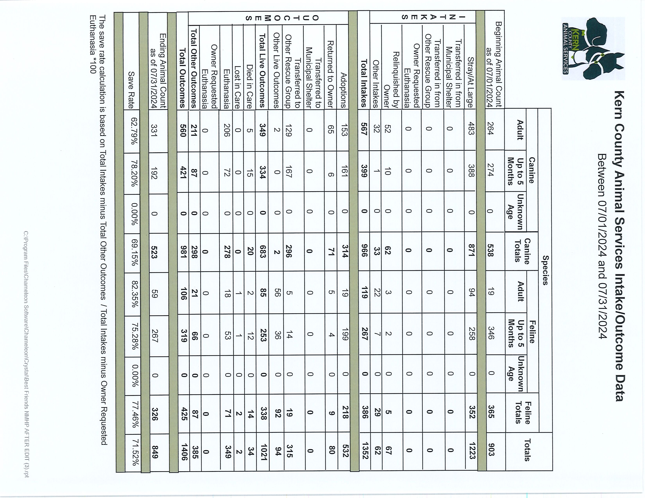

Slide 26
