Slide 1

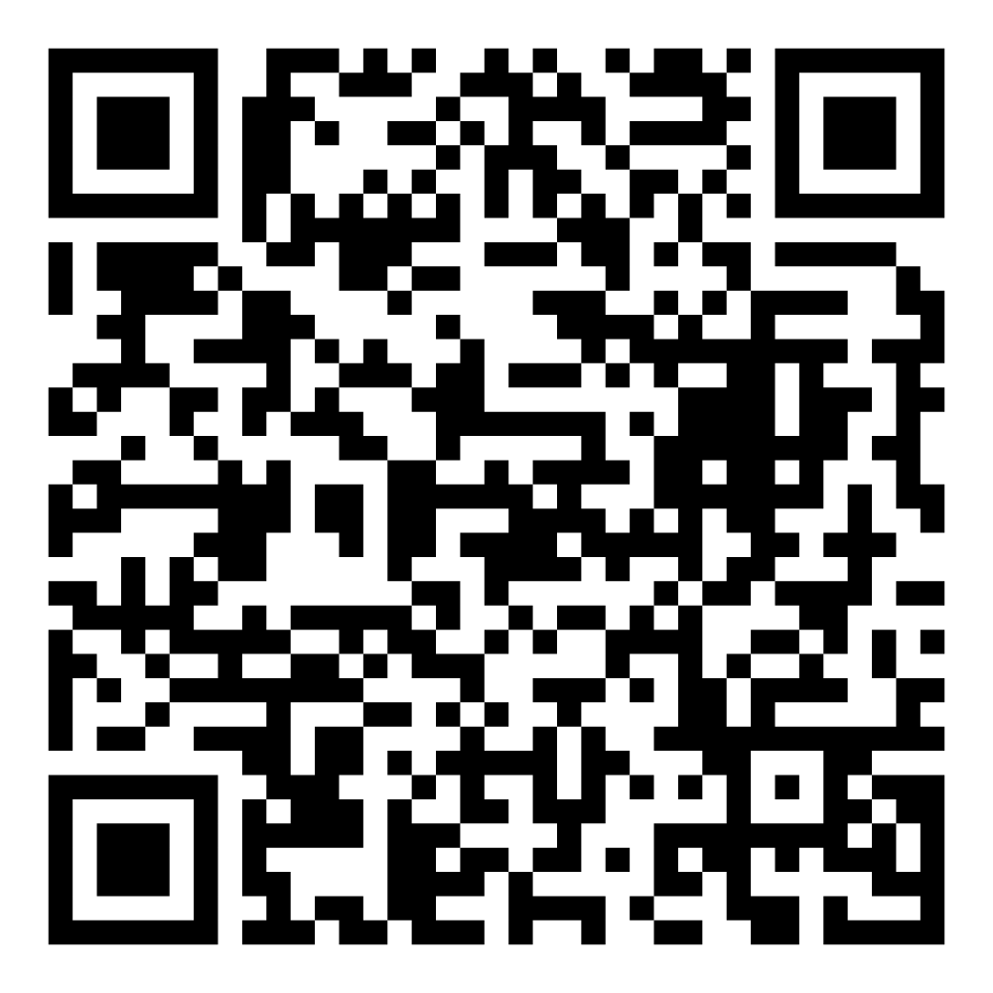
Director’s Report
August 2025

Slide 2
Program Highlights
August 2025
Adoption: 183 dogs, 103 puppies, 17 cats, and 200 kittens under 5 months of age were adopted for a total of 503 animals adopted from Kern County Animal Shelters in the month of August.
Foster: 19 dogs, 17 puppies, 7 cats, and 96 kittens entered the Department’s Foster Care Program in August, for a total of 139 animals.
Rescue: 169 dogs, 130 puppies, 5 cats, and 30 kittens were transferred to other animal rescue organizations in August, for a total of 334 animals.
Spay/Neuter: A total of 279 animals were altered at low-cost KCAS spay/neuter clinics in the month of August.
TNR: 230 cats were spayed or neutered and released in August of 2025. Year-to-date, 1274 cats have gone through the program, and since 2013 26,652 cats have been spayed or neutered and returned to field.

Slide 3



Monthly Adoption Promotions
August 2025
Fee-Waived Adoptions
August 1st – August 30th

Slide 4
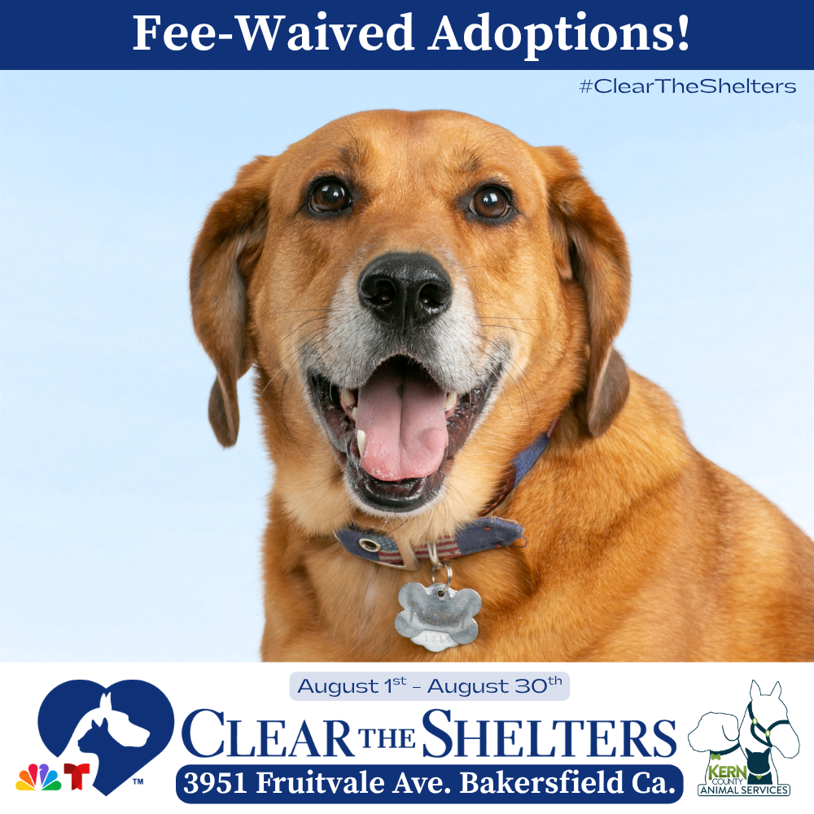

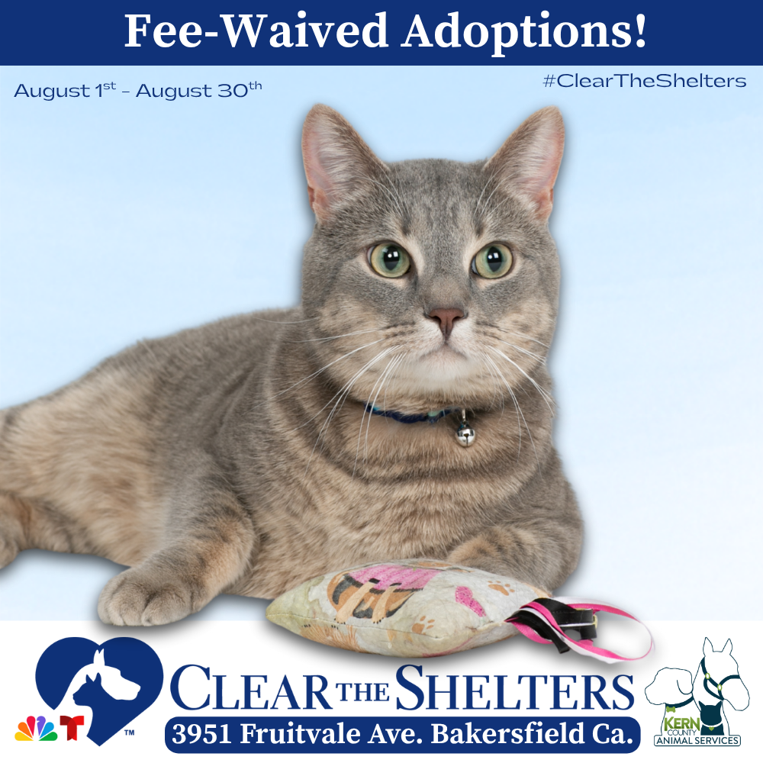
Monthly Adoption Promotions
August 2025
Fee-Waived Adoptions
August 1st – August 30th

Slide 5


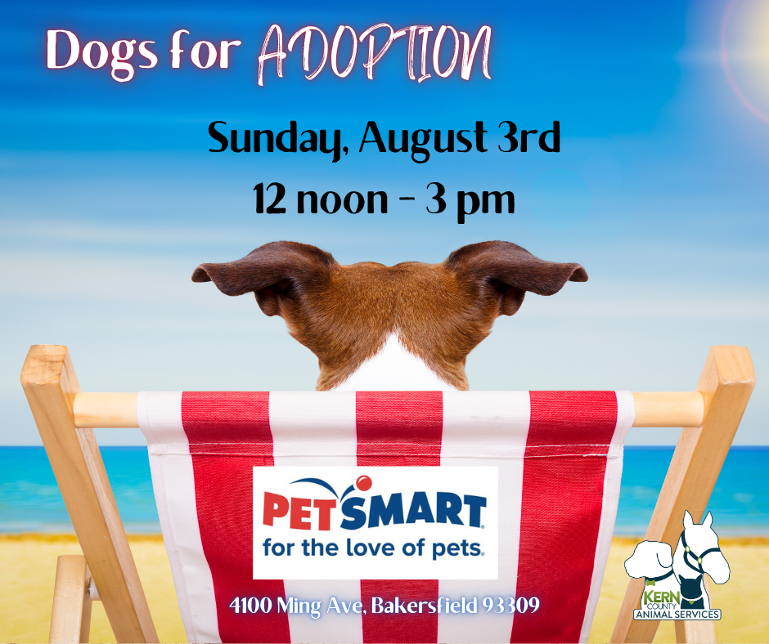
Offsite Adoption Events
August 1st – 3rd

Slide 6
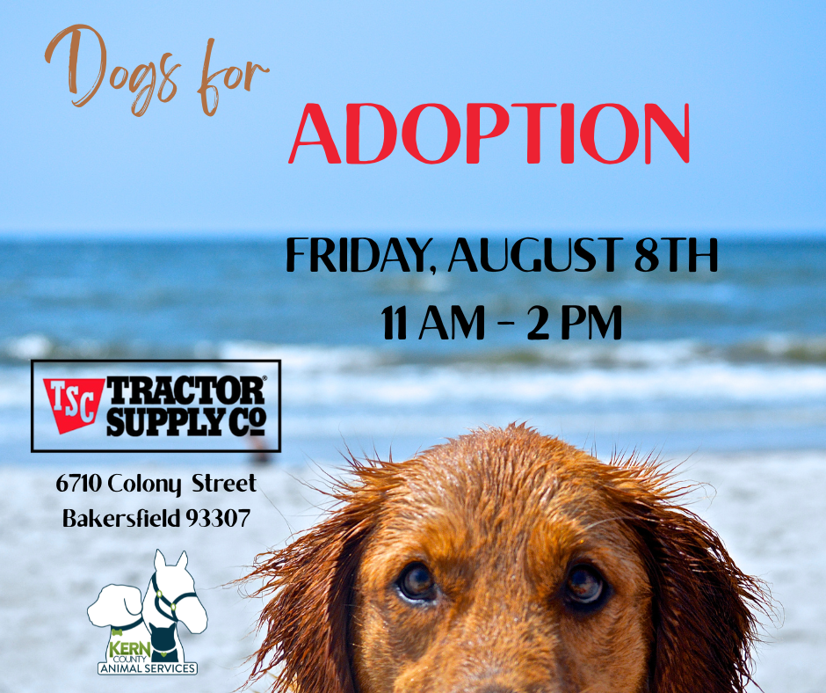

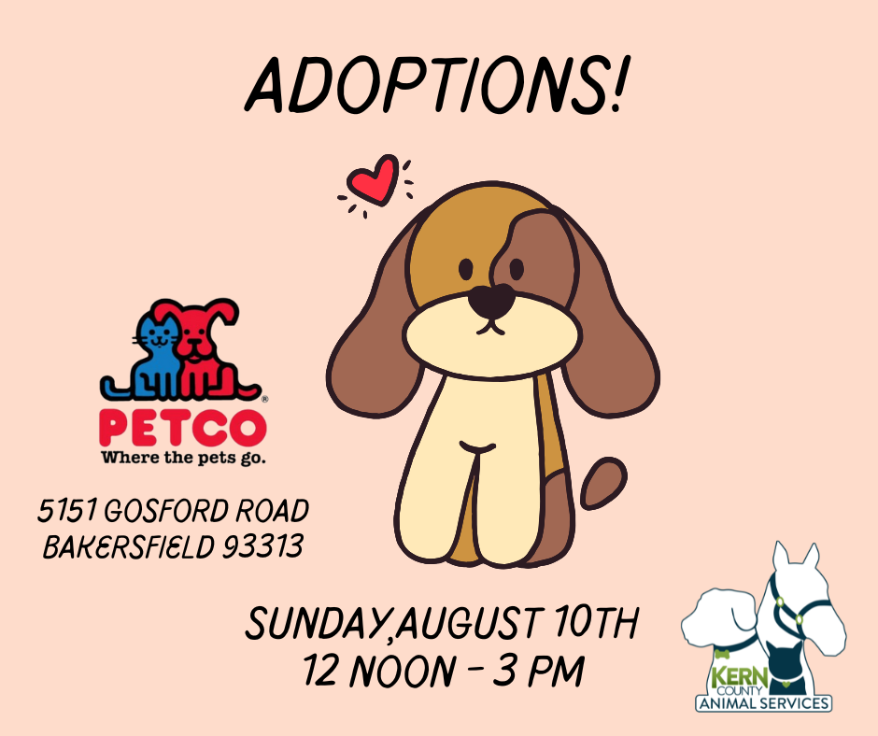
Offsite Adoption Events
August 8th – August 10th

Slide 7



Offsite Adoption Events
August 15th – 17th

Slide 8
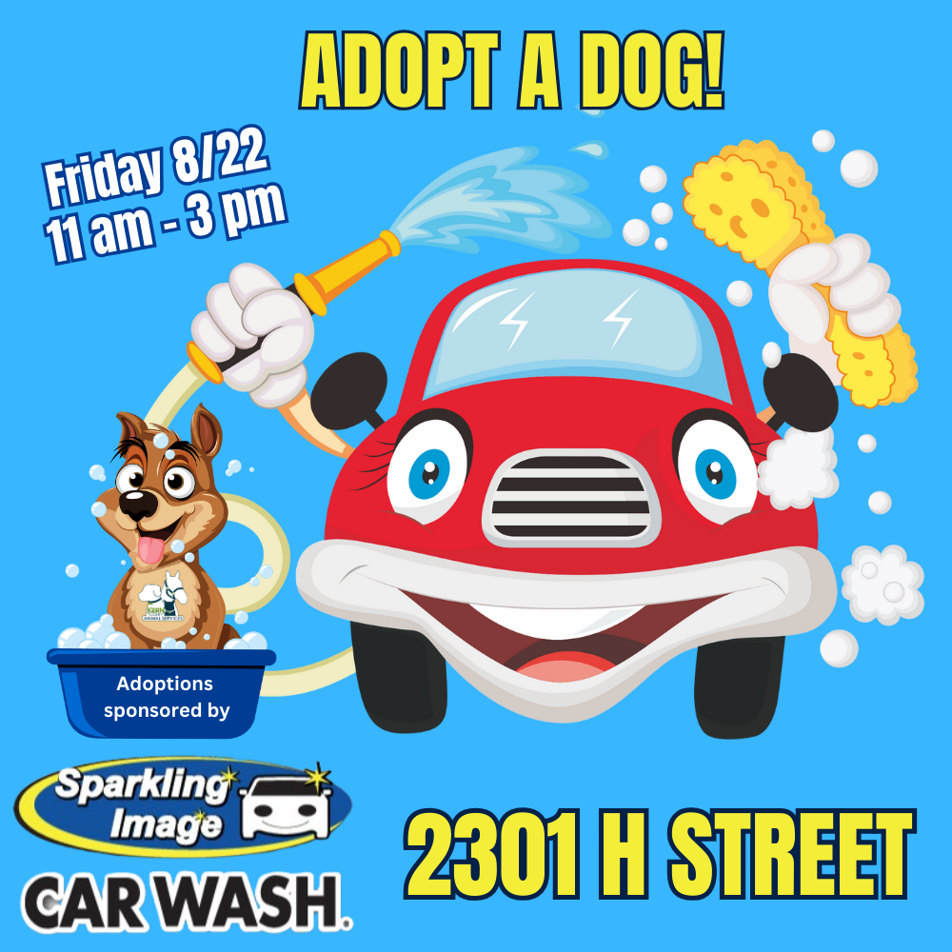


Offsite Adoption Events
August 22nd – August 24th

Slide 9



Offsite Adoption Events
August 29th – August 30th

Slide 10
Low-Cost Spay/Neuter Clinics
August 2025
Date | Location | Surgeries
August 6th | Rosamond | 58
August 7th | Heritage Park | 58
August 14th | Calvary Church w/ S.O.S. Rescue | 58
August 19th | Bakersfield Harley Davidson | 47
August 21st | Heritage Park | 58
 | Total Surgeries | 279

Slide 11

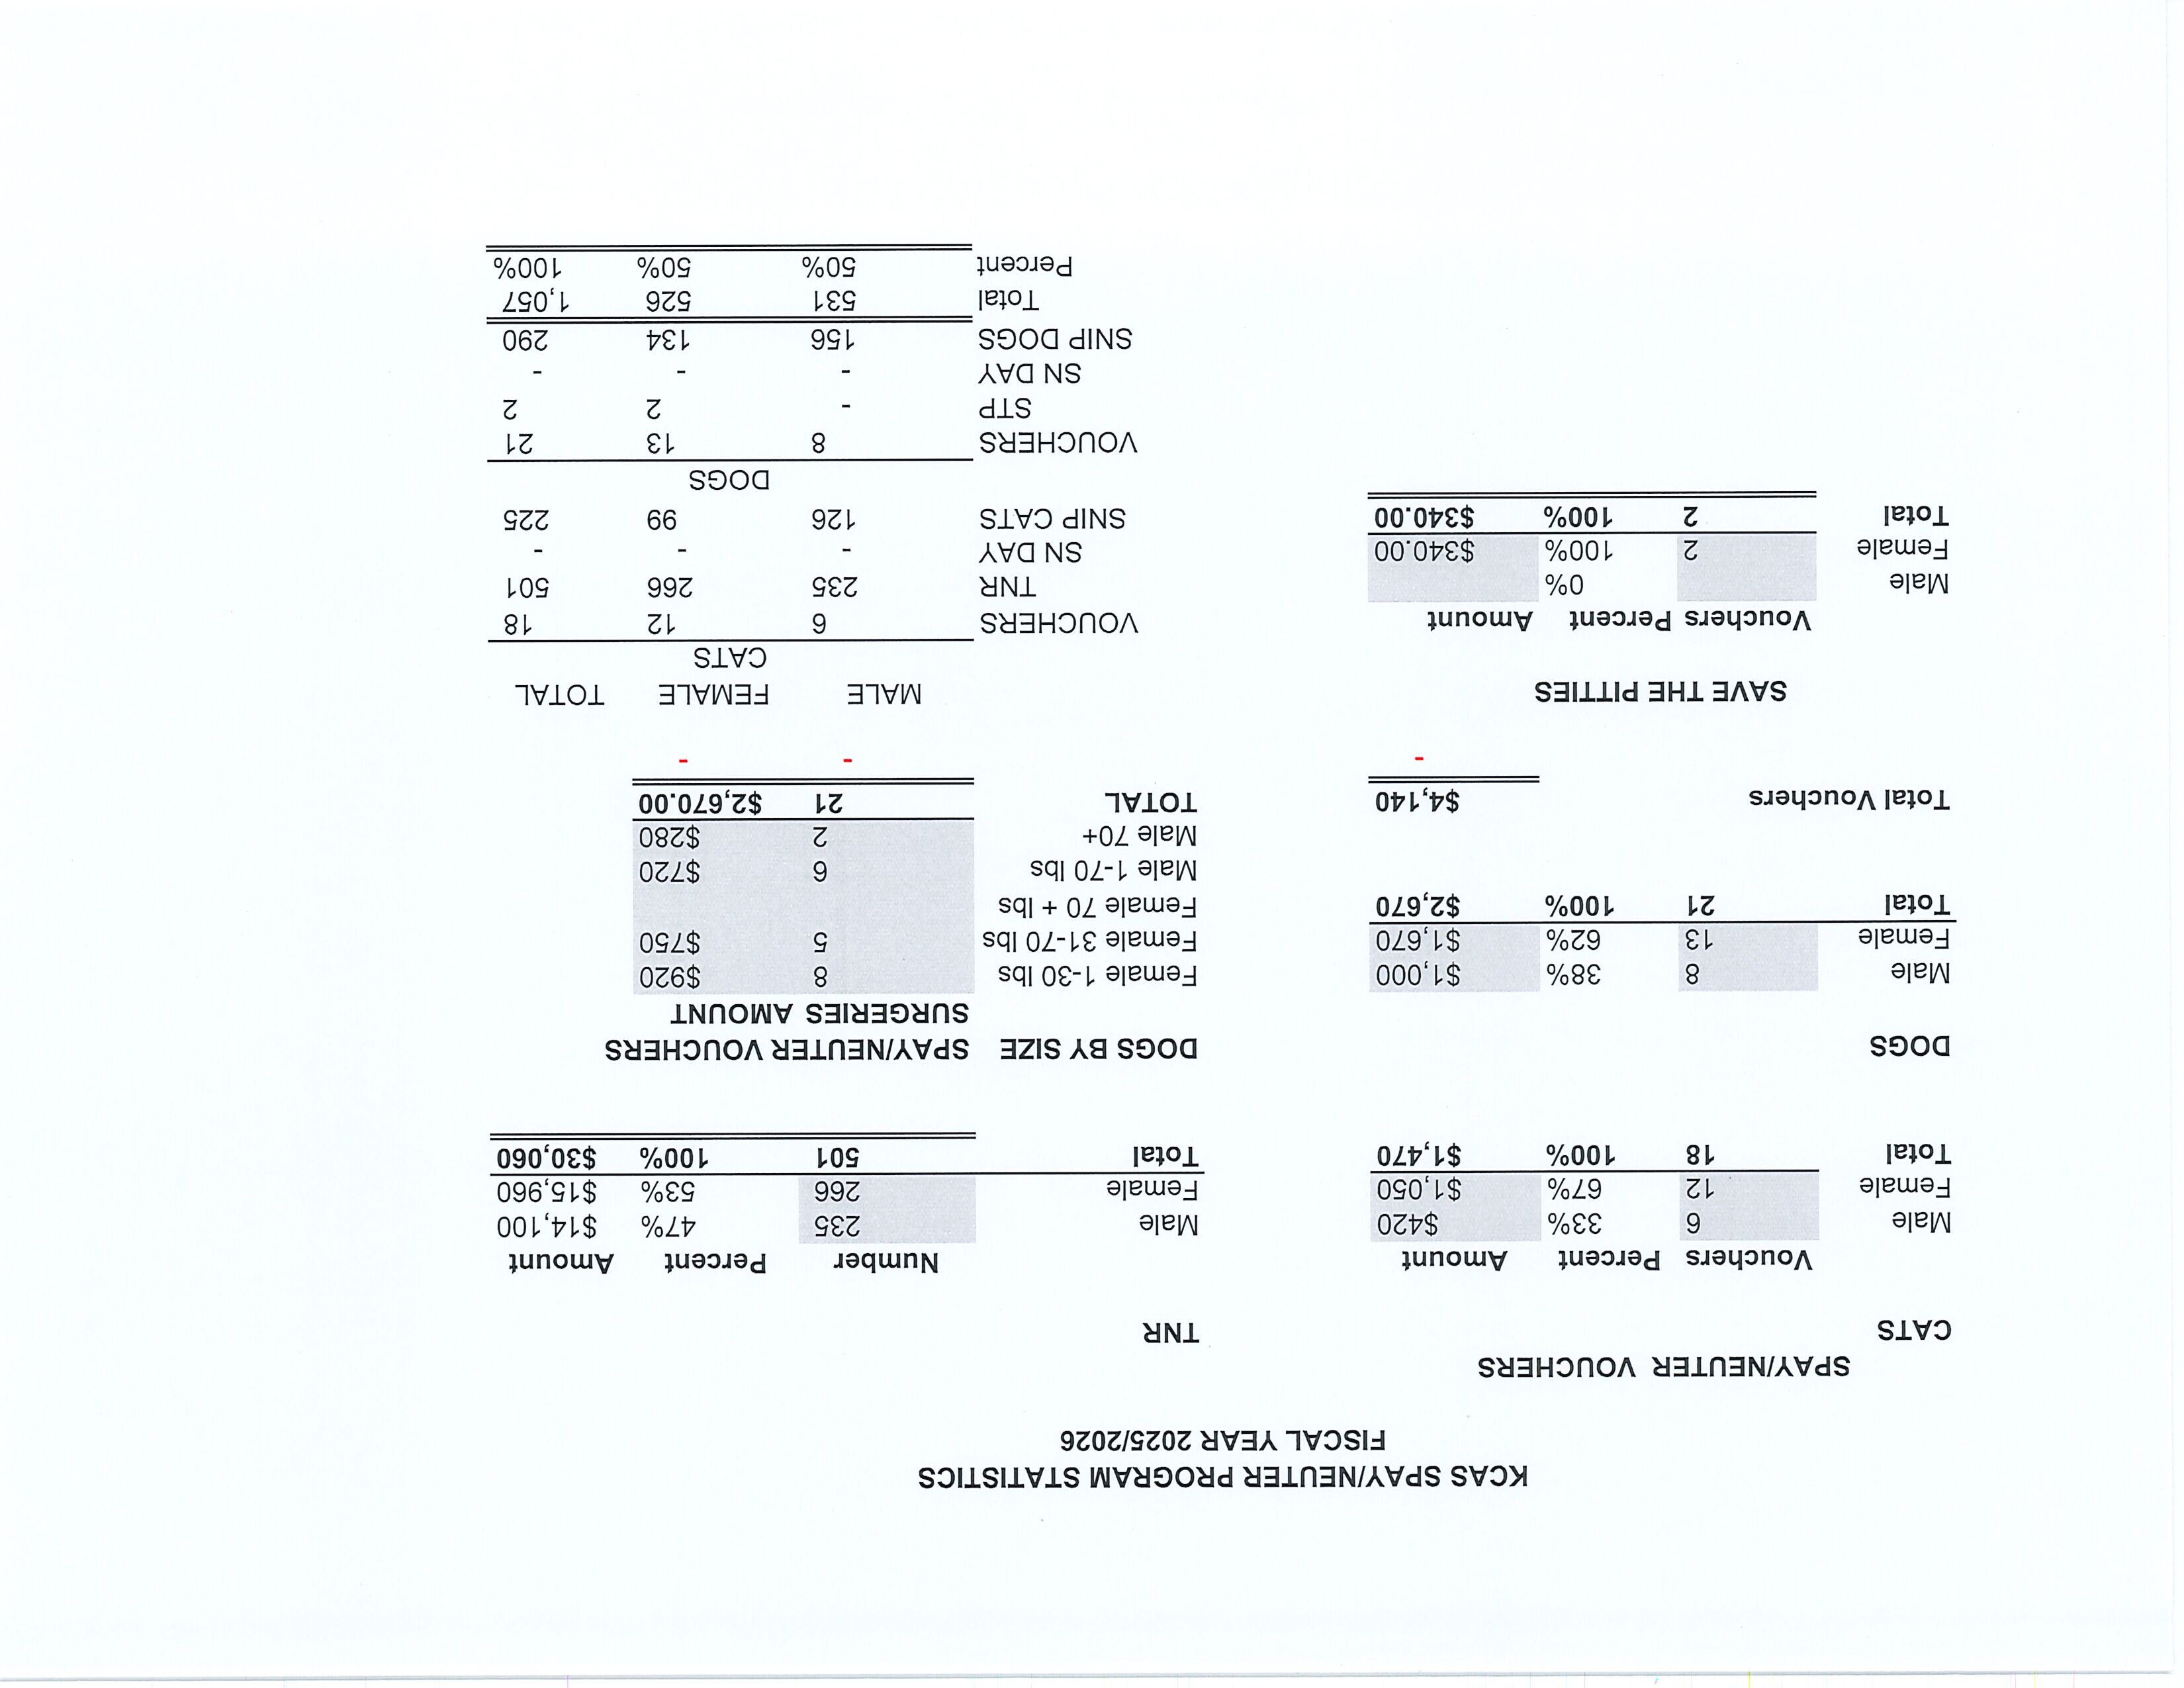


Slide 12
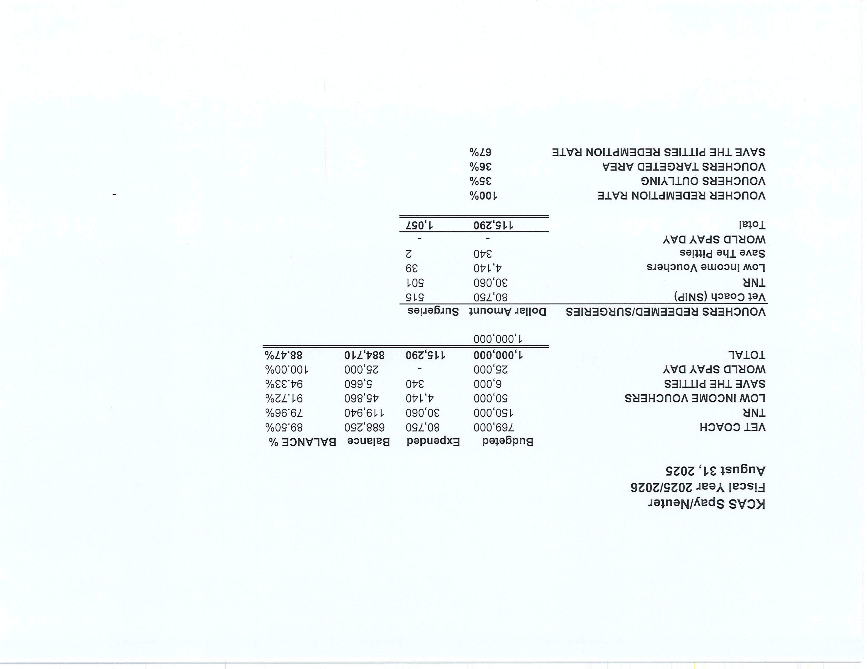

Slide 13
Low-Cost Vaccination Clinics
August 2025
Rabies
395
Microchips
Bordetella
53
88
DHPP* 381
FVRPC* 182
*DHPP and FVRCP vaccinations provided at no-cost by Petco Love.

Slide 14



Streets Of Bakersfield
August 2nd | August 16th | August 30th

Slide 15


Streets Of Bakersfield Weekend Sleepovers
August 2nd - 4th | August 16th - 18th | August 30th – September 2nd

Slide 16
Volunteer Program
August 2025
Active Volunteers
101
New Volunteers
42
Volunteer hours donated in July
Volunteer hours donated in 2025
1,190
7,464.78

Slide 17
Field Service Calls – August 2025
AREA | CALLS PER AREA
Lake Isabella | 140
Mojave | 132
North County | 57
Northeast | 383
Northwest | 309
Ridgecrest | 24
Southeast | 174
Southwest | 103
Taft | 117
Tehachapi | 55
TOTAL | 1,494
71 dogs were returned to their owners in the field in August 2025.
152 dogs were secured on property by Animal Control Officers in August 2025

Slide 18
Commercial Animal Facility Calls
August 2025
TYPE | CALLS PER TYPE
CAF – Breeder | 18
CAF – Rescue | 0
CAF – Kennel | 1
CAF – Boarding | 2
TOTAL | 19
4 Inspections Passed
0 Inspections Failed
0 Citations Issued
4 Permits Issued
52 Active CAF Permits

Slide 19

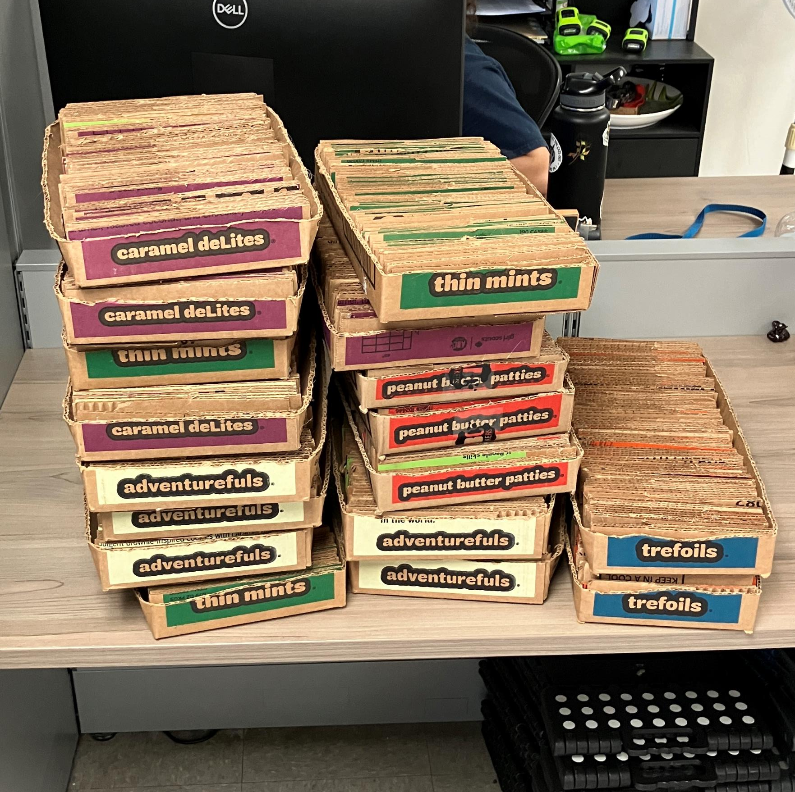
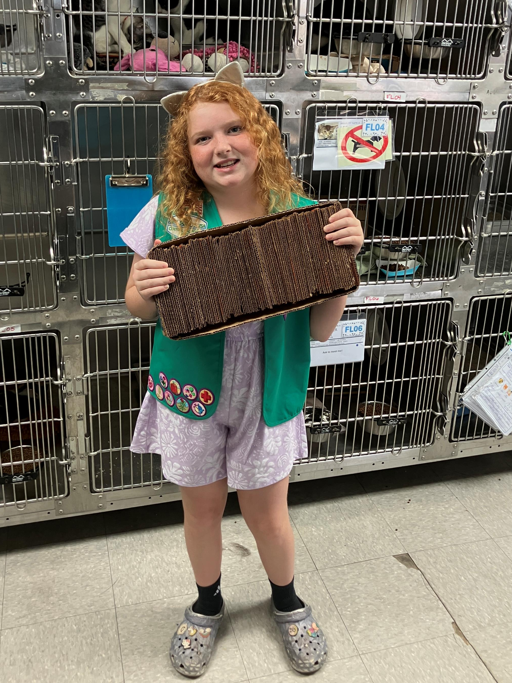
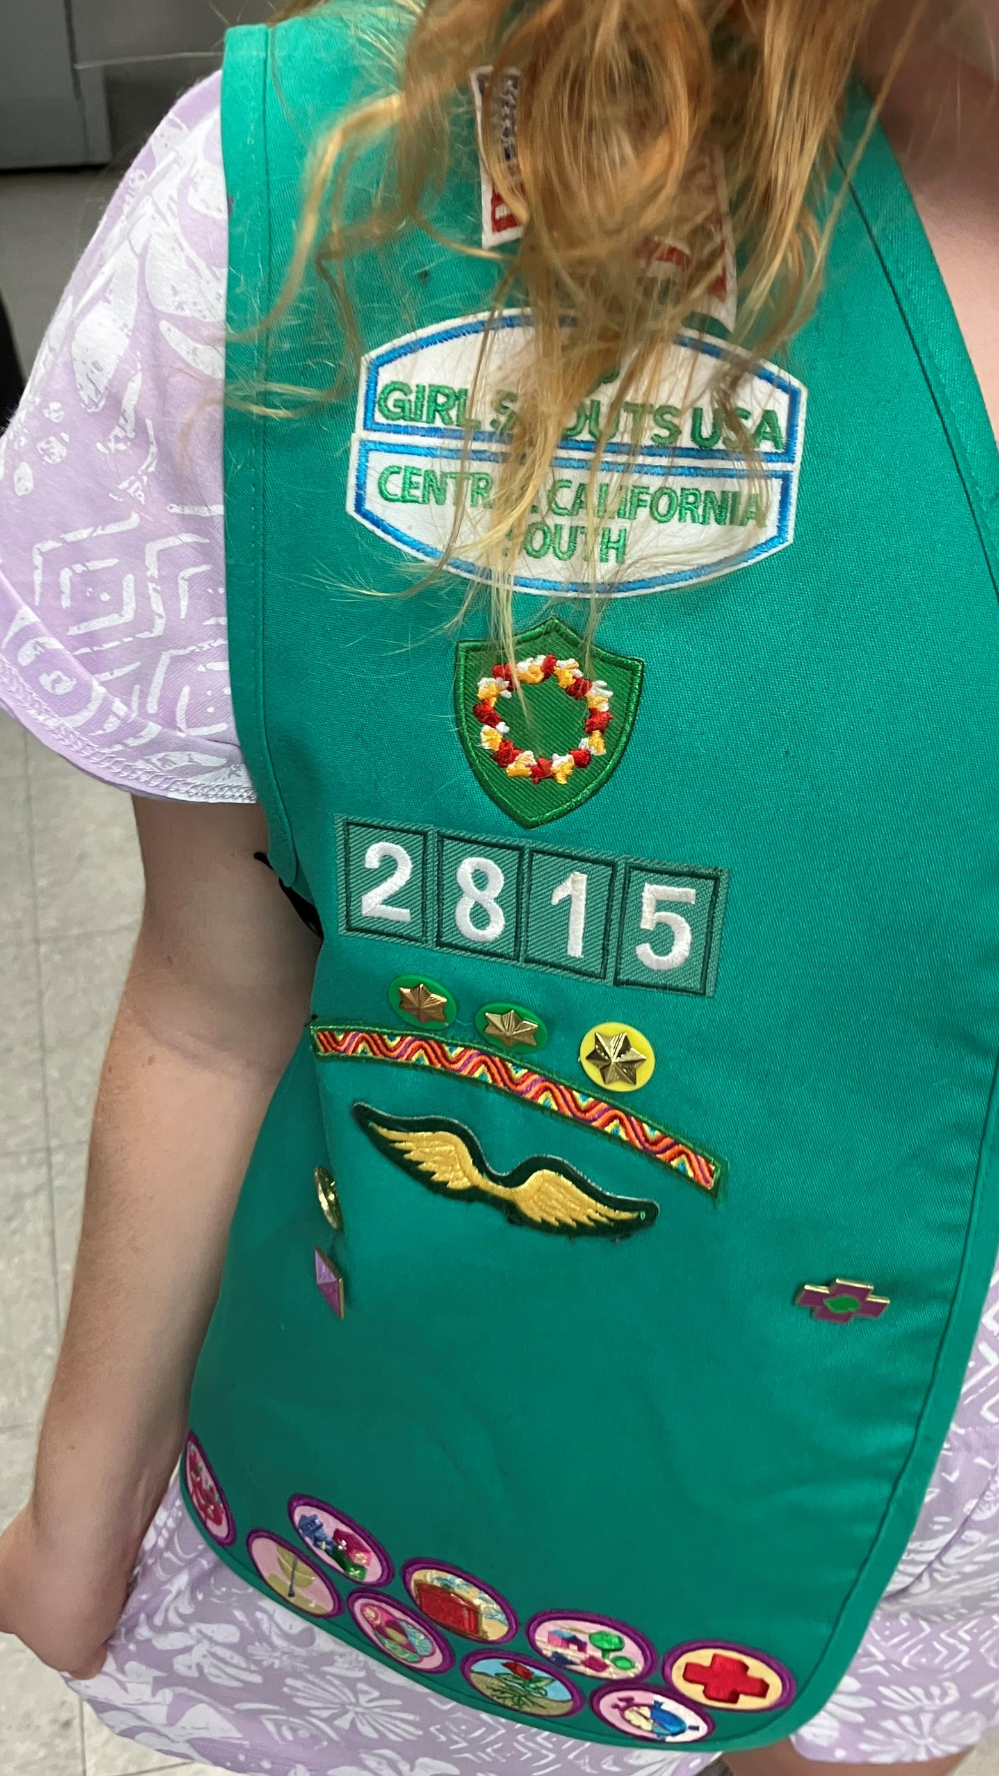
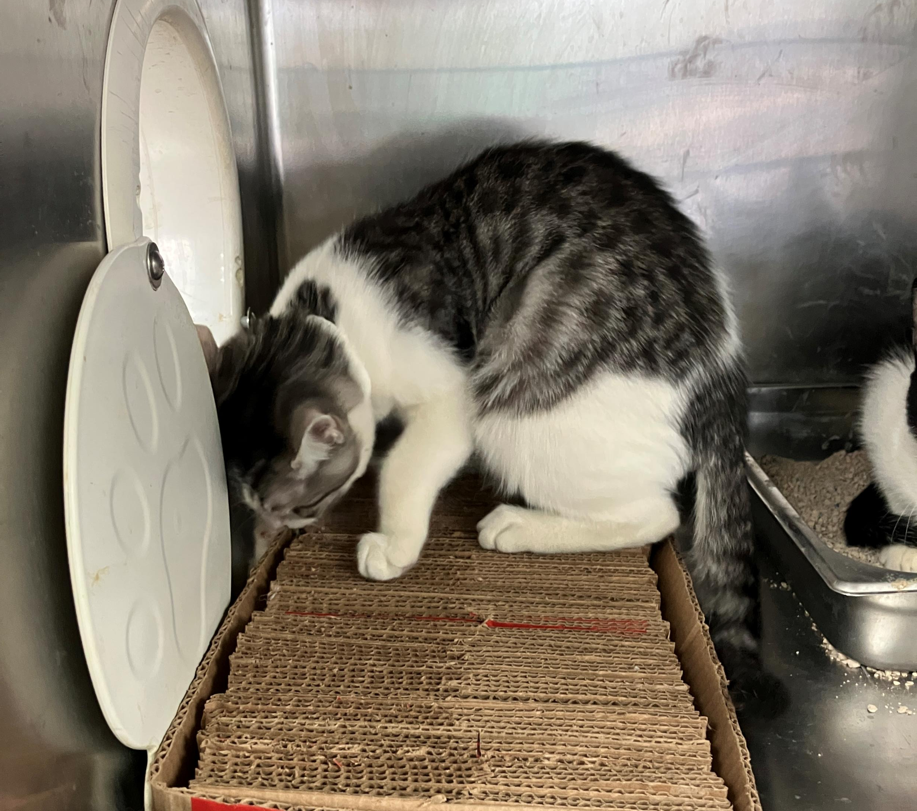
Lillian’s Cat Scratchers
August 11th, Lillian, from Girl Scouts Troop 2815, put her creativity to work and crafted over 20 cat scratchers for our adoptable kittens and cats! Her material of choice? Girl Scout Cookie boxes, of course!
She also designed a flyer to spread awareness about the importance of recycling and why safe scratching options are essential for cats’ wellbeing. You can spot her flyer in this collection of photos!
A huge thank you to Lillian for her creativity, kindness, and support of our shelter pets.

Slide 20
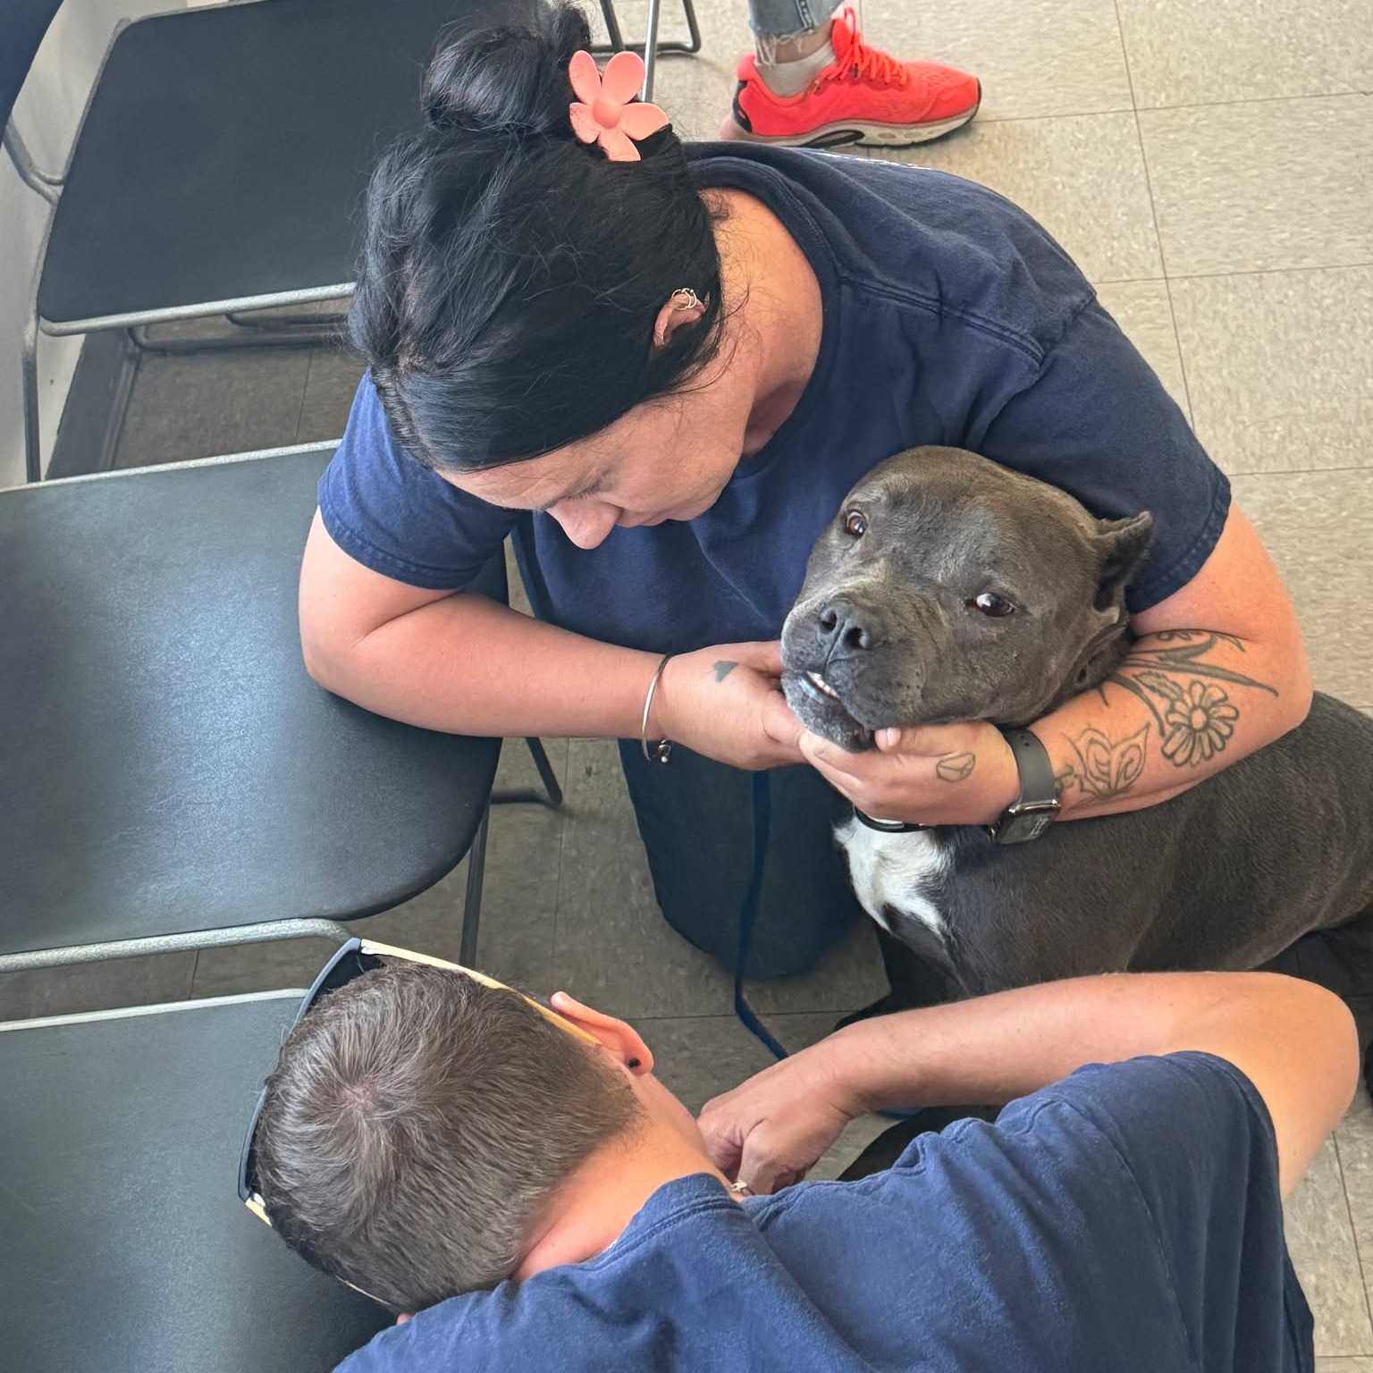
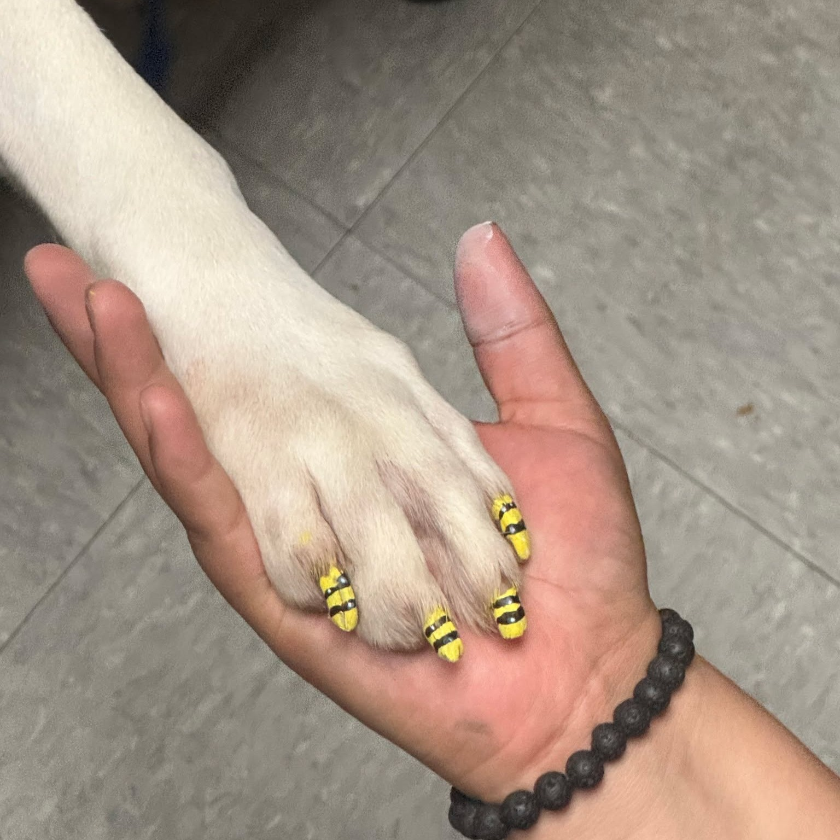
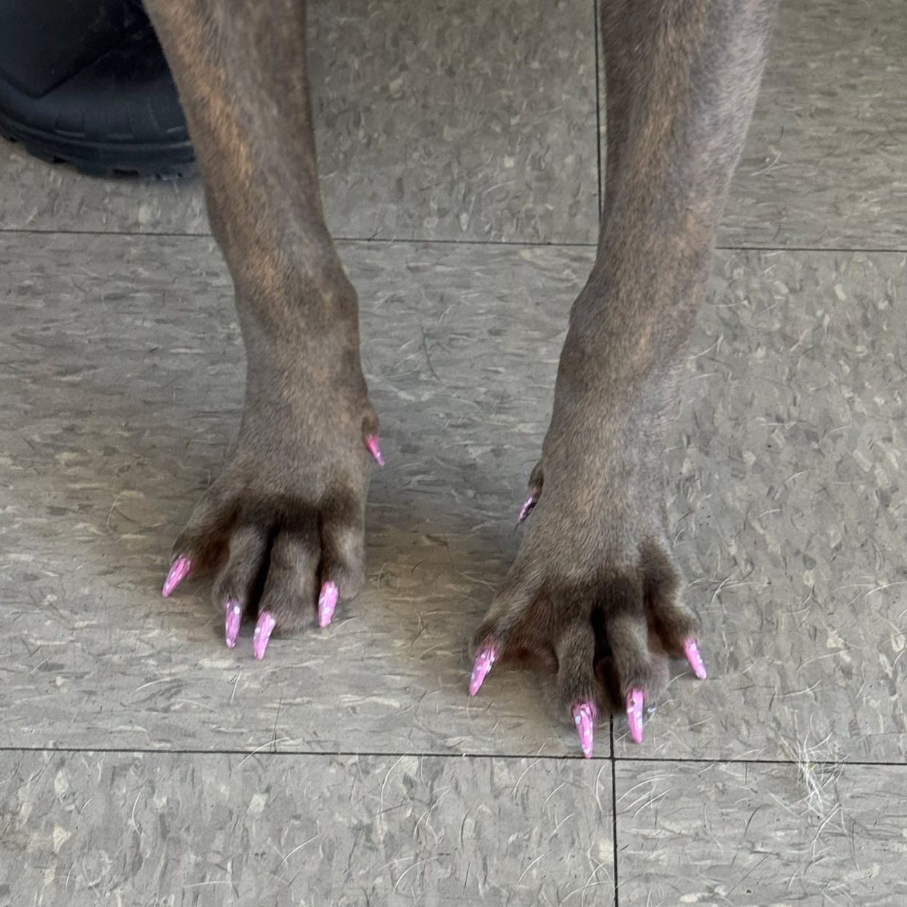
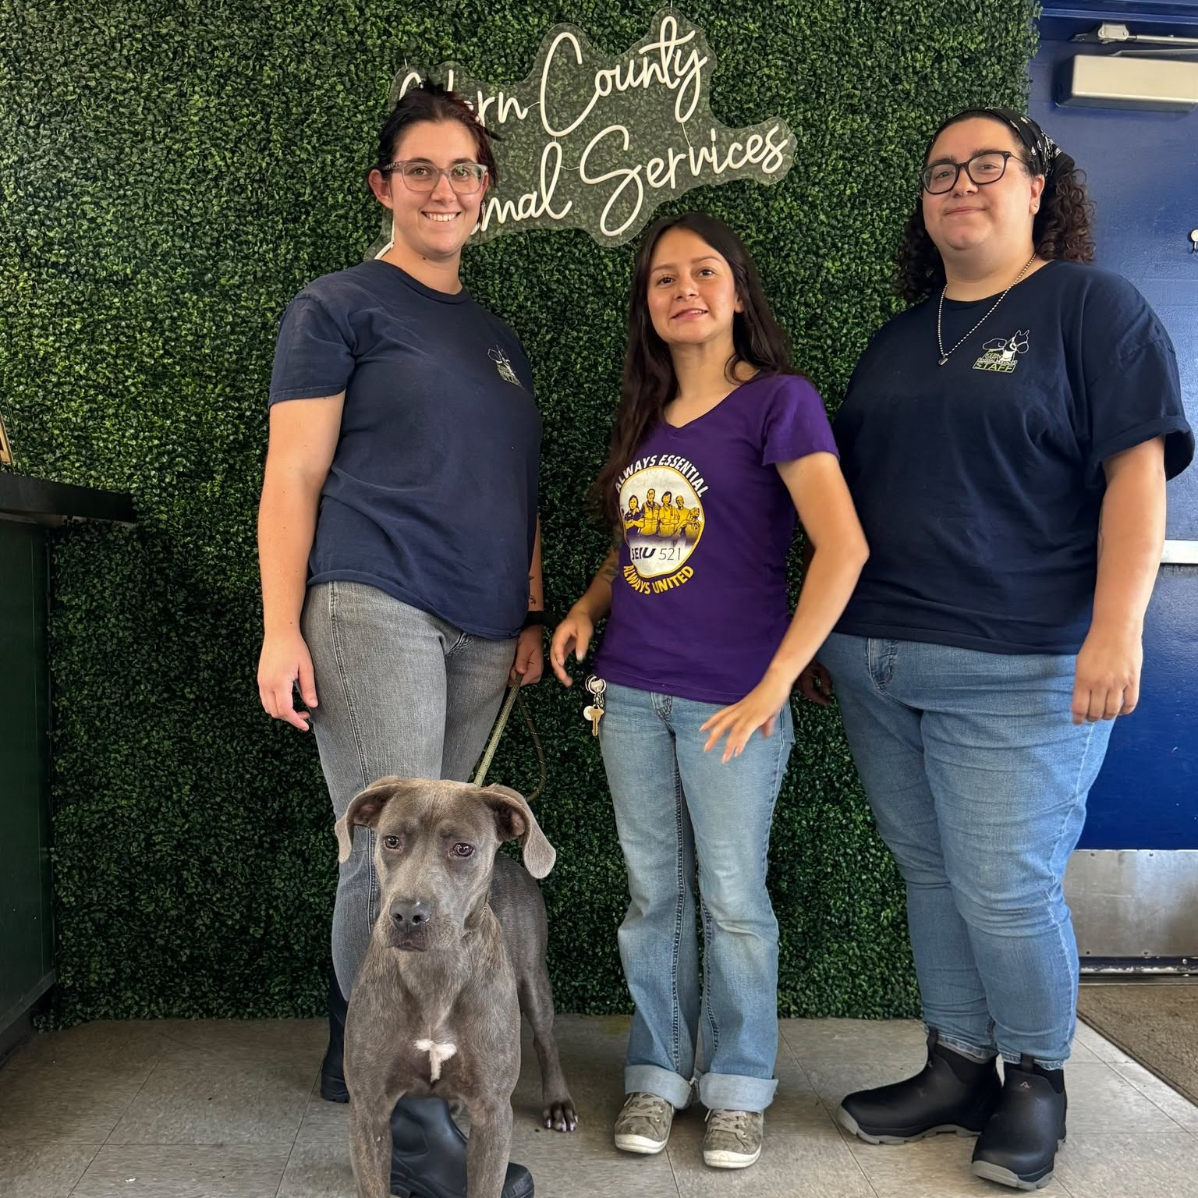
Painted Nails
On August 13th, our KCAS staff did something extra special to help some of their favorite shelter dogs stand out - they painted their nails! Check out the results! We think they nailed it!

Slide 21
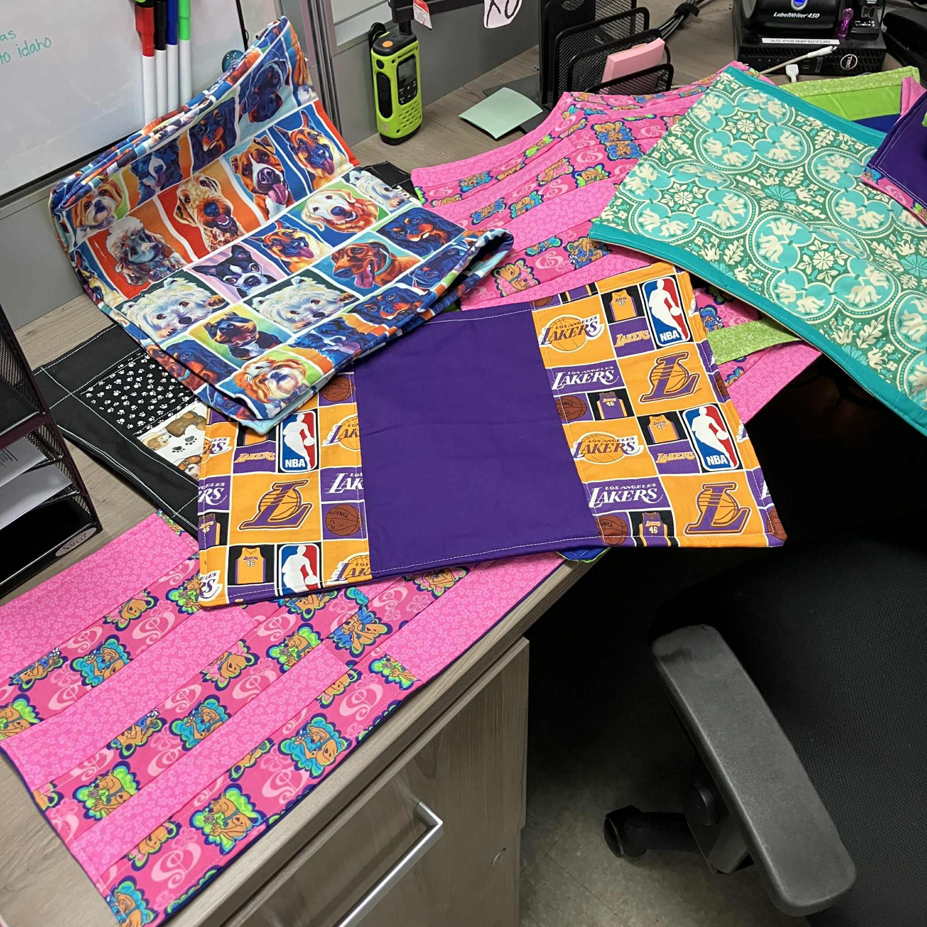
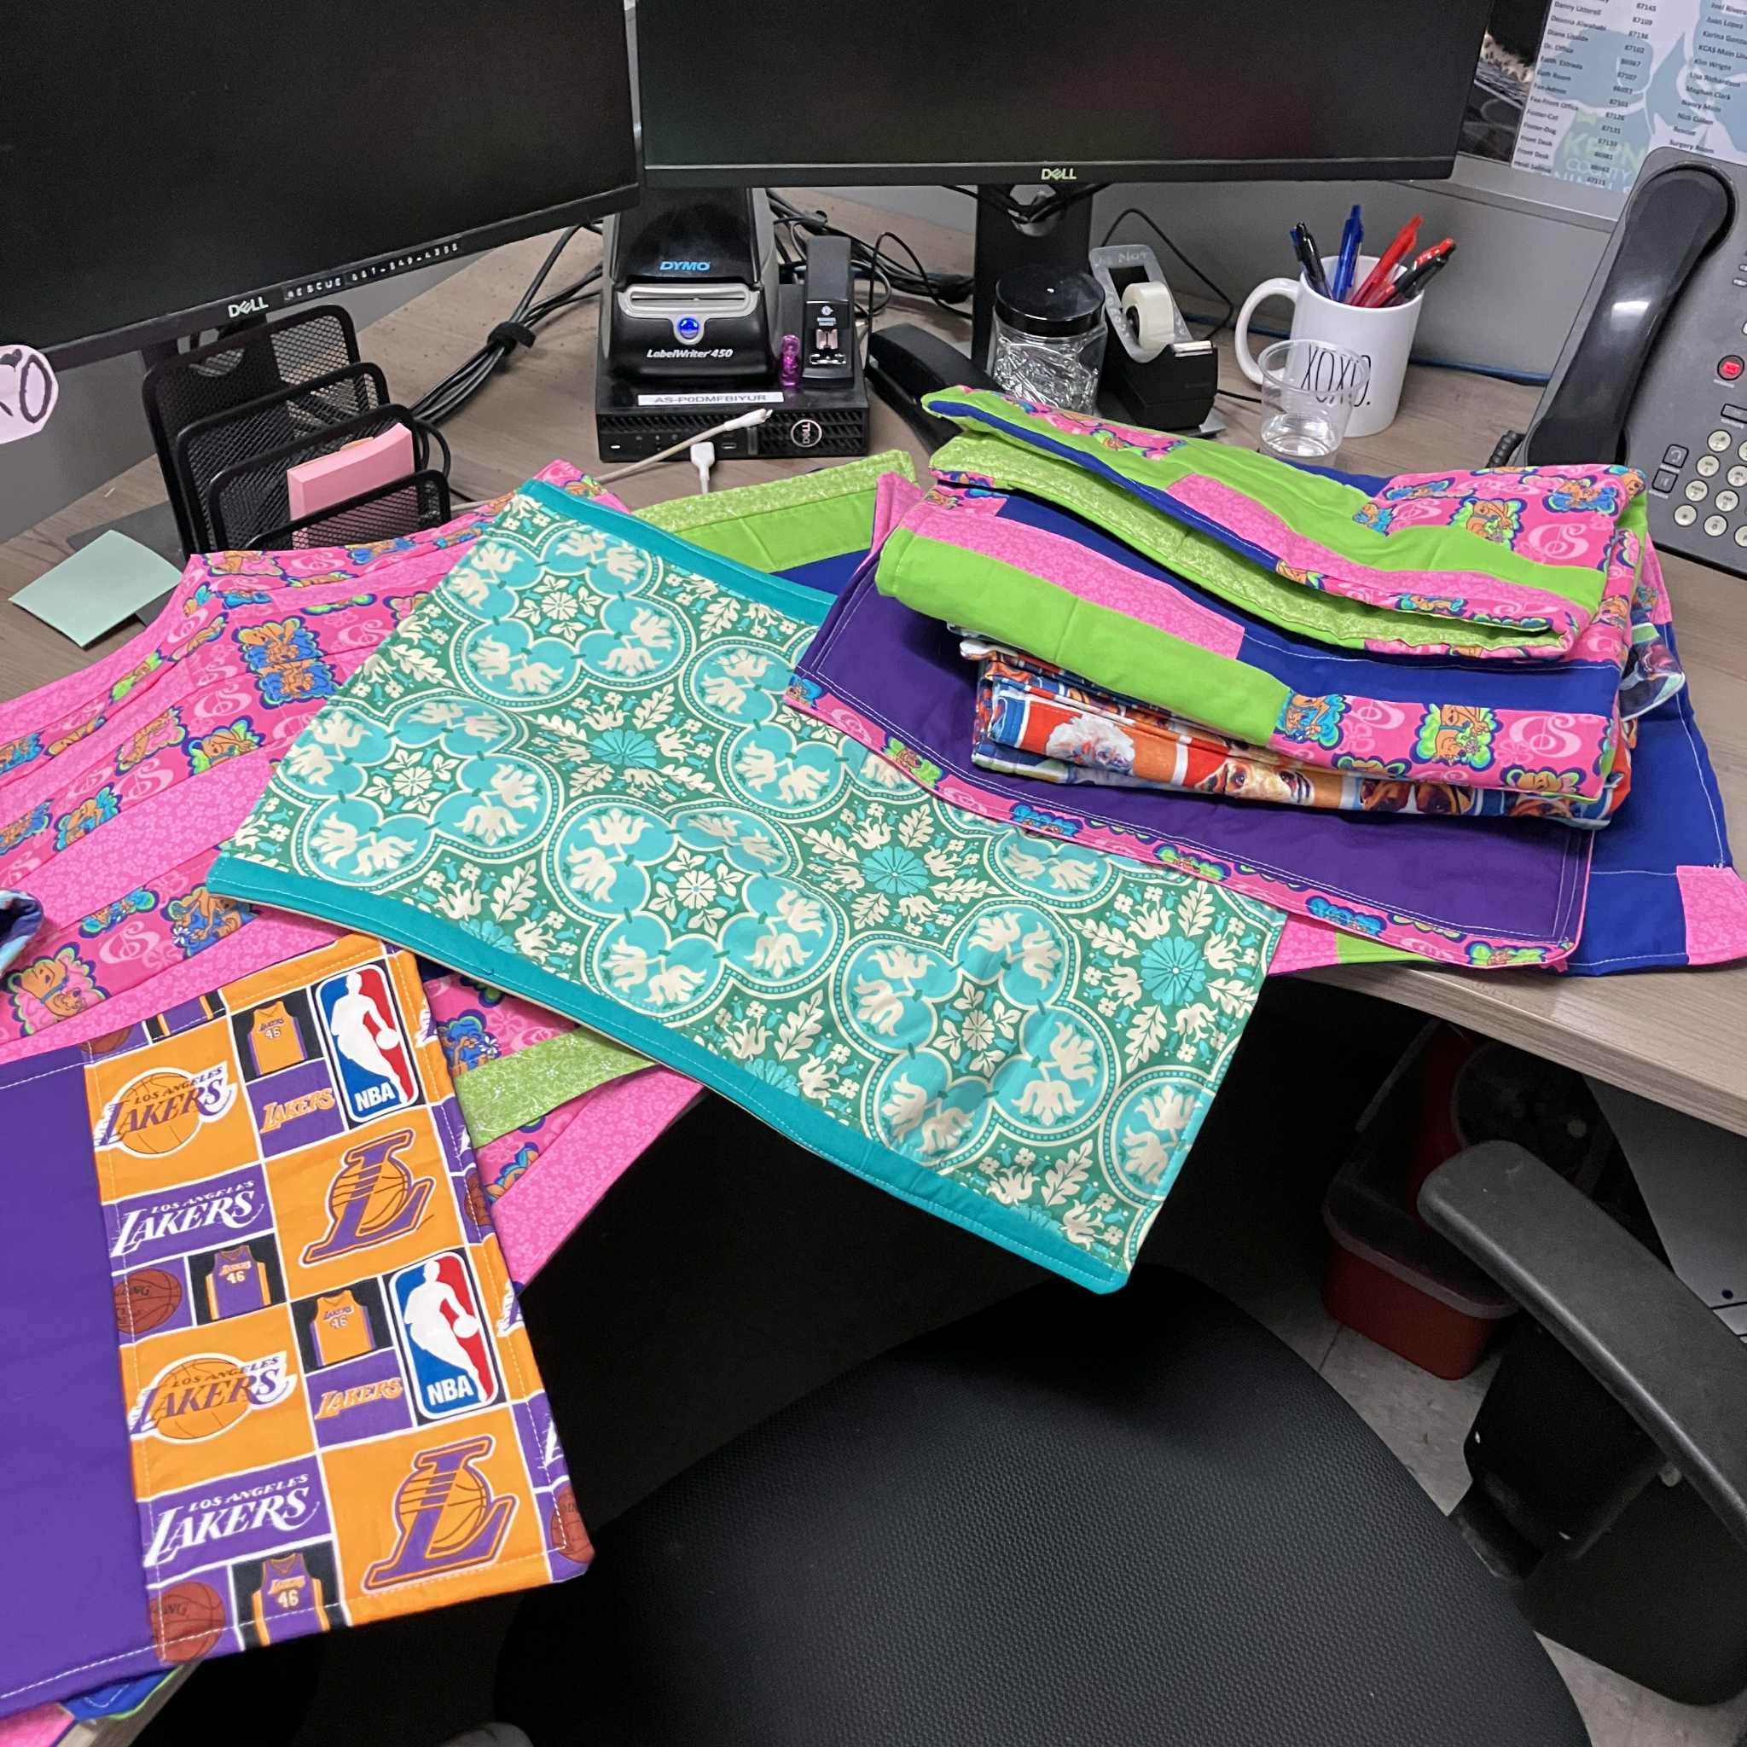
Kendra’s Quilts
Take a look at this! Kendra Morales has been busy making handmade kennel quilts for the animals in our smaller kennels.
These photos show just a few of the beautiful quilts she’s created for our pets recently.
Thank you, Kendra!

Slide 22
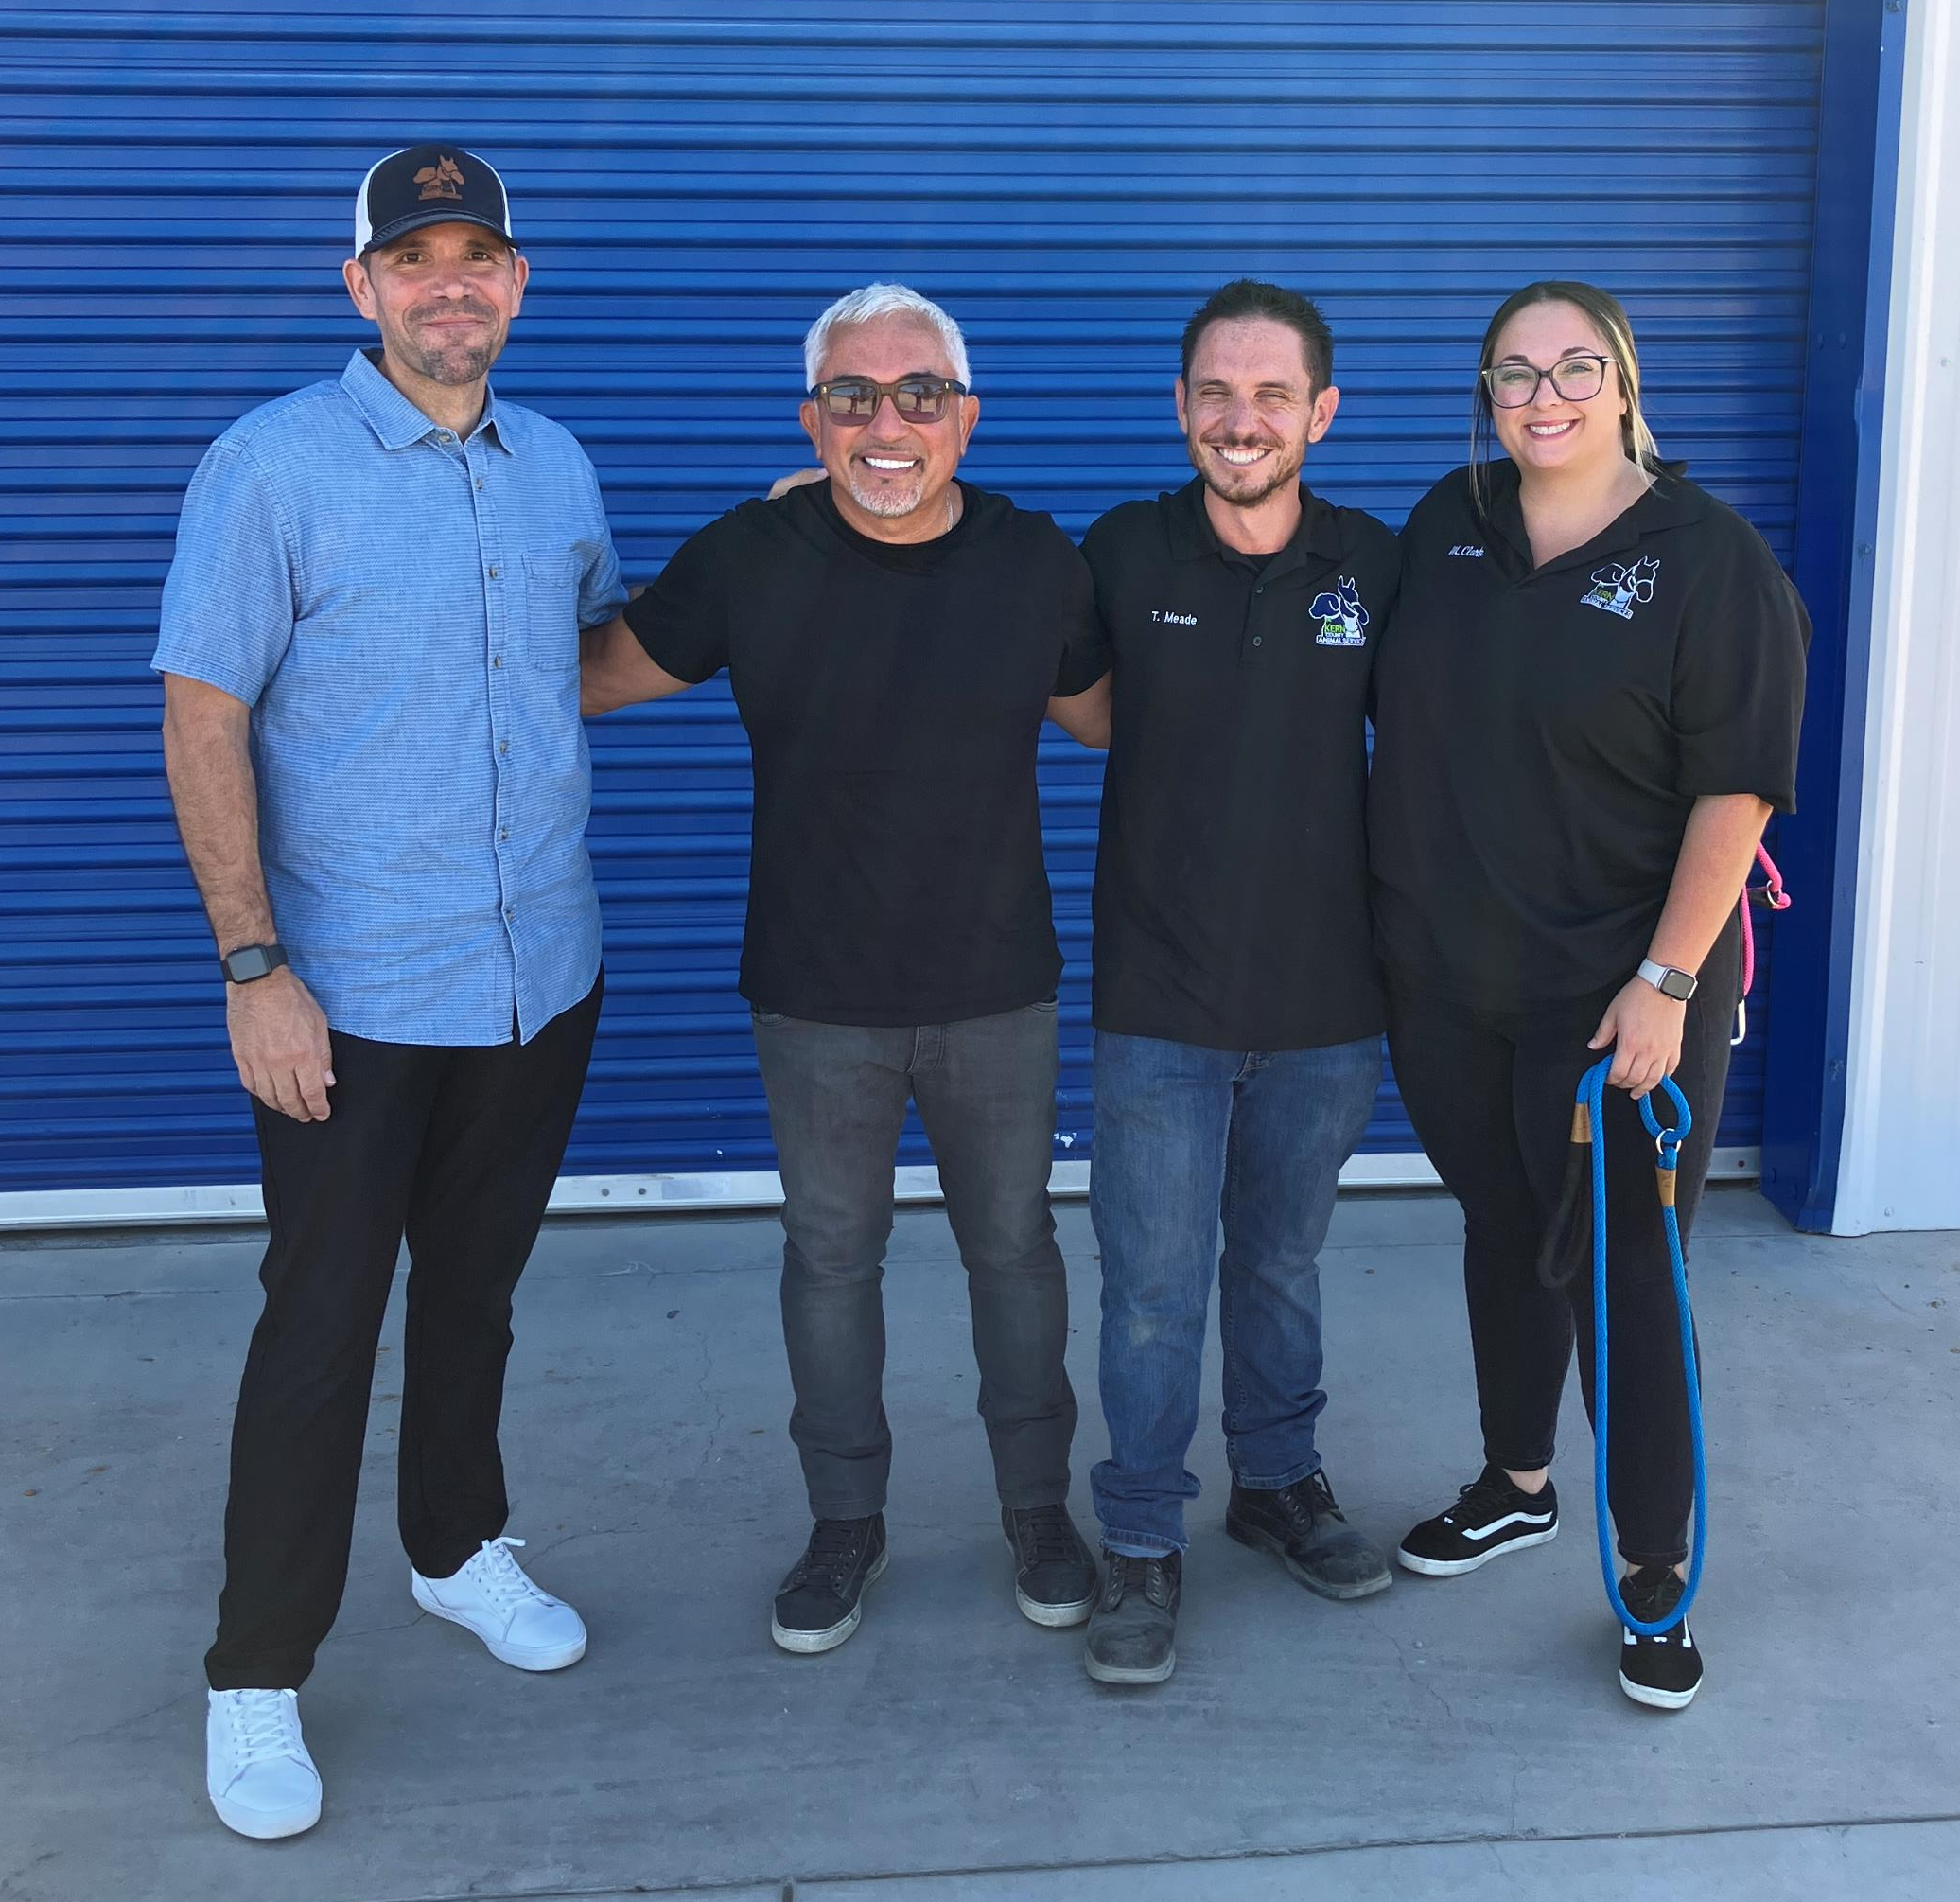
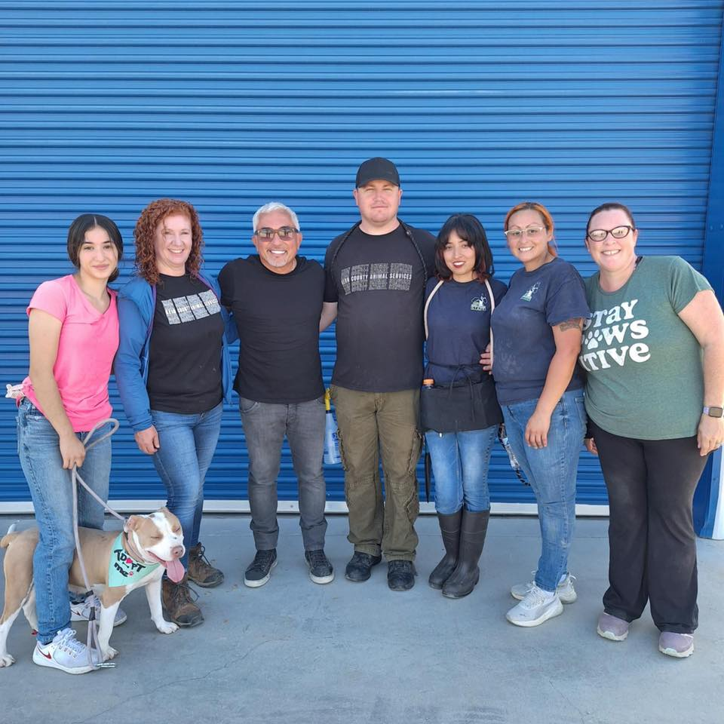
Cesar Millan Visit
August 20th, Kern County Animal Services welcomed a very special guest to the shelter - Cesar Millan, The Dog Whisperer himself!
Cesar and his team joined our Behavior Team during one of our playgroups, offering valuable advice and feedback that we’re so grateful for. He even stepped into a kennel to work hands-on with a German Shepherd who was fearful of the leash.
A huge thank you to Cesar his team for supporting both our staff and the animals here at Kern County Animal Services!

Slide 23
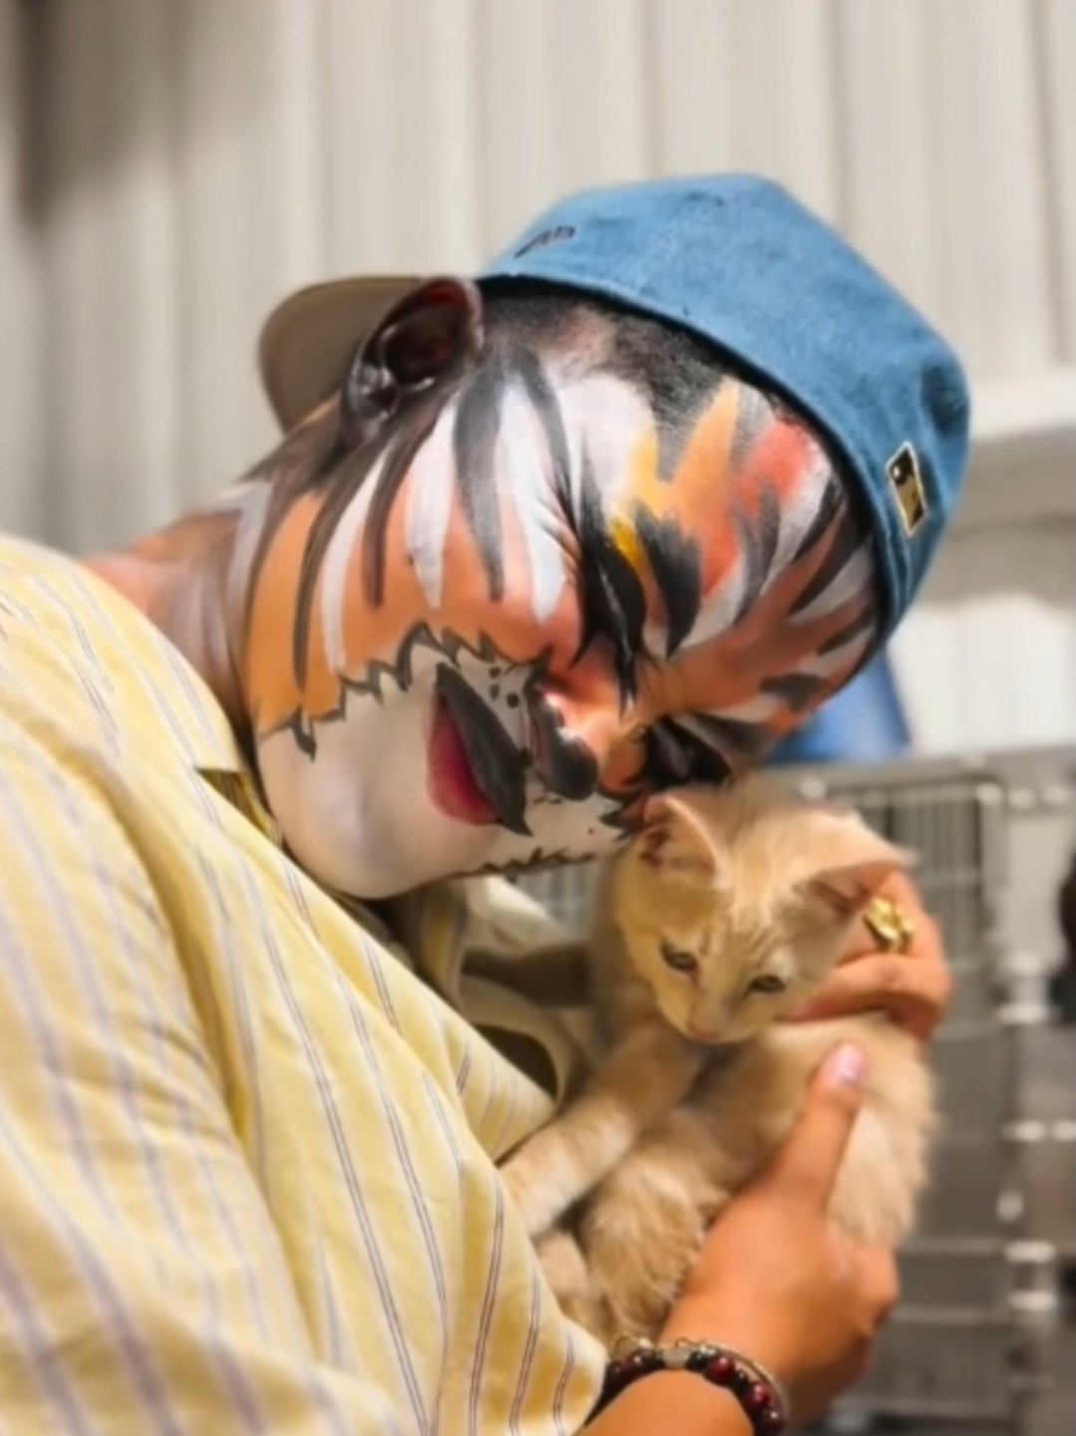
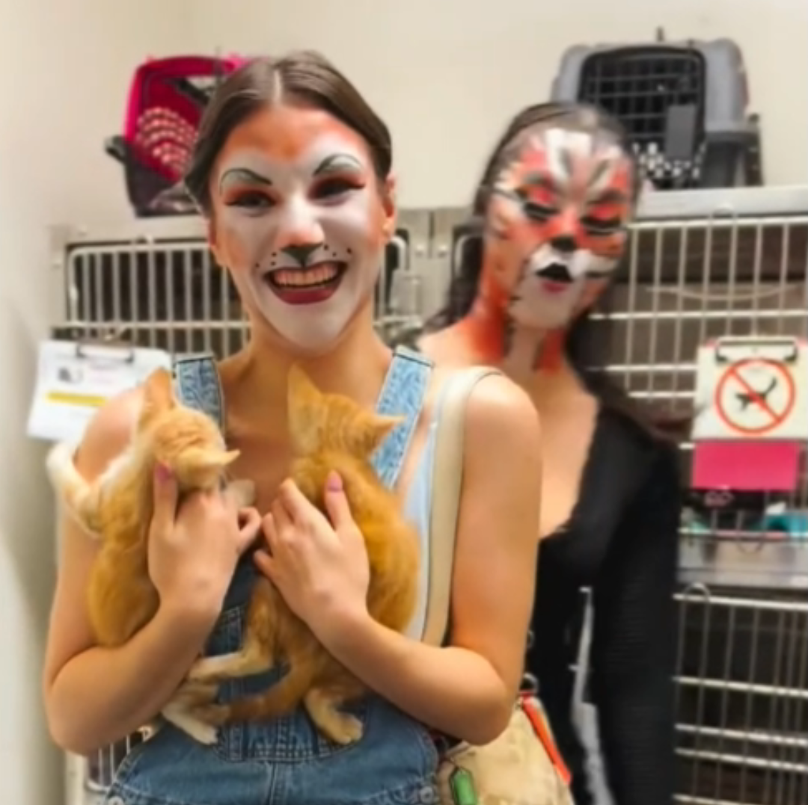
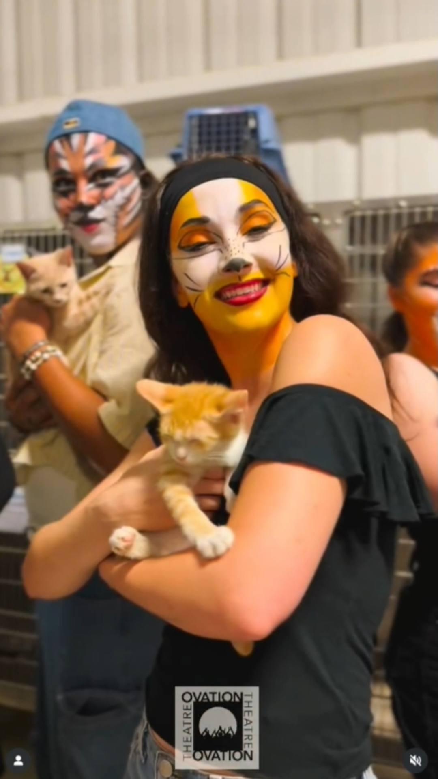
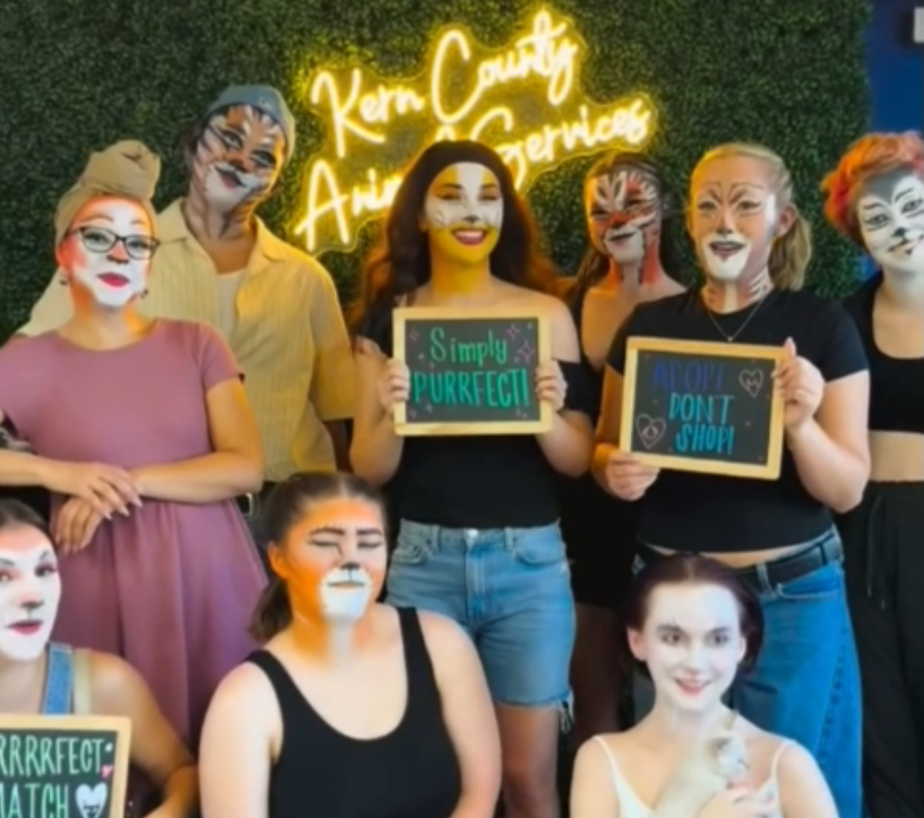
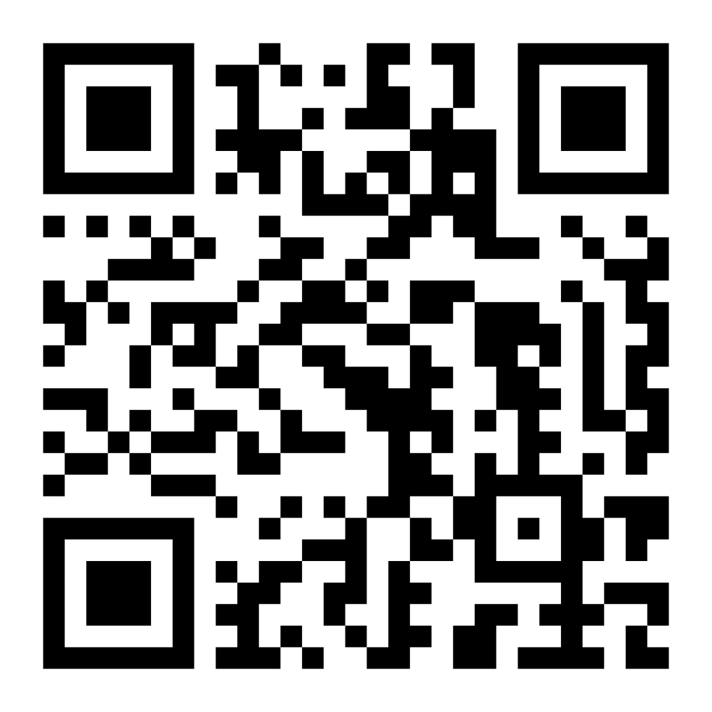
Cats & Cats
A big thank you to the Ovation Theatre and the cast of Cats! They stopped by the shelter on their way to showtime to cuddle and spend time with our adoptable cats!
Scan the QR code to see the video!

Slide 24

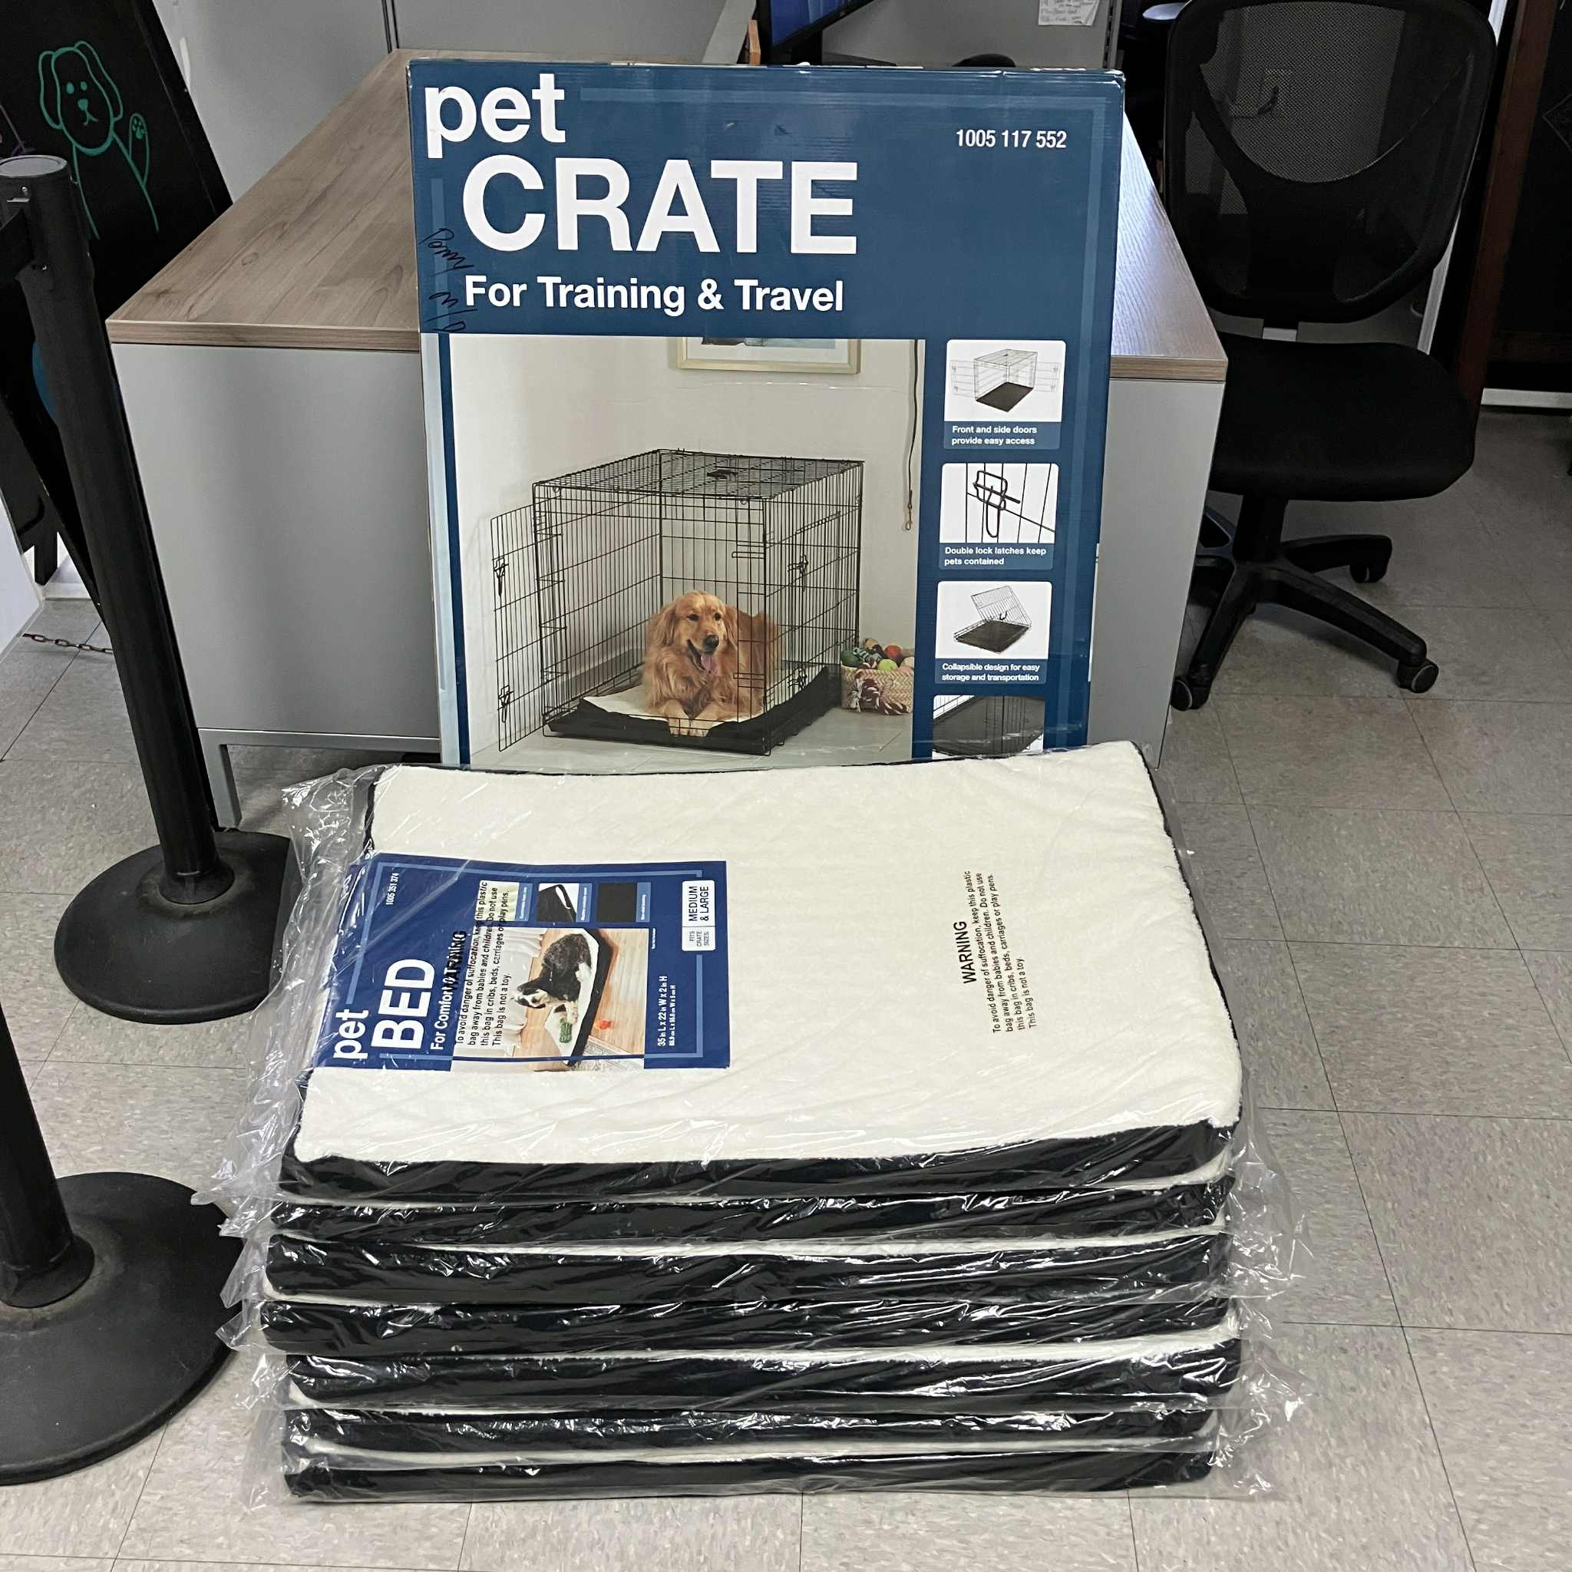
Home Depot Donation
The Home Depot on Gosford has once again come through for our shelter pets! On August 21st, they delivered a generous donation of padded pet beds, along with a large pet crate.
This isn’t the first time the Gosford Home Depot has supported our homeless pets, and we certainly hope it won’t be the last. We are so grateful for their continued kindness and generosity!

Slide 25
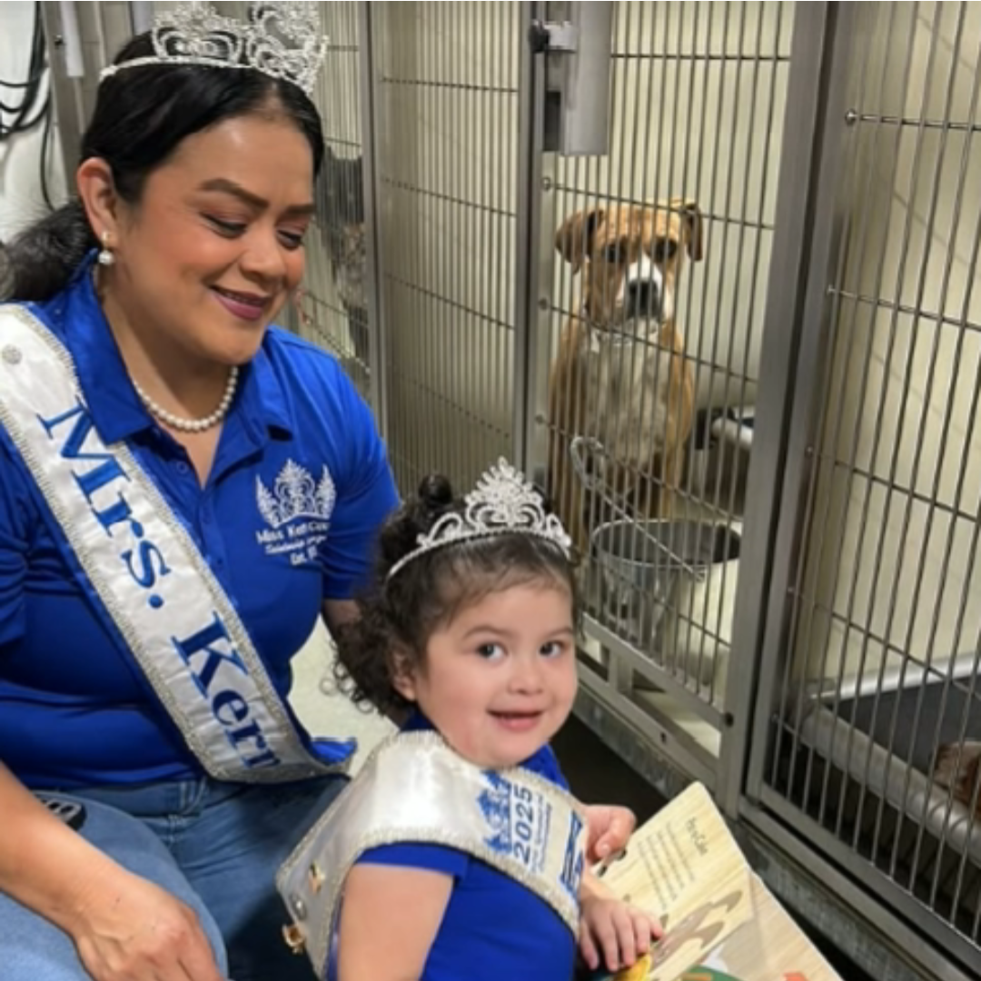
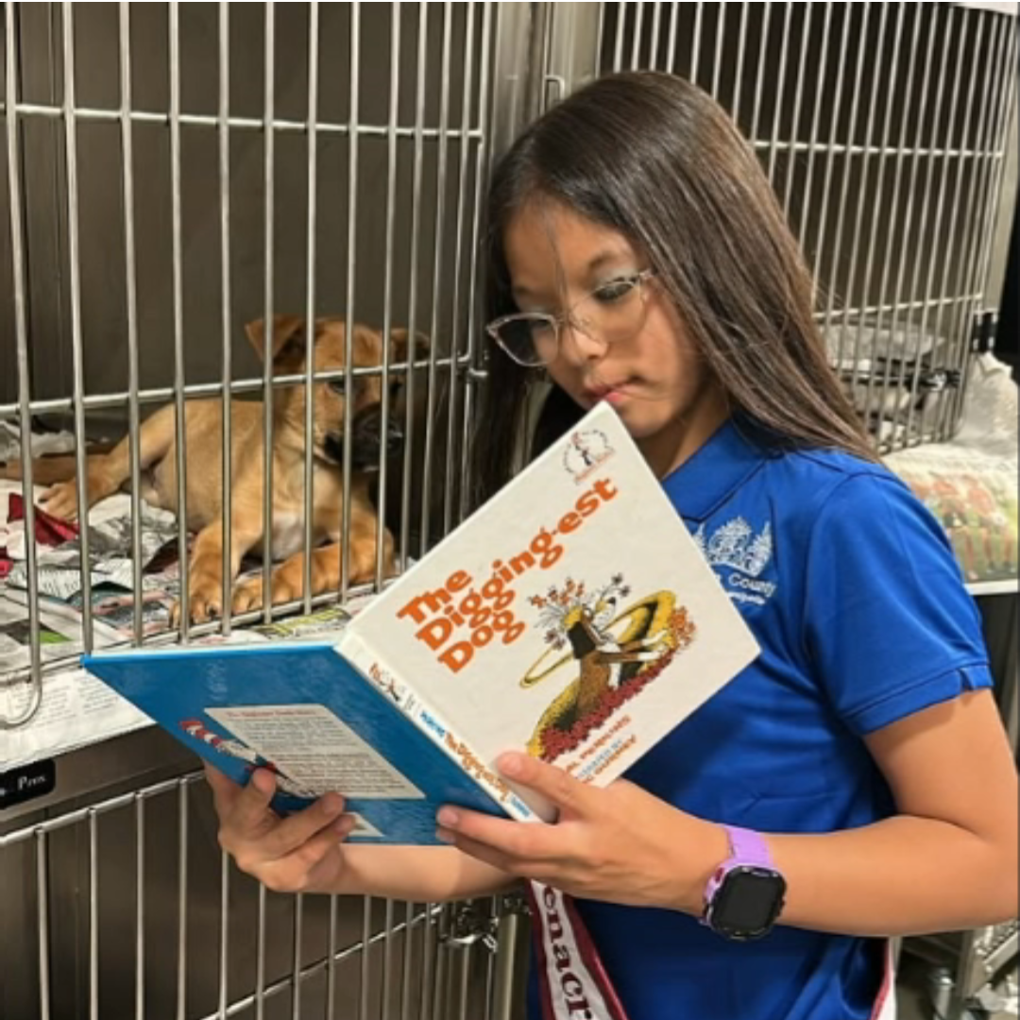
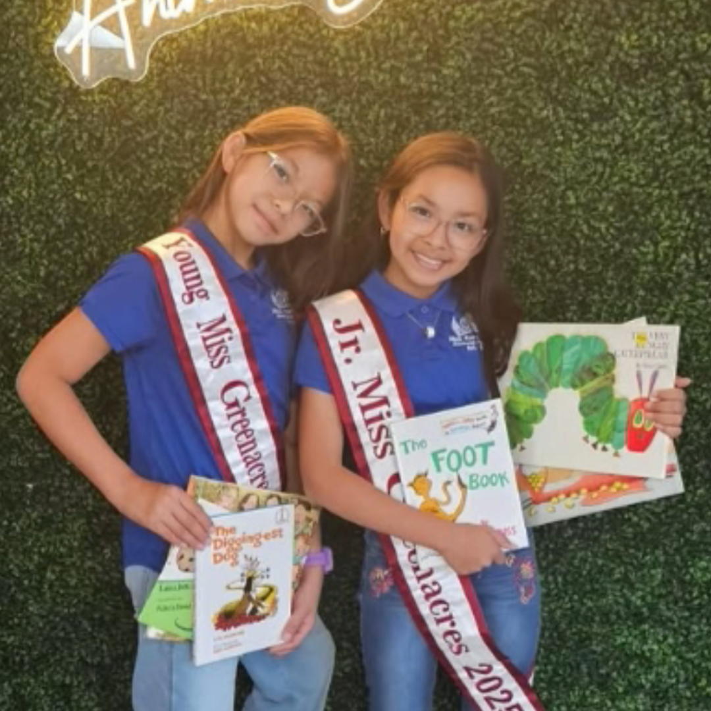
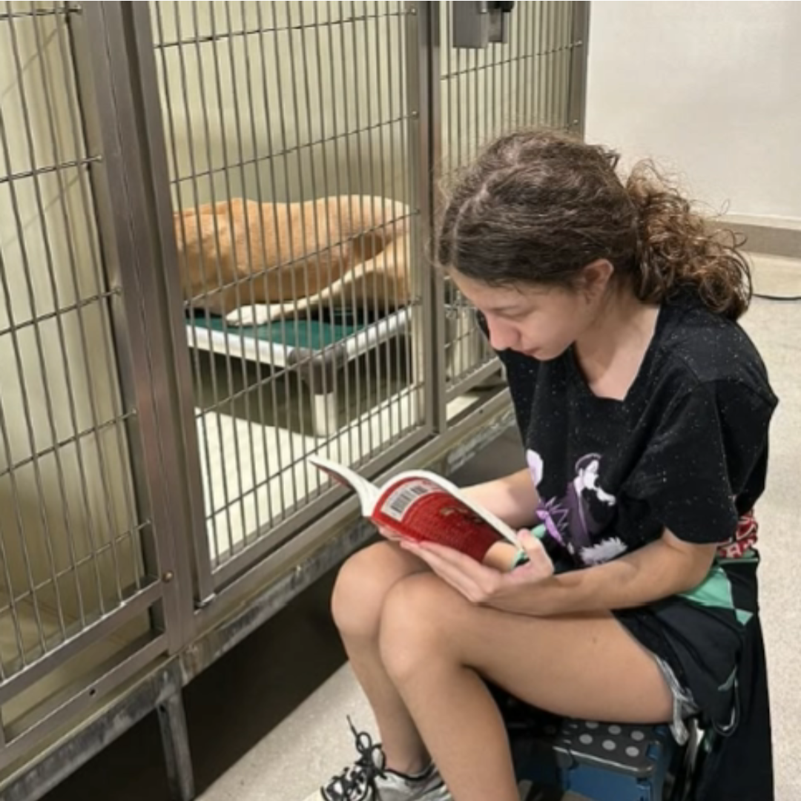
Tales for Tails
Our Tales for Tails Summer Reading Program continued on August 27th with another wonderful evening. Families and shelter pets came together for a night of reading, learning, and connection.
The next Tales for Tails Night will take place on Wednesday, September 24th. For more information, please contact us at AnimalServicesVolunteer@kerncounty.com

Slide 26
2025 Year To Date
January 1st – August 31st
3,448
Adoptions
2,676
Rescued
510
Returned To Owner
5,866
Spay/Neuter Surgeries
8,155
Total Lives Saved
78.05%
Save Rate

Slide 27
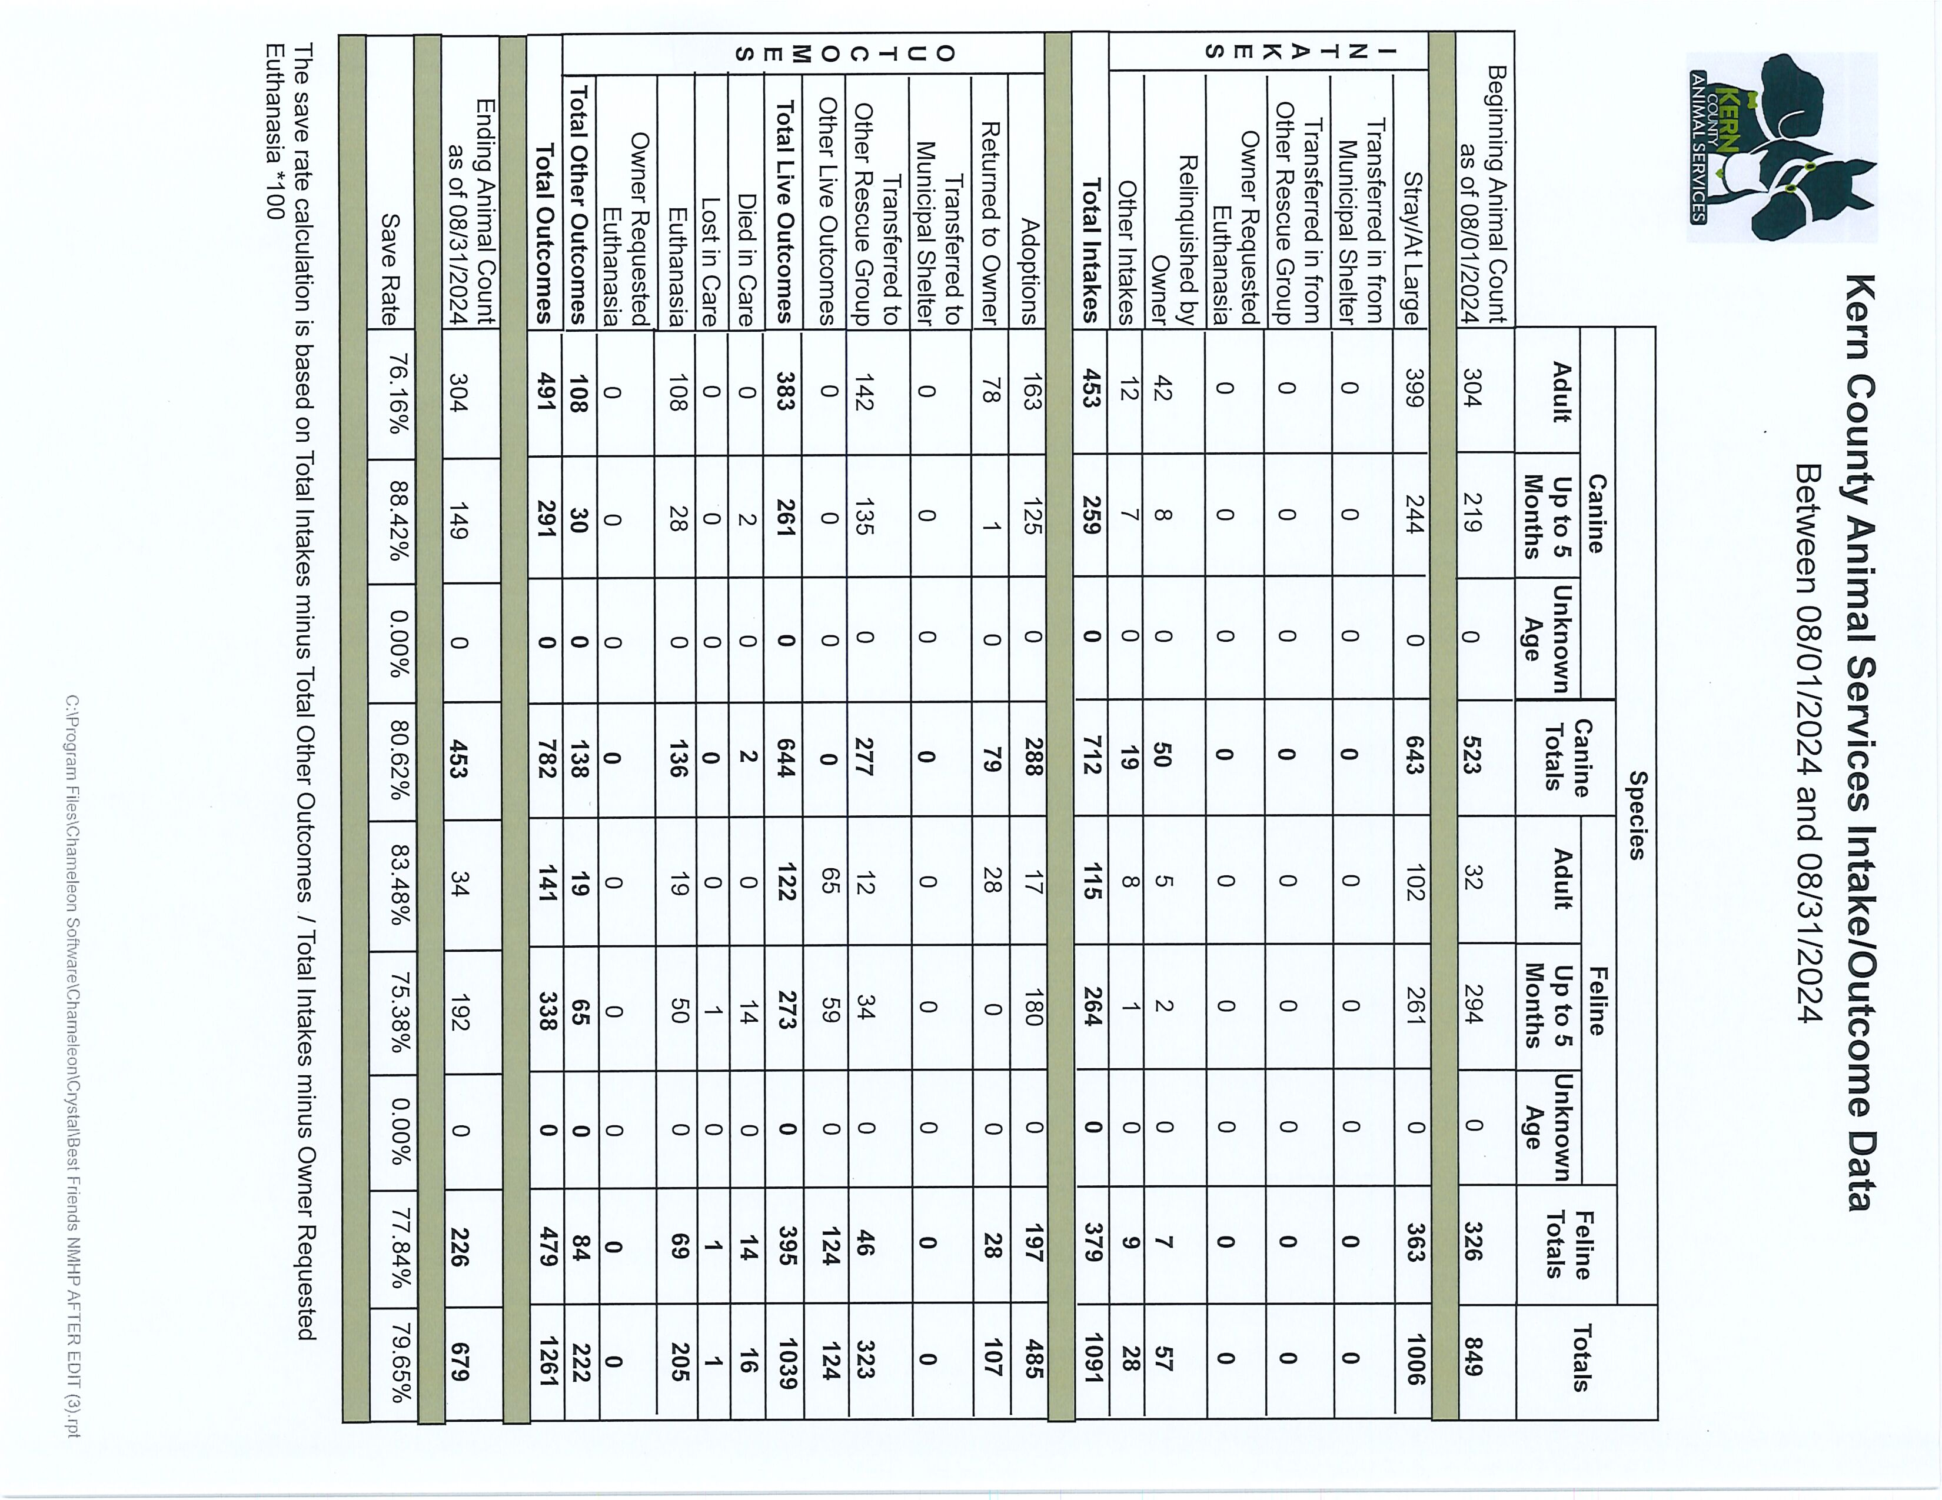

Slide 28
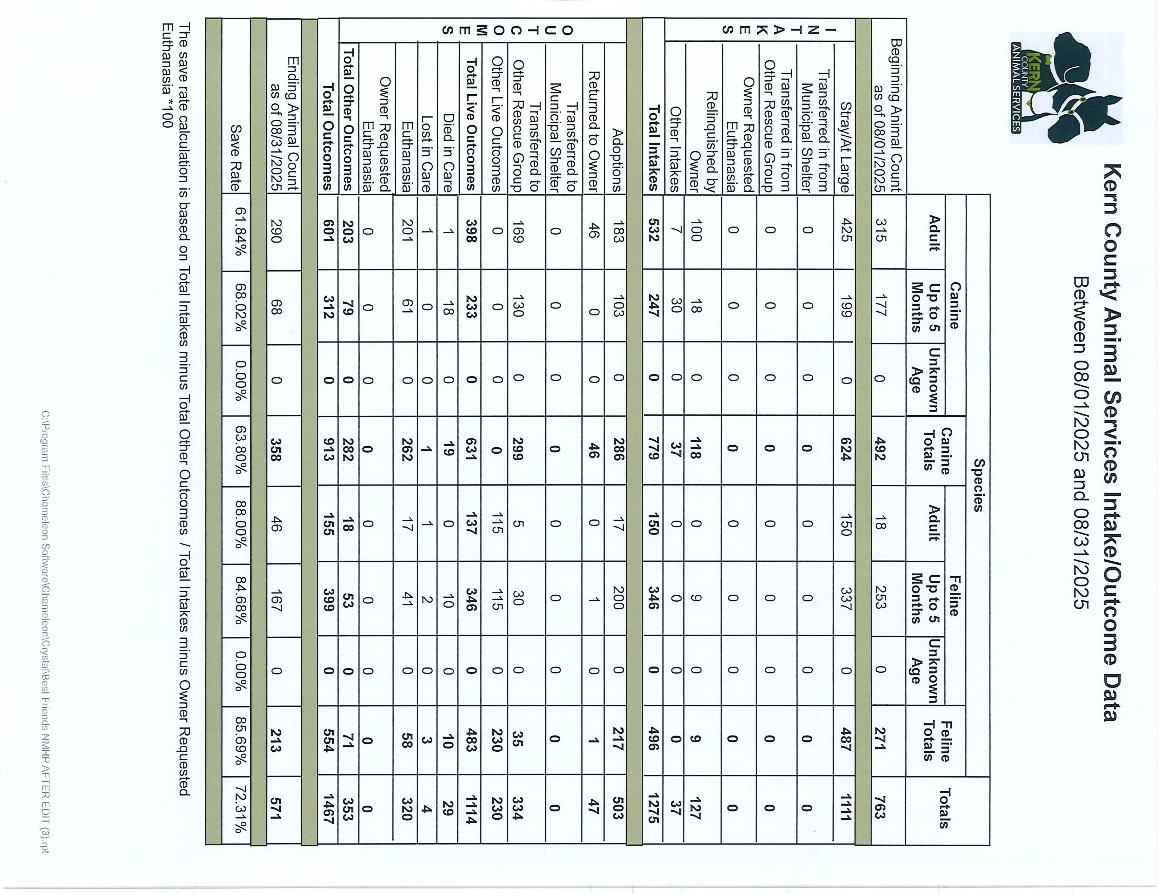

Slide 29
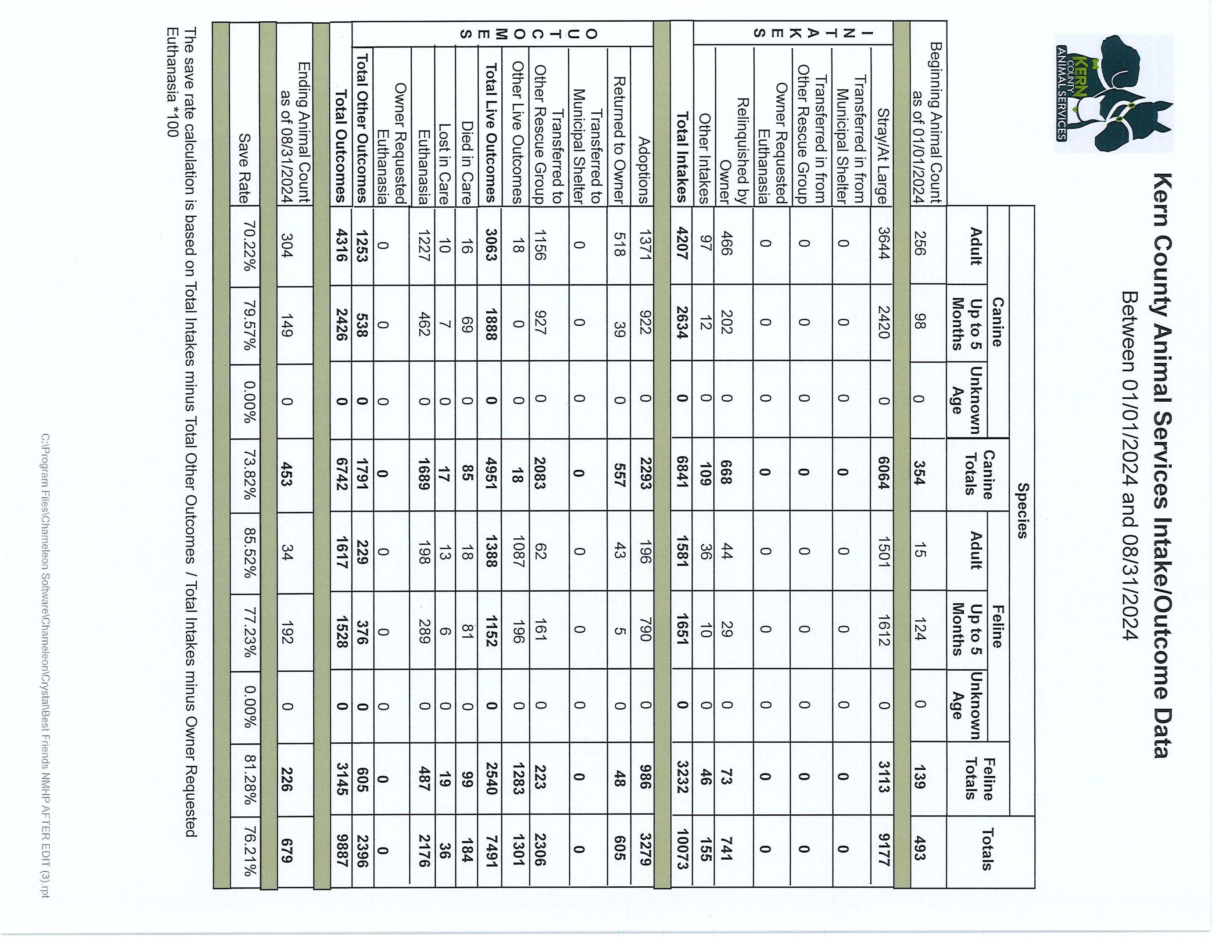

Slide 30
