Slide 1






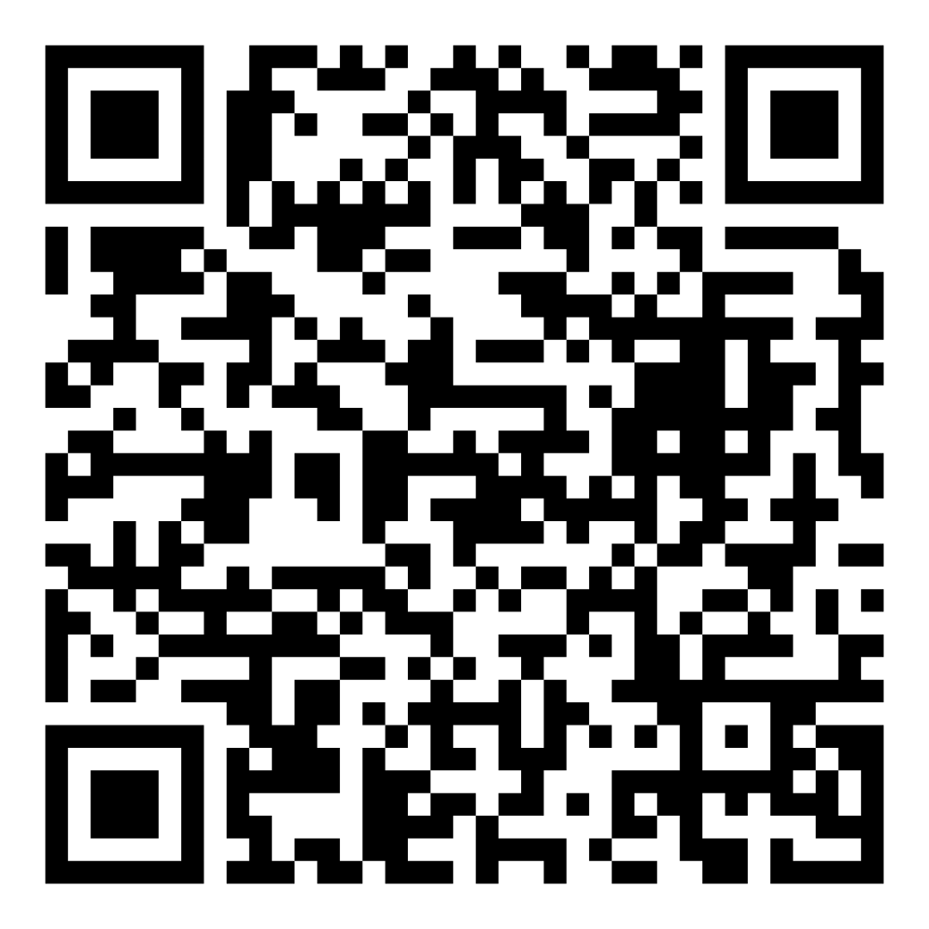
Director’s Report
October 2025

Slide 2

Program Highlights October 2025
Adoption: 190 dogs, 89 puppies, 39 cats, and 154 kittens under 5 months of age were adopted for a total of 472 animals adopted from Kern County Animal Shelters in the month of October.
Foster: 40 dogs, 65 puppies, 1 cats, and 158 kittens entered the Department’s Foster Care Program in October, for a total of 264 animals.
Rescue: 238 dogs, 134 puppies, 4 cats, and 16 kittens were transferred to other animal rescue organizations in October, for a total of 392 animals.
Spay/Neuter: A total of 381 animals were altered at low-cost KCAS spay/neuter clinics in the month of October.
TNR: 270 cats were spayed or neutered and released in October of 2025. Year-to-date, 2125 cats have gone through the program, and since 2013 23,711 cats have been spayed or neutered and returned to field.

Slide 3
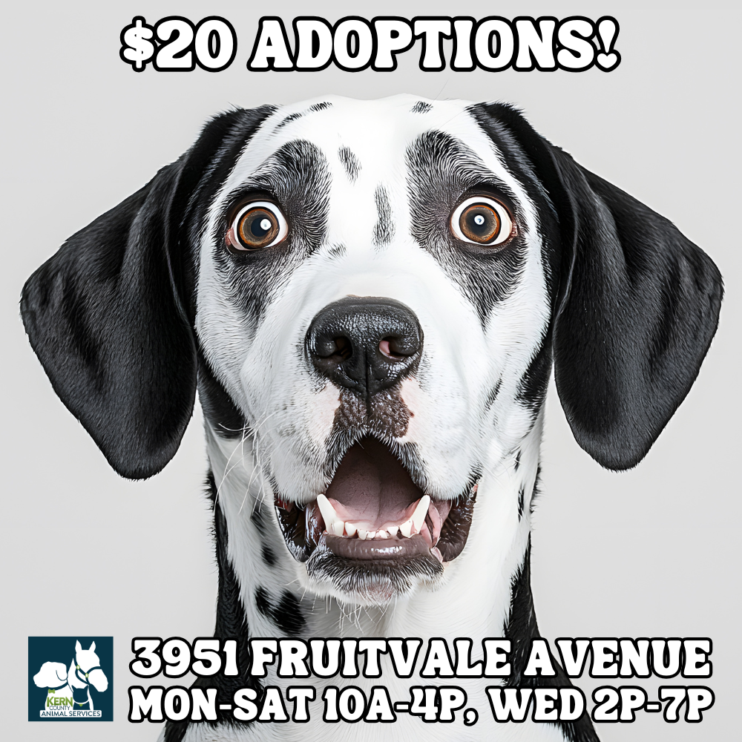
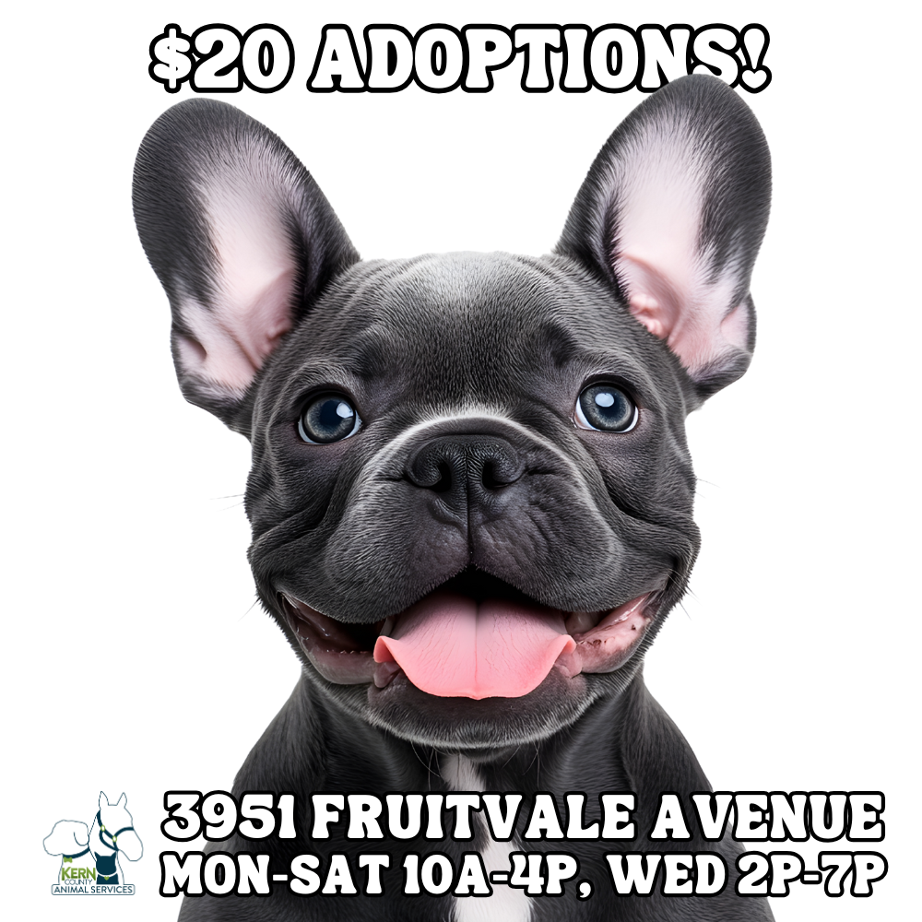
October Adoptions

Slide 4
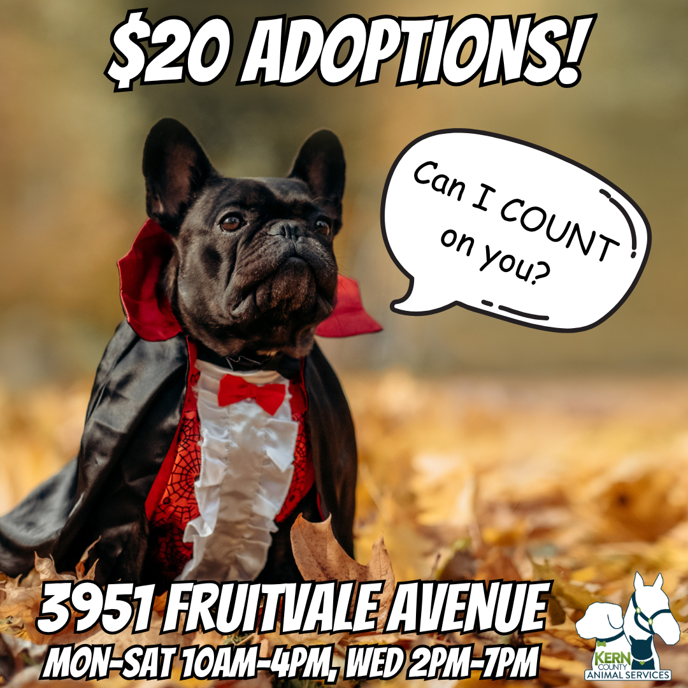
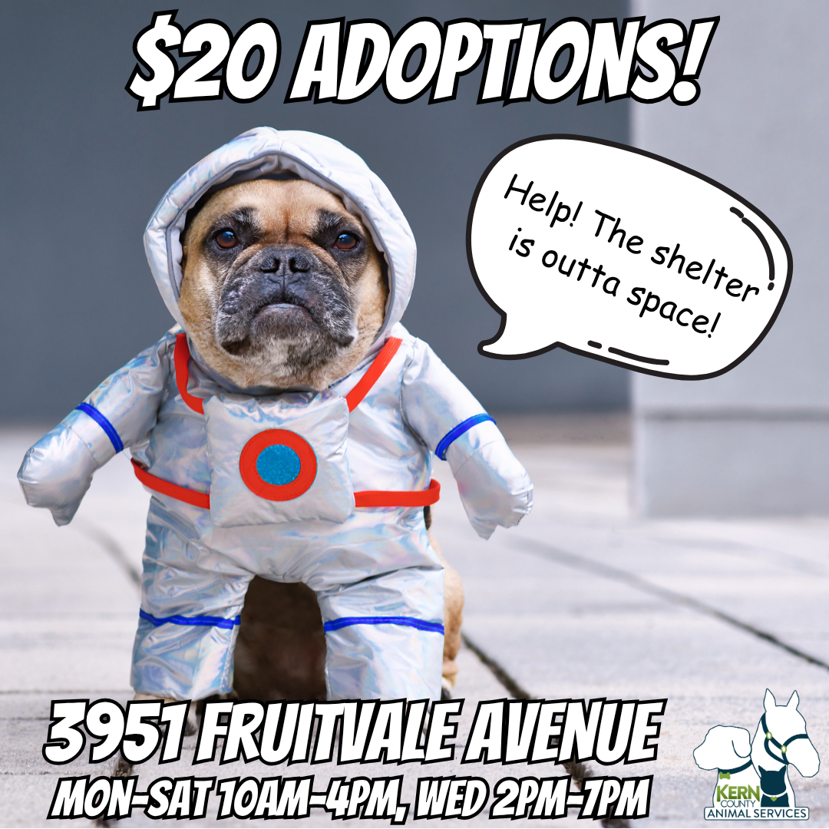
Halloween Adoptions

Slide 5

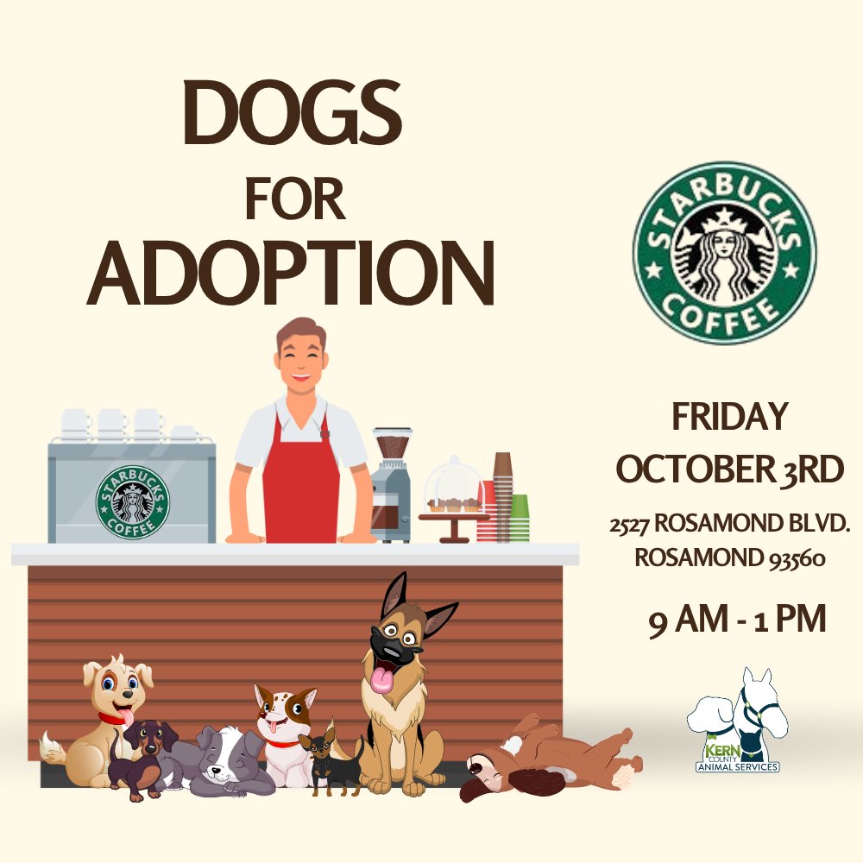

Offsite Adoption Events:
October 3rd, 4th, 5th

Slide 6



Offsite Adoption Events:
October 10th, 11th, 12th

Slide 7
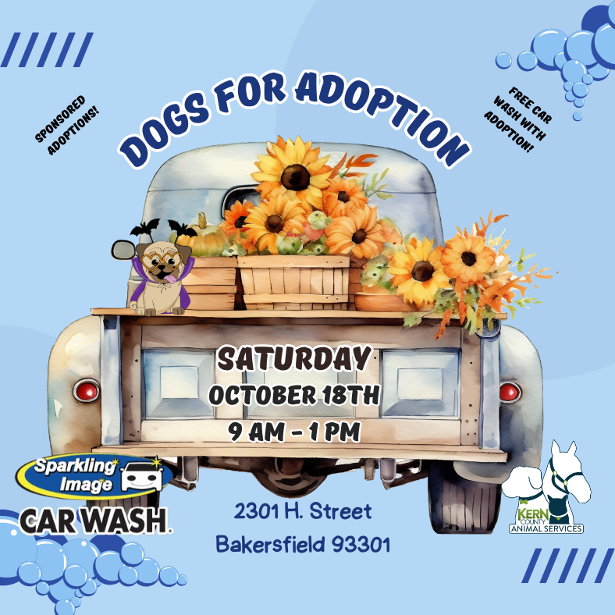


Offsite Adoption Events:
October 17th, 18th, 19th

Slide 8

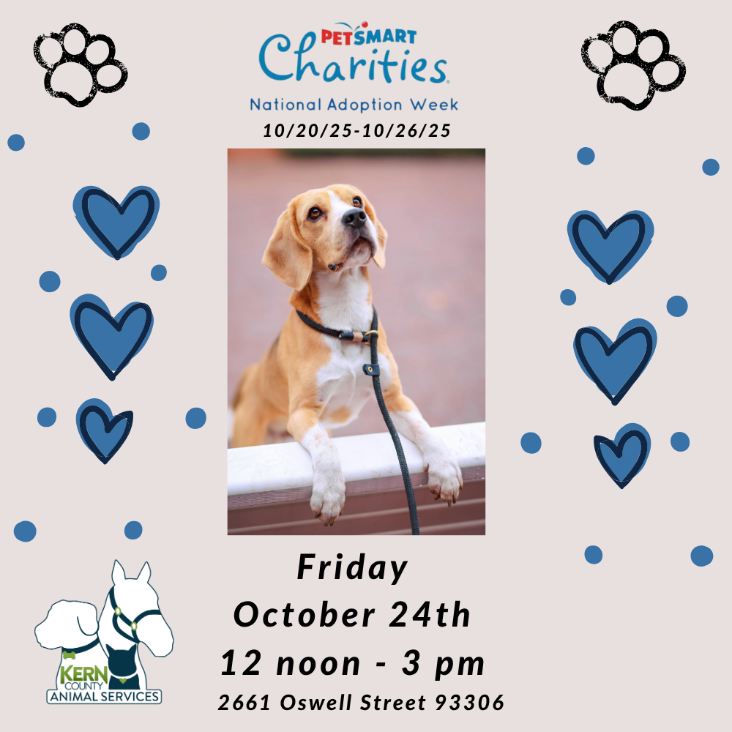

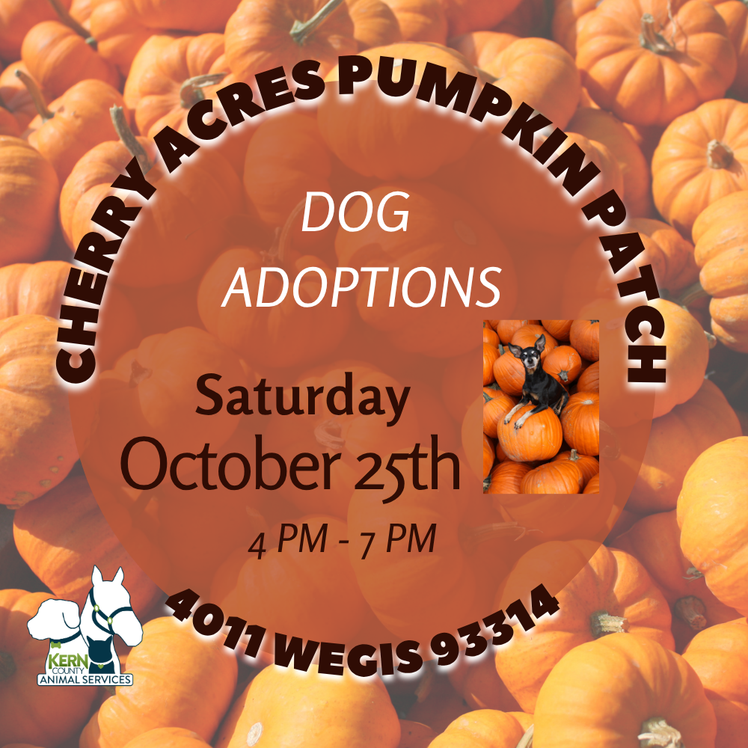

Offsite Adoption Events:
October 23rd, 24th, 25th, 31st

Slide 9


Streets Of Bakersfield
October 11th & 25th

Slide 10
Low-Cost Spay/Neuter Clinics October 2025
Date | Location | Surgeries
October 2nd | Heritage Park (with S.O.S. Rescue) | 54
October 9th | Heritage Park (with S.O.S. Rescue) | 56
October 20th | The Rio | 52
October 20th | Boron, Ca. | 44
October 22nd | Mojave, Ca. | 57
October 28th | Heritage Park (with S.O.S. Rescue) | 55
October 30th | Heritage Park (with S.O.S. Rescue) | 63
 | Total Surgeries | 381

Slide 11
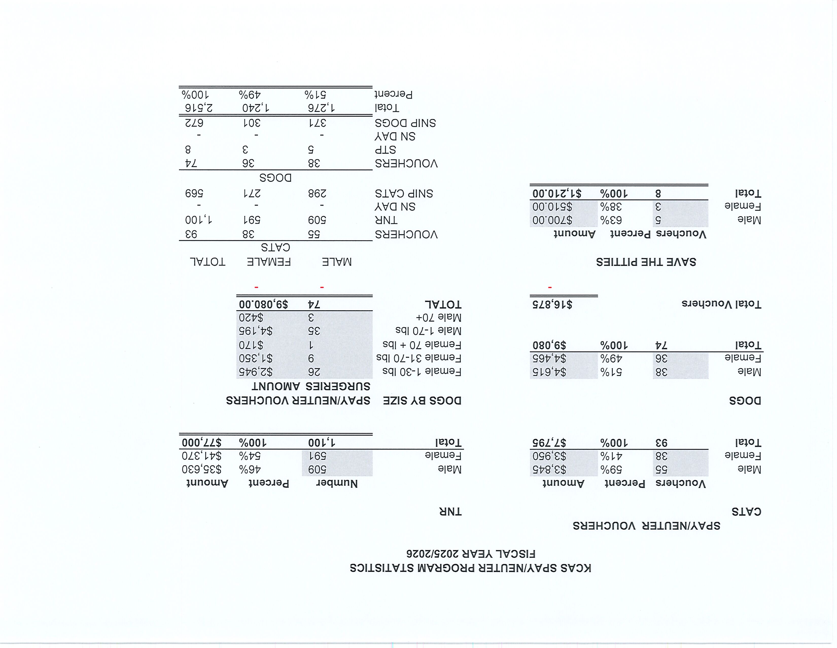

Slide 12
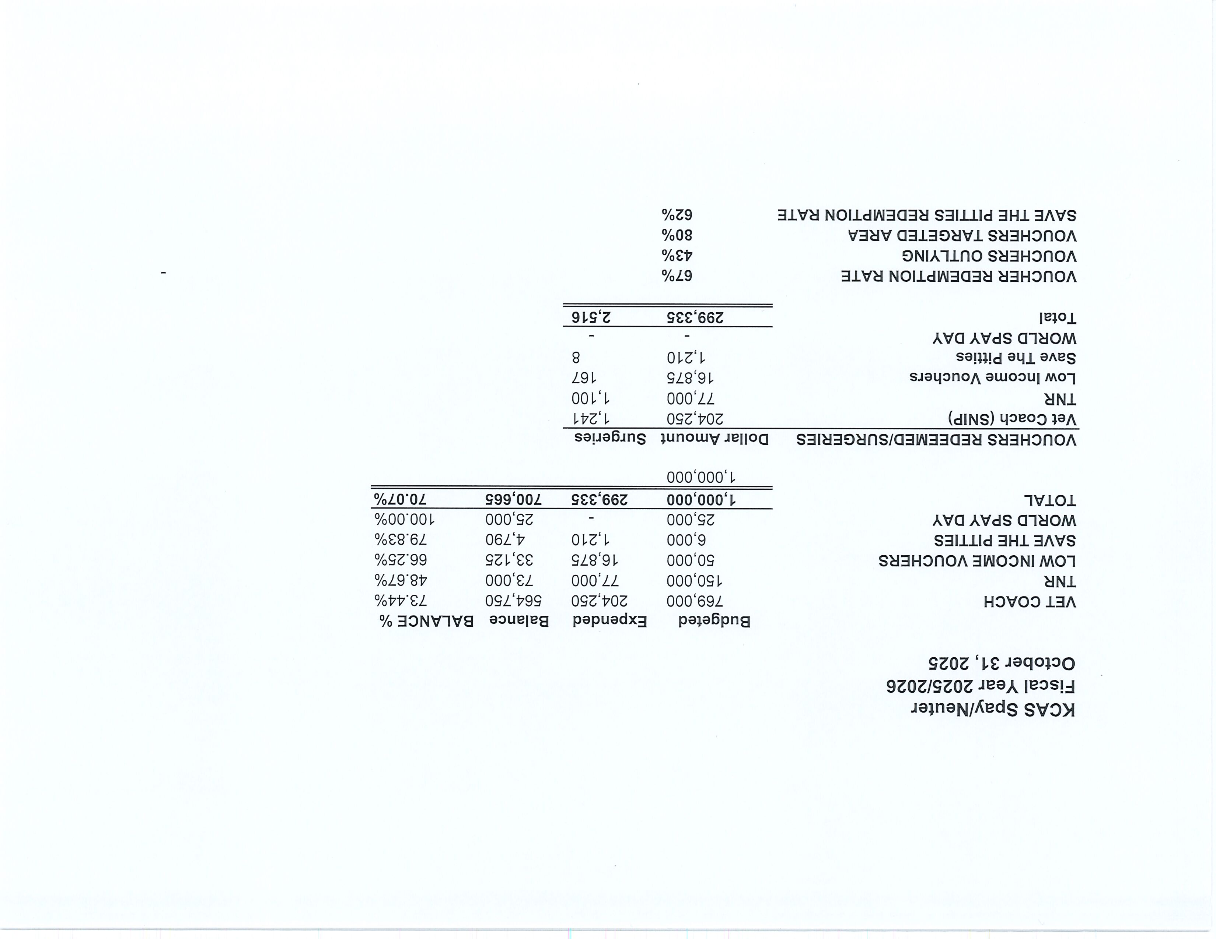

Slide 13
Low-Cost Vaccination Clinics October 2025
Rabies
463
Microchips
Bordetella
53
78
DHPP* 384
FVRPC* 217
*DHPP and FVRCP vaccinations provided at no-cost by Petco Love.

Slide 14
Field Service Calls: October 2025
AREA | CALLS PER AREA
Lake Isabella | 121
Mojave | 132
North County | 98
Northeast | 361
Northwest | 349
Ridgecrest | 20
Southeast | 202
Southwest | 144
Taft | 135
Tehachapi | 64
TOTAL | 1,626
50 dogs were returned to their owners in the field in October 2025.
151 dogs were secured on property by Animal Control Officers in October 2025

Slide 15
Commercial Animal Facility Calls October 2025
TYPE | CALLS PER TYPE
CAF – Breeder | 22
CAF – Rescue | 4
CAF – Kennel | 1
CAF – Boarding | 3
TOTAL | 30
4 Inspections Passed
0 Inspections Failed
0 Citations Issued
0 Permits Issued
52 Active CAF Permits

Slide 16
Volunteer Program October 2025
Active Volunteers
102
New Volunteers
39
Volunteer hours donated in October
Volunteer hours donated in 2025
716.28
8,946.07

Slide 17
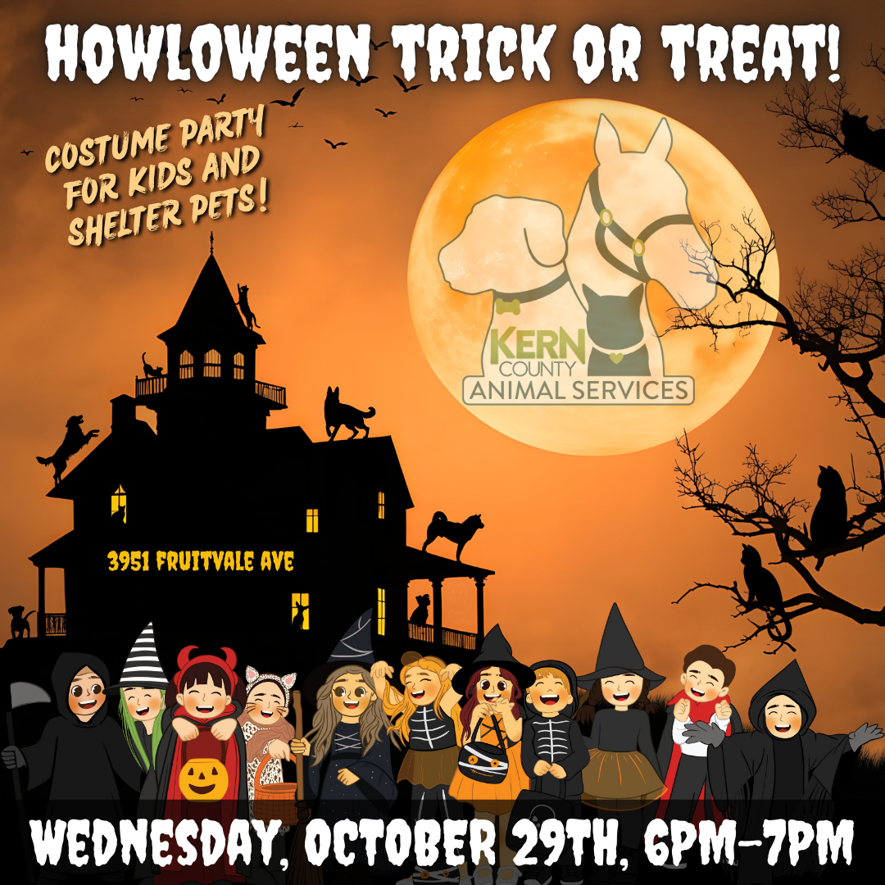
Howlaween Trick or Treat
October 29th - Kern County Animal Services hosted its 2nd Annual Howl-O-Ween Trick-or-Treat event at the shelter, where costumed staff handed out treats for both kids and shelter pets. Many of the adoptable animals joined in on the fun too, showing off their adorable Halloween costumes for visitors to enjoy.
Along with the Trick-or-Treat event, the KCAS staff held their annual pumpkin carving contest.

Slide 18
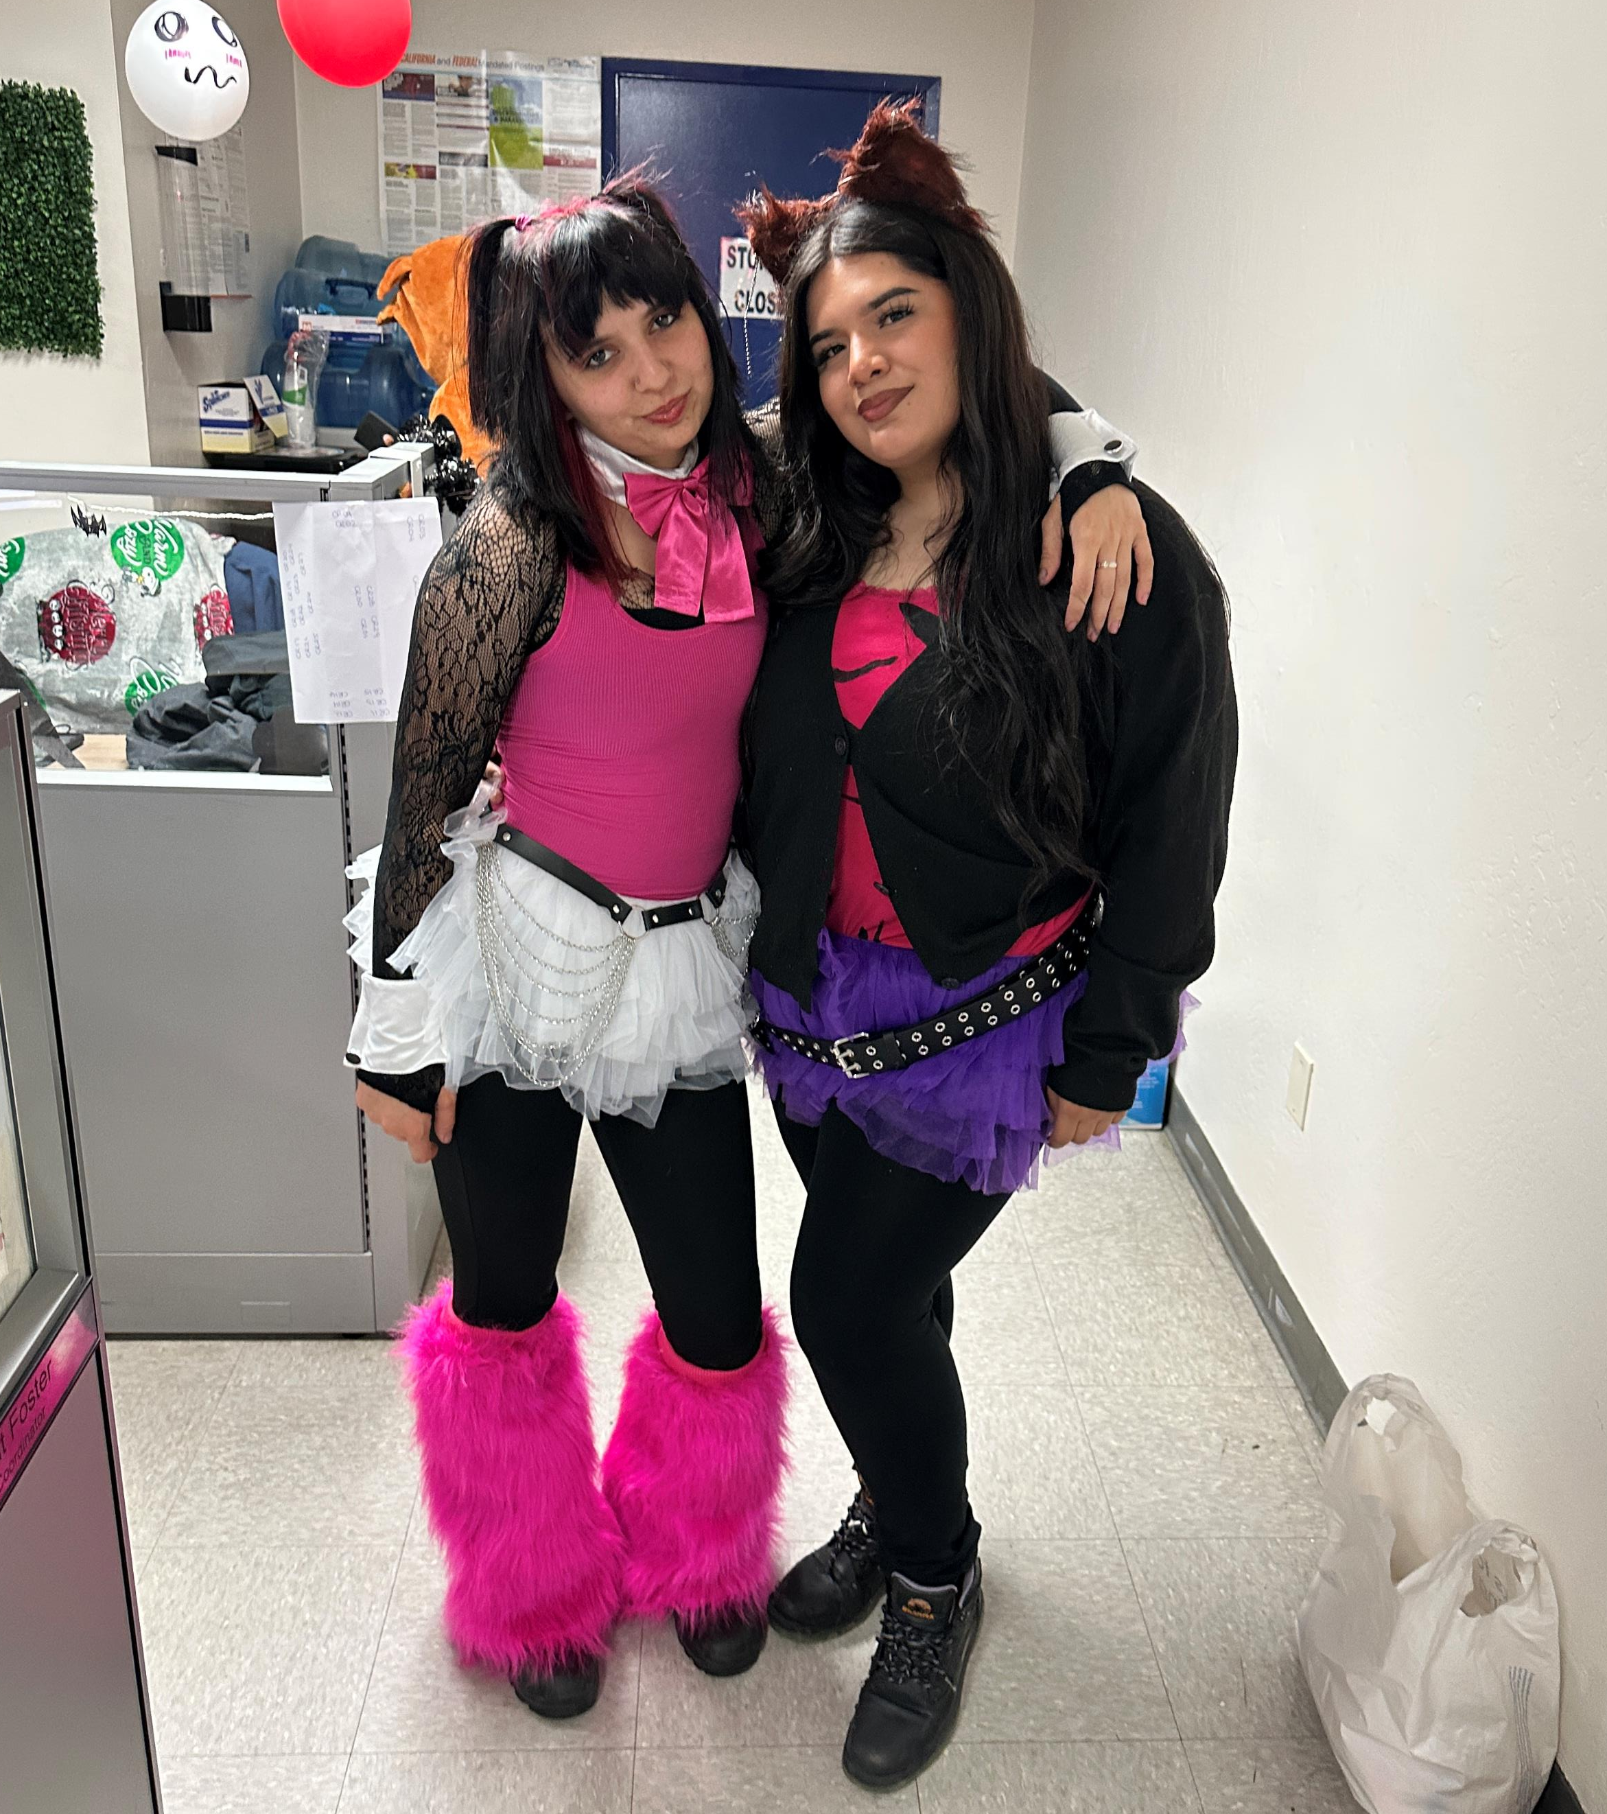
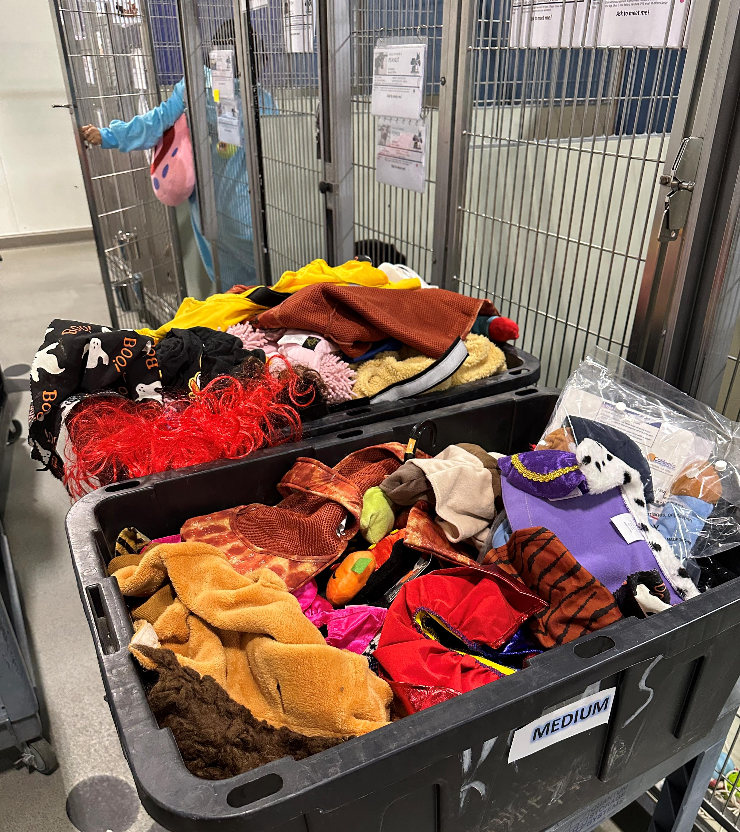
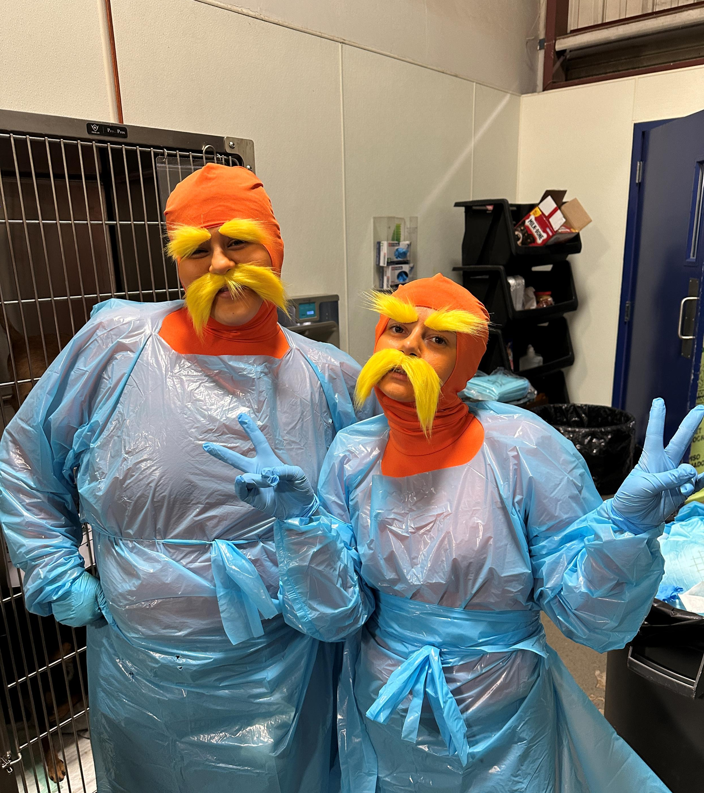
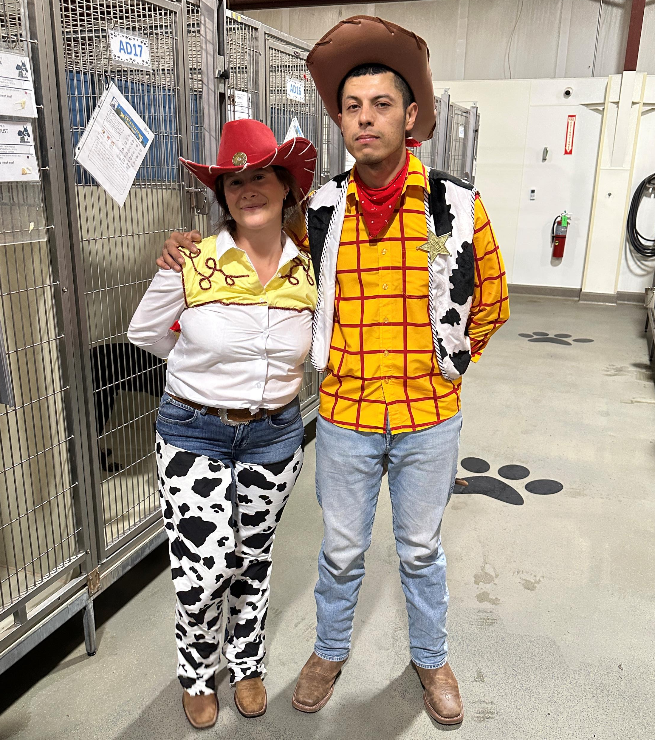
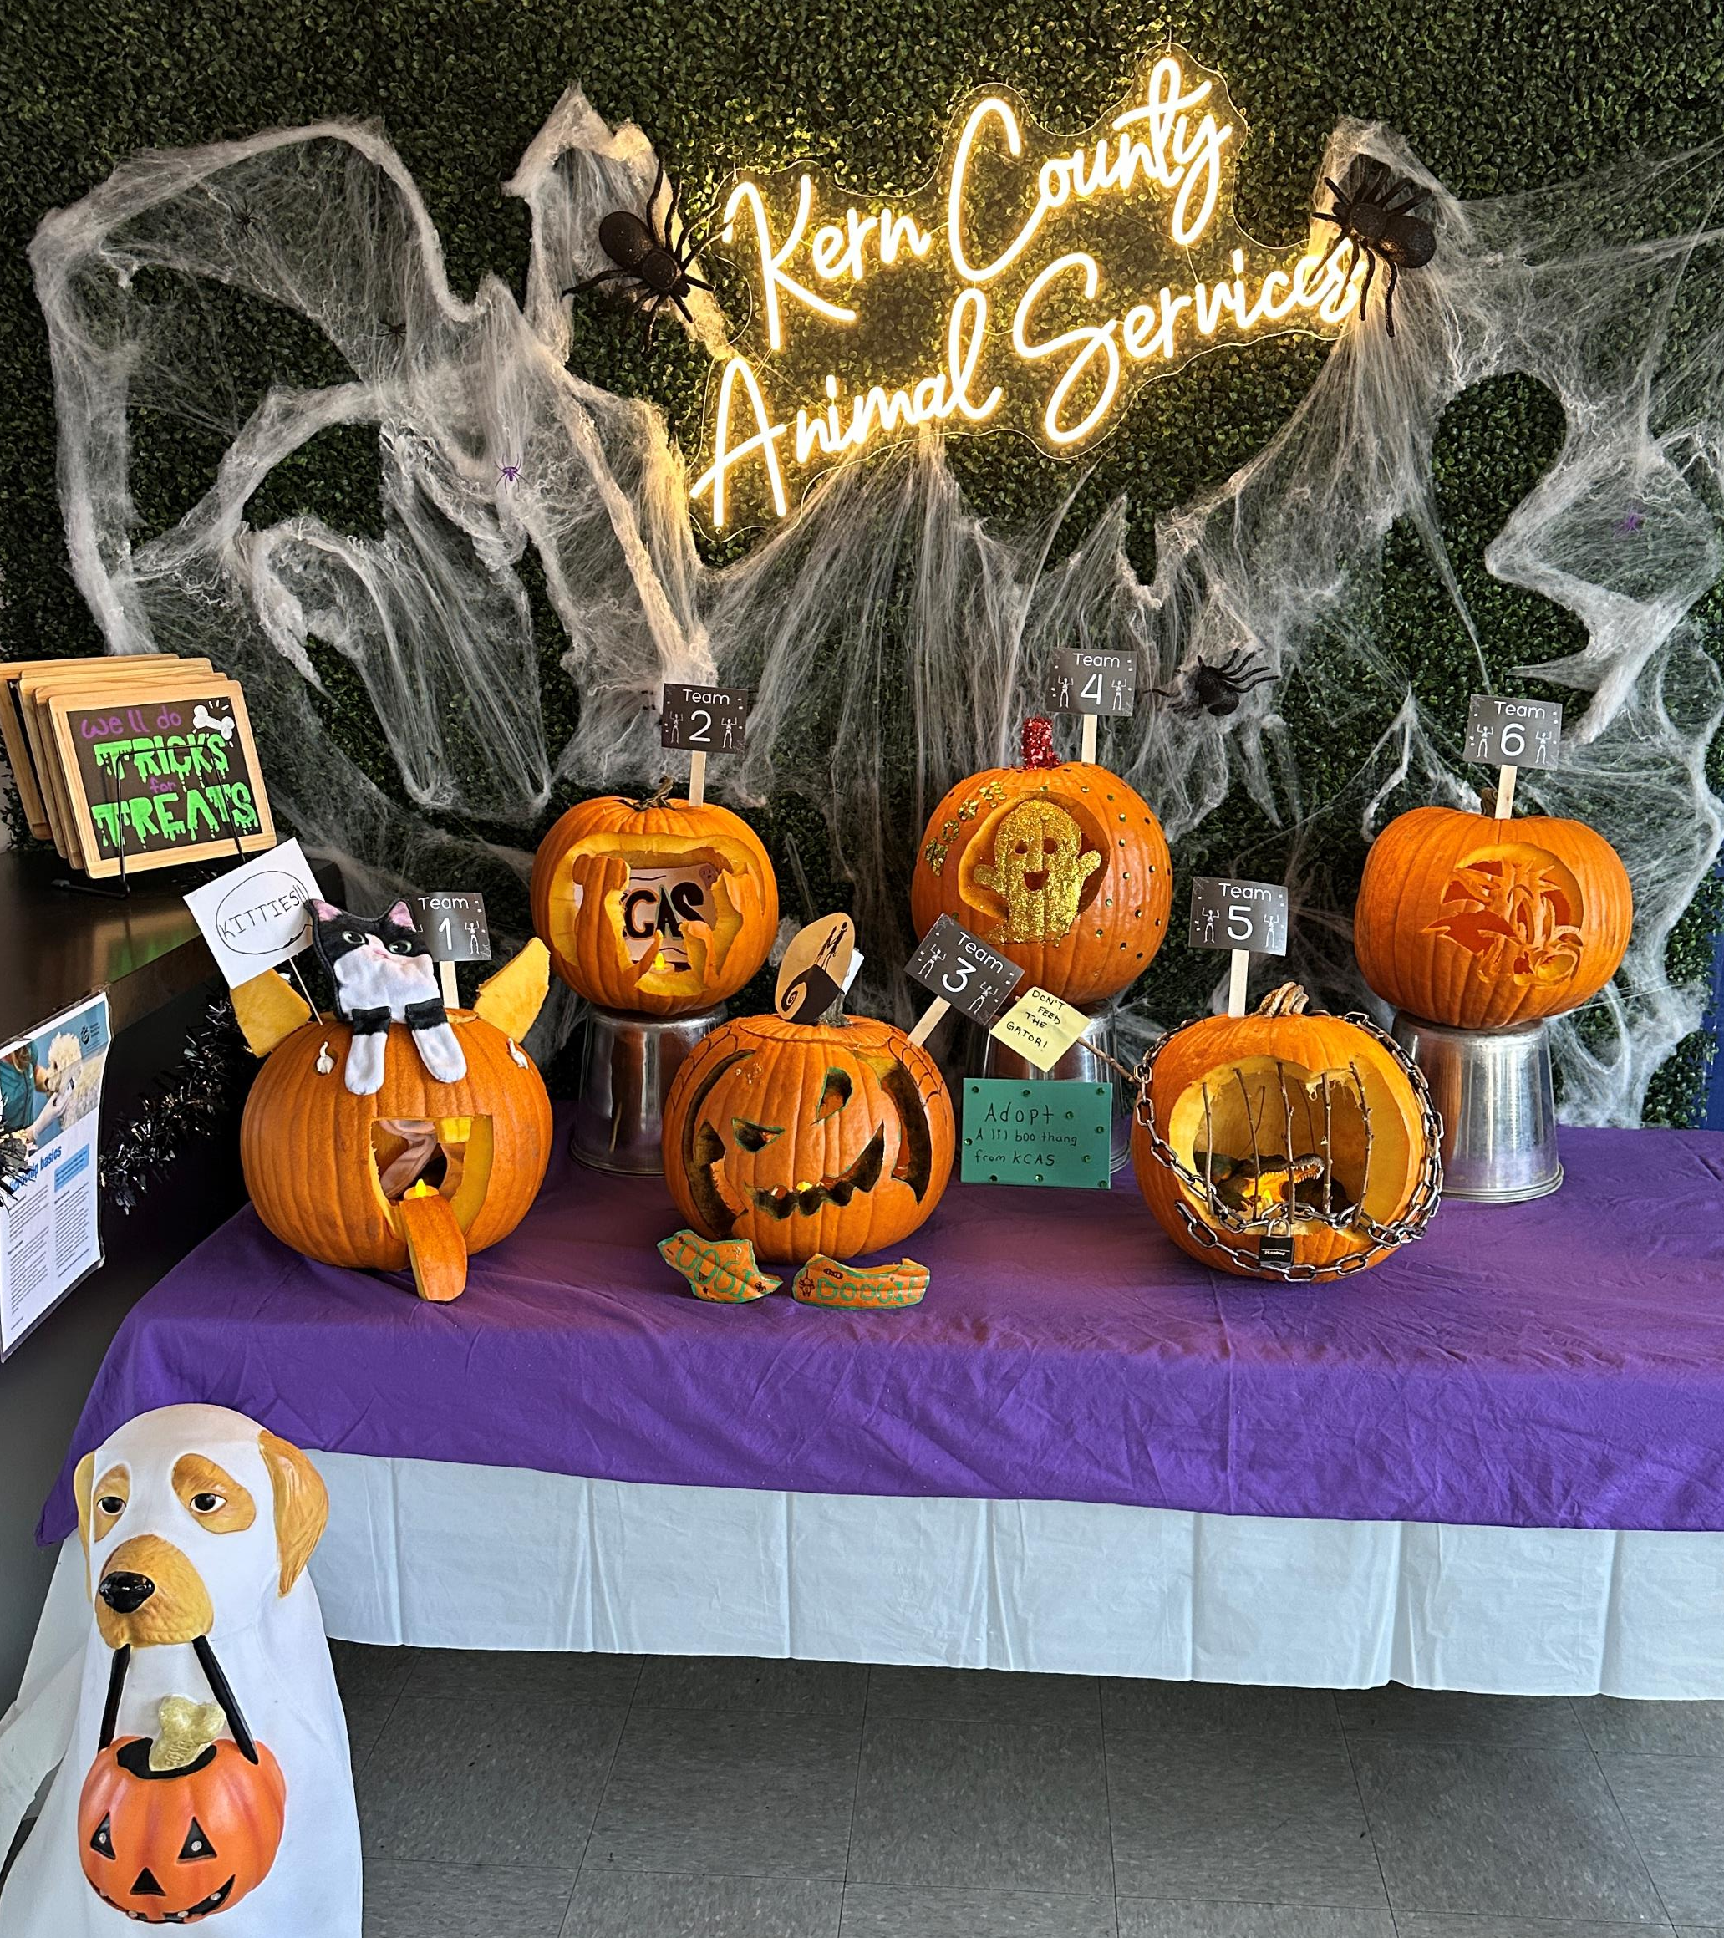
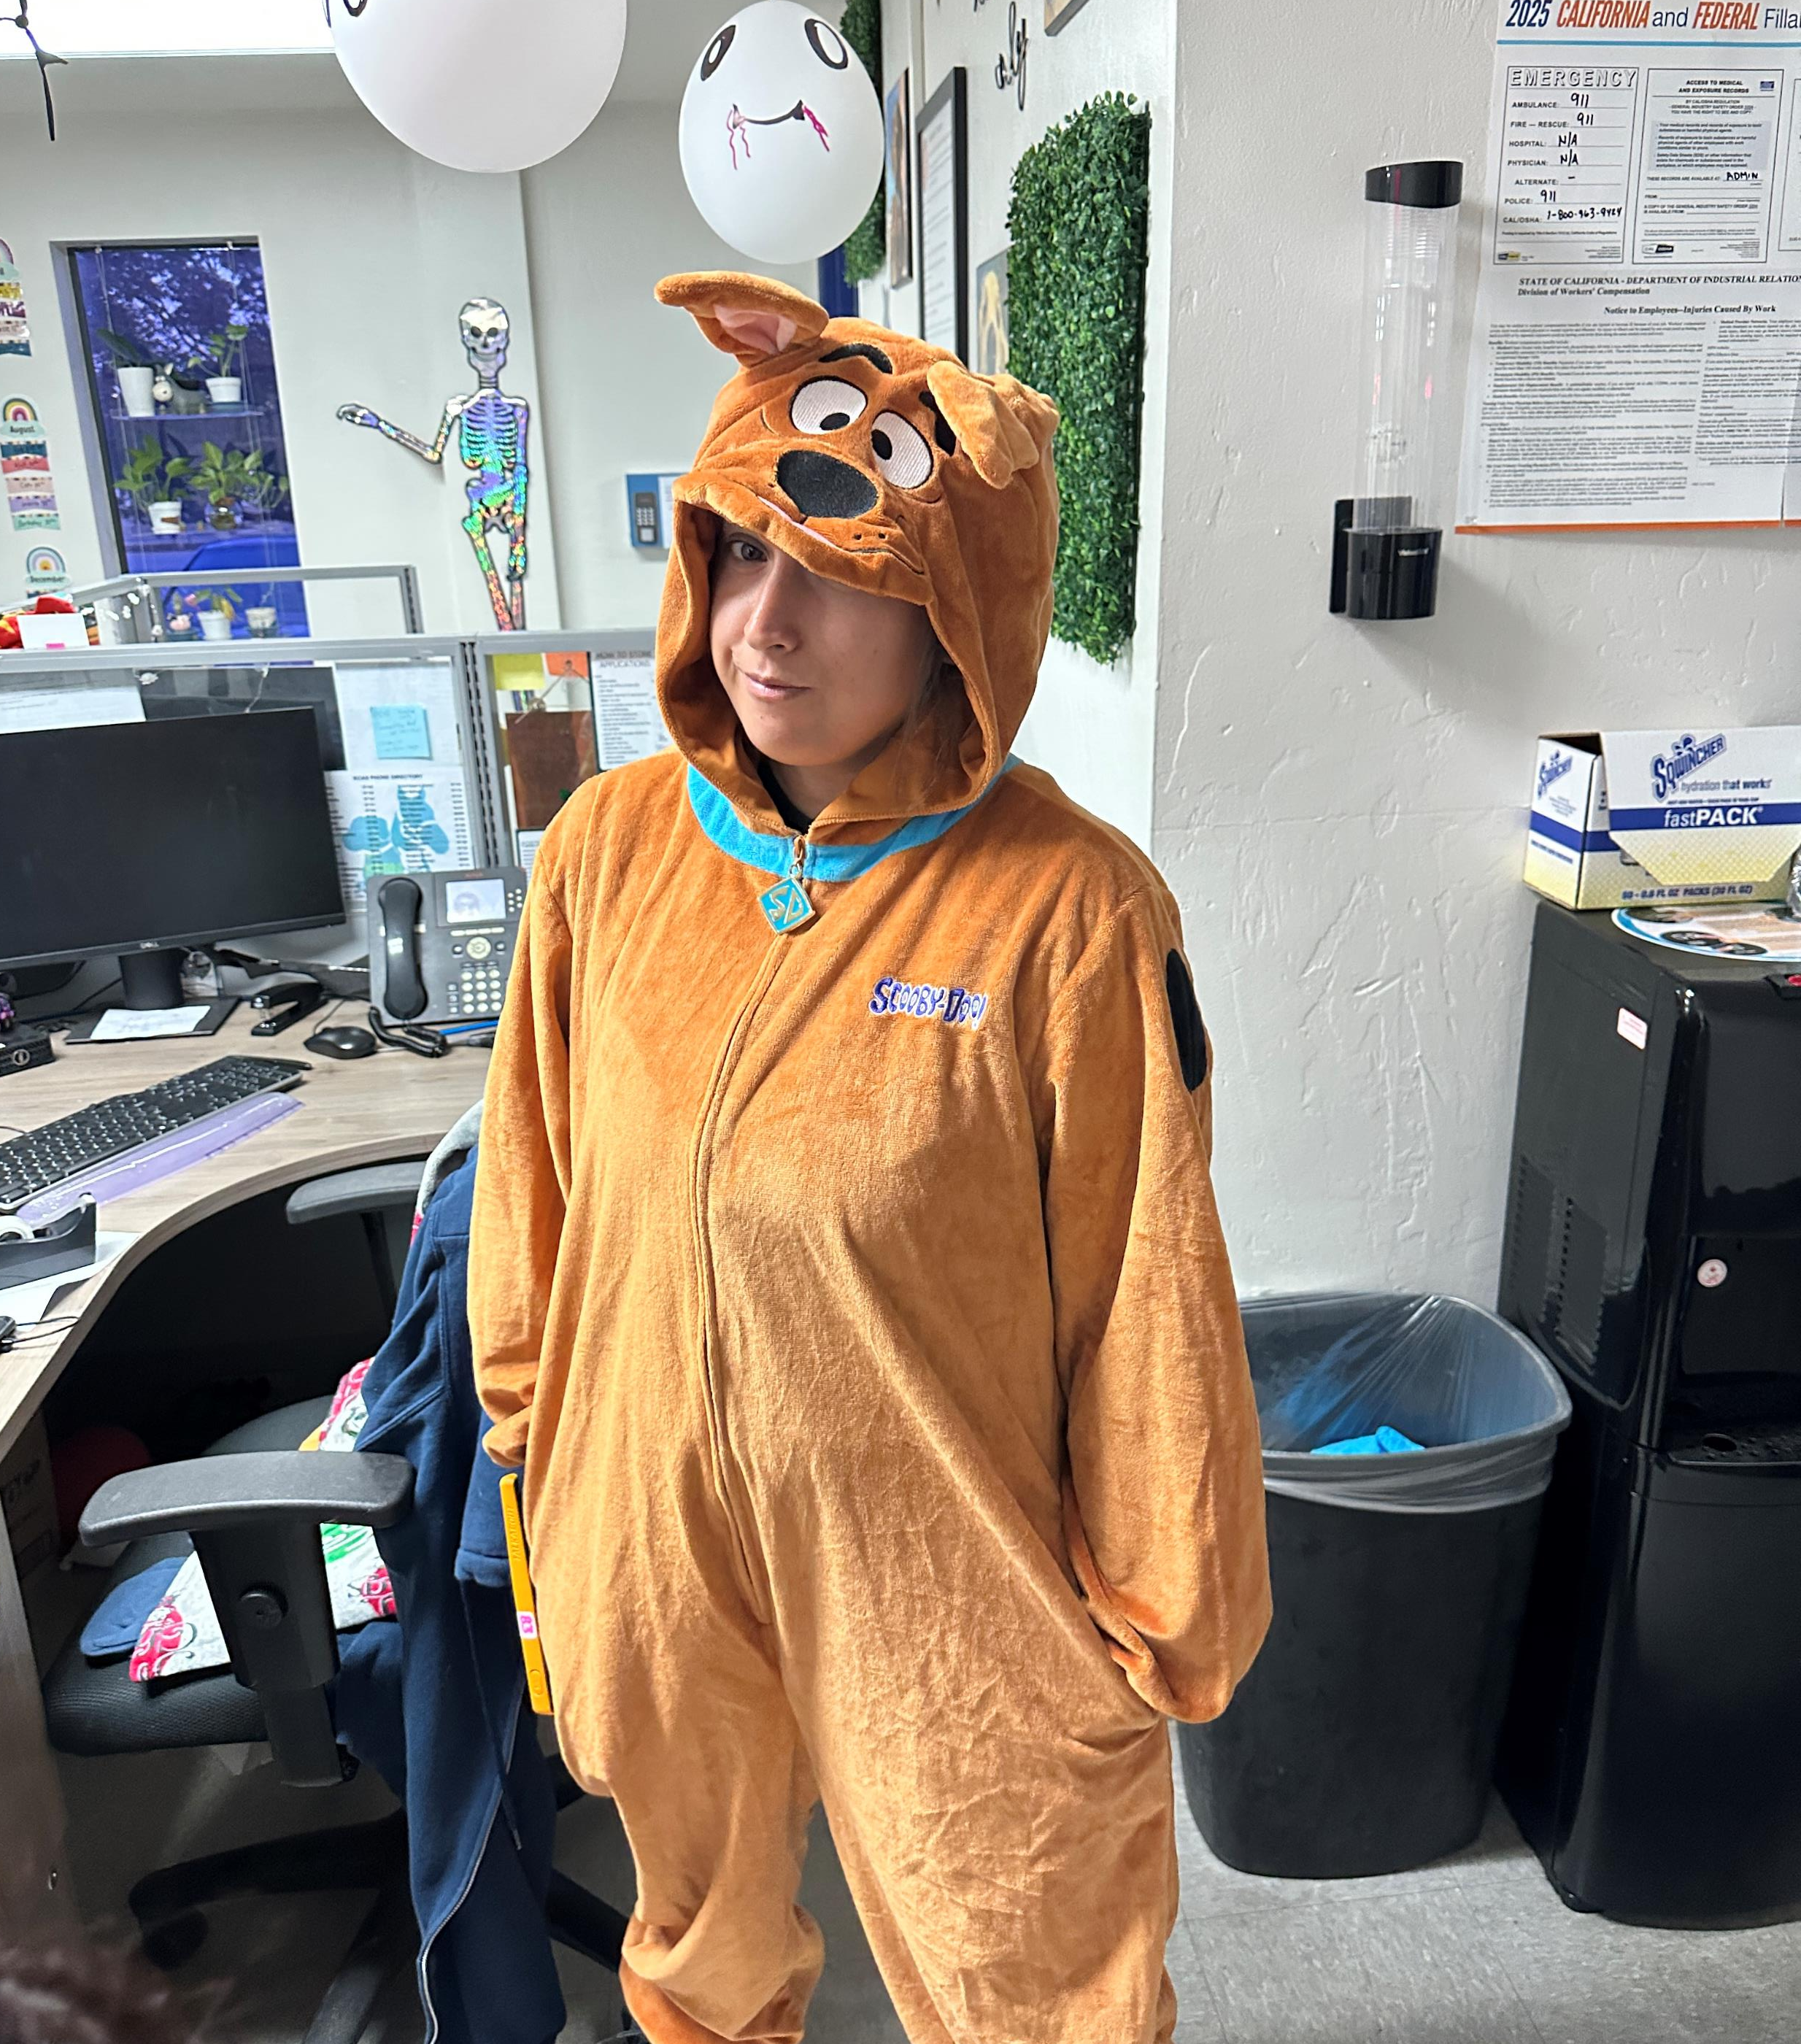

Slide 19
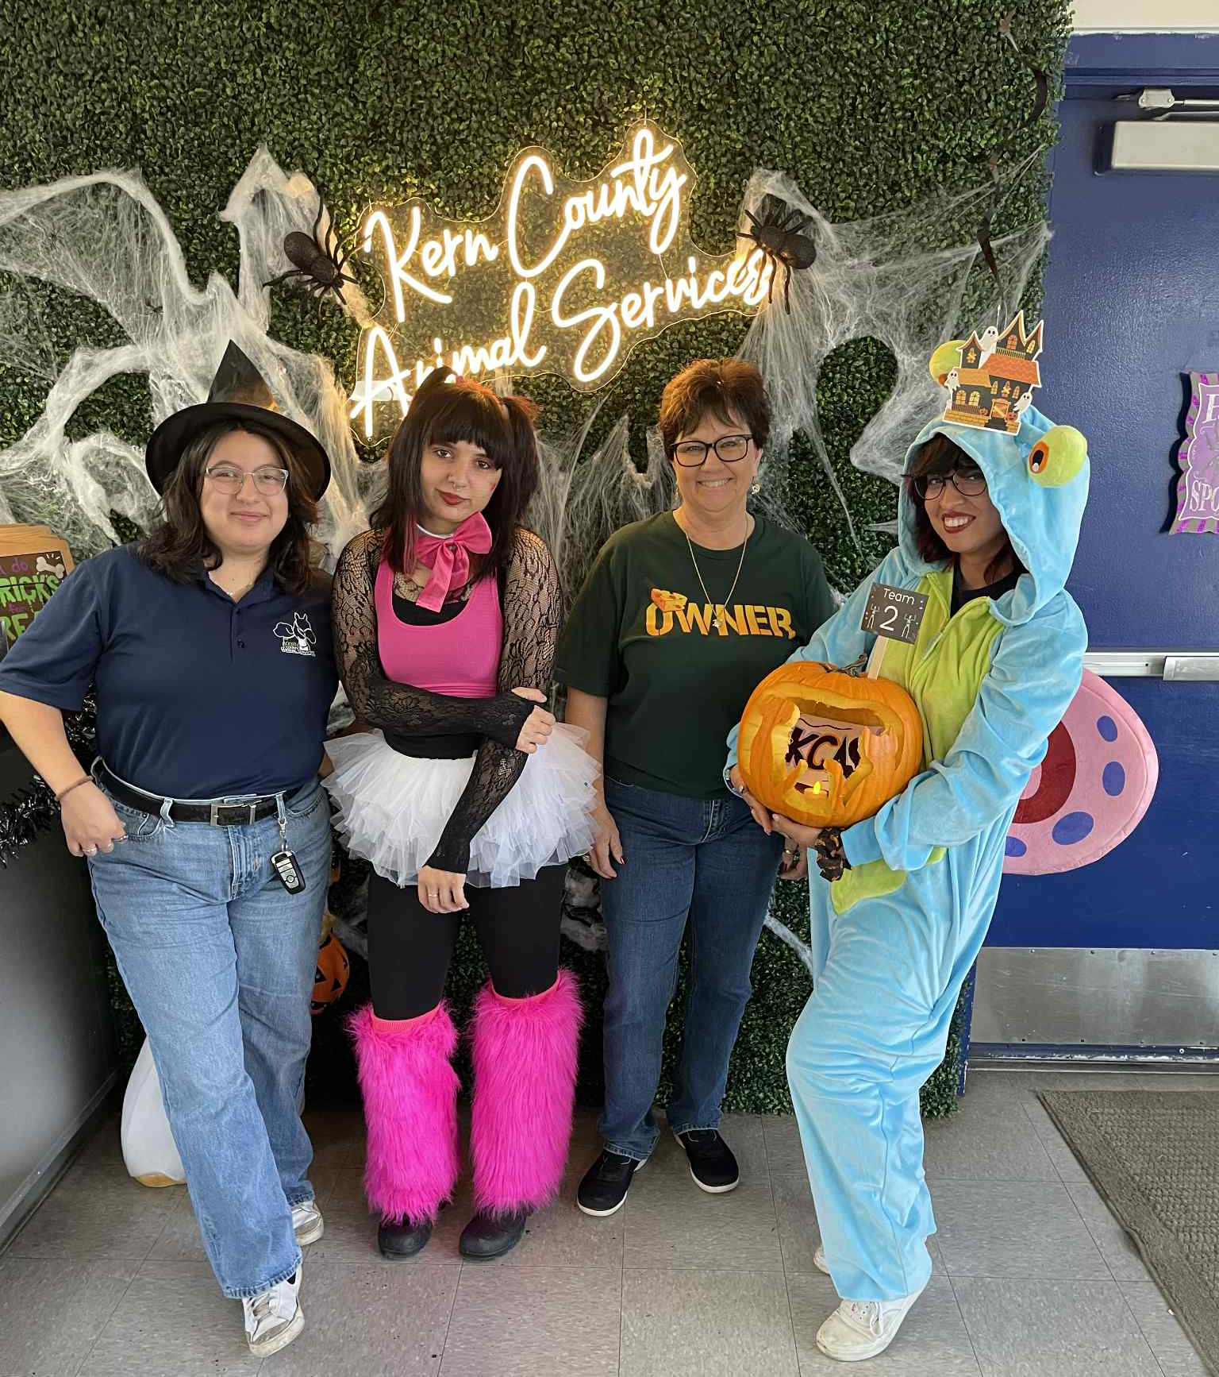
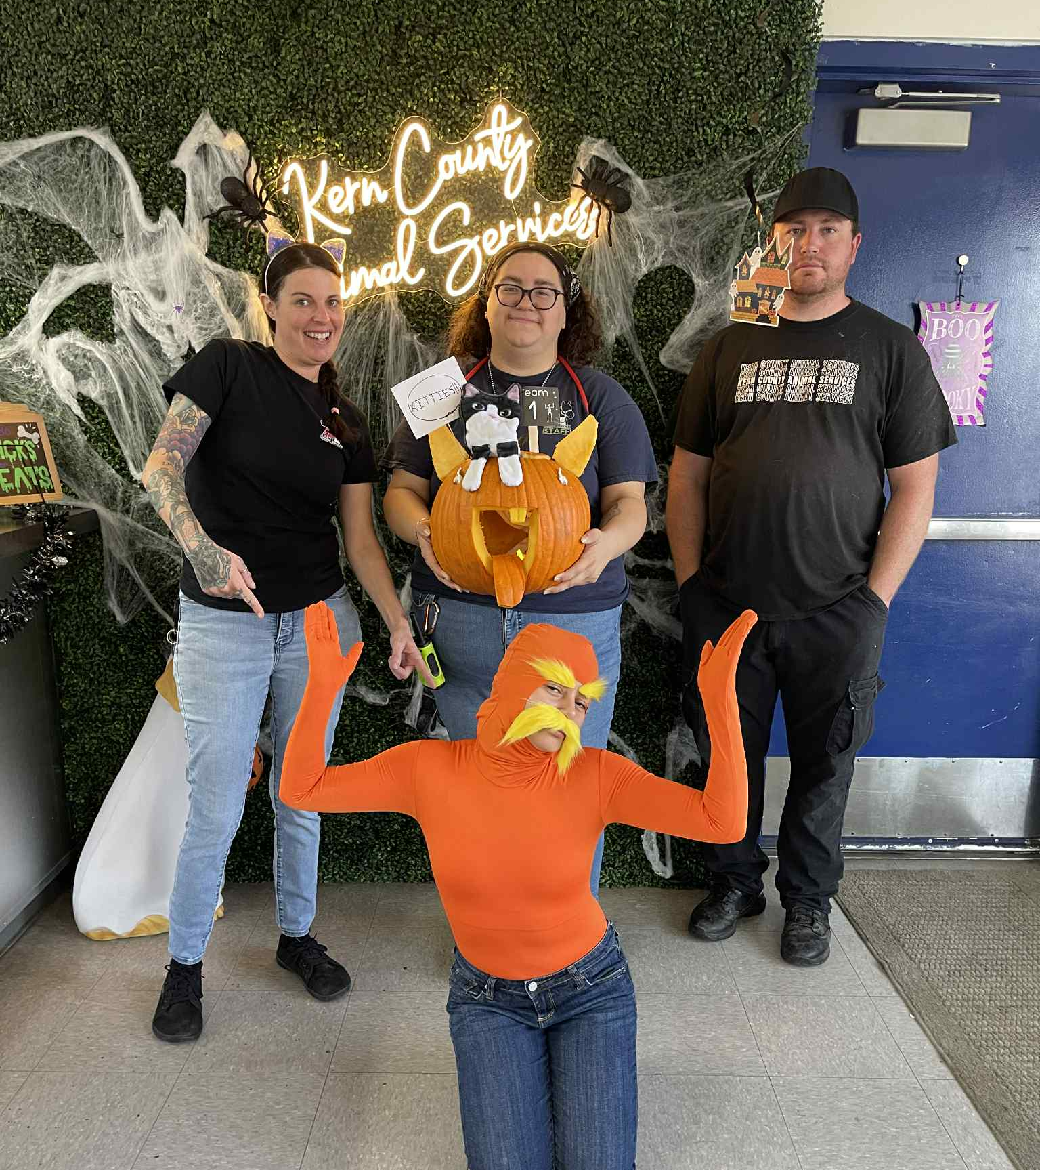
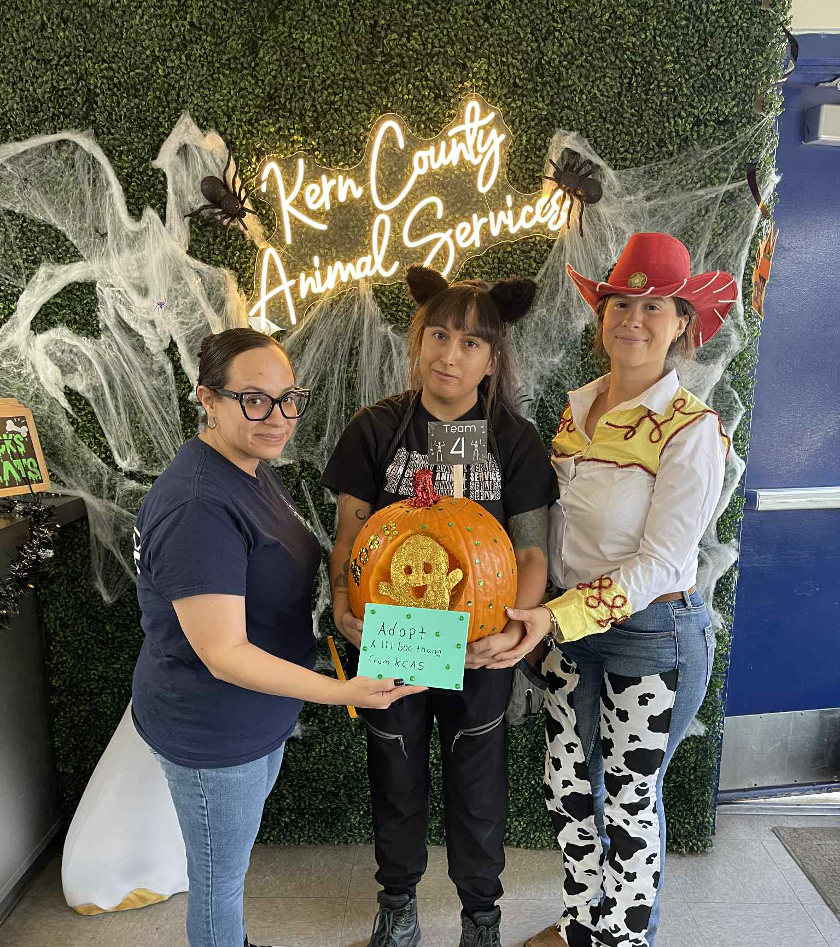
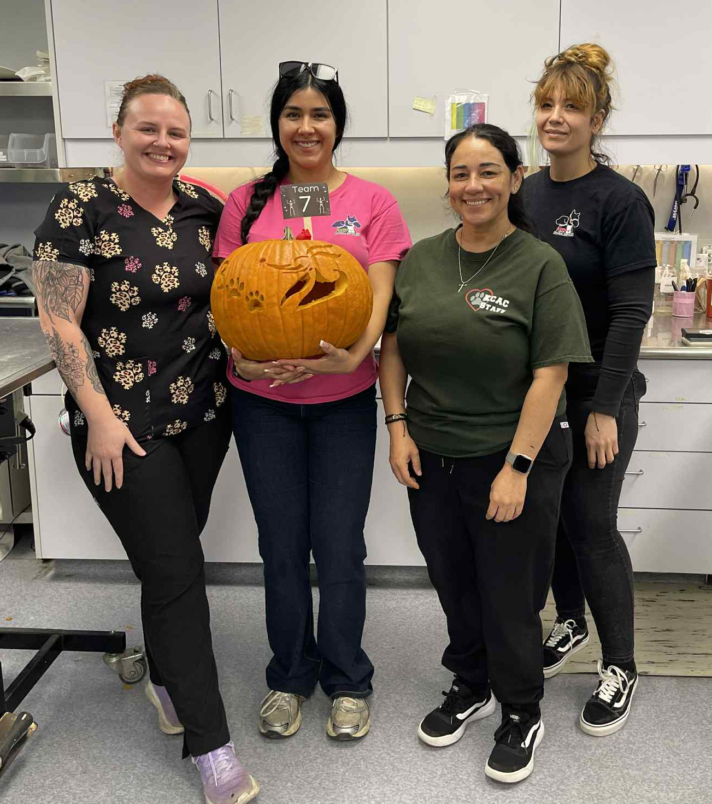
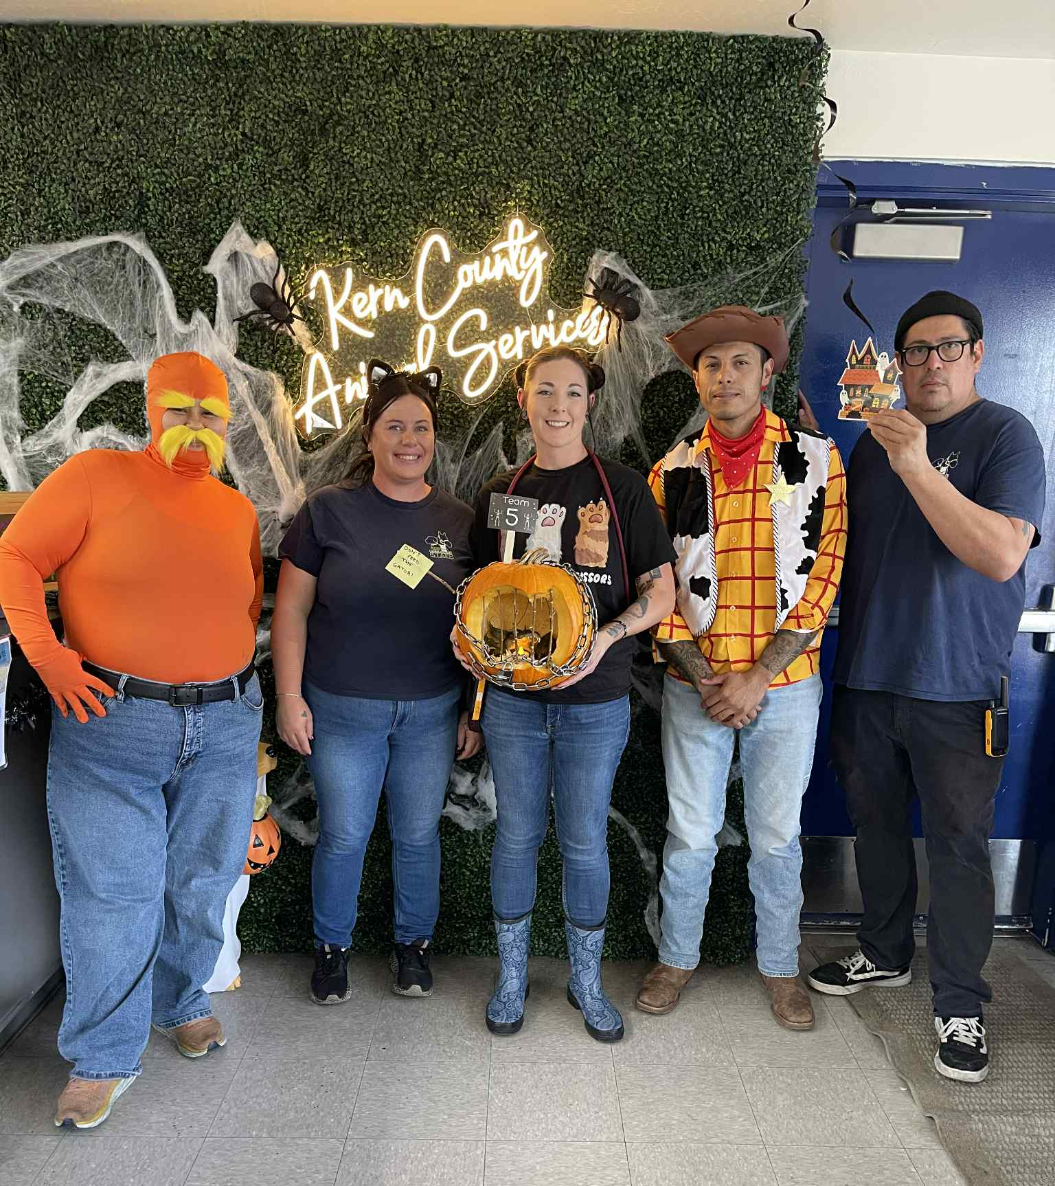
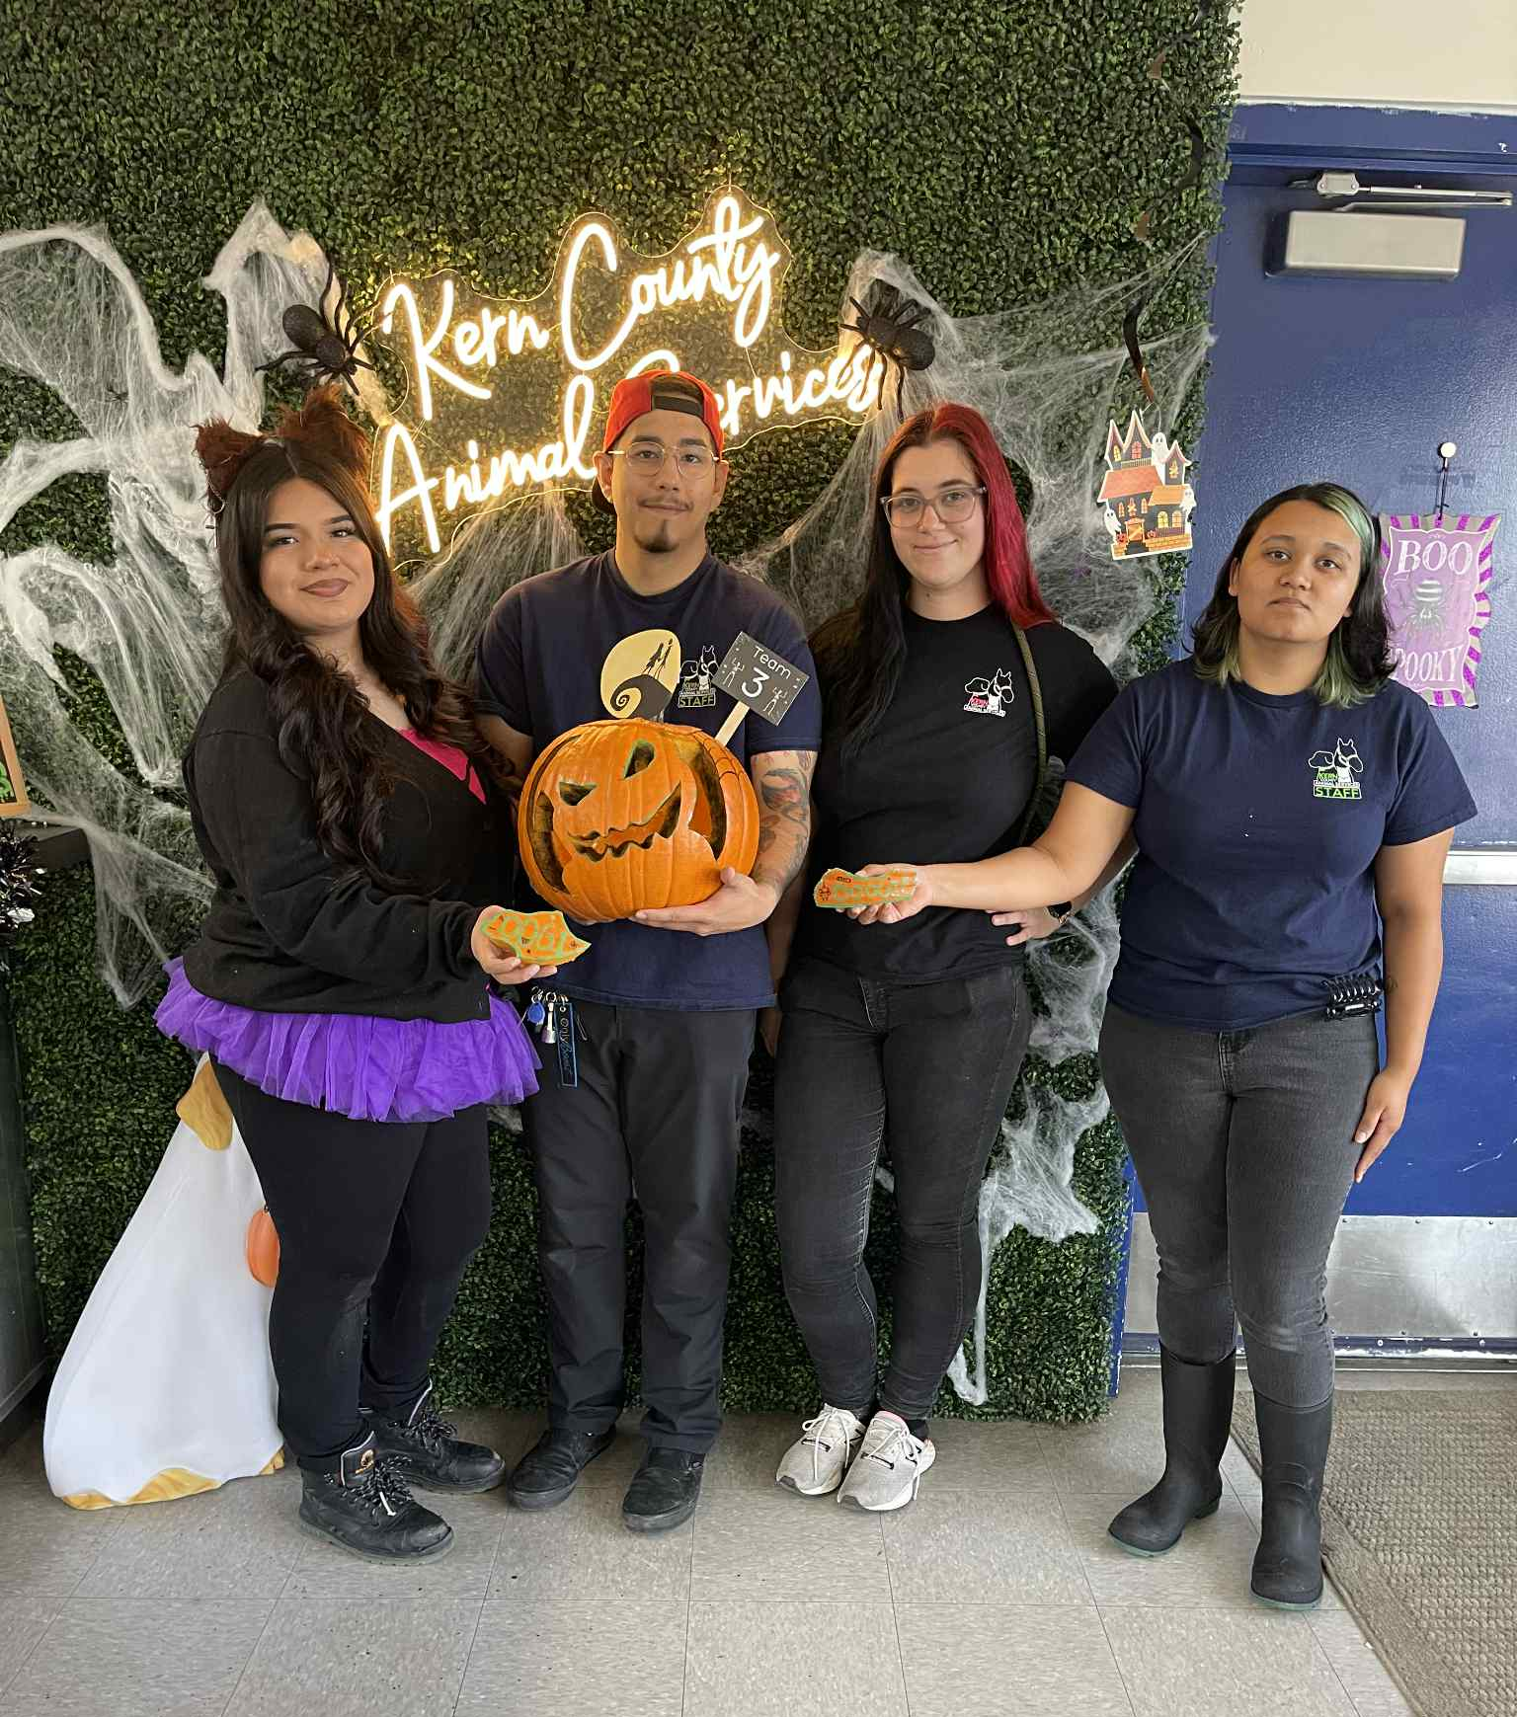

Slide 20
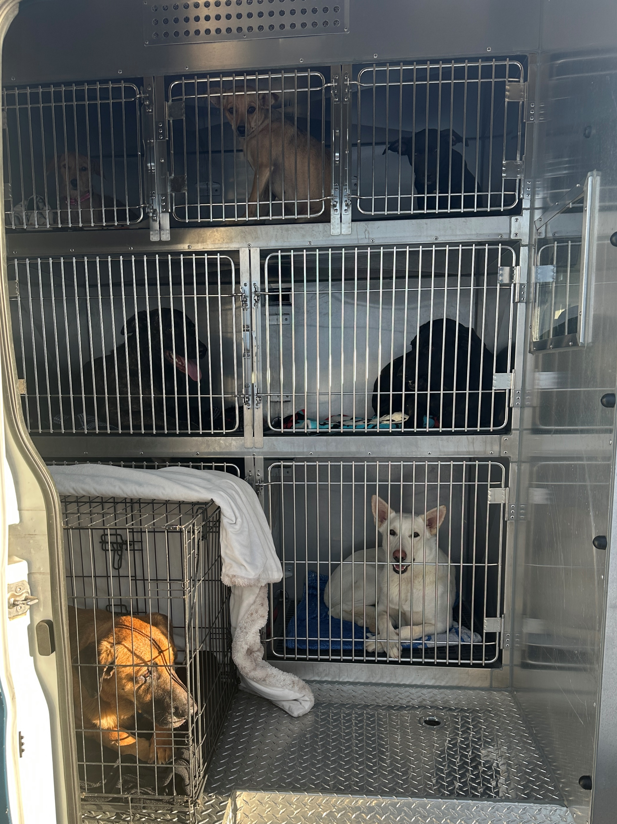
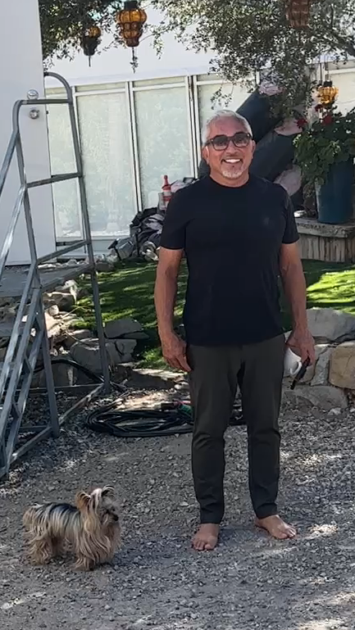
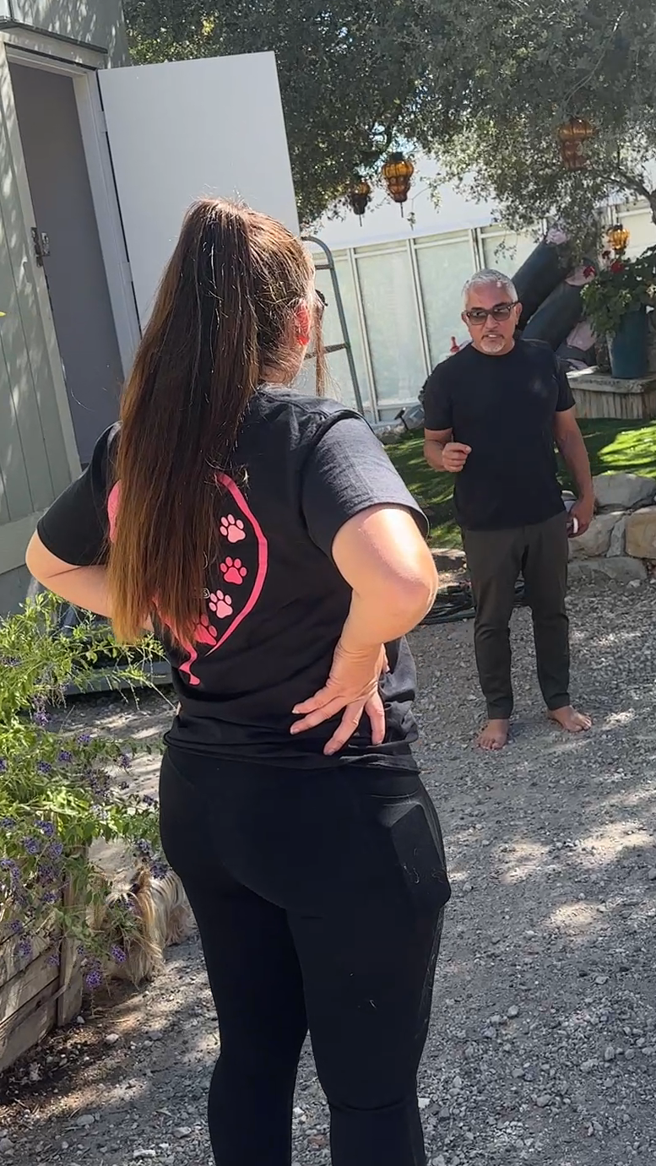
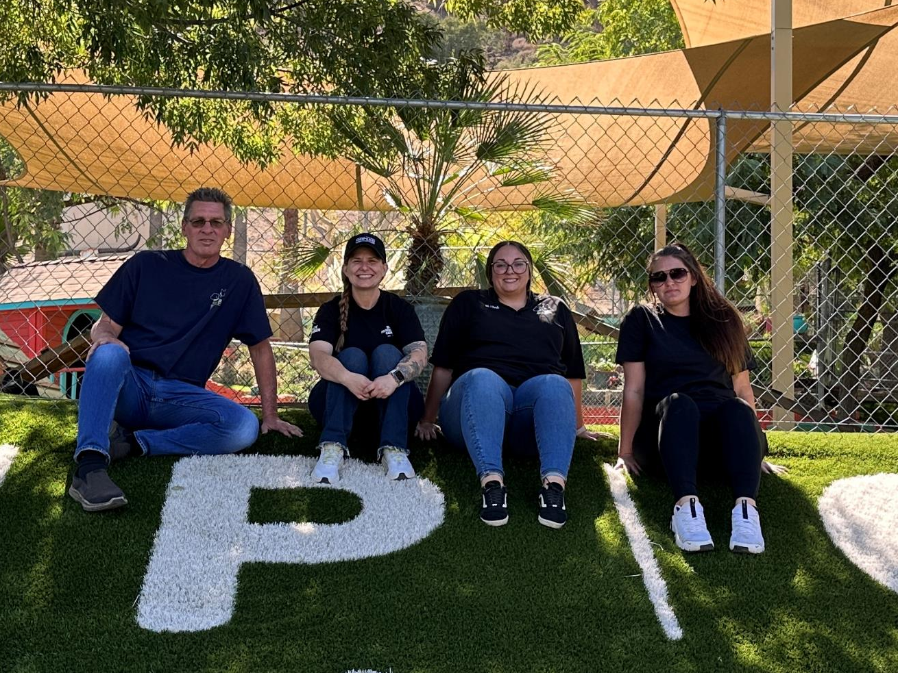
Foster Dogs with Cesar Millan
October 6th - Eighteen of our KCAS foster dogs spent a full week at Cesar Millan’s Dog Psychology Center near Santa Clarita!
Our foster pups were selected to participate in training sessions, giving them valuable socialization and structure while also helping those enrolled in the program learn hands-on skills.
Best of all, many of the dogs who spent the week with Cesar have since been adopted! A wonderful outcome for these deserving pups!

Slide 21
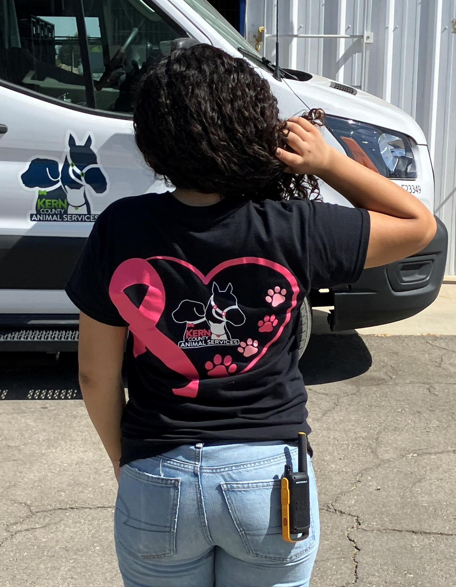
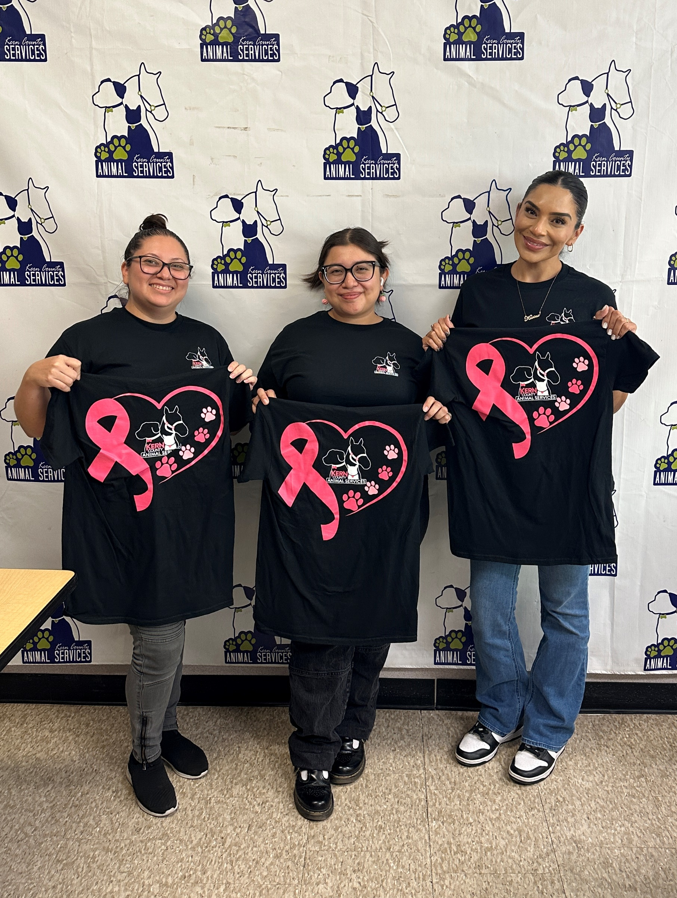
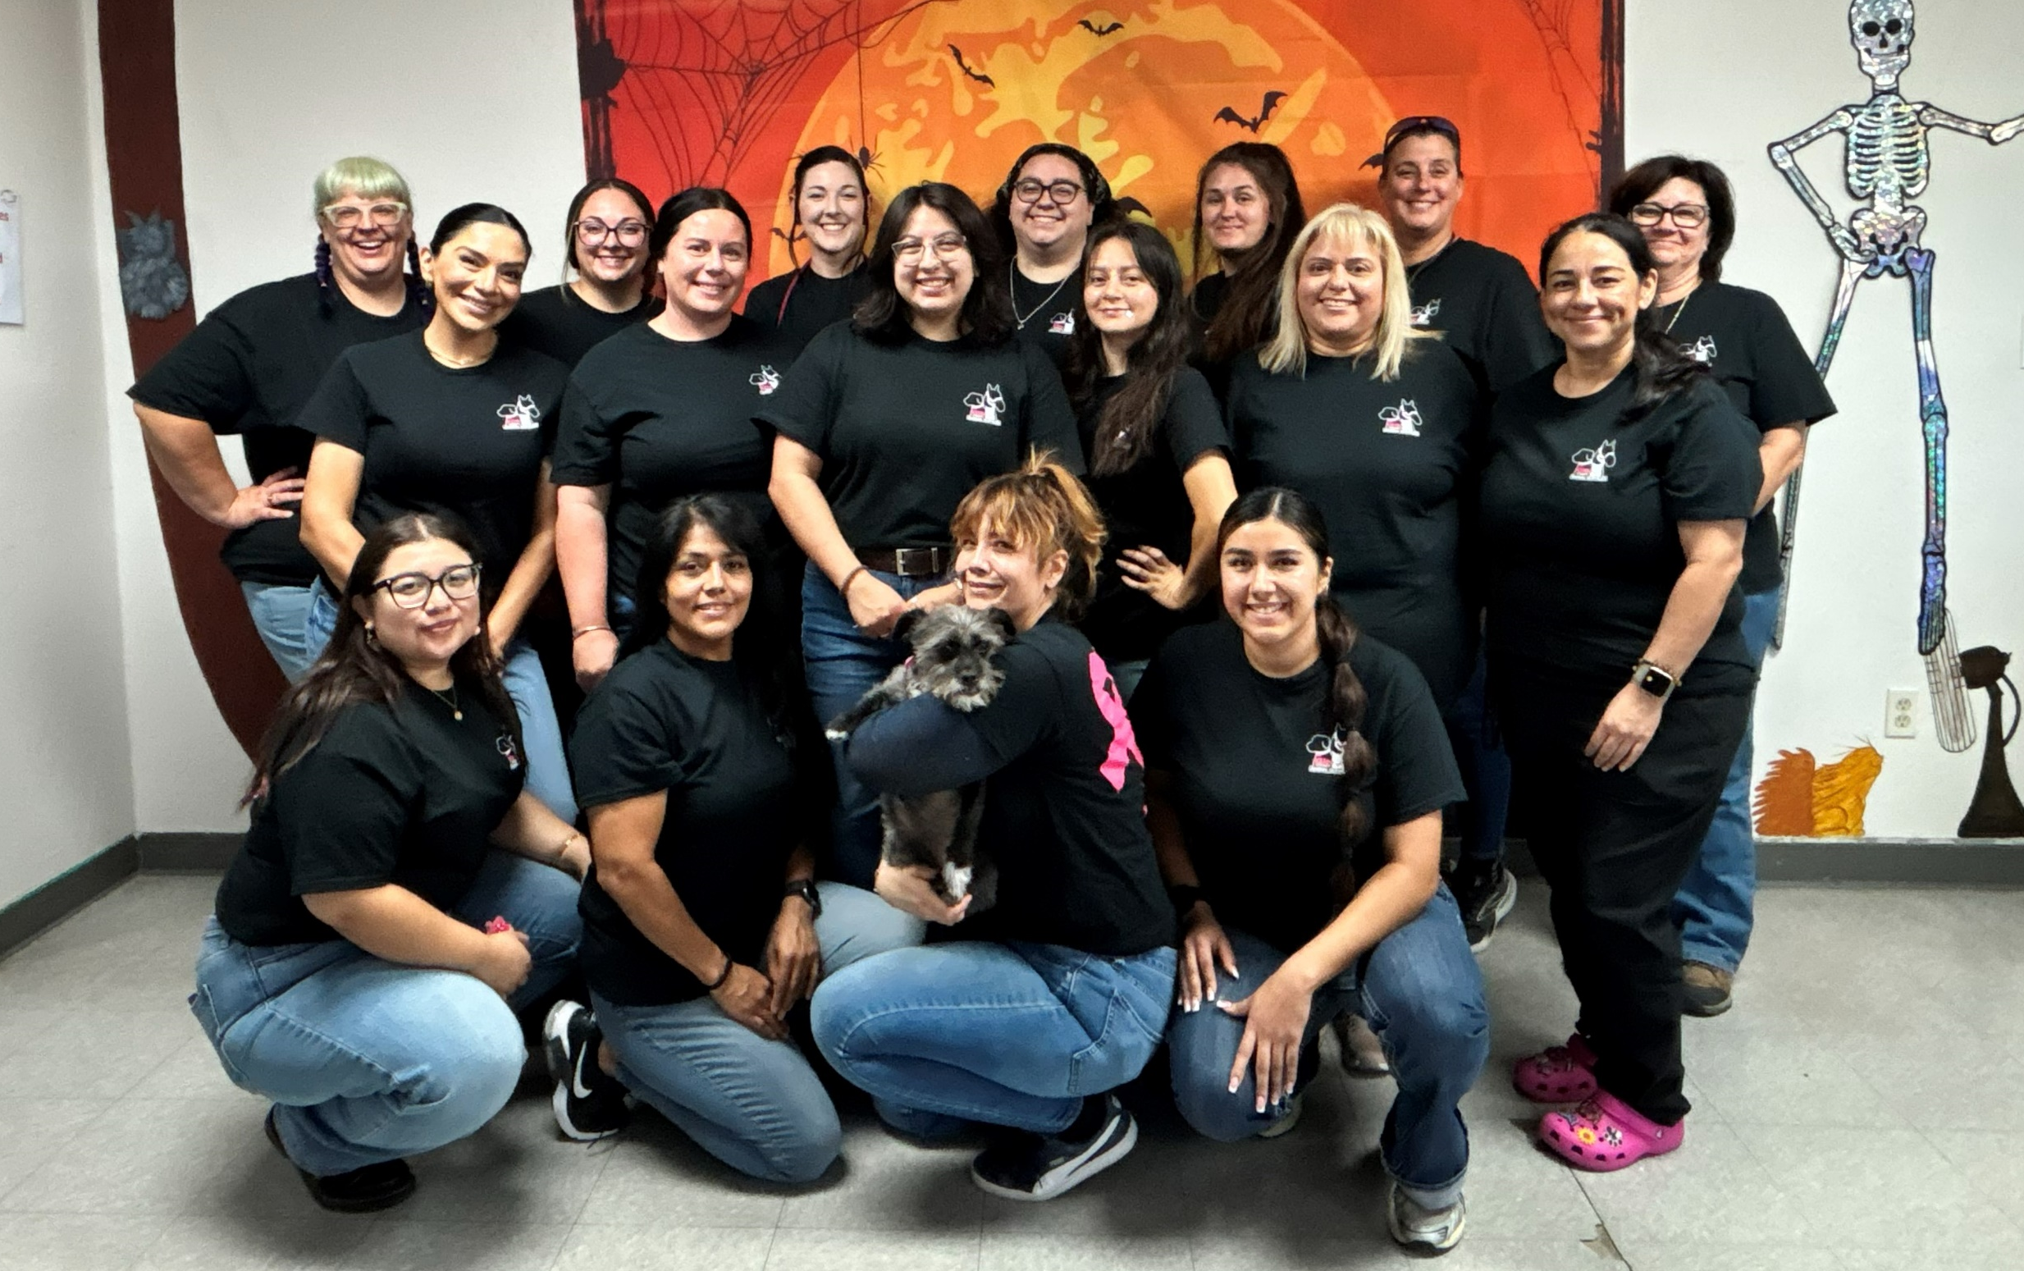
Breast Cancer Awareness Month
October 13th - In honor of Breast Cancer Awareness Month, Kern County Animal Services created limited-edition pink KCAS shirts for staff, with each shirt requiring a minimum $20 donation. The shelter raised over $800, all of which was donated directly to Links for Life Bakersfield, a local organization that provides crucial support, resources, and breast-health education to individuals and families affected by breast cancer.
KCAS staff proudly wore their new shirts to help raise awareness throughout the month of October.

Slide 22
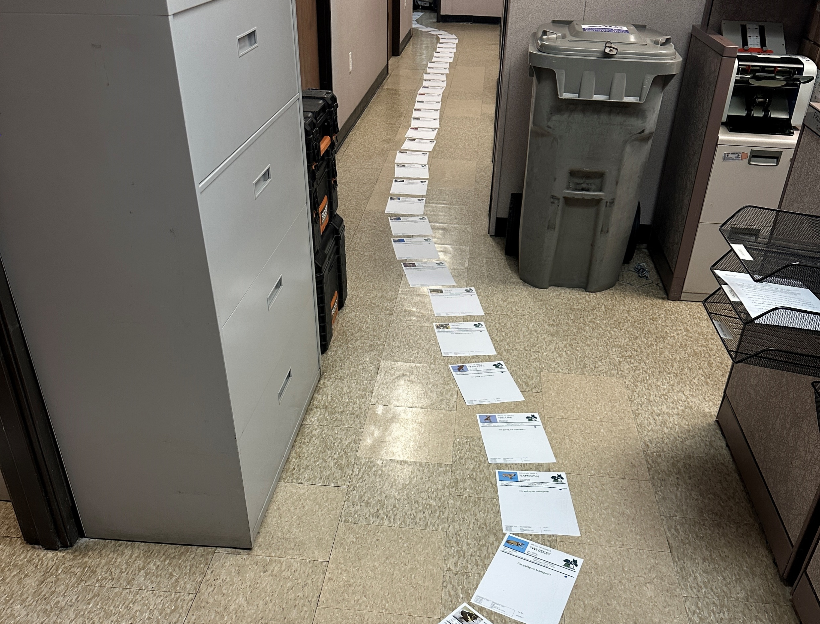
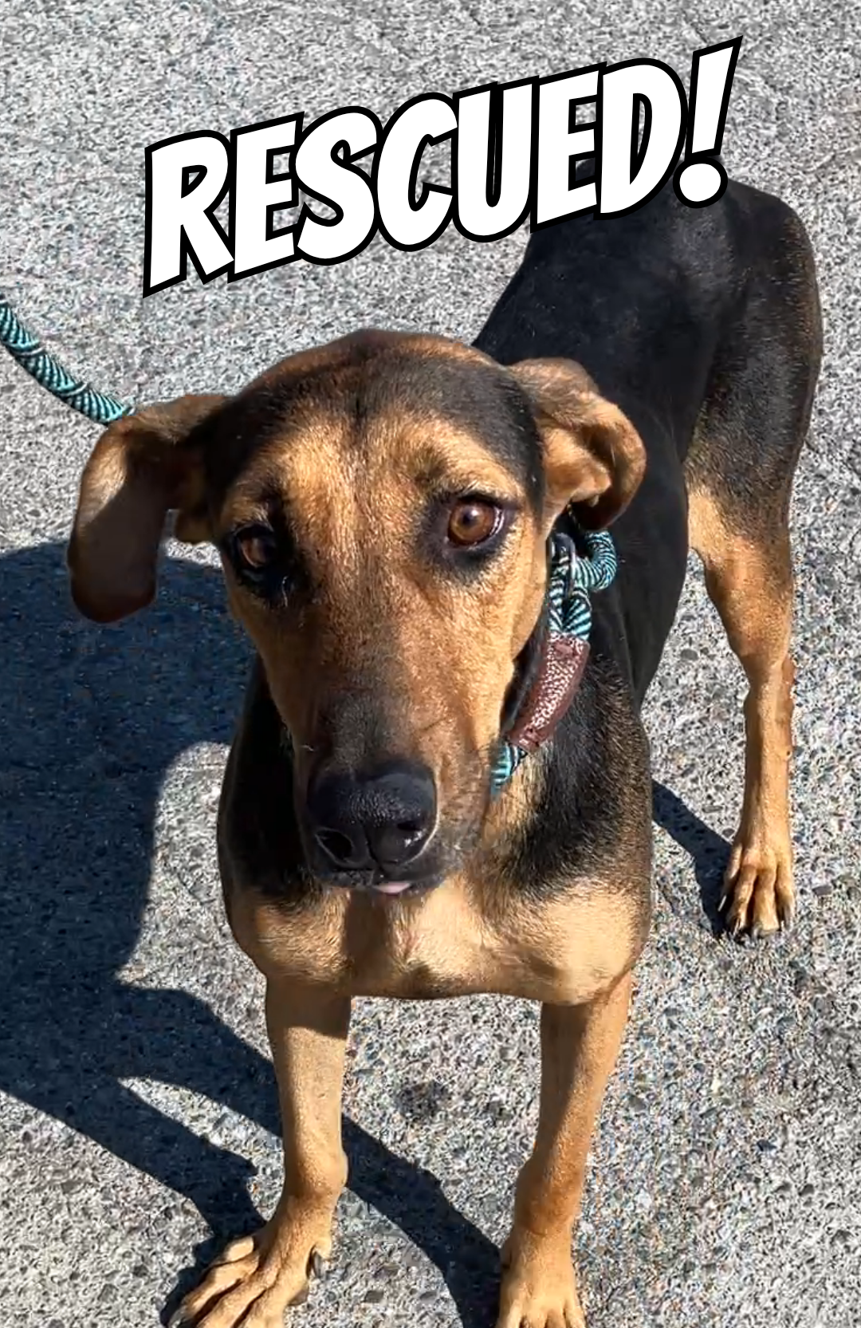
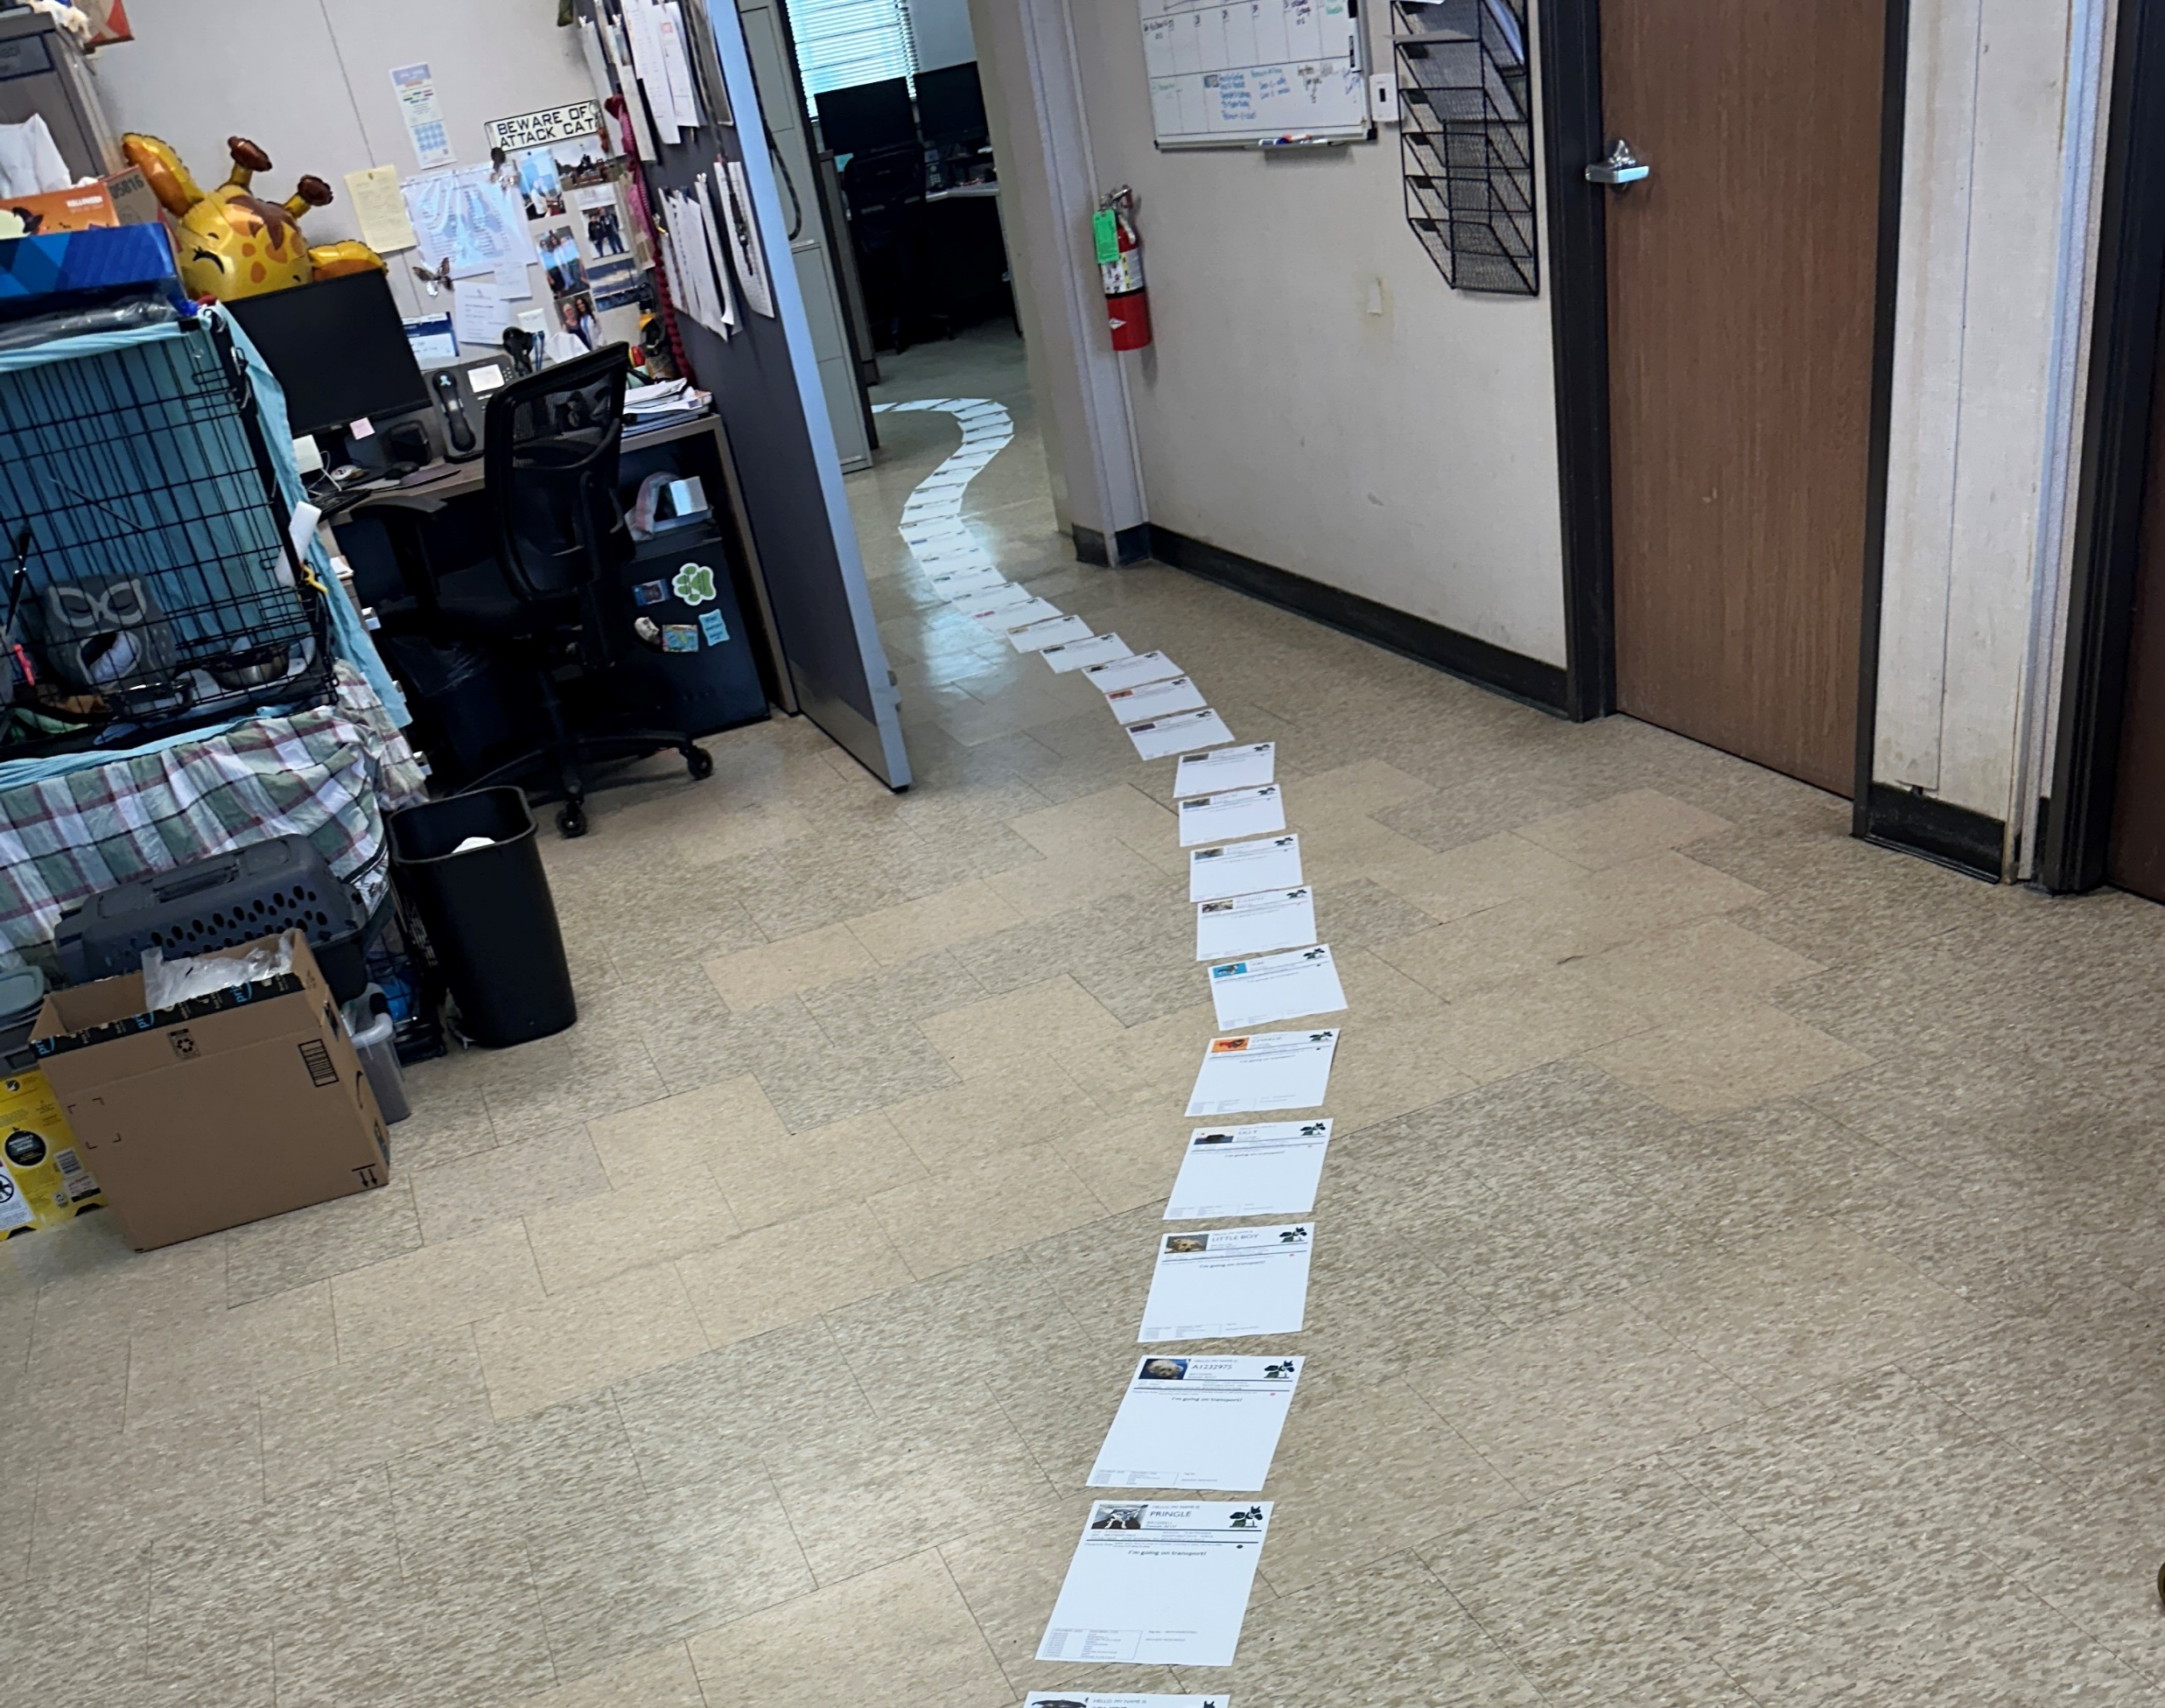
70 Dogs Rescued
October 20th - Over the weekend of October 18–19, 70 dogs found their way out of the shelter thanks to our amazing rescue partner organizations!
Two of these photos show all 70 kennel cards laid out end to end. An incredible sight and a reminder of how many lives were saved in just one weekend.
Among them was Delilah, one of our most well-known shelter dogs.
A huge thank you to the KCAS Rescue Team, our staff, and our volunteers for working together to make this possible. You helped save so many lives!

Slide 23
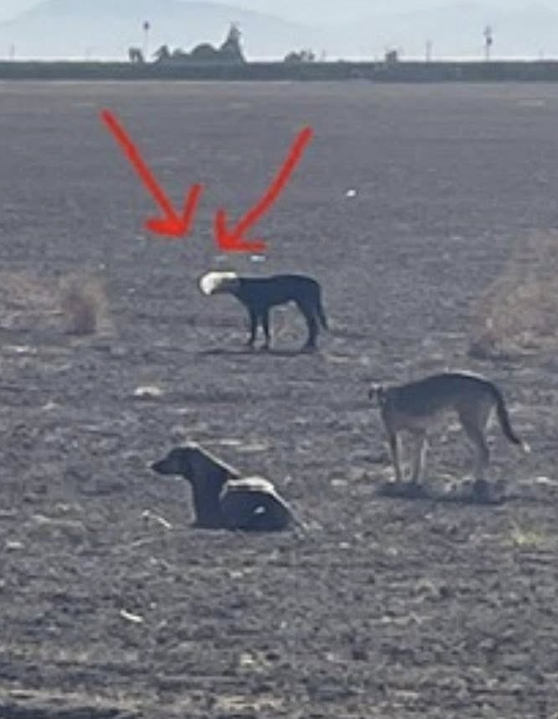
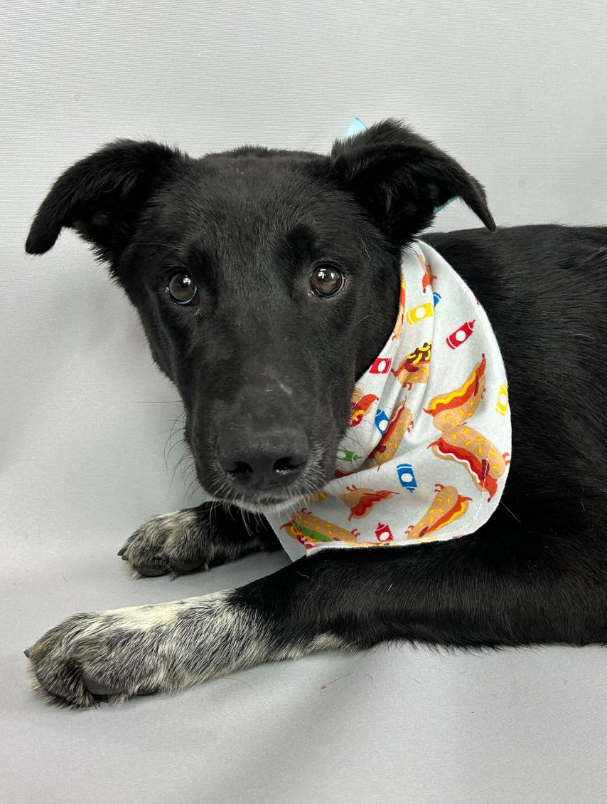
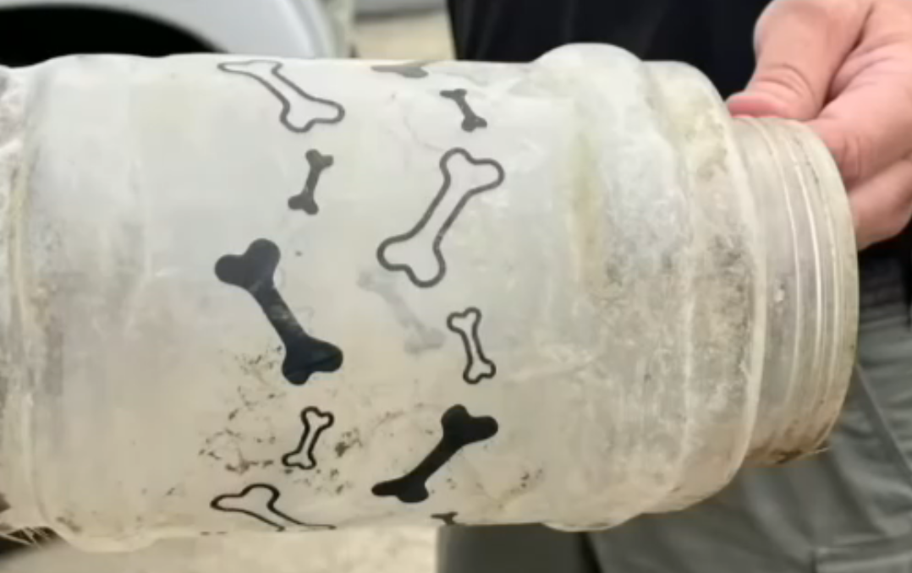
Beckett the Buckethead
October 23rd - Beckett was seen for several days in a field in Wasco with eight other dogs. All of them were skittish and too afraid to approach humans. Beckett was living with a plastic container stuck on his head, leaving him unable to eat or drink and making him vulnerable to predators.
Our animal control officers from KCAS were able to catch him and bring him to the shelter.
Beckett is currently in a KCAS foster home and hoping to find his new forever family.

Slide 24
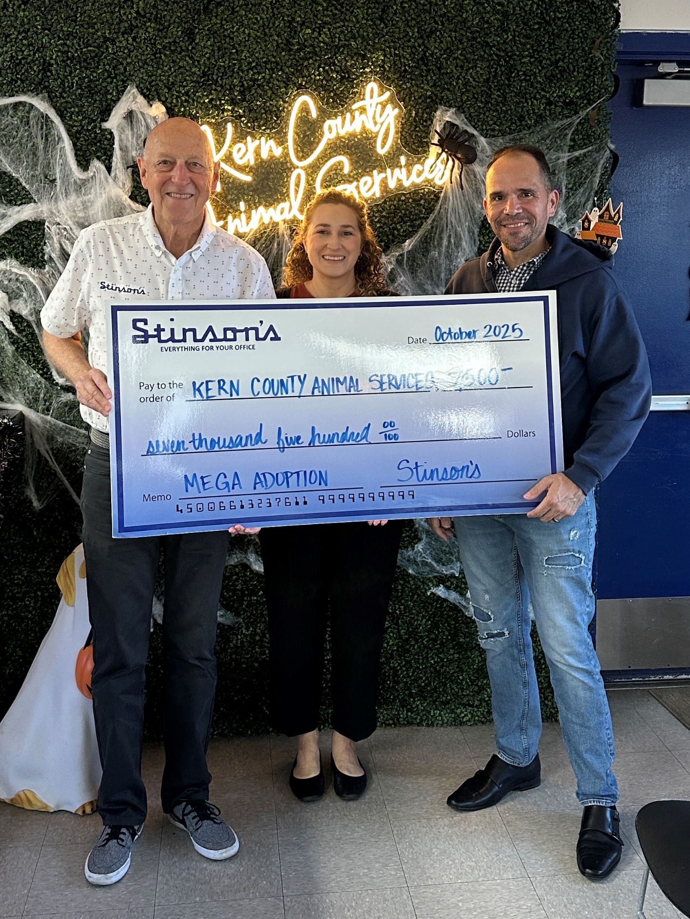
Stinson’s Mega Donation
October 27th - This amazing local Kern County business donated $7,500 to support the annual Mega Adoption Event.
Stinson’s hosted a fundraiser and then matched every donation they received, all to help local pets find their forever homes.
We’re incredibly grateful for community partners who give back and make a real difference for pets right here in Kern County!

Slide 25
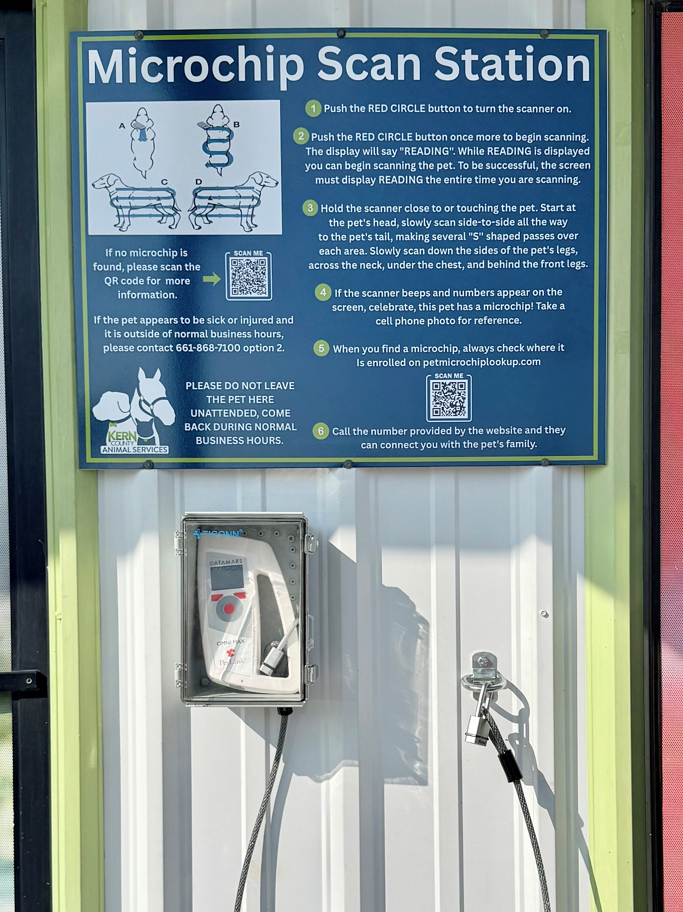
Microchip Scan Station
October 30th - If you’ve found a lost pet, you can now scan it for a microchip 24 hours a day, 365 days a year at Kern County Animal Services, located at 3951 Fruitvale Avenue!
Clear instructions on how to use the scanner, along with the steps to take after scanning the pet, are posted right at the station.

Slide 26
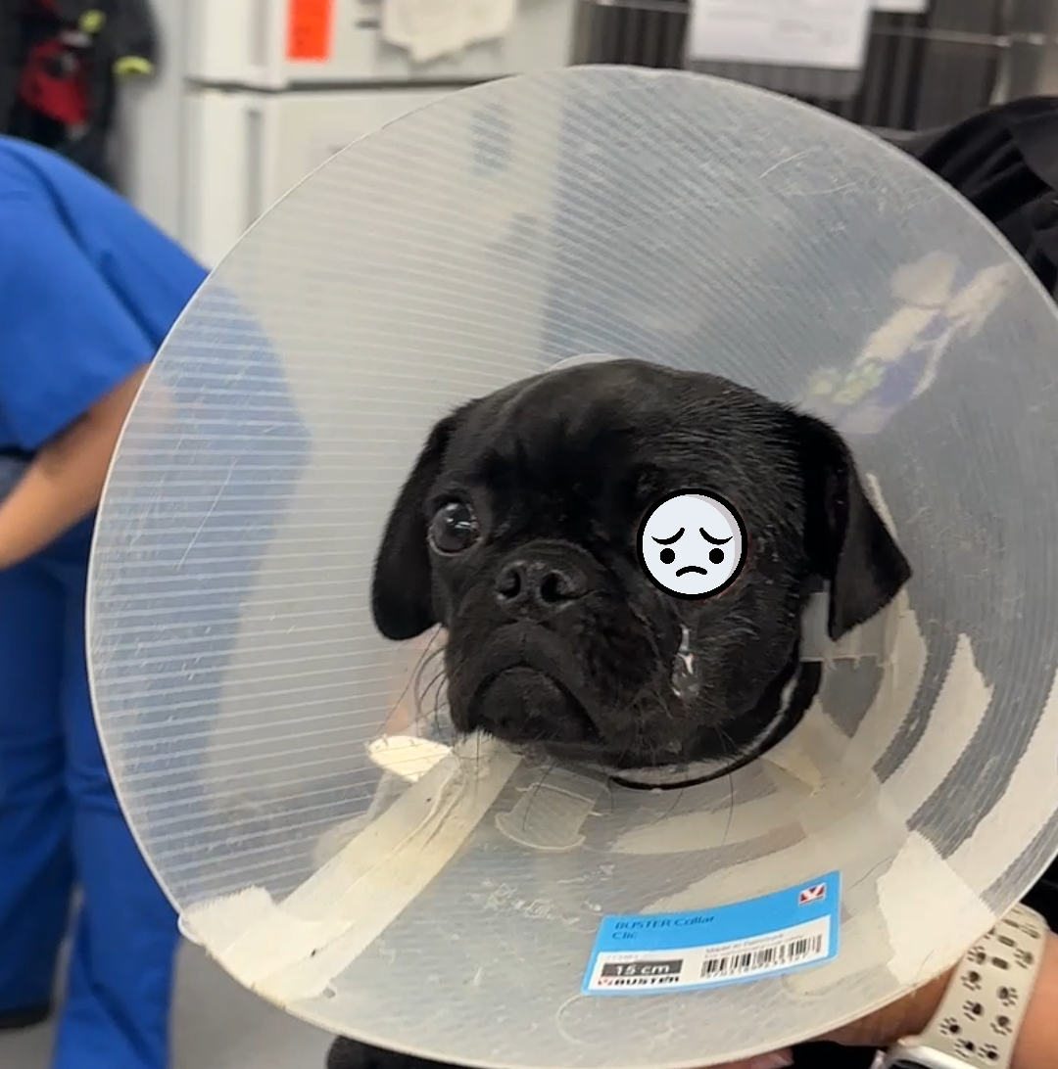

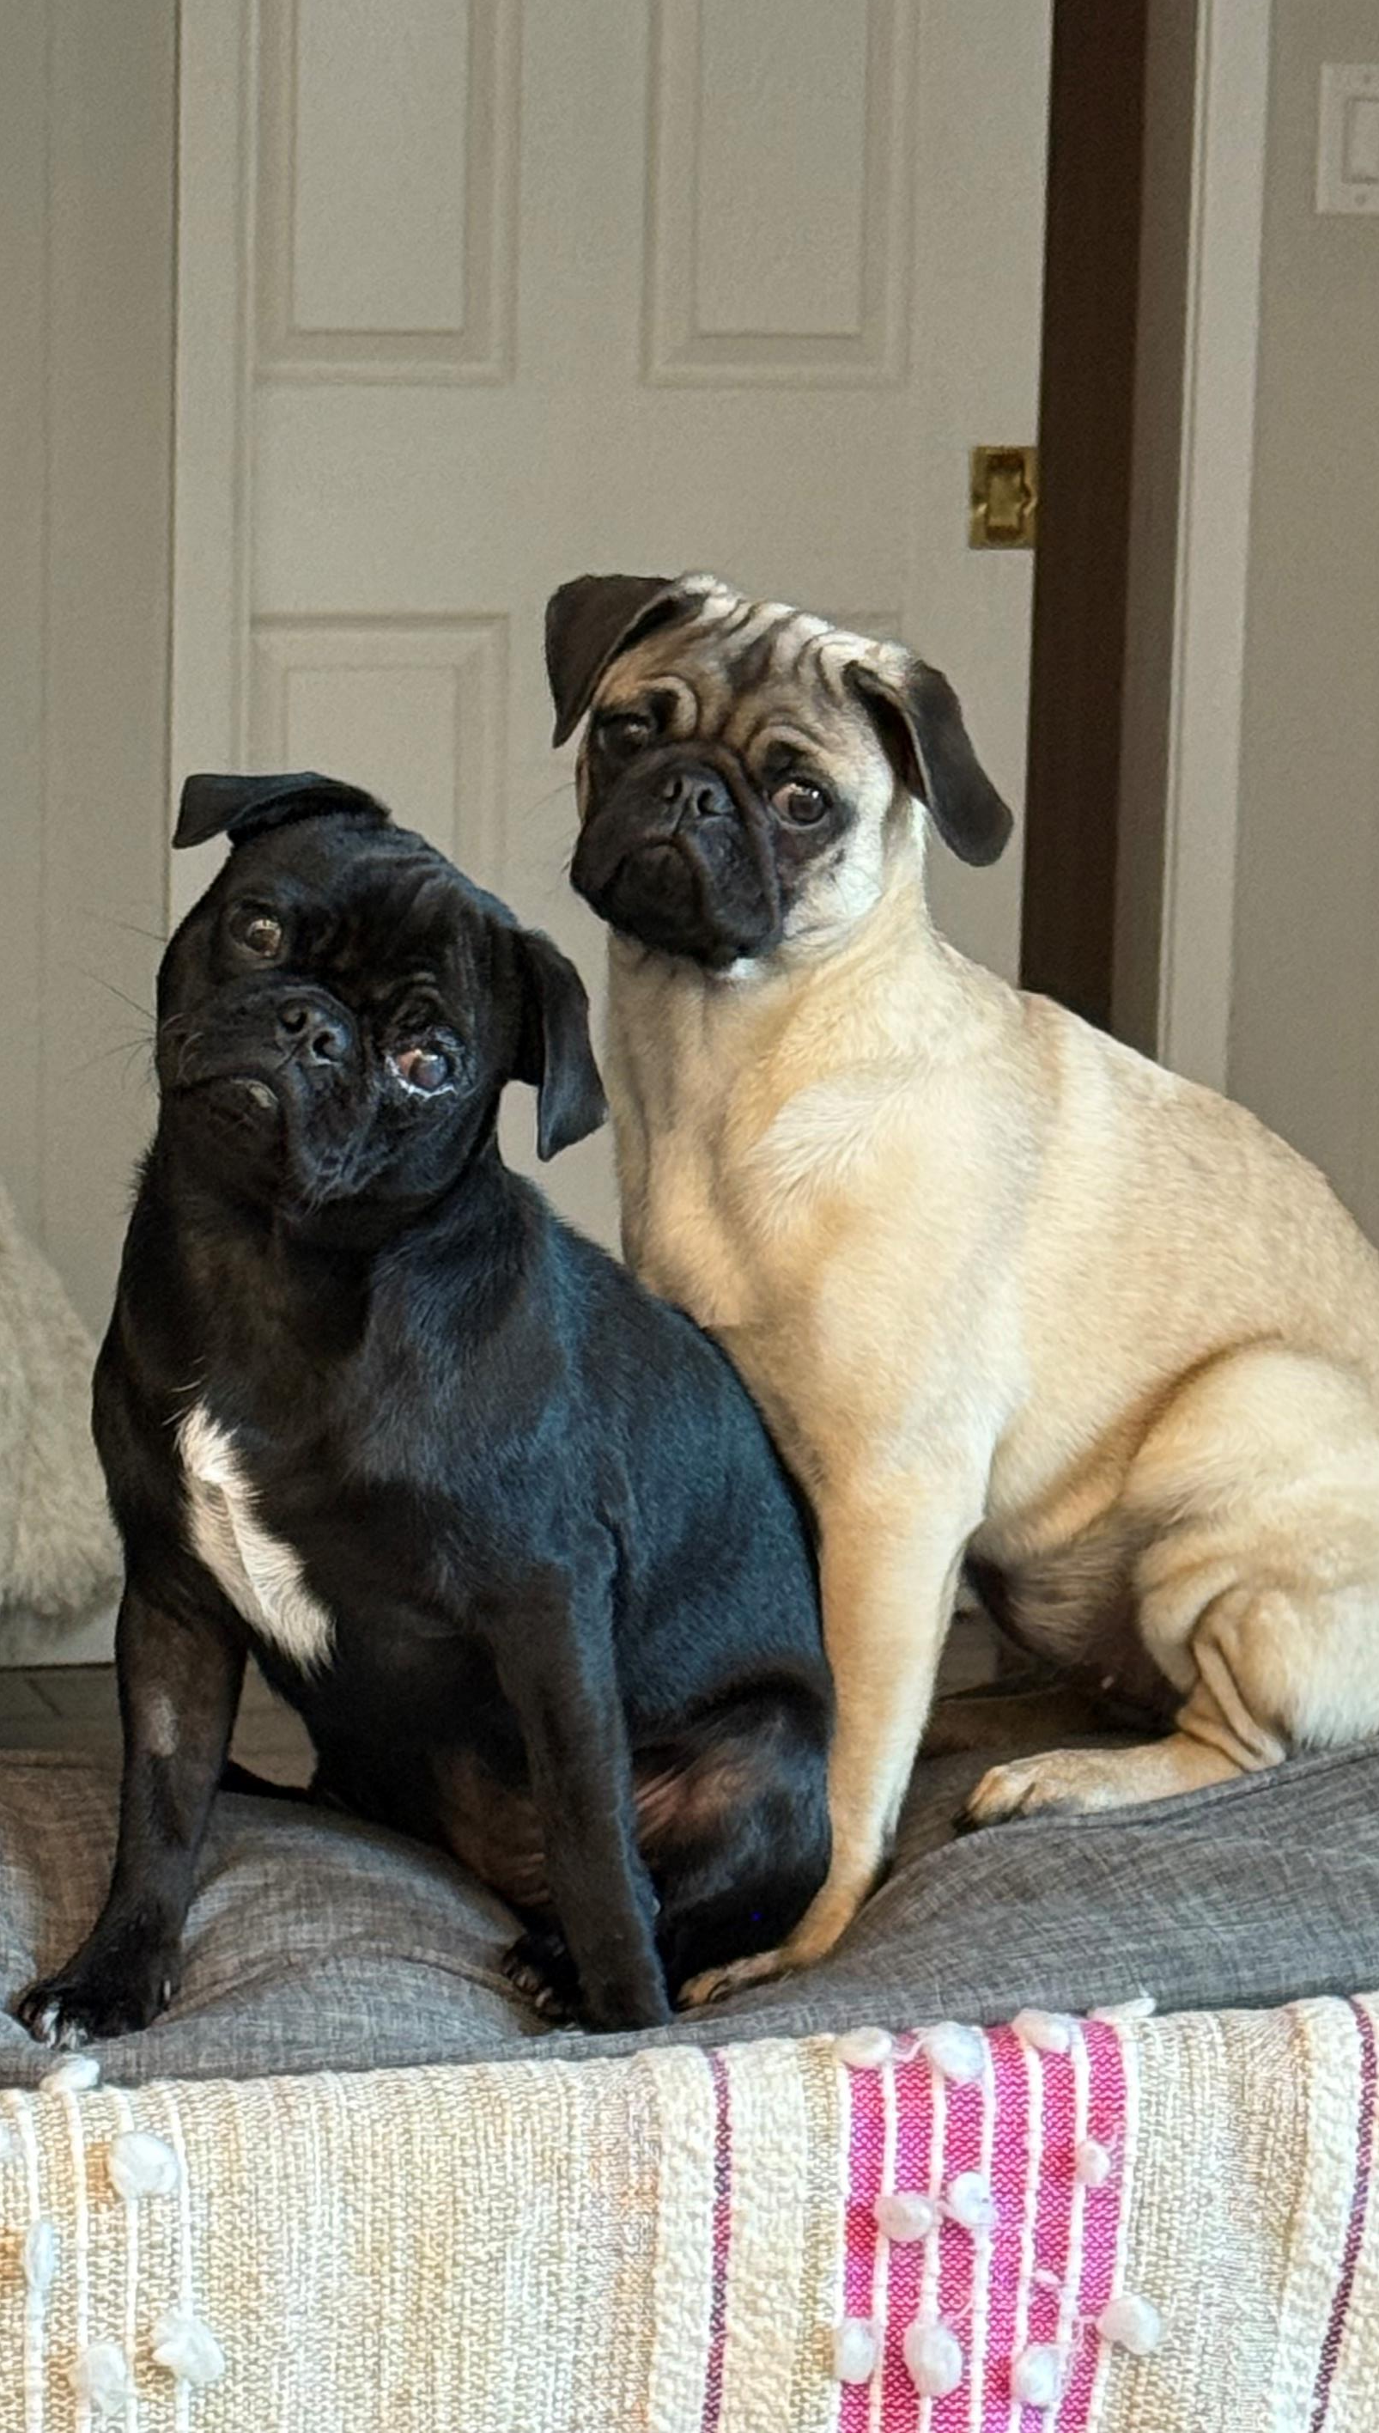

Peekaboo the Pug
October 31st - Peekaboo’s condition when she first arrived at the shelter was truly heartbreaking. She came in with a serious eye injury that put her eye at risk. But thanks to the dedicated care of the KCAS Medical Staff, this sweet girl got exactly what she needed to heal.
Not long after her recovery began, Peekaboo went to a rescue organization, then into a foster home, which soon became her forever home!

Slide 27
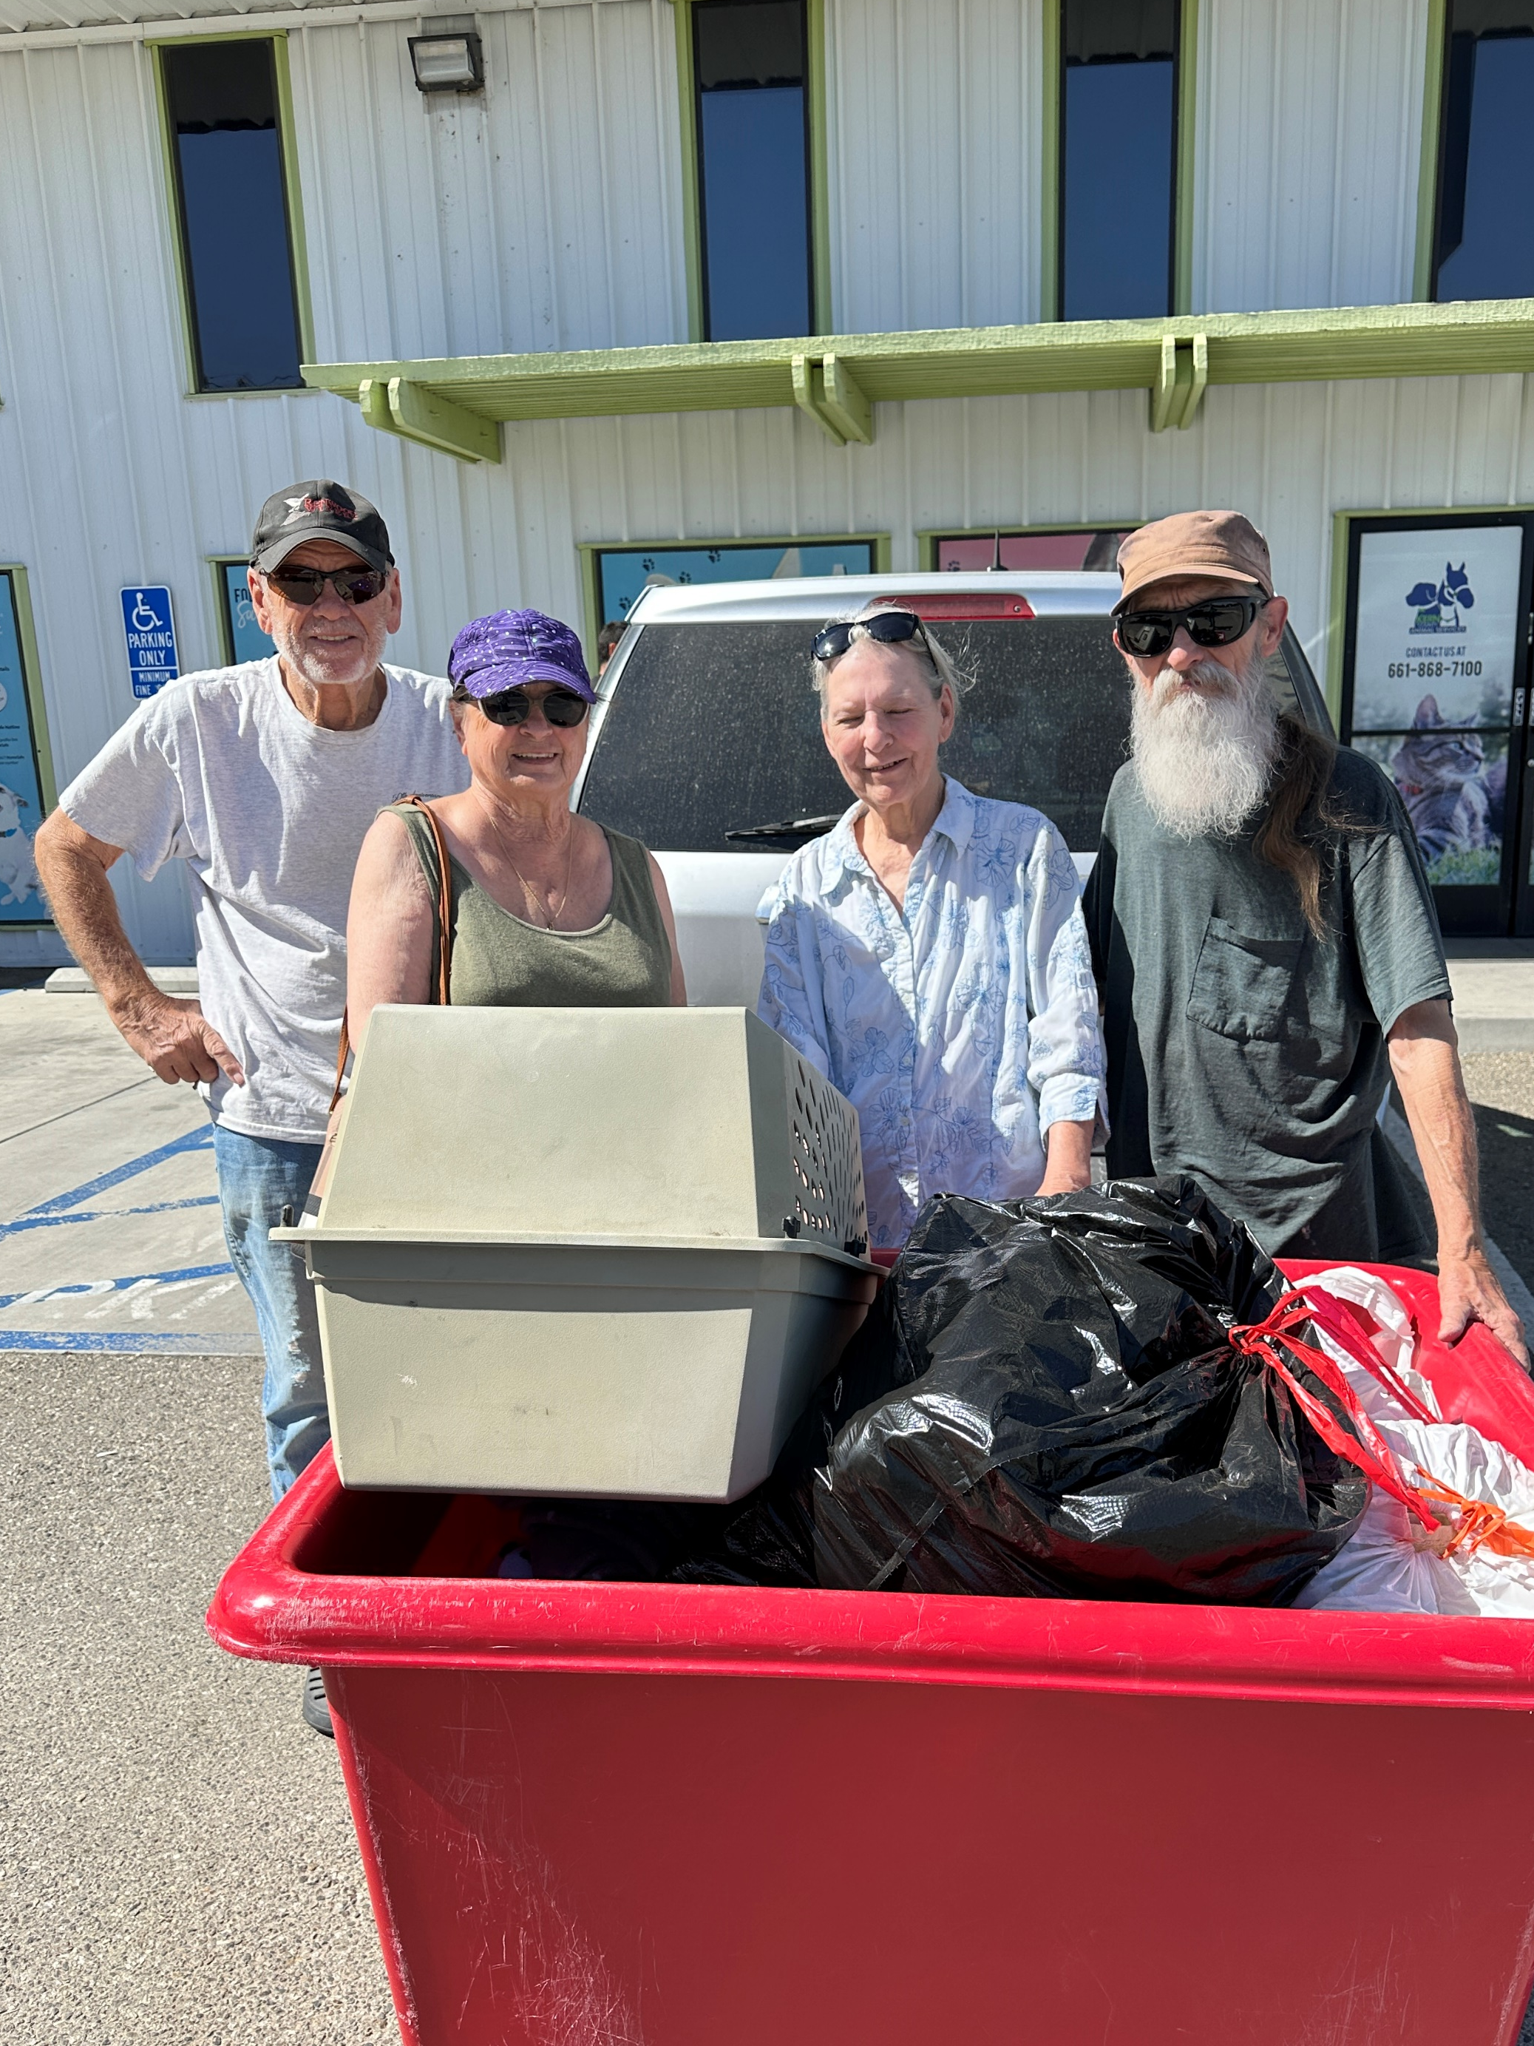
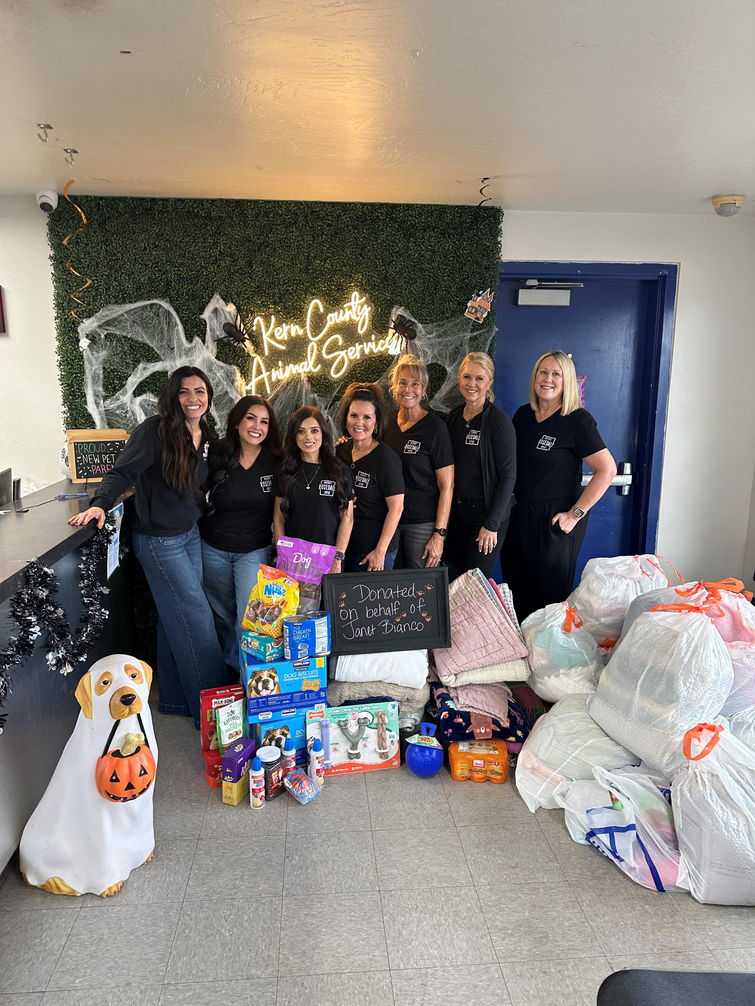
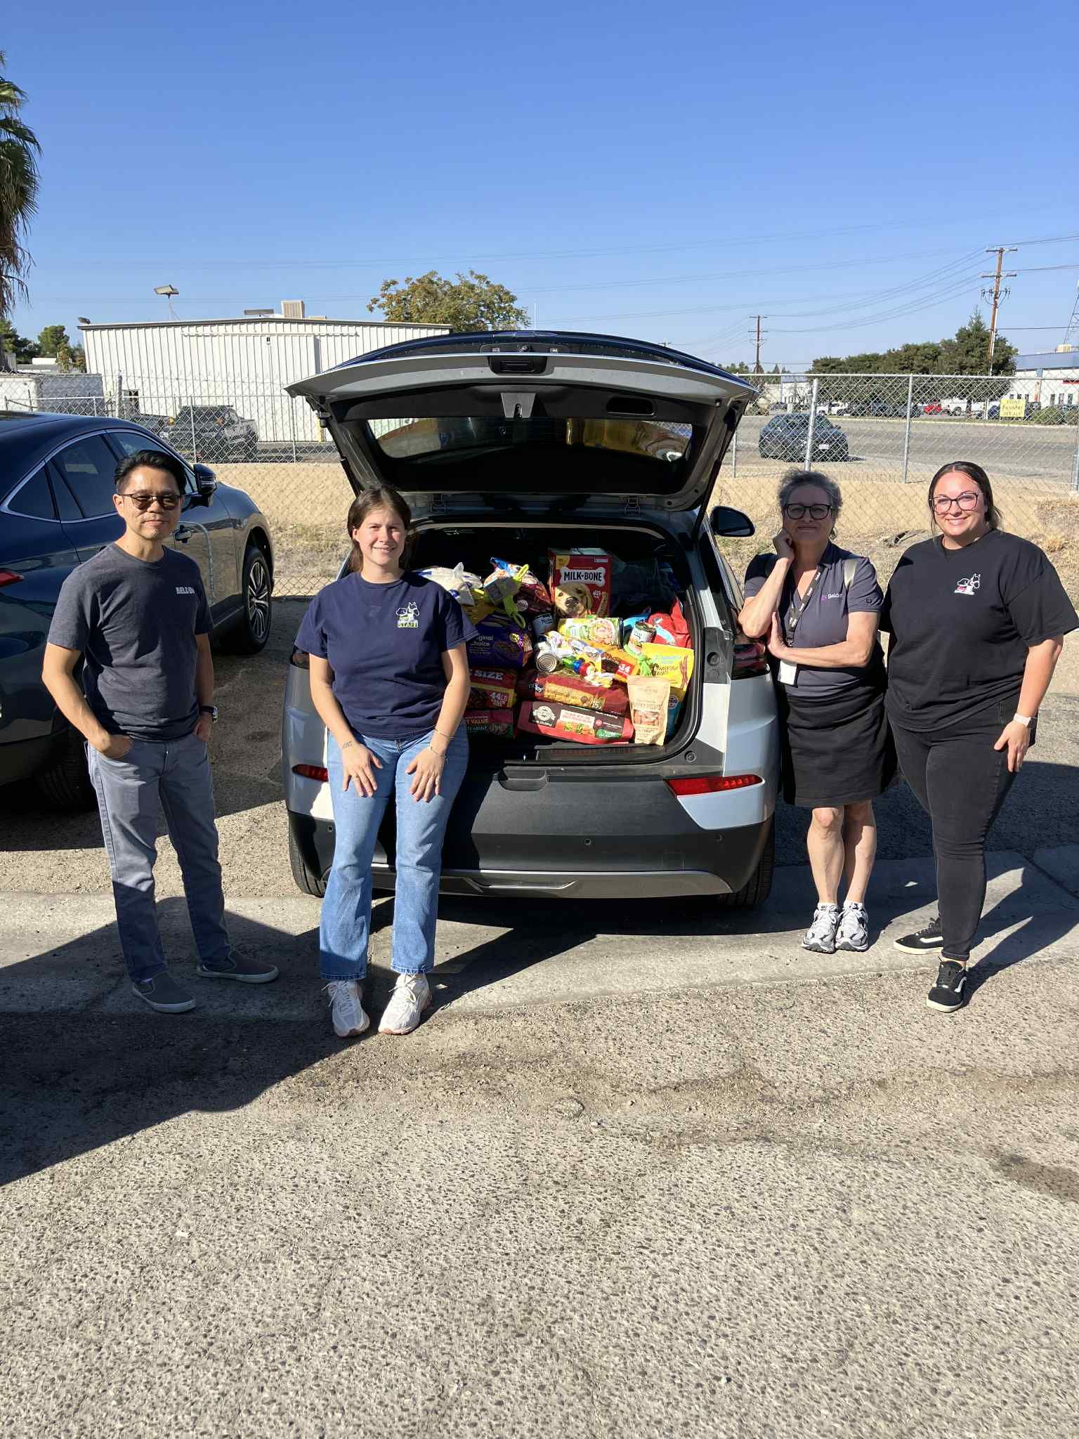
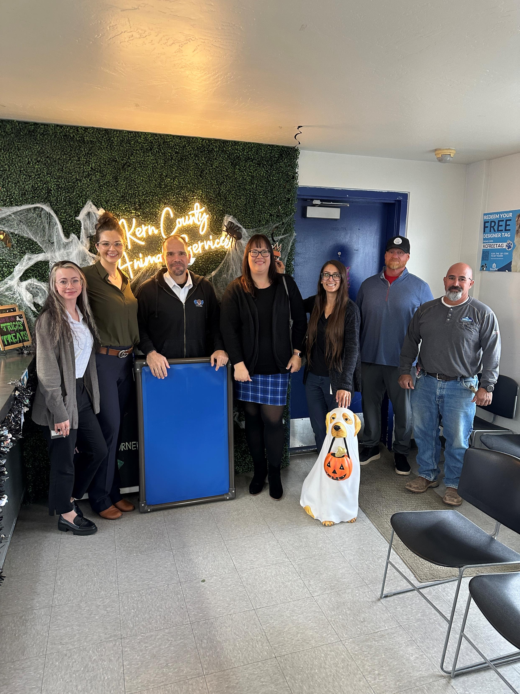
October Donations
Kern County Animal Services relies on the kindness of our community, and in October, several wonderful organizations and individuals stepped forward to help us continue caring for the animals who need us most.
To name just a few of the amazing donors who made a difference this month: Sentinel Peak Resources, Rosedale Union School District, Belden Inc., Cheryl & Bill, and Mike & Marie.
Your donations directly support the daily care, comfort, and wellbeing of our shelter pets. We truly couldn’t do this work without compassionate people like you standing beside us.
Our entire team thanks you for making a difference.

Slide 28
2025 Year To Date January 1st – October 31st
4,308
Adoptions
3,315
Rescued
628
Returned To Owner
7,325
Spay/Neuter Surgeries
10,394
Total Lives Saved
79.55%
Save Rate

Slide 29
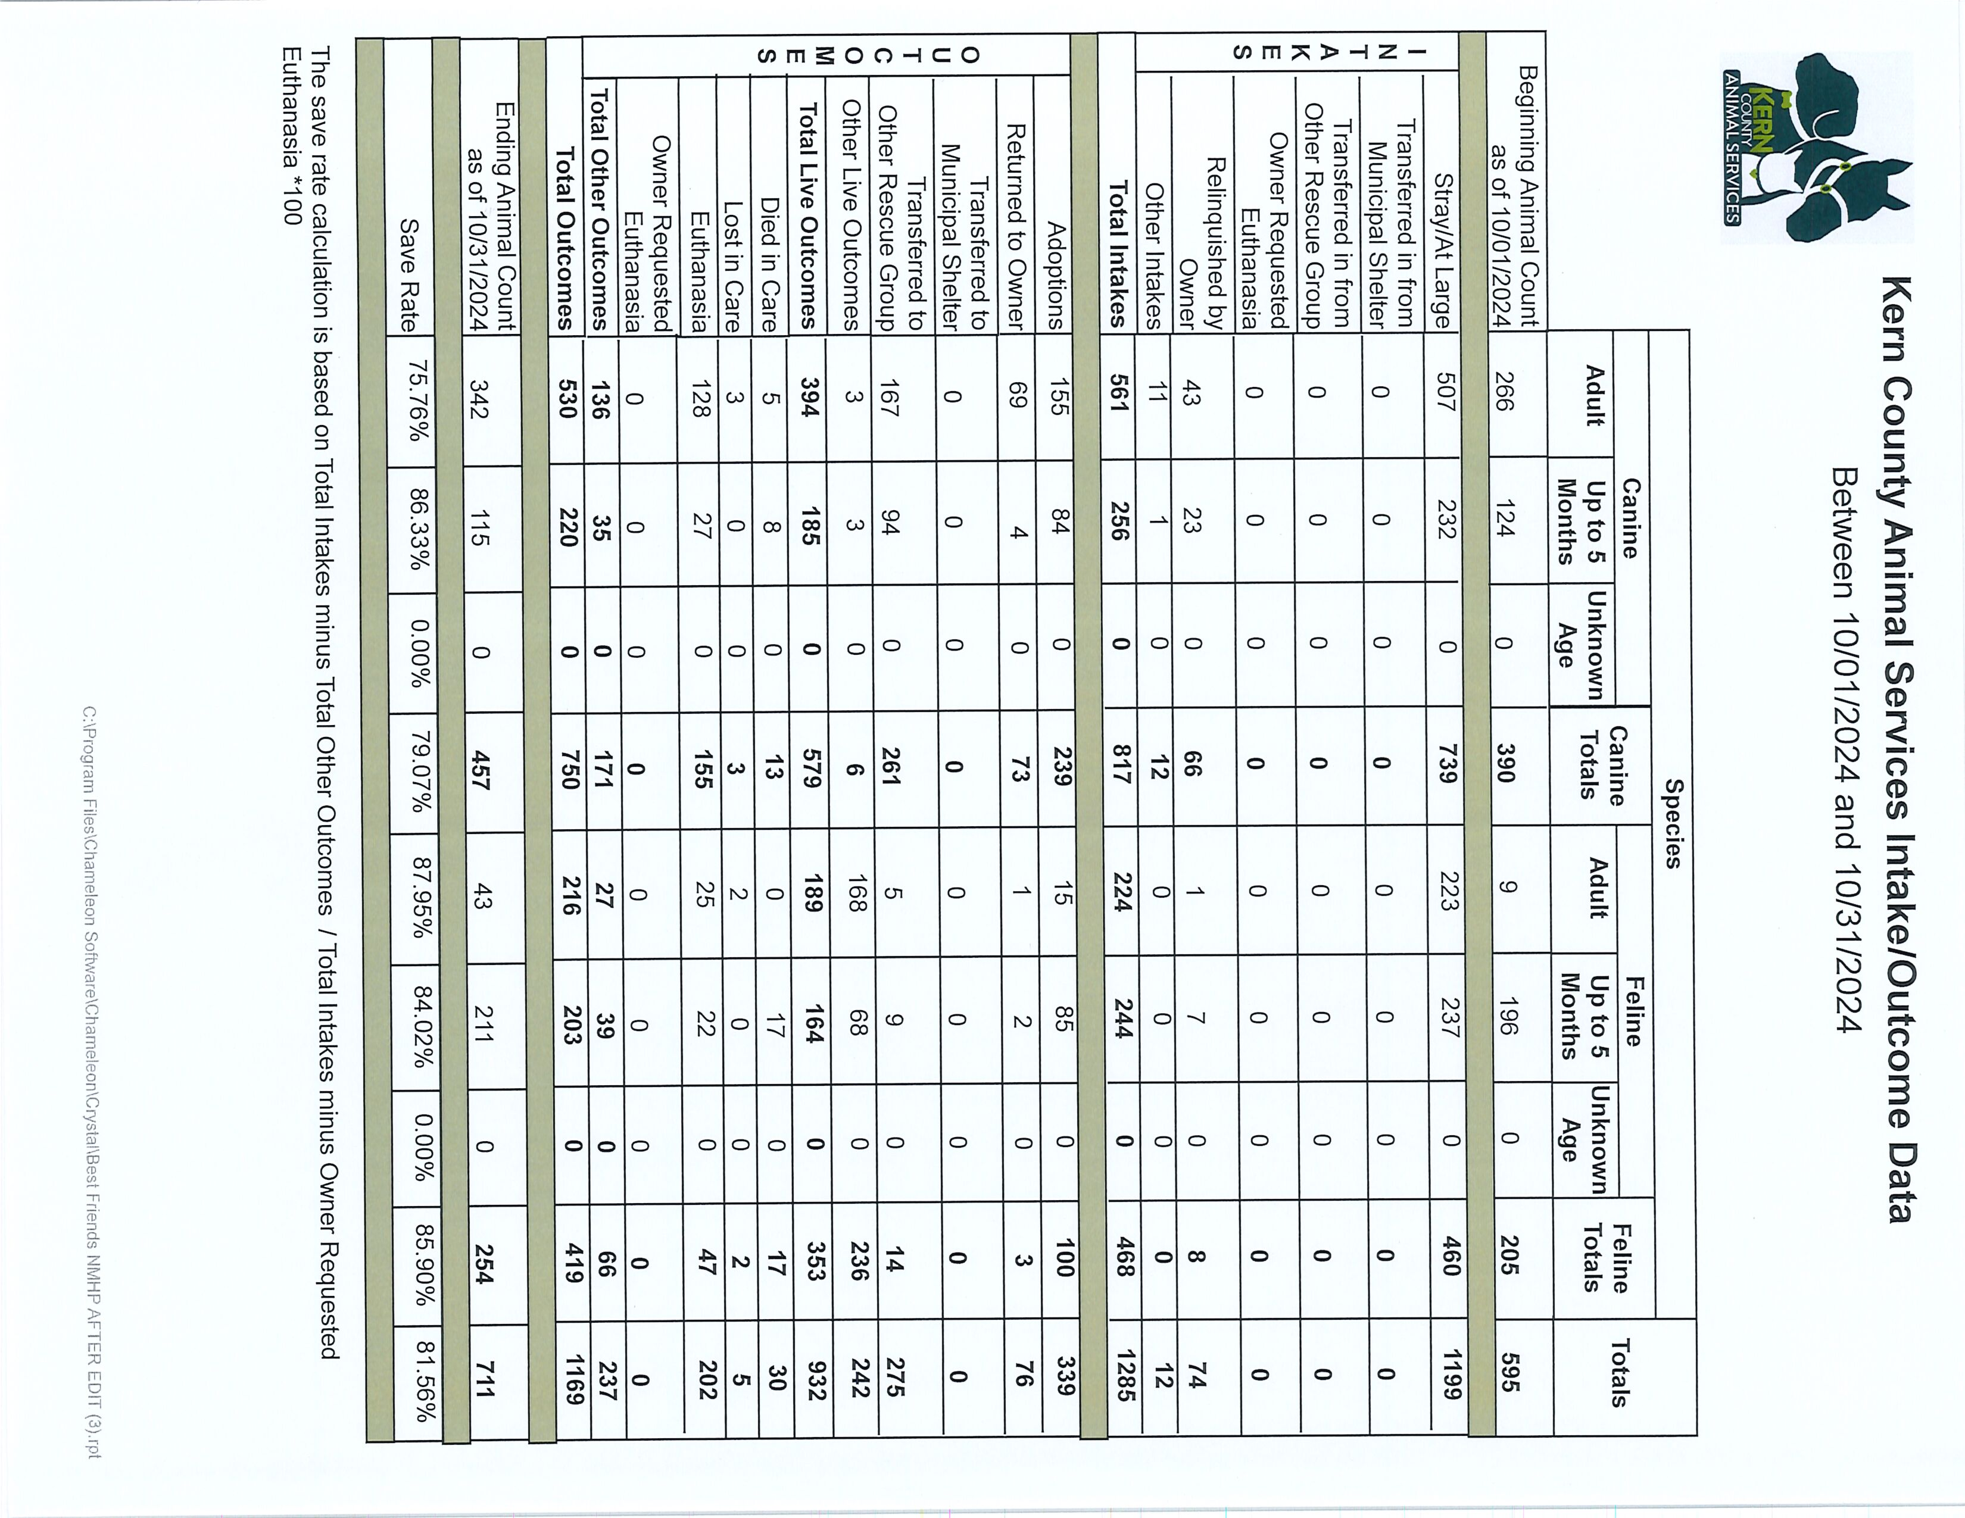

Slide 30
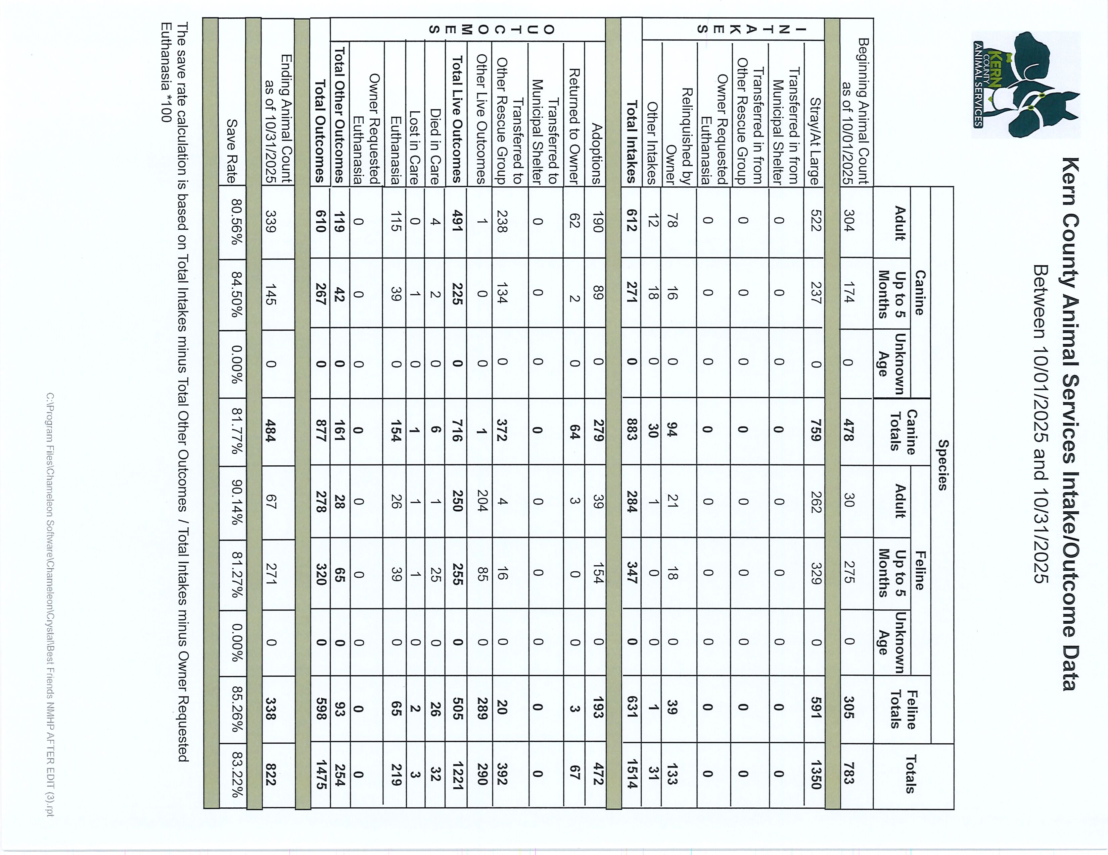

Slide 31
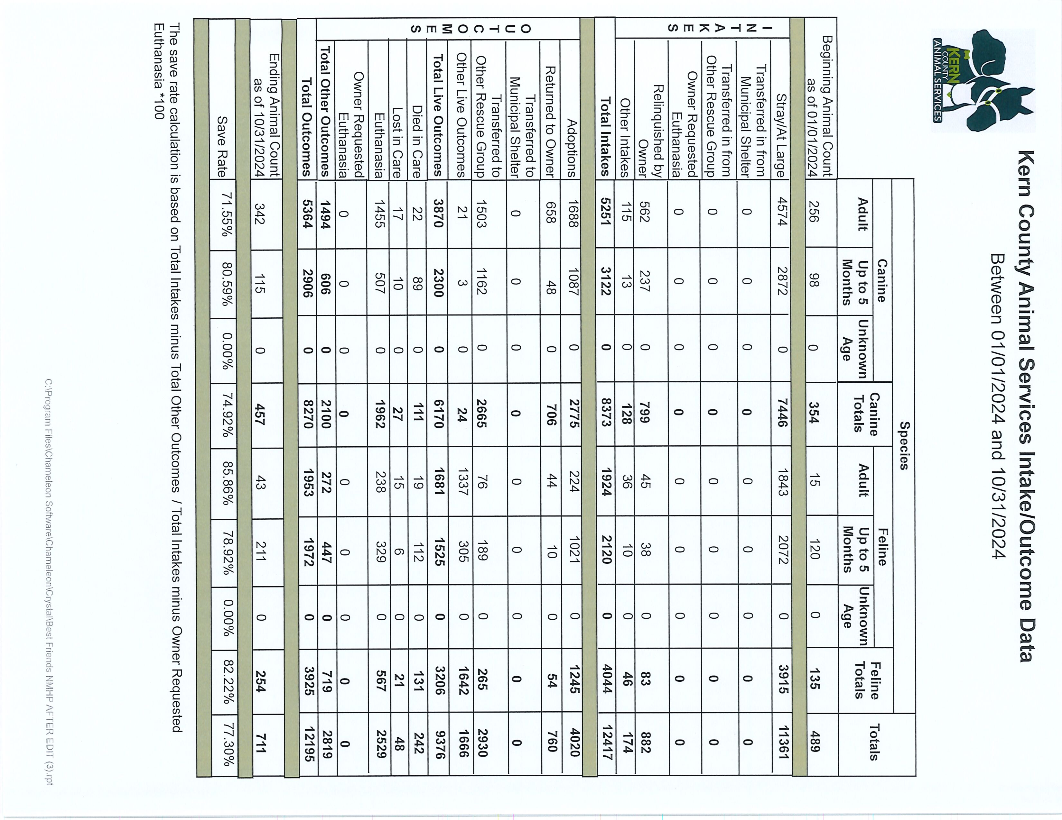

Slide 32
