Slide 1






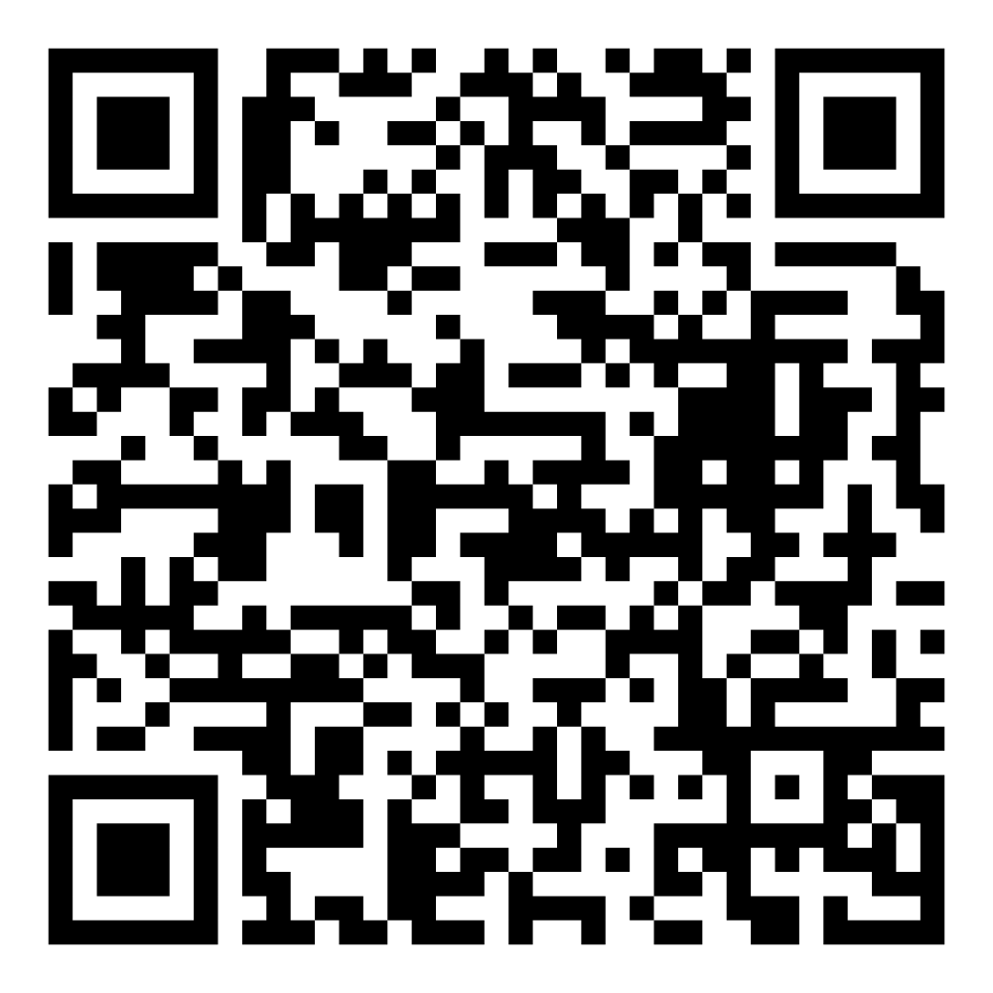
Director’s Report
November & December 2025

Slide 2

Program Highlights
November & December 2025
Adoption: 315 dogs, 196 puppies, 78 cats, and 273 kittens under 5 months of age were adopted for a total of 862 animals adopted from Kern County Animal Shelters in the months of November and December.
Foster: 93 dogs, 92 puppies, 4 cats, and 110 kittens entered the Department’s Foster Care Program in November and December, for a total of 299 animals.
Rescue: 302 dogs, 291 puppies, 33 cats, and 31 kittens were transferred to other animal rescue organizations in November and December, for a total of 657 animals.
Spay/Neuter: A total of 981 animals were altered at low-cost KCAS spay/neuter clinics in the month of November and December.
TNR: 245 cats were spayed or neutered and released in November and December. Year-to-date, 2,370 cats have gone through the program, and since 2013 24,042 cats have been spayed or neutered and returned to field.

Slide 3

Mega Adoption Event 2025
November 8th - The Mega Adoption Event once again proved to be the Southern San Joaquin Valley’s biggest pet adoption event! Families and animal lovers packed The Park at River Walk to meet adoptable pets from over 20 shelters and rescues and explore 30+ pet-related vendor booths offering supplies, services, and resources. It was a huge day for rescue, responsible pet ownership, and celebrating our local pet community!
Over 70 pets found their new forever homes!

Slide 4
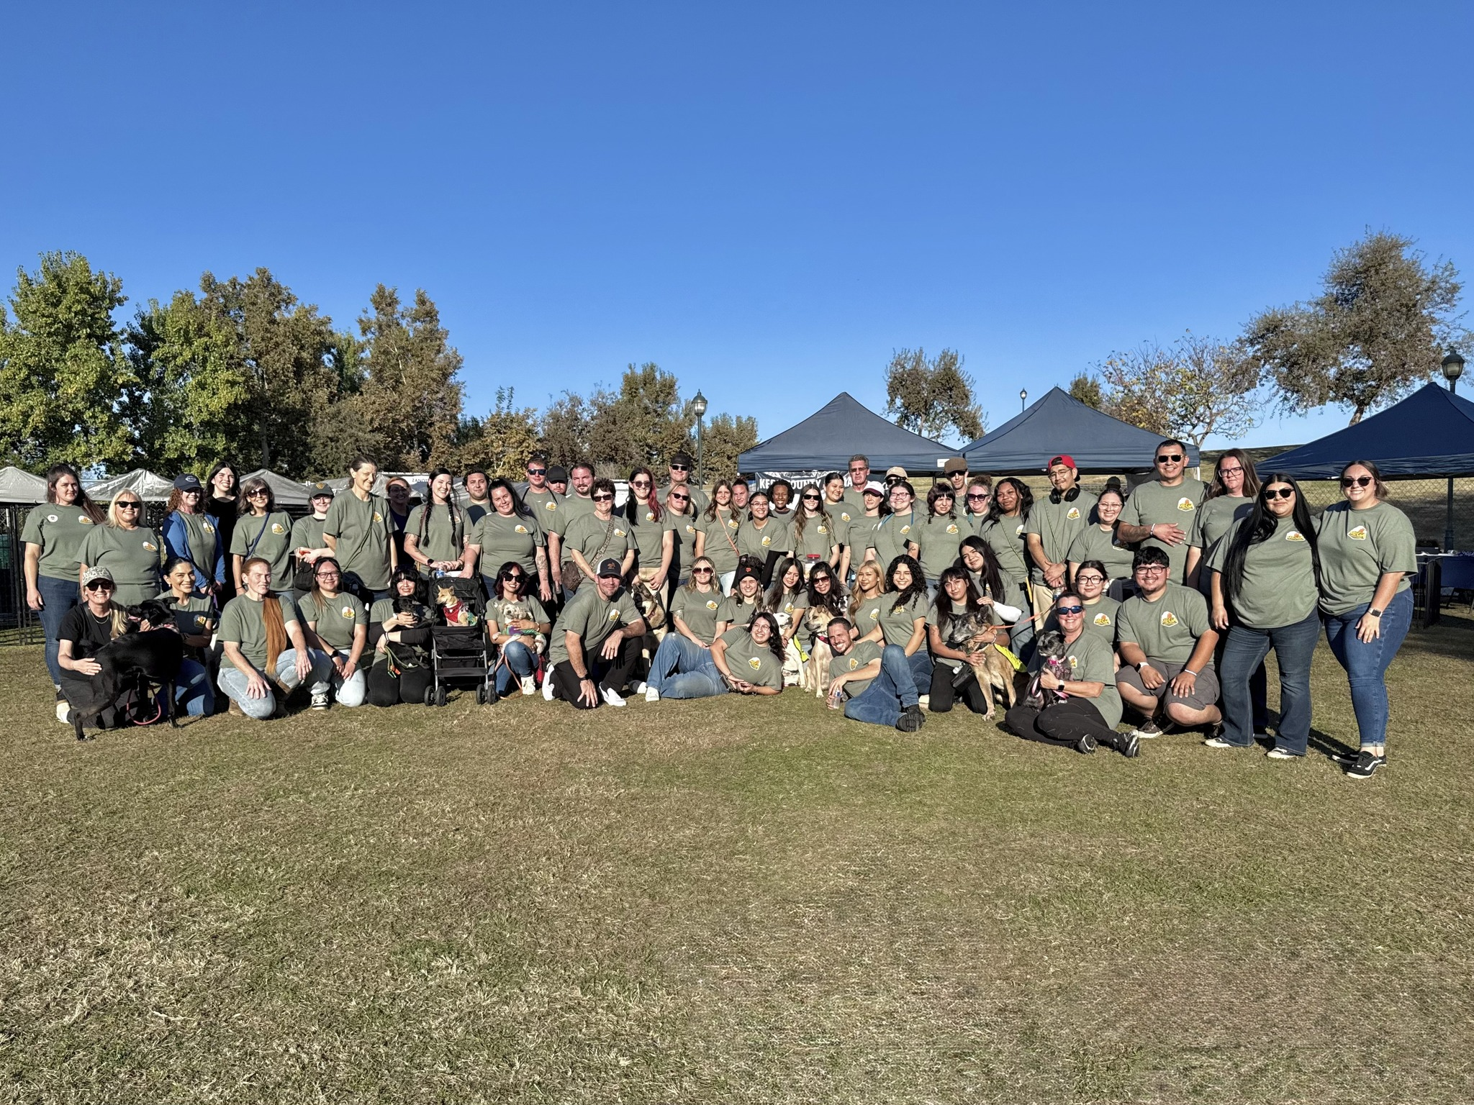
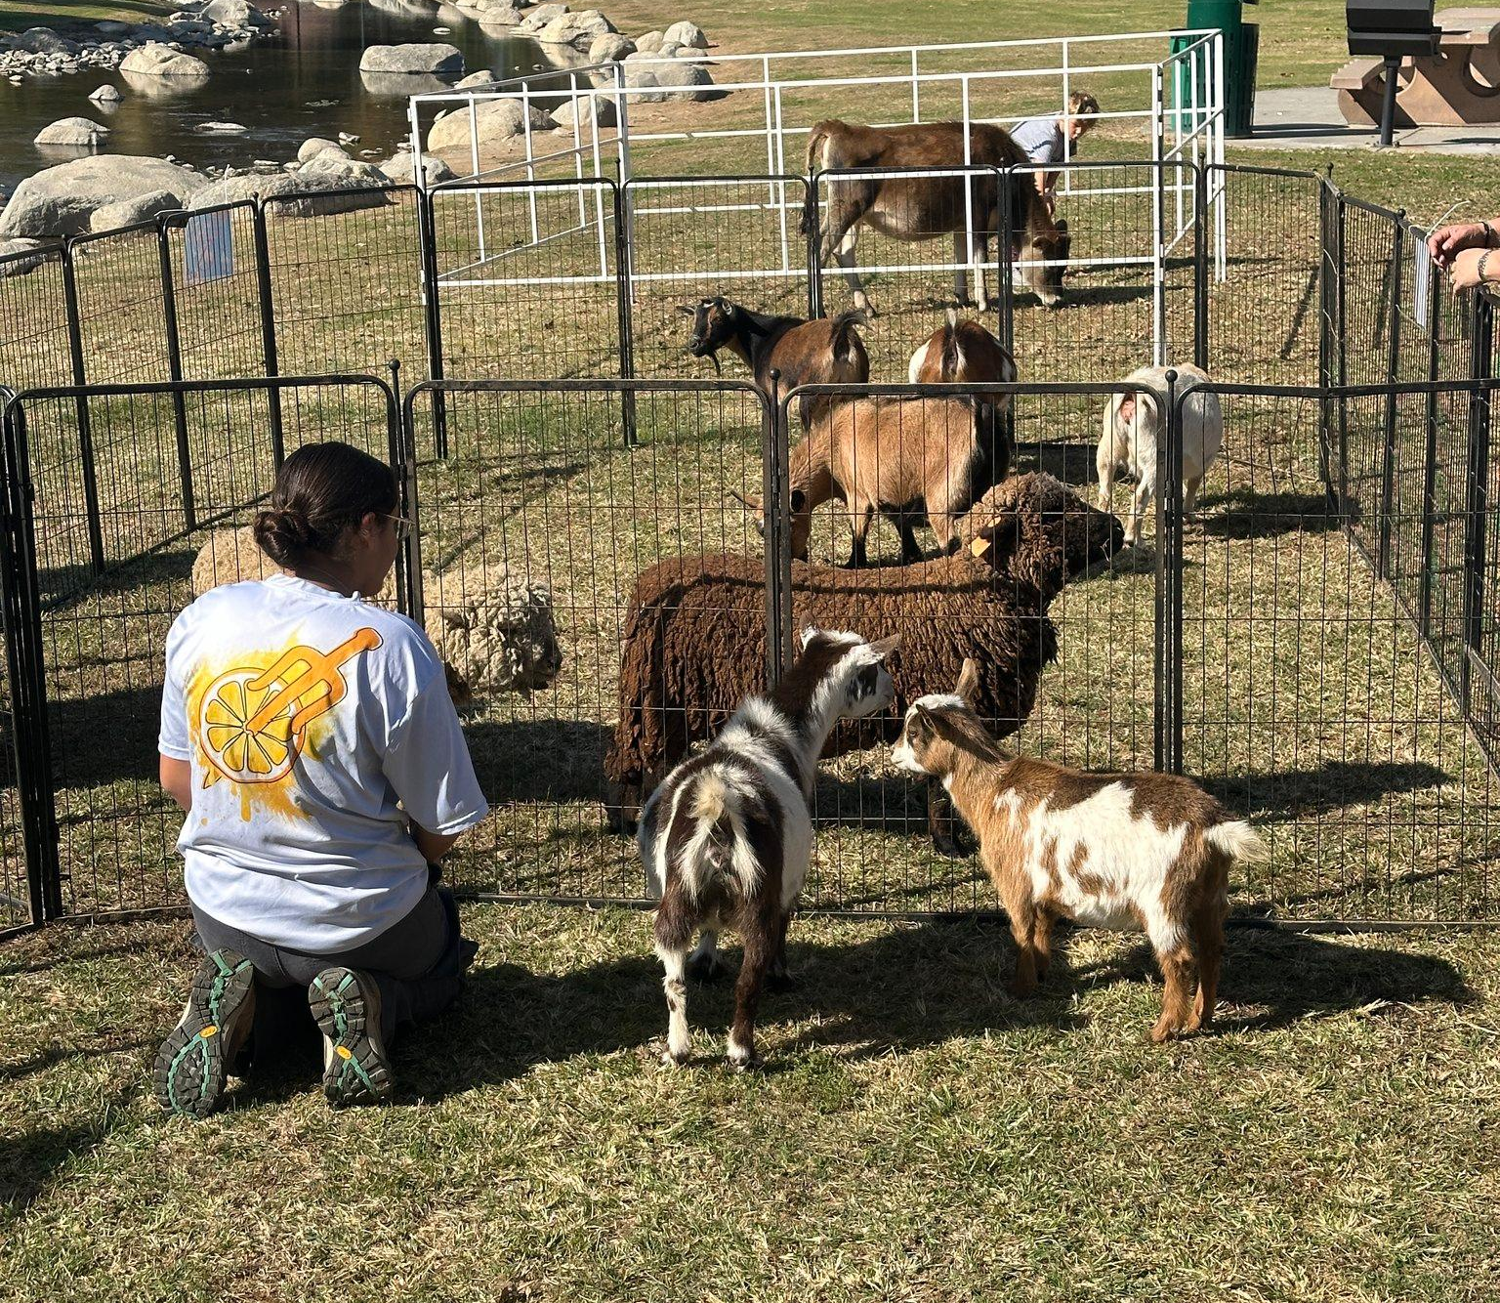
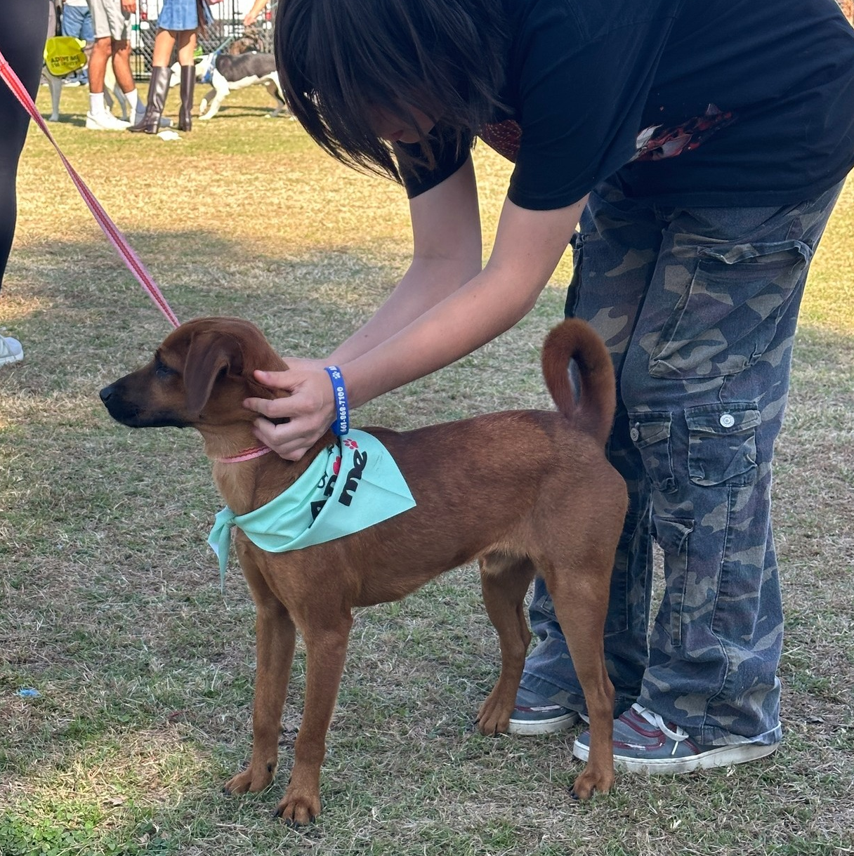
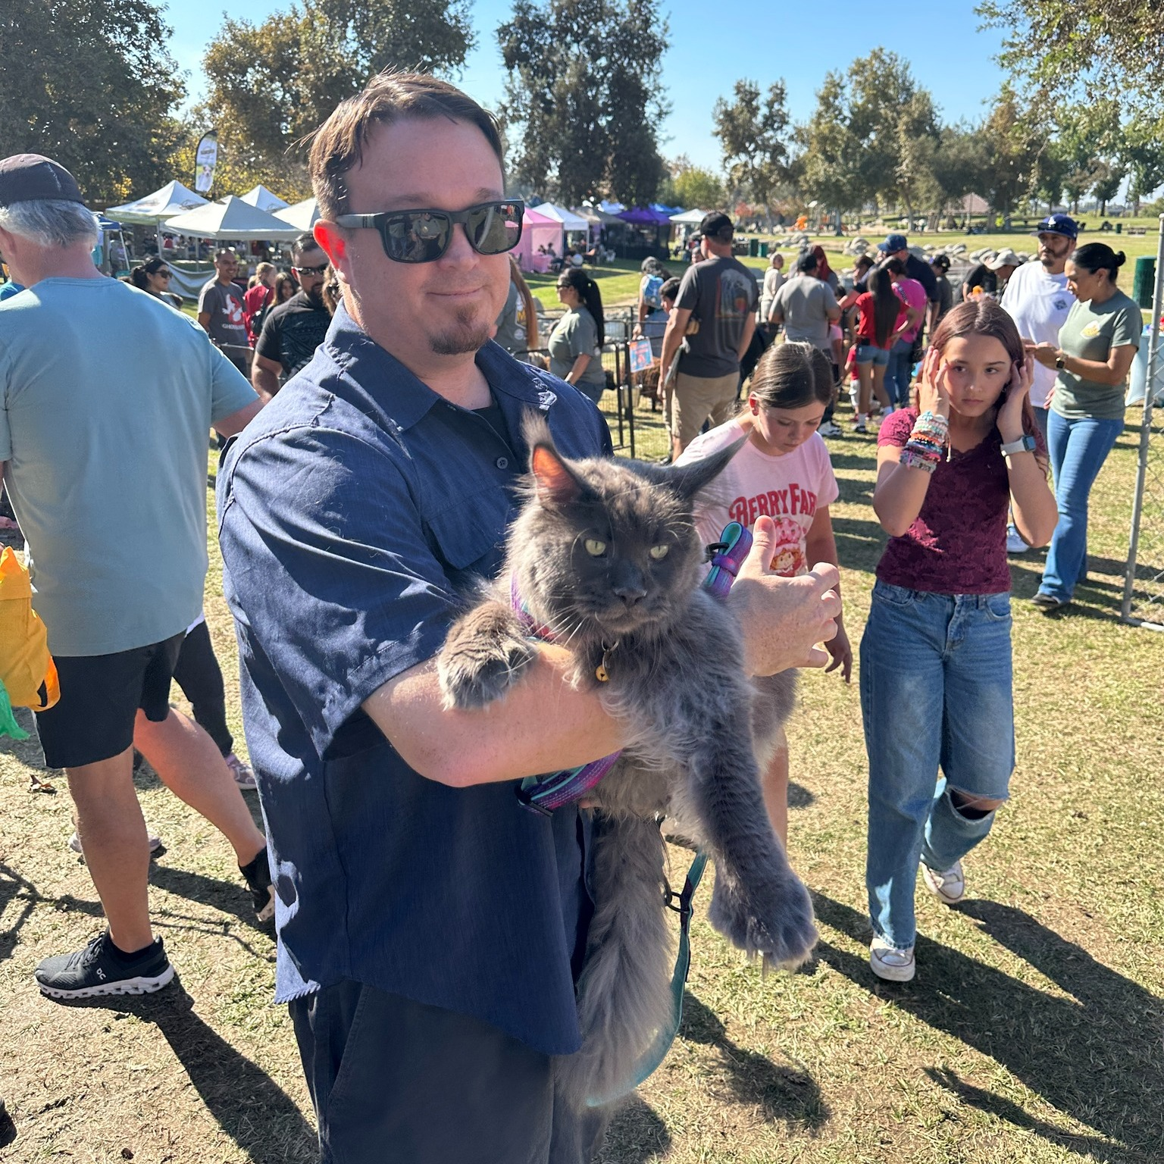
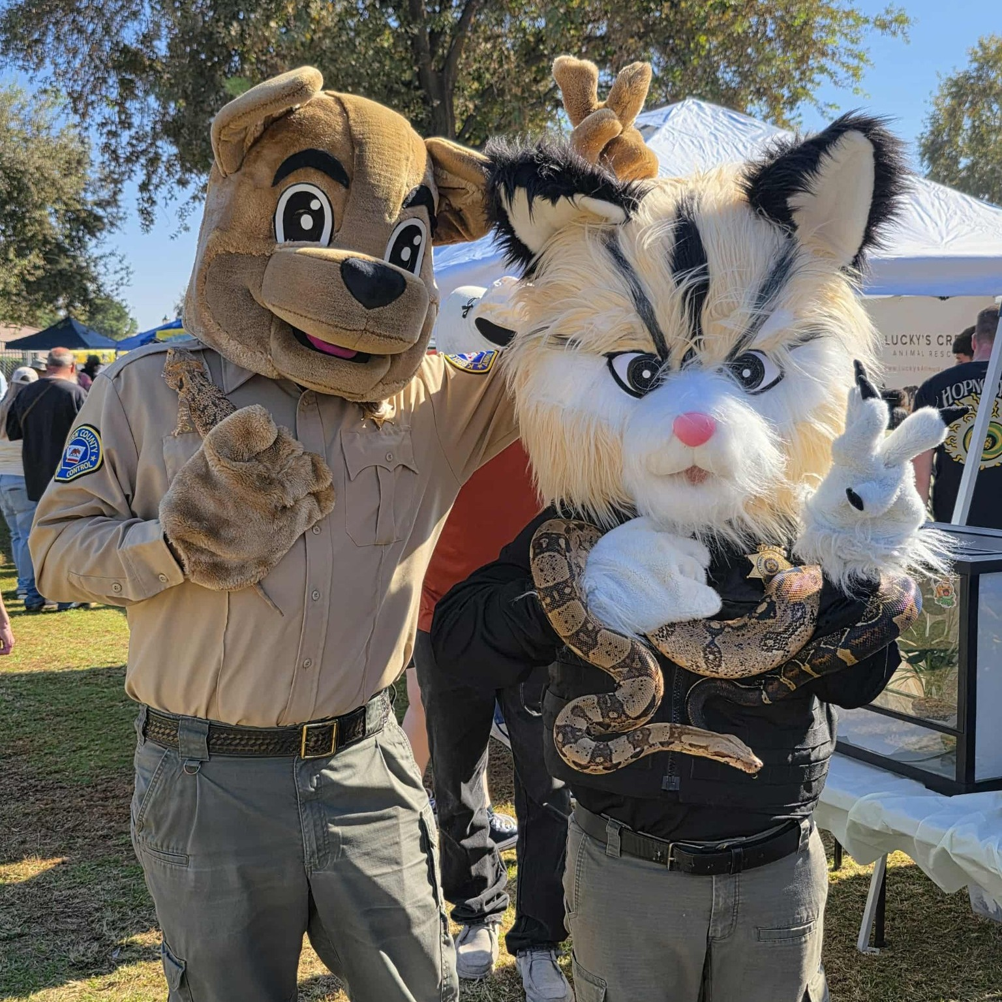

Slide 5
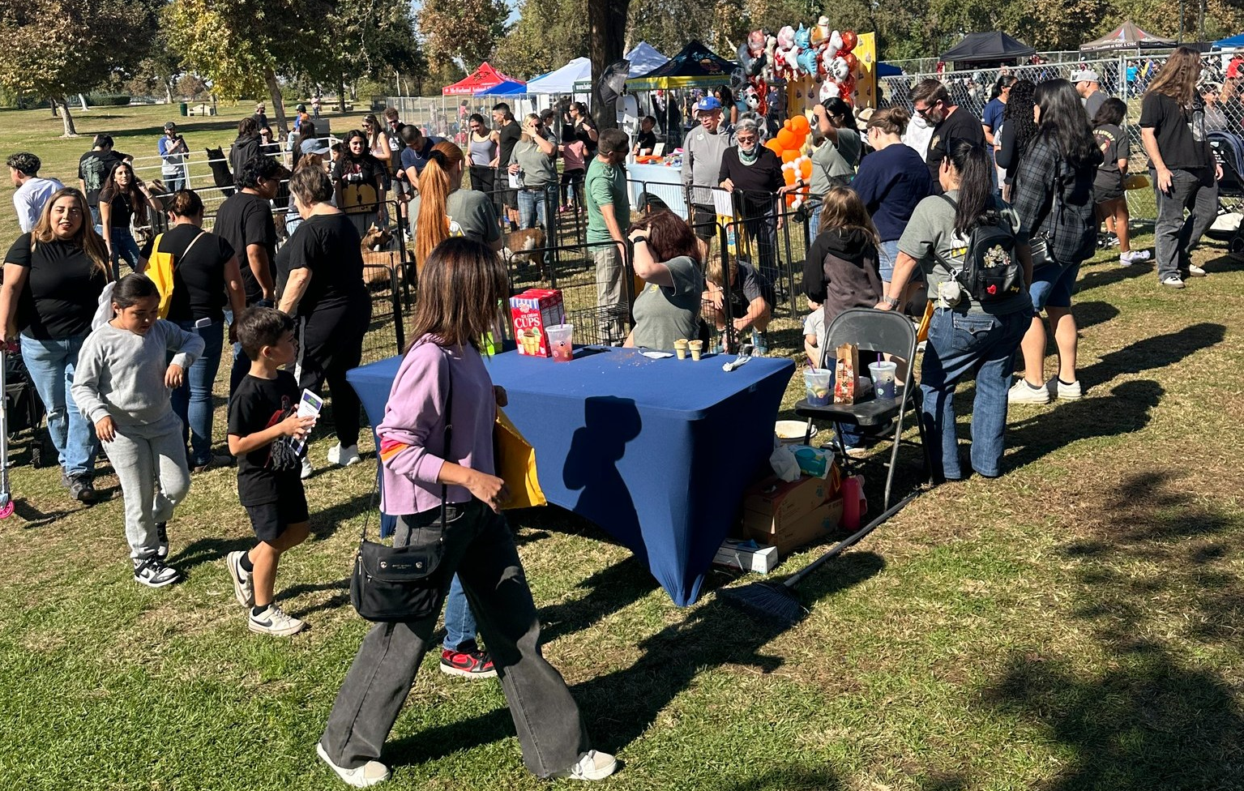
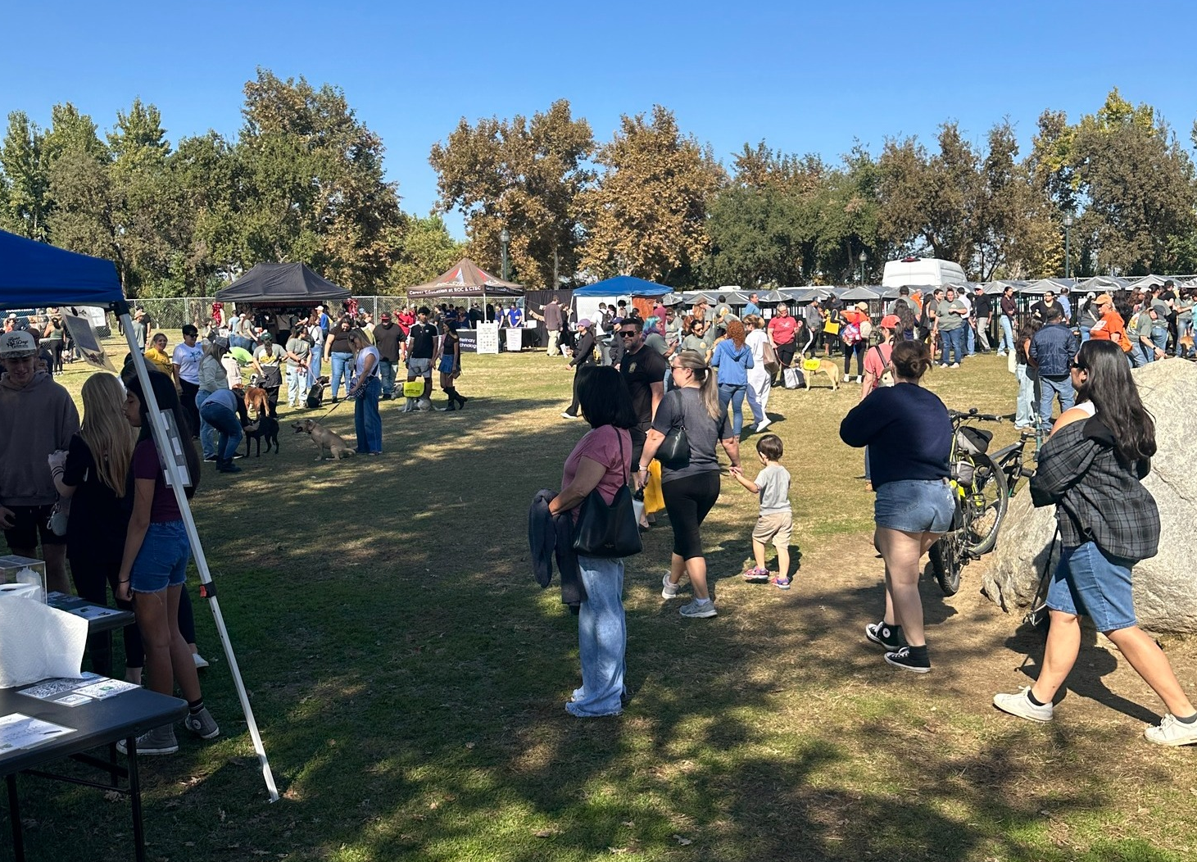
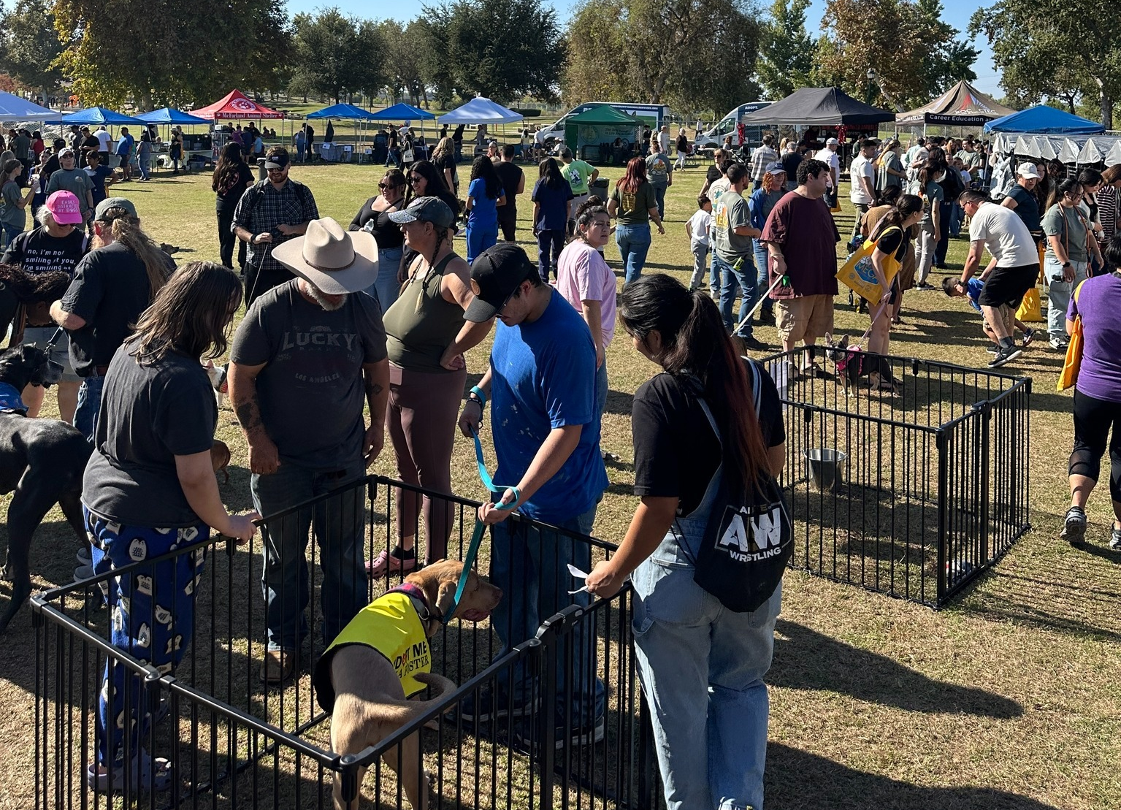
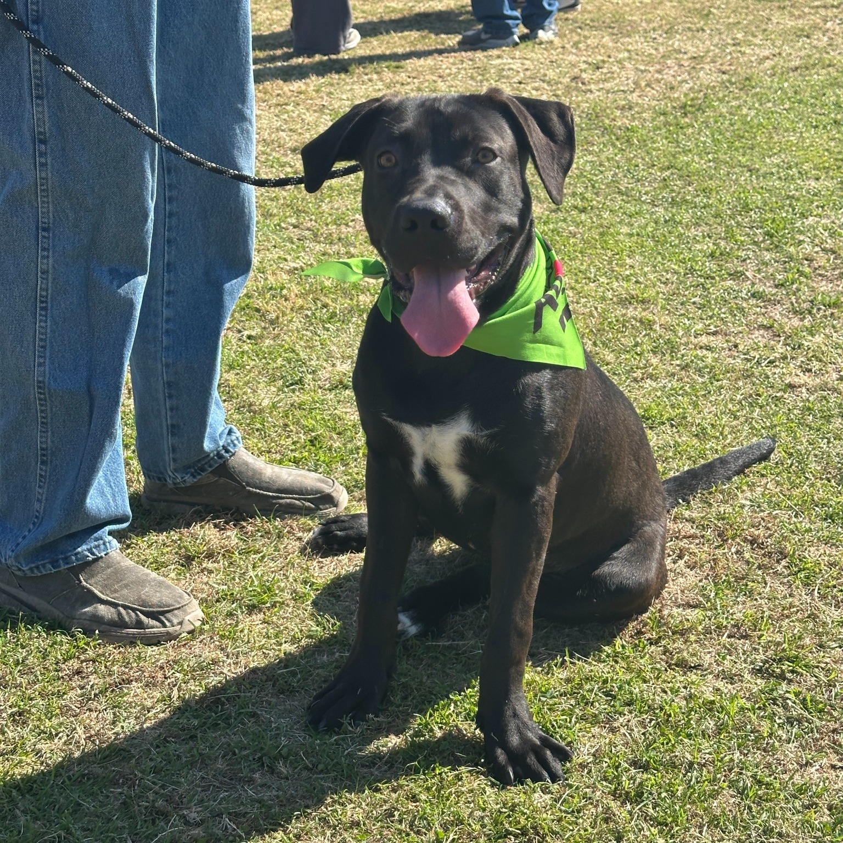
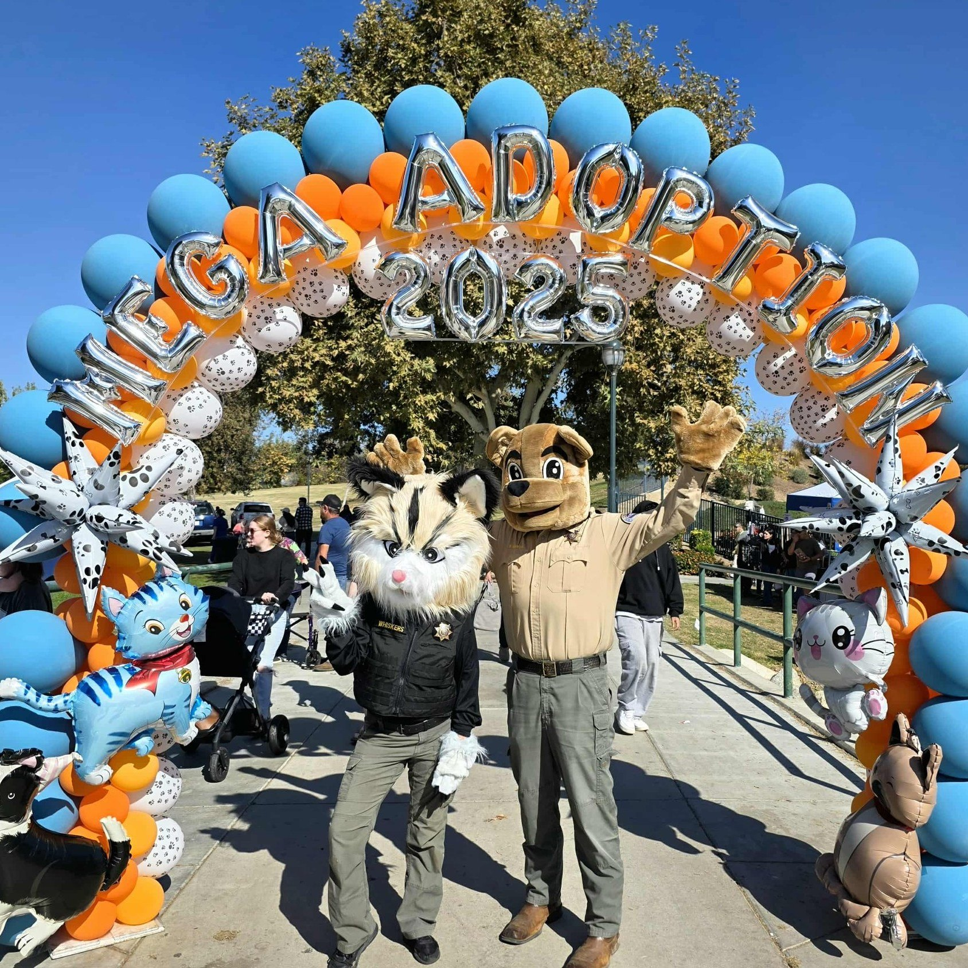
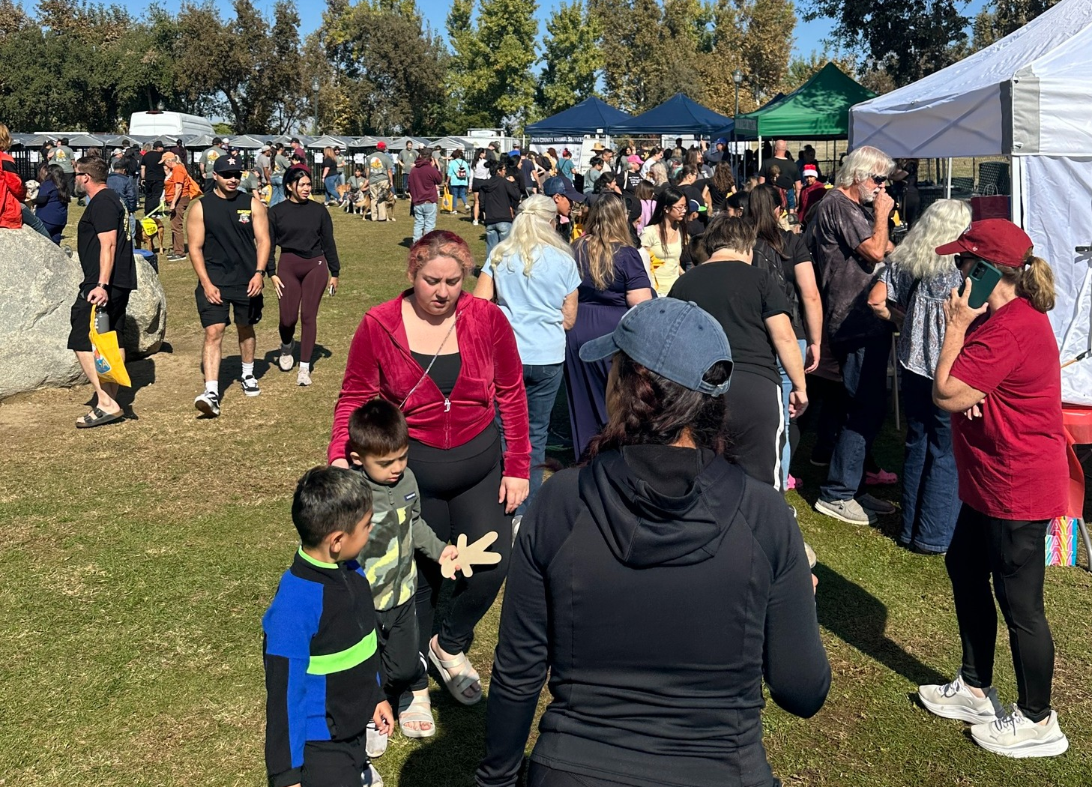

Slide 6
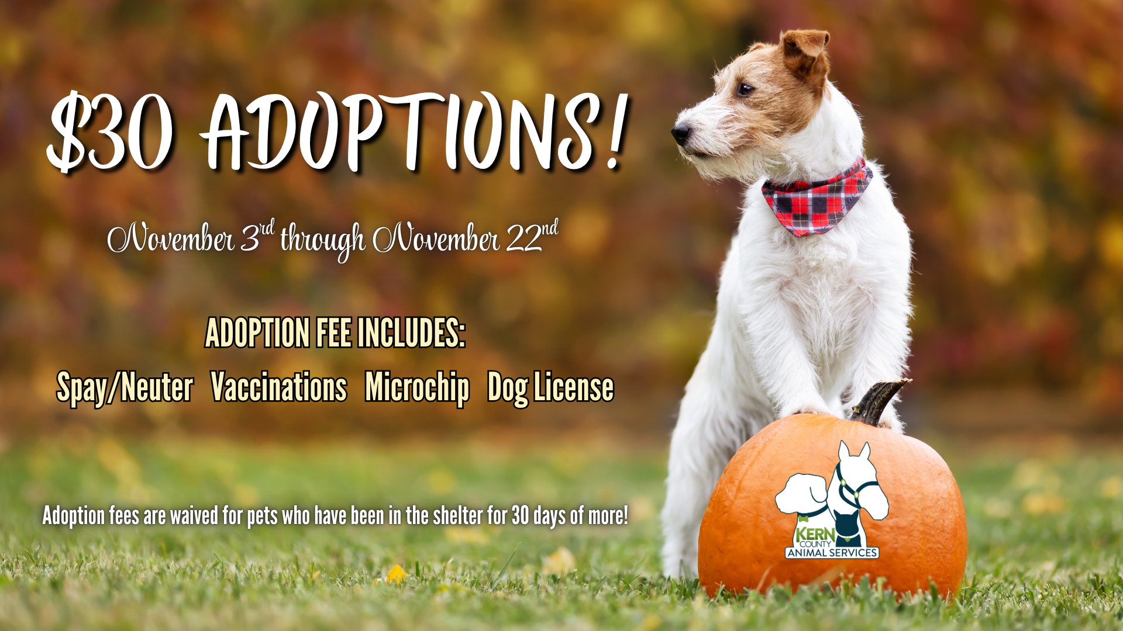
November Adoptions

Slide 7
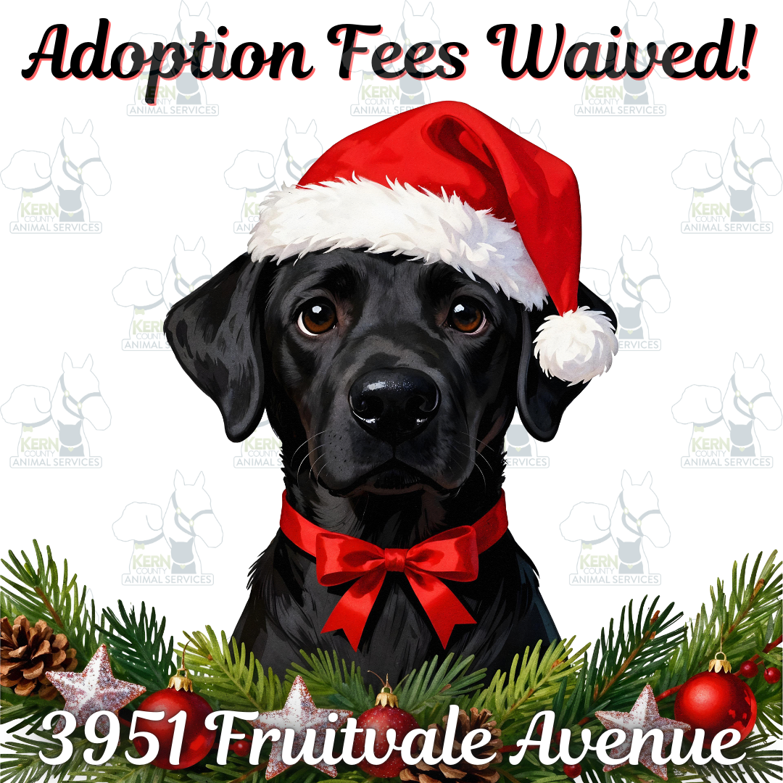
December Adoptions

Slide 8
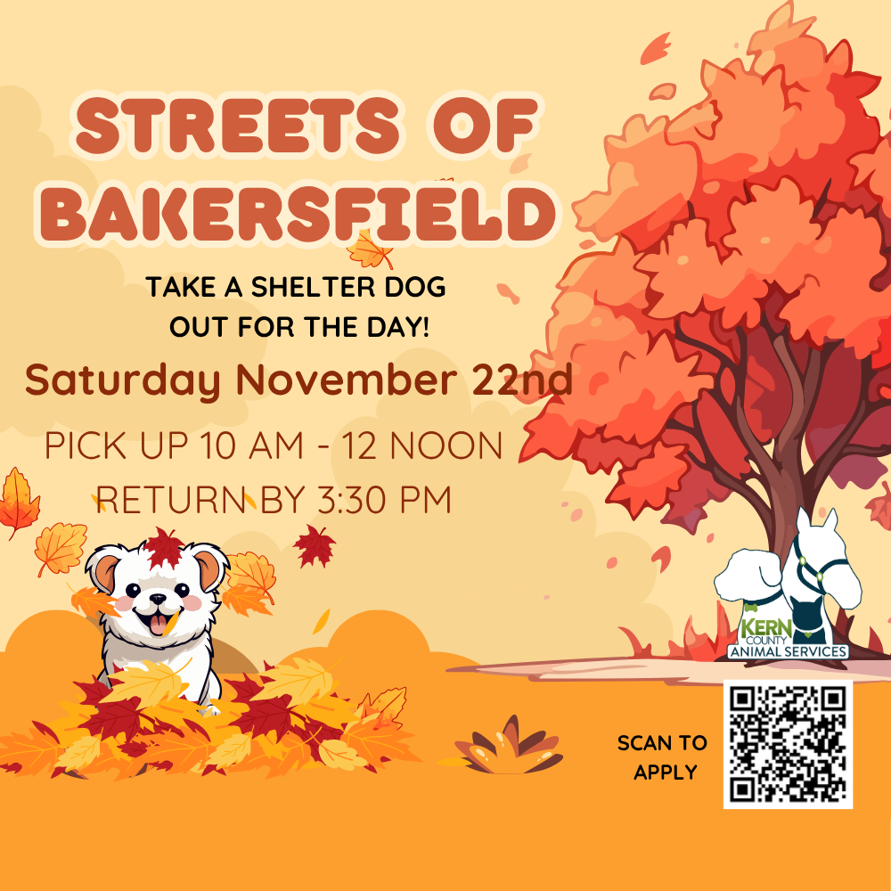

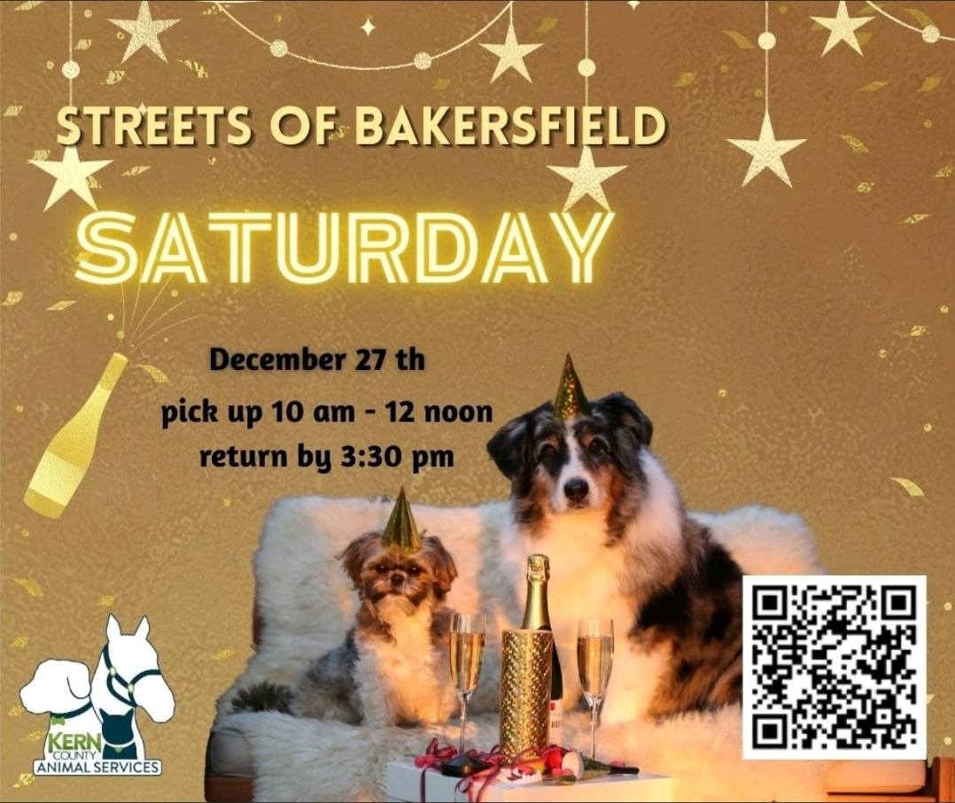
Streets of Bakersfield

Slide 9
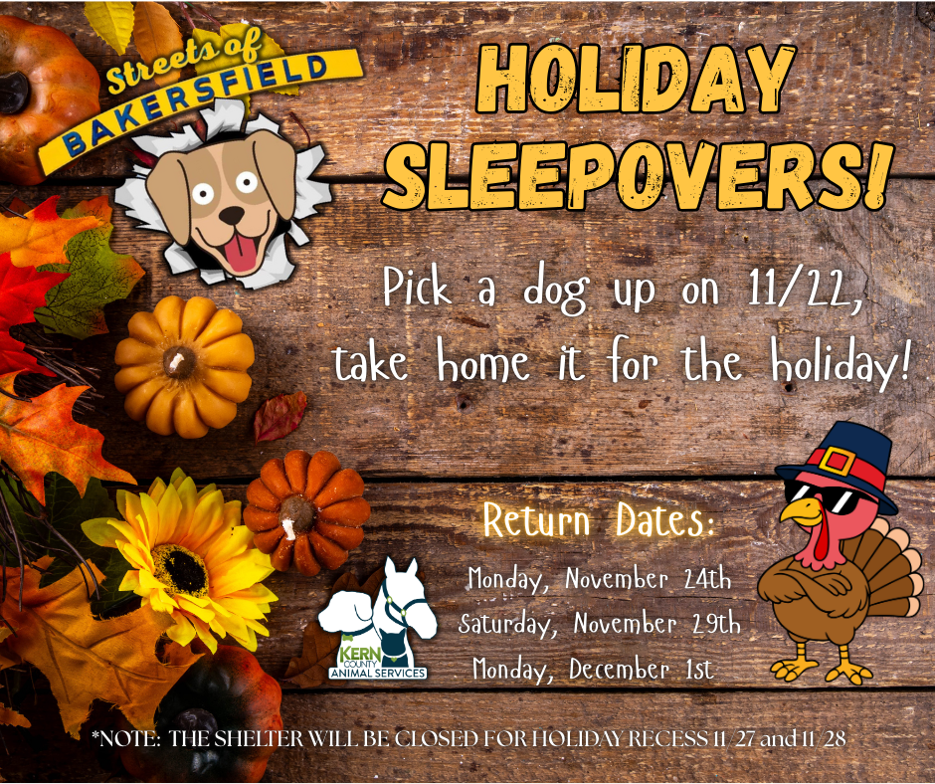
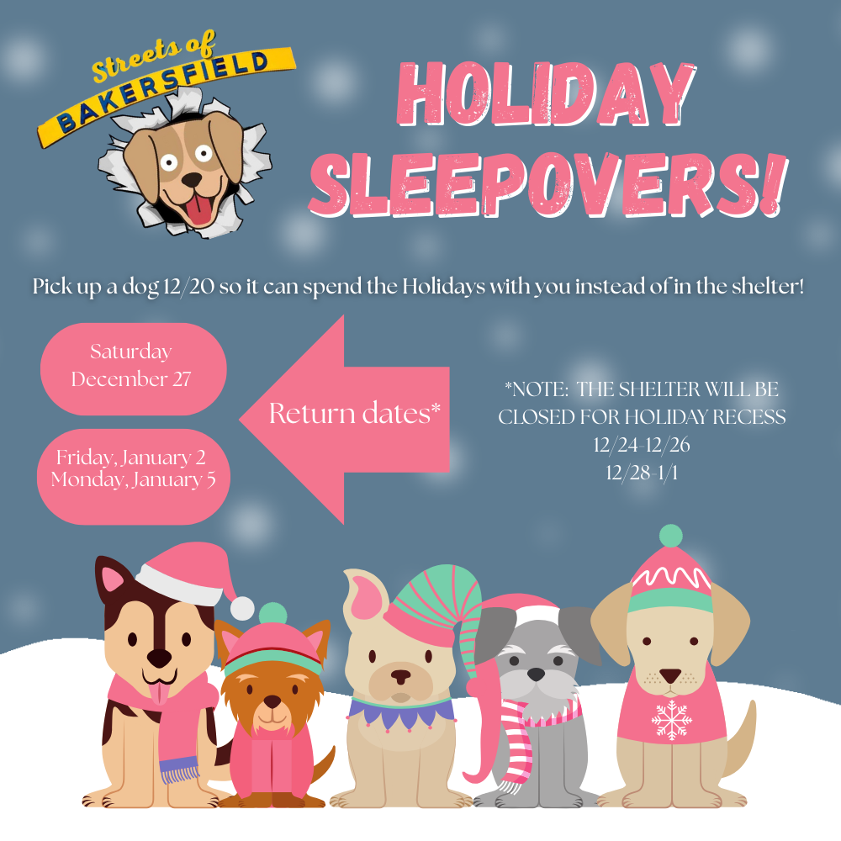
Holiday Sleepovers

Slide 10
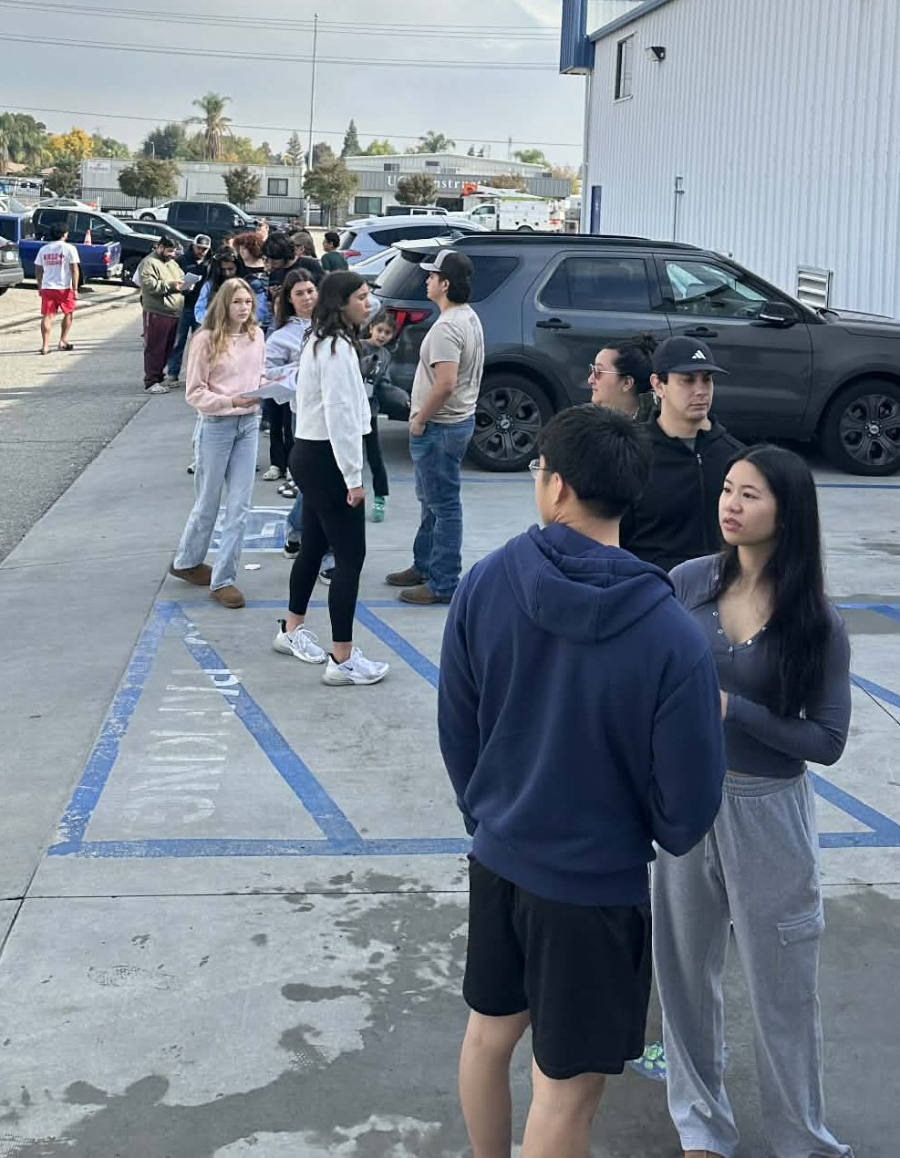
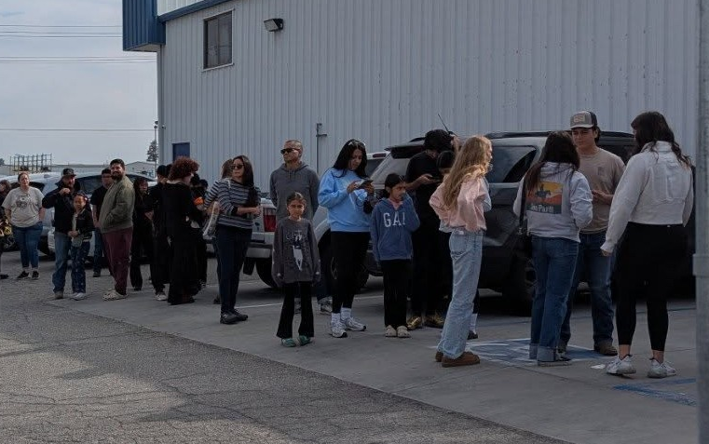
Biggest Streets of Bakersfield ever!
November 22nd – Our Streets of Bakersfield event was our most successful to date! A total of 60 dogs enjoyed a Doggy Day Out with their wonderful chaperones, giving them exercise, enrichment, and valuable exposure outside the shelter. Many of those pups were quickly adopted, fostered, or rescued after their doggy day out!

Slide 11
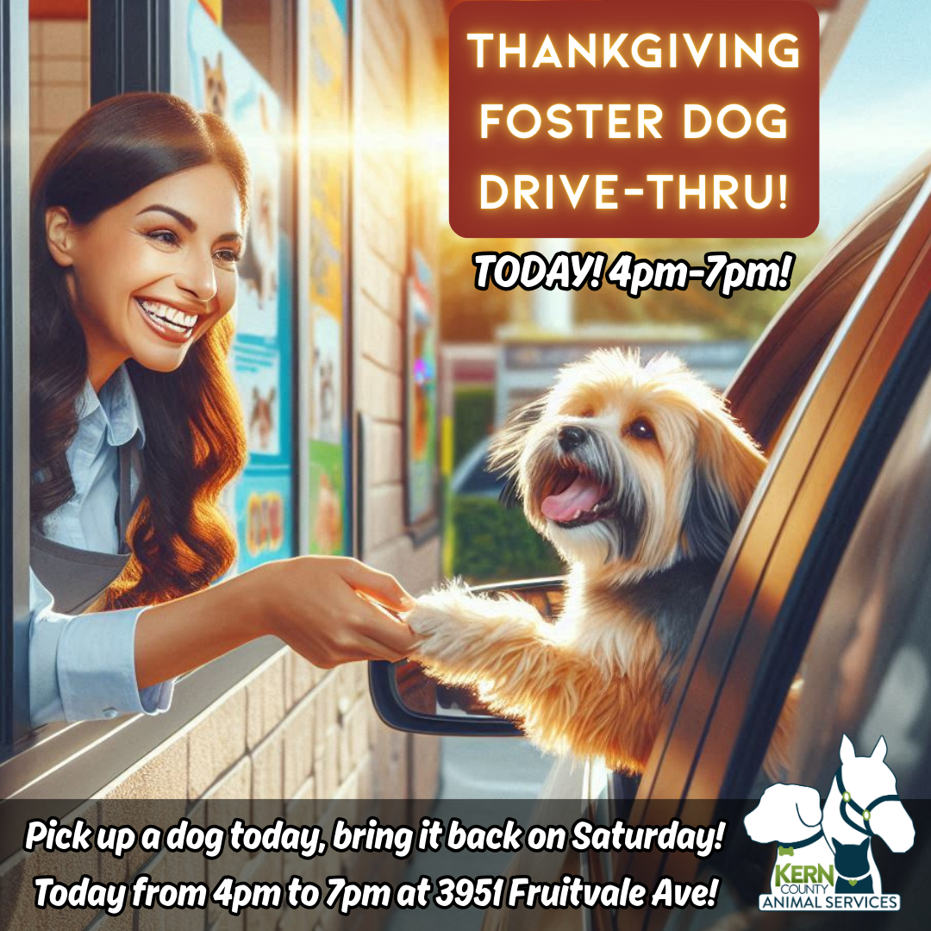
Foster Dog Drive-Thru
November 26th - Our Thanksgiving Foster Dog Drive-Thru was a tremendous success! Thanks to our supportive community, 19 shelter dogs spent the holiday weekend in cozy homes instead of kennels.
Short-term foster programs like this give our pets the chance to relax, show their true personalities, and make important connections with potential adopters.
Many of these dogs return to the shelter with new photos, stories, and exposure that greatly improve their chances of finding a permanent home.

Slide 12
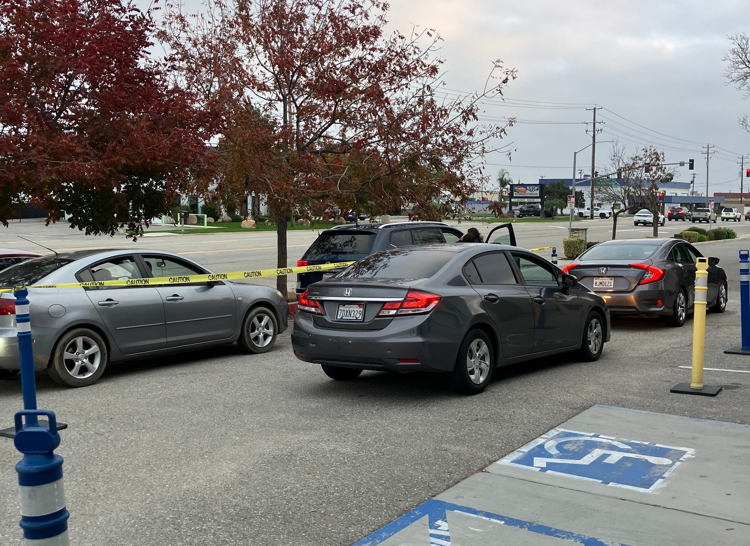
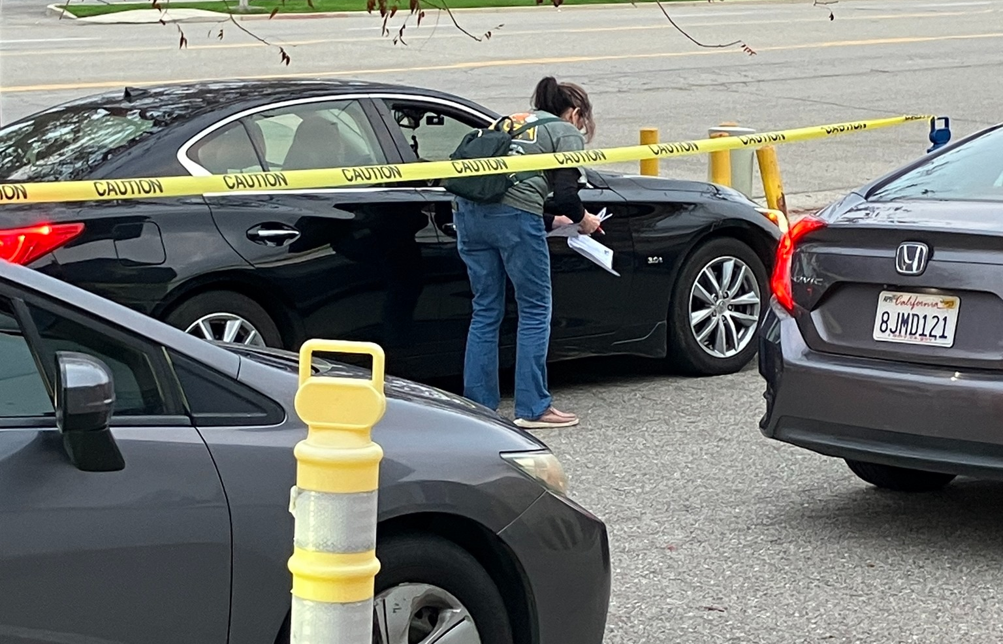
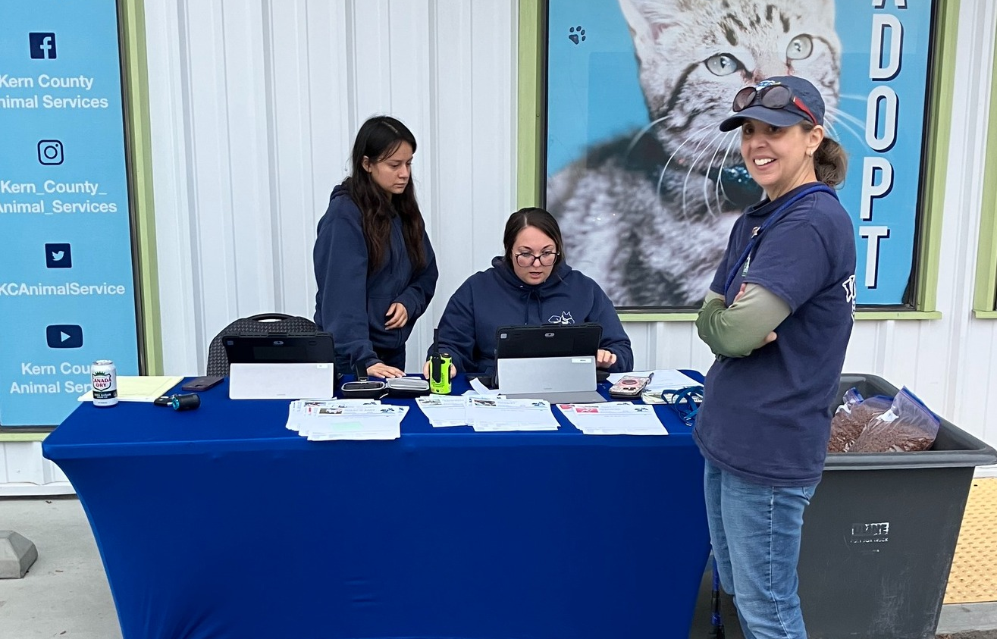
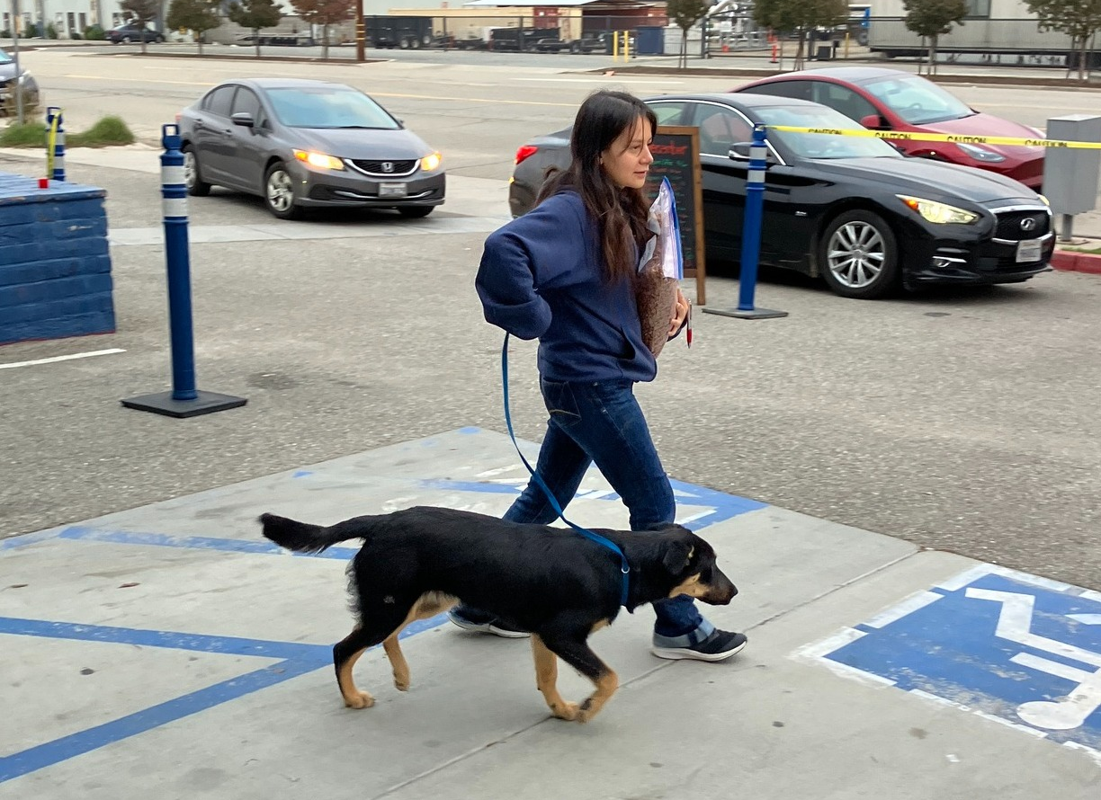

Slide 13


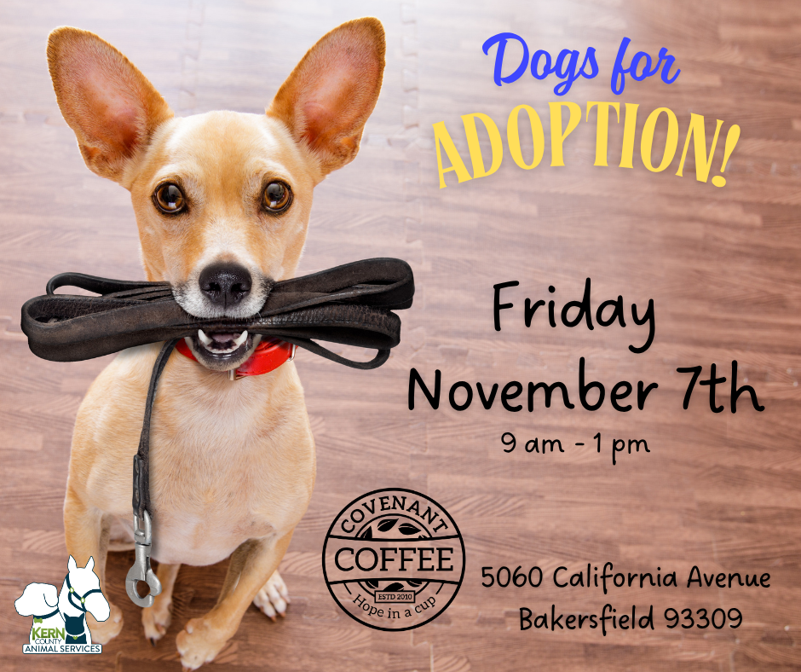
Offsite Adoption Events:
November 1st, 2nd, and 7th

Slide 14
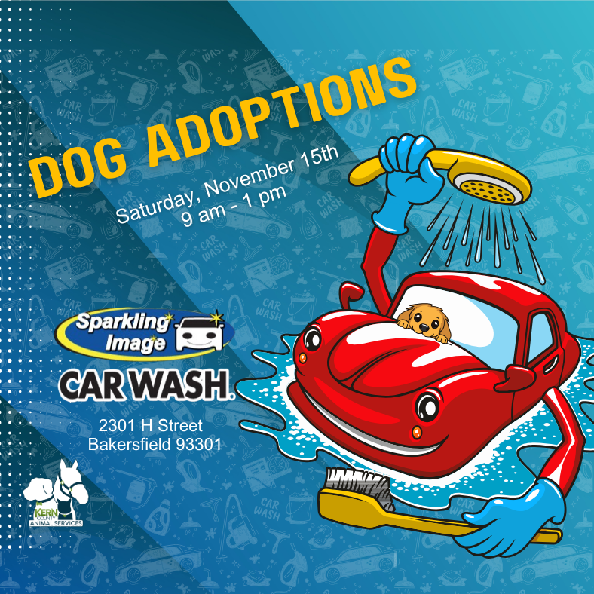
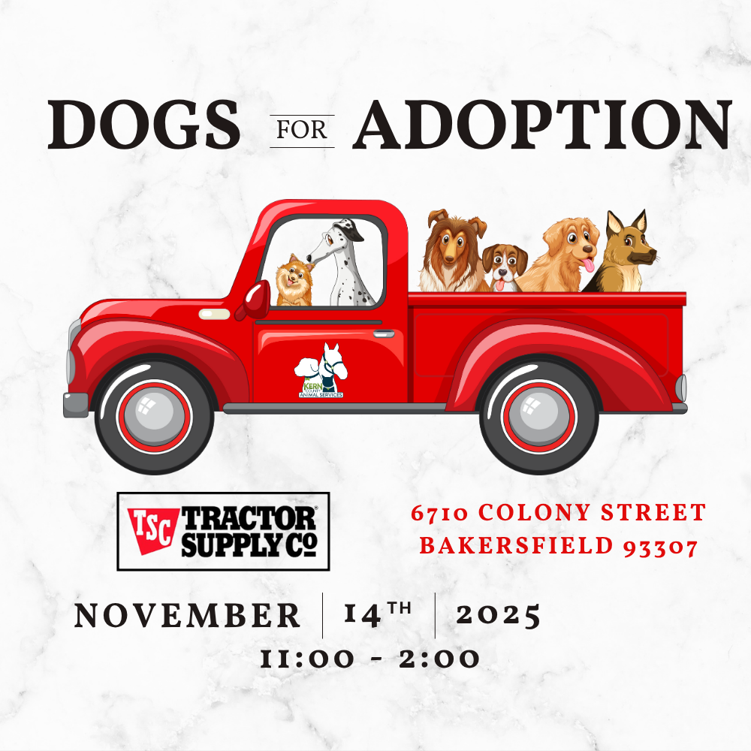
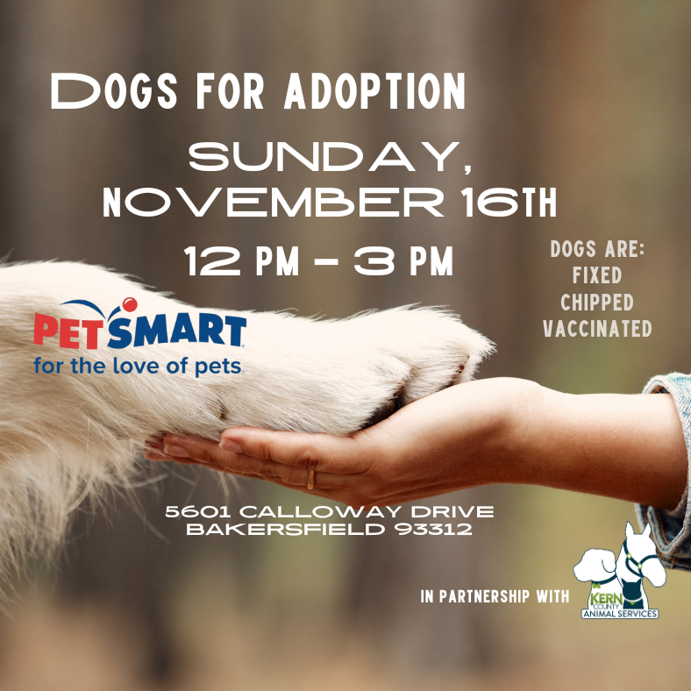
Offsite Adoption Events:
November 14th – 16th

Slide 15
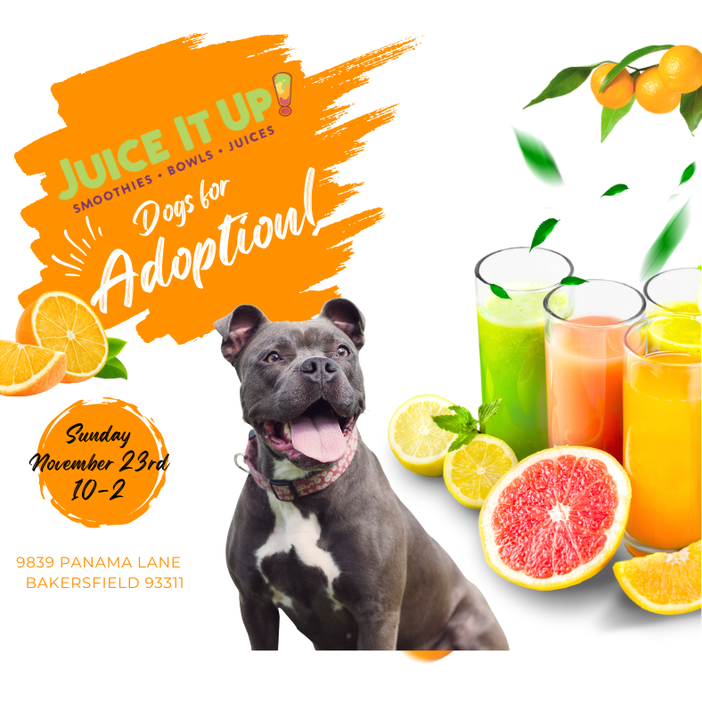

Offsite Adoption Events:
November 22nd & 23rd

Slide 16
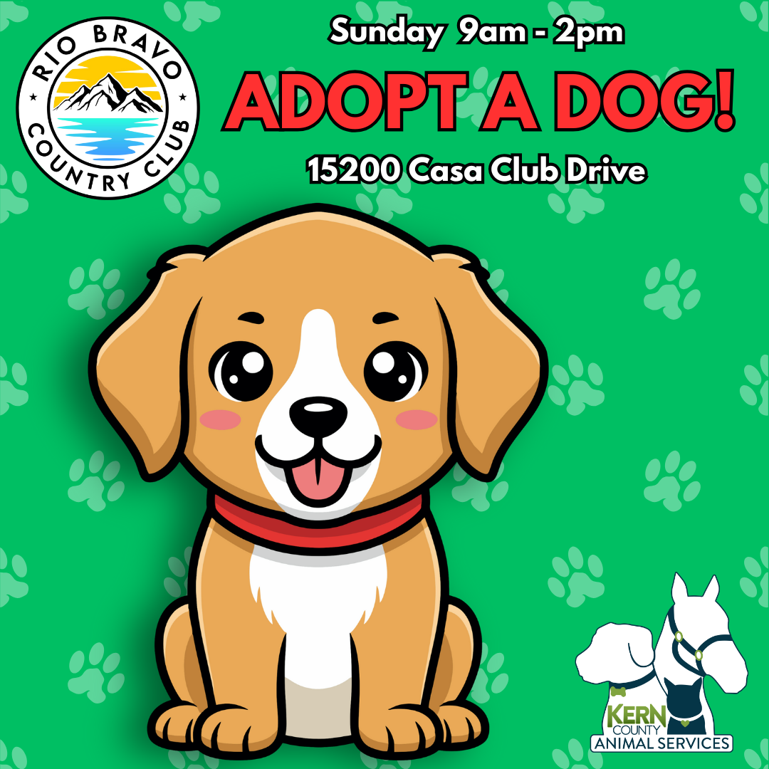


Offsite Adoption Events:
November 28th, 29th, 30th

Slide 17
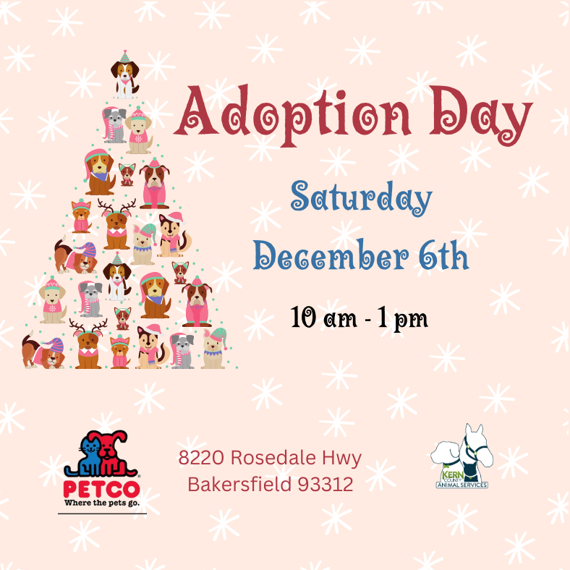

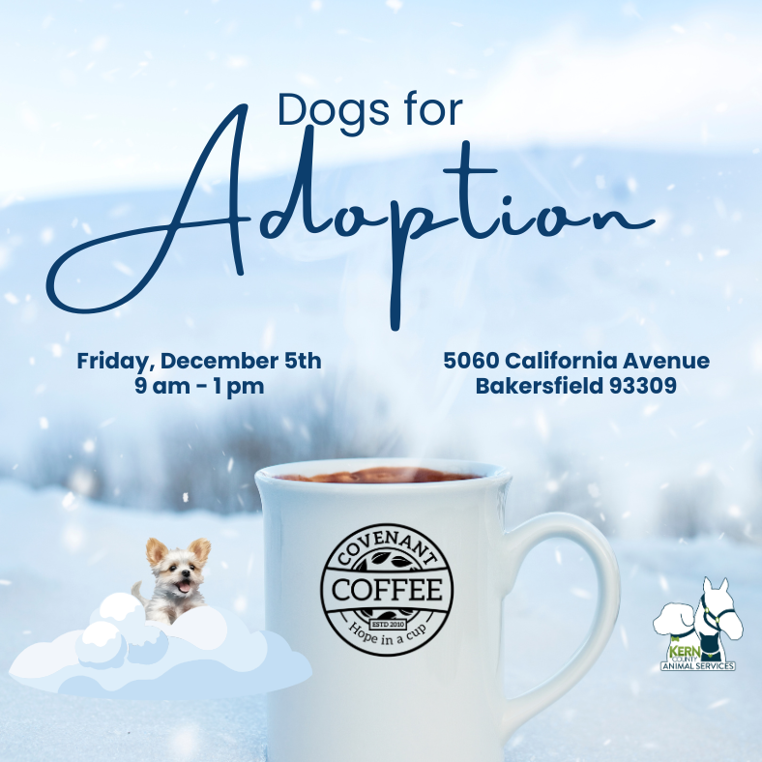
Offsite Adoption Events:
December 5th – 7th

Slide 18
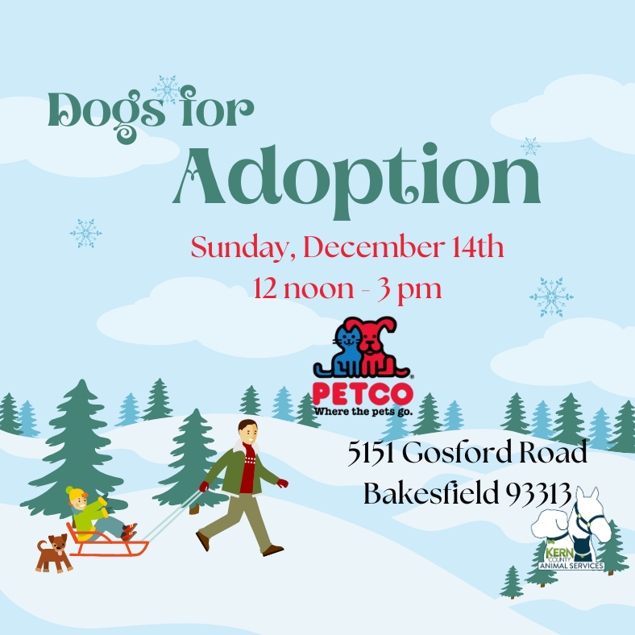

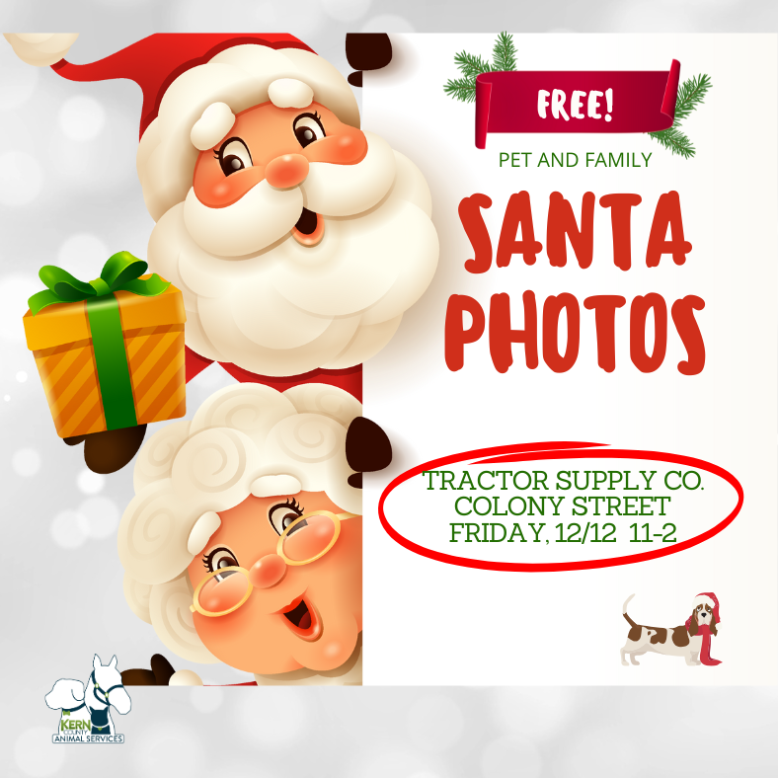
Offsite Adoption Events:
December 12th – 14th

Slide 19
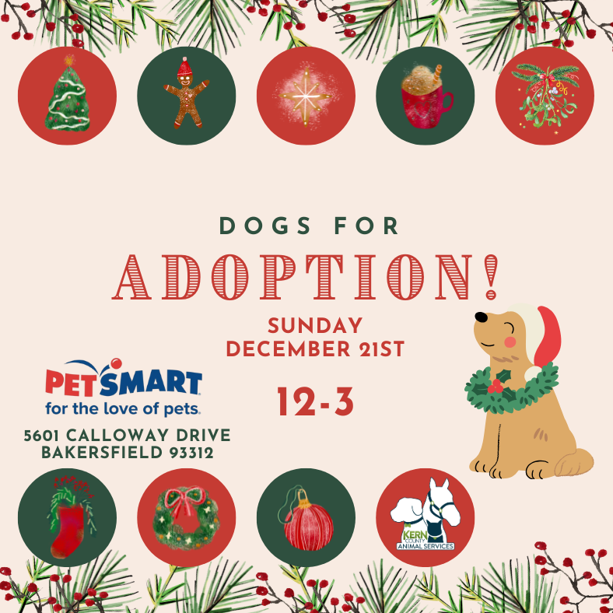

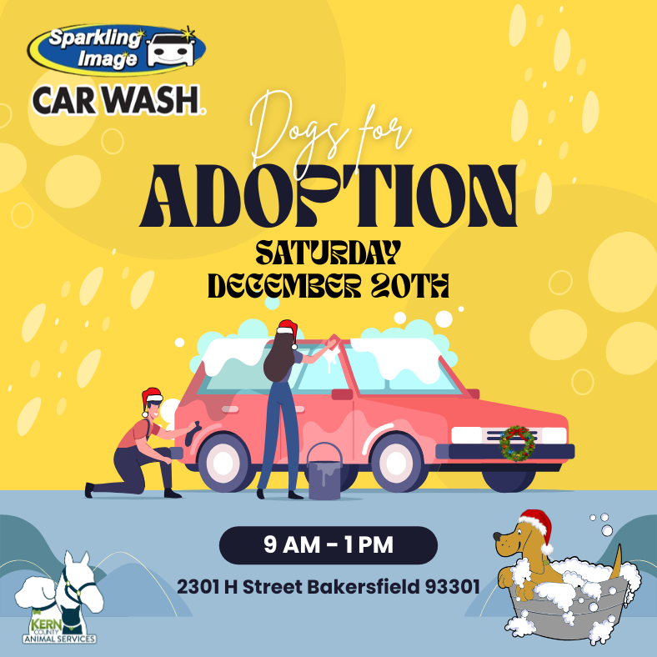
Offsite Adoption Events:
December 19th – 21st

Slide 20

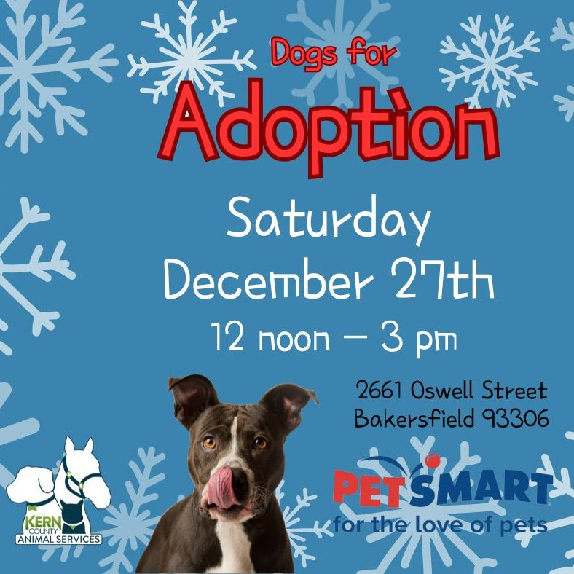
Offsite Adoption Events:
December 27th & 28th

Slide 21
Low-Cost Spay/Neuter Clinics
November 2025
Date | Location | Surgeries
November 4th | Heritage Park | 68
November 5th | Lake Isabella, Ca | 53
November 8th | Mega Adoption Event (with S.O.S. Rescue) | 113
November 10th | Heritage Park | 50
November 11th | Dogtopia | 56
November 13th | Heritage Park | 59
November 21st | Mojave, Ca. | 34
November 24th | The Rio | 58
November 29th | Heritage Park | 73
November 30th | Heritage Park | 51
 | Total Surgeries | 615

Slide 22
Low-Cost Spay/Neuter Clinics
December 2025
Date | Location | Surgeries
December 1st | Dogtopia | 54
December 2nd | Heritage Park | 50
December 9th | Harley Davidson | 44
December 11th | Tehachapi, Ca. (with Have A Heart) | 25
December 18th | City of Bakersfield Shelter (with S.O.S. Rescue) | 32
December 29th | Heritage Park | 54
December 30th | Heritage Park | 50
December 31st | Heritage Park | 57
 | Total Surgeries | 366

Slide 23
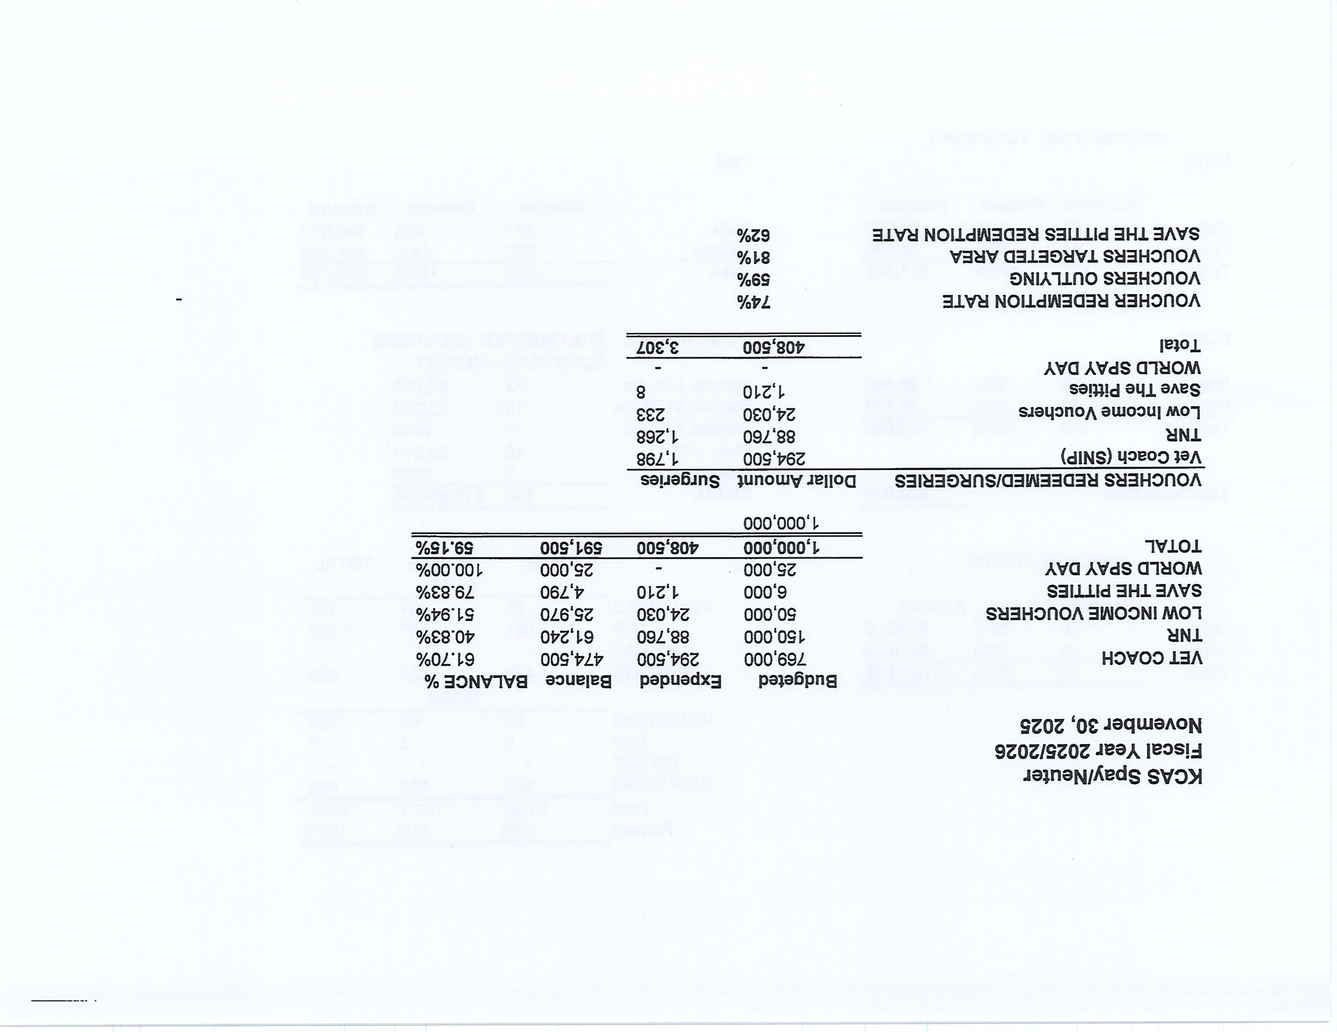

Slide 24
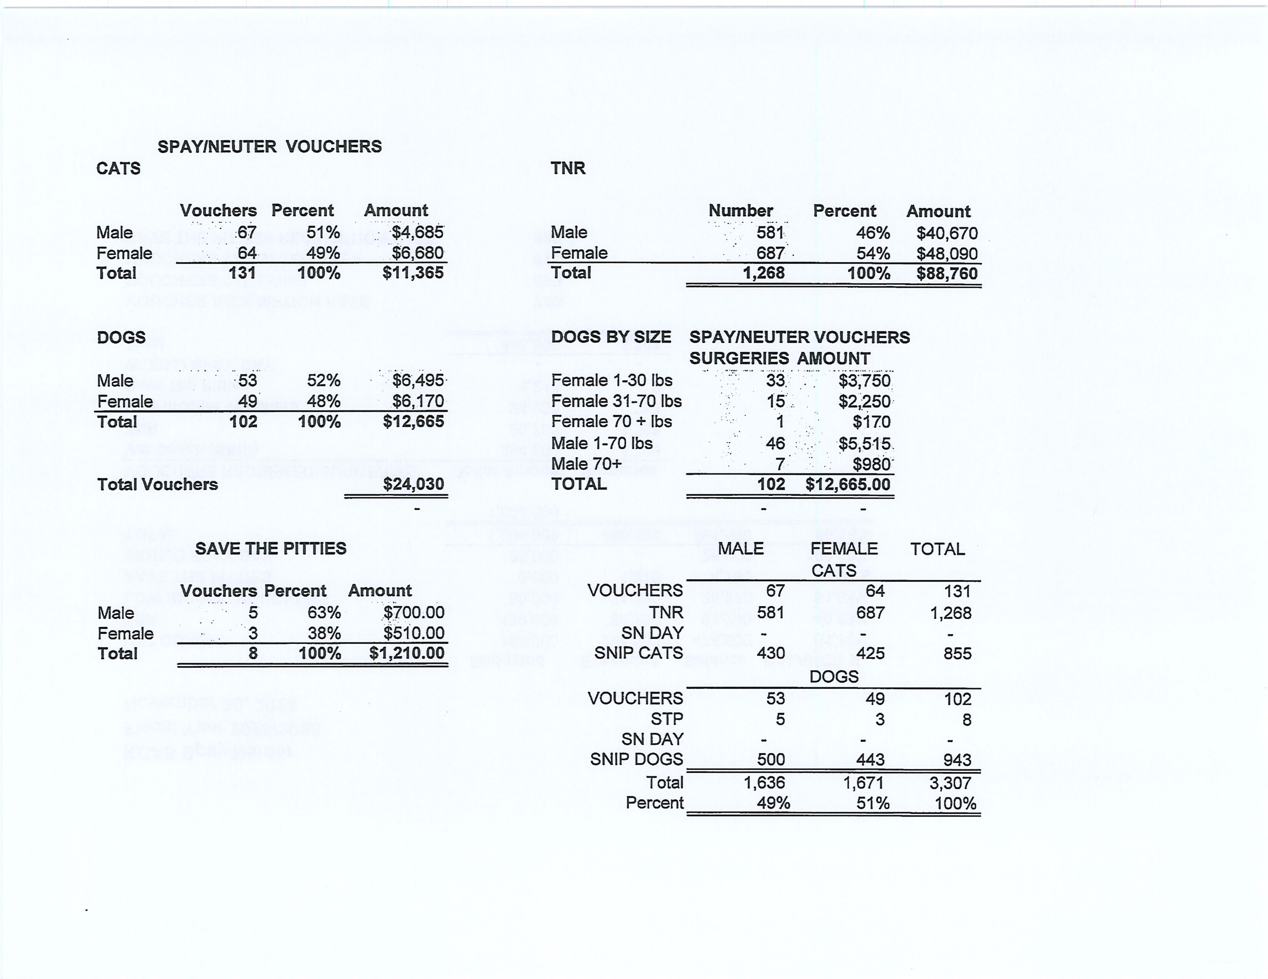

Slide 25
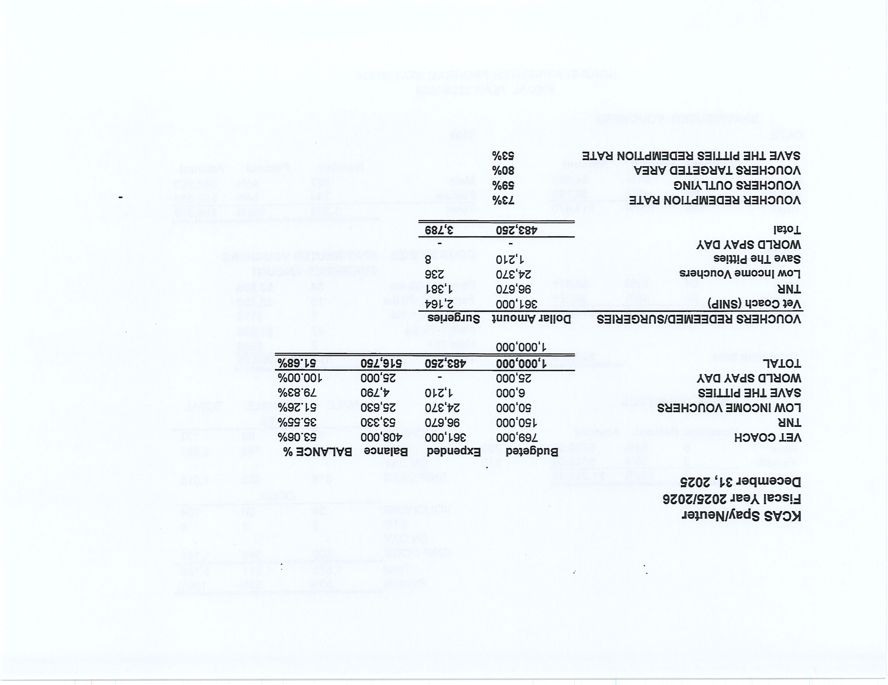

Slide 26
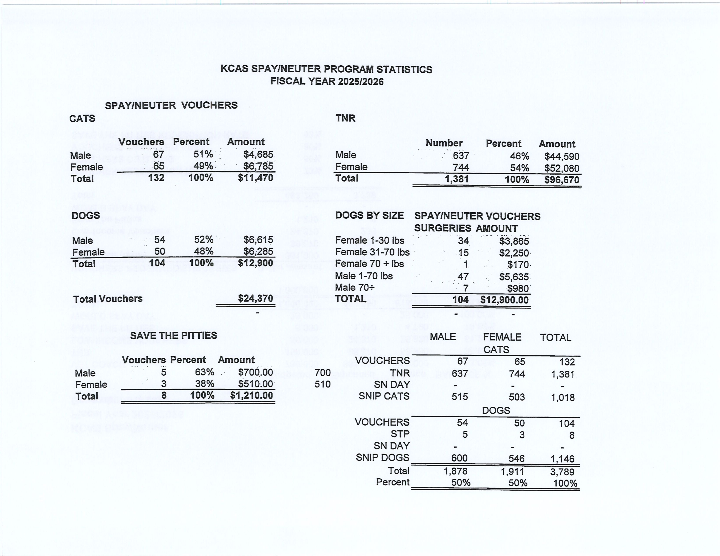

Slide 27
Low-Cost Vaccination Clinics
November and December 2025
Rabies
875
Microchips
Bordetella
70
73
DHPP* 595
FVRPC* 427
*DHPP and FVRCP vaccinations provided at no-cost by Petco Love.

Slide 28
2025 Vaccination Clinic Summary
KCAS would like to thank the thousands of responsible pet owners across Kern County who took advantage of these clinics to help keep their pets healthy, happy, and safe.
We also want to give a huge shout-out and heartfelt thank-you to our dedicated KCAS staff members and partnering veterinarians whose hard work, compassion, and commitment made these vital clinics possible. These efforts truly make a difference for pets and the community we serve.
Clinic statistics from January 2025 through December 2025:
Rabies vaccinations: 5,014
DHPP vaccinations: 4,041
FVRCP vaccinations: 2,183
Bordetella vaccinations: 514
Microchips implanted: 835

Slide 29
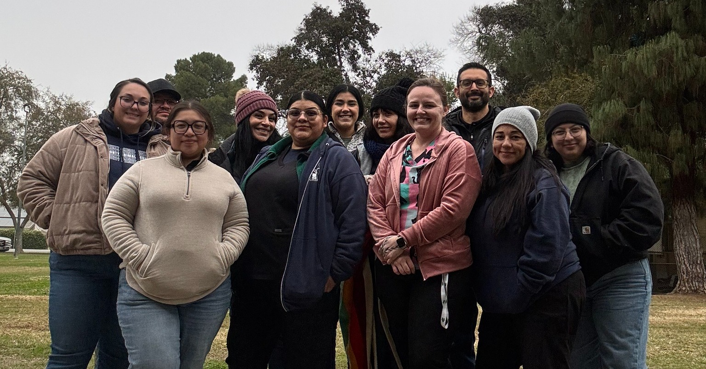
2025 KCAS Vaccination Clinic Team

Slide 30
Field Service Calls: November and December 2025
AREA | CALLS PER AREA
Lake Isabella | 200
Mojave | 237
North County | 138
Northeast | 661
Northwest | 562
Ridgecrest | 45
Southeast | 300
Southwest | 289
Taft | 213
Tehachapi | 110
TOTAL | 2,755
56 dogs were returned to their owners in the field in Nov. & Dec. 2025.
244 dogs were secured on property by Animal Control Officers in Nov. & Dec. 2025

Slide 31
Commercial Animal Facility Calls
November and December 2025
TYPE | CALLS PER TYPE
CAF – Breeder | 15
CAF – Rescue | 4
CAF – Kennel | 0
CAF – Boarding | 0
TOTAL | 19
1 Inspections Passed
0 Inspections Failed
0 Citations Issued
0 Permits Issued
52 Active CAF Permits

Slide 32
Volunteer Program
November and December 2025
Active Volunteers
243
New Volunteers
114
Volunteer hours donated in November and December
Volunteer hours donated in 2025
1,464.83
10,410.9

Slide 33
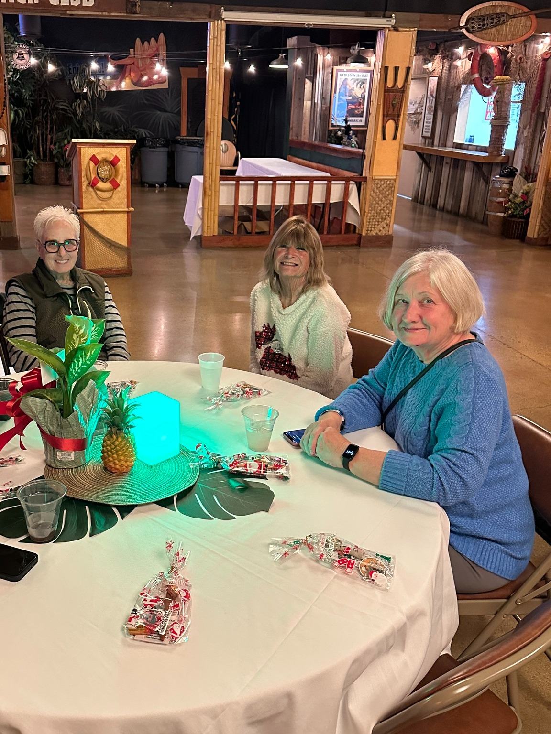
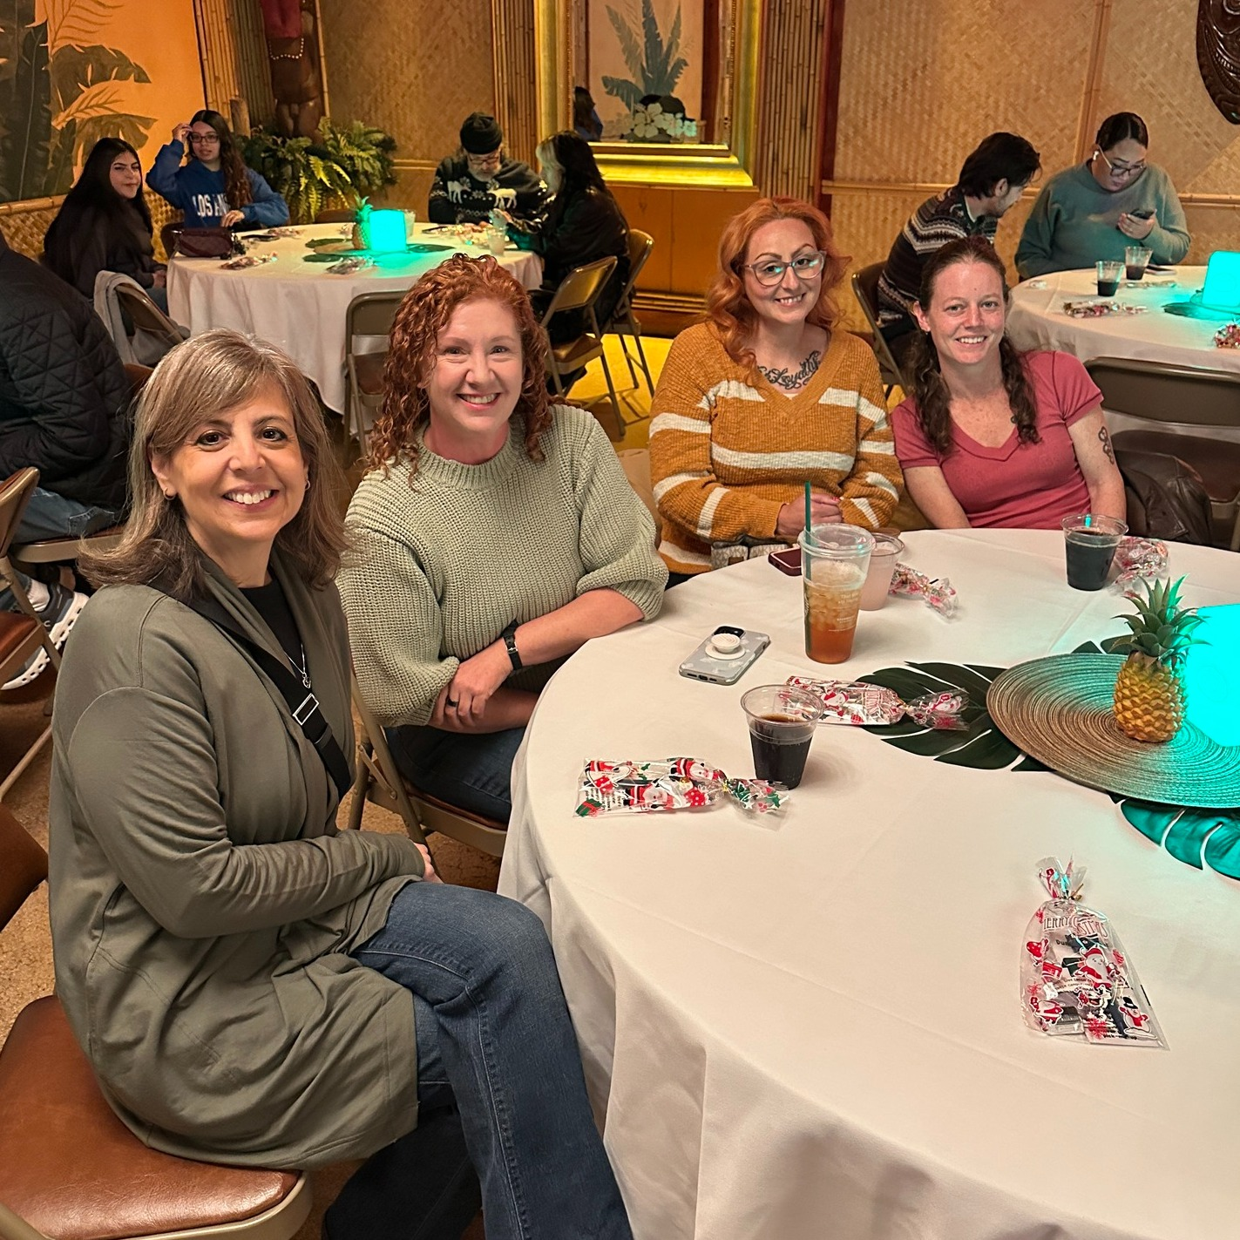
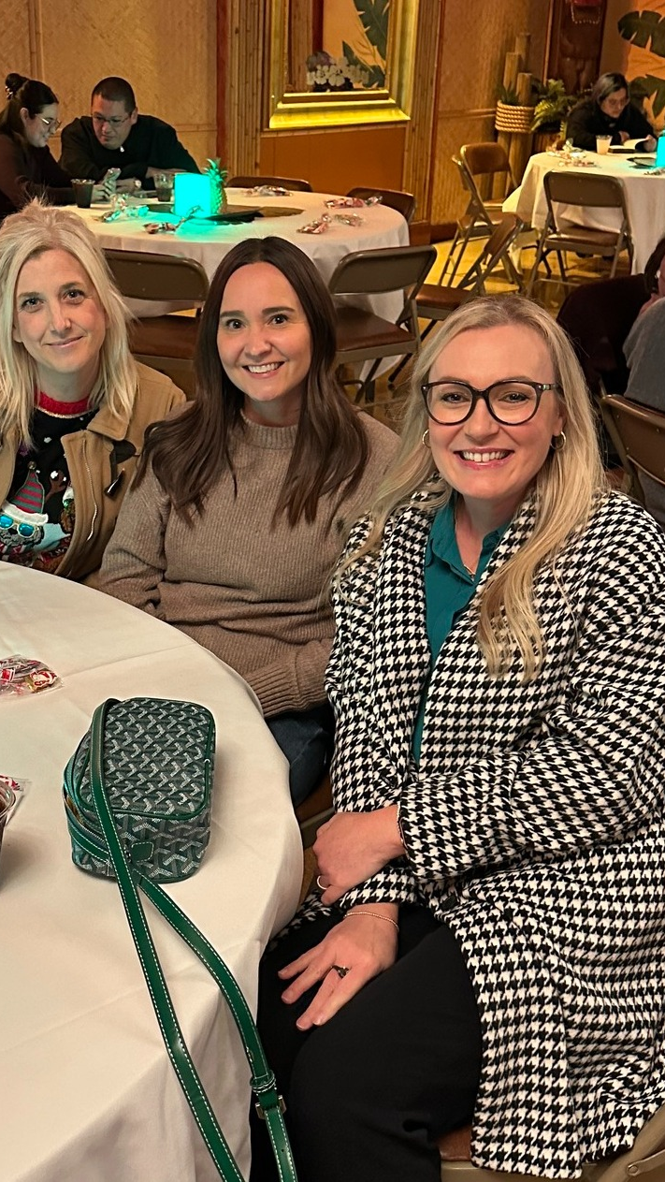
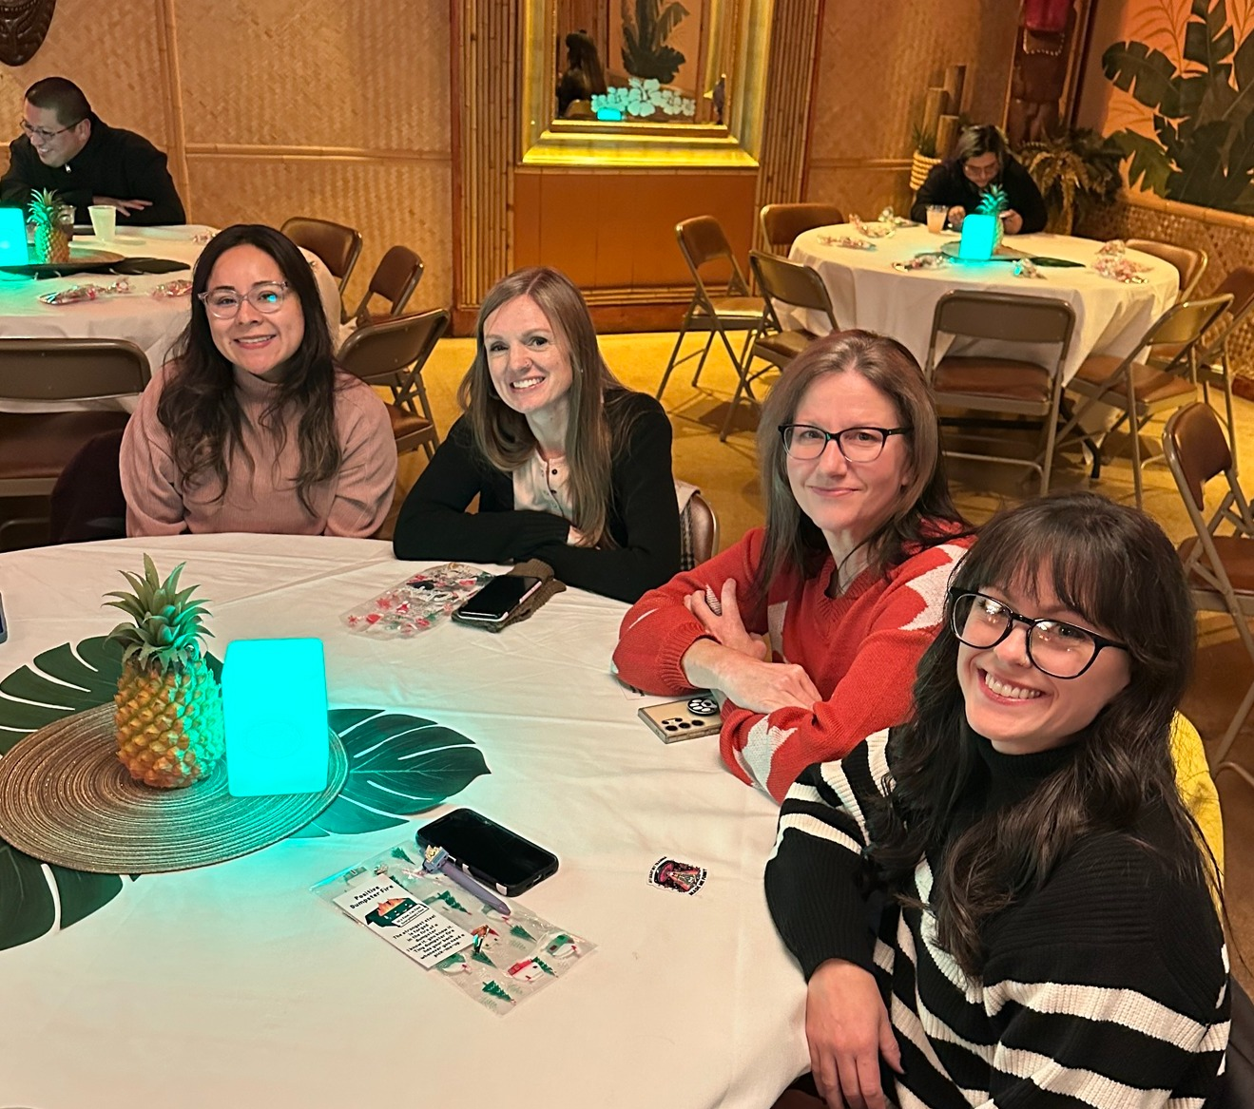
KCAS Volunteer Appreciation Dinner
December 8th – Kern County Animal Services held it’s annual Volunteer Appreciation Dinner.
Thank you to everyone who joined us, and to those who could not attend but continue to give so much of themselves.
No single event could ever capture the depth of our gratitude. Your dedication, compassion, and hard work have an extraordinary impact on our staff and, most importantly, on the animals in our care.
Each and every one of you is making a difference and saving lives. From the bottom of our hearts - thank you, thank you, thank you!
A special thank you to the Friends of Kern County Animal Shelters Foundation for making this annual dinner possible.

Slide 34
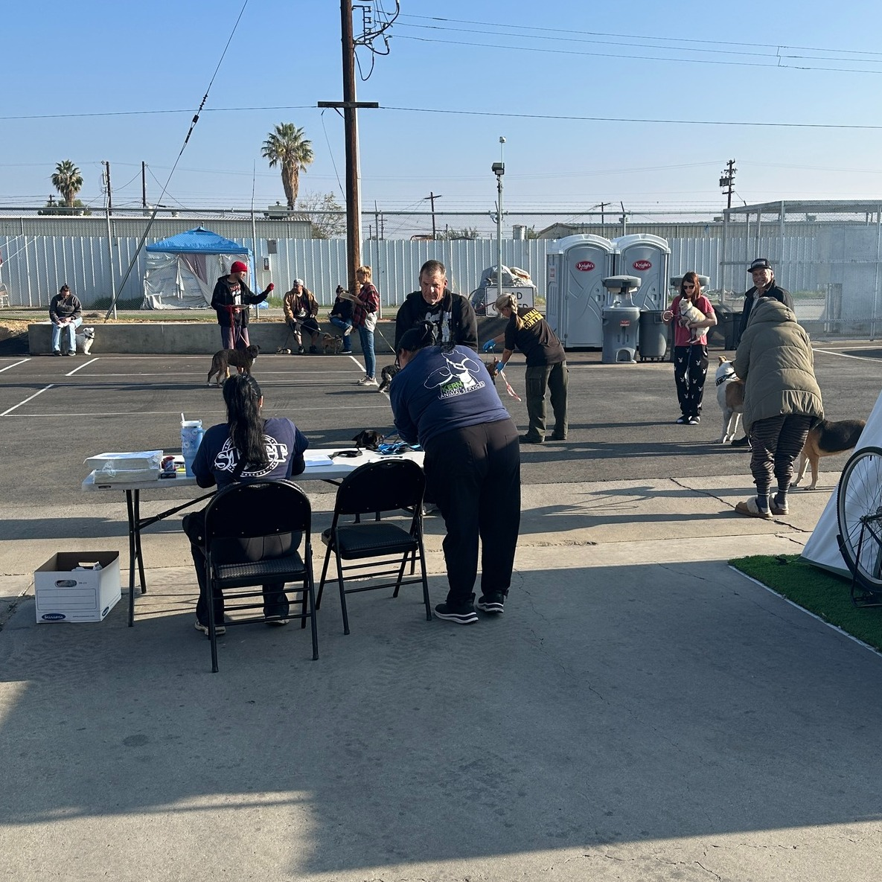
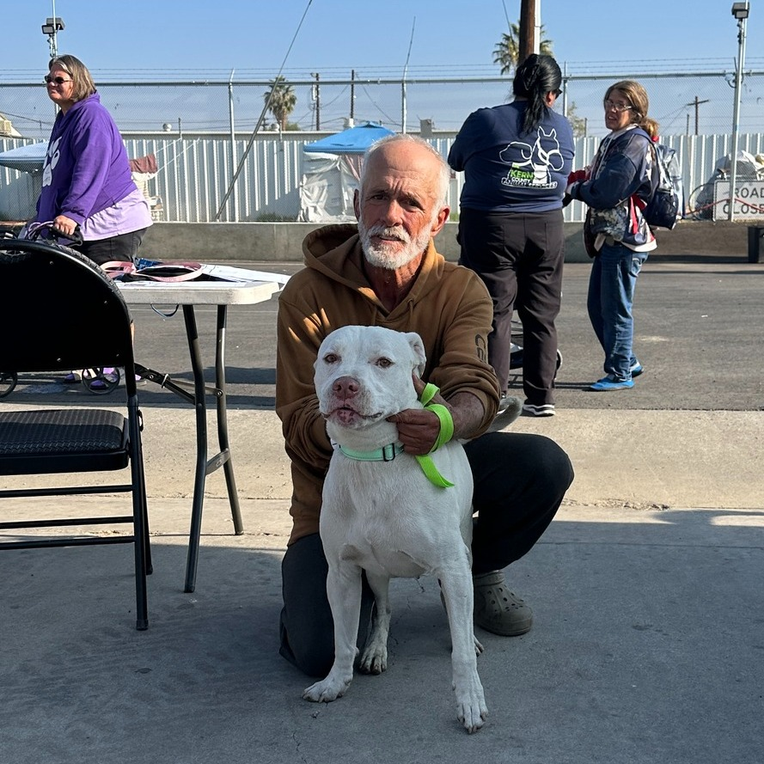
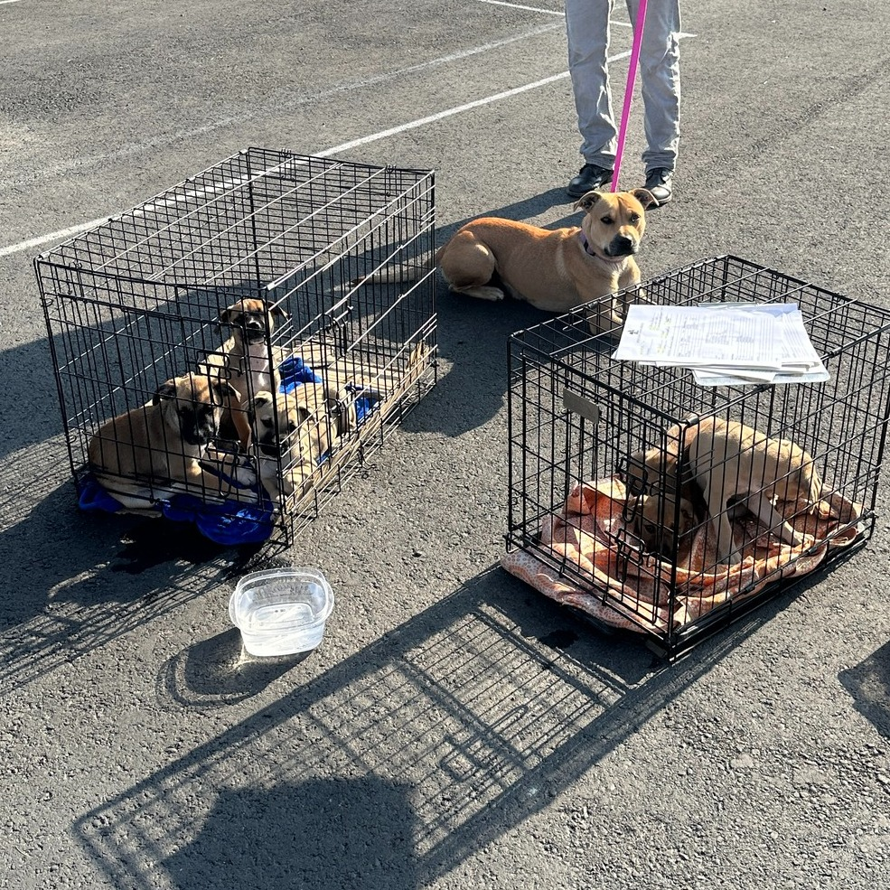

Helping the
Unhoused
December 2nd - Dr. King and our KCAS Medical Staff continued their visits to assist pets and their owners at the M Street Navigation Center.
They provide health screenings, along with medications to treat common canine health issues. Additional resources and care options are also made available when needed.
Both the pets and their owners have been so grateful for the support, and we are just as grateful for the opportunity to provide it!
Big thanks to the Community Action Partnership of Kern (aka CAPK) and the important work they do in our community!

Slide 35



Tick
During the clinic, the KCAS med staff met a little dog named Tick, who was suffering from a large mass that had protruded from her body.
Tick was brought to the shelter the following day, where Dr. King and her team were able to remove the mass and provide the care she needed. After a full recovery, Tick’s owner came to the shelter and happily reunited with her!

Slide 36




Digging For Puppies
December 18th - KCAS Animal Control Officer Padilla rescued a mom and her puppies from a deep hole where they had been living on their own. One little pup had hidden far in the back and was not easy to reach. It took extra time and effort, but in the end, every single puppy was safely rescued.
Thank you, ACO Padilla, for your dedication and for saving these precious lives!

Slide 37




Salt & Pepper
November 24th - These 2 little dogs came to the shelter severely matted, but our grooming team got them all cleaned-up!
Soon after, they safely left the shelter with an animal rescue organization!

Slide 38

Thanksgiving Breakfast
November 27th - Kern County Animal Services held it’s annual Thanksgiving Breakfast for shelter pets.
Every pet in our shelter enjoyed a special holiday treat, all donated by generous animal lovers like you.
Most of the smiling faces helping serve breakfast were volunteers who chose to spend their morning making our shelter pets feel extra special and loved.

Slide 39





Slide 40






Slide 41

Santa Photos
December 7th - Santa Claus made his annual stop at Kern County Animal Services and took dozens of festive photos with kids, families, and pets from across our community!
Santa also took photos at our offsite adoption events at Petco Gosford on November 29th and Tractor Supply Company on December 12th

Slide 42





Slide 43



NOR Christmas Parade
December 13th

Slide 44


Slide 45

Tree Lighting Ceremony
November 28th - Officers Barker and Whiskers brought some holiday cheer to the Town & Country Shopping Center as they joined Santa Claus for the annual tree-lighting ceremony and pet parade. It was a festive evening filled with bright lights, happy pets, and plenty of community spirit!
Adoptable KCAS pets were also at the event hoping to find their new forever homes.

Slide 46



Slide 47

Ponder Environmental Services
November 4th - Kern County Animal Services would like to extend our sincere appreciation to Ponder Environmental Services for their generous donation of dog food, puppy pads, blankets, and other essential supplies for our shelter pets. Their contribution supports the ongoing care and comfort of animals in our facility, and we are truly grateful for their partnership and support.

Slide 48



Bakersfield Obedience Training Club
December 4th - A huge thank you to the Bakersfield Obedience Training Club for stopping by with an SUV full of donations for our shelter pets! Our animals received food, supplies, and other essentials.
Our staff was treated to a big tray of Christmas cookies as well.
We’re grateful to Kathy, Joan, and everyone at BOTC for their continued generosity and support. We appreciate you!

Slide 49

BHS
Blankets
December 22nd - A big shout-out to the incredible students at Bakersfield High School for dropping off so many much-needed blankets. Their generosity helped dozens of our shelter pets sleep warmer and more comfortably this season.

Slide 50
2025 Year To Date
January 1st – December 31st
5,171
Adoptions
3,972
Rescued
650
Returned To Owner
8,306
Spay/Neuter Surgeries
12,289
Total Lives Saved
79.18%
Save Rate

Slide 51



Slide 52



Slide 53



Slide 54



