Slide 1






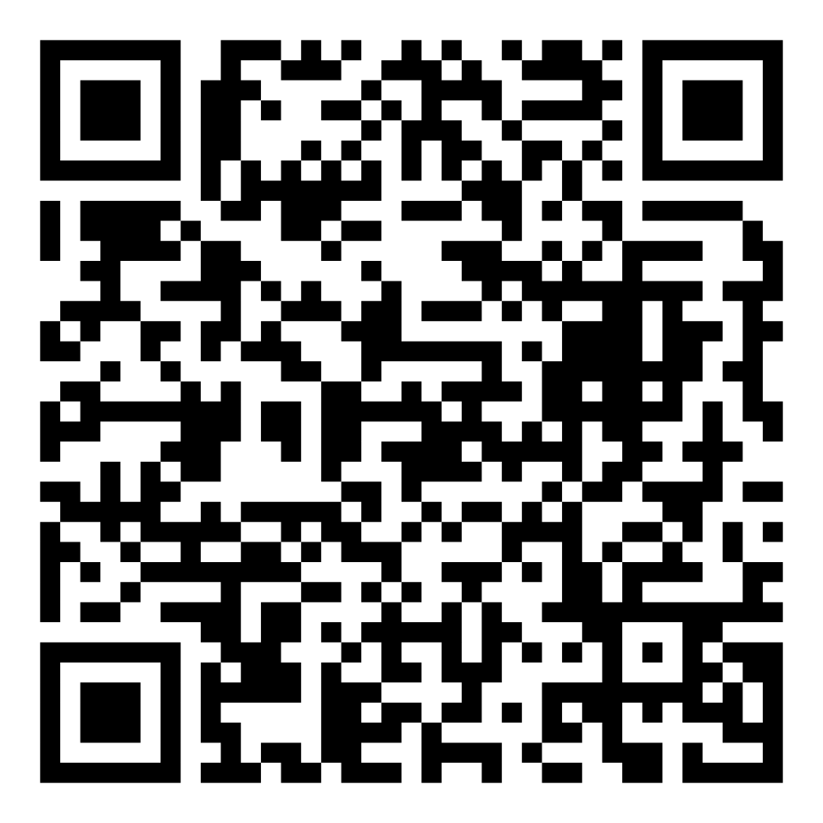
Director’s Report
January 2026

Slide 2

Program Highlights
January 2026
Adoption: 188 dogs, 122 puppies, 41 cats, and 103 kittens under 5 months of age were adopted for a total of 454 animals adopted from Kern County Animal Shelters in the month of January.
Foster: 37 dogs, 50 puppies, 4 cats, and 15 kittens entered the Department’s Foster Care Program in January, for a total of 106 animals.
Rescue: 180 dogs, 176 puppies, 12 cats, and 4 kittens were transferred to other animal rescue organizations in January, for a total of 372 animals.
Spay/Neuter: A total of 327 animals were altered at low-cost KCAS spay/neuter clinics in the month of January.
TNR: 182 cats were spayed or neutered and released in January. Year-to-date, 182 cats have gone through the program, and since 2013 24,224 cats have been spayed or neutered and returned to field.

Slide 3
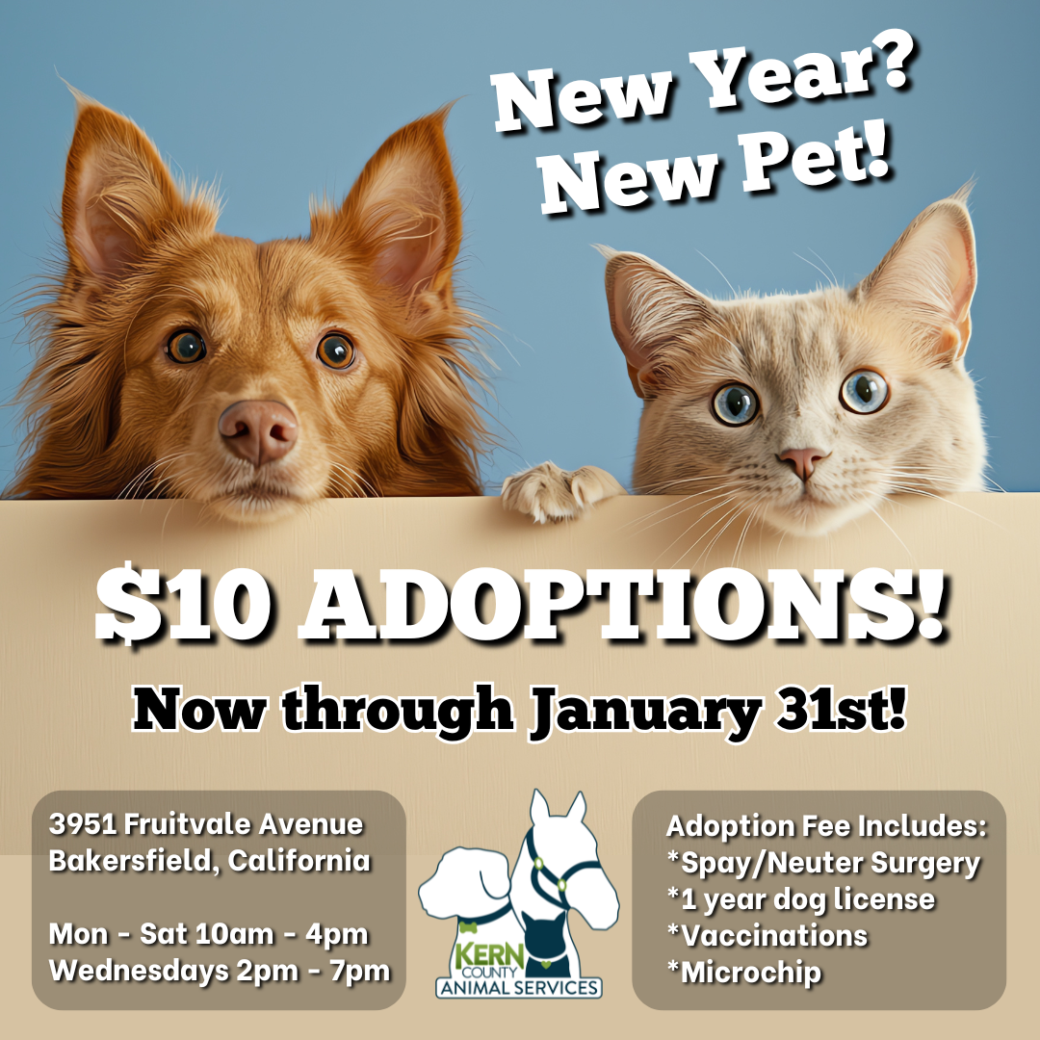

January Adoptions
January 2nd – January 31st

Slide 4

Offsite Adoption Events:
January 3rd

Slide 5
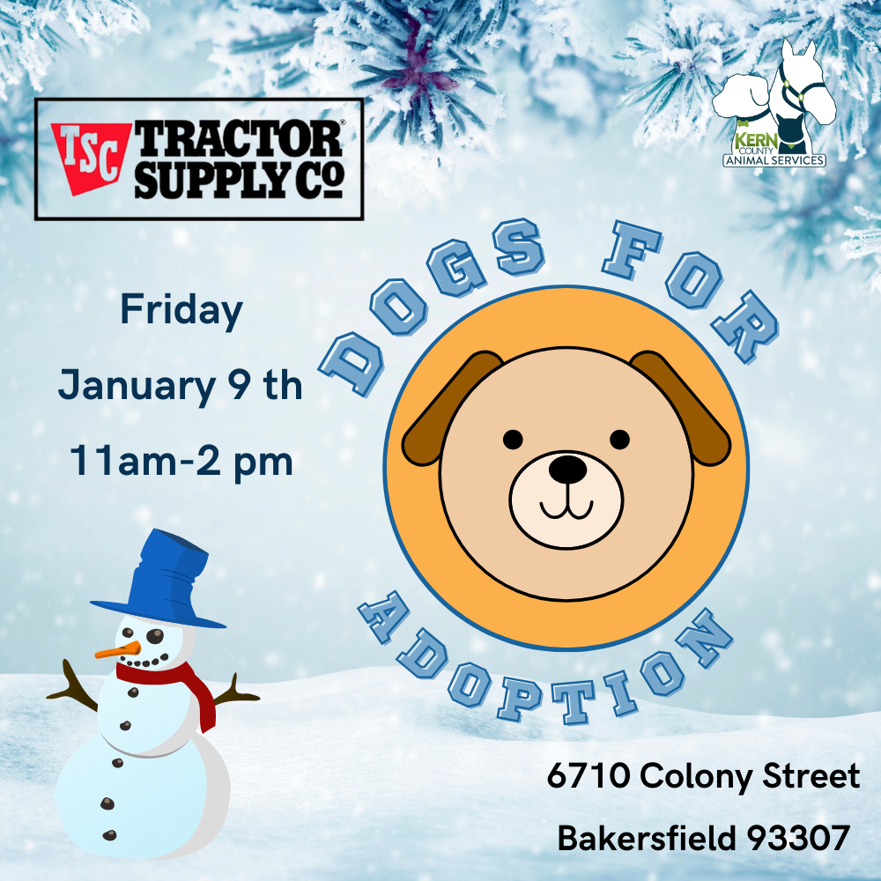


Offsite Adoption Events:
January 9th – 11th

Slide 6


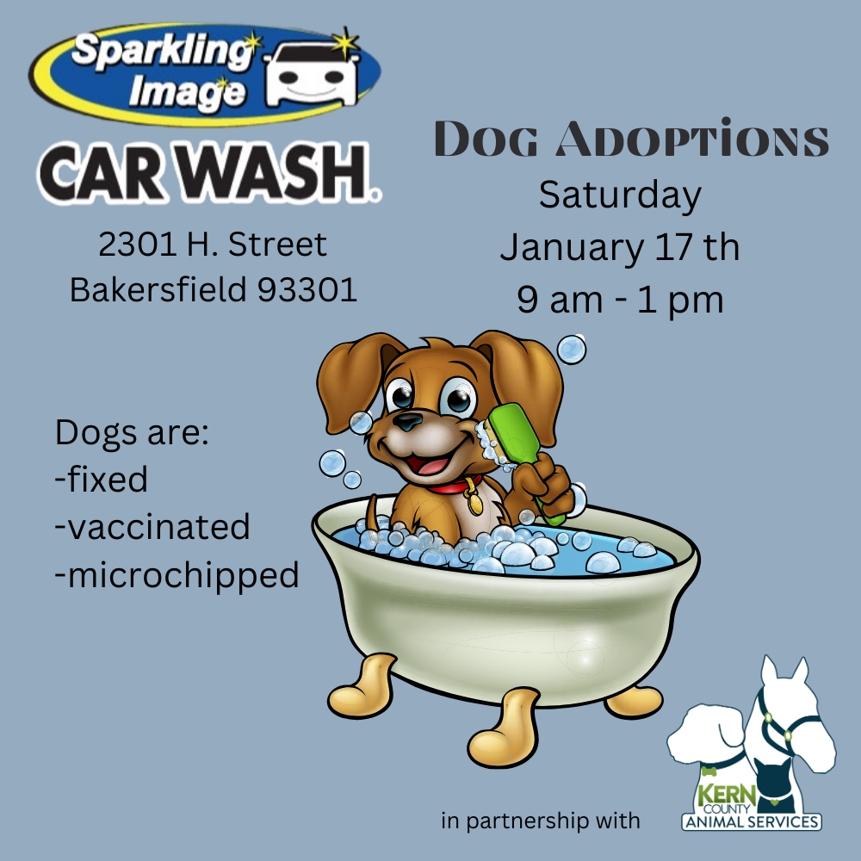
Offsite Adoption Events:
January 16th, 17th, 18th

Slide 7
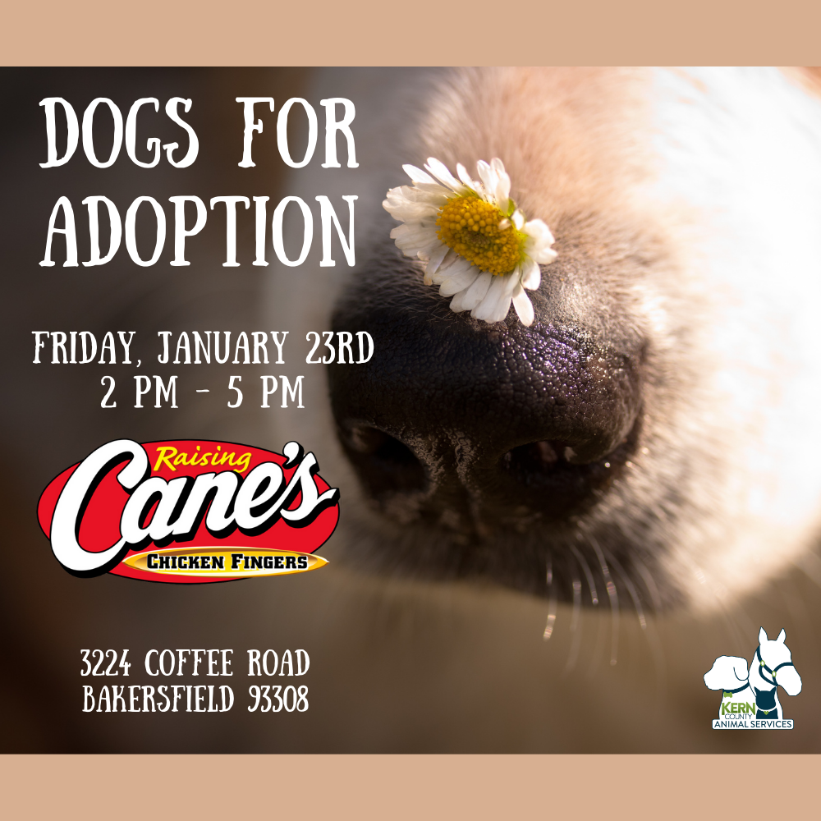


Offsite Adoption Events:
January 23rd, 24th, 25th

Slide 8


Offsite Adoption Events:
January 30th & 31st

Slide 9


Streets of Bakersfield
January 10th & January 24th

Slide 10
Low-Cost Spay/Neuter Clinics
January 2026
Date | Location | Surgeries
January 5th | Heritage Park | 49
January 6th | Heritage Park | 54
January 13th | Heritage Park | 55
January 23rd | Heritage Park | 53
January 27th | Heritage Park | 55
January 29th | Heritage Park | 61
 | Total Surgeries | 327

Slide 11
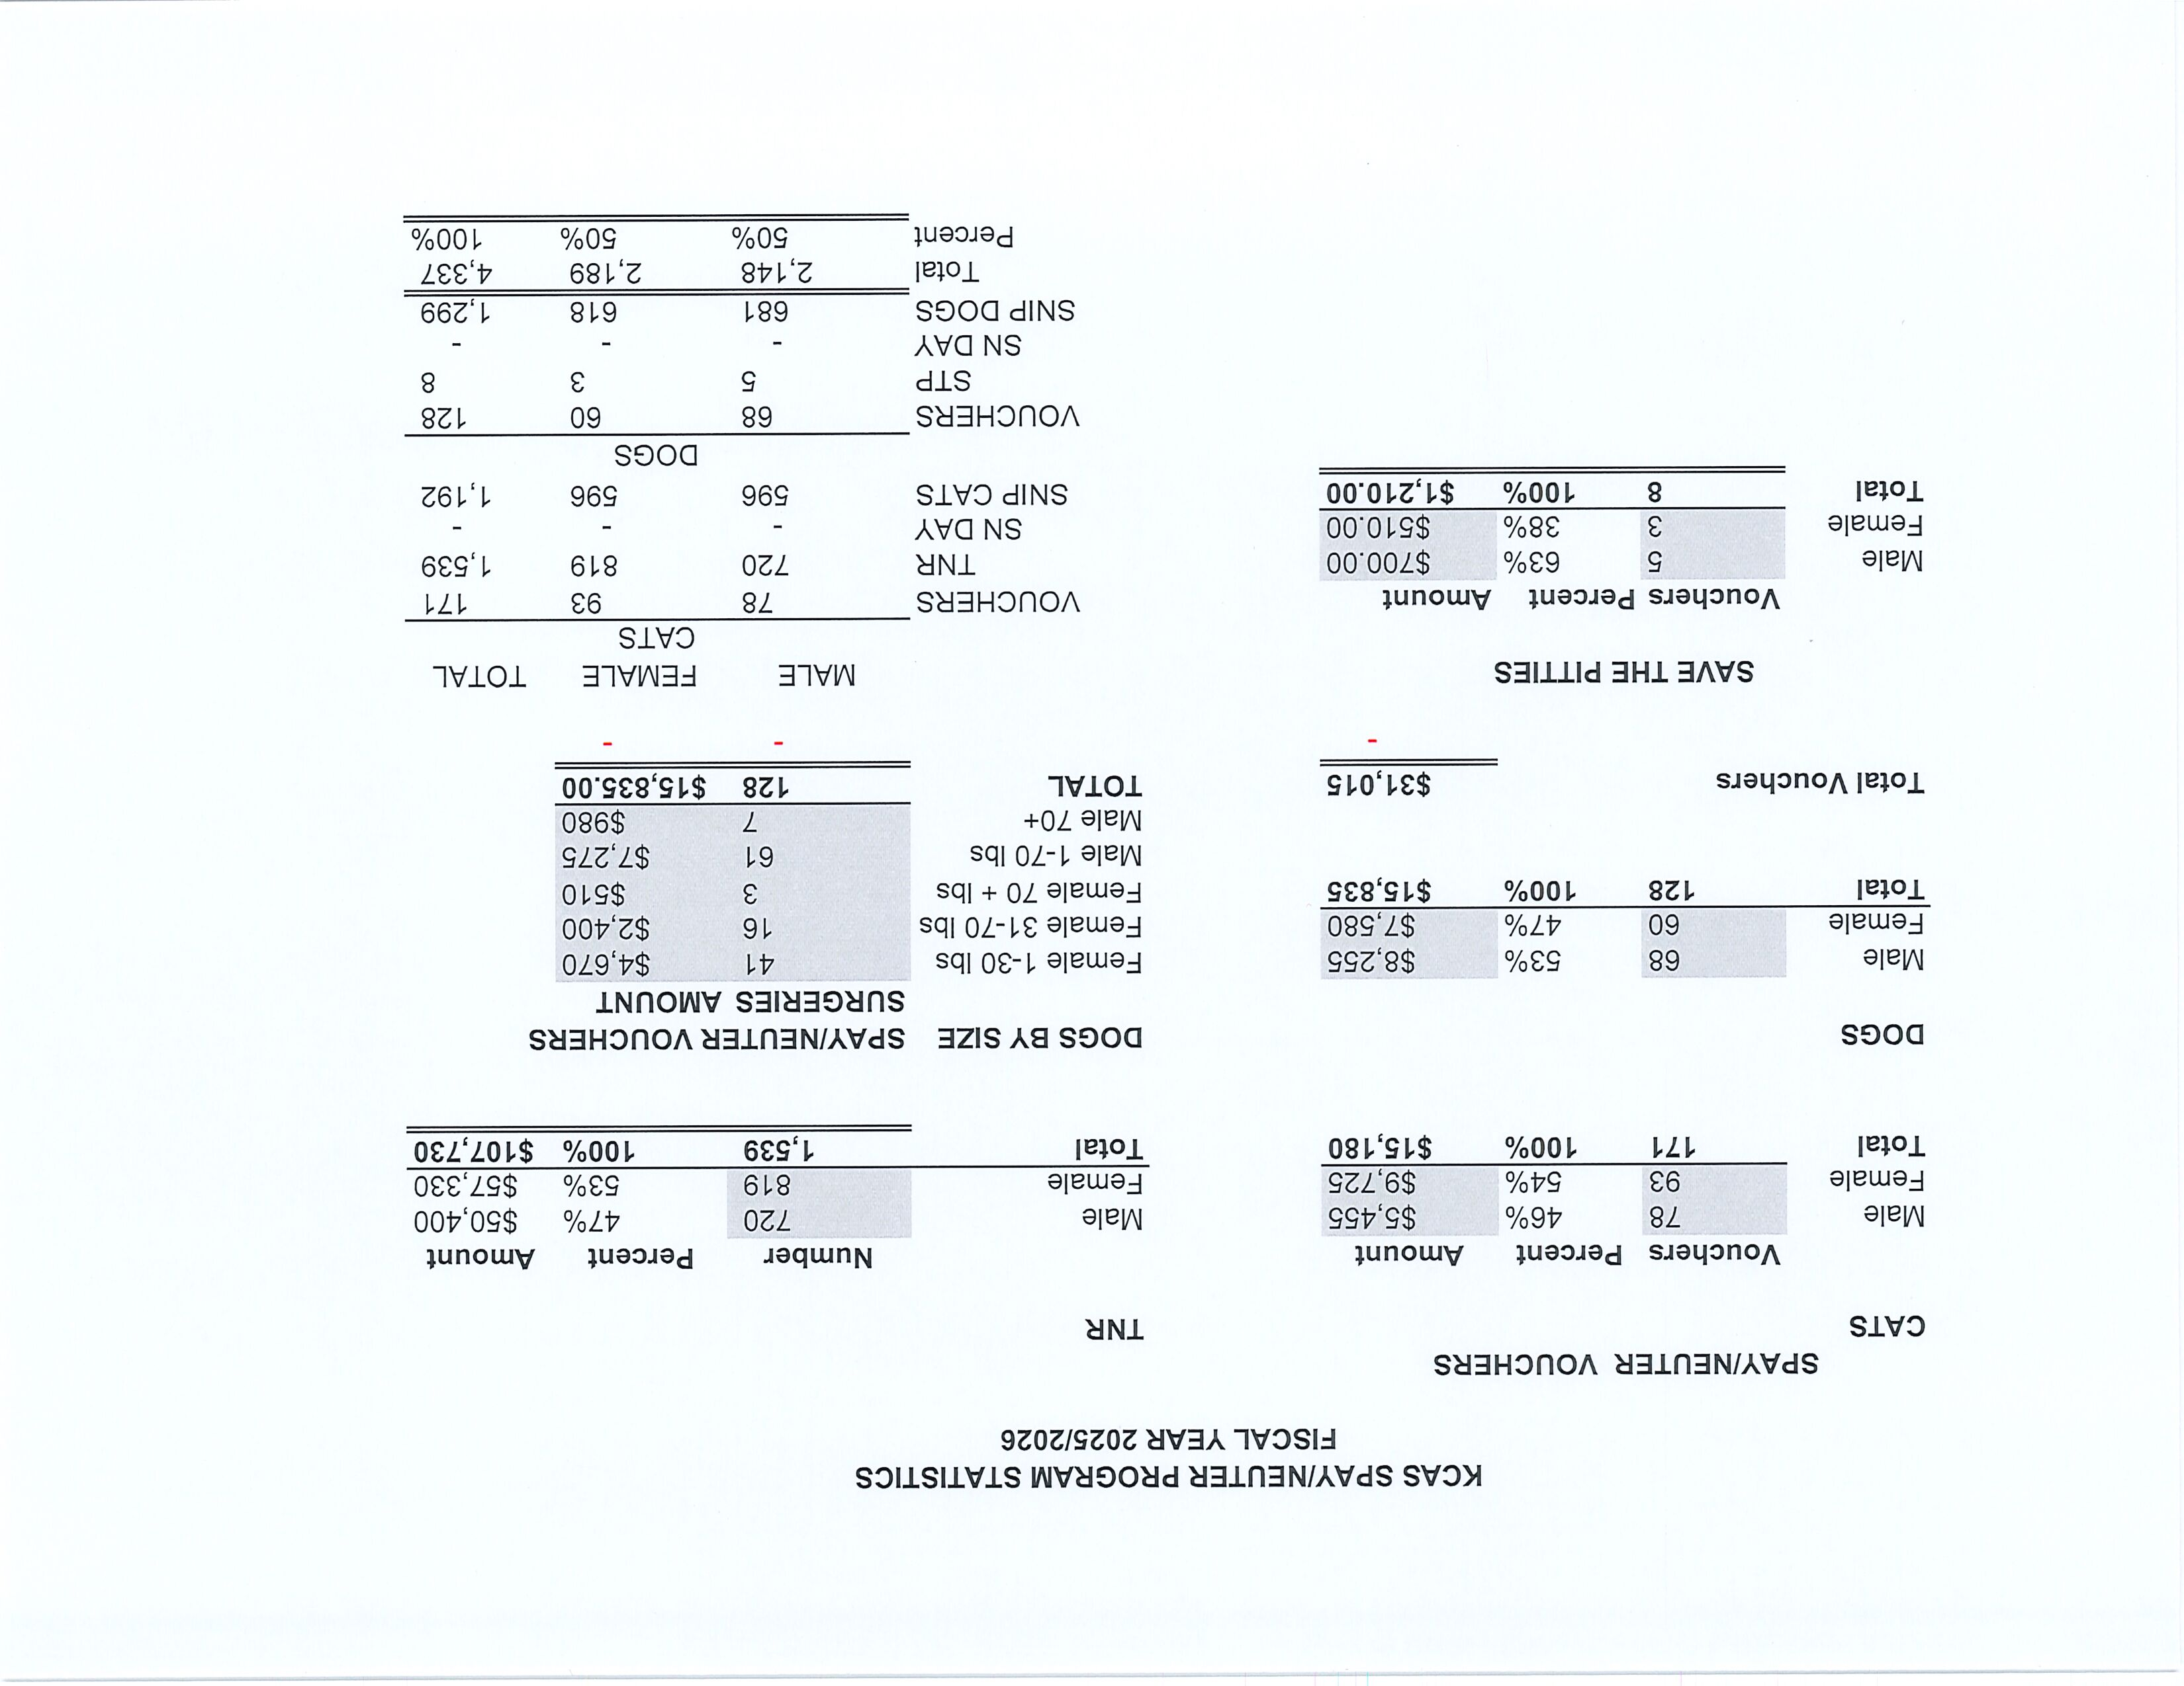

Slide 12
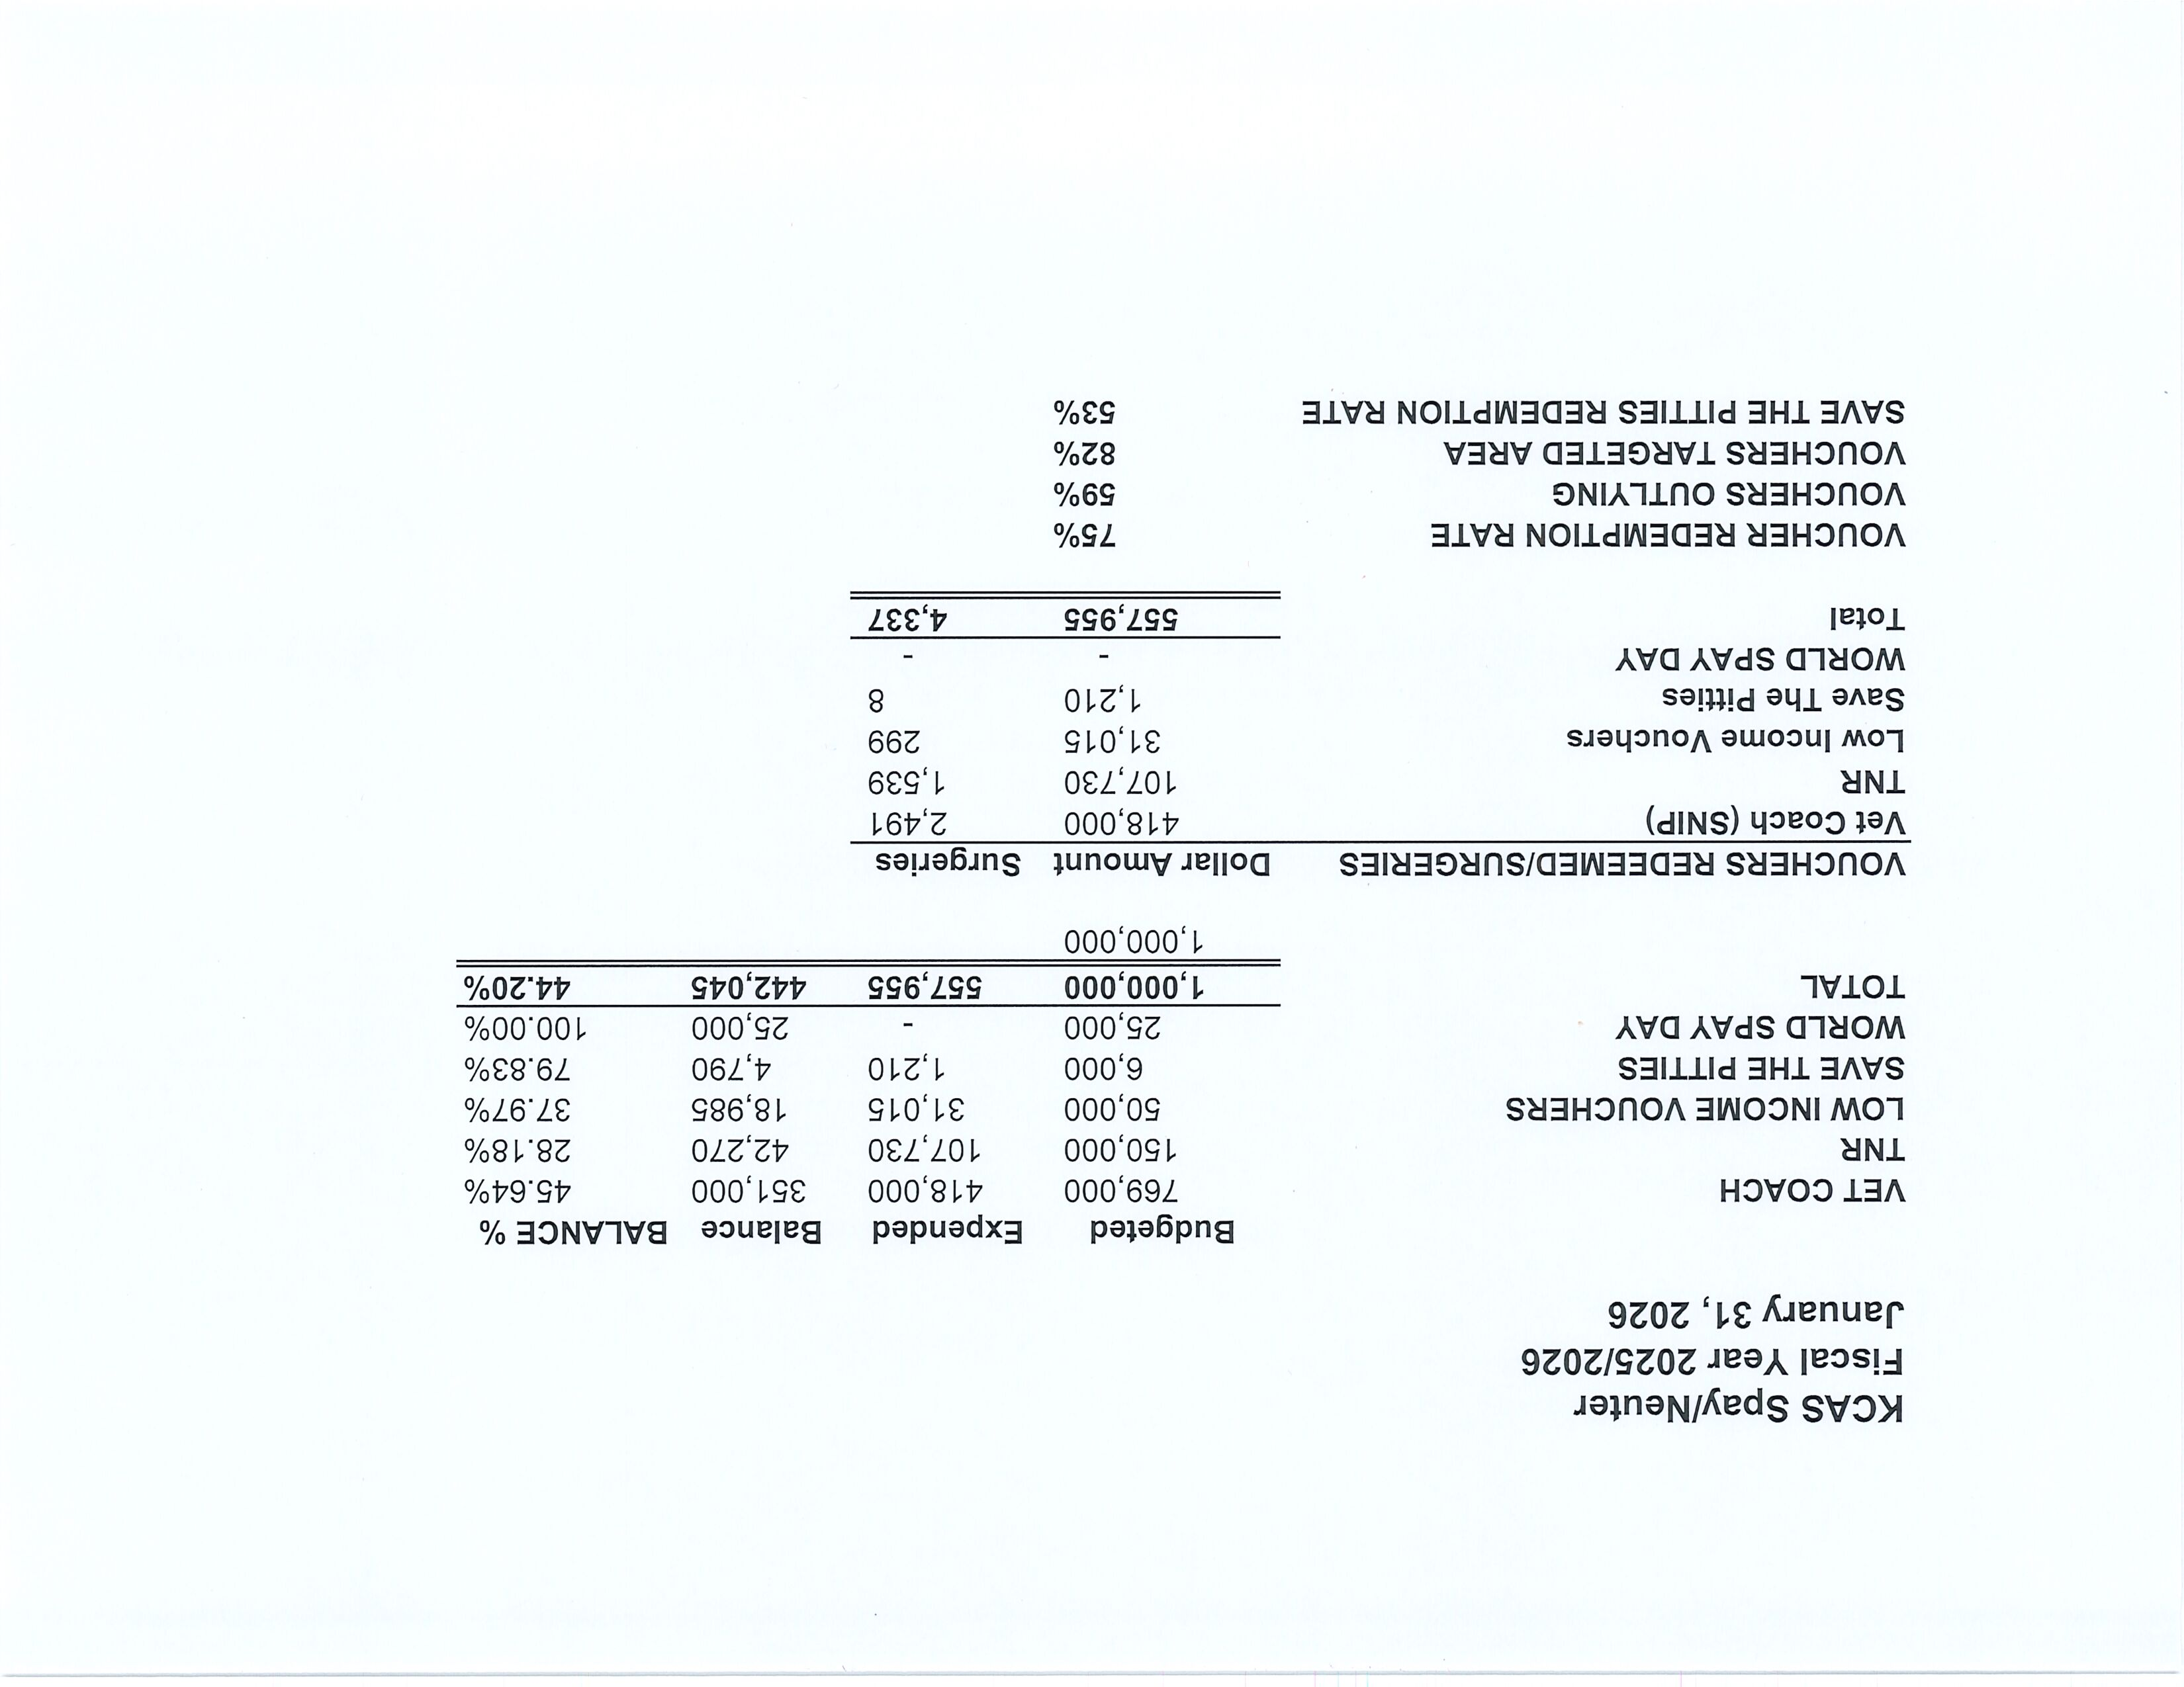

Slide 13
Field Service Calls: January 2026
AREA | CALLS PER AREA
Lake Isabella | 149
Mojave | 199
North County | 58
Northeast | 392
Northwest | 284
Ridgecrest | 31
Southeast | 231
Southwest | 209
Taft | 110
Tehachapi | 65
TOTAL | 1,728
108 dogs were returned to their owners in the field in January 2026.
181 dogs were secured on property by Animal Control Officers in January 2026.

Slide 14
Commercial Animal Facility Calls
January 2026
TYPE | CALLS PER TYPE
CAF – Breeder | 6
CAF – Rescue | 0
CAF – Kennel | 0
CAF – Boarding | 0
TOTAL | 6
3 Inspections Passed
0 Inspections Failed
0 Citations Issued
0 Permits Issued
52 Active CAF Permits

Slide 15
Volunteer Program
January 2026
Active Volunteers
99
New Volunteers
35
Volunteer hours donated in January
Year-To-Date volunteer hours donated in 2026
588.76
588.76

Slide 16
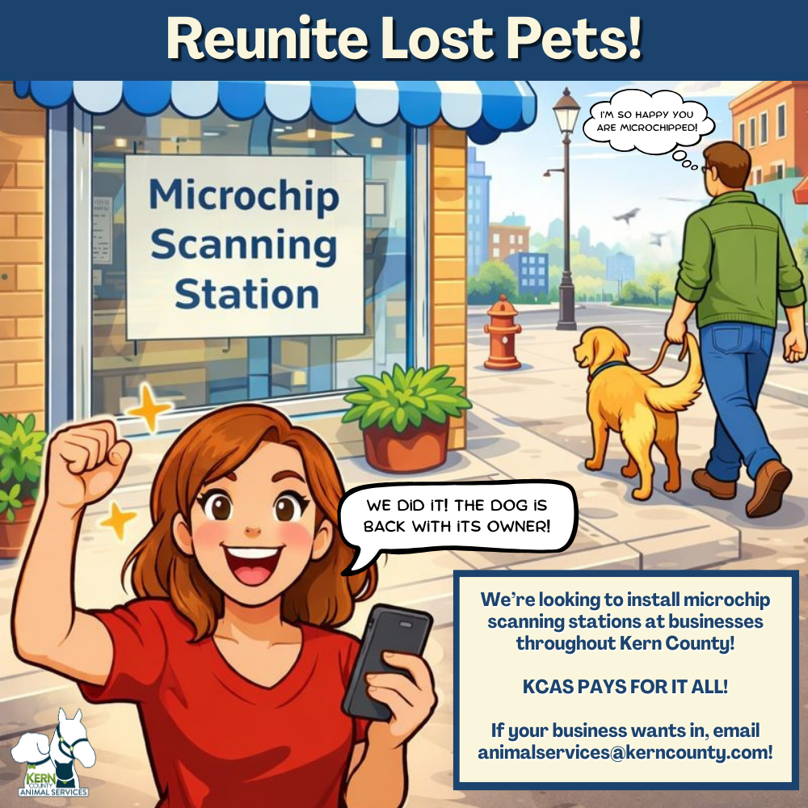
Microchip Scanning Stations
This Microchip Scanning Station Initiative from Kern County Animal Services invites local businesses to host a permanent pet microchip scanner at their location. These compact stations allow community members to quickly scan lost pets and contact their owners without needing to travel to the shelter, helping reunite families faster and reducing shelter intake. By creating a county-wide network of convenient scanning locations, this program turns everyday businesses into powerful partners in improving animal welfare across Kern County.
Scanners, instructions, and signage provided by KCAS at no cost!

Slide 17
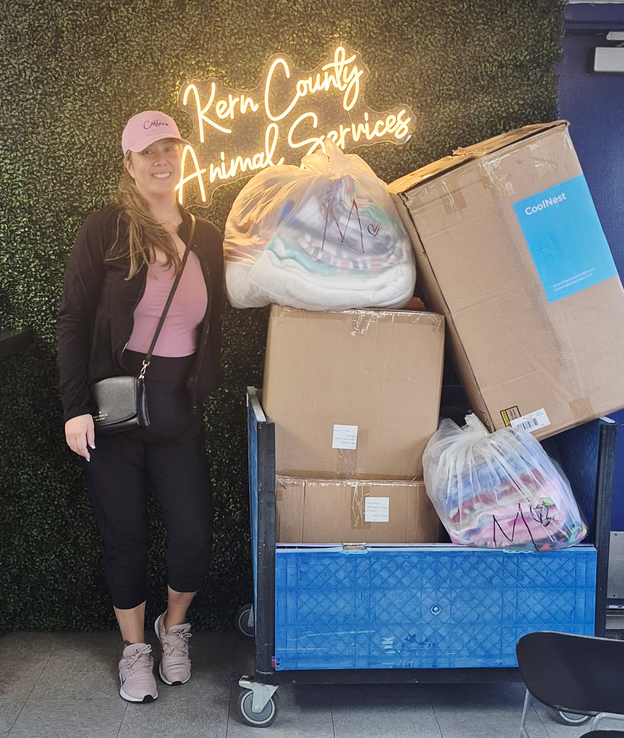
Thank you,
Aracely Morales!
A big thank-you to Aracely Morales for stepping up to help shelter pets! What began as a personal effort grew into a community act of kindness when she encouraged friends and coworkers to join in. Together they collected over 200 blankets and towels for animals in need. Her initiative shows how one person’s compassion can inspire many and make a meaningful difference for shelter pets.

Slide 18

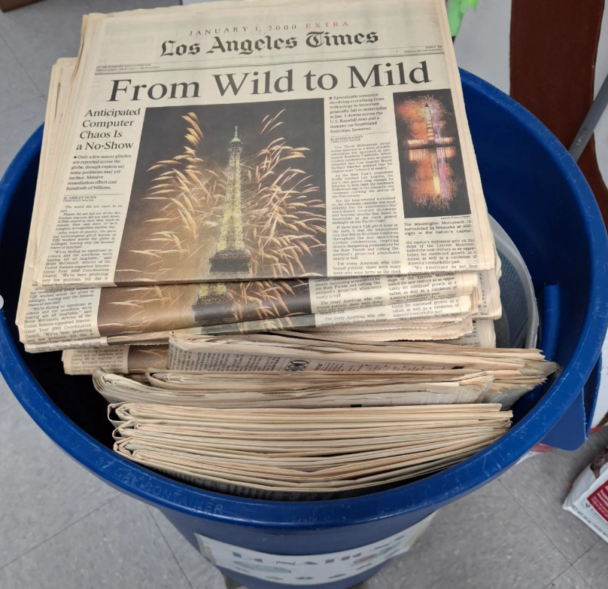
Thank you,
Kern County Library!
Thank you to Kern County Library for generously donating a full load of newspapers to Kern County Animal Services! These supplies help keep our smallest puppies and kittens comfortable and cared for in their kennels, and we truly appreciate the support for our youngest shelter residents.

Slide 19
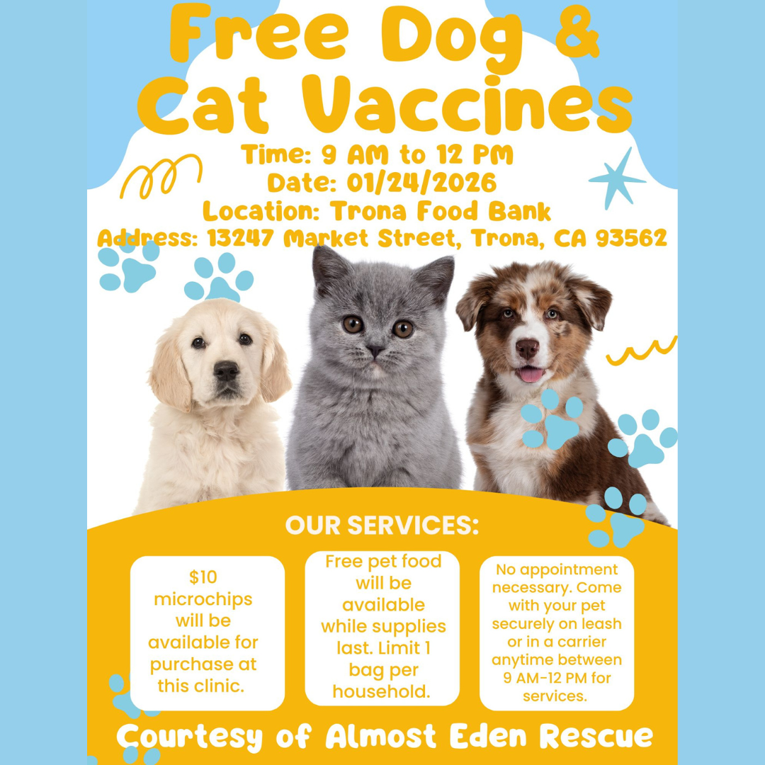

Helping Others
Help Pets
Using its largest social media platforms, Kern County Animal Services helped spotlight fellow animal welfare partners working to improve pet health across Kern County.
On January 24, Almost Eden Rescue hosted a low-cost vaccination clinic for residents of Trona, Ca.
On January 31 Kern Valley Animal Shelter and Kern Veterinary Hospital teamed up to provide another affordable vaccination clinic for their local community.

Slide 20


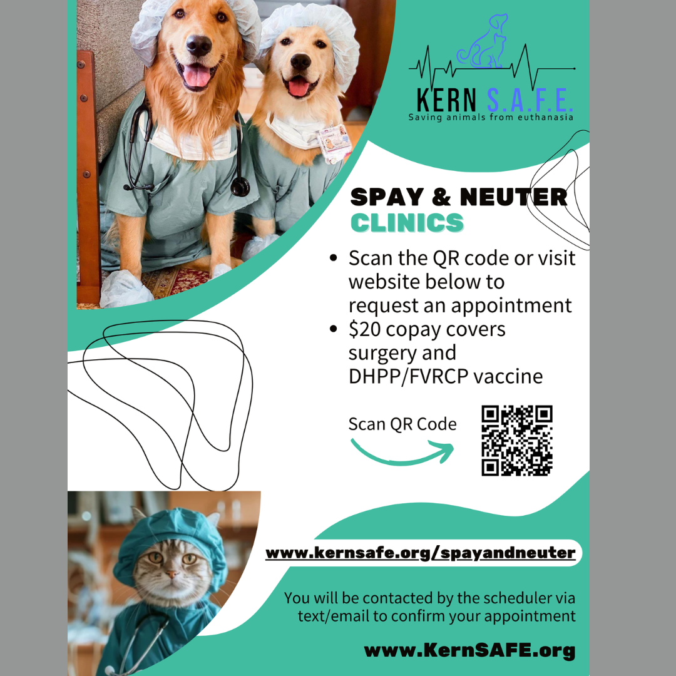
Community
Spay/Neuter
Support
Through its social media outreach, Kern County Animal Services also helped promote affordable spay/neuter resources for local pet owners.
On January 30, Almost Eden Rescue hosted a low-cost clinic serving California City and surrounding areas.
Ongoing services are also available through Kern SAFE Animal Coalition and the Regional Occupational Center’s ROC Pets program at ROC CTEC, providing continued access to affordable care throughout Kern County.

Slide 21
2026 Year To Date
January 1st – January 31st
454
Adoptions
379
Rescued
97
Returned To Owner
509
Spay/Neuter Surgeries (Clinics + TNR)
1094
Total Lives Saved
82.16%
Save Rate

Slide 22
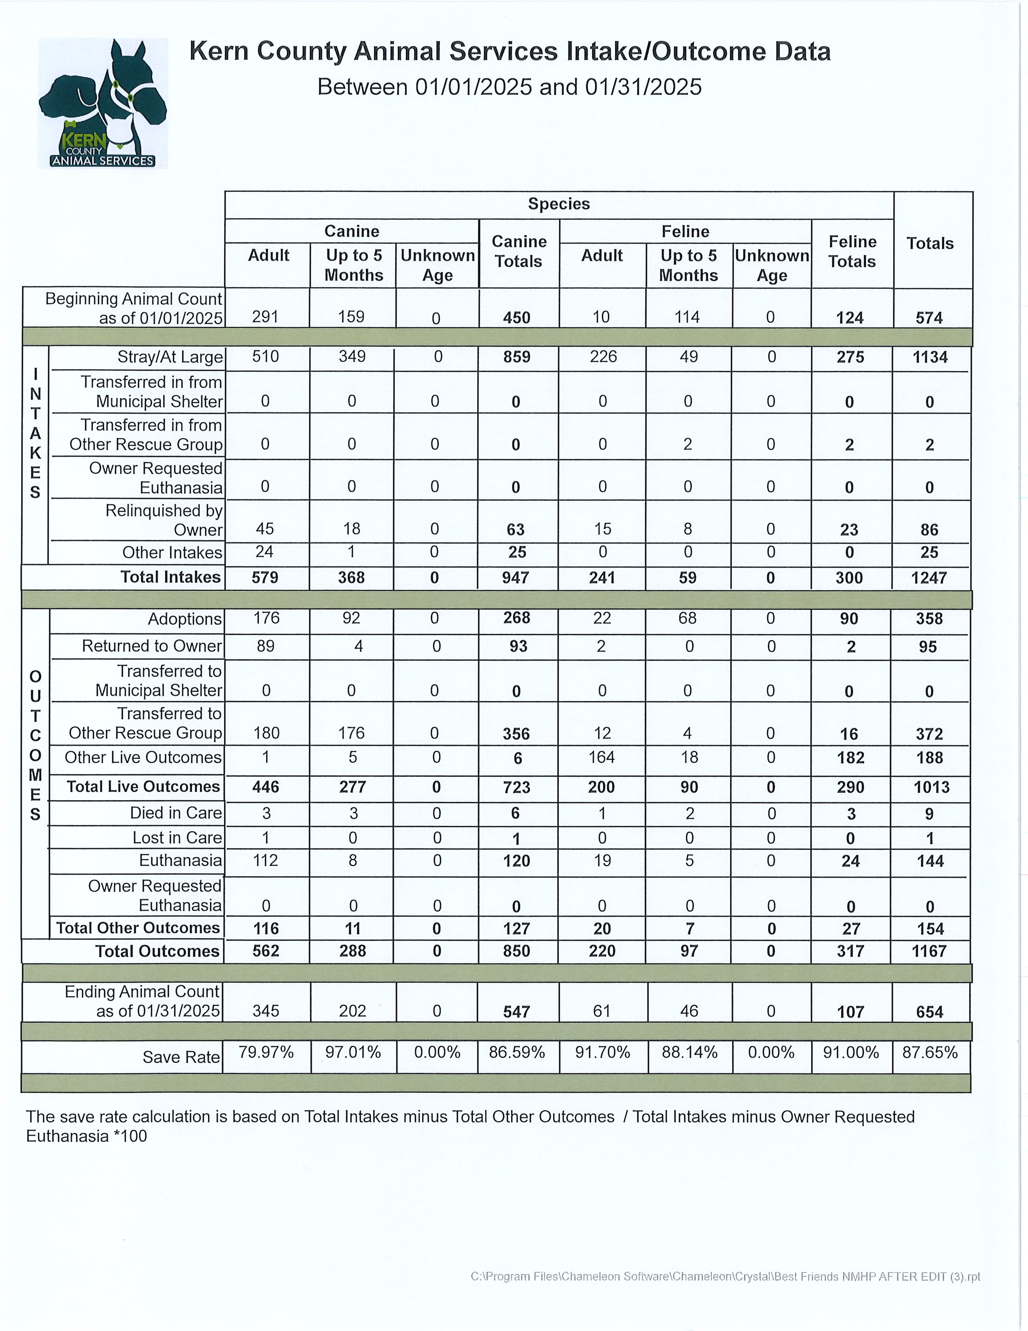

Slide 23
