Slide 1






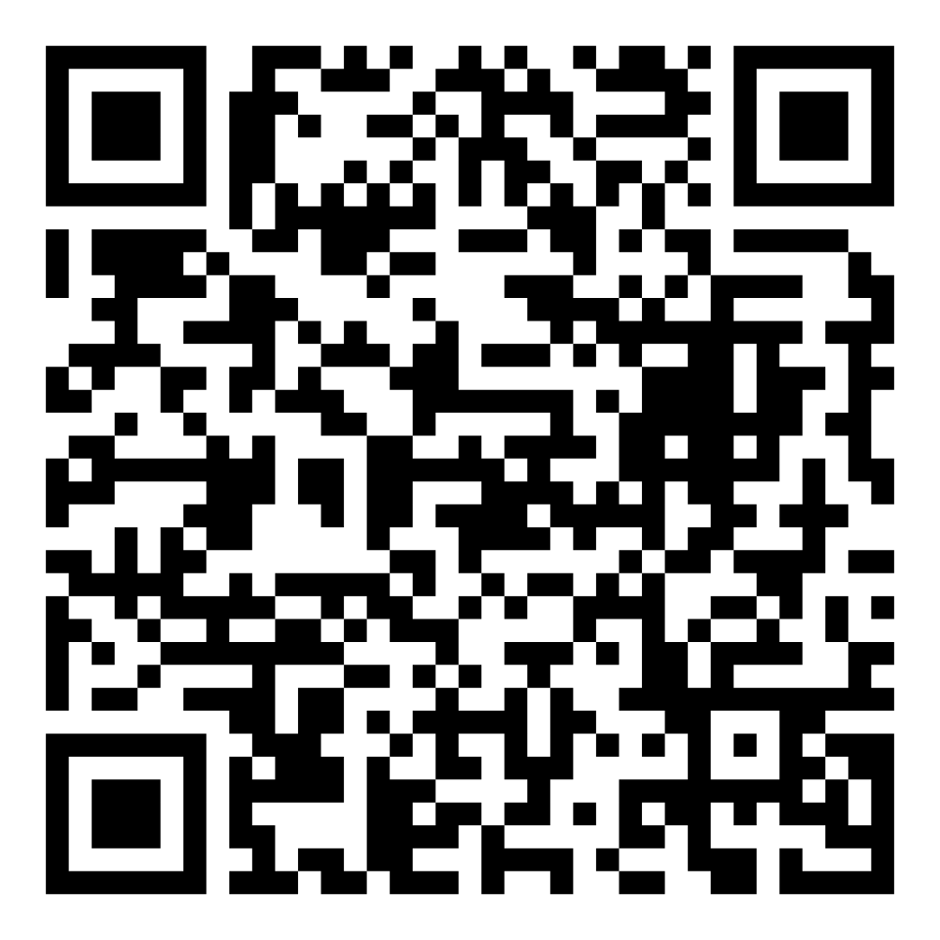
Director’s Report
February 2026

Slide 2

Program Highlights February 2026
Adoption: 150 dogs, 129 puppies, 48 cats, and 14 kittens under 5 months of age were adopted for a total of 341 animals adopted from Kern County Animal Shelters in the month of February.
Foster: 29 dogs, 39 puppies, 7 cats, 22 kittens, 1 rabbits, and 1 other animal entered the Department’s Foster Care Program in February, for a total of 99 animals.
Rescue: 183 dogs, 157 puppies, 15 cats, and 12 kittens were transferred to other animal rescue organizations in February, for a total of 367 animals.
Spay/Neuter: A total of 499 animals were altered at low-cost KCAS spay/neuter clinics in the month of February.
TNR: 110 cats were spayed or neutered and released in February. Year-to-date, 292 cats have gone through the program, and since 2013 24,334 cats have been spayed or neutered and returned to field.

Slide 3


February Adoptions February 2nd – February 28th

Slide 4

Fee-Waived Valentine Adoptions February 14th

Slide 5


Caturday Adoptions Saturday, February 28th

Slide 6



Offsite Adoption Events:
February 1st, 7th, 8th

Slide 7



Offsite Adoption Events:
February 13th, 14th, 15th

Slide 8

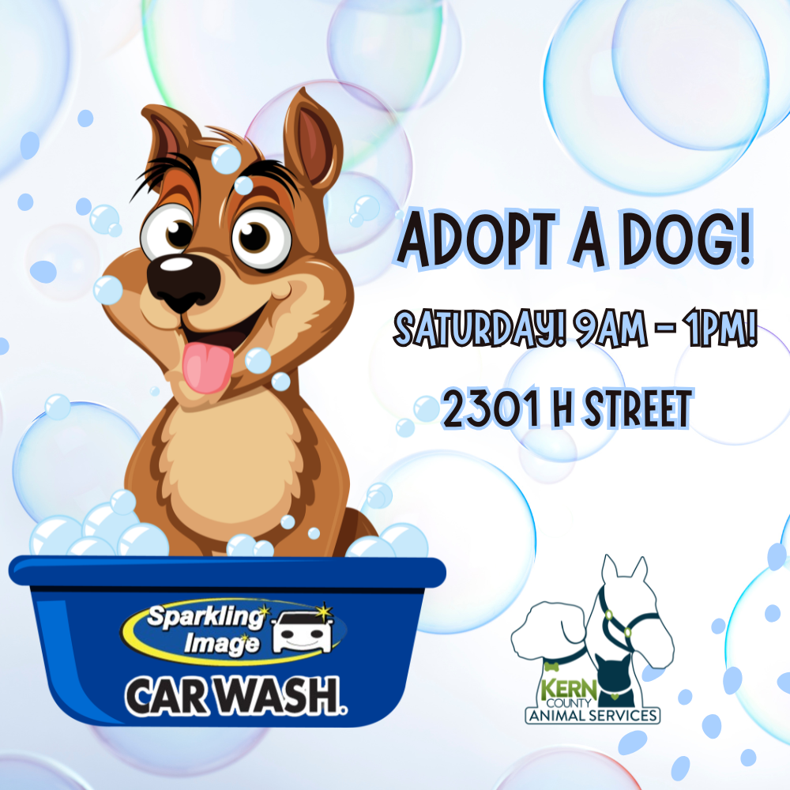

Offsite Adoption Events:
February 20th, 21st, 22nd

Slide 9

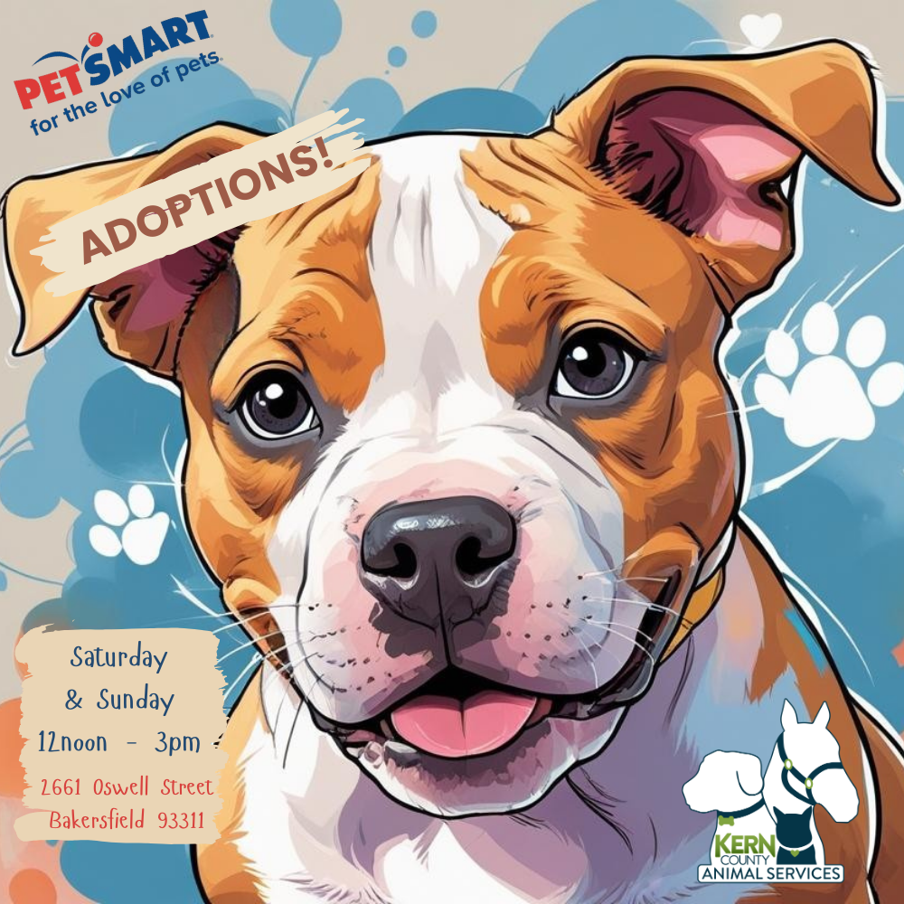
Offsite Adoption Events:
February 27th, 28th

Slide 10

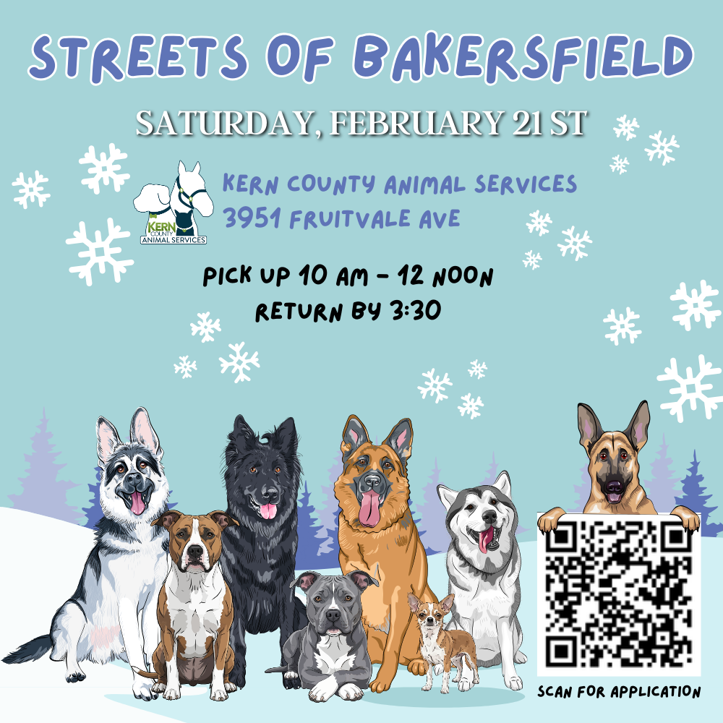
Streets of Bakersfield February 7th & February 21st

Slide 11
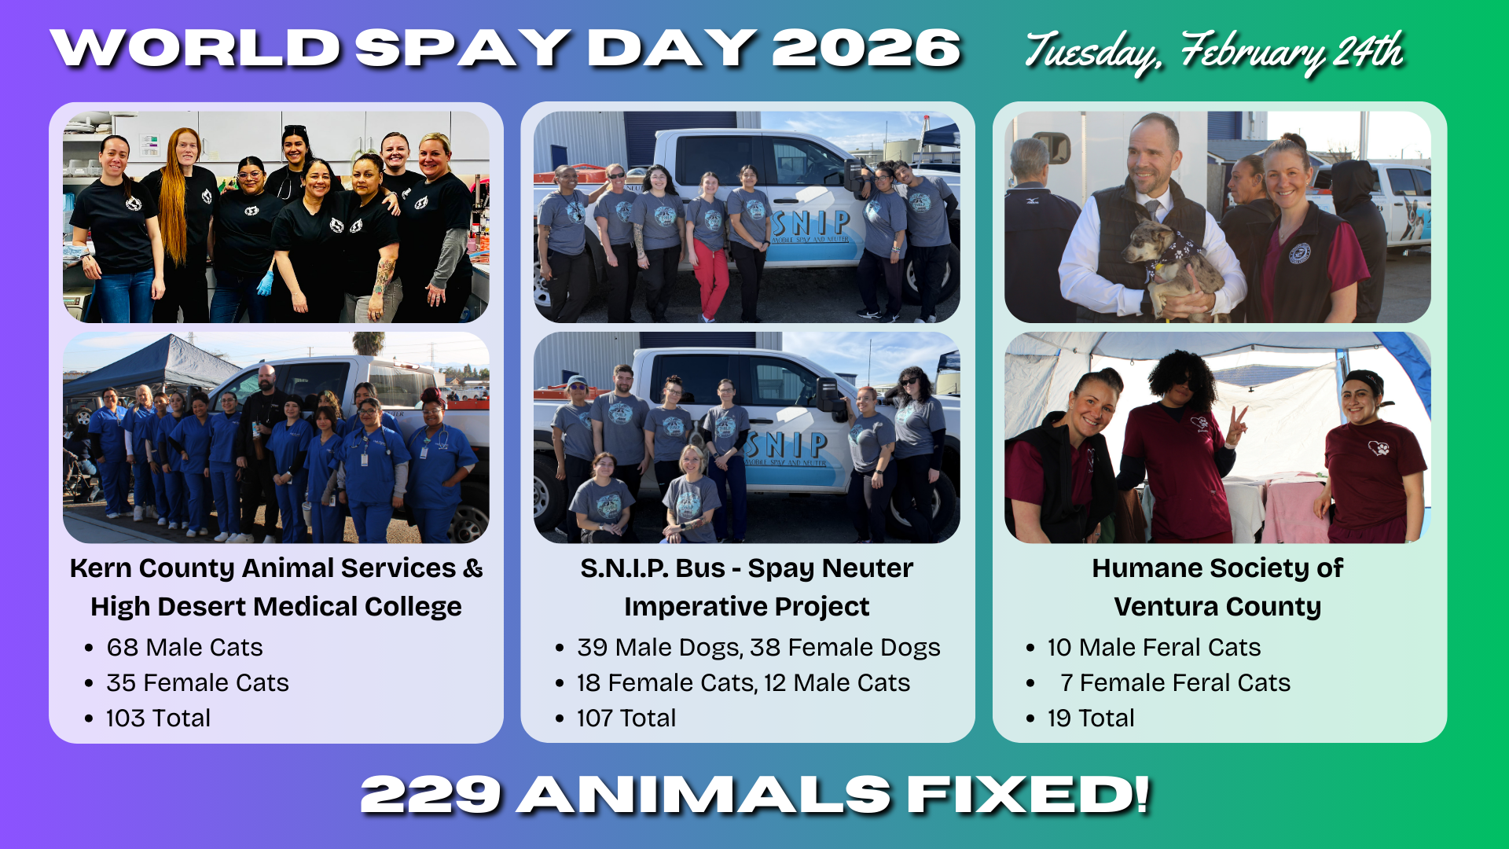

Slide 12
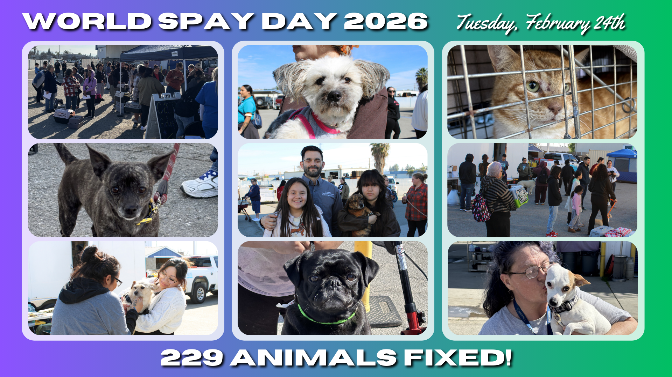

Slide 13
Low-Cost Spay/Neuter Clinics February 2026
Date | Location | Surgeries
February 4th | Kern River Valley | 90
February 5th | Green Gardens | 61
February 12th | Heritage Park | 65
February 18th | Dogtopia | 55
February 21st | Virginia Park | 63
February 24th | World Spay Day at KCAS | 107
February 25th | Heritage Park | 58
 | Total Surgeries | 499

Slide 14
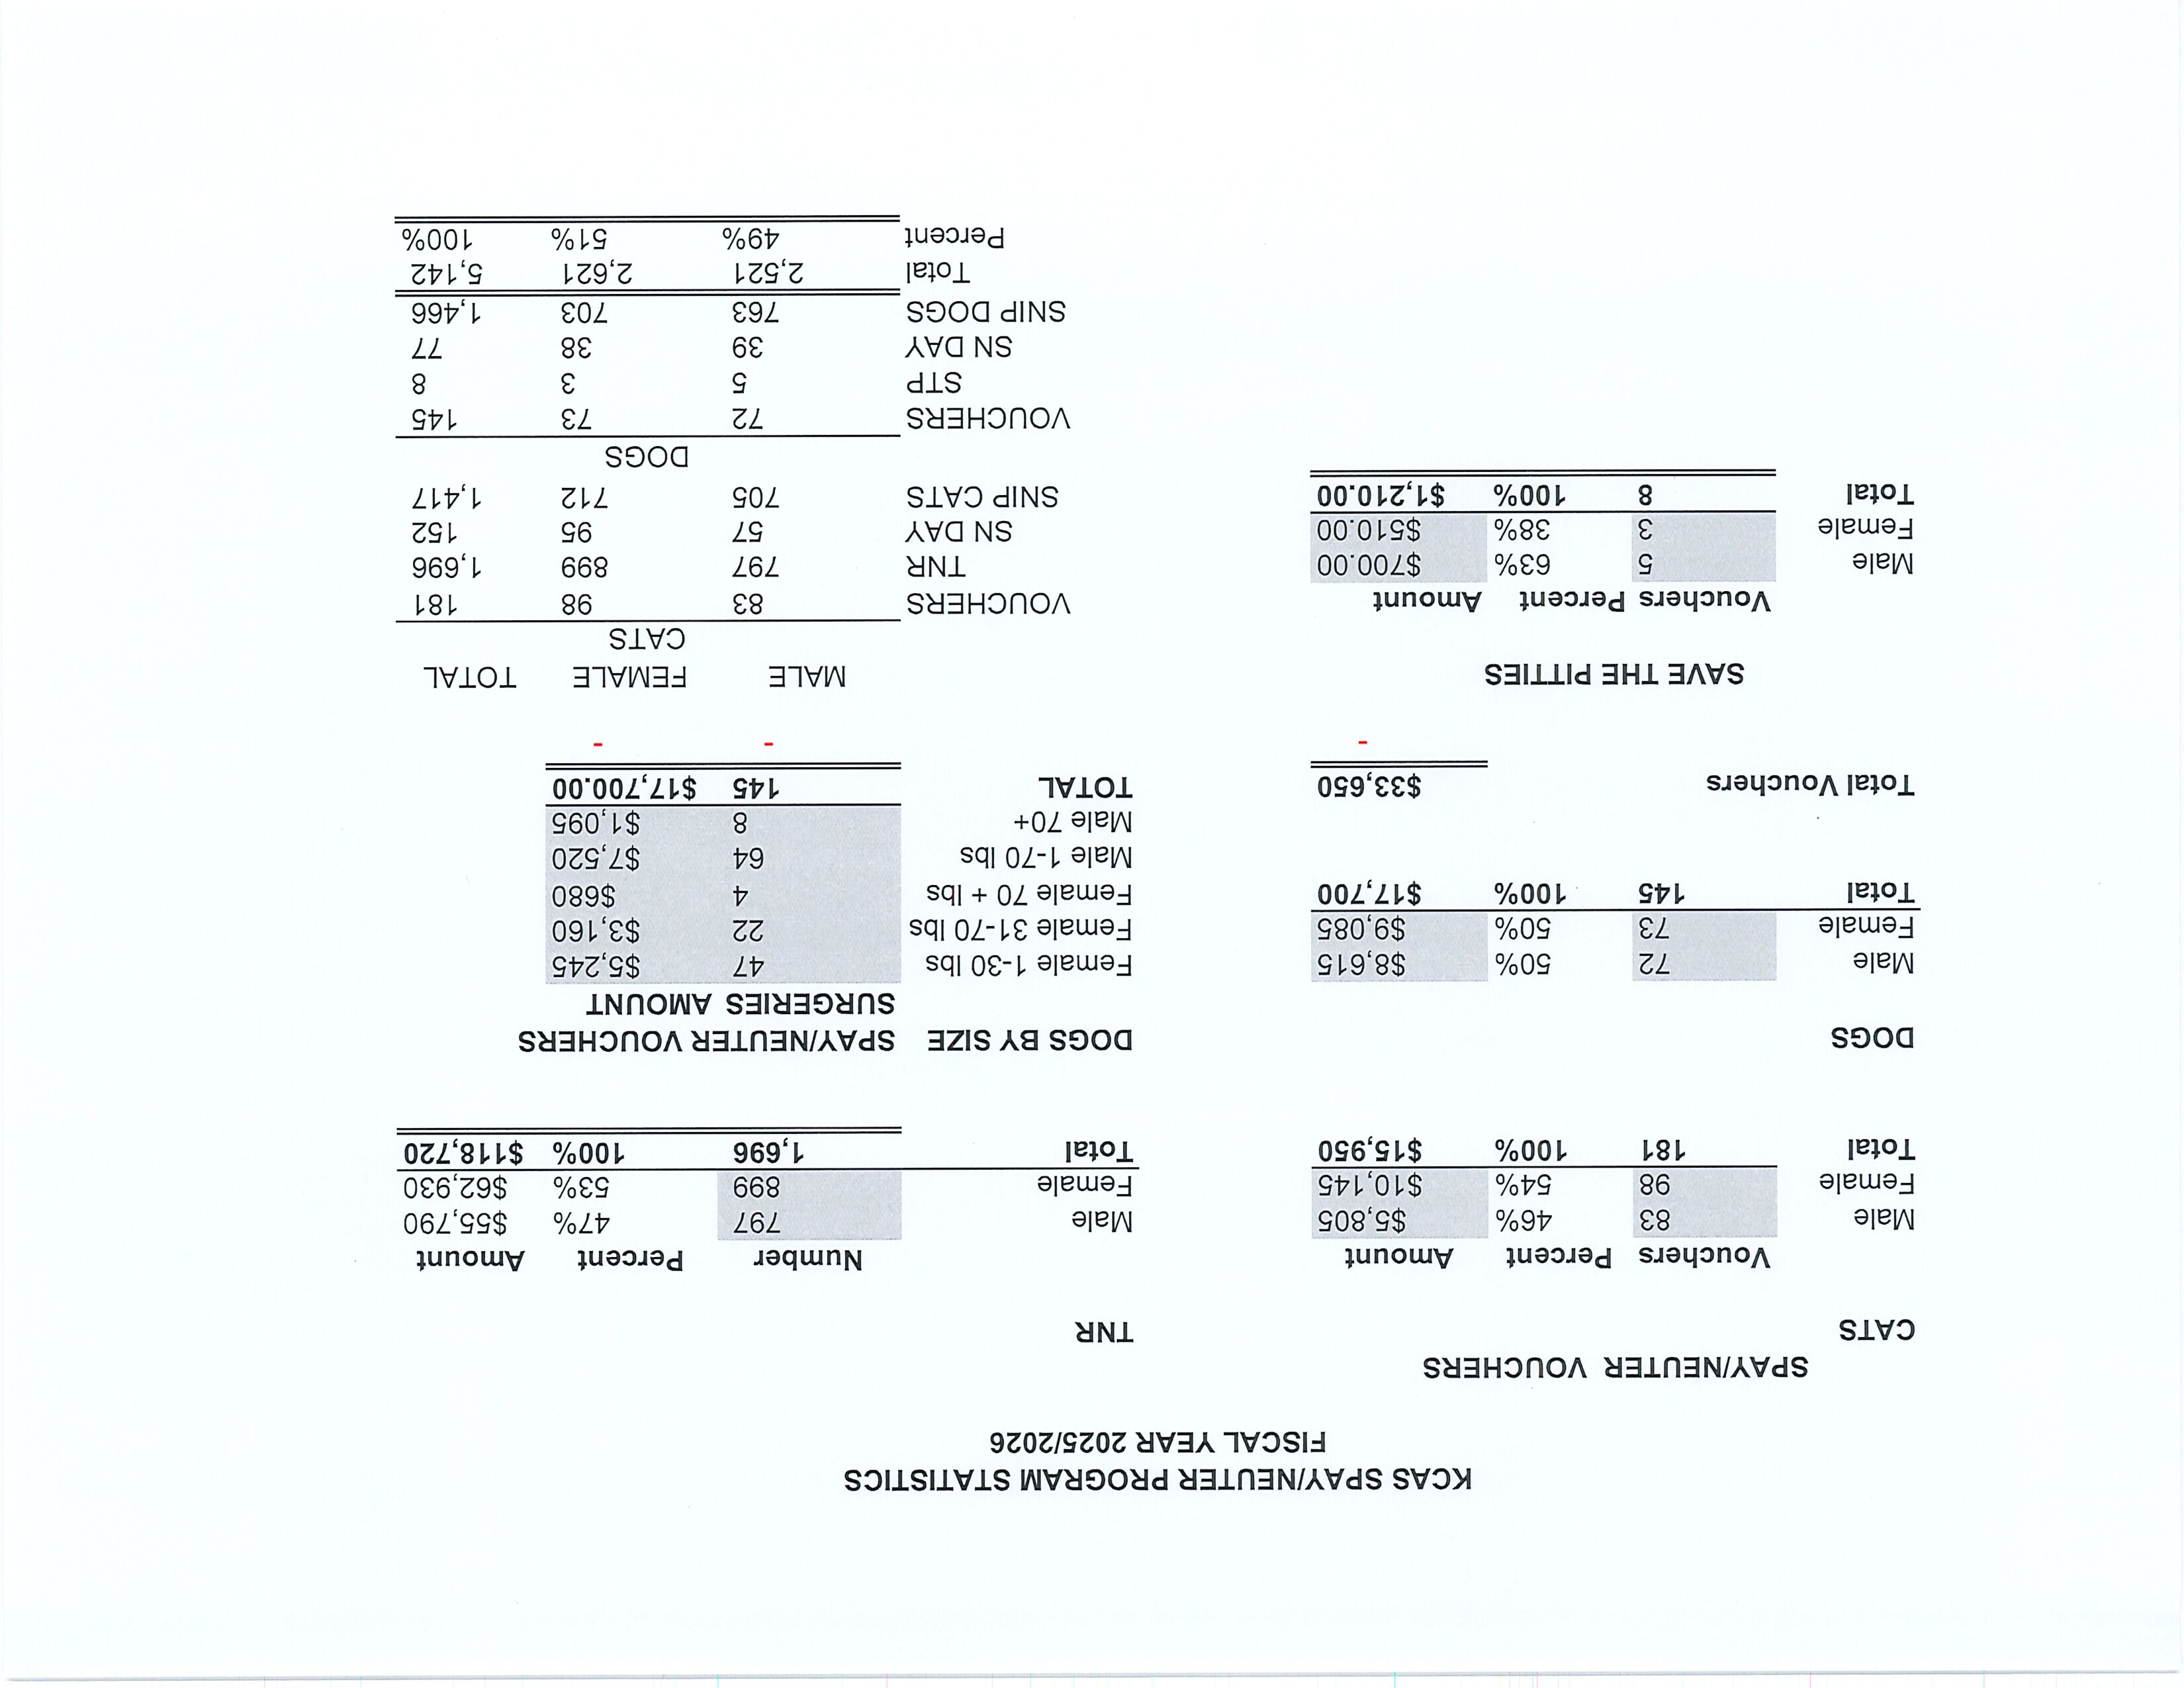

Slide 15
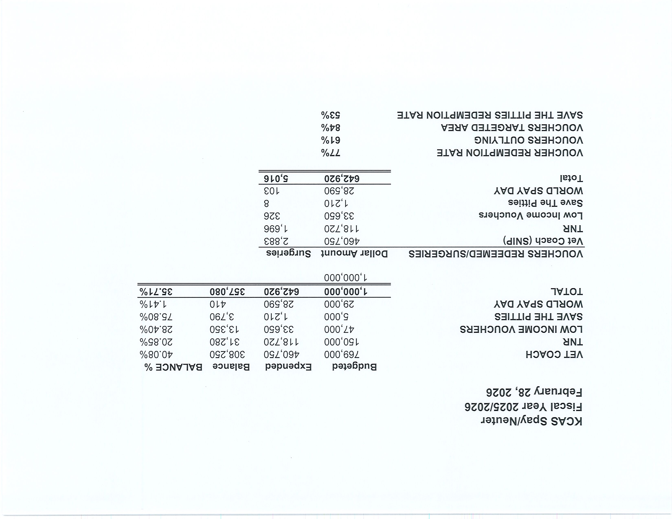

Slide 16
Low-Cost Vaccination Clinics February 2026
Rabies
527
Microchips
Bordetella
78
123
DHPP* 413
FVRPC* 223
*DHPP and FVRCP vaccinations provided at no-cost by Petco Love.

Slide 17
Field Service Calls: February 2026
AREA | CALLS PER AREA
Lake Isabella | 140
Mojave | 115
North County | 40
Northeast | 360
Northwest | 274
Ridgecrest | 36
Southeast | 197
Southwest | 162
Taft | 142
Tehachapi | 54
TOTAL | 1,520
24 dogs were returned to their owners in the field in February 2026.
96 dogs were secured on property by Animal Control Officers in February 2026.

Slide 18
Commercial Animal Facility Calls
February 2026
TYPE | CALLS PER TYPE
CAF – Breeder | 5
CAF – Rescue | 0
CAF – Kennel | 0
CAF – Boarding | 0
TOTAL | 5
1 Inspections Passed
0 Inspections Failed
0 Citations Issued
0 Permits Issued
52 Active CAF Permits

Slide 19
Volunteer Program February 2026
Active Volunteers
84
New Volunteers
67
Volunteer hours donated in February
Year-To-Date volunteer hours donated in 2026
520.93
1109.69

Slide 20
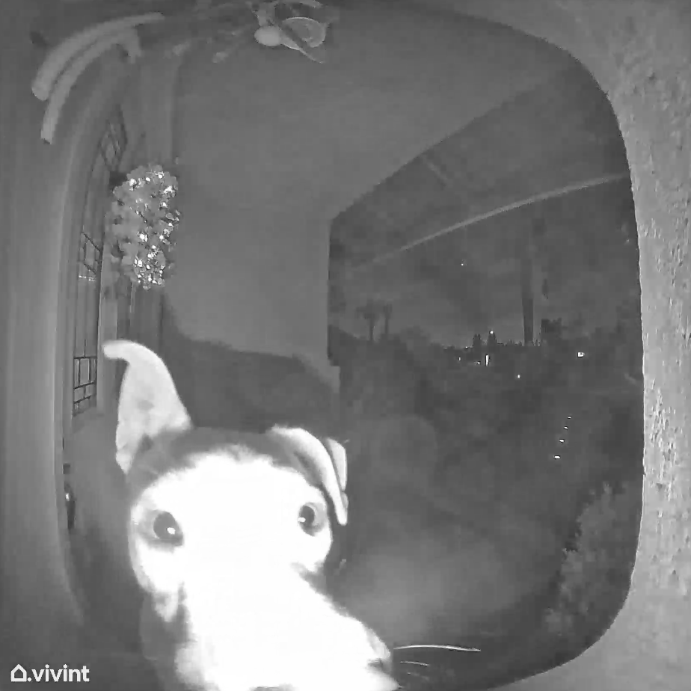
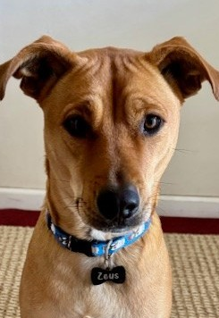
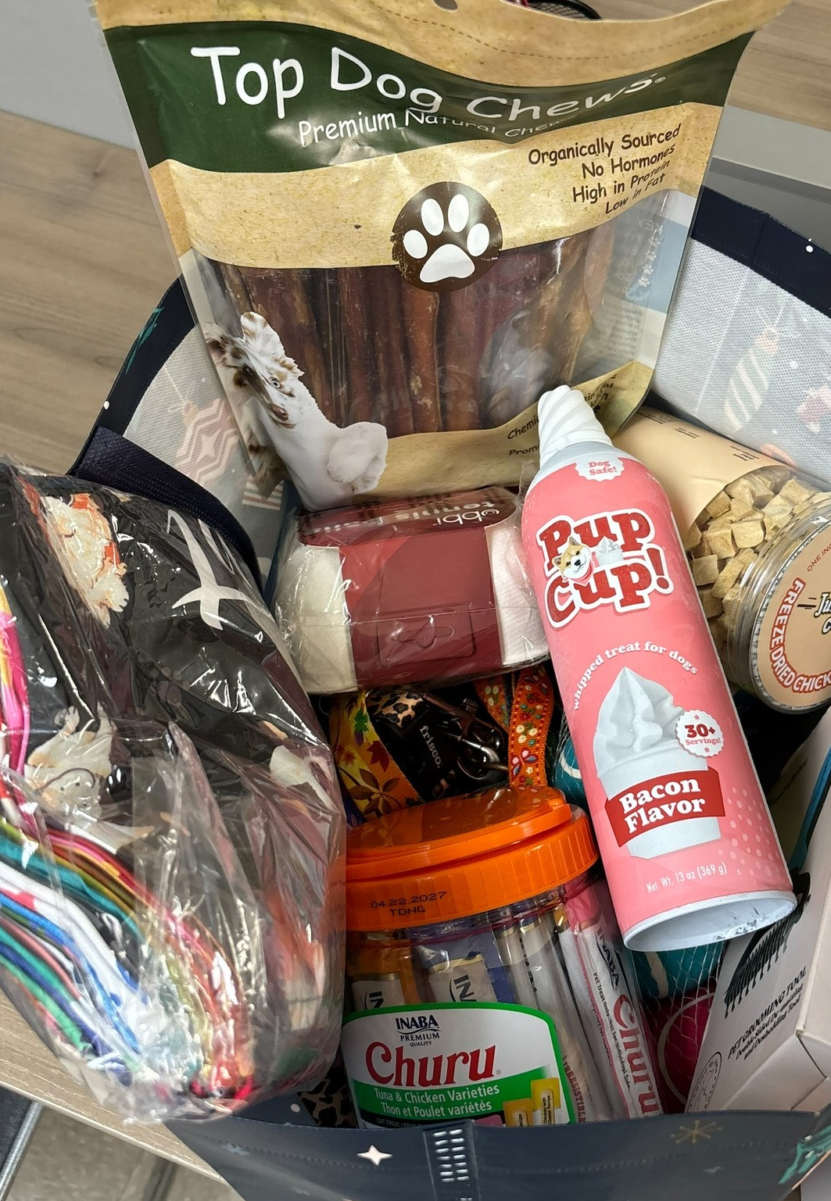
Donations from Zeus!
About a year ago, Zeus rang a family’s doorbell while lost and chose to stay on their porch until he got help. Though he had a microchip, his owner never responded, and over time, Zeus found his forever home with the family who took him in.
In February, Zeus and his mom, Renee, came to the shelter to help dogs who haven’t been as lucky as he was. They donated toys, supplies, and more for pets still waiting for their second chance.

Slide 21
2026 Year To Date January 1st – February 28th
795
Adoptions
747
Rescued
171
Returned To Owner
509
Spay/Neuter Surgeries (Clinics + TNR)
2,597
Total Lives Saved
82.69%
Save Rate

Slide 22
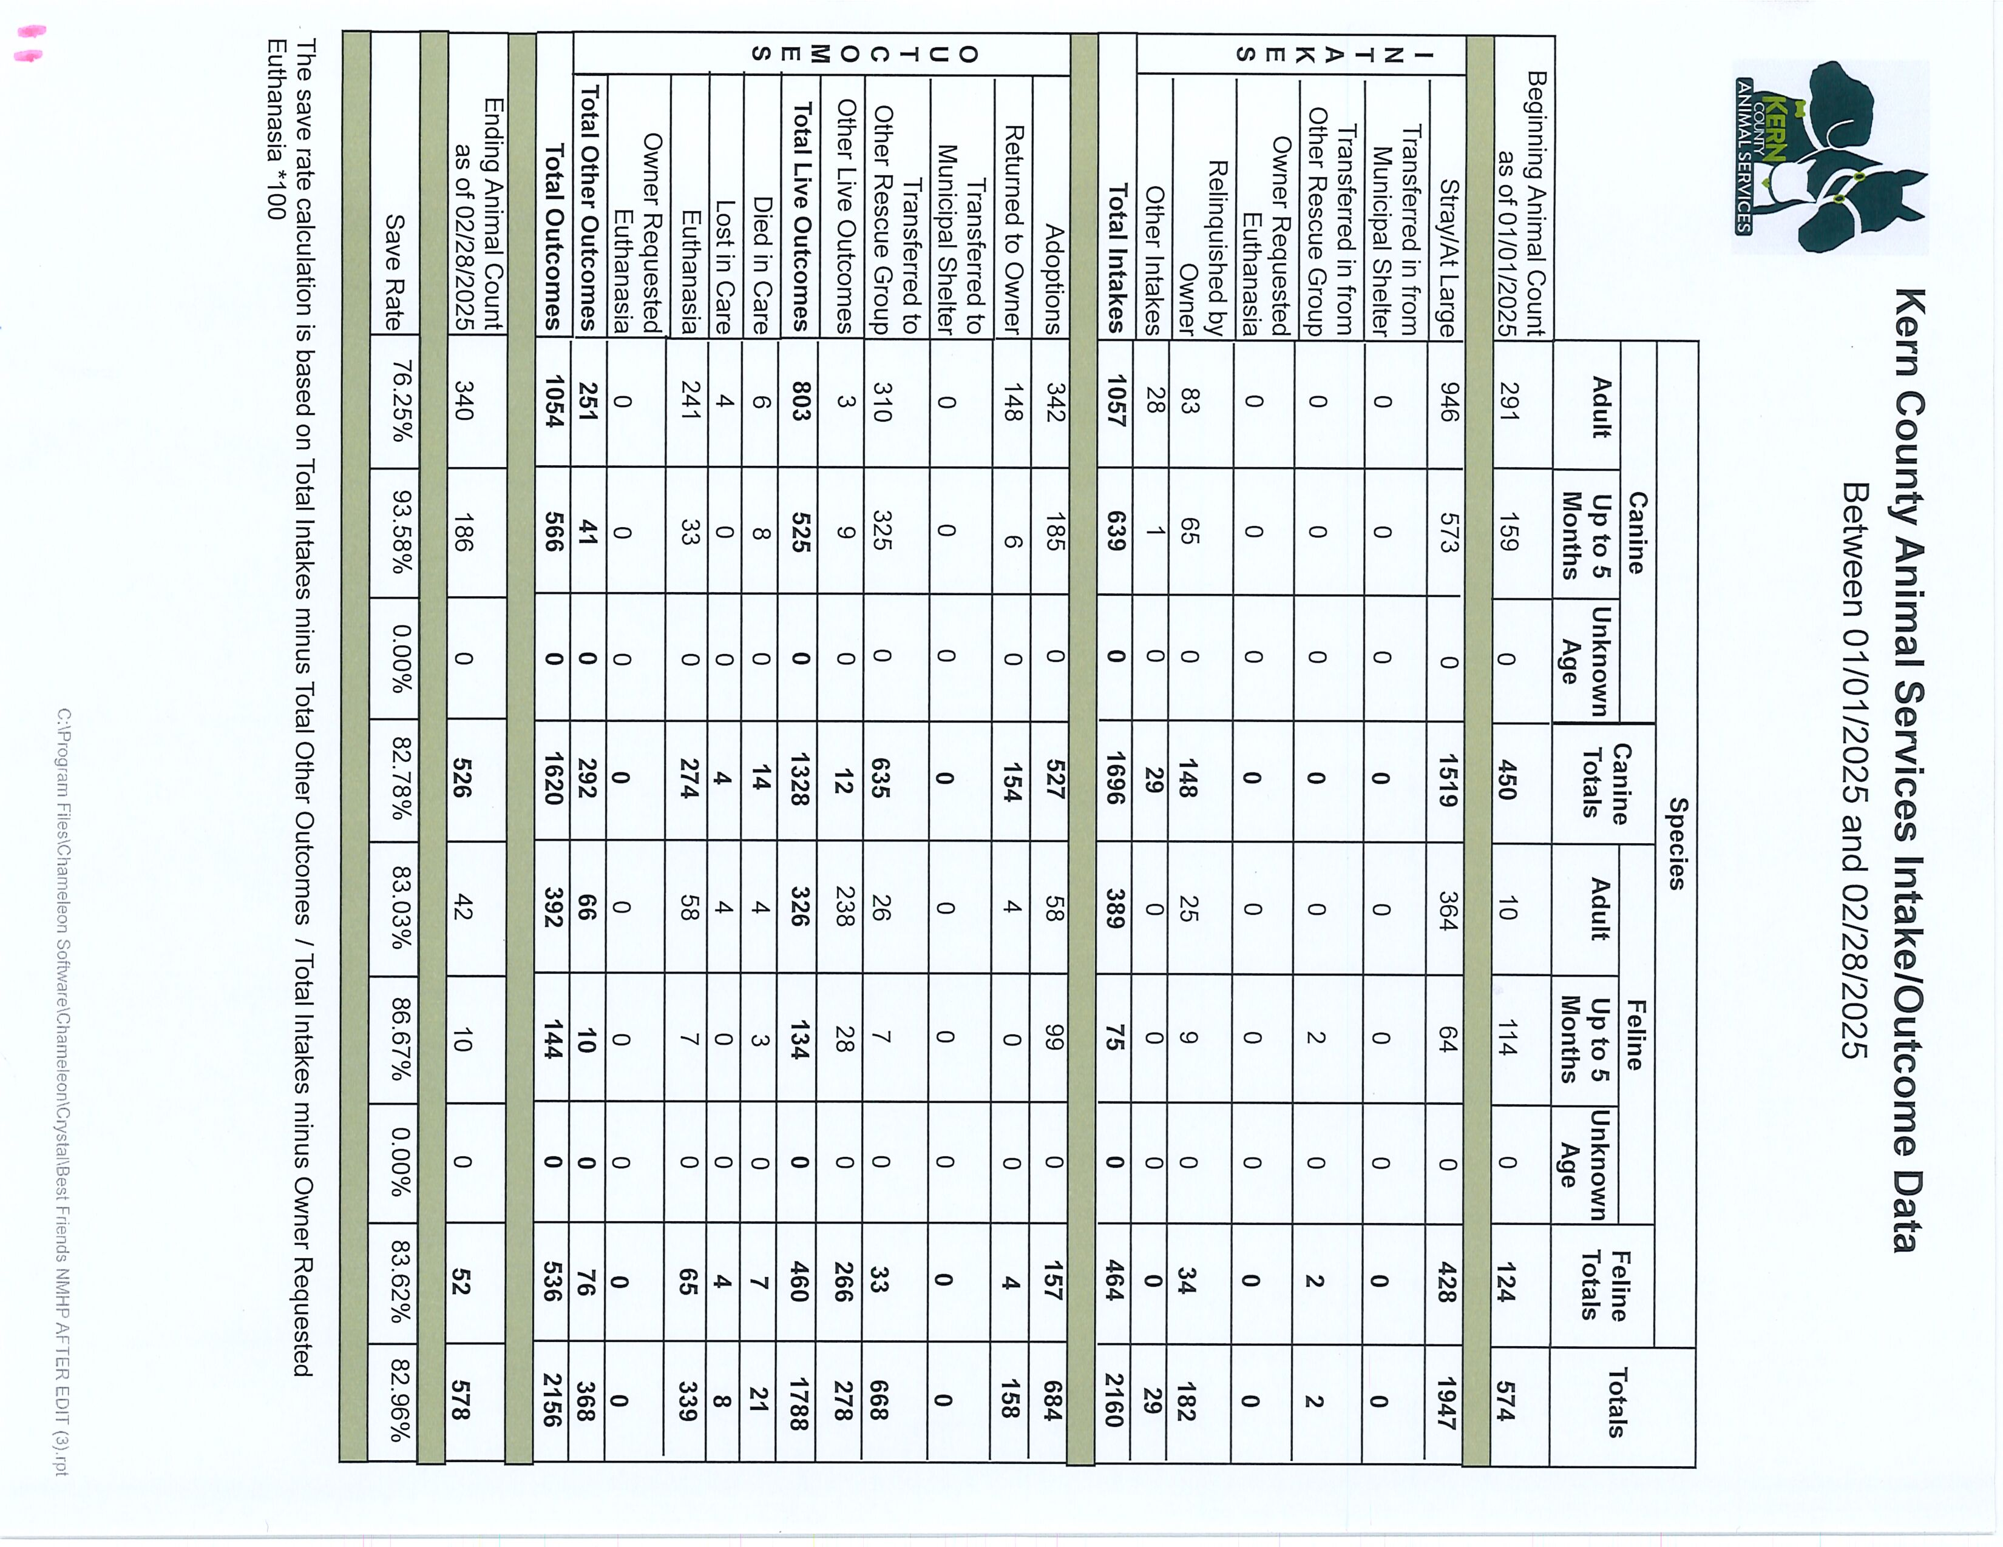

Slide 23
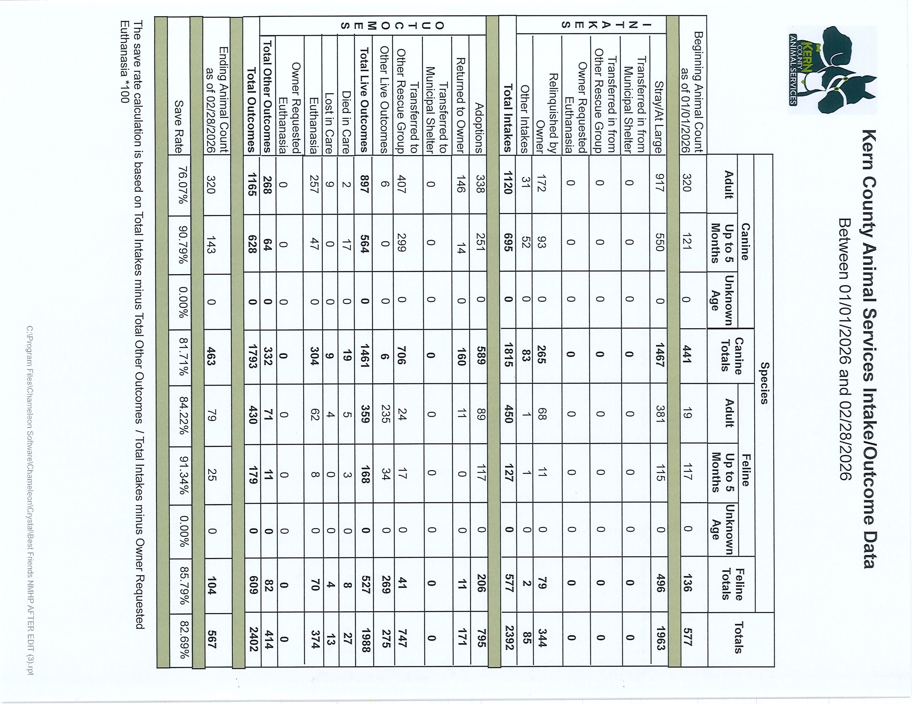

Slide 24
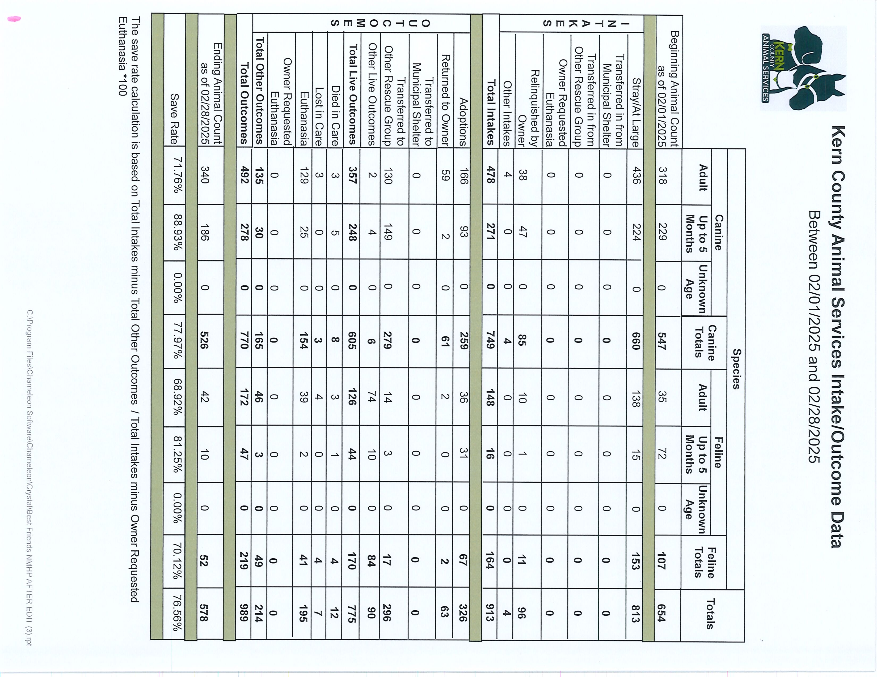

Slide 25
