Slide 1

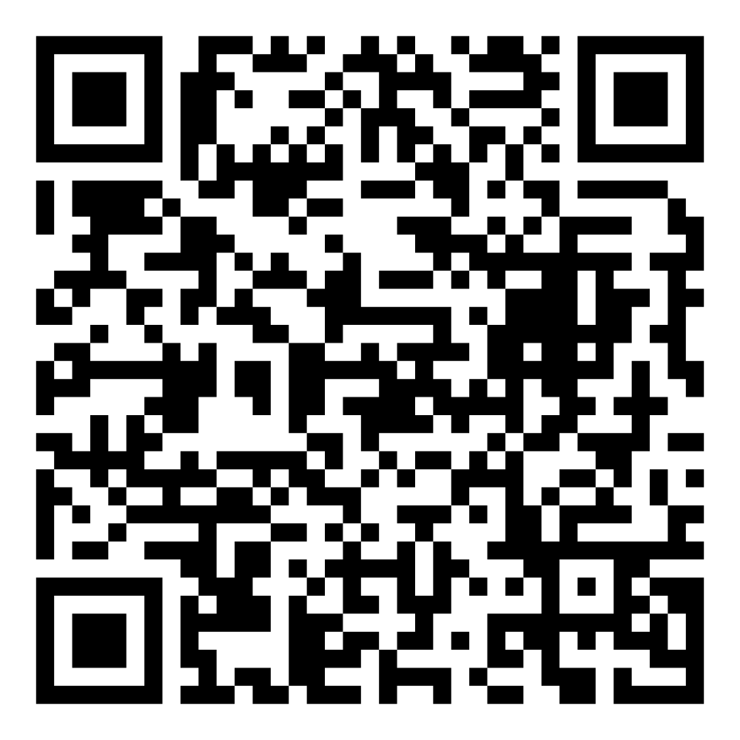
Director’s Report
March 2026

Slide 2



Program Highlights March 2026
Adoption: 165 dogs, 116 puppies, 75 cats, and 9 kittens under 5 months of age were adopted for a total of 365 animals adopted from Kern County Animal Shelters in the month of March.
Foster: 30 dogs, 53 puppies, 2 cats, 118 kittens, and 1 other animal entered the Department’s Foster Care Program in March, for a total of 204 animals.
Rescue: 148 dogs, 93 puppies, 15 cats, and 27 kittens were transferred to other animal rescue organizations in March, for a total of 283 animals.
Spay/Neuter: A total of 357 animals were altered at low-cost KCAS spay/neuter clinics in the month of March.
TNR: 192 cats were spayed or neutered and released in March. Year-to-date, 530 cats have gone through the program, and since 2013 24,704 cats have been spayed or neutered and returned to field.

Slide 3
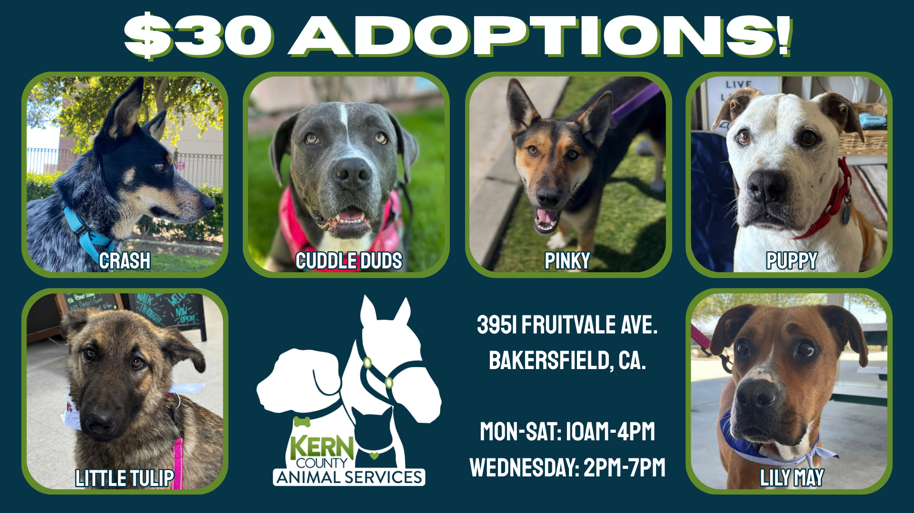
March Adoptions March 2nd – March 28th

Slide 4
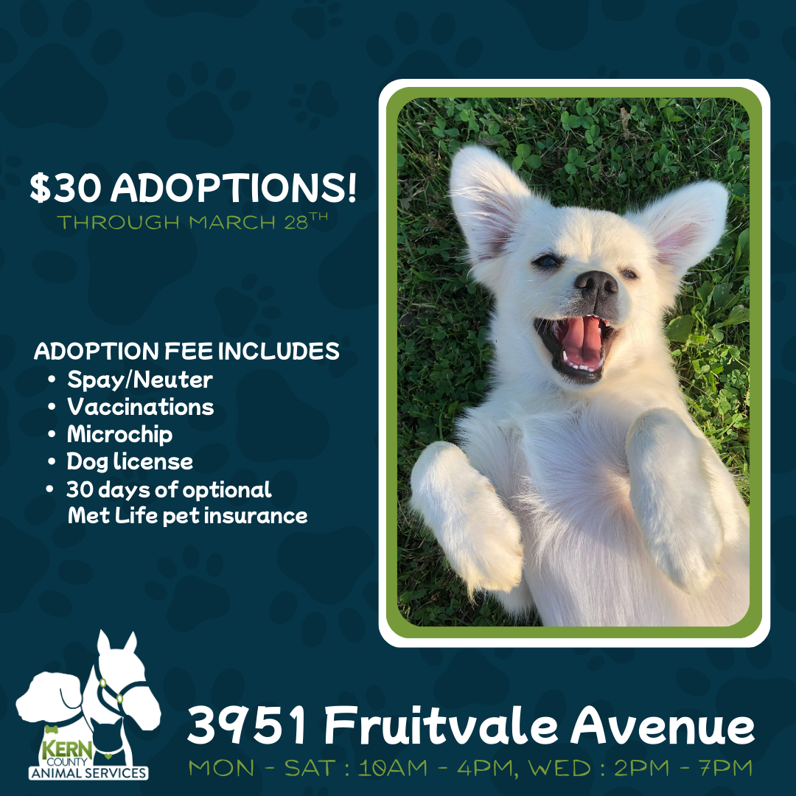
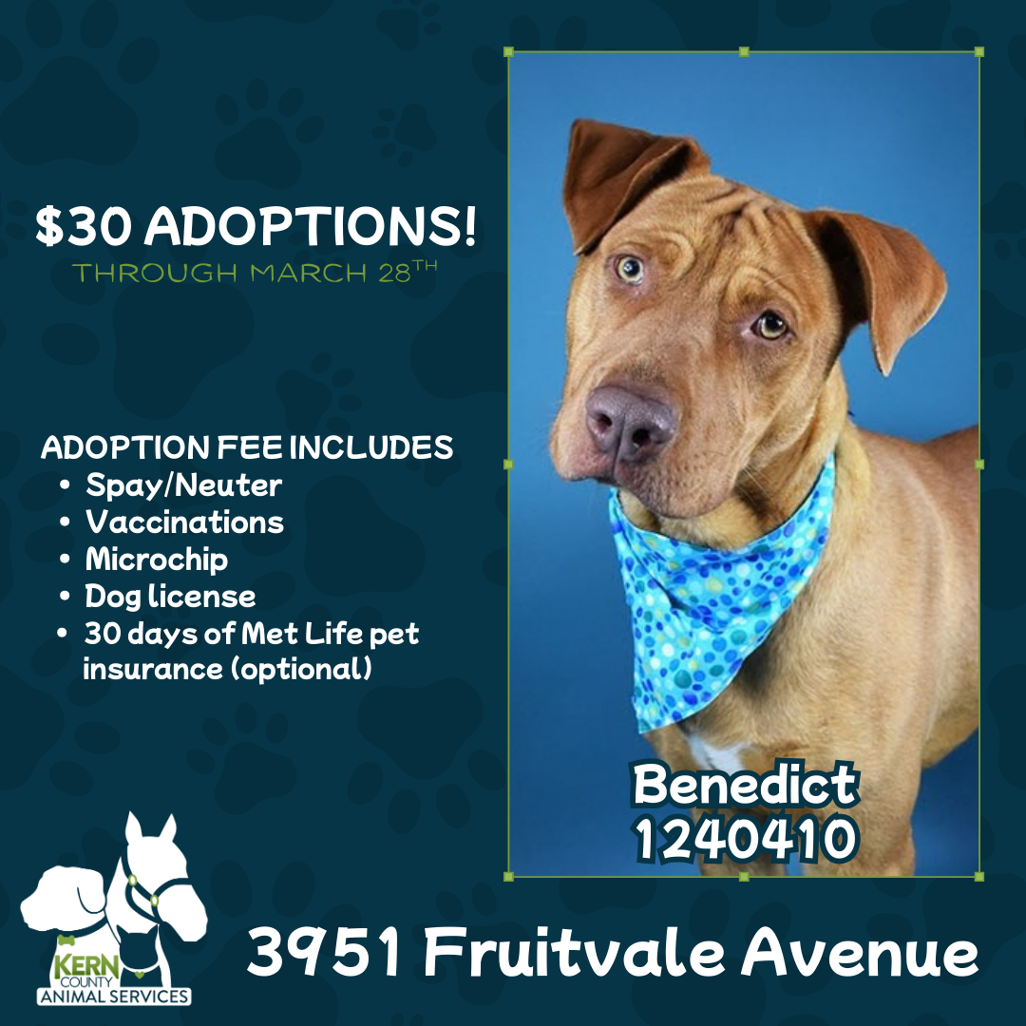
March Adoptions March 2nd – March 28th

Slide 5

Fee-Waived St. Patrick's Day Adoptions March 17th

Slide 6



Offsite Adoption Events:
March 6th – 8th

Slide 7



Offsite Adoption Events:
March 13th – 15th

Slide 8
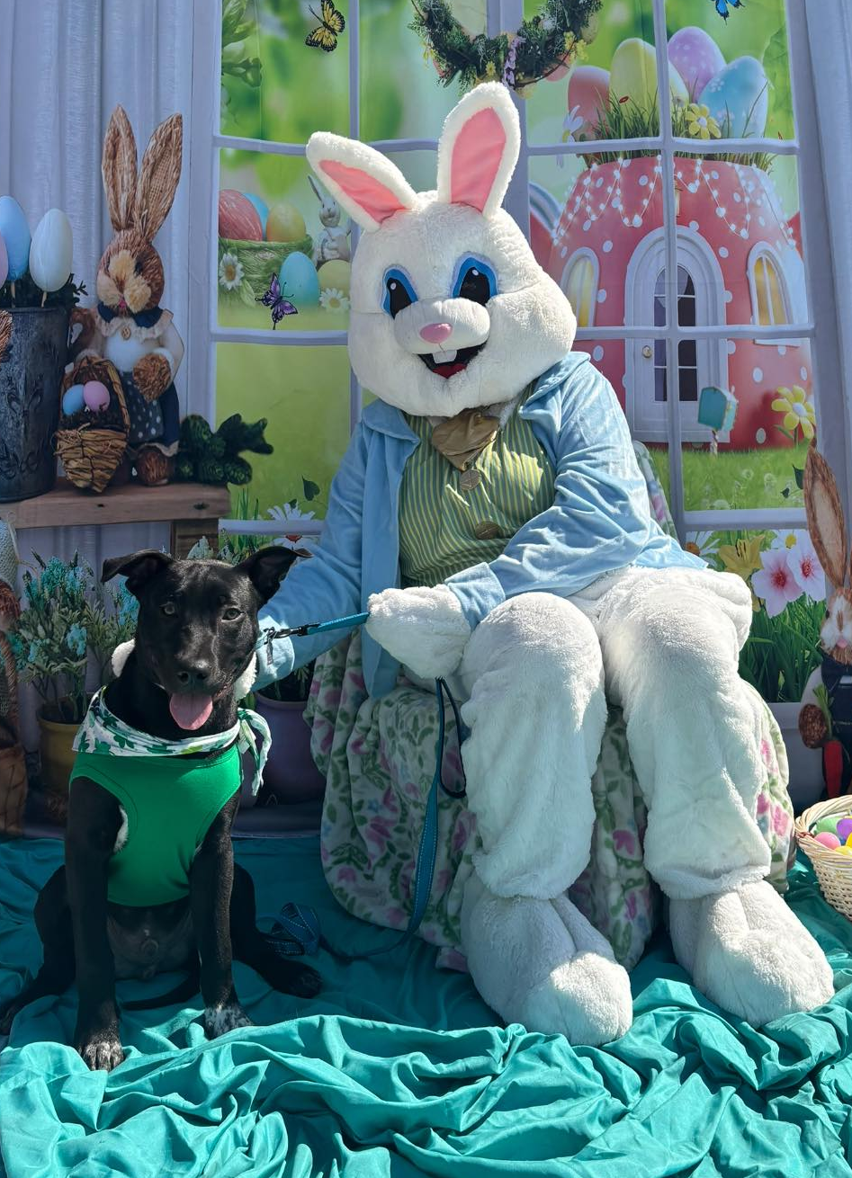
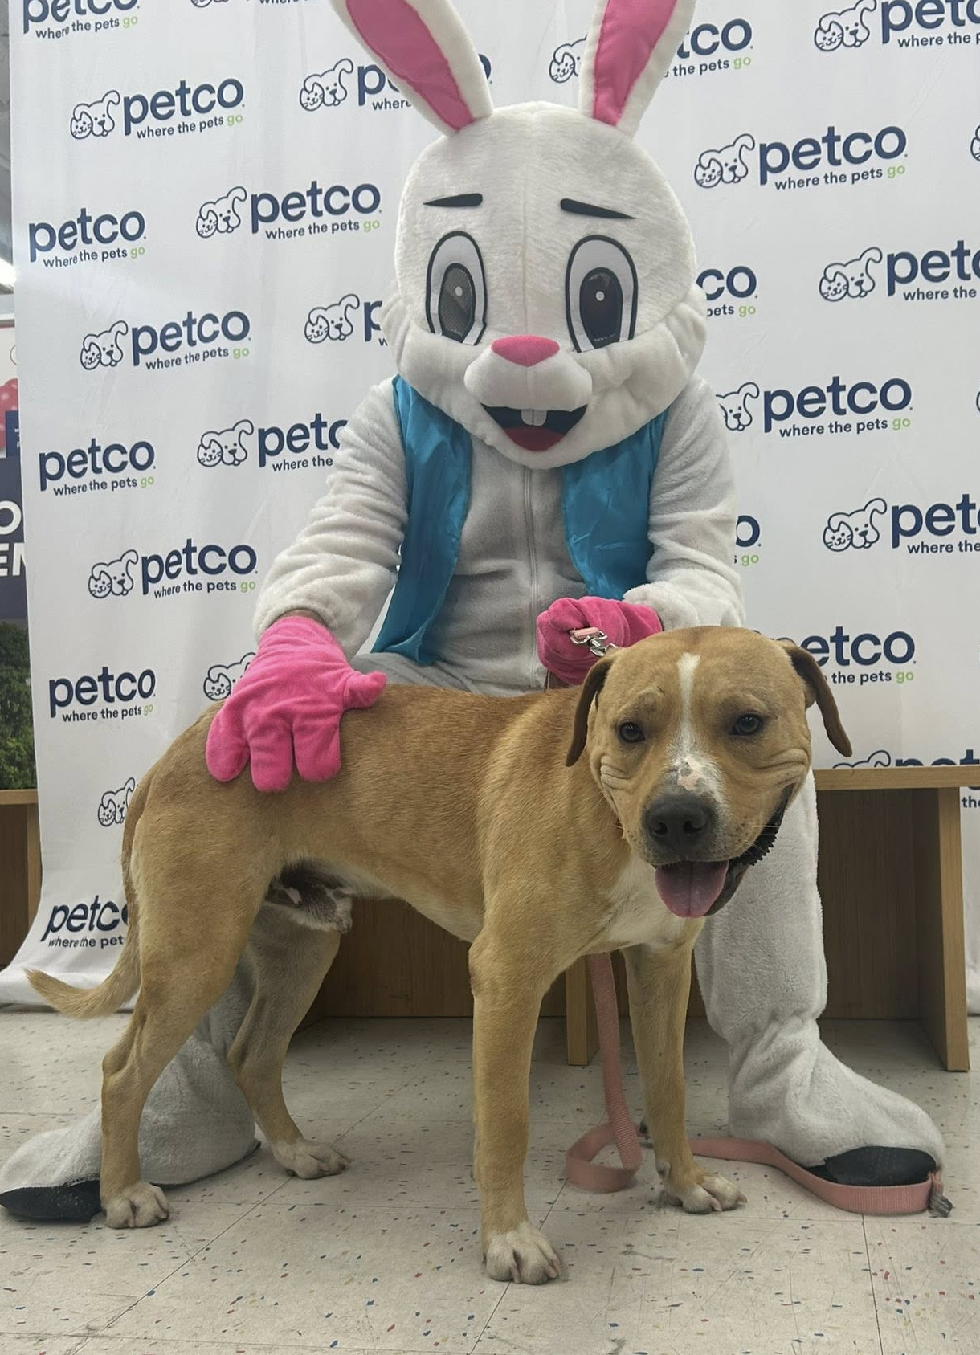

Slide 9



Offsite Adoption Events:
March 20th – 22nd

Slide 10



Offsite Adoption Events:
March 26th – 29th^{th}

Slide 11




Slide 12
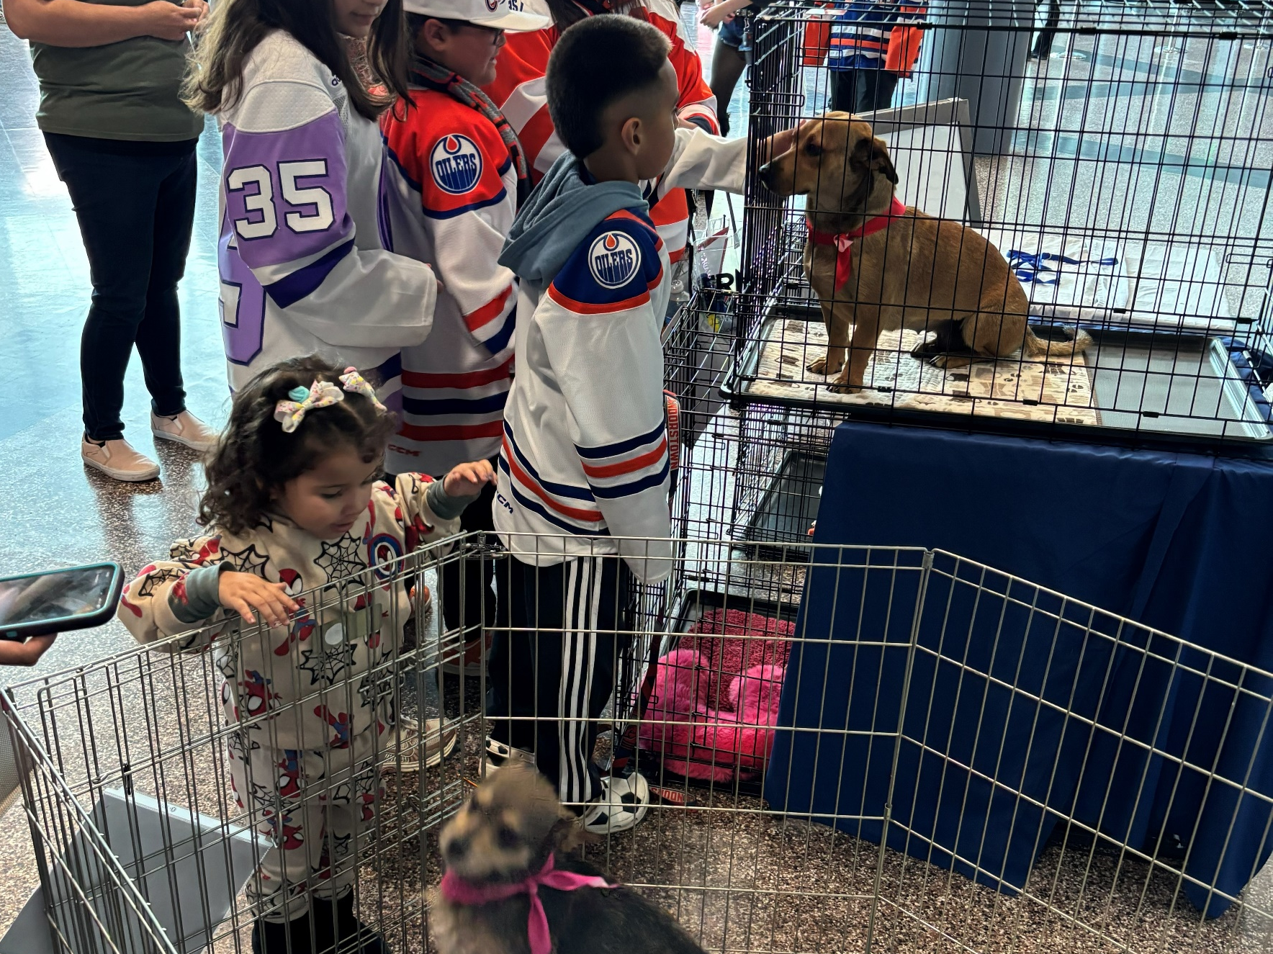
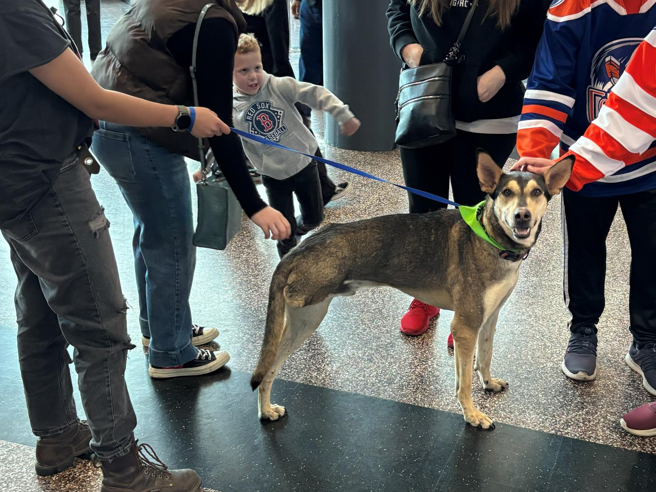
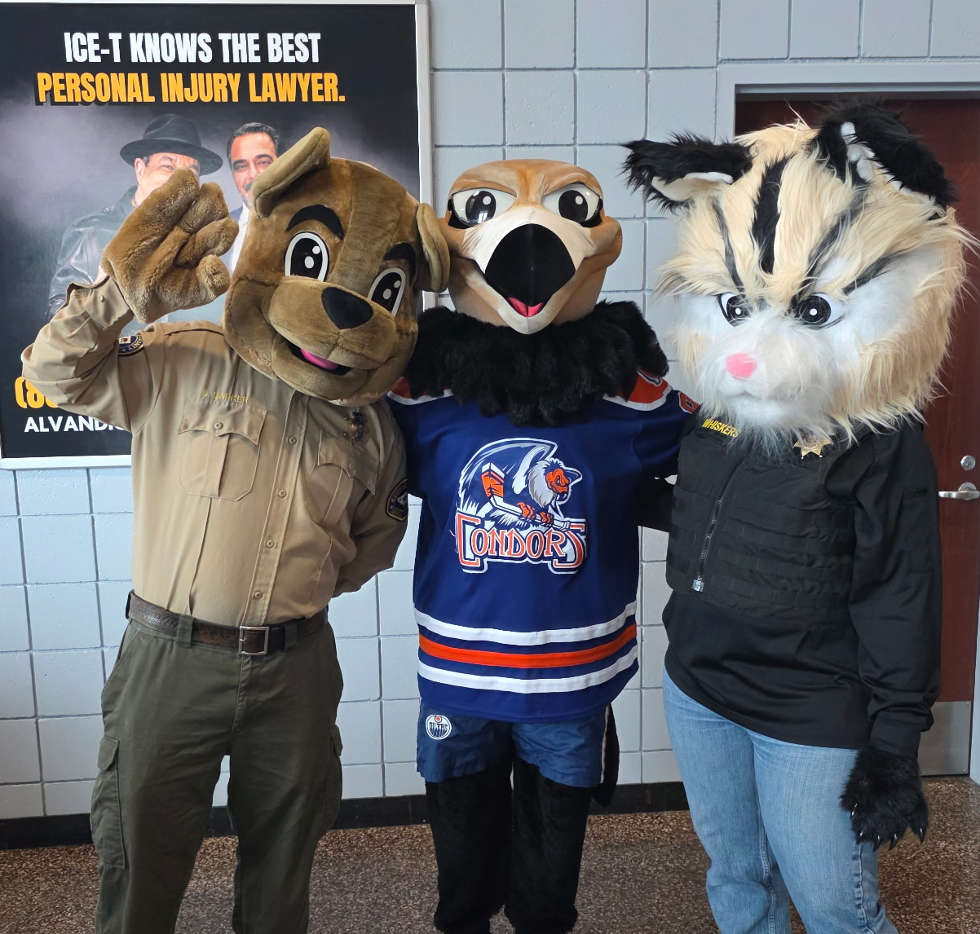
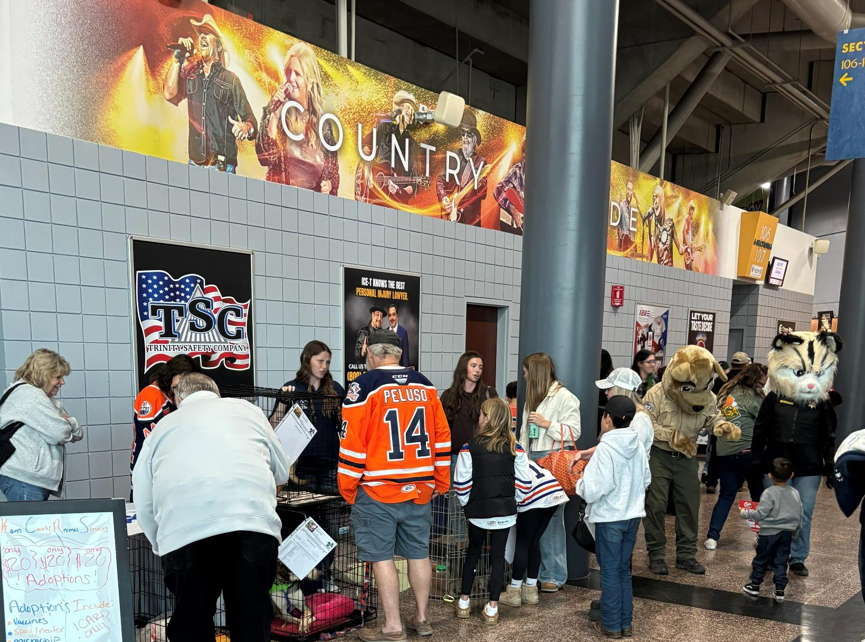
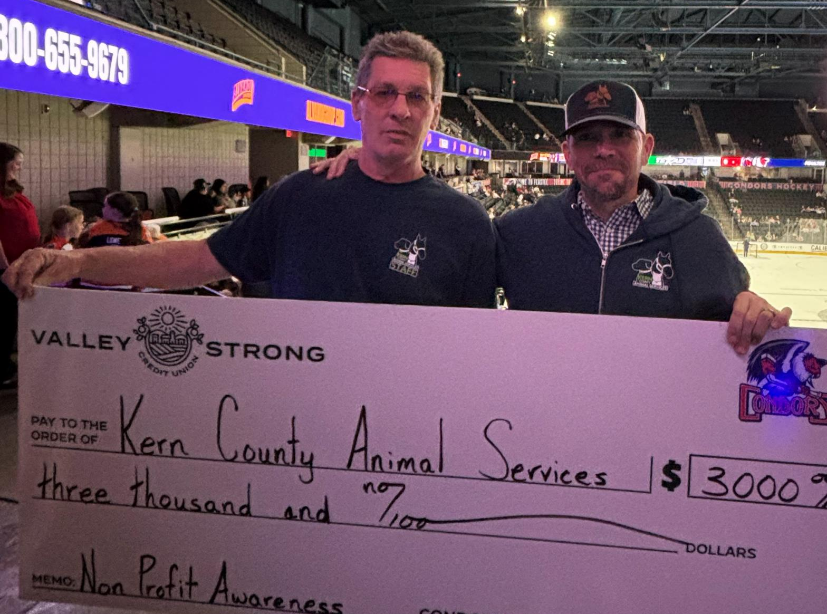

Slide 13


Streets of Bakersfield March 7th & March 21st

Slide 14

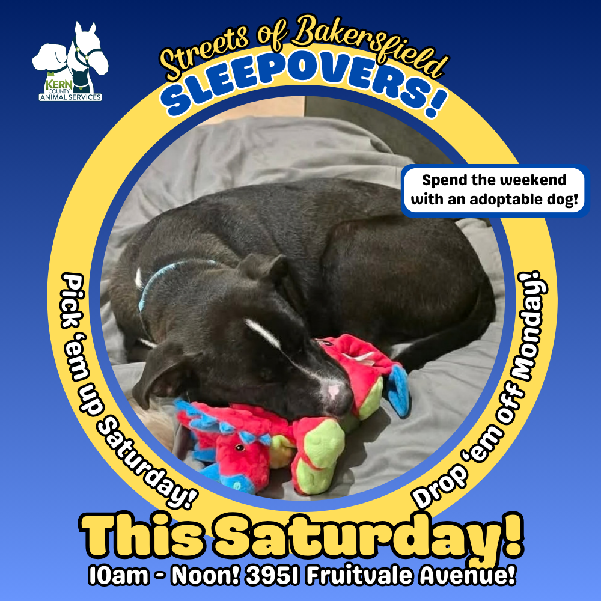
Streets of Bakersfield Sleepovers March 7th & March 21st

Slide 15
Low-Cost Spay/Neuter Clinics March 2026
Date | Location | Surgeries
March 5th | Heritage Park | 55
March 10th | Heritage Park | 50
March 14th | Heritage Park | 62
March 16th | Inyo Kern | 44
March 17th | Dogtopia | 44
March 23rd | Virginia Park | 53
March 26th | Heritage Park | 49
 | Total Surgeries | 357

Slide 16
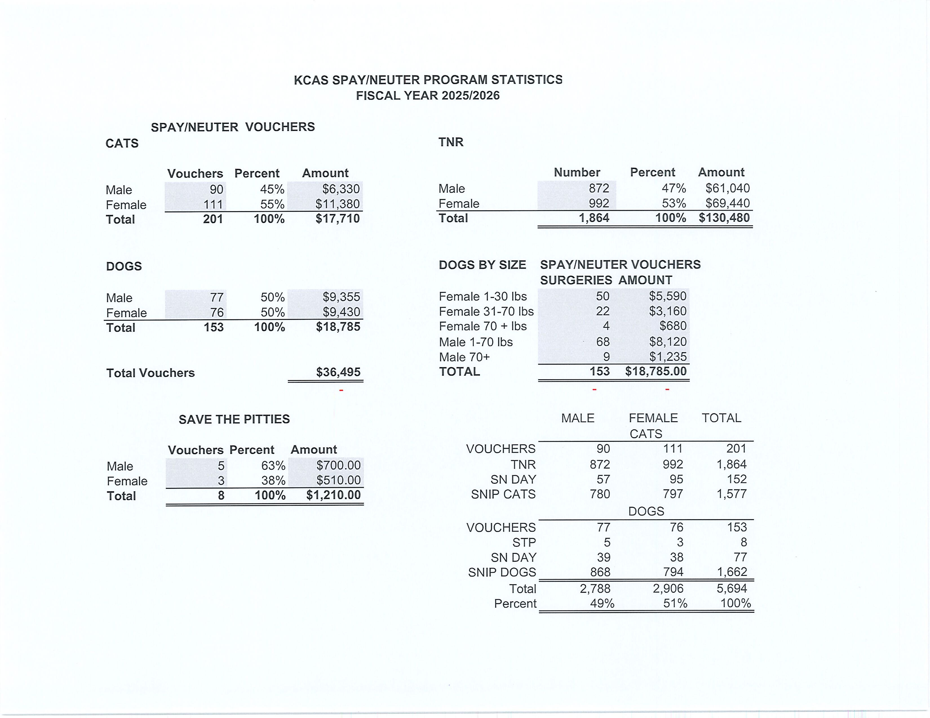

Slide 17
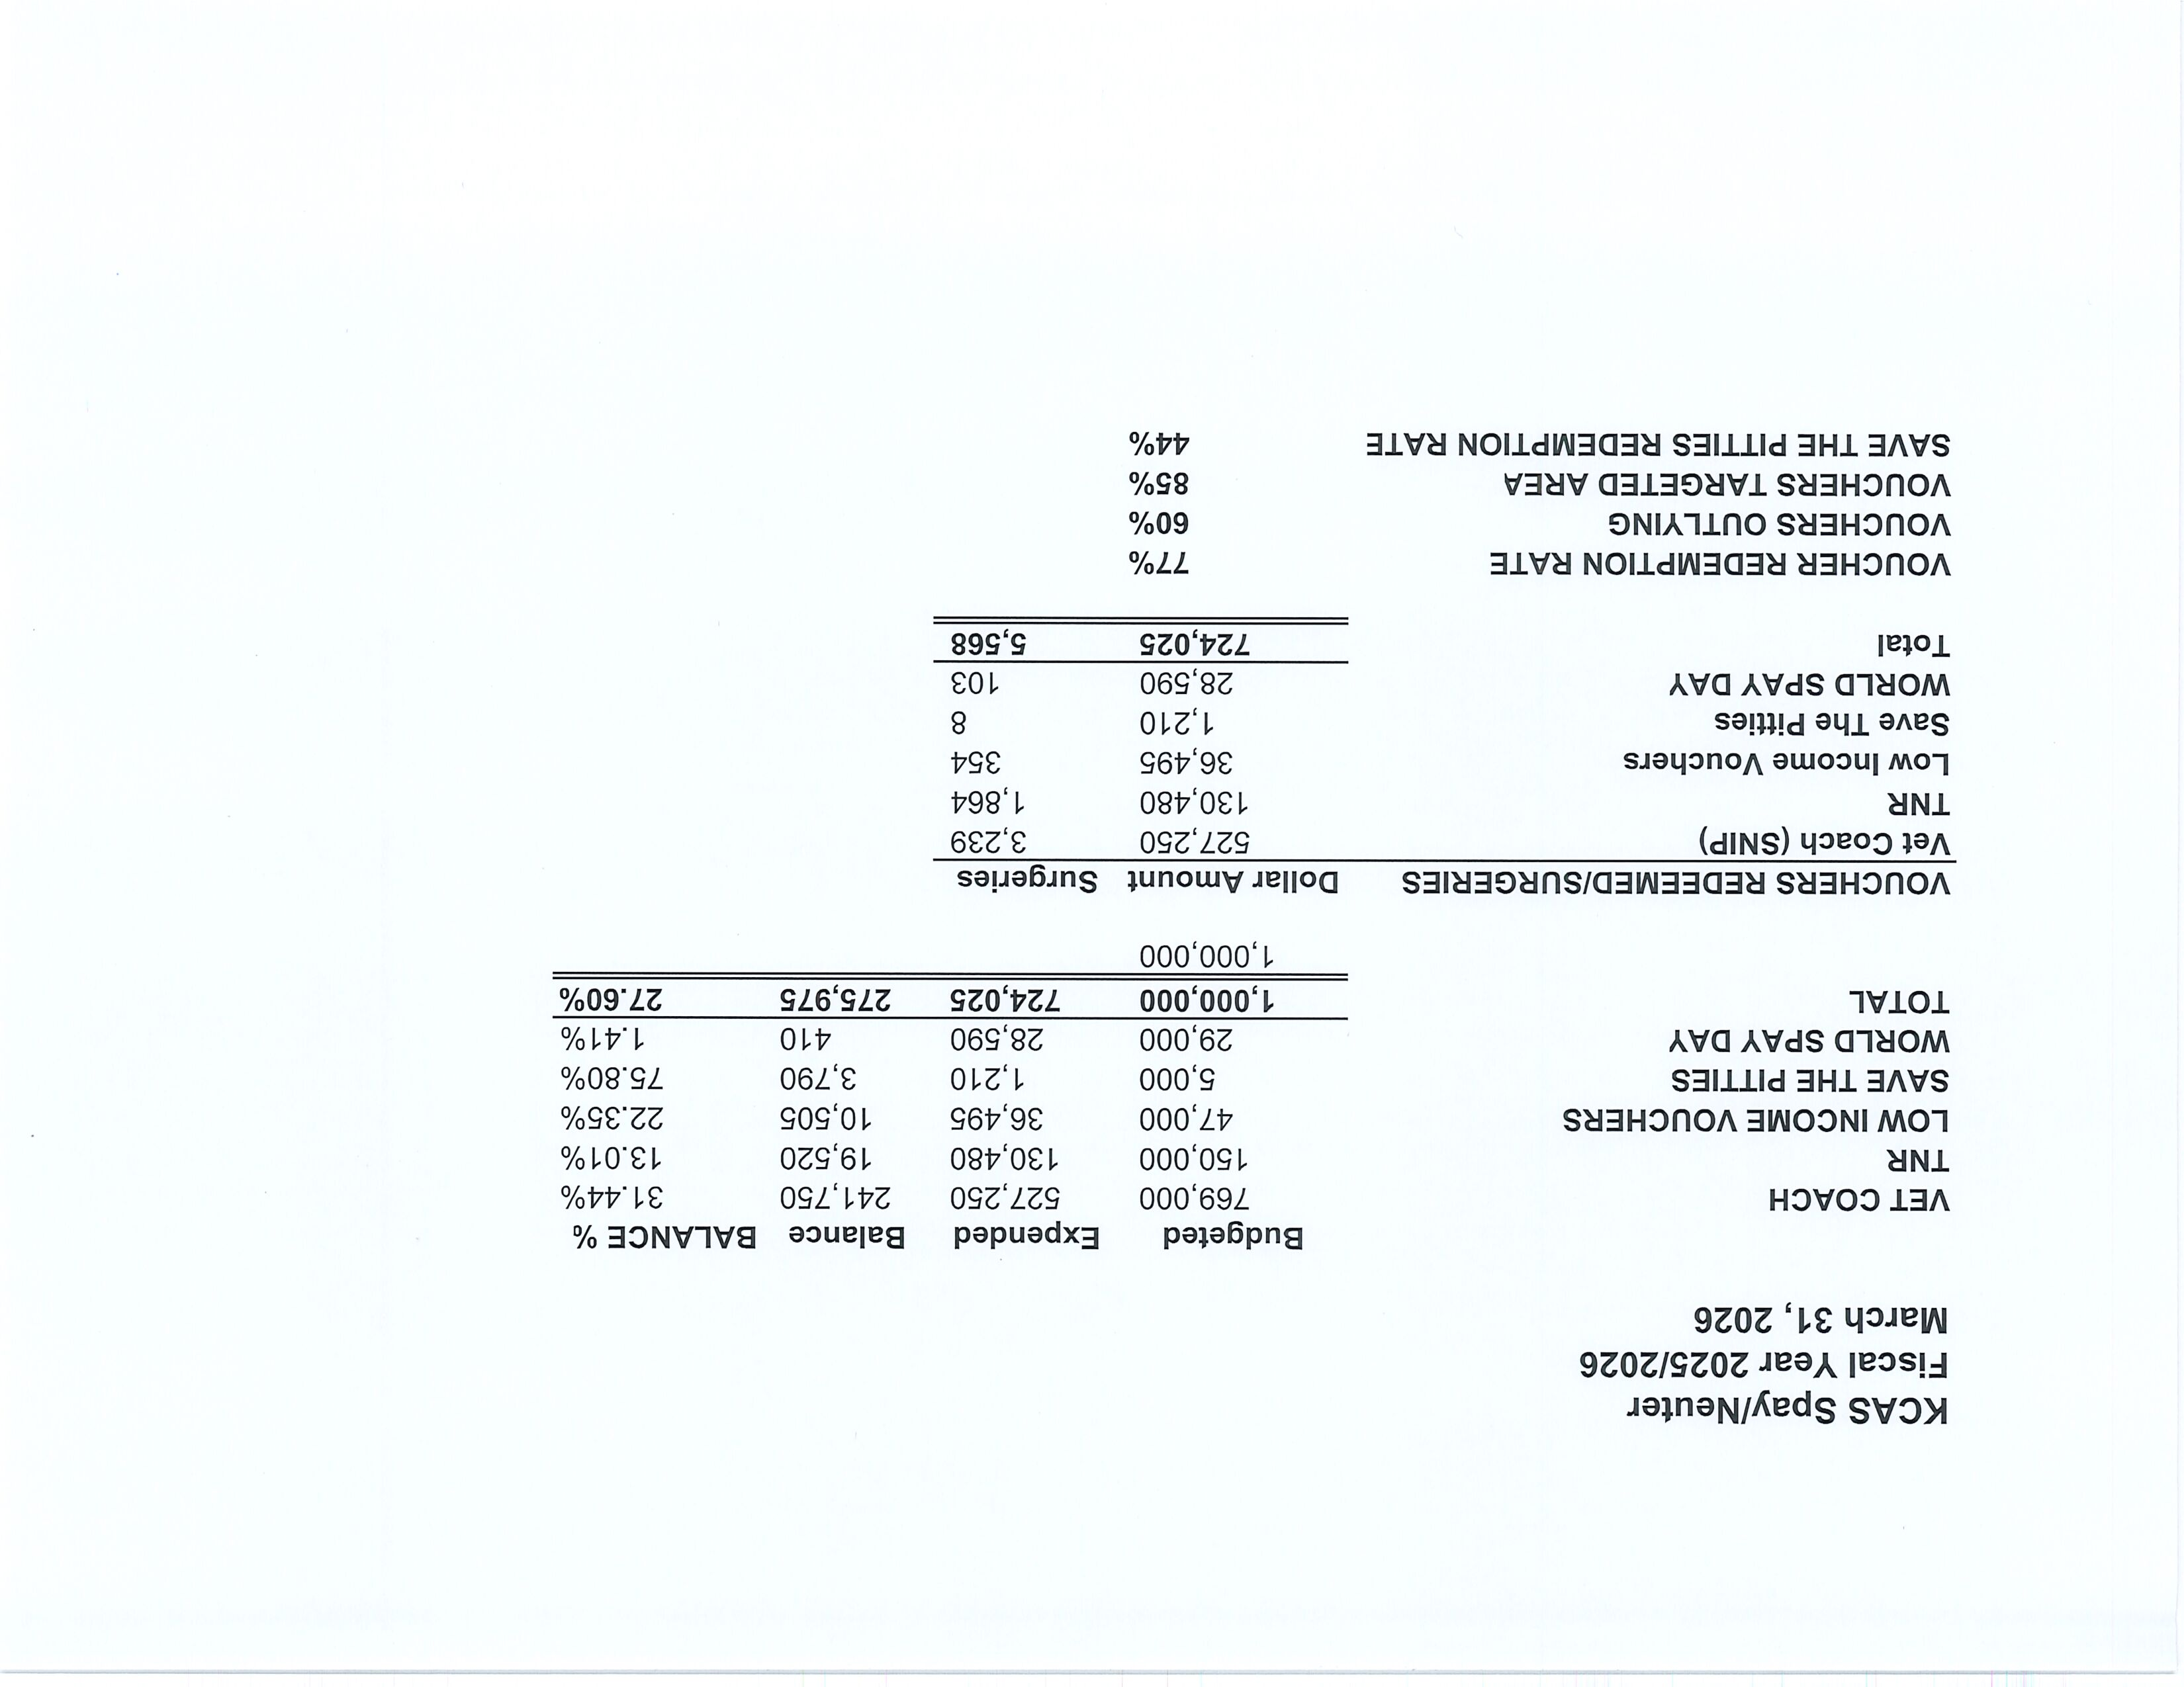

Slide 18
Low-Cost Vaccination Clinics March 2026
Rabies
615
Microchips
Bordetella
155
158
DHPP* 615
FVRPC* 213
*DHPP and FVRCP vaccinations provided at no-cost by Petco Love.

Slide 19
Hope on Hart Wellness Clinic
March 10th - Dr. King and her medical staff from KCAS held another community pet wellness clinic at Hope the Mission’s “Hope on Hart” housing site in Oildale.
Throughout the morning, pet owners received free health screenings, medications for common canine conditions, and guidance on additional care options when needed.
Animal Control Officer Johnston lent a hand, while also making time for plenty of belly rubs! Director Nick Cullen and Deputy Director Melissa Wells were also there to support the event.
These clinics are part of KCAS’s ongoing effort to serve residents facing housing or financial challenges, helping ensure their pets still have access to essential veterinary care. The event saw a strong turnout, with many grateful pet owners taking advantage of the services.

Slide 20
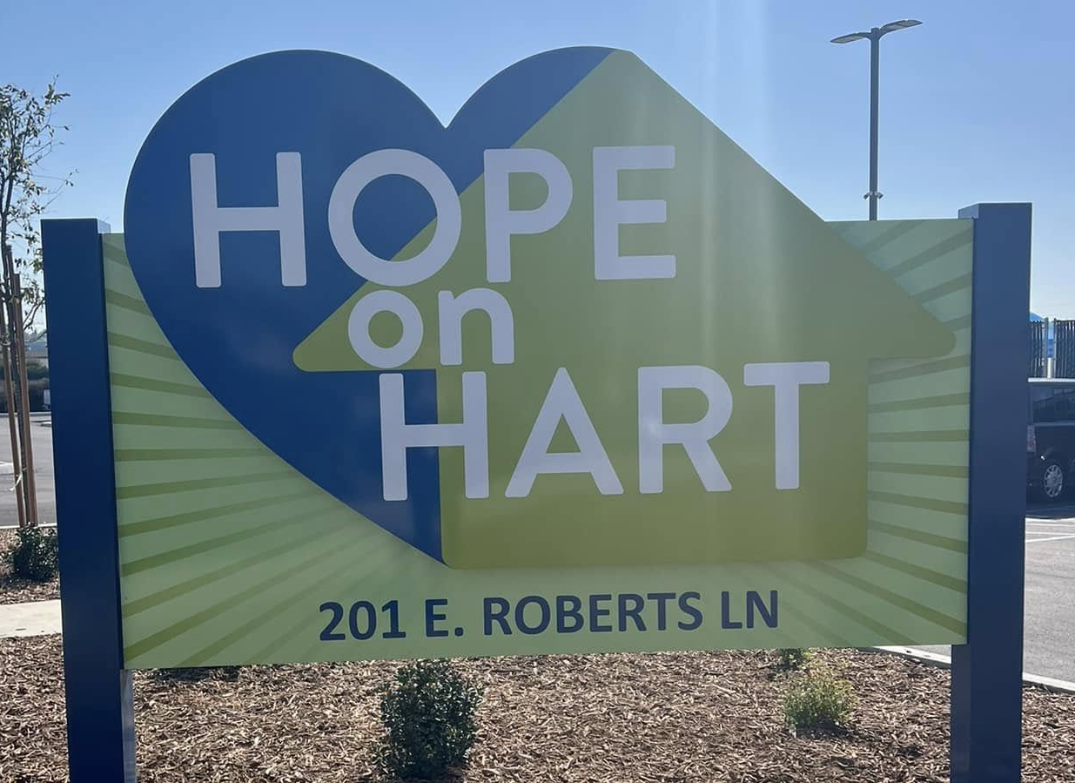
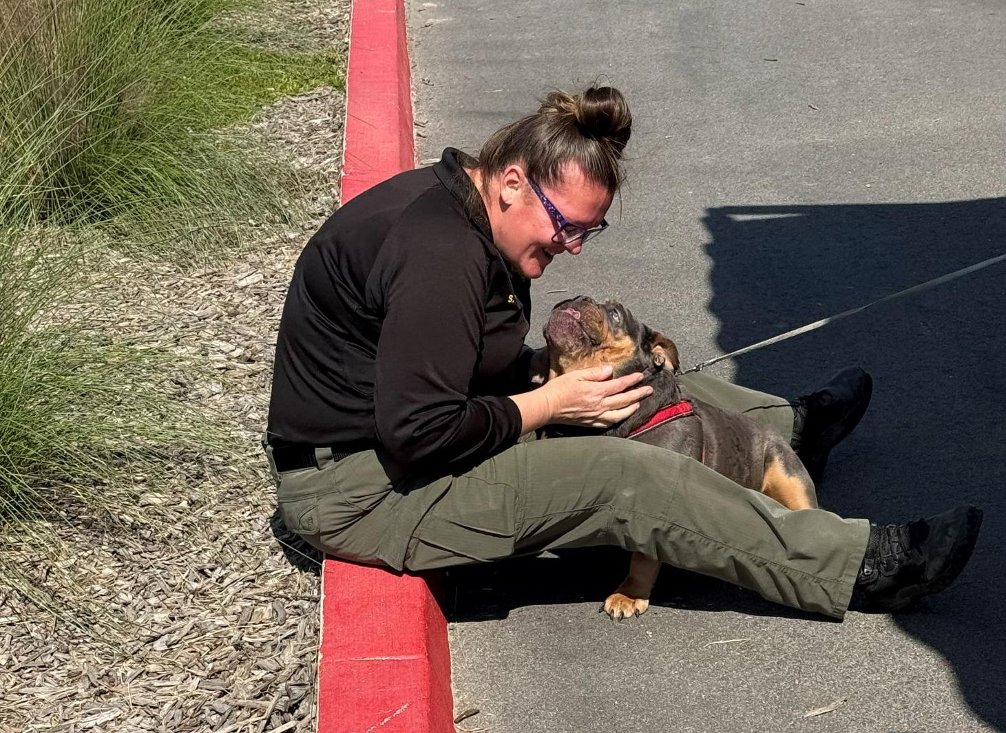
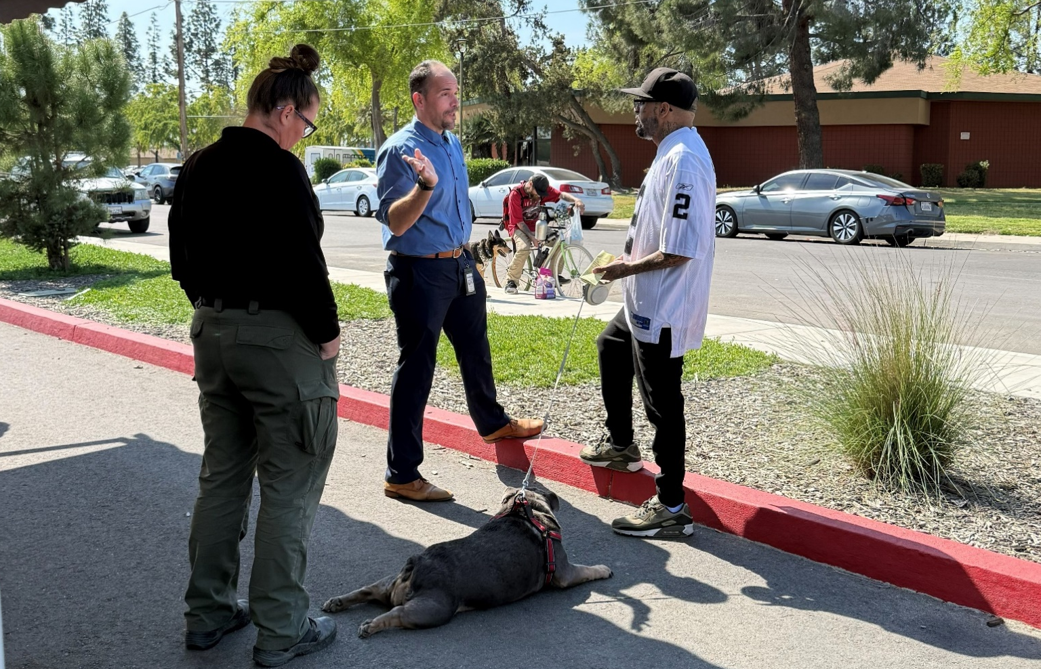
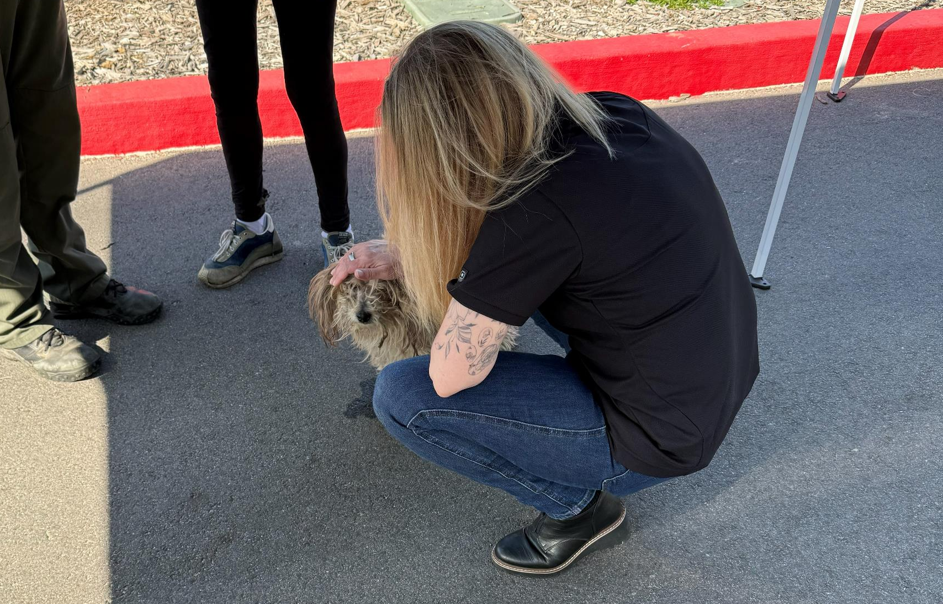

Slide 21
Field Service Calls: March 2026
AREA | CALLS PER AREA
Lake Isabella | 132
Mojave | 125
North County | 60
Northeast | 374
Northwest | 299
Ridgecrest | 28
Southeast | 237
Southwest | 157
Taft | 171
Tehachapi | 76
TOTAL | 1,659
17 dogs were returned to their owners in the field in March 2026.
63 dogs were secured on property by Animal Control Officers in March 2026.

Slide 22
Commercial Animal Facility Calls
March 2026
TYPE | CALLS PER TYPE
CAF – Breeder | 26
CAF – Rescue | 4
CAF – Kennel | 0
CAF – Boarding | 3
TOTAL | 33
10 Inspections Passed
0 Inspections Failed
0 Citations Issued
0 Permits Issued
52 Active CAF Permits

Slide 23
Volunteer Program March 2026
Active Volunteers
129
New Volunteers
83
Volunteer hours donated in March
Year-To-Date volunteer hours donated in 2026
600.24
1709.93

Slide 24
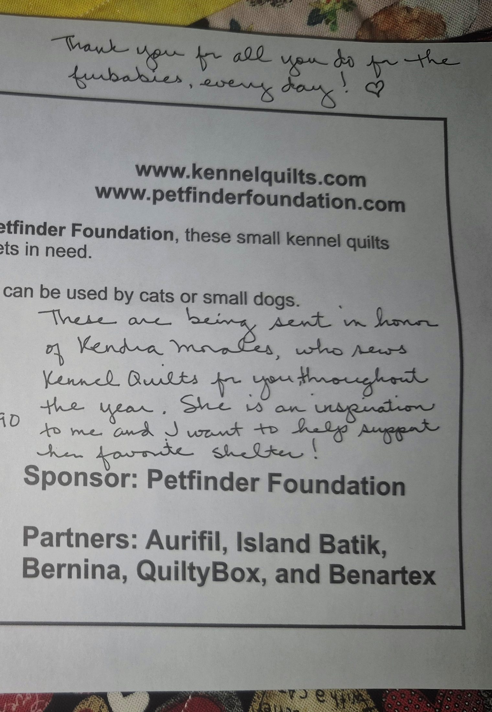
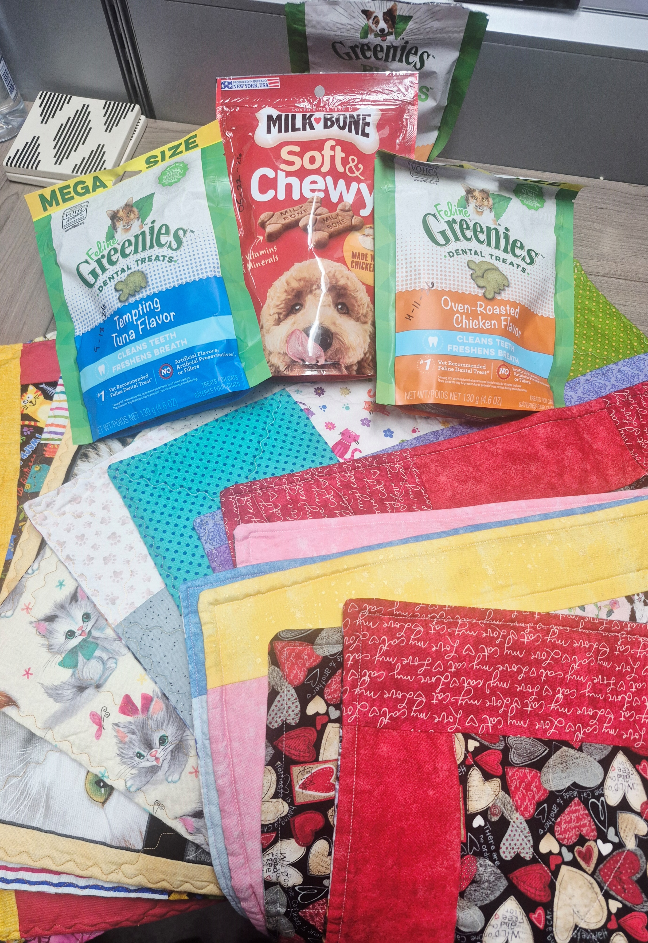
Donation of Quilts & Treats
March 2nd - In conjunction with Kennel Quilts and the Petfinder Foundation, Vivian Piper donated over a dozen small kennel quilts to the animals in our shelter! She donated bags of treats too! Her message read: "These are being sent in honor of Kendra Morales, who sews kennel quilts for you throughout the year. She is an inspiration to me and I want to help support her favorite shelter! Thank you for all you do for the furbabies every day!" Thank YOU, Vivian! And Kendra too!

Slide 25

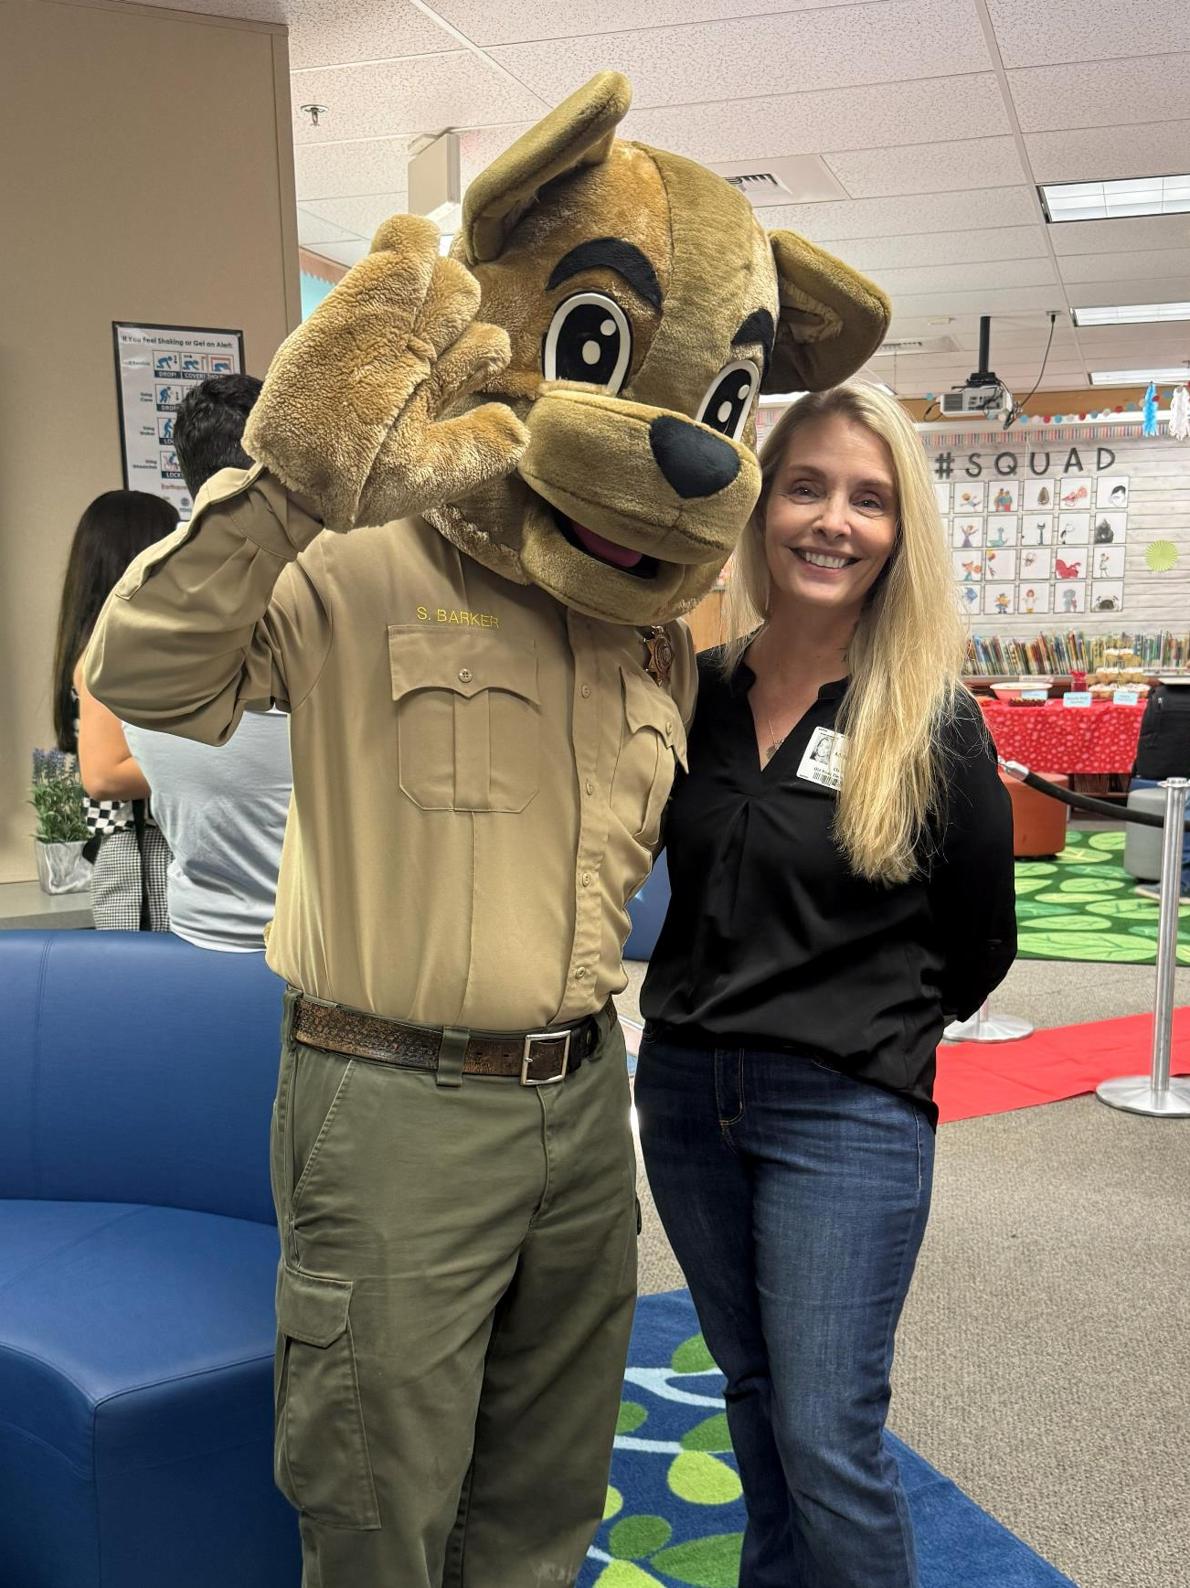
Celebrity Reading Day at Old River Elementary
March 24th - Officer Shepherd Barker and Deputy Director Melissa Wells stopped by to read for the kids at Old River Elementary!

Slide 26
2026 Year To Date January 1st – February 28th
795
Adoptions
747
Rescued
171
Returned To Owner
509
Spay/Neuter Surgeries (Clinics + TNR)
2,597
Total Lives Saved
82.69%
Save Rate

Slide 27
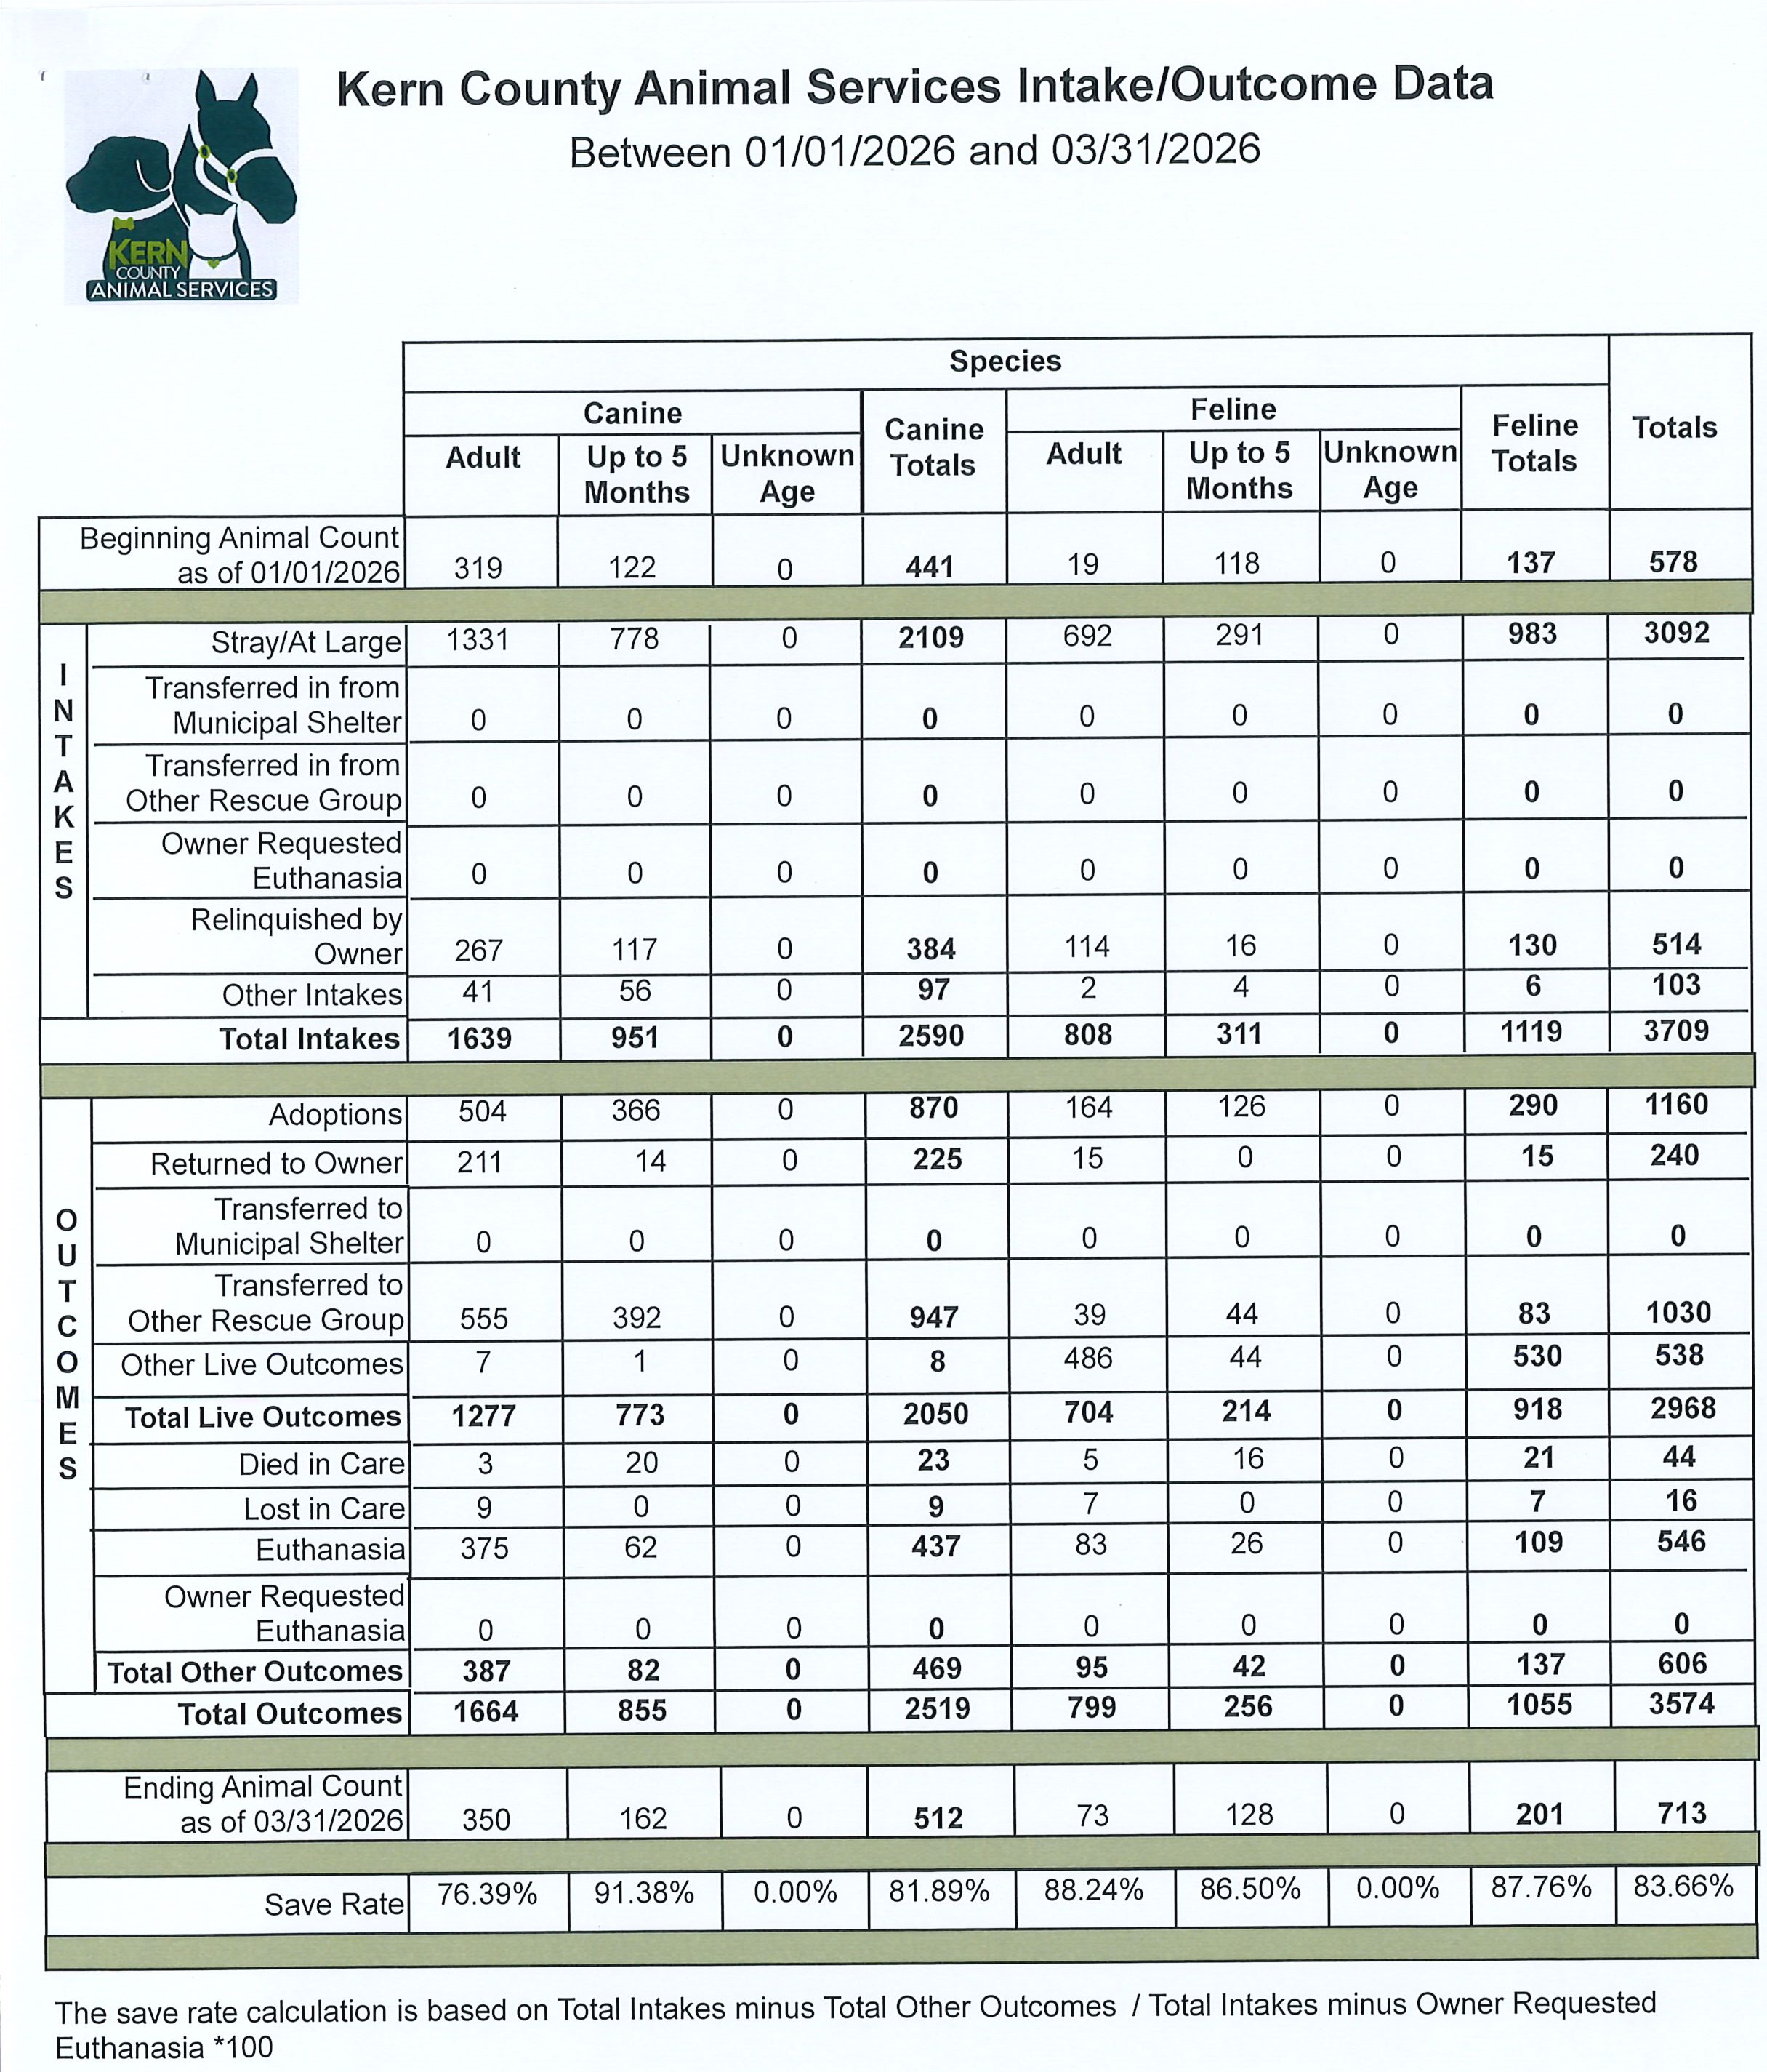
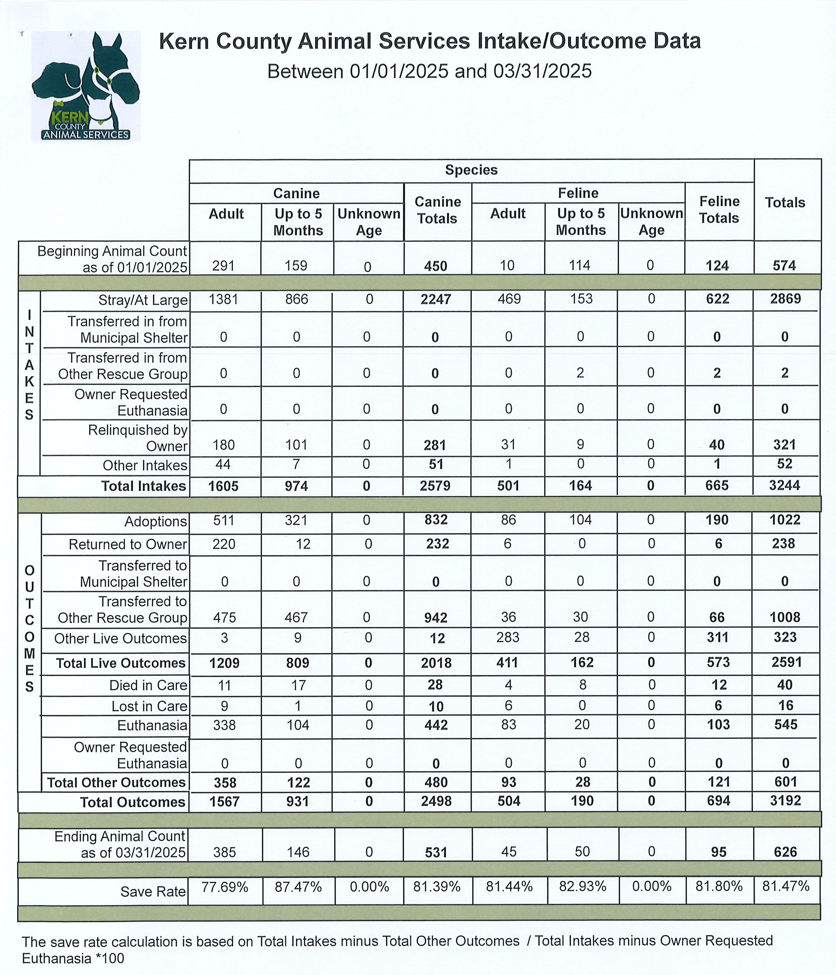

Slide 28
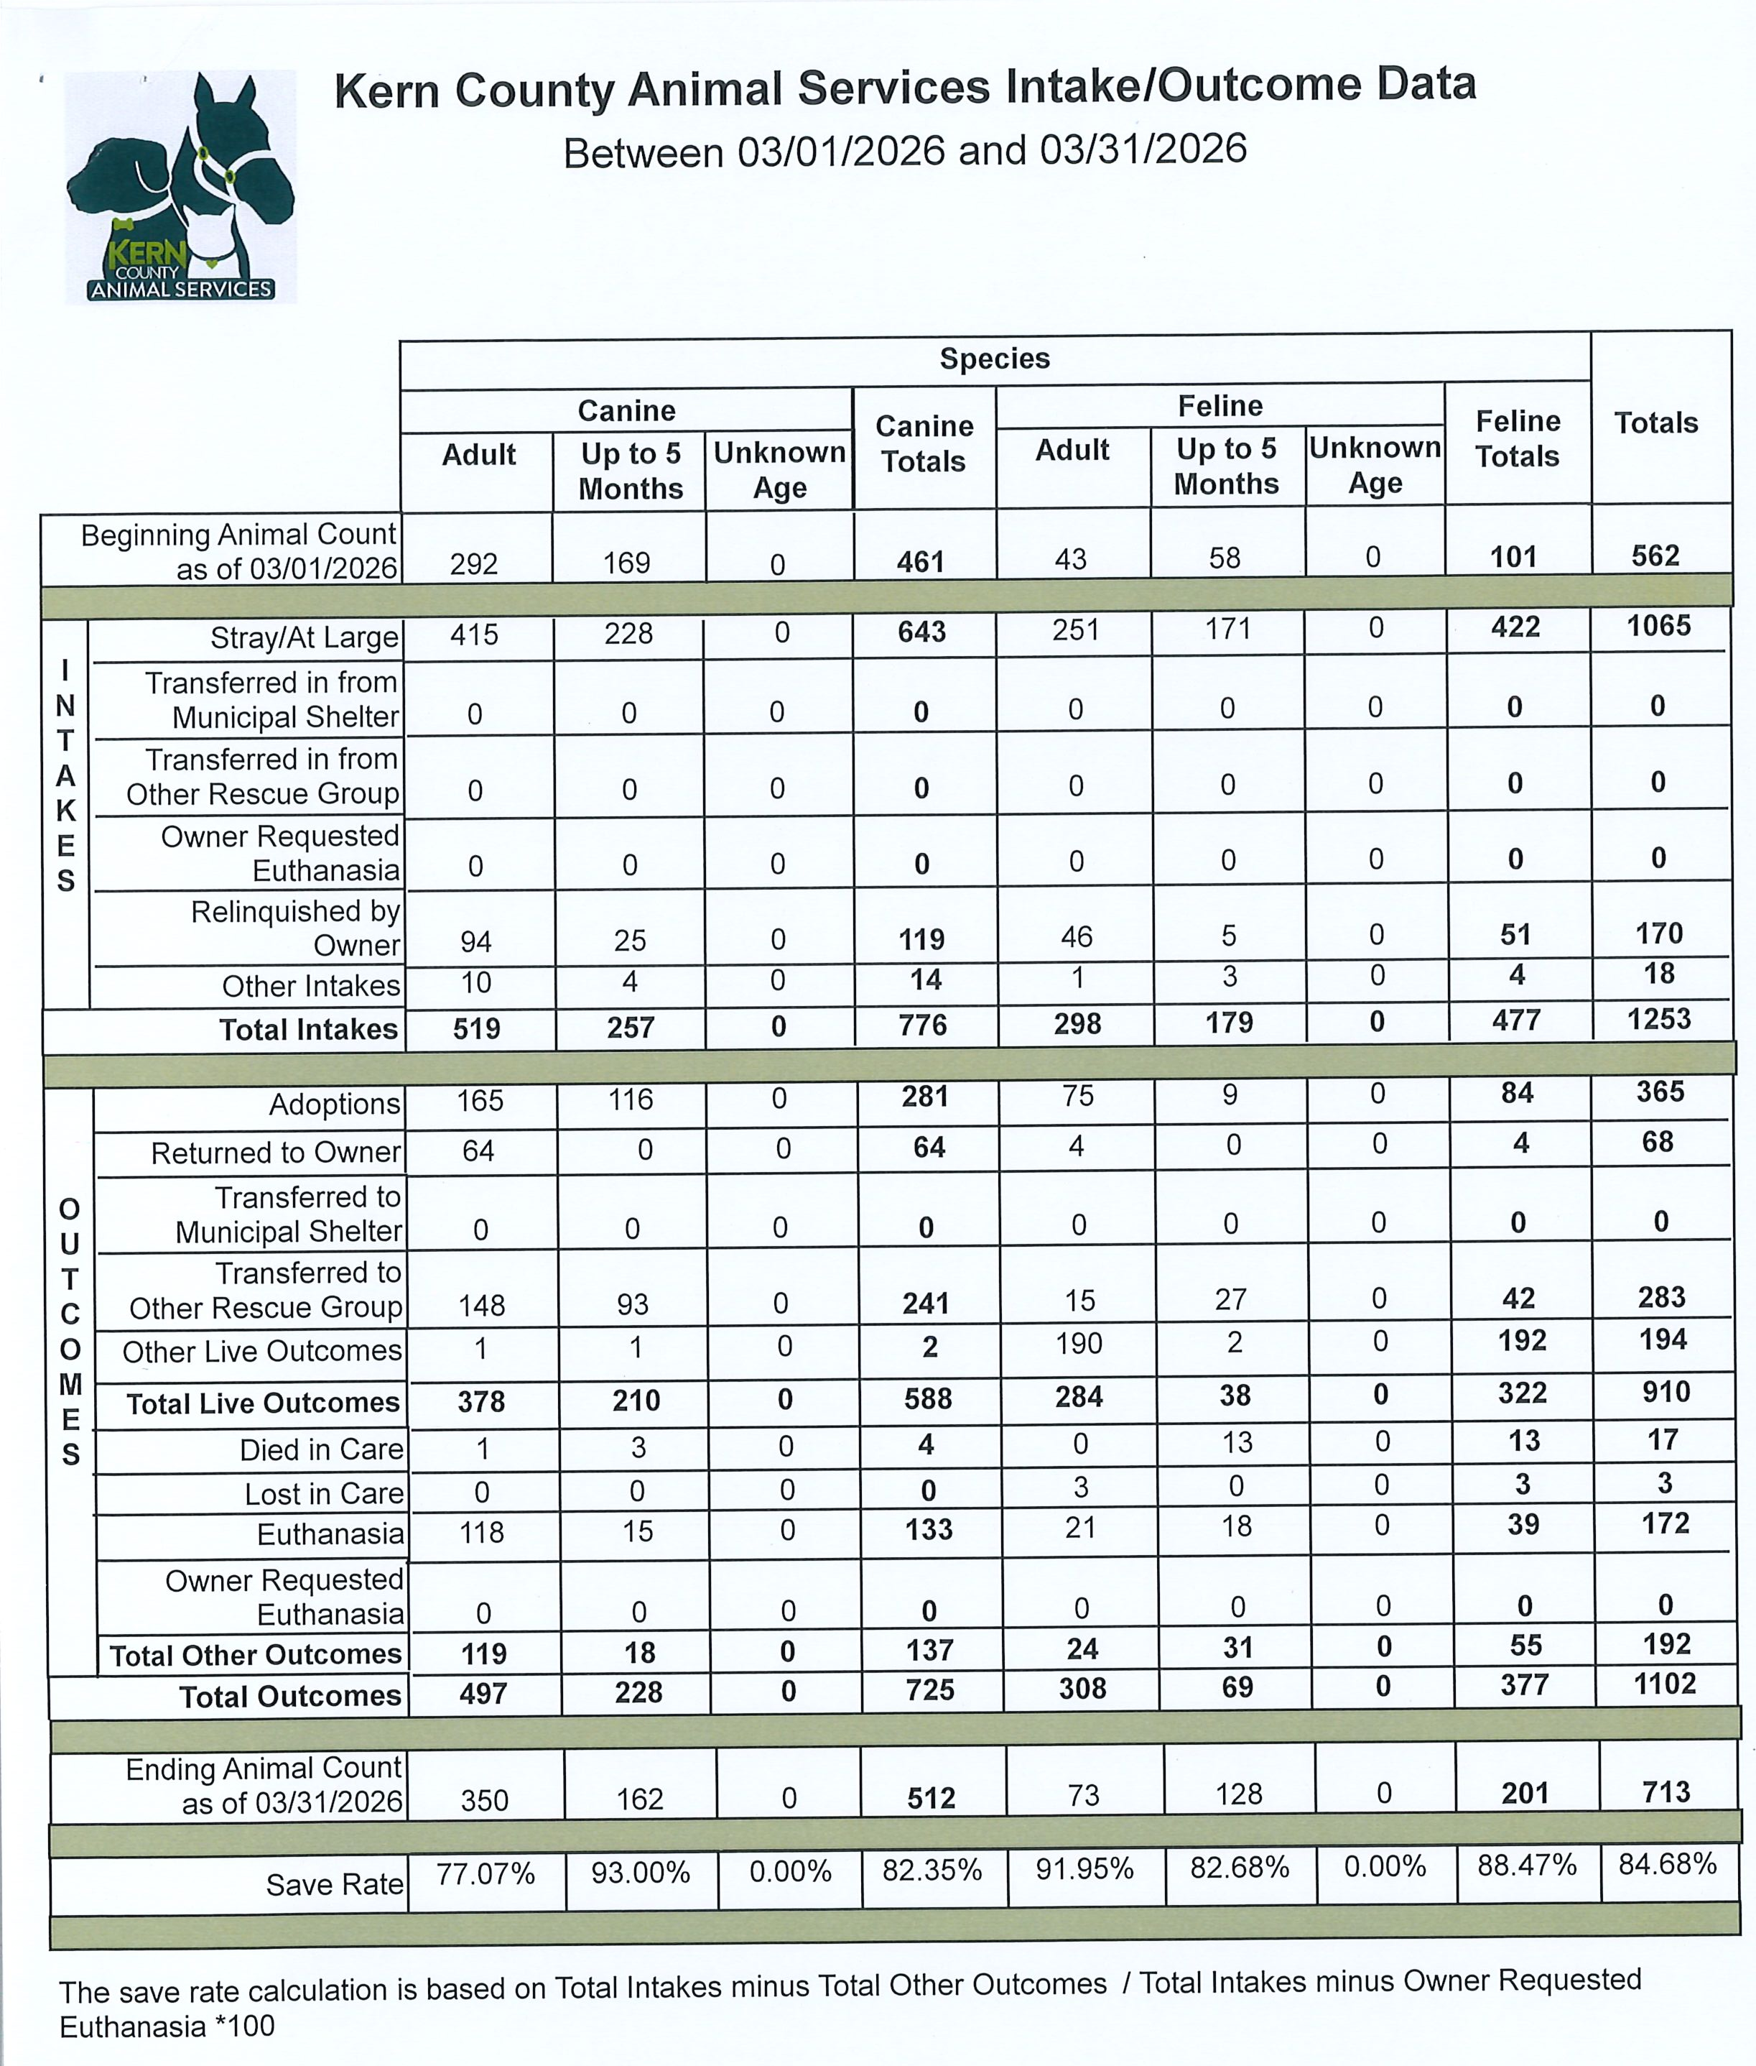
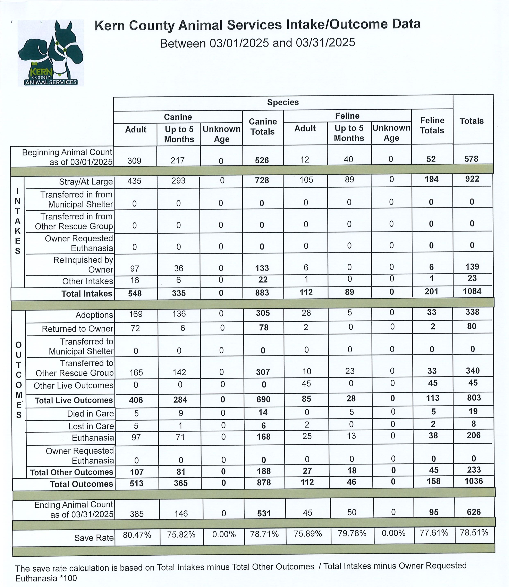

Slide 29
