Slide 1

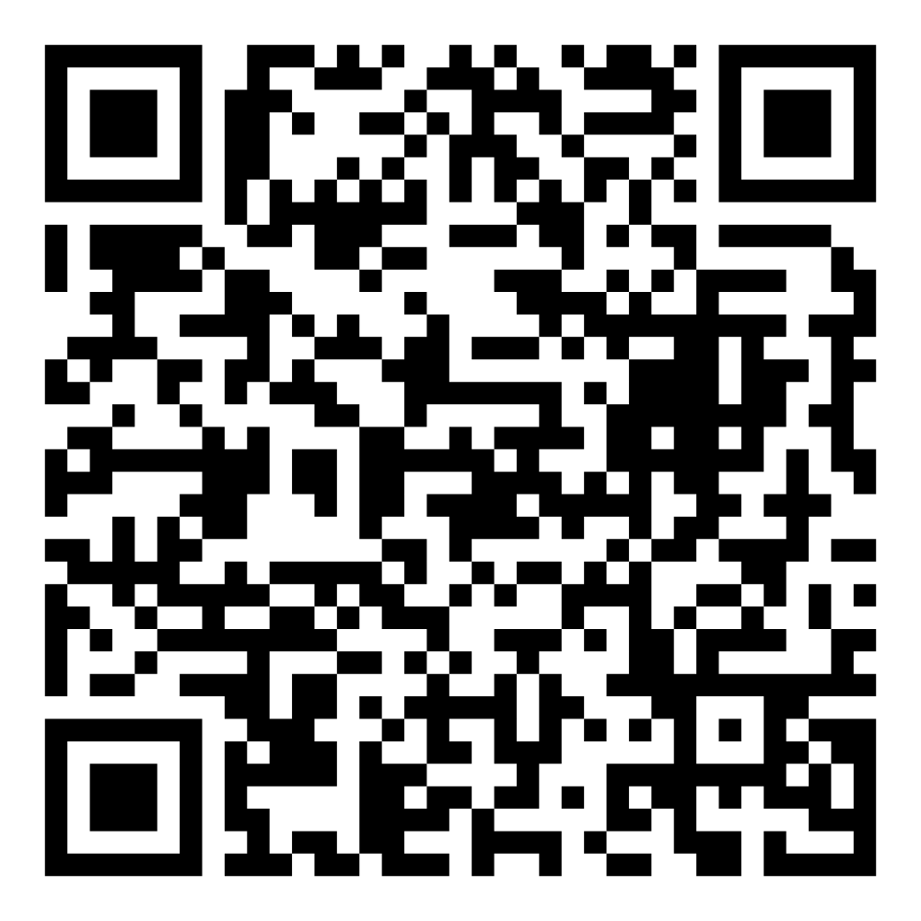
Director’s Report
April 2026

Slide 2



Program Highlights April 2026
Adoption: 143 dogs, 98 puppies, 54 cats, and 33 kittens under 5 months of age were adopted for a total of 328 animals adopted from Kern County Animal Shelters in the month of April.
Foster: 25 dogs, 53 puppies, 4 cats, 221 kittens, and 1 other animal entered the Department’s Foster Care Program in April, for a total of 304 animals.
Rescue: 182 dogs, 140puppies, 16 cats, and 71 kittens were transferred to other animal rescue organizations in April, for a total of 409 animals.
Spay/Neuter: A total of 382 animals were altered at low-cost KCAS spay/neuter clinics in the month of April.
TNR: 102 cats were spayed or neutered and released in April. Year-to-date, 632 cats have gone through the program, and since 2013 25,336 cats have been spayed or neutered and returned to field.

Slide 3

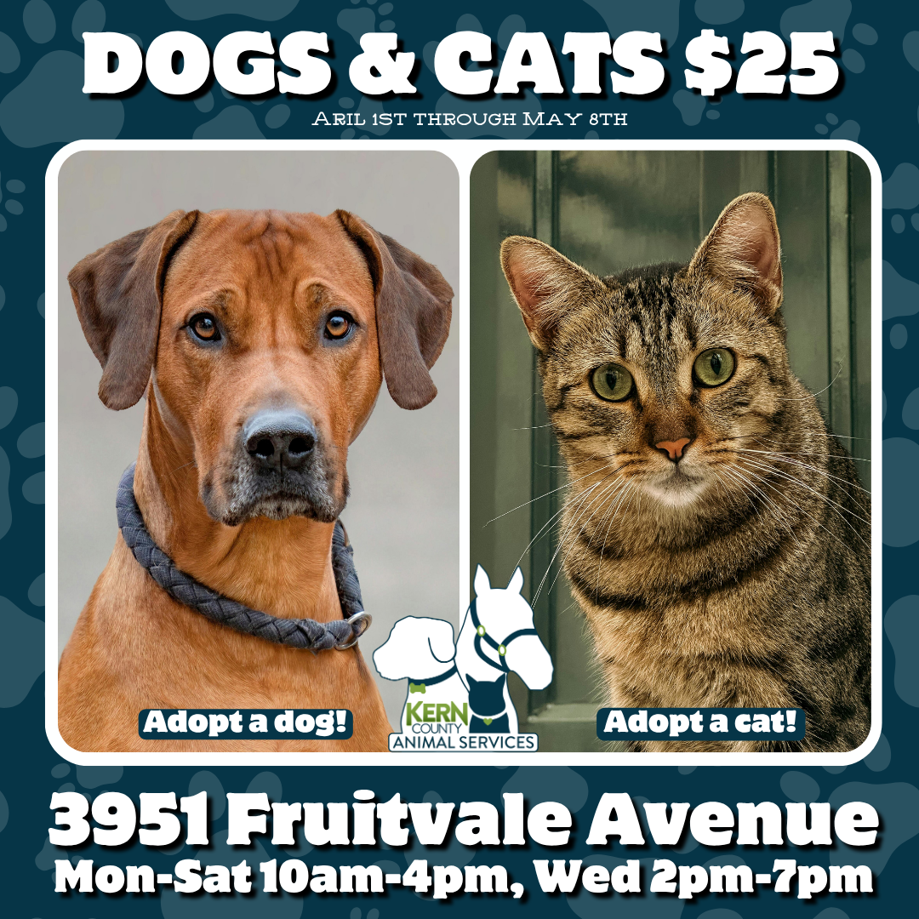
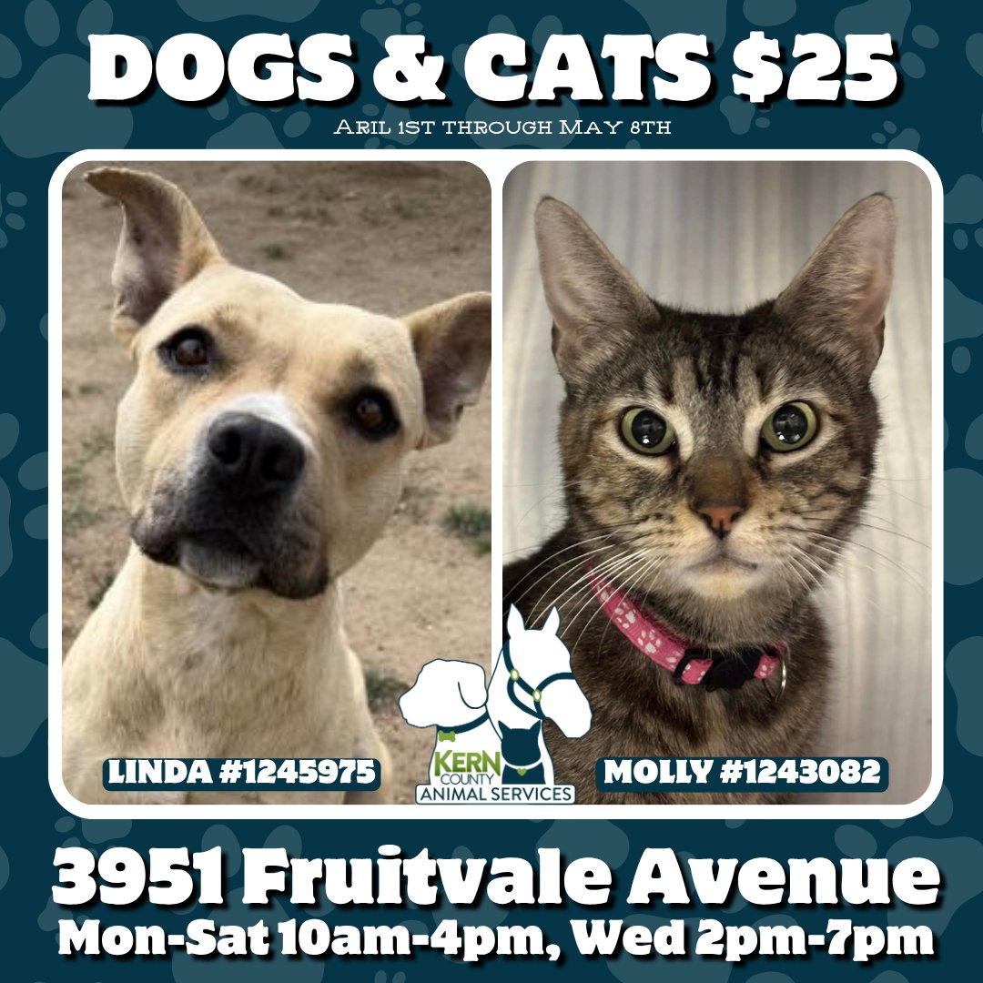
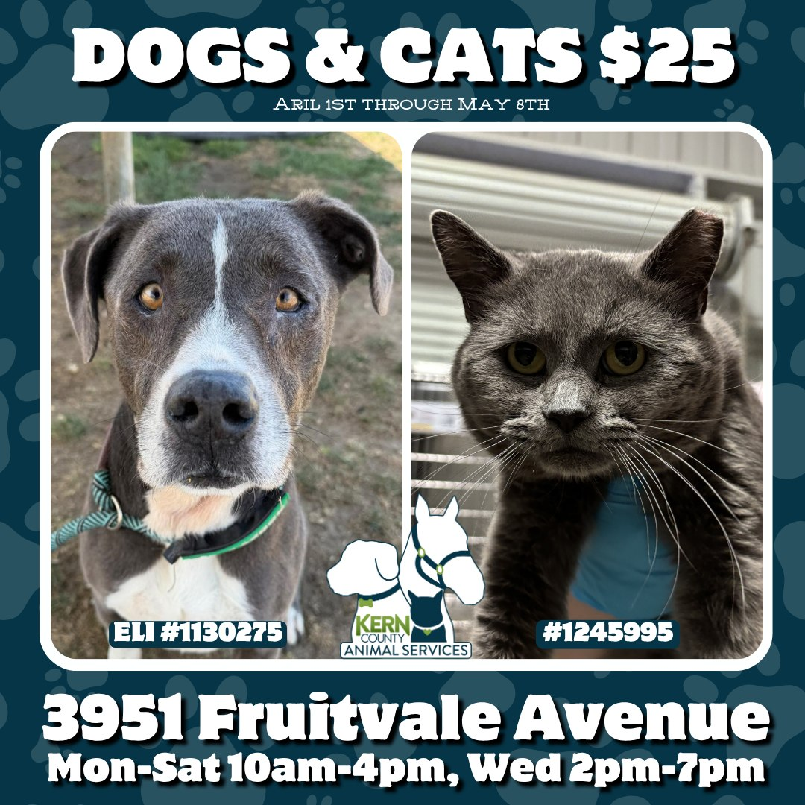

April Adoptions April 6th – May 2nd

Slide 4
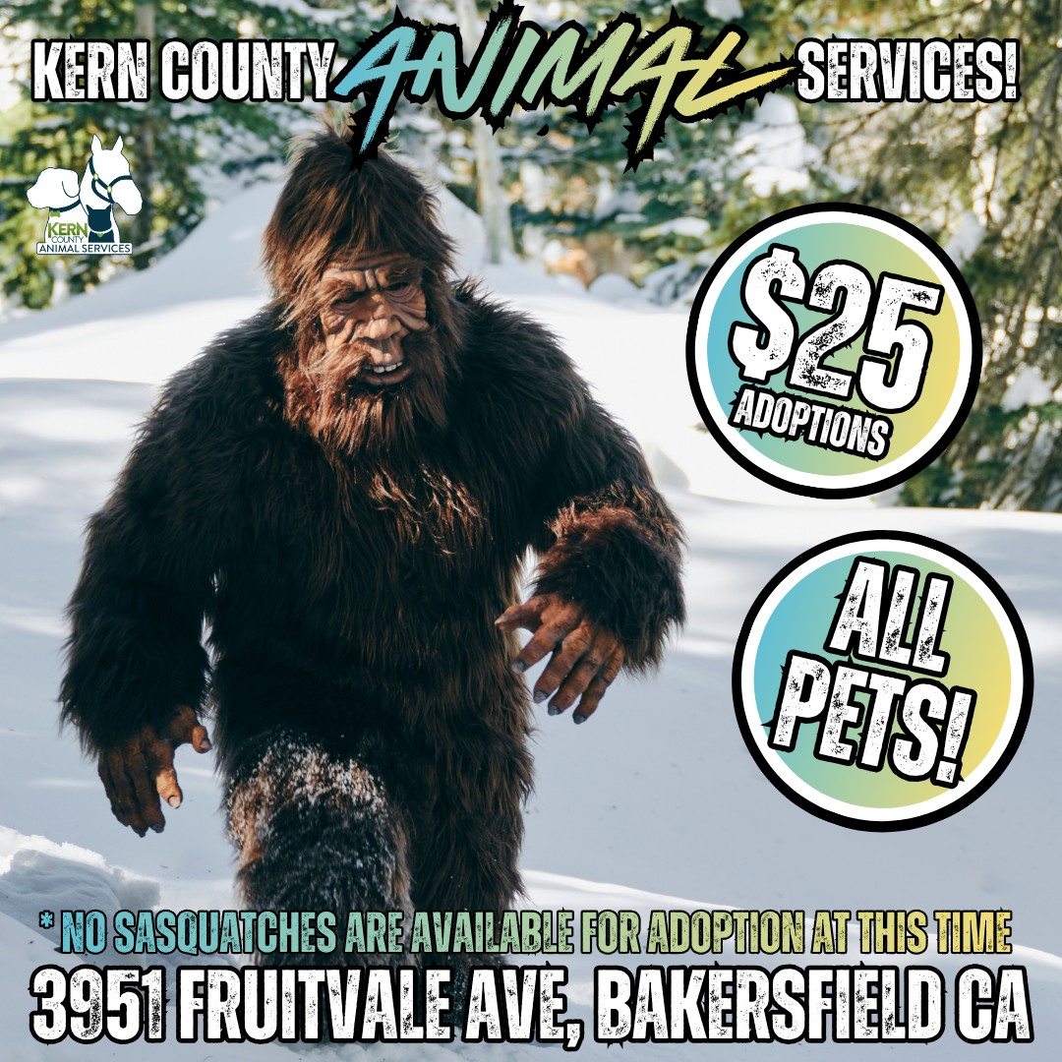

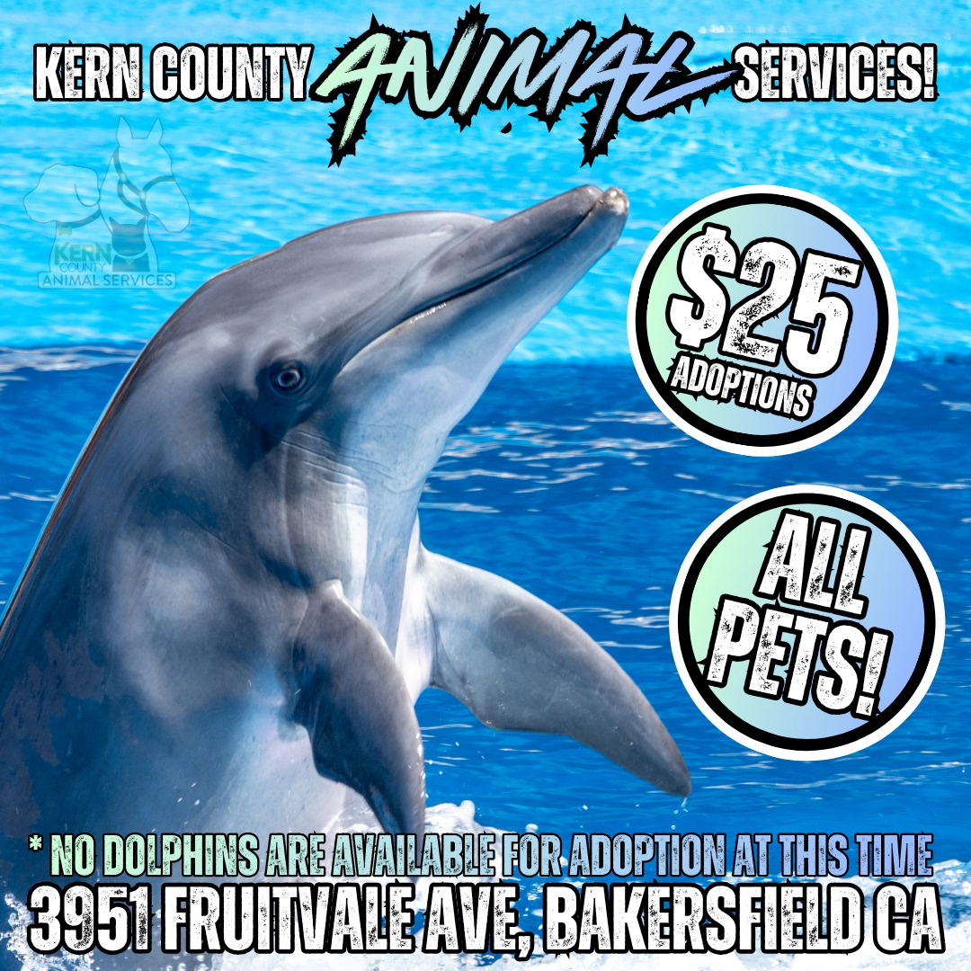
April Fools Adoptions April 1st

Slide 5



Offsite Adoption Events:
April 3rd – 5th

Slide 6
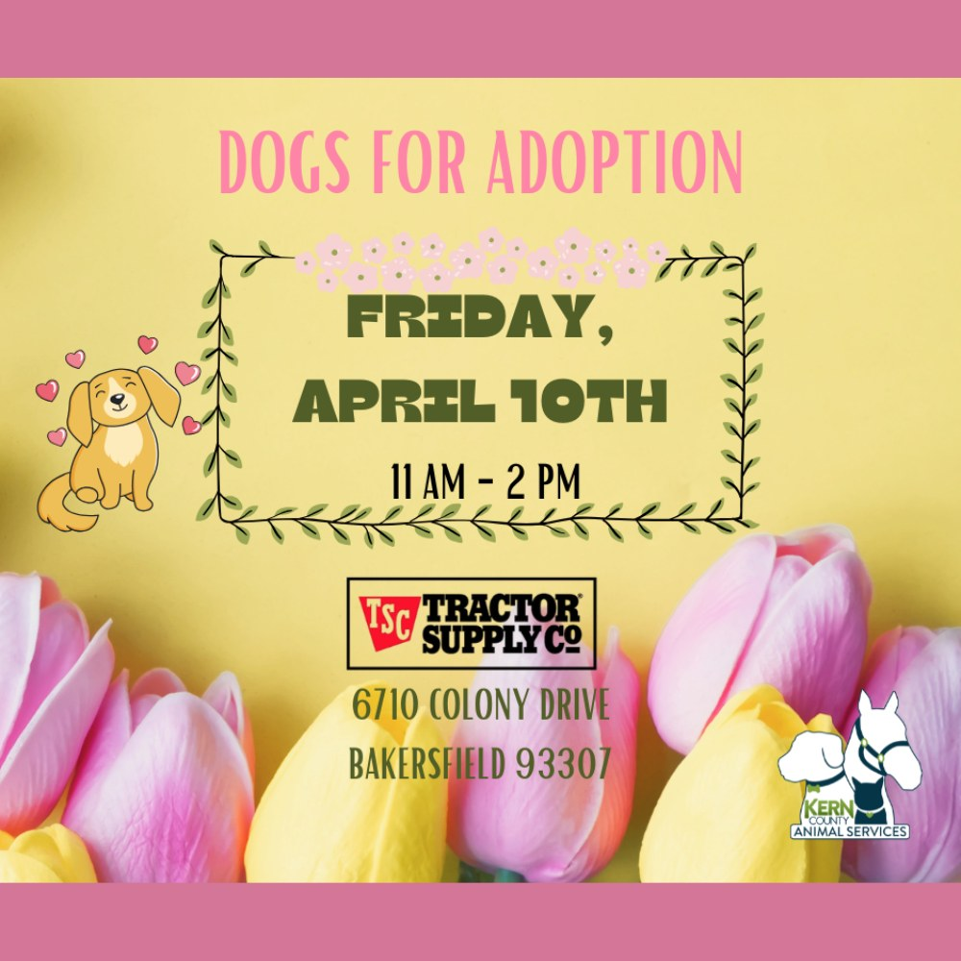
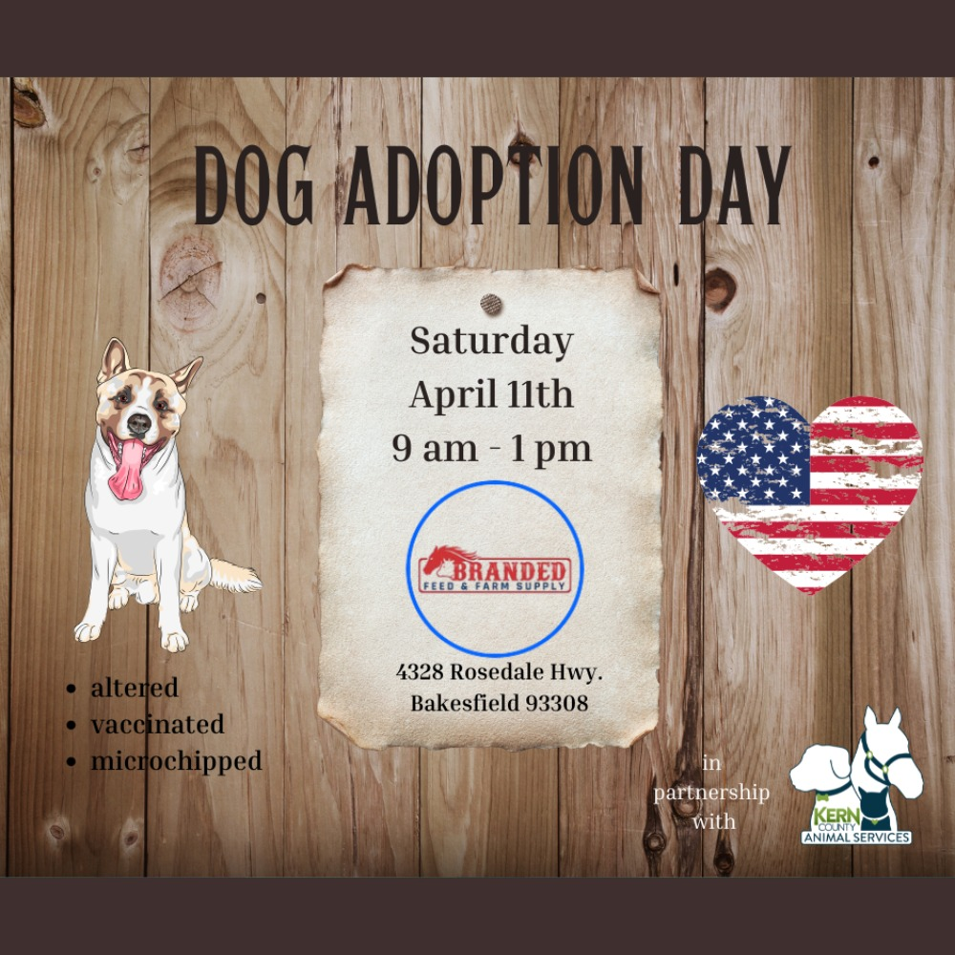

Offsite Adoption Events:
April 10th – 12th

Slide 7
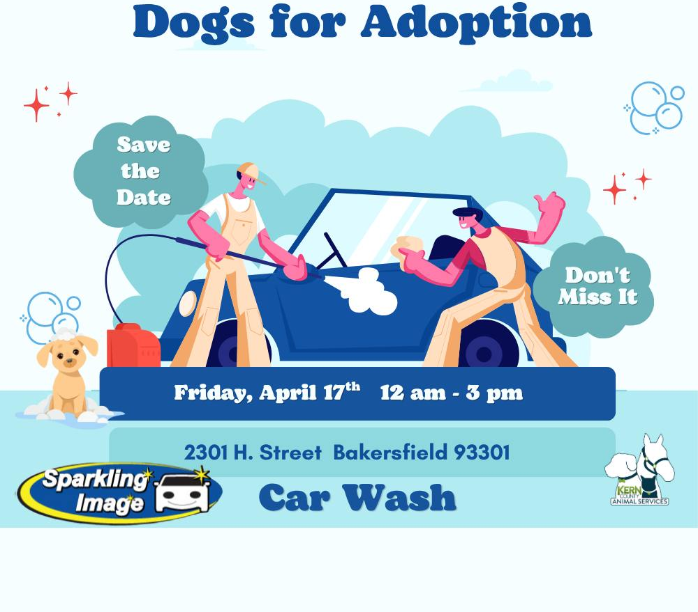

Offsite Adoption Events:
April 17th – 19th

Slide 8
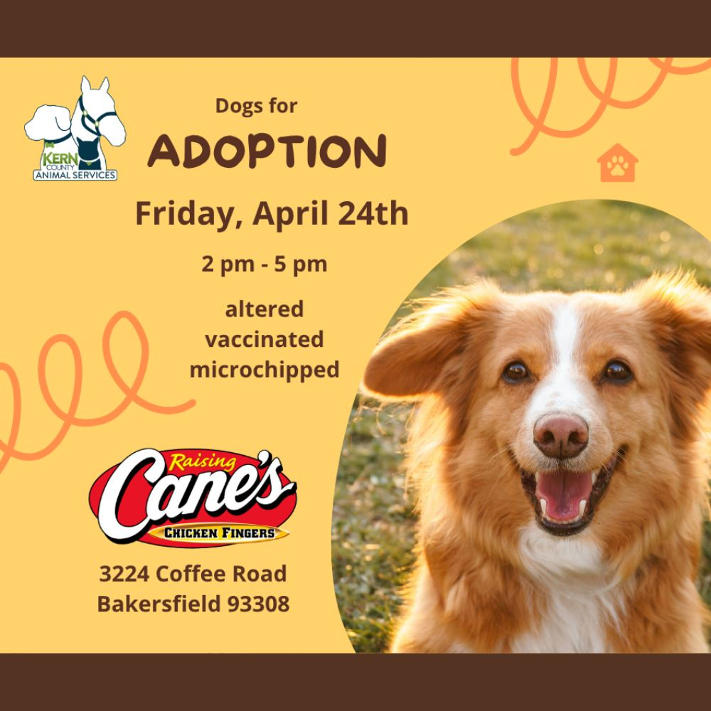


Offsite Adoption Events:
April 24th – 26th

Slide 9
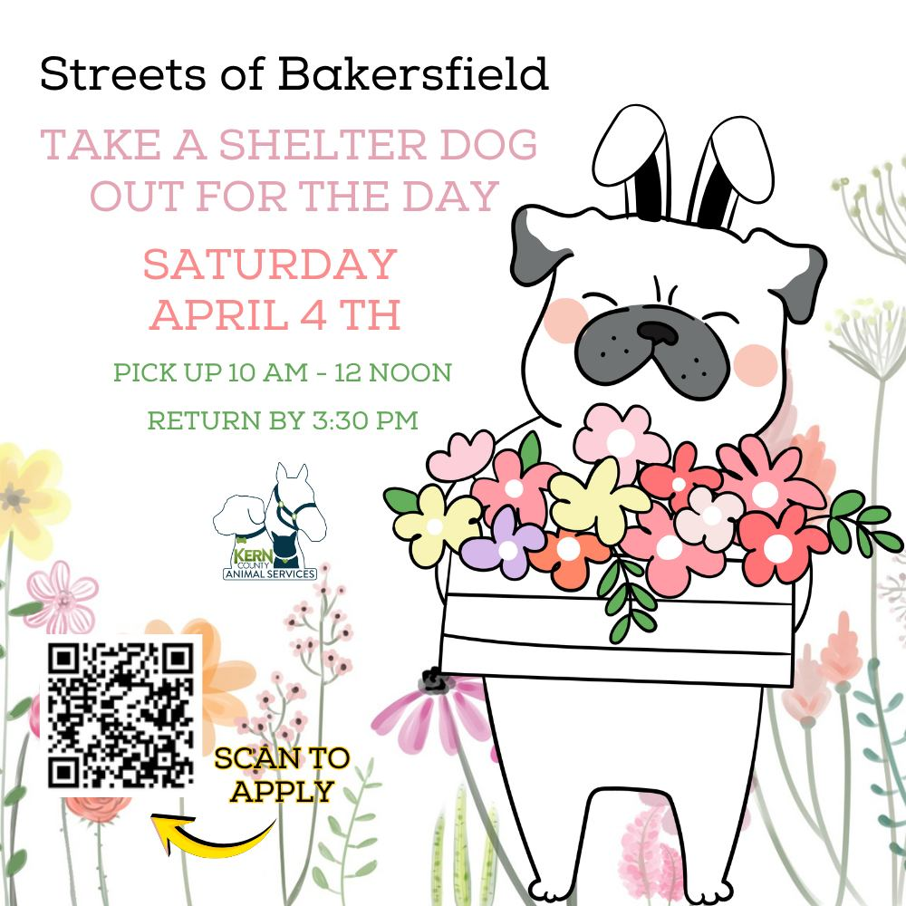

Streets of Bakersfield April 4th & April 18th

Slide 10
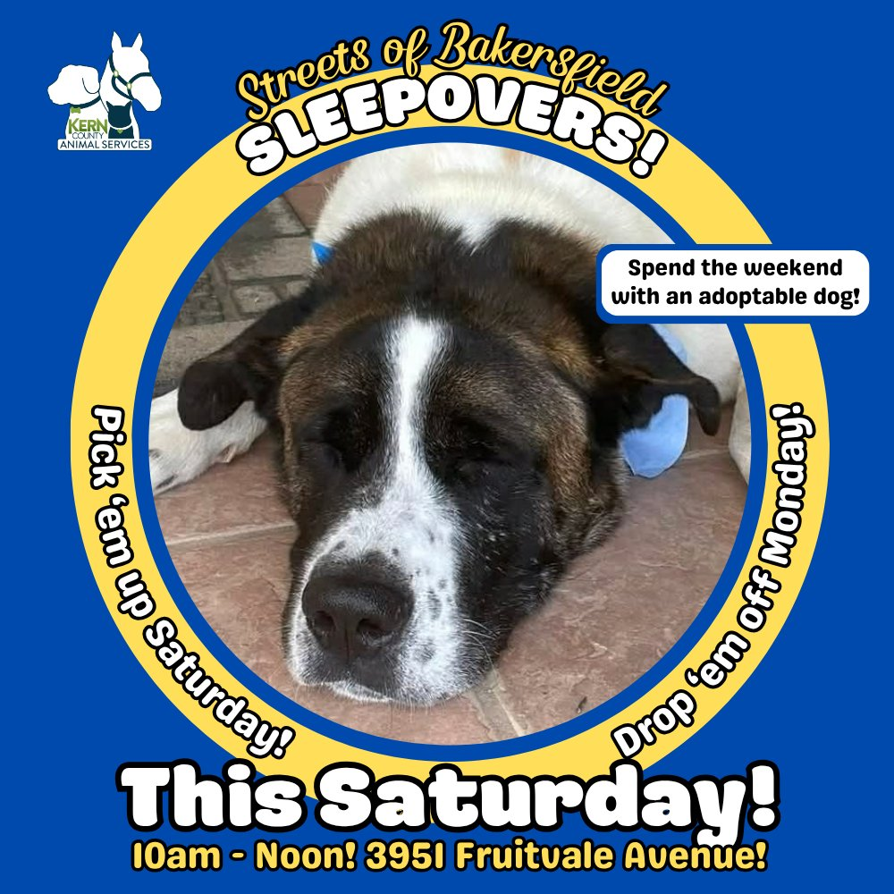
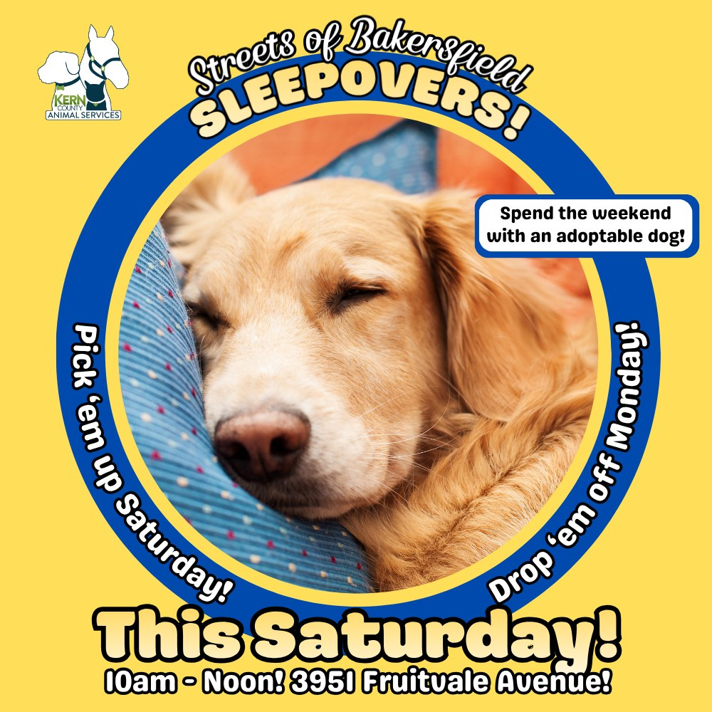
Streets of Bakersfield Sleepovers April 4th – 6th & April 18th – 20th

Slide 11
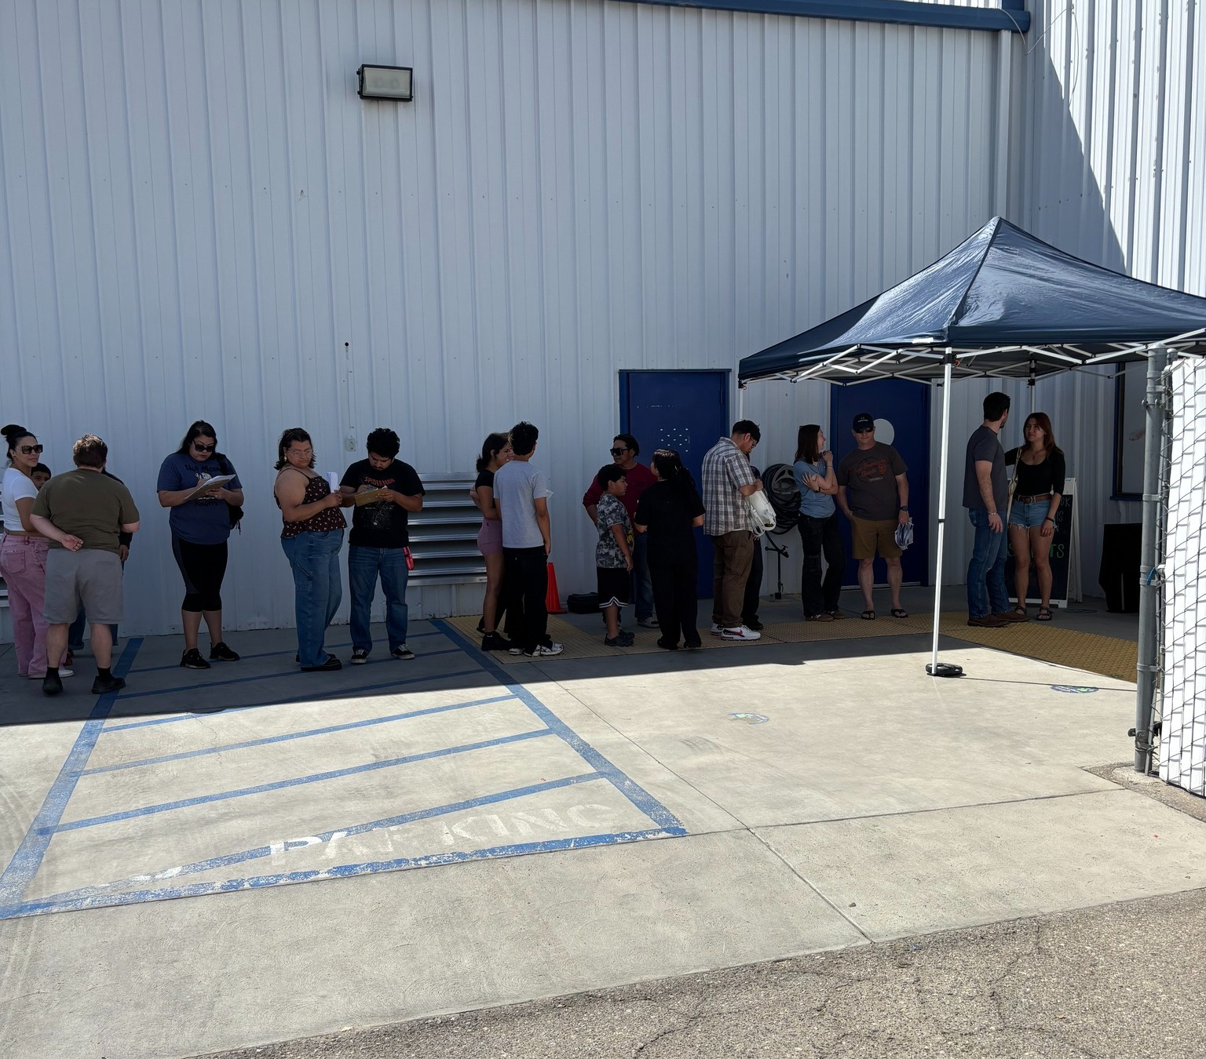
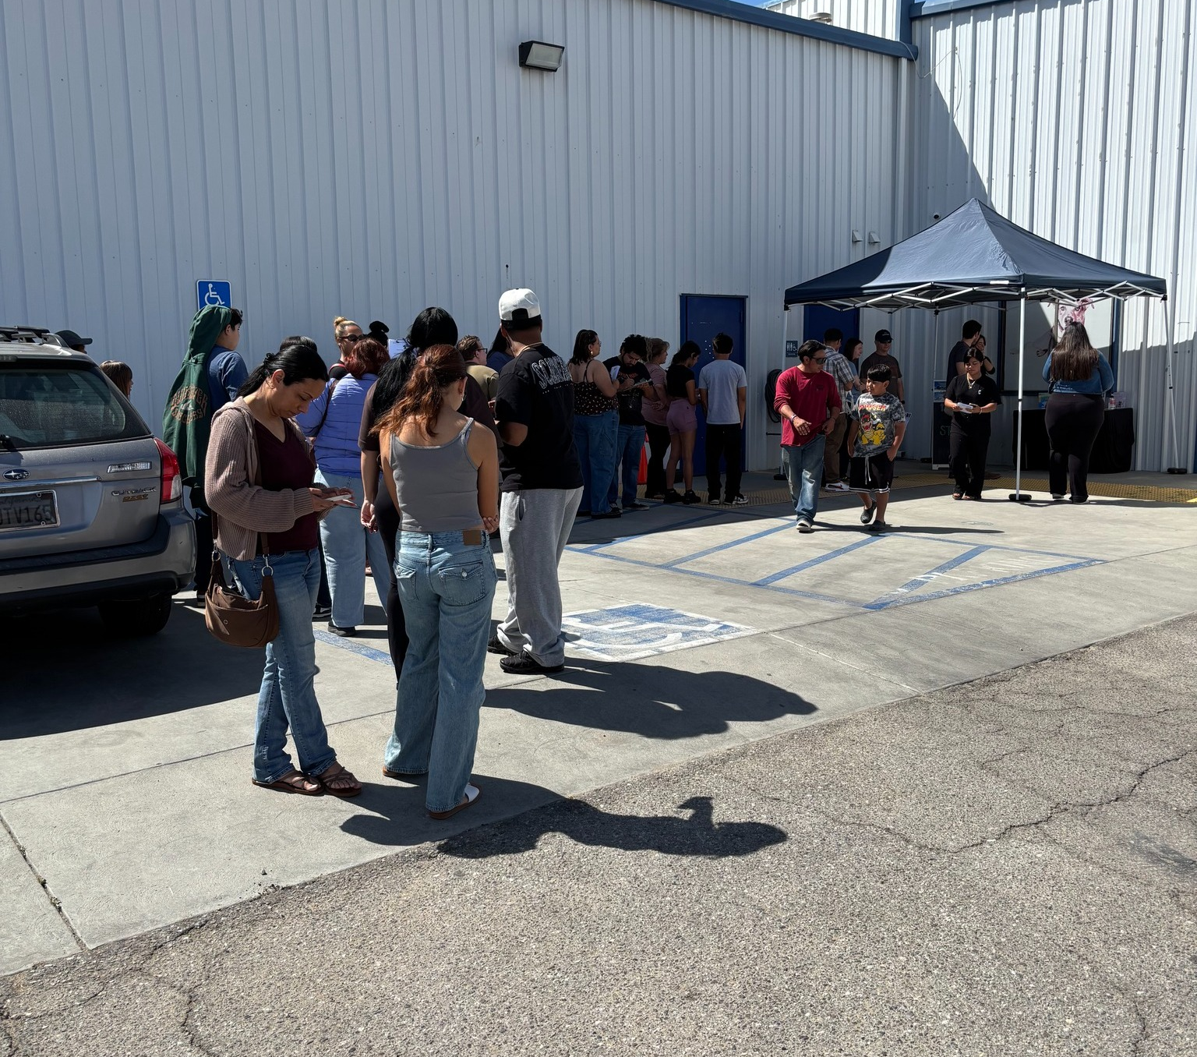
Streets of Bakersfield Hits All-Time High! A record number of dogs hit the Streets of Bakersfield on Saturday, April 6th! 68 dogs enjoyed a Doggy Day Out, and 12 got to enjoy a weekend sleepover by spending Saturday and Sunday nights out of the shelter.

Slide 12
Low-Cost Spay/Neuter Clinics April 2026
Date | Location | Surgeries
April 7th | Taft, Ca. | 41
April 9th | Virginia Park | 47
April 10th | Inyo/Ridgecrest, Ca. | 33
April 14th | Bakersfield Harley Davidson | 58
April 17th | Faro Church | 20
April 21st | Heritage Park | 53
April 22nd | Heritage Park | 33
April 23rd | Boron, Ca. | 61
April 30th | Buttonwillow, Ca. | 36
 | Total Surgeries | 382

Slide 13
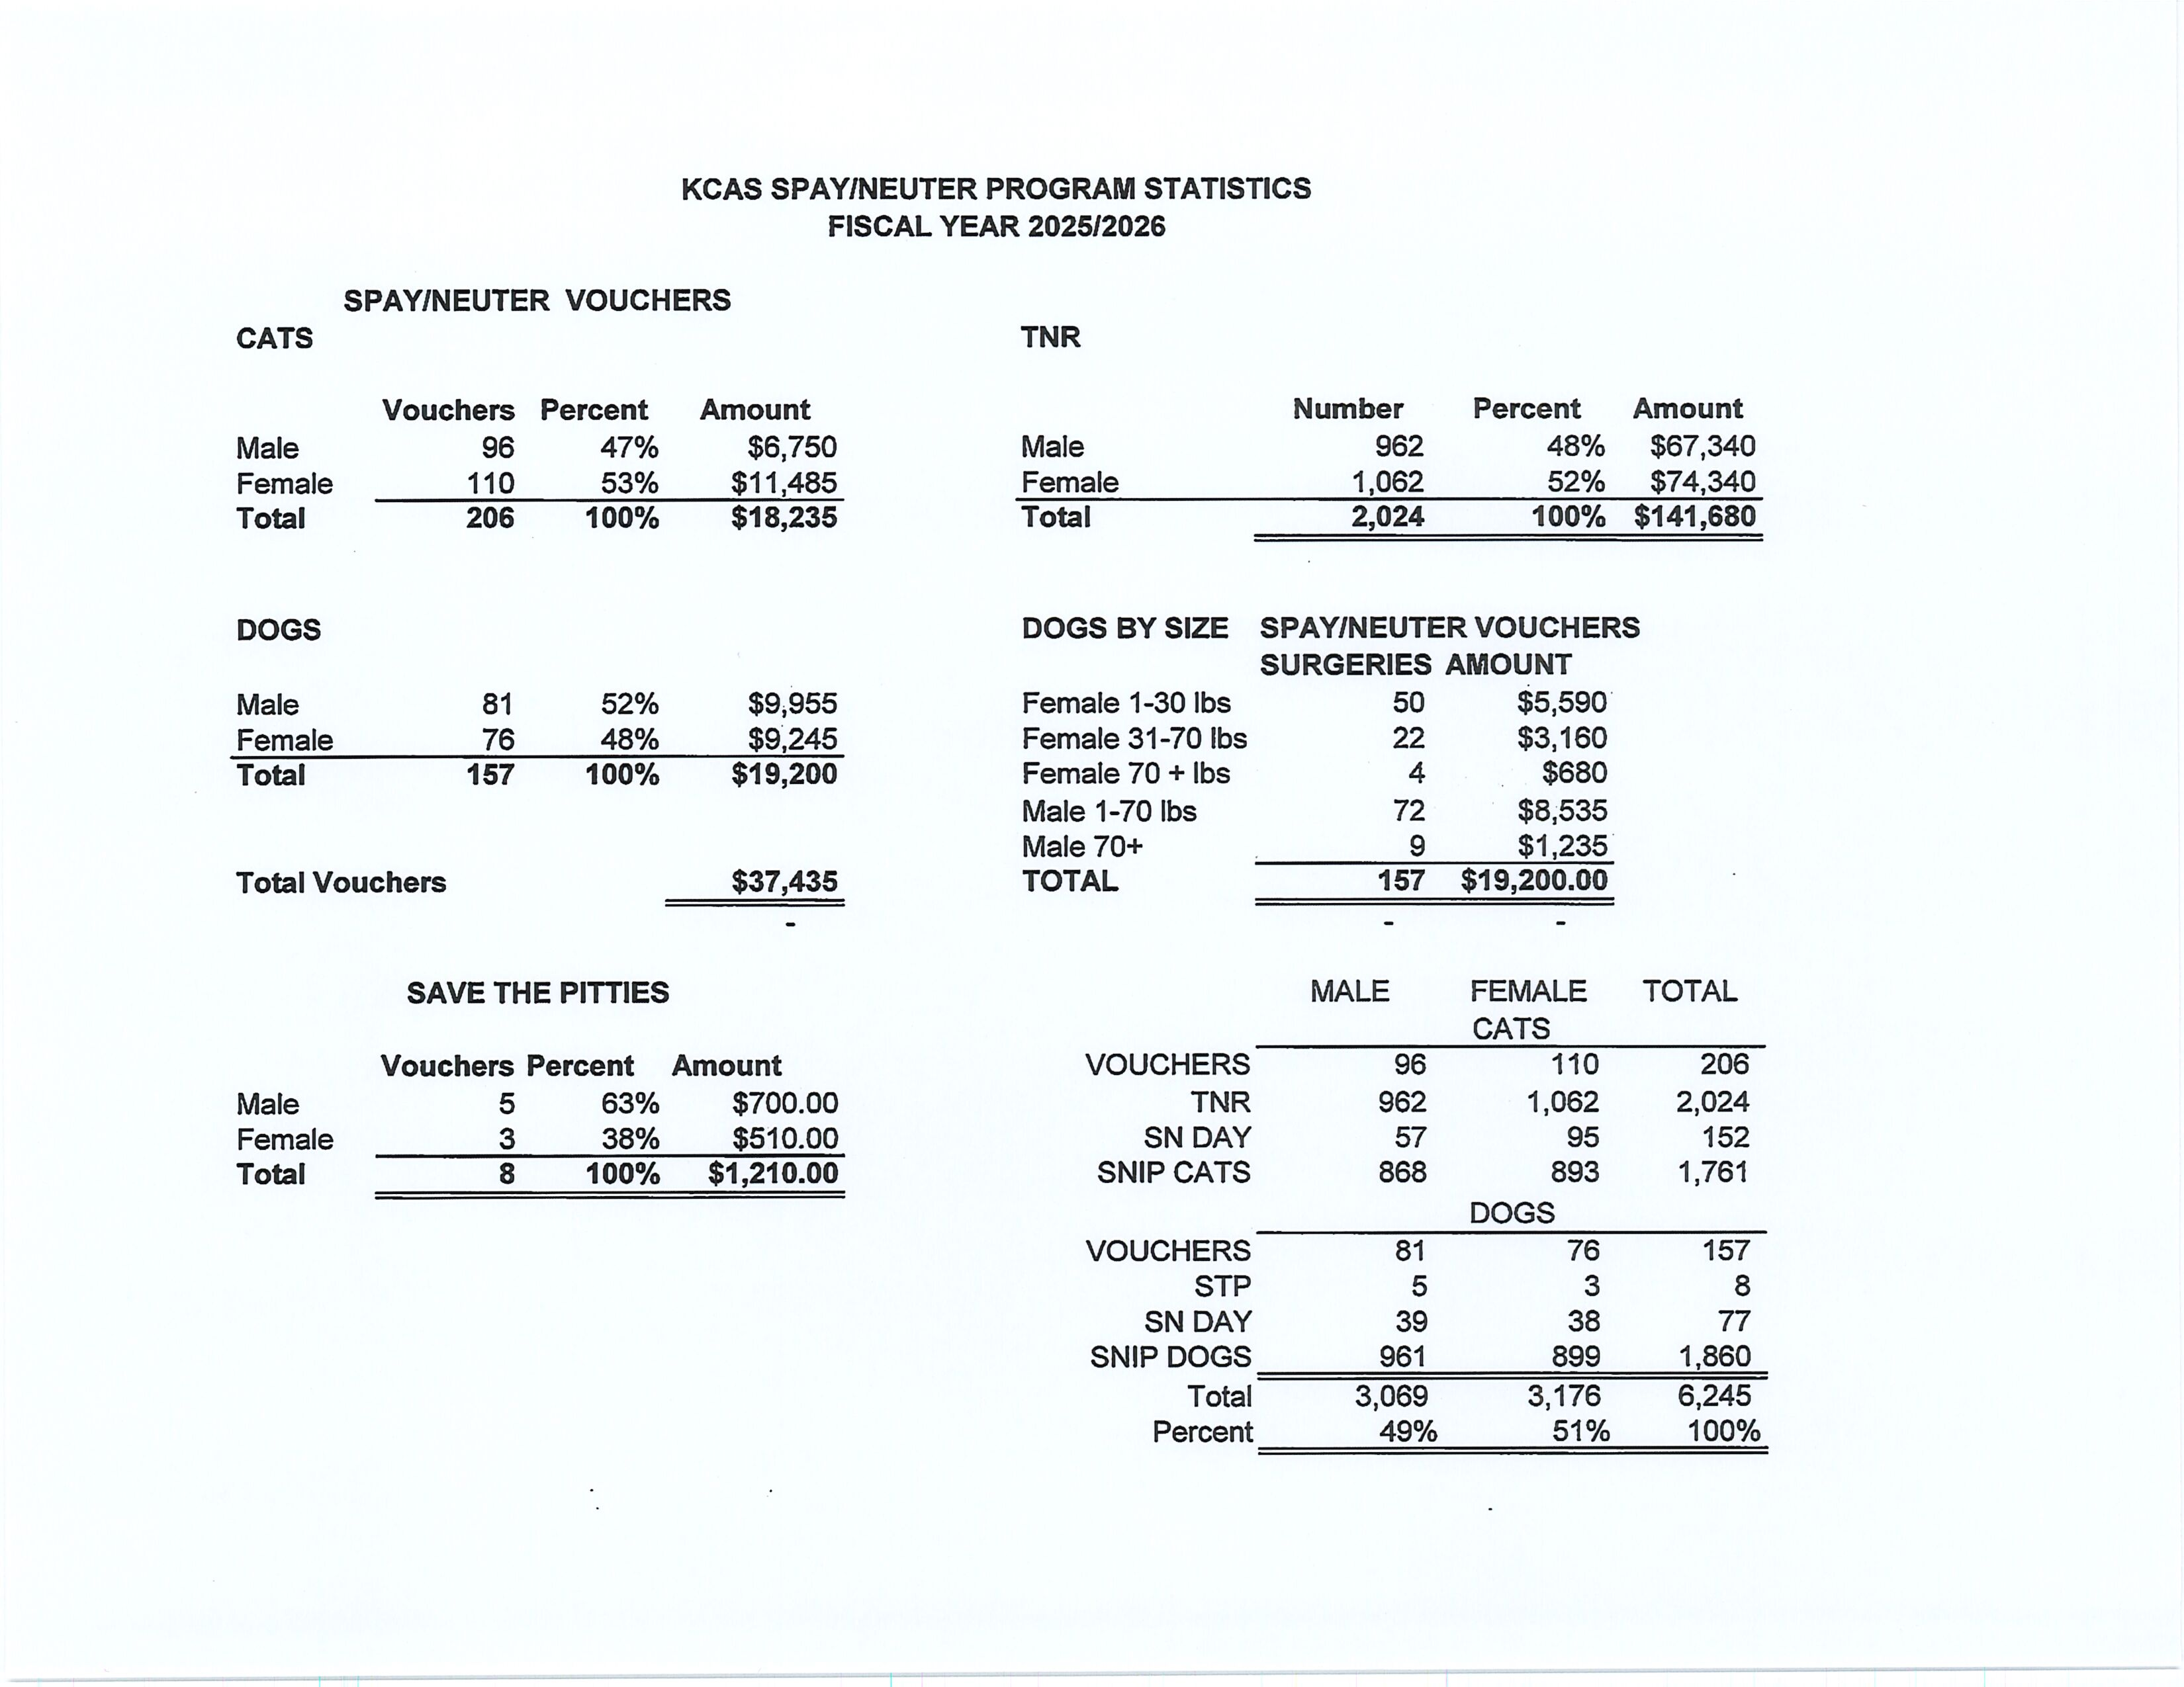

Slide 14
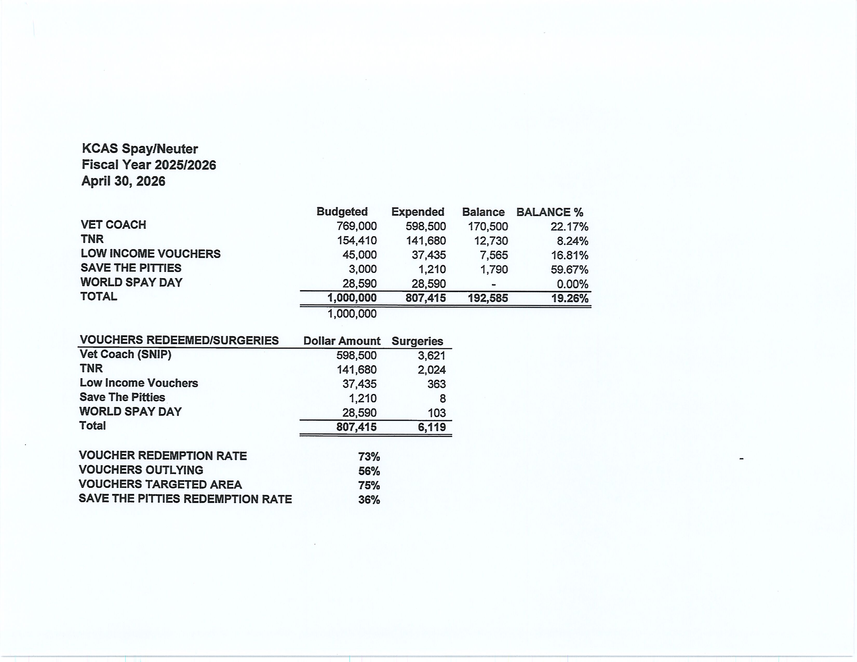

Slide 15
Low-Cost Vaccination Clinics April 2026
Rabies
456
Microchips
Bordetella
87
49
DHPP* 363
FVRPC* 211
*DHPP and FVRCP vaccinations provided at no-cost by Petco Love.

Slide 16
Field Service Calls: April 2026
AREA | CALLS PER AREA
Lake Isabella | 145
Mojave | 143
North County | 75
Northeast | 295
Northwest | 313
Ridgecrest | 34
Southeast | 180
Southwest | 144
Taft | 105
Tehachapi | 48
TOTAL | 1,482
23 dogs were returned to their owners in the field in April 2026.
100 dogs were secured on property by Animal Control Officers in April 2026.

Slide 17
Commercial Animal Facility Calls
April 2026
TYPE | CALLS PER TYPE
CAF – Breeder | 9
CAF – Rescue | 7
CAF – Kennel | 2
CAF – Boarding | 5
TOTAL | 23
4 Inspections Passed
0 Inspections Failed
0 Citations Issued
0 Permits Issued
52 Active CAF Permits

Slide 18
Volunteer Program April 2026
Active Volunteers
126
New Volunteers
72
Volunteer hours donated in April
Year-To-Date volunteer hours donated in 2026
732.08
2,442.01

Slide 19
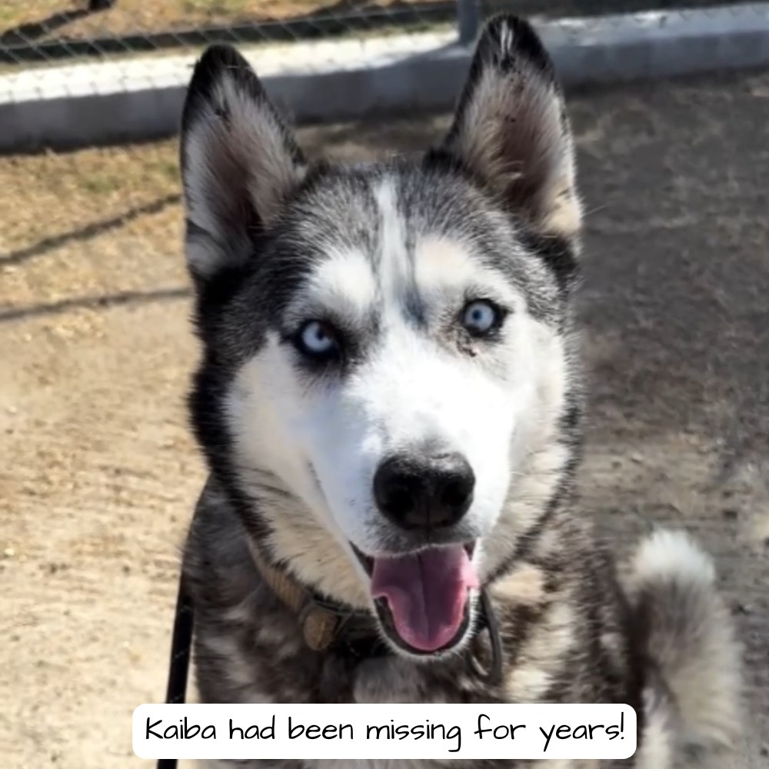
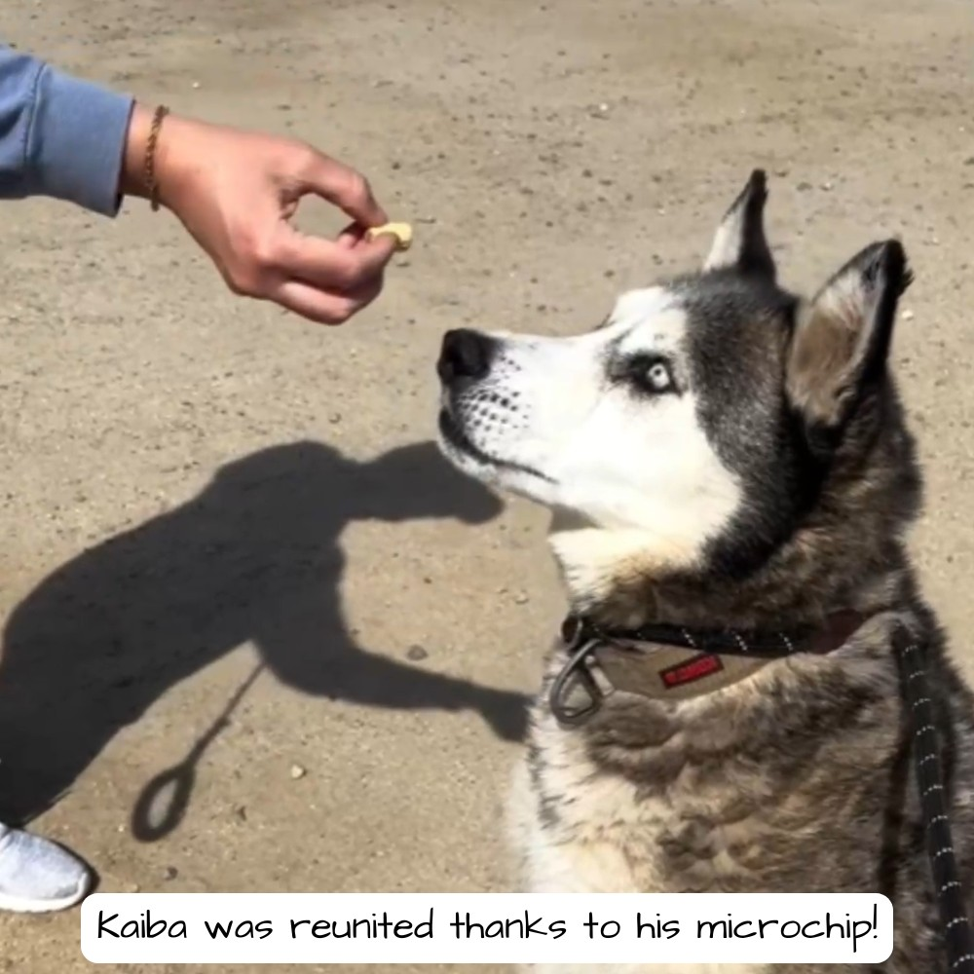
Kaiba Reunited!
Kaiba came to KCAS with a severe nosebleed that was later diagnosed as a bleeding disorder.
Although his microchip information was outdated, staff refused to give up and tracked down his owner in Los Angeles.
Kaiba had been missing for years, and the emotional reunion was filled with disbelief, happy tears, and joy.
Now, Kaiba is finally back home where he belongs.

Slide 20
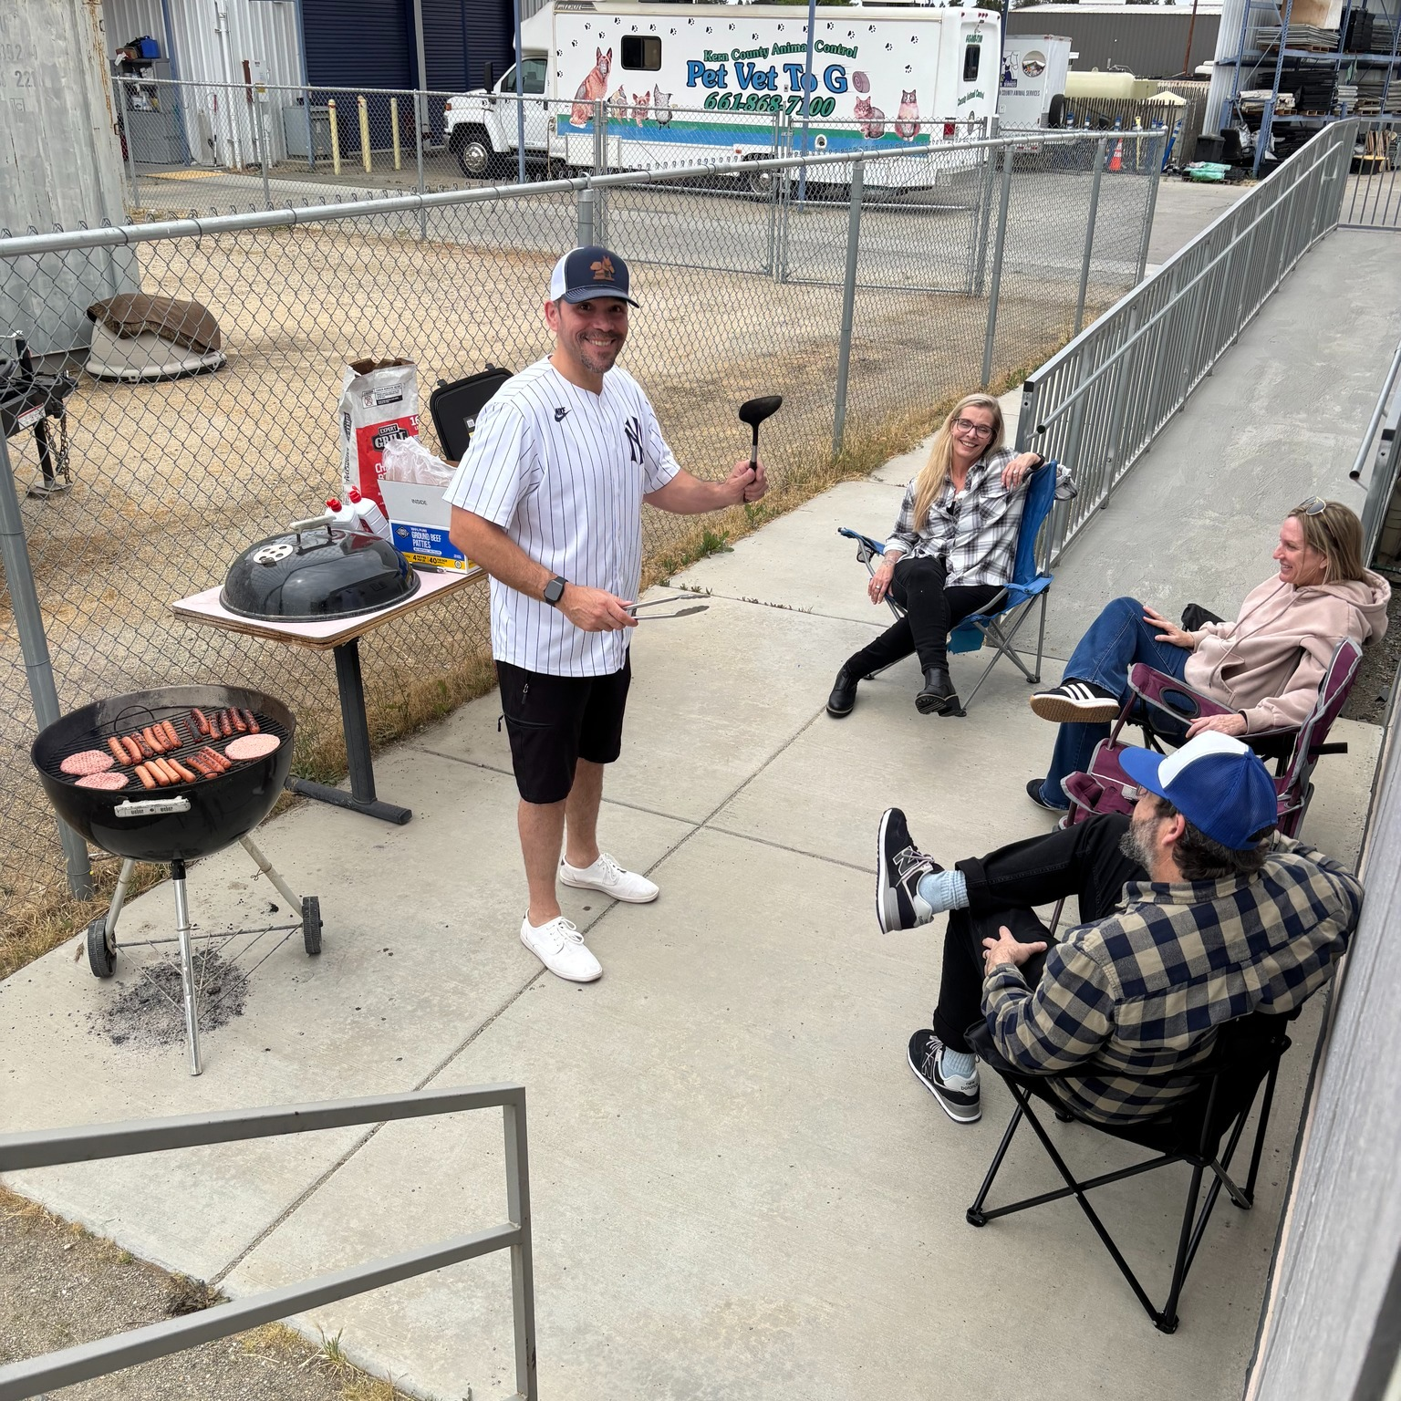
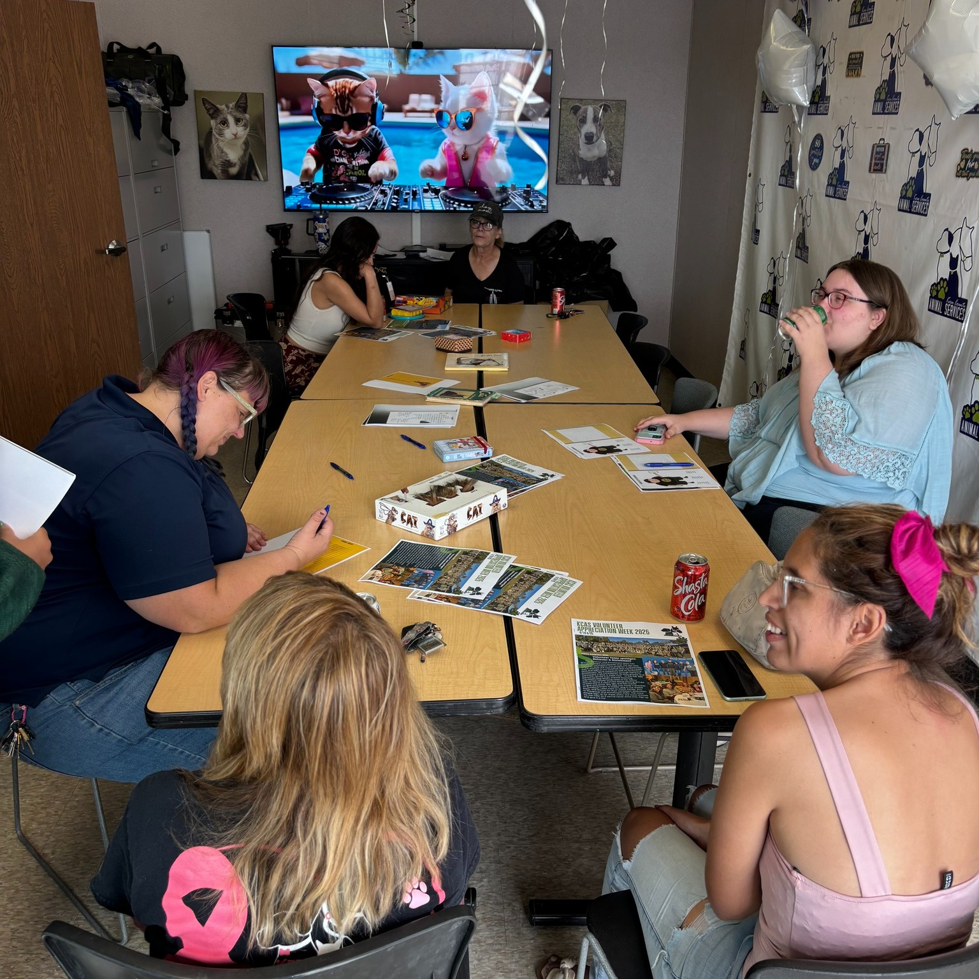
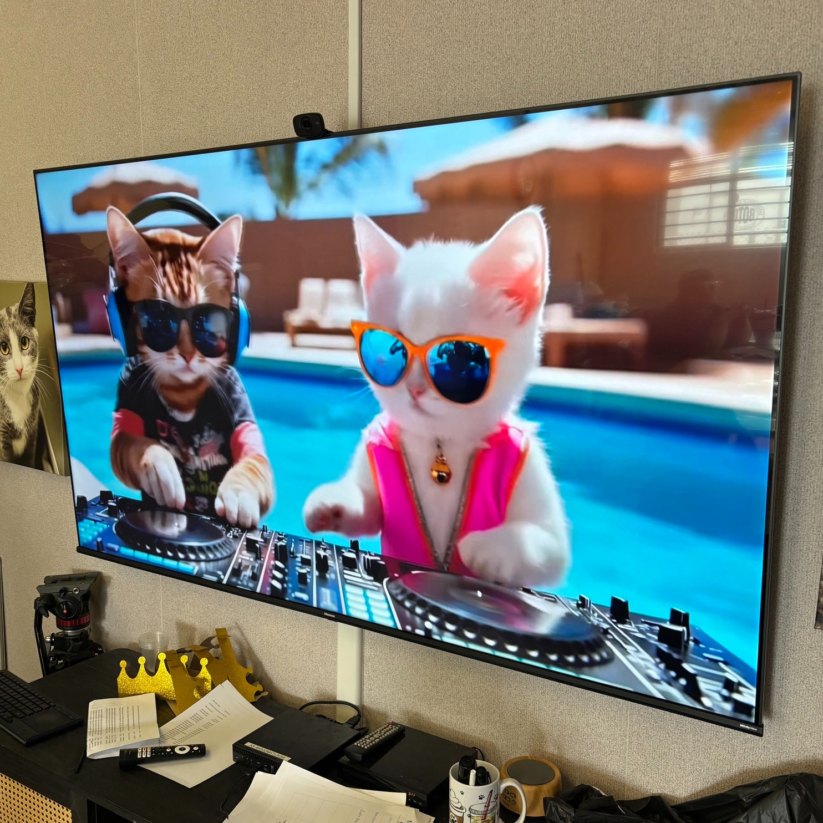
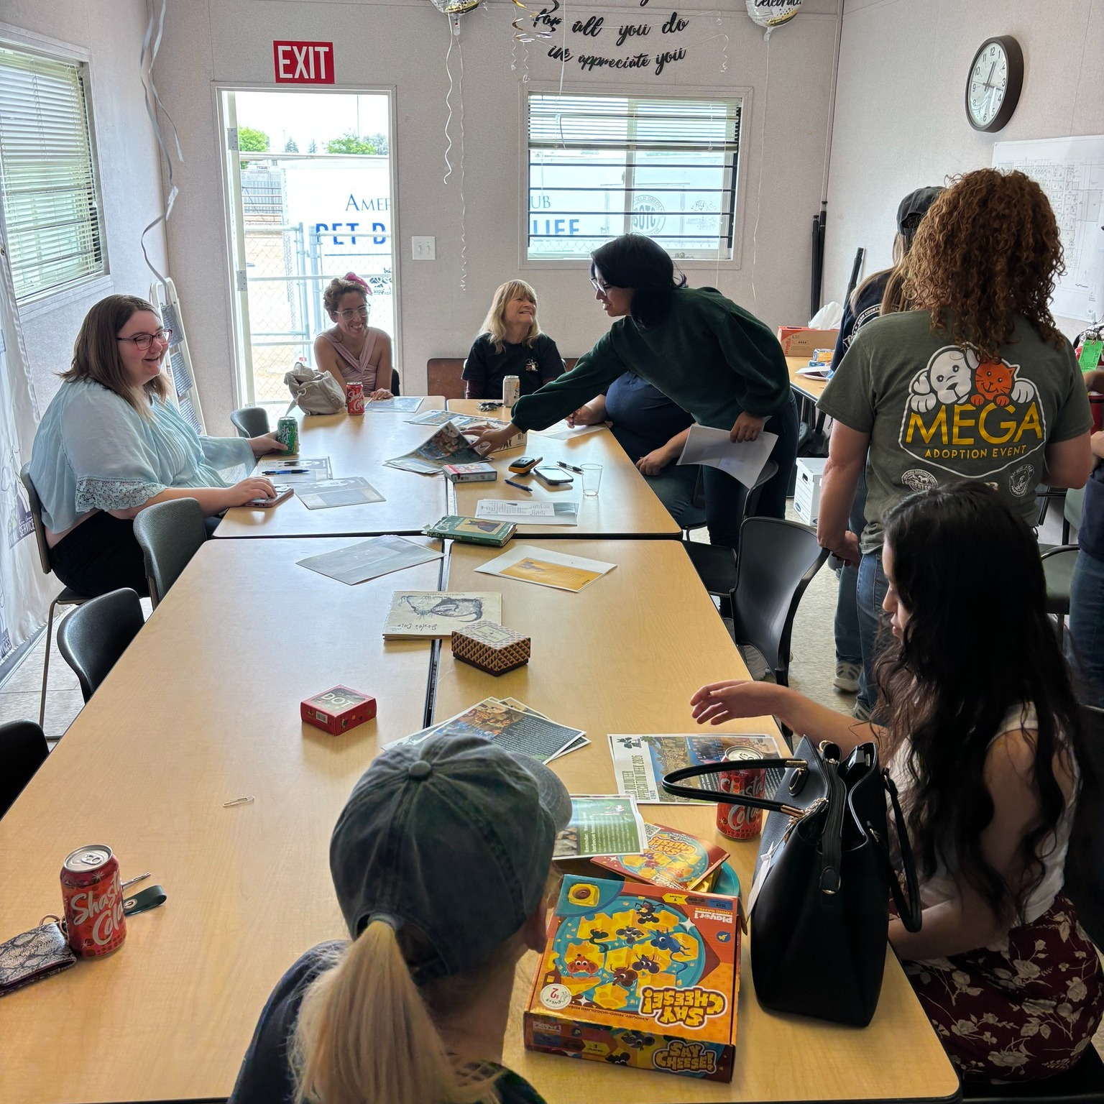
Volunteer Appreciation BBQ
Volunteer Appreciation Week wrapped up on Saturday, April 25th with a fun lunchtime BBQ celebrating the incredible volunteers of Kern County Animal Services.
Volunteers enjoyed great food, games, music, and plenty of laughs while being recognized for the compassion, dedication, and positive impact they bring to the animals in our shelter every day.
Special thanks to KCAS Volunteer Coordinator Berkeley for helping make it all happen!

Slide 21
Discovery Donations
Discovery Elementary continued its wonderful annual tradition of supporting the pets at Kern County Animal Services with a generous donation drive led by students, parents, and teachers. After delivering a huge tub of supplies, the group toured the shelter to meet the animals their kindness will help. The donated items are already making a difference for pets in our care!

Slide 22
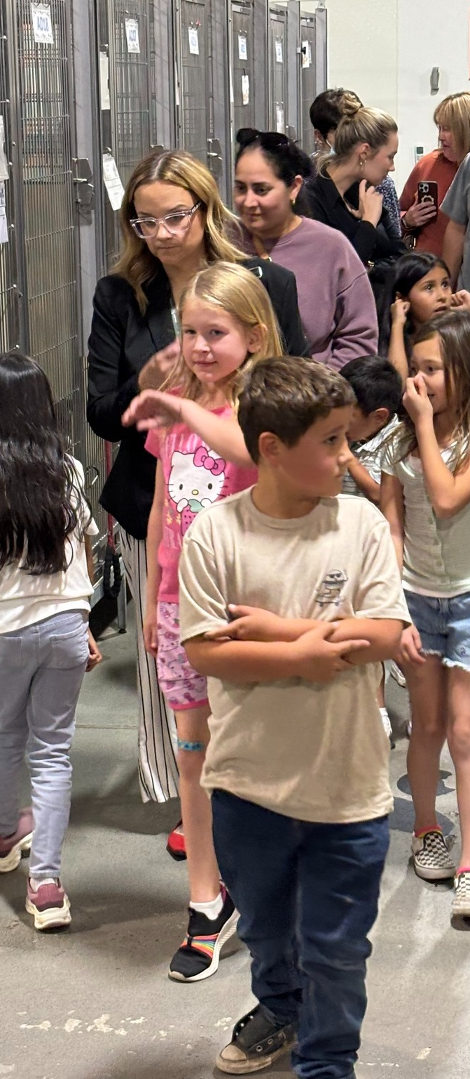
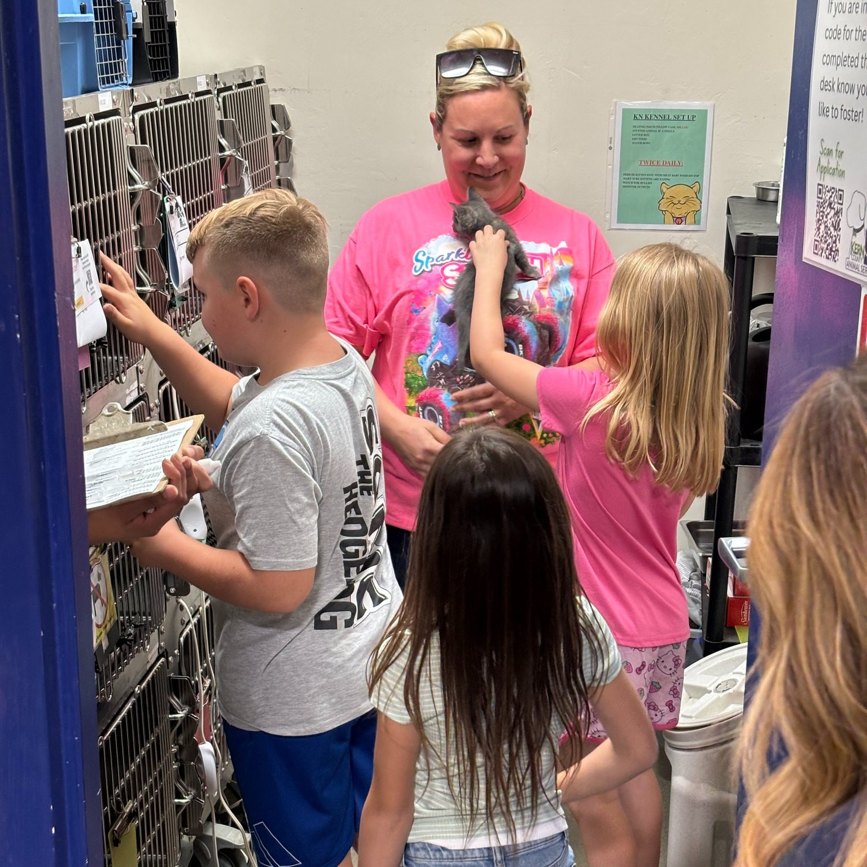
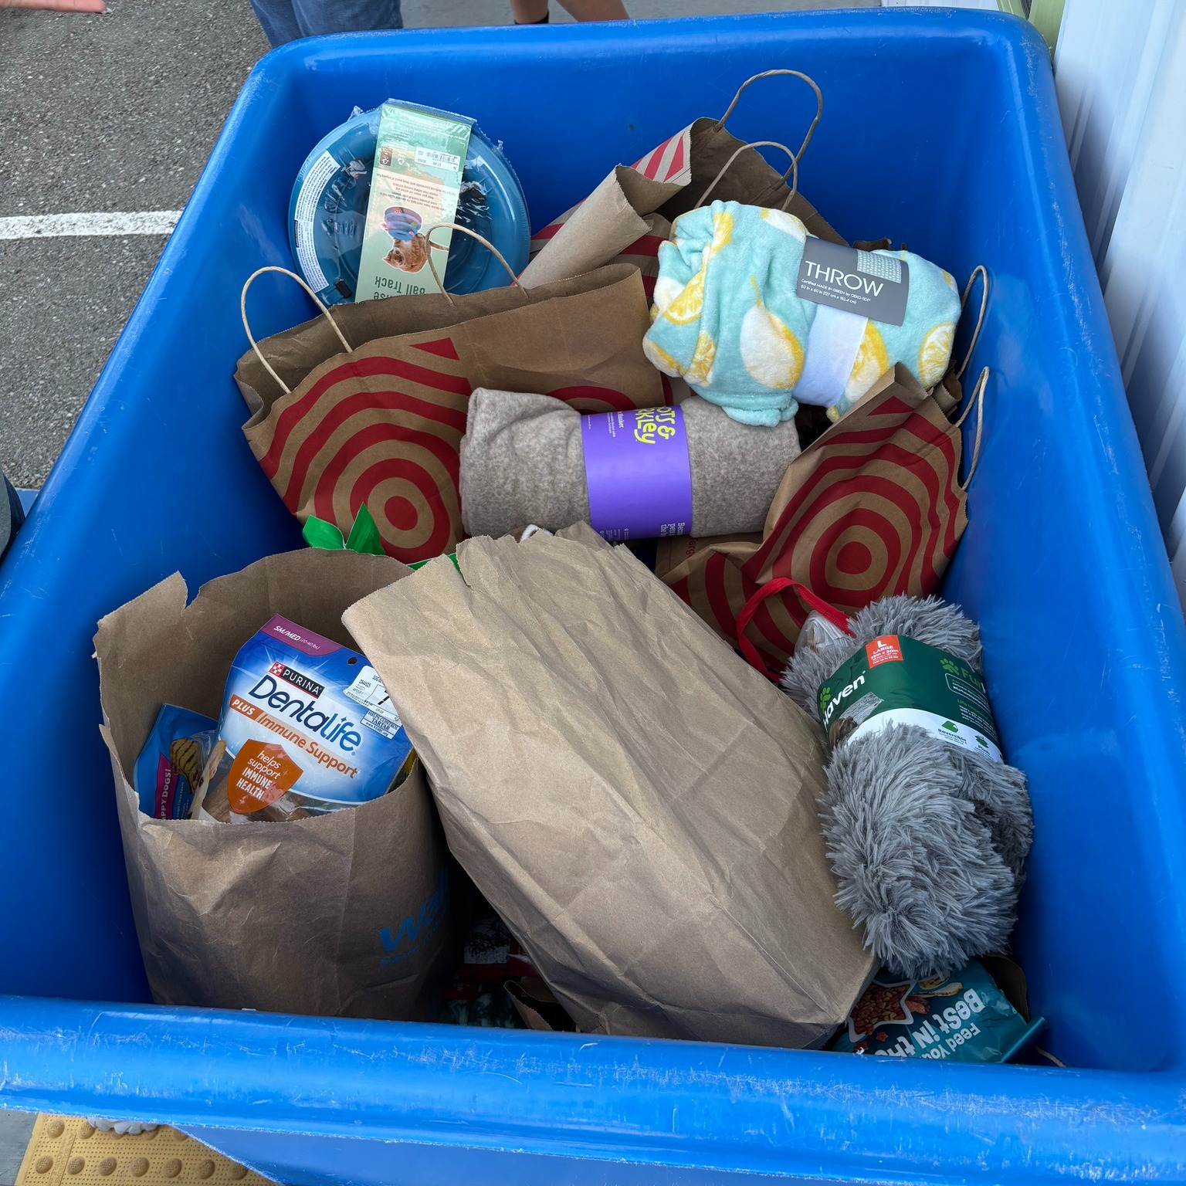
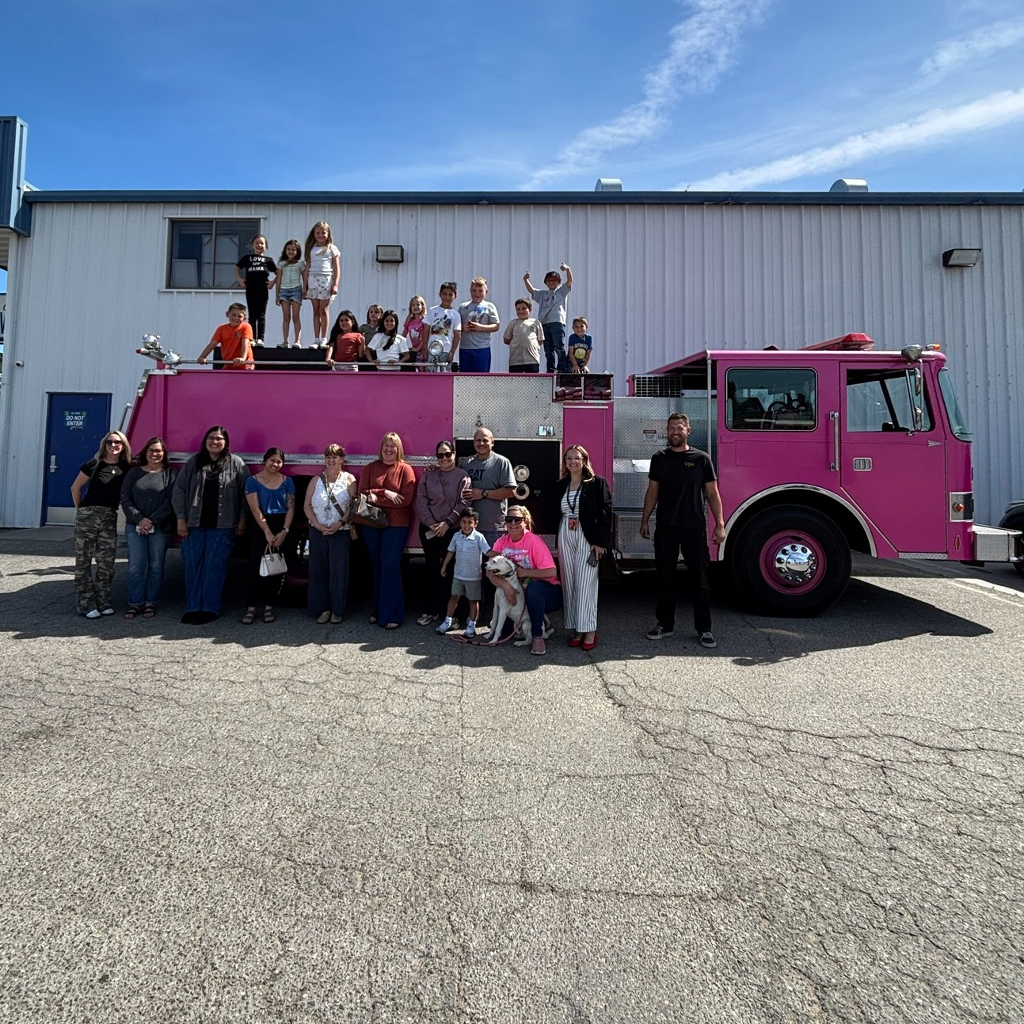
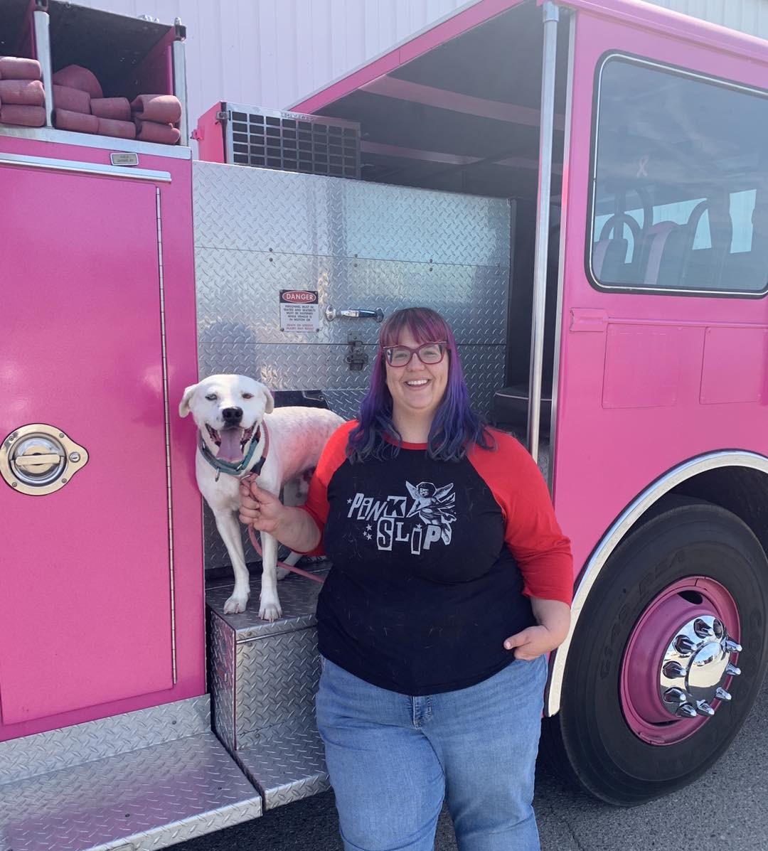

Slide 23
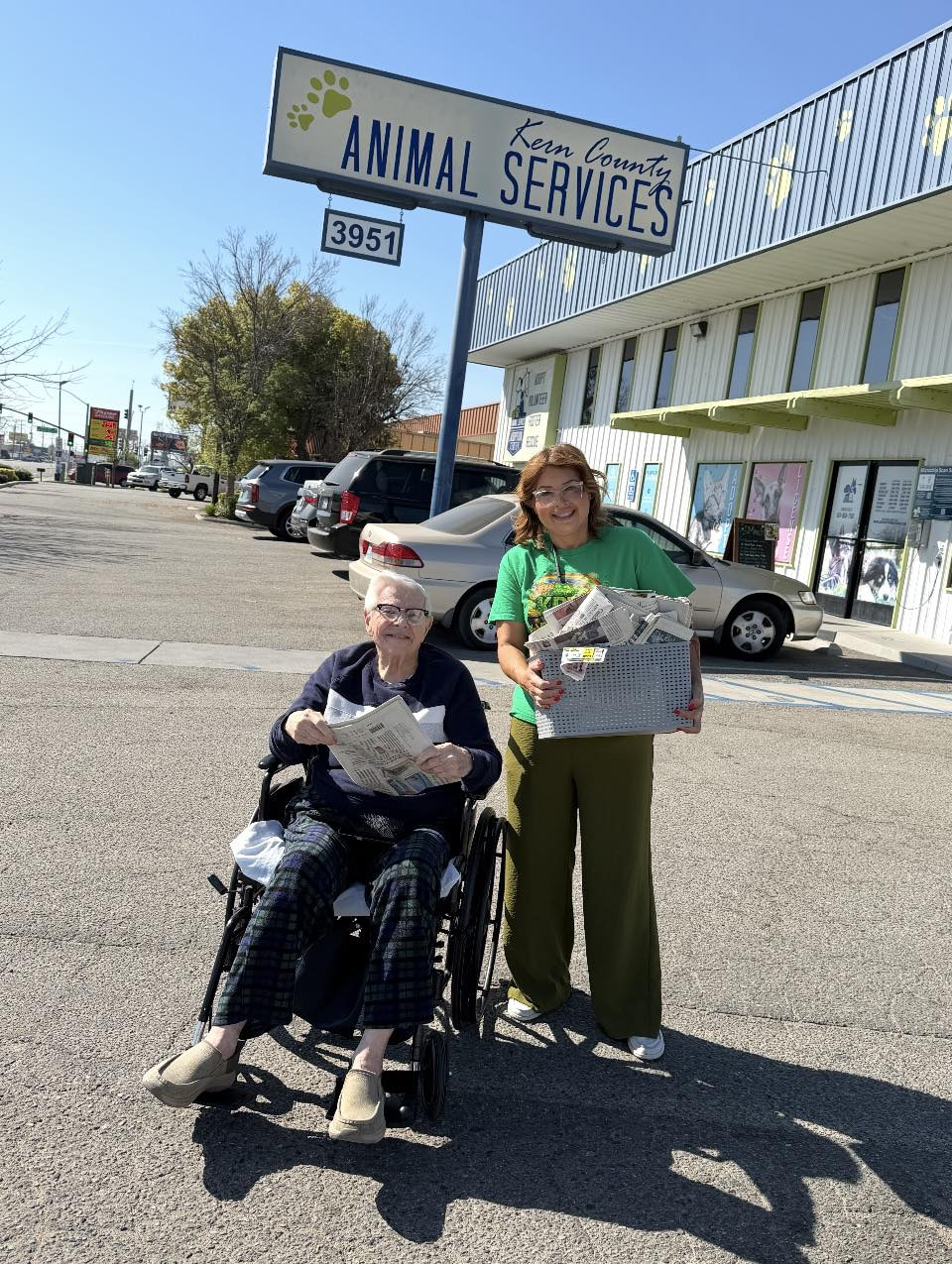
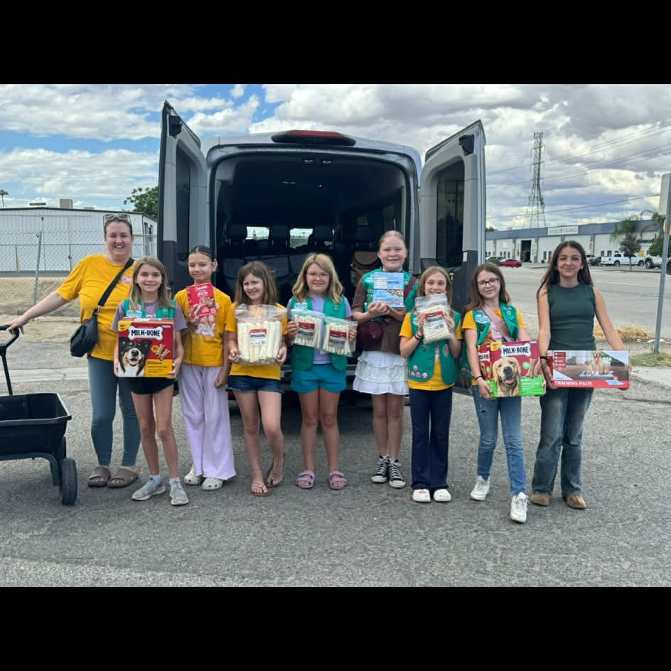
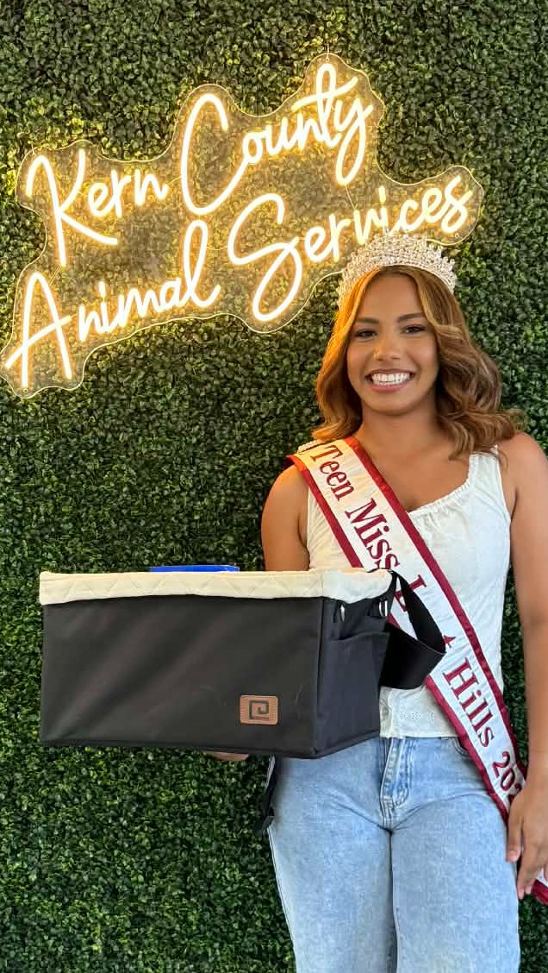
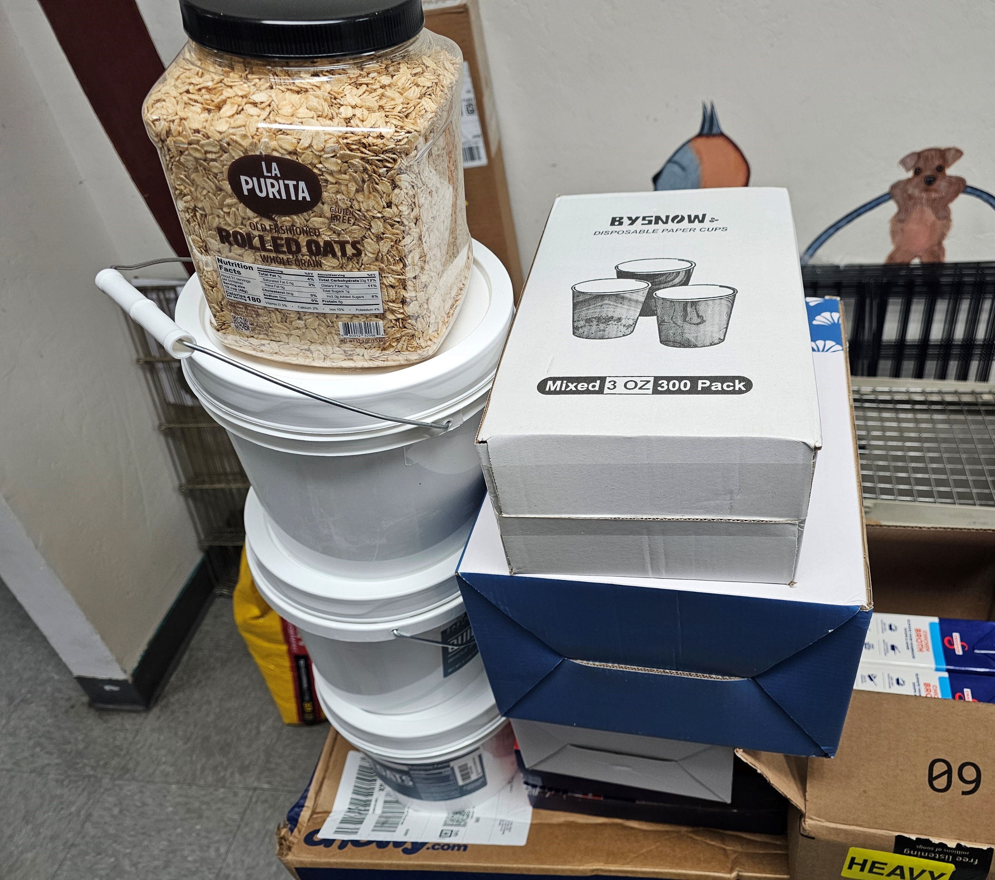
Community Donations
A huge thank you to everyone in our community who donated to the animals at Kern County Animal Services during the month of April!
Special thanks to Girl Scout Troop 3670, Jocelyn “Teen Miss Lost Hills” from the Miss Kern County Pageant, and our friends at Kern River Transitional Care for their generosity and support.
From toys and treats to food, supplies, enrichment items, and newspapers, every donation helps make life better for the pets in our care. Thank you, Kern County, for continuing to support our shelter animals!

Slide 24
2026 Year To Date January 1st – April 30th
1,488
Adoptions
1,439
Rescued
323
Returned To Owner
993
Spay/Neuter Surgeries (Clinics + TNR)
3,891
Total Lives Saved
81.06%
Save Rate

Slide 25
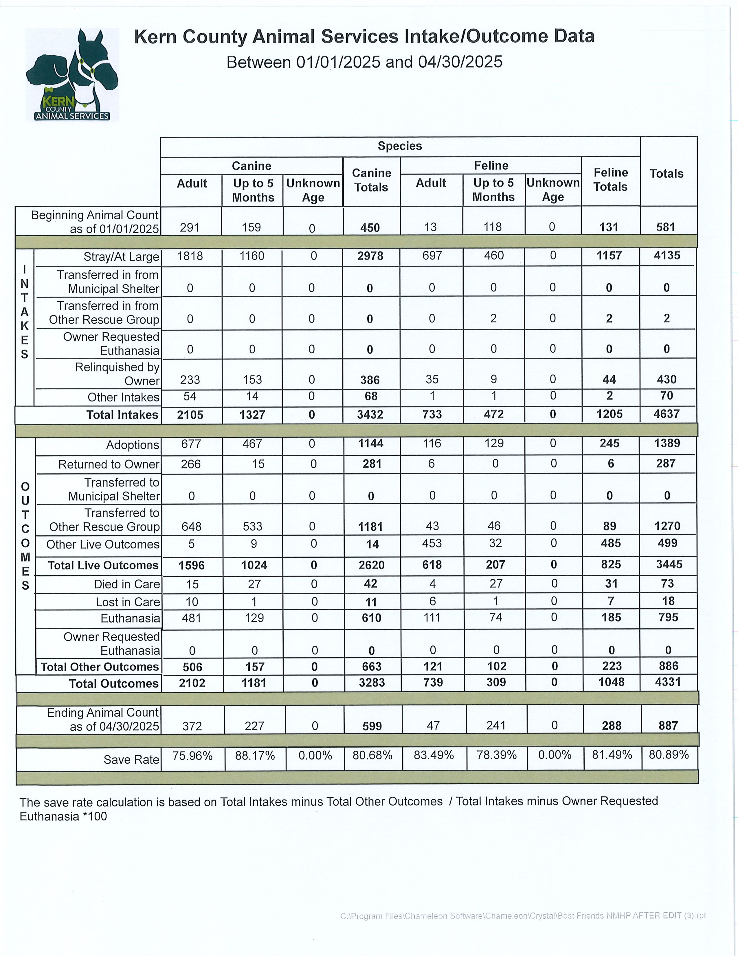
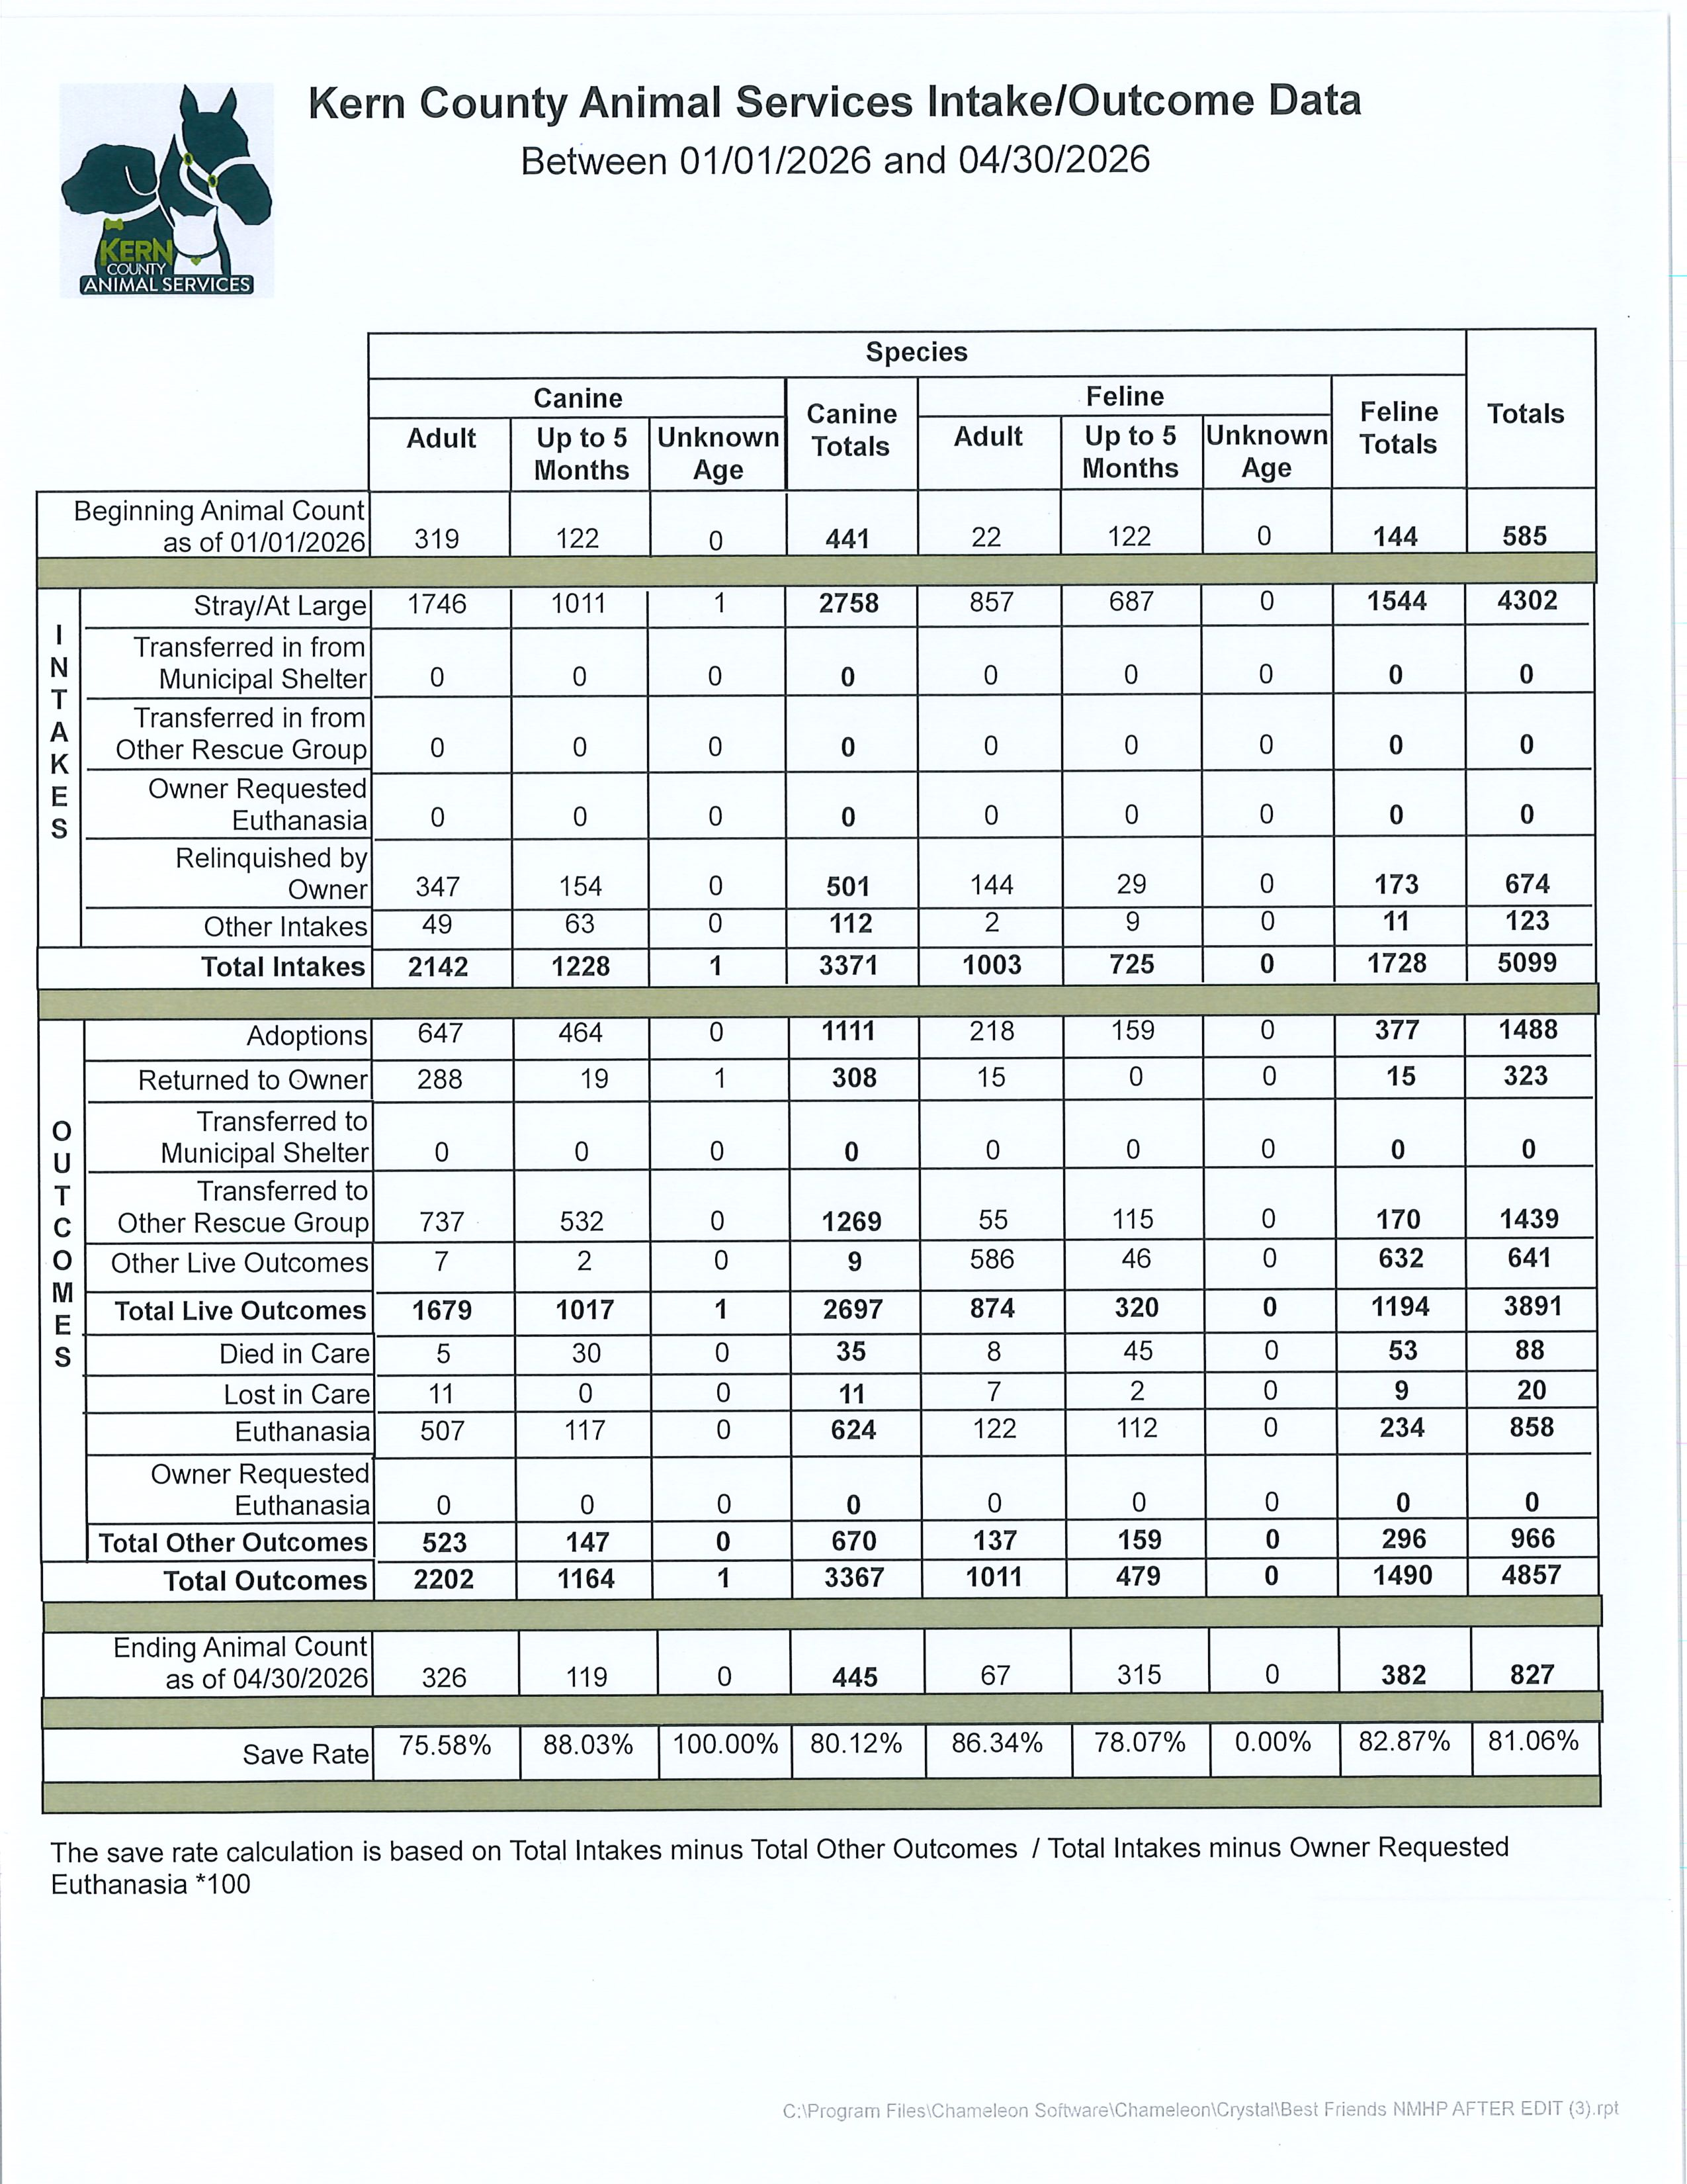

Slide 26
