Slide 1

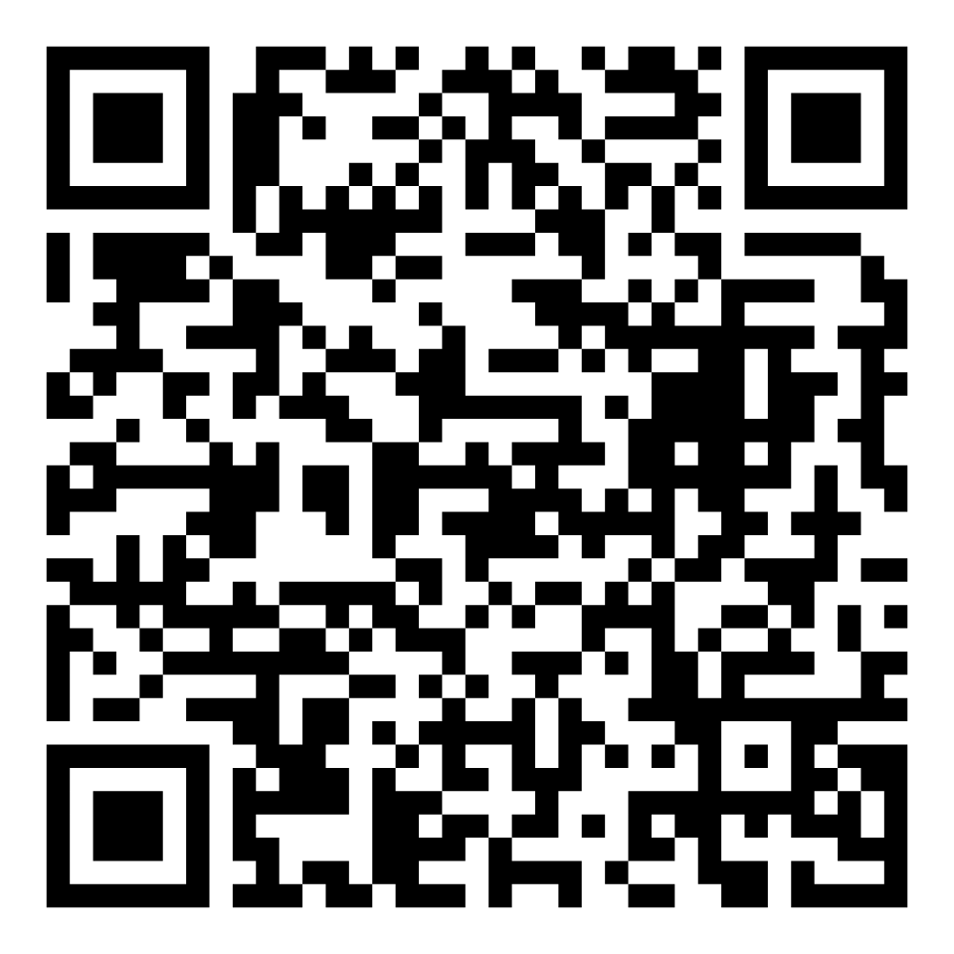
Director’s Report
May 2026

Slide 2

Program Highlights
May 2026
Adoption: 170 dogs, 98 puppies, 42 cats, and 146 kittens under 5 months of age were adopted for a total of 456 animals adopted from Kern County Animal Shelters in the month of May.
Foster: 39 dogs, 52 puppies, 7 cats, 296 kittens, and 1 other animal entered the Department’s Foster Care Program in May, for a total of 395 animals.
Rescue: 166 dogs, 128 puppies, 12 cats, and 43 kittens were transferred to other animal rescue organizations in May, for a total of 349 animals.
Spay/Neuter: A total of 435 animals were altered at low-cost KCAS spay/neuter clinics in the month of May.
TNR: 161 cats were spayed or neutered and released in May. Year-to-date, 942 cats have gone through the program, and since 2013 25,497 cats have been spayed or neutered and returned to field.

Slide 3





$10 May Adoptions
May 4th – May 30th

Slide 4
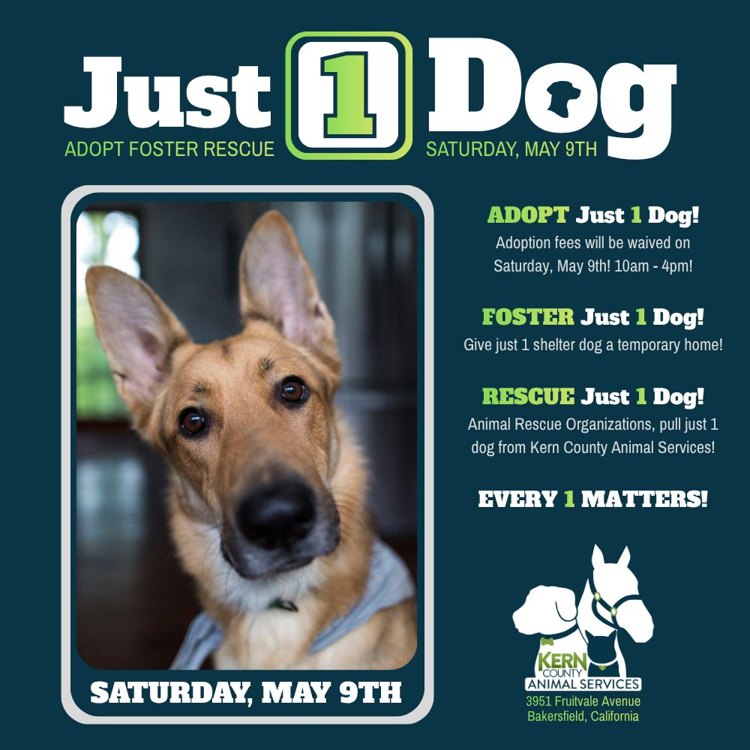
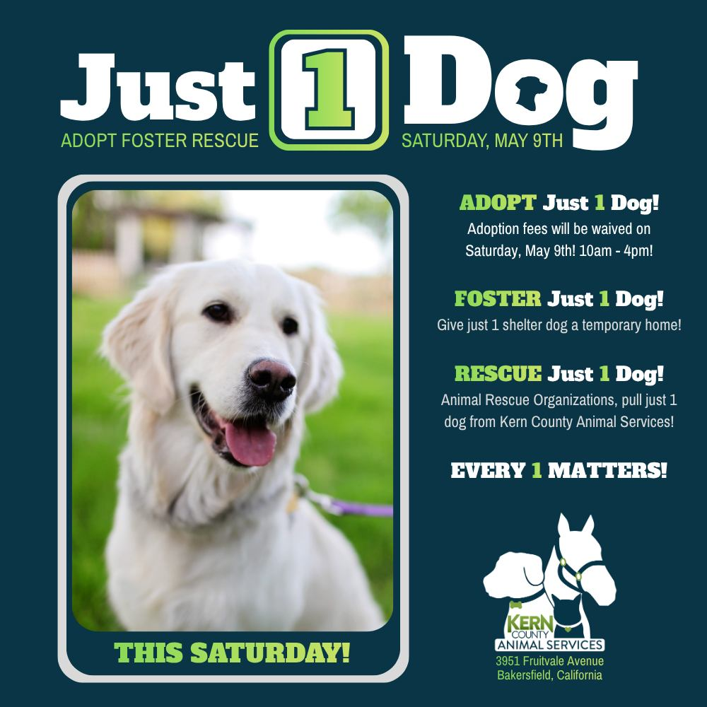

“Just 1 Dog” Adoption Event
Saturday, May 9th

Slide 5


Slide 6
Offsite Adoption Events
Adoptable dogs from Kern County Animal Services are out in the community every Friday, Saturday, and Sunday!
These special events give some of our most overlooked dogs a chance to shine outside the shelter. Many of them have been waiting patiently for their forever homes for no fault of their own! This is their chance to stand out!
Offsite events are a great way to connect in a more relaxed setting, where folks can spend time getting to know a smaller group of carefully selected, highly adoptable dogs.

Slide 7





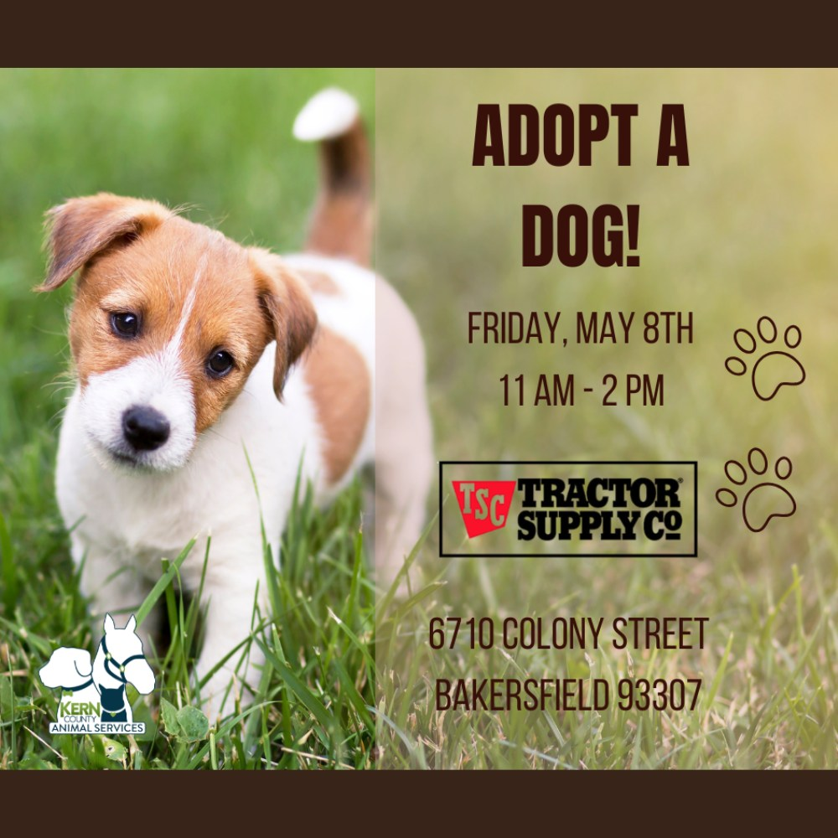

Slide 8


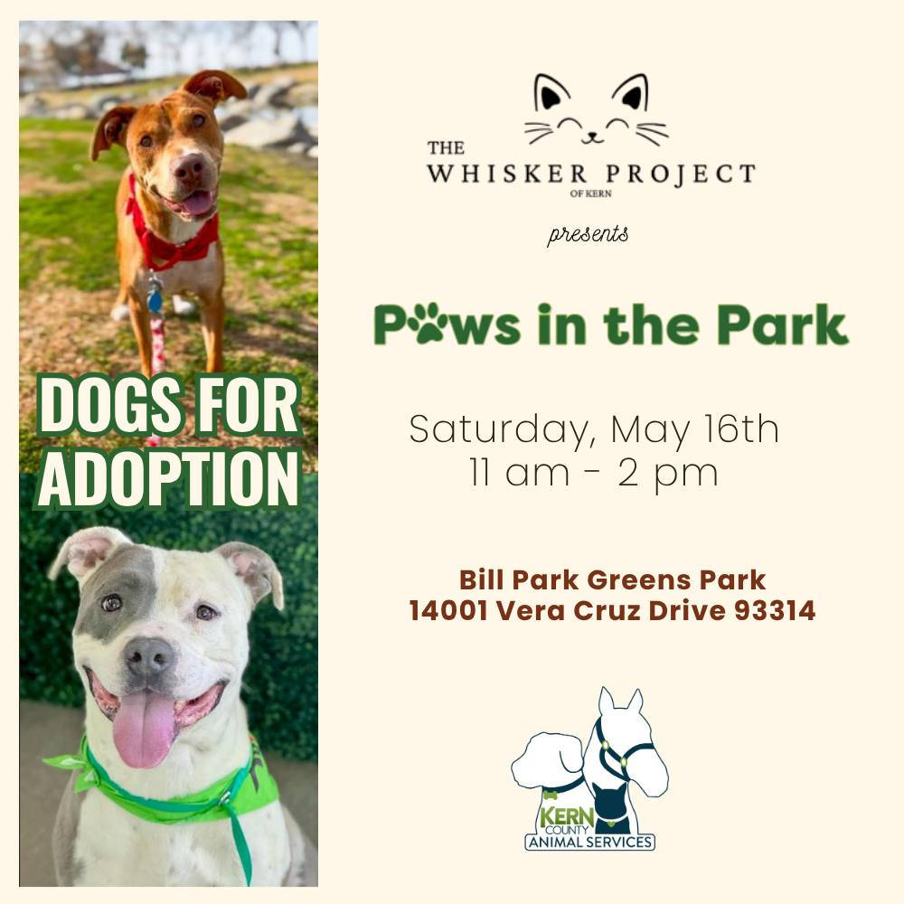

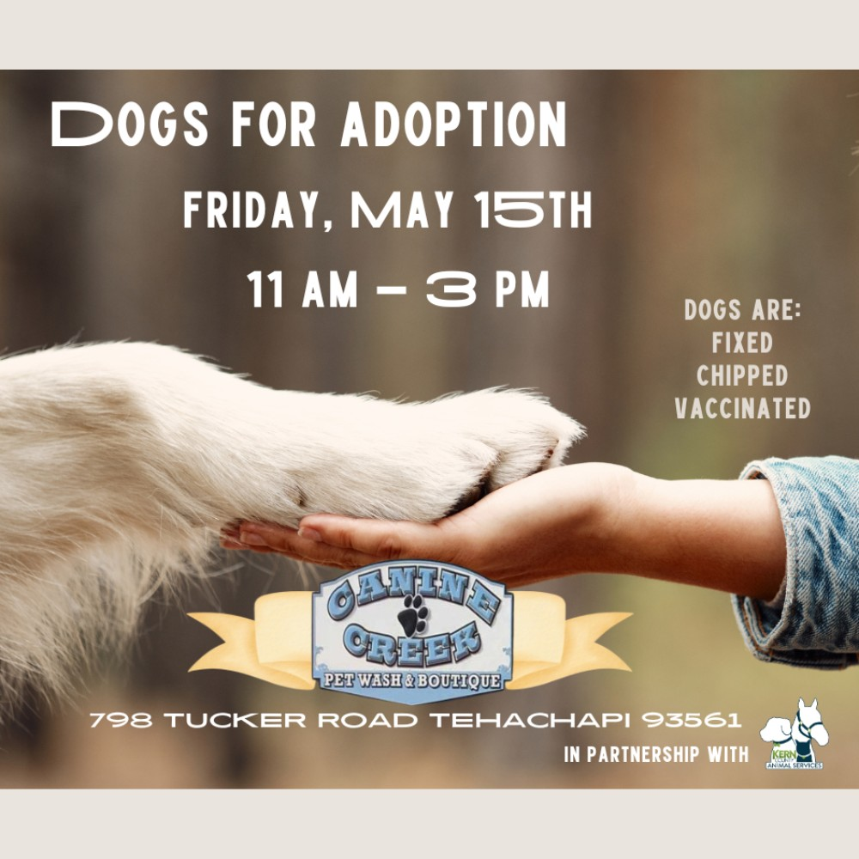
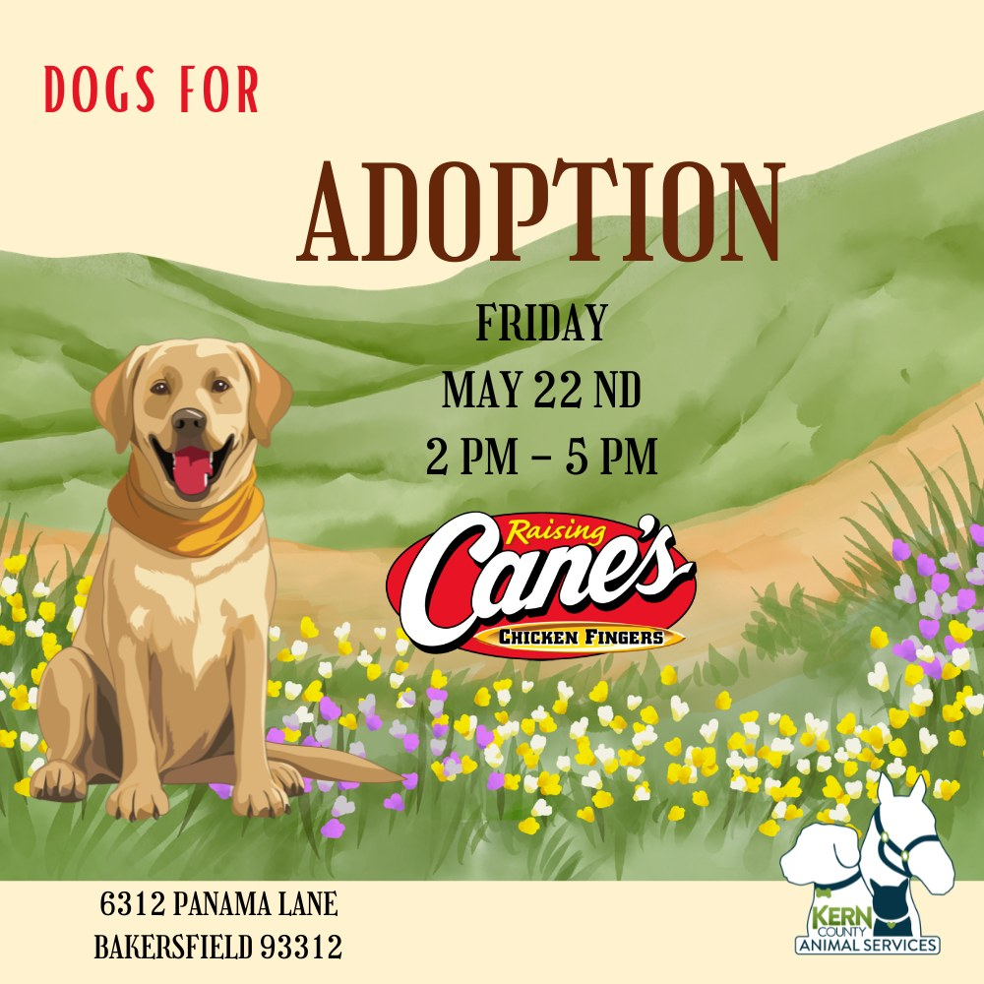

Slide 9

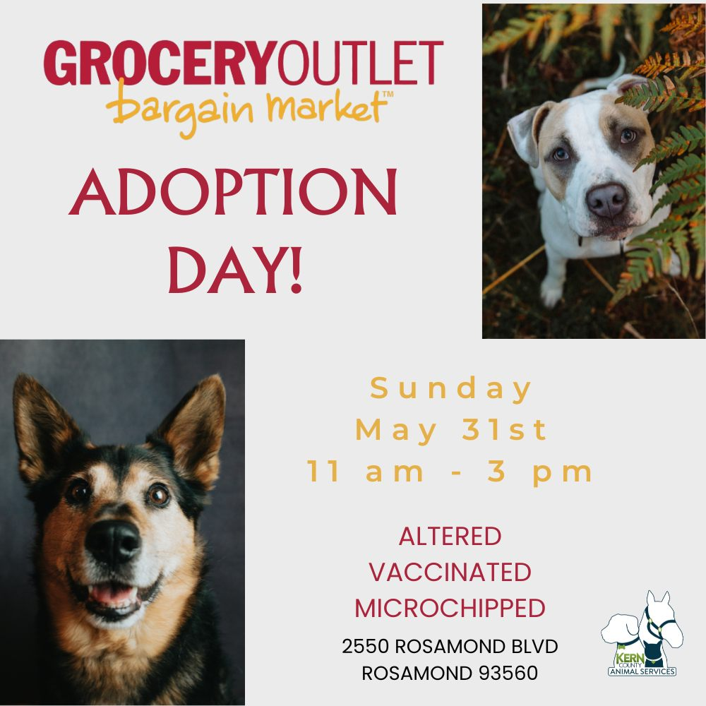
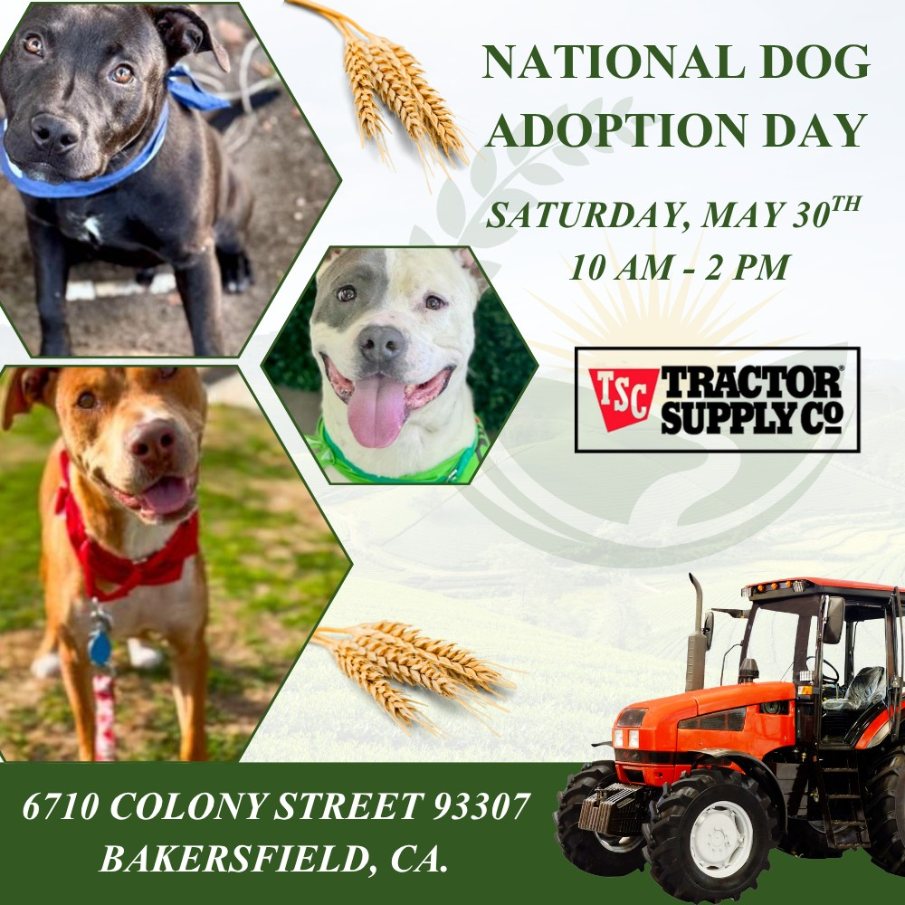

Slide 10
Streets of Bakersfield
Streets of Bakersfield is our "Doggy Day Out" program where the public can take shelter dogs on day outings. Your adventure can include a hike, a trip to the park, a coffee date or even hanging out at home.
These field trips help our shelter dogs manage kennel stress, burn off energy and get more exposure to potential adopters.
You can take a dog out for a few hours or even for the whole weekend!
Dogs can be picked up between 10am and 12 noon. “Day Out” dogs are brought back by 3:30pm. “Sleepover” dogs are returned the following Monday before 4pm.
The Streets of Bakersfield program runs every other Saturday.

Slide 11
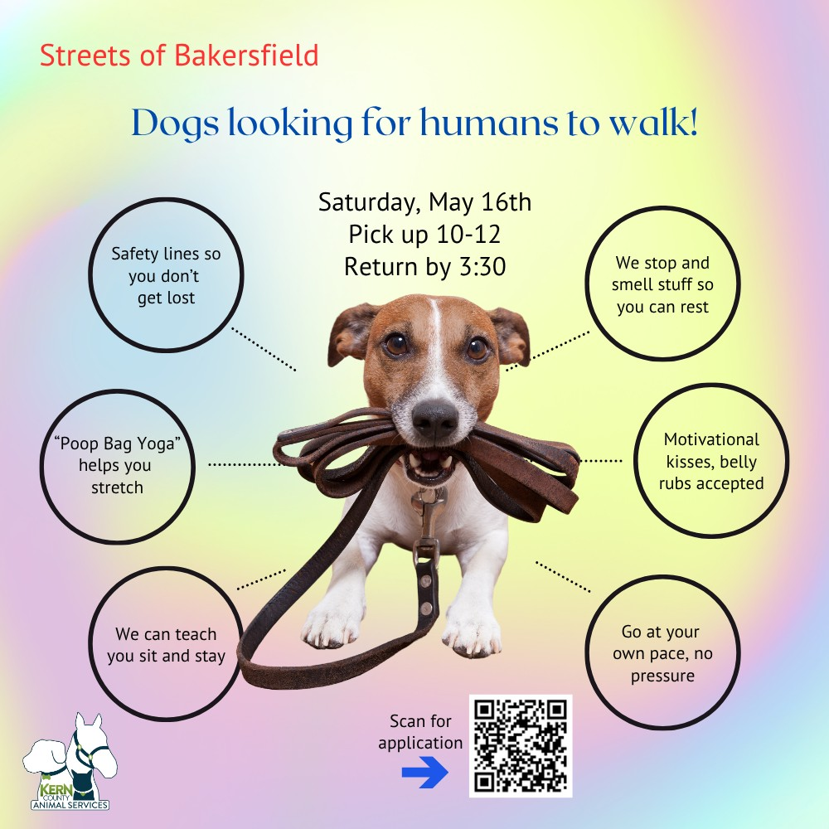

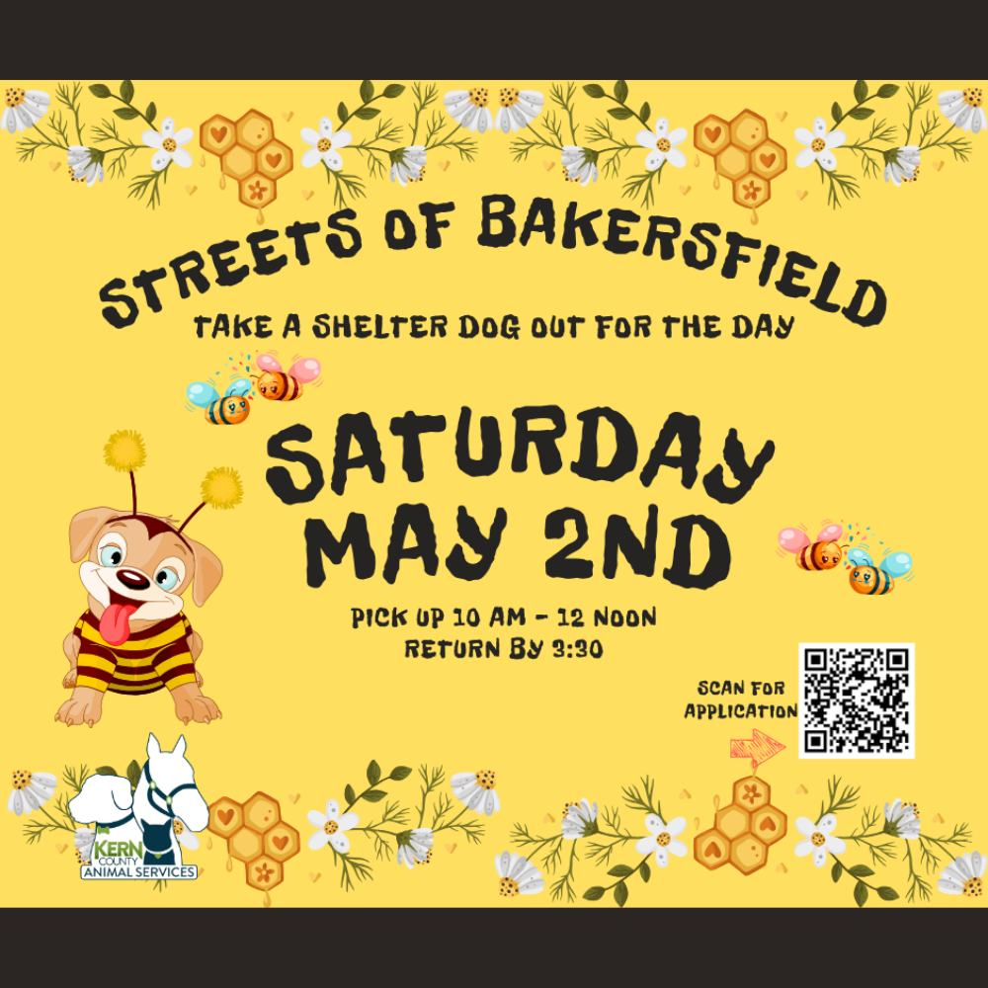
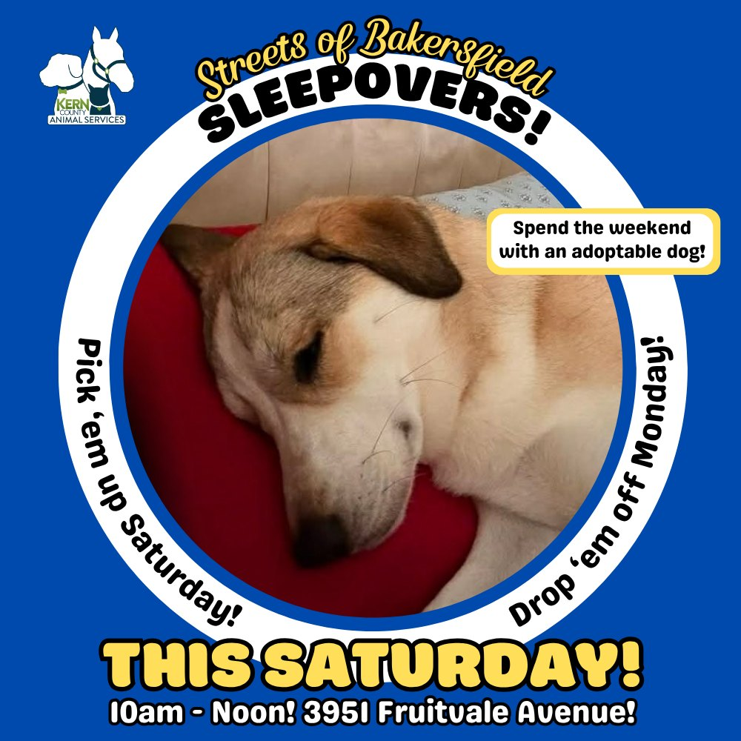

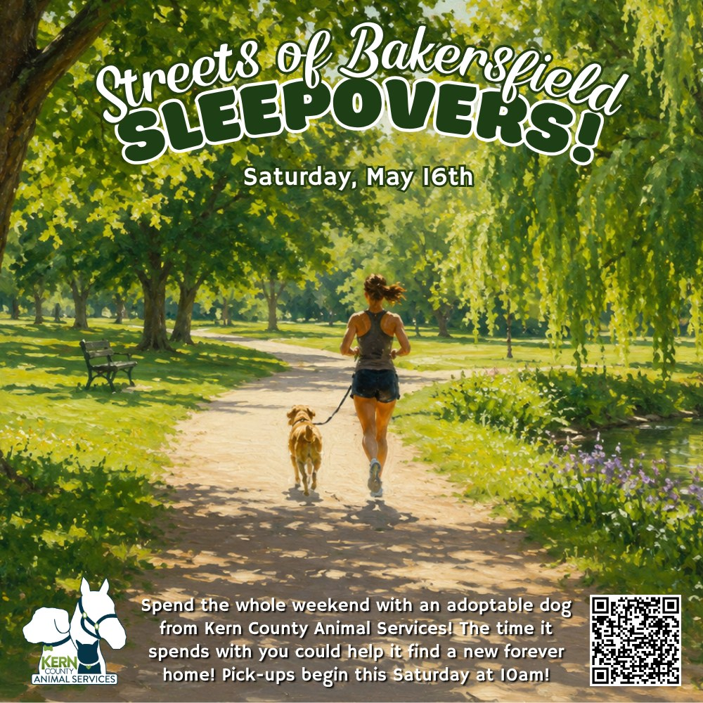

Slide 12
Low-Cost Spay/Neuter Clinics
May 2026
Date | Location | Surgeries
May 1st | Dogtopia | 46
May 5th | Heritage Park | 57
May 13th | Lake Isabella, Ca. | 41
May 14th | Heritage Park | 57
May 15th | Heritage Park | 29
May 19th | Rosamond, Ca. | 51
May 20th | Virginia Park | 48
May 22nd | Virginia Park | 25
May 26th | Virginia Park | 55
May 27th | Kern County Veterans Dept. | 26
 | Total Surgeries | 435

Slide 13
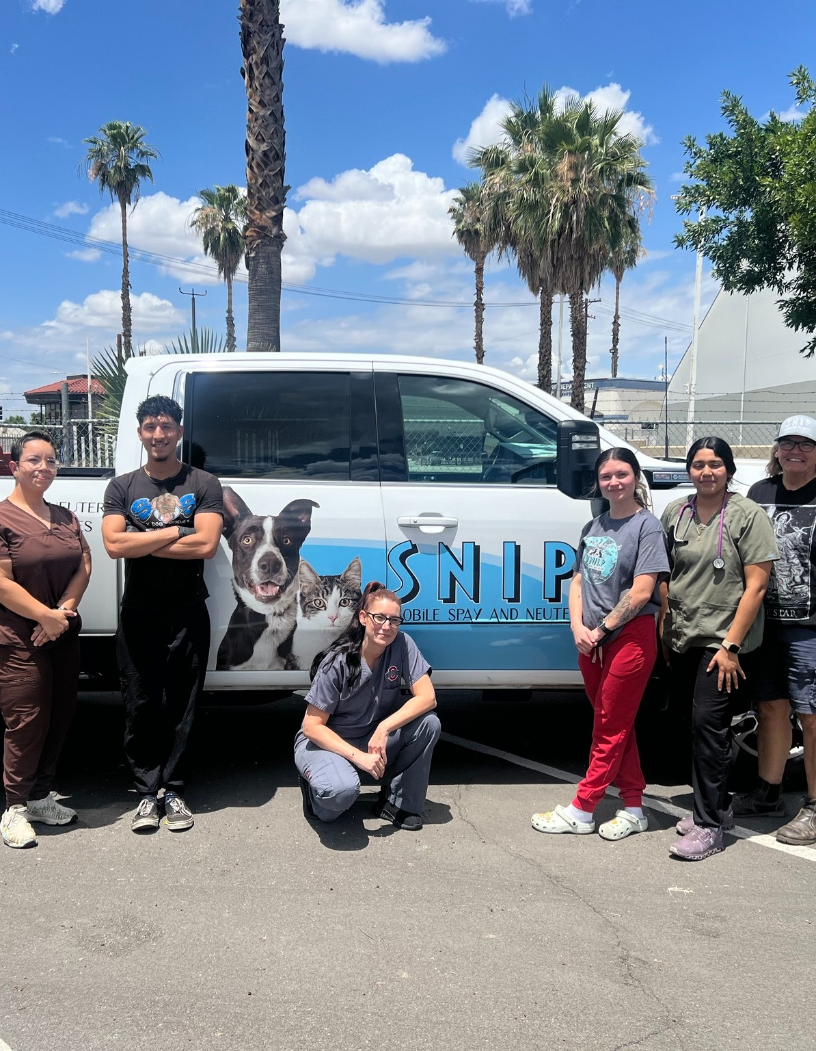

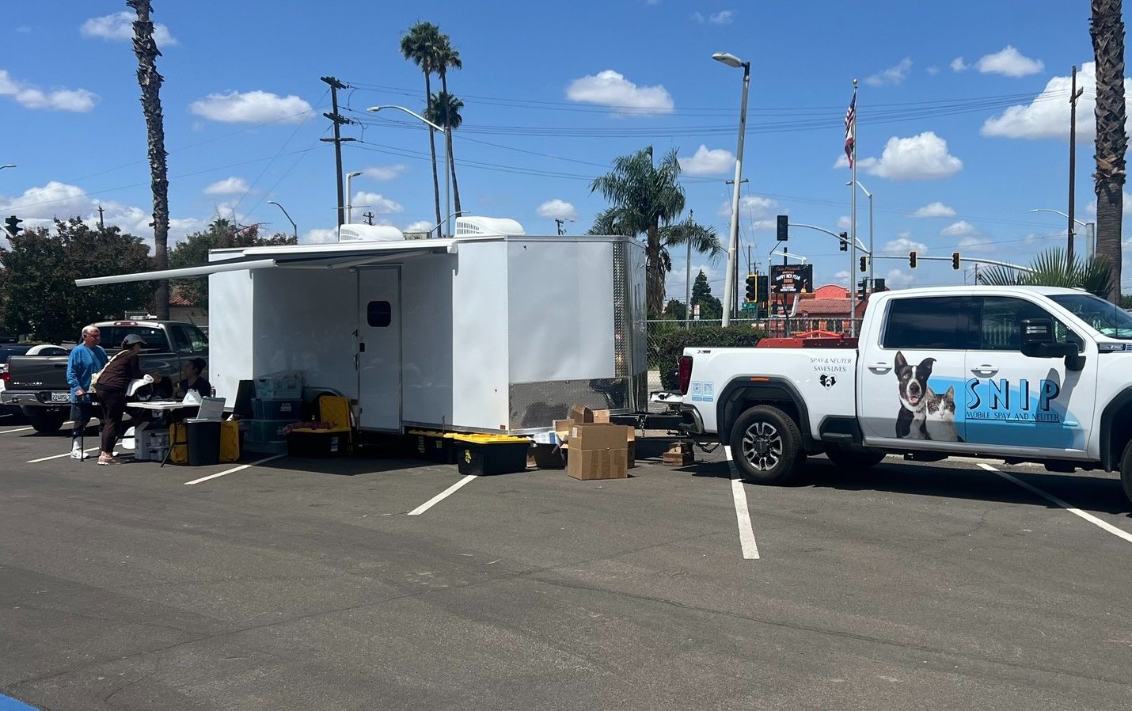
Spay/Neuter Clinic for Veterans
On Wednesday, May 27, Kern County Animal Services hosted a low-cost SNIP Bus spay/neuter clinic at the Kern County Veterans Service Department for veterans and their immediate family members.
The clinic was made possible through an "It Takes Balls" Southern California grant from Miranda Lambert's MuttNation and the Doris Day Animal Foundation.
Their generous support helped provide affordable spay/neuter services, reducing pet overpopulation in our community and helping save lives.

Slide 14
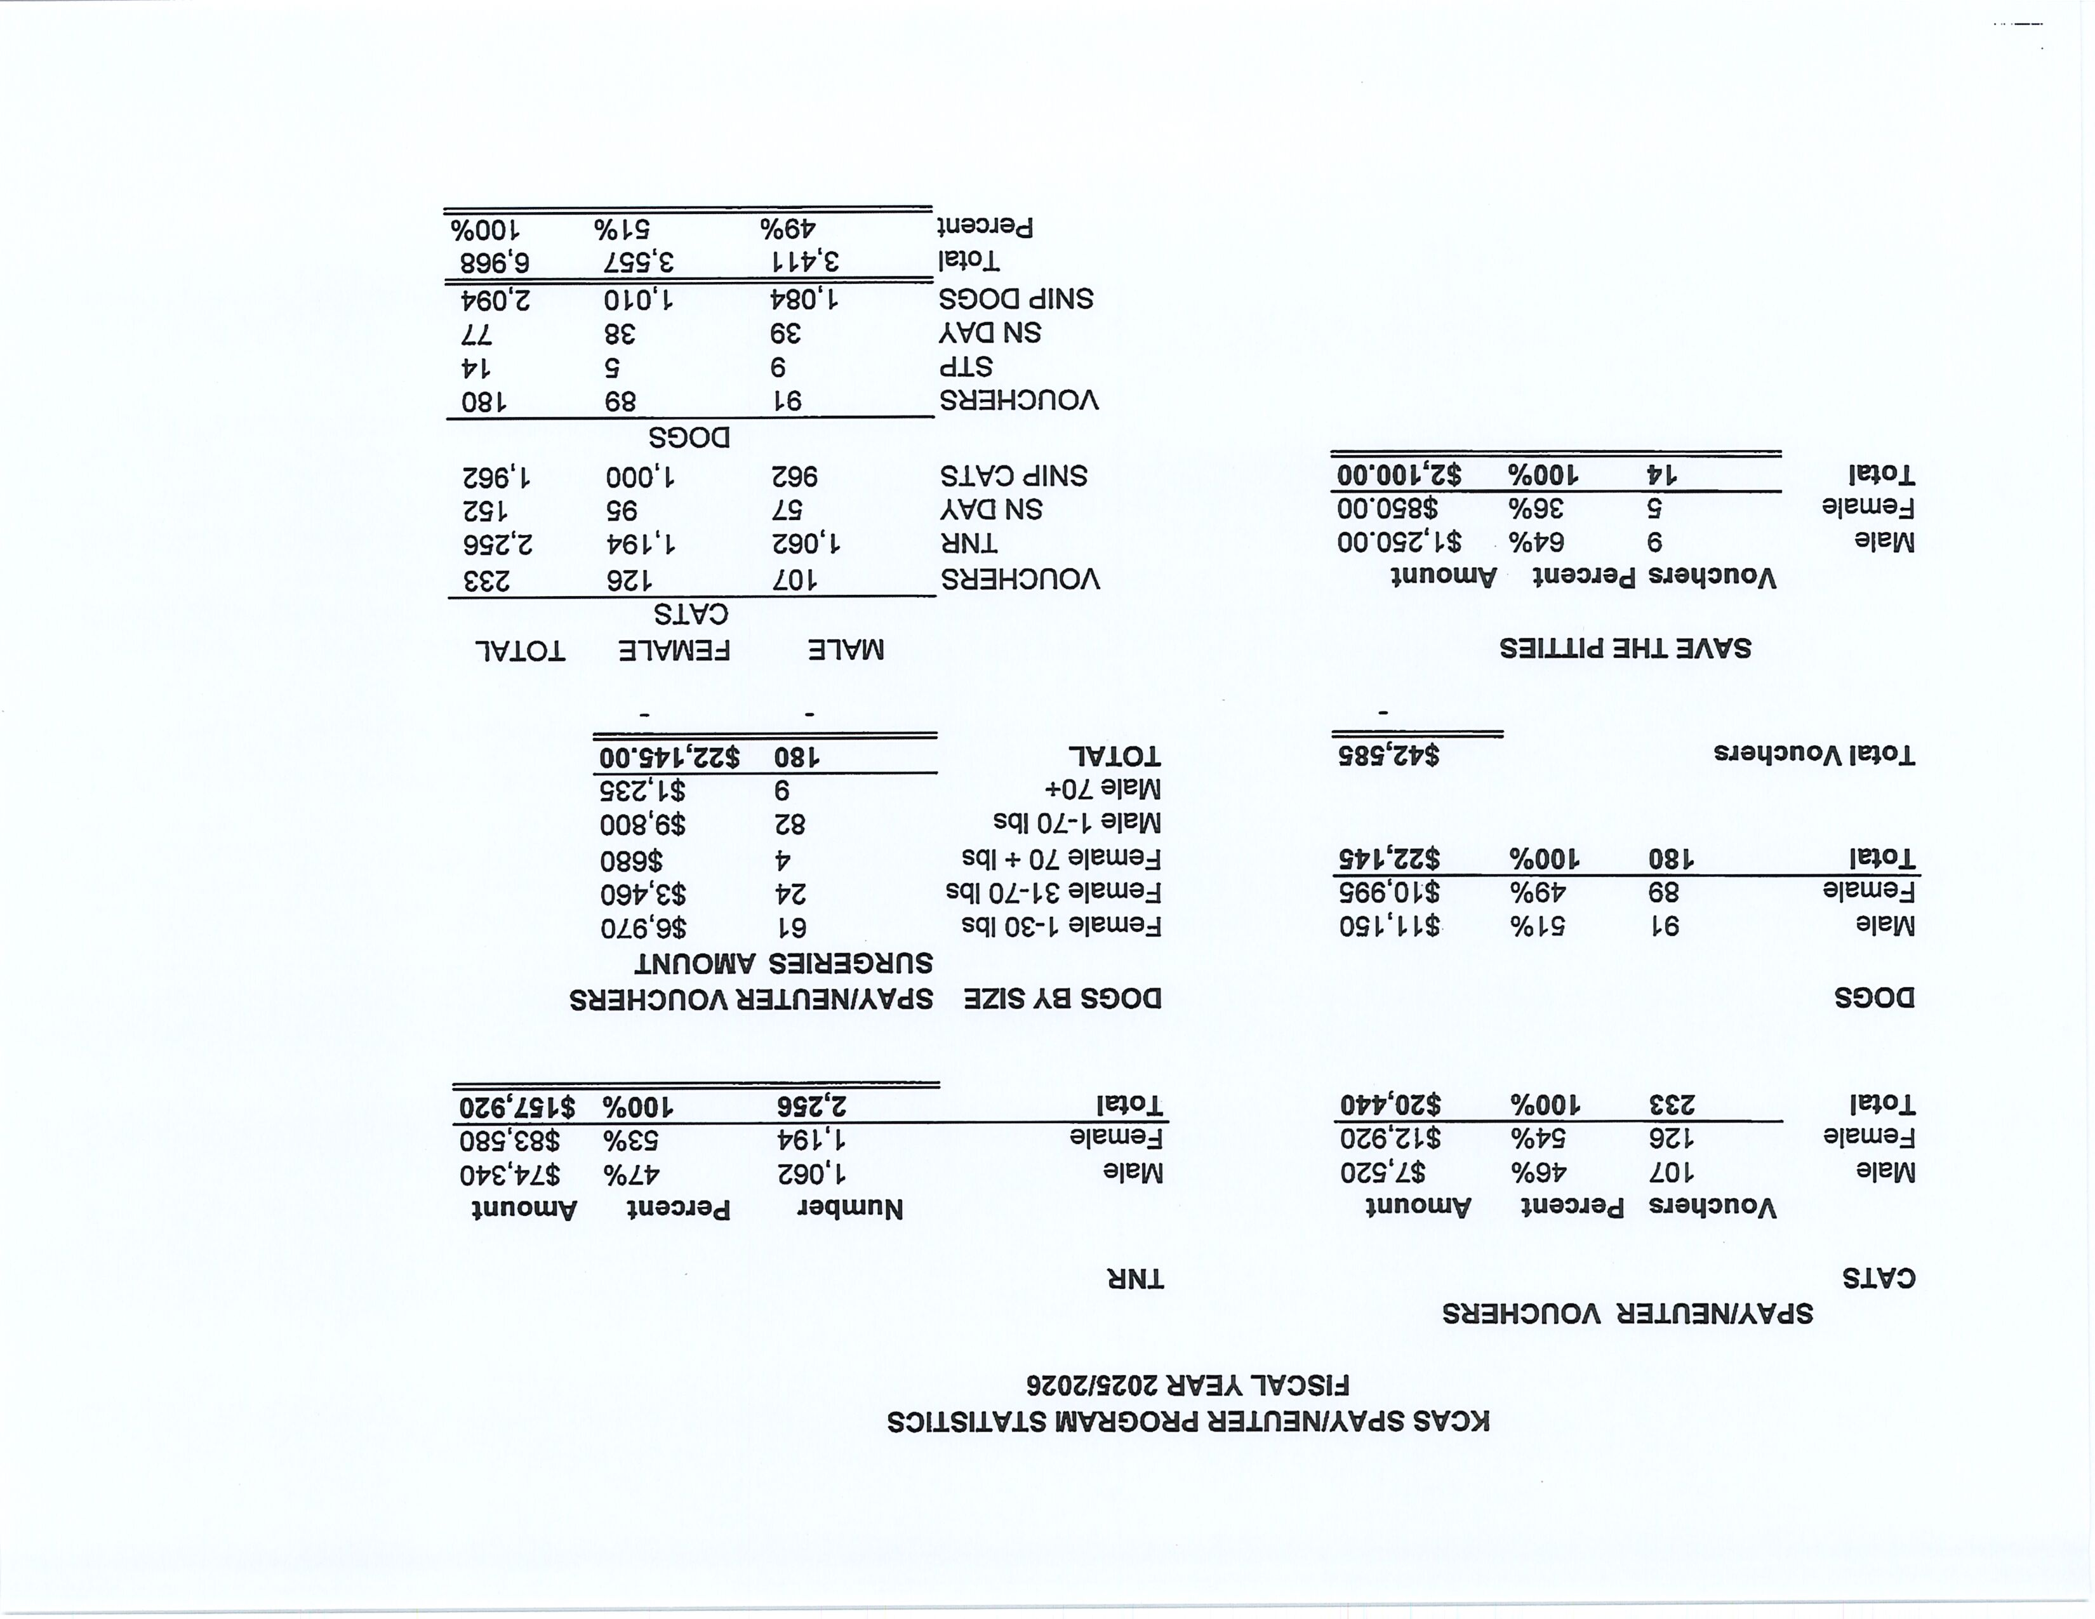

Slide 15
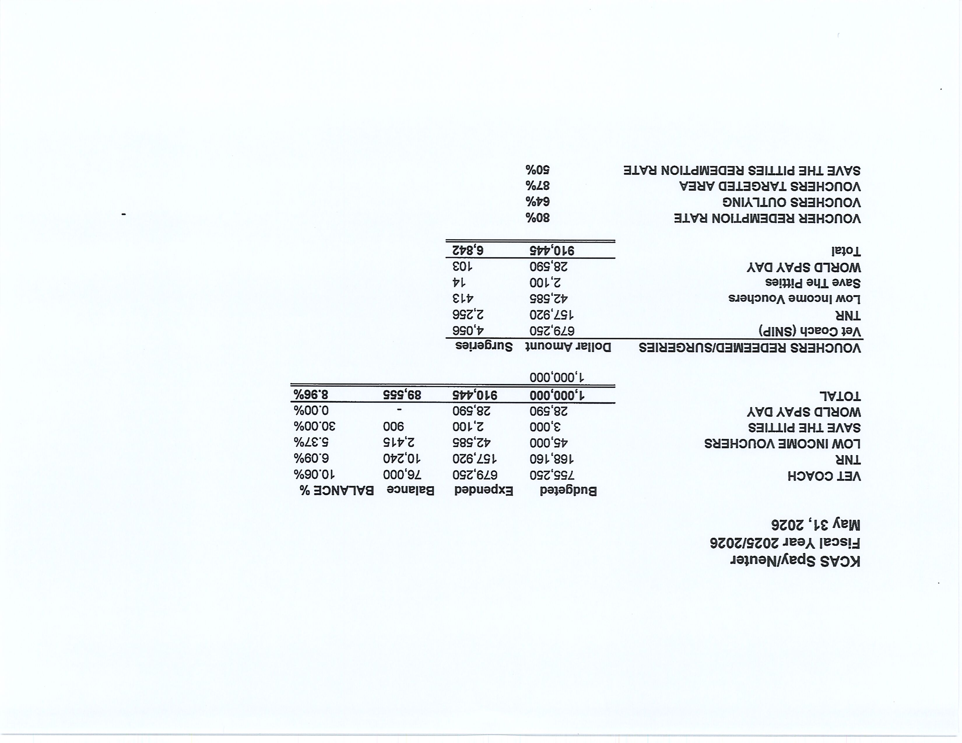

Slide 16
Low-Cost Vaccination Clinics
May 2026
Rabies
319
Microchips
Bordetella
8
16
DHPP* 152
FVRPC* 162
*DHPP and FVRCP vaccinations provided at no-cost by Petco Love.

Slide 17
Field Service Calls: May 2026
AREA | CALLS PER AREA
Lake Isabella | 116
Mojave | 119
North County | 46
Northeast | 310
Northwest | 302
Ridgecrest | 25
Southeast | 156
Southwest | 137
Taft | 137
Tehachapi | 69
TOTAL | 1,417
30 dogs were returned to their owners in the field
in May 2026.
157 dogs were secured on property by Animal Control Officers in May 2026.

Slide 18
Commercial Animal Facility Calls
May 2026
TYPE | CALLS PER TYPE
CAF – Breeder | 6
CAF – Rescue | 0
CAF – Kennel | 0
CAF – Boarding | 0
TOTAL | 6
1 Inspections Passed
0 Inspections Failed
0 Citations Issued
0 Permits Issued
52 Active CAF Permits

Slide 19
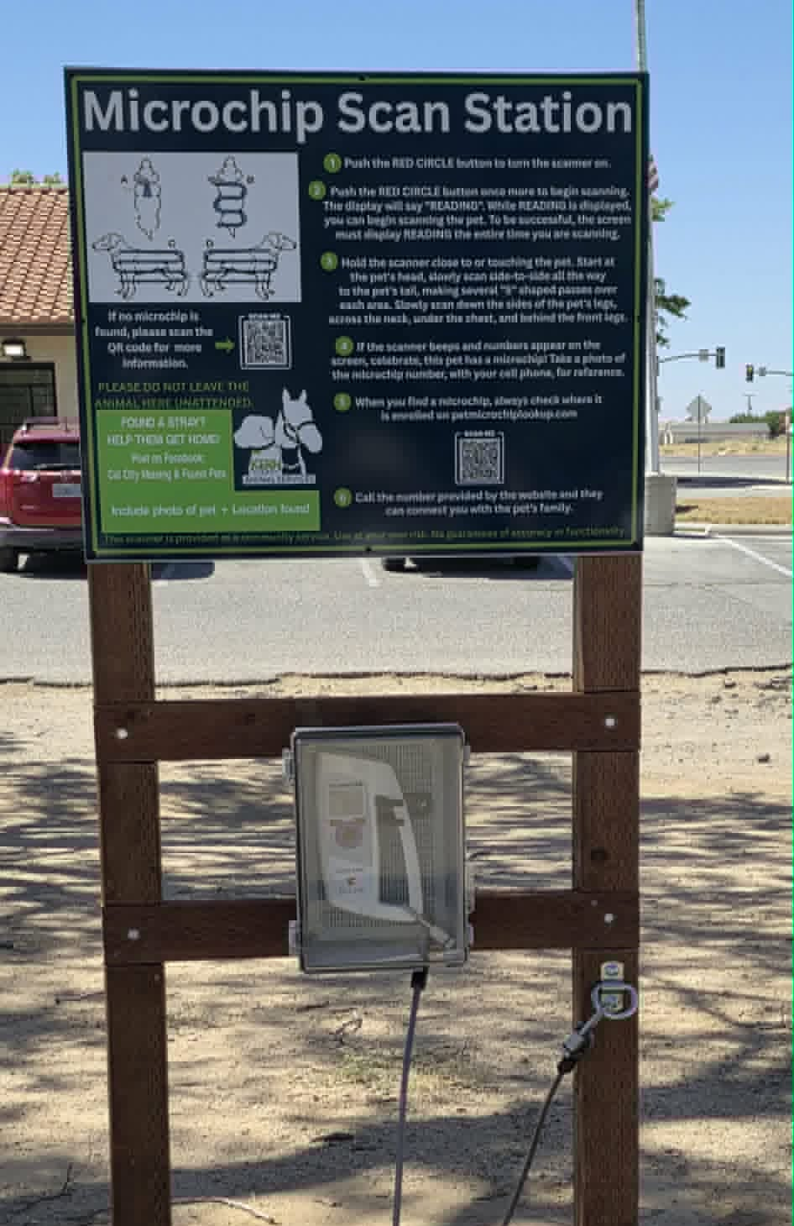
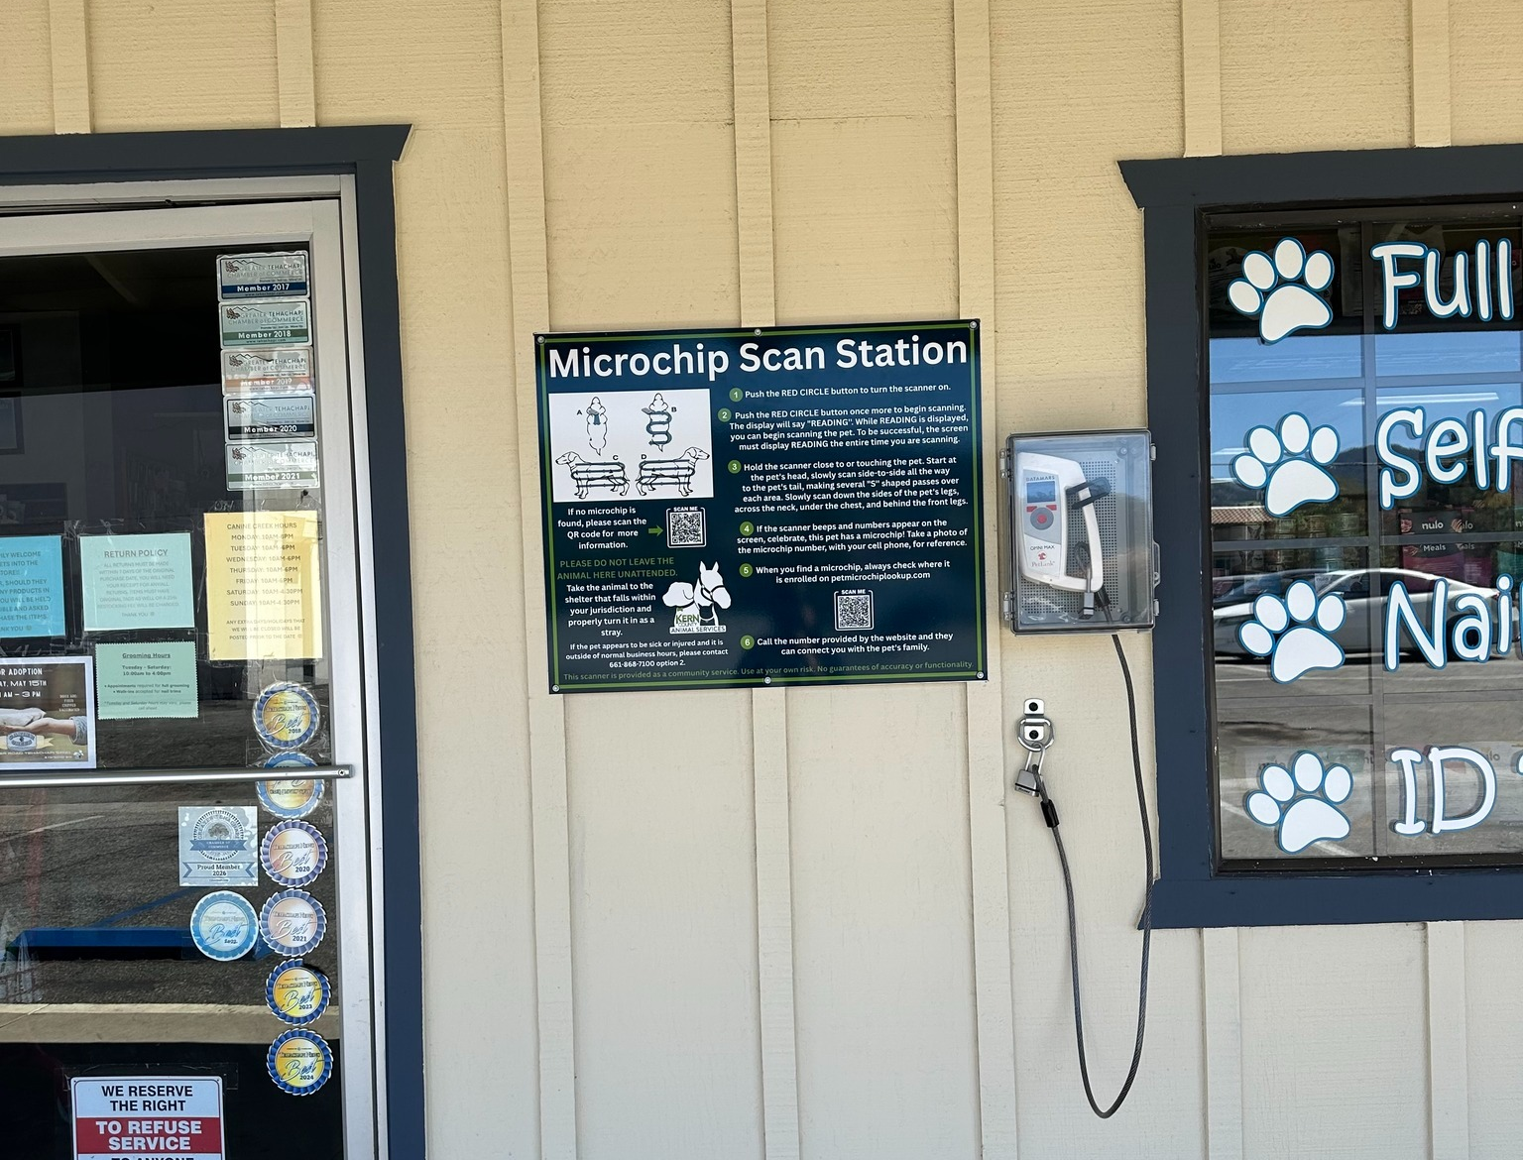
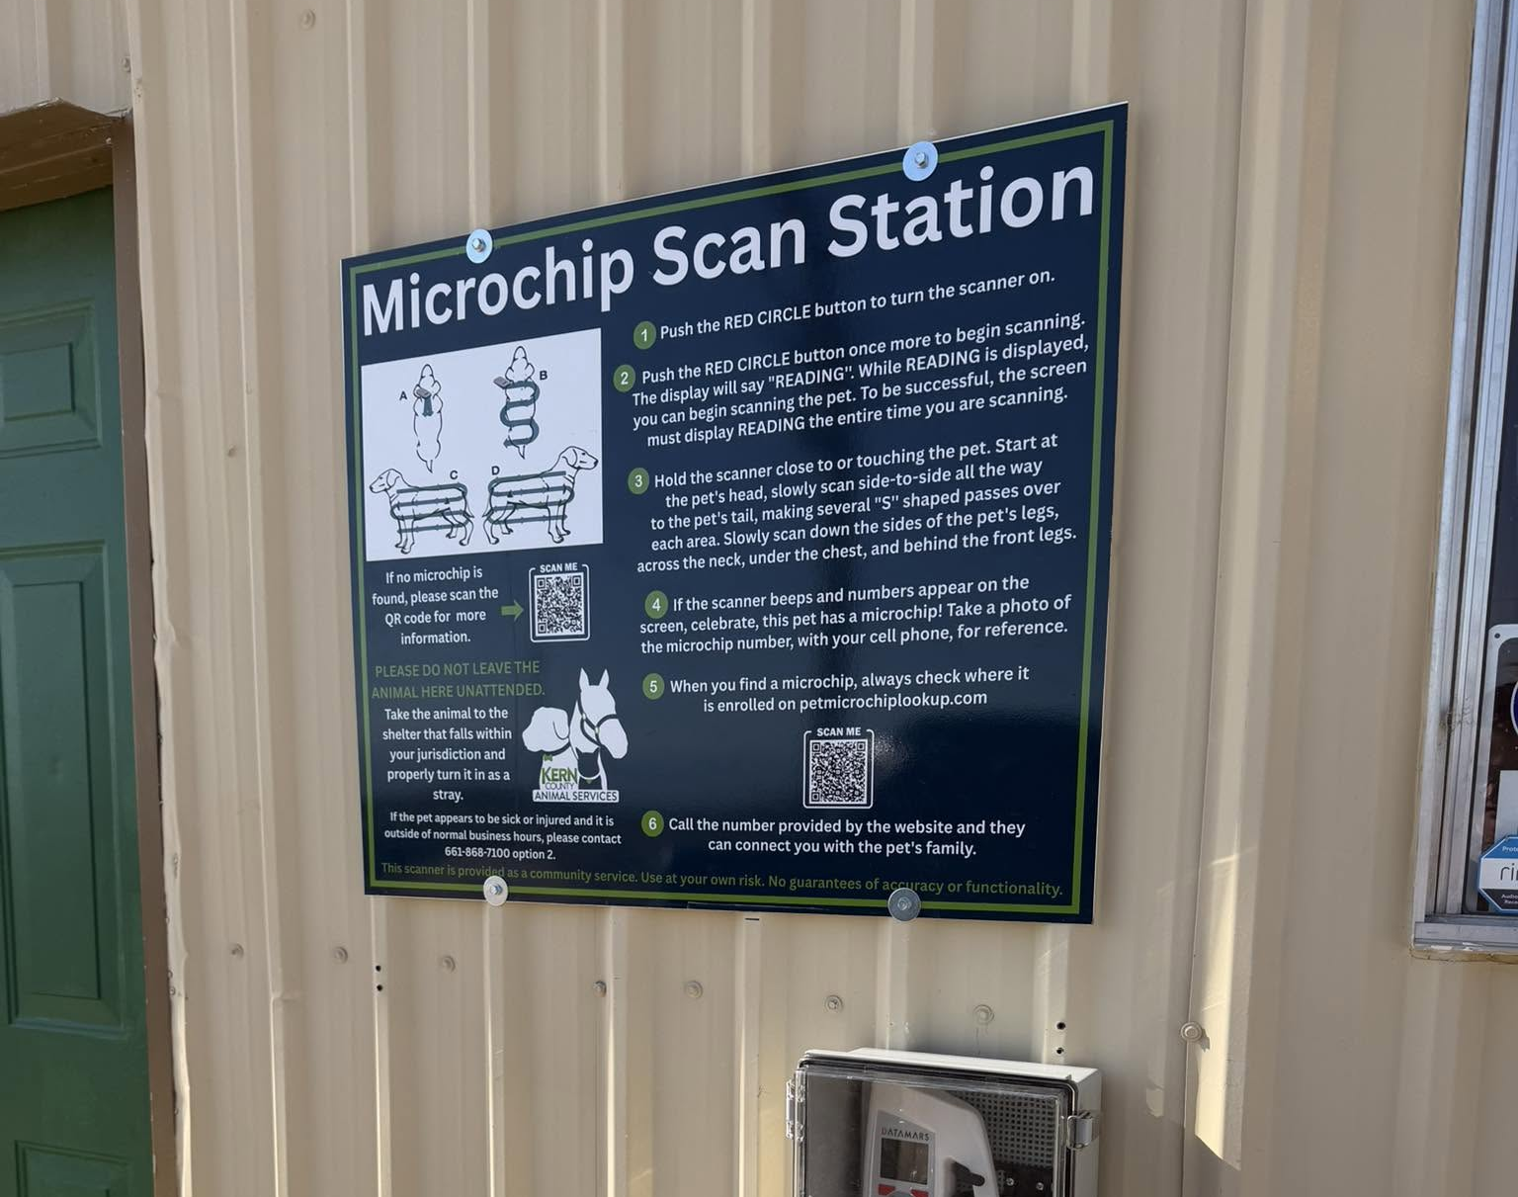
Microchip Scanning Stations
Kern County Animal Services has partnered with Canine Creek in Tehachapi, Almost Eden Rescue in Ridgecrest, Strata Credit Union on Panama Lane, the California City Police Department and Diane Perry to install a new permanent Microchip Scan Stations in their communities.
These microchip scan stations provide the public with a convenient place to have found pets scanned for a microchip, helping reunite lost pets with their families quickly and safely.
KCAS is looking to expand the program by placing additional scan stations in communities throughout Kern County, including Wasco, Shafter, McFarland, Delano, Lake Isabella, Mojave, Boron, Arvin, and Southwest Bakersfield.
Local businesses interested in helping improve animal welfare can host a station at no cost, with all equipment provided by Kern County Animal Services.

Slide 20
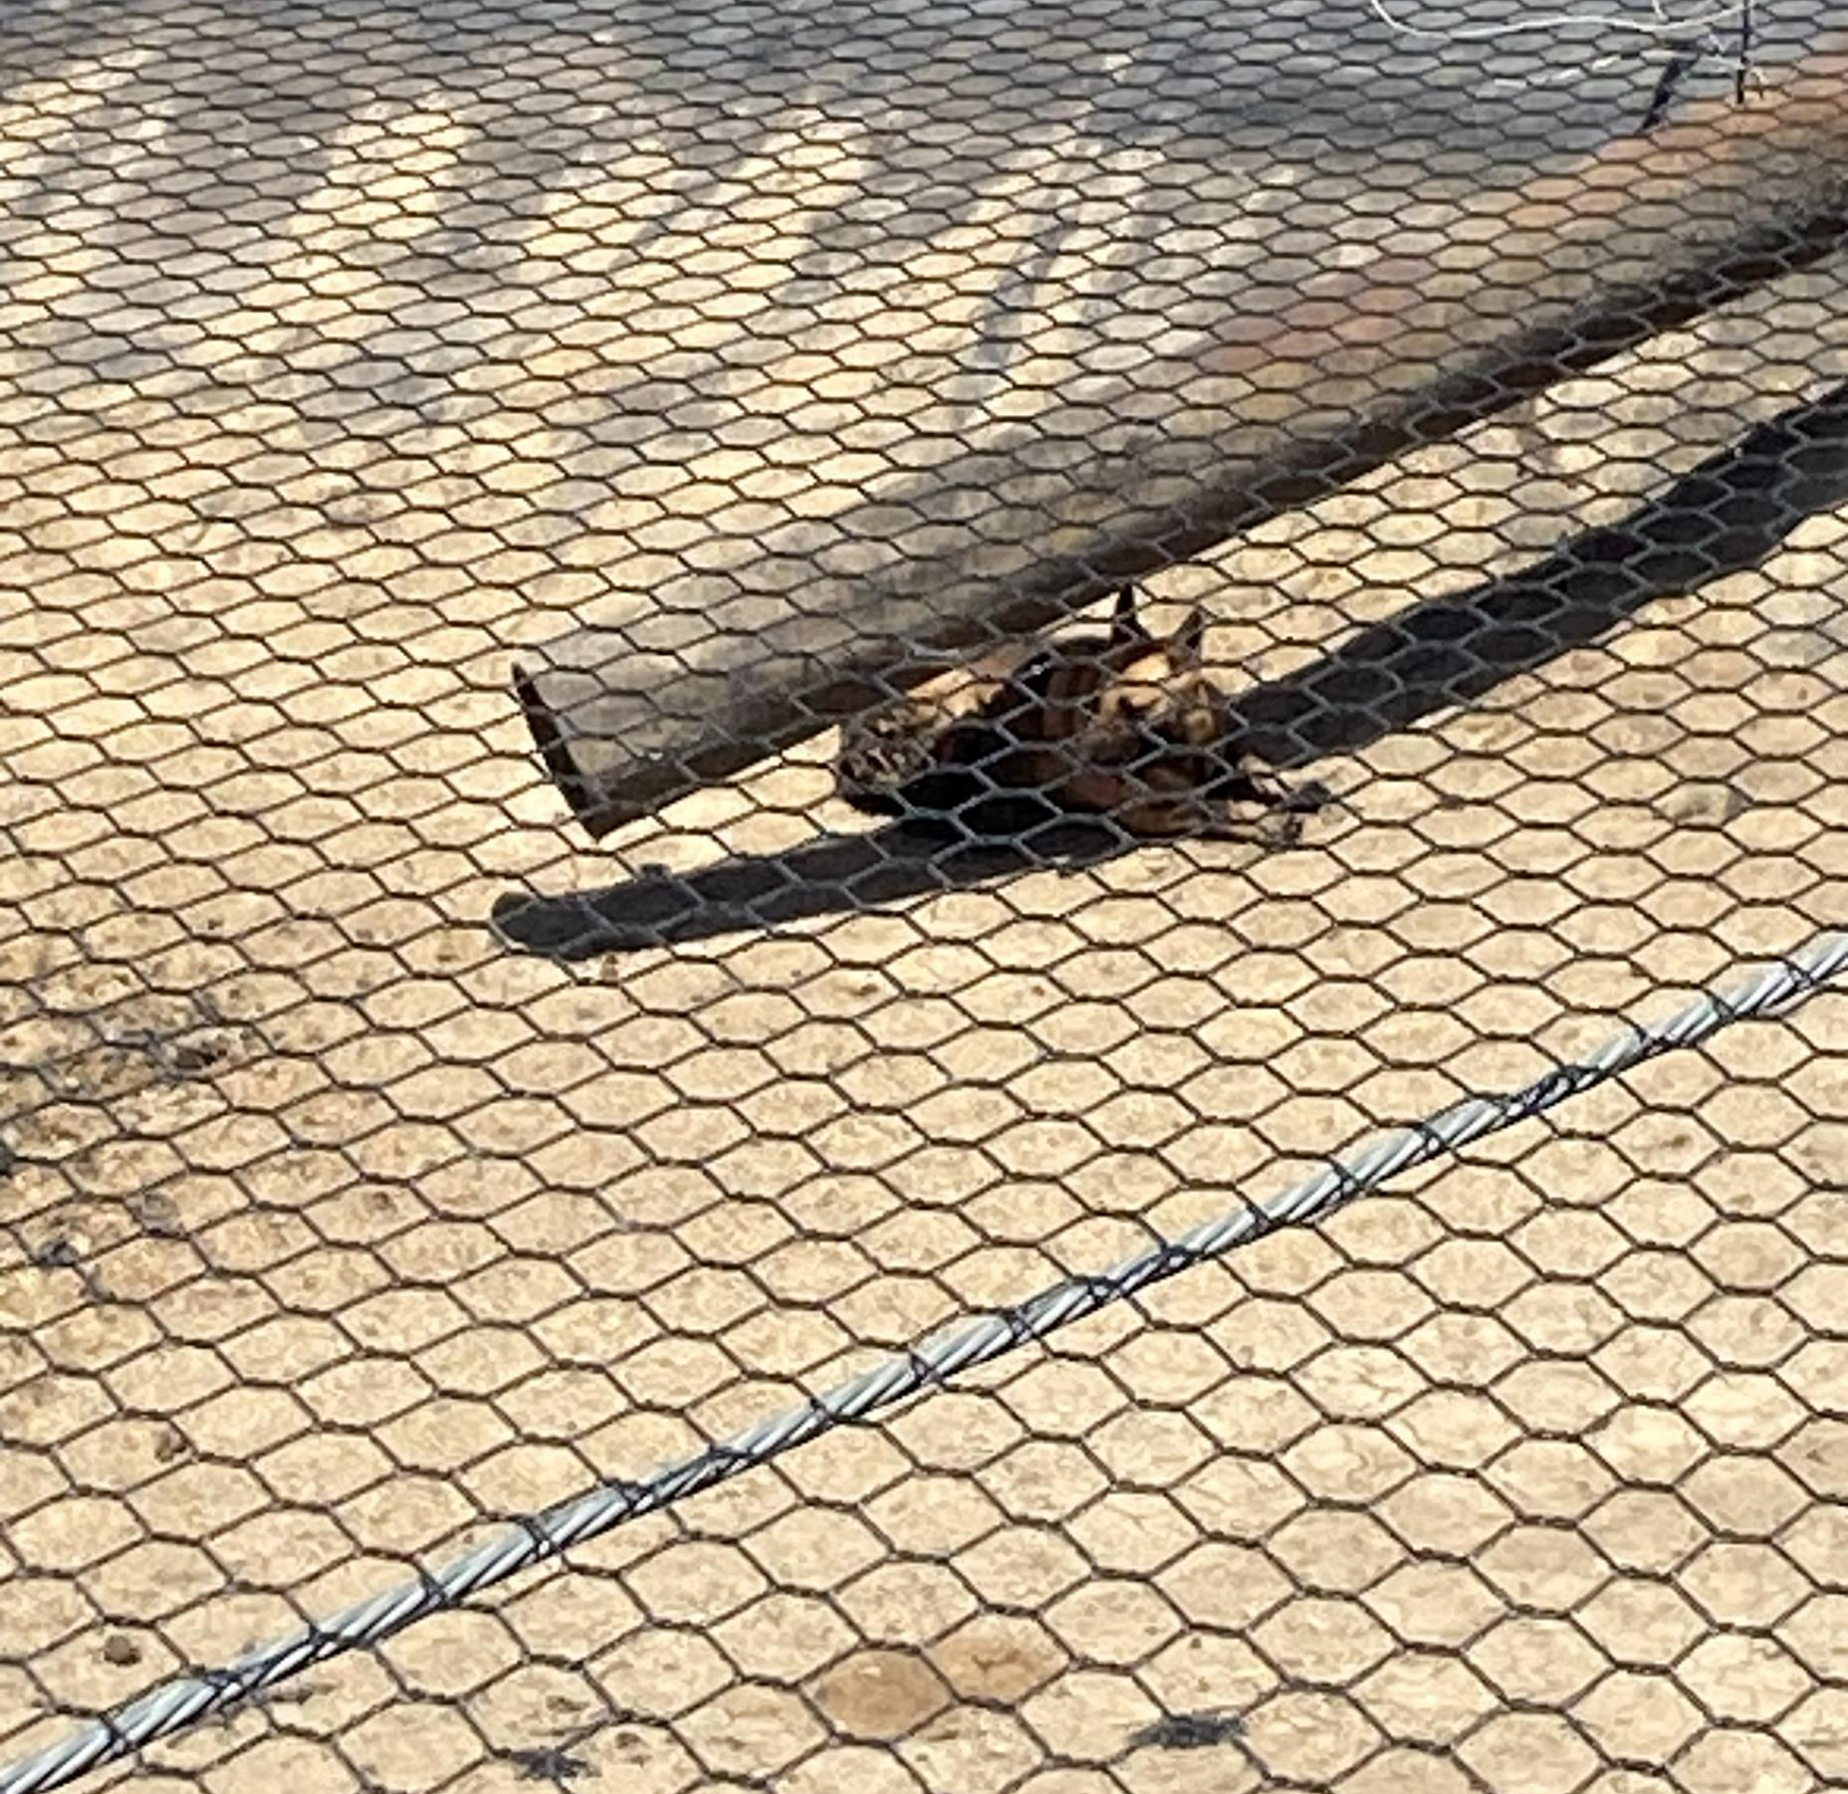
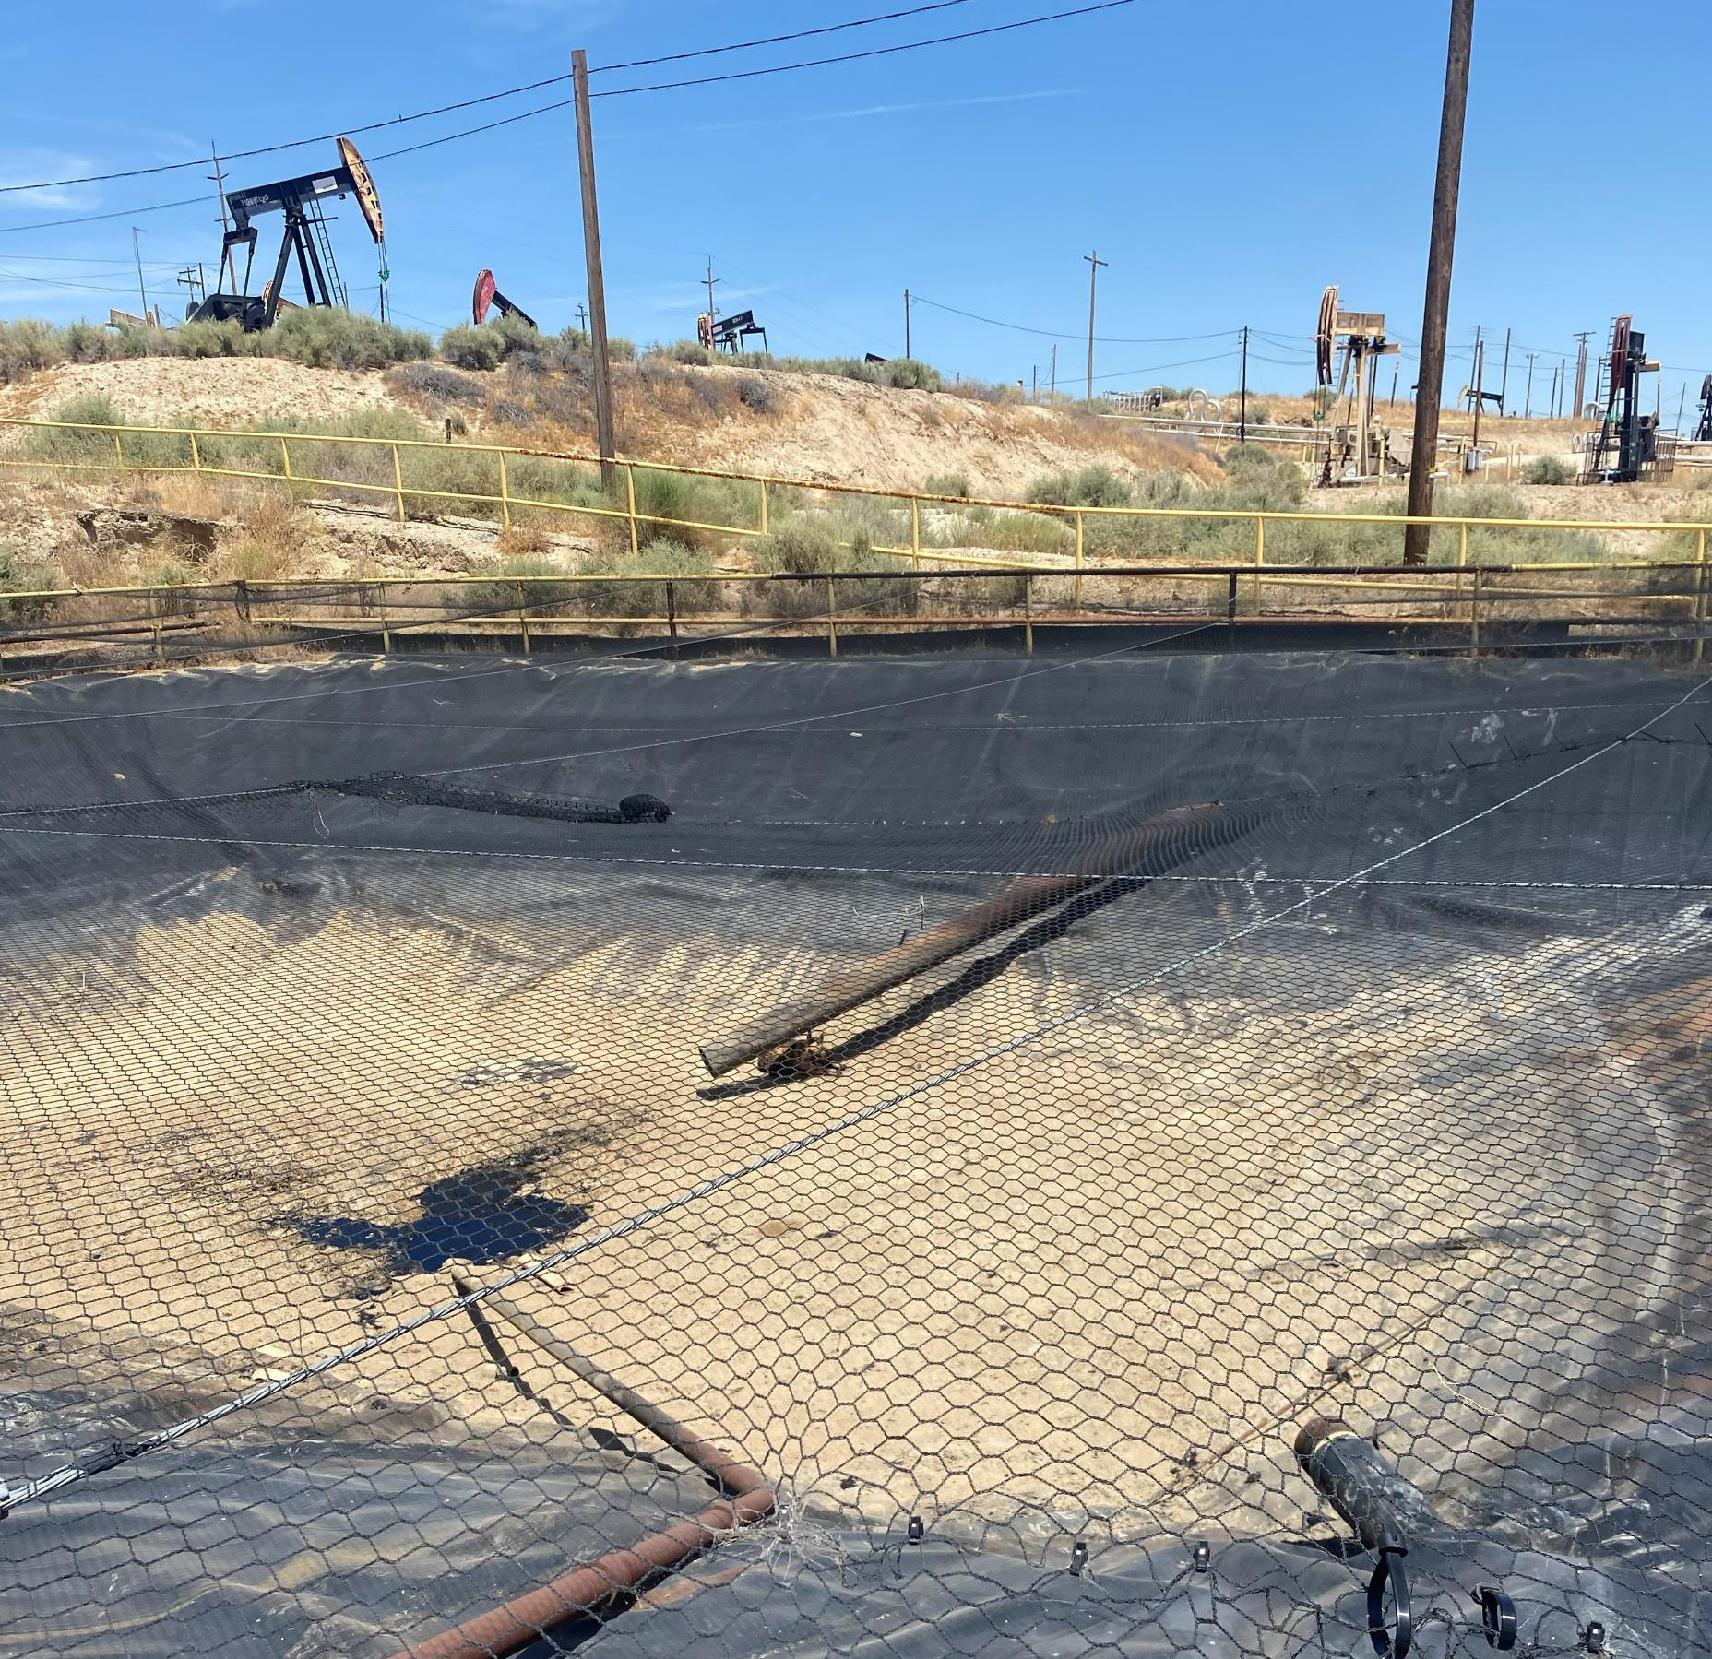
Rescued from Oilfield
Labrea was found in Taft covered in oil. Cleaning her up took plenty of baths, hard work, and patience, but through it all, she remained an absolute sweetheart.
At 4 years old and 75 pounds, Labrea showed everyone just how affectionate and resilient she is.
The best part? Just a few days later, Labrea was reunited with her owner and finally headed home where she belongs.
These photos show just how much oil covered her body, as well as KCAS Animal Control Officer Manning, who rescued her from the oil sump.

Slide 21
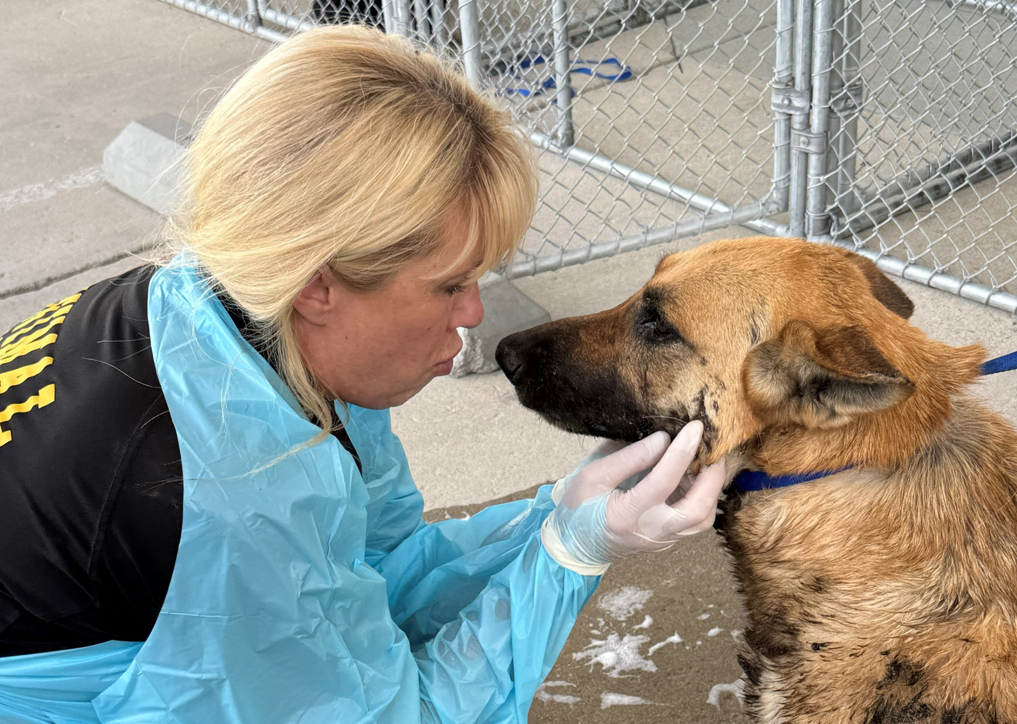
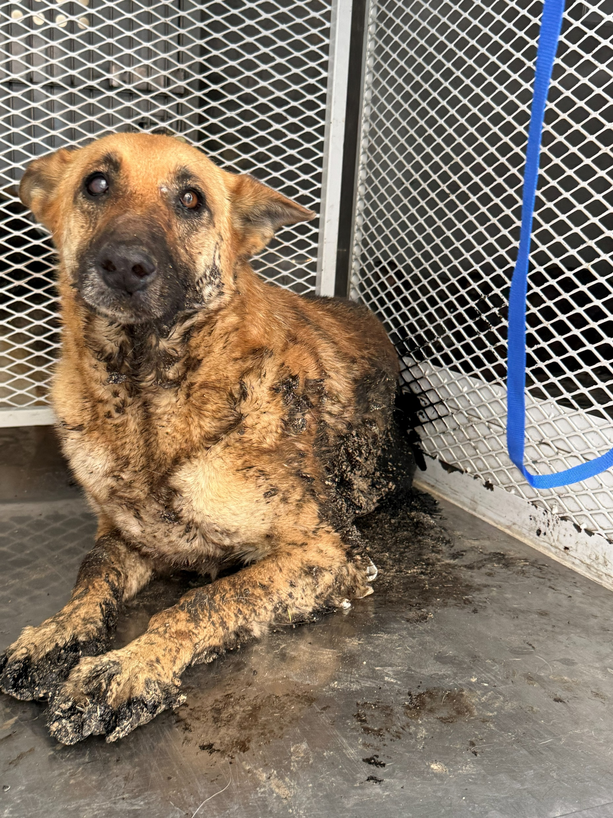
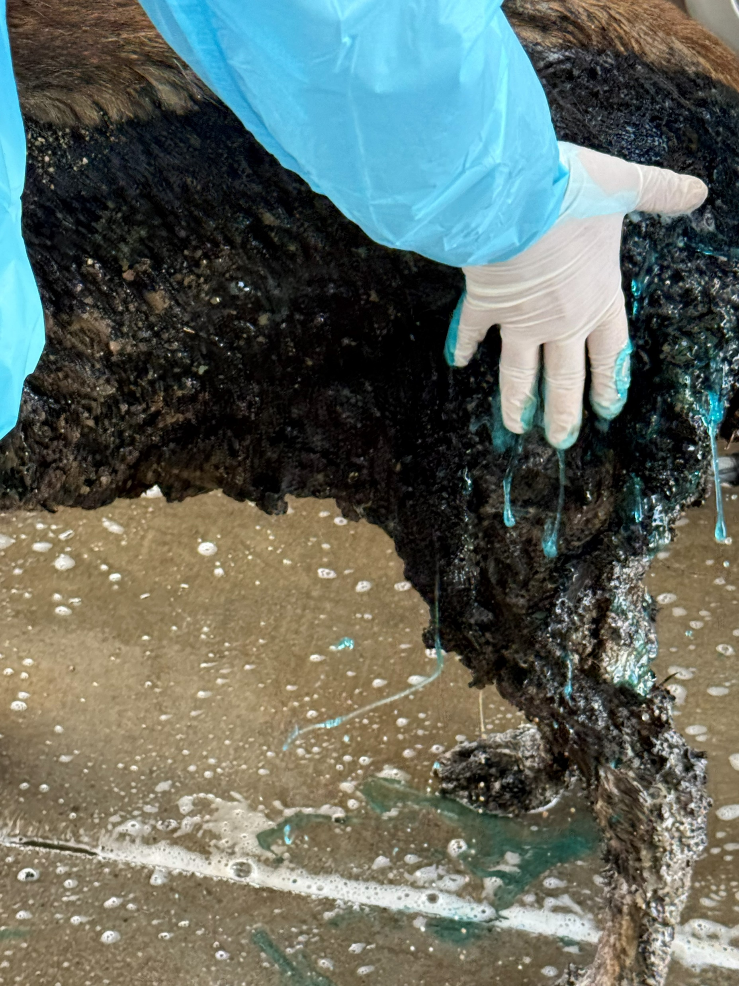
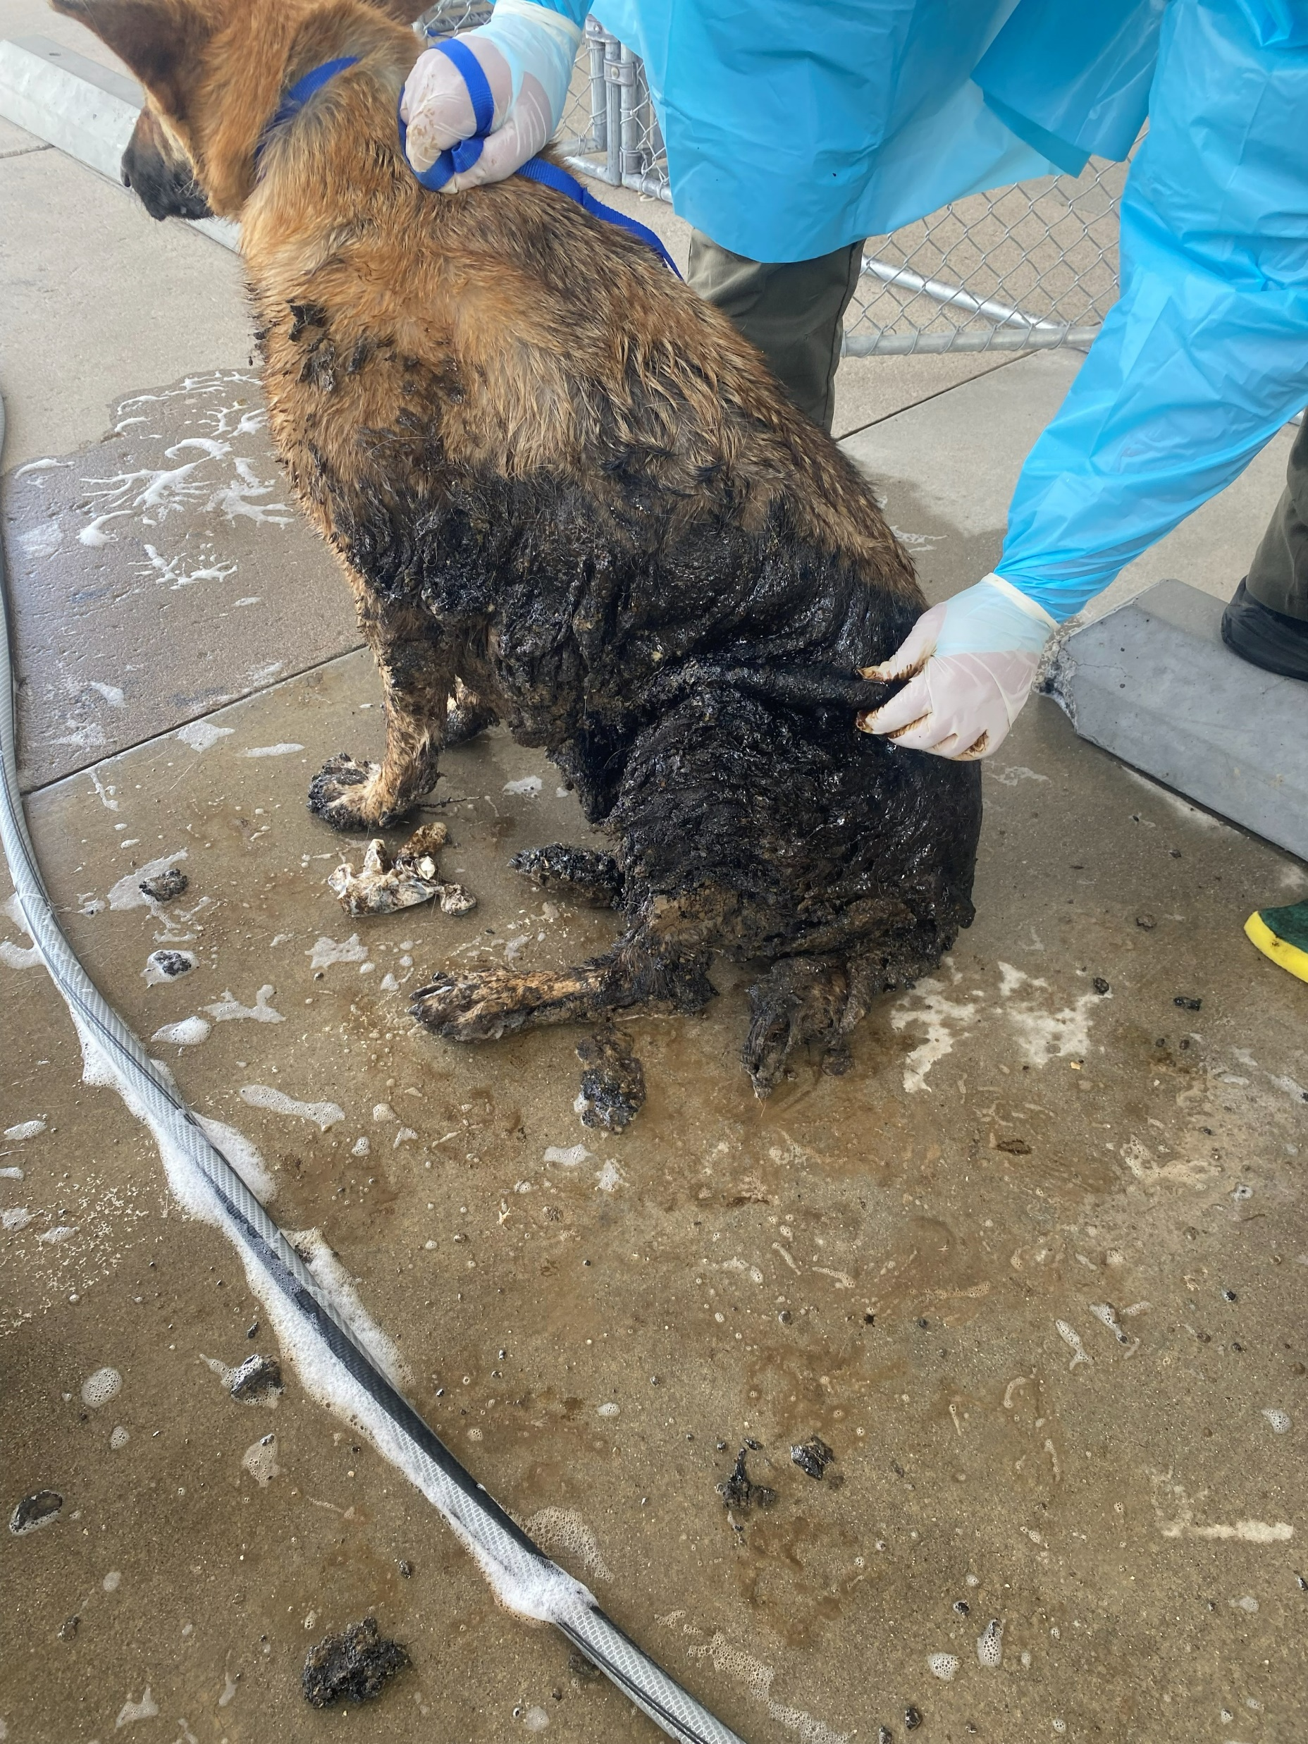

Slide 22
Volunteer Program
May 2026
Active Volunteers
134
New Volunteers
72
Volunteer hours donated in May
Year-To-Date volunteer hours donated in 2026
750.46
3,192.47

Slide 23
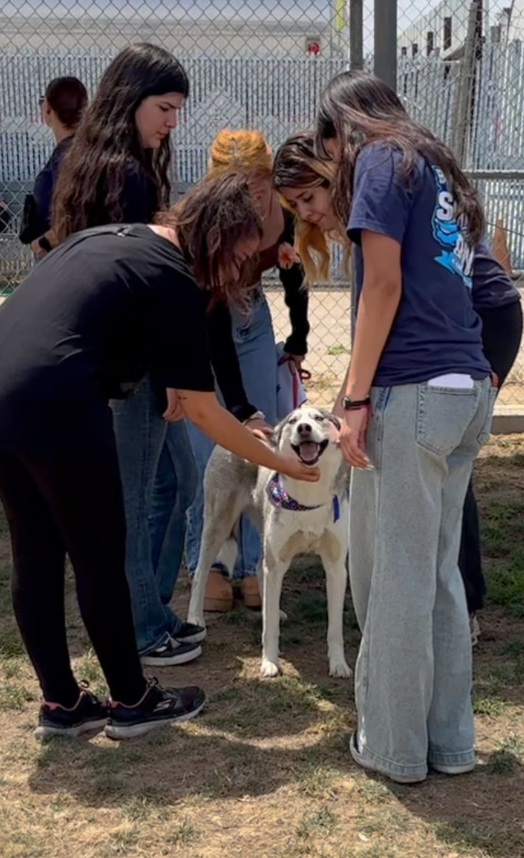
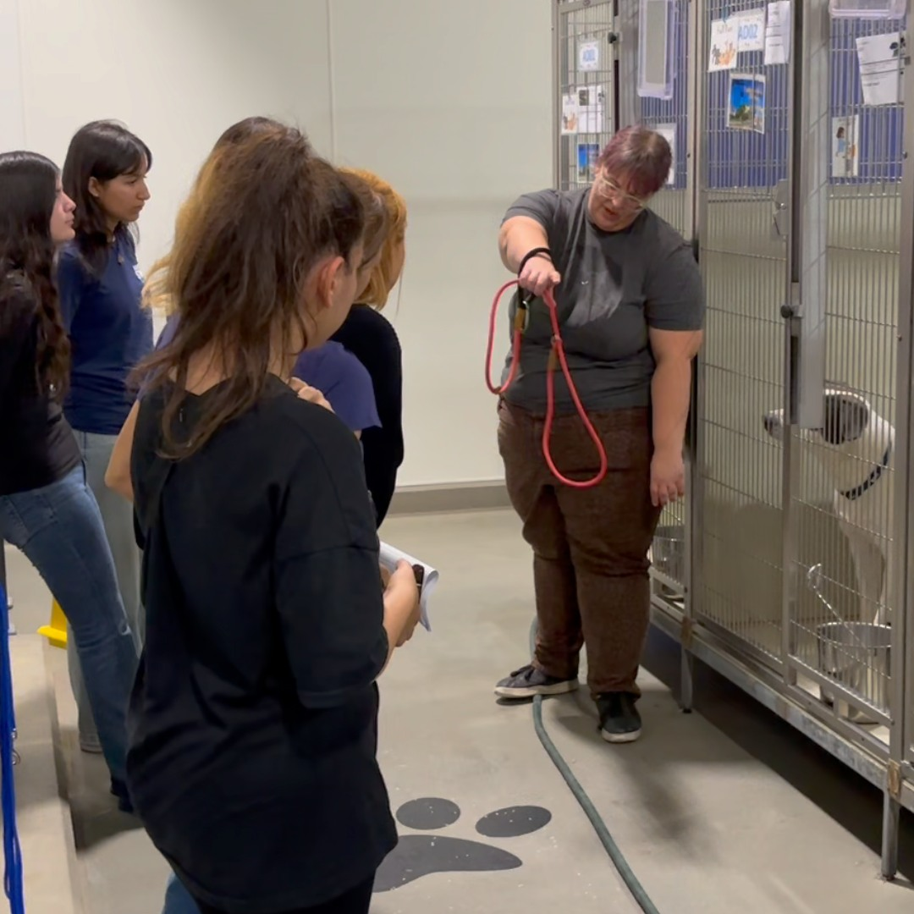
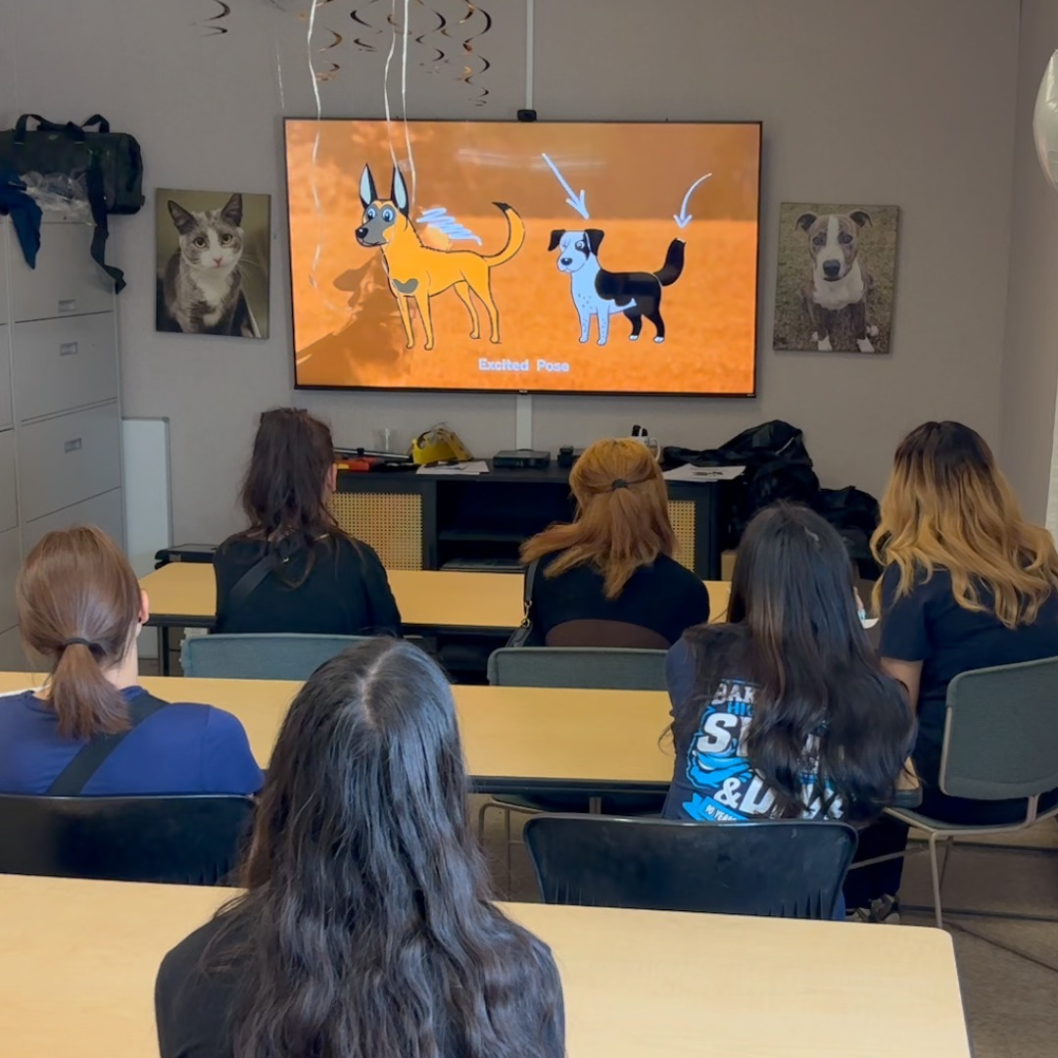
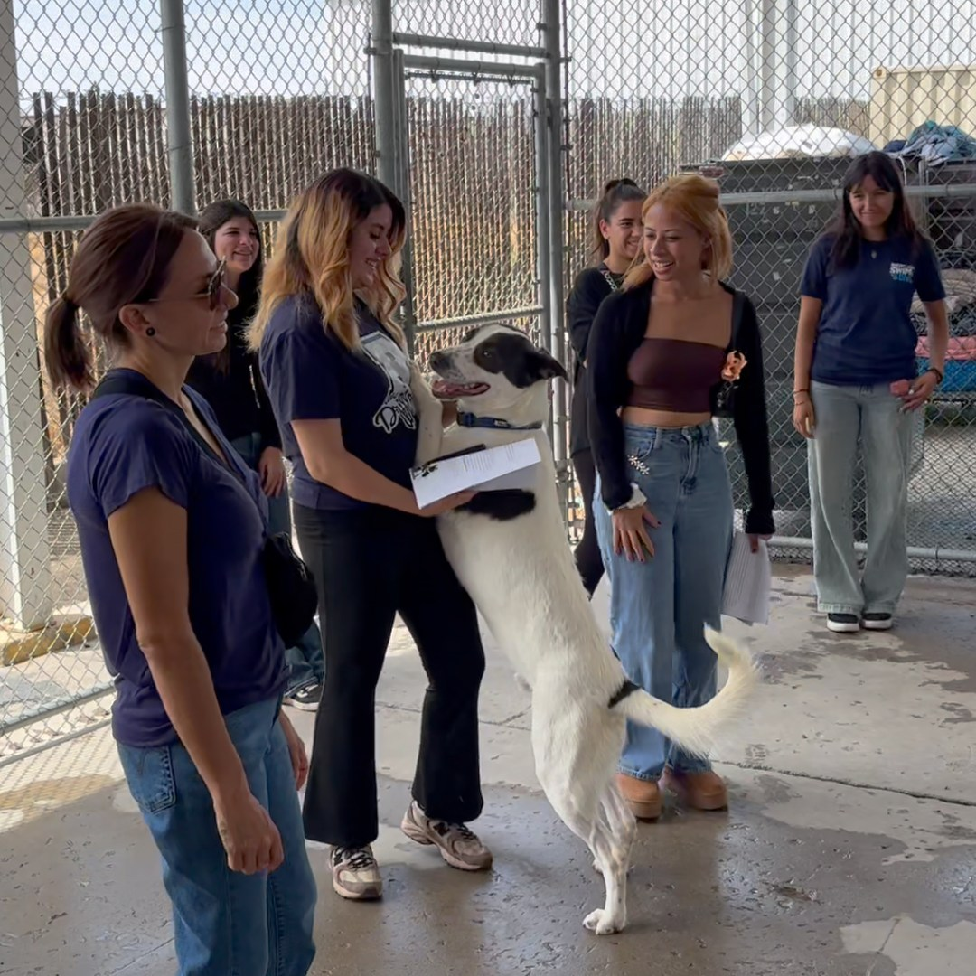
Dog Walking Class
Kern County Animal Services recently hosted a dog walking class led by Community Engagement Coordinator Berkeley Hanley, giving volunteers the opportunity to learn how they can expand the positive impact they make on the animals in our shelter.
With the shelter over capacity, many dogs are spending long hours in their kennels. Volunteers help provide much-needed exercise, enrichment, and socialization through simple walks that reduce stress, improve behavior, and can even increase a dog's chances of adoption.
Participants also learned about opportunities to assist with multi-dog playgroups and the Streets of Bakersfield program. Just one hour of volunteering can make a meaningful difference in a shelter dog's day.

Slide 24
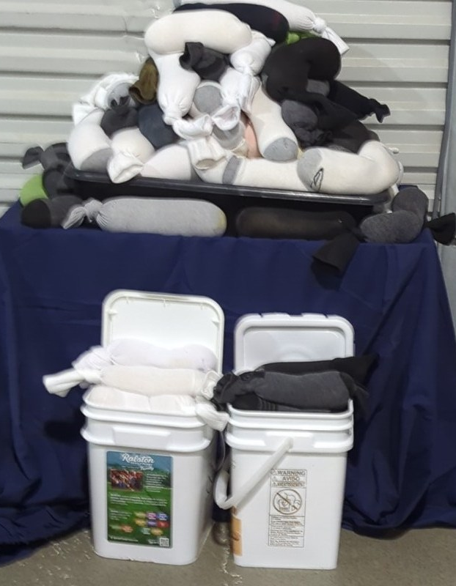
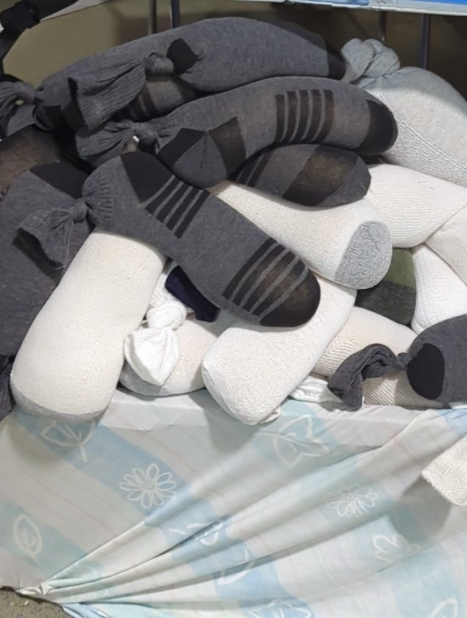
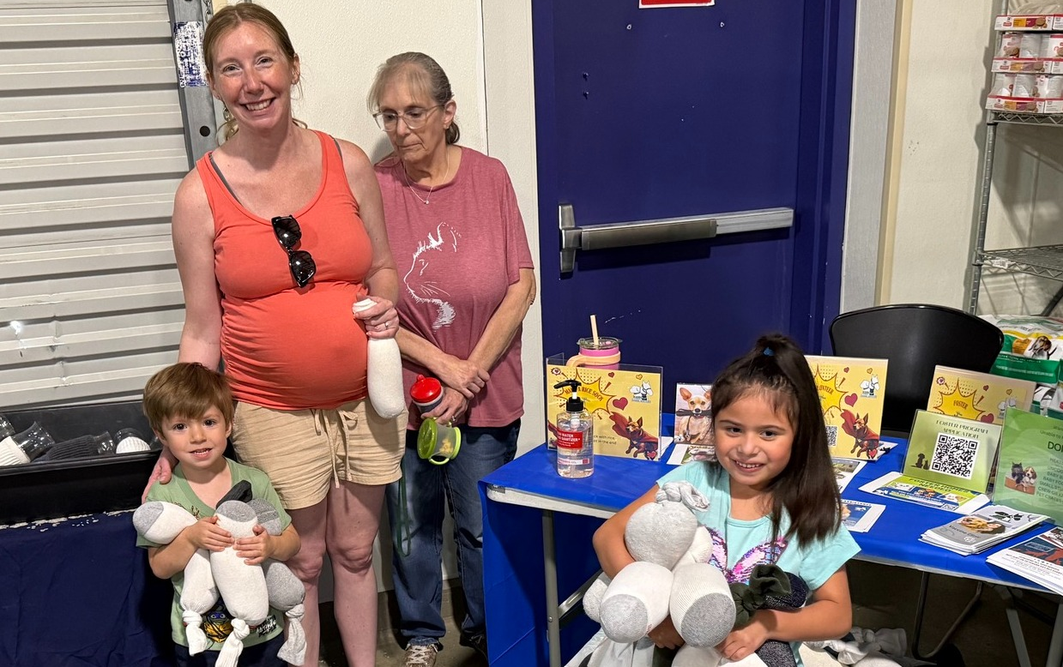
Rice Sock Superheroes
Heroes of all ages joined us at the shelter during our “Just 1 Dog” adoption event to help create lifesaving rice socks for the newborn kittens in our care. These simple, heated socks provide critical warmth for orphaned kittens who are too young to regulate their own body temperature, giving them a better chance to thrive.
Thanks to the hard work and compassion of our community, more than 120 rice socks were filled during the event! The response was so amazing that we ran out of rice!
A huge thank you to everyone who spent part of their day helping our tiniest and most vulnerable shelter residents. Every rice sock made will provide comfort and warmth to kittens who need it most, and every helping hand made a difference.

Slide 25


Slide 26
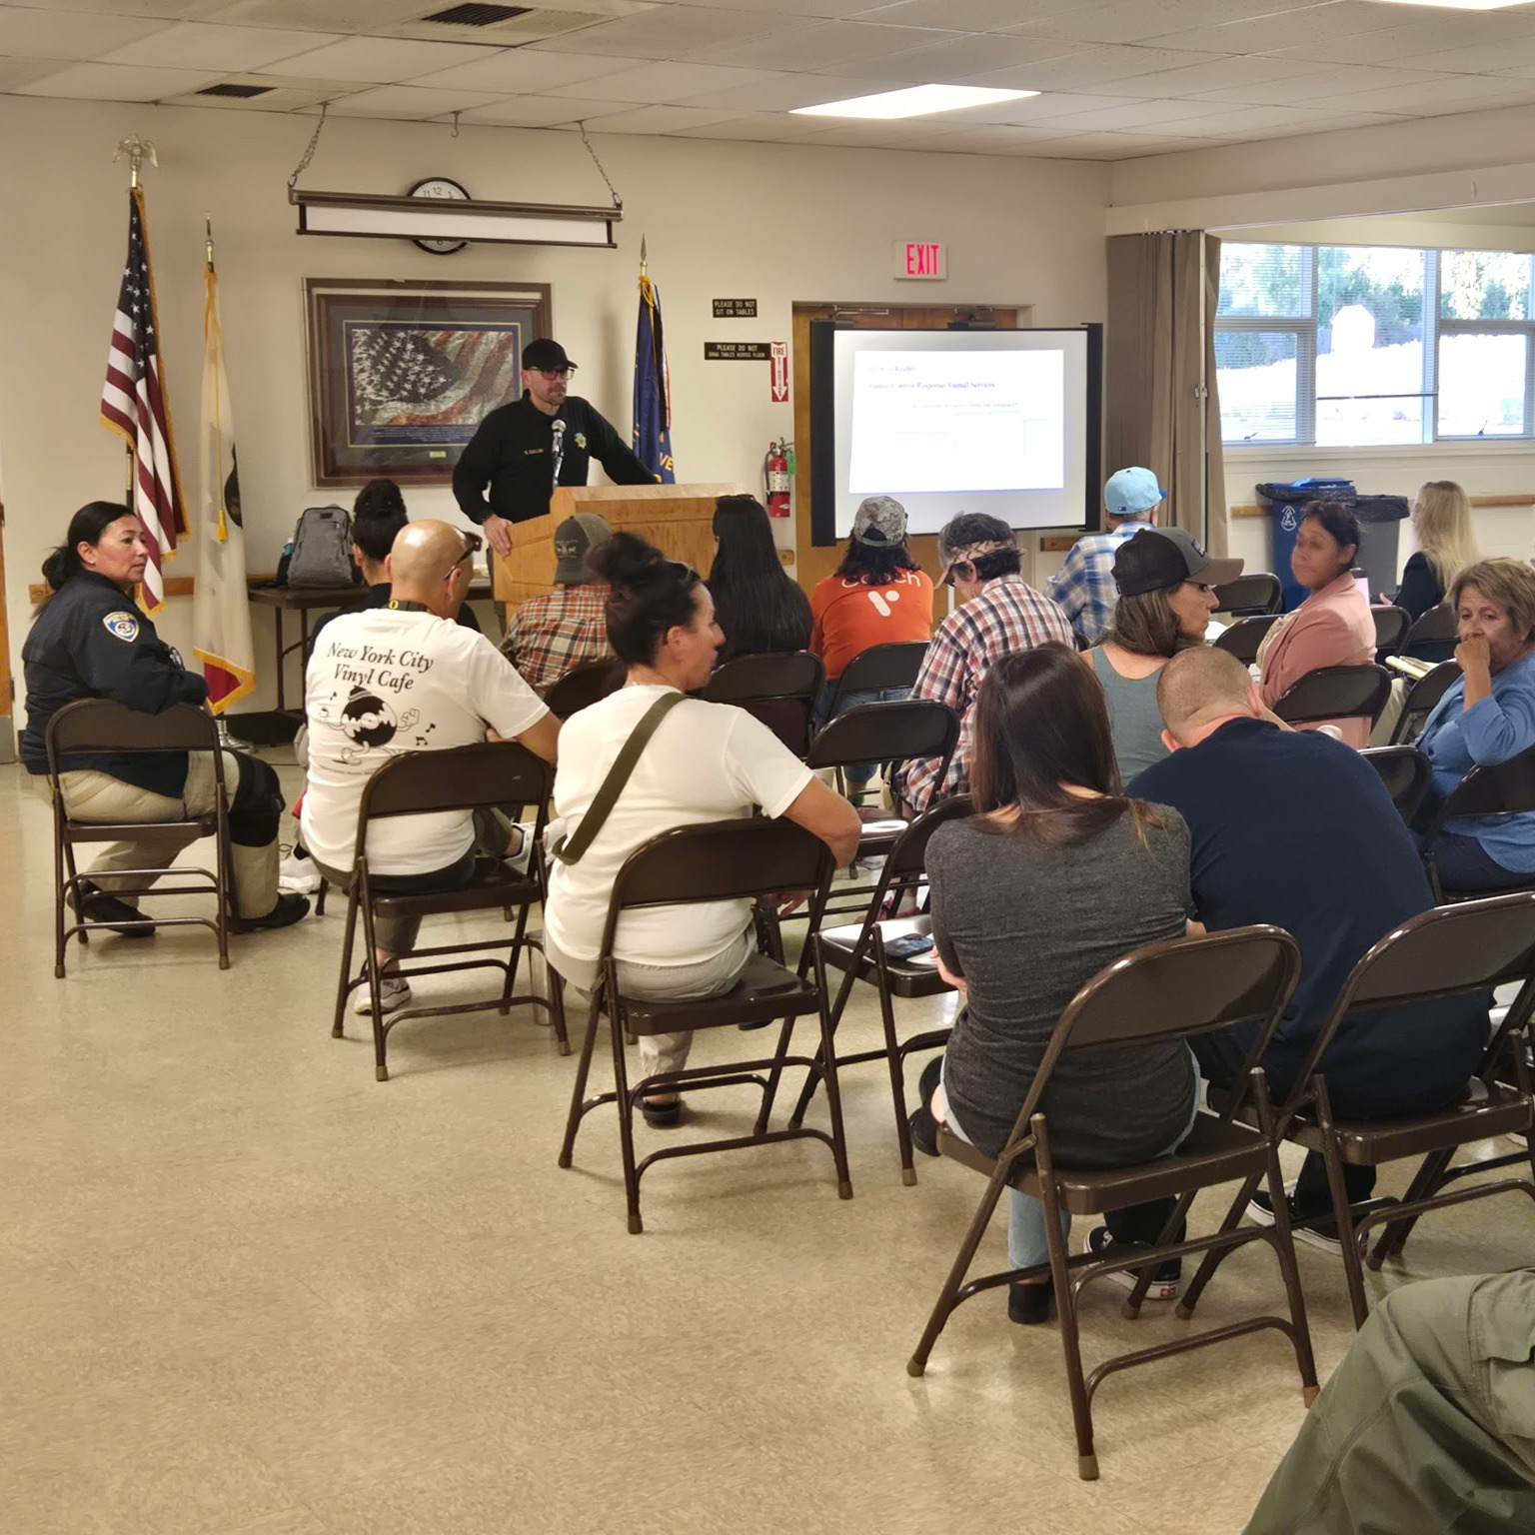
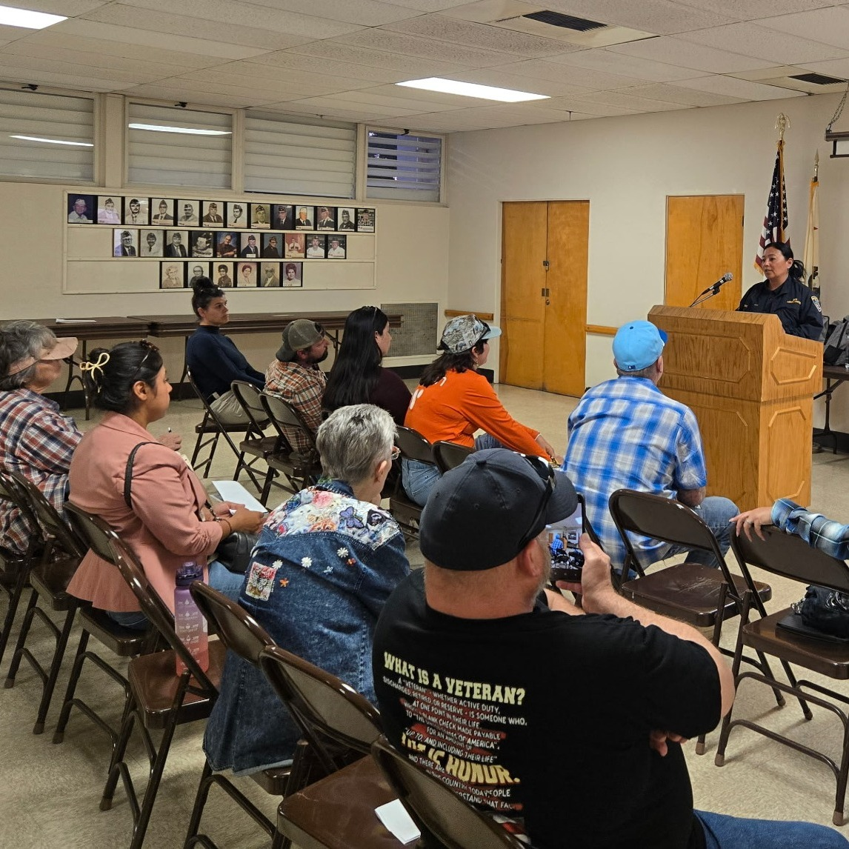
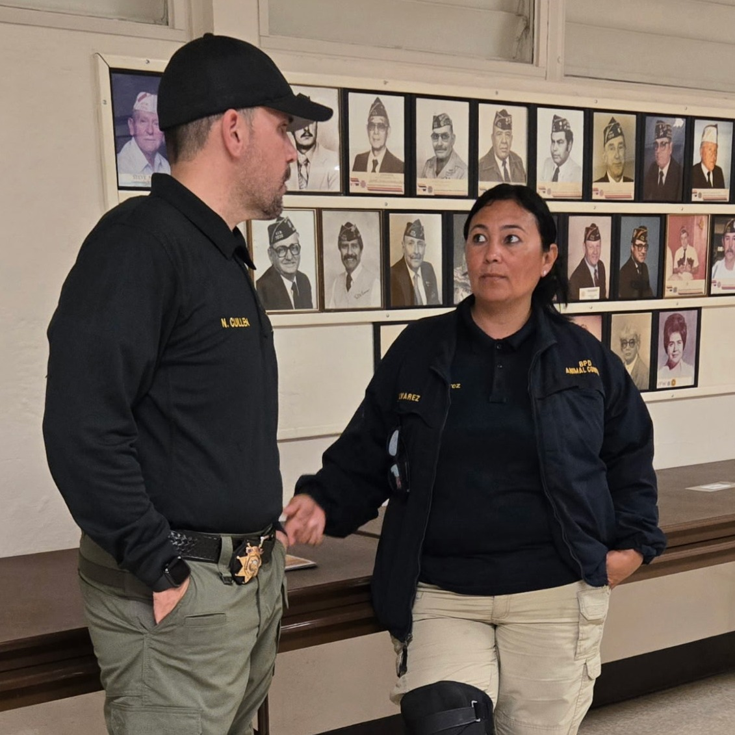
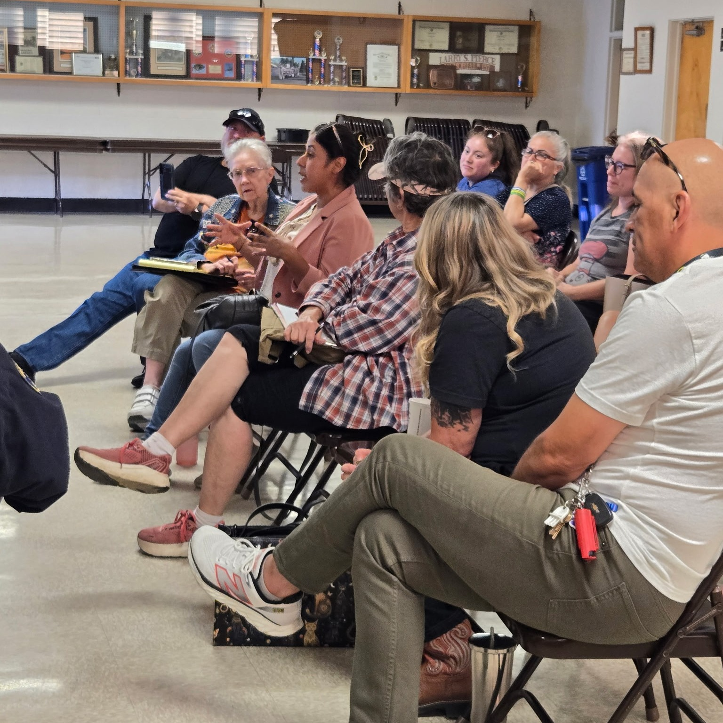
Community Animal Welfare Meeting
Wednesday, May 6th - Kern County Animal Services partnered with the City of Bakersfield Animal Care Center, City of Bakersfield Animal Control, SOS Dog Rescue – Strength of Shadow, and Kern SAFE Animal Coalition to host the first Community Animal Welfare Meeting.
Thank you to everyone who attended and took part in the discussion. The strong turnout, engagement, and passion shown by community members made it clear just how much Kern County cares about animals and the people who love them.
These important conversations are helping build collaboration among animal welfare organizations, advocates, and residents as we work together toward positive change for animals throughout our community. We appreciate all of our partners and attendees for making the meeting a success and helping lay the groundwork for future efforts.

Slide 27
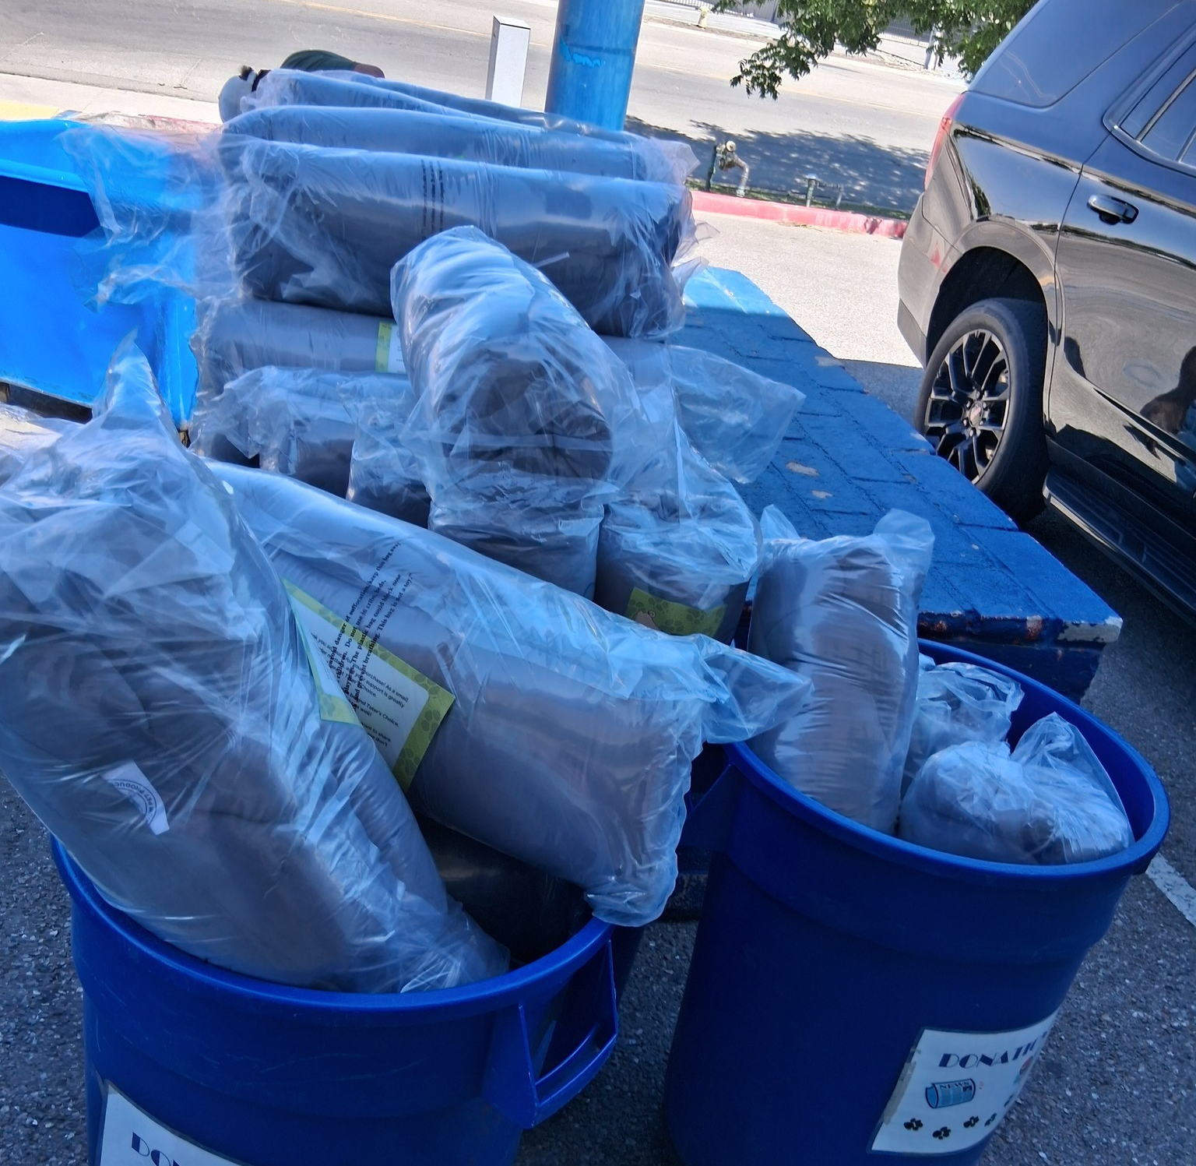
30 Pet Beds
Tater’s Choice Premium Pet Products donated thirty brand-new dog beds to the shelter!
Thanks to Tater and his family for making our shelter pets happier and so much more comfortable!

Slide 28

Beautologie Adoption Promotion
Thanks to Beautologie Medical Group for partnering with us on a special adoption promotion! Throughout the campaign, anyone who adopted a pet received 25% off medical aesthetic treatments, helping adopters celebrate their new furry family member with a little self-care as well.
We appreciate Beautologie Medical Group's commitment to help more shelter animals find loving homes. Every partnership like this helps bring attention to the many wonderful pets waiting for families

Slide 29
2026 Year To Date
January 1st – May 31st
1,947
Adoptions
1,788
Rescued
383
Returned To Owner
1,589
Spay/Neuter Surgeries (Clinics + TNR)
5,069
Total Lives Saved
80.80%
Save Rate

Slide 30
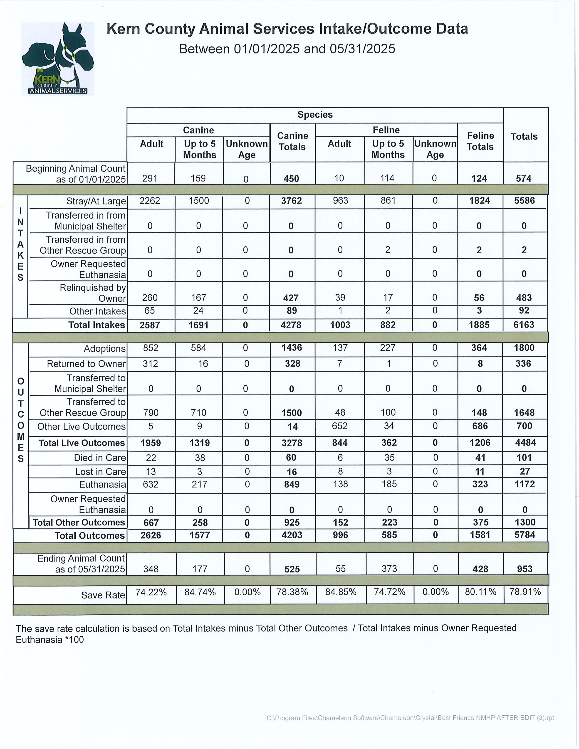
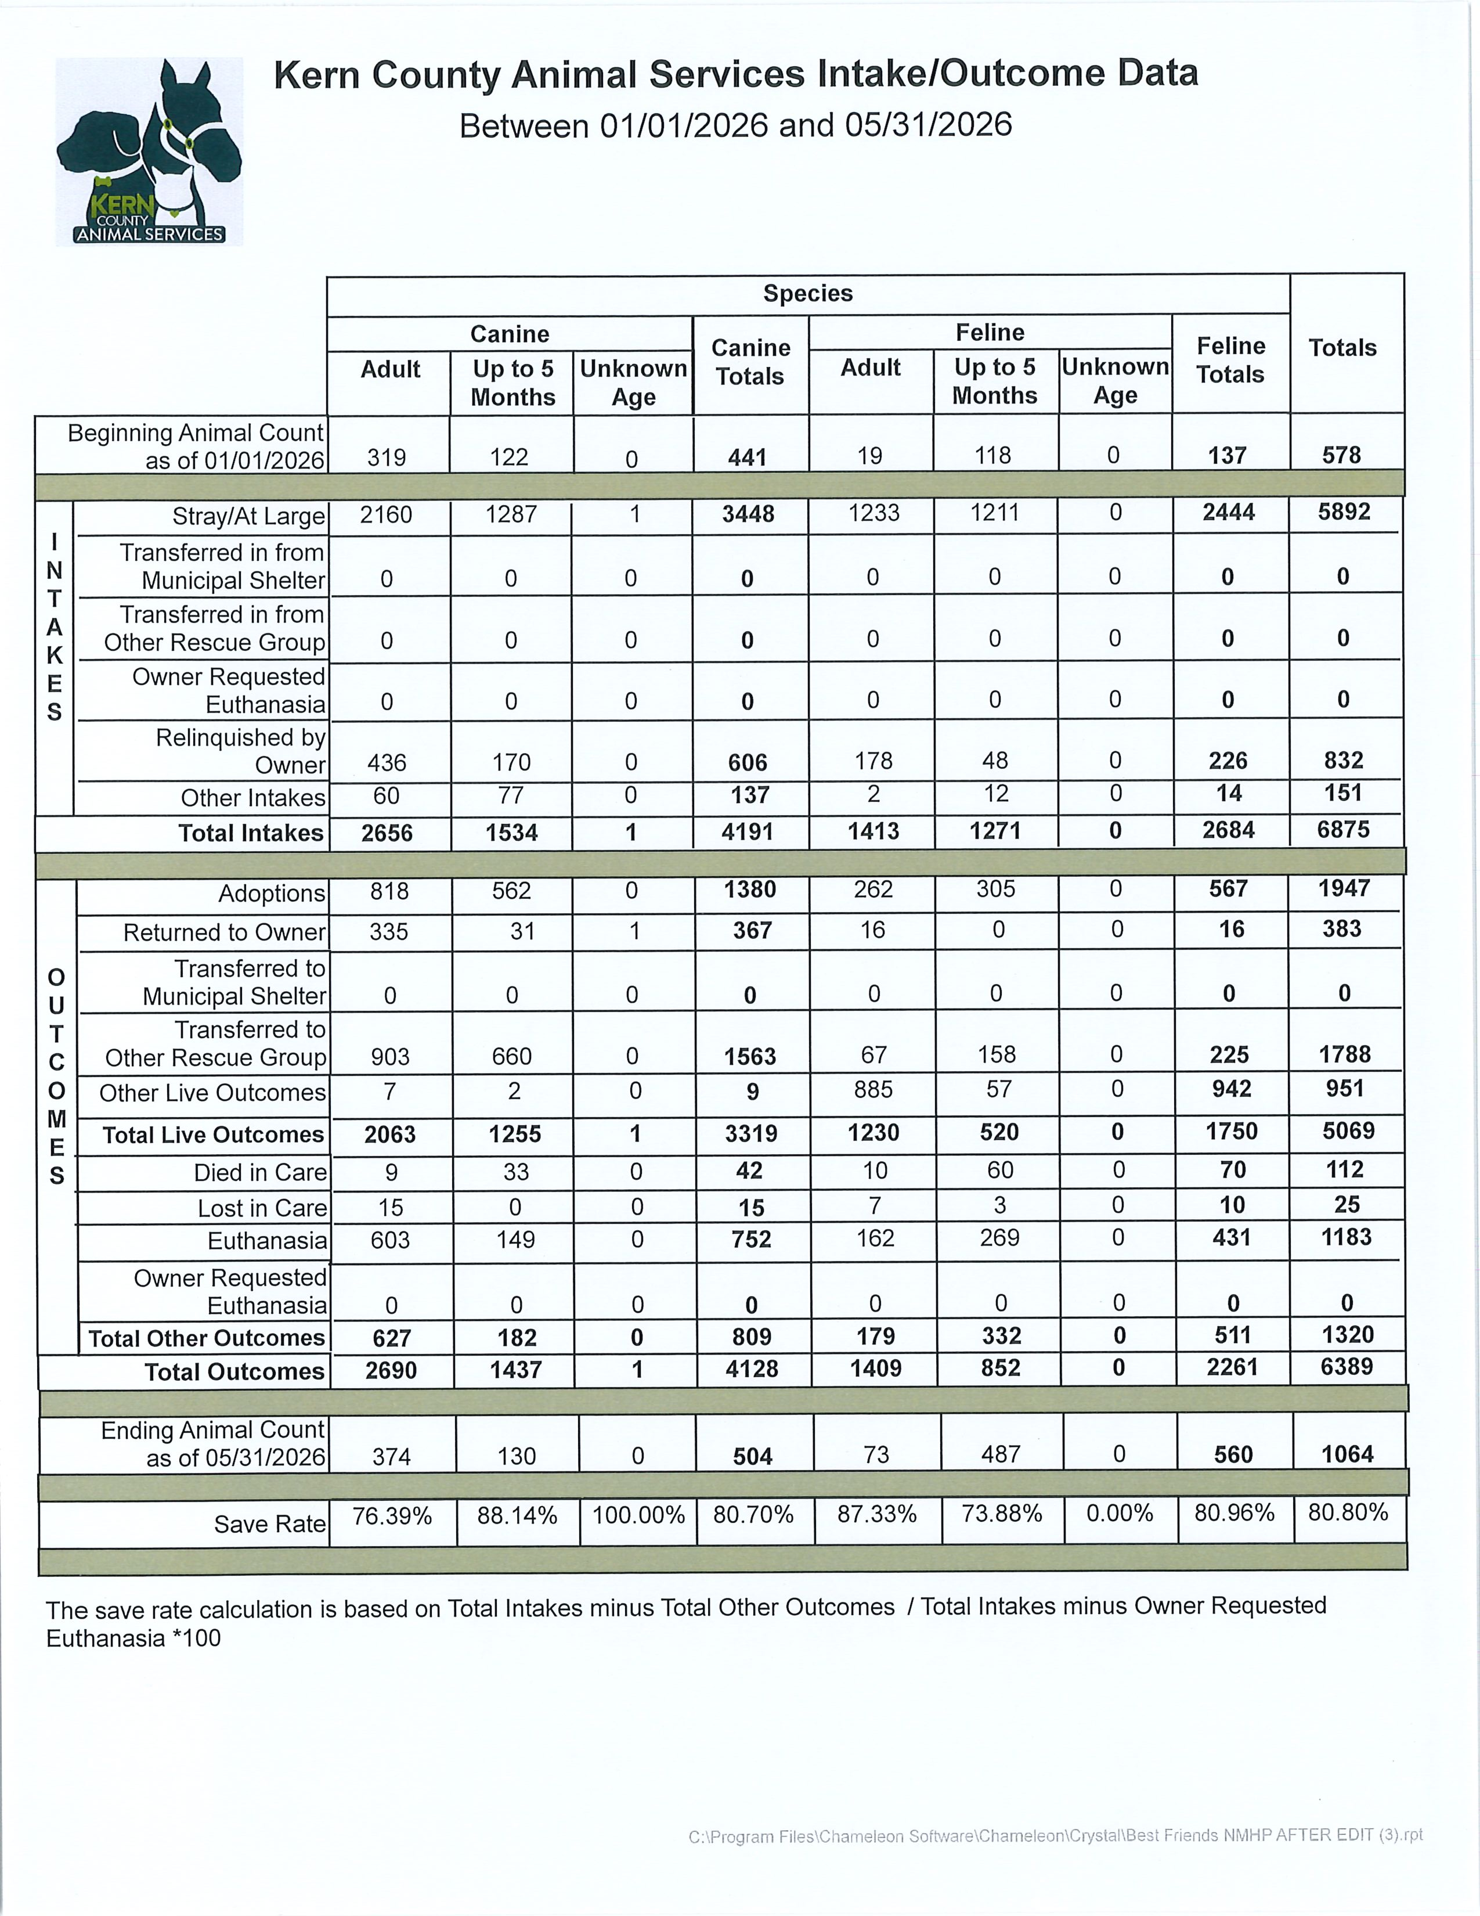

Slide 31
