Slide 1

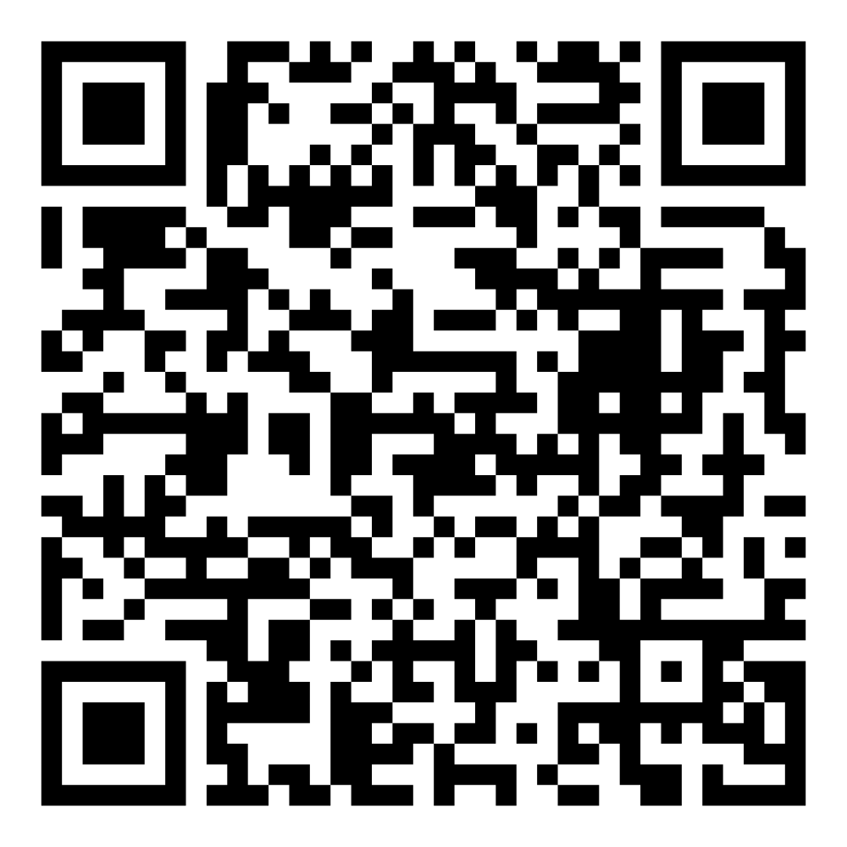
Director’s Report
June 2026

Slide 2

Program Highlights
June 2026
Adoption: 154 dogs, 111 puppies, 25 cats, and 243 kittens under 5 months of age were adopted for a total of 533 animals adopted from Kern County Animal Shelters in the month of June.
Foster: 32 dogs, 43 puppies, 3 cats, 159 kittens, and 15 barnyard animals entered the Department’s Foster Care Program in June, for a total of 252 animals.
Rescue: 158 dogs, 112 puppies, 12 cats, and 99 kittens were transferred to other animal rescue organizations in June, for a total of 381 animals.
Spay/Neuter: A total of 413 animals were altered at low-cost KCAS spay/neuter clinics in the month of June.
TNR: 218 cats were spayed or neutered and released in June. Year-to-date, 1237 cats have gone through the program, and since 2013 25,254 cats have been spayed or neutered and returned to field.

Slide 3






$20 June Adoptions
June 1st – June 26th

Slide 4
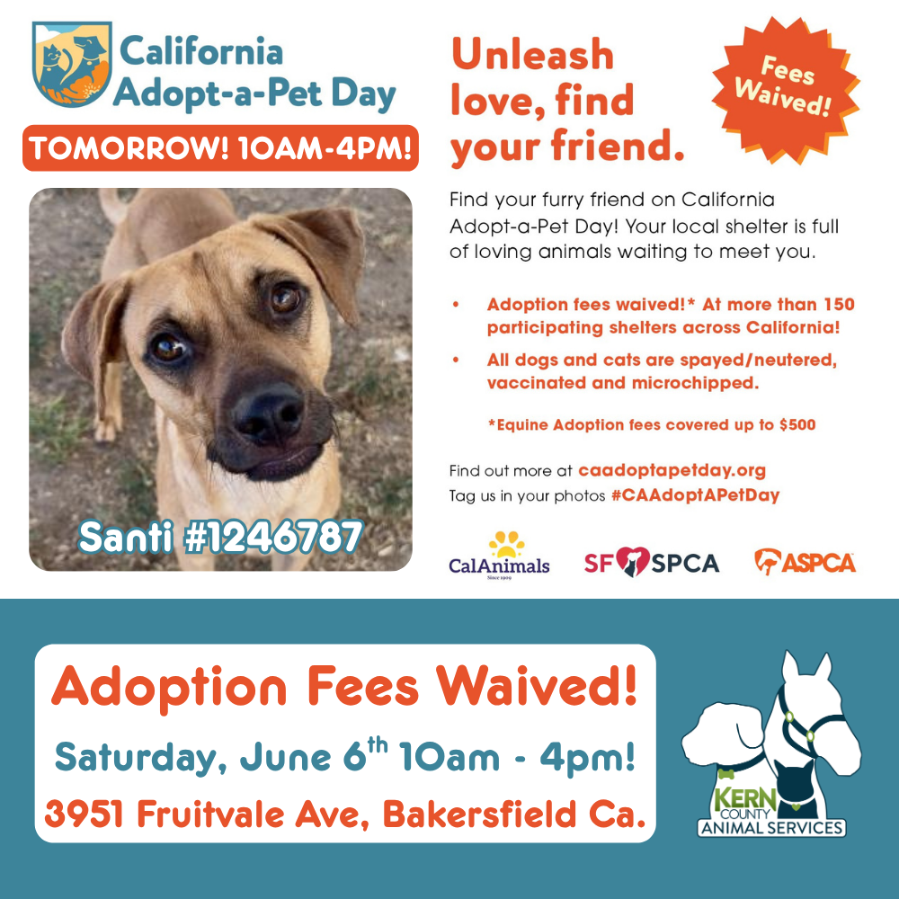
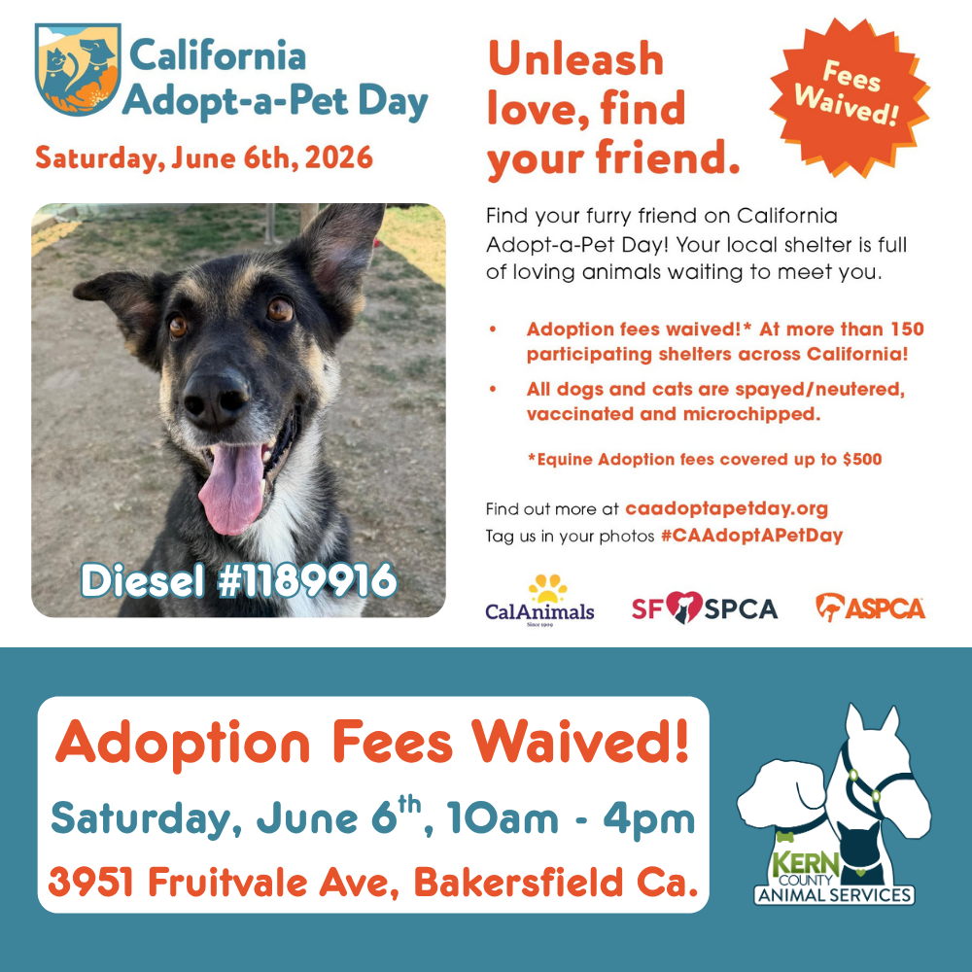
California Adopt-a-Pet Day
Saturday, June 6th

Slide 5
Offsite Adoption Events
Adoptable dogs from Kern County Animal Services are out in the community every Friday, Saturday, and Sunday!
These special events give some of our most overlooked dogs a chance to shine outside the shelter. Many of them have been waiting patiently for their forever homes for no fault of their own! This is their chance to stand out!
Offsite events are a great way to connect in a more relaxed setting, where folks can spend time getting to know a smaller group of carefully selected, highly adoptable dogs.

Slide 6
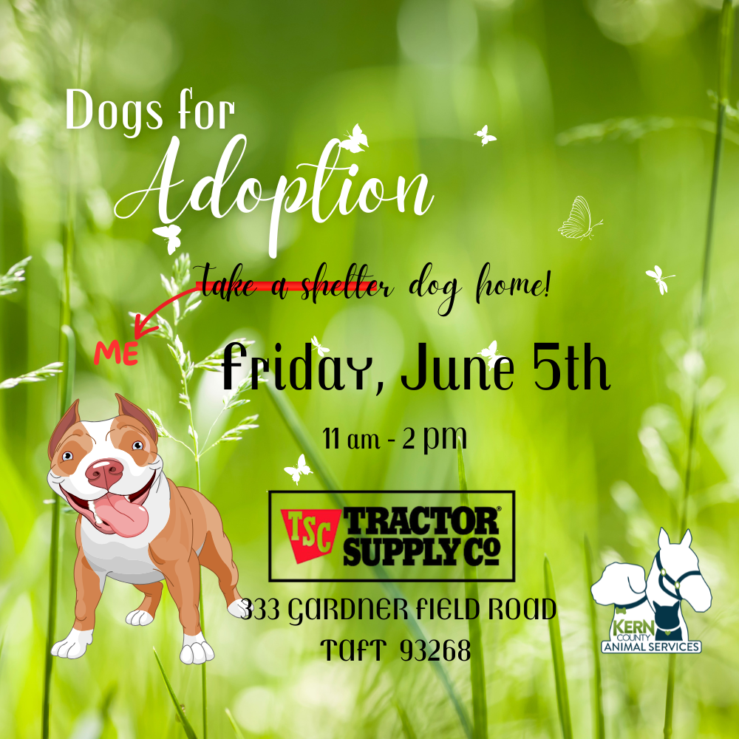

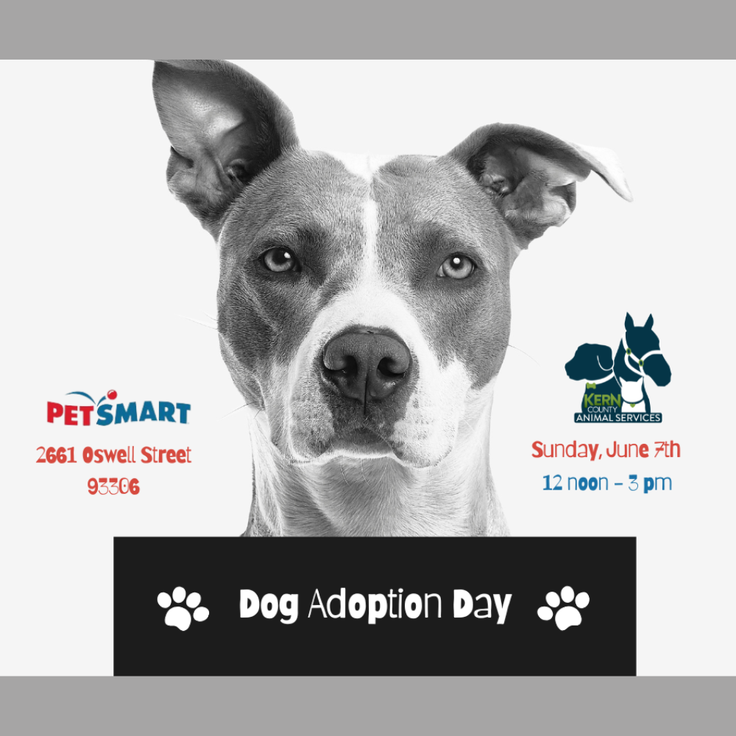




Slide 7


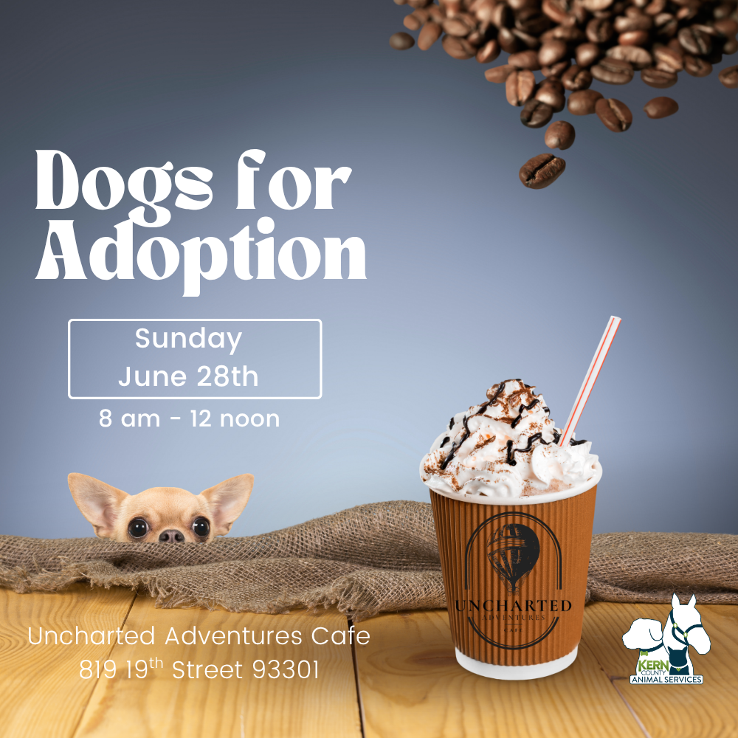
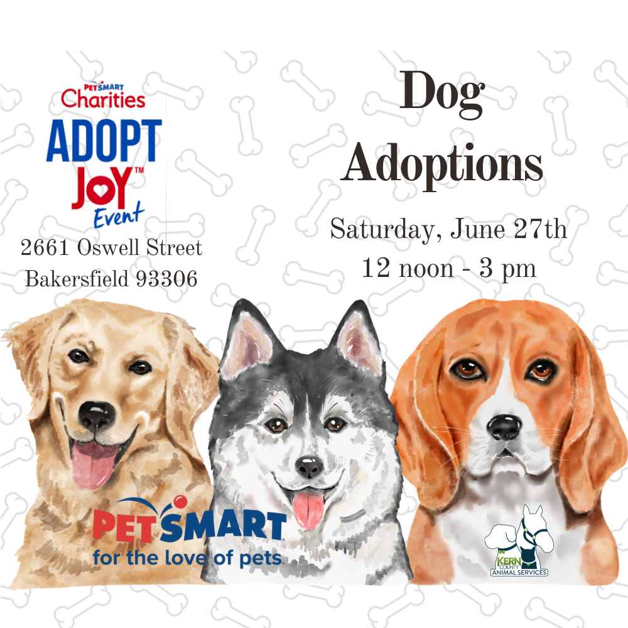


Slide 8

Streets Of Bakersfield
Click for Video!

Slide 9





Slide 10
Low-Cost Spay/Neuter Clinics
June 2026
Date | Location | Surgeries
June 1st | Rosamond, Ca. | 68
June 2nd | Oildale, Ca. | 59
June 3rd | Boron, Ca. | 33
June 4th | Heritage Park | 55
June 9th | Heritage Park | 46
June 10th | Virginia Park | 47
June 12th | Virginia Park | 56
June 15th | Tehachapi, Ca. | 49
 | Total Surgeries | 413

Slide 11
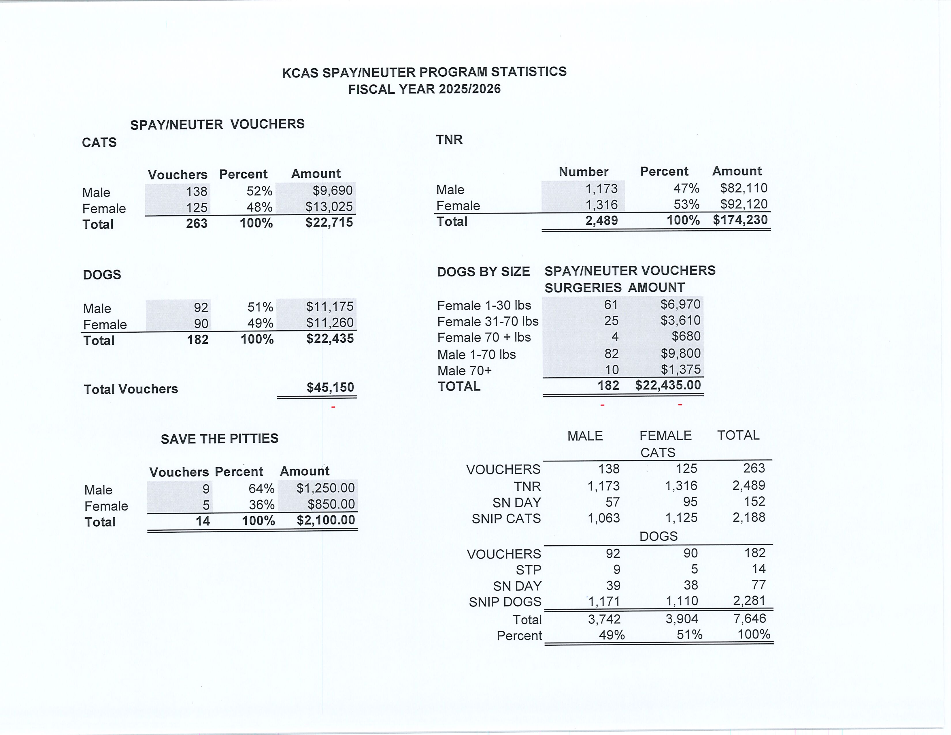

Slide 12
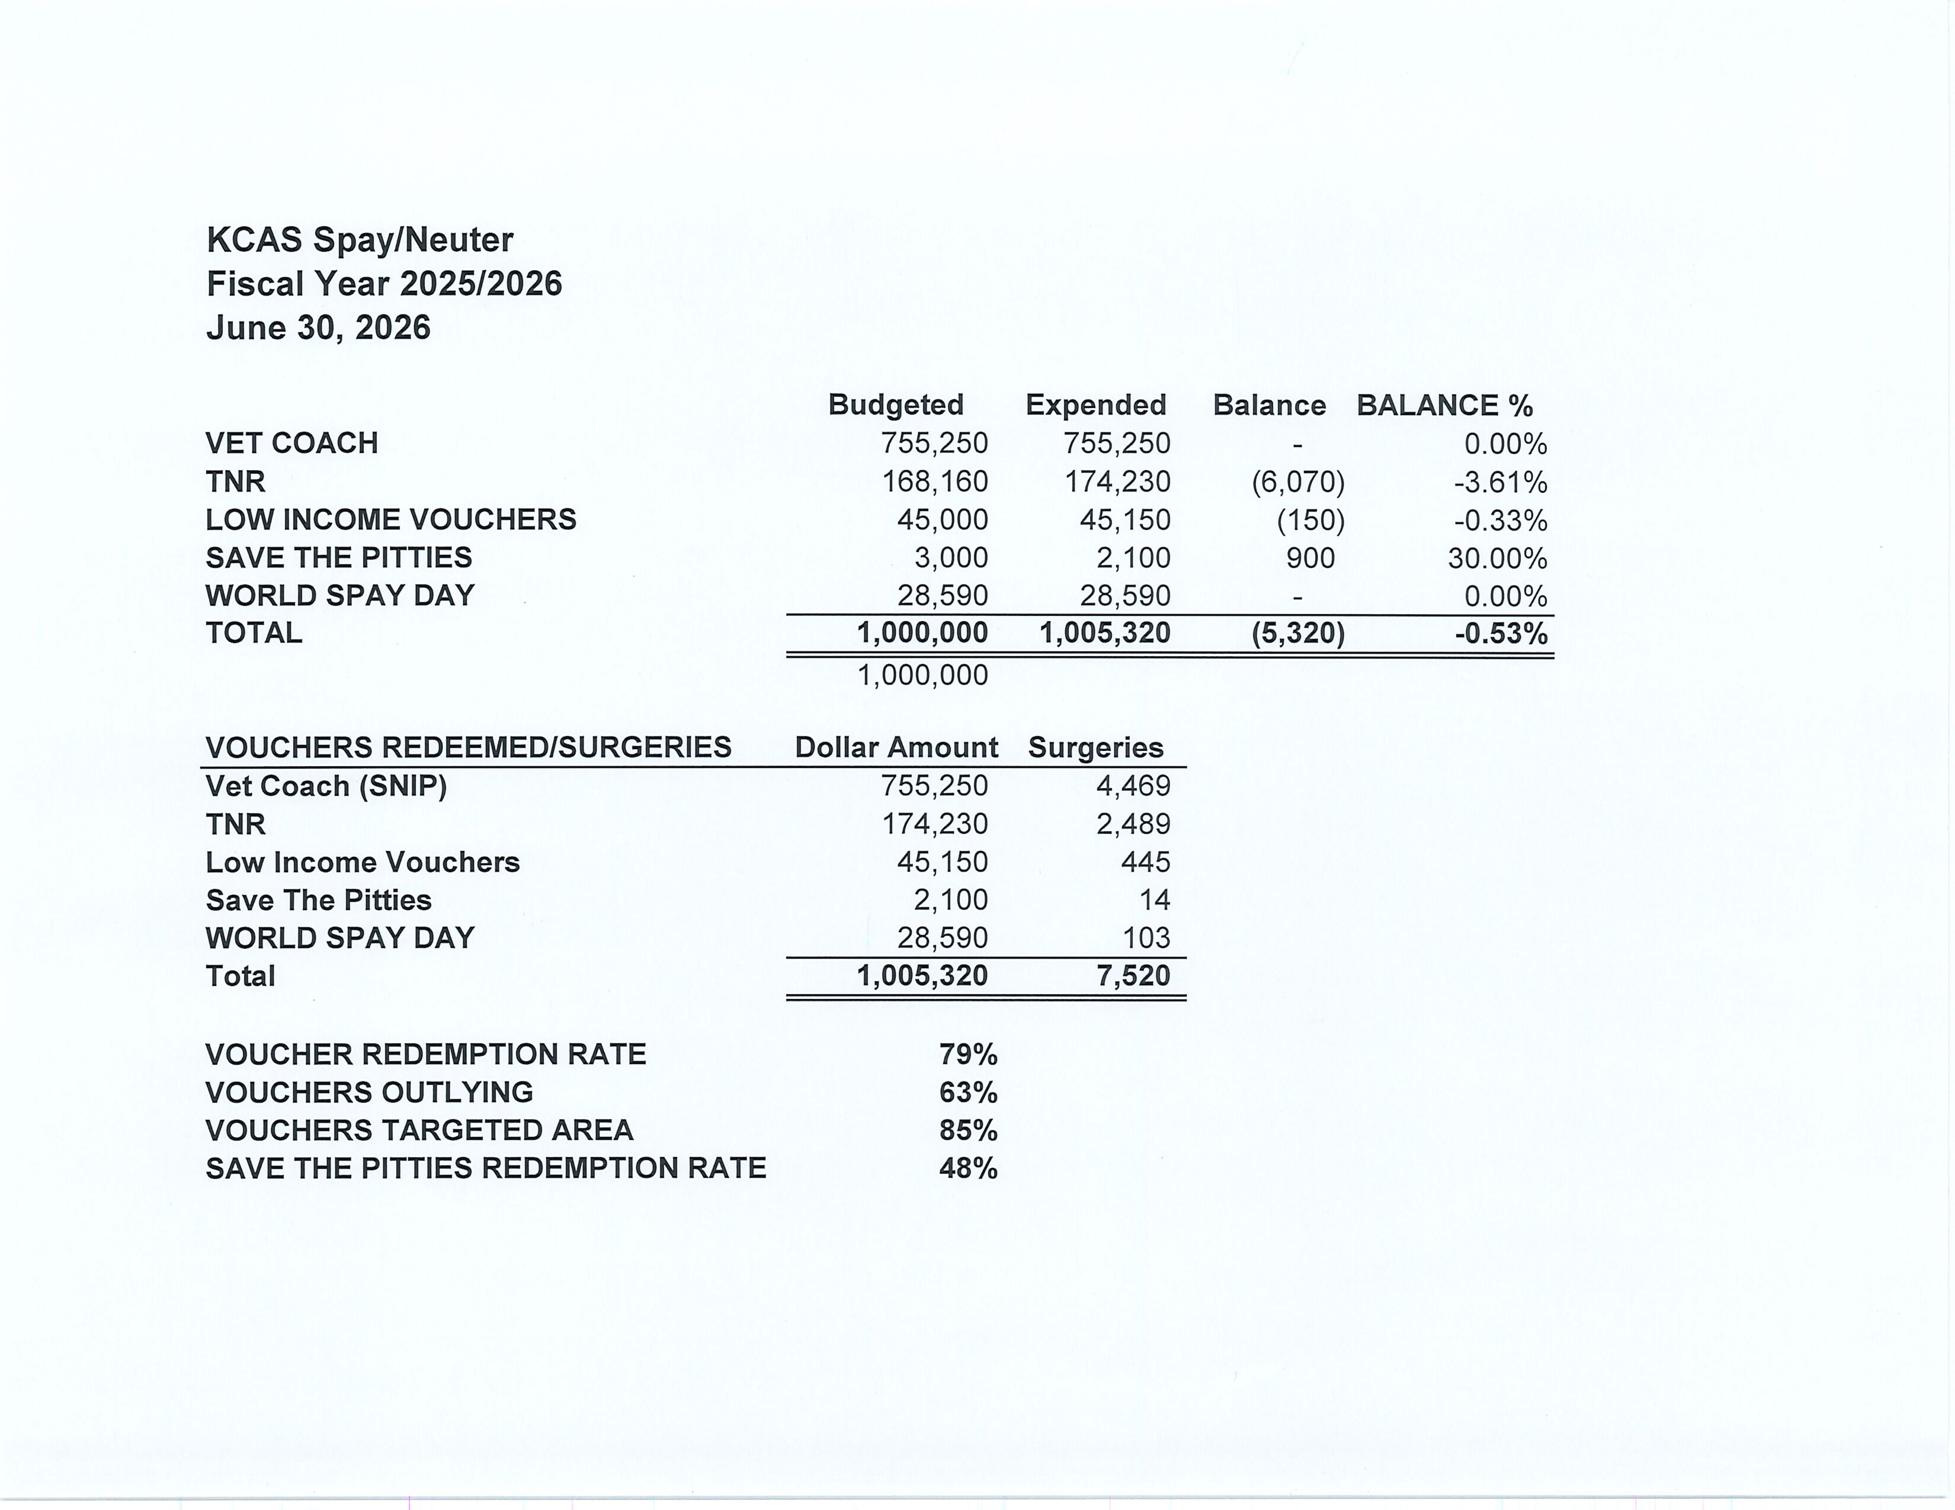

Slide 13
Low-Cost Vaccination Clinics
June 2026
Rabies
444
Microchips
Bordetella
44
43
DHPP* 197
FVRPC* 236
*DHPP and FVRCP vaccinations provided at no-cost by Petco Love.

Slide 14
Field Service Calls: June 2026
AREA | CALLS PER AREA
Lake Isabella | 172
Mojave | 121
North County | 89
Northeast | 313
Northwest | 289
Ridgecrest | 26
Southeast | 178
Southwest | 138
Taft | 112
Tehachapi | 69
TOTAL | 1,507
35 dogs were returned to their owners in the field
in June 2026.
76 dogs were secured on property by Animal Control Officers in June 2026.

Slide 15
Commercial Animal Facility Calls
June 2026
TYPE | CALLS PER TYPE
CAF – Breeder | 8
CAF – Rescue | 5
CAF – Kennel | 0
CAF – Boarding | 0
TOTAL | 6
5 Inspections Passed
0 Inspections Failed
0 Citations Issued
0 Permits Issued
52 Active CAF Permits

Slide 16
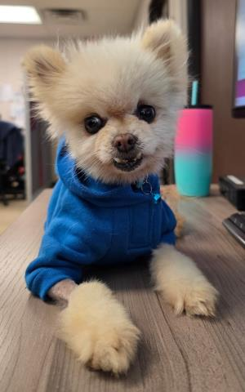

Pip!
Pip was a 10-year-old male Pomeranian who was picked up as a stray on the east side of Bakersfield. He arrived at the shelter in rough shape. His coat was severely matted and dirty, and he had significant dental disease. Despite everything he had been through, Pip never lost his sweet and friendly personality.
One of our Animal Control Officers gave Pip a much-needed bath and groom, revealing the adorable little dog that had been hidden beneath all that neglected fur.
Pip is now safe in the care of S.O.S. Dog Rescue and will soon find his new forever home!
Click the play button to see his video!

Slide 17
Volunteer Program
June 2026
Active Volunteers
112
New Volunteers
81
Volunteer hours donated in May
Year-To-Date volunteer hours donated in 2026
786.42
3,978.89

Slide 18
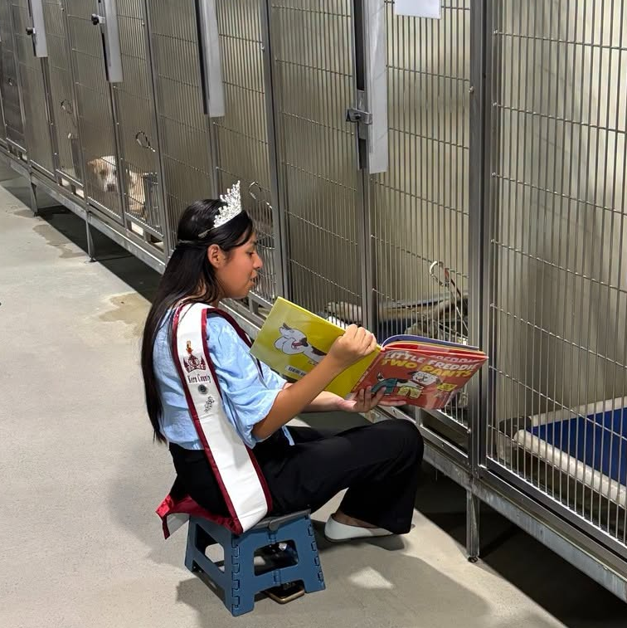
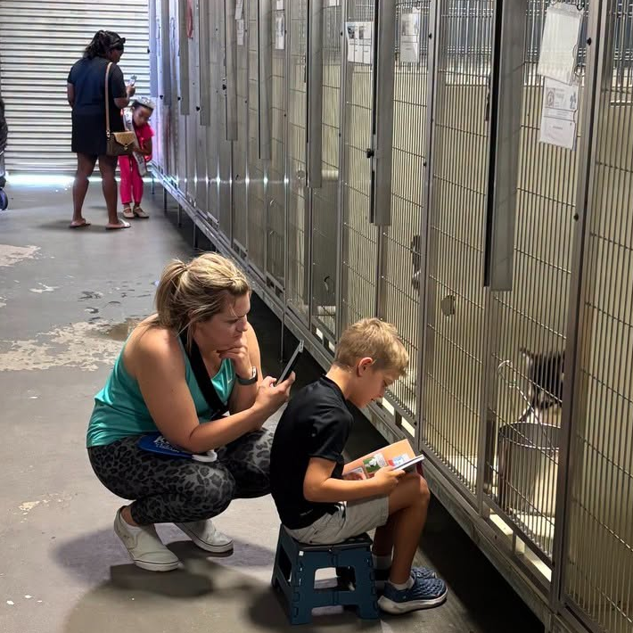
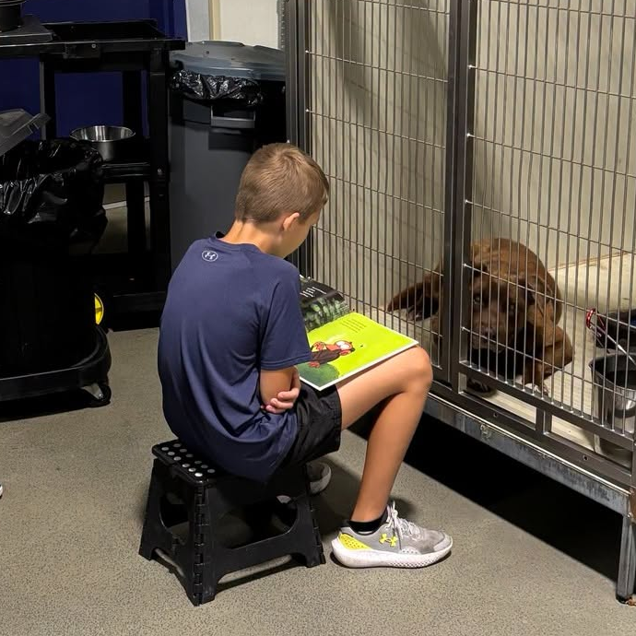
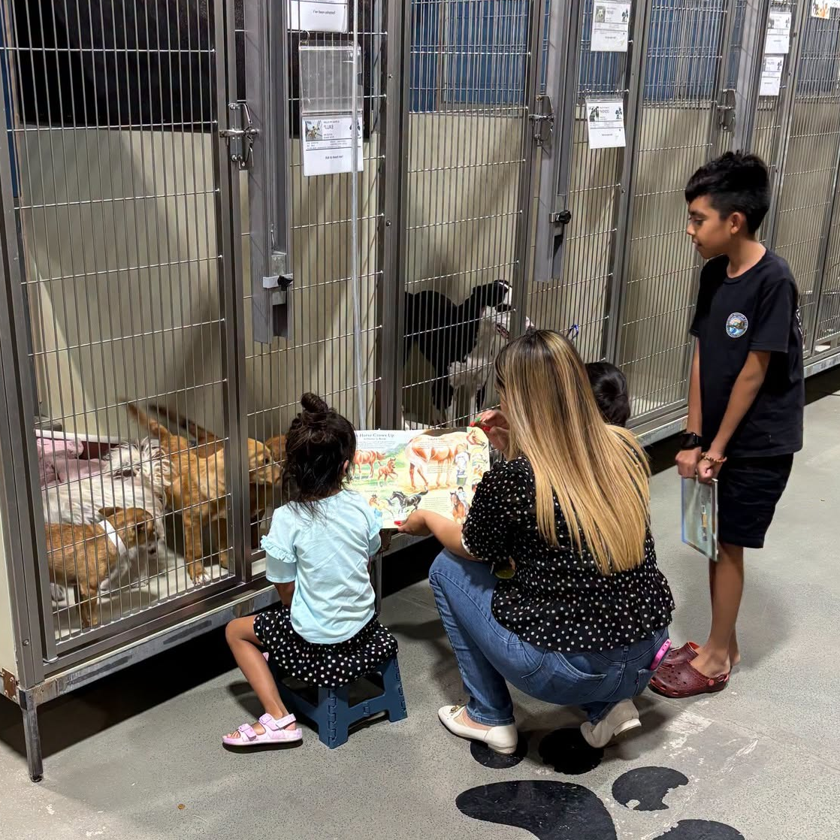
Tales for Tails
A big thank you to everyone who joined us for a special night of reading to our shelter dogs and cats. Our animal friends loved the extra attention while young readers practiced their reading skills in a calm, encouraging environment. It was heartwarming to see so many smiling faces, wagging tails, and happy purrs throughout the evening.
Thank you to the Kern County Library for providing a fantastic selection of books for readers of all ages and for helping make this event such a success.
The next Tales for Tails on Wednesday, July 29, from 5:30 to 7:00 PM at Kern County Animal Services, 3951 Fruitvale Avenue. Our shelter pets can't wait to read with you!

Slide 19


Slide 20
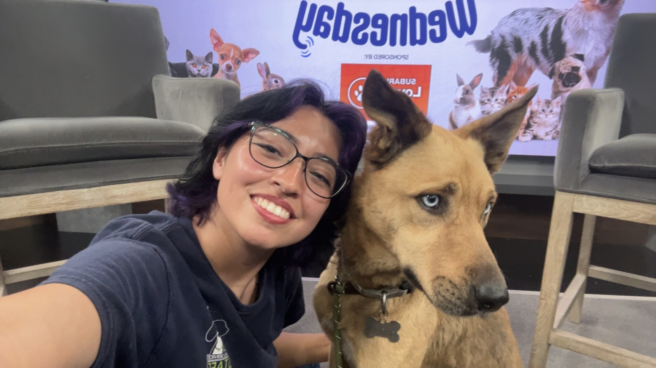
Wag Wednesday with Scooby-Doo
Scooby-Doo from Kern County Animal Services was the star of the June 3rd installment of Wag Wednesday on KERO TV 23ABC.
A special shout-out to Celestial from the KCAS Behavior Team for helping make the segment a success and showing off what an amazing pup Scooby-Doo is.
Soon after his appearance, Scooby left the shelter safely with an animal rescue organization!
Click the play button to see his video!

Slide 21
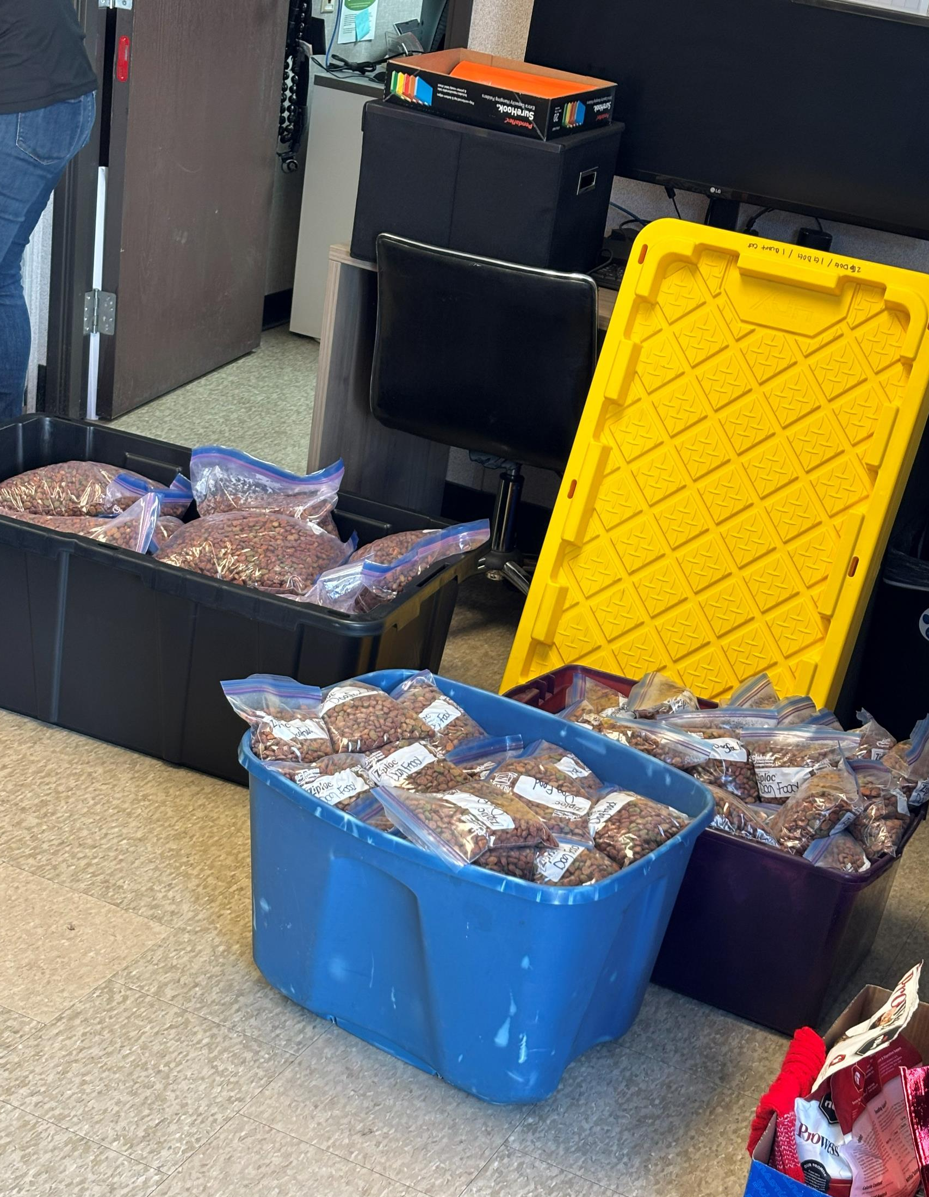
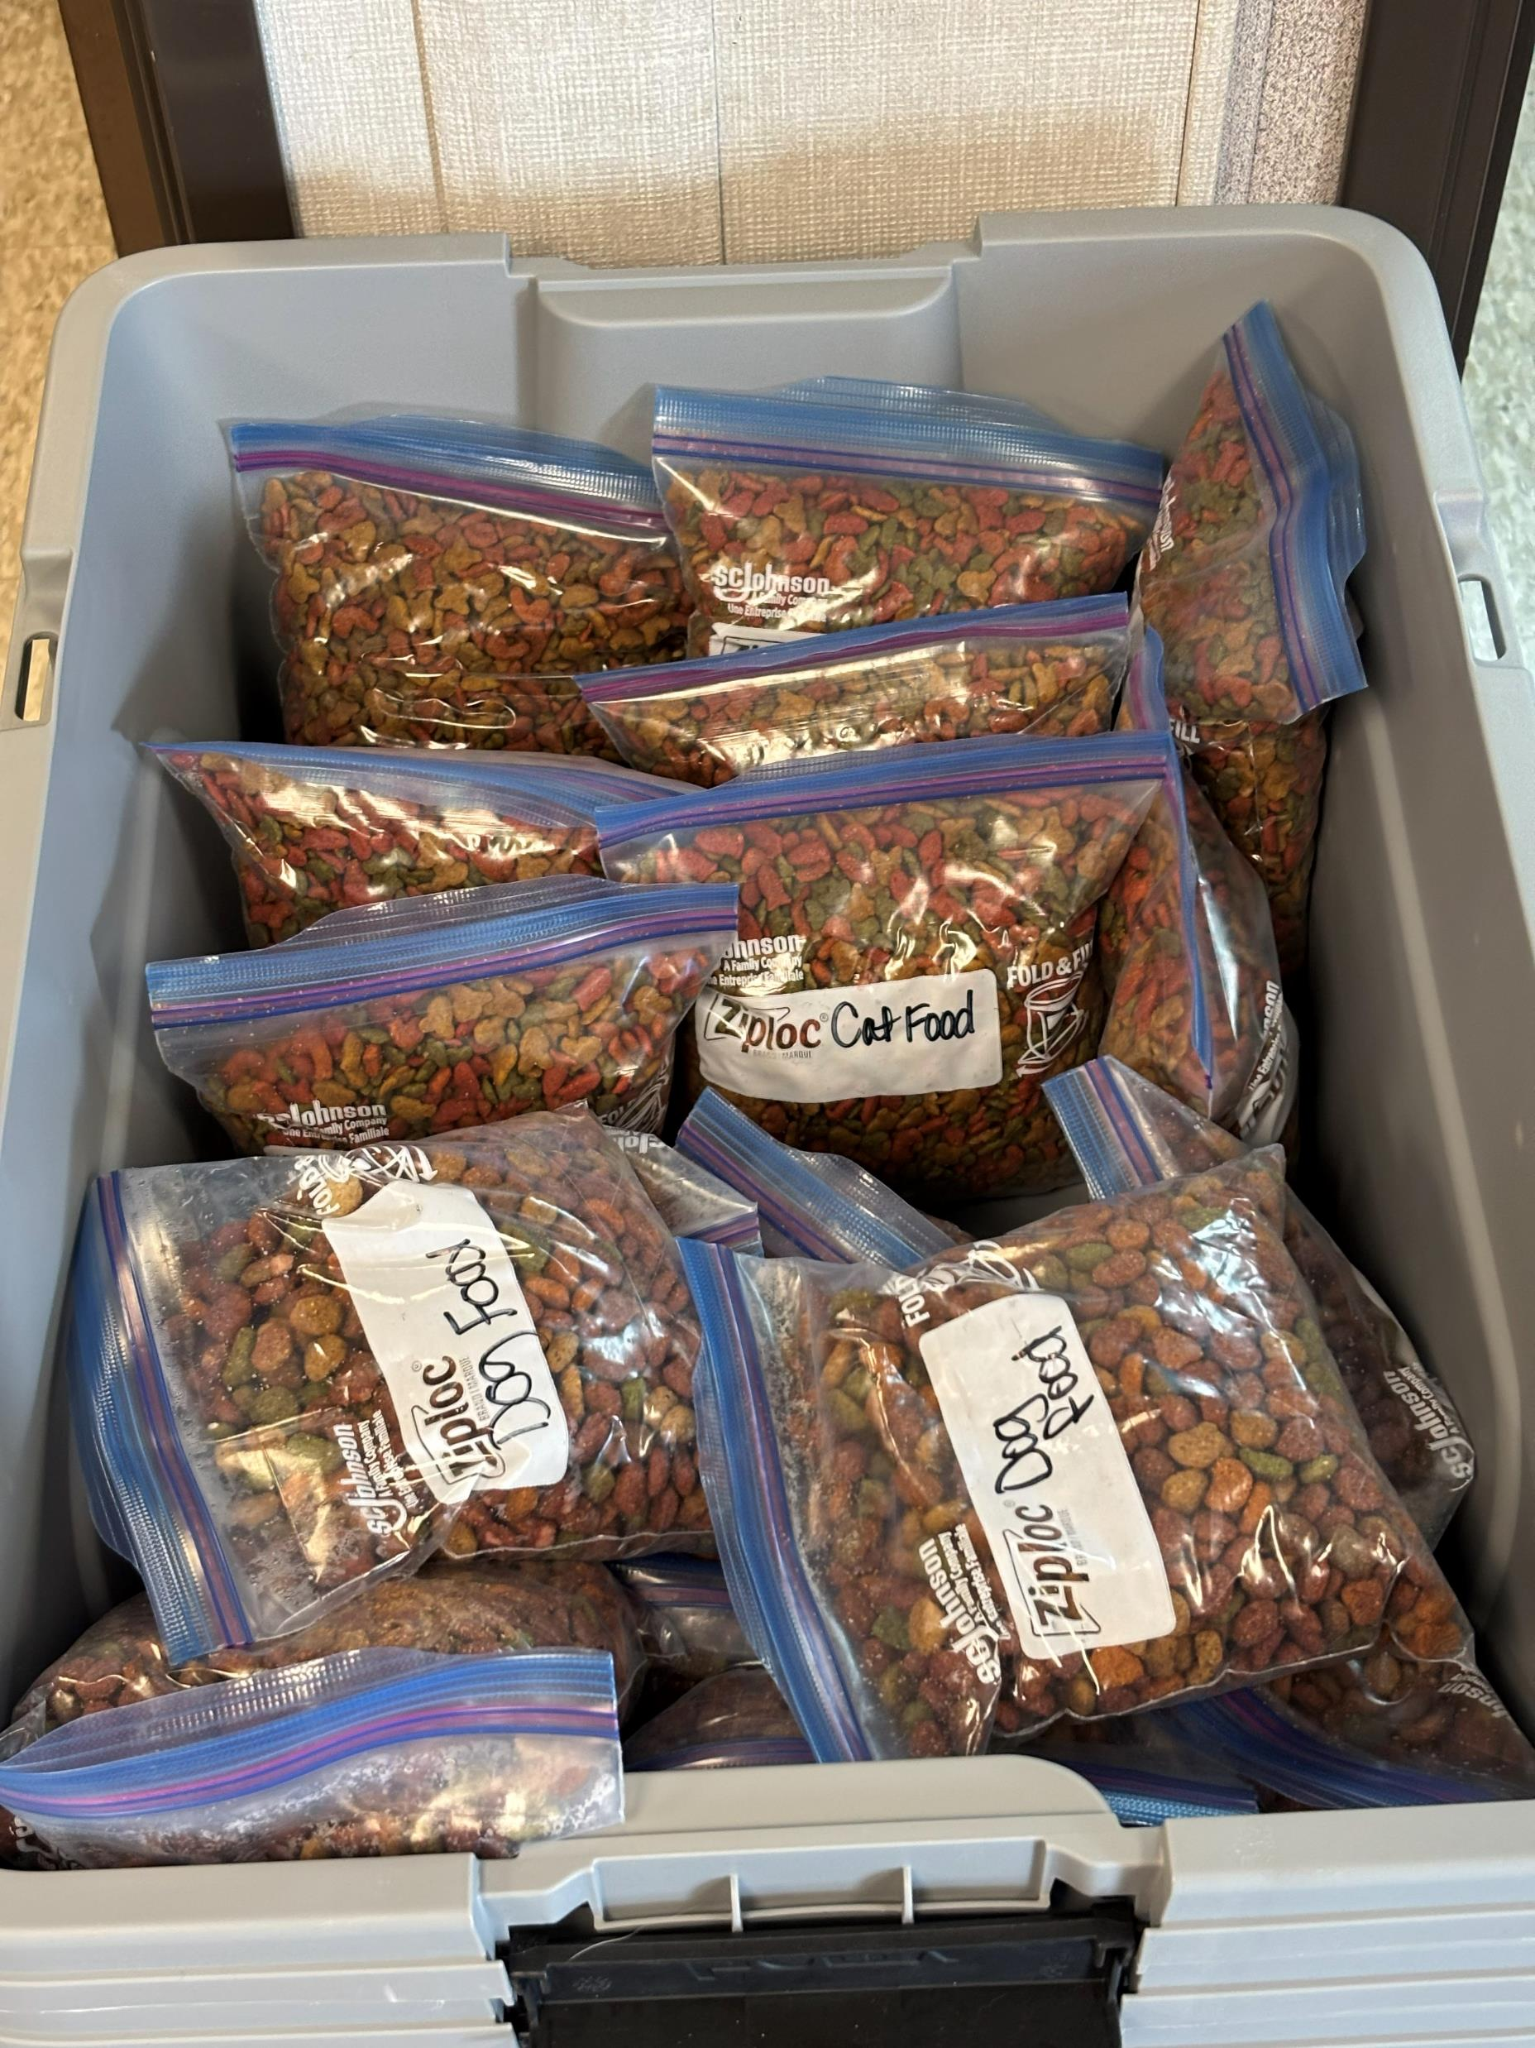
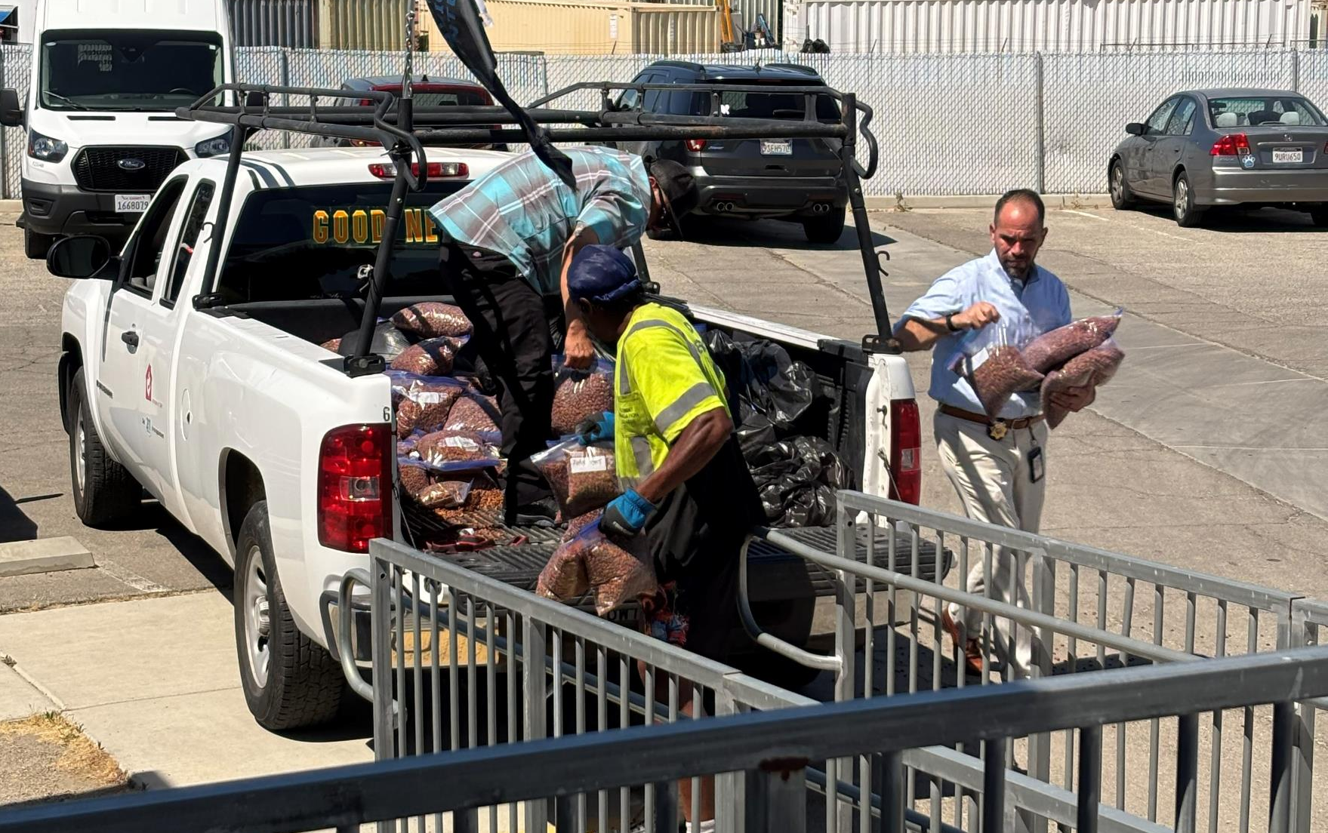
Pet Food Pantry
Kern County Animal Services is once again offering free pet food to pet owners who are struggling to keep their dogs and cats fed.
Bags of dog food and cat food are available during normal business hours at the shelter at 3951 Fruitvale Avenue.
There are no income restrictions and no complicated application process. All you have to do is ask. We will ask you to complete a brief questionnaire for research and accounting purposes.
In addition, our Animal Control Officers carry pet food with them while on patrol and may be able to assist pet owners in need as they respond to calls throughout our community.
We know times can be tough. If a little extra help with pet food will keep a beloved pet at home with its family, we're happy to help.

Slide 22
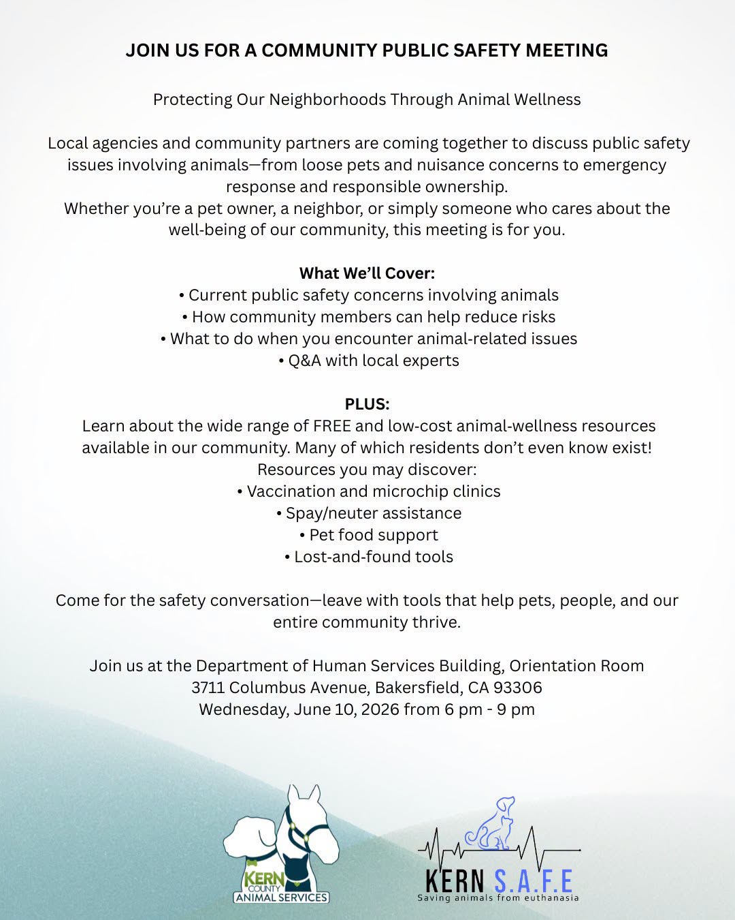
Animal Wellness Community Meeting
Wednesday, June 10th
Thank you to everyone who joined us for the second Animal Wellness Community Meeting on June 10th at the Department of Human Services Building.
We appreciate everyone who took the time to attend, ask questions, share ideas, and take part in the conversation about improving animal welfare in Kern County. Whether you came as a pet owner, a concerned neighbor, or an advocate for animals, your participation made a difference.
We were grateful to be joined by SOS Dog Rescue - Strength of Shadow and Kern SAFE as we discussed community resources, responsible pet ownership, public safety, and ways we can work together to help both people and pets.
Strong partnerships and engaged community members are essential to creating positive change, and we're thankful for everyone who continues to support that mission. We look forward to future meetings and opportunities to work together to build a safer, more compassionate community for people and animals alike.

Slide 23
2026 Year To Date
January 1st – June 30th
2,486
Adoptions
2,169
Rescued
452
Returned To Owner
2,220
Spay/Neuter Surgeries (Clinics + TNR)
6,356
Total Lives Saved
79.62%
Save Rate

Slide 24
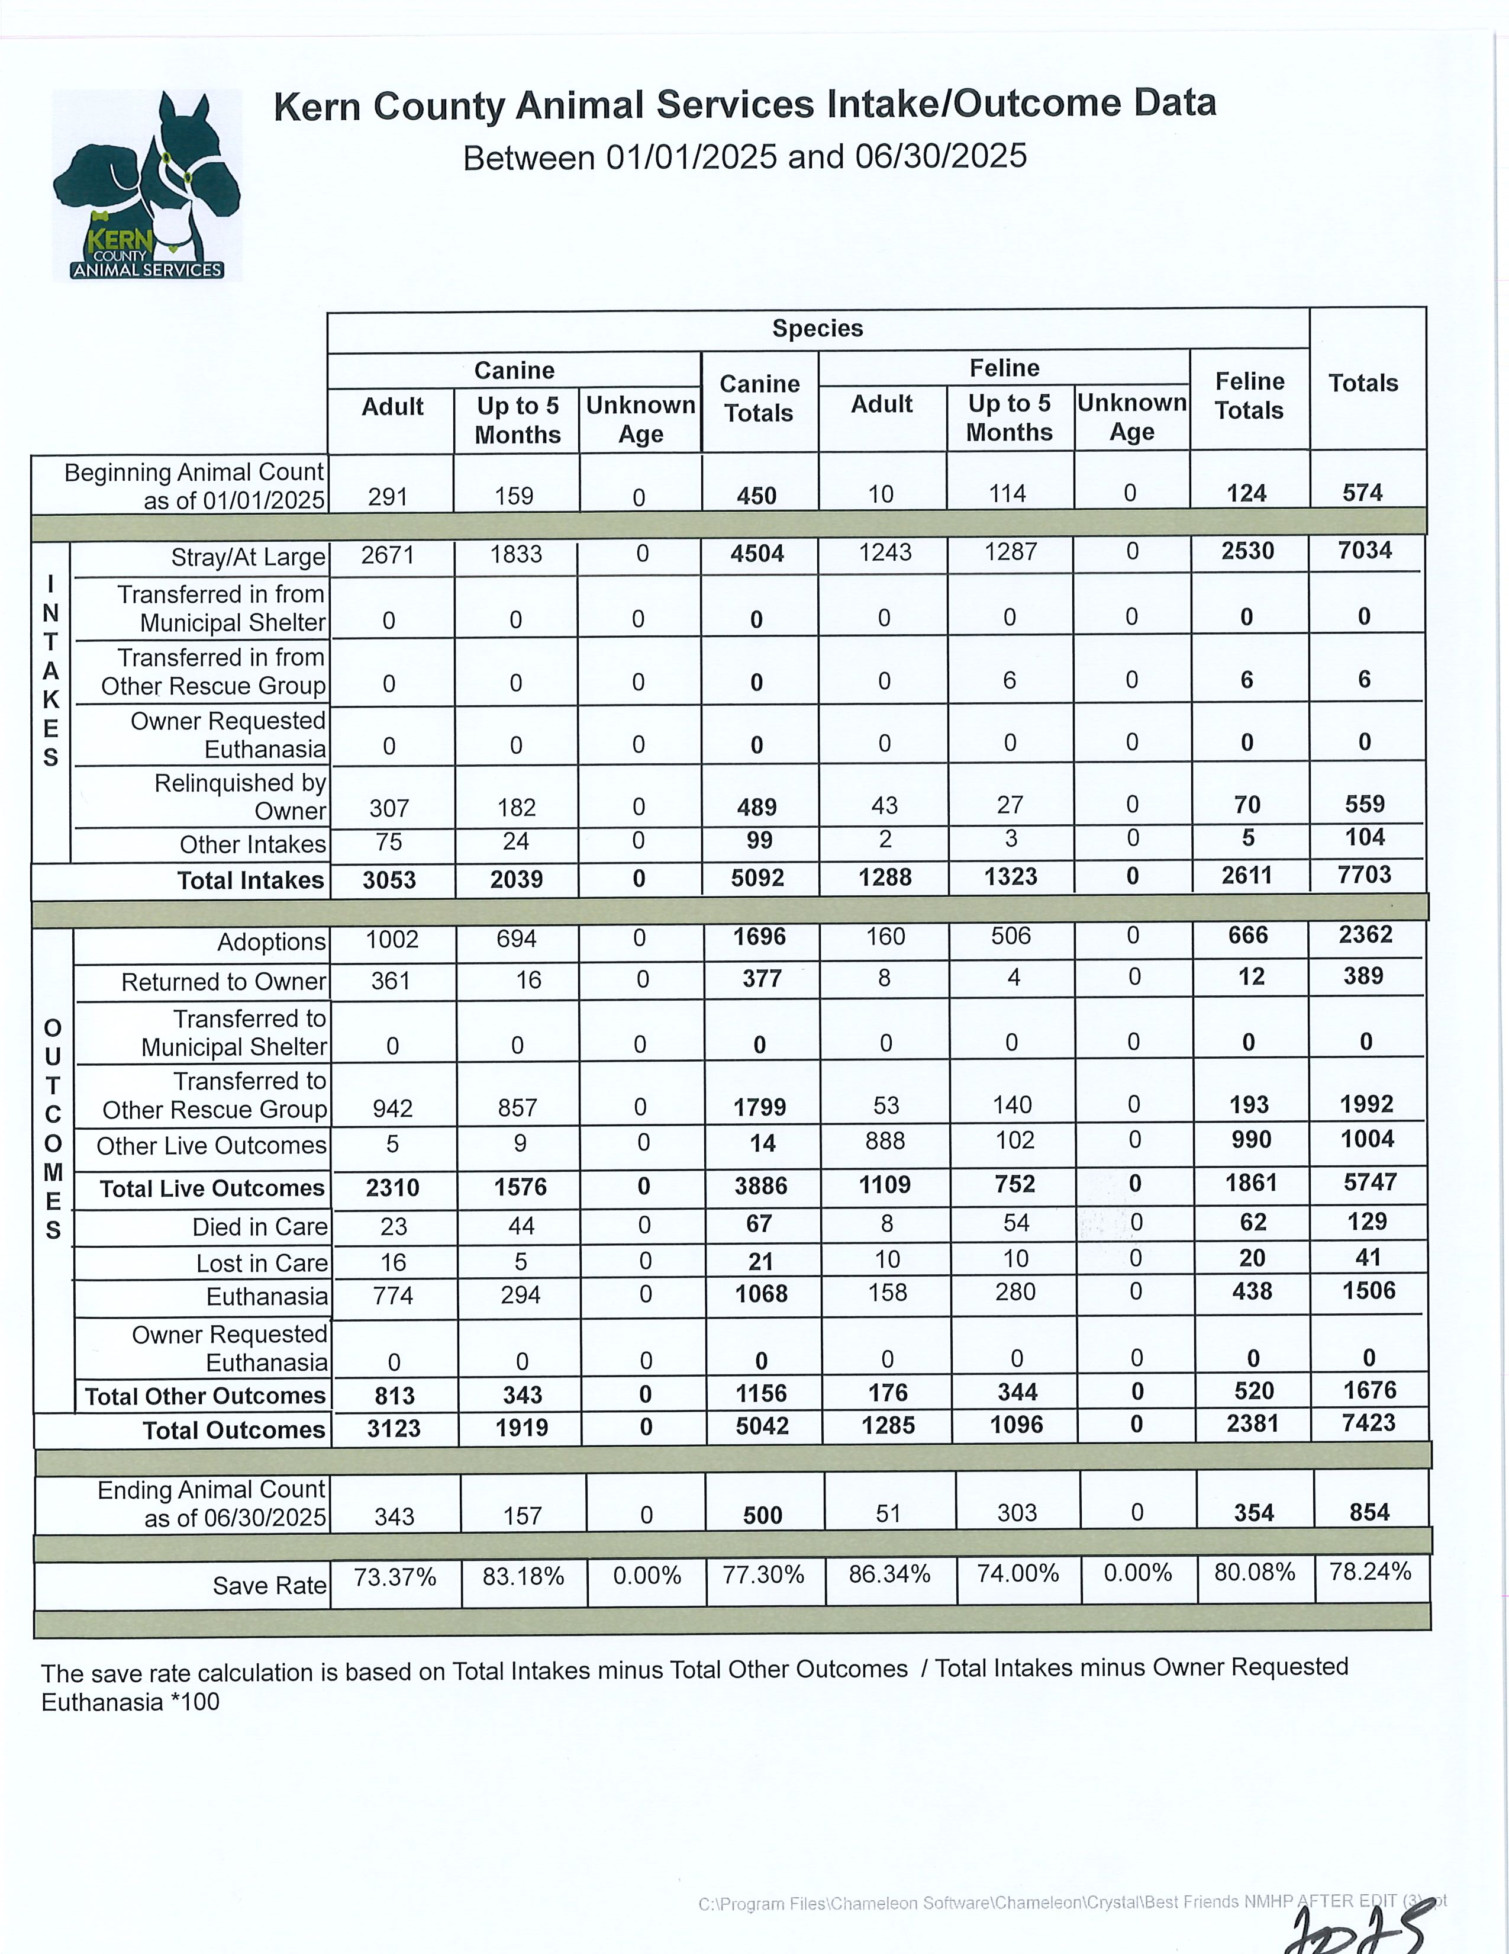
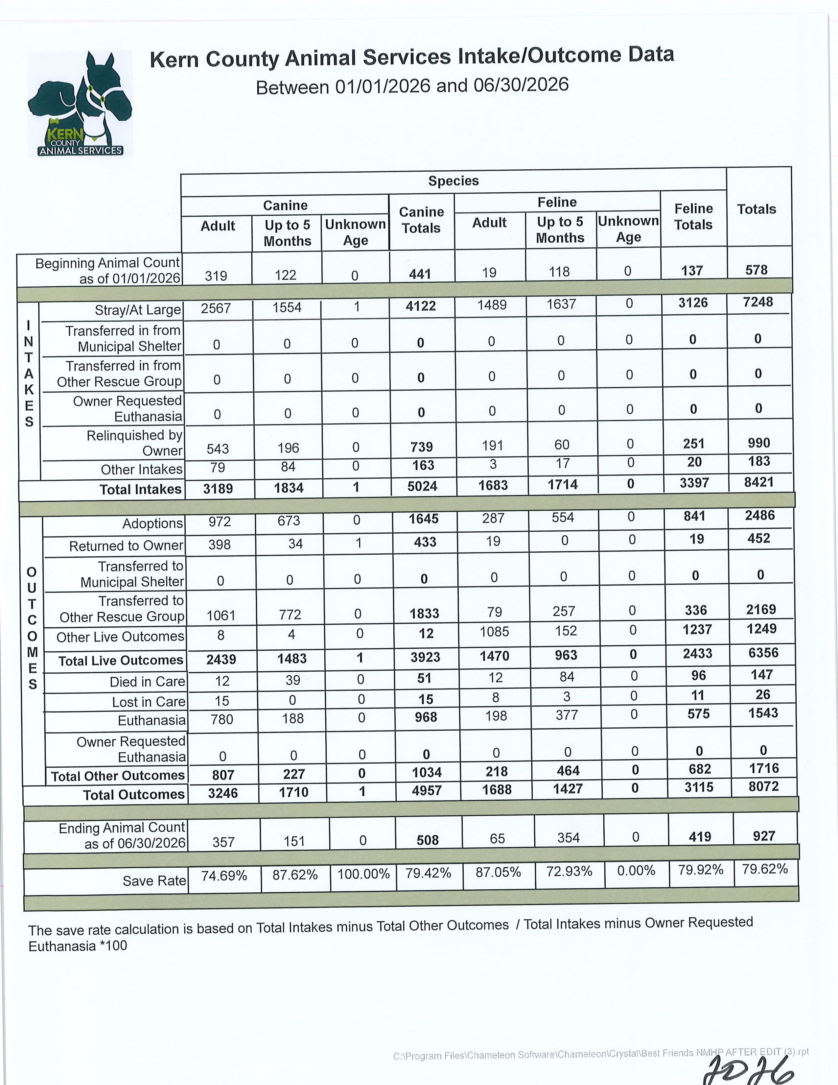

Slide 25
