Slide 1

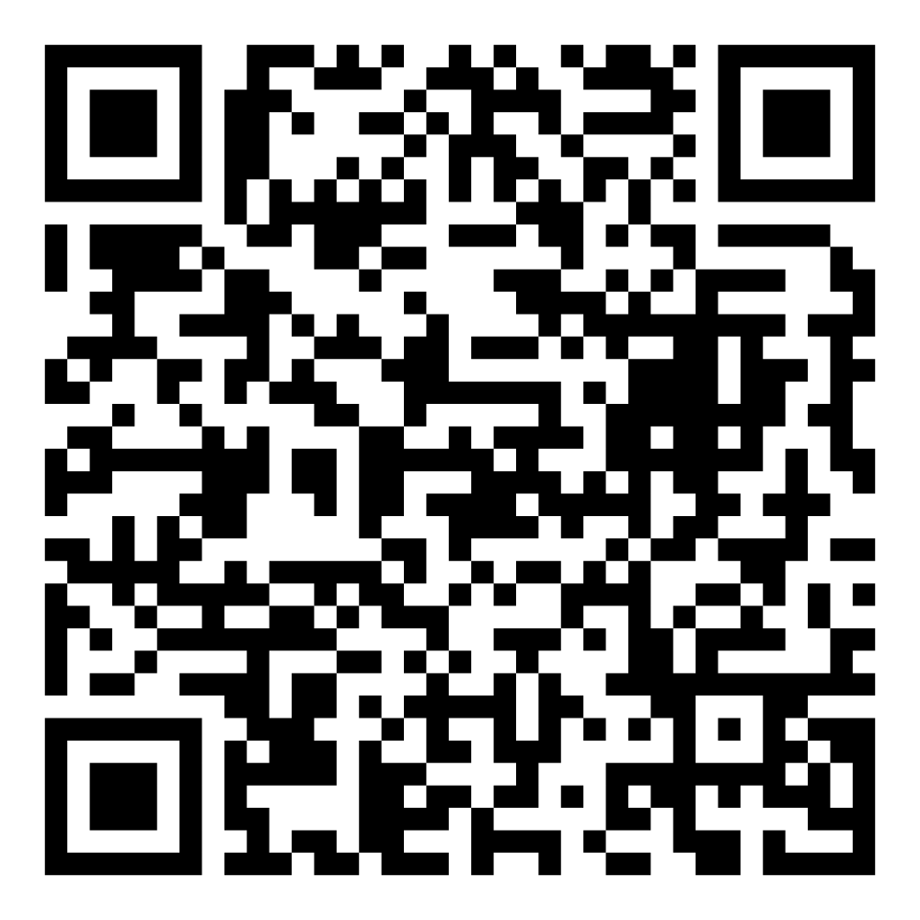
Director’s Report
July 2026

Slide 2



Program Highlights
July 2026
Adoption: 133 dogs, 103 puppies, 19 cats, and 264 kittens under 5 months of age were adopted for a total of 519 animals adopted from Kern County Animal Shelters in the month of July.
Foster: 36 dogs, 43 puppies, 1 cat, 138 kittens, and 38 barnyard animals entered the Department’s Foster Care Program in July, for a total of 256 animals.
Rescue: 195 dogs, 126 puppies, 3 cats, and 8 kittens were transferred to other animal rescue organizations in July, for a total of 332 animals.
Spay/Neuter: A total of 246 animals were altered at low-cost KCAS spay/neuter clinics in the month of July.
TNR: 206 cats were spayed or neutered and released in July. Year-to-date, 1,483 cats have gone through the program, and since 2013 25,500 cats have been spayed or neutered and returned to field.

Slide 3

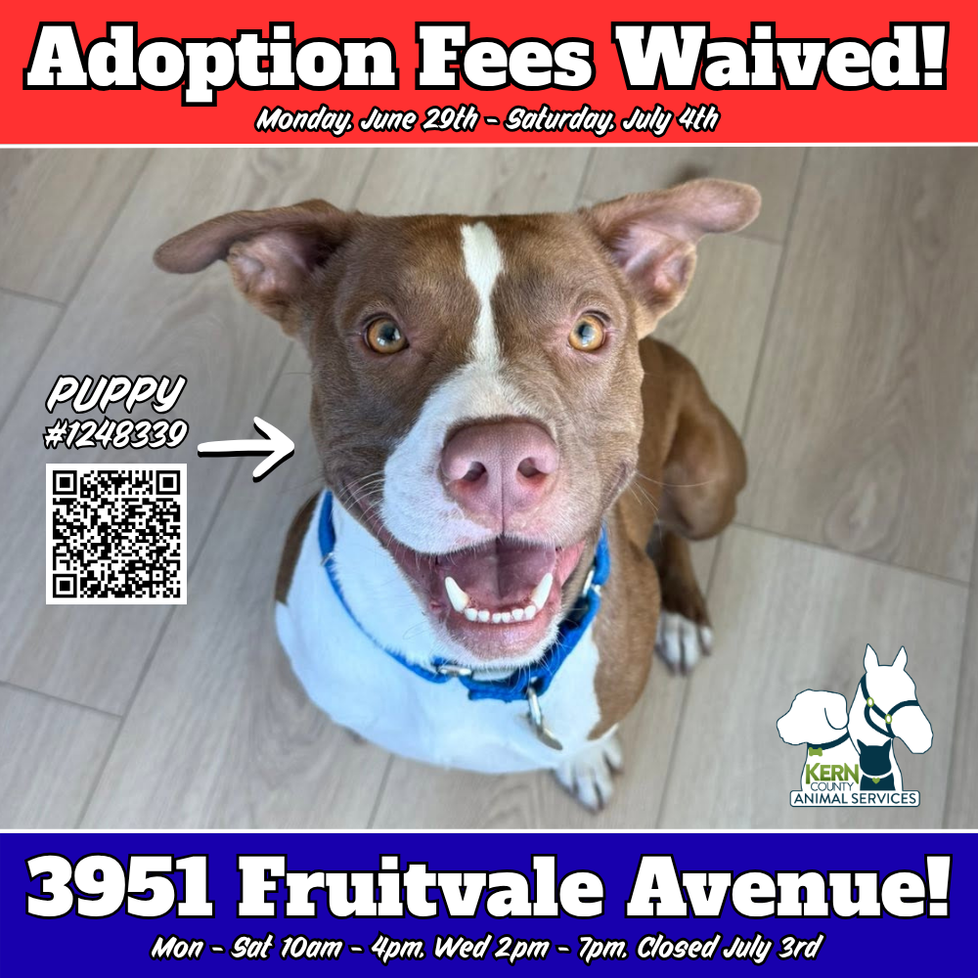
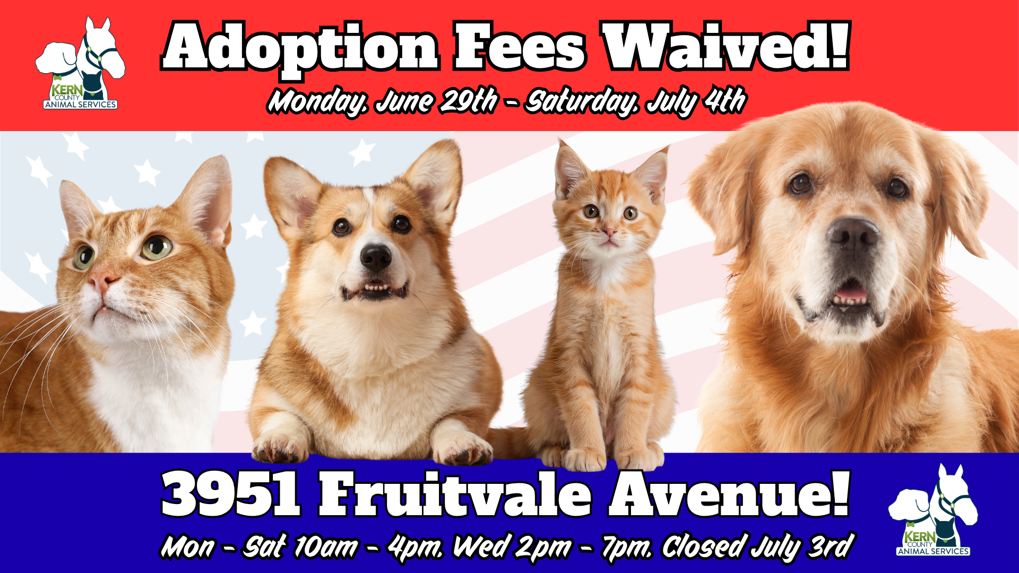

Fee-Waived Adoptions
June 29th - July 4th

Slide 4



Slide 5


Slide 6
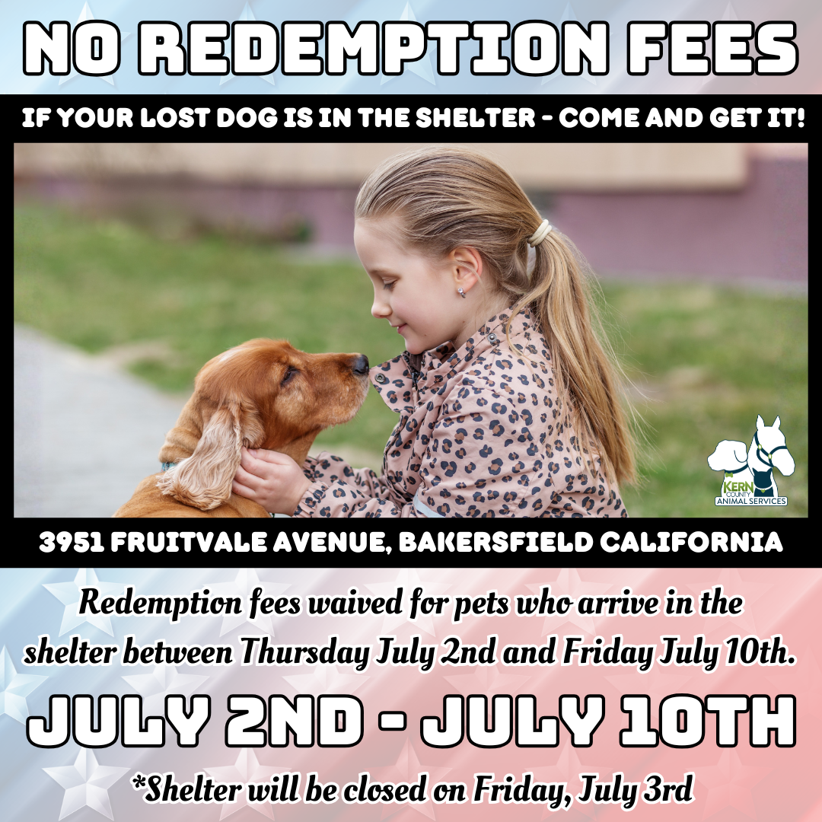

Slide 7
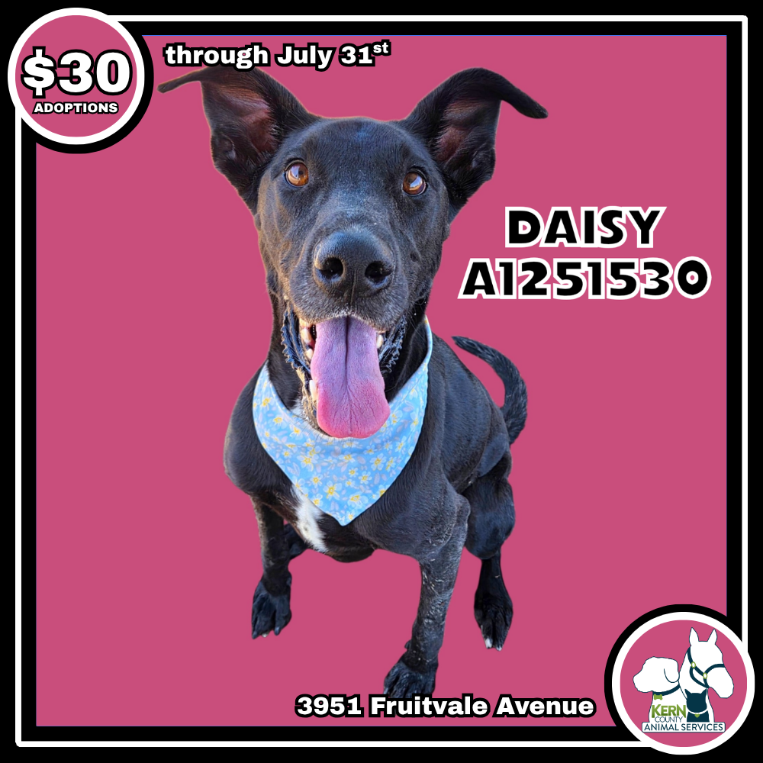
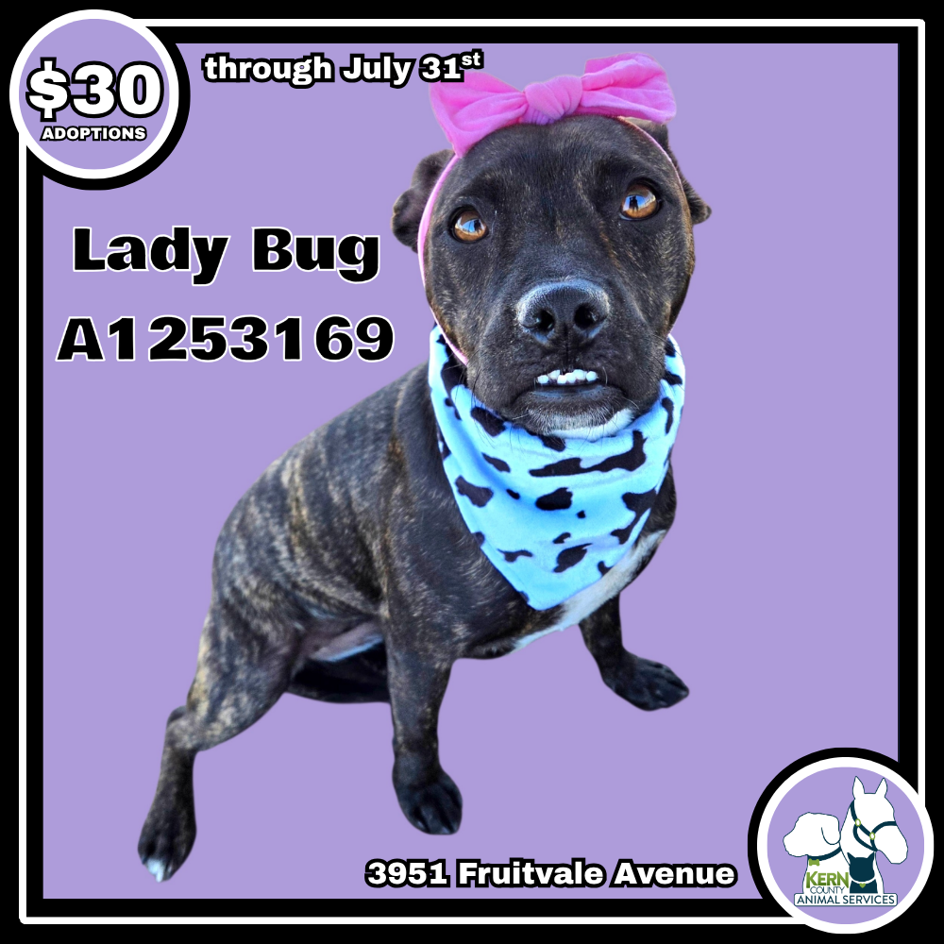
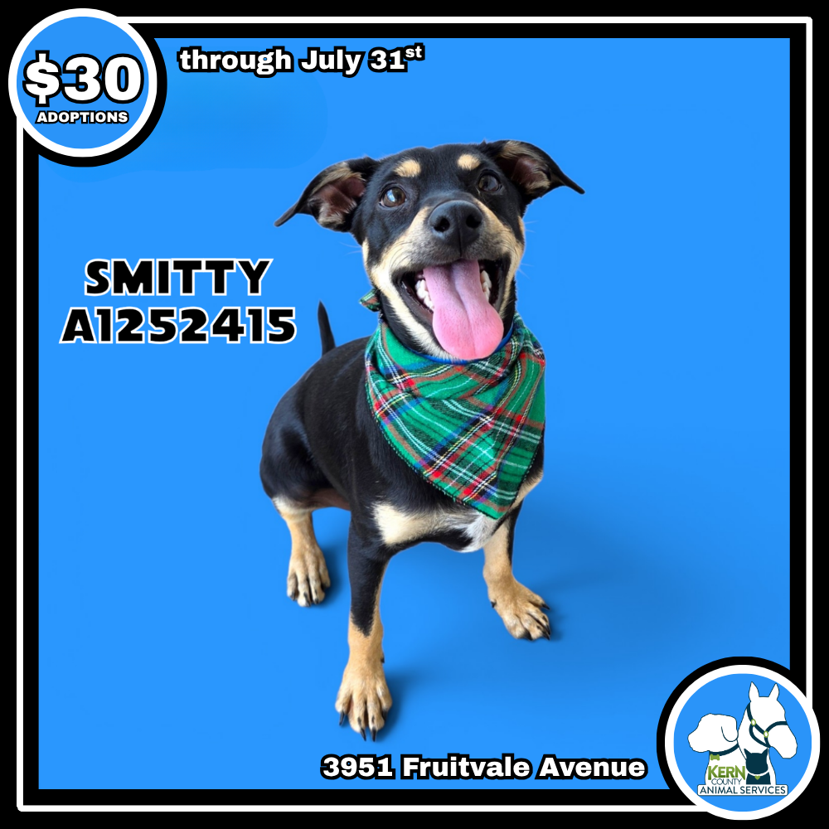
$30 Adoptions
July 6th – July 31st

Slide 8

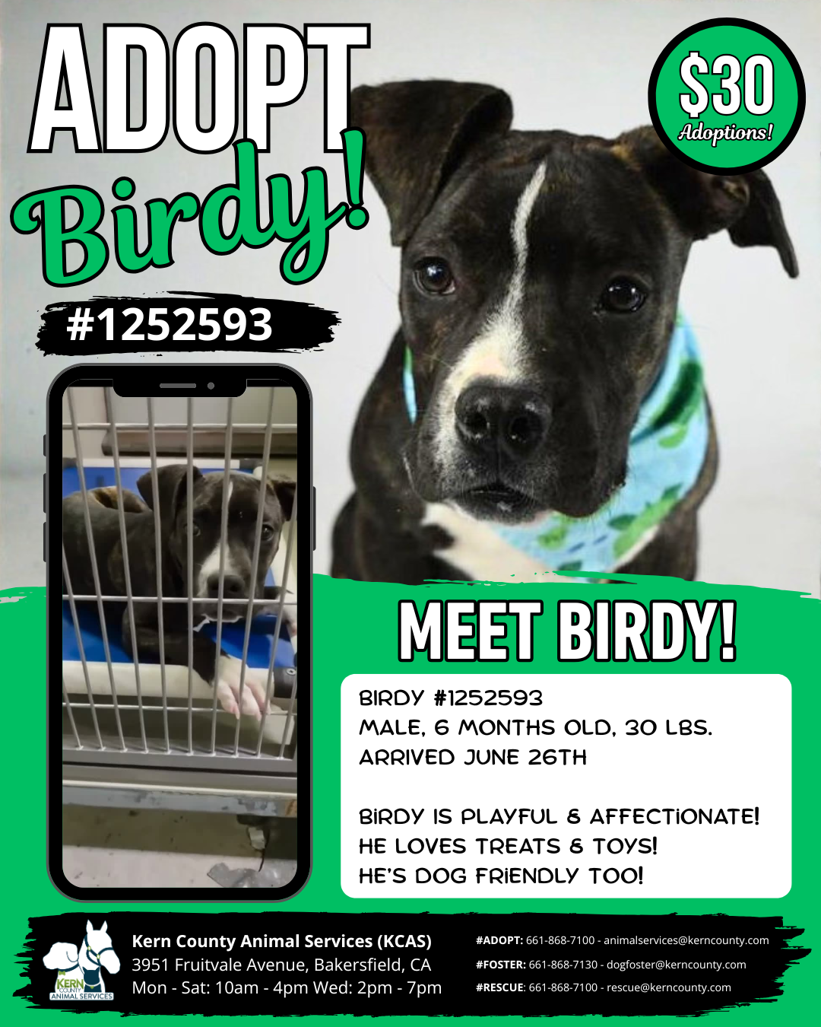


Slide 9
Offsite Adoption Events
Adoptable dogs from Kern County Animal Services are out in the community every Friday, Saturday, and Sunday!
These special events give some of our most overlooked dogs a chance to shine outside the shelter. Many of them have been waiting patiently for their forever homes for no fault of their own! This is their chance to stand out!
Offsite events are a great way to connect in a more relaxed setting, where folks can spend time getting to know a smaller group of carefully selected, highly adoptable dogs.

Slide 10






Slide 11




Slide 12






Slide 13
Streets of Bakersfield
Streets of Bakersfield is our "Doggy Day Out" program where the public can take shelter dogs on day outings. Your adventure can include a hike, a trip to the park, a coffee date or even hanging out at home.
These field trips help our shelter dogs manage kennel stress, burn off energy and get more exposure to potential adopters.
You can take a dog out for a few hours or even for the whole weekend!
Dogs can be picked up between 10am and 12 noon. “Day Out” dogs are brought back by 3:30pm. “Sleepover” dogs are returned the following Monday before 4pm.
The Streets of Bakersfield program runs every other Saturday.

Slide 14




Slide 15
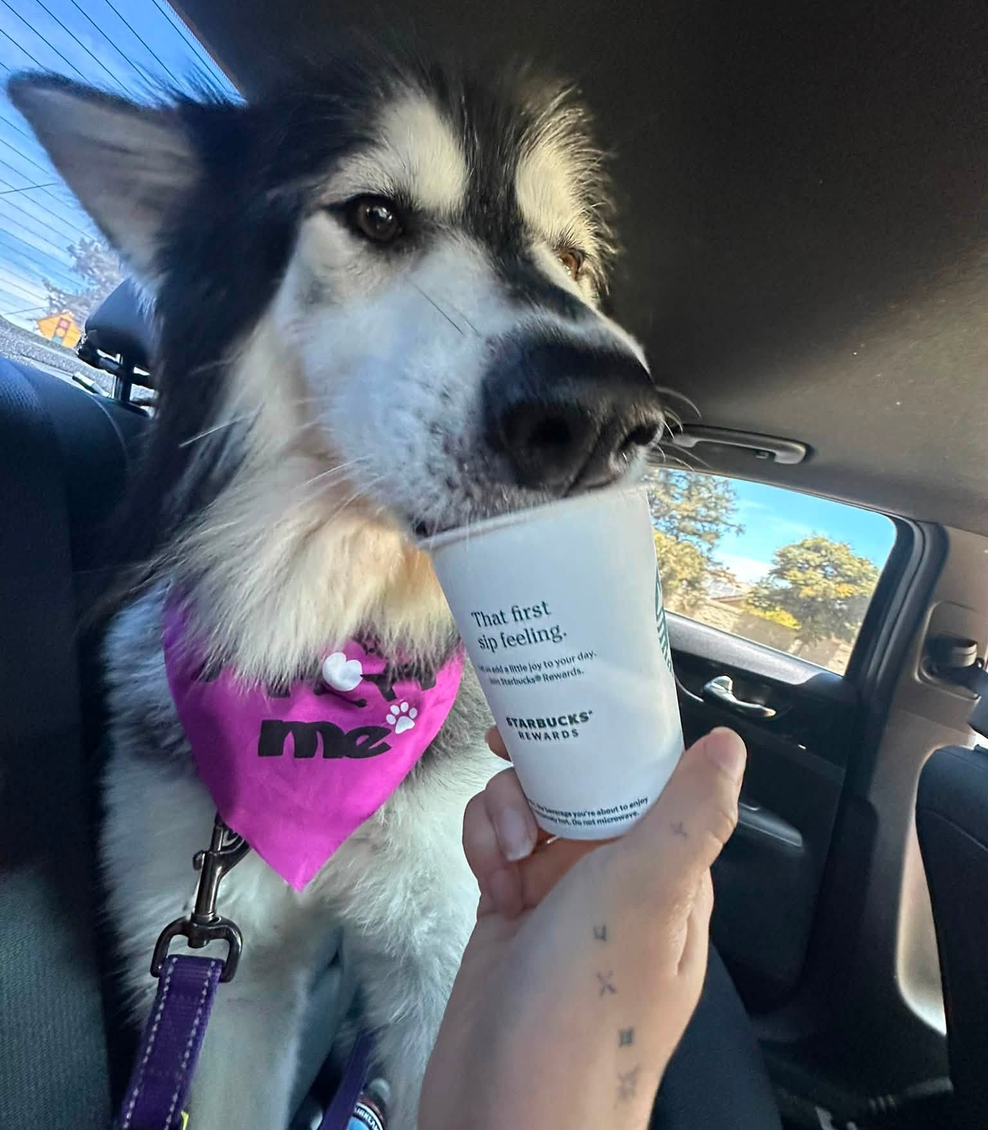
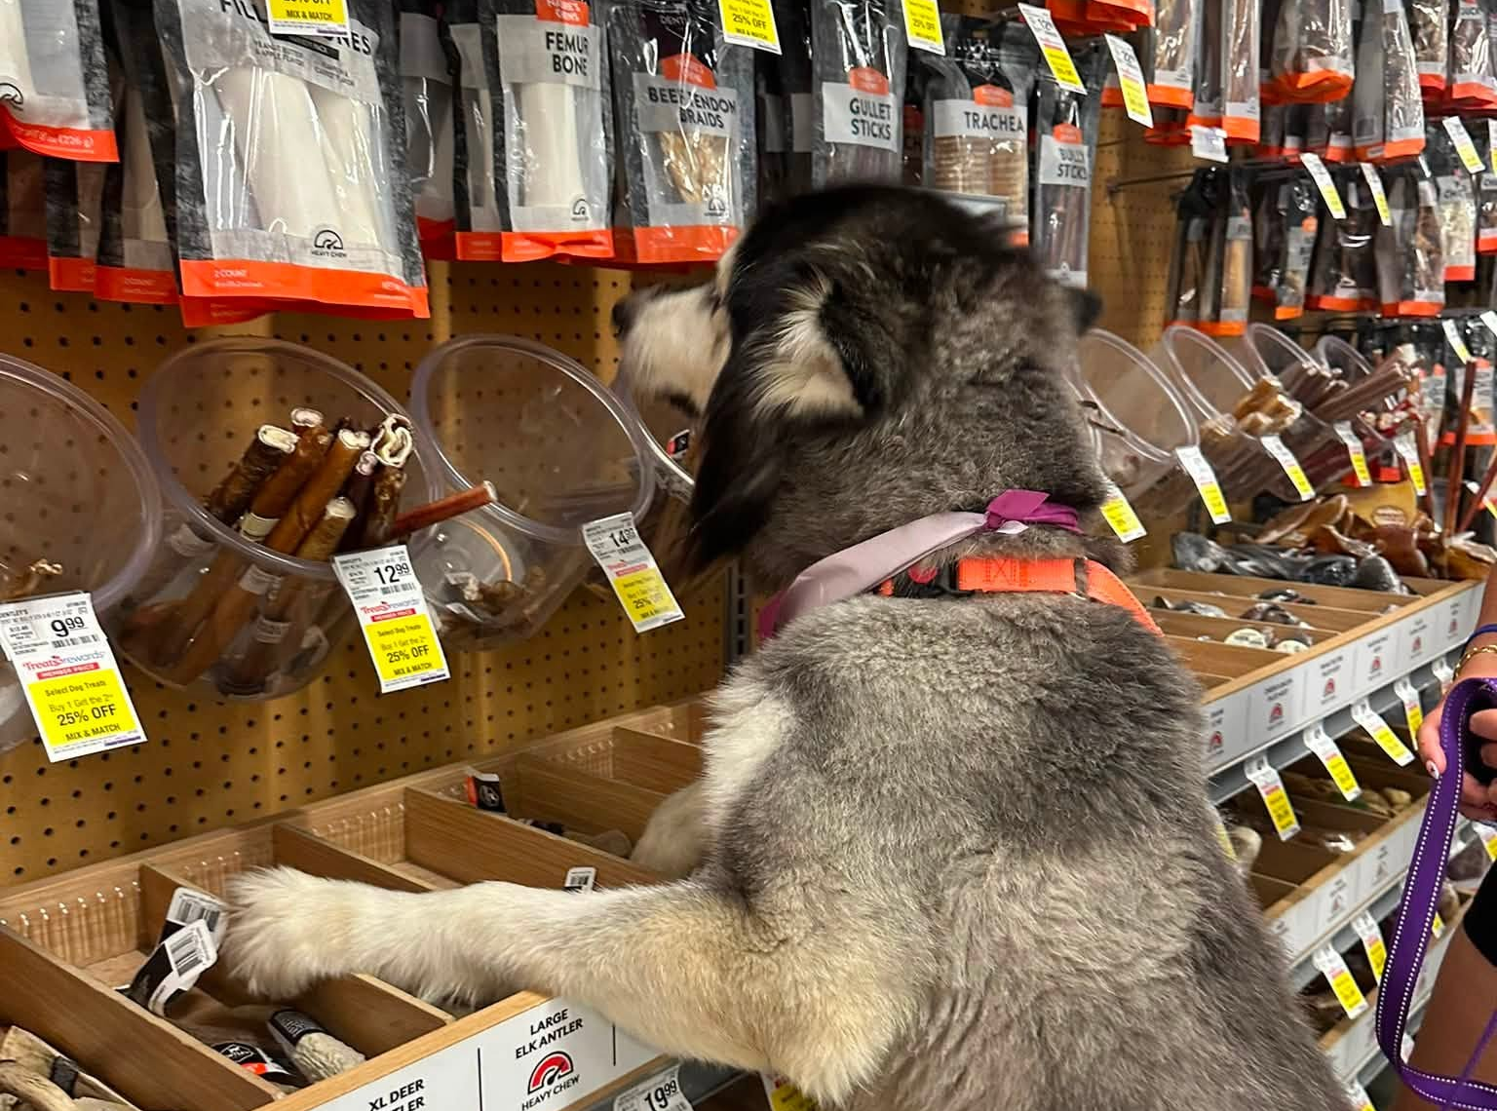
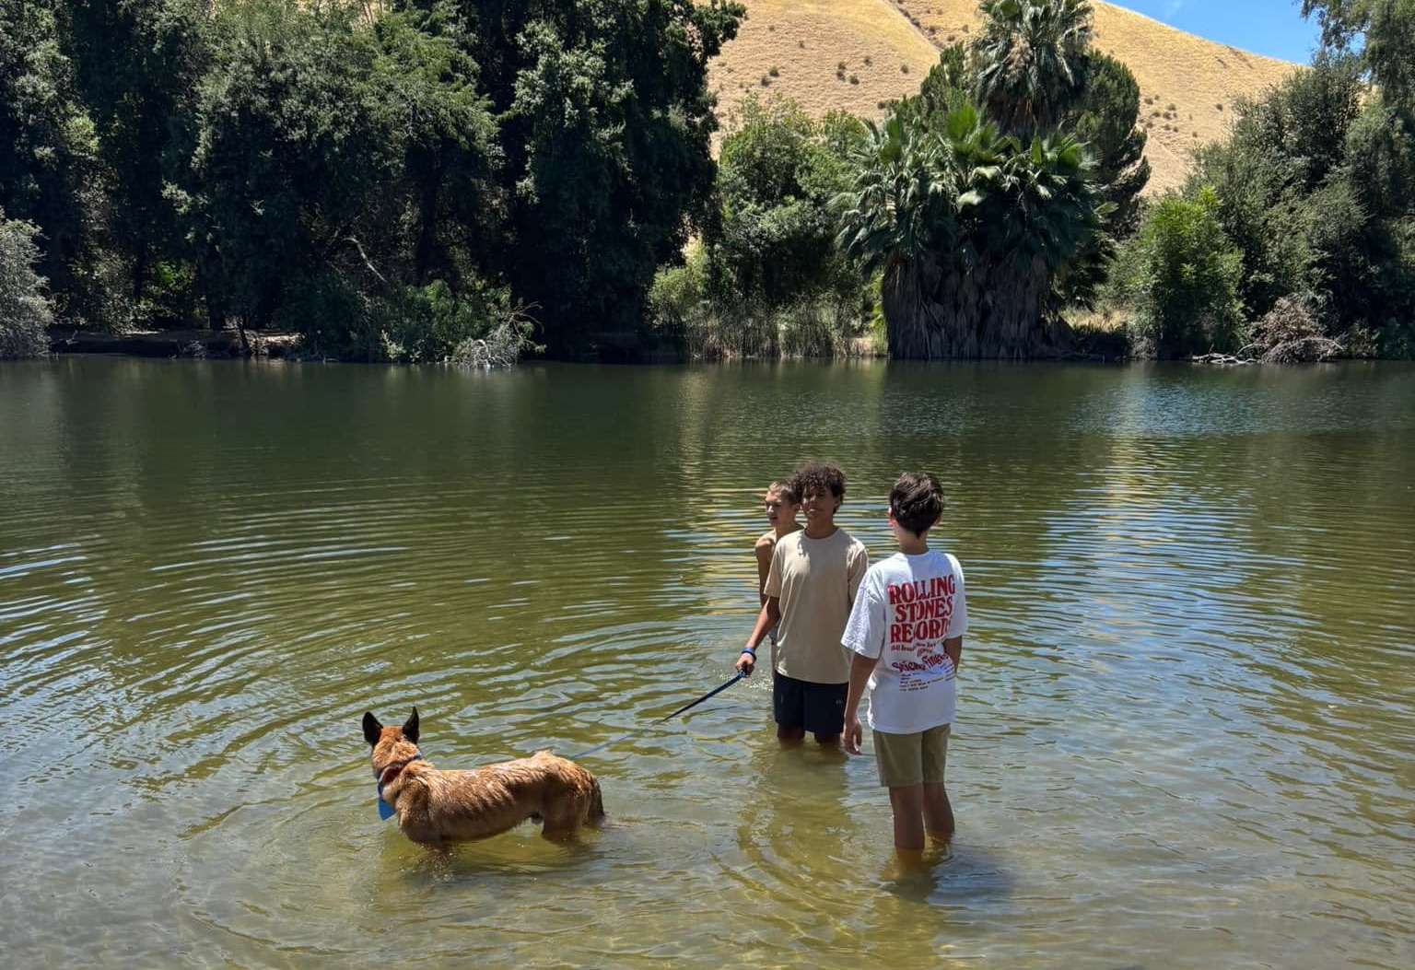
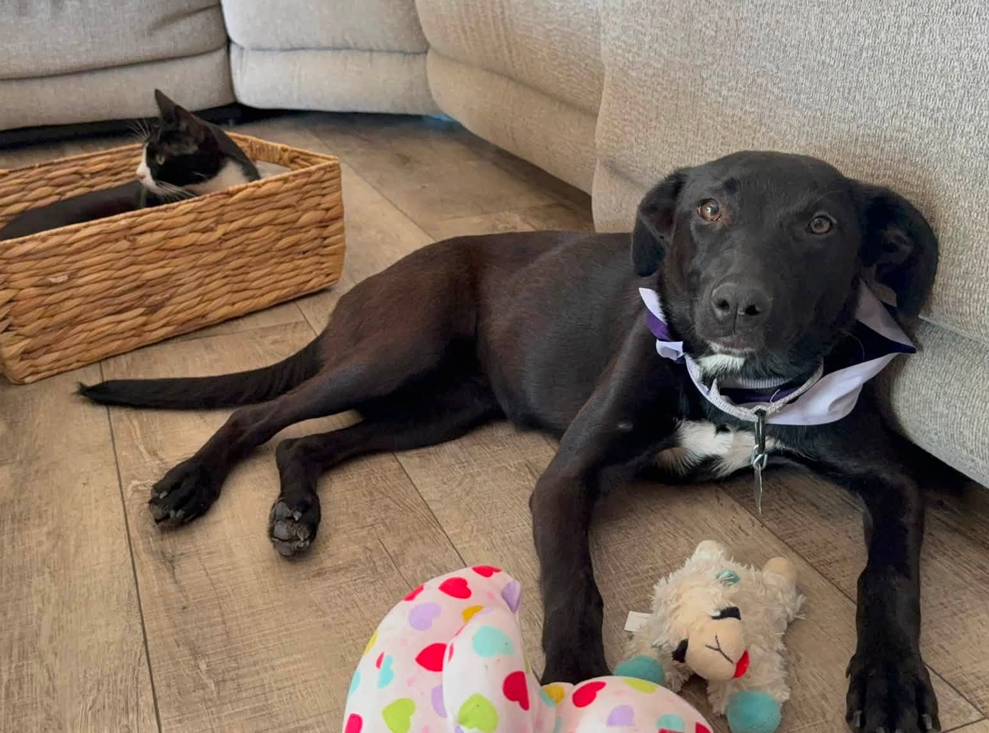

Slide 16
Low-Cost Spay/Neuter Clinics
July 2026
Date | Location | Surgeries
July 16th | Heritage Park | 53
July 20th | Heritage Park | 57
July 21st | Heritage Park | 69
July 29th | Heritage Park | 67
 | Total Surgeries | 246

Slide 17
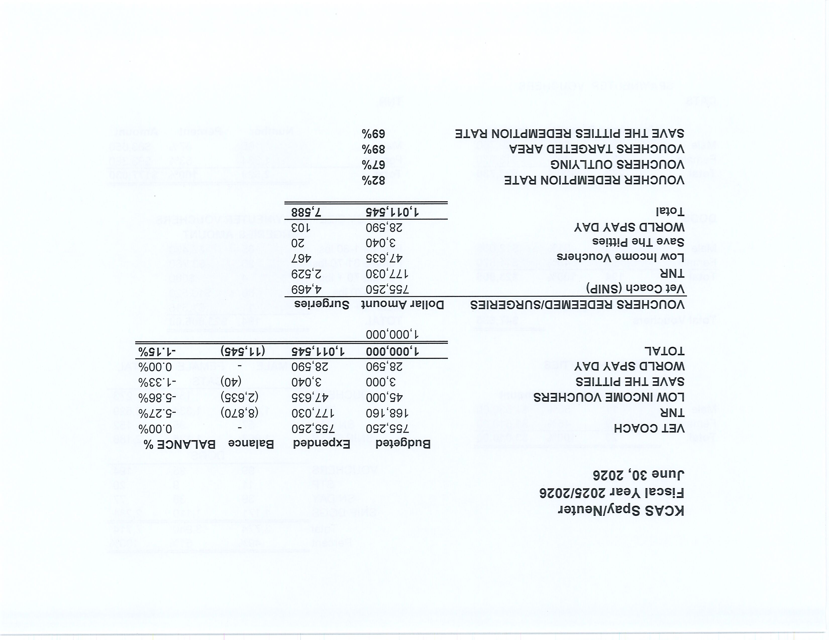

Slide 18
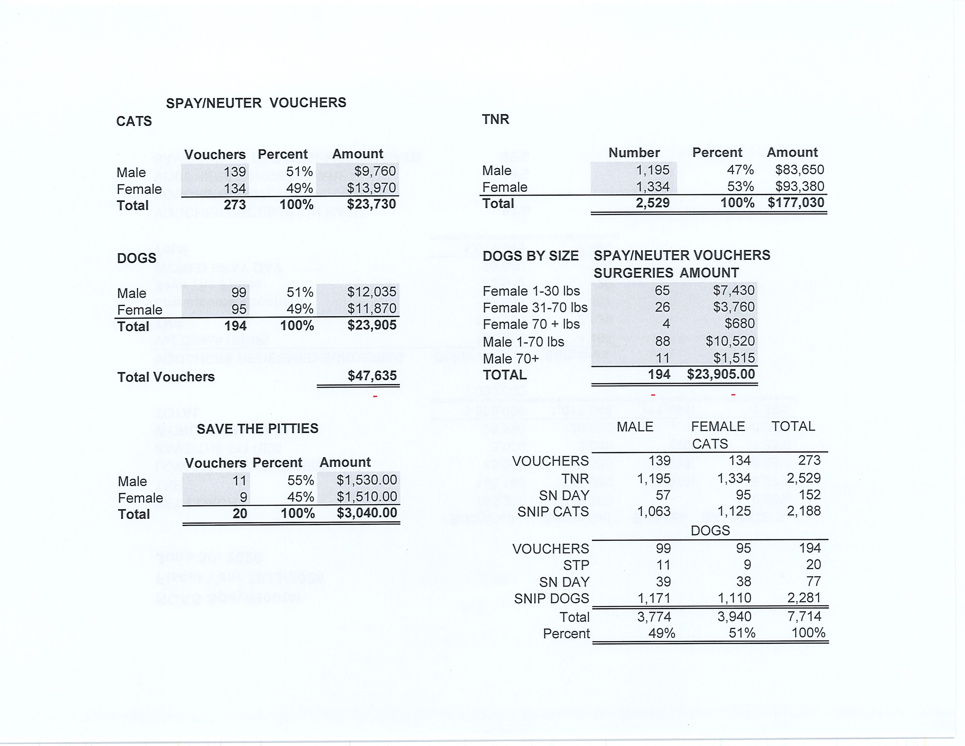

Slide 19
Low-Cost Vaccination Clinics
July 2026
Rabies
257
Microchips
Bordetella
56
37
DHPP* 180
FVRPC* 183
*DHPP and FVRCP vaccinations provided at no-cost by Petco Love.

Slide 20
Field Service Calls: July 2026
AREA | CALLS PER AREA
Lake Isabella | 111
Mojave | 133
North County | 37
Northeast | 310
Northwest | 252
Ridgecrest | 51
Southeast | 148
Southwest | 148
Taft | 106
Tehachapi | 79
TOTAL | 1,375
22 dogs were returned to their owners in the field
in July 2026.
90 dogs were secured on property by Animal Control Officers in July 2026.

Slide 21
Commercial Animal Facility Calls
July 2026
TYPE | CALLS PER TYPE
CAF – Breeder | 12
CAF – Rescue | 0
CAF – Kennel | 6
CAF – Boarding | 0
TOTAL | 18
4 Inspections Passed
0 Inspections Failed
0 Citations Issued
0 Permits Issued
52 Active CAF Permits

Slide 22
Zeus Reunited!
While traveling through Kern County, Zeus and his owner were involved in a serious car accident. His owner was transported to the hospital, while Zeus, thankfully uninjured, was brought to Kern County Animal Services.
When Zeus arrived, we had no way of knowing who he belonged to until staff scanned him for a microchip. That tiny chip allowed us to identify and contact his owner. The very next day, Zeus was reunited with his family. Animal Control Officer Tipton even gave him a ride home!
This happy reunion was made possible by a microchip no bigger than a grain of rice.
Whether it's a microchip, a collar with ID tags, or both, keeping identification on your pet is one of the easiest and most effective ways to help ensure they find their way home if they're ever lost.
Kern County Animal Services offers FREE microchips for all residents of unincorporated Kern County.

Slide 23
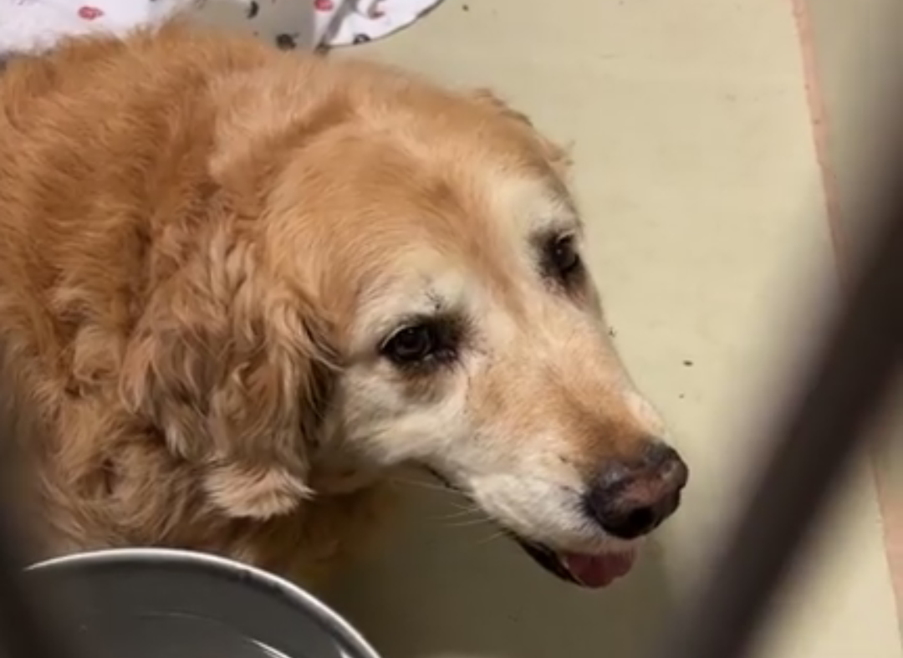
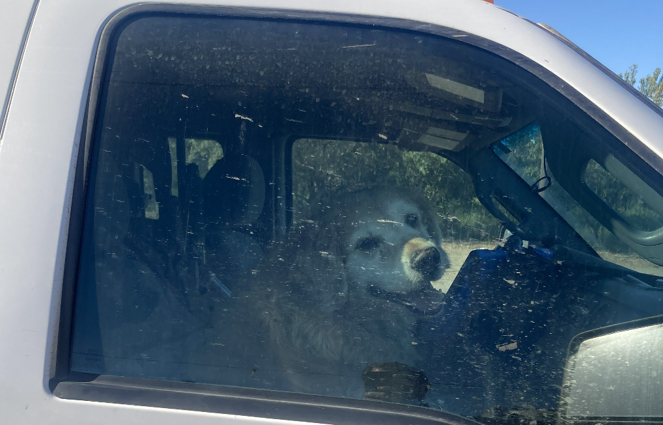
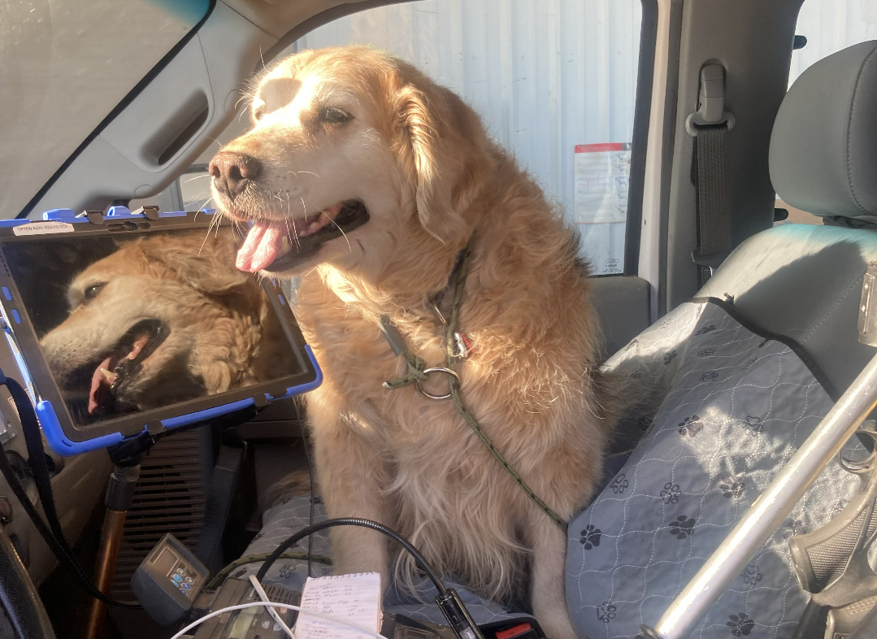
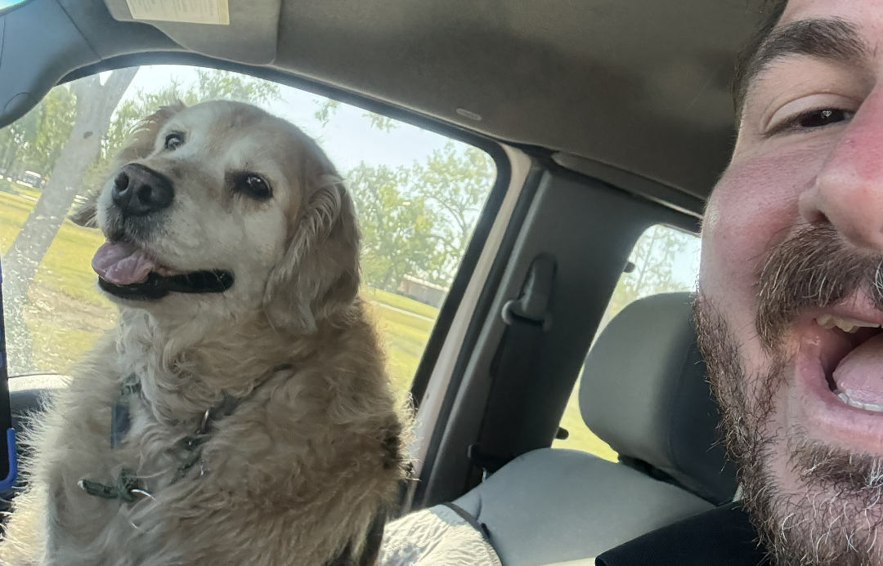

Slide 24
Volunteer Program
July 2026
Active Volunteers
107
New Volunteers
48
Volunteer hours donated in July
Year-To-Date volunteer hours donated in 2026
820.06
4,012.53

Slide 25
Volunteer Spotlight
It's been a while since we've showcased the incredible work of our volunteer groomer, Joan. Just look at these recent before-and-after transformations below!
Thanks to Joan's talent, patience, and care, they left looking like brand-new pups. The before-and-after photos speak for themselves.
It's no surprise that all four found homes quickly and are now safely out of the shelter.
For the past 20 years, Joan has volunteered her time and grooming skills to help shelter dogs get the second chance they deserve. Twenty years of changing lives, one dog at a time.
We couldn't be more thankful for Joan and every volunteer who gives their time to support the animals in our care.
If you'd like to become part of our volunteer team and help make stories like these possible, we'd love to hear from you. Learn more at KernCountyAnimalServices.org + How To Help + Volunteer

Slide 26
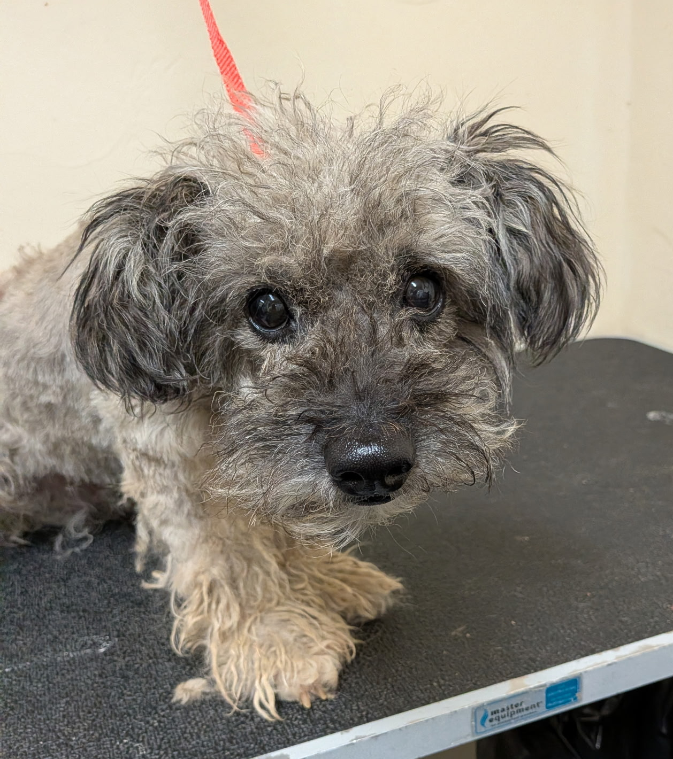
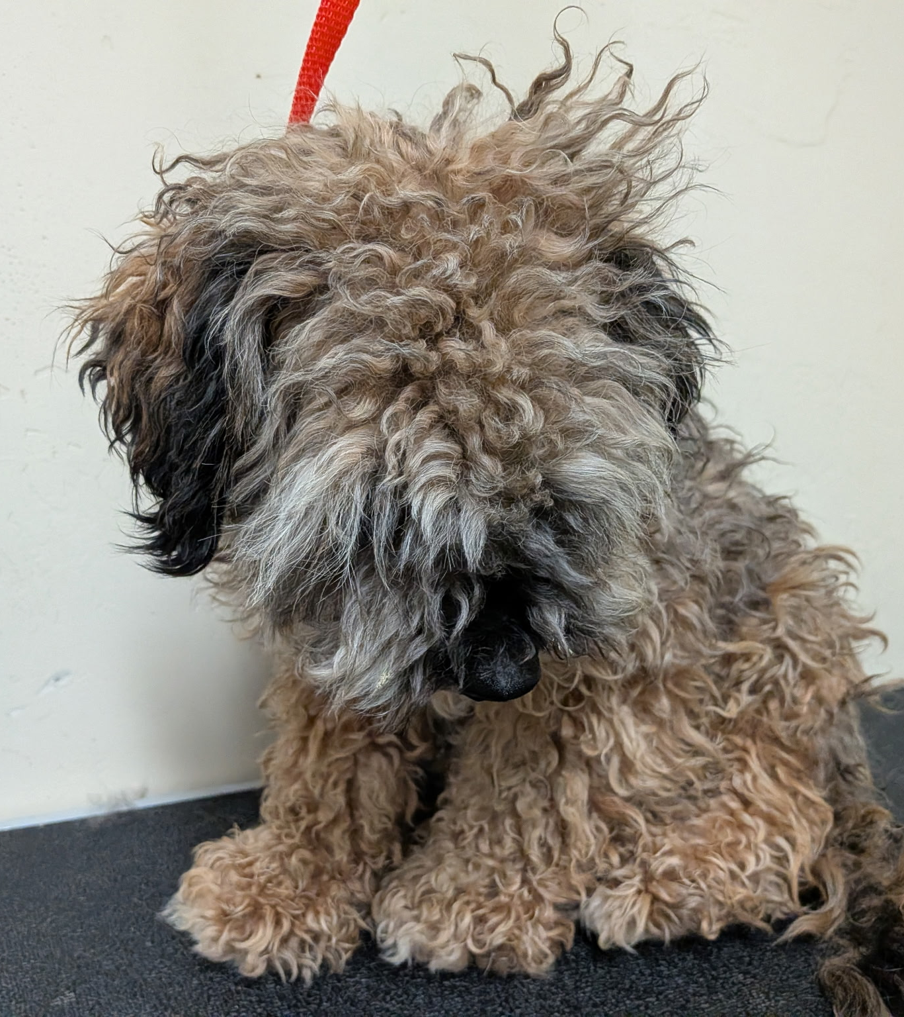
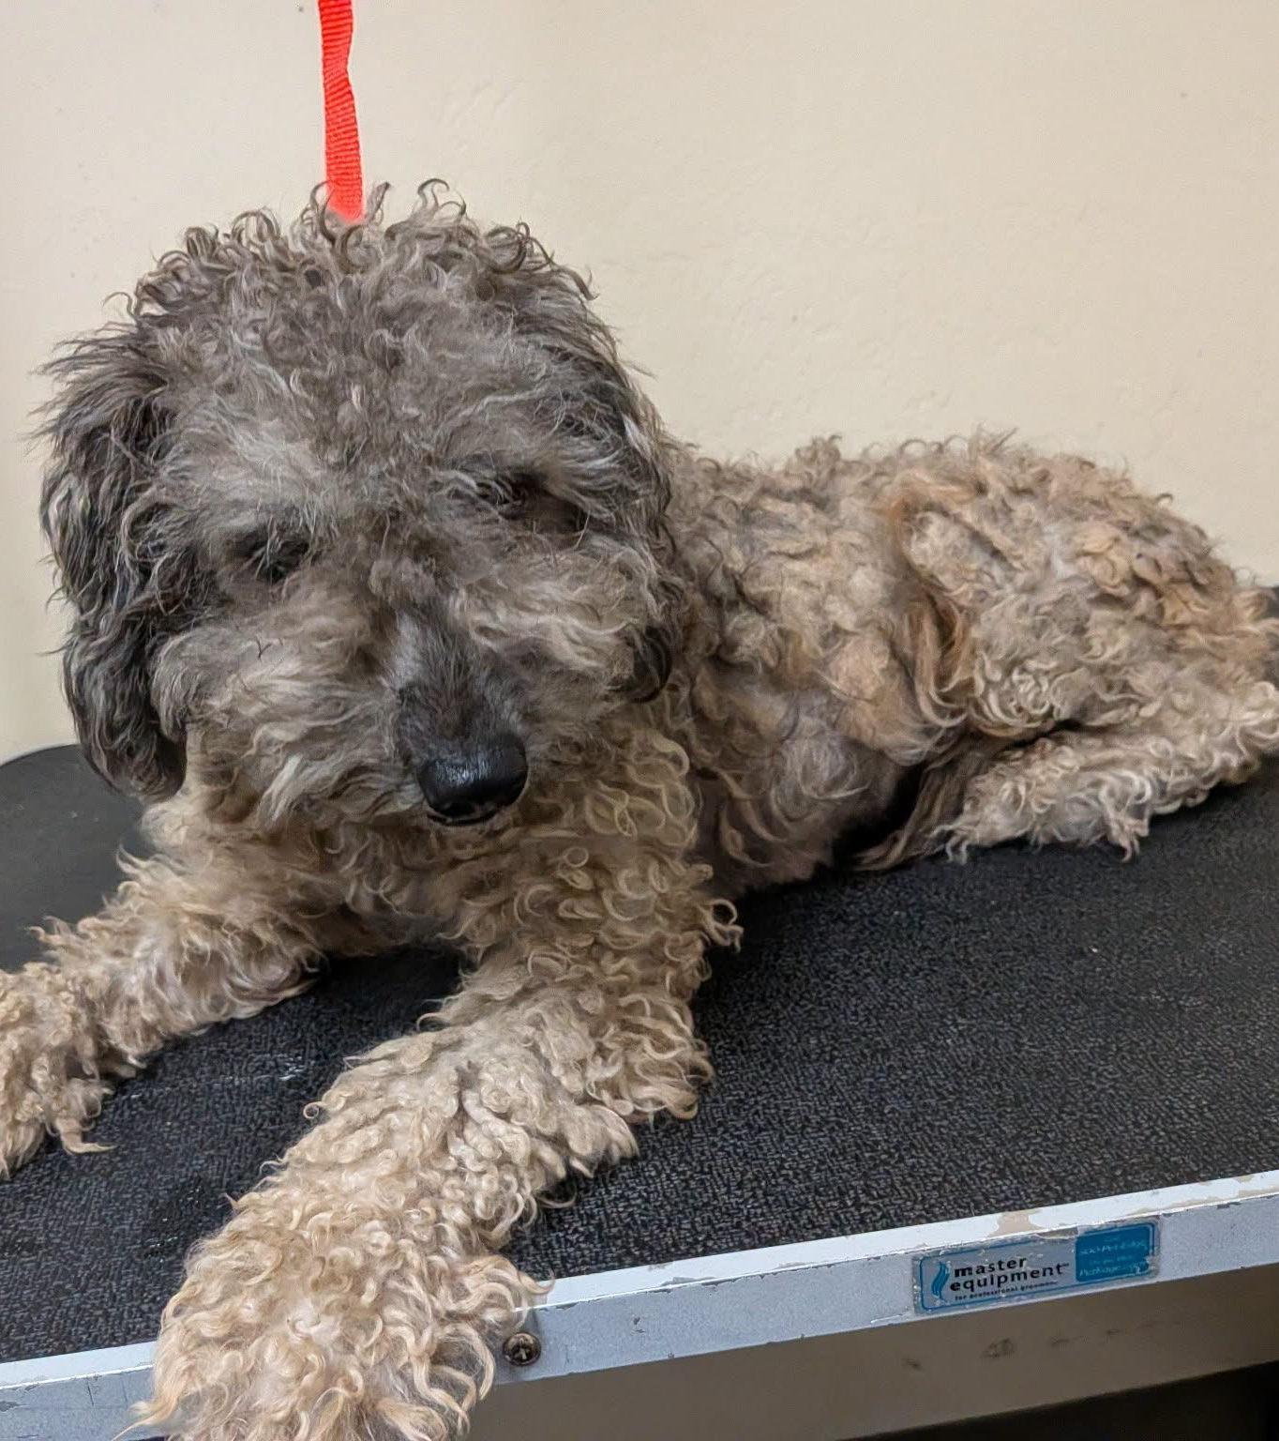
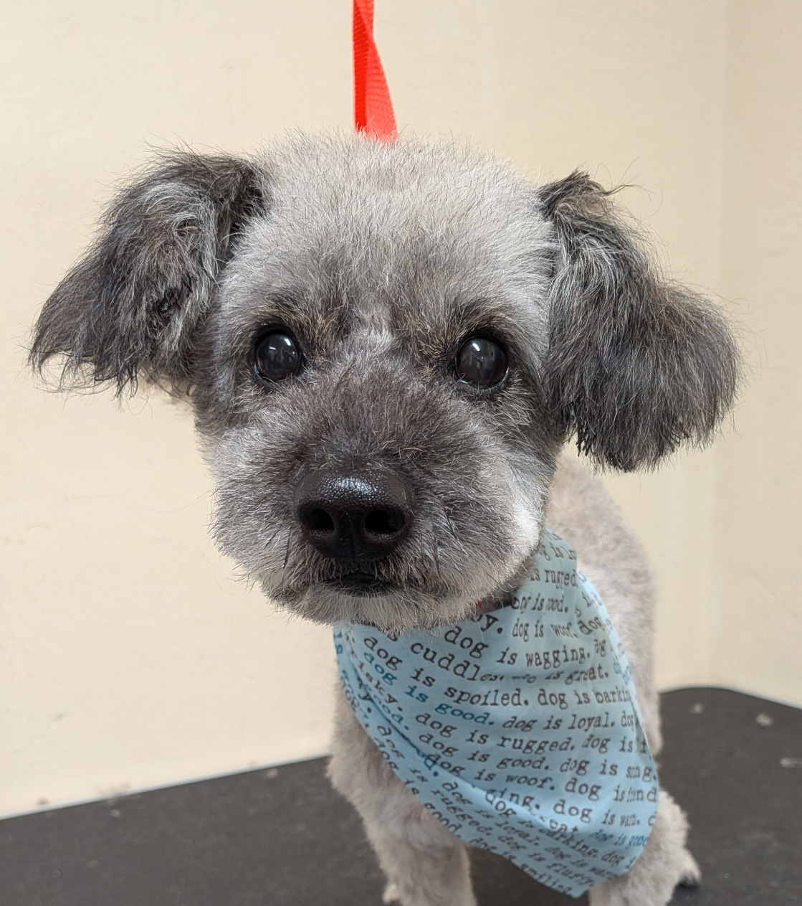
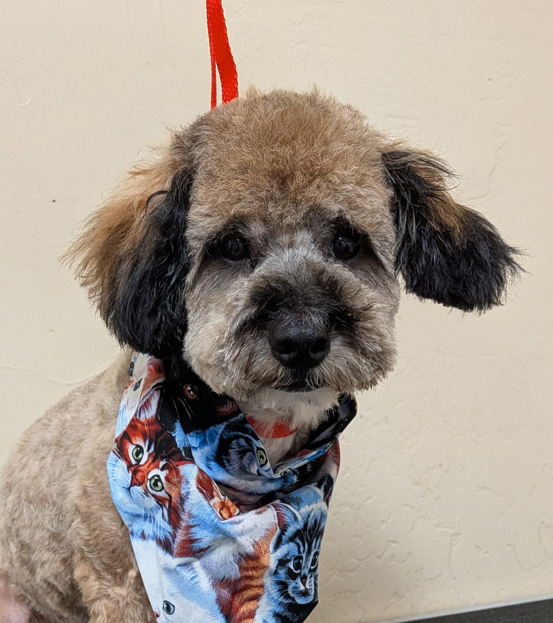
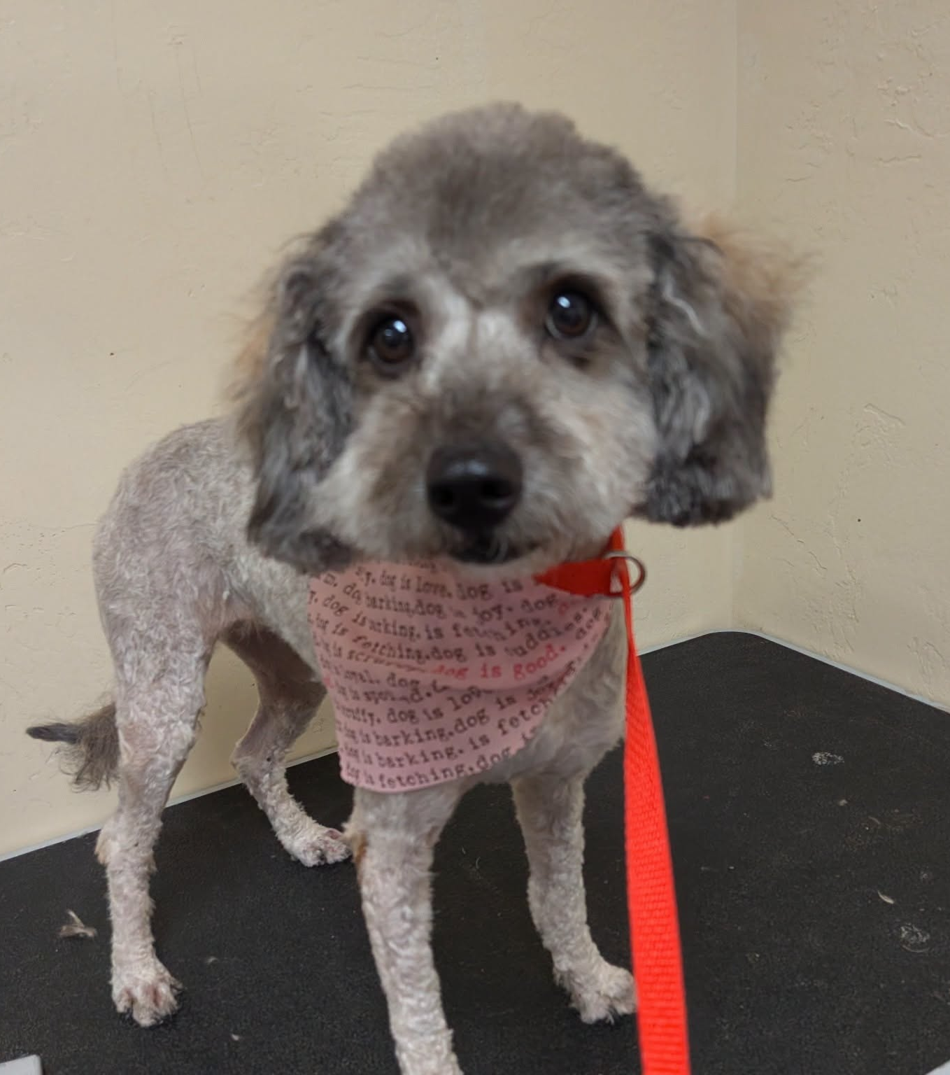

Slide 27
2026 Year To Date
January 1st – July 31st
3.007
Adoptions
2,501
Rescued
507
Returned To Owner
2,041
Spay/Neuter Surgeries (Clinics + TNR)
7,510
Total Lives Saved
79.14%
Save Rate

Slide 28
Tales for Tails
Wednesday, July 29th was another wonderful evening of Tales For Tails!
A big thank you to everyone who joined us for a special night of reading to our shelter dogs and cats. Our animal friends loved the extra attention while young readers practiced their reading skills in a calm, encouraging environment. It was heartwarming to see so many smiling faces, wagging tails, and happy purrs throughout the evening.
Thank you to the Kern County Library for providing a fantastic selection of books for readers of all ages and for helping make this event such a success.
Missed this month's event? Don't worry! Join us for the next Tales for Tails on Wednesday, August 26th, from 5:30 to 7:00 PM at Kern County Animal Services, 3951 Fruitvale Avenue.

Slide 29
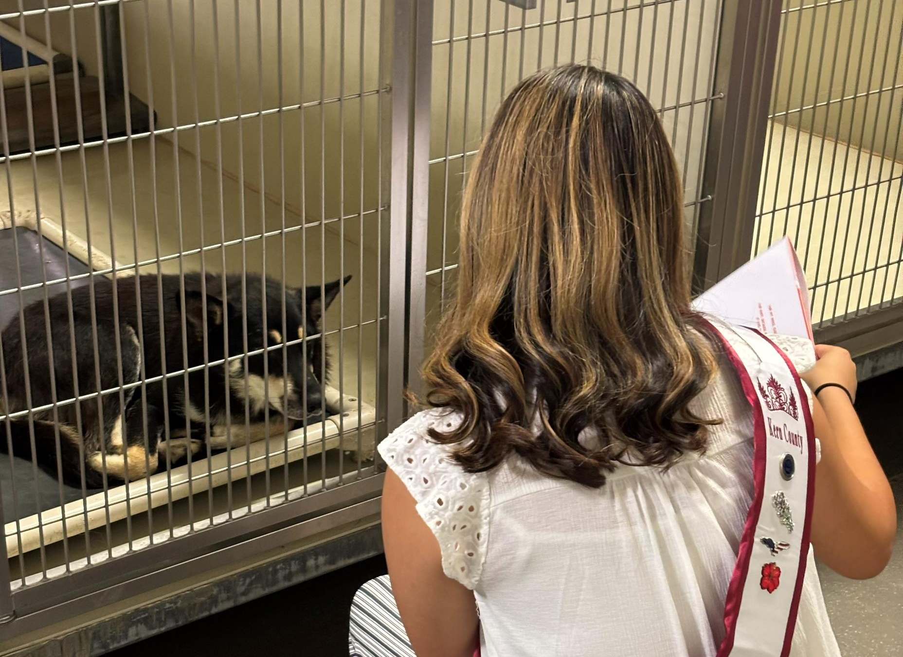
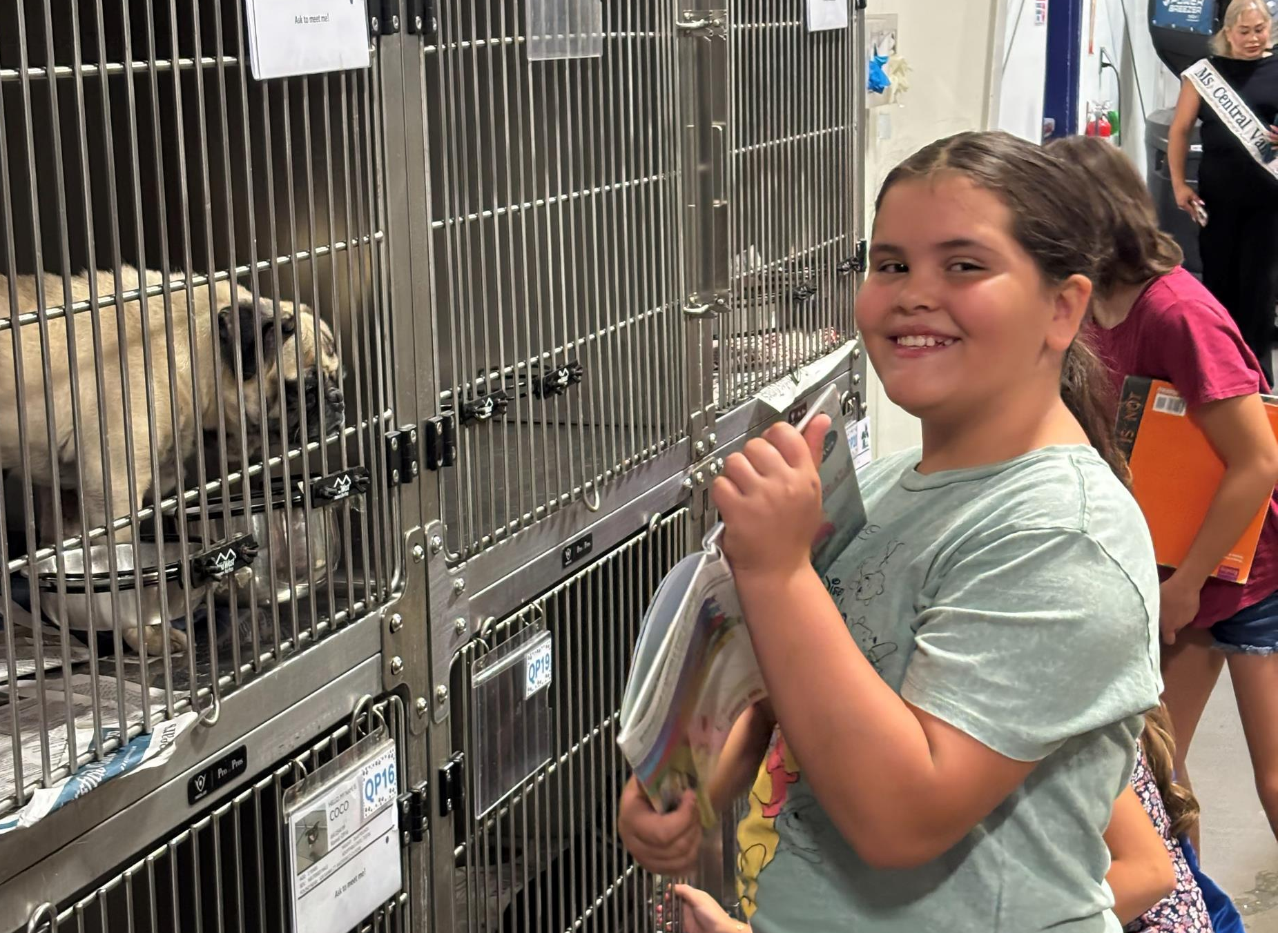
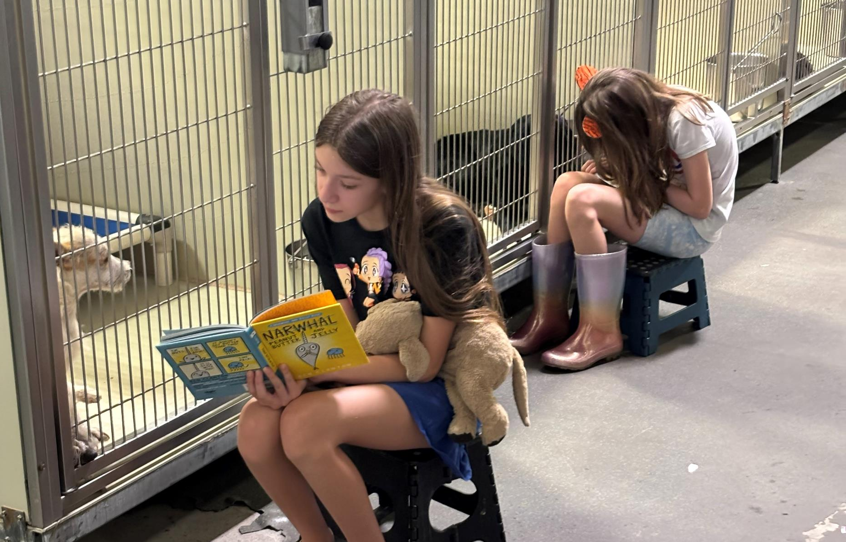
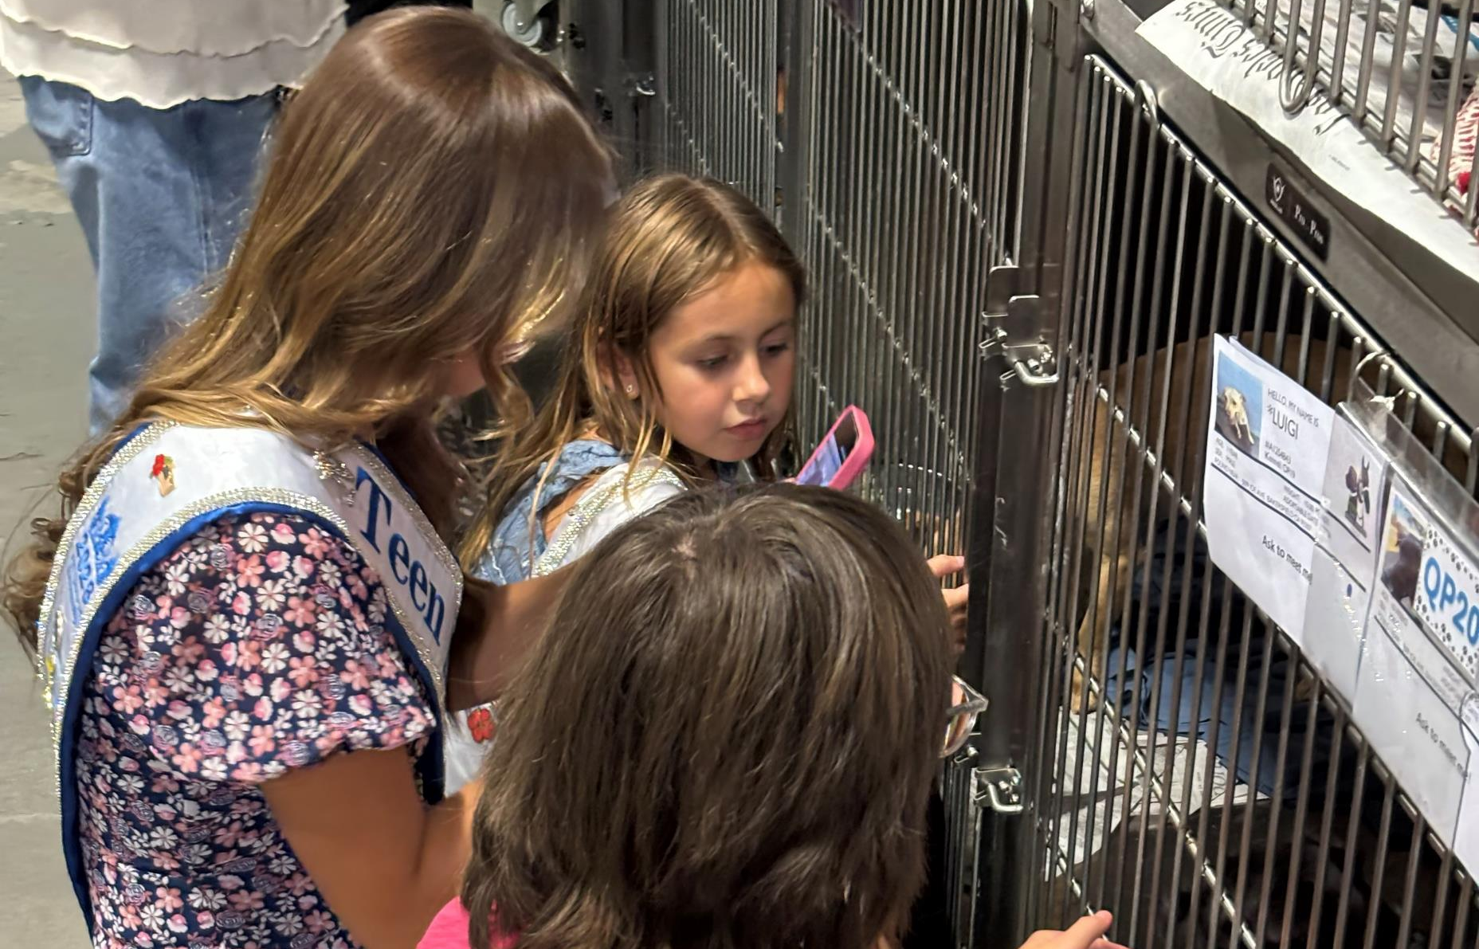

Slide 30
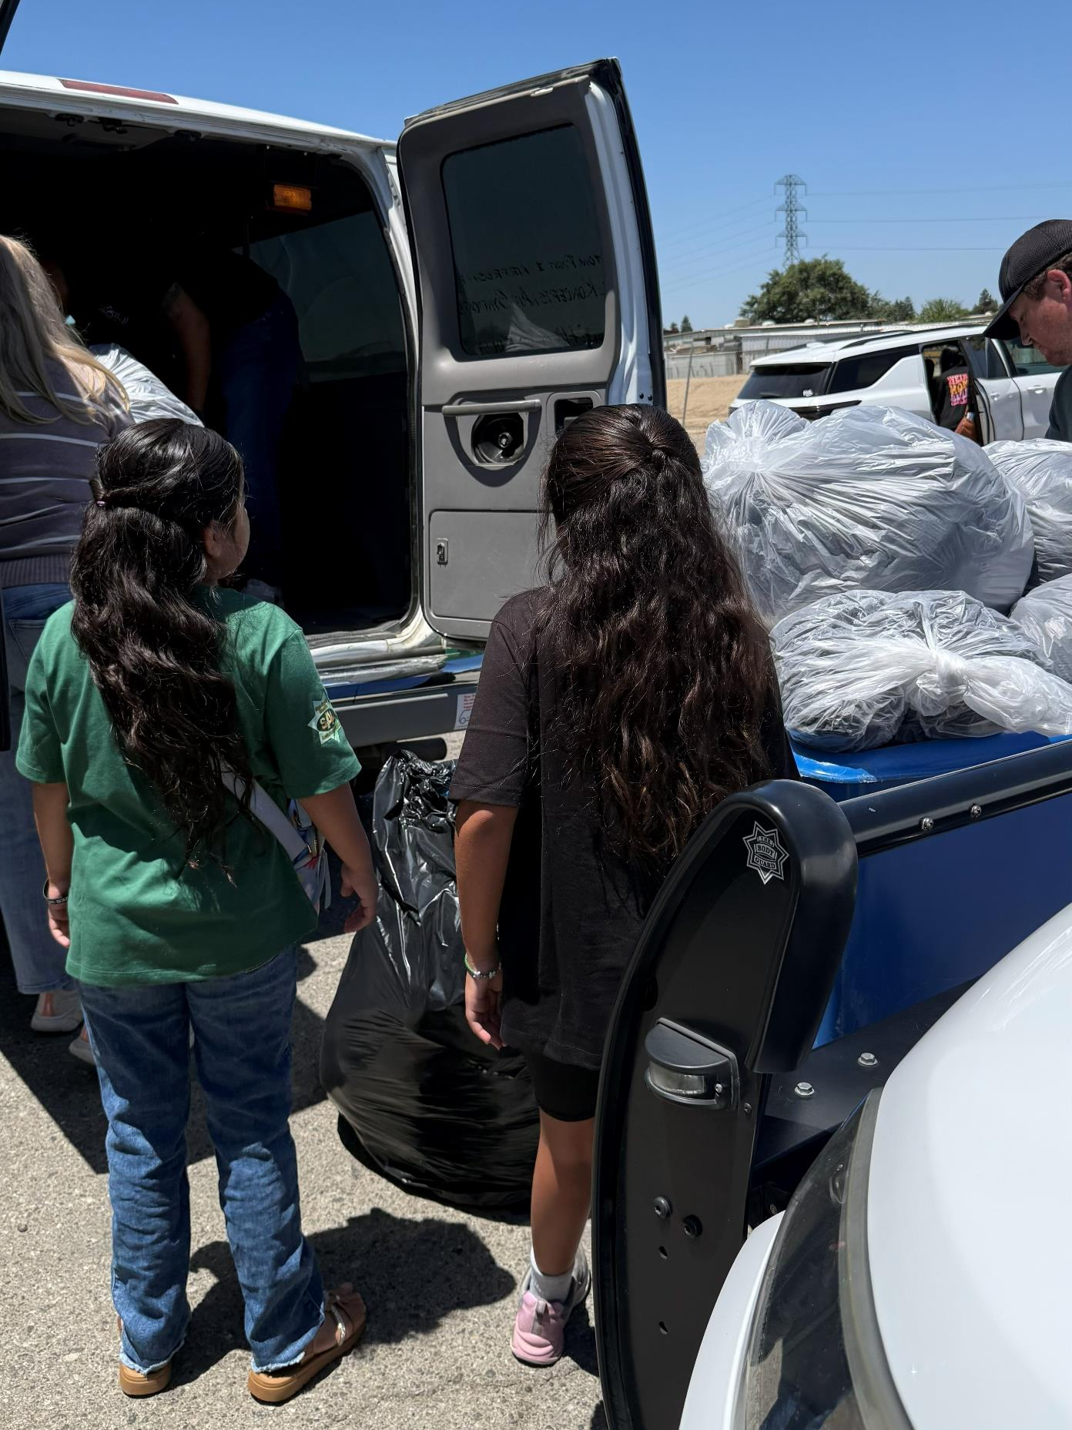
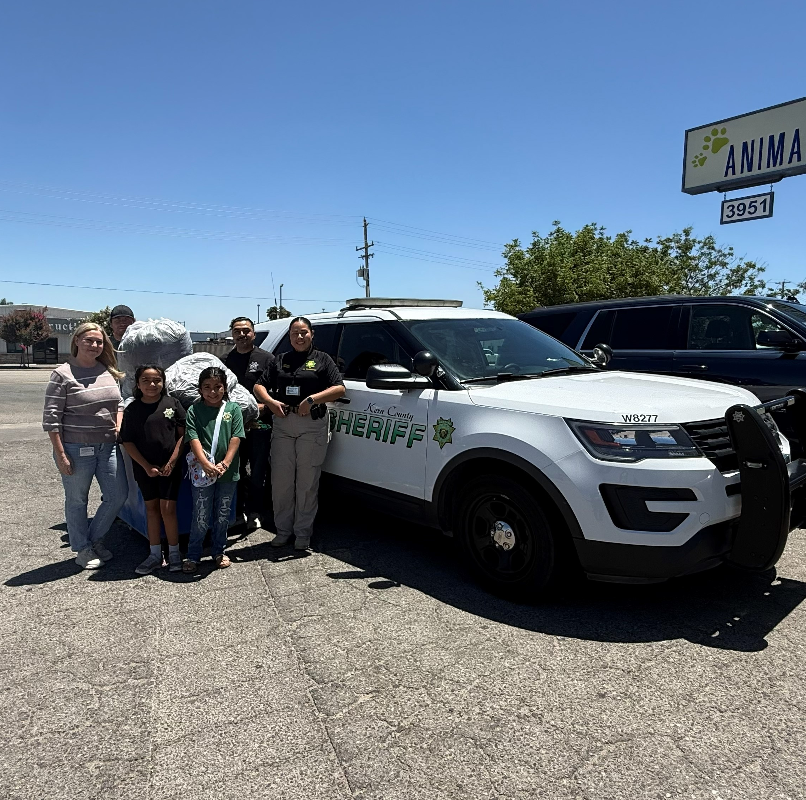
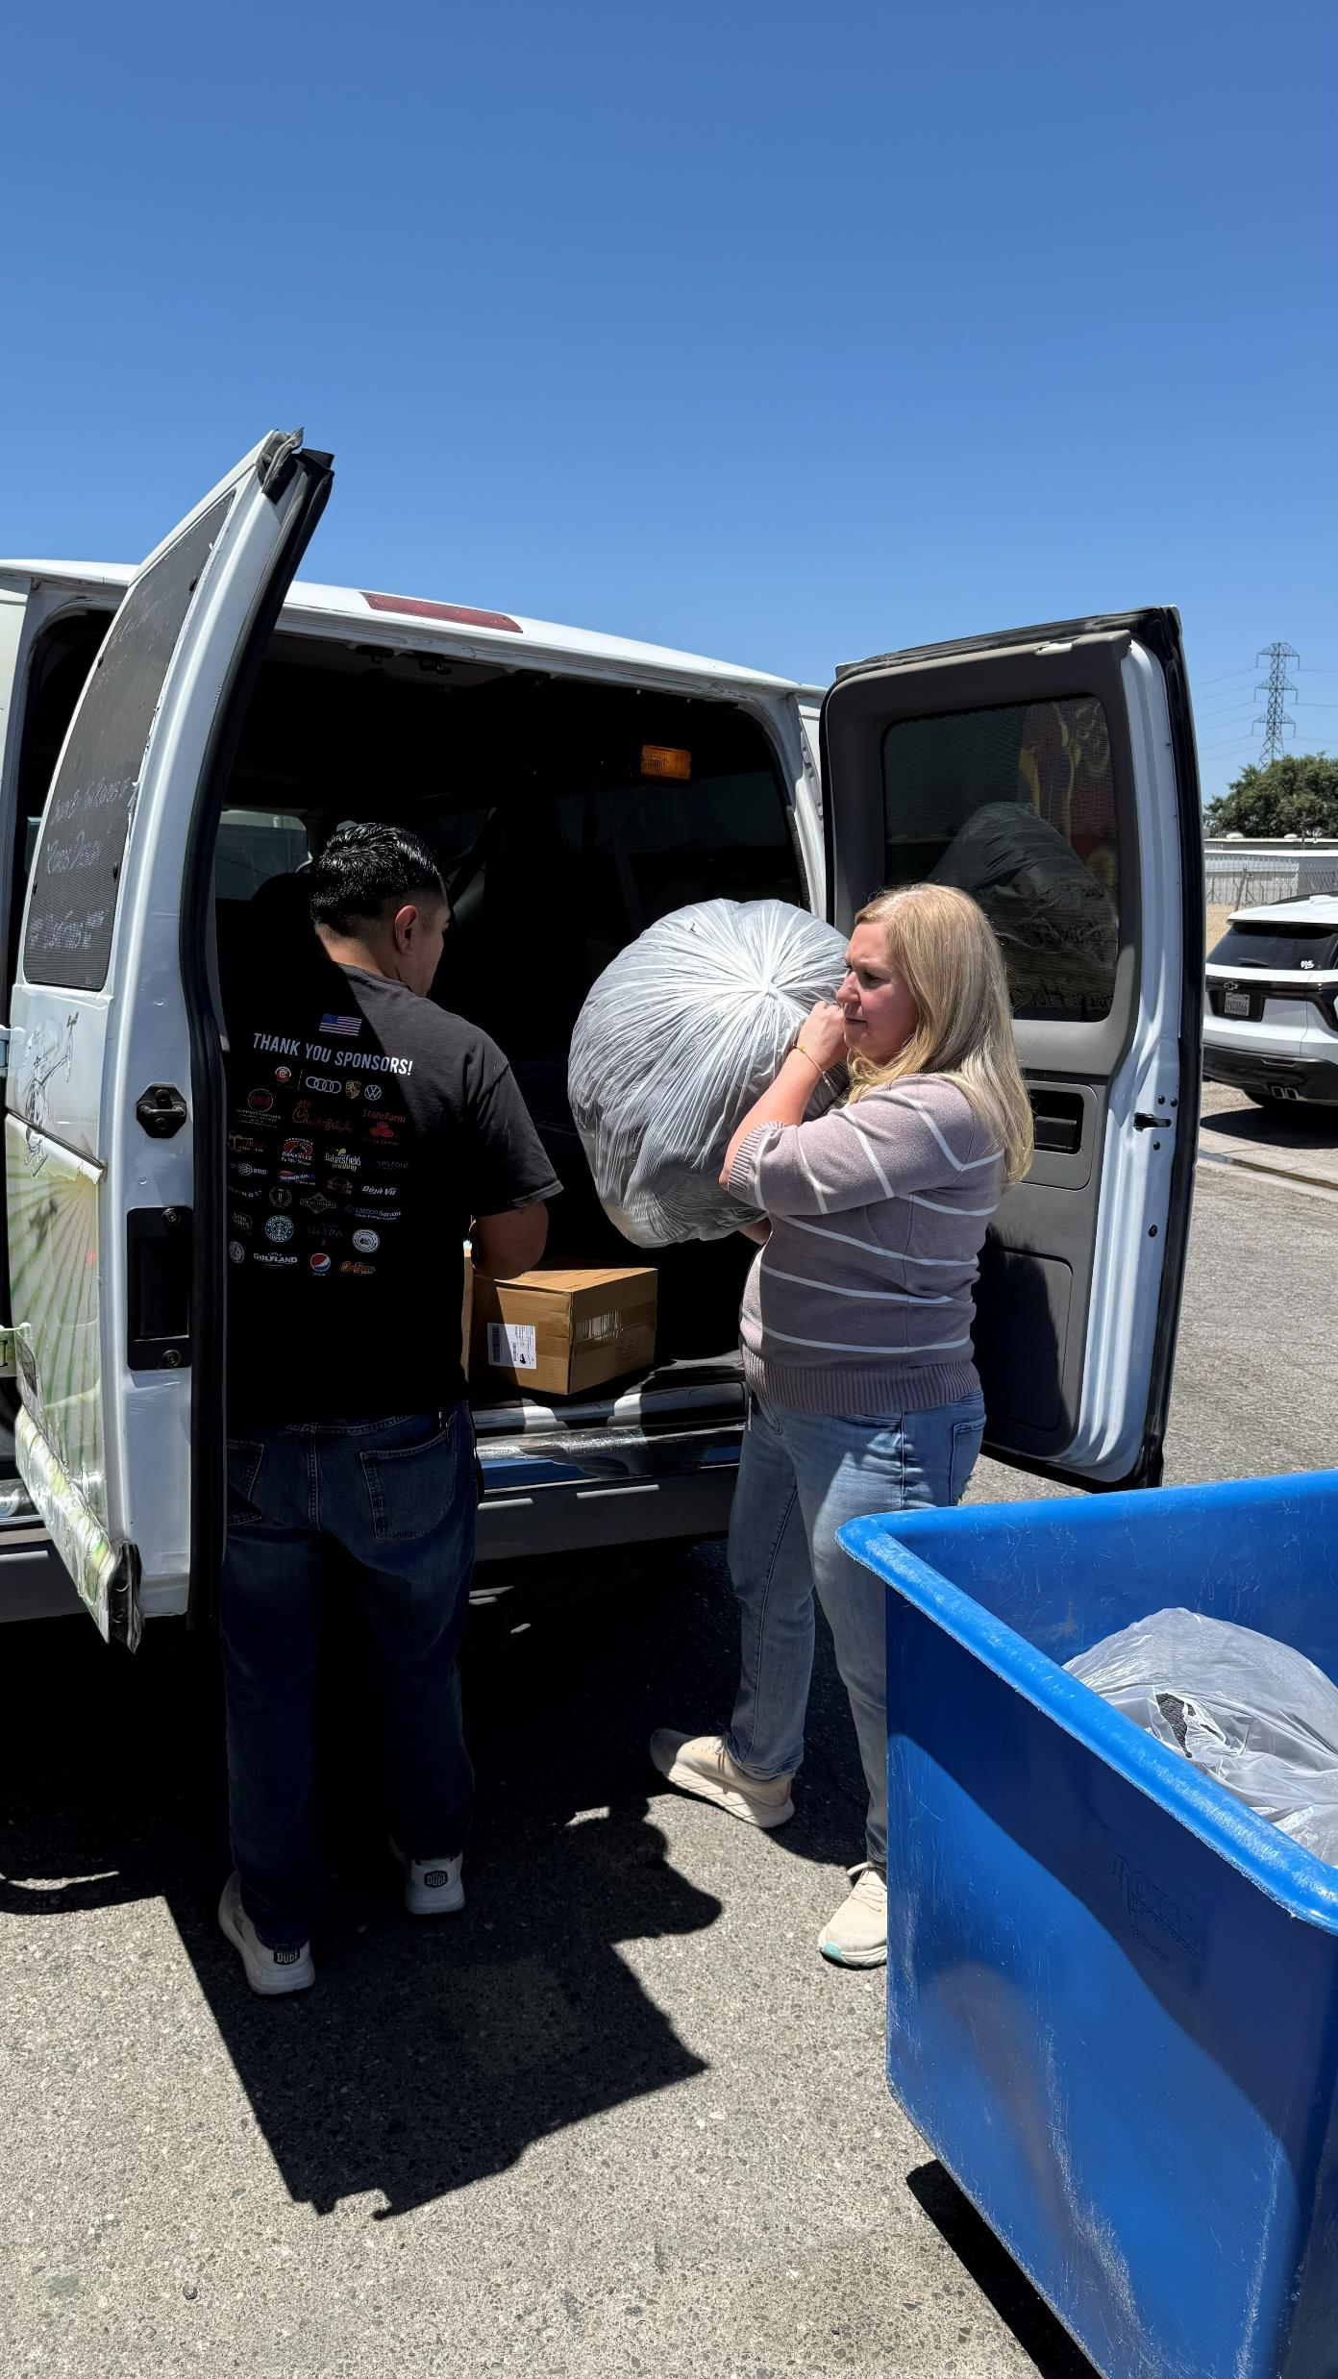
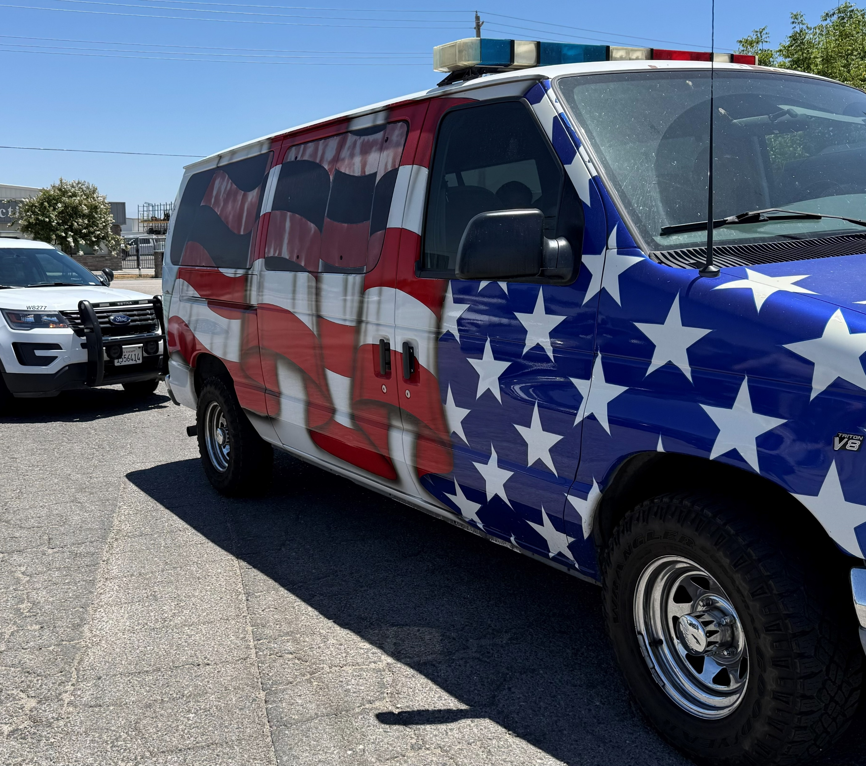
Donations from SAL!
Thanks to the members of the Kern County Sheriff's Activities League and their families for this huge donation of blankets and towels! The animals in our shelter truly appreciate you!
FYI - The Kern County Sheriff’s Activities League is dedicated to developing local youth into responsible, productive, and ethical citizens and reducing juvenile victimization, crime, and delinquency.
If you have a child 8 years or older who is interested in joining the Bakersfield SAL you can find them at https://kcsal.com

Slide 31

KCAS Caught Stealing Memes
Two Russian rooftoppers went viral in July 2026 after illegally climbing the Empire State Building’s 1,454-foot spire to propose and hang a peace banner.
The dramatic photo quickly became a viral meme template, with people and brands digitally changing the banner’s message to say all kinds of things.
KCAS got in on the viral trend by sharing some of the best memes, seen below.

Slide 32







Slide 33
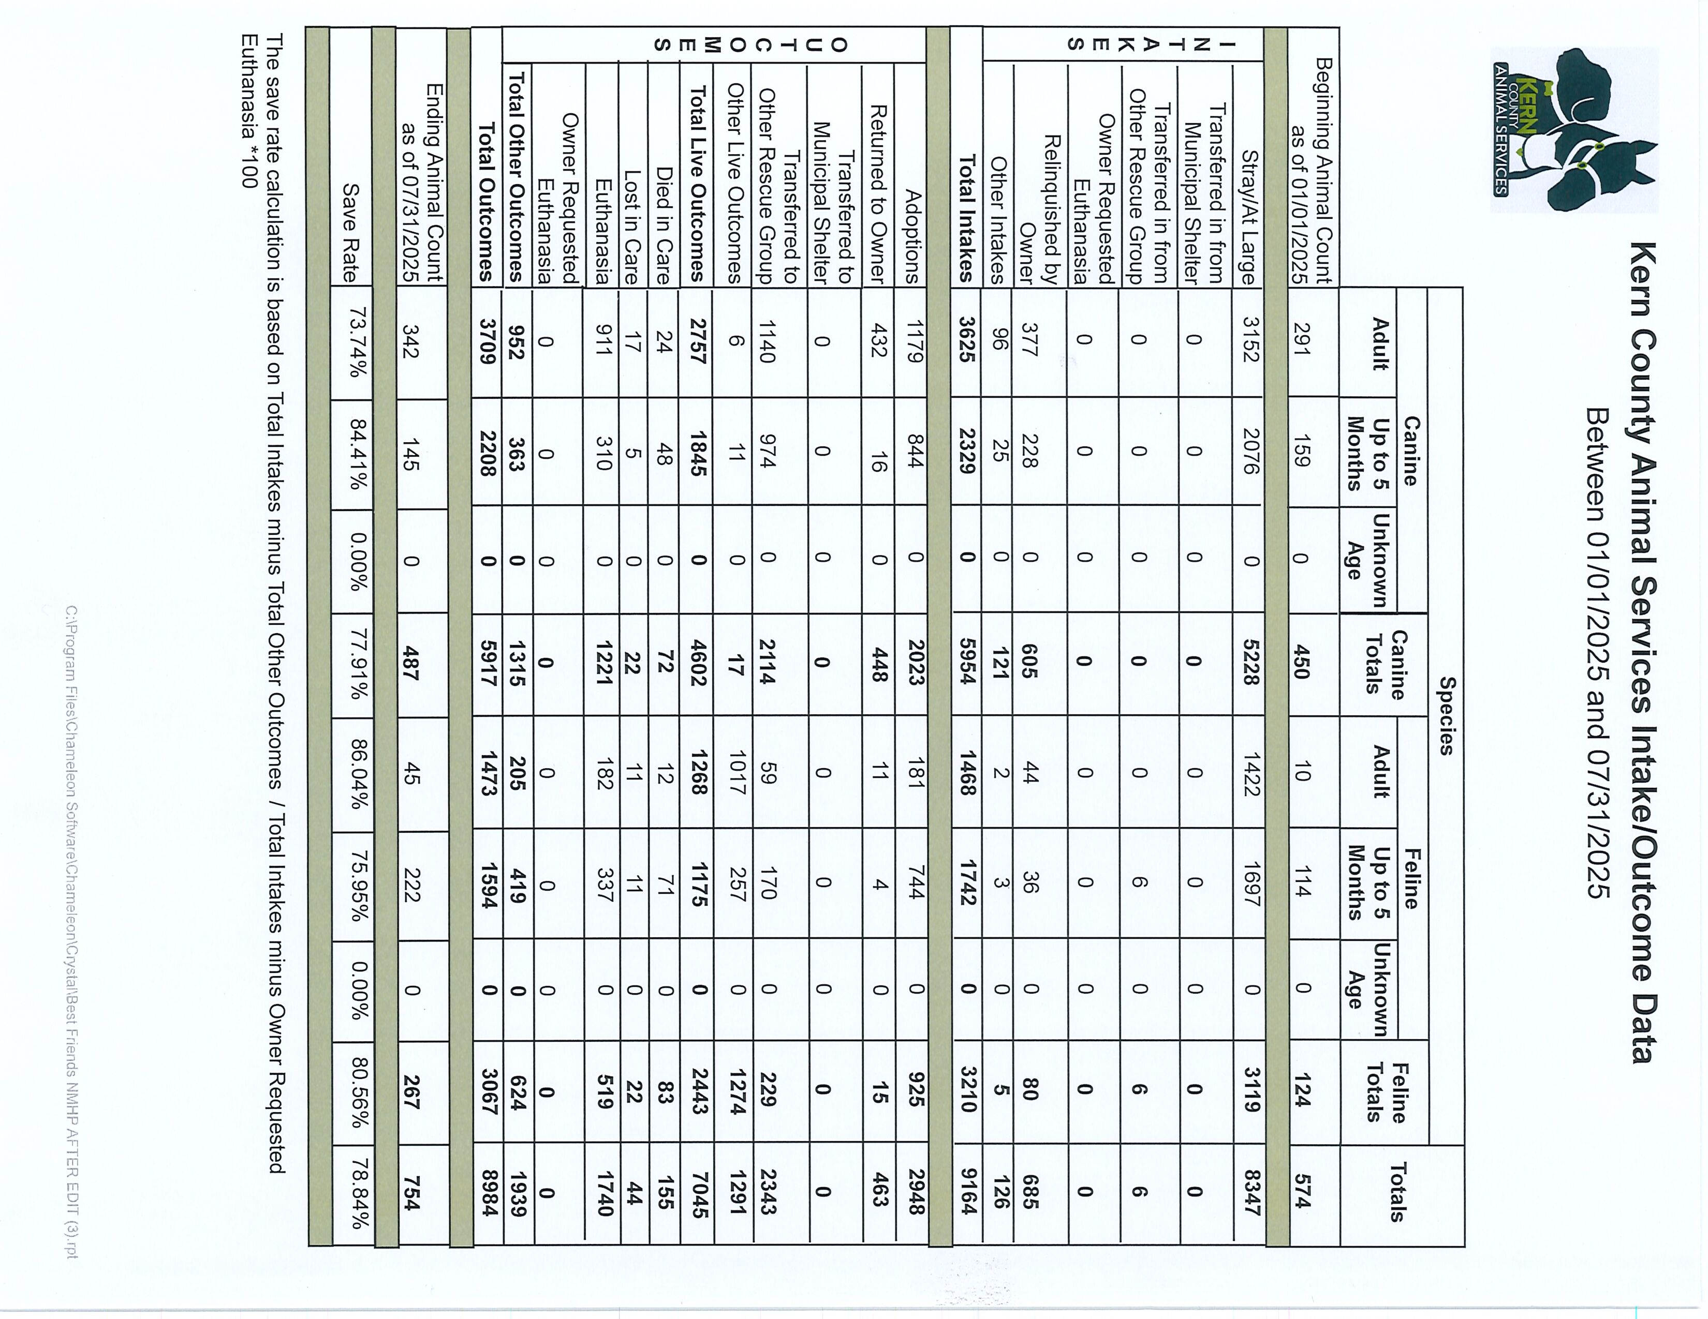

Slide 34
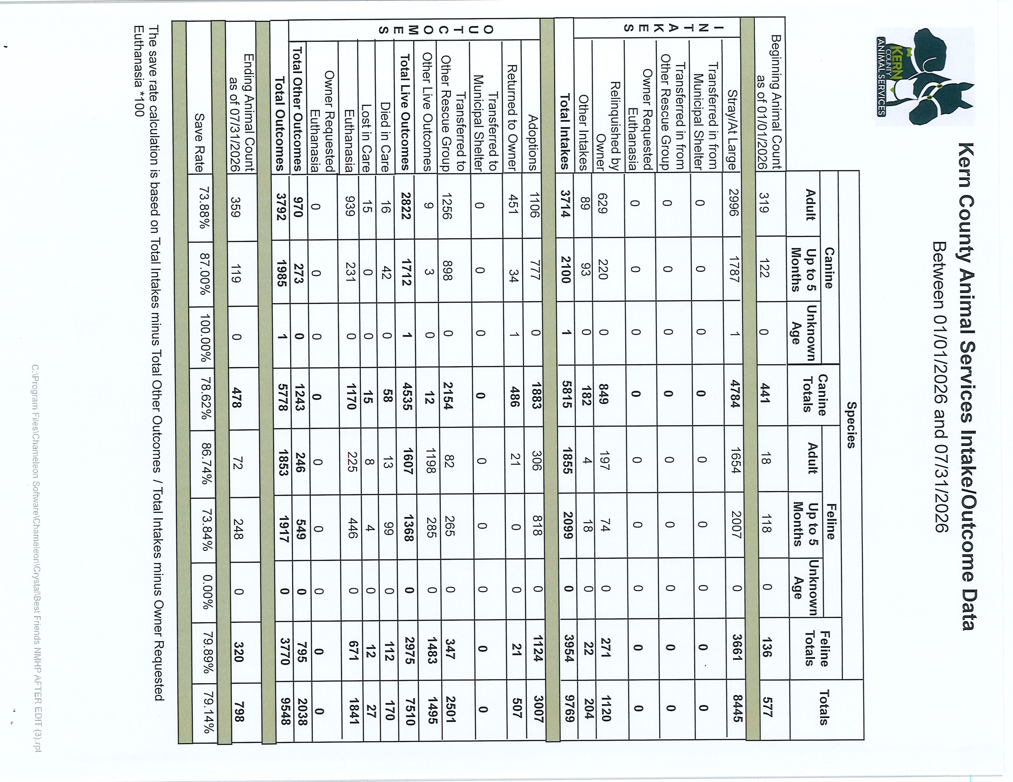

Slide 35
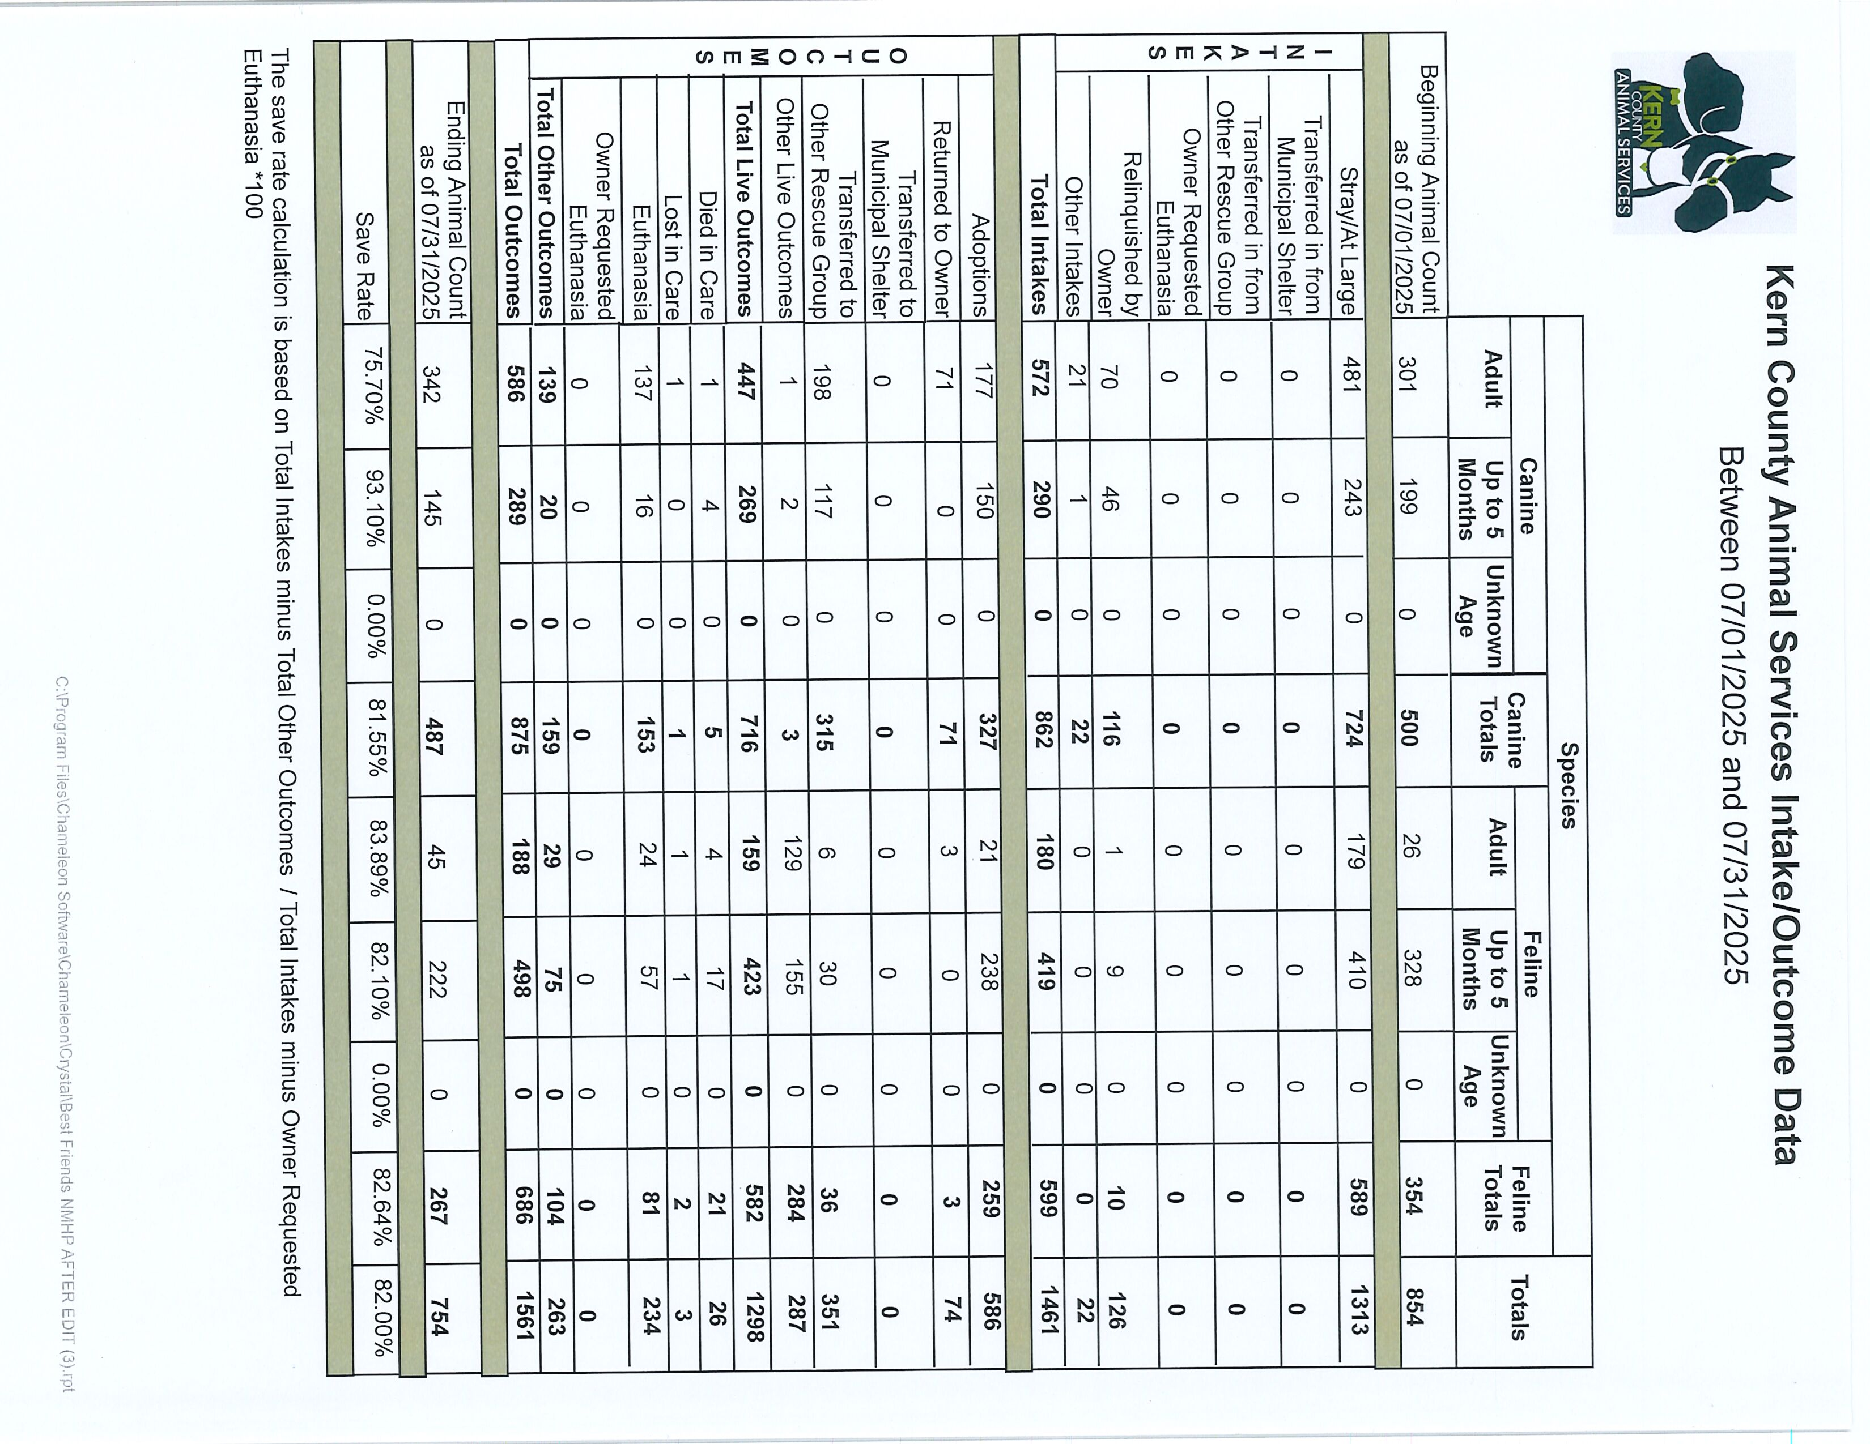

Slide 36
