Slide 1

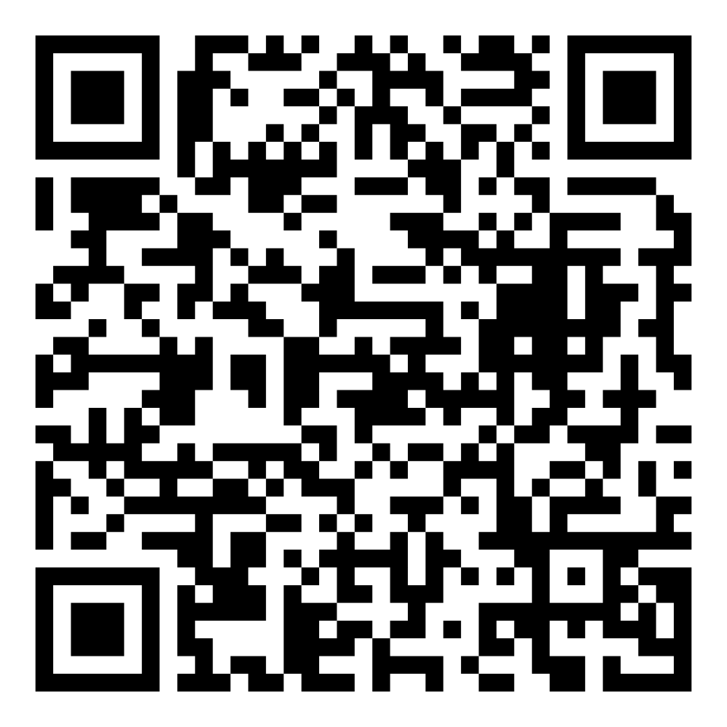
Director’s Report
August 2026

Slide 2



Program Highlights
August 2026
Adoption: 174 dogs, 86 puppies, 34 cats, and 151 kittens under 5 months of age were adopted for a total of 445 animals adopted from Kern County Animal Shelters in the month of August.
Foster: 36 dogs, 55 puppies, 1 cat, and 112 kittens entered the Department’s Foster Care Program in August, for a total of 204 animals.
Rescue: 166 dogs, 69 puppies, 7 cats, and 22 kittens were transferred to other animal rescue organizations in August, for a total of 264 animals.
Spay/Neuter: A total of 416 animals were altered at low-cost KCAS spay/neuter clinics in the month of August.
TNR: 177 cats were spayed or neutered and released in August. Year-to-date, 1,678 cats have gone through the program, and since 2013 25,695 cats have been spayed or neutered and returned to field.

Slide 3



Clear The Shelters
August 1st - August 31st

Slide 4
Offsite Adoption Events
Adoptable dogs from Kern County Animal Services are out in the community every Friday, Saturday, and Sunday!
These special events give some of our most overlooked dogs a chance to shine outside the shelter. Many of them have been waiting patiently for their forever homes for no fault of their own! This is their chance to stand out!
Offsite events are a great way to connect in a more relaxed setting, where folks can spend time getting to know a smaller group of carefully selected, highly adoptable dogs.

Slide 5


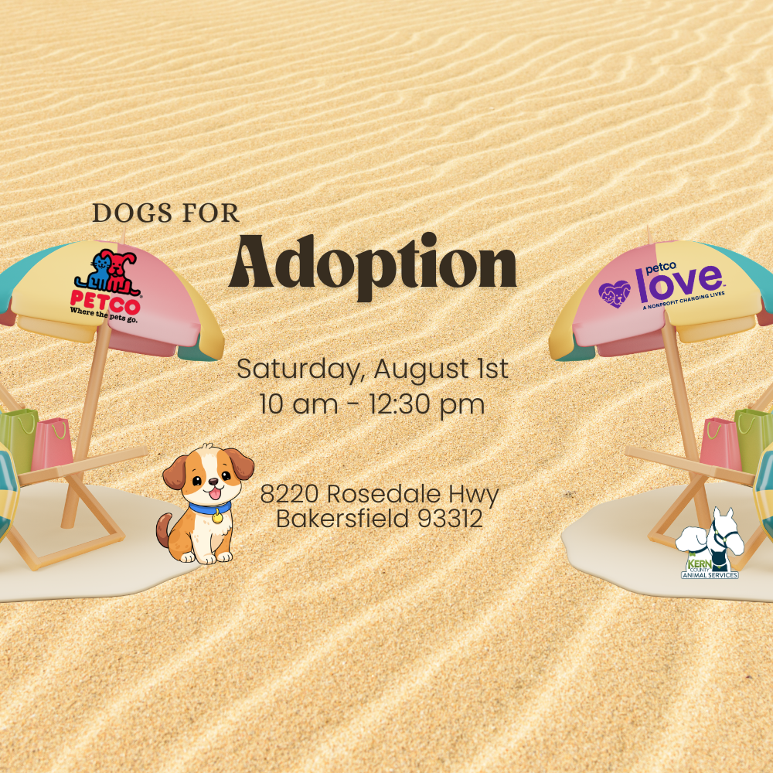


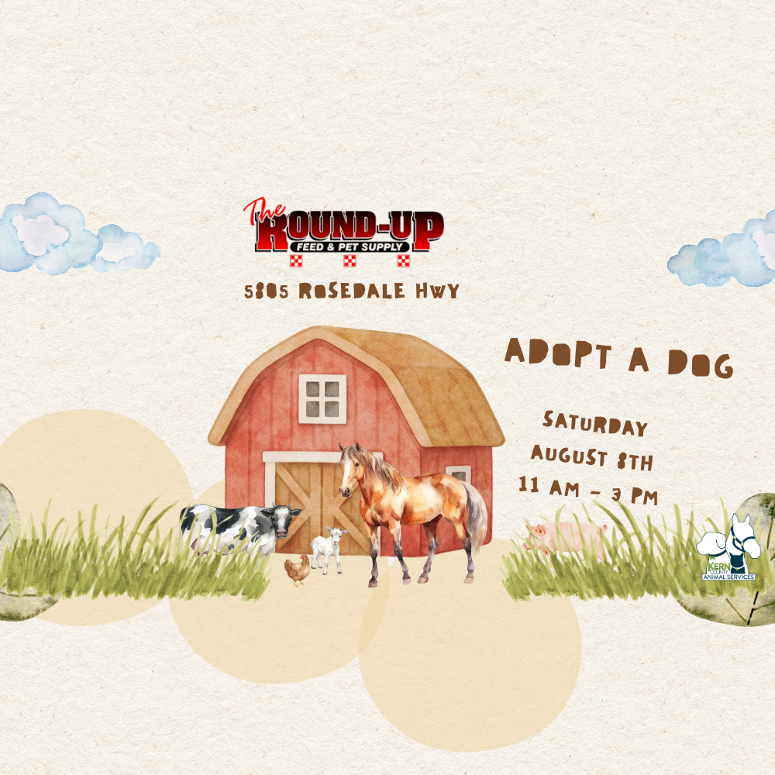


Slide 6
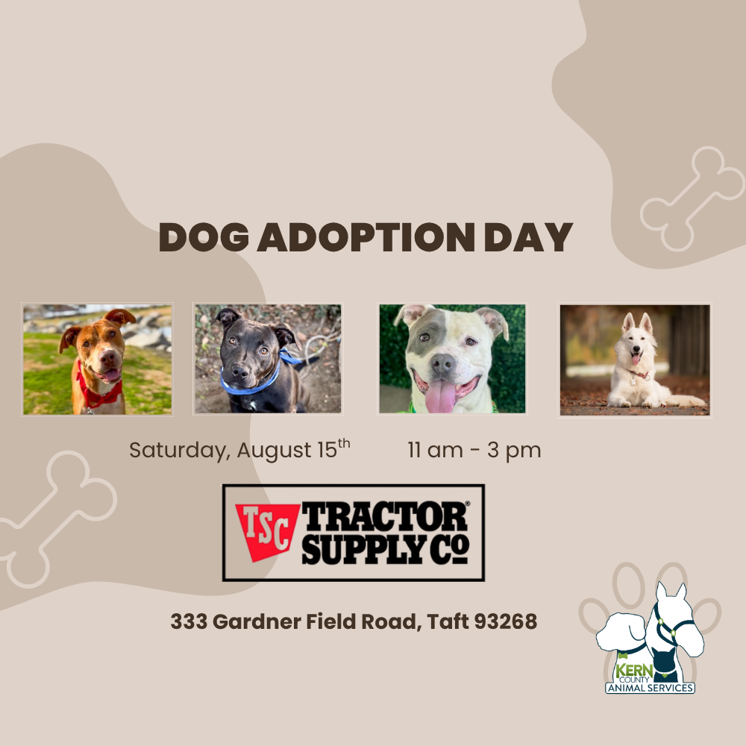
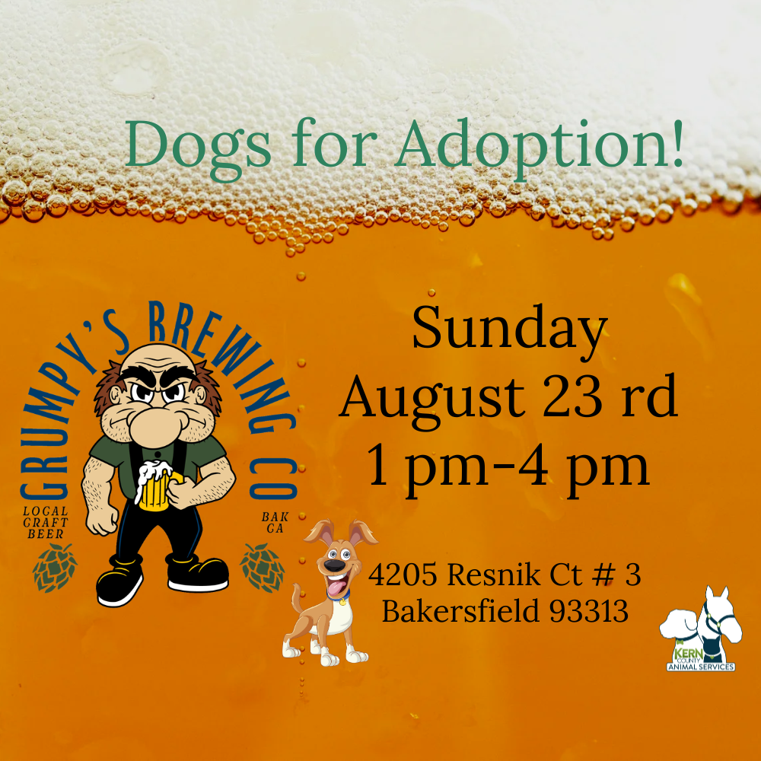
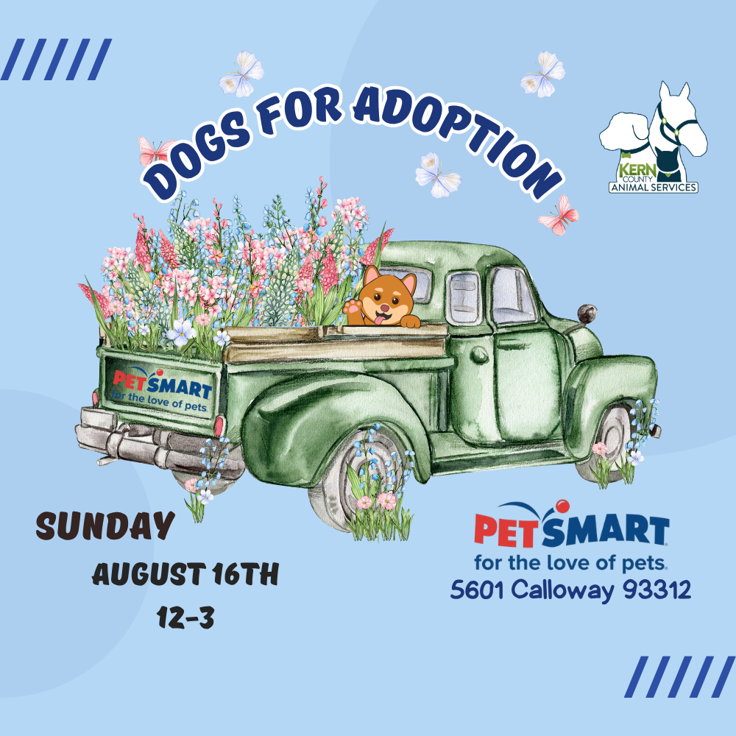
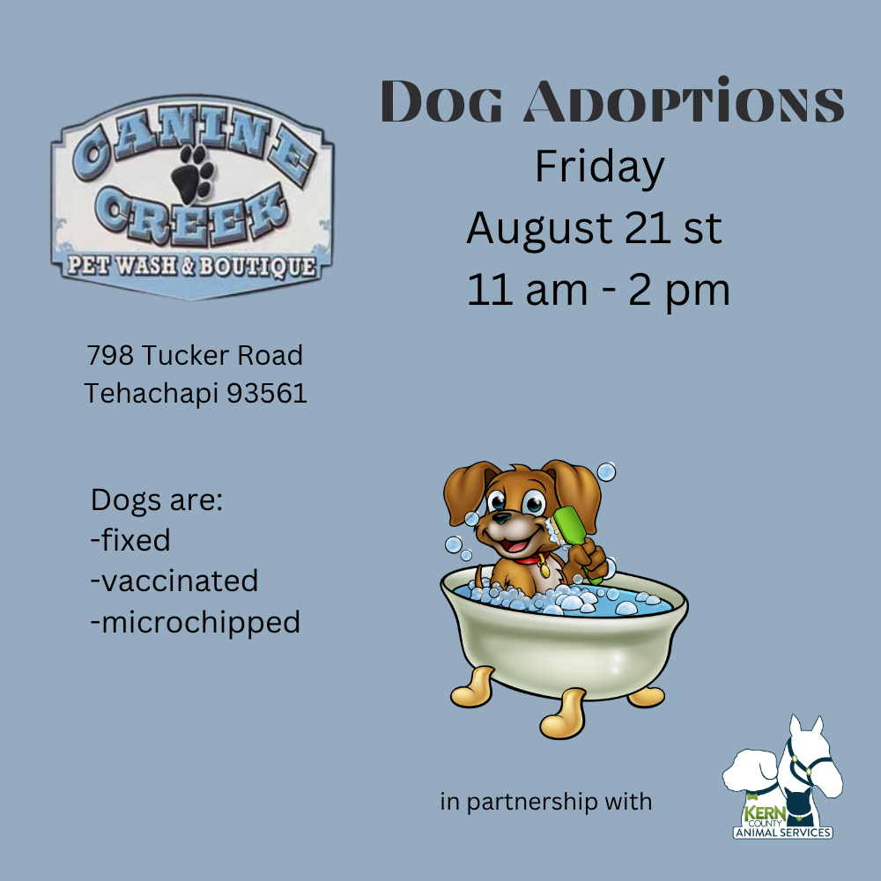

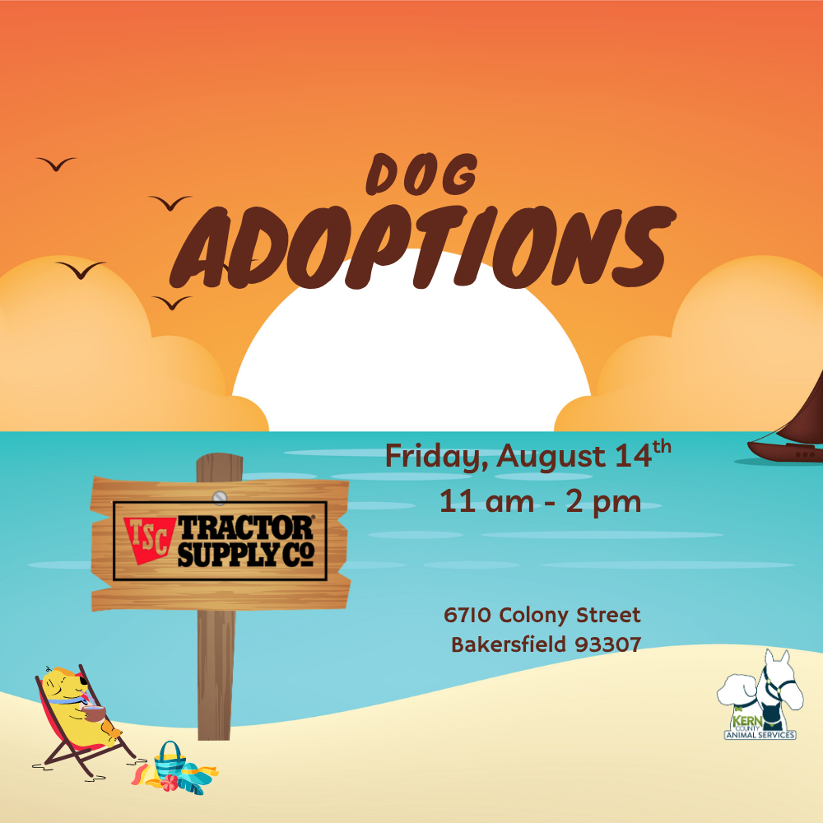

Slide 7
Streets of Bakersfield
Streets of Bakersfield is our "Doggy Day Out" program where the public can take shelter dogs on day outings. Your adventure can include a hike, a trip to the park, a coffee date or even hanging out at home.
These field trips help our shelter dogs manage kennel stress, burn off energy and get more exposure to potential adopters.
You can take a dog out for a few hours or even for the whole weekend!
Dogs can be picked up between 10am and 12 noon. “Day Out” dogs are brought back by 3:30pm. “Sleepover” dogs are returned the following Monday before 4pm.
The Streets of Bakersfield program runs every other Saturday.

Slide 8



Slide 9
Low-Cost Spay/Neuter Clinics
August 2026
Date | Location | Surgeries
August 5th | Rathbun Library | 54
August 7th | Heritage Park | 33
August 10th | KCAS Feral Cat Clinic | 80
August 12th | Harley Davidson | 51
August 19th | Heritage Park | 30
August 20th | Heritage Park | 56
August 25th | Heritage Park | 56
August 27th | Rathbun Library | 56
 | Total Surgeries | 416

Slide 10
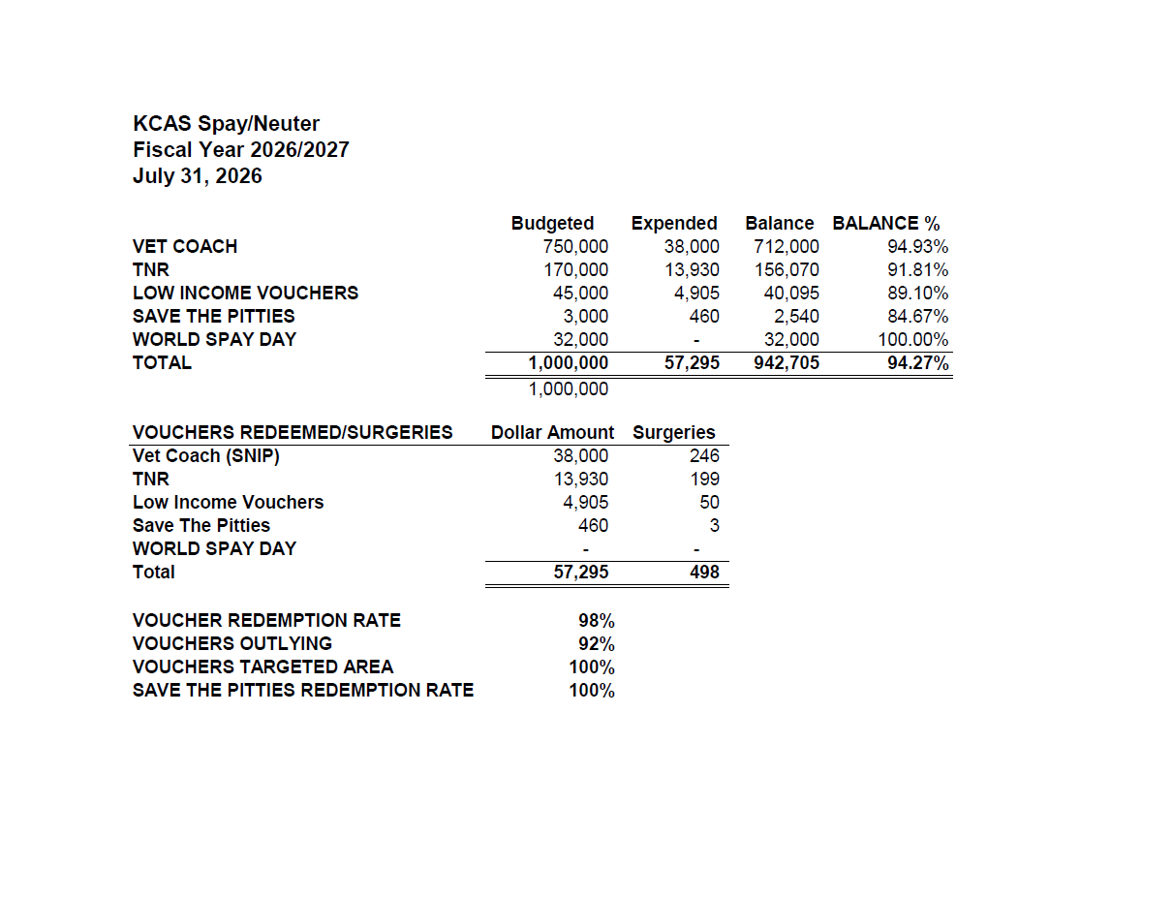

Slide 11
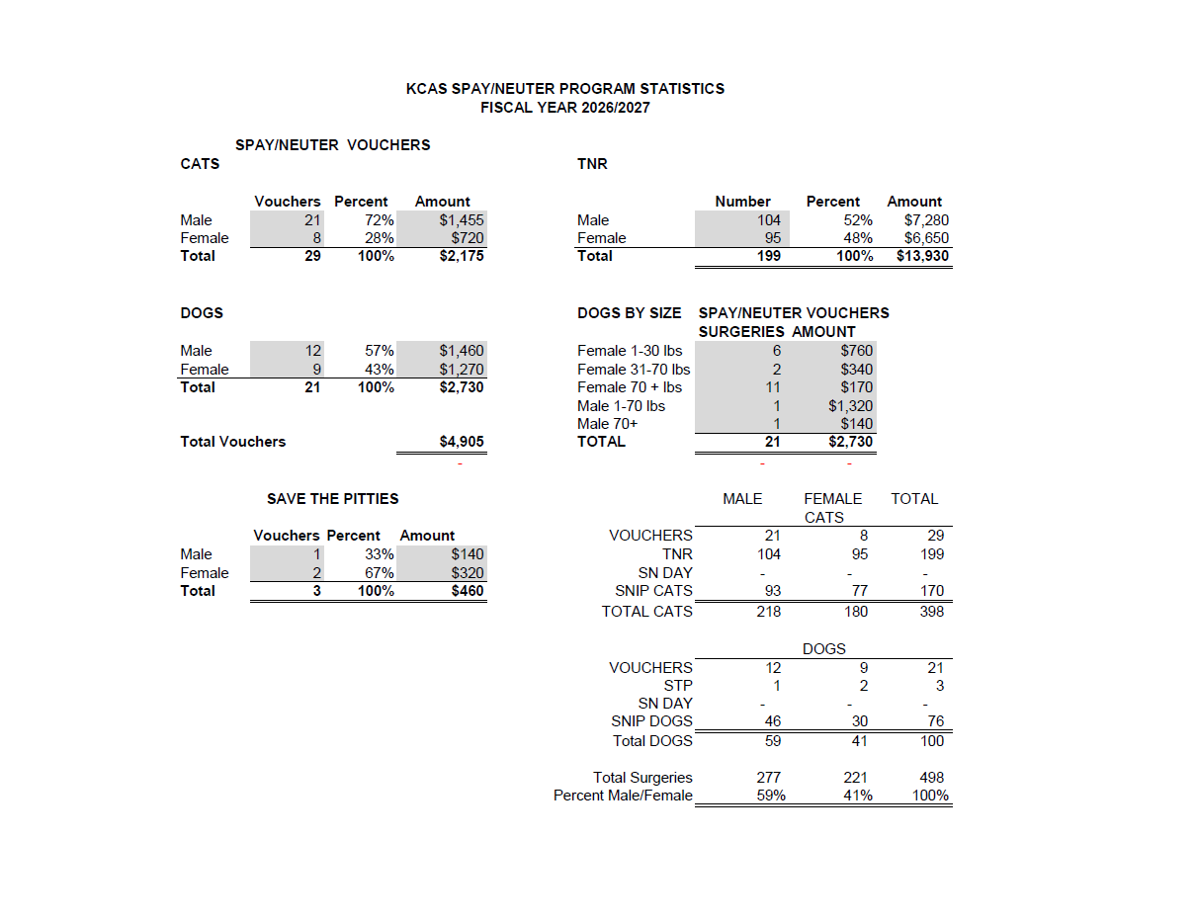

Slide 12
Low-Cost Vaccination Clinics
August 2026
Rabies
497
Microchips
Bordetella
94
84
DHPP* 309
FVRPC* 317
*DHPP and FVRCP vaccinations provided at no-cost by Petco Love.

Slide 13
Field Service Calls: August 2026
AREA | CALLS PER AREA
Lake Isabella | 102
Mojave | 144
North County | 50
Northeast | 274
Northwest | 238
Ridgecrest | 19
Southeast | 106
Southwest | 109
Taft | 75
Tehachapi | 94
TOTAL | 1,211
36 dogs were returned to their owners in the field
in August 2026.
58 dogs were secured on property by Animal Control Officers in August 2026.

Slide 14
Commercial Animal Facility Calls
August 2026
TYPE | CALLS PER TYPE
CAF – Breeder | 7
CAF – Rescue | 0
CAF – Kennel | 2
CAF – Boarding | 1
TOTAL | 10
4 Inspections Passed
0 Inspections Failed
0 Citations Issued
0 Permits Issued
52 Active CAF Permits

Slide 15
Supporting Pets of
Homeless People
9/01/25 – 7/02/26
Activity Type | Activity Totals | % of Total
Spay/Neuter | 446 | 64.6%
General Support | 178 | 25.8%
Owner Location | 39 | 5.7%
Patrol | 27 | 3.9%
Overall Total | 690 | 100.0%

Slide 16
Volunteer Program
August 2026
Active Volunteers
69
New Volunteers
58
Volunteer hours donated in August.
Year-To-Date volunteer hours donated in 2026.
599.67
4,612.2

Slide 17
Lola’s LOVE Story
The L.O.V.E. Project provides veterinary care assistance to Kern County pet owners facing critical medical needs.
Recently, 14-year-old Lola suffered a jaw fracture. Her owner, Ashley, was given the difficult choice of surgery or euthanasia. After discovering the L.O.V.E. Project and receiving assistance, Lola was able to undergo surgery and return home to recover.
“I want to thank you all for helping my sweet girl. You have no idea how much this means to us!” - Lola’s Mom, Ashley
Lola’s story is one example of how the L.O.V.E. Project helps pets and the people who love them during times of critical need.
Assistance is available for a limited time while funding lasts, thanks to generous donors to the Friends of Kern County Animal Shelters Foundation.
For more information, click the “Pet Resources” tab at Kern County Animal Services.org.

Slide 18
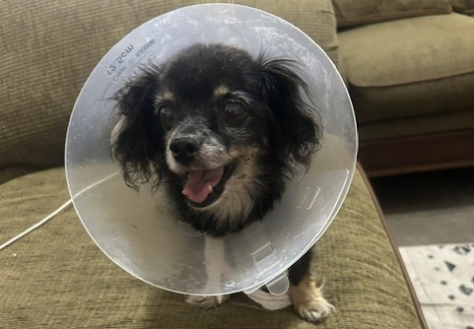
Lola

Slide 19
Community Cat Clinic
A huge thank you to The Whisker Project of Kern and SNIP Bus (Spay Neuter Imperative Project) for an incredible effort to fix 87 feral cats on Monday, August 10th!
Spaying and neutering nearly 90 cats is no small undertaking. It took a massive amount of time, dedication, coordination, and hard work from the volunteers with The Whisker Project and the entire SNIP team.
We are incredibly grateful to everyone who volunteered their time, donated resources, transported cats, provided care, and helped make this massive project possible.

Slide 20
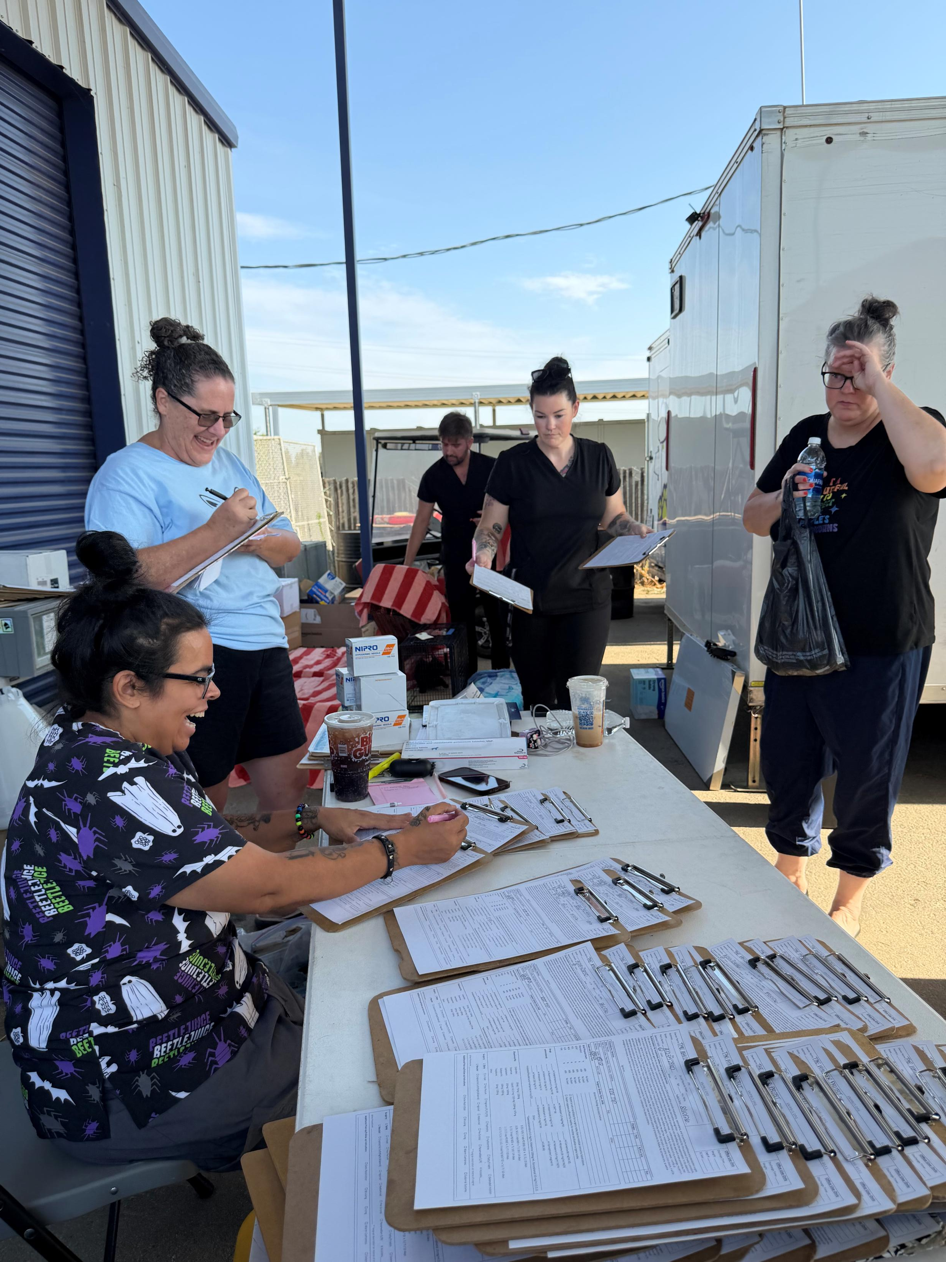
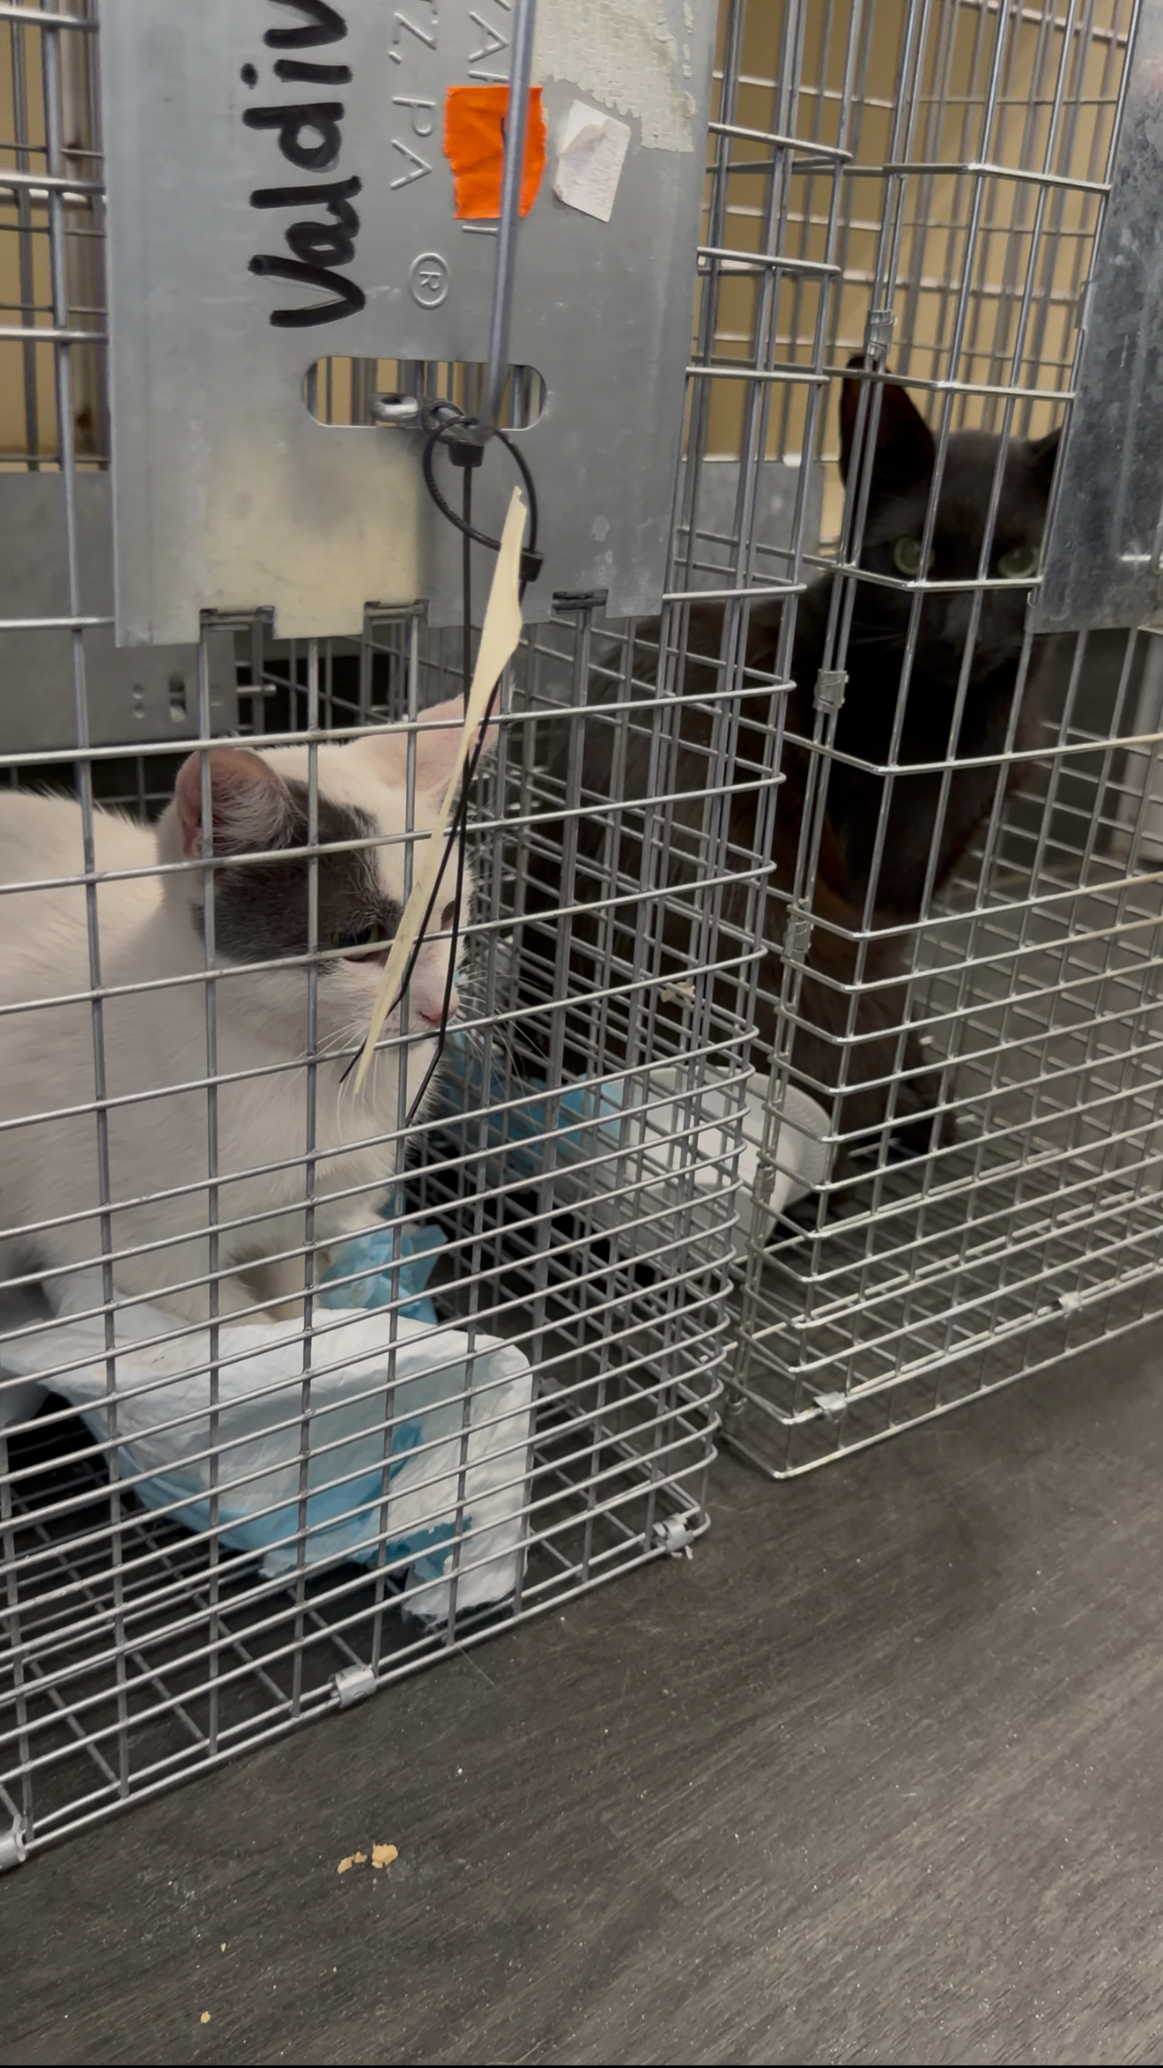
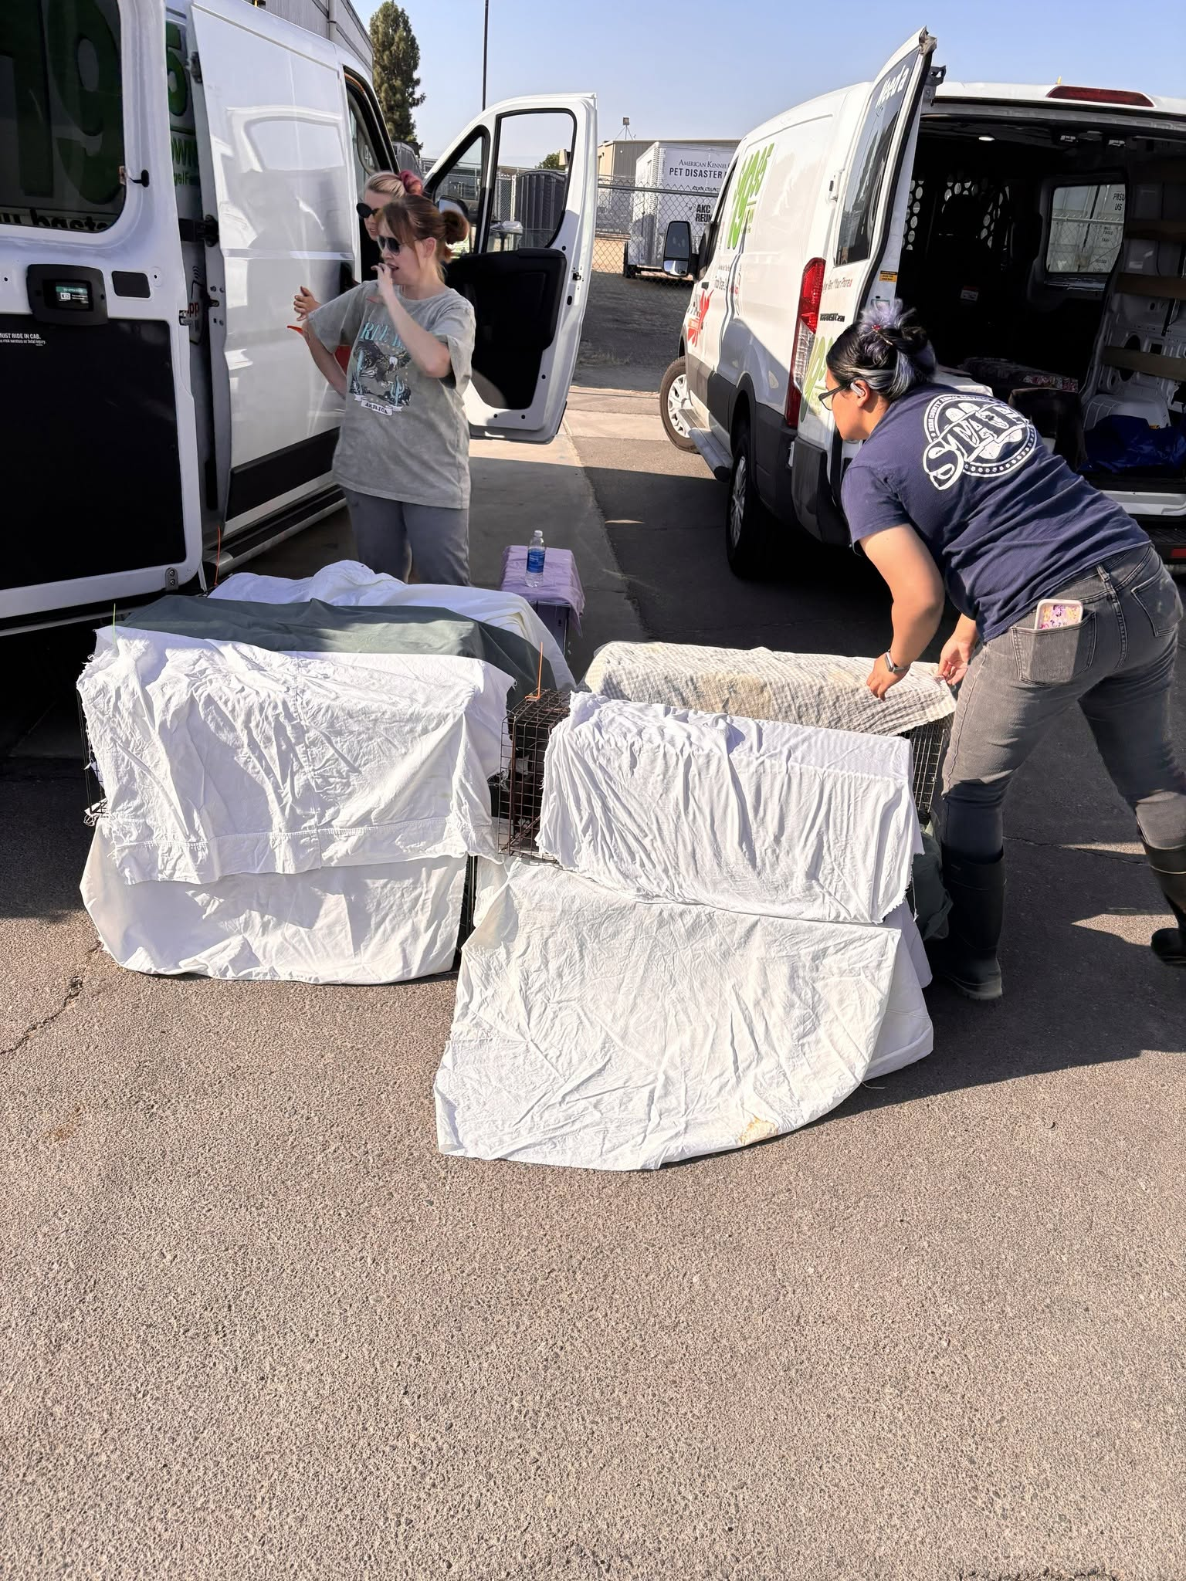
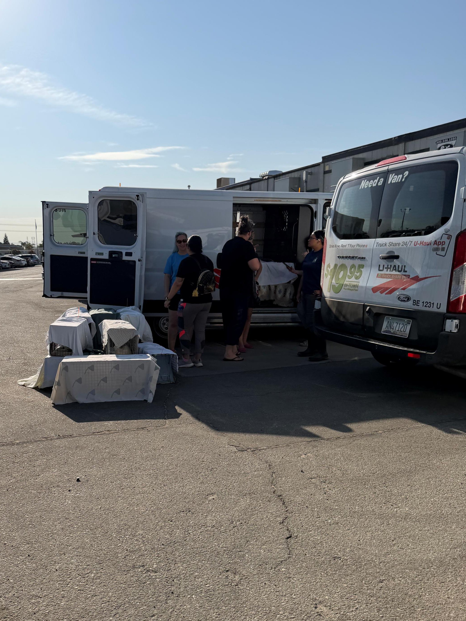

Slide 21
Tales for Tails
Wednesday, August 26th was our final Tales For Tails event of 2026.
A big thank you to everyone who joined us for these special nights of reading to our shelter dogs and cats. Our animal friends loved the extra attention while young readers practiced their reading skills in a calm, encouraging environment. It was heartwarming to see so many smiling faces, wagging tails, and happy purrs during Tails for Tails
Thank you to the Kern County Library for providing a fantastic selection of books for readers of all ages and for helping make this event such a success.

Slide 22
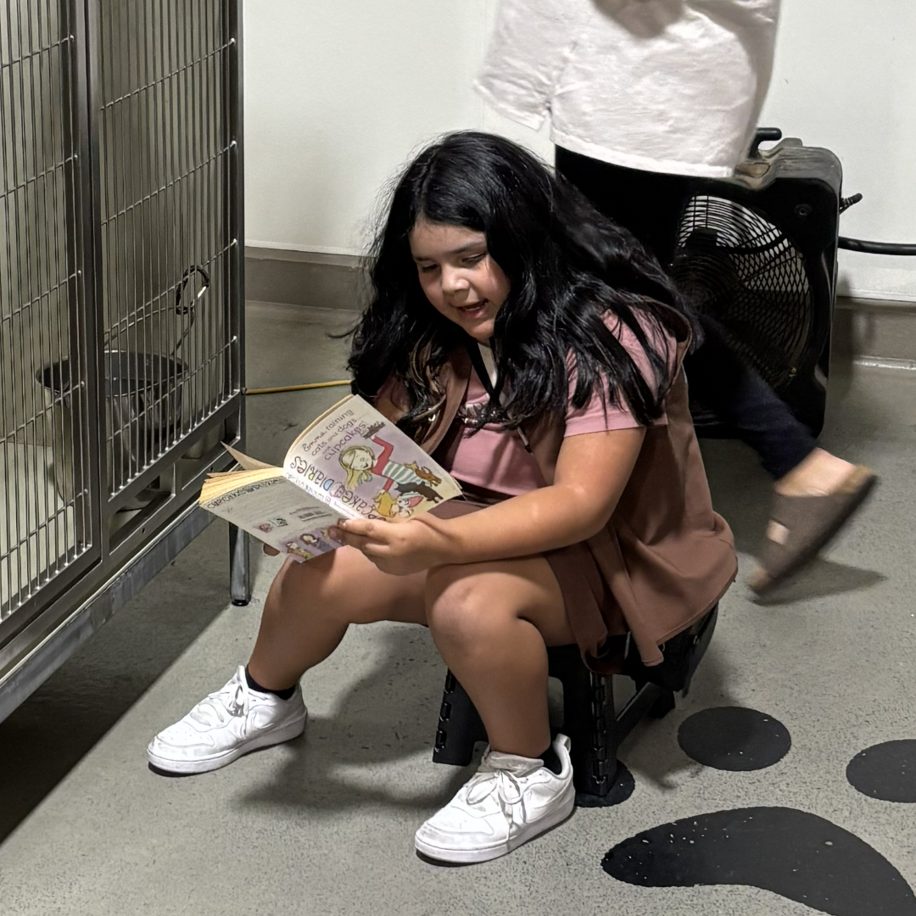
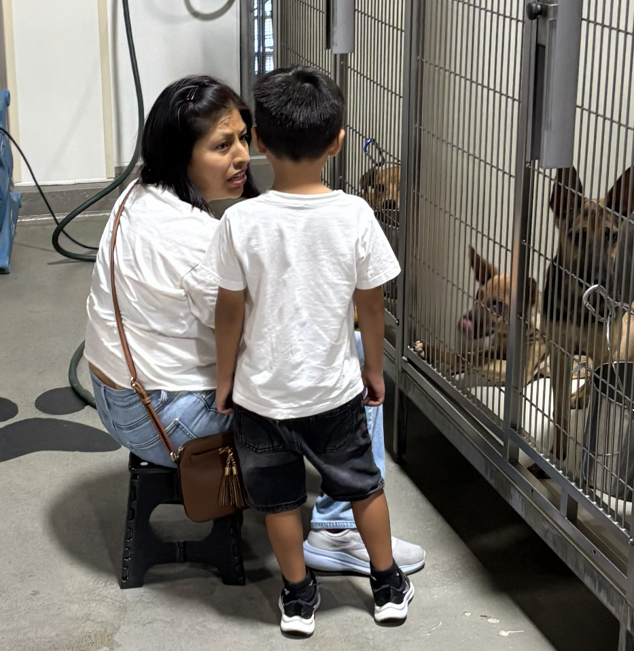
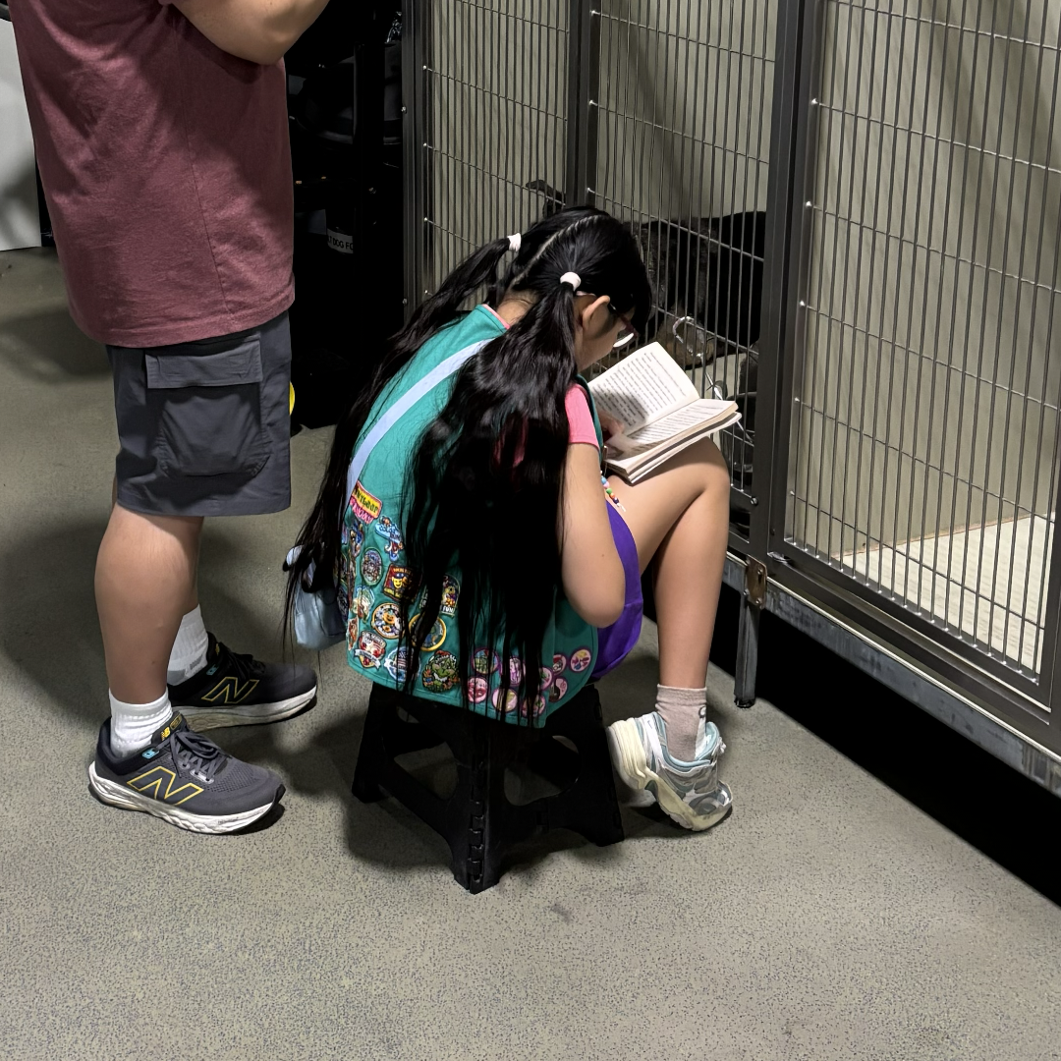
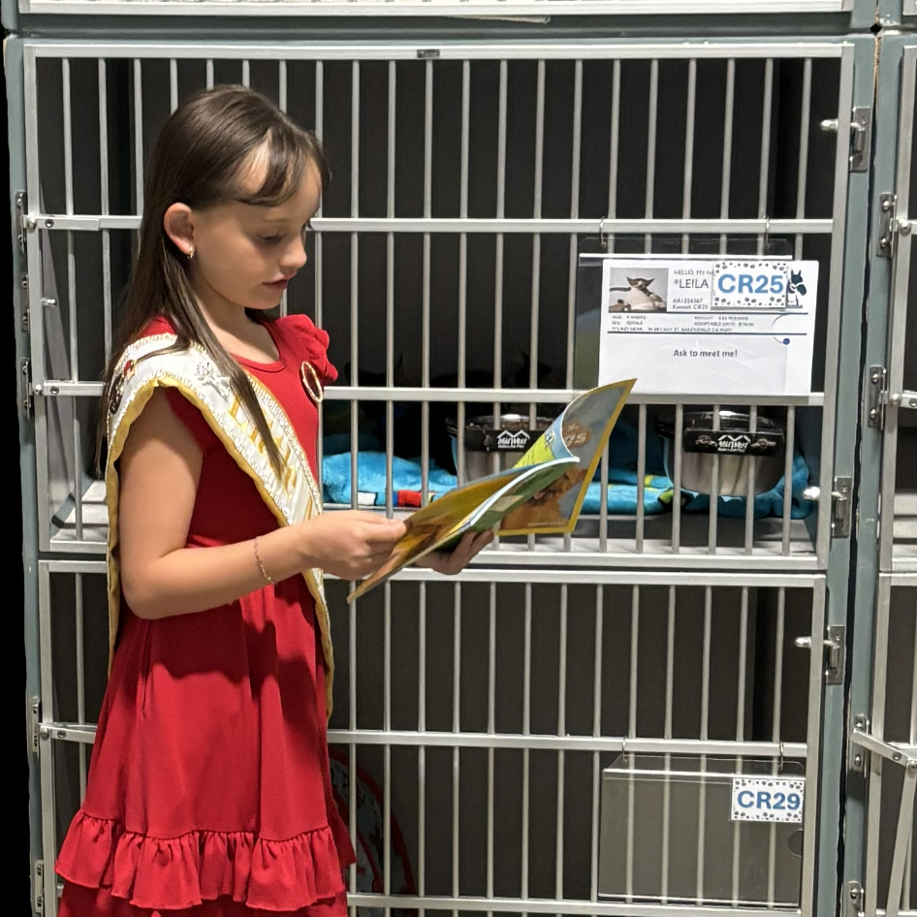
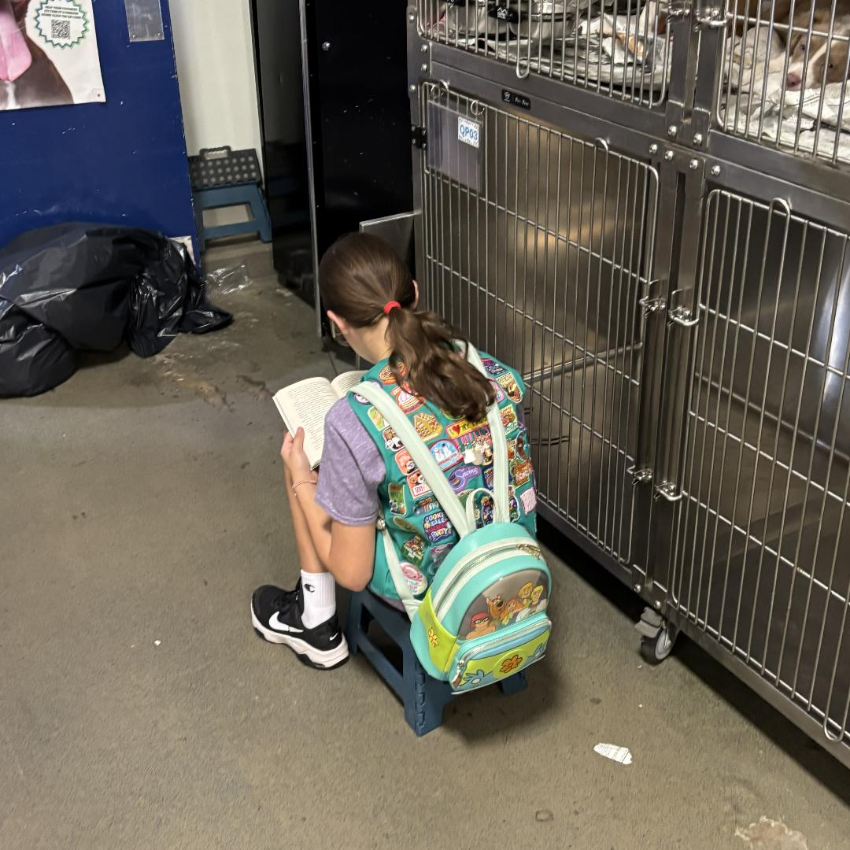
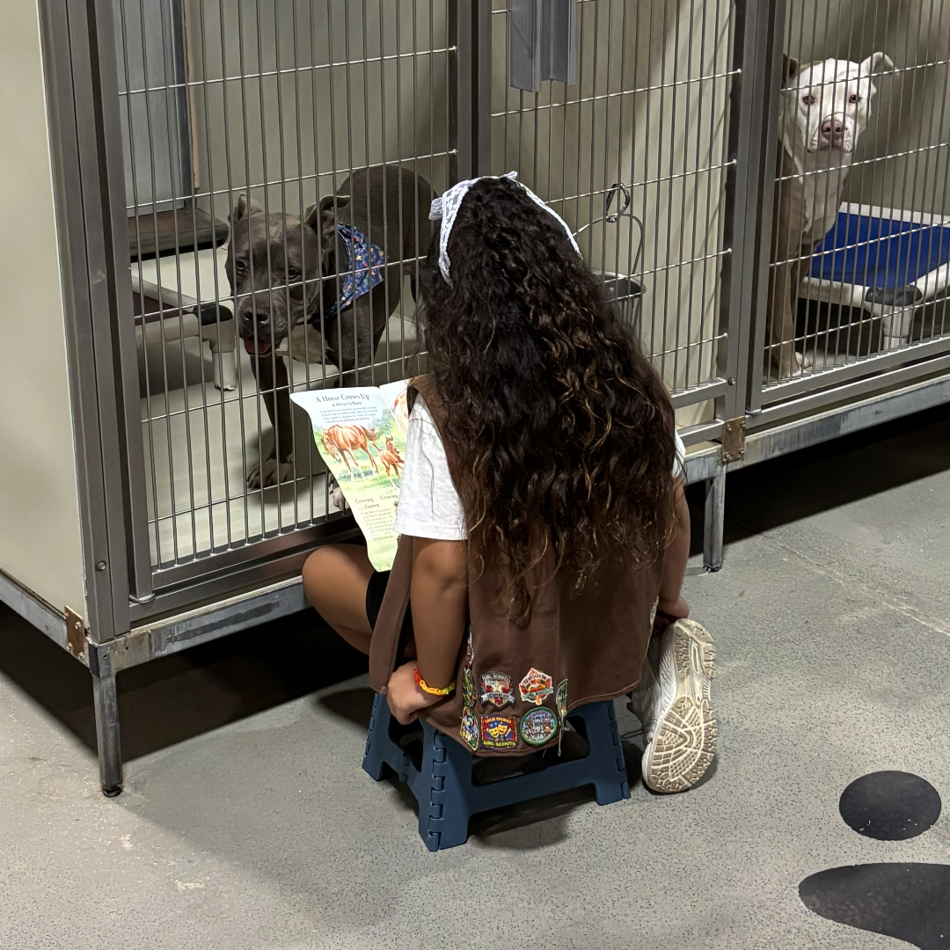

Slide 23
What a Cool Donation!
A huge thank you to Deb Bloom and everyone at The SPAY(CE) Project for helping our shelter pets beat the Bakersfield heat in August!
Summertime in Bakersfield means long stretches of triple-digit temperatures, and keeping our animals comfortable is always a top priority. Thanks to their incredible generosity, two huge pallets of ice blocks were delivered to the shelter, allowing us to place a cooling block in every kennel.
Their kindness made a real difference for the animals in our care, by helping them stay cooler and more comfortable during the extreme summer days. We are so grateful for their support!

Slide 24
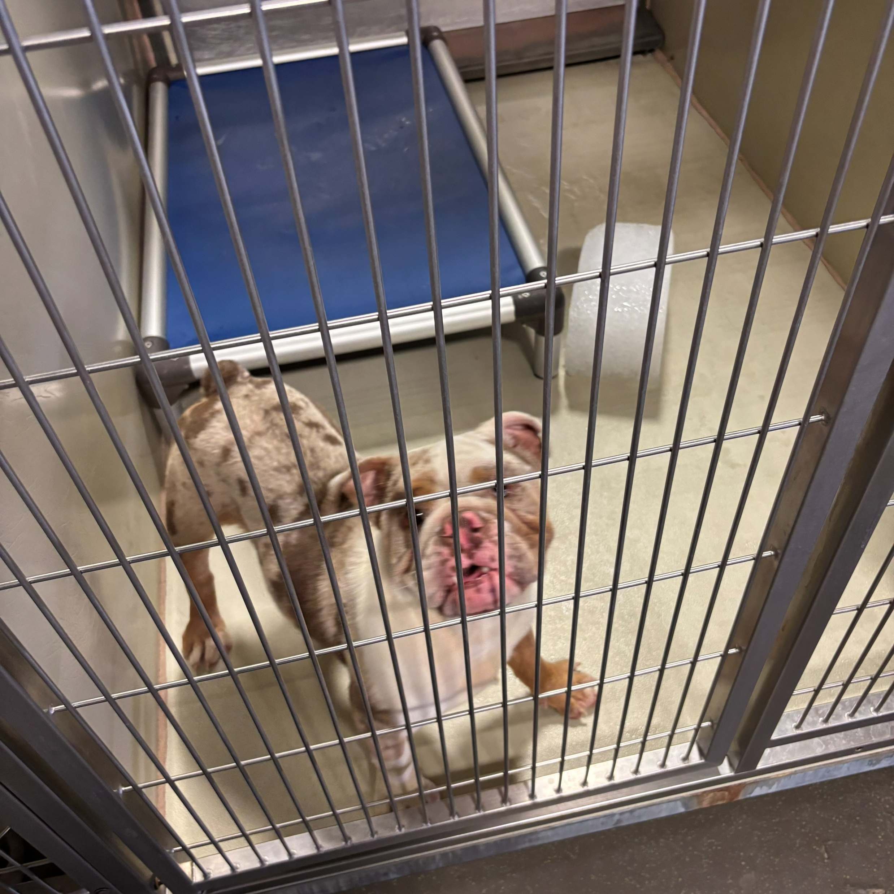
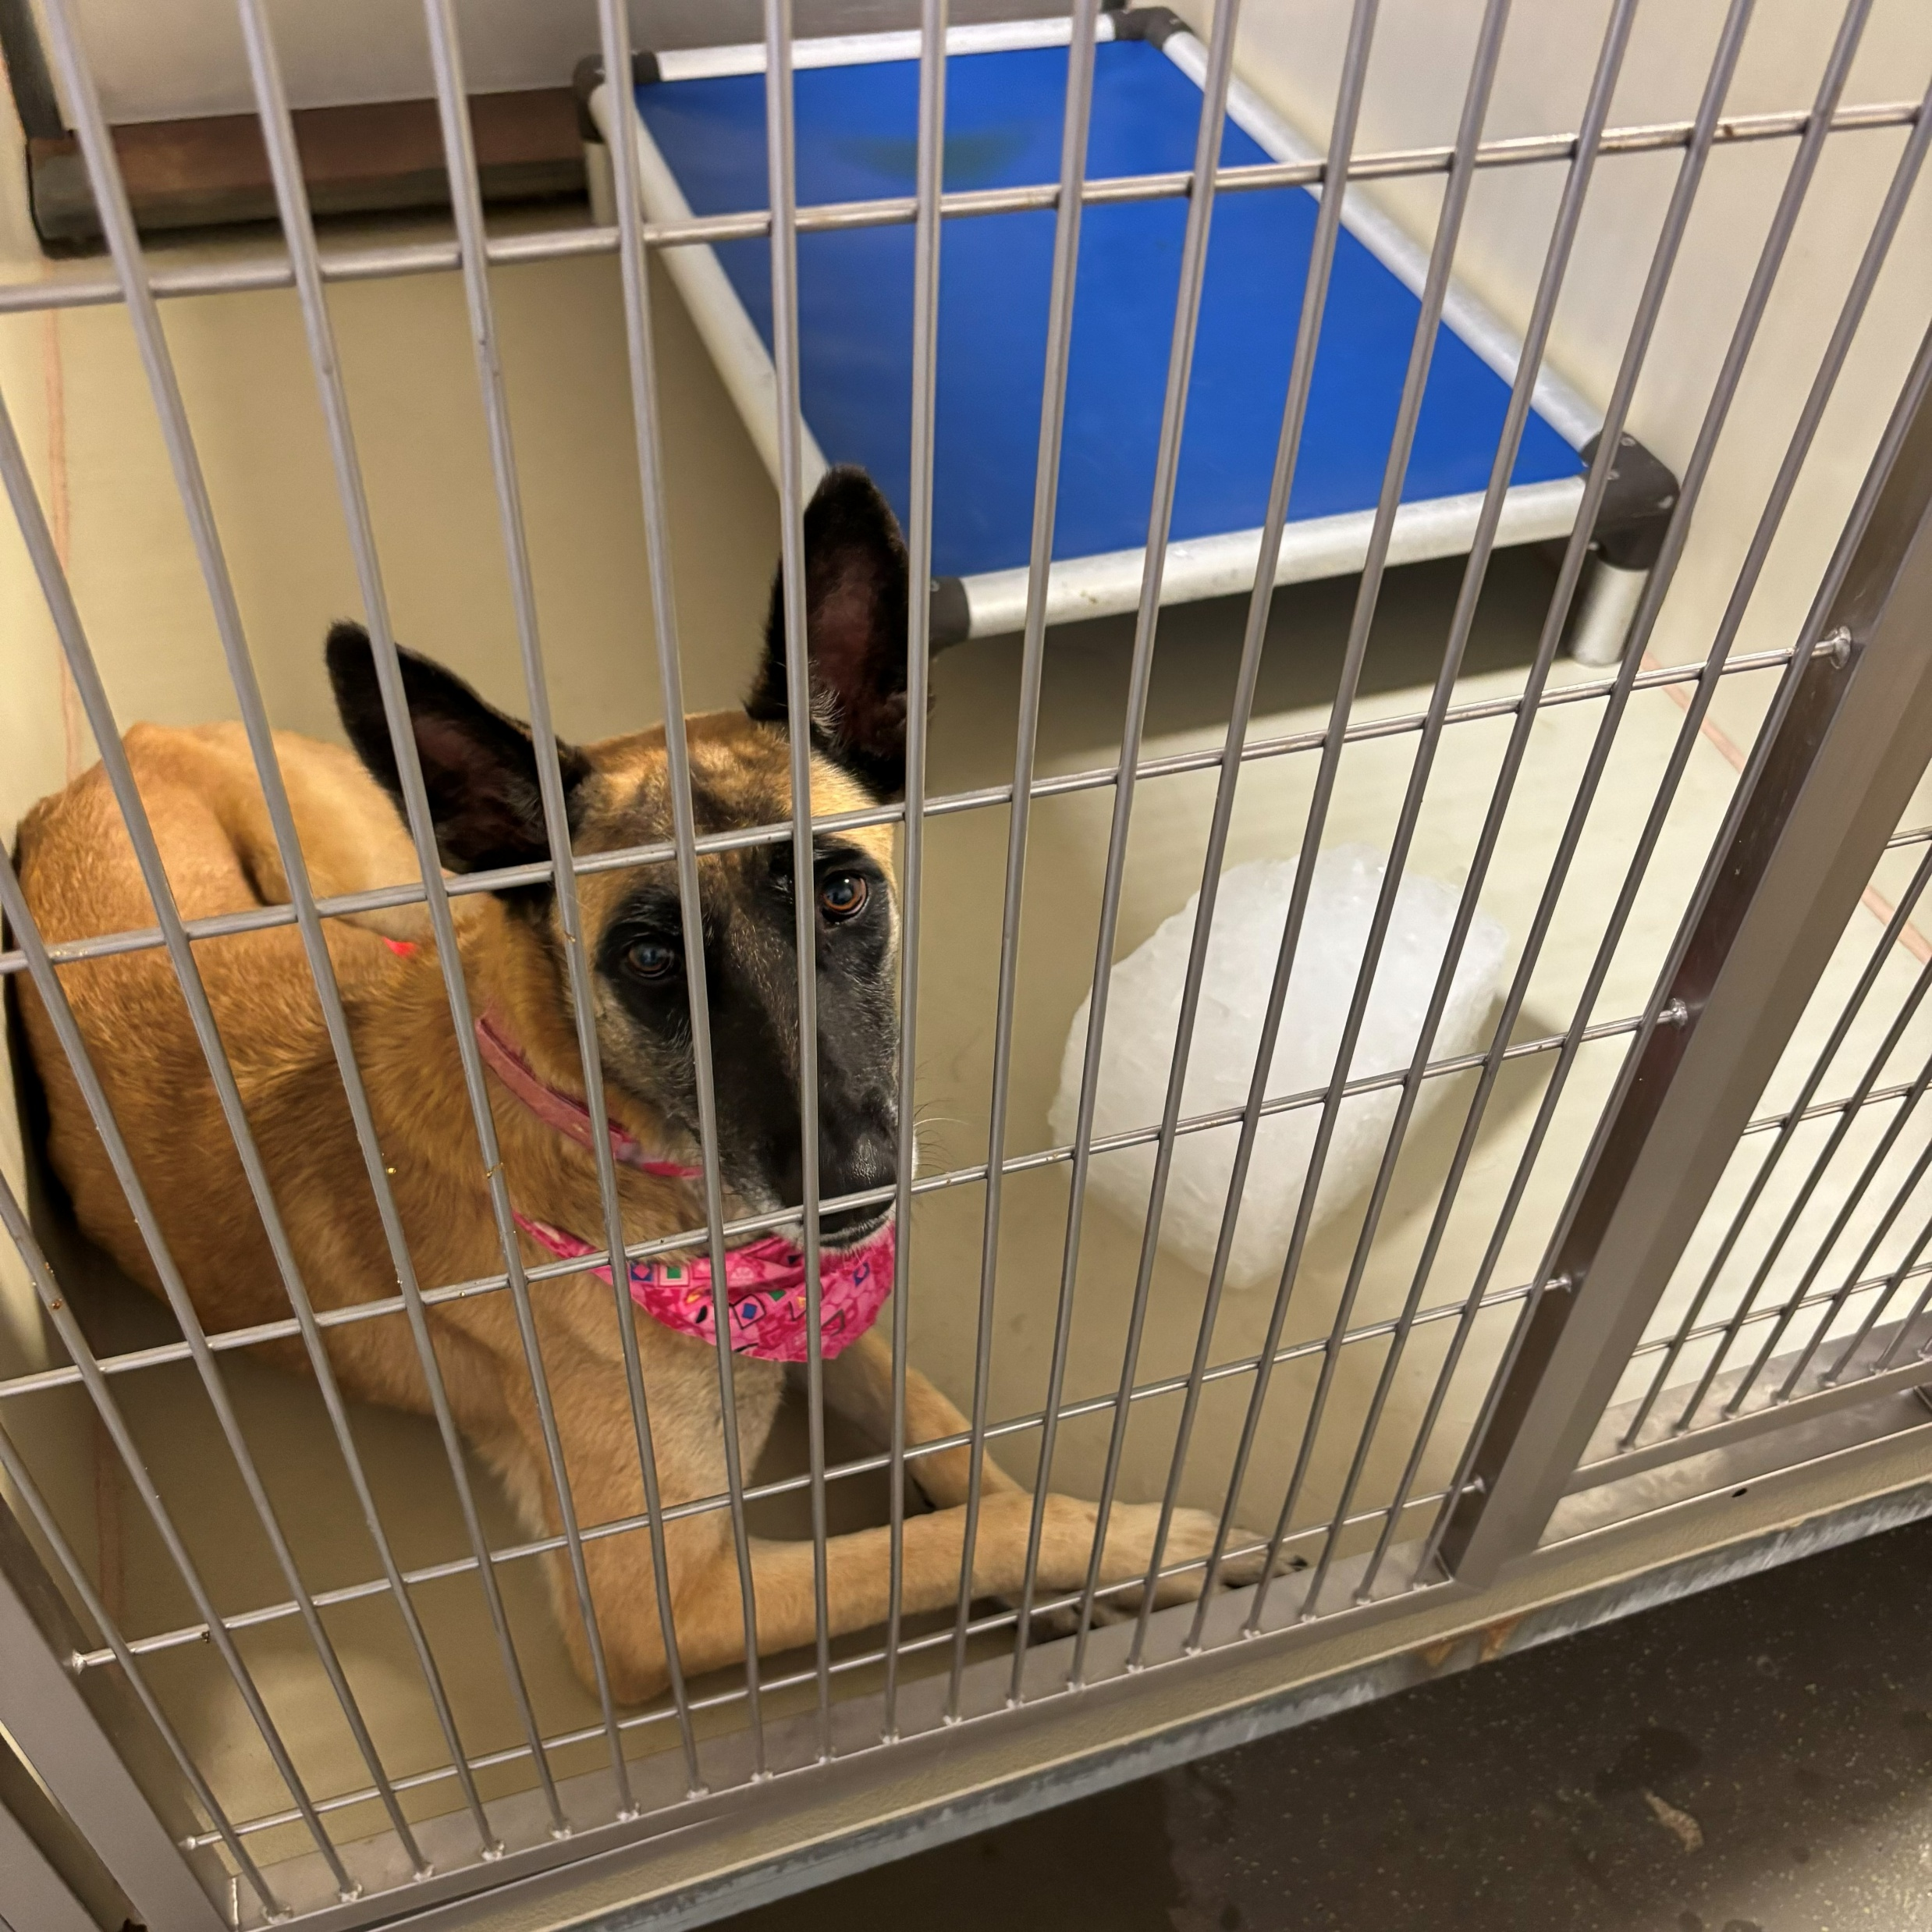
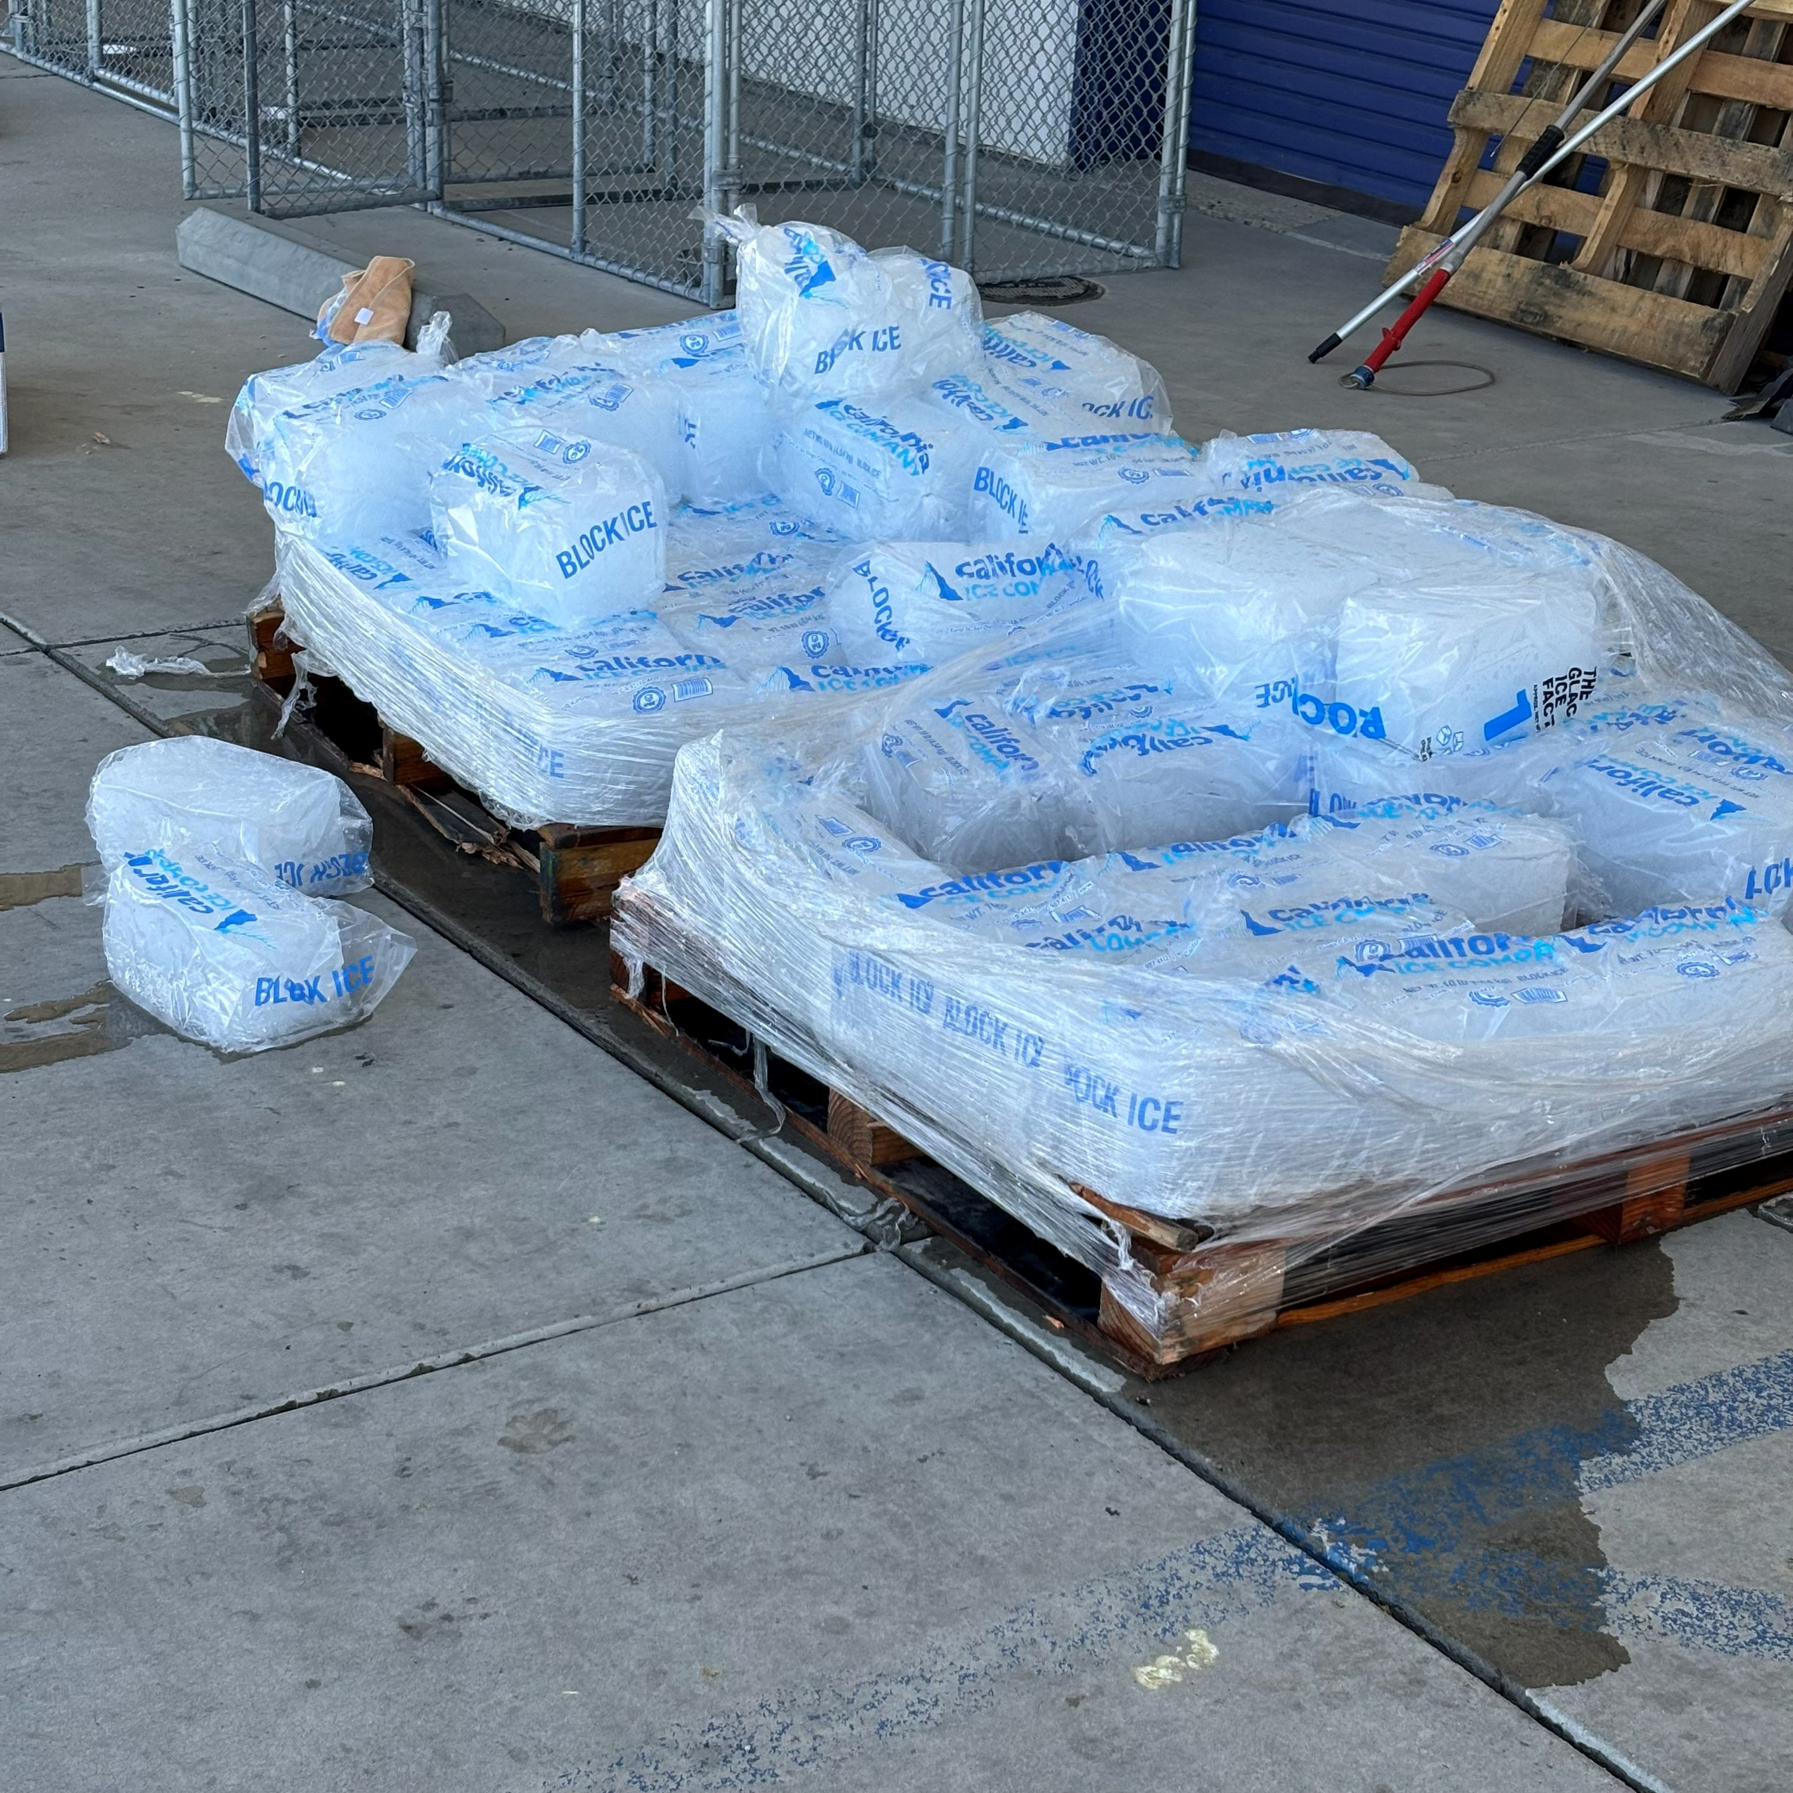
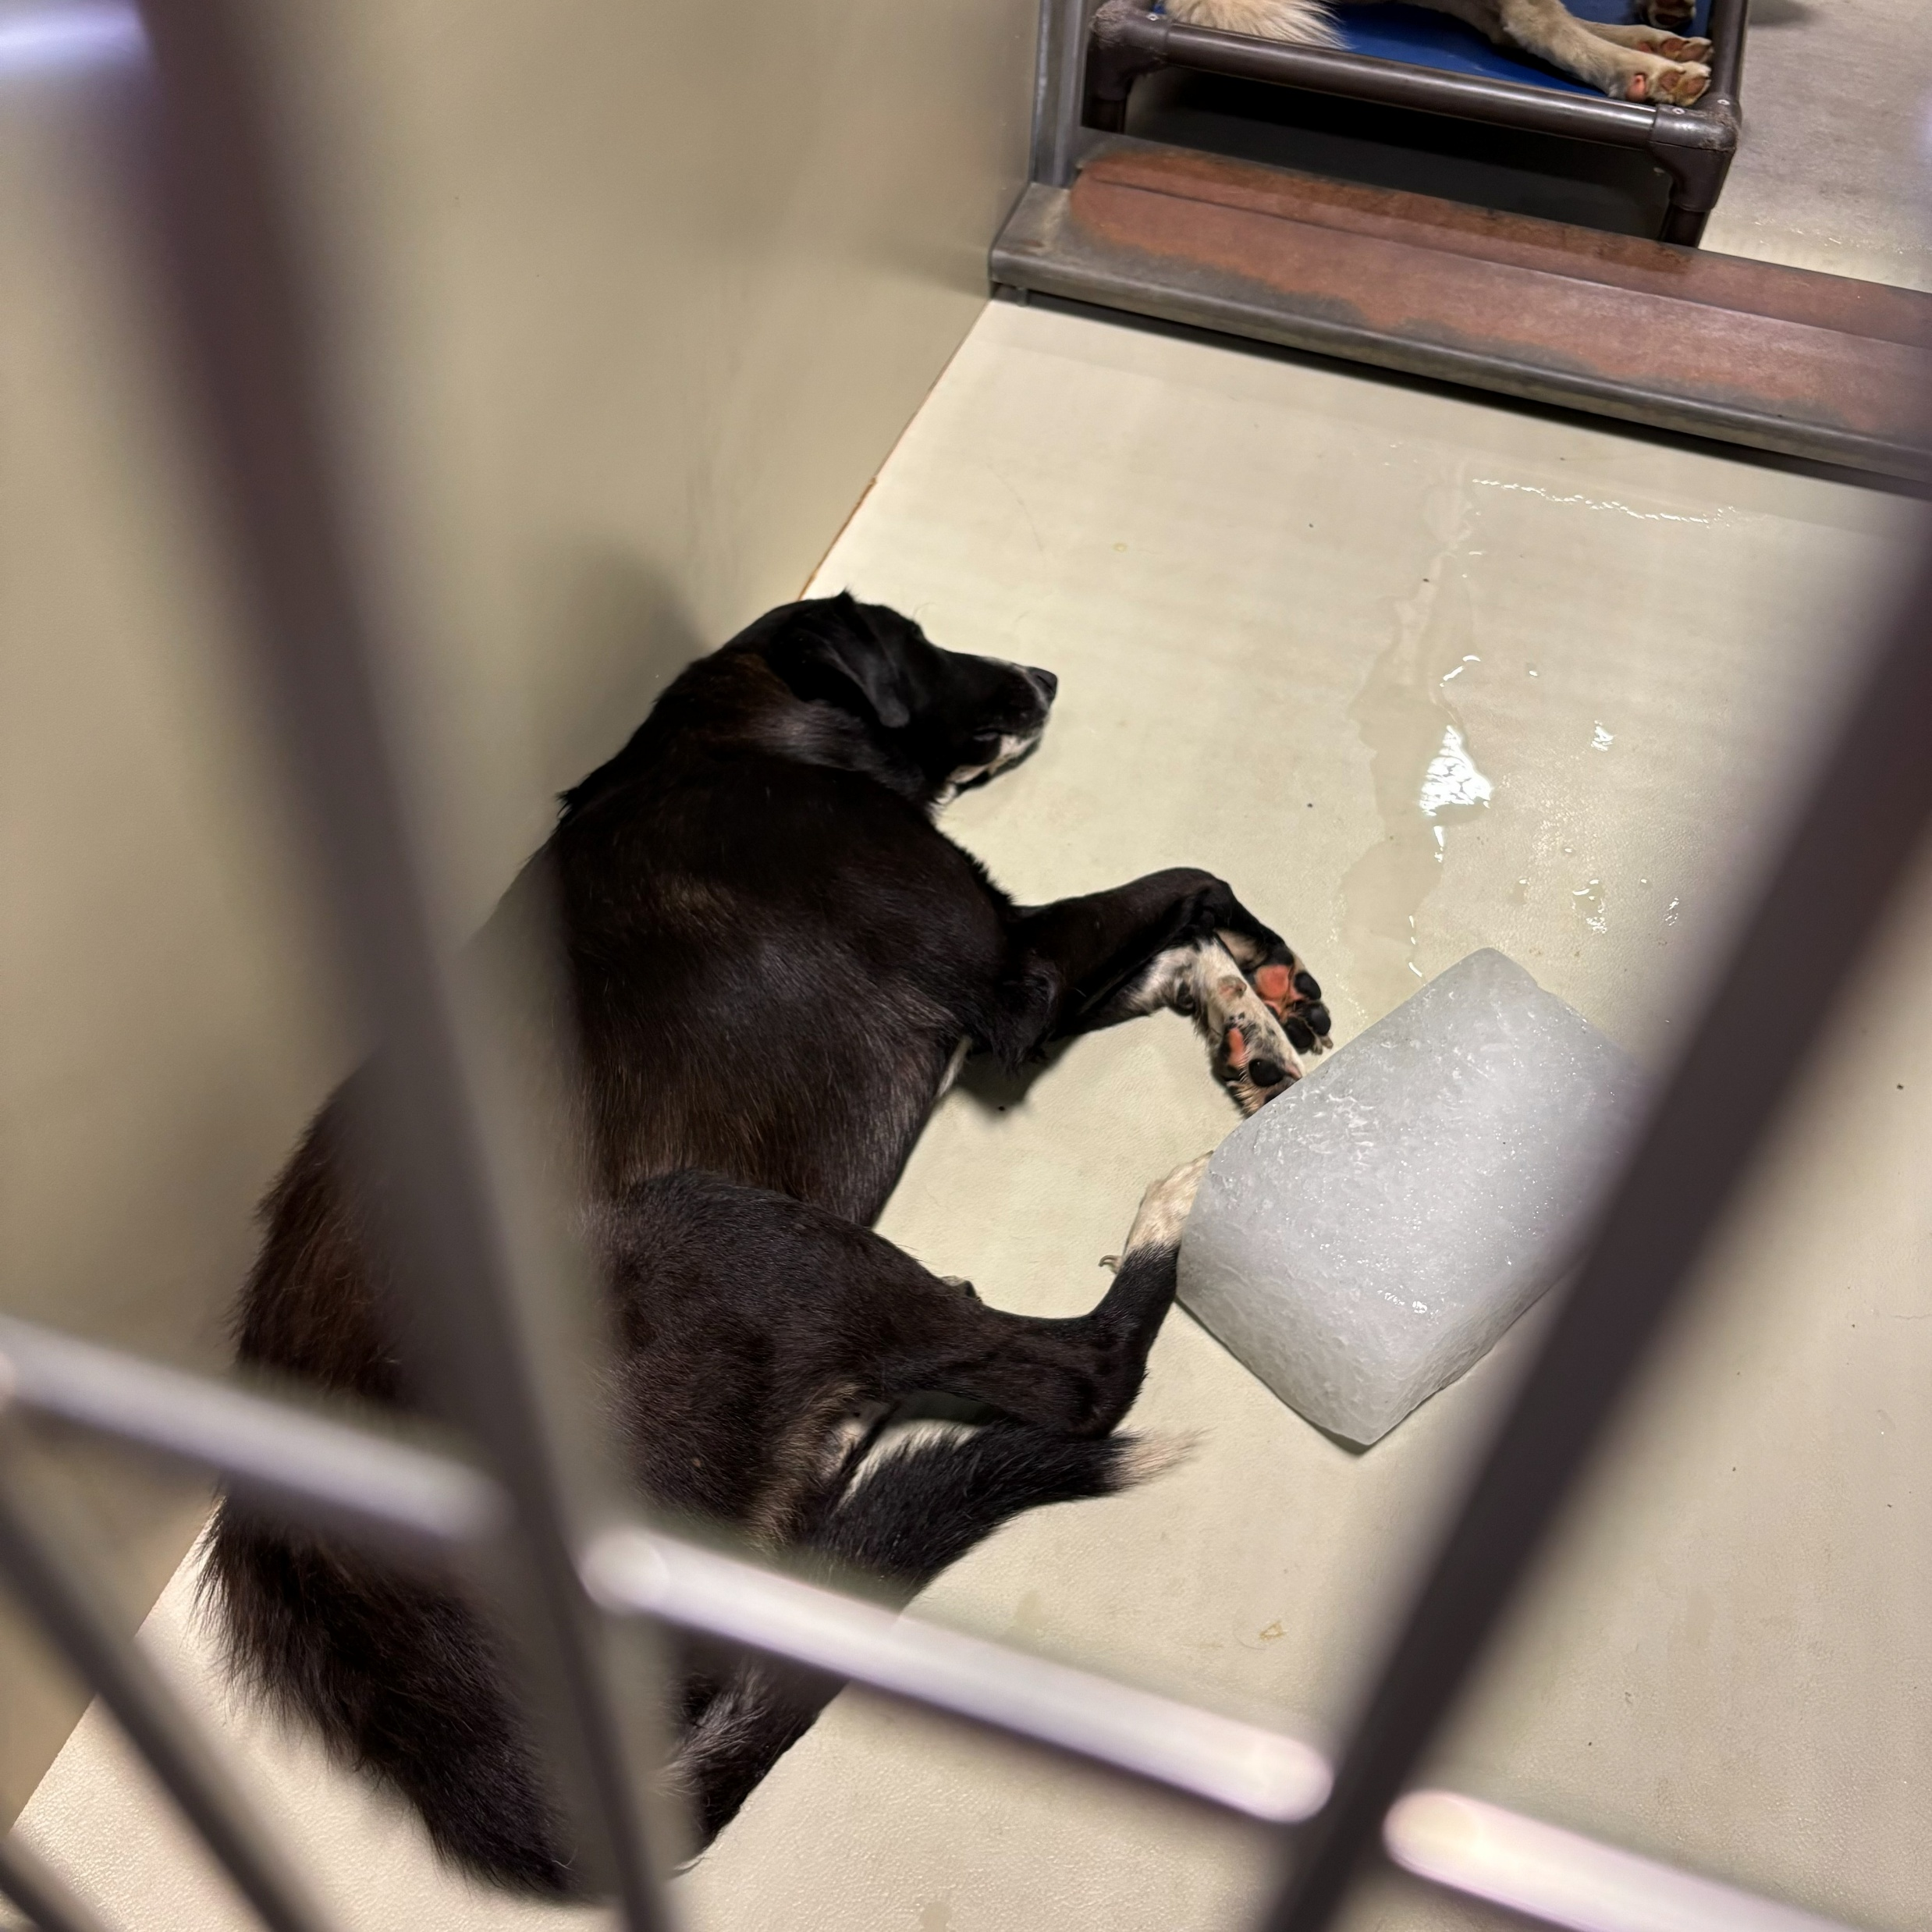
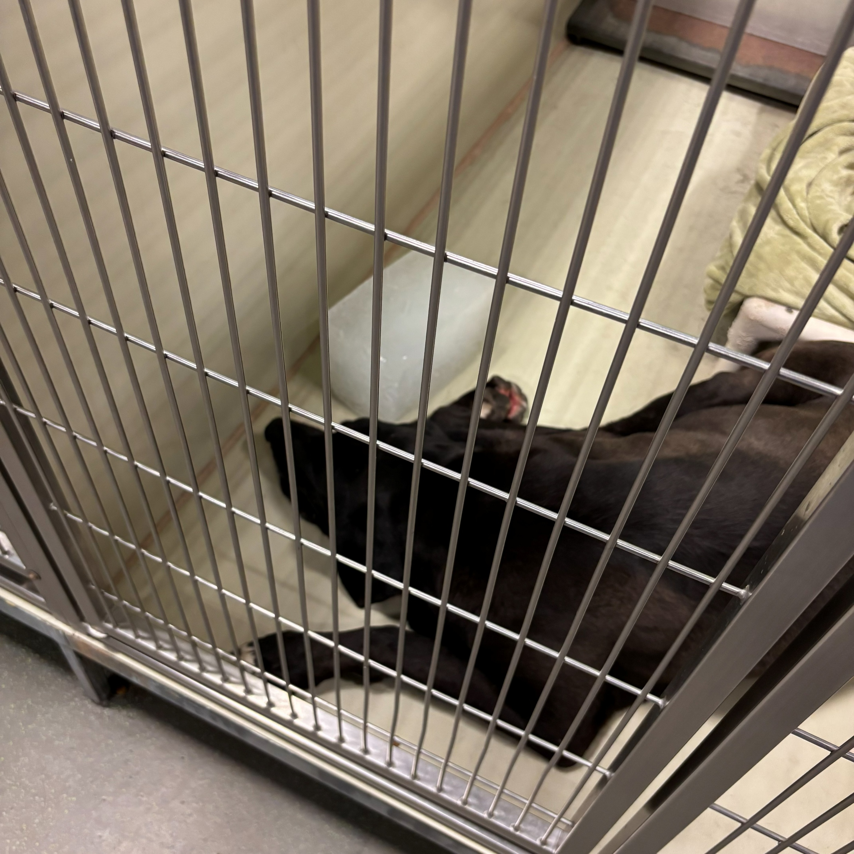

Slide 25
2026 Year To Date
January 1st – August 31st
3,452
Adoptions
2,765
Rescued
571
Returned To Owner
2,634
Spay/Neuter Surgeries (Clinics + TNR)
8,482
Total Lives Saved
79.44%
Save Rate

Slide 26
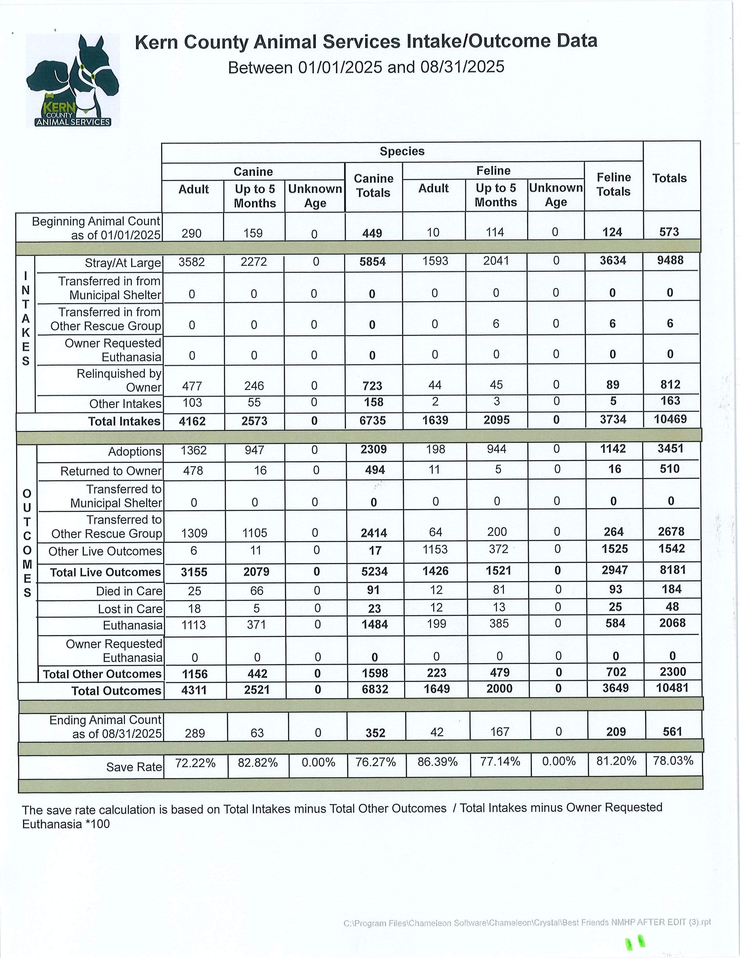

Slide 27
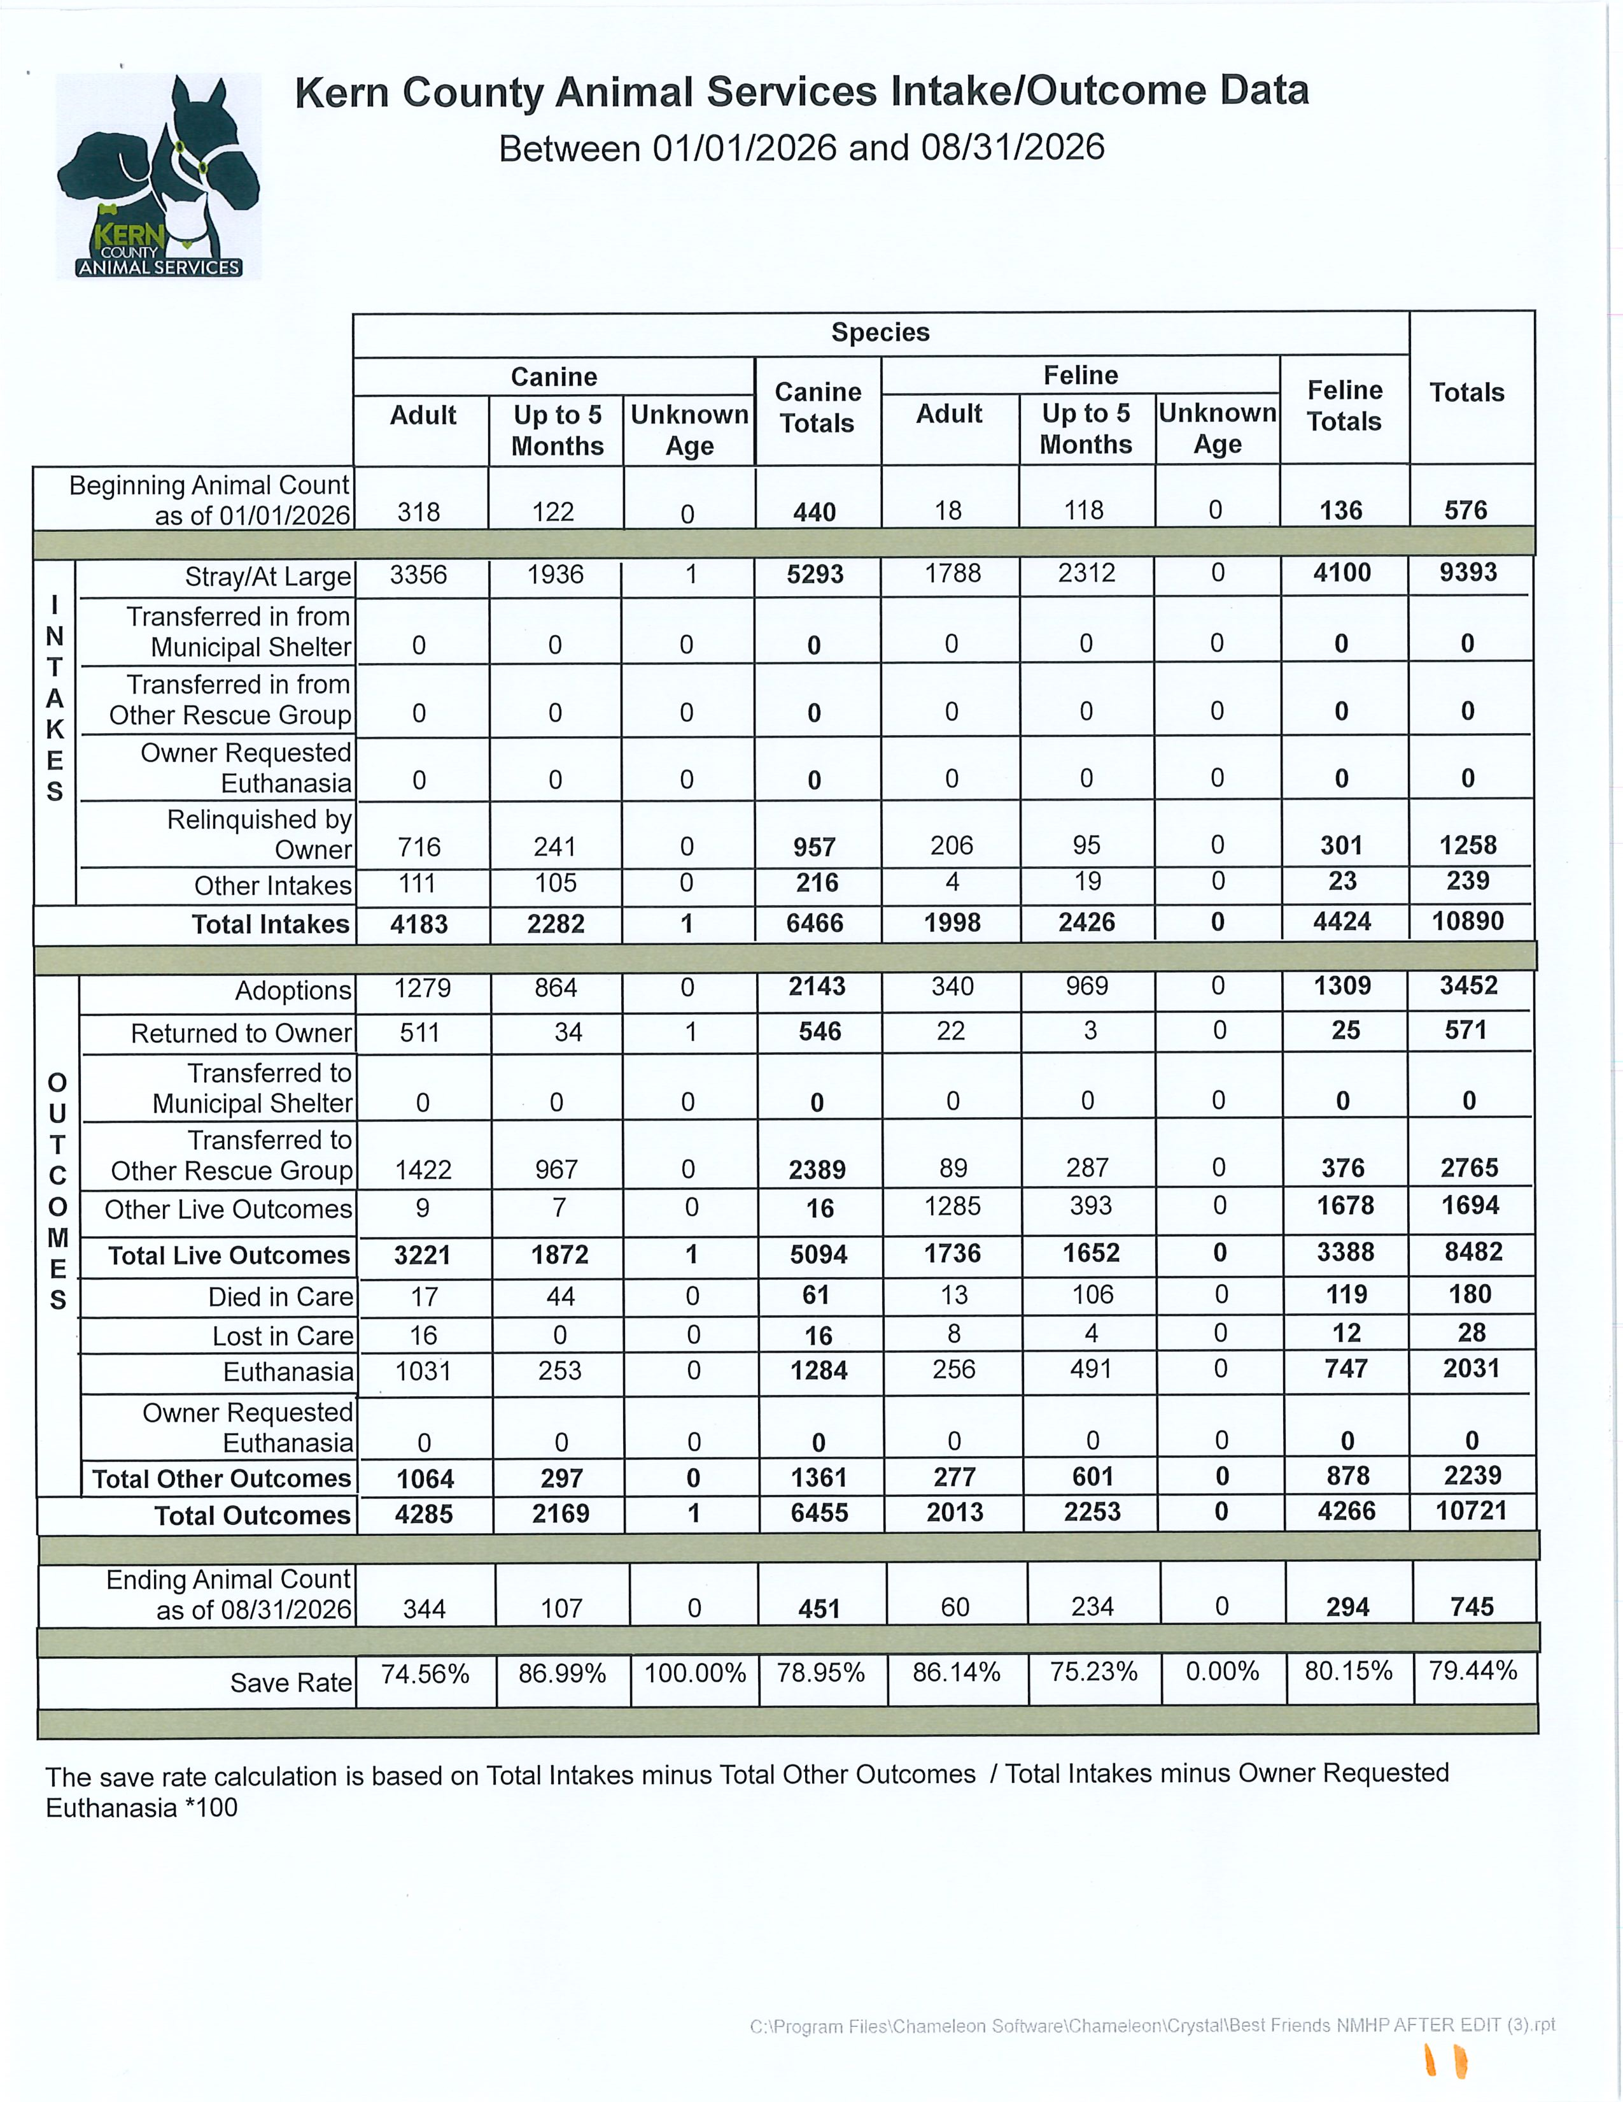

Slide 28
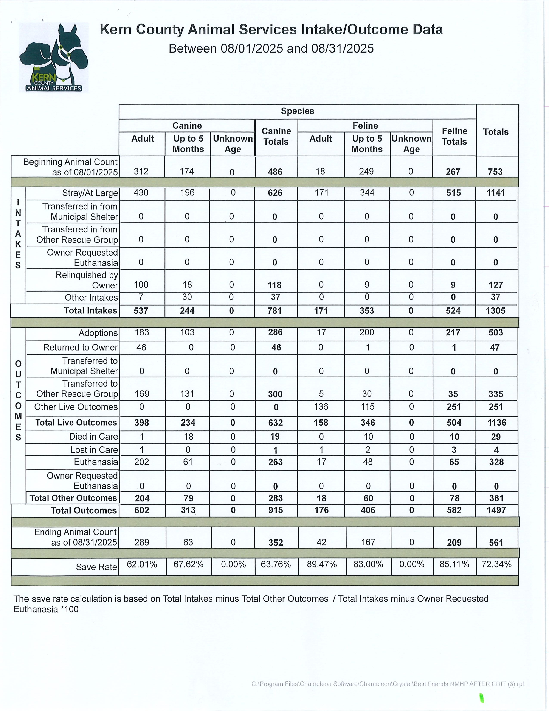

Slide 29
