Slide 1

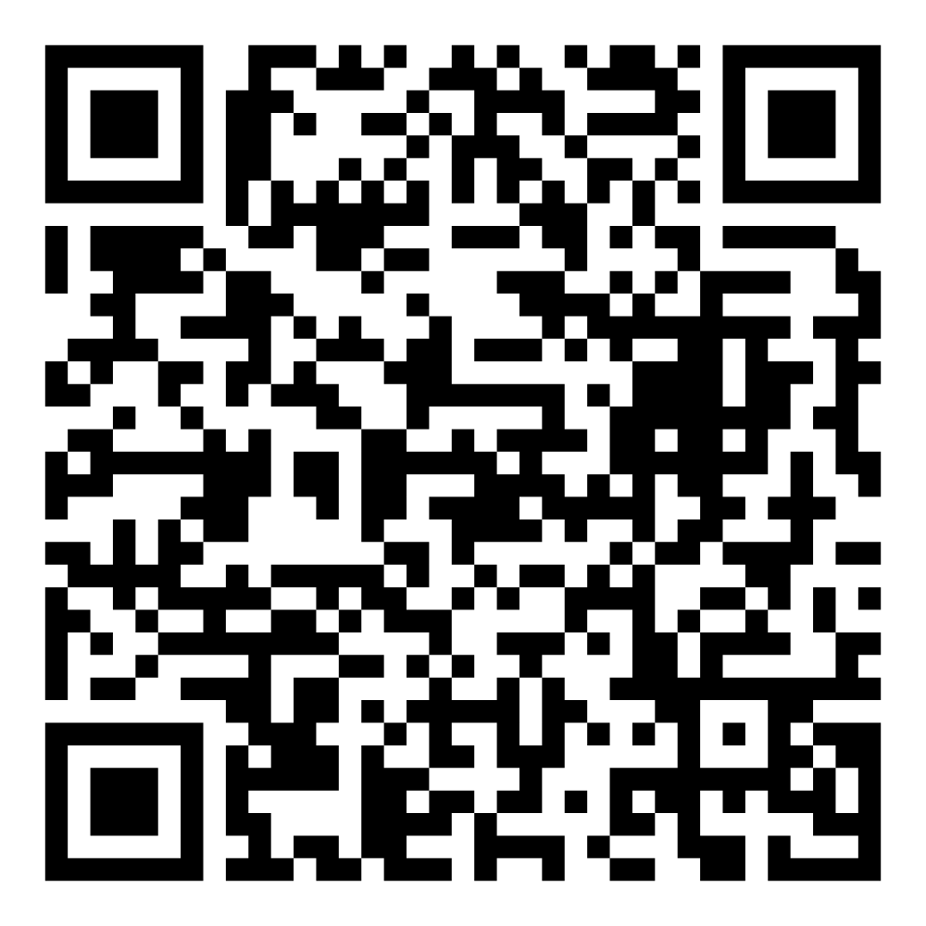
Director’s Report
September 2026

Slide 2



Program Highlights
September 2026
Adoption: 145 dogs, 85 puppies, 62 cats, and 125 kittens under 5 months of age were adopted for a total of 417 animals adopted from Kern County Animal Shelters in the month of September.
Foster: 26 dogs, 27 puppies, 3 cats, 136 kittens, and 2 other animals entered the Department’s Foster Care Program in September, for a total of 194 animals.
Rescue: 182 dogs, 101 puppies, 10 cats, and 30 kittens were transferred to other animal rescue organizations in September, for a total of 323 animals.
Spay/Neuter: A total of 447 animals were altered at low-cost KCAS spay/neuter clinics in the month of September.
TNR: 165 cats were spayed or neutered and released in September. Year-to-date, 1,843 cats have gone through the program, and since 2013 25,861 cats have been spayed or neutered and returned to field.

Slide 3

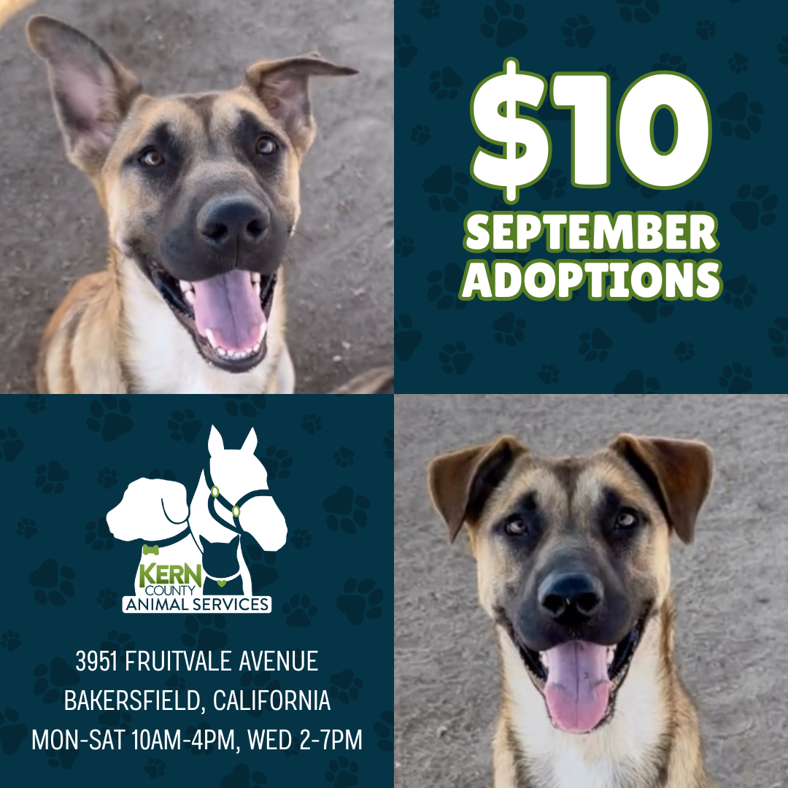
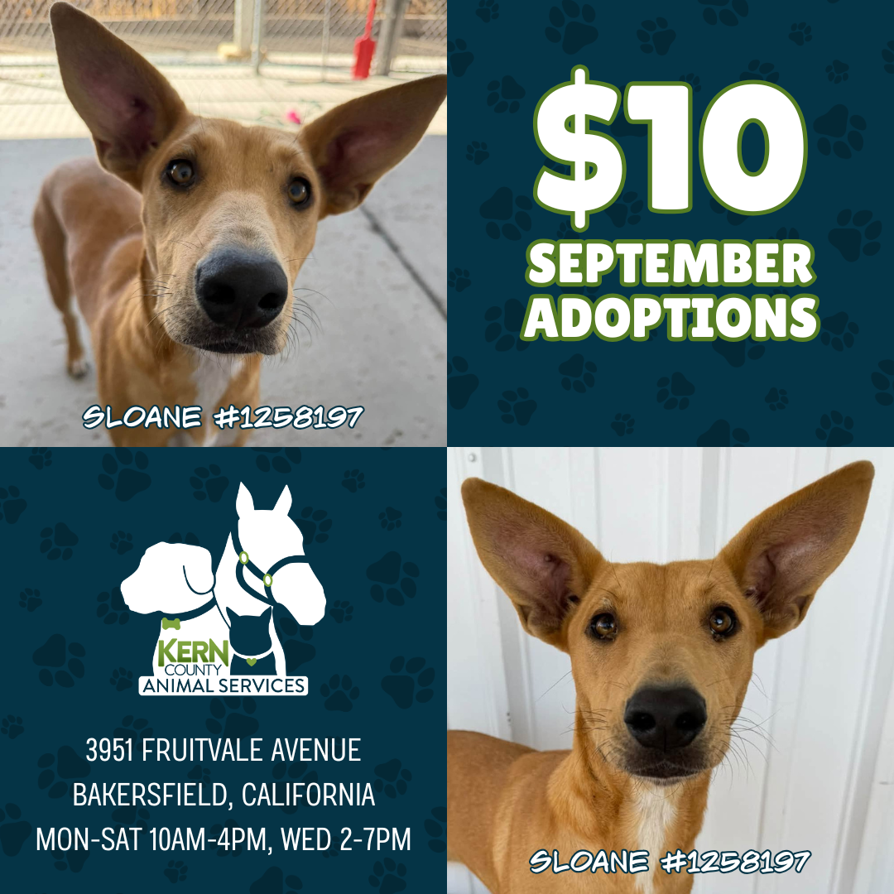
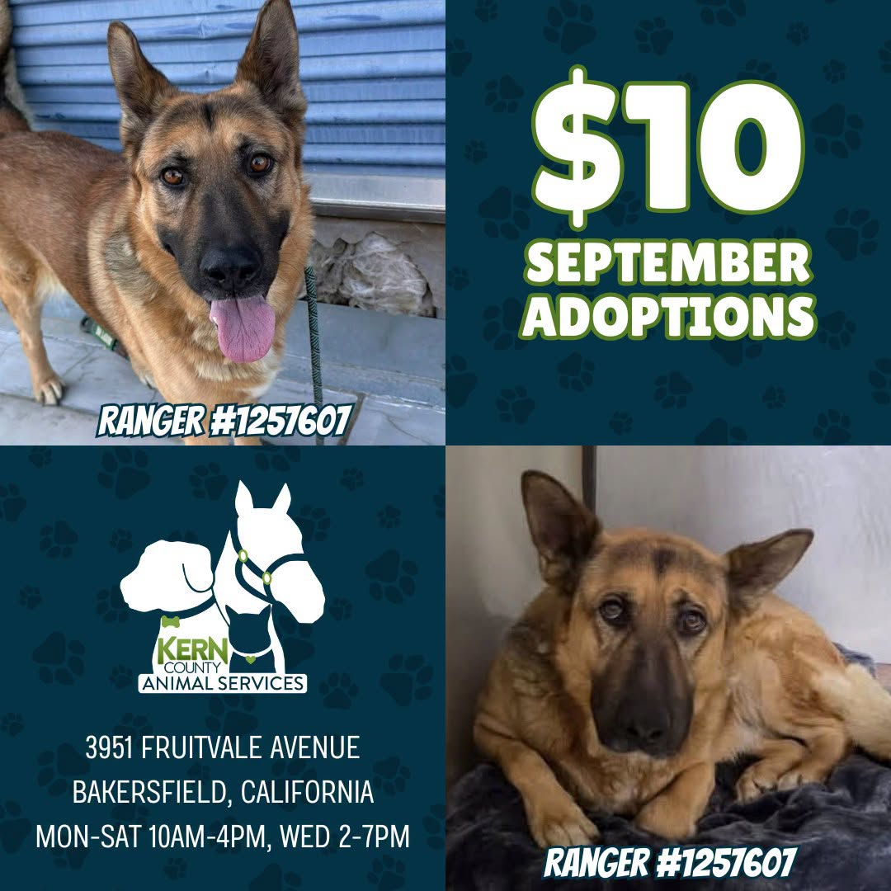

$10 Adoptions
September 1st – October 3rd

Slide 4
Offsite Adoption Events
Adoptable dogs from Kern County Animal Services are out in the community every Friday, Saturday, and Sunday!
These special events give some of our most overlooked dogs a chance to shine outside the shelter. Many of them have been waiting patiently for their forever homes for no fault of their own! This is their chance to stand out!
Offsite events are a great way to connect in a more relaxed setting, where folks can spend time getting to know a smaller group of carefully selected, highly adoptable dogs.

Slide 5


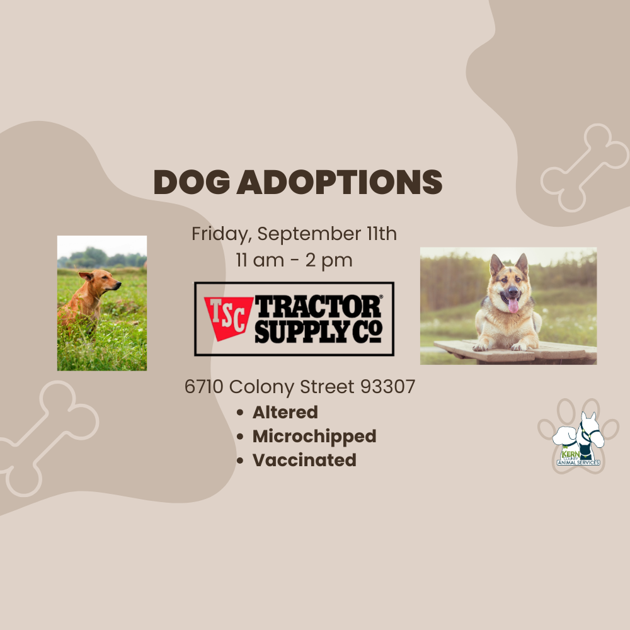




Slide 6
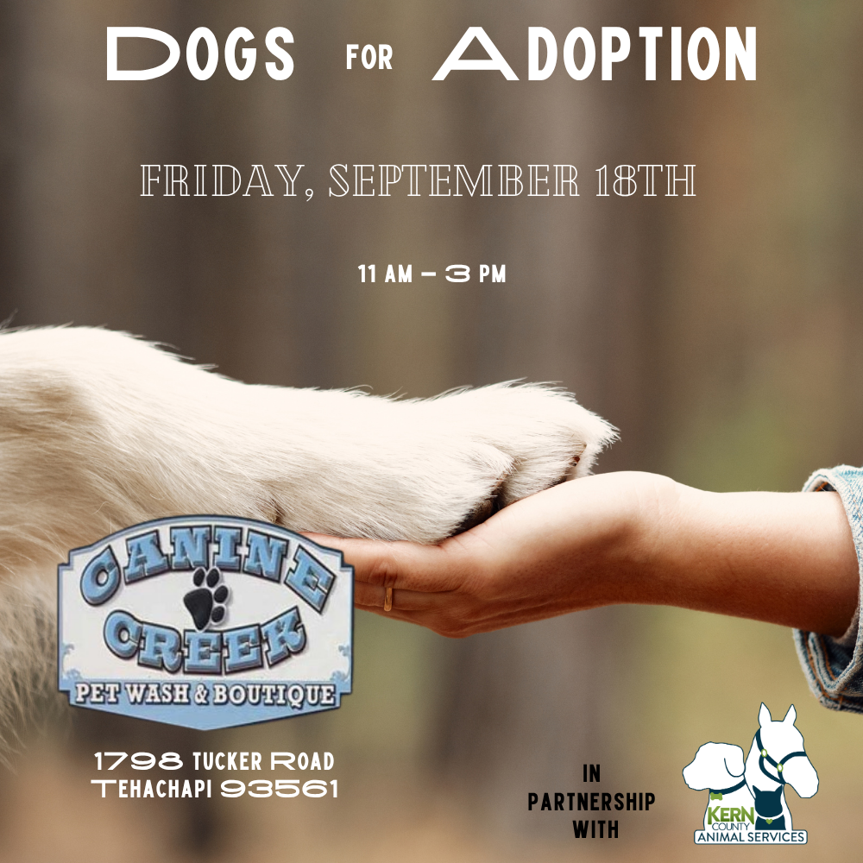
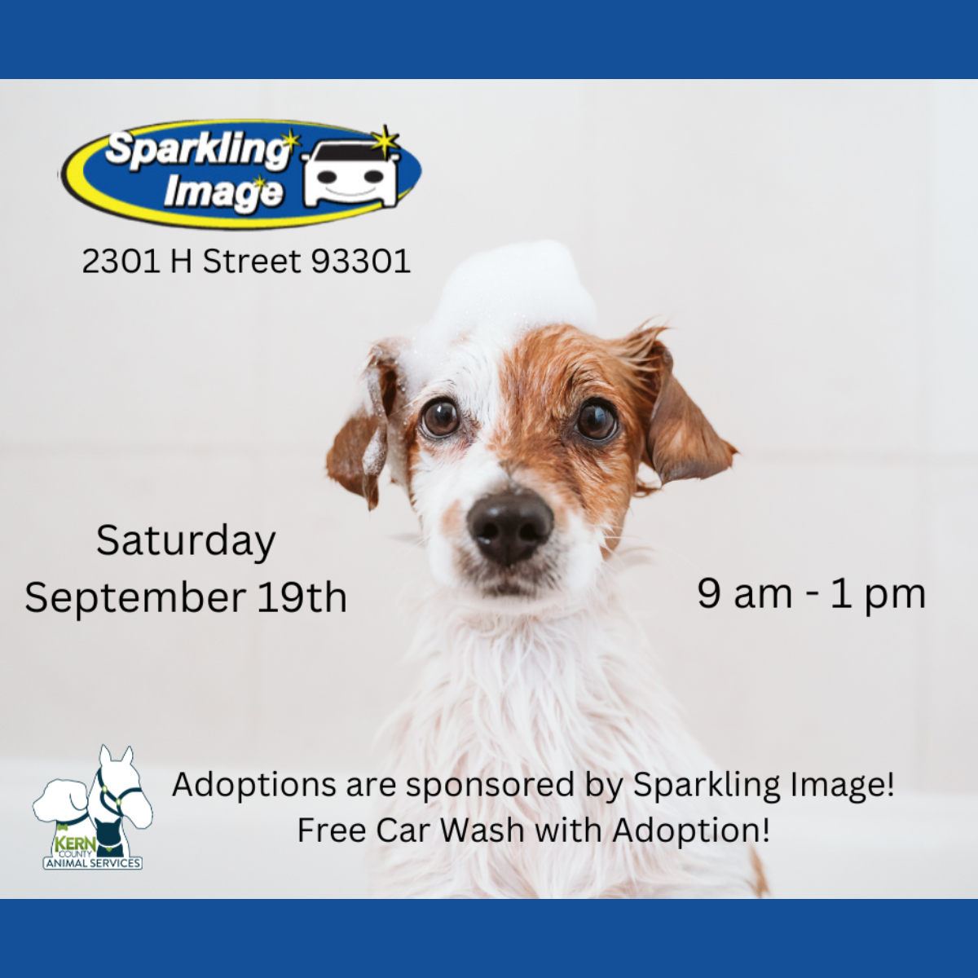





Slide 7
Streets of Bakersfield
Streets of Bakersfield is our "Doggy Day Out" program where the public can take shelter dogs on day outings. Your adventure can include a hike, a trip to the park, a coffee date or even hanging out at home.
These field trips help our shelter dogs manage kennel stress, burn off energy and get more exposure to potential adopters.
You can take a dog out for a few hours or even for the whole weekend!
Dogs can be picked up between 10am and 12 noon. “Day Out” dogs are brought back by 3:30pm. “Sleepover” dogs are returned the following Monday before 4pm.
The Streets of Bakersfield program runs every other Saturday.

Slide 8
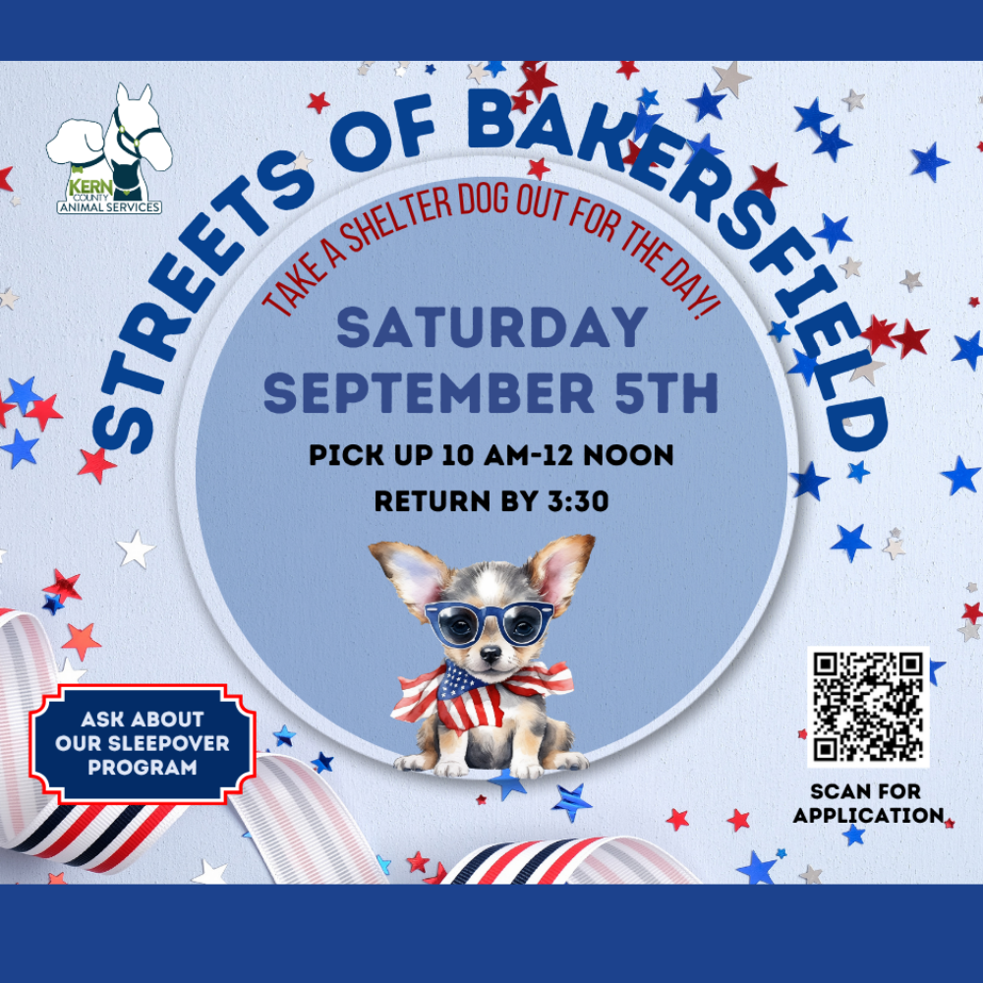
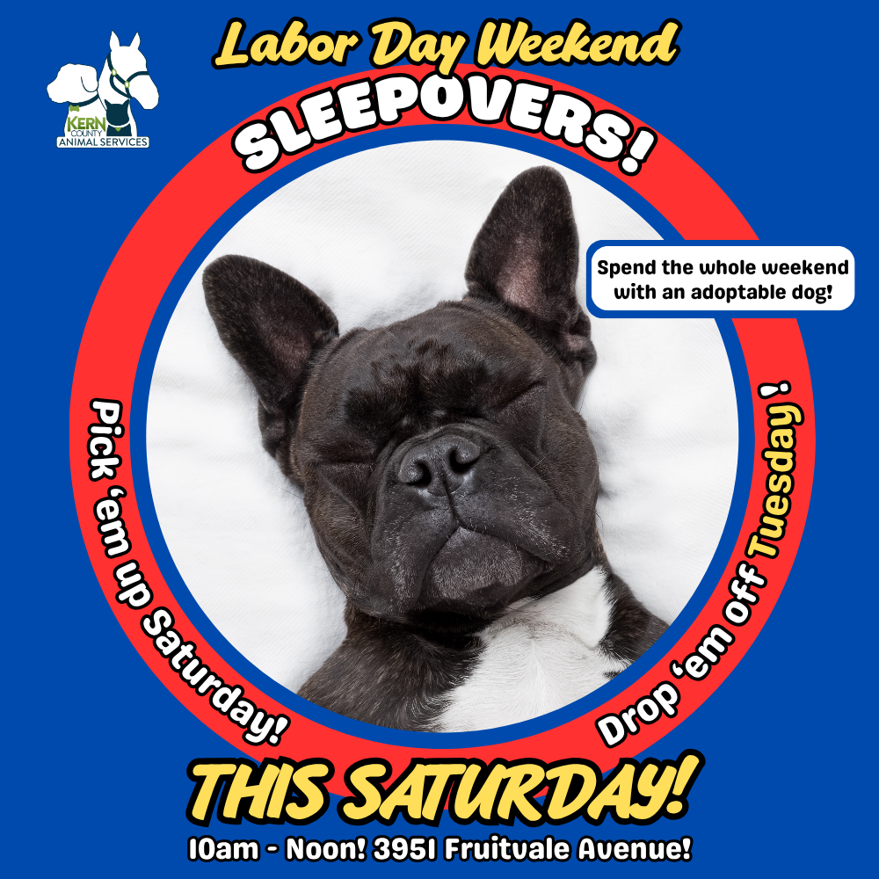

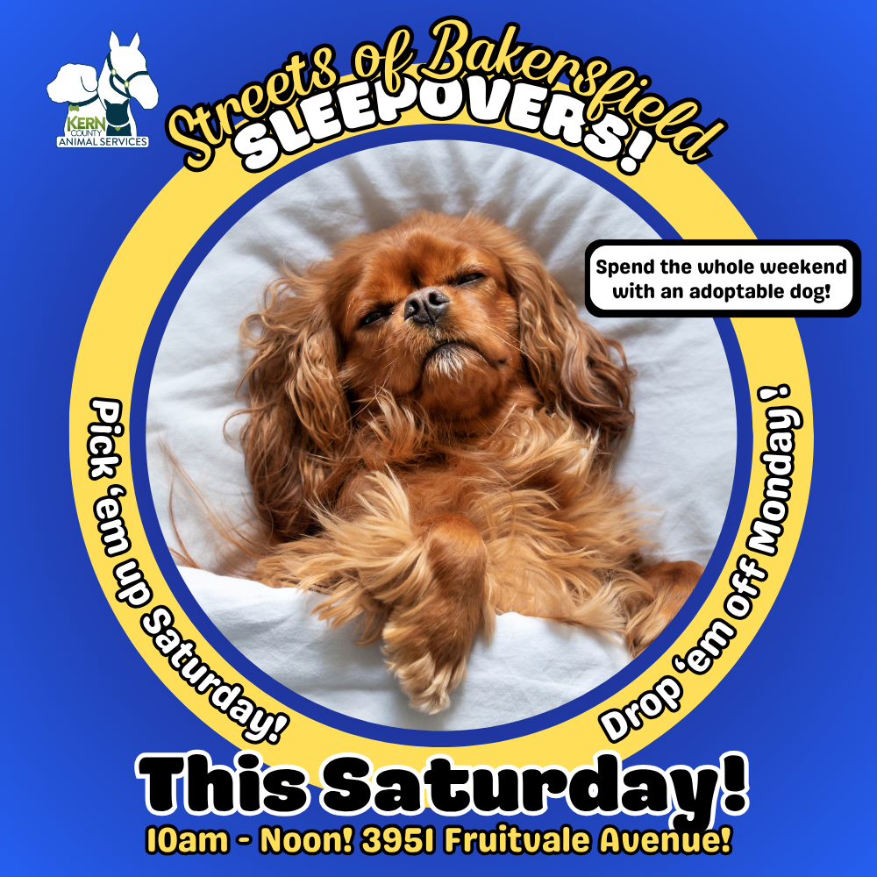

Slide 9
Low-Cost Spay/Neuter Clinics
September 2026
Date | Location | Surgeries
Sept. 2nd | Oildale (Rathbun Library) | 45
Sept. 3rd | Heritage Park | 30
Sept. 8th | Heritage Park | 67
Sept. 11th | Heritage Park | 24
Sept. 15th | Oildale (North Chester & Roberts) | 53
Sept. 16th | Oildale (Rathbun Library) | 55
Sept. 17th | Heritage Park | 27
Sept. 23rd | Heritage Park | 57
Sept. 25th | Pioneer Park | 29
Sept. 30th | Heritage Park | 60
 | Total Surgeries | 447

Slide 10
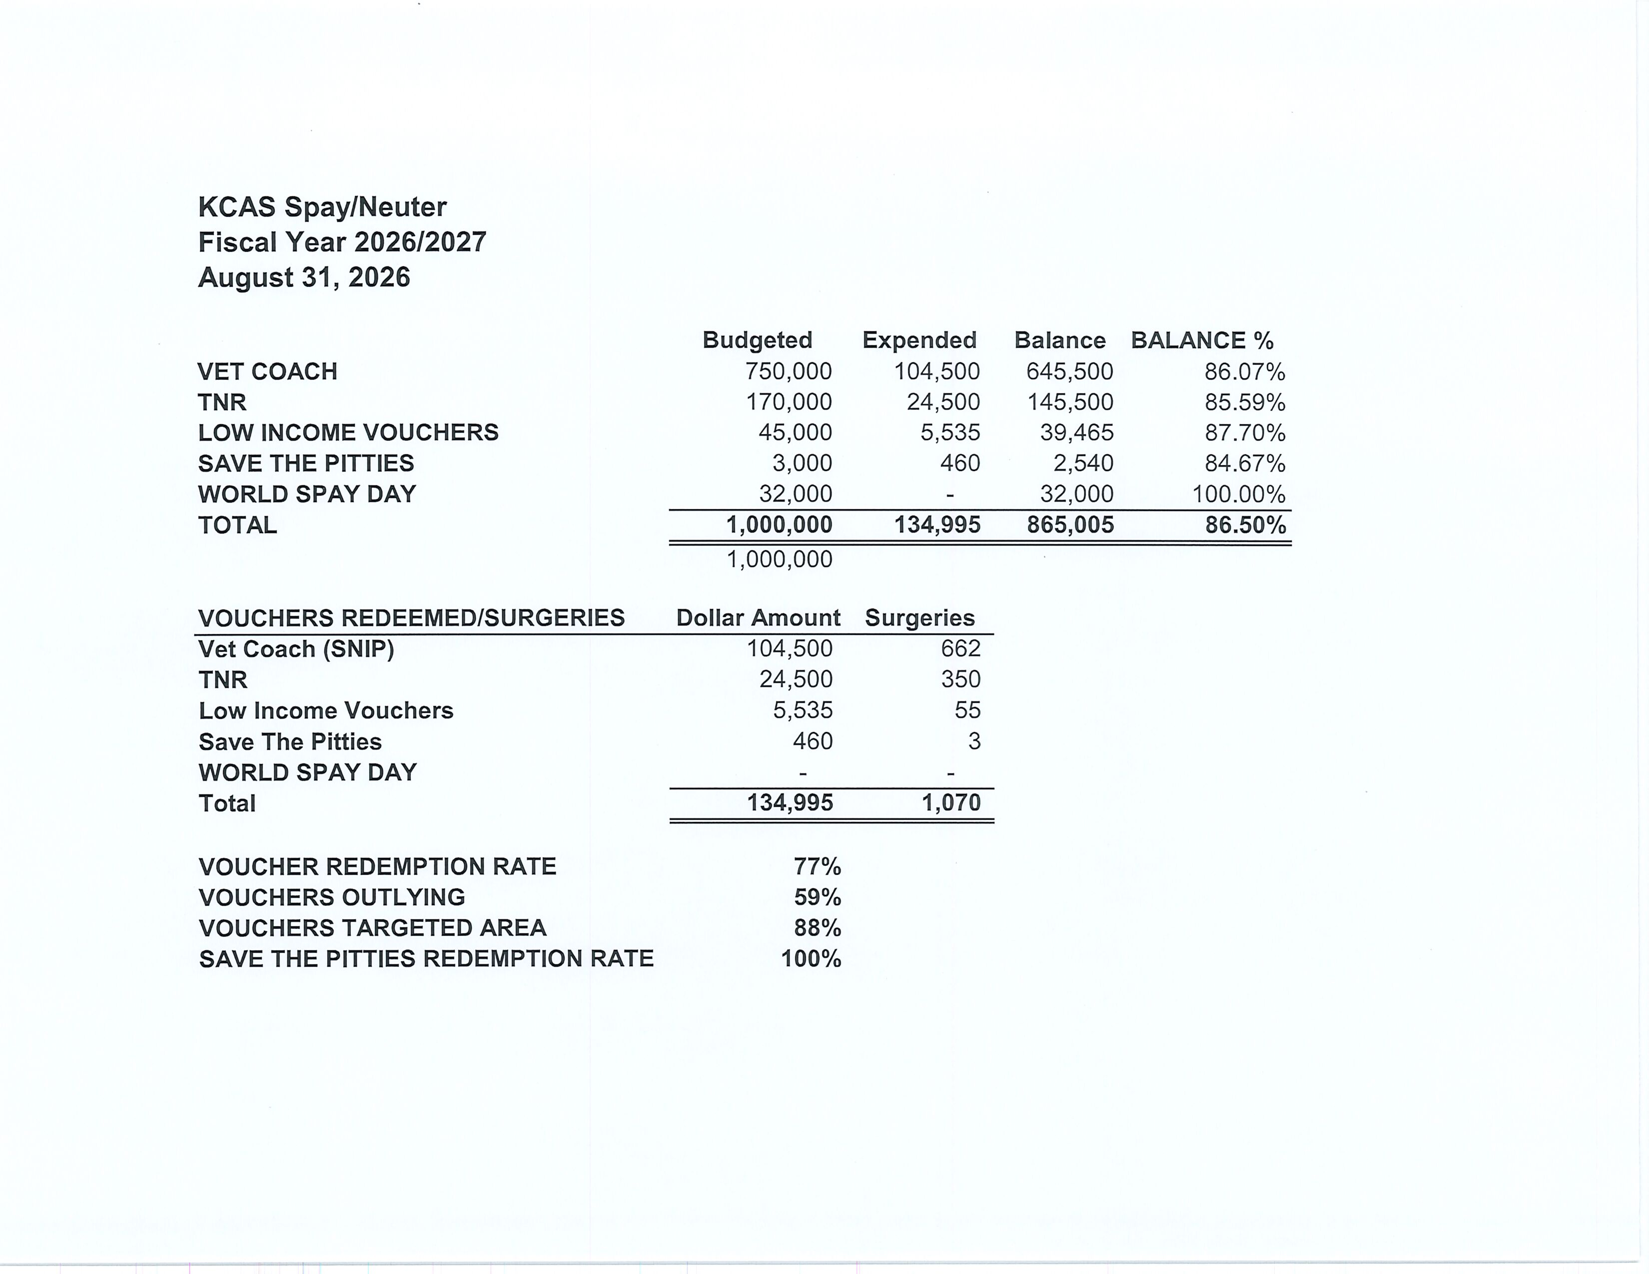

Slide 11
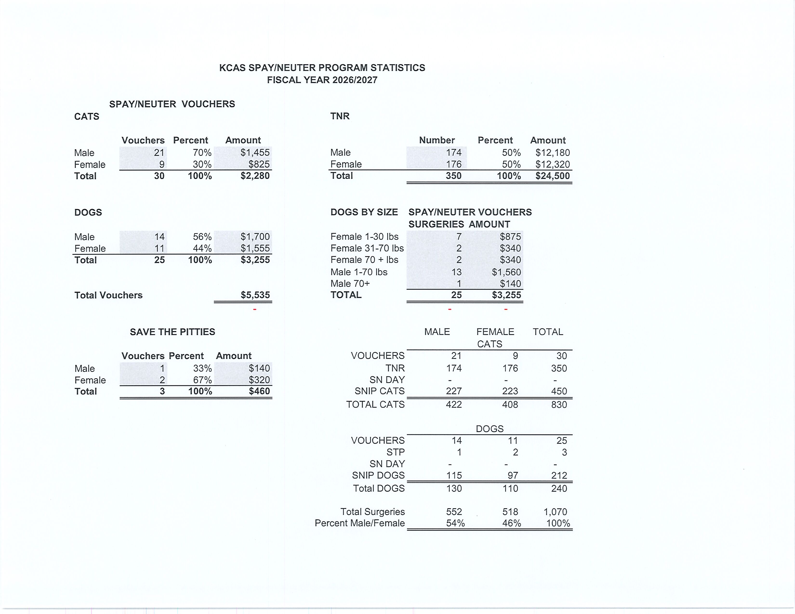

Slide 12

Free SPHP Clinics
In partnership with Kern Behavioral Health and Recovery Services, the KCAS Medical team held two successful Supporting Pets of Homeless People clinics in September.
Together, these two clinics helped 38 pets belonging to people experiencing homelessness by providing access to essential veterinary care and supporting the bond between people and their beloved companions.
Services offered included vaccinations, deworming, flea and tick treatment, and exams for minor medical problems.
We are grateful to everyone who helped make these clinics possible and to our community partners for helping us provide compassionate veterinary care to people who might otherwise be unable to afford it for their pets.

Slide 13
Low-Cost Vaccination Clinics
September 2026
Rabies
414
Microchips
Bordetella
27
27
DHPP* 194
FVRPC* 241
*DHPP and FVRCP vaccinations provided at no-cost by Petco Love.

Slide 14
Field Service Calls: September 2026
AREA | CALLS PER AREA
Lake Isabella | 94
Mojave | 166
North County | 34
Northeast | 280
Northwest | 282
Ridgecrest | 33
Southeast | 143
Southwest | 153
Taft | 89
Tehachapi | 79
TOTAL | 1,353
25 dogs were returned to their owners in the field
in September 2026.
51 dogs were secured on property by Animal Control Officers in September 2026.

Slide 15
Commercial Animal Facility Calls
September 2026
TYPE | CALLS PER TYPE
CAF – Breeder | 26
CAF – Rescue | 11
CAF – Kennel | 0
CAF – Boarding | 9
TOTAL | 46
7 Inspections Passed
0 Inspections Failed
0 Citations Issued
0 Permits Issued
52 Active CAF Permits

Slide 16
Volunteer Program
September 2026
Active Volunteers
100
New Volunteers
35
Volunteer hours donated in August.
Year-To-Date volunteer hours donated in 2026.
574.6
5,186.8

Slide 17
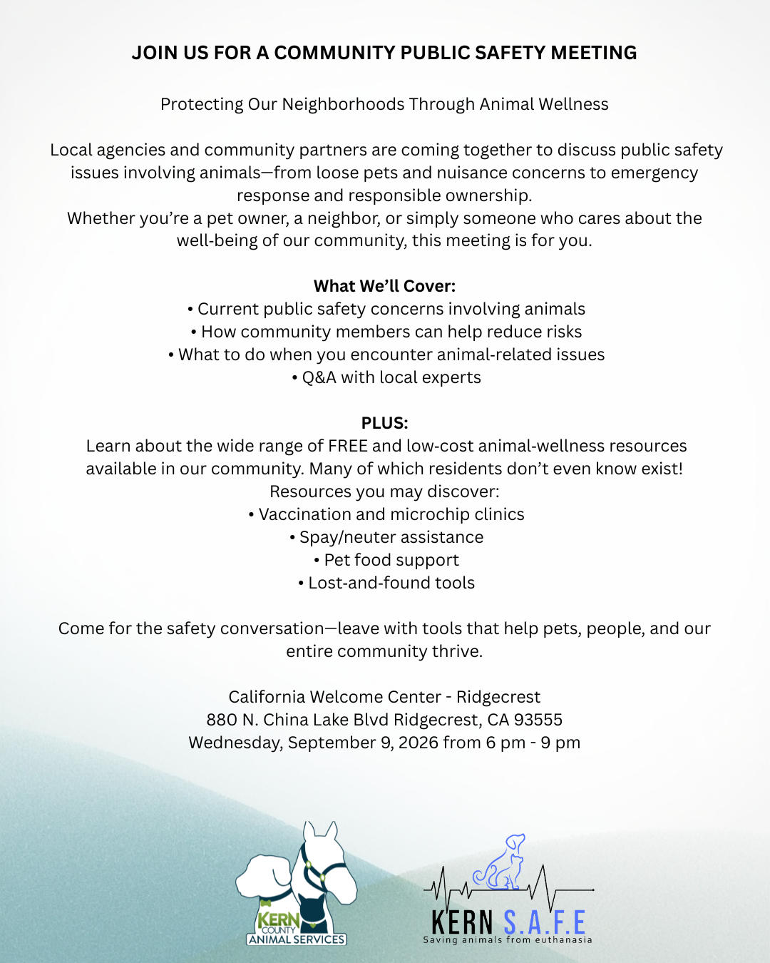
Ridgecrest Community
Meeting
On Wednesday, September 9th, community members gathered in Ridgecrest for an evening of conversation about animal welfare and the well-being of their community.
The meeting brought together leadership from Kern County Animal Services, SOS Dog Rescue - Strength of Shadow, and Kern SAFE to connect with residents, hear concerns, and discuss issues affecting local pets and the community.
Thank you to everyone who took the time to participate and show their support for the animals and people of Ridgecrest!

Slide 18
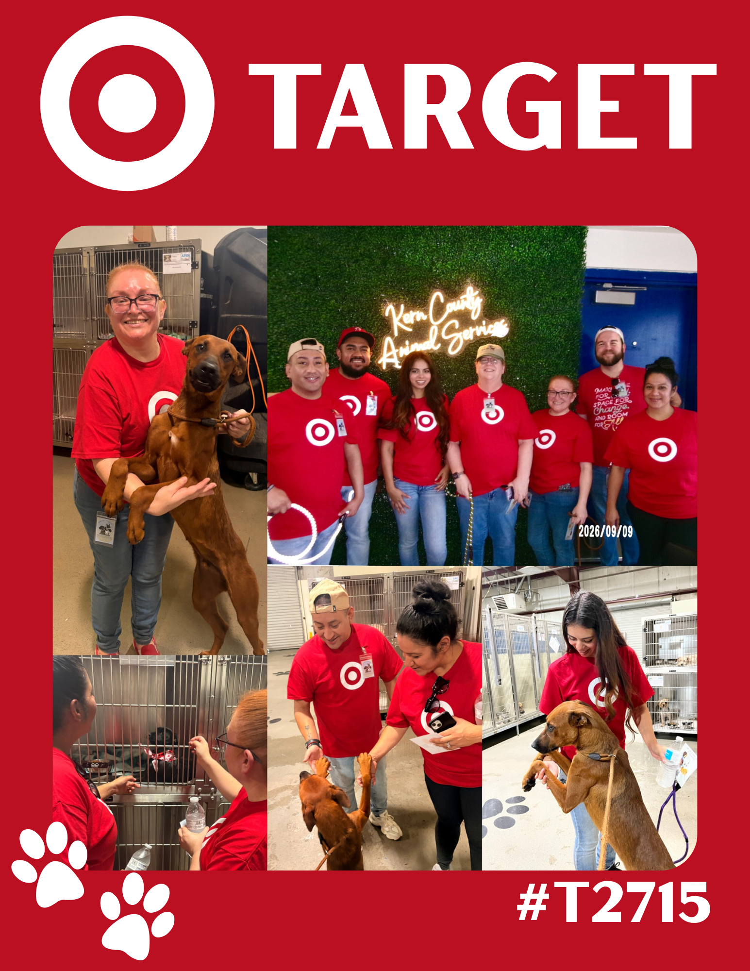
Thank you, Target!
The fine folks from the Target on Stockdale Highway volunteered their time to our shelter pets on Thursday, September 10th!
They provided so much affection and attention to the animals in our care. Taking them for walks, taking them to the play yard, giving them pets and treats, and just making their time in the shelter a whole lot brighter!
If you'd like to volunteer any amount of your time to help the homeless pets in our shelter, hit us up at KernCountyAnimalServices.org + How To Help + Volunteer!

Slide 19
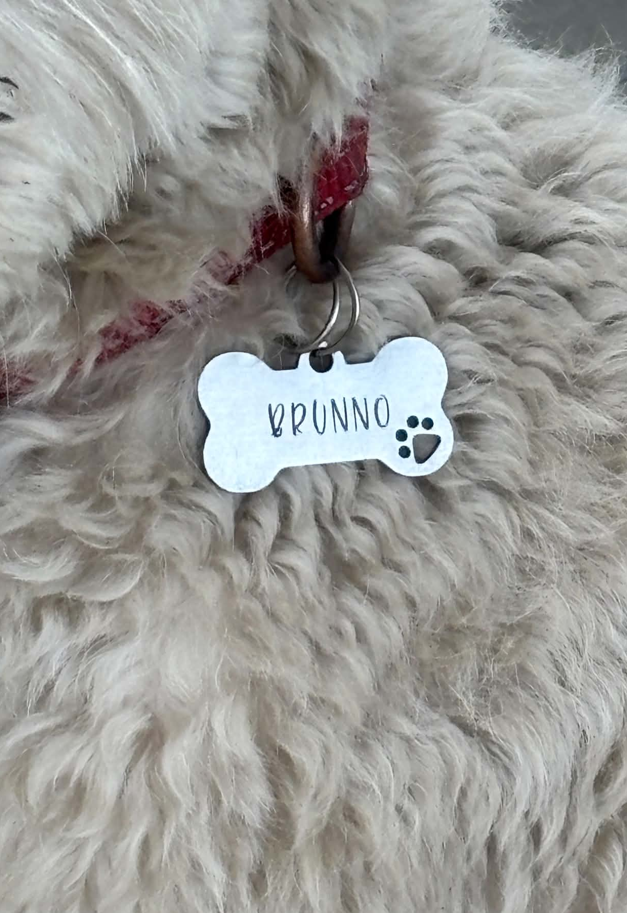
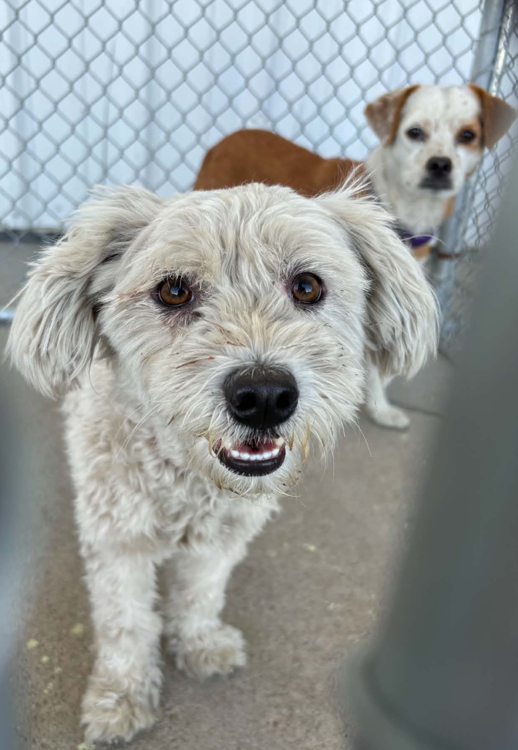
Brunno is
Back Home!
Brunno is another great example of how ID tags and microchips save lives!
This cute little guy was brought to the shelter on September 12th, but thanks to his microchip, he was reunited with his owner just 2 days later!
Imagine how many animals could avoid entering our shelter if every pet in Kern County had an up-to-date ID tag and microchip. Fewer lost pets in the shelter means more pets staying safe at home!
1 in 3 pets go missing at some point in their lives. If your furry friend ever gets lost, make sure you’re both set up for success!
KCAS always offers free ID tags and free microchips to residents of unincorporated Kern County. Find out more at Kern County Animal Services.org!

Slide 20
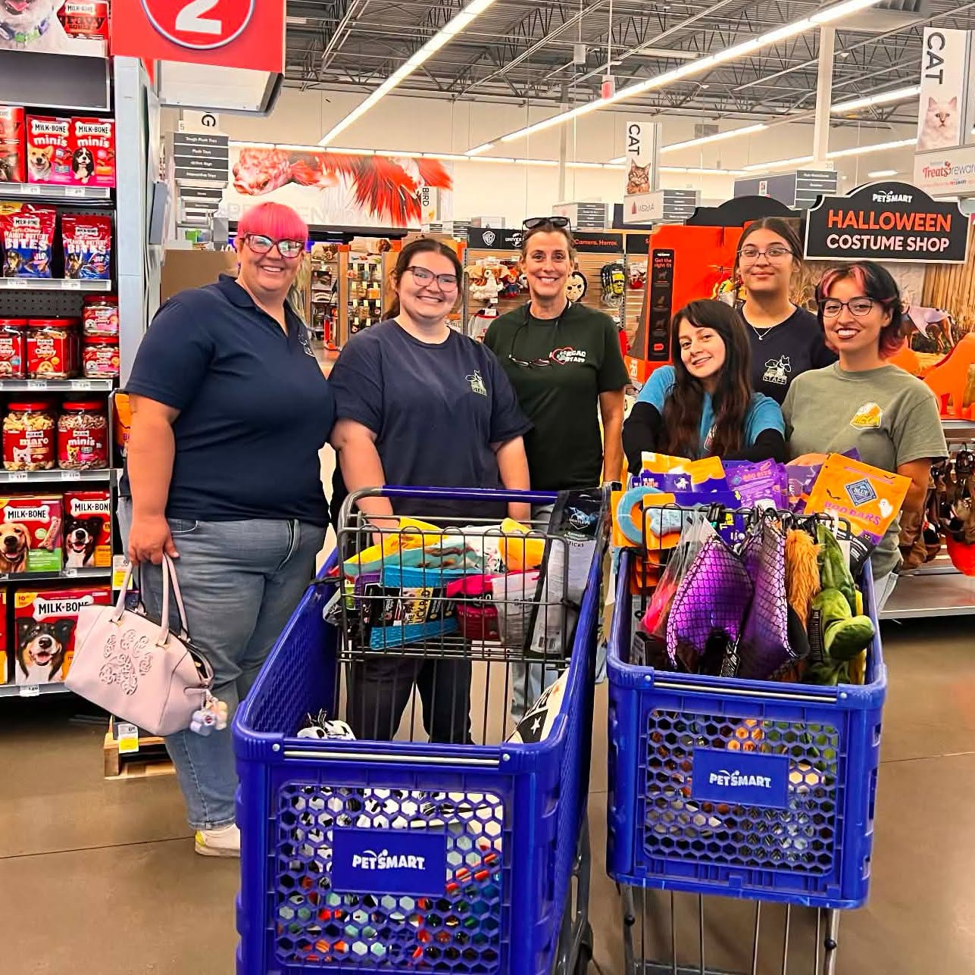
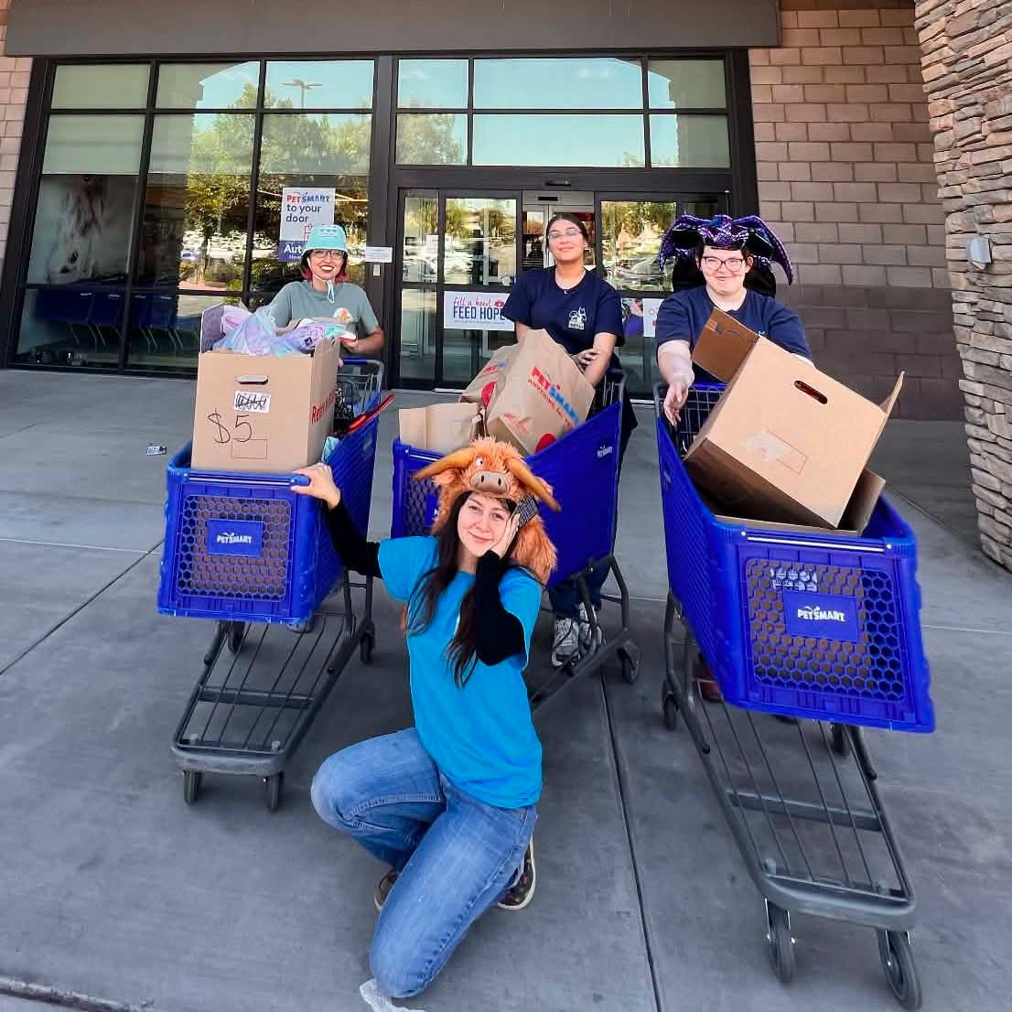
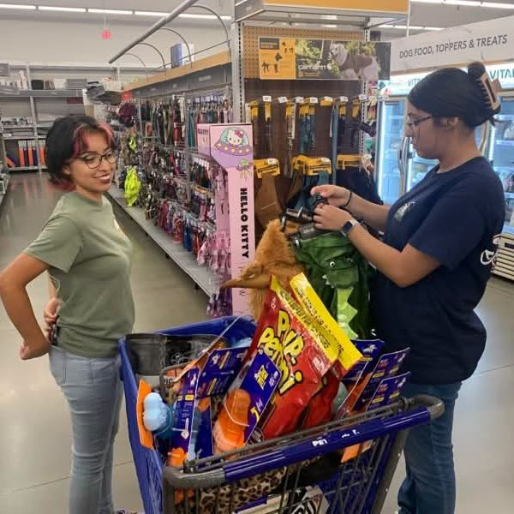
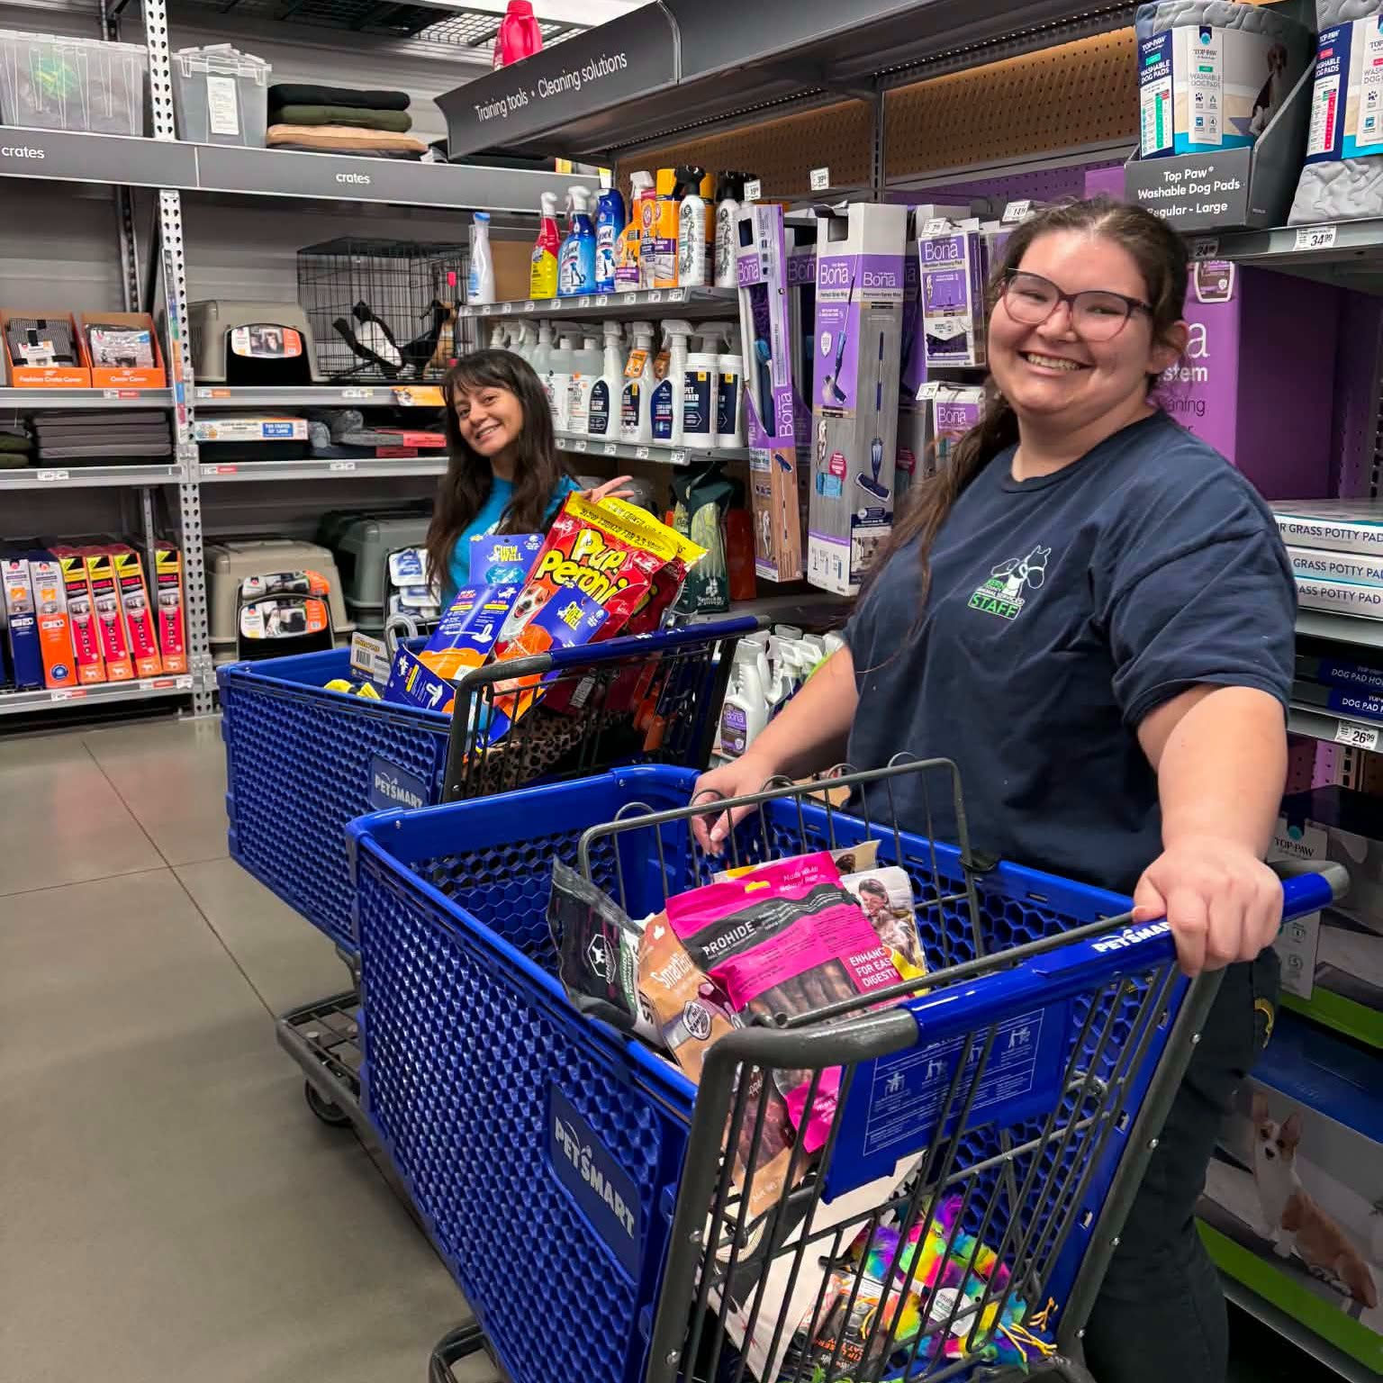
PetSmart Shopping Spree!
We're sending a HUGE thank you to the PetSmart on Calloway!
They donated a $500 shopping spree to Kern County Animal Services!
The Calloway store was named a PetSmart Charities "Paws For Joy Champion" for their fundraising efforts and the life-saving work they do to serve pets and people in our local community.
One of the prizes they received was a $500 shopping spree for one of the organizations they partner with, and they chose KCAS!
We are so grateful for the support the PetSmart on Calloway and all PetSmart stores provide to us and the pets in our care who are so deserving of a home!

Slide 21
2026 Year To Date
January 1st – September 30th
3,876
Adoptions
3,094
Rescued
630
Returned To Owner
3,246
Spay/Neuter Surgeries (Clinics + TNR)
9,458
Total Lives Saved
79.85%
Save Rate

Slide 22
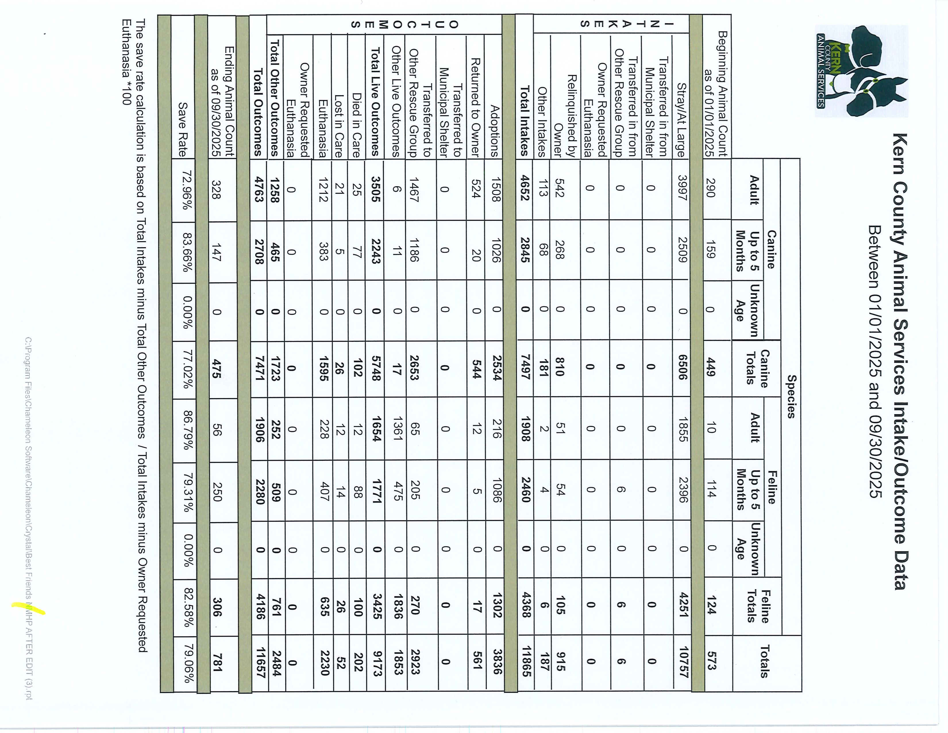

Slide 23
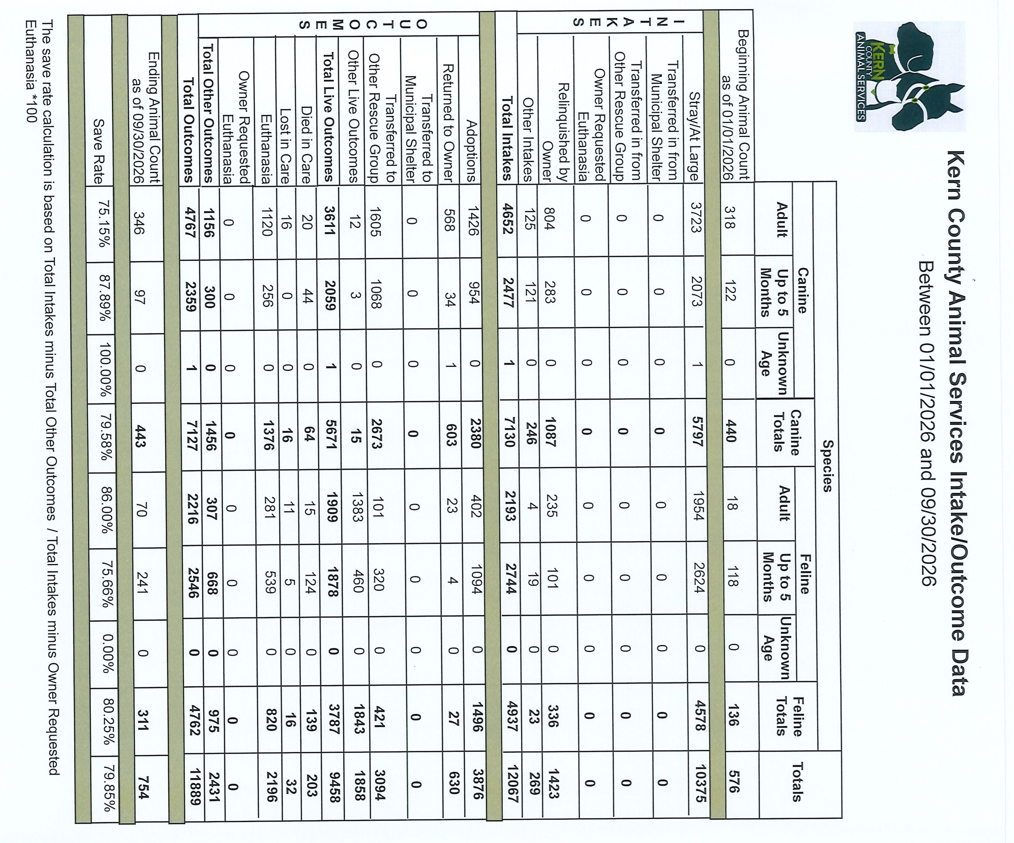

Slide 24
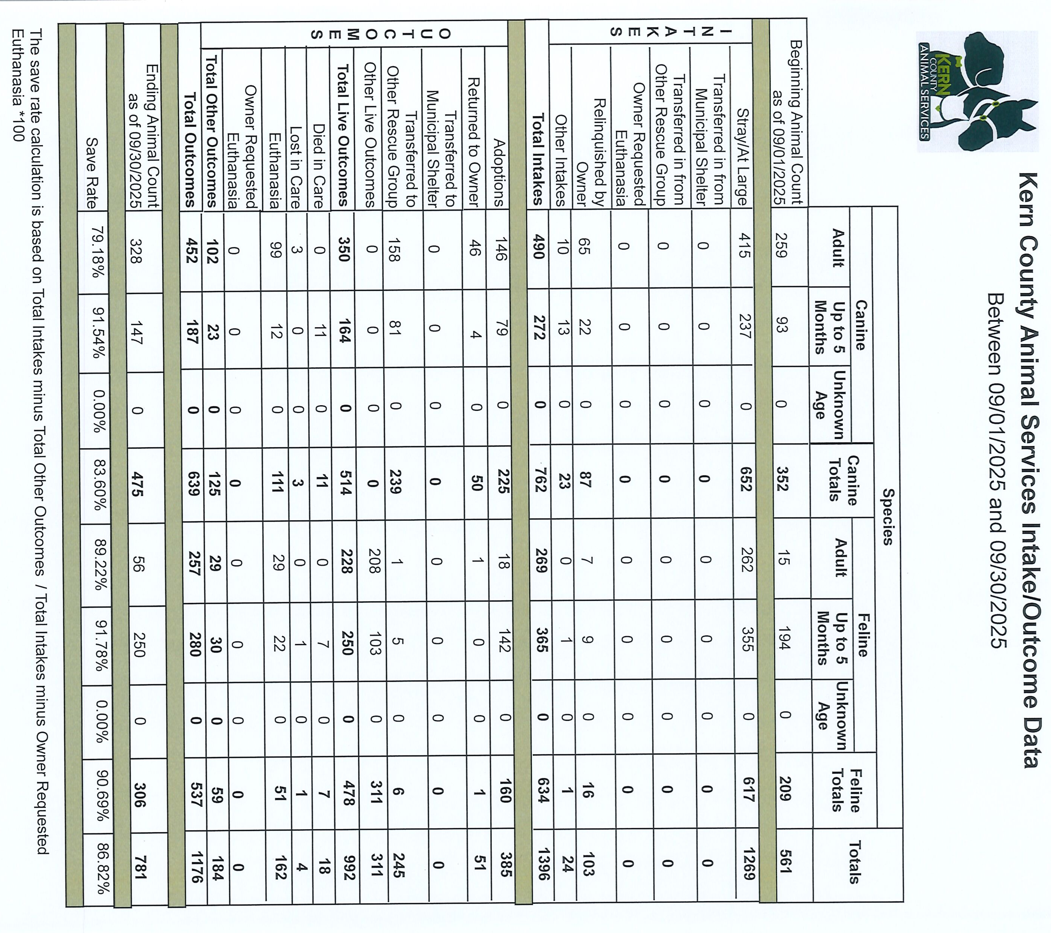

Slide 25
